Slide 1
Fast Timing for High-Rate Environments with Micromegas
E. Delagnes, G. Fanourakis, E. Ferrer Ribas, I. Giomataris, C. Godinot, D. González Díaz, U. Joshi, Changguo Lu, M. Kebbiri, K.T. McDonald, H. Muller, E. Olivieri, T. Papaevangelou, A. Peyaud, F. Resnati, L. Ropelewsky, R. Veenhof, S. White

Slide 2
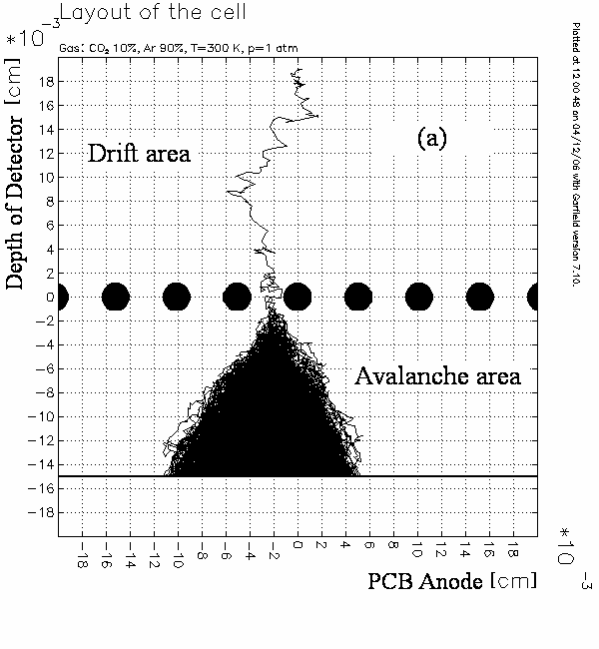
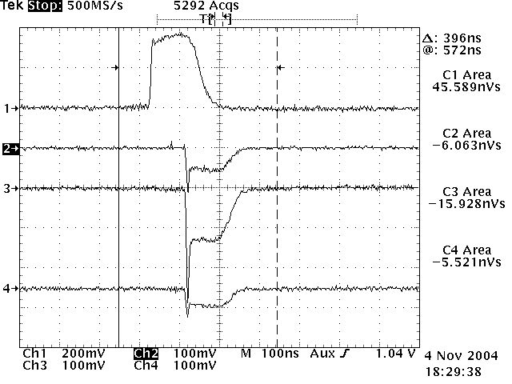
Micromegas time scales
The electron multiplication takes place in high E field (> 20 kV/cm)
between the anode (strips, pads) and the mesh in one stage
small amplification gap (50-150 μm)
fast signals (~ 1 ns)
short recovery time (~50 ns)
high rate capabilities (> MHz/cm²)
high gain (up to 10⁵ or more)
A GARFIELD simulation of a Micromegas avalanche (Lanzhou university)
micromesh signal
strip 1
strip 2
strip 3
Time response is limited from the continuous ionization on the drift gap

Slide 3
Localizing the e⁻ creation point
Limit the direct gas ionization
use a radiator / photocathode electron emitter:
Cherenkov light produced by charged particles crossing a MgF₂ crystal
Photoelectrons extracted from a photocathode (CsI)
Simultaneous & well localized ionization of the gas (time jitter for the Cherenkov light ~10 ps)
Well defined, small drift gap with strong electric field (~10kV/cm), or no drift
Reflective mode
Semitransparent mode
Charged particle
Charged particle
~80 photons/cm
~80 photons/cm
crystal
crystal
photon
photon
photocathode
electron
preamplification
electron
photocathode
micromesh
micromesh
avalanche
avalanche
anode
anode
insulator
insulator

Slide 4
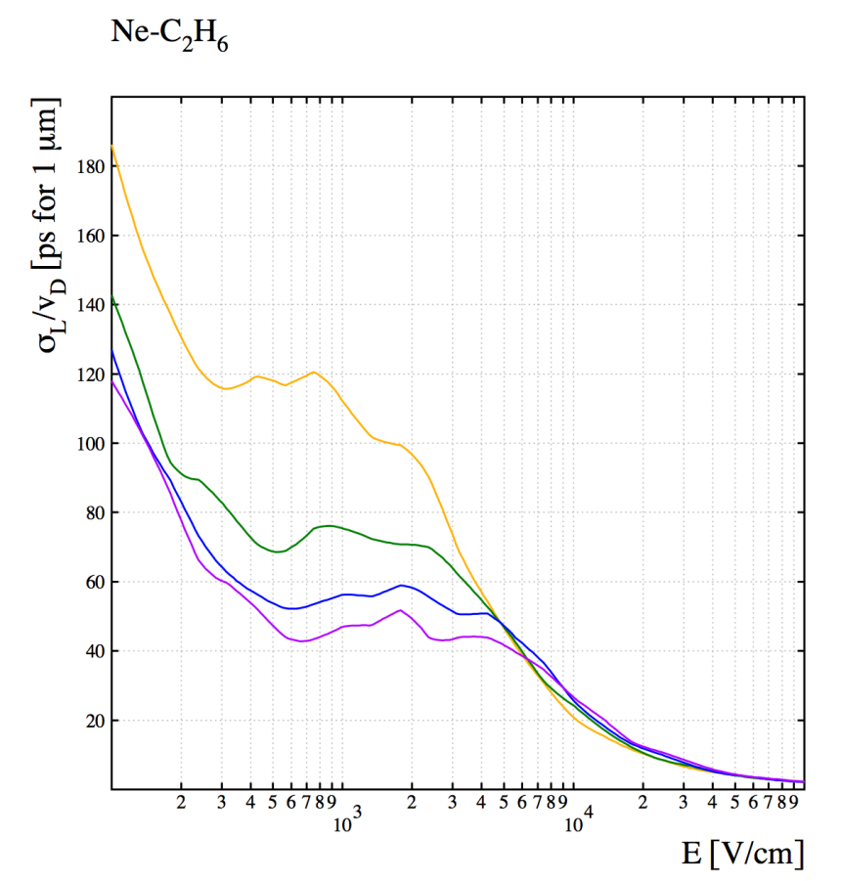
Limiting the e⁻ diffusion in the gap
Small drift gap + strong electric field
Limited diffusion
Simulations:
Few hundred μm drift field can provide time jitter per electron ~ 100 ps (Ed ~ 5kV/cm)
Several gas mixtures possible
Good performance for high amplification fields (>50 kV/cm)
➔ preamplification improves time resolution!
5%
10%
15%
20%
Longitudinal time jitter as function of the drift field for several Ne mixtures. (R. Veenhof)

Slide 5
RD51 common fund project
Awarded 3/2015
Title of project: Fast Timing for High-Rate Environments: A Micromegas Solution
Contact persons: Sebastian White (co-PI), Princeton/CERN Sebastian.White@cern.ch
Ioannis Giomataris (co-PI), Saclay ioa@hep.saclay.cea.fr
RD51 Institutes:
1. IRFU-Saclay, contact person Ioannis Giomataris ioa@hep.saclay.cea.fr
E. Delagnes, T. Papaevangelou, M. Kebbiri, E. Ferrer Ribas, A. Peyaud, C. Godinot
2. NCSR Demokritos, contact person George Fanourakis gfan@inp.demokritos.gr
3. CERN, contact person, Leszek Ropelewsky Leszek.Ropelewski@cern.ch E. Olivieri, H. Muller, F. Resnati
+ RD51&Uludag University, Rob Veenhof veenhof@mail.cern.ch
4. Universidad de Zaragoza, Diego González Díaz* diegogon@unizar.es
Ext. Collaborator:
Princeton University, contact person K.T. McDonald, kirkmcd@princeton.edu
Sebastian White, Changguo Lu
* Present Institute: Uludag/CERN

Slide 6
The RD51 project
R&D on charged particle timing towards ~10 ps
➔ high rates / high radiation environment (HL-LHC)
Project goal: demonstrate this level of performance based on a Micromegas photomultiplier with Cerenkov-radiator front window
Single electron time jitter ~100 ps
produce sufficient photoelectrons to reach timing response ~ 10 ps.
Build a Micromegas prototype equipped with crystal / photocathode
Demonstrate the ~100 ps time jitter for single e- using high precision UV laser
Semitransparent / Reflection mode
Gas optimization
Measure time resolution @ MIP beam

Slide 7
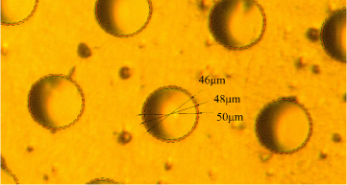
UV photon detection
crystal
Reflective photocathode:
Photosensitive material is deposited on the top surface of the micromesh.
Photoelectrons extracted by photons will follow the field lines to the amplification region
The photocathode does not see the avalanche ➔ no ion feedback effect ➔ higher gain in single stage (~ 10⁵)
Better aging properties
High electron extraction & collection efficiency
Reflection on the crystal ?
e⁻ path variation
Limitation to Microbulk / opaque meshes
Semi-transparent photocathode:
Photosensitive material is deposited on an aluminized MgF₂ window (drift electrode)
Extra preamplification stage ➔ better long-term stability, higher total gain
Various MM technologies & gas mixtures possible
Lower photon extraction efficiency
Photocathode resistance to sparks (?)
Ion backflow ➔ aging (?)
photon
electron
photocathode
micromesh
avalanche
anode
insulator
crystal
photon
photocathode
electron
preamplification
micromesh
avalanche
anode
insulator

Slide 8
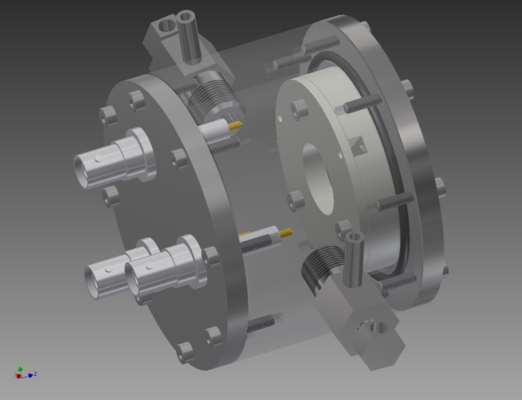
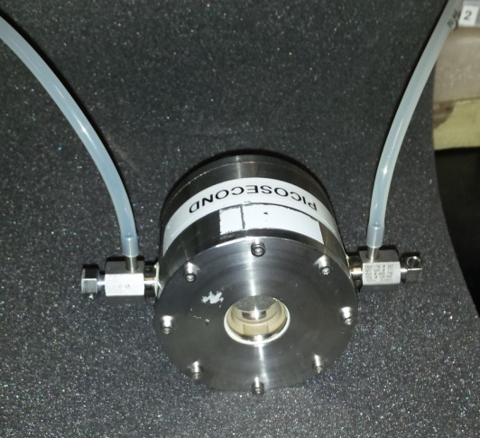
Design of the prototype
First tests with UV lamp / laser ➔ quartz windows
Microbulk Micromegas ø 1cm
Possibility to deposit CsI on the mesh surface
Capacity ~ 35 pF
Bulk Micromegas ø 1cm
Capacity ~ 5 pF
Amplification gap 64 / 128 / 192 μm
Ensure homogeneous small drift gap & photocathode polarization
Photocathode: 10 nm Al
Stainless steel chamber compatible with sealed mode operation
Very thin detector active part (<5 mm)

Slide 9
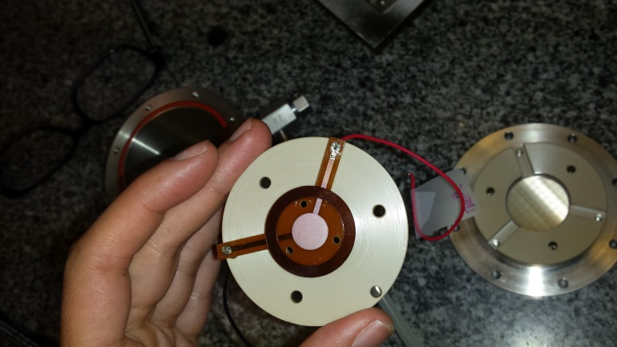
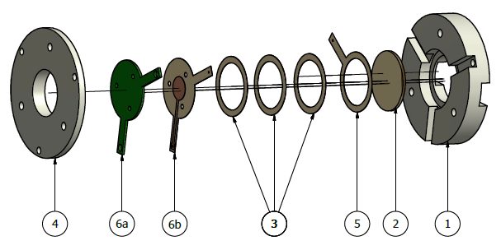
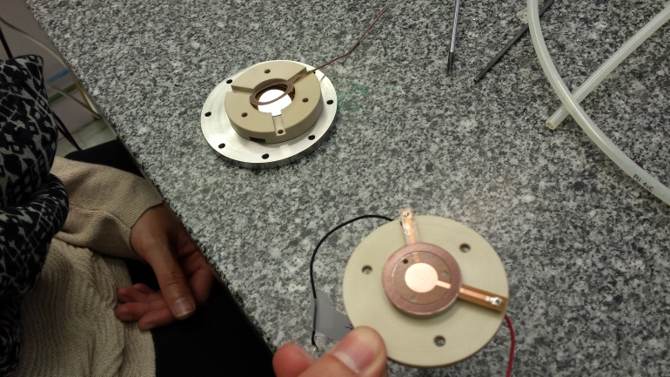
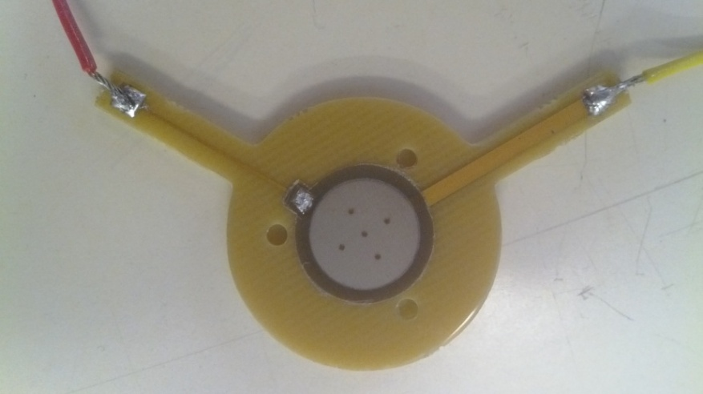
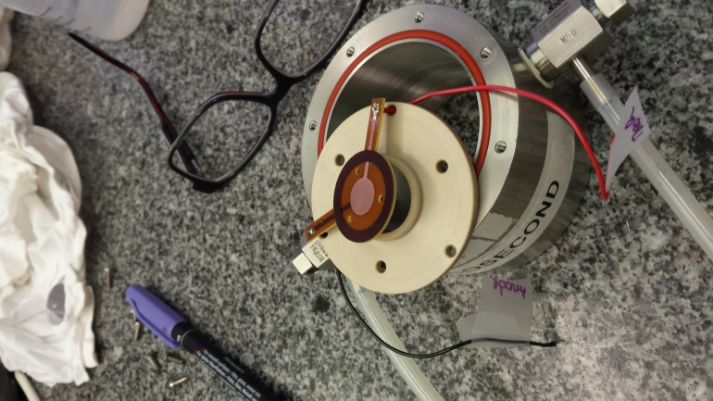
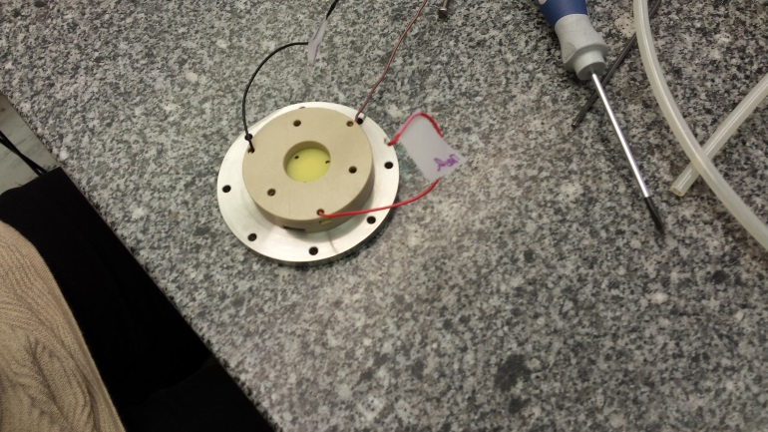
Detector prototype

Slide 10
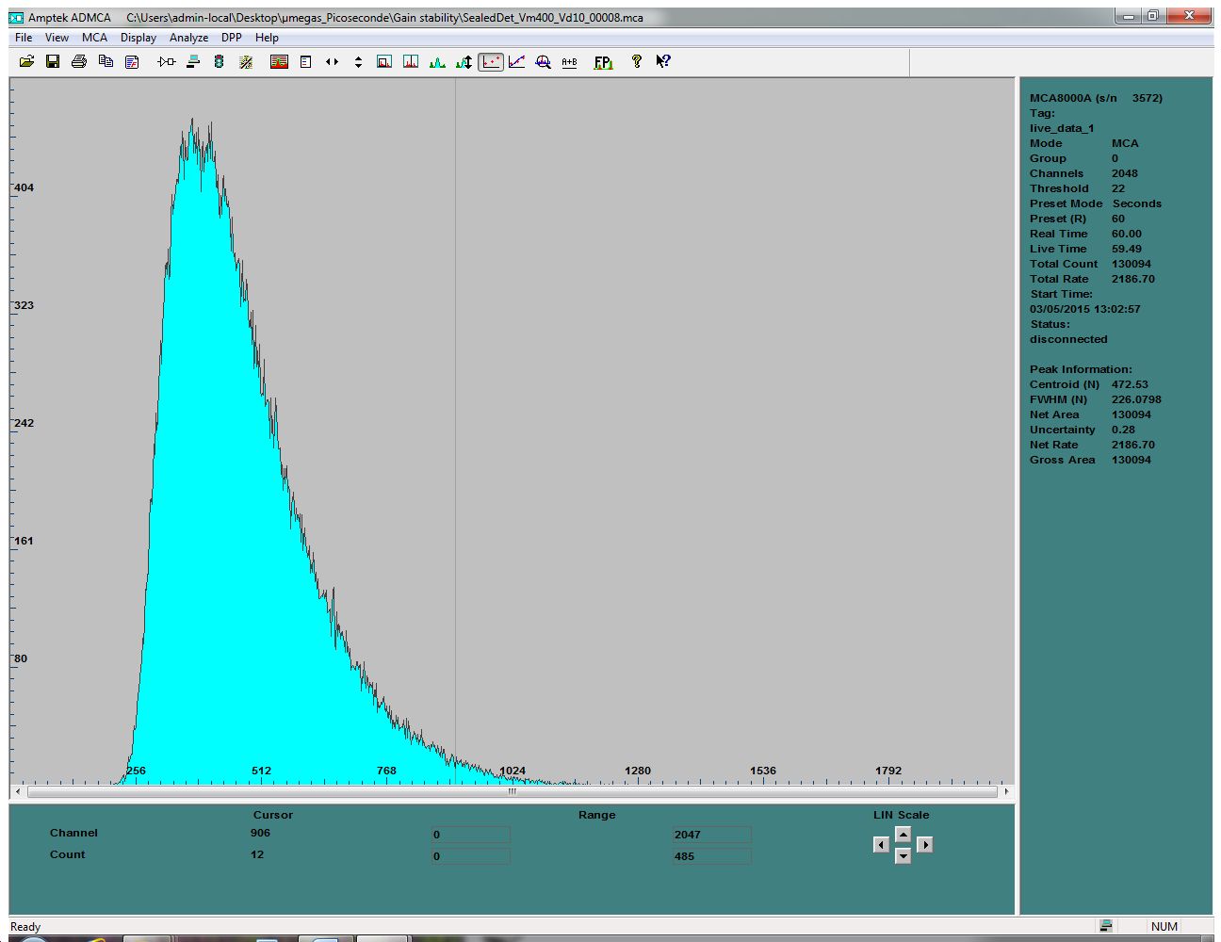
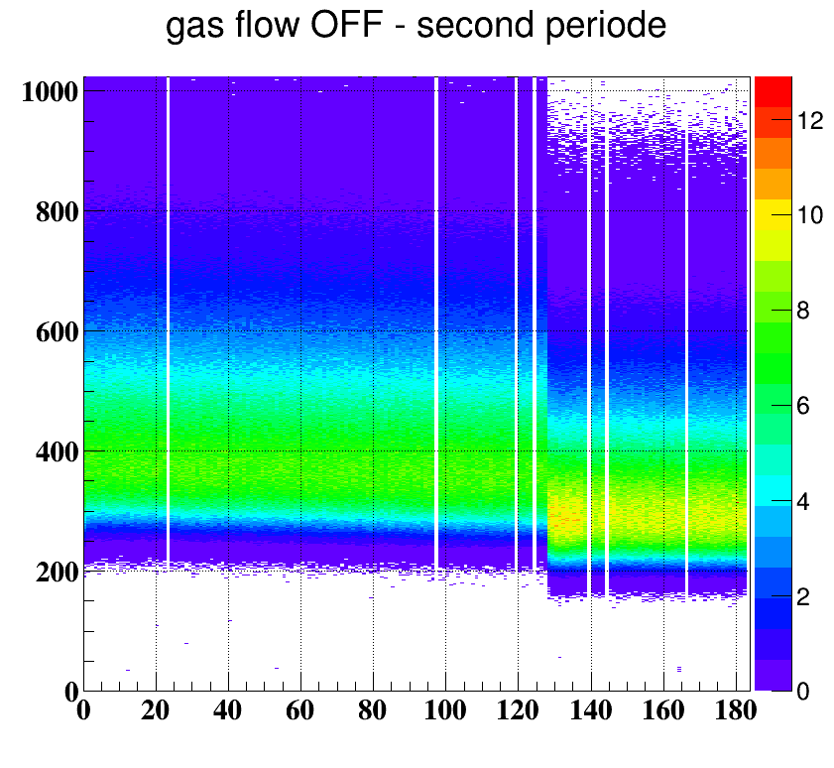
Tests with deuterium flash lamp
Estimated ~20 photoelectrons per pulse by comparing with the amplitude of the signal from a candle
24 hour run in sealed mode. Lamp not very stable

Slide 11
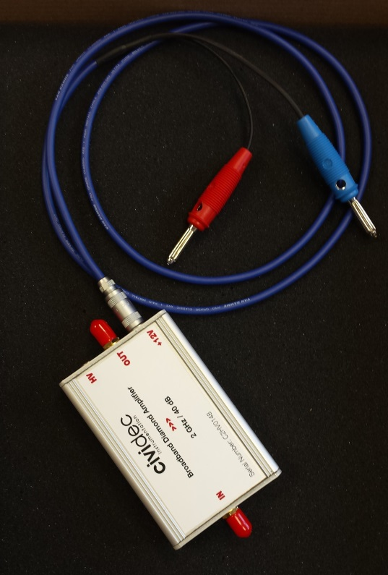
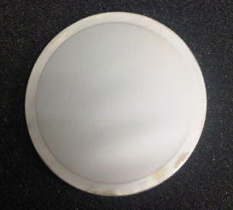
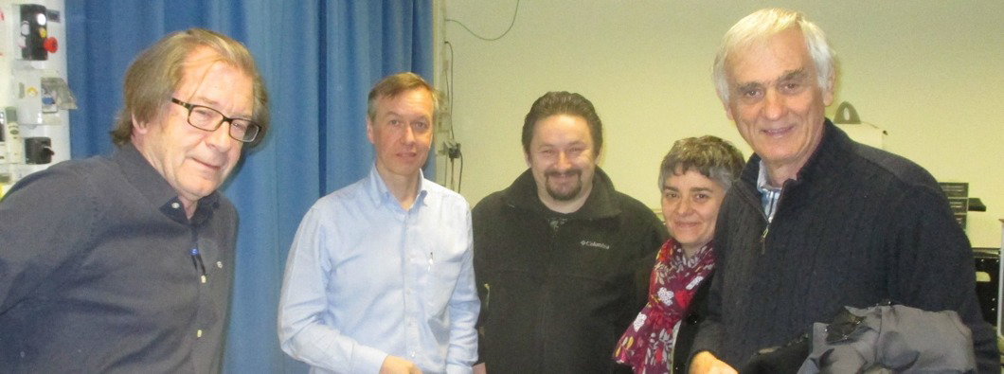
Measuring single p.e.
IRAMIS facility @ CEA Saclay (thanks to Thomas Gustavsson! )
UV laser with σ_{t} ~ 100 fs
λ = 275-285 nm after doubling
intensity ~ 3 mJoule / pulse
Repetition 80 MHz (!!) - limitations on gain
Reduced to 8 kHz on the second day
Light attenuators (fine micro-meshes 10-20% transparent)
Trigger from fast PD
Cividec 2 GHz, 40 db preamplifier (thanks to Erich )

Slide 12
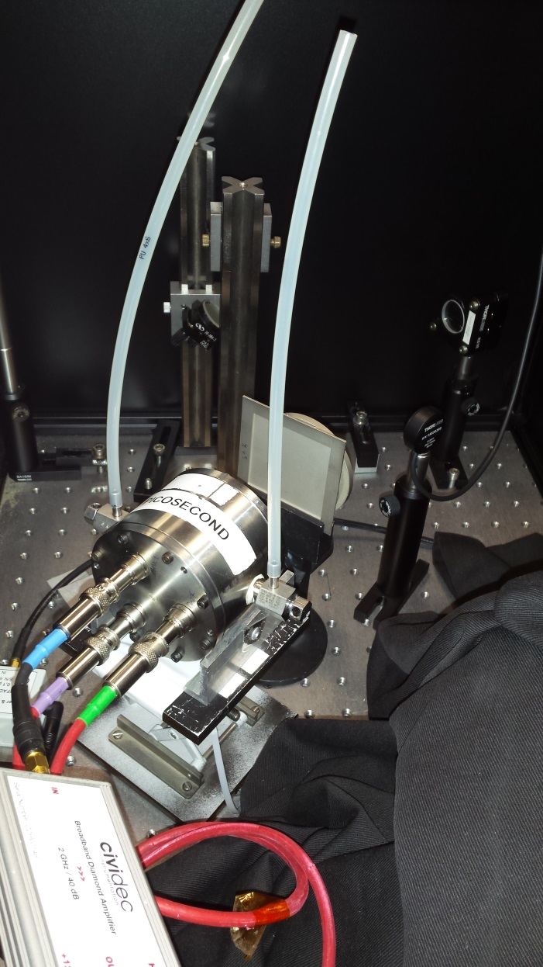
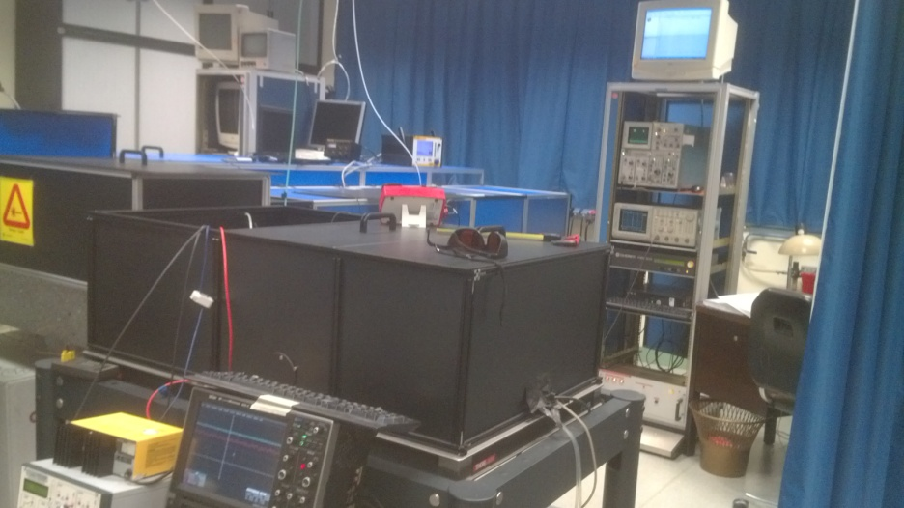
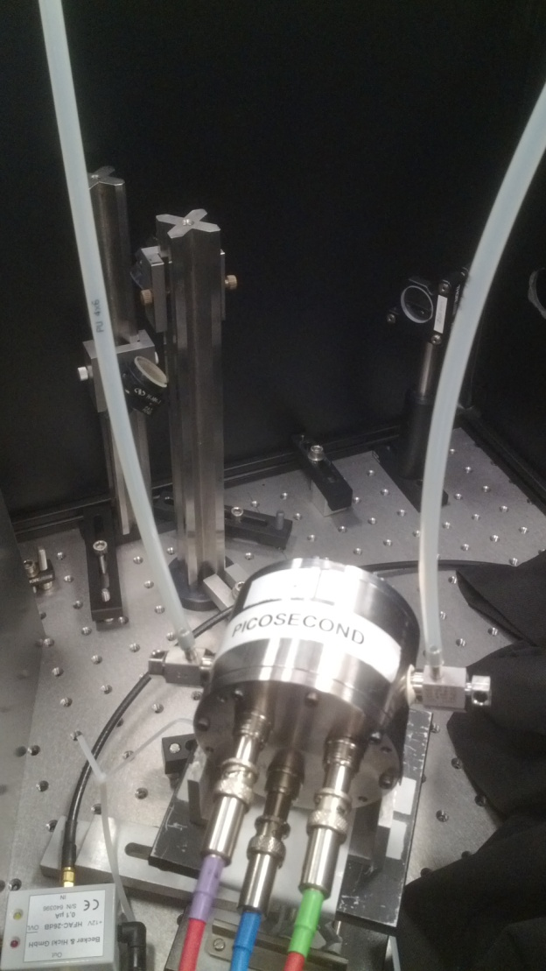
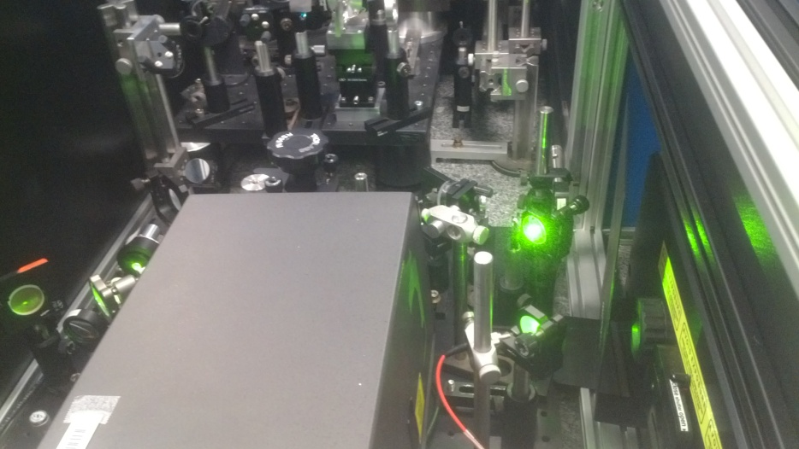
Measurements @ IRAMIS laser

Slide 13
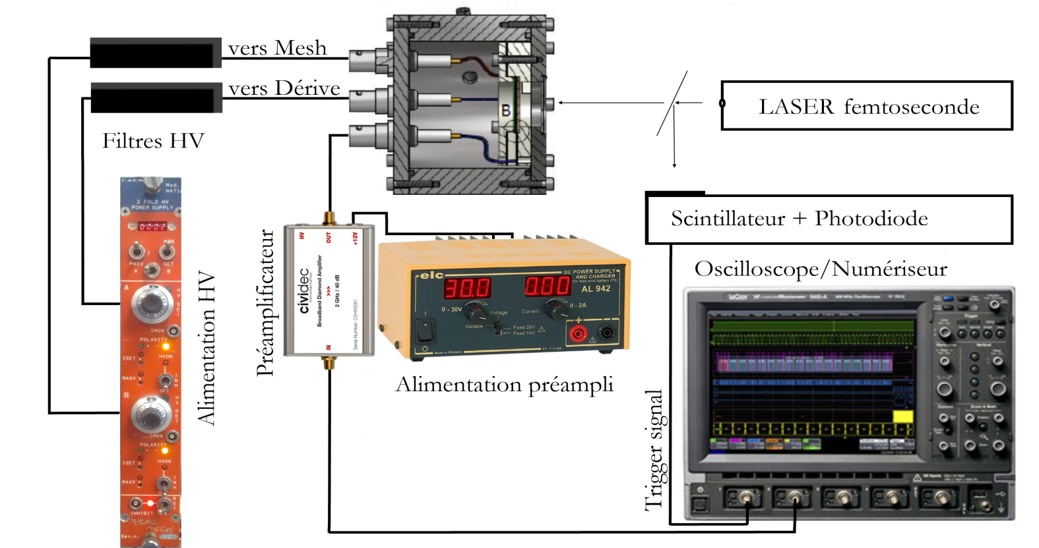
Data acquisition
Registration of Micromegas & photodiode waveforms with 2GHz oscilloscope @ 10 GS/s
Offline analysis
thanks to Xavier & w. R. Zuyeuski
for osciloscope & LabView software

Slide 14
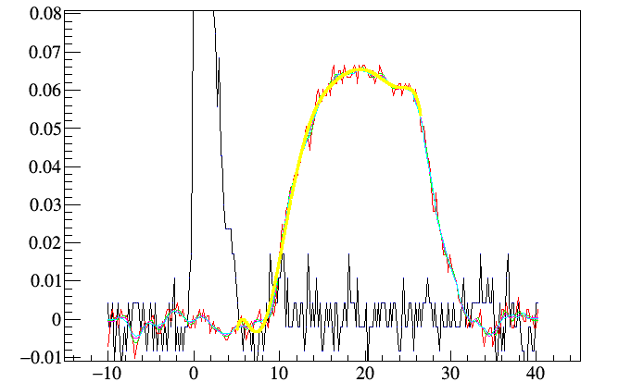
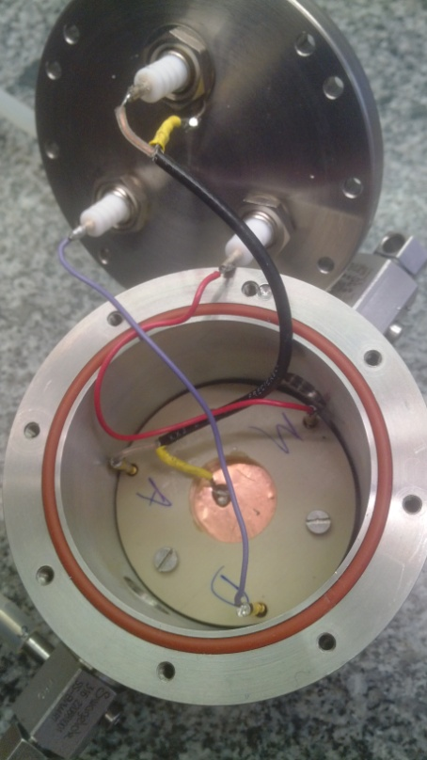
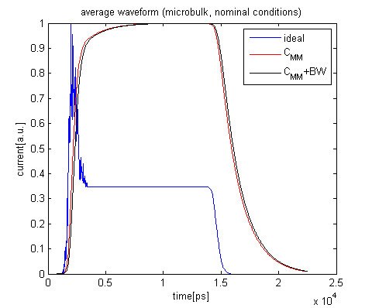
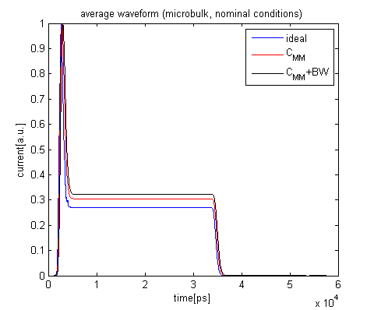
Response to single p.e.
Strong attenuation, so that events with no pulse appear
UV light from continuous source (candle)
Microbulk
Bulk 128
Signal modeling by
D. Gonzalez Diaz & F. Resnati

Slide 15
Signal Modeling (D. Gonzalez Diaz, F. Resnati, R. Veenhof)

Slide 16
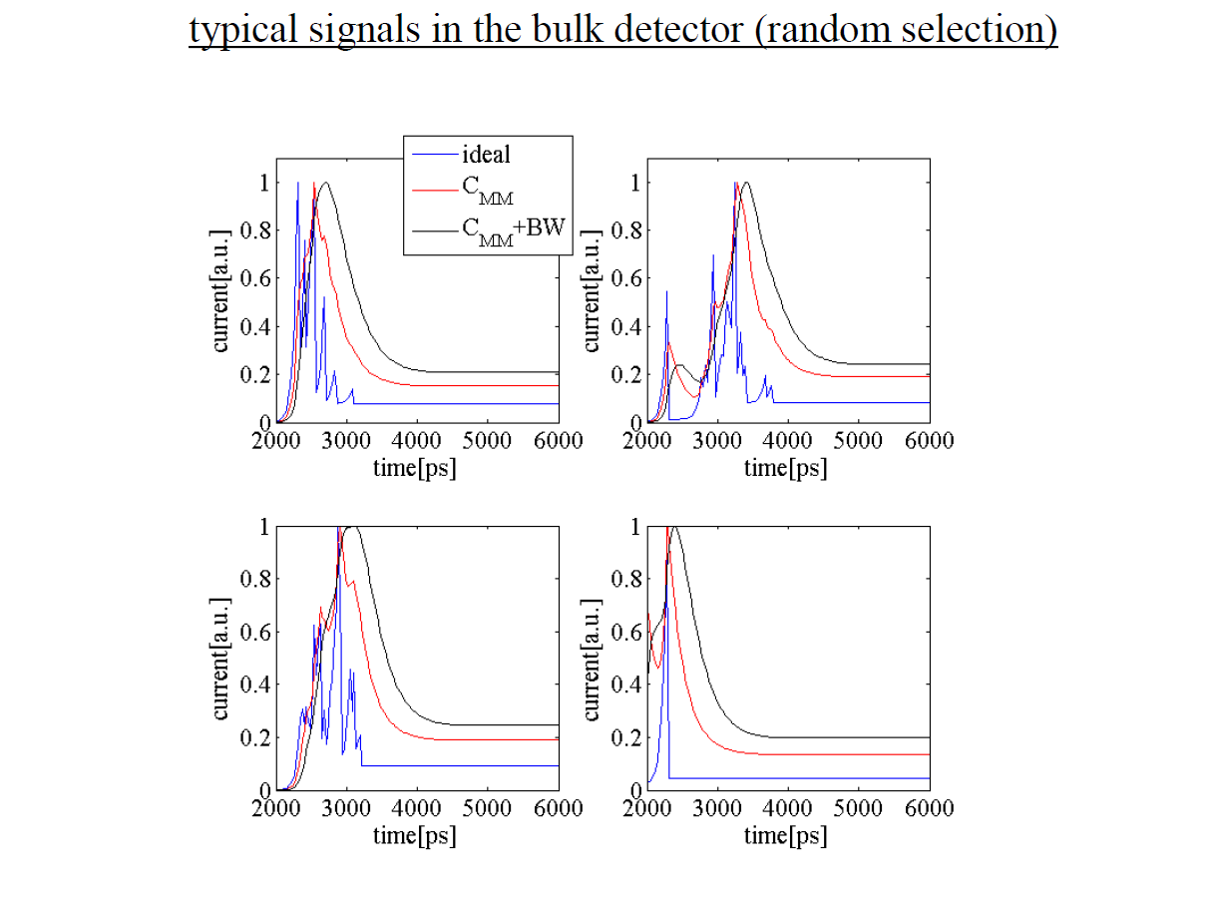
Signal Modeling (D. Gonzalez Diaz, F. Resnati, R. Veenhof)

Slide 17
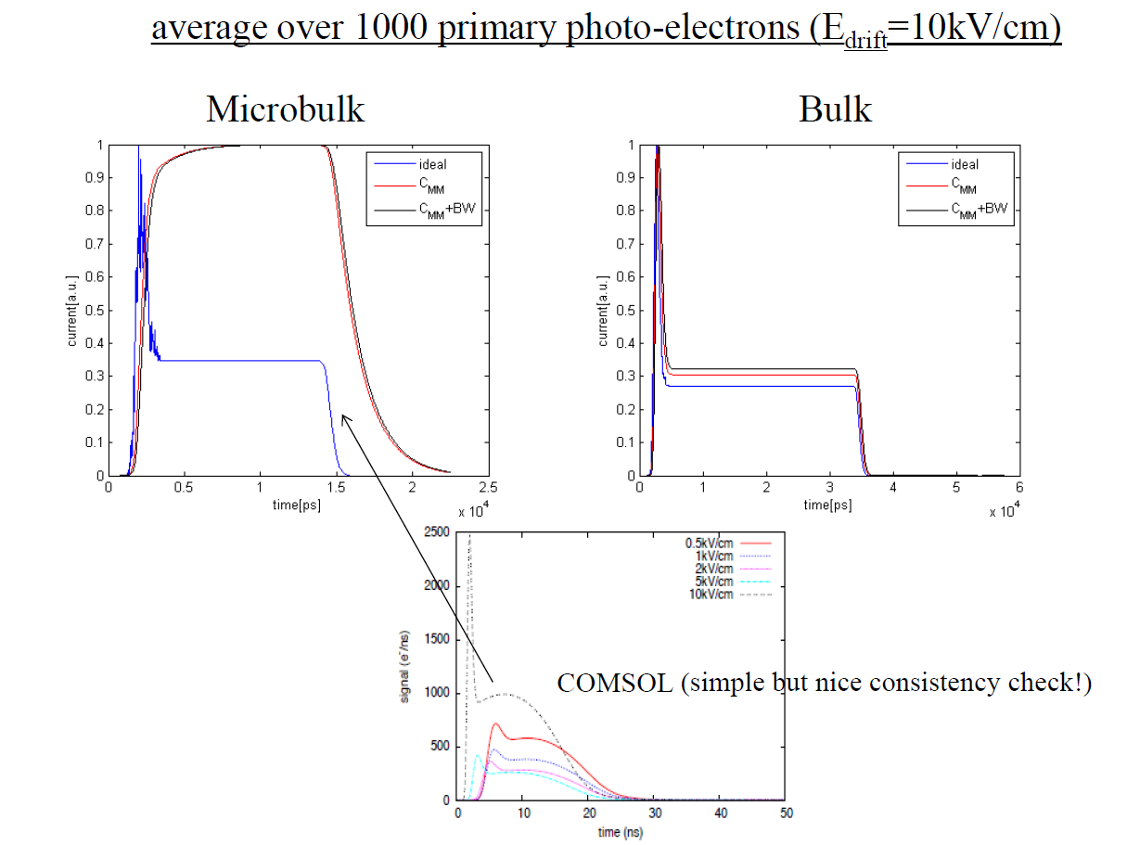
Signal Modeling (D. Gonzalez Diaz, F. Resnati, R. Veenhof)

Slide 18
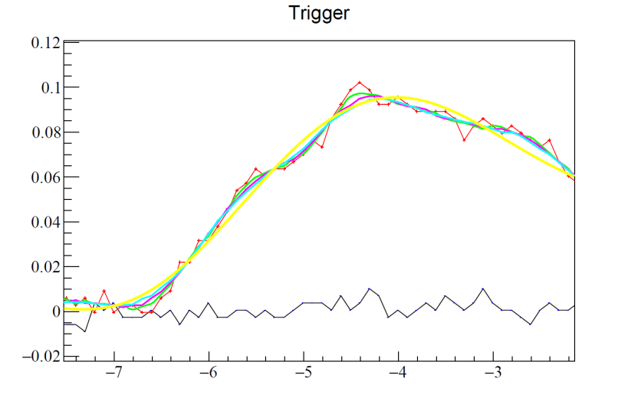
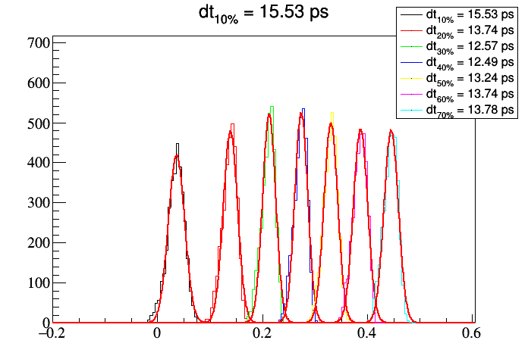
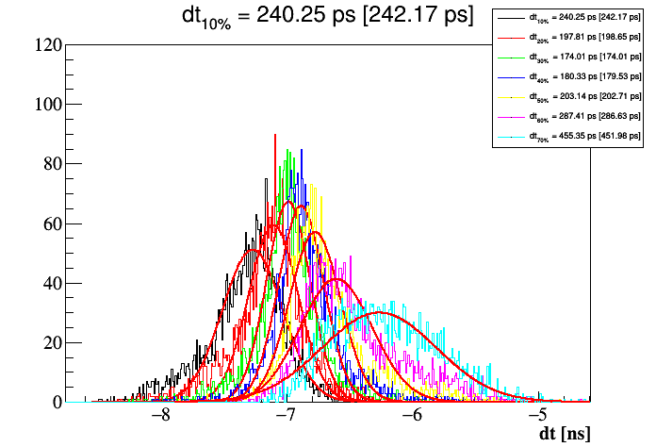
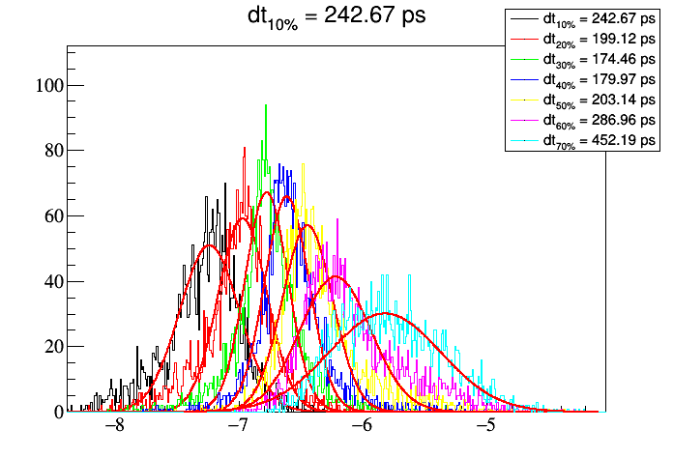
Calculation of σ_{T} (~1 p.e.)
Calculate attenuation from <ampl>
Calculate <N_{p.e.}> from zeros.
28.9% zeros ➔ <N_{p.e.}> = 1.26
Soft smoothing + CF
σ_{Τ} PD
T_{mm} – T_{PD} [σ_{T} corr]
E_{drift} = 10 kV/cm²
σ_{Τ} Micromegas

Slide 19
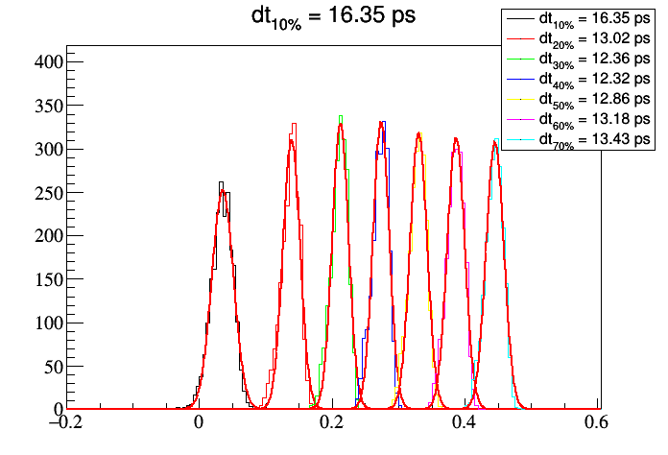
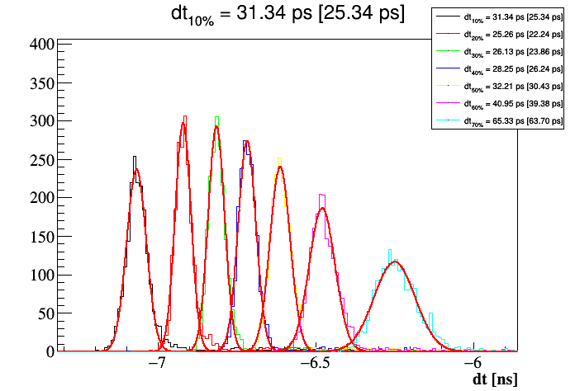
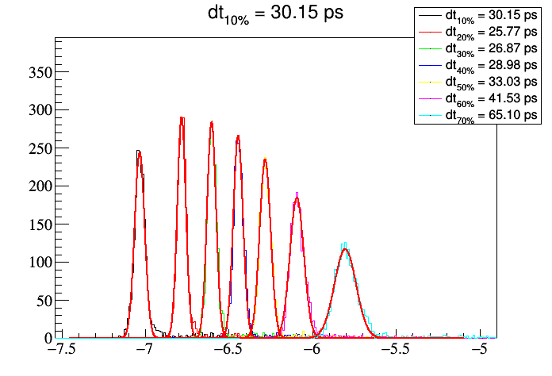
Calculation of σ_{T} (~50 p.e.)
σ_{Τ} PD
E_{drift} = 10 kV/cm²
<N_{p.e}.> = 51.4
T_{mm} – T_{PD} [σ_{T} corr]
σ_{Τ} Micromegas

Slide 20
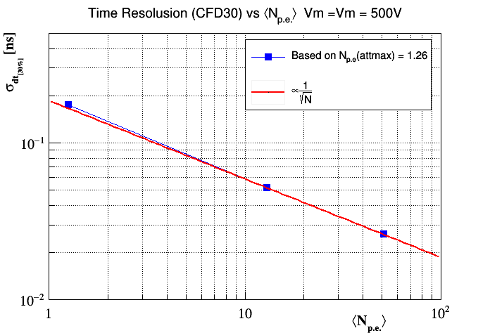
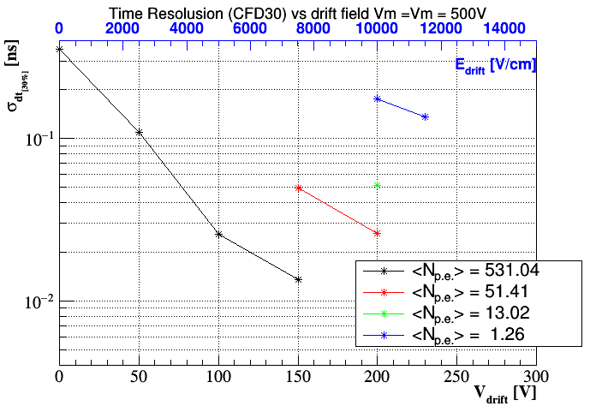
Constant Fraction analysis
Calibrated attenuators
Maximum attenuation ➔ 29% zeros ➔ <N> ~1.26 p.e.
Results given for the mean photoelectron number – impossible to discriminate 1e/2e events
Resolution scaling with 1/sqrt(N) law
Gas used: Ne (90%) + C2H6 (10%)
Not optimal!
Very promising result:
~180 ps for 1.26 p.e.

Slide 21
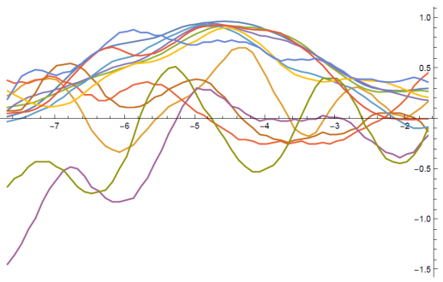
Wavelet treatment (by Sebastian White)
CERN Detector Seminar 25/09/2015

Slide 22
Wavelet treatment (by Sebastian White)

Slide 23
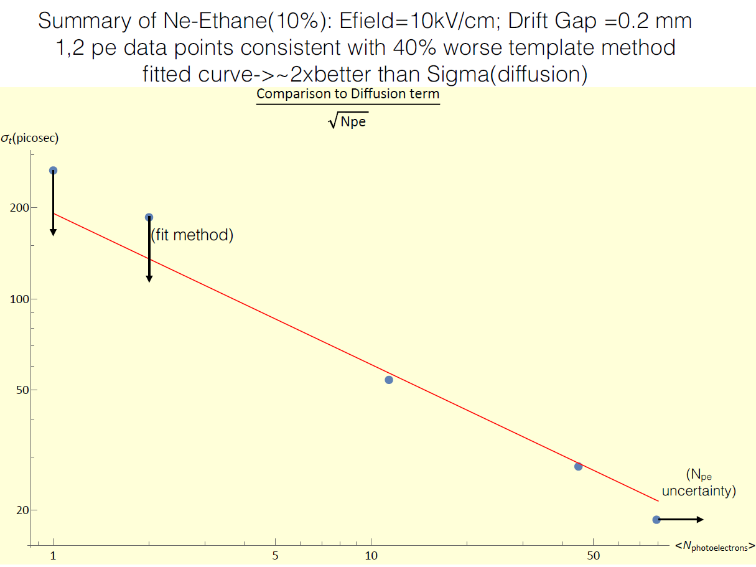
Wavelet treatment (by Sebastian White)

Slide 24
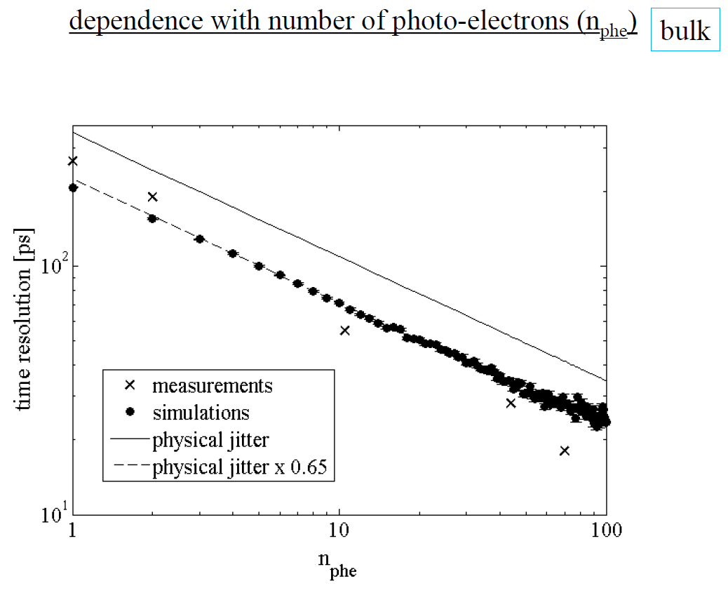
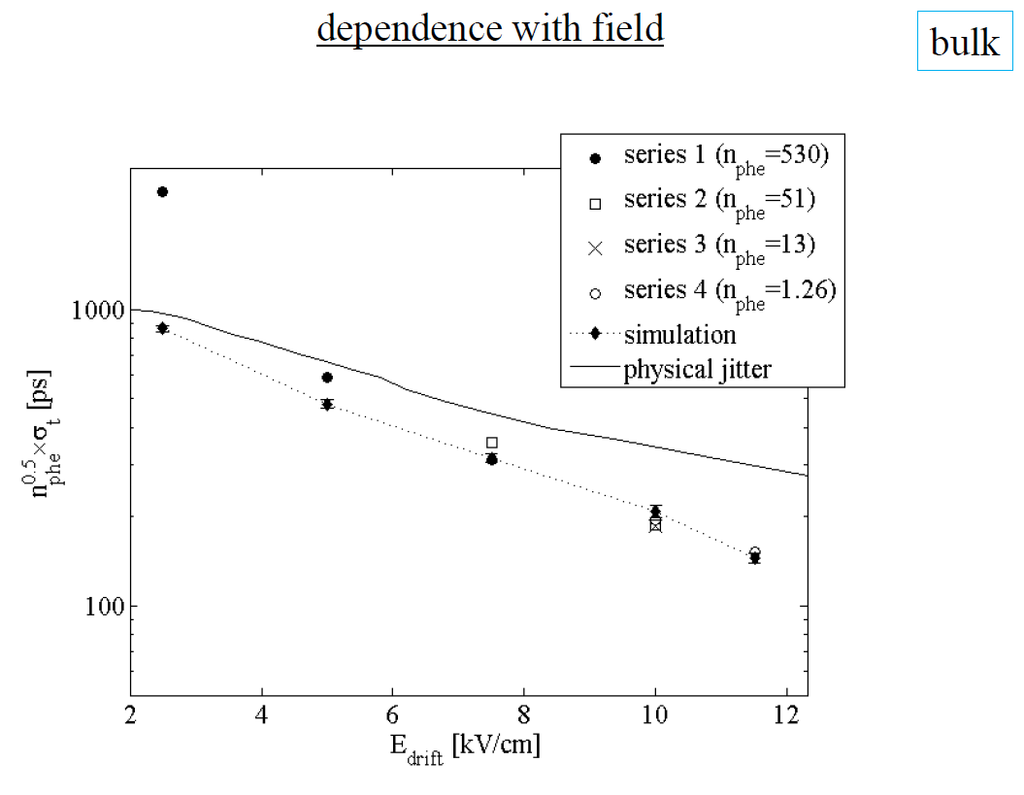
Comparison with the simulation
Improvement compared to the physical jitter due to the preamplification
Excellent agreement between data & simulation

Slide 25
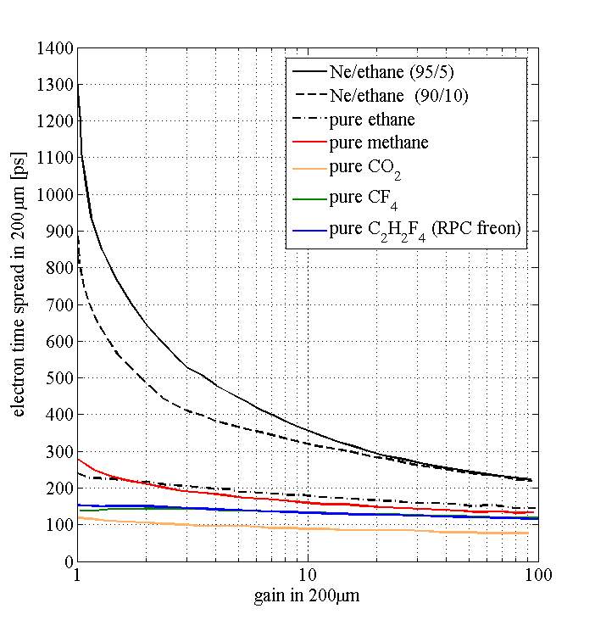
Optimum gas mixtures for timing
Look for the minimum time spread (‘fastest mixture’) at any given gain
By Rob Veenhof & Diego Gonzales
Notes:
Working fields in the MM for pure quenchers need to be about x2 higher. May limit the gain in case of defects.
Drift fields for pure quenchers need to be about x3 higher.
Dissociative attachment for CO₂ and freons expected to be compensated by gain. Needs to be verified.
now
Selection of non flammable gas!
( e^{αG})

Slide 26
Next steps – detector improvement
Detector studies
Existing chamber
Bulk technology for semi-transparent mode
Microbulk for reflective mode
Thin-mesh bulk Improve electron transparency / minimize path variations. First fabrication tests OK
Laboratory tests (picosecond laser @ IRAMIS)
Gas optimization (He mixtures, quenchers…)
Reflective mode
Continue single photo-electron performance studies
Drift gaps
Effect of the pillars
Build a second setup @ CERN
Particle beam tests
Design of a pixelated prototype (~5×5 cm²).
Scalable to ~1 m²
Simulations / Calculations
Performance
Detector design
Gas selection / optimization
Photocathode / crystal selection

Slide 27
Next steps (photocathode, aging, robustness)
Radiator / photocathode
Crystal selection / photon yield
Photocathode (CsI fabrication, handling, storage, protection…)
Aging tests
Deterioration with time
Particle flux => high rate tests @ IRAMIS
Robustness
Total reflection problem @ reflective mode ? Coating,...
Secondary Emitter (Collaboration with CEA/DRT)
Replace the crystal + photocathode with secondary electron emitter
Robustness / spark reduction
Free choice of substrate material
Investigate materials with high secondary electron yield. (Doped-) diamond deposition, DLC, graphene…
Conductive
Robust
Multi layer detector
Diamond / graphene layer for photocathode protection ?
Improvement with
reflective mode

Slide 28
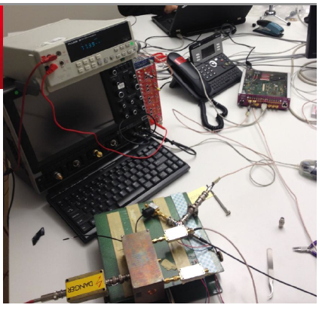
Next steps (Electronics)
Electronics
SAMPIC (D. Breton / LAL)
Radiation hard amplifiers ➔ Mitch Newcomer / PENN
Onboard electronics ?
Improve signal transfer lines, bandwidth
Fast charge preamplifier? (integration ~ps ?)

Slide 29
Conclusions - outlook
A Micromegas photodetector has been constructed in order to study the potential for ~10 picosecond timing for charged particles
First tests with a laser are positive.
180 ps time resolution for <N>=1.26 p.e. has been measured with a standard bulk Micromegas in semi-transparent & sealed mode + preamplification
Big margin for improvement
Gas optimization
Thin mesh
Reflective mode to be studied.
Alternative design with secondary emitter
R&D will continue. More resources (hopefully!)
Involvement of more groups / labs
Involvement of the Saclay SPP group
Request for ANR funding
Encouraging results + growing interest!

Slide 30
Thank you!

Slide 31
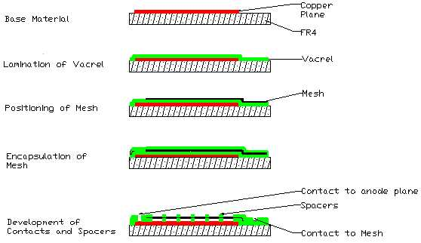
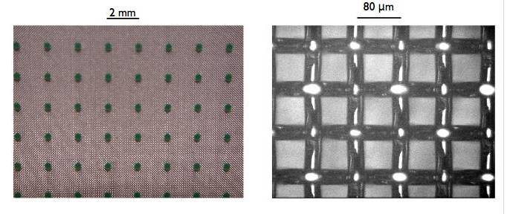
Bulk technology
Readout plane + mesh all in one
Woven Inox mesh 30 µm
vacrel 128 µm
Well established technique (lamination)
Readout pads
Bulking: Process to encapsulate the mesh on a PCB (mesh = stretched wires)
The pillars are attached to a woven mesh and to the readout plane (PCB)
Typical mesh thickness 30 μm, gap 128 μm
Uniformity, robustness, low cost, no supporting frame,
Easy fabrication
Large area detectors
Mass production!
Ideal gap for Ne/He - based mixtures
One main disadvantage: Woven mesh ➔ Not possible to deposit the photosensitive material
pad
pillar

Slide 32
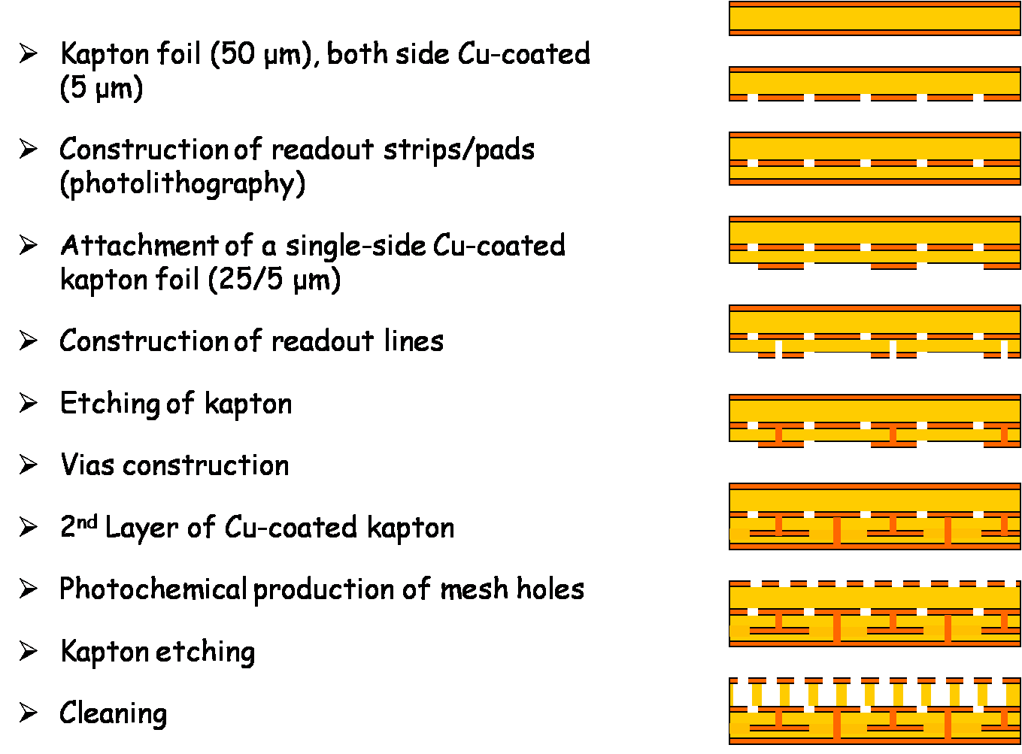
Microbulk technology
Micromesh
5µm copper
Readout plane + mesh all in one
Kapton 50 µm
Readout pads
Microbulk Micromegas
The pillars are constructed by chemical processing of a kapton foil, on which the mesh and to the readout plane are attached. Mesh is a mask for the pillars!
Typical mesh thickness 5 μm, gap 50/25 μm
All advantages of a bulk Micromegas & enhanced performance
In addition:
Direct deposition of photosensitive material
Big optical opacity (>90%)
Big electron collection efficiency (>95%)
Less outgassing
But:
Higher capacity
Fabrication process of 2D readouts complicated
Mesh can not be replaced if damaged
Maximum gap 50 μm (present technology) is not optimum for Ne/He-based gas mixtures ➔ maximum gain?
Lower capacitance
Under development

Slide 33
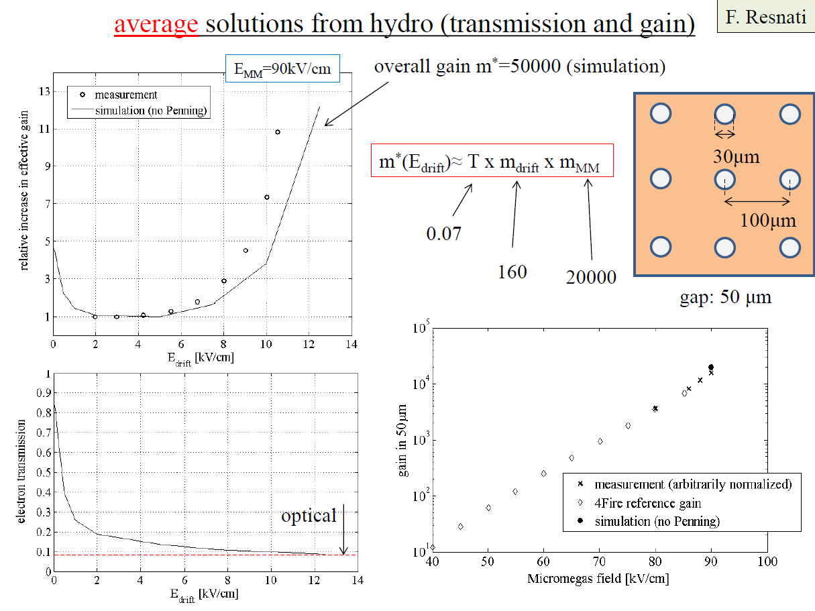

Slide 34
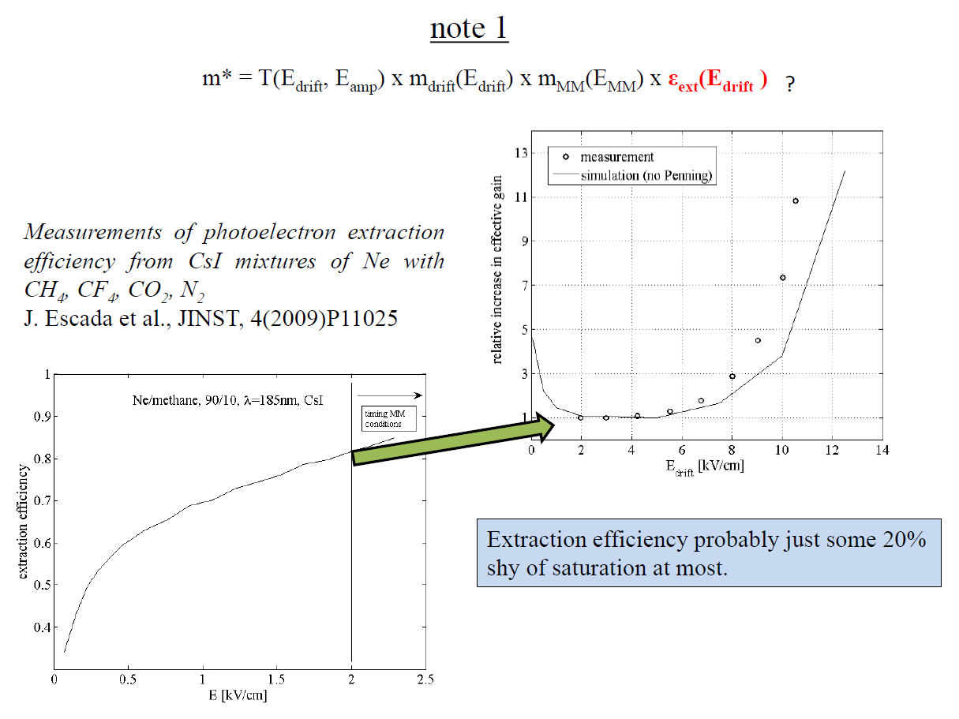

Slide 35
