Slide 1
Caliste – MicroMegas: A Spectro-Polarimeter for Soft X-Ray Astrophysics
Paul Serrano
on behalf of Caliste-MM team
CEA/IRFU, université paris-sud
MPGD 2015
12/10/15 – 15/10/15

Slide 2
Soft X-Ray polarimetry: Why?
Gives information on the magnetic field of the source
Interesting for astrophysical observations of soft X-Rays sources (1 keV – 20 keV): pulsars, Supernovae remnants
Until early 2000: few techniques, with low sensitivity (Thomson scattering or Bragg Diffraction)
→ few experiments (ex: OSO-8 graphite crystal polarimeter)
Growing interest of the astrophysical community

Slide 3
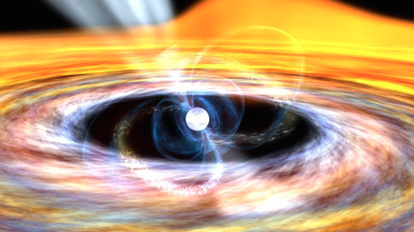
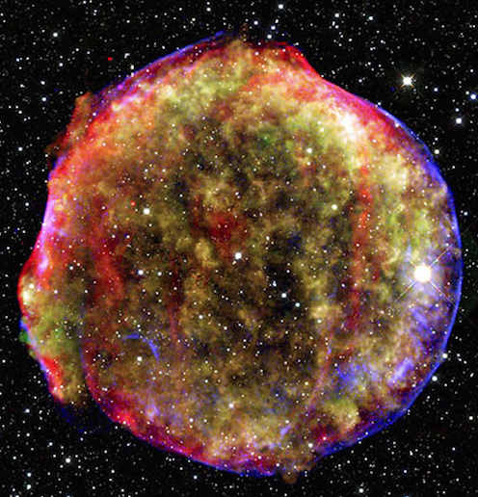
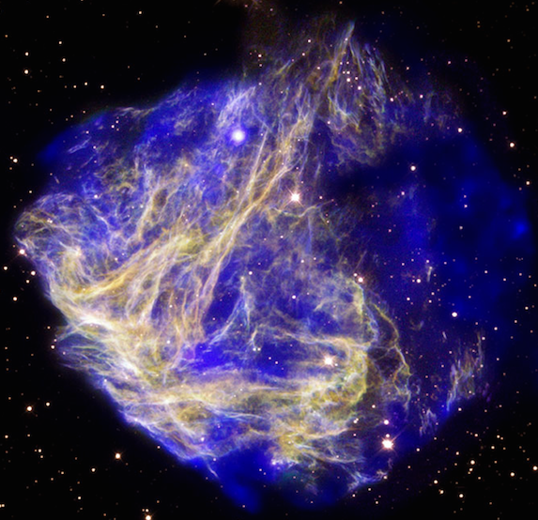
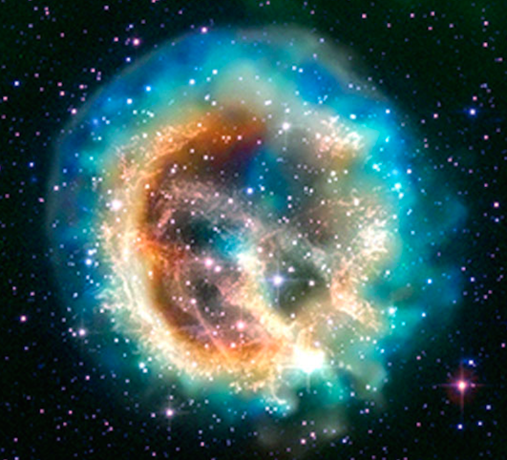
Soft X-Ray polarimetry: possible applications
Resolve the geometry of the accretion (fan or pencil beam) in accreting X-rays pulsars
Study the cosmic ray acceleration in Supernovae Remnants
Observing the vacuum magnetic birefringence by observing neutron stars

Slide 4
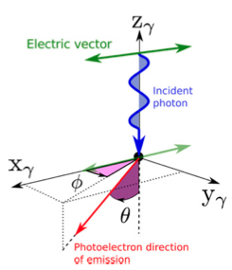
Soft X-Ray polarimetry in a Gaseous Detector (1)
Electric Vector
Soft X-Rays conversion in gas done by photo-electric effect
Φ = angle between photon's electric field and azimuthal direction of photo-electron
θ = polar angle
Incoming photon
Photo-electron direction
Muleri, 2014 ApJ, 782, 28

Slide 5
Soft X-Ray polarimetry in a Gaseous Detector (2)
Differential Cross Section:
Emission probability modulated by cos(Φ)²: The photo-electron has a greater probability of being ejected at the angle Φ=0
Doing angular distribution of azimuthal ejection direction of the photo-electrons give access to the polarization of the source

Slide 6
Piggyback Micromegas (1)
Mesh
128 μm
Bulk Principle
Anode = resistive layer spread on ceramic plate
R = 100MΩ
Resistive Layer
20 μm
Ceramic Layer
300 μm
No electronics inside the detector : signal read through the ceramic
Interchangeable Electronics, possibly contactless
Protection from Sparks
D. Attié et al., JINST 1305 (2013) P05019.

Slide 7
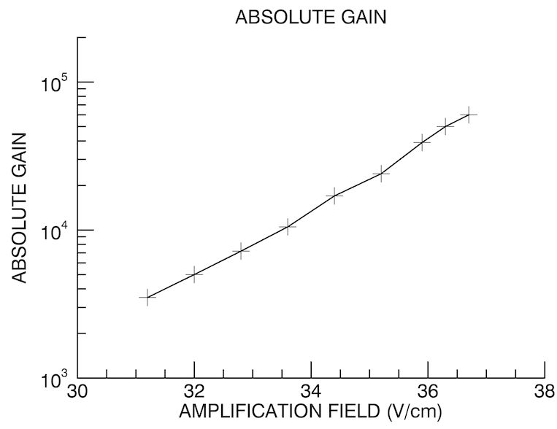
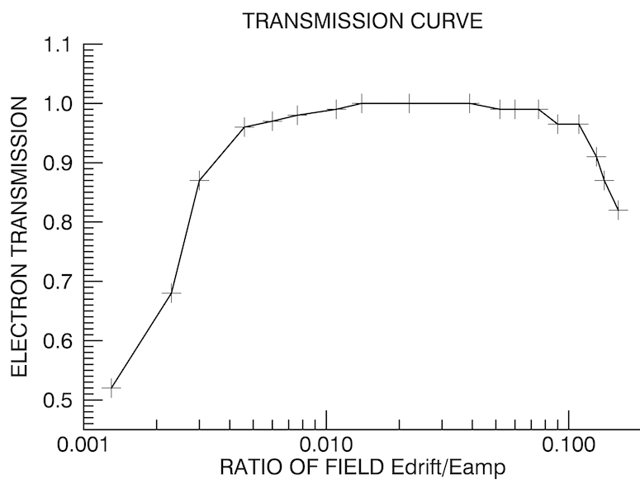
Piggyback Micromegas (2)
Source = ⁵⁵Fe (6 keV photons)
Argon – Isobutane 95% - 5%
Signal read on mesh

Slide 8
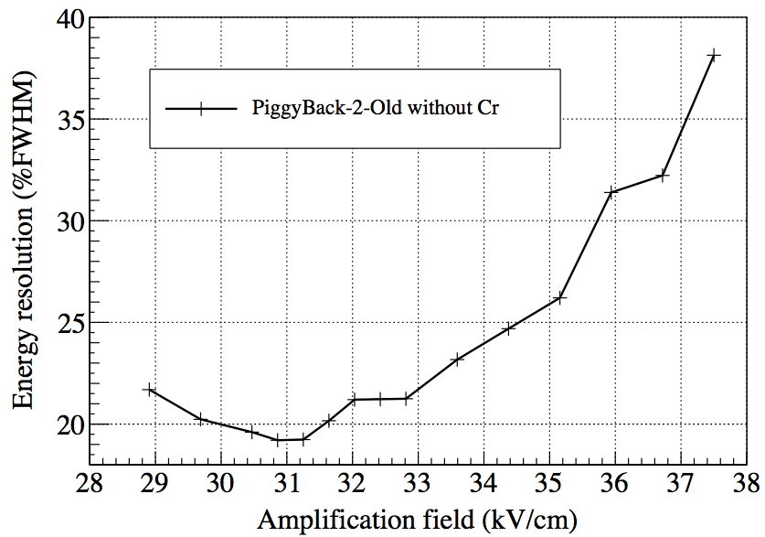
Piggyback Micromegas (3)
Source = ⁵⁵Fe (6 keV photons)
Argon – Isobutane 95% - 5%
Signal read on mesh

Slide 9
Piggyback Micromegas (4)
Readout electronics must have some specificities:
Low Noise and sensitive enough to read the signal through the ceramic
Small pixels to recover the photo-electron’s track and do polarimetry
Able to perform spectroscopy
For Hard X-Ray polarimetry (using Compton scattering): semiconductor detectors use such electronics. Caliste is one of those

Slide 10
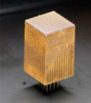
Caliste (1)
Initially for semiconductor space detectors
10 x 10 x 20,7 mm³ (Compact)
16x16 pixels : 8 ASICs of 32 channels
Pixel Ø = 500 μm ; Pixel Pitch = 580 μm
Consumption = 850 μW/channel (218 mW in total)
Low Noise (ENC = 50 e⁻ rms)
Tunable:
Threshold on each pixel
Shaping Time
Dead Time
...
Dynamic
PAC polarisation current
Controller Frequency
O. Limousin et al., NIMA, Vol.647 Issue 1 pp.46-54

Slide 11
Caliste (2)
Each channel is an autotrigged spectroscopic chain
Undershoot Suppression
Tunable Shaping Time
Tunable Current
Signal Shaping

Slide 12
Caliste (3)
An incoming charge on a pixel will be converted into a pulse, and we measure the amplitude of this pulse If this amplitude is above a tunable threshold (independent for each channel) then the signal is read
Specificity: Caliste is radiation-hard and already space-qualified

Slide 13
Caliste - MM
The characteristics of Caliste, first made to read the signal of semiconductors, are adapted to read the signal of a piggyback detector (sensitive, low noise and spectroscopic capabilities)
Multiple parameters to take into account for the detector Caliste-MM:
Resistivity of the piggyback
Thickness of the ceramic
Distance between ceramic and Caliste

Slide 14
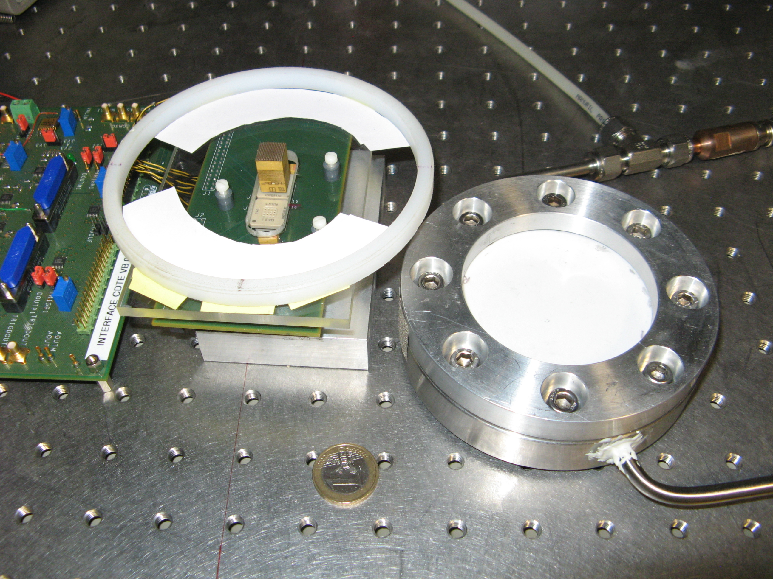
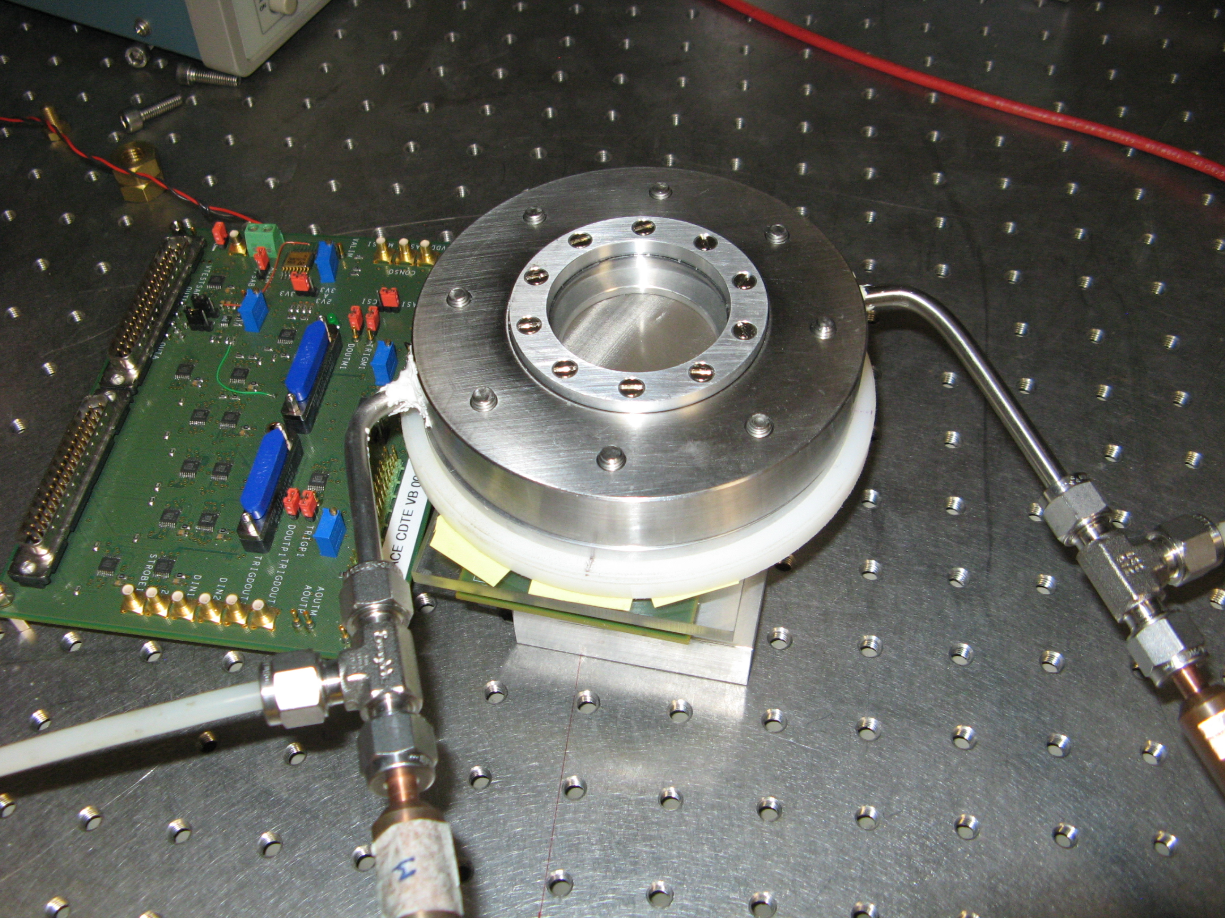
SETUP Caliste-MM

Slide 15
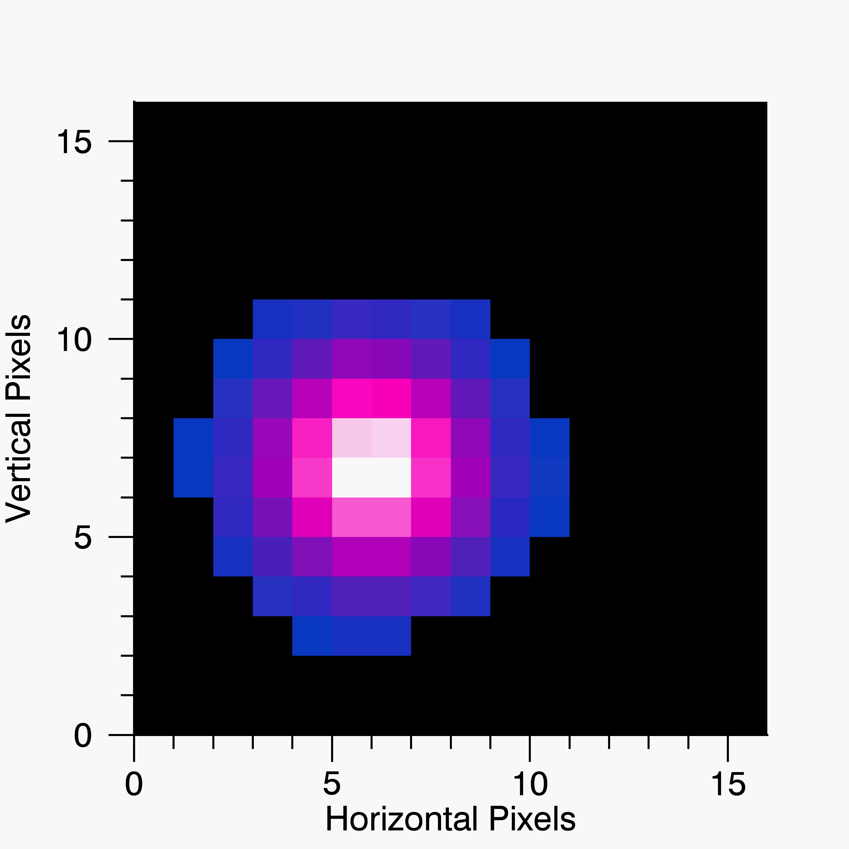
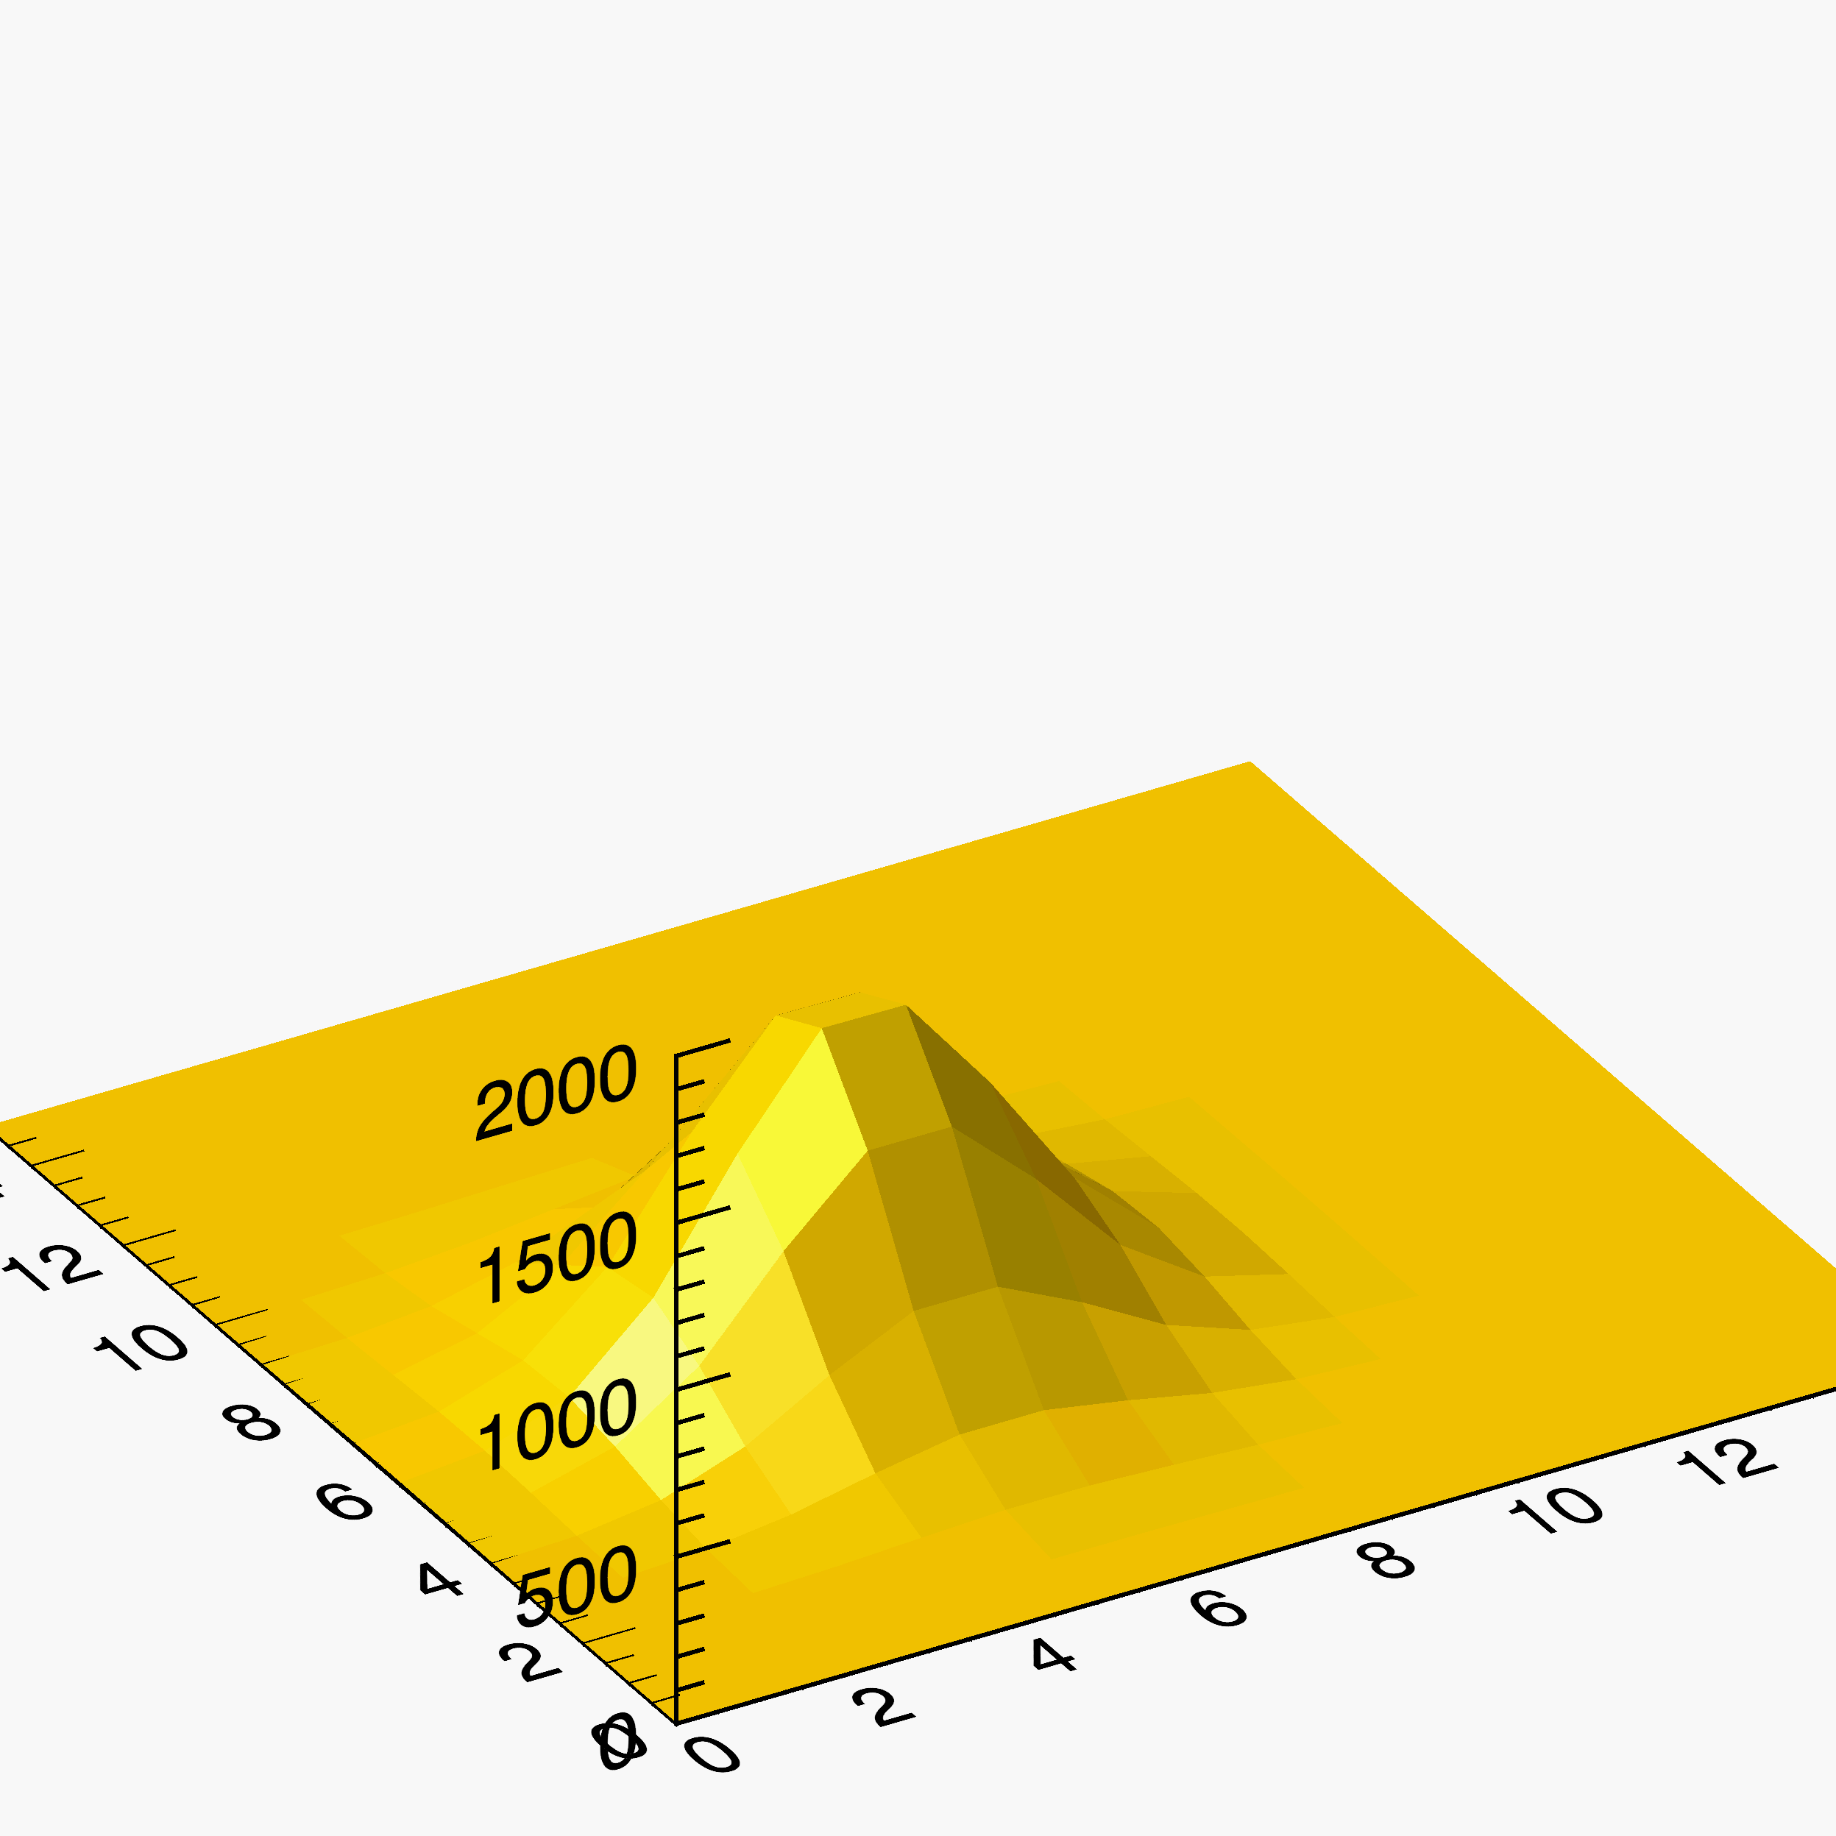
Caliste - MM: Events
Gas used = Argon-Ethane 90% - 10%
Atmospheric pressure (1 bar)
Caliste at 500um from the ceramic: contactless configuration
Illumination by ⁵⁵Fe source (6 keV photons)
Typical events read on the Caliste

Slide 16
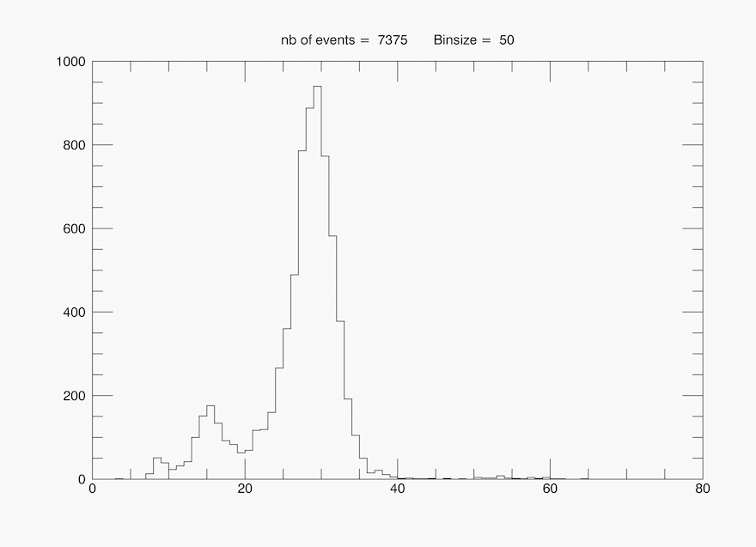
Caliste - MM: Spectroscopy
Building a spectrum of the events
Escape peak of Argon visible
Resolution of 17.8% FWHM at 6 keV
Nb of Counts
Energy (ADU)

Slide 17
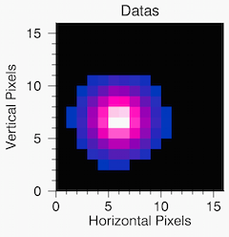
Caliste - MM: Polarimetry
Photo-electron’s track impossible to see in Argon at atmospheric pressure
Solutions:
Smaller pixels
Changing pressure
Changing gas

Slide 18
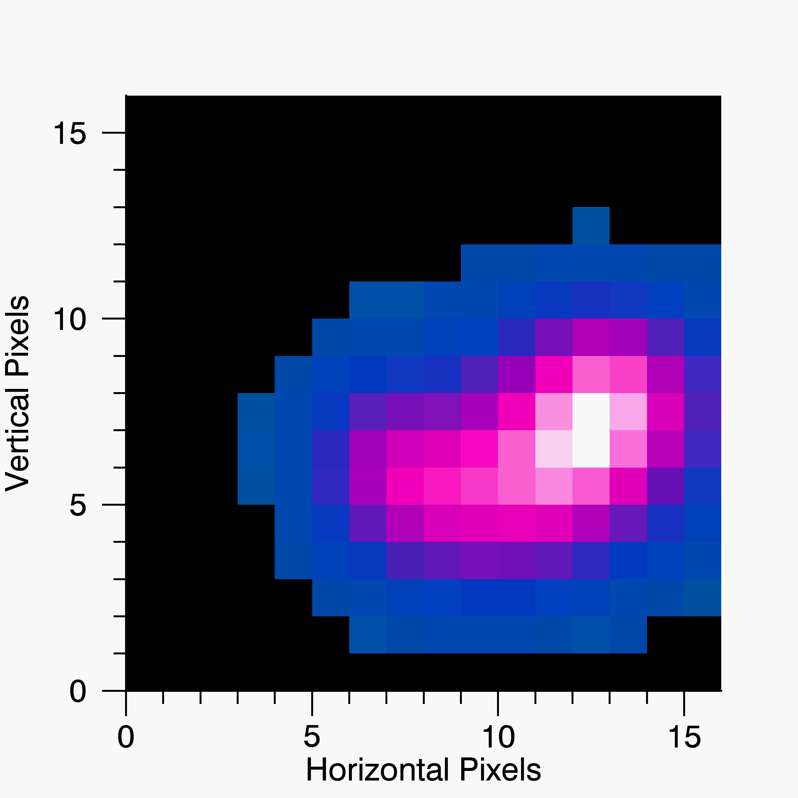
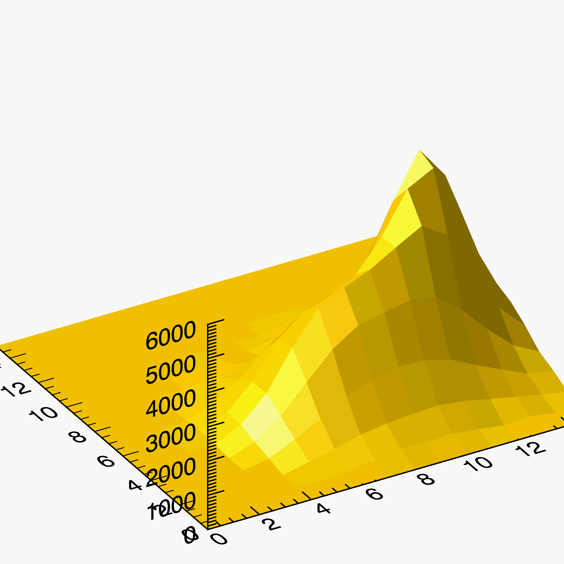
Caliste - MM: Polarimetry (2)
Use of a mixture of Helium-CO2
The Helium is much lighter than Argon and allows the photo-electron recoil: the photo-electron’s track is visible
→ we can recover the direction of ejection

Slide 19
Conclusion
Soft X-Ray polarimetry is a topic of current interest in astrophysics. It can be done in gaseous detectors by recovering the direction of ejection of the photo-electron
Gaseous detector = piggyback: outside electronics → interchangeable electronics and protection from sparks
Readout electronics = Caliste: low noise, high sensitive, fine pitch and space-qualified electronics
The combination Caliste-MM shows promising results:
1st spectrum of a detector with contactless electronics
good spectroscopic resolution
visible tracks of photo-electrons

Slide 20
Caliste-MM : prospects
Optimization of the parameters of the detectors: resistivity of the piggyback, thickness of the ceramic layer, distance between Caliste and the ceramic, and use of thin mesh
Test with Argon in under-pressure (200 mBar): GEANT4 simulations done by Philippe Gros let expect photo-electrons tracks at 6keV
Testing the detector in sealed mode
Tracking algorithm to recover the direction of ejection of the photo-electron
Test in polarized beam and measure of polarimetry

Slide 21
Questions ?
CALISTE MM TEAM: D. Attié, D. Desforge, E. Ferrer Ribas, Y. Giomataris, F. Jeanneau, O. Limousin, T. Papaevangelou, A. Peyaud, P. Serrano

Slide 22
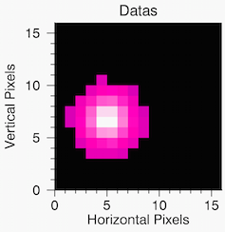
Escape Event
Argon escape event

Slide 23
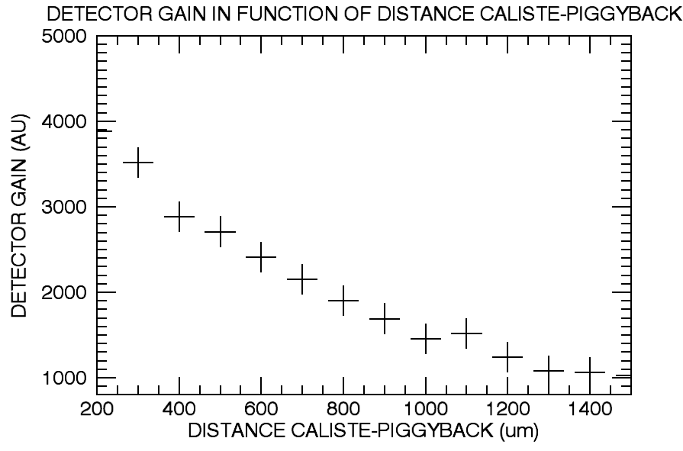
Distance

Slide 24
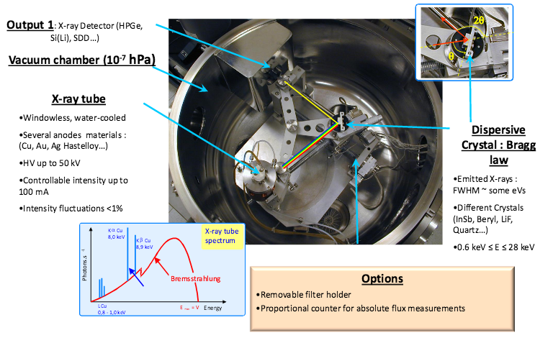
Caliste – MM: Spectroscopy (2)
The Source Of Low Energy X-rays (SOLEX) facility in Saclay
Tunable monochromatic X-ray source (1 ev of resolution from 1 keV to 20 keV)
4 – Y. Menesguen and M. C. Lepy, NDIP 2011

Slide 25
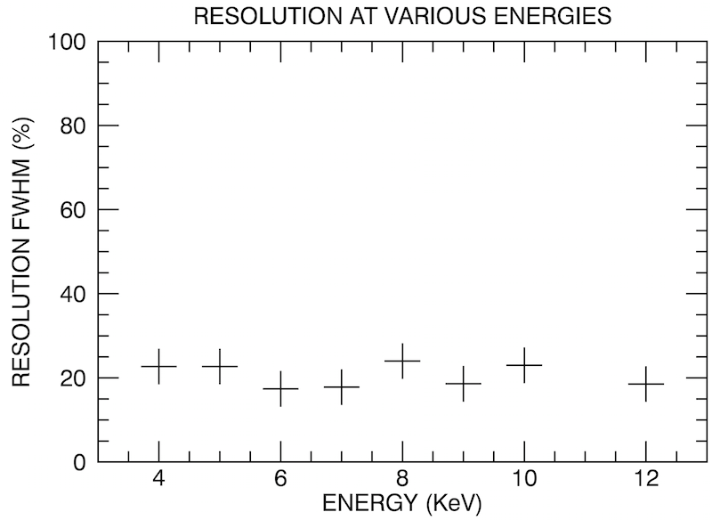
Caliste – MM: Spectroscopy (3)

