Slide 1


Innovative Micromegas manufacturing with
Microfabrication techniques
and use of Graphene
Chryssa Vassou
NCSR Demokritos
14/10/2015
NCSR Demokritos
Institute of Nuclear and Particle Physics
C. Vassou, T. Geralis
Institute of Nanoscience and Nanotechnology
M. Vlachopoulou, A. Tserepi, A. Dimoulas
National Technical University of Athens
J. Marquez Velasco
University of Athens
A. Giamini

Slide 2
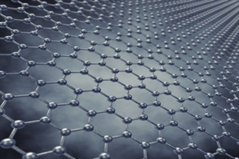

Micromegas Detector microfabrication
Our primary motivation: 1) Operate a dual phase gas Micromegas
Place graphene on top of the mesh
Graphene is not permeable by molecules Different gas in the conversion volume (Gas1)
and different in the amplification volume (Gas2)
e.g. exploit good conversion efficiency in Gas1
and good gas gain in Gas2
2) suppress ion backflow.
Requirement Good electron transparency
Drift
Gas1
Conversion
Graphene
PDMS membrane 30um holes
micromesh
Pillars
Gas2
amplification
Cu layer with holes (mesh)
PCB
strips

Slide 3
Steps to be performed:
Create substrate with holes (PDMS)
  Holes diameter: 50 μm, S = 2 x 2 cm²
Bond it on a Cu foil
Etch copper holes to create mesh
Place Graphene on top of PDMS
Place the structure on top of the Anode
that has the pillars attached to it
30 μm
5 μm
Graphene – monoatomic layer
Graphene – monoatomic layer
30 μm
50 μm

Slide 4






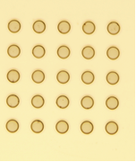

Lithography process to generate the appropriate master for the PDMS membrane (30um Width, 50um diameter holes)
SU-8 3050
Dispensing SU-8 3050
photoresist on a Si wafer
Si
Design and build quartz mask with holes
of 50 μm. Mask dimension: 2 cm x 2 cm
Several hole option on the same mask
Spin-coating & soft bake
Quartz Mask aligning
Exposure with a UV lamp
Basic lithography steps
Spin-coating :
Soft bake
Exposure
Post bake
Development
Post bake
50um diameter
Post-exposure bake,
development with
SU-8 developer
30um

Slide 5
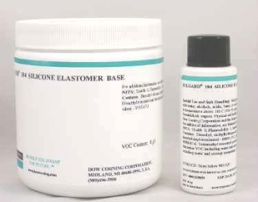





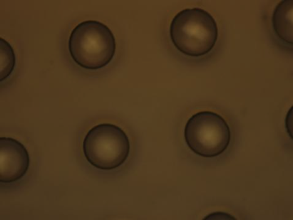

PDMS membrane process
PDMS membrane 30 um transfer to modified glass substrate
Si master
Polydimethylsiloxane or PDMS is a polymer widely used for the manufacture of microfluidic chips
Chemical formula for CH₃[Si(CH₃)₂O]_{n}Si(CH₃)₃
Drop deposit PDMS
Modified glass
with PFOTS
Process
Lay one PDMS drop on Si master
Carrier : modified glass with PFOTS
clamp with magnets
Set under vacuum
bake
clamp, vacuum and cure
Magnetic clamps
O2 plasma treat
and bond
PDMS membrane 30um height,50um diam. [2]
50um diam
30um
Remove glass intermediate

Slide 6
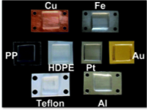

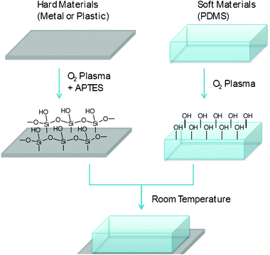
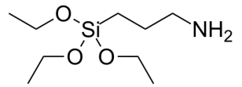


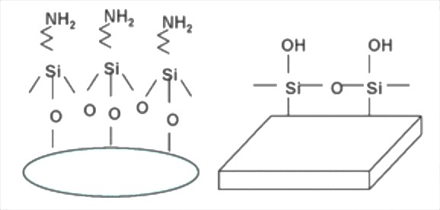
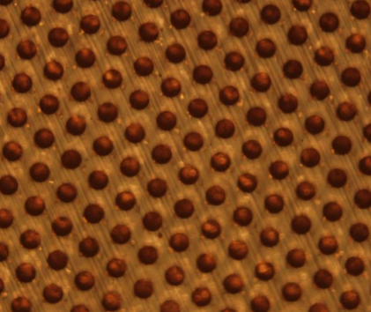

Bonding technique for Cu to PDMS
Cu
(3Aminopropyl)triethoxysilane or APTES :
APTES is an aminosilane frequently used in the process of silanization
use with PDMS → APTES can be used to covalently bond thermoplastics to PDMS
[3], [4]
+APTES
Cu
Oxidation of PDMS → Oxidation of PDMS using plasma, changes the surface chemistry of PDMS and produces silanol terminations (SiOH) on its surface. This helps make PDMS hydrophilic for thirty minutes. This process also makes the surface resistant to the adsorption of hydrophobic and negatively-charged molecules
+ plasma O2
+ APTES
Cu
PDMS membrane
PDMS membrane
Cu
cu
PDMS
(a)
(b)
(a) : Cu coated with APTES
(b) : PDMS treated with plasma O2
Cu
(c) Bonded substrates
Detach glass

Slide 7

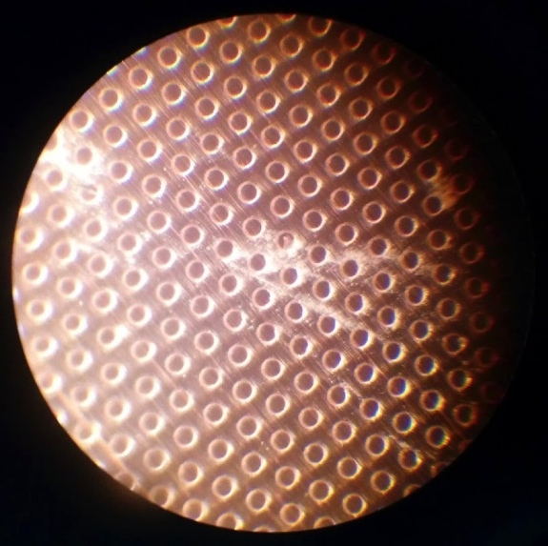
Etching Cu to generate holes
PDMS membrane
Etchant Cu
PDMS membrane
Cu through hole

Slide 8
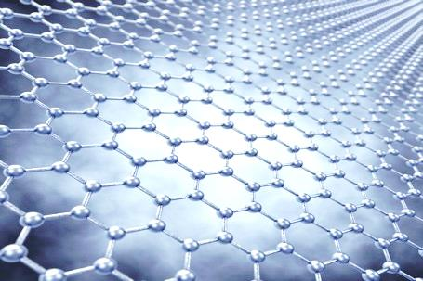
Deposition of graphene monolayer
4) Transport Graphene on PDMS
Graphene
PDMS membrane
PDMS substrate
Produce Graphene on Cu foil
Cover it with PMMA
Dissolve Cu
Place PMMA+Graphene on PDMS
Dissolve PMMA
Cu Mesh
Raman spectroscopy was used to confirm the graphene transfer uniformly on the PDMS membrane
Graphene (D, G, 2D)
We have placed a graphene surface of 1 x 1 cm²
on to of the PDMS substrate
Future plans
Measure electron transparency with and without Graphene
Investigate for defects
Measure gas diffusion through Graphene
Possibly lay double or triple layers

