Slide 1
Trigger vs triggerless approaches in large-size experiments
U. Marconi
INFN Bologna (Italy)
MPGD2015, Trieste

Slide 2
The high luminosity LHC programme
Update of the European Strategy for Particle Physics: (Adopted 30 May 2013, in a special session of CERN Council at Brussels).
“The discovery of the Higgs boson is the start of a major programme of work to measure this particle’s properties with the highest possible precision for testing the validity of the Standard Model and to search for further new physics at the energy frontier. The LHC is in a unique position to pursue this programme”.
“Europe’s top priority should be the exploitation of the full potential of the LHC, including the high-luminosity upgrade of the machine and detectors with a view to collecting ten times more data than in the initial design, by around 2030”.
“This upgrade programme will also provide further exciting opportunities for the study of flavour physics and the quark-gluon plasma”.

Slide 3
The LHC at CERN
LHC main design parameters:
Luminosity and Pileup
R(t) = L(t) × σ(E) = μ(t) × ν
Beam energy: 7 TeV
Collision energy: 14 TeV
2808 bunches/beam
~10¹¹ proton/bunch
Bunch crossing: 40 MHz
Collision period: 25 ns
Luminosity: ~10³⁴ cm⁻²s⁻¹
R(t): proton-proton collision rate (s⁻¹).
L(t): luminosity (cm⁻²s⁻¹)
σ(E): cross section (cm⁻²)
μ(t): event multiplicity
ν: bunch crossing frequency (s⁻¹).

Slide 4
LHC Machine Evolution
Run 2:
Start with 6.5 TeV and later decision towards 7 TeV according to magnet training
LHC Injector Upgrades (LIU)
HL-LHC
300 fb⁻¹
0.75 x 10³⁴ cm⁻²s⁻¹
50 ns Bunches
Pileup ~20
1.5 x 10³⁴ cm⁻²s⁻¹
25 ns Bunches
Pileup ~40
2.2 x 10³⁴ cm⁻²s⁻¹
25 ns Bunches
Pileup ~60
5.0 x 10³⁴ cm⁻²s⁻¹
25 ns Bunches
Pileup ~140
(peak 200)
LHC event rate increase by a factor ~3
Goal of HL-LHC project: 300 fb⁻¹ per year, 3000 fb⁻¹ in about 10 year.

Slide 5
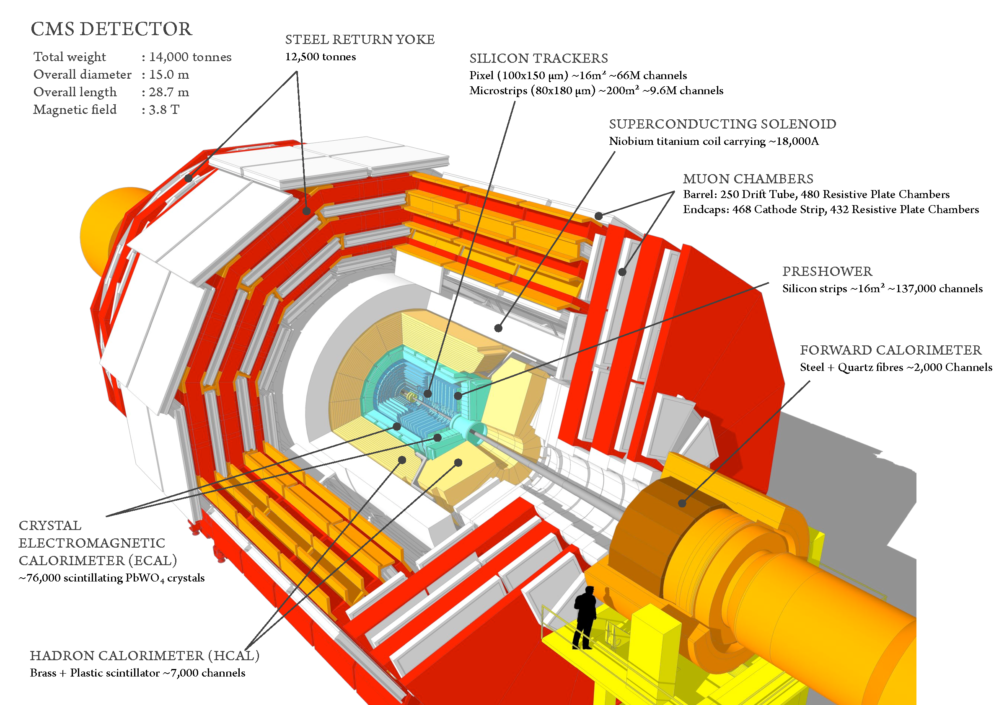
Event multiplicity (Central Detectors)
σ_{inelastic}∼ 85 mb
10³⁴ × 85 × 10⁻²⁷/ 40 ×10⁶ ~ 20 interactions/crossing

Slide 6
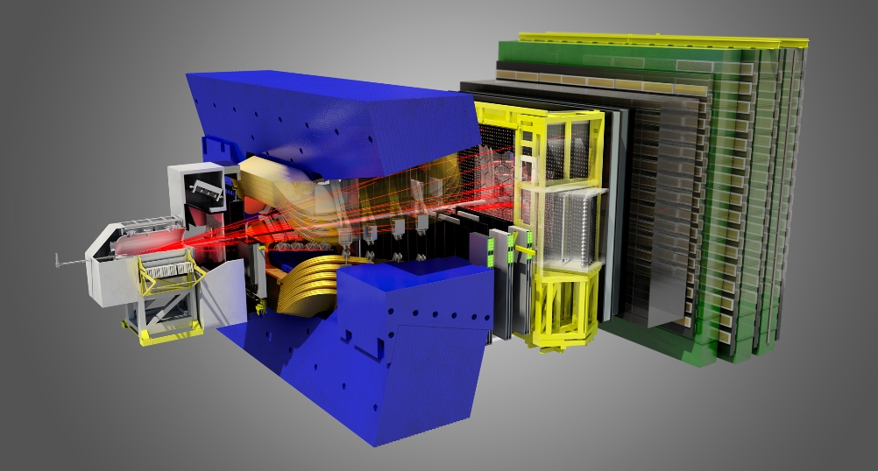
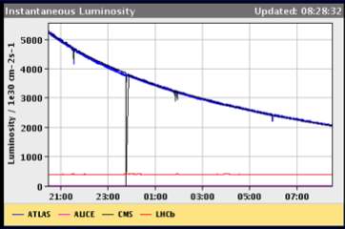
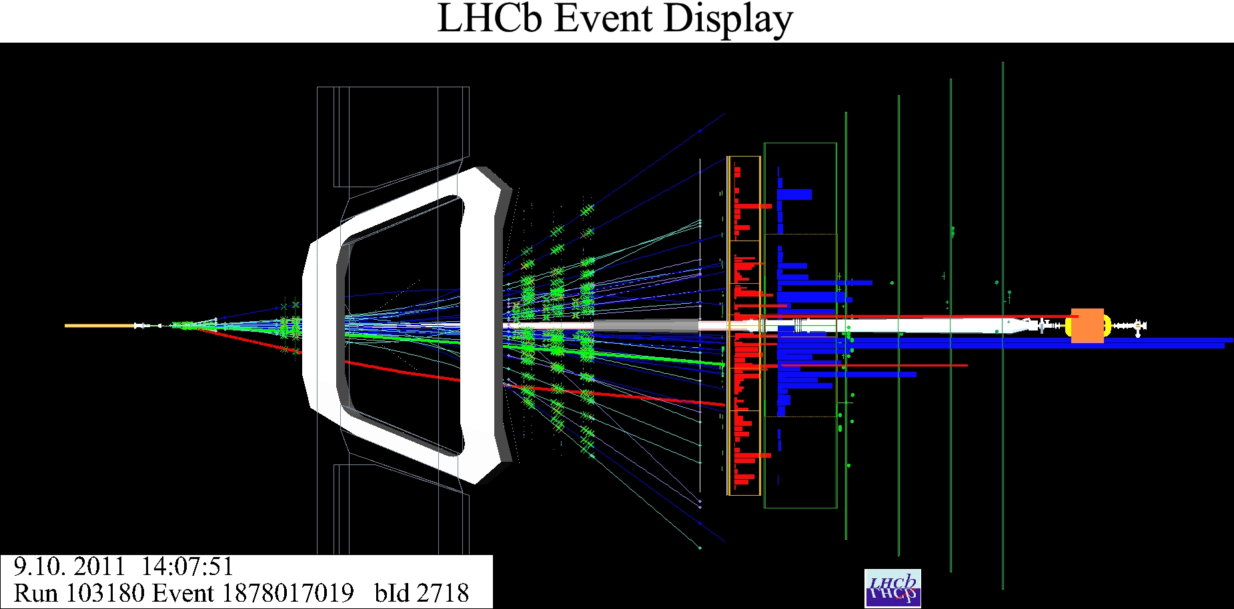
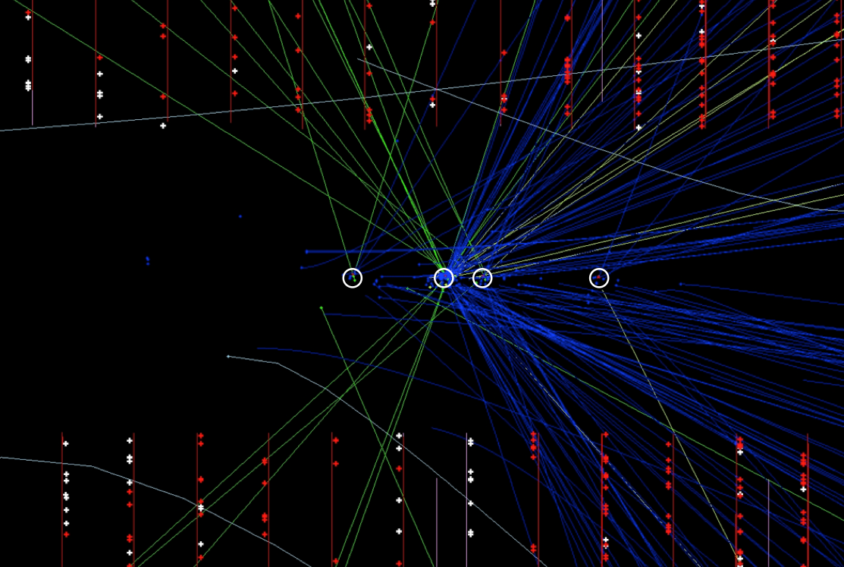
LHCb: flavour physics at the LHC
Forward spectrometer
Luminosity
LHCb
4×10³² cm⁻² s⁻¹
LHCb event display

Slide 7
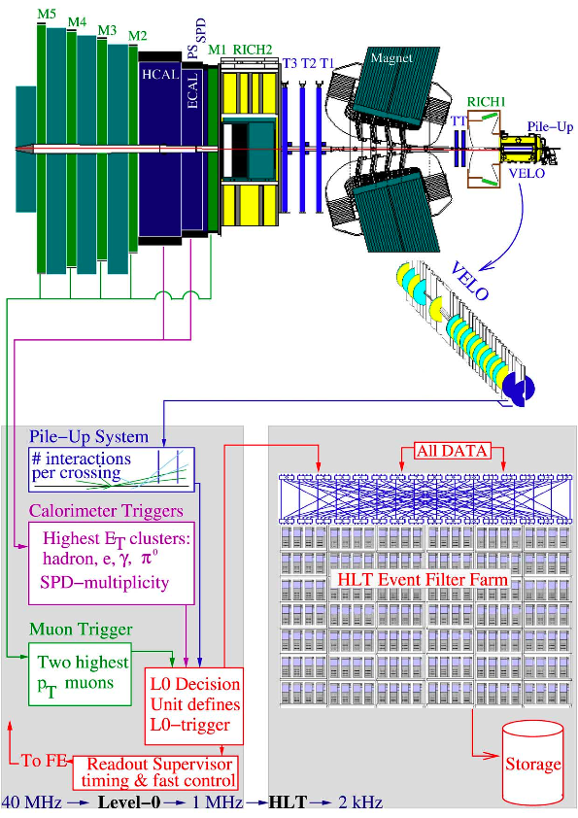
Multi-level trigger (the present LHCb)
Level-0 hardware trigger
Synchronous with the BX
Constant latency 4 μs (fully pipelined)
Based on FPGA
40 MHz → 1 MHz.
HLT software trigger
Algorithms running on PC farm
1 MHz → 5-10 kHz
Interface to the read-out network: TELL1 boards
Read-out network:
Gigabit Ethernet LAN.
Read-out @ 1.1 MHz.
Aggregate throughput: 0.5 Tb/s.
5 kHz

Slide 8
DAQ example (the present LHCb)
Push-protocol with centralized flow-control
IP
over
Ethernet
1GbE
Trigger rate
1.1 MHz
Event size 50kB
Readout boards (313 x TELL1)
4 Gb/s output bandwidth each
Buffering and event formatting
0.5 Tb/s
High performance
computers
Event Filter Farm
60 sub-farms of 40 nodes
~ 50000 HLT
trigger processes
Multi-core processors

Slide 9
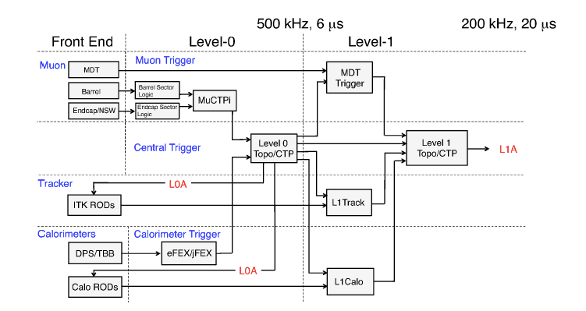
Multi-level trigger (2)
ATLAS
arXiv:1409.5002v1
To disk after HLT
O(400 Hz) in 2012
O(1 kHz) in 2015-2018
O(5-10 kHz) in 2025+
Throughput to disk: ~ 10 kHz × 1 MB = 10 GB/s

Slide 10
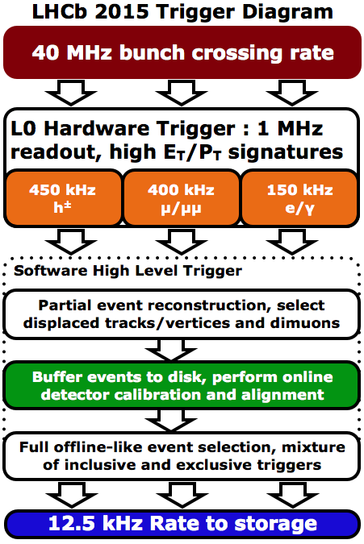
LHCb trigger evolution (farm optimal usage)
LHC stable beams during 30% of the running period: 70% of the time the CPU of the HLT farm would be idle
Real-time HLT1: HLT1 selects events that are temporarily stored on local disks (farm servers).
Staging after the HLT1 filter occurs at a rate of about 100 kHz.
An enriched sample to analyse further.
Deferred HLT2: Performs the final event filtering, relying on up-to-date calibration constants, with offline quality.
Trigger algorithm: ~350 trigger lines
Output rate ~10 kHz
Throughput ~ 10 kHz * 50 kB = 0.5 GB/s

Slide 11
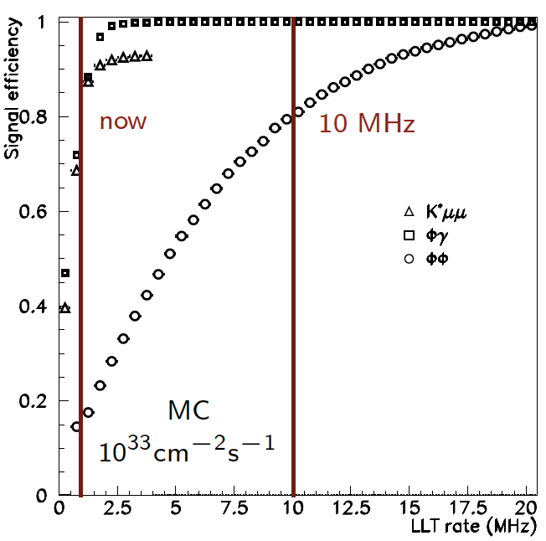
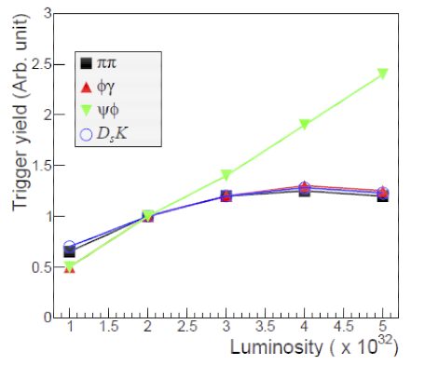
The 1 MHz readout rate limitation (the need of a different trigger strategy)
B meson decay modes
ε > 80%
“Framework TDR for the LHCb Upgrade: Technical Design Report”; The LHCb Collaboration,CERN/LHCC-2012-007, LHCb-TDR-12 - 2012
Due to the available bandwidth and the limited discrimination power of the hadronic L0 trigger, LHCb experiences the saturation of the trigger yield on hadronic channels around 4. ×10³² cm⁻²s⁻¹
Increasing the first level trigger rate considerably increases the efficiency on the hadronic channels.
Notes:
The Level-0 trigger unfortunately does not allow for efficient triggering on decays which only have hadronic content. It turns out that as the luminosity increases so does the inefficiency
in the hadronic triggers and the net yield of hadronic events levels off, while the yield of events
with leptonic content scales with the luminosity increase.

Slide 12
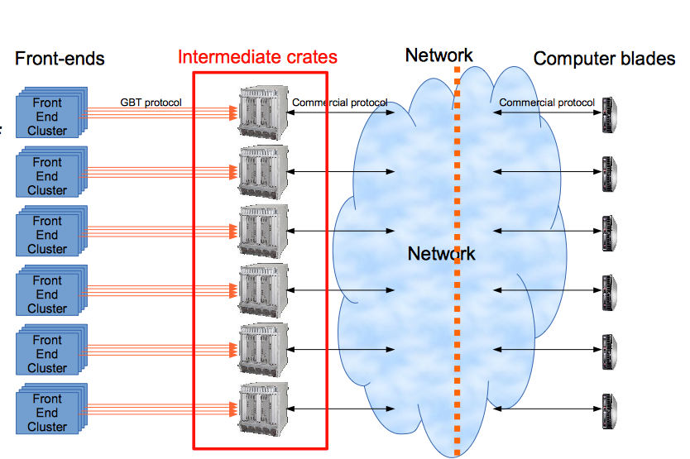
LHCb DAQ Upgrade: First Idea
GBT
FPGA → event fragments to the farm
FEE
FEE
FEE
FEE
FEE
FEE
Intermediate layer of electronics boards arranged in crates to decouple FEE and the HLT PC farm: for buffering and data format conversion.
The optimal solution with this approach: ATCA, μTCA crates, ATCA carrier board hosting AMC standard mezzanine boards.
AMC boards equipped with FPGAs to de-serialize the input streams and transmit event-fragments to the farm, using a standard network protocol, using 10 Gb Ethernet.

Slide 13
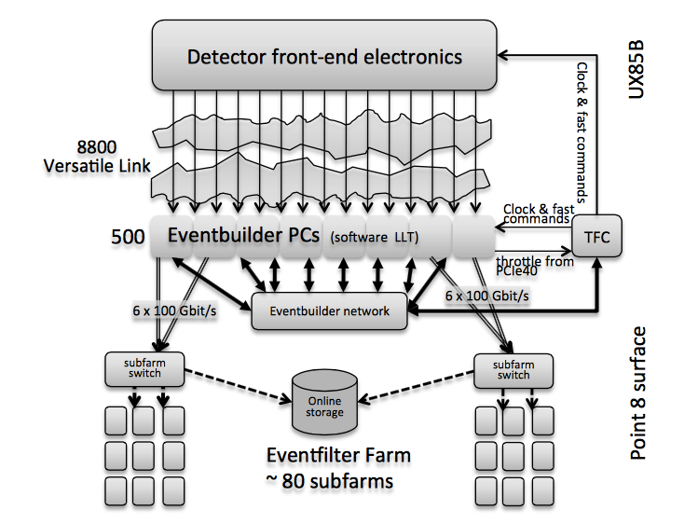
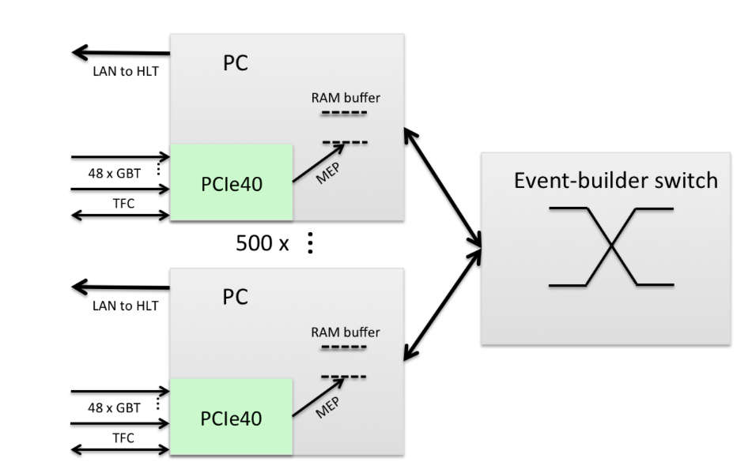
40 MHz PCI Express based readout
5 Gb/s , 300 m long fibres
from the FEE
directly to the Event Builder
~ 9000
optical link
Event Builder
30 MHz × 100 kB/evt
CERN-LHCC-2014-016
HLT threads
n ~ 30 MHz × 20 ms ~ 6 × 10⁵

Slide 14
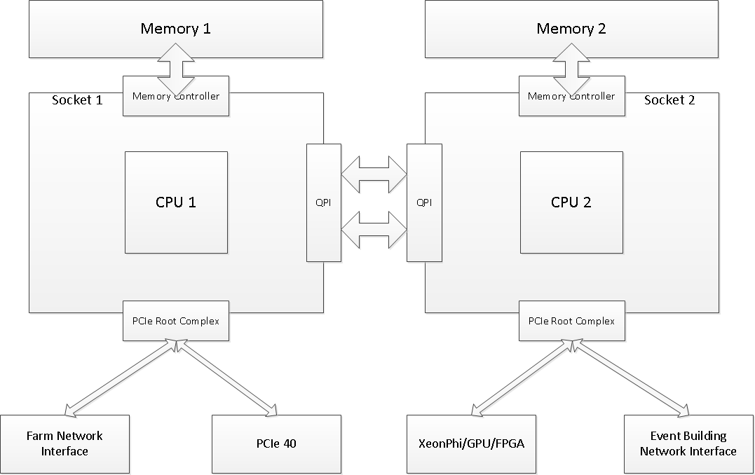
Event builder node data flux (high performance computer)
DDR3
40-50 GB/s
Half duplex
DDR3
40-50 GB/s
Half duplex
events that are being
built on this machine
opportunity for doing
pre-processing of
full event here
2x50 GB/s
Full duplex
opportunity for doing
pre-processing of
full event here
Co-processor
Event Building
Network Interface
PCIe40
data from
the detector
~ 100 Gb/s
to the HLT
from the
event builder
to the
event builder
Dual-port IB FDR – 110 Gb/s
Server NUMA architecture

Slide 15
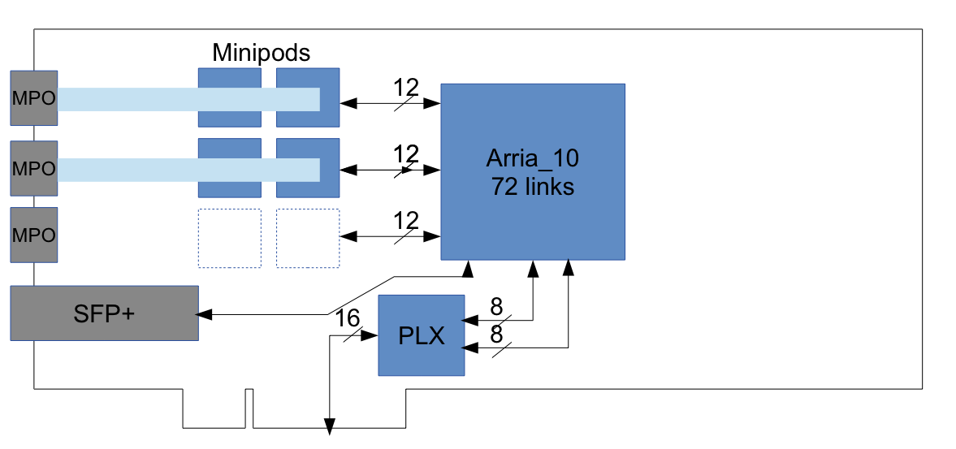
PCIe Gen3 based readout
A main FPGA manages the input streams and transmits data to the event-builder server through a PCIe Gen3 interface.
PCIe Gen3 throughput: 16-lane × 8 Gb/s/lane = 128 Gb/s
48 optical links
from the FEE
DMA over 8-lane PCIe-3 hard IP blocks
16-lane PCIe-3 edge connector
to the motherboard of the host PC

Slide 16
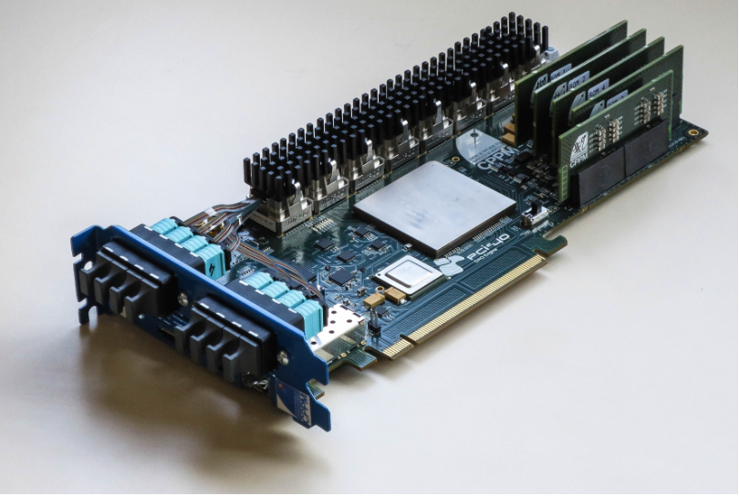
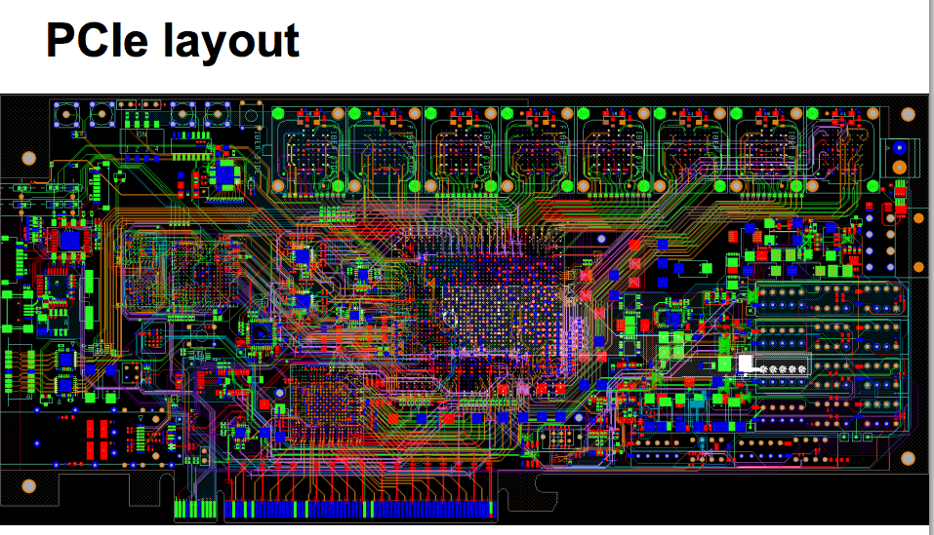
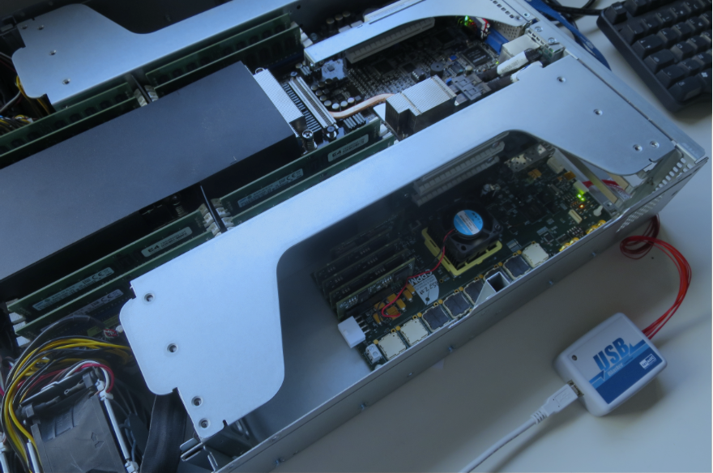
Readout board
Optical interface
PCIe edge connector
Server hosting the
read-out board

Slide 17
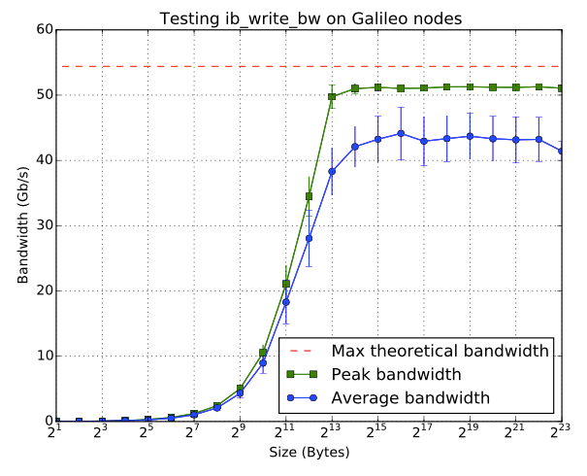
Large scale tests on InfiniBand cluster
Average bandwidth available
In a point-to-point connection

Slide 18
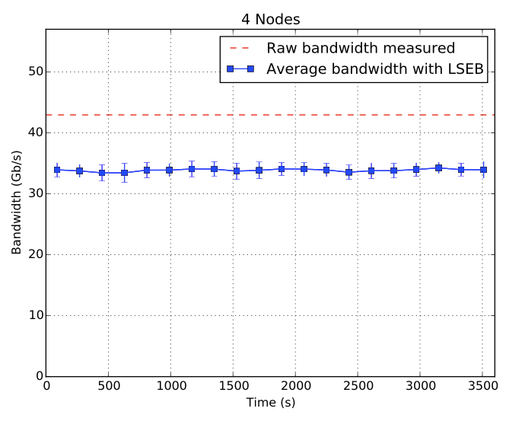
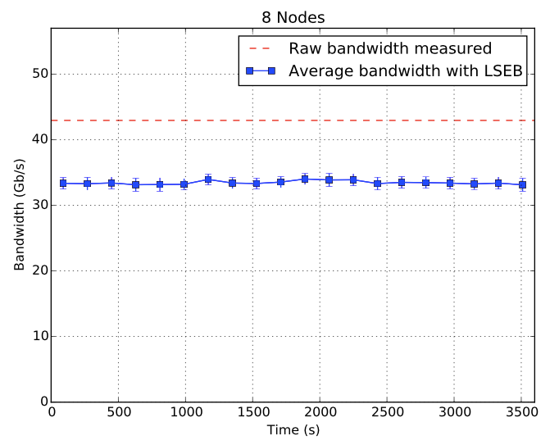
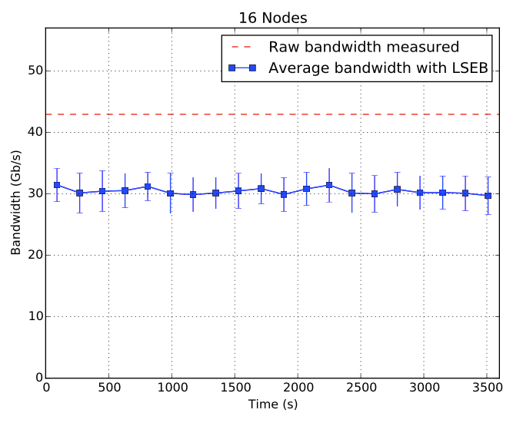
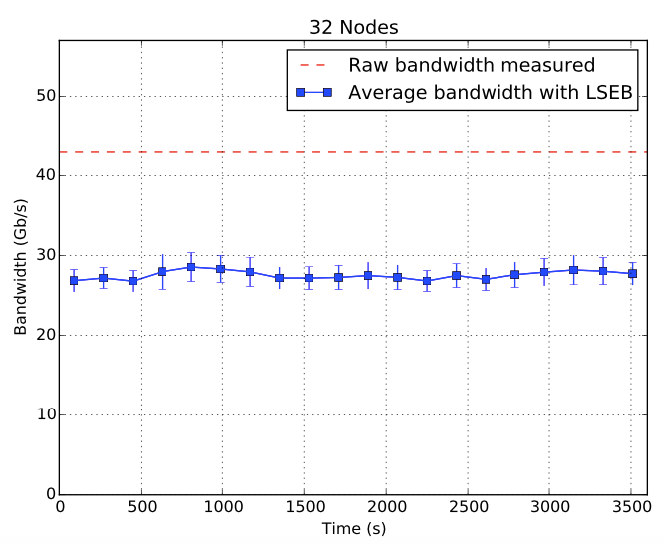
Bandwidth vs n. of nodes IB verbs
33.87 Gb/s
33.46 Gb/s
30.43 Gb/s
27.55 Gb/s

Slide 19
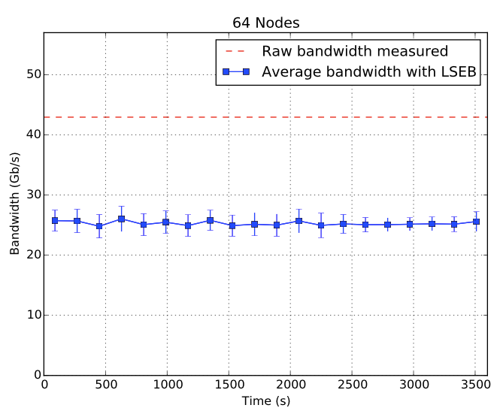
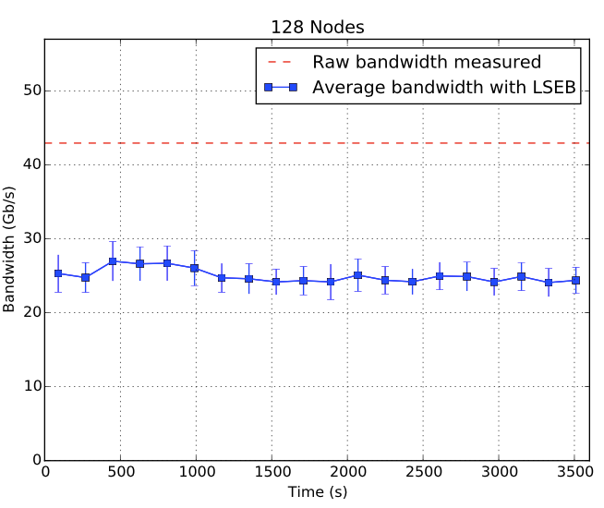
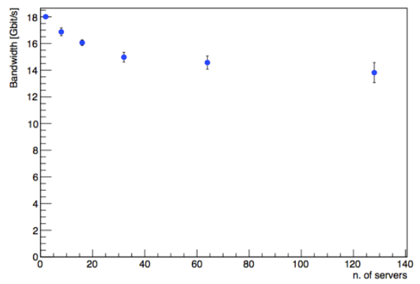
Bandwidth vs n. of nodes IB verbs
25.29 Gb/s
24.98 Gb/s
Using MPI instead of IB verbs
Unidirectional accounting
Fully duplex
Bidirectional × 2

Slide 20
Notes:
The CPU power in this Event Building farm opens the option for a more cost effective implementation of the LLT in
software.

Slide 21
The evolution of Network Interconnects
EDR (100 Gb/s) HCA
expected
PCIe Gen4
expected
PCIe Gen3
available
100 GbE NIC
expected
Chelsio T5 (40 GbE
and Intel 40 GbE
expected
Mellanox FDR
Mellanox 40 GbE NIC

Slide 22
InfiniBand vs Ethernet
Guaranteed delivery. Credit based flow control:
Ethernet: Best effort delivery. Any device may drop packets;
Hardware based re-transmission:
Relies on TCP/IP to correct any errors;
Dropped packets prevented by congestion management:
Subject to micro-bursts;
Cut through design with late packet invalidation:
Store and forward. Cut-through usually limited to local cluster;
RDMA baked into standard and proven by interoperability testing:
Standardization around compatible RDMA NICs only now starting;
Need same NICs are both ends;
Trunking is built into the architecture:
Trunking is an add-on, multiple standards an extensions;
The network protocol is not coded into FPGA →
Select the best industrial standard available

Slide 23
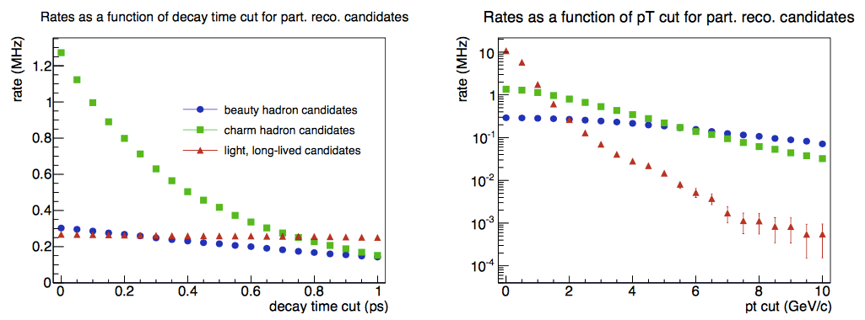
HLT output rate
Candidates which had at least two tracks from which a vertex could be produced.
max: 10 GB/s
τ > 0.2 ps
LHCb-PUB-2014-040
“The problem is no longer to find one specific event among billion background events, but discriminate in a minimally biasing way between various topologically similar signals”.
There will be signal modes where 100% pure trigger must be downscaled to fit into the output bandwidth allocated: the trigger will frequently be the offline event selection.
Notes:
The conclusion to be drawn from this section is that the allowable output rate of signal is the greatest challenge facing the upgraded trigger system. The problem is no longer the classical “find one specific event among billion background events”, but the more complex
“discriminate in a minimally biasing way between various topologically similar signals”. In certain cases there will be signal modes in the upgrade where even a 100% pure trigger must be downscaled to fit into the output bandwidth allocated. In these circumstances, the trigger algorithms should be as similar as possible to the offline event selections, since the trigger will frequently be the offline event selection. This is the rationale behind the trigger design described in the remainder of this document.

Slide 24
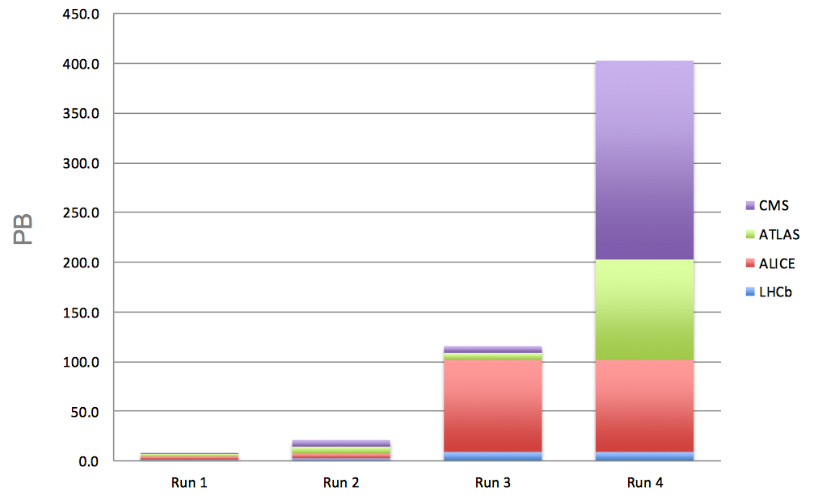
RAW data HL-LHC
LHCb data rate: 10 kHz × 100 kB = 10³ × 10⁶ = 1 GB/s → Data per year: 10⁹ × 10⁷ = 10 PB/y
raw data volume ~ event rate × event size × time
CMS Run 4 data storage volume 50 times more than Run 3
• Very rough estimate of a new RAW data per year of running using a simple extrapolation of current data volume scaled by the output rates.
• To be added: derived data (ESD, AOD), simulation, user data...

Slide 25
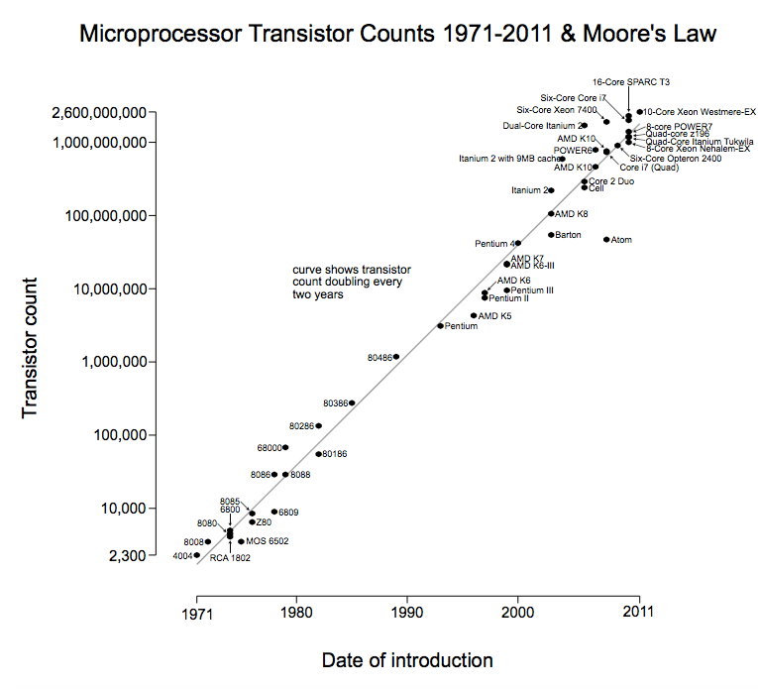
Transistor count
Moore’s law will hold at least until 2020

Slide 26
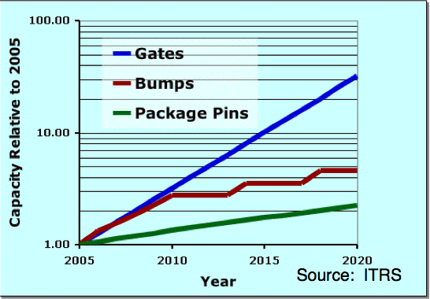
FPGAs
Moore’s law holds for FPGAs
Altera Stratix 10 in 14 nm
Smaller feature size means higher-speed and/or less power consumption
No problem in logic density
Challenges
Programmability
Long-term maintenance of design FPGA software which is rapidly changing
Conserve tools in virtual machines, but this will need continuous support
Source: I. Bolsen (Xilinx) 2012

Slide 27
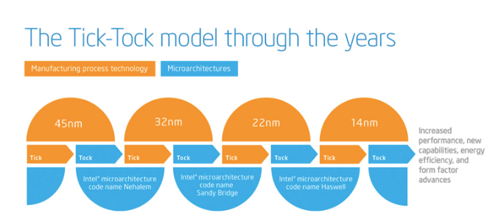
Processor advancement
Technology
14 nm (2013/14)
10 nm (2015/16)
7 nm (2017/18)
5 nm (2019/20)
The architecture has become more efficient with deeper pipelines, smarter branch prediction and hardware prefetching of data from memory into caches.

Slide 28
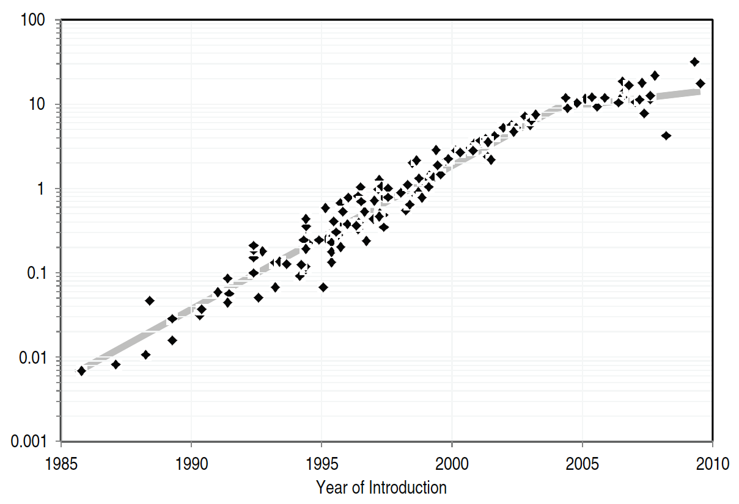
Microprocessor performance
Computer performance was growing exponentially at the rate of more than 50 percent per year…
Integer application performance (SPECint2006) over time (1985-2010).
We have enjoyed huge and steady advances over the years: ×1000 in CPUs power in the last 20 years.
From: "The Future of Computing Performance: Game Over or Next Level?"

Slide 29
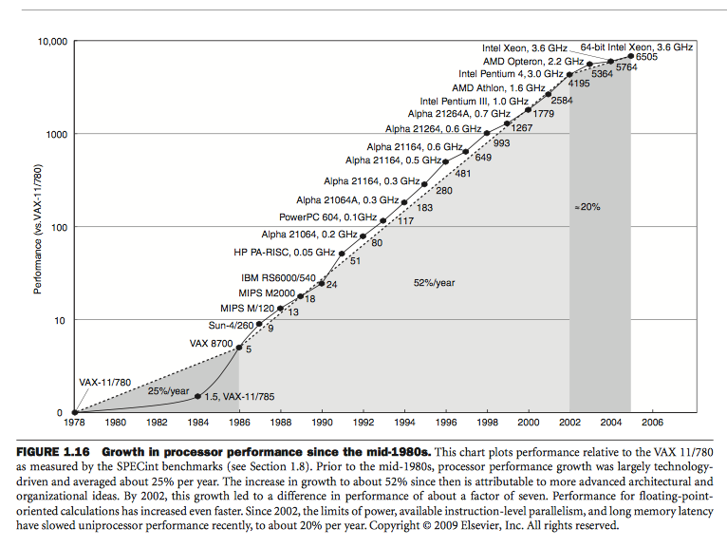
Pentium Pro in 1996: 150 MHz
Pentium 4 in 2003: 3.8 GHz (~25x)
Intel Xeon E5-2650 v2
“only” 2.60 GHz

Slide 30
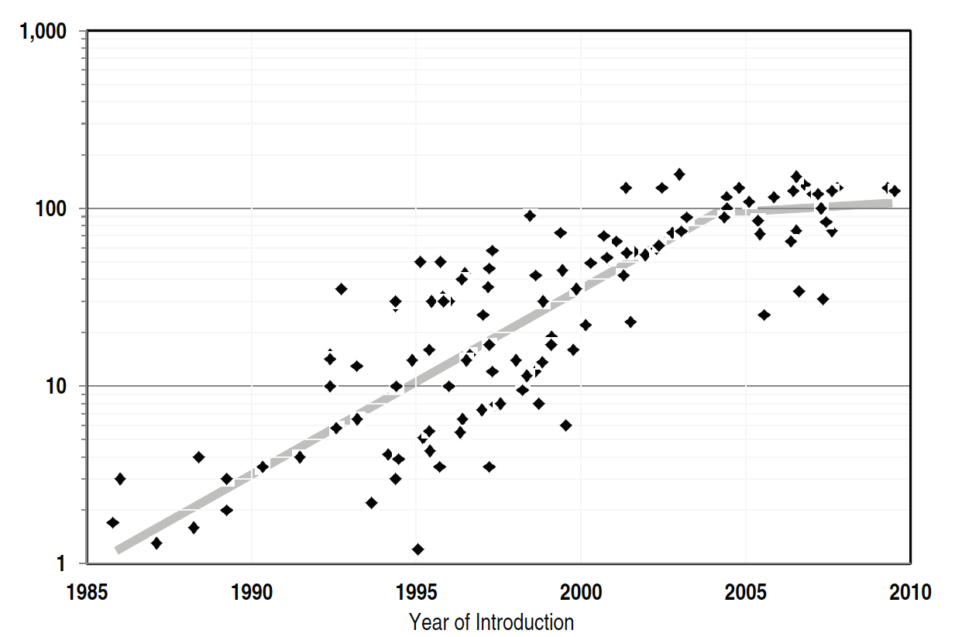
Microprocessor Power dissipation
The focus is shifting to performance/watt, not just performance/price.
130 W is the physical limit for air cooling, and even approaching 130 W requires massive heat sinks and local fans.
Power consumption
From: "The Future of Computing Performance: Game Over or Next Level?"

Slide 31
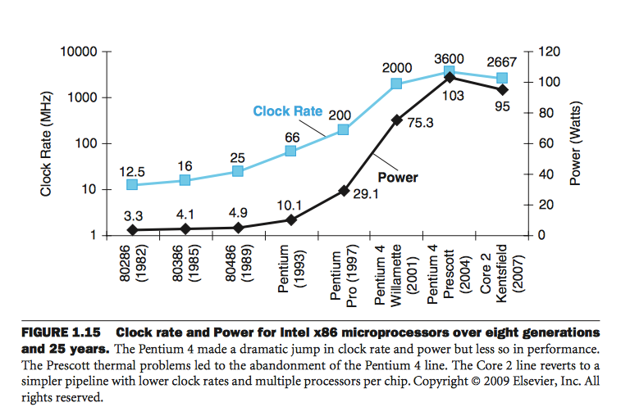
The power wall

Slide 32
The case for a single chip multiprocessor
Faced with this situation, building a complex wide issue superscalar CPU is not the most efficient use of silicon resources.
Due to fundamental circuit limitations and limited amounts of instruction level parallelism, the superscalar execution model has provide diminishing returns in performance for increasing issue width.
As a result, the computer hardware industry has commenced building chips with multiple processors. Current chips range from several complex processors to hundreds of simpler processors, and future generations will keep adding more.
To optimally use chip multiprocessors, applications must use a parallel programming model, which divides a program into parts that are then executed in parallel on distinct processors.
“We have turned to multi-core chips not because of the success of our parallel software but because of our failure to continually increase CPU frequency”.

Slide 33
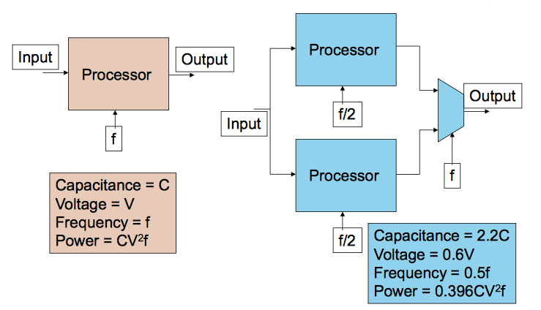
Reduced power consumption
Chandrakasan, A.P.; Potkonjak, M.; Mehra, R.; Rabaey, J.; Brodersen, R.W., "Optimizing power using transformations," IEEE Transactions on Computer-Aided Design of Integrated Circuits and Systems,, vol.14, no.1, pp.12-31, Jan 1995

Slide 34
Challenges of Parallel Execution
Not all problems are amenable to parallelization (Amdahl’s law).
You can never do better than the remaining serial part of a process.
Hard to think “parallel”
Communication
Synchronization
Debugging
Amdahl’s law
The maximum speedup
P is the proportion of a program that can be made parallel
N is the number of processors
If P is 90%, then (1 − P) is 10%, and the problem can be sped up by a maximum of a factor of 10, no matter how large the value of N used.
Notes:
Amdahl's law does represent the law of diminishing returns if you are considering what sort of return you get by adding more processors to a machine

Slide 35
Parallel programming tools
General-purpose GPU
Silicon Graphics Reality Engine GPU date 1993.
Why hot now? Reasonable programming model and modest device cost.
In certain applications that can be executed in massively parallel fashion, this can yield several orders of magnitude better performance than a conventional CPU.
The underlying architecture of a GPU is quite different from a standard CPU. Developers have to face issues, such data uploading and memory is access in order to obtain the optimal performance.
Massively Integrated Core (MIC) model
An example of this technology is the Intel Xeon Phi, which uses a number of Pentium 1 GHz x86-based processor cores.
Custom FPGAs to perform parallel tasks in the reconstruction of tracks in a collision event, are also being studied in the various experiments at the LHC.

Slide 36
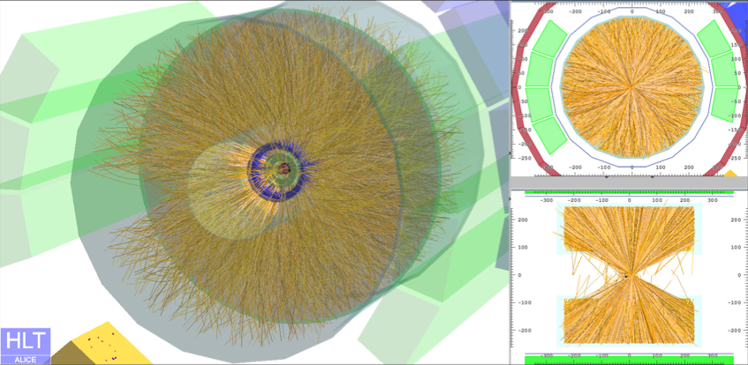
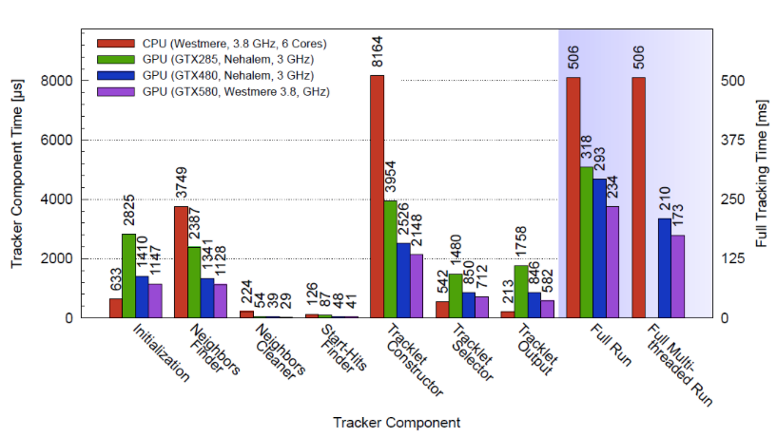
GPU at LHC
Massively parallel computing techniques at the LHC experiments focus on the specific problem of track reconstruction in the online trigger system.
HLT used in the ALICE experiment, where GPUs have been implemented for reconstruction of tracks in the central Time Projection Chamber (TPC) tracker.
D. Rohr et al. [ALICE HLT Collaboration],
ALICE HLT TPC tracking of Pb-Pb Events on GPUs,
J. Phys. Conf. Ser. 396, 012044 (2012).

Slide 37
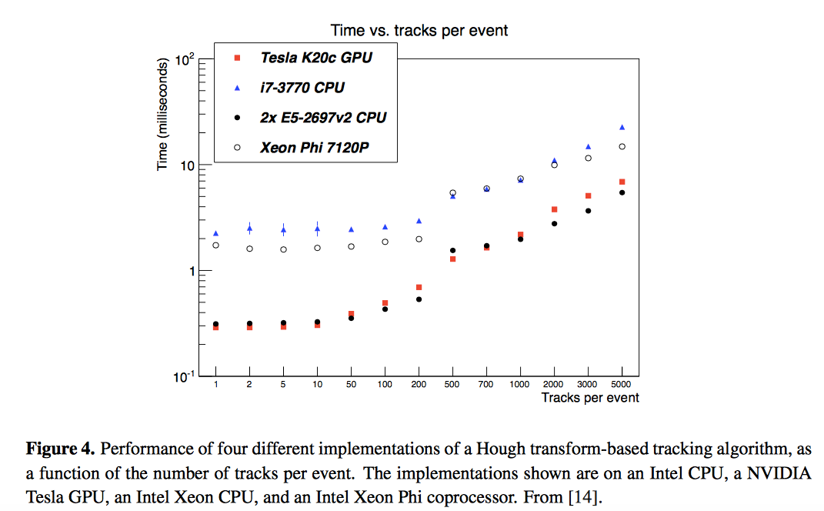
GPU at LHC cont.
Real Time Particle Tracking based on Hough Transform at the LHC
arXiv:1310.7556 [physics.comp-ph]

Slide 38
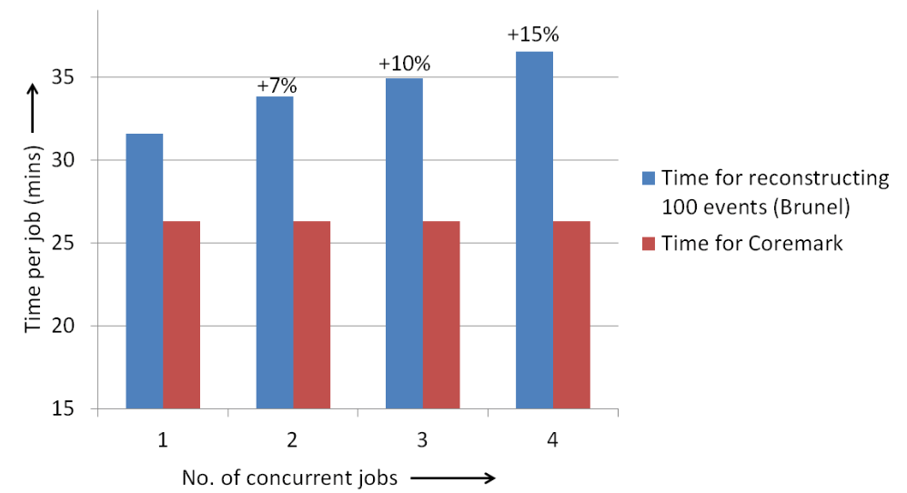
ARM processors
LHCb test results on single core performance. Time for reconstructing 1000 events
https://twiki.cern.ch/twiki/bin/view/LHCb/LHCbSoftwareStackOnARM
Scaling:
x86 scales linearly for real cores, HT add about 40%
ARM memory bandwidth does not scale

Slide 39
HEP programming
Event-level parallelism has been used for decades: large jobs can be split into N processes, each responsible for processing M events.
With the current multi-core chip approach memory must be made available to each process: Dual socket server with eight-core CPU needs 32-48 GB or more.
Large memory are becoming available, but memory could reveal a limitation to compute efficiently with both many-core server and more seriously with co-processors.

Slide 40
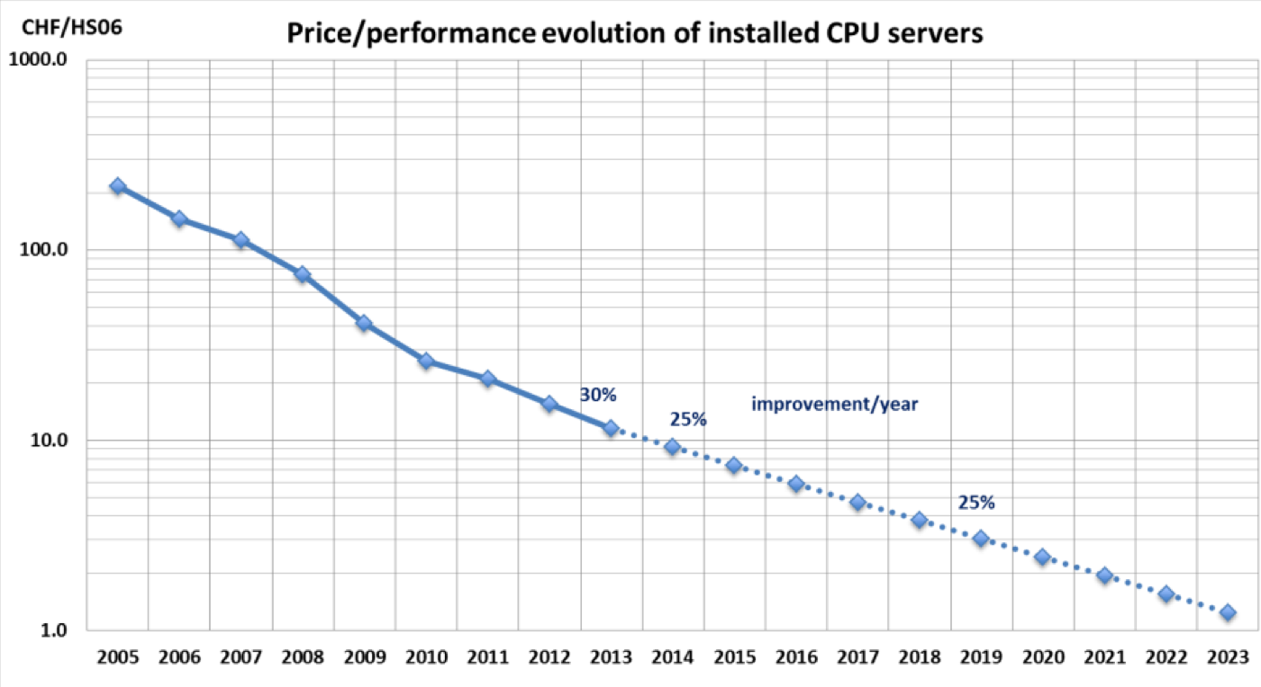
CPU price/performance evolution (CERN Computing Center)
25% performance improvement per
year is not the same as doubling the
performance every 2 years (more like 3).
Changes in the assumed %/year lead to big differences on a 10-20 year timescale.

Slide 41
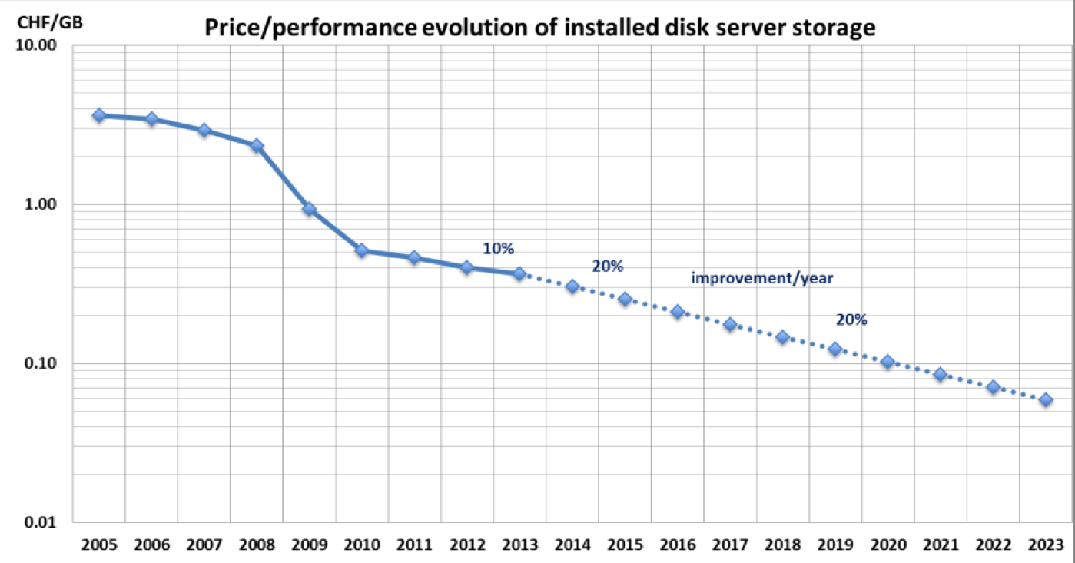
Price/performance evolution (CERN)

Slide 42
The End

Slide 43
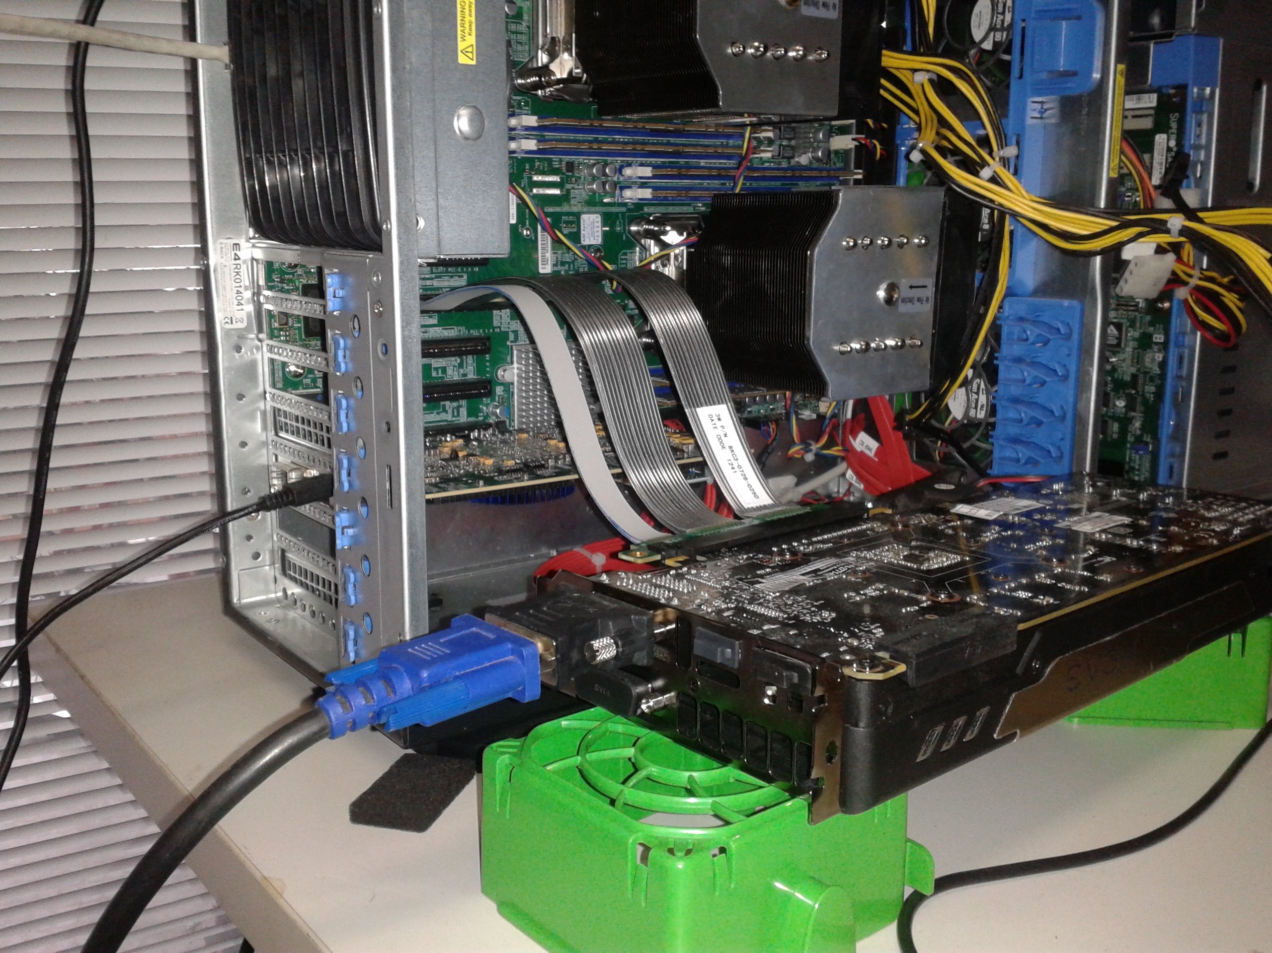
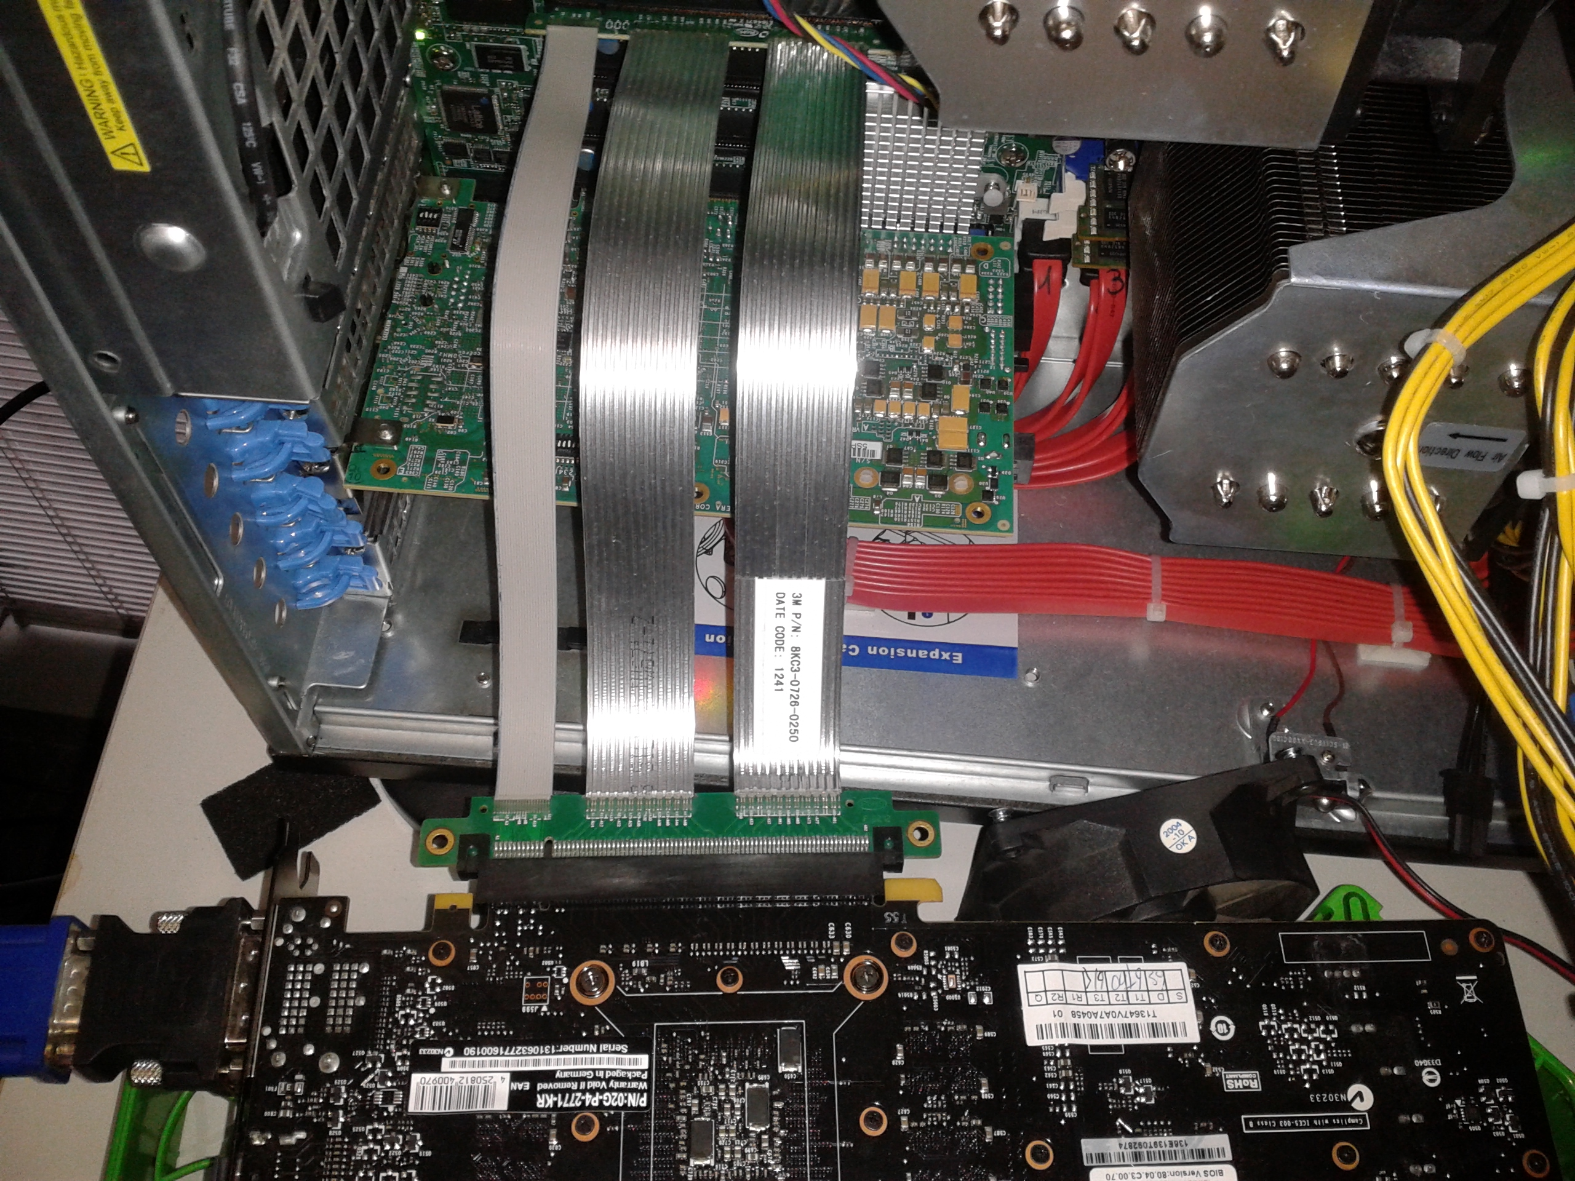
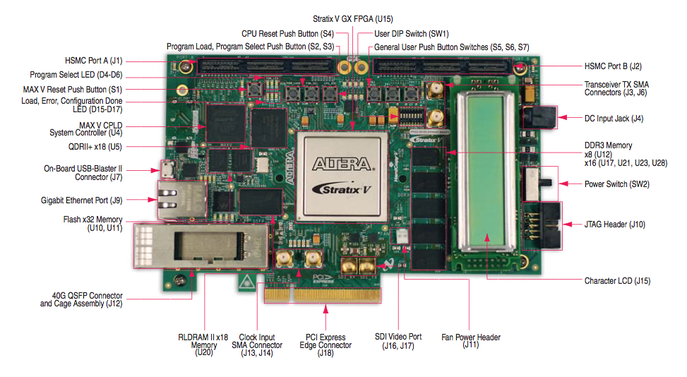
The PCIe-Gen3 DMA Test Setup
ALTERA evaluation board, Stratix V GX FPGA
The FPGA provides 8-lane PCIe-3 hard IP blocks and DMA engines.
GPU used to test 16-lane PCIe-3
data transfer between the device and the host memory
Notes:
You can see here pictures of the setup.
On the right the development board connected to the PC.
You can see also a GPU connected to the 16-lane PCIe slot since we used it to test the performance of the 16-lane data transfer moving data from the GPU to the host memory. The bandwidth scale as expected.

Slide 44
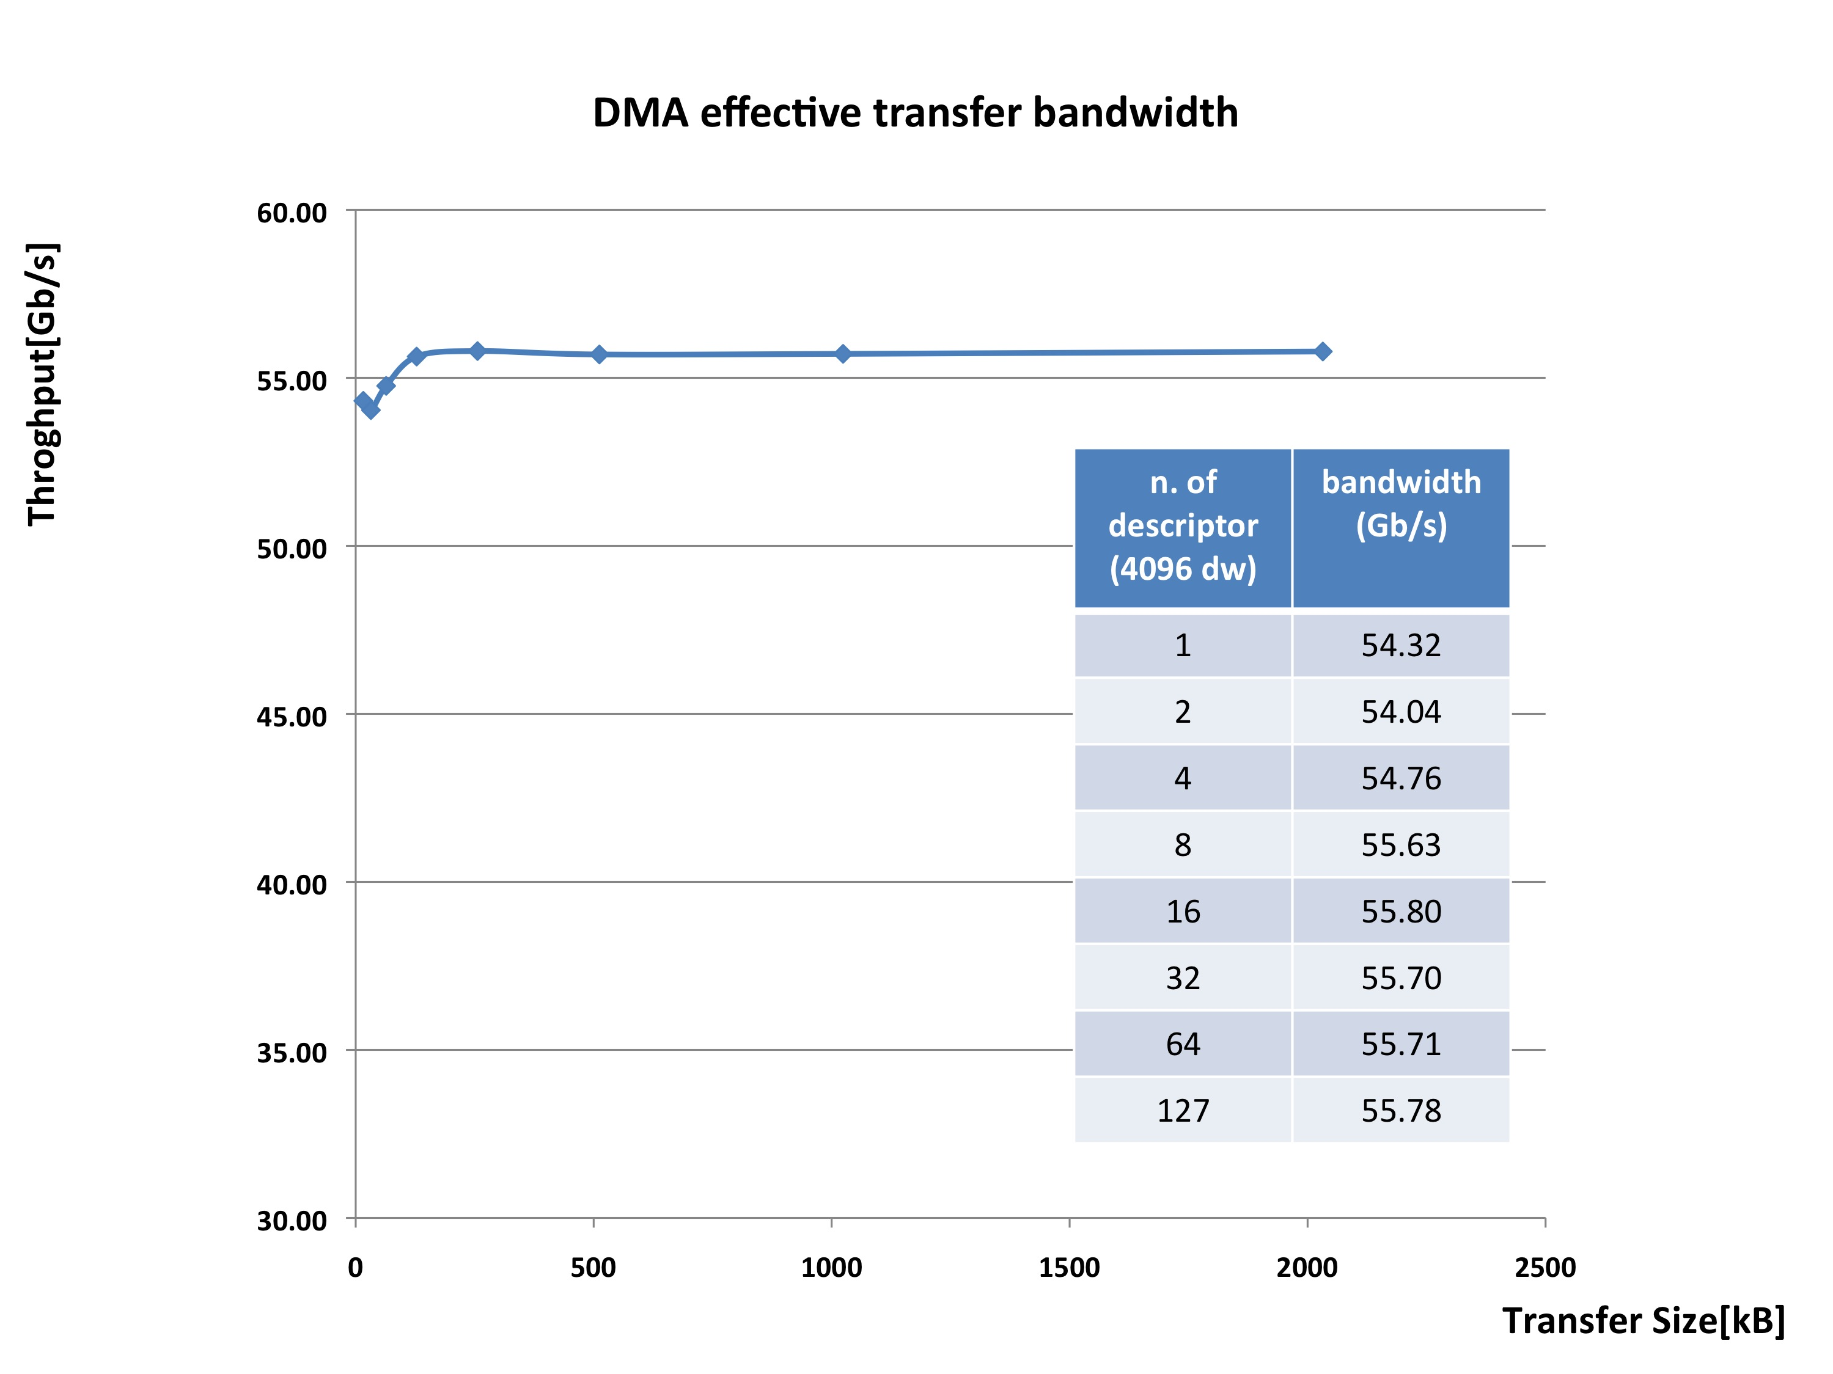
DMA PCIe-Gen3 Effective Bandwidth
DMA maximum transfer rate ~ 56 Gb/s
DMA over 8-lane PCIe-3 hard IP blocks
ALTERA Stratix V
Notes:
8 lane
Altera hard IP block
Teorica 64 Gb/s
Duty cycle DMA 88% = 56 Gb/s

