Slide 1
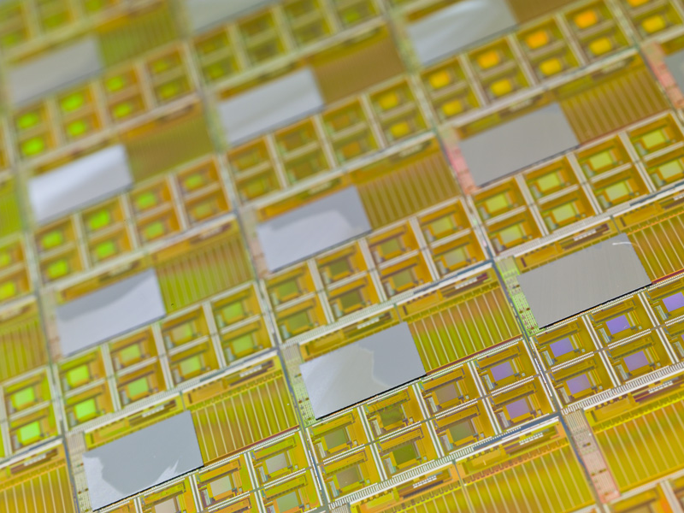
Trends in Silicon-Based Detectors
Ronald Lipton, Fermilab
Outline
Current Status and technologies
Sensor Technologies
Interconnect
Summary

Slide 2
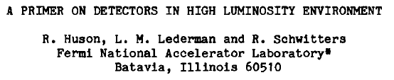


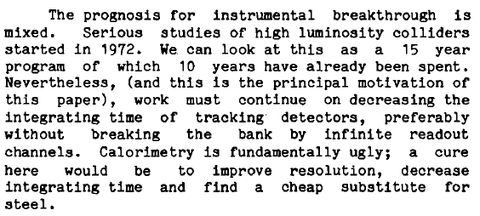
From Snowmass 1982
Or why you can’t do physics at 10³³

Slide 3
The Next Generation
The next generation of experiments require huge areas of complex silicon sensors and electronics ~ 200 m² each for the ATLAS and CMS trackers + 600 for CMS HGCAL
600 m² for the CMS HGC
For HL-LHC we would also like to tag arrival times of tracks and showers to the ~20 ps level to separate vertices of origin.
Larger areas
More complexity-track-based L1 triggers
Increased radiation hardness
Lower mass
…

Slide 4
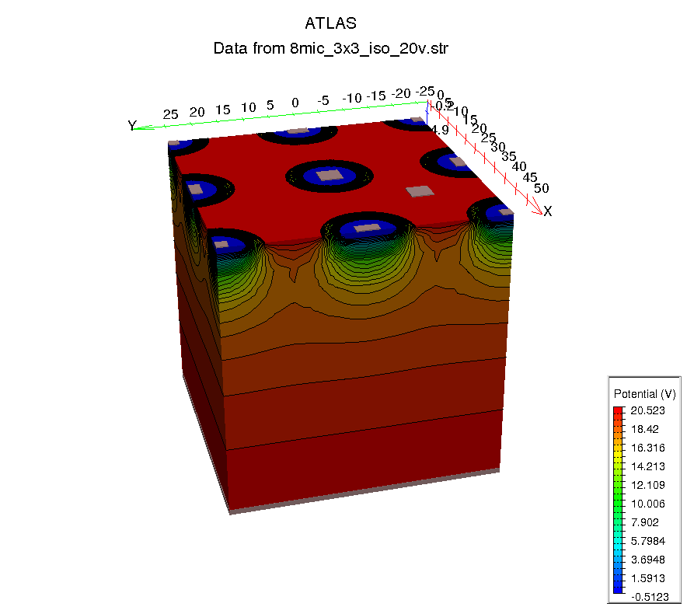
The Background
Particle Physics applications of silicon-based
detector systems have benefited enormously
from the tremendous R&D effort and
infrastructure associated with the
semiconductor industry, which is based on
obsolescence of your iphone every ~ two
years. We now have:
Access to IC foundries willing to
collaborate on innovative structures
Development of novel interconnect technologies for sensors and readout chips
Access to sophisticated TCAD simulation tools to design and simulate semiconductor systems
We can design and build systems that would have been far beyond our reach a few years ago
HEP often can act as a “first adopter” of these technologies – we are willing to take more risks than commercial ventures

Slide 5
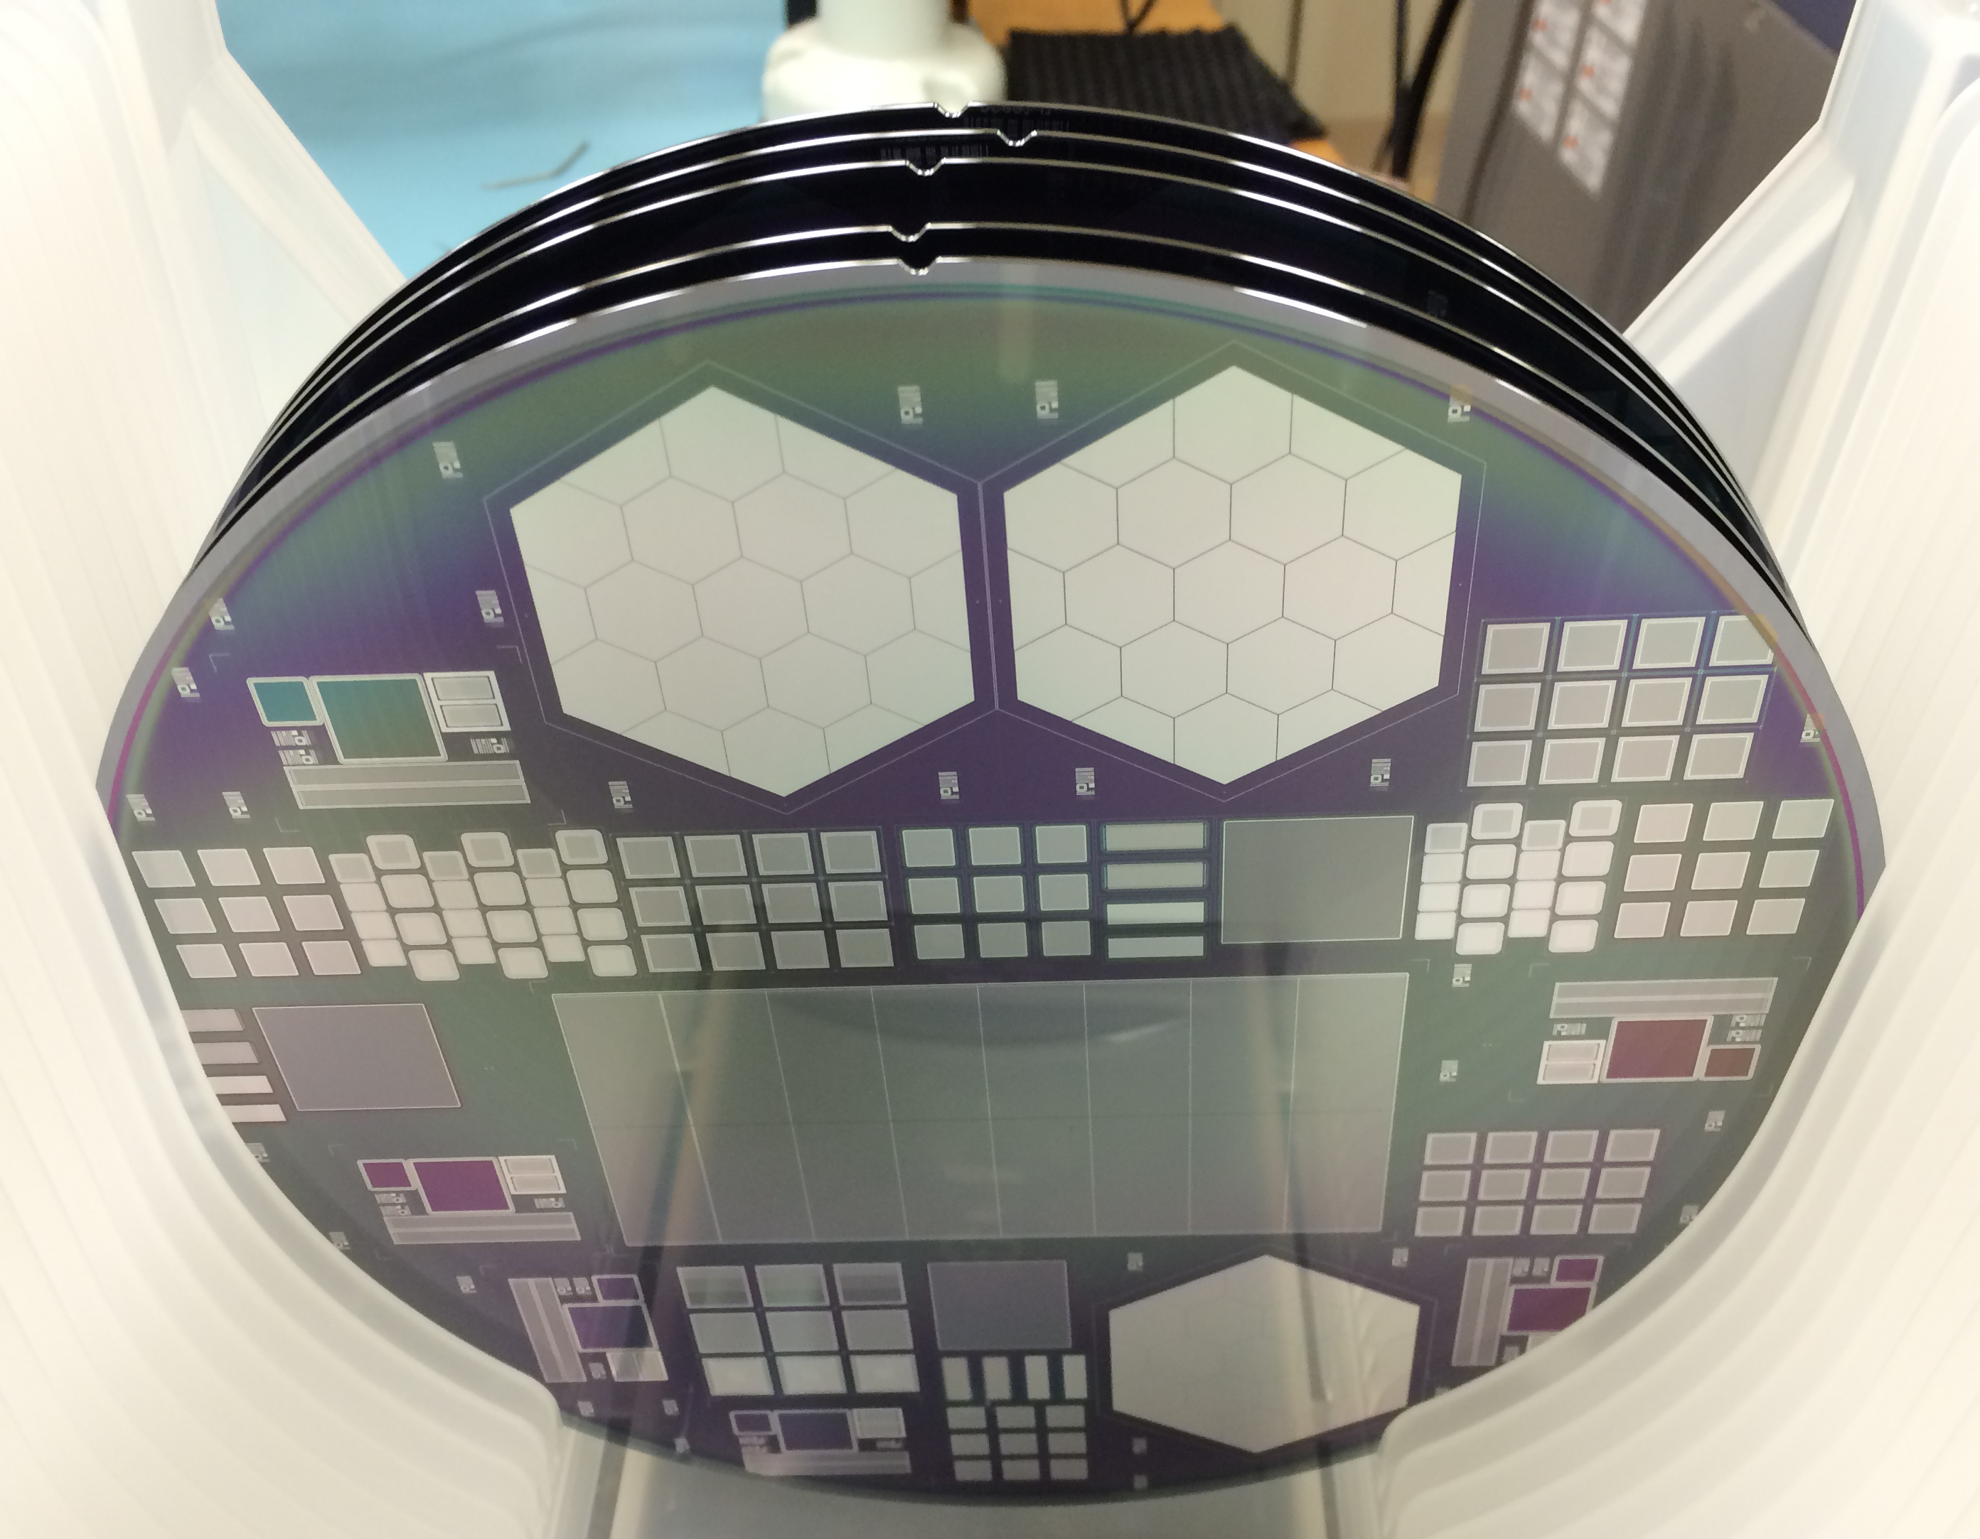
Costs, Areas, and Yields
We are interested in building large area silicon-
based trackers and calorimeters with fine pixel
pitch and low cost. We would like to integrate low
cost “simple” sensors with complex readout.
Cost of a CMOS silicon IC is about $3/cm² not including startup mask costs
  Area of an IC is limited to 2x3 cm² (or so) by the stepper reticule
  Yields of 80-95%
Cost of a silicon-based sensor is about $4-10 cm²
  Area of a sensor can be as large as the 6” or 8” wafer size using contact masks
  The structures are simple and the yield can be high
Fine pitch bump bonding of sensors to ROICs is expensive
To build large area devices:
Mate large die readout ICs with die sized sensors
  But there are edge effects that cause dead regions
Assemble an array of readout die on a large sensor - YIELD!

Slide 6
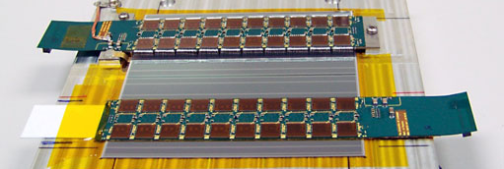
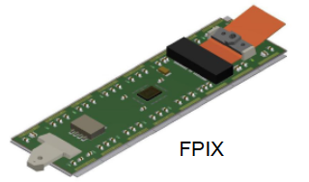
Current Technologies
Sensor wafers on 4” or 6” silicon
Readout chips with >65 nm feature size
(Industry is at 14 nm and shrinking)
Strip Modules ~10x10 cm (6” wafer), with readout
at the periphery, wirebond interconnect
  50 micron pitch
Pixel modules ~4x5 cm with bump bonded interconnect
  100 micron pixels
  4-6 ICs per module
First applications of 3D structures for radiation hardness (ATLAS IBL)
Avalanche devices for photodetection only
Radiation hardness achieved by:
  Deep submicron electronics
  Thin, oxygenated silicon
  Low temperature operation
ATLAS tracker module

Slide 7
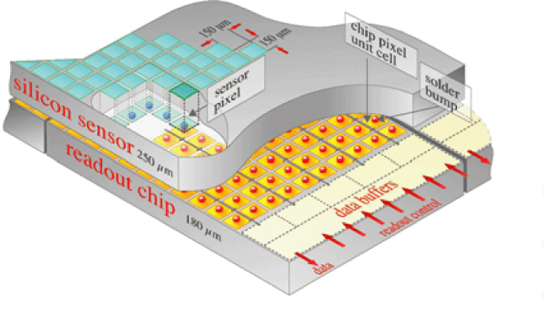
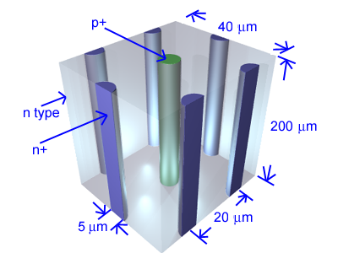
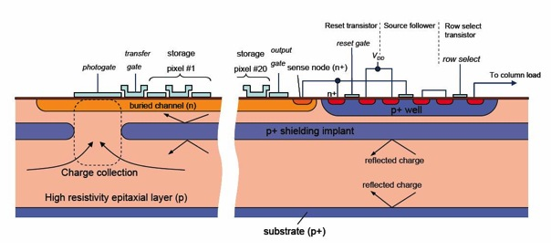
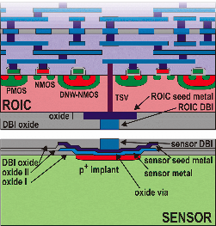
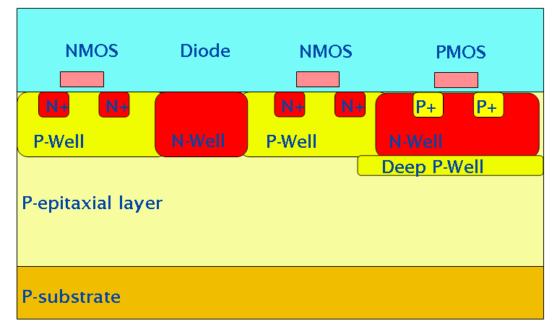
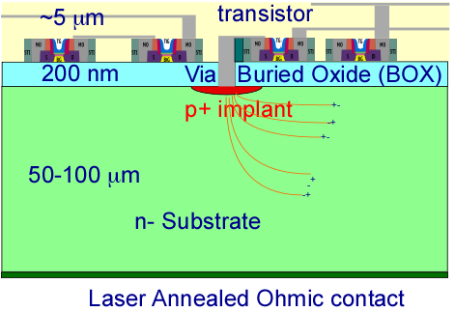
Sensor/Interconnect
Technologies
Hybrid
bonding
An embarrassment of options
3D sensors
CCD
(SLD)
source
top gate
drain
clear
bulk
3D
electronics
~1µm
p+
n+
p+
n+
n+
s
p
n
DEPFET
(Belle II)
i
x
internal gate
a
-
y
-
-
+
50 µm
-
r
-
t
-
e
m
m
+
y
-
s
-
n
-
+
+
-
p+
rear contact
CMOS MAPS
SOI

Slide 8
The Playing Field – thumb in the air plot
Hybrid
pixels
3D sensors
3D
electronics
Radiation
hardness
CMOS MAPS
SOI
DEPFET
CCDs
Cost/area

Slide 9
The Playing Field – thumb in the air plot II
3D
electronics
Integration
density
CMOS MAPS
Hybrid
pixels
SOI
3D sensors
DEPFET
CCDs
Cost/area

Slide 10
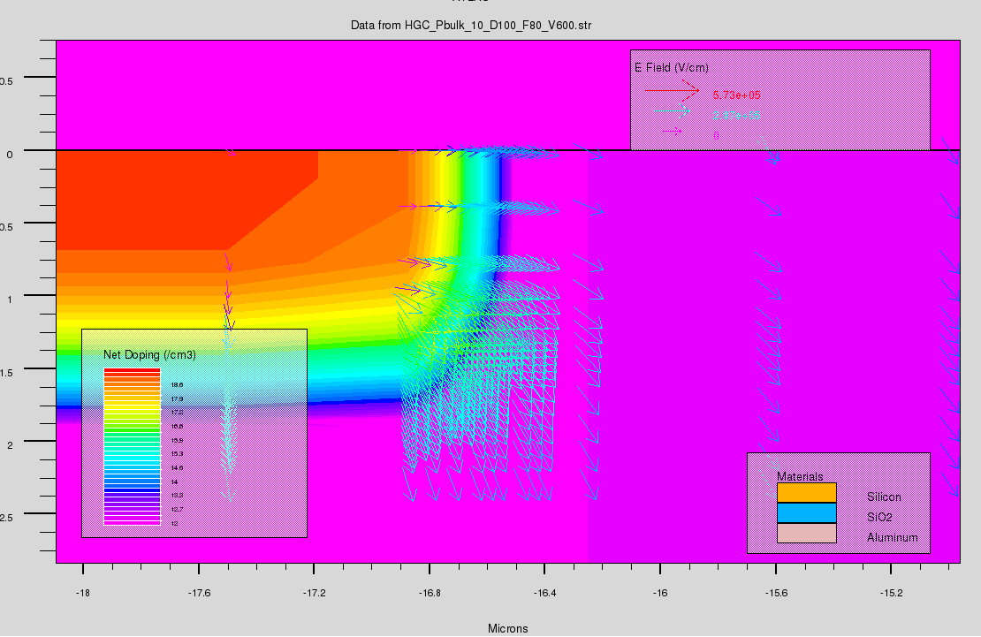
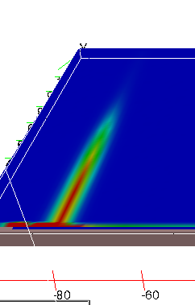
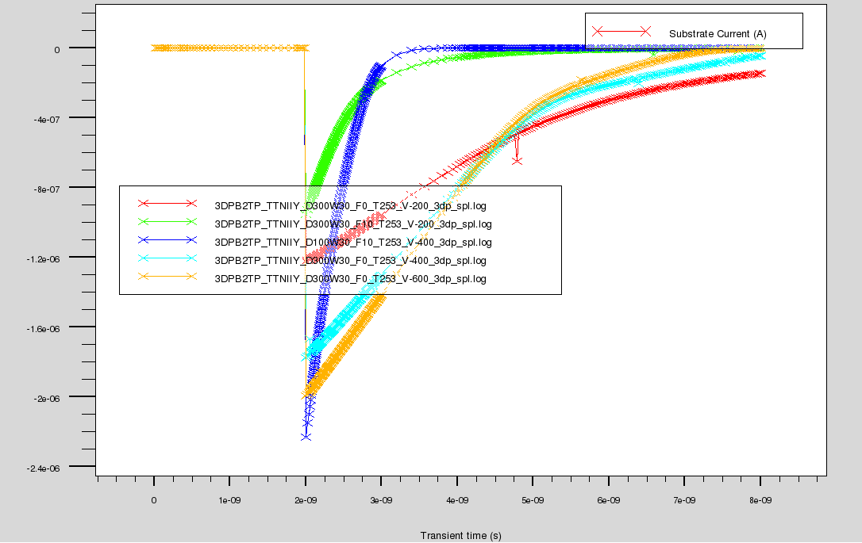
TCAD
E field near implant
Much of this work is enabled by the sophisticated TCAD software developed for the semiconductor industry
Simulate full process flow (implantation, annealing…)
Simulate internal fields and charge carriers
Developed simulations of radiation damage due to induced traps.
MIP
simulation
Current pulses for
Various fluences
And bias

Slide 11
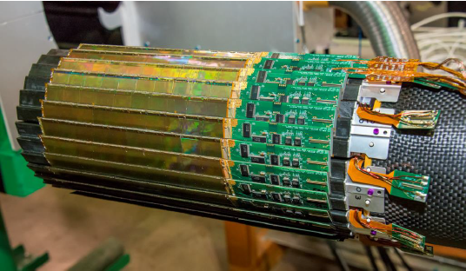
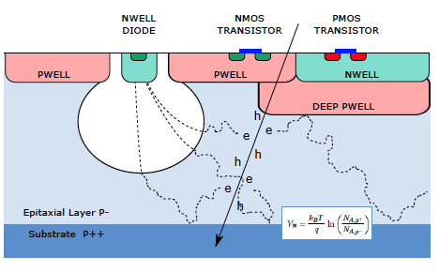
Monolithic Active Pixels (MAPS)
This technology is an outgrowth of the imaging industry- use a thin epitaxial high resistivity layer to collect charge from light exposure (or tracks).
Uses “standard” CMOS processes
Charge collection by diffusion (slow and rad soft)
Parasitic charge collection by PMOS structures – protect by p-well
Thin active layers
Susceptible to digital-analog coupling
due to thin layers – rolling shutter
Used in STAR at RHIC and ALICE upgrades. Moderate rates and radiation dose.
Problems can be addressed by adding a drift field to the structure…
STAR HFT
ALICE MAPS sensor

Slide 12
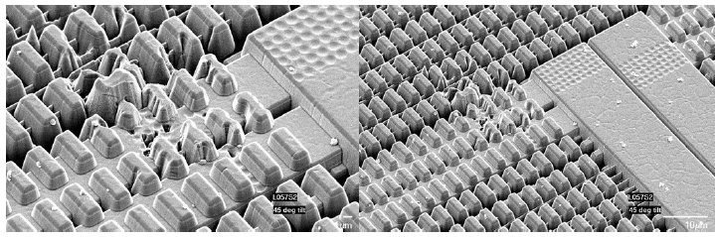
HRCMOS
High-Resistivity CMOS was developed for imaging applications (cell phone cameras). $10 Billion business. Features high-resistivity (1000 Ω cm ) thin epitaxial layers in a standard process.
Imaging needs only thin layers – low signal for MIPs
Building reticle sized sensors into large arrays with good yield requires R&D
STAR Heavy Flavor Tracker is the first deployment in an experiment
  Sensors thinned to 50 microns
  Air cooled
  Experienced latchup due to heavily ionizing particles…

Slide 13
HVCMOS
High resistivity substrates have become available with multi-well geometries in standard CMOS processes with HV transistors – HVCMOS
An extension of CMOS MAPS with larger charge collection volume, faster collection, more radiation hard
Ability to integrate amplification with sensor – take advantage of low detector capacitance
Transistors able to withstand ~100V
But
Depletion depth limited
Larger capacitance due to shallow wells?
Size limited by CMOS reticule
ATLAS looking at HVCMOS with a simple amp/disc to replace HR silicon material in strip detectors
[Peric]
“3D” connection
To ROIC wafer

Slide 14
Radiation Hardness
Radiation induces trapping centers in silicon
Collect charge quickly – high fields
Thin detectors thickness>trapping doesn’t help
Low temperatures “freezes” out traps
Radiation increases leakage current
Operate at low temperature
Extensive studies of “defect engineering” in RD 50
Very complex pathology of traps and defects
Oxygenation helps for pions not neutrons.

Slide 15
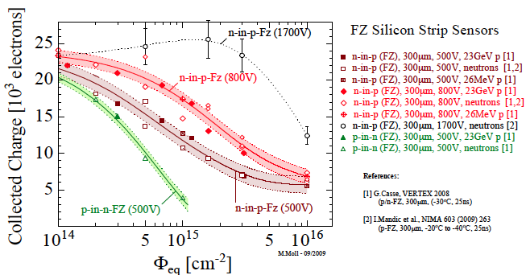
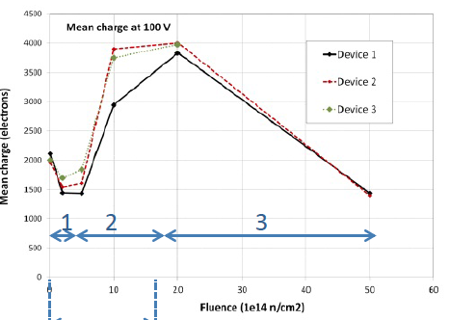
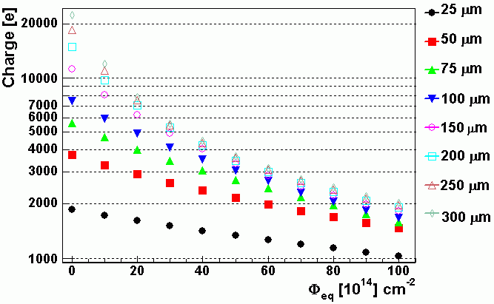
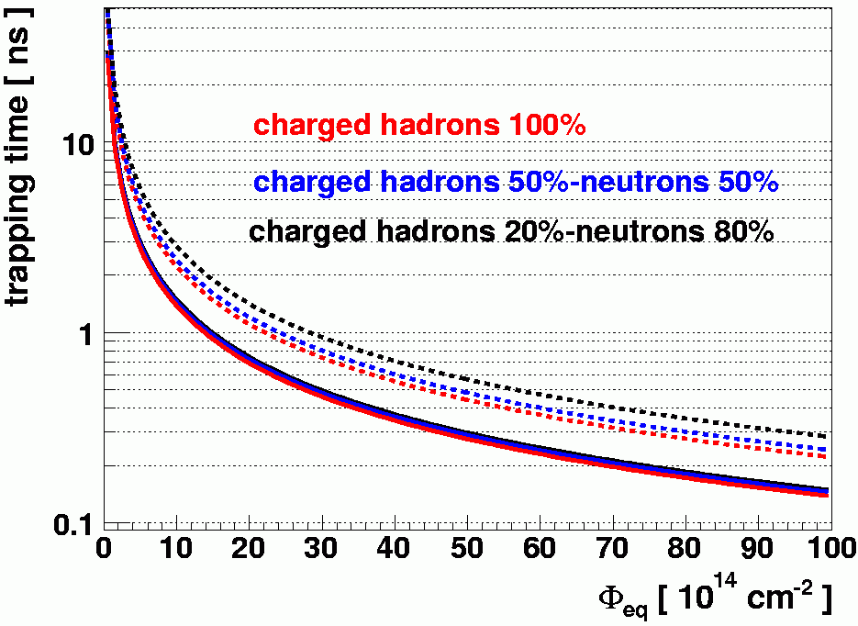
Radiation Hardness
10¹⁵ n/cm²
LGAD Charge coll. vs Fluence
Planar silicon ~ 300 micron
Trapping time vs Fluence
Collected charge vs
Fluence
extrapolated values
electrons
holes

Slide 16
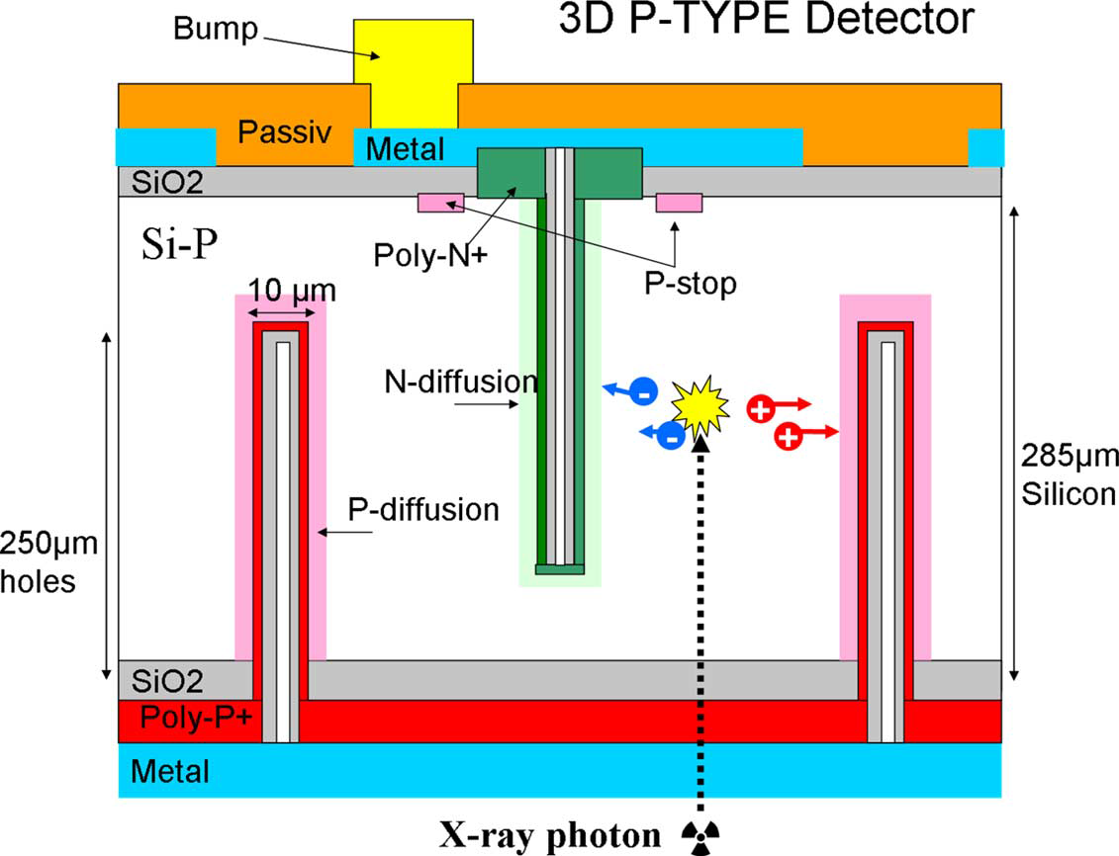
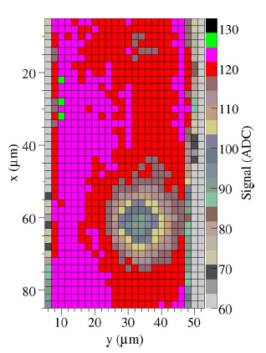
3D Silicon Detectors
3D detectors utilize technologies developed for MEMS, high aspect ratio deep reactive ion etching, to generate electrodes in bulk material rather than on the surface. This reduces the effective drift distance, increasing radiation hardness, while maintaining the full signal.
Increases collecting fields
Shortens collection time
Reduces effect of trapping
Relatively high capacitance
Complex fabrication – high cost
Used in outer IBL sensors. This technology can also be used to fabricate active edge sensors

Slide 17
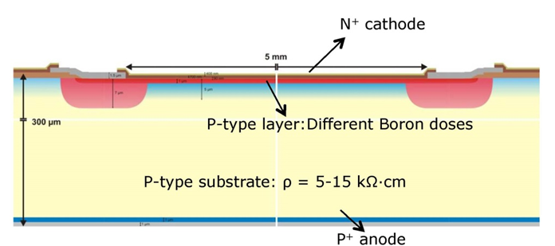
Avalanche-based, “Ultra Fast” Detectors
Time resolution can be parameterized as
Silicon rise time is usually limited by drift velocity(<10⁷ cm/sec) and sensor thickness. This can provide resolution on the 100’s of ps level.
This can be improved by using an avalanche diode, that provides a large signal and fast rise time.
Resolution must be demonstrated
Cost effective production of large areas
Large levels of dark current
Benefits from LIDAR R&D. Challenges in power dissipation in fast amps
[Sadrozinski]

Slide 18
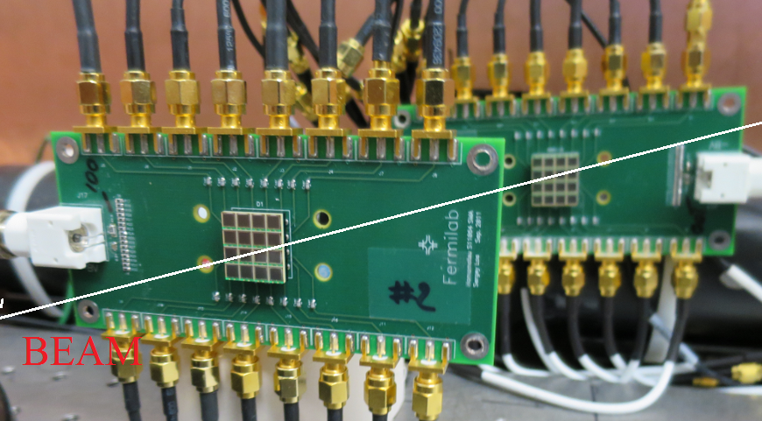
SiPM Based fast tracking
SiPMs are arrays of geiger mode avalanche diodes connected by bias and summing network
  Low interconnect capacitance
  Excellent multi-photon resolution and quantum efficiency
  Sensitive to MIPs?
[Ronzhin]

Slide 19
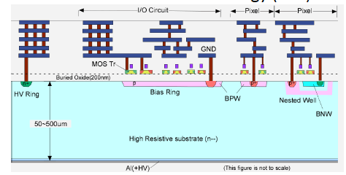
Others
DEPFET (MPI – Belle II)
  Charge collected under
  DEPFET gate.
  Low noise, moderate
  speed, not very rad hard
SOI
  Sensor in the handle wafer in an SOI stack
  “Backgate Effect” field in bulk effects transistor operation
  Radiation-induced charge in oxide affect transistors in top
CCD
  Variants proposed for ILC vertex

Slide 20

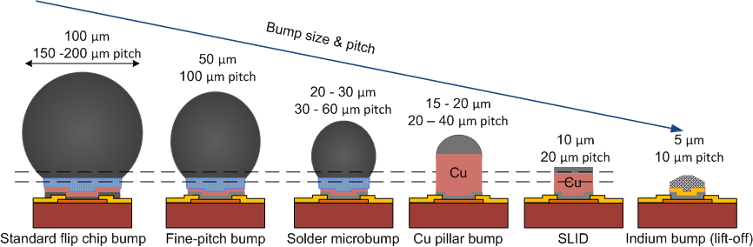
Interconnect Technologies
Continuous advance in technology – lower cost and finer pitch
Solder and indium bumps
Copper pillars
DBI oxide bonding
Bump bonding (Google search)
2 μm
4 μm pitch
DBI
[Vaehanen]

Slide 21
Hybrid Bonding

Slide 22
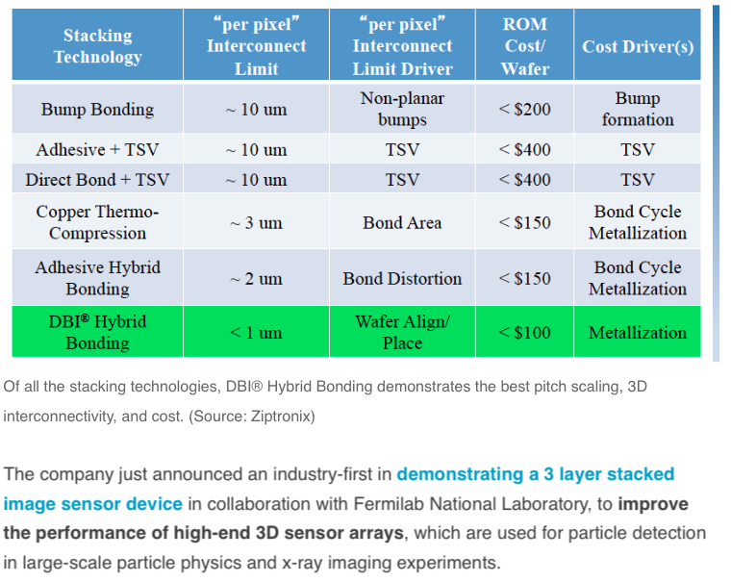
Future Costs (Ziptronix)

Slide 23
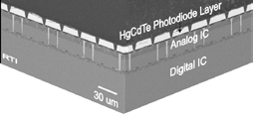
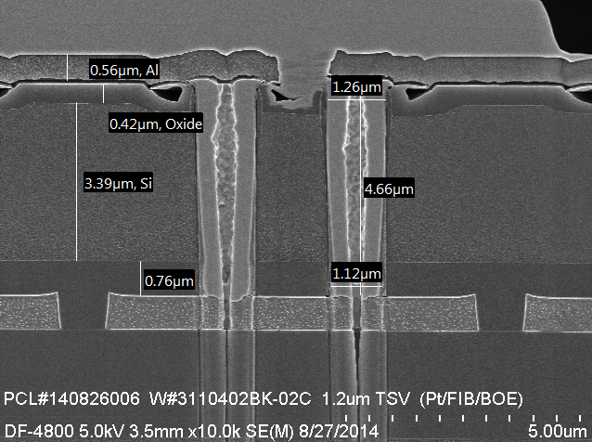
3D Integrated Circuit Technologies
A chip (structure) in three dimensional integrated circuit (3D-IC) technology is composed of two or more layers of active electronic components, integrated both vertically and horizontally by wafer bonding, thinning, and insertion of through silicon vias (TSV)
For the past decade Fermilab has worked with vendors to demonstrate and develop these technologies.
TSV
RTI Inc DARPA demonstrator
FNAL/Tezzaron
Demonstration
TSVs

Slide 24

3D can solve all your ills!
Low cost, very fine pitch bonding
Much better power distribution and
connectivity
Radiation hard, thin sensors and
readout
Complex electronics without expensive
process nodes
Separation of analog and digital –
lower thresholds
Lower interconnect capacitance and
power
Tiled, large area devices
But we are dependent on commercial, large volume development

Slide 25
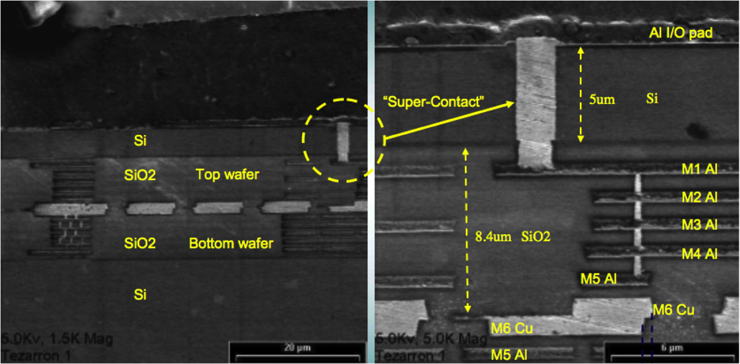
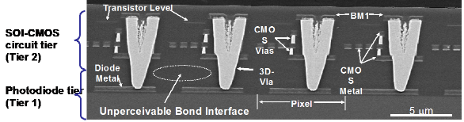
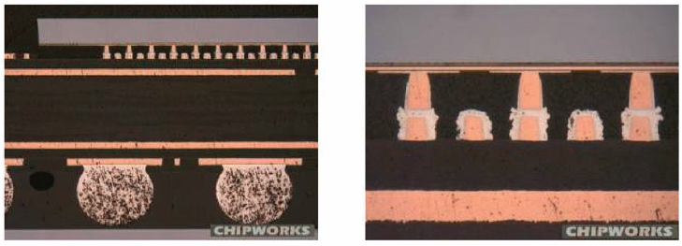
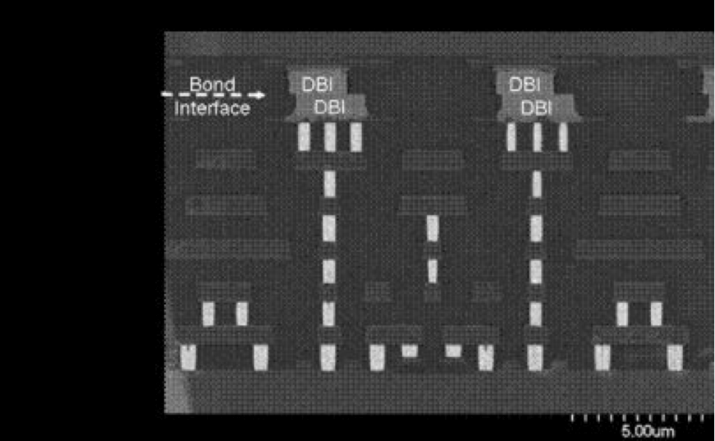
3D Interconnect Examples
Copper bonded two-tier IC
(Tezzaron)
Technology based on:
Bonding between layers
  Copper/copper
  Oxide to oxide fusion
  Copper/tin bonding
  Polymer/adhesive bonding
  Cu stud
Through wafer via formation and
metalization
8 micron pitch, 50 micron thick oxide bonded imager (Lincoln Labs)
Cross-section of the TI XAM3715, a 45nm applications processor mounted on a BGA substrate
8 micron pitch DBI (oxide-metal) bonded
PIN imager (Ziptronix)

Slide 26
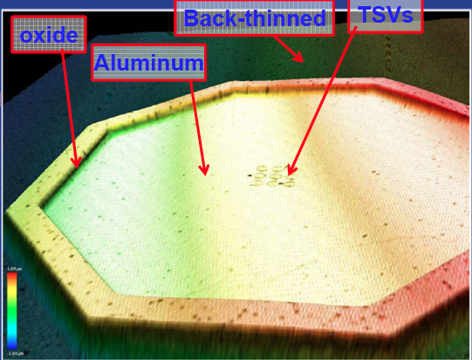
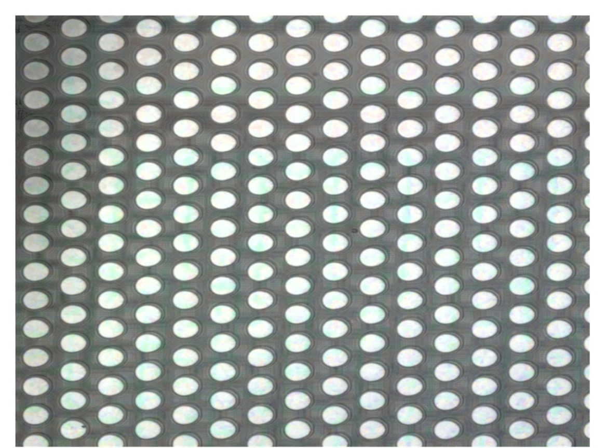
Sensor Oxide Bonding
A promising fine pitch bonding technology
the direct bond interconnect (DBI)
oxide bond process from Ziptronix
  No bump bonds – planar resulting wafer
  Very fine pitch - 4 microns used for
  3D Tezzaron wafers
  Mechanical strength enables
  aggressive post-bond thinning
  Uses standard IC processes - CMP and
  metalization
  Can withstand high temperatures
Wafer-wafer bond can be reworkable
In principal can be low cost
4 micron pitch

Slide 27
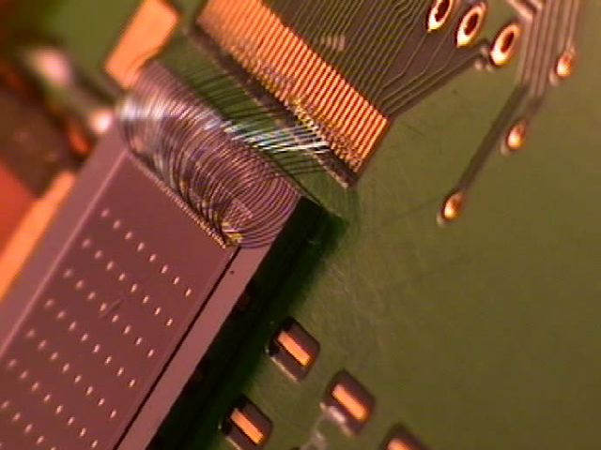
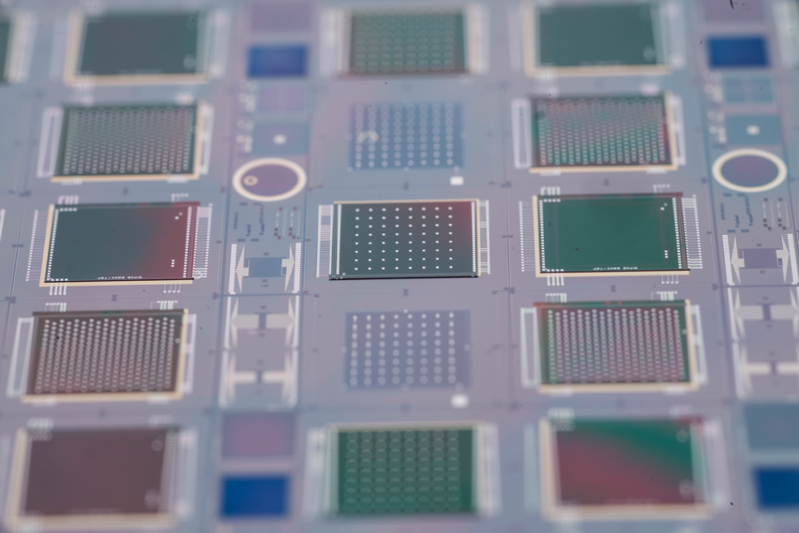
3D Demonstration Project
A working 3D process was demonstrated in a FNAL/BNL 3-layer (2 readout + 1 sensor) 3D wafer with chips for ILC, CMS and X-ray imaging (VIPIC) in collaboration with Tezzaron and Ziptronix.
Test board
.5 mm sensor
VICTR
VIP
34 micron high 2-tier VICTR chip
VIPIC
Wafer before dicing

Slide 28
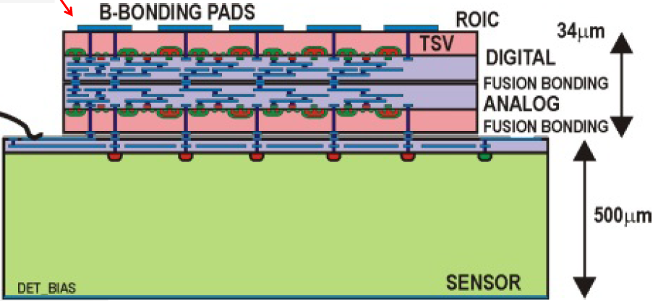
Sensor Integration –Three tier devices
We then chip-to-wafer oxide (DBI) bonded 3D chips to BNL sensors to form three-tier integrated sensor/electronics assemblies
  VIP(ILC), VICTR(CMS), and VIPIC(X-Ray) assemblies
Wafer-wafer bond
Chip-wafer bond
3
2
1

Slide 29
VIP
VICTR
VIP
VIPIC
VIPIC
Next step is tiling these into dense arrays

Slide 30
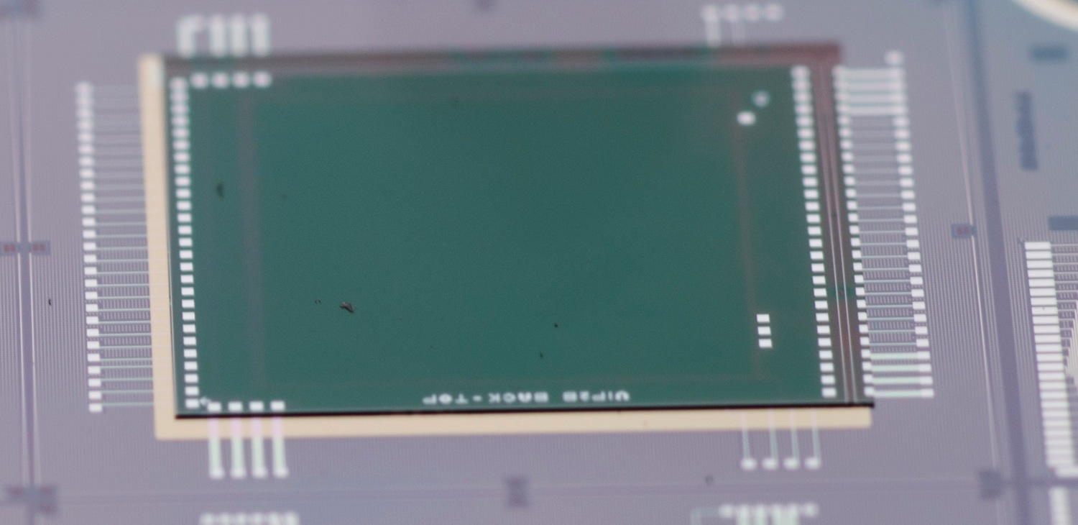
VIP
2-tier VIP chip
24 micron pitch pixels
192x192
34 μ
sensor

Slide 31
Some Results
For the VIPIC x-ray imaging chip we were able to compare noise of the oxide-bonded pixels to the same chip with bump bonds.
The noise in the oxide bonded pixels is almost a factor of two lower than the conventionally bump bonded parts due to lower capacitance.

Slide 32
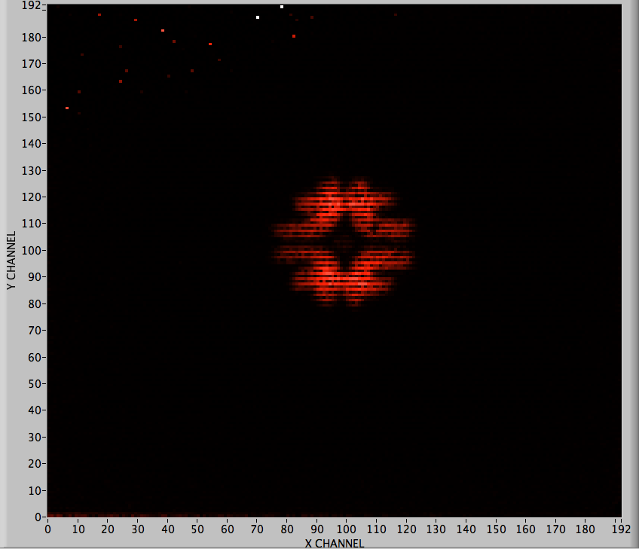
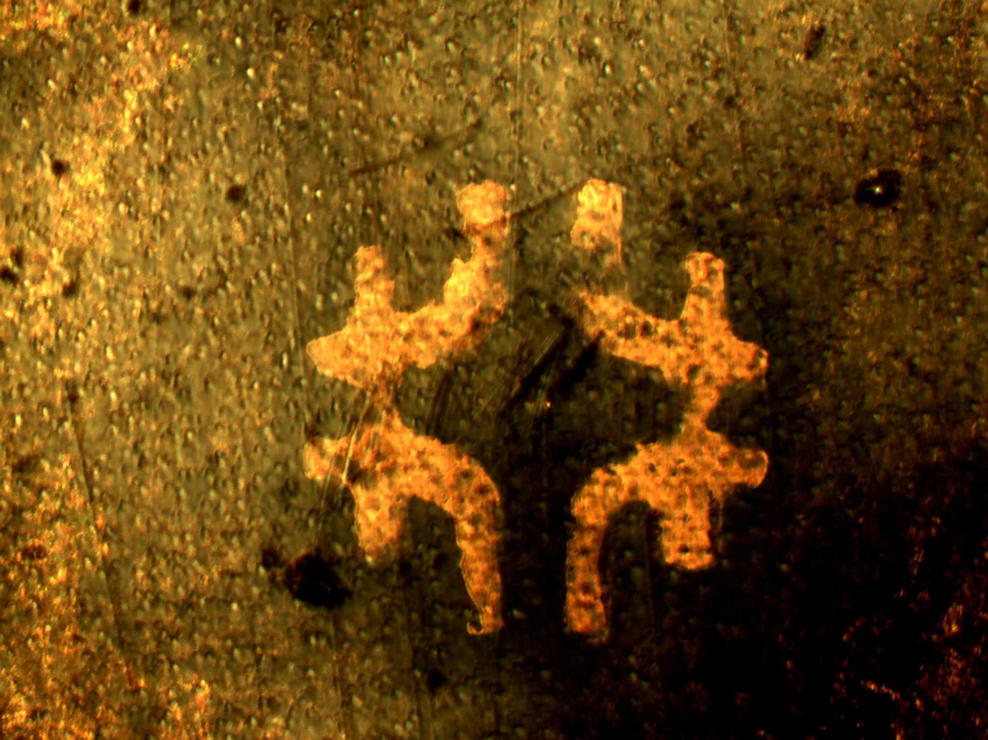

More 3D Results
400x400 μm
mask
VIP – 24m pixels,
Time stamp, ADC
CD109 radiogram of tungsten mask
Ru¹⁰⁹ beta track

Slide 33
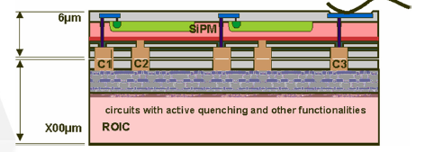
Other possible appliction - 3D SiPM
3D Integrate the SiPM with active quenching and digital readout
  Micropixel resolution, turn off noisy pixels
  Lower capacitance -> faster
  Active quenching -> Faster, less afterpulsing
  High fill factor
  Digital readout of a digital device…

Slide 34
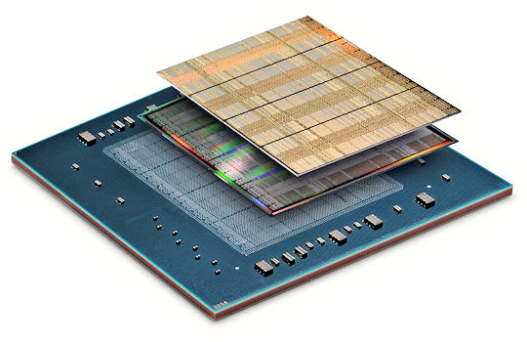
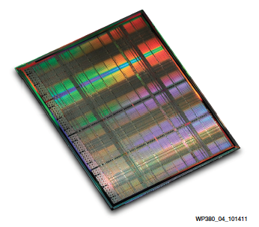
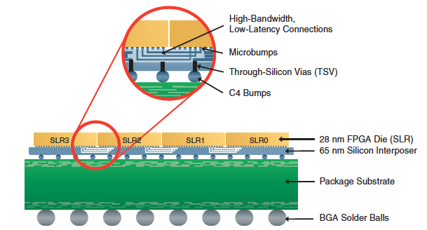
2.5D Assemblies
The commercial world is moving toward “2.5D” assemblies, using TSVs in a silicon or glass interposer
Higher speed assemblies, with much finer pitch (20x) than conventional PCBs.
Initial use on FPGAs
Xylinx ultra scale FPGA
Silicon
interposer

Slide 35
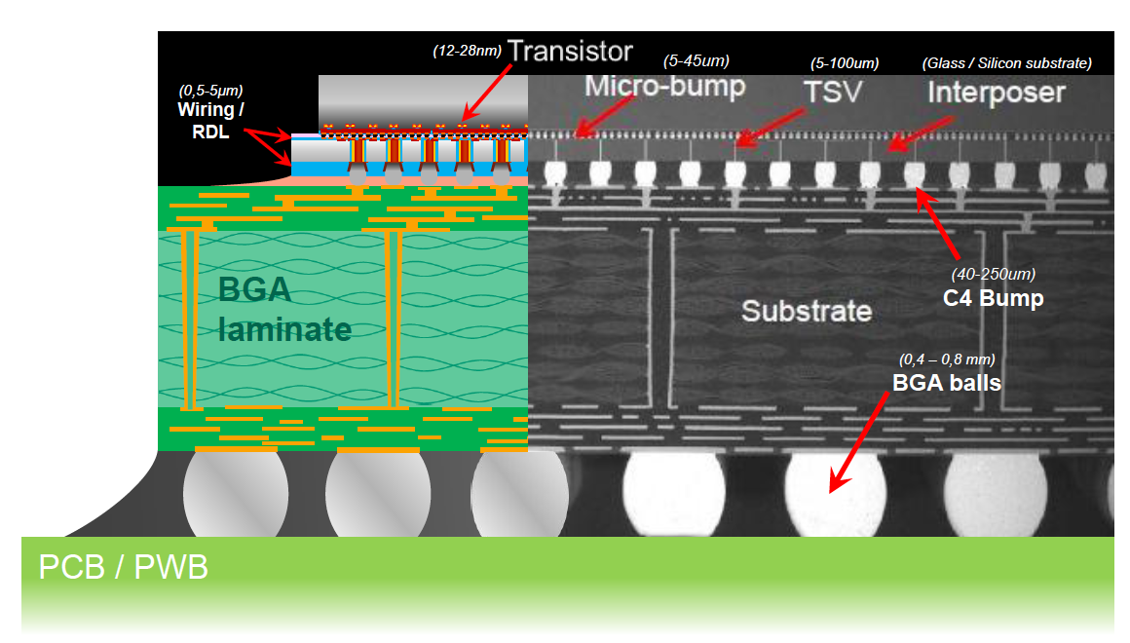
2.5D Interconnect Scales

Slide 36
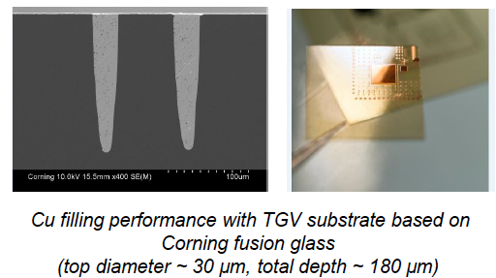
Interposer based assemblies for tracking
Interposers can be used as pitch adapters to mate large area silicon sensors to readout ICs
Glass-based interposers have
low dielectric constant and can
be fabricated in large panels.
Lithography similar to silicon.
Can achieve 20 micron diameter
>10:1 aspect ratio
Fermilab design for FASTPAX
X-ray imager

Slide 37


2.5/3D for large area devices
Large area complex, pixelated tiled arrays.

Slide 38
Summary
Silicon technologies for HEP offer opportunities for larger, faster, cheaper, more precise systems for trackers and calorimeters.
Complementary in many ways to GMPD – more precise and rad hard, but the natural size (cm) is much small and devices are much more expensive.
Silicon-based fast tracker/time tagger systems could select vertices at HL-LHC to a few mm
CMOS maps can provide cheaper, more precise Si trackers
New forms of wafer-level interconnect can provide dense integration of sensors and readout with low mass
Large arrays of smart, tiled sensors

Slide 39


“Killer” Applications
In Physics
Large area tracking and imaging arrays with intelligent pixels and without dead regions (VIPIC-L, active edge integration)
3D associative memories for high speed correlations between detector layers
Commercial Thrusts
Complex FPGA systems (now)
Eventually - Integrated system processor/memory/IO on a heterogeneous die
Each 3D layer
processes
a detector
layer
Xilinx Virtex-7 H580T 3D FPGA
IBM/Cornell/UCSB Study – vision of 10Tflop 3D chip

Slide 40
Extras

Slide 41

The Tracking Detector Commandments
Thou shalt minimize mass
Thou shalt have high
digital bandwidth
Thou shalt be radiation hard
Thou shalt not dissipate power
Thou shalt have complex functionality
Thou shalt maximize position resolution (minimize pitch)
Thou shalt minimize dead regions
Thou not covet thy neighbors signals
Thou shalt be affordable
Thou shalt have fast analog signal processing (396 ns -> 25ns -> 1-2 ns -> 100 ps)
Obeying these “commandments” force us to push the technological and engineering envelope

Slide 42


Chip-to-Wafer bond
DBI bonding of ROICs (VICTR,
VIPIC, VIP) to BNL sensor wafer
Wafer-wafer
3D Bond
DBI bonded
chips
6” sensor wafer
Expose TSVs, pattern Top aluminum
Dice
Oxide bond
Handle wafer
DBI bond ROIC chips to sensor wafer (RT pick+Place)
Expose sensor side TSVs, pattern DBI structures
Grind and etch to expose top connections

Slide 43

Commercial Bonding Costs and Yields (old)
<$1/cm²?
Current and projected costs and yields for sensor/readout integration technologies

Slide 44

Glass interposers

Slide 45



Silicon-based Tracking
D0 Layer 0
Building these devices is essentially an electronics packaging problem, an unusual one…
With billions of channels, 100’s m² surface area
With tbyte/sec bandwidth
Cooled to -20 deg C
With minimal mass
Arranged to give us the information we need to do physics
Given the microscopic scale of the elements, the problems of sensors, readout, and interconnect are inexorably linked.
Analog cable
Flex foldover

Slide 46

a

Slide 47
Hierarchy of interconnect
Cables ~ mm
PC Board ~ 500 micron
  Bump/wire bonds ~ 100’s of micron
    C4 bumps ~ 100 micron
      Micro-bumps ~ 10-20 micron
        3D Interconnect ~ 2-5 micron

