Slide 1


status of FCC-hh/FCC-ee machine studies
M. Benedikt, D. Schulte, F. Zimmermann
gratefully acknowledging input from FCC global design study team
Pisa, 3 February 2015

Slide 2
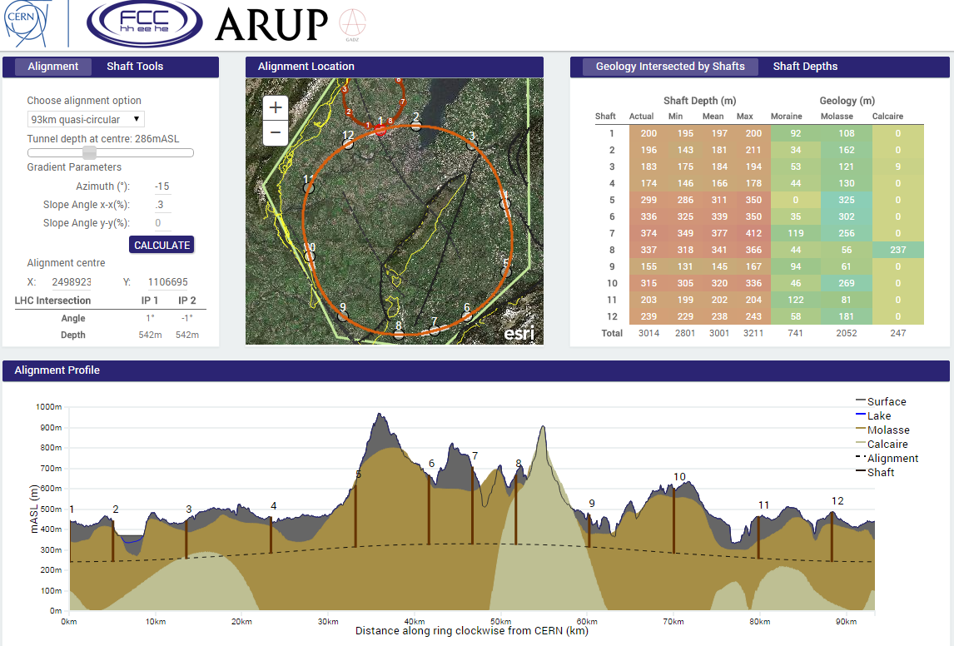
Tunnel Optimisation Tool (TOT)
(4) Information about the shafts is also given including their depth, the geology intersected by each shaft and the total shaft depth for a tunnel alignment
(1) All tunnel shapes and sizes that have been studied are stored in TOT
(2) The location, depth, rotation and slope can be changed for a particular tunnel shape and circumference
(3) As the tunnel is moved around, the alignment profile shows a basic projection of the geology intersected along the circumference of the tunnel
J. Osborne

Slide 3
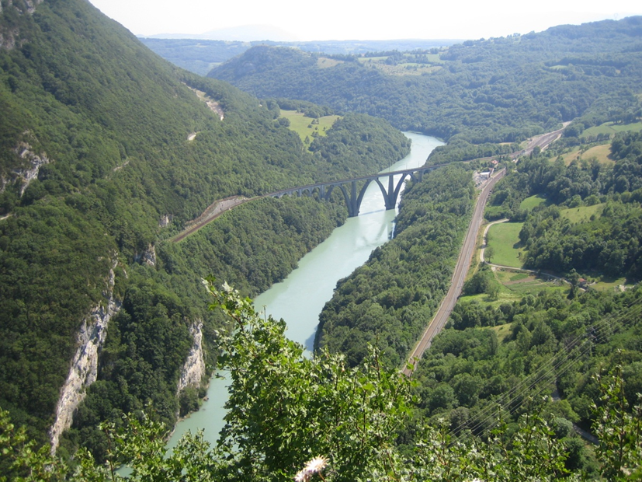
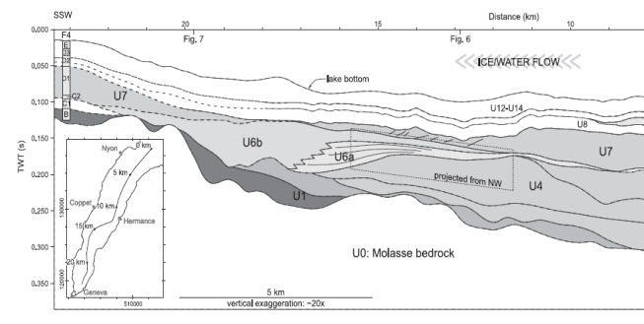

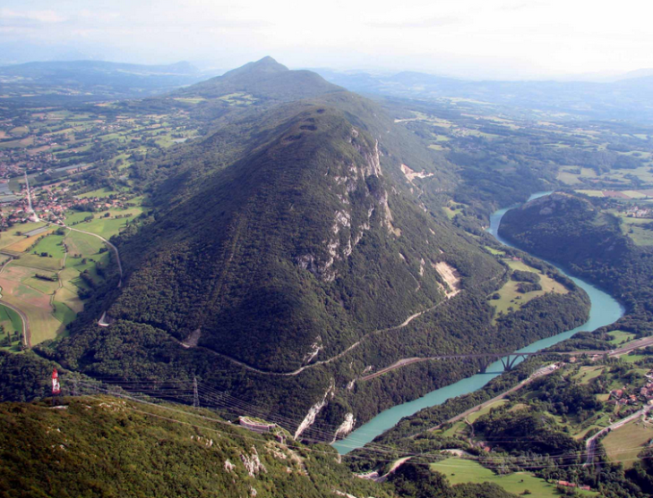
input into the tool : some critical areas
Rhone leaving the Geneva Basin
Depth under lake Geneva
(in molasse or moraines)
J. Osborne
Avoid Vuache faulting

Slide 4

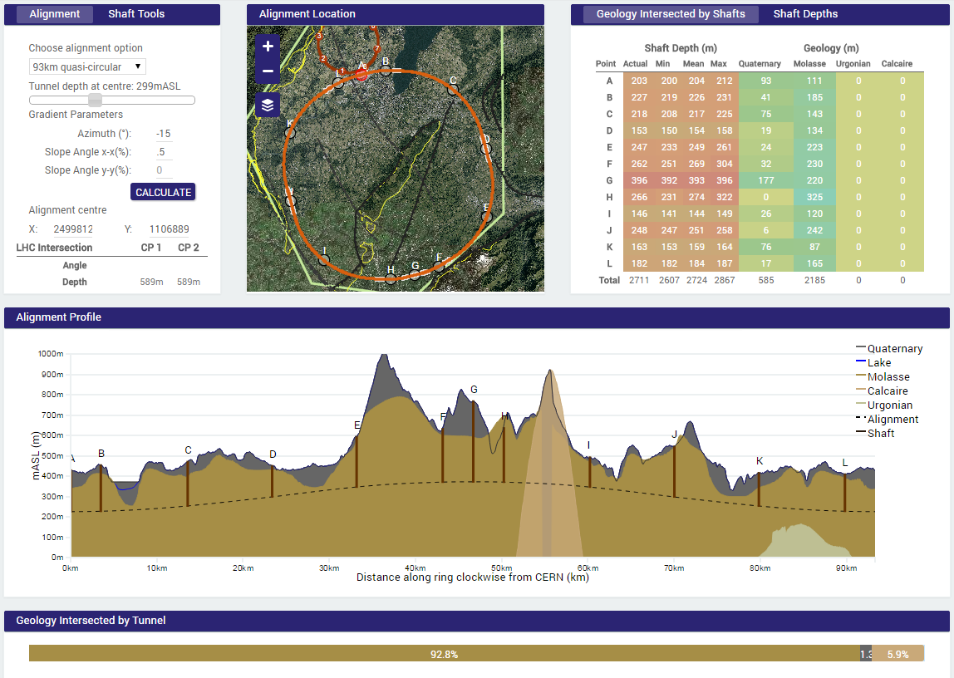
geological tunnel optimization tool,
example: site study 93 km
PRELIMINARY
Preliminary conclusions:
93 km fits geological situation really well, better than a smaller ring size.
100 km tunnel seems also well compatible with geological considerations.
The LHC could be used as an injector
J. Osborne & C. Cook

Slide 5
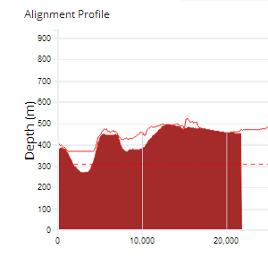
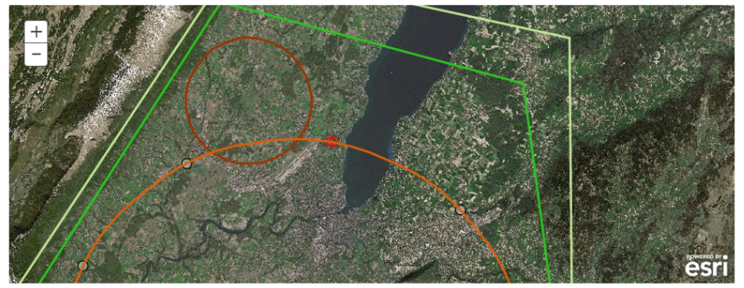
Lake Crossing: Tunnelling Considerations
Superficial sediments
Immersed Tube Tunnel
Moraine
Slurry TBM
Molasse
Open Shield
John Osborne (CERN-GS)

Slide 6
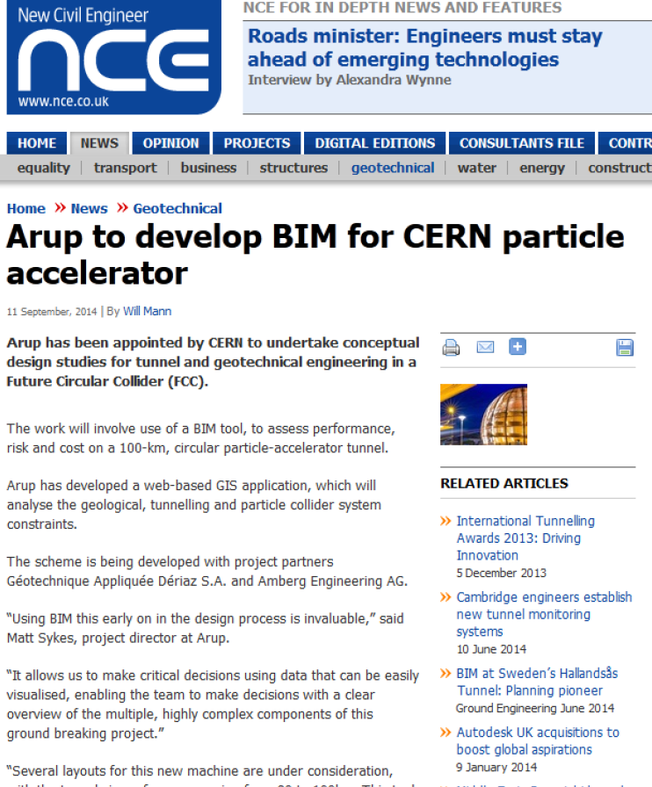
Tunnel Optimization Tool (TOT) in the news
J. Osborne
Arup News
Original news story on our website is here:
http://www.arup.com/News/2014_09_September/09_Sept_Arup_Arup_develops_BIM_tool_for_future_particle_accelerator)
NCE (Online and Print)
http://www.nce.co.uk/news/geotechnical/arup-to-develop-bim-for-cern-particle-accelerator/8669570.article
Construction Manager
http://www.construction-manager.co.uk/news/particle-physicists-and-engineers-build-bim-model-/
The Construction Index
http://www.theconstructionindex.co.uk/news/view/arup-develops-bim-tool-for-next-gen-cern-accelerator
Tunnels and Tunnelling:
http://www.tunnelsonline.info/news/arup-appointed-for-collider-tunnel-design-studies-4380226
BIM Crunch
http://www.bimcrunch.com/index.php/component/k2/item/1231-arup-developing-bim-tool-for-concept-design-of-future-particle-accelerator
WN.com
http://article.wn.com/view/2014/09/09/Arup_develops_BIM_tool_for_future_particle_accelerator_at_CE/
Construction Shows
http://www.constructionshows.com/new-building-information-tool-developed-arup-cutting-edge-project/1512656
Global Construction Review
http://www.globalconreview.com/news/arup-chosen-engineer-europes-100km-particle-accele/
In addition to these it will also be featured in:
UK Government’s BIM Task Force Newsletter (to be published)
The Structural Engineer Magazine (flagship publication for The Institution of Structural Engineers)
NON-CONSTRUCTION INDUSTRY PRESS
The Huffington Post
http://www.huffingtonpost.co.uk/2014/09/22/cern-particle-accelerator_n_5860116.html?utm_hp_ref=uk&ir=UK
Gizmodo UK
http://www.gizmodo.co.uk/2014/09/what-it-takes-to-build-the-largest-particle-collider-ever-made/
Interest from ILC Japan for a similar tool
Tool Application will be presented at IPAC15

Slide 7
Preliminary layout FCC-hh

Slide 8
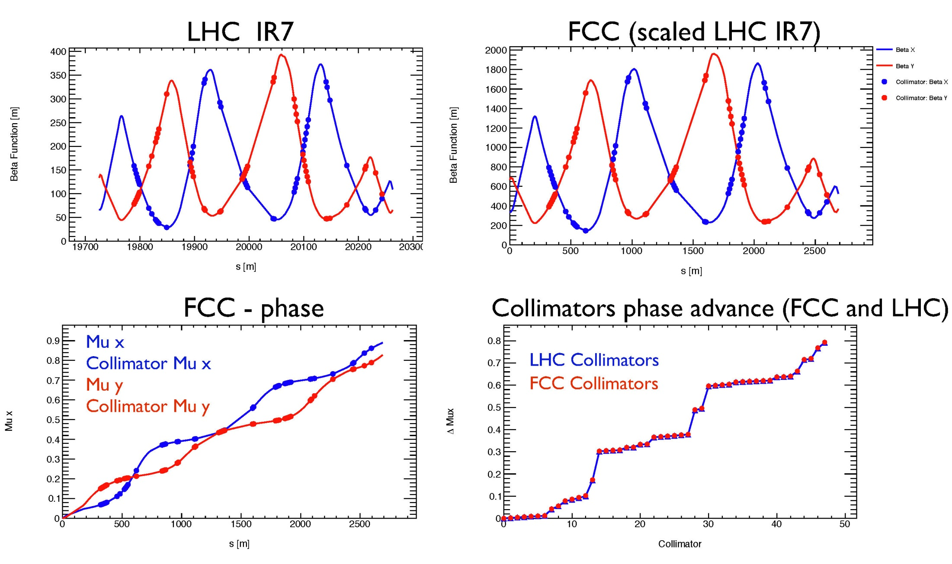
collimation optics
M. Fiascaris
S. Redaelli
scaling from LHC: same half gaps & same phase advances

Slide 9
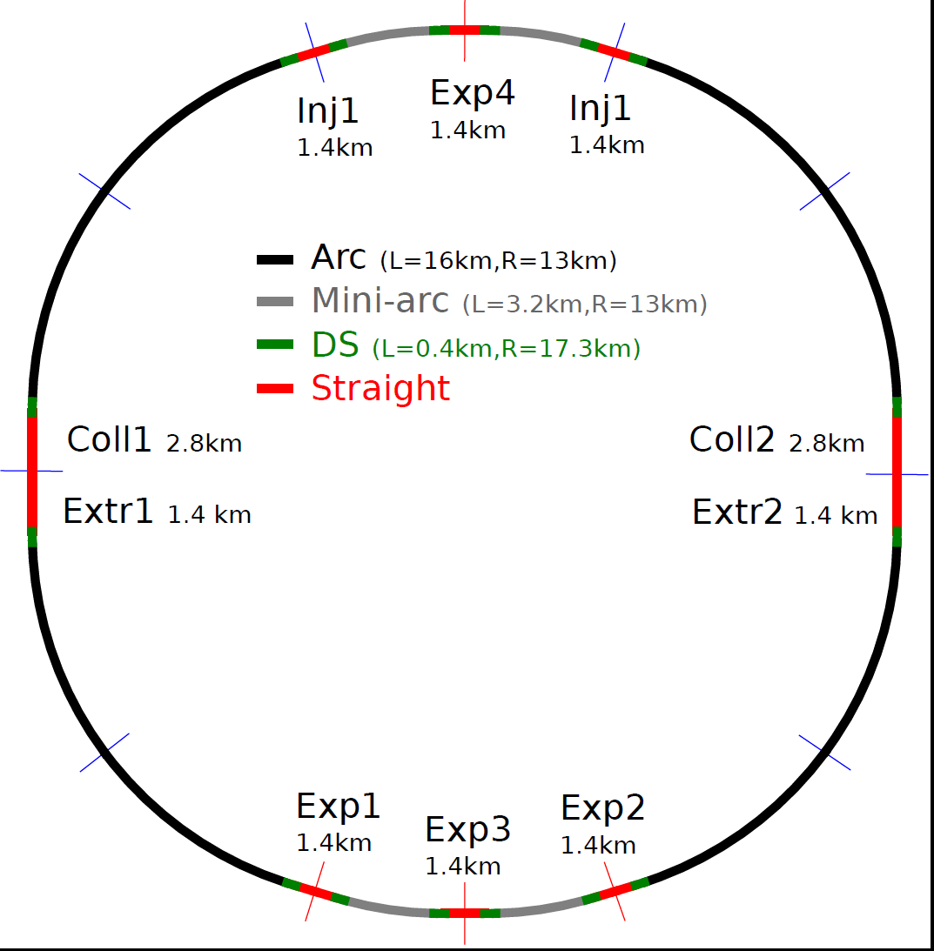
Preliminary layout FCC-ee
INJ + RF
EXP + RF
INJ + RF
RF?
RF?
COLL + EXTR + RF
COLL + EXTR + RF
RF?
RF?
EXP + RF
EXP + RF
EXP + RF

Slide 10
parameter | LHC | HL-LHC | FCC-hh
c.m. energy [TeV] | 14 |  | 100
dipole magnet field [T] | 8.33 |  | 16 (20)
circumference [km] | 26.7 |  | 100 (83)
luminosity [10³⁴ cm⁻²s⁻¹] | 1 | 5 | 5 [→20?]
bunch spacing [ns] | 25 |  | 25 {5}
events / bunch crossing | 27 | 135 | 170 {34}
bunch population [10¹¹] | 1.15 | 2.2 | 1 {0.2}
norm. transverse emitt. [μm] | 3.75 | 2.5 | 2.2 {0.44}
IP beta-function [m] | 0.55 | 0.15 | 1.1
IP beam size [μm] | 16.7 | 7.1 | 6.8 {3}
synchrotron rad. [W/m/aperture] | 0.17 | 0.33 | 28 (44)
critical energy [keV] | 0.044 |  | 4.3 (5.5)
total syn.rad. power [MW] | 0.0072 | 0.0146 | 4.8 (5.8)
longitudinal damping time [h] | 12.9 |  | 0.54 (0.32)
Cms energy
Luminosity
FCC-hh baseline parameters defined in EDMS No. 1342402, FCC-ACC-SPC-0001

Slide 11
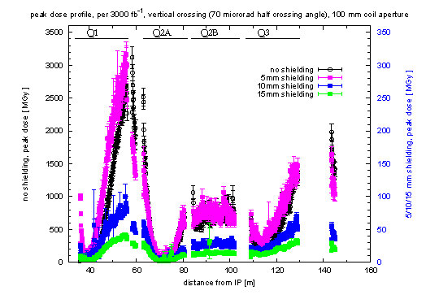
shielding of final triplet
l*=36 m
50 MGy
at
3000/fb
M.I. Besana and F. Cerutti

Slide 12
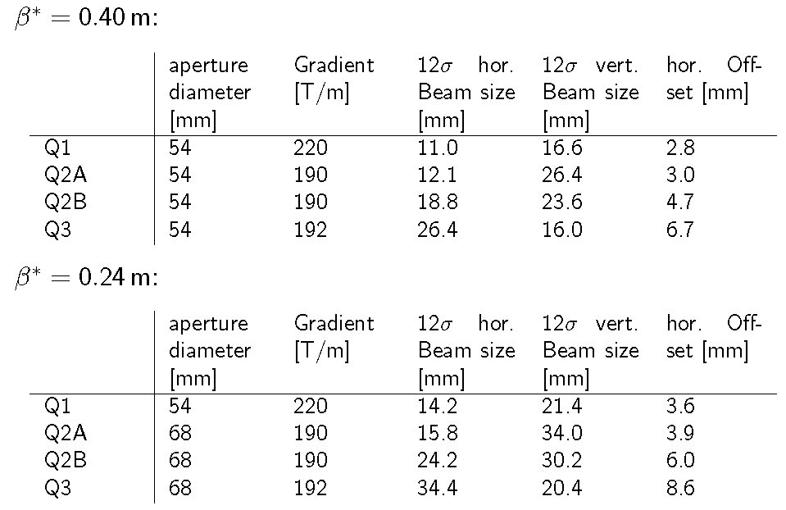
β* reach
R. Martin
l*=36 m

Slide 13
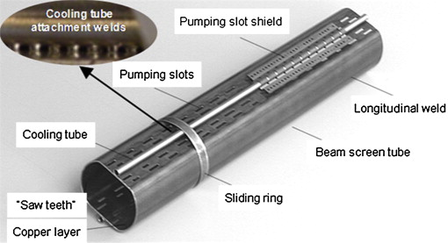
FCC-hh synchrotron radiation
High synchrotron
radiation load (SR) of protons @ 50 TeV:
~30 W/m/beam (@16 T)
5 MW total in arcs
(LHC <0.2 W/m)
Beam screen to capture SR and “protect” cold mass
Power mostly cooled at beam screen temperature;
Only minor part going to magnets at 2 – 4 K
→ Optimisation of temperature, space, vacuum, impedance, e-cloud, etc.

Slide 14
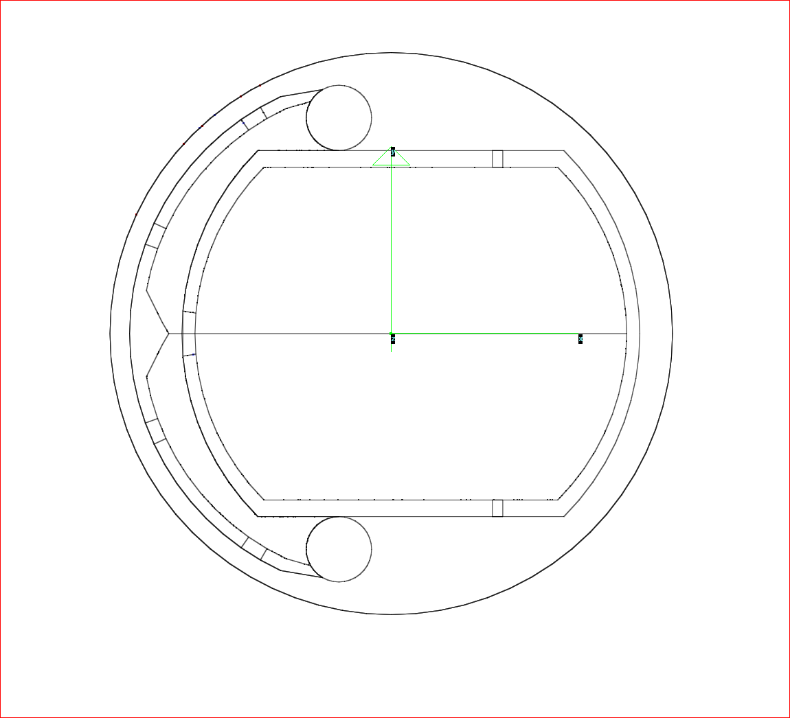
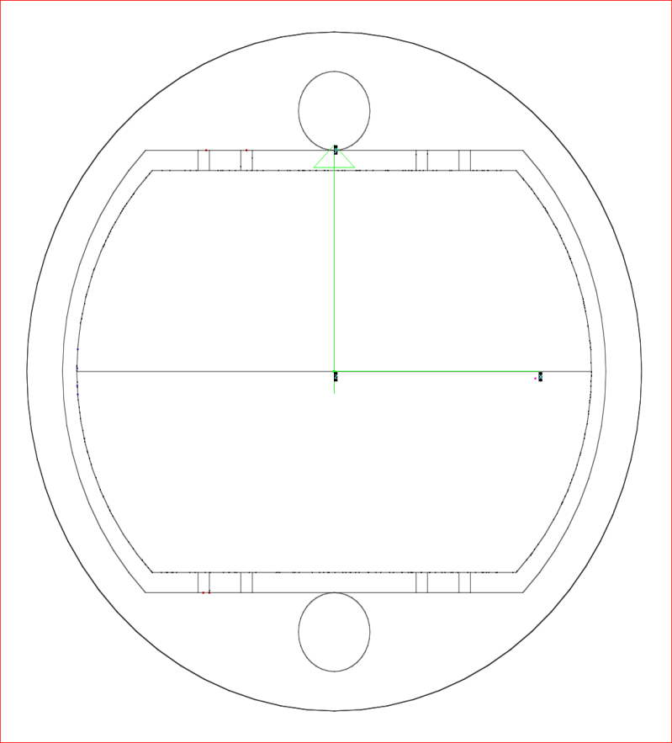
advanced beam screen
Configuration:
A combined BS, made up of a LHC-like BS with a continuous slot and an “external” SR power absorber is proposed here.
R. Kersevan
Continuous slot
V-shaped SR abs.
43
18
18
15
18
Slotted BS solution
asymmetric
LHC-like BS solution

Slide 15
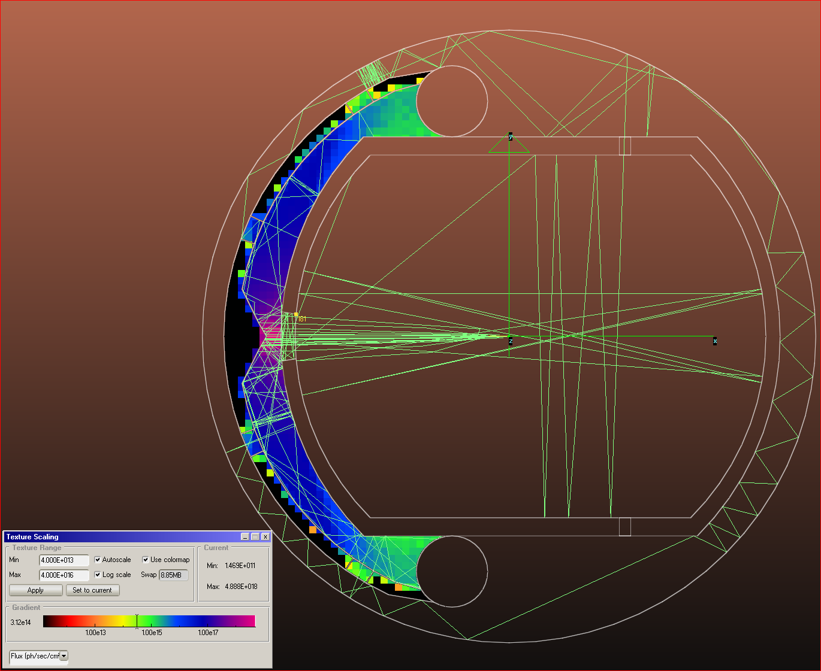
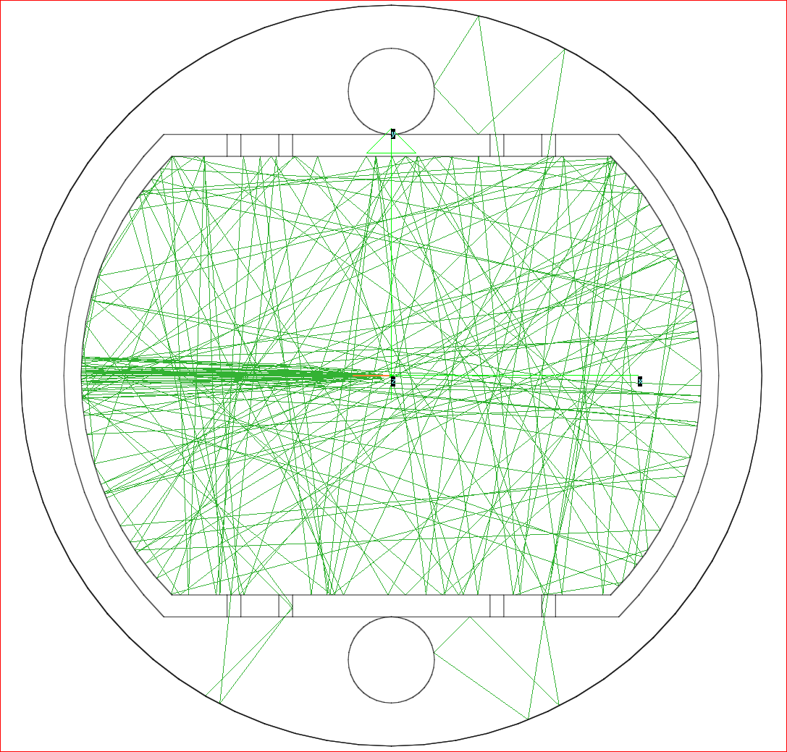
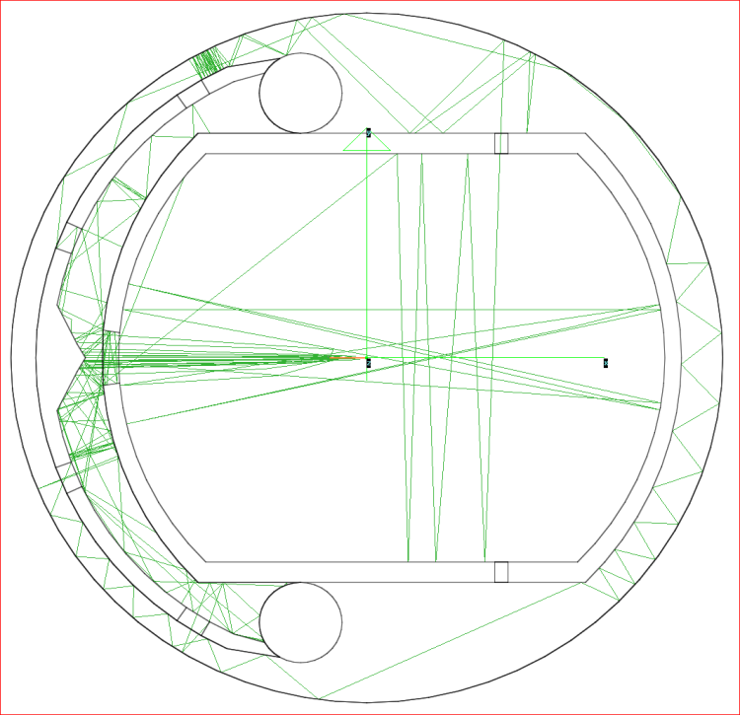
photon tracks with slot & V
SR Ray-Tracing (Synrad+):
The high-energy small vertical angle opening of the primary SR fan passes almost unscathed inside of the 2x 1.57 mm-high continuous slot
R. Kersevan
All SR-induced gas load may interact with the beam
Only a fraction of the SR-induced gas load may interact with the beam

Slide 16
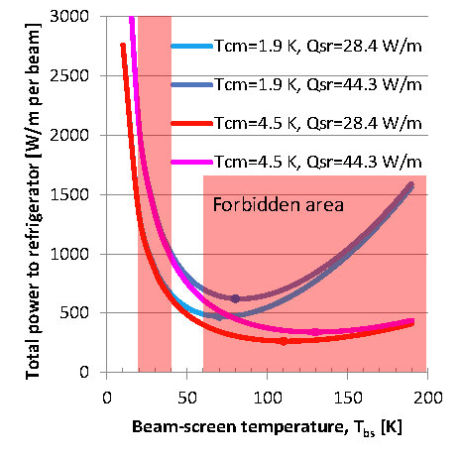
FCC-hh: cryo power for SR heat
contributions: beam screen (BS) & cold bore (BS heat radiation)
Contributions to cryo load:
beam screen (BS) &
cold bore (BS heat radiation)
At 1.9 K cm optimum BS temperature range: 50-100 K;
But impedance increases with temperature → instabilities
40-60 K favoured by vacuum & impedance considerations
→ 100 MW refrigerator power on cryo plant
P. Lebrun, L. Tavian

Slide 17
FCC-hh luminosity goals & phases
FCC-hh general considerations (assuming operation over 25 years)
  Initial luminosity should be equal to final HL LHC luminosity
    ➔ 5x10³⁴ cm⁻²s⁻¹ with ~125 days effective operation / year
  Integrated luminosity (10 years, 125 days eff. operation/y) should be ~ equal to LHC total luminosity ➔ O(3000 fb⁻¹).
  FCC total luminosity should be one order higher than LHC total ➔ O(30,000 fb⁻¹)
Present parameter sets for the two operation phases:
  phase 1 (baseline):
    5x10³⁴ cm⁻²s⁻¹ (peak), average 250 fb⁻¹/year (stops incl.)
    ➔ 2500 fb⁻¹ within total of 10 years (~HL LHC total luminosity)
  phase 2 (ultimate):
    2.5x10³⁵ cm⁻²s⁻¹ (peak), average 1000 fb⁻¹/year (stops incl.)
      ➔ 15,000 fb⁻¹ within 15 years (~6x HL-LHC total luminosity).
  yielding total luminosity ~17,500 fb⁻¹ over 25 years of operation

Slide 18
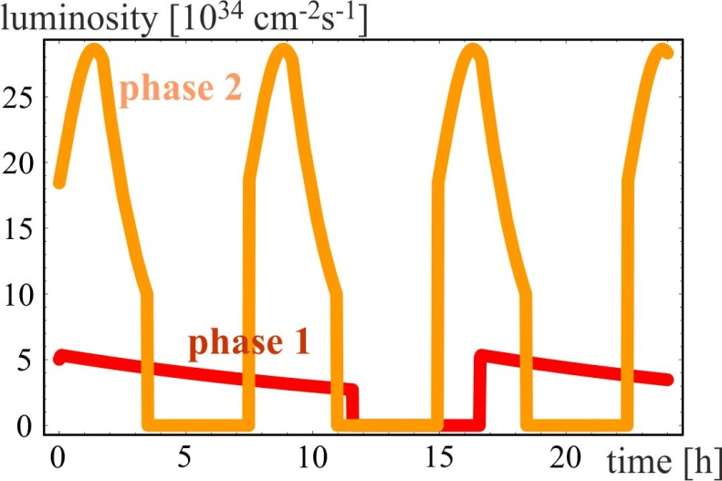
luminosity evolution over 24 h
radiation damping: τ~1 h
  for both phases:
  beam current 0.5 A unchanged!
  total synchrotron radiation power ~5 MW.
phase 1: β*=1.1 m, ΔQ_{tot}=0.01, t_{ta}=5 h
→
phase 2: β*=0.3 m, ΔQ_{tot}=0.03, t_{ta}=4 h

Slide 19
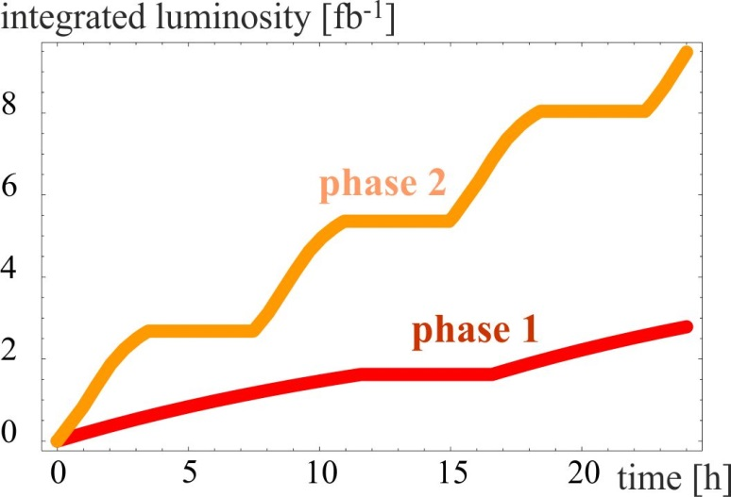
integrated luminosity / day
phase 1: β*=1.1 m, ΔQ_{tot}=0.01, t_{ta}=5 h
phase 2: β*=0.3 m, ΔQ_{tot}=0.03, t_{ta}=4 h

Slide 20
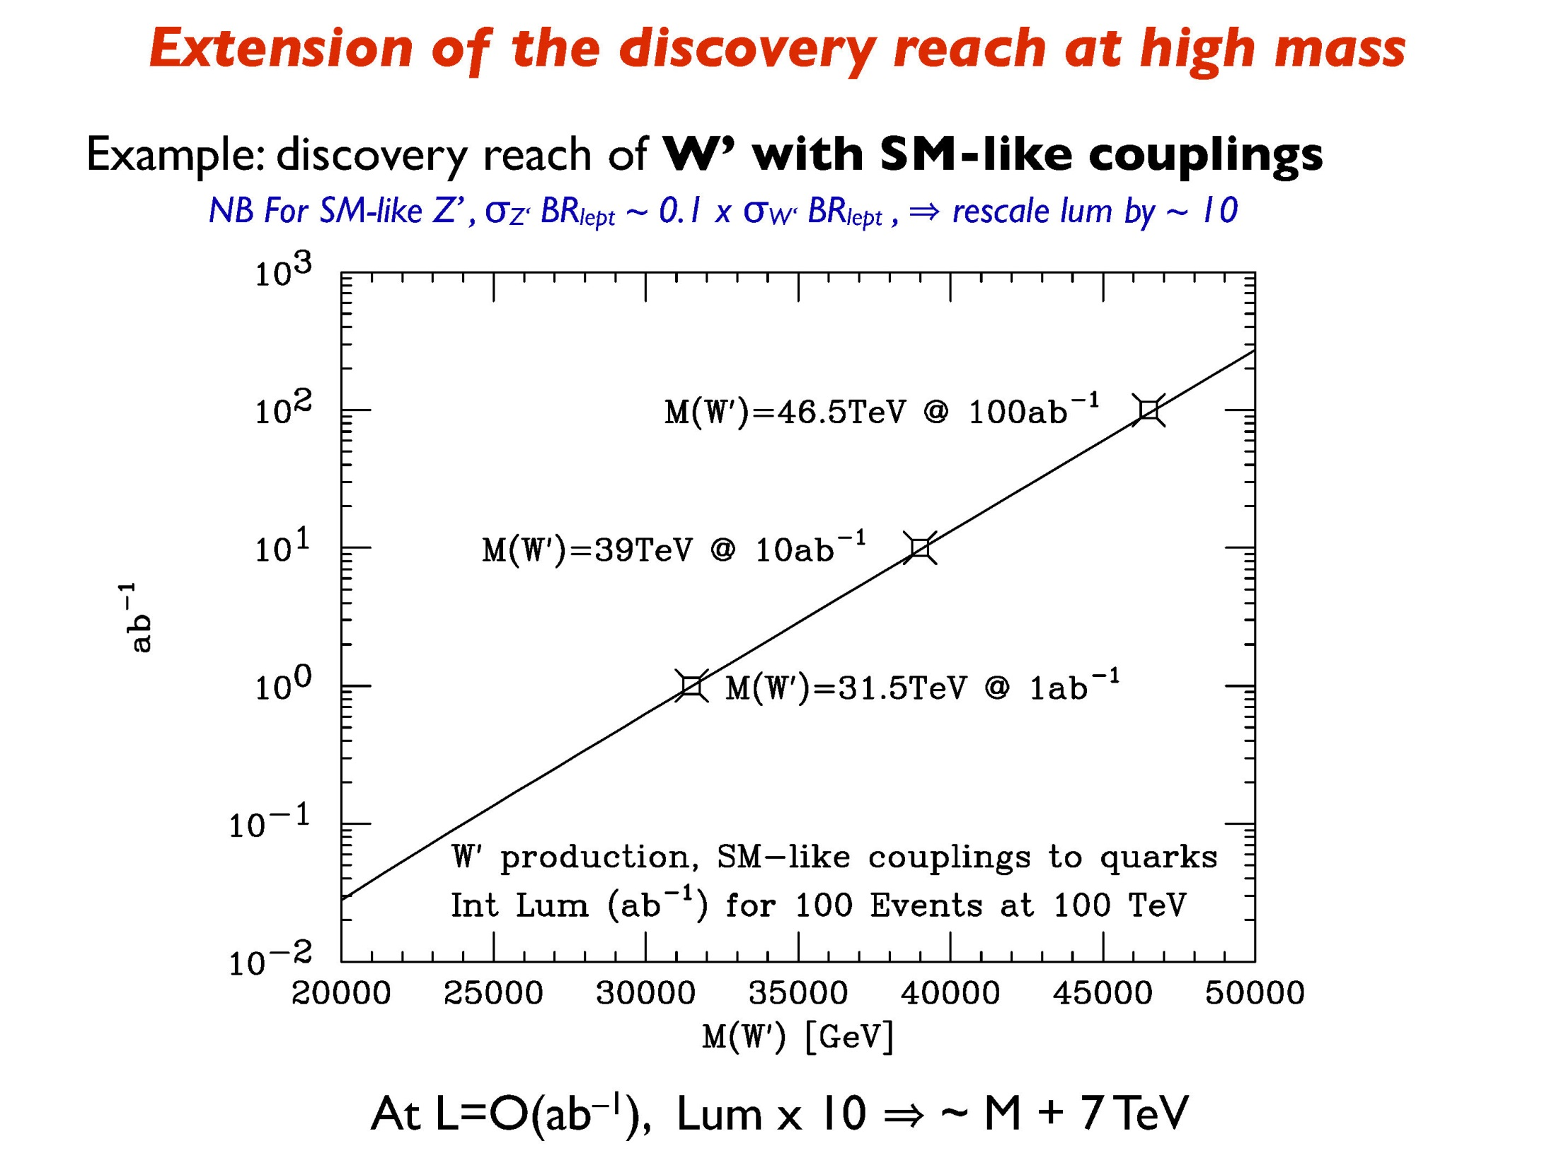
M. Mangano

Slide 21
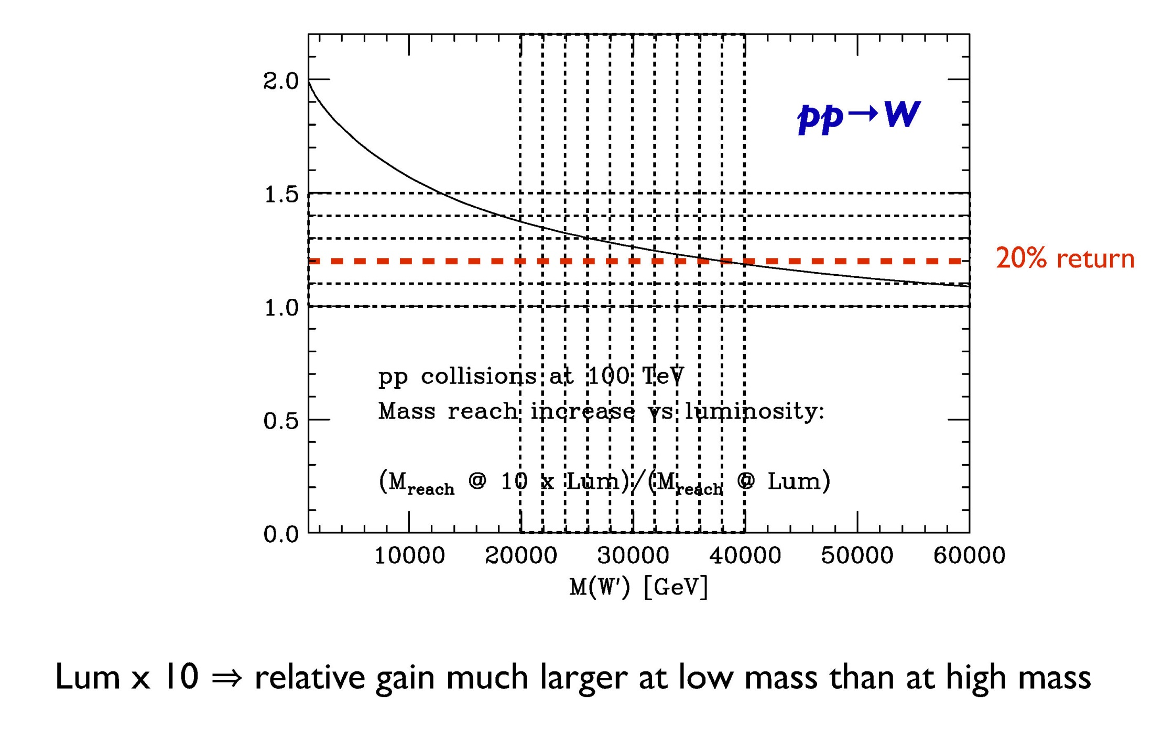
M. Mangano

Slide 22
parameter | LEP2 | FCC-ee |  |  |  |  | CepC
 |  | Z | Z (c.w.) | W | H | t | H
E_{beam} [GeV] | 104 | 45 | 45 | 80 | 120 | 175 | 120
circumference [km] | 26.7 | 100 | 100 | 100 | 100 | 100 | 54
current [mA] | 3.0 | 1450 | 1431 | 152 | 30 | 6.6 | 16.6
P_{SR,tot} [MW] | 22 | 100 | 100 | 100 | 100 | 100 | 100
no. bunches | 4 | 16700 | 29791 | 4490 | 1360 | 98 | 50
N_{b} [10¹¹] | 4.2 | 1.8 | 1.0 | 0.7 | 0.46 | 1.4 | 3.7
ε_{x} [nm] | 22 | 29 | 0.14 | 3.3 | 0.94 | 2 | 6.8
ε_{y} [pm] | 250 | 60 | 1 | 1 | 2 | 2 | 20
β∗_{x} [m] | 1.2 | 0.5 | 0.5 | 0.5 | 0.5 | 1.0 | 0.8
β∗_{y} [mm] | 50 | 1 | 1 | 1 | 1 | 1 | 1.2
σ∗_{y} [nm] | 3500 | 250 | 32 | 130 | 44 | 45 | 160
σ_{z,SR} [mm] | 11.5 | 1.64 | 2.7 | 1.01 | 0.81 | 1.16 | 2.3
σ_{z,tot} [mm] (w beamstr.) | 11.5 | 2.56 | 5.9 | 1.49 | 1.17 | 1.49 | 2.7
hourglass factor F_{hg} | 0.99 | 0.64 | 0.94 | 0.79 | 0.80 | 0.73 | 0.61
L/IP [10³⁴ cm⁻²s⁻¹] | 0.01 | 28 | 212 | 12 | 6 | 1.7 | 1.8
τ_{beam} [min] | 300 | 287 | 39 | 72 | 30 | 23 | 40
the large number of bunches at Z, W & H requires 2 rings
FCC-ee baseline parameters defined in EDMS No. 1346081, FCC-ACC-SPC-0003 (Rev. 2.0)
short lifetimes due to high luminosity → continuous injection (top-up)

Slide 23
parameter | LEP2 | FCC-ee
 |  | Z | Z (c.w.) | W | H | t
E_{beam} [GeV] | 104 | 45 | 45 | 80 | 120 | 175
beam-beam par. ξ_{y}/IP | 0.06 | 0.03 | 0.175 | 0.06 | 0.093 | 0.092
current [mA] | 3.0 | 1450 | 1431 | 152 | 30 | 6.6
P_{SR,tot} [MW] | 22 | 100 | 100 | 100 | 100 | 100
no. bunches | 4 | 16700 | 29791 | 4490 | 1360 | 98
N_{b} [10¹¹] | 4.2 | 1.8 | 1.0 | 0.7 | 0.46 | 1.4
ε_{x} [nm] | 22 | 29 | 0.14 | 3.3 | 0.94 | 2
ε_{y} [pm] | 250 | 60 | 1 | 1 | 2 | 2
β∗_{x} [m] | 1.2 | 0.5 | 0.5 | 0.5 | 0.5 | 1.0
β∗_{y} [mm] | 50 | 1 | 1 | 1 | 1 | 1
σ∗_{y} [nm] | 3500 | 250 | 32 | 84 | 44 | 45
σ_{z,SR} [mm] | 11.5 | 1.64 | 2.7 | 1.01 | 0.81 | 1.16
σ_{z,tot} [mm] (w beamstr.) | 11.5 | 2.56 | 5.9 | 1.49 | 1.17 | 1.49
hourglass factor F_{hg} | 0.99 | 0.64 | 0.94 | 0.79 | 0.80 | 0.73
L/IP [10³⁴ cm⁻²s⁻¹] | 0.01 | 28 | 212 | 12 | 6 | 1.7
τ_{beam} [min] | 434 | 298 | 39 | 73 | 29 | 21

Slide 24
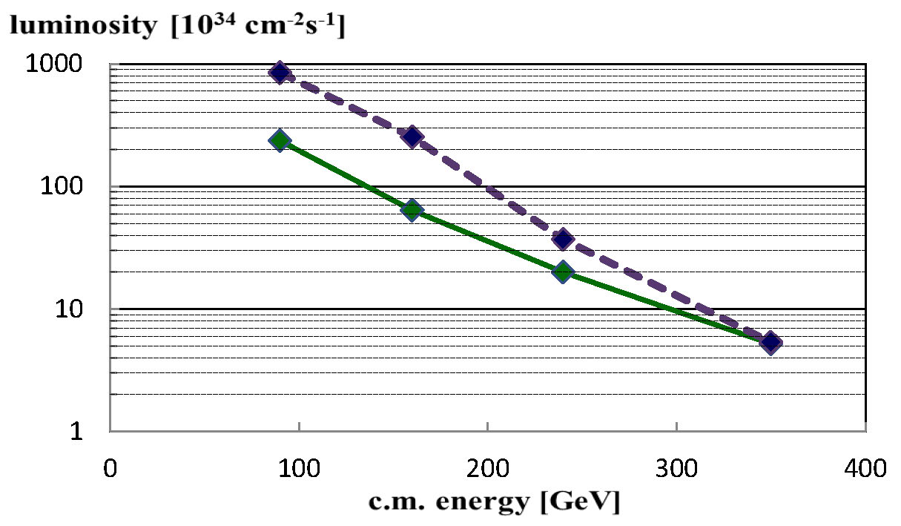

FCC-ee alternative scheme
crab waist & improved parameters
baseline
Z
W
H
$$t\overline{t}$$
A. Bogomyagkov, E. Levichev, D. Shatilov

Slide 25
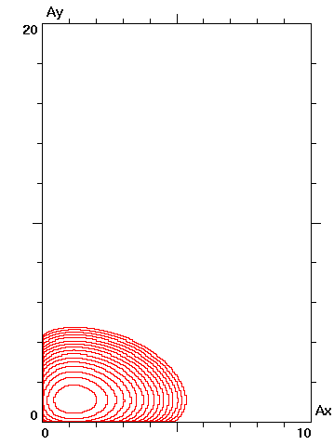
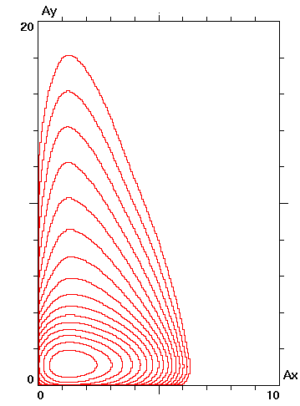
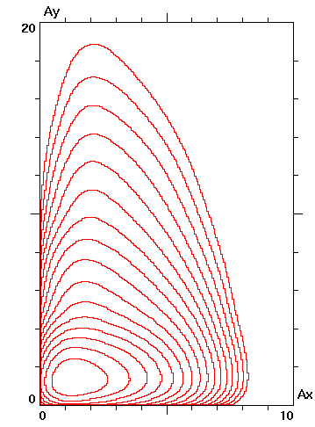
D. Shatilov
Beam-Beam Optimization (120 GeV, β_{y}*= 1 mm)
 | Crab Waist | × Head-on × | Crossing (11 mrad)
RF voltage [GV] | 2.3 | 5.5 | 5.5
RF frequency [MHz] | 400 | 800 | 800
Tunes ν_{x} /ν_{y} /ν_{s} | 0.54 / 0.57 / 0.009 | 0.54 / 0.61 / 0.0255 | 0.52 / 0.57 / 0.0255
Bunch length [mm] | 2.76 / 6.77 | 0.98 / 1.47 | 0.98 / 1.62
Bunch population | 3.5 ⋅ 10¹¹ | 5 ⋅ 10¹⁰ | 6 ⋅ 10¹⁰
Footprint size Δν_{x} /Δν_{y} | 0.019 / 0.126 | 0.087 / 0.128 | 0.063 / 0.104
Lifetime bb+bs [min] | 17 | 120 | 200
Luminosity [cm⁻²s⁻¹] | 9.8 ⋅ 10³⁴ | 7.2 ⋅ 10³⁴ | 5.8 ⋅ 10³⁴
Luminosity (β_{y} = 2 mm) | 8.3 ⋅ 10³⁴ | 6.8 ⋅ 10³⁴ | 5.0 ⋅ 10³⁴
Density contour plots

Slide 26
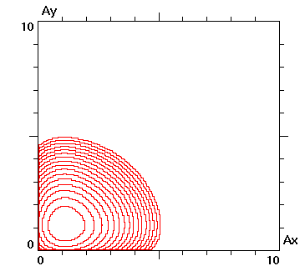
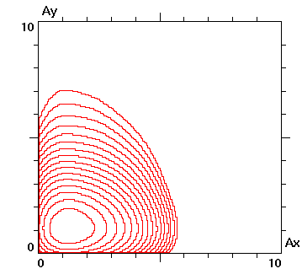
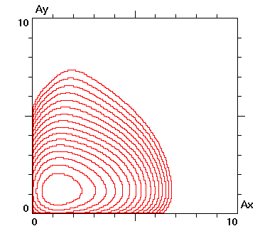
D. Shatilov
Beam-Beam Optimization (175 GeV, β_{y}*= 2 mm)
 | Crab Waist | × Head-on × | Crossing (11 mrad)
RF voltage [GV] | 9.5 | 11 | 11
RF frequency [MHz] | 400 | 400 | 400
Tunes ν_{x} /ν_{y} /ν_{s} | 0.54 / 0.57 / 0.0132 | 0.54 / 0.61 / 0.0172 | 0.52 / 0.57 / 0.0172
Bunch length [mm] | 2.75 / 3.74 | 2.11 / 2.56 | 2.11 / 2.68
Bunch population | 2.0 ⋅ 10¹¹ | 1.1 ⋅ 10¹¹ | 1.2 ⋅ 10¹¹
Footprint size Δν_{x} /Δν_{y} | 0.023 / 0.079 | 0.071 / 0.137 | 0.047 / 0.106
Lifetime τ_{bs} [min] | 18 | 35 | 25
Luminosity [cm⁻²s⁻¹] | 1.15 ⋅ 10³⁴ | 1.3 ⋅ 10³⁴ | 1.2 ⋅ 10³⁴
Luminosity (β_{y} = 1 mm) | 1.25 ⋅ 10³⁴ | 1.3 ⋅ 10³⁴ (800 MHz) | 1.25 ⋅ 10³⁴ (800 MHz)
Density contour plots
If additional ε_{y} growth due to coupling and dynamical ε_{x} is accounted, crab waist could become the best.

Slide 27
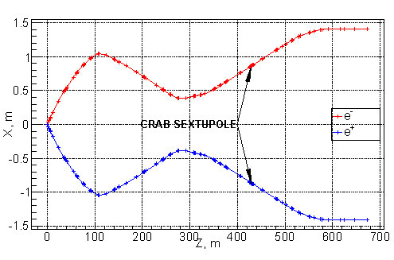
FCC-ee crab-waist IR
A. Bogomyagkov

Slide 28
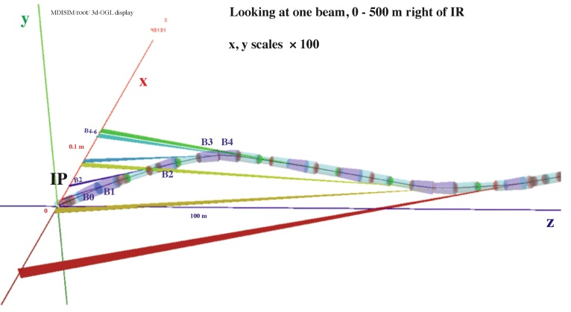
IR synchrotron radiation
H. Burkhardt
M. Boscolo
Photon energy ~350 keV very similar to LEP2 where this was acceptable with IRs designed for low synrad & ~100 collimators and local masks,
further optimization required in the context of MDI (SR background→ weaker bends?)

Slide 29
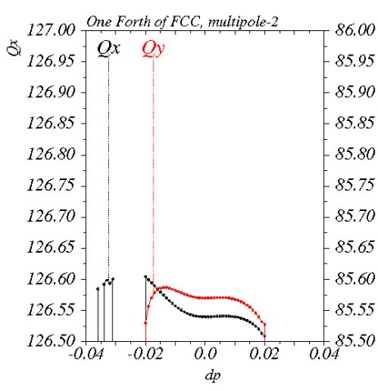
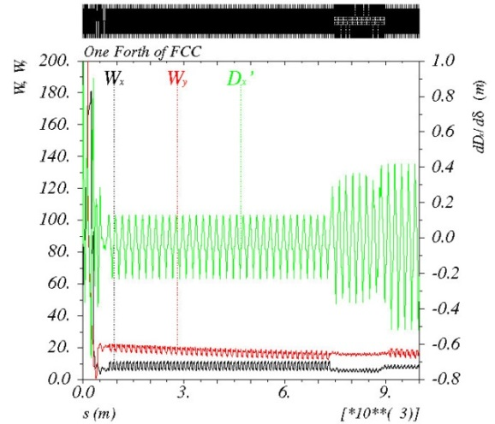
Closed ring for FCC-ee optics
chromatic optics
functions over ¼ ring
energy acceptance ±2%
(lifetime OK even at 350 GeV)
A. Bogomyagkov

Slide 30
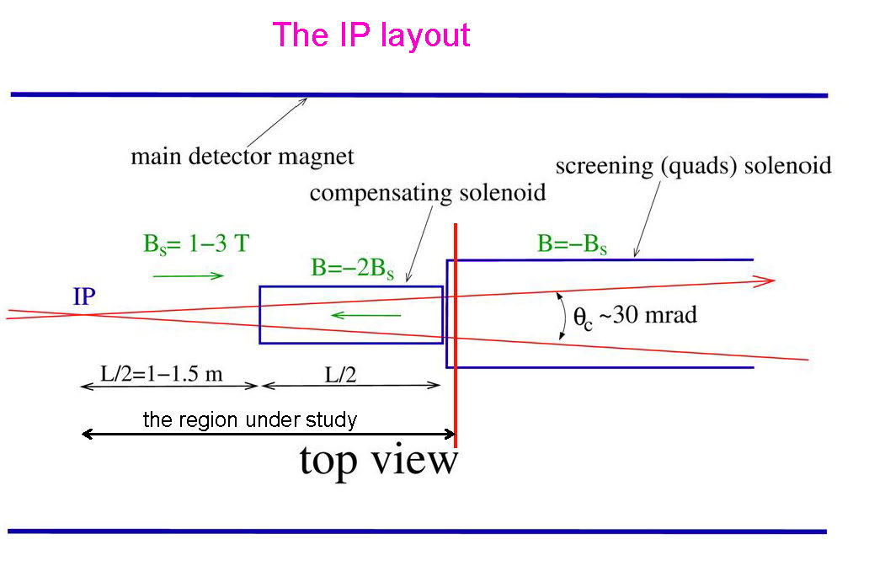
IR with solenoids & crossing angle
V. Telnov,
A. Bogomyagkov
vertical emittance growth
between 1% and 100%
further optimization underway

Slide 31
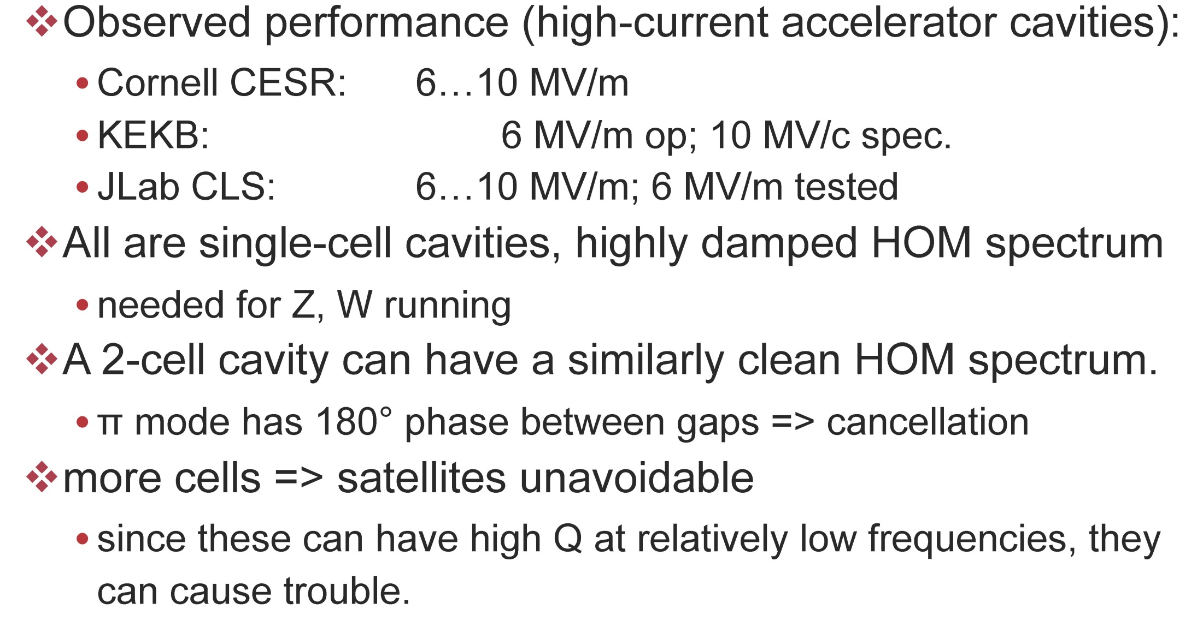
RF cavities
U. Wienands

Slide 32
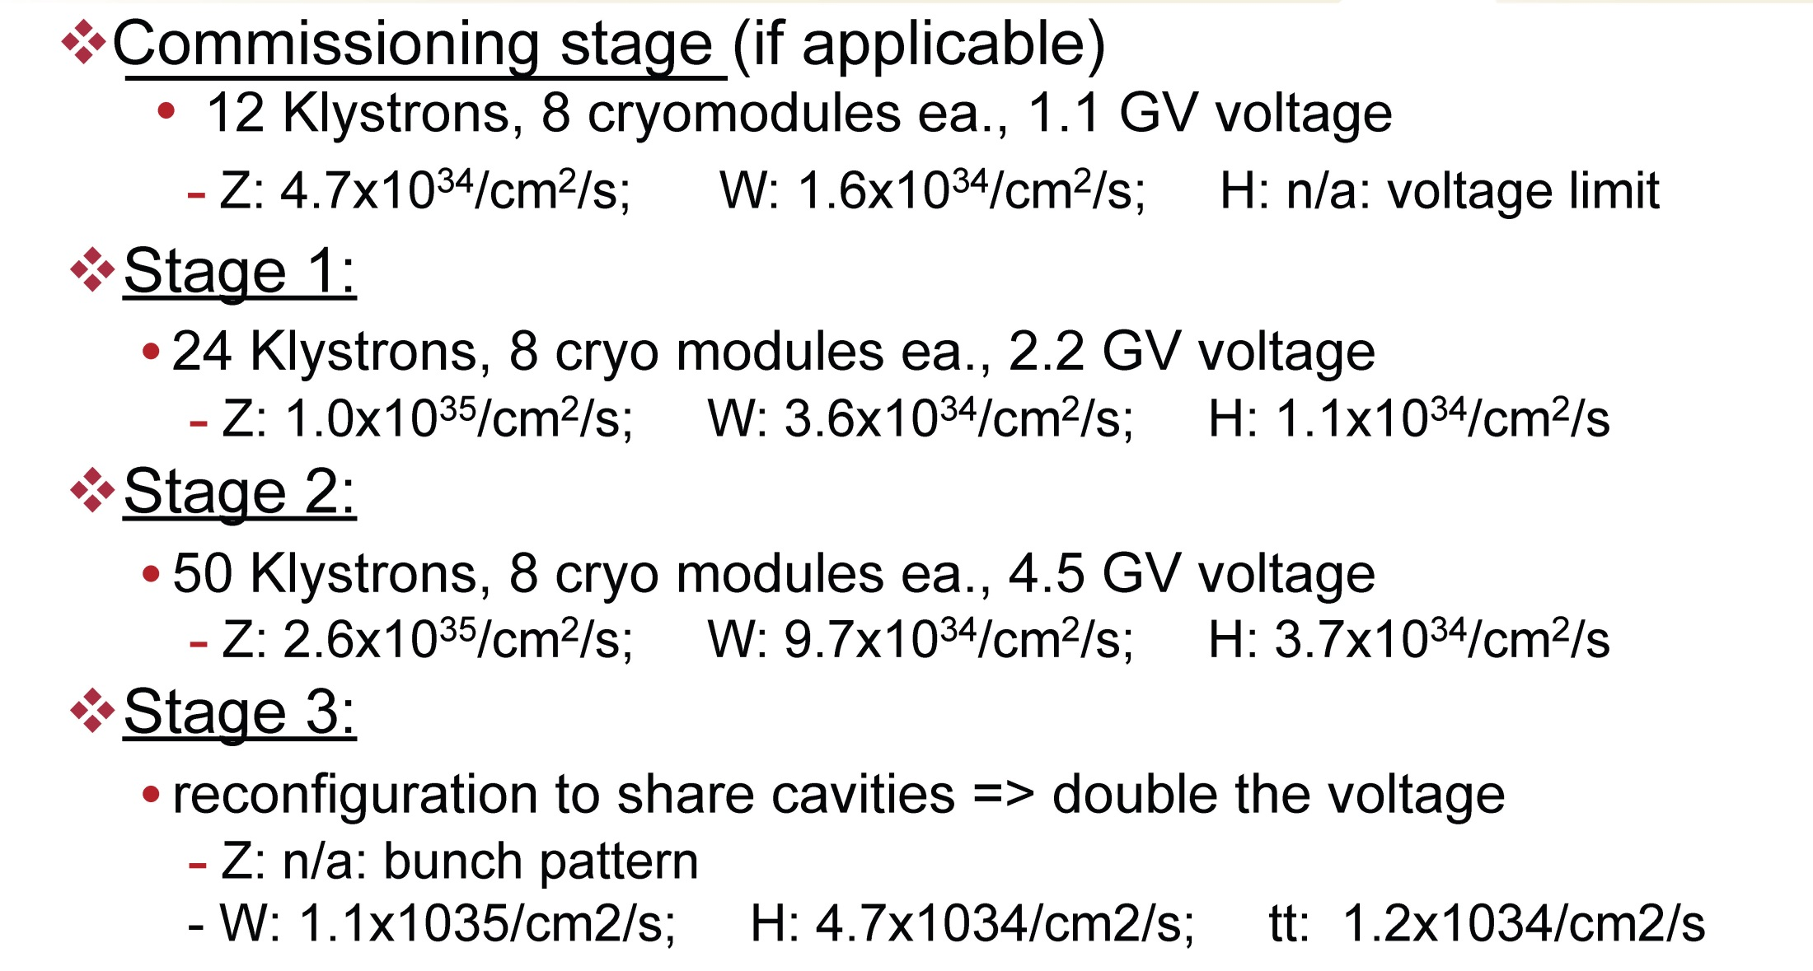
FCC-ee RF staging
1 MW klystron driving 8 cavity-modules up to 12 MV (400 MHz), 1 cavity module consists of 2 two-cell cavities
U. Wienands

Slide 33
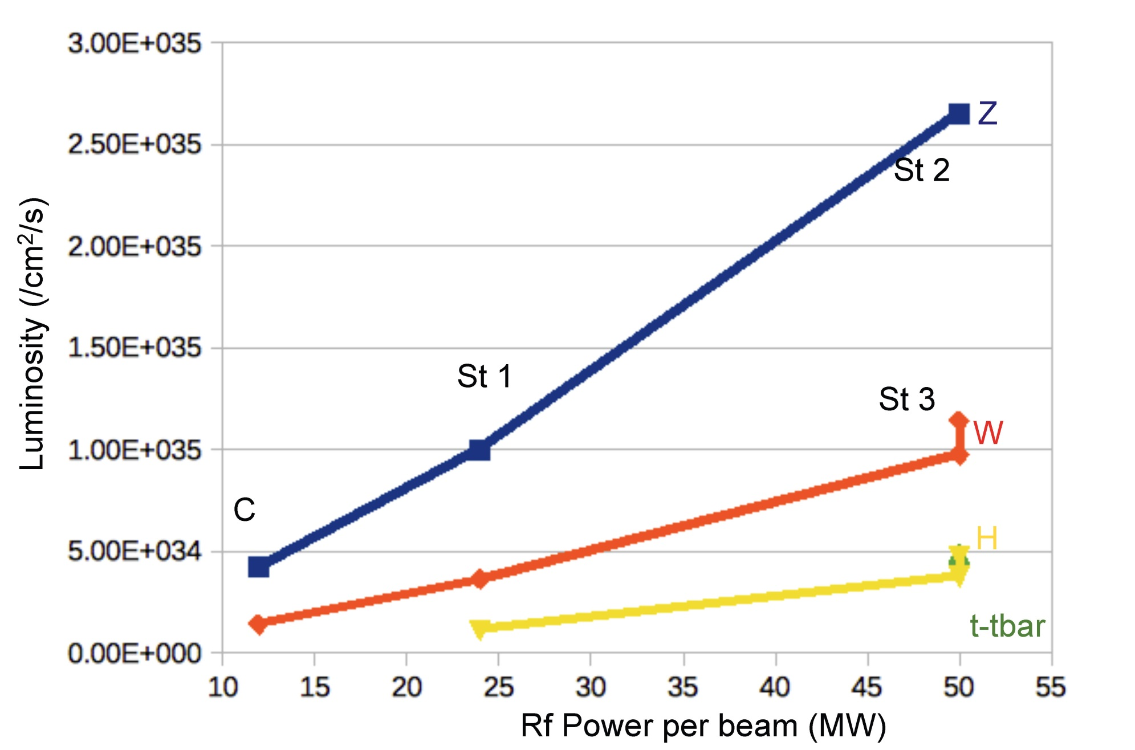
FCC-ee staging
U. Wienands

Slide 34
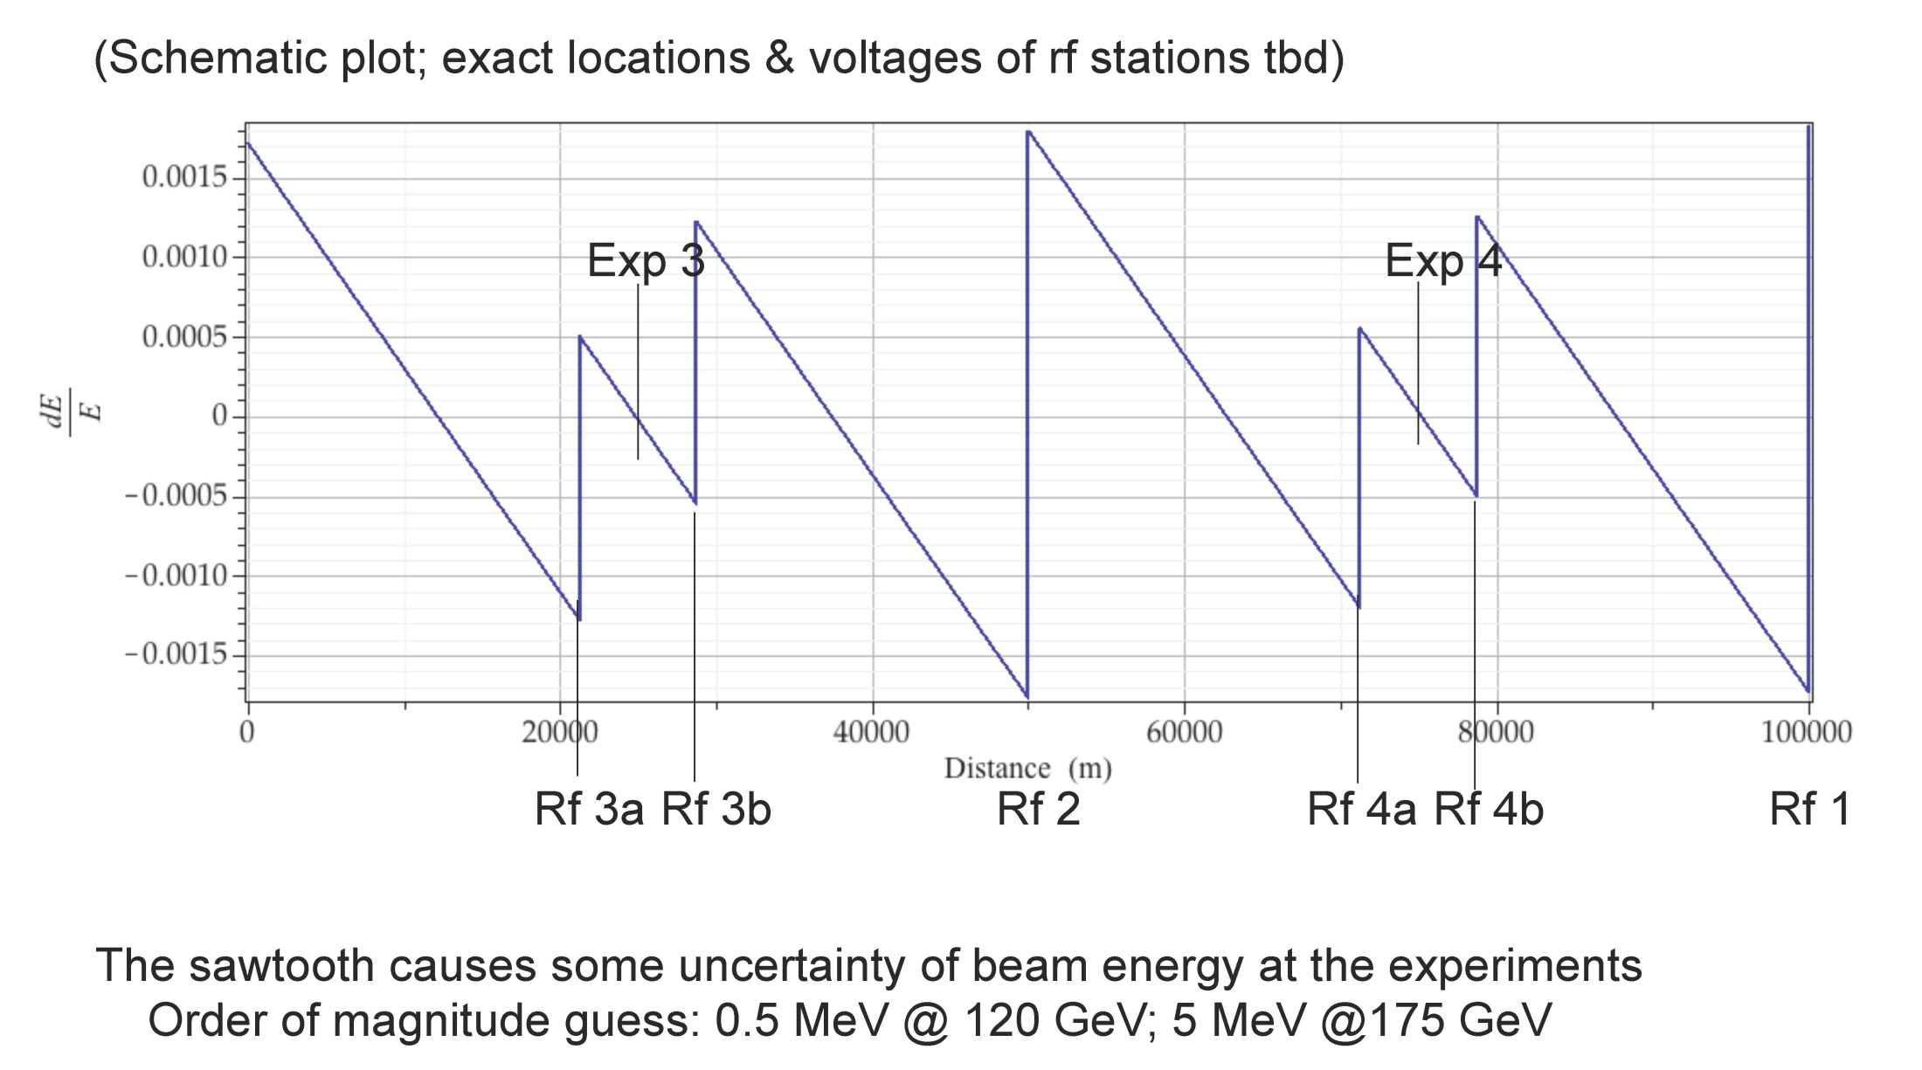
energy sawtooth
U. Wienands

Slide 35
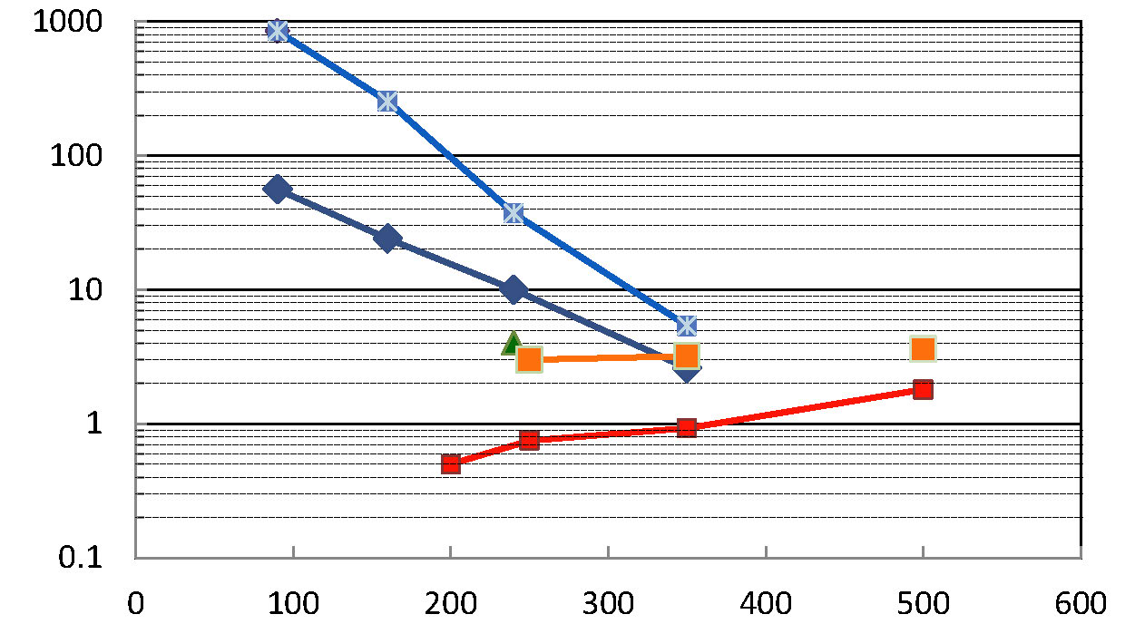
how much luminosity is needed?
L [10³⁴ cm⁻²s⁻¹]
Z W H ttbar
100 ab⁻¹/yr
FCC-ee crab waist w 4 IPs
10 ab⁻¹/yr
FCC-ee baseline w 2 IPs
1 ab⁻¹/yr
ILC upgrades
CepC w 2 IPs
100 fb⁻¹/yr
ILC baseline
10 fb⁻¹/yr
E_{CM} [GeV]

Slide 36
a few conclusions
work on both colliders is progressing well, in international collaboration
closed optics solutions are available now
tunnel optimization tool – first in the world !?
compatible ring layouts for hh and ee
first thoughts on vacuum, cryogenics & SRF
possibility of using LHC as hadron injector
performance potential better than baseline
  hh: phase-2 (smaller β*, larger ΔQ)
  ee: crab-waist option & optimization
much more work to be done …

