Slide 1
Progress in synchrotron radiation studies and tools
Helmut Burkhardt (CERN) and Manuela Boscolo (INFN-LNF)
Contact for detector/experiments : Nicola Bacchetta
presented by M. Boscolo,
FCC-ee Physics Workshop (TLEP9), Pisa, Feb. 4th 2015

Slide 2
Introduction
Synchrotron radiation fans in IR region for the BINP and CERN designs at top energy, 175 GeV / beam
More on MDI for FCC-ee, concepts and generic simulations :
Principles and scaling presentation by M.B. Oct. ’13 at TLEP#6 CERN
Experience with backgr. presentation by Helmut March’ 14 at EIC’14 JLAB
MDI for FCC-ee presentation by Nicola June ’14 at TLEP#7 CERN
Losses in IR and Touschek presentation by M.B. Oct.’14 at HF2014 Beijing
IRChallenges presentation by Helmut Oct.’14 at TLEP#8 Paris
Synchrotron Rad. in IR presentation by Helmut Dec. ‘14 at VIDYO meet. No.11 CERN
Synchrotron Radiation is a big concern for FCC-ee, in addition there are other background sources that need careful studies

Slide 3
Background Sources
Two Main Classes:
Synchrotron Radiation
beam particles e+, e-, e+e- effects
Bhabha
Beamstrahlung
Touschek
beam-gas
pair production
….
Both aspects deeply studied for present/past machines
beam particles effects (better) studied at Factories
SR manageable extrapolation from LEP experience

Slide 4
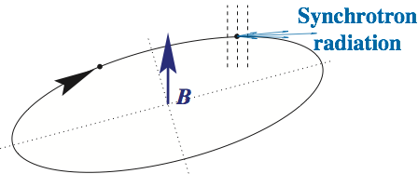
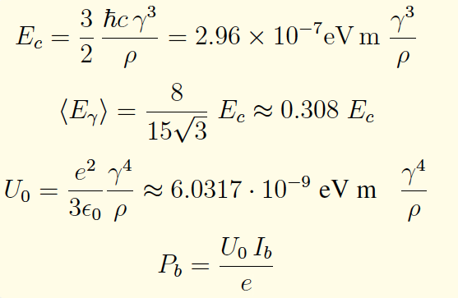
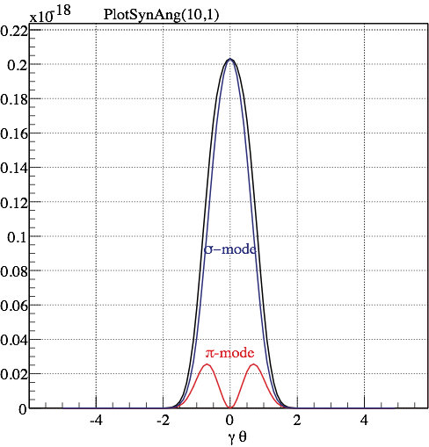
Synchrotron Radiation
mean free path length λ between radiation
LEP2, TLEP, B ≃ O ( 0.1 T ) O ( 1 m )
SynRad cone distribution mostly from bending angle O( mrad )
+ minor contribution from
beam divergence O( 10 μrad)
and SynRad process
angular distribution (at Ec)
~ 1/γ = 3 μrad @ TLEP

Slide 5
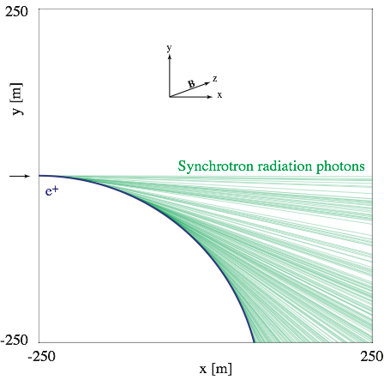
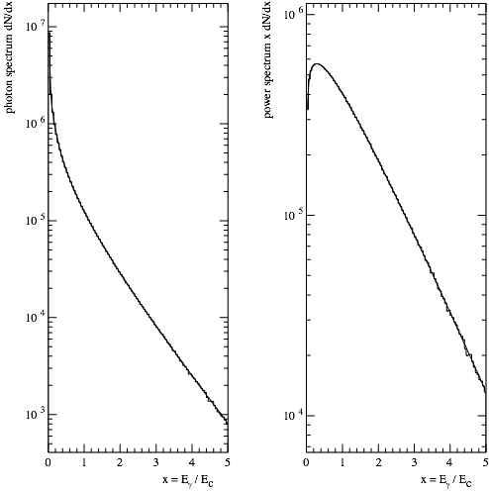
Spectrum
Photon energy in units of the critical energy. x = Eγ / Ec
For hom. field over formation length : single spectrum
Geant4
TestEm16
weight
with
photon energy
Photon spectrum
Power spectrum
10 GeV e+ moving initially in x-direction, bend downwards on a circular path by a 0.1 T magnetic field in z-direction. Geant4 TestEm16
This year : generalized to long live charged particle
in Geant4 10.1 released 5/12/2014
Ref.: H.B., CERN-OPEN-2007-018, Geant4 physics-manual Implemented as process G4SynchrotronRadiation

Slide 6
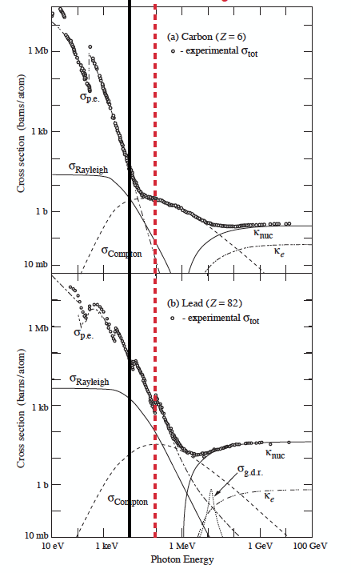
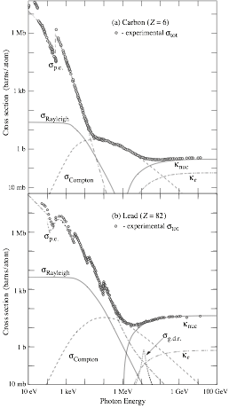
Spectrum and absorption
✔ < 10 keV
very difficult above 100 keV
Typical mean (0.3 Ec) photon energies
B-factories (and FCC-hh) mostly below 10 keV
LEP1 : 21 keV
LEP2 : 320 keV (arc, last bend 10× lower)
TLEP : ~ 350 keV ( arc, 175 GeV)
-> very similar to LEP2
difficult to collimate
Enormous photon flux, MWs of power
can get kW locally, melt equipment, detectors..
Aim as for LEP2 :
do not generate hard synchrotron radiation
anywhere close to the IR

Slide 7
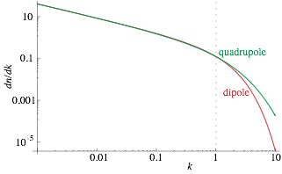
Approach for FCC-ee IR challenges
Challenge: maximize performance (integrated luminosity) for experiments for good or at least tolerable experimental (background, stability) conditions.
Some key points :
Minimize synchrotron radiation in the IR region =>
Bends as weak as possible and as far as possible from IP
Quads have to be strong and close to IP,
Minimize offset from quad axis
Careful with vertical halo/tails
SR Monte Carlo : H.B. CERN-OPEN-2007-018 integrated in G4
For FCC the approach has been to start developing the software tools
H.B. Chapter 5.2 Landolt-Börnstein New Series I/21C
γ spectrum
γ-energy / Ecrit.

Slide 8
SR from the final focusing magnets
SR from the last vertical focusing magnet can usually be shielded from the IP detector beam pipe. This is more difficult when the photons penetrate the beam pipe
SR from the last horizontal focusing magnet is more difficult to block because the beam is over-focused in order to compensate for the defocusing from the last quadrupole
[M. Sullivan, HF2014, Beijin, 9-12 Oct. 2014]

Slide 9
MDISim: generic tool for IR studies
MAD-X lattice and survey (geometry), if available with apertures: basis
ROOT: main geometry and interface tool
With extra library to read MAD-X tfs files and calculate derived machine parameters (SynRad)
Step 1 : Construct tables (ntuples) with detailed information element by element
transformation of Courant-Snyder machine coordinates to Euclidian detector coordinates

Slide 10
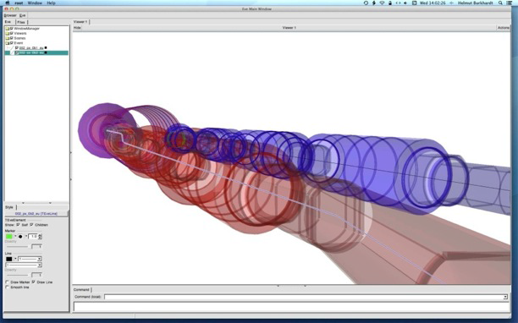
Display geometry and optionally accelerator tracks
Step 2 : geometry display based on MAD-X aperture information using the EVE (Event Visualization Environment)
Step 3 : accelerator tracking (several options, example here is MAD-X, LHC IR geometry)
Run our demo :
http://hbu.web.cern.ch/hbu/Geom/my_Geom_Eve_Display.C
root
.x my_Geom_Eve_Display.C

Slide 14
TLEP Optics with Crab Waist - BINP
(TLEP_V14_IR_6-13-2)
MDISIM output
red color : energy over 100 keV, and within 200 m of IP
bends
iele NAME KEYWORD S L Angle Emean ngamBend rho B BETX SIGX divx Power
m m keV m T m mm mrad Watt
13 L.MB0 SBEND 22.56 10.5 0.001 348.64 3.6071 1.05e+04 0.055594 122 0.4646 0.02834 3.349e+04
15 L.MB1 SBEND 33.66 10.5 0.0037 1290 13.346 2.84e+03 0.205698 14.21 0.1586 0.02834 4.585e+05
39 L.MB2 SBEND 73.68 10.5 0.0037674 1313.5 13.59 2.79e+03 0.209446 78.22 0.372 0.01655 4.753e+05
59 L.MB3 SBEND 107.2 14.5 0.0051804 1307.9 18.686 2.8e+03 0.208551 2.024 0.05984 0.03686 6.508e+05
65 L.MB4 SBEND 123.5 14.5 0.0051804 1307.9 18.686 2.8e+03 0.208551 185.1 0.5723 0.03686 6.508e+05
91 L.MB5 SBEND 179.7 14.5 0.00063536 160.41 2.2918 2.28e+04 0.025578 6.146 0.1043 0.01713 9789
105 L.MB6 SBEND 221.5 14.5 0.0002393 60.415 0.86319 6.06e+04 0.00963366 84.76 0.3873 0.005598 1389
129 L.MB7 SBEND 274.6 14.5 -0.0031537 796.19 11.376 4.6e+03 -0.126959 8.549 0.123 0.01494 2.412e+05
135 L.MB8 SBEND 291 14.5 -0.0031537 796.19 11.376 4.6e+03 -0.126959 26.96 0.2184 0.01494 2.412e+05
161 L.MB9 SBEND 345.5 14.5 -0.0028026 707.57 10.109 5.17e+03 -0.112827 19.14 0.184 0.01956 1.905e+05
235 L.MB10 SBEND 526.5 10.5 0.0011018 384.13 3.9743 9.53e+03 0.0612522 18.23 0.1796 0.02132 4.065e+04
241 L.MB11 SBEND 543.5 10.5 0.0011018 384.13 3.9743 9.53e+03 0.0612522 23.68 0.2047 0.01544 4.065e+04
247 L.MB12 SBEND 571.8 10.5 0.0011018 384.13 3.9743 9.53e+03 0.0612522 7.454 0.1148 0.01544 4.065e+04
253 L.MB13 SBEND 588.8 10.5 0.0011018 384.13 3.9743 9.53e+03 0.0612522 86.85 0.392 0.02132 4.065e+04
273 MB1.A1C1.DS SBEND 686.4 10.5 0.00048843 170.29 1.7618 2.15e+04 0.0271539 35.99 0.2523 0.01122 7989
275 MB2.A1C1.DS SBEND 697.5 10.5 0.00048843 170.29 1.7618 2.15e+04 0.0271539 16.97 0.1733 0.01122 7989
282 MB3.A1C1.DS SBEND 711.4 10.5 0.00048843 170.29 1.7618 2.15e+04 0.0271539 36.24 0.2532 0.01122 7989
284 MB4.A1C1.DS SBEND 722.5 10.5 0.00048843 170.29 1.7618 2.15e+04 0.0271539 73.12 0.3597 0.01122 7989
292 MB5.A1C2.DS SBEND 736.4 10.5 0.00048843 170.29 1.7618 2.15e+04 0.0271539 35.99 0.2523 0.01122 7989
294 MB6.A1C2.DS SBEND 747.5 10.5 0.00048843 170.29 1.7618 2.15e+04 0.0271539 16.97 0.1733 0.01122 7989
from summing up energy loss the 1660 bends U0sum=2.149 GeV PowSum= 57.234 MW
Quads, at 1 sigmax, horizontal
iele Element s betx sigx divx K1L k0 L x Angle Emean ngam Power
m m mm mrad m-2 m-1 m mm keV Watt
5 L.MQ0_1 3.8 41.5 0.2709 0.006531 -0.29142 7.8947e-05 1.8 8.6833e-32 0.000142104 289.004 0.512589 3944.81
7 L.MQ0_2 5.6 183 0.5684 0.003113 -0.29142 0.00016565 1.8 1.7717e-31 0.000298166 606.395 1.07553 17367.2
9 L.MQ1_1 7 393 0.8338 0.002122 0.15977 0.00013321 1 2.5822e-31 0.000133211 487.651 0.480509 6239.69
11 L.MQ1_2 8 433 0.8752 0.002022 0.15977 0.00013984 1 2.7024e-31 0.000139835 511.902 0.504405 6875.72
17 L.MQ2_1 35.7 7.16 0.1126 0.01571 -0.06095 6.8626e-06 1 5.8903e-20 6.86259e-06 25.1222 0.0247543 16.56
19 L.MQ2_2 36.7 5.8 0.1013 0.01747 -0.06095 6.1735e-06 1 7.0102e-20 6.17354e-06 22.5998 0.0222688 13.4015
from summing up energy loss in the 1562 quads U0Sum=0.00390576 GeV plane=x PowSum=104.006 kW
Optics files in /afs/cern.ch/eng/fcc/ee/TLEP_V14_IR_6-13-2/ by Anton Bogomyagkov et al as presented by Anton and Dmitry last Dec.: https://indico.cern.ch/event/356596/

Slide 15
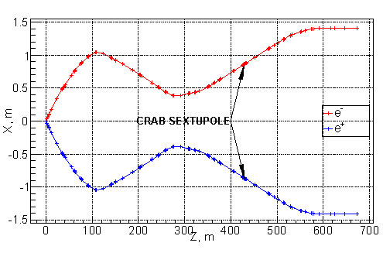
FCC-ee crab-waist IR
A. Bogomyagkov

Slide 16
SynRad bend cones TLEP_V14_IR_6-13-2 BINP
y
MDISIM/root/ 3d-OGL display
x
Looking at one beam, 0 - 500 m right of IR
x, y scales × 100
B4-6
B3
B4
0.1 m
IP
B2
B2
B0
B1
0
100 m
z

Slide 17
TLEP Optics - CERN
(TLEP_V12A)
MDISIM output
red color : energy over 100 keV, and within 200 m of IP
bends
iele NAME KEYWORD S L Angle Emean ngamBend rho B BETX SIGX divx Power
m m keV m T m mm mrad Watt
14 BMVC SBEND 129 47.26 0.002 154.92 7.2143 2.36e+04 0.024704 315.4 0.5597 0.005639 7368
24 BMVC SBEND 273.8 47.26 0.002 154.92 7.2143 2.36e+04 0.024704 101.8 0.318 0.00564 7368
26 BMVC SBEND 322.1 47.26 0.002 154.92 7.2143 2.36e+04 0.024704 315.4 0.5597 0.005639 7368
36 BMVC SBEND 466.8 47.26 0.002 154.92 7.2143 2.36e+04 0.024704 101.8 0.318 0.00564 7368
39 BMHC SBEND 503 35.19 -0.002 208.03 7.2143 1.76e+04 -0.0331727 21.71 0.1468 0.006974 9893
49 BMHC SBEND 611.6 35.19 -0.002 208.03 7.2143 1.76e+04 -0.0331727 100.1 0.3153 0.006973 9893
51 BMHC SBEND 647.8 35.19 -0.002 208.03 7.2143 1.76e+04 -0.0331727 21.71 0.1468 0.006974 9893
61 BMHC SBEND 756.4 35.19 -0.002 208.03 7.2143 1.76e+04 -0.0331727 100.1 0.3153 0.006973 9893
79 MB1.A3C1.DS SBEND 808.8 10.5 0.00049583 172.87 1.7885 2.12e+04 0.0275653 36.2 0.1896 0.008248 2038
81 MB2.A3C1.DS SBEND 819.9 10.5 0.00049583 172.87 1.7885 2.12e+04 0.0275653 17.59 0.1322 0.008248 2038
88 MB3.A3C1.DS SBEND 833.8 10.5 0.00049583 172.87 1.7885 2.12e+04 0.0275653 36.26 0.1898 0.008233 2038
90 MB4.A3C1.DS SBEND 844.9 10.5 0.00049583 172.87 1.7885 2.12e+04 0.0275653 71.82 0.2671 0.008233 2038
98 MB5.A3C2.DS SBEND 858.8 10.5 0.00049583 172.87 1.7885 2.12e+04 0.0275653 35.5 0.1878 0.008334 2038
100 MB6.A3C2.DS SBEND 869.9 10.5 0.00049583 172.87 1.7885 2.12e+04 0.0275653 17.04 0.1301 0.008334 2038
107 MB7.A3C2.DS SBEND 883.8 10.5 0.00049583 172.87 1.7885 2.12e+04 0.0275653 36.37 0.19 0.008385 2038
109 MB8.A3C2.DS SBEND 894.9 10.5 0.00049583 172.87 1.7885 2.12e+04 0.0275653 73.15 0.2695 0.008385 2038
119 MB9.A3C3 SBEND 908.8 10.5 0.00099166 345.74 3.5771 1.06e+04 0.0551306 36.11 0.1894 0.008386 8152
121 MB10.A3C3 SBEND 919.9 10.5 0.00099166 345.74 3.5771 1.06e+04 0.0551306 17.09 0.1303 0.008386 8152
130 MB11.A3C3 SBEND 933.8 10.5 0.00099166 345.74 3.5771 1.06e+04 0.0551306 36.29 0.1898 0.00838 8152
132 MB12.A3C3 SBEND 944.9 10.5 0.00099166 345.74 3.5771 1.06e+04 0.0551306 72.99 0.2692 0.00838 8152
from summing up energy loss the 6592 bends U0sum=7.801 GeV PowSum=51.4238 MW
Quads, at 1 sigmax, horizontal
iele Element s betx sigx divx K1L k0 L x Angle Emean ngam Power
m m mm mrad m-2 m-1 m mm keV Watt
3 Q4 3.07 16.7 0.129 0.007701 -0.6072 7.8304e-05 1.0741 3.9205e-21 8.41039e-05 286.651 0.303374 573.256
5 Q3 6.31 127 0.3545 0.002801 0.27506 9.7521e-05 1.2351 1.3913e-20 0.00012045 356.999 0.434479 1022.47
8 Q2 65.4 28.7 0.1688 0.005882 -0.038944 6.5752e-06 1 2.412e-20 6.5752e-06 24.0701 0.0237176 3.76329
10 Q1 80.8 101 0.3168 0.003135 0.033179 1.0511e-05 1 4.0143e-20 1.05115e-05 38.4799 0.0379163 9.61782
13 QDV 81.8 102 0.318 0.003123 -0.014755 4.6918e-06 0.5 4.0051e-20 2.34588e-06 17.1753 0.00846191 0.958055
15 QFV2 130 312 0.5568 0.001784 0.02951 1.6431e-05 1 5.3019e-18 1.64308e-05 60.149 0.0592681 23.4999
19 QDV2 178 8.04 0.08934 0.01112 -0.02951 2.6363e-06 1 8.399e-18 2.63629e-06 9.65078 0.00950944 0.604971
23 QFV2 227 315 0.5597 0.001774 0.02951 1.6517e-05 1 2.2837e-17 1.65167e-05 60.4635 0.059578 23.7463
25 QDV2 275 102 0.318 0.003123 -0.02951 9.3835e-06 1 1.0464e-17 9.38351e-06 34.3507 0.0338476 7.66444
PowSum=91.4409 kW
Based on tlep_v12a_cern_full_ring.madx from Roman Martin received by email on 10/12/2014

Slide 18
SynRad bend cones for CERN optics
TLEP_V12A
MDISIM/root/ 3d-OGL display
y
x
Looking at one beam, 0 - 500 m right of IR
x, y scales × 100
IP
BMVC, 129m
z
BMVC 273.8m
BMVC,322m
BMVC, 467 m

Slide 19
Synchrotron Radiation
Concerns:
compatibility of stay-clear apertures with effective masking of incoming SR
edge scattering from upstream SR masks
backscattering from downstream aperture limitations

Slide 20
Beam Particle Effects
Beam-gas
Touschek
Radiative Bhabha
Beamstrahlung
strongly dependent on momentum acceptance
e+e- pairs
Machine Induced Backgrounds
single beam effect, losses in the whole tunnel
IP backgrounds, mainly losses at IP,
multiturn tracking needed for low-angle scatterings

Slide 21
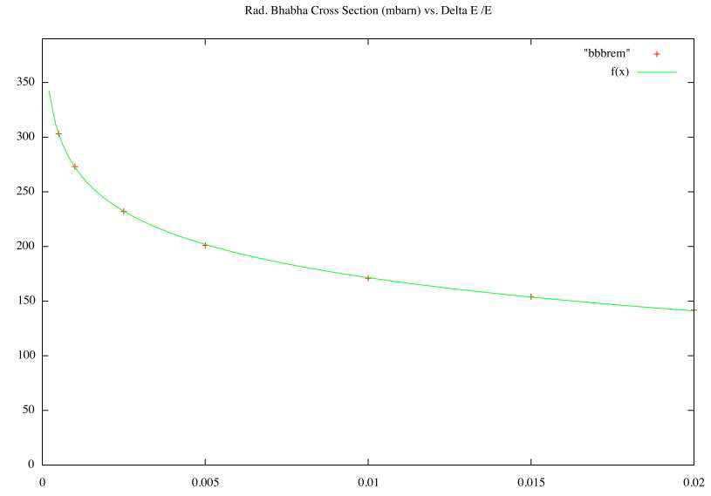
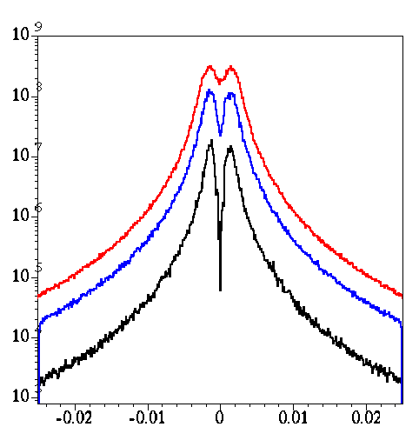
Dependence on Energy Acceptance
Radiative Bhabha Cross-section (SuperB)
Beamsstrahlung rate (FCC-ee)
σ(radBhabha) [mbarn]
350
300
250
200
150
100
50
0
[M. Zanetti]
BBBREM
f(x)
σ * L = Bremsstrahlung rate
ΔE/E
Touschek particles/ second
0 0.005 0.01 0.015 0.02
Rate (Hz)
SuperB LER (4 GeV; 1.49mA 1 bunch)
SuperB HER (7 GeV; 1.49mA 1 bunch)
DAFNE crabwaist (0.51 GeV; 10mA 1 bunch)
Lifetime estimated for these effects usually assumes ring’s energy acceptance
ΔE/E
Notes:
R=sigma*L
R=dN/dt= N/tau
tau=N/R=N/(sigma*L)

Slide 22
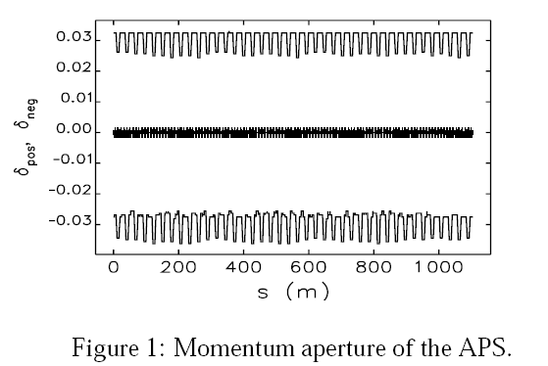
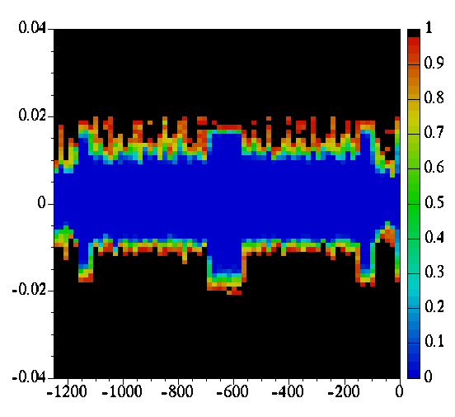
Momentum aperture
Crucial for all sources inducing a δE/E
like Touschek, rad Bhabha, beamstralung (HE)
Best determined with full tracking
A.Xiao,M.Borland, PAC07 p.3457
δE/E
Loss probability
momentum aperture
LER SuperB
Touschek Monte Carlo tracking
s(m)
IP
Not just an s dependent momentum aperture
PEP-X Y. Cai, SLAC
FLS-2012, March 2012

Slide 23
Pair production: e⁺e⁻ (and μ⁺μ⁻)
e⁺e⁻ -> e⁺e⁻ e⁺e⁻
It can be studied with GUINEA-PIG generator
can be high production rate but particles have low energy and loop in the solenoid field
relevant for which sub-system?
typically low energy curling e⁺e⁻ relevant for vertex detector and first layers of tracking devices
first guess at generator level (with magnetic fields)
full simulation with Geant4 needed for detailed study
Same statements are valid for μ⁺μ⁻ production (e⁺e⁻ -> e⁺e⁻ μ⁺μ⁻) to be checked at these energies

Slide 24
Conclusions
Synchrotron radiation in the IR region is a major issue for TLEP @ top energy
Photon energy very similar to LEP2 where this was acceptable with IRs designed for low synrad + ~100 collimators and local masks, ( L ~ 1.e32cm-2s-1 )
Work for FCC-ee / TLEP only started --- much more to do
on IR synchrotron radiation and beam particle effects

