Slide 1

BINP, Novosibirsk
MCGPJ for the processes e+e- → hadrons with kaons in FS for experiments
with CMD-3 detector at the VEPP-2000 collider
G.V. Fedotovich
V.L.Ivanov
WG 18-19 November
LNF, Frascati, Italy

Slide 2
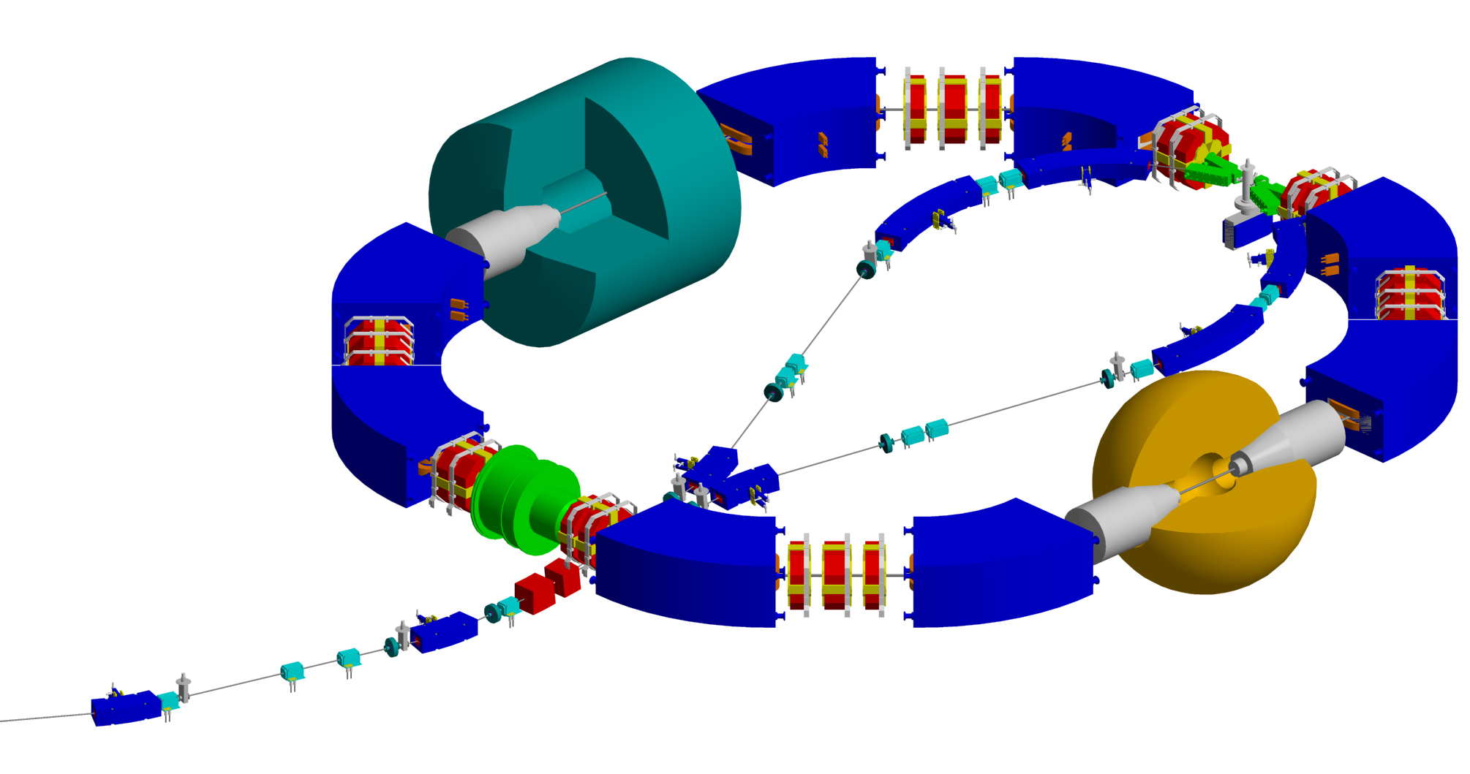
VEPP-2000 with round beams
Integrated luminosity ~ 100 pb-1 per detector/year
revolution time – 82 ns beam current – 200 mA
beam length – 3.3 cm energy spread – 0.7 MeV
circumference – 24.4 m beta function in IP β_{x}= β_{z} =4.3cm
L = 10³² cm⁻²s⁻¹ at 2.0 GeV Lpeak = 10³¹ cm⁻²s⁻¹ at 1 GeV
CMD-3
SND
Notes:
2

Slide 3
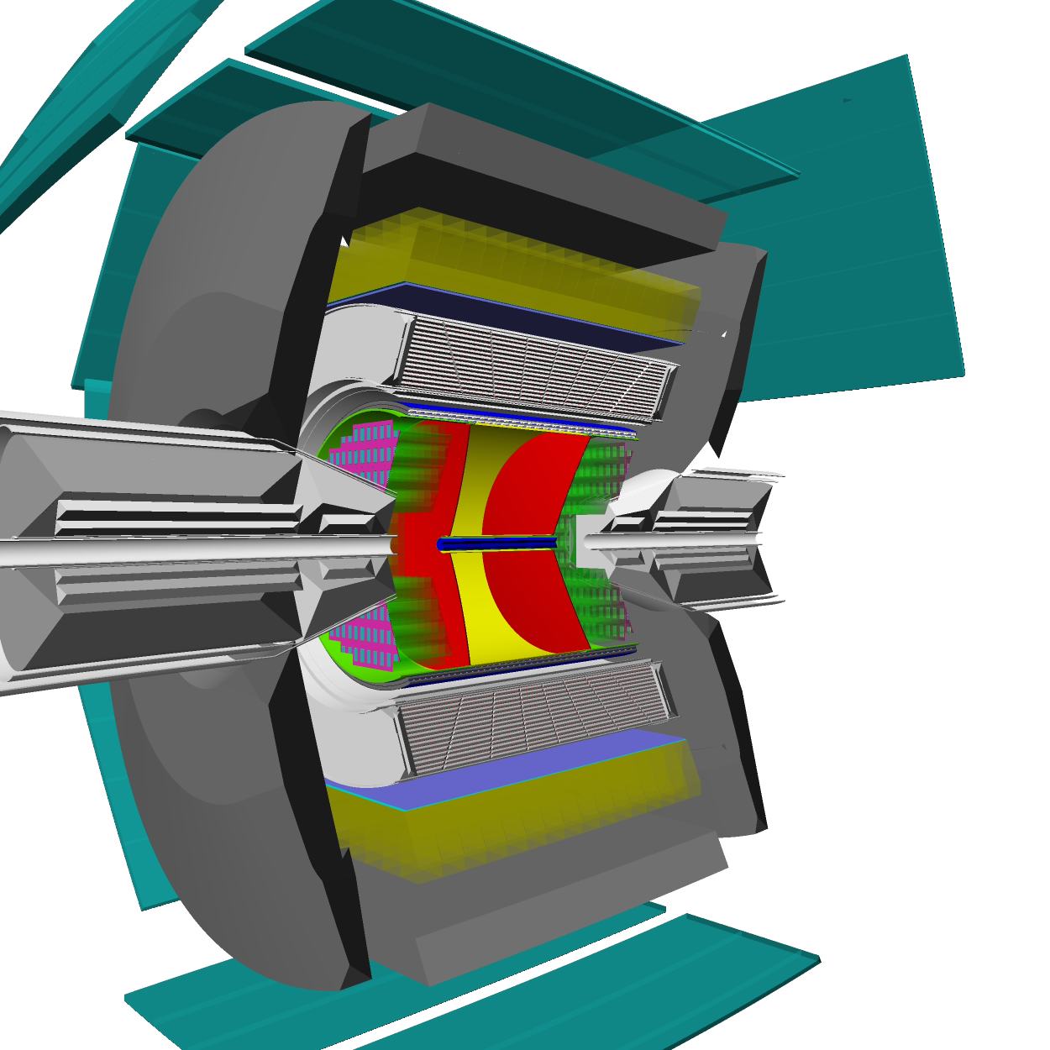
3D view CMD-3 detector
DC – 1218 hexagonal cells with sensitive
wires, W-Re alloy, 15 μ in diameter.
Z-chamber – start FLT, precise determine
z-coordinate ~ 500μ (acceptance)
LXe calorimeter thickness 5X₀, 264 towers & 2112 strips. Spatial resolution 1 – 2 mm
Calorimeter with CsI crystals (∼3,5 t), 8 octants, number of crystals - 1152, 8 X₀.
TOF – 16 counters, time resolution ~ 1ns
Muon range system – 8 octants (cosmic veto, time resolution ~ 1ns )
Magnetic field is about 1.3 T
Notes:
3

Slide 4
Motivation
Hadronic contribution to (g-2)/2 of muon, coming from VEPP-2000
energy range, is about 92 %
One of the aim of experiments with CMD-3 is to measure the main
multihadrons XS with systematic uncertainty smaller than 3% (∼0.05 ppm, except ω and ϕ)
Systematic accuracy HXS (ππ) at least better than 0.35% is required.
Hadronic contribution to AMM of muon is about 60ppm: 60×0.005 = 0.2ppm
The aim of new FNAL and JPARC experiments for (g-2) is to improve
the previous BNL result by a factor of 4! and to achieve the accuracy ∼ 0.15 ppm - good test of SM
Obviously that the systematic uncertainly of RC for the MHXS should
be smaller than 1-2%
Measurement of the cross sections e+e- → hadrons is interesting to
study intermediate states which should explain the dynamics production of
multihadrons events
Conclusion: Previous experience for 3 pion channel – FSR contributes to
XS at the level 0.3%. Obviously for multihadrons channels the FSR will contribute to XS smaller than 0.3%!!! In the scale of 1-2% accuracy we can neglect by FSR and consider photon jet radiation in collinear regions only.
Notes:
4

Slide 5
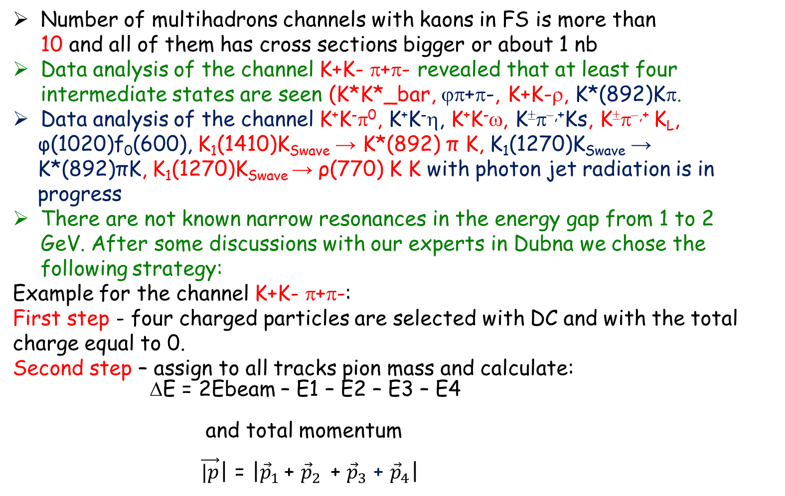
Motivation and approach

Slide 6
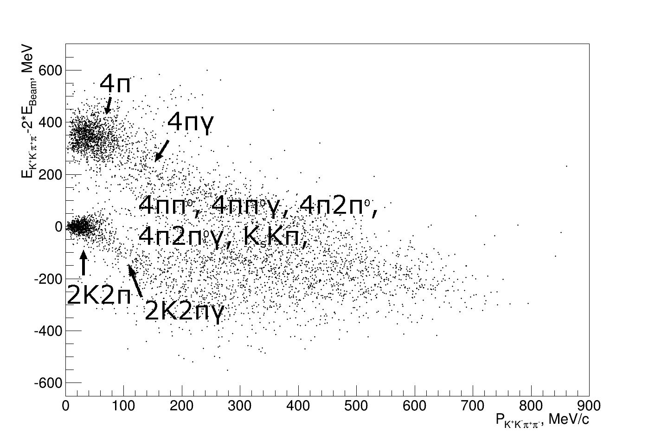
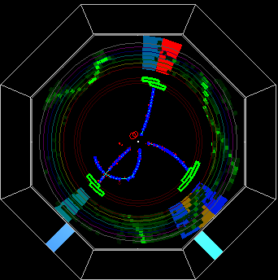
Events with four tracks in DC
All four particles have tracks in DC and their momenta are reconstructed according to the track curvature in DC
Energy-momentum conservation is used to extract K+K-π+π- events
Selected test events are inside the red rectangle
Study different invariant mass distributions to choose the main intermediate states – IN ORDER TO CORRECTLY CALCULATE THE DETECTION EFFICIENCY

Slide 7
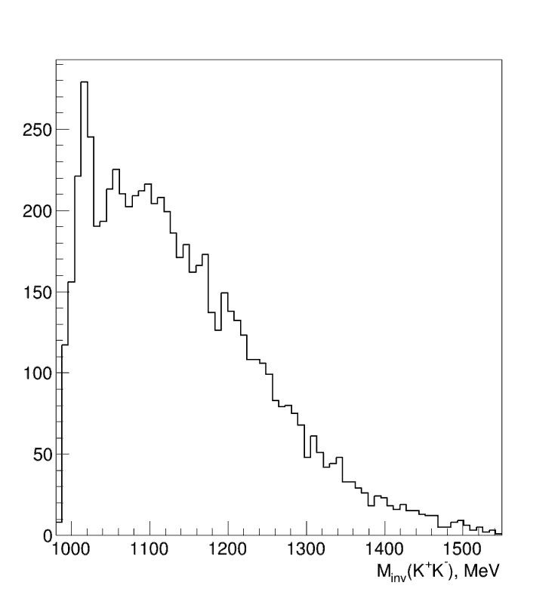
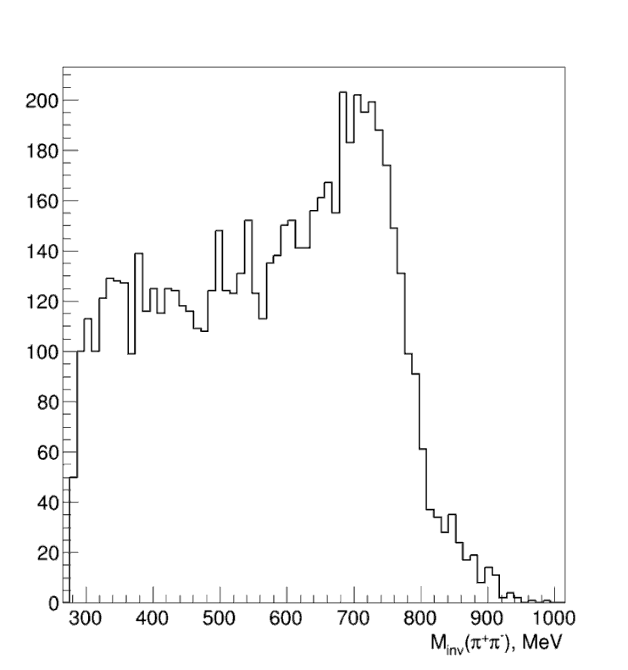
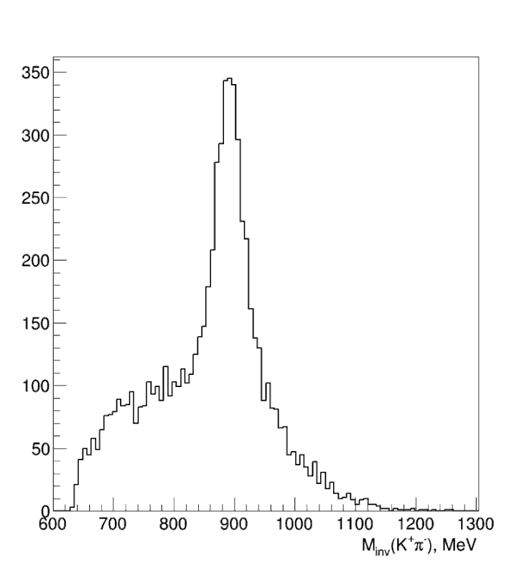
Dynamics
It was found that the dominant intermediate
states are:
K*(892) in invariant mass combination K±π∓
ρ⁰(770) in invariant mass combination π⁺π⁻
φ⁰(1020) in invariant mas combination K⁺K⁻
φ⁰(1020)
ρ⁰(770)
K*(892)

Slide 8
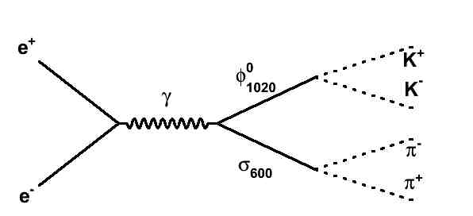
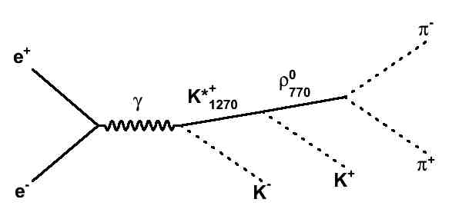
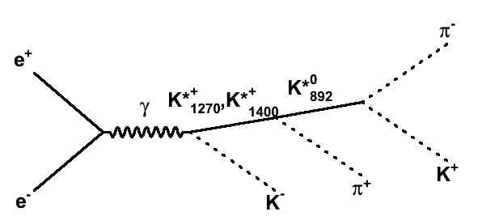
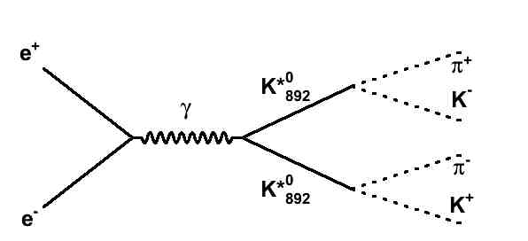
Simulation
Matrix element is written with the all intermediate states found under assumption that two-particles middle states give the main contribution.
The simplest model is chosen to correctly described (more or less) the experimental angular and momentum distributions.
Parameters of matrix element have been defined for all energy points from approximation of angle and invariant mass distributions.

Slide 9
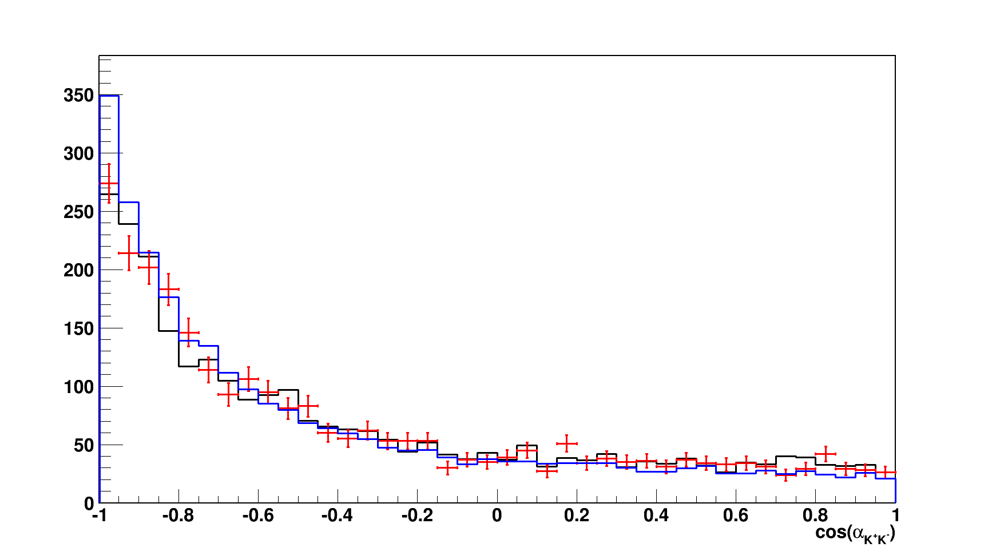
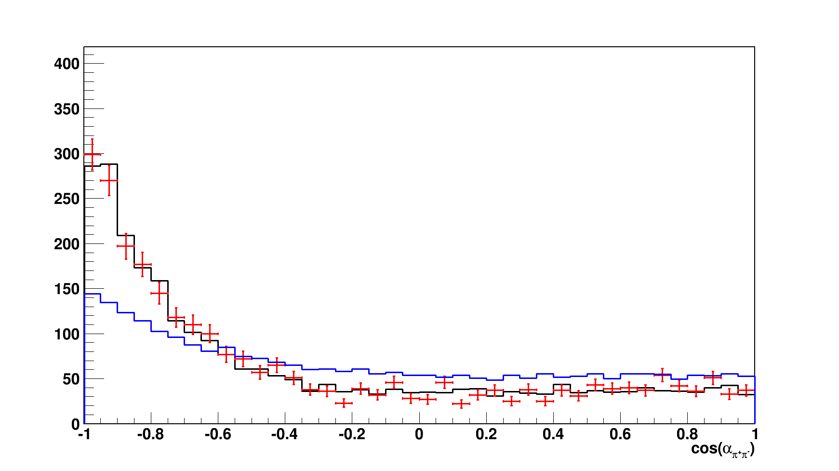
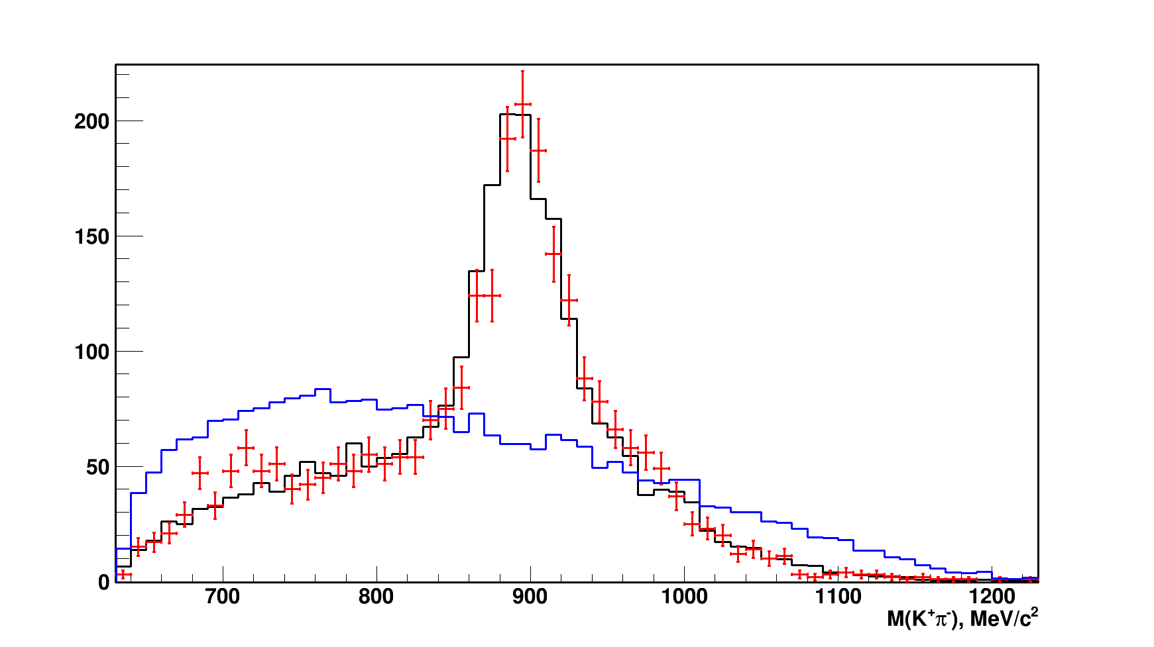
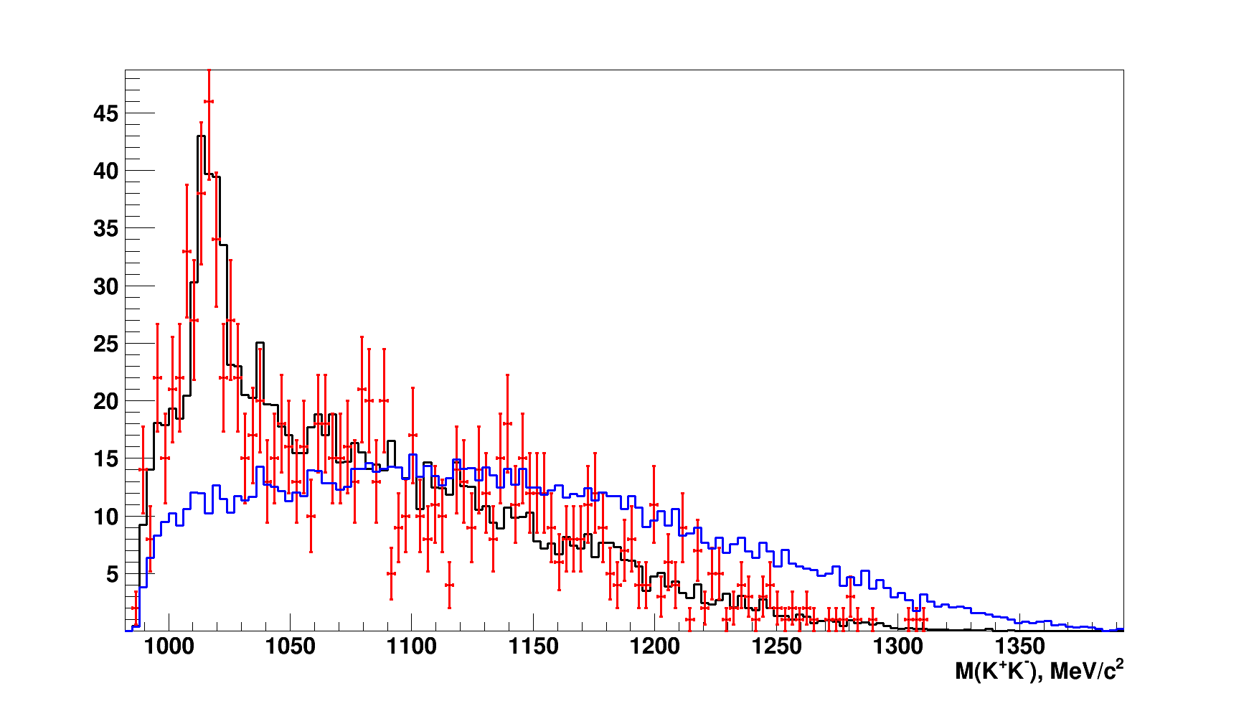
Simulation vs Experiment
/26
Comparison of the experimental angular and momentum distributions with simulation (collected several energy points to increase statis).
Red – experiment, BLACK – simulation, BLUE - PHASE SPACE

Slide 10
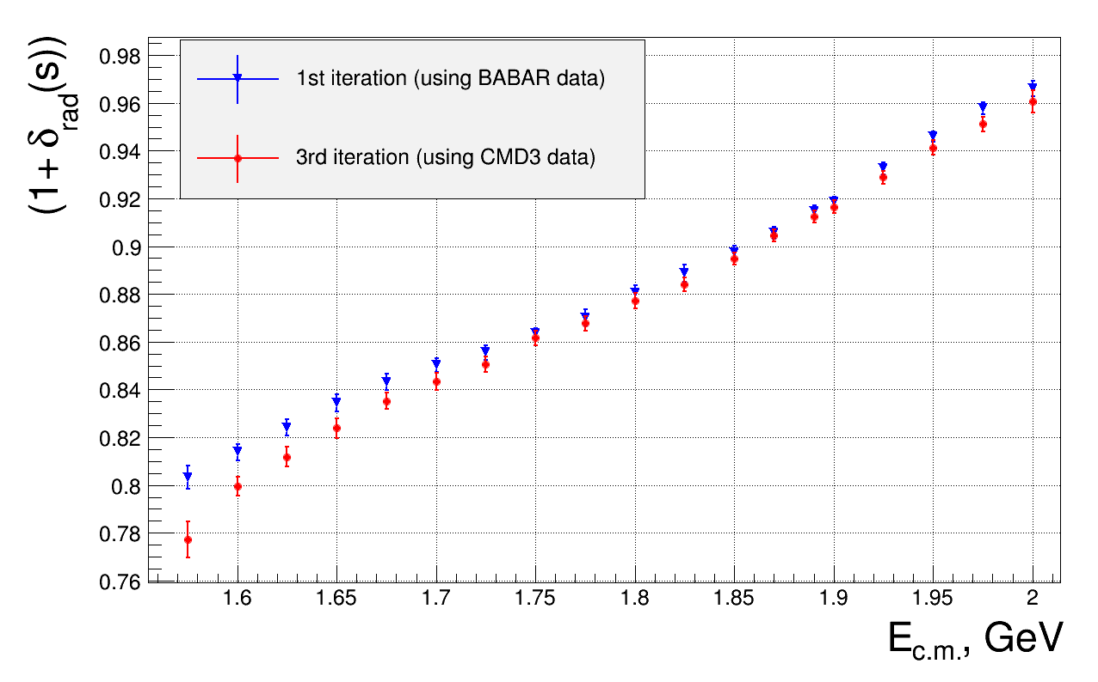
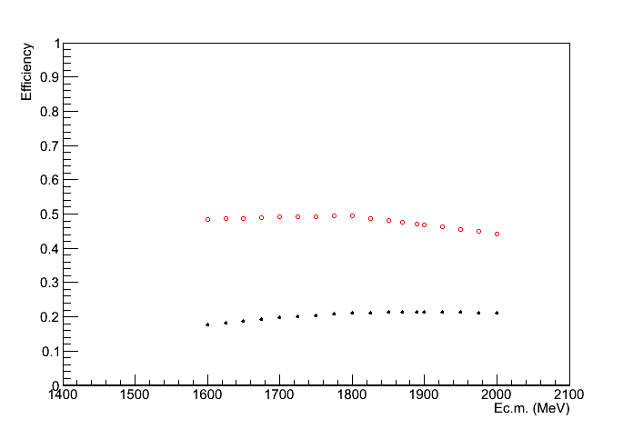
Radiative correction with photon jet radiation in collinear region (MCGPJ)
CONCLISION!

Slide 11
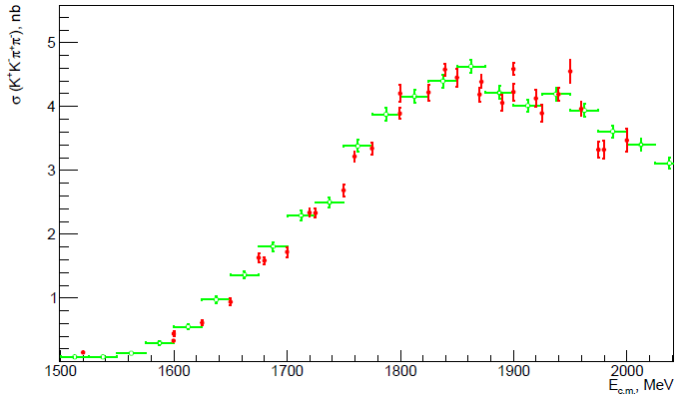
Cross section of the process e⁺e⁻→K⁺K⁻π⁺π⁻
- CMD3
- BaBar
preliminary

Slide 12
/26
Another example: e⁺e⁻ → φη → K⁺K⁻η
Process e+e- → K+K-η was studied at Babar experiment in η → 2γ decay mode (480 events) and in the channel η → π⁺π⁻π° (250 events)
It was found the process is basically goes through ϕη intermediate state. Non-resonant cross section σ(e⁺e⁻ → K⁺K⁻η) is suppressed by a factor of 15. Therefore we can neglect by it (at the first time) keep in mind the accuracy about 10%
To select signals under study we use only the tracks of charged kaons in DC. It allows to increase significantly statistics and to facilitate the analysis of date
The all main decay modes of η are taken into account: Br(η → 2γ ) ∼ 39.31%, Br(η → 3π°) ∼ 32.57%, Br(η → π⁺π⁻π°) ∼ 22.74%.
Analysis is based on integrated luminosity about 21 pb⁻¹ collected in center of mass energy range from 1.5 to 2 GeV
To perform the analysis, matrix element was written for the channels, which are seen in invariant and missing mass distributions:
e⁺e⁻ → K⁺K⁻η, K⁺K⁻π°, K⁺K⁻ω. Two last channels produced physical
background

Slide 13
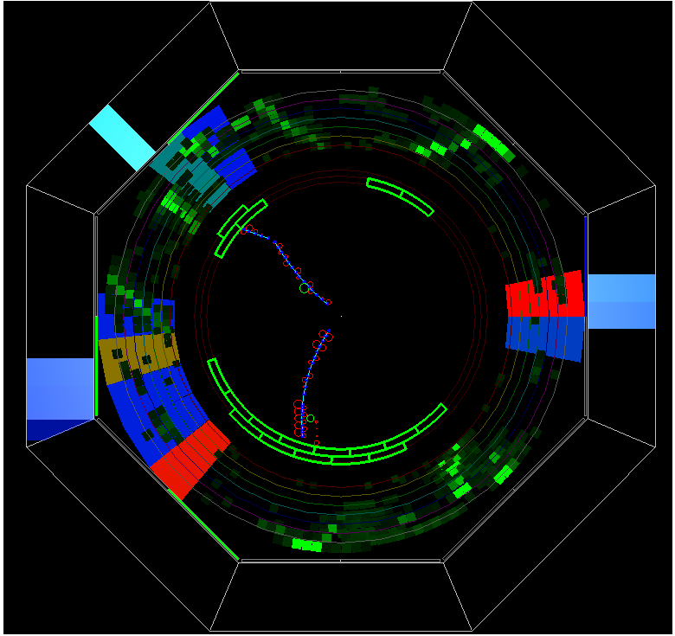
Back slides

Slide 14
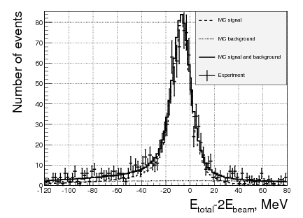
Selection criteria
/26
Two tracks in DC coming from interaction point
Total charge = 0
Momentum of every charged kaons ∈ 40,550 MeV/c (according to sim)
Ionization losses must confirm dE/dx losses of kaons.
Invariant mass two kaons should be around ϕ- meson:
1000 MeV < M_{inv}(K⁺K⁻) < 1050 MeV
Constraints on the angle between kaons (according to sim)
So we have two “kaons”
The total energy of particles system is defined as:
This plot demonstrates the selection quality
using kinematic cuts only. Nevertheless some structure is seen on both tails.
It is important to find out what intermedi-ate states are responsible for two charged kaons production and what other particles can be produced too.

Slide 15
Invariant and missing mass of
the system K⁺K⁻
All data are collected
To perform the analysis, matrix elements were written for the channels,
which are seen in invariant and missing mass distributions:
e+e- → K⁺K⁻η, K⁺K⁻π°, K⁺K⁻ω, K⁺K⁻f₀(600)

Slide 16
Radiative correction and efficiency
/26
After this step we know the main mechanism K+K-η production is
e+e- → ϕ’(1680) → ϕ(1020)η with known angular distribution proportional to 1 + cos²θ. Now we calculate the detection efficiency with RC (including all kinematics cuts) and we are able reconstruct the visible cross section. Next step → we calculate the cross section and repeat this procedure several times. As a rule three iteration is enough to have accuracy better than 1%.

Slide 17
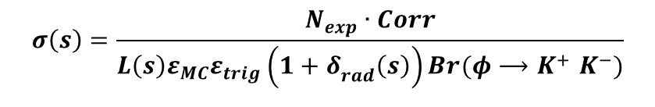
Cross section of the process e⁺e⁻ → K⁺K⁻η
/26
BABAR
Statistic ∼ 750 events
CMD-3 (preliminary)
statistics ~ 2500 events
Four-fold increase
preliminary

Slide 18
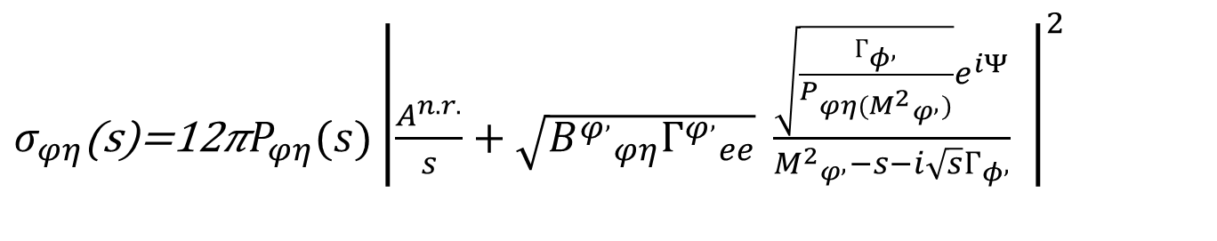
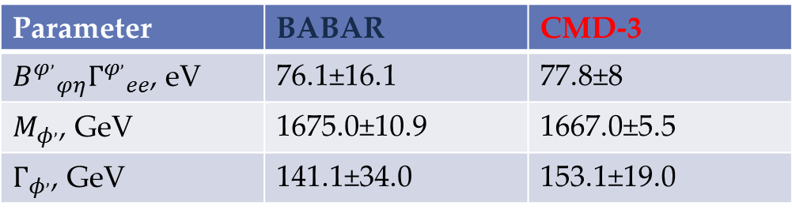
Approximation of cross section
/26
Parameter | BABAR | CMD-3
 | 76.1±16.1 | 77.8±8
 | 1675.0±10.9 | 1667.0±5.5
 | 141.1±34.0 | 153.1±19.0

Slide 19
Conclusion and Outlook
CMD-3 collected data in a broad energy region. Particularly
inside energy band from 1 to 2 GeV integrated luminosity
∼ 35 pb-1
L~2x10³¹ cm⁻¹sec⁻² has been reached and limited while by positron rate
production. “Unlimited” positron source is in preparation. Luminosity and
statistics will be increase by a factor of 10
For some hadronic channels statistical errors are smaller 5% and will be
improved in future runs. We can meet statistical accuracy ∼ 1% ÷ 3%
for some MH channels
MC generators for these channels with RC should has systematic uncertainly smaller 1% (desirable)
MCGPJ based on SF approach is in progress now for multihadrons
channels with kaons in final states.
Cross section of the process e⁺e⁻ → K⁺K⁻η was measured in the energy
region 1.57-2 GeV with statistical error about 7-10% (number of events
is about 2500) and systematic uncertainty is estimated as 10%
Cross section of the process e⁺e⁻ → K⁺K⁻π⁺π⁻ was measured in the energy region 1.5-2 GeV with statistical error about 4-10%. The systematic uncertainty is estimated as 7%.

Slide 20
Back slides

Slide 21
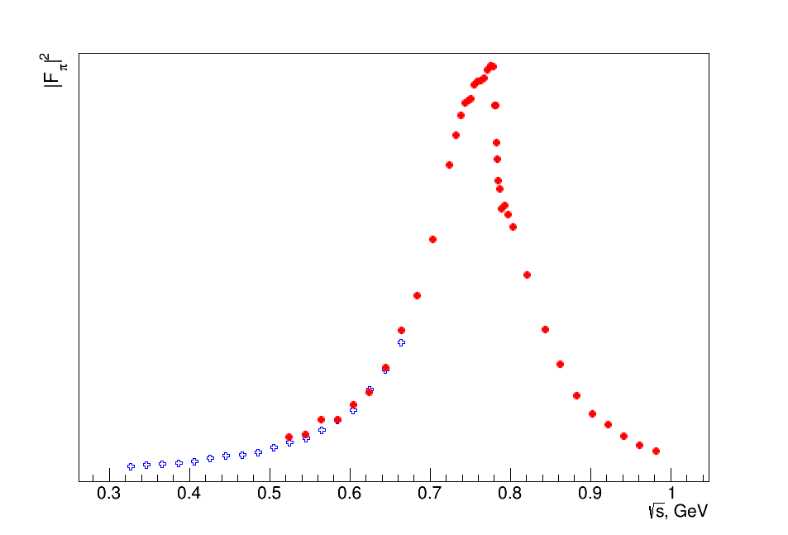
e+e- -> π+π- by CMD3
|Fπ|²
e/μ/π separation using energy deposition in calorimeter
Very preliminary
e/μ/π separation using particles momentum

Slide 22

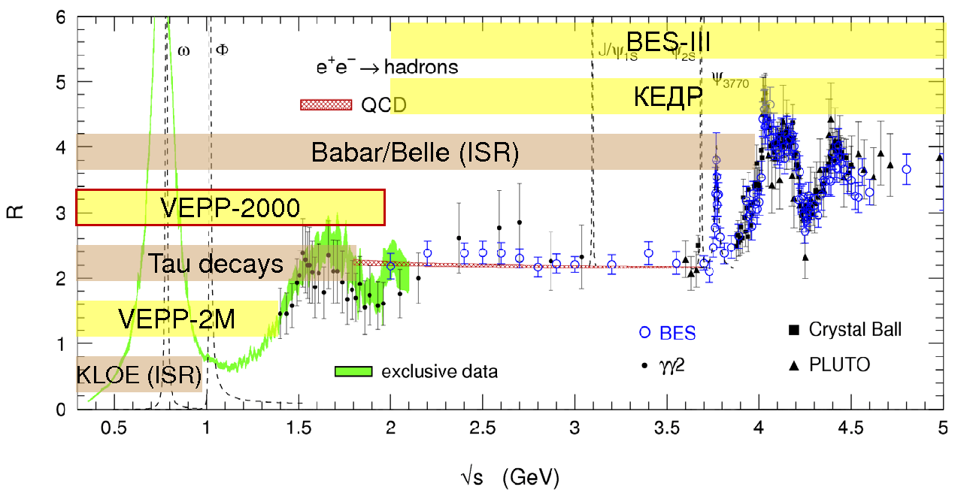
R(s) measurements at low s
At low s R(s) has to be measured in each channel.
The value and the error of the hadronic contribution
to muon (g-2) are dominated by low energy R(s) (<2GeV give 92%).
α_{QED}(M_{Z}) – half of error comes from 2E < 4 GeV

Slide 23
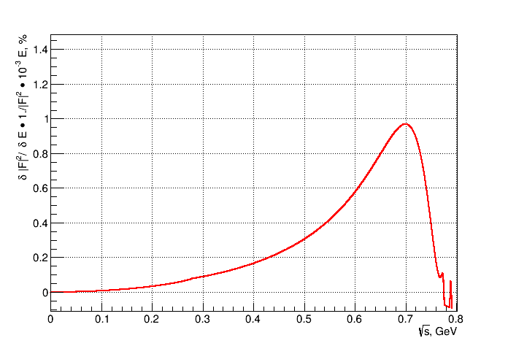
Accuracy of energy measurement
(current status)
0.1 МэВ
0.3 % systematic
0.16 МэВ
0.1 % systematic

Slide 24
SM prediction for muon g-2
a_{μ}^{exp} = (g-2)_{μ}/2 = (11 659 208.9 ± 6.3)x 10⁻¹⁰
a_{μ}^{th} = a_{μ}^{QED} + a_{μ}^{EW} + a_{μ}^{hadr} Δ(Exp. – Theor.)
~3.3-3.6σ
QED contribution 11 658 471.808 ±0.015 Kinoshita & Nio, Aoyama et al
EW contribution 15.4 ±0.2 Czarnecki et al
NLO hadronic −9.8 ± 0.1 HLMNT11
LO hadronic 694.1 ±4.3x 10⁻¹⁰ HLMNT 11
Main channels which contribute to precision at √s<1.8 GeV
π+π− 505.65 ± 3.09
π+π−2π0 18.62 ± 1.15
π+π−π0 47.38 ± 0.99 (mostly from omega region)
2π+2π− 13.64 ± 0.36 (BaBar)
K+K- 22.95 ± 0.26 (BaBar)
Isospin relations: 5.98 ± 0.42 for not measured KKπ, KK2π, 2π4π0, 2π3π0
12.46 ± 0.76 for √s<2 GeV)
(1.5 - 3σ of total error - crucial in case of isospin violation)
Rqcd[2-11GeV] 41.19 ± 0.82
LBL 10.5 ± 2.6 Prades, de Rafael & Vainshtein need more theory
Theory TOTAL ± 4.9
δa_{μ}

Slide 25
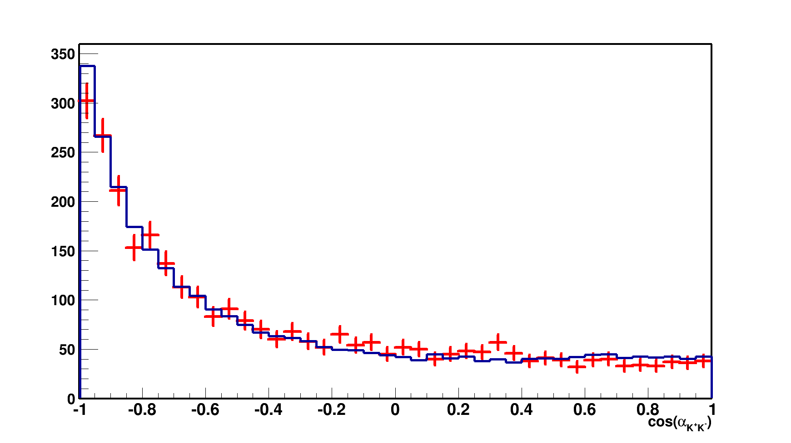
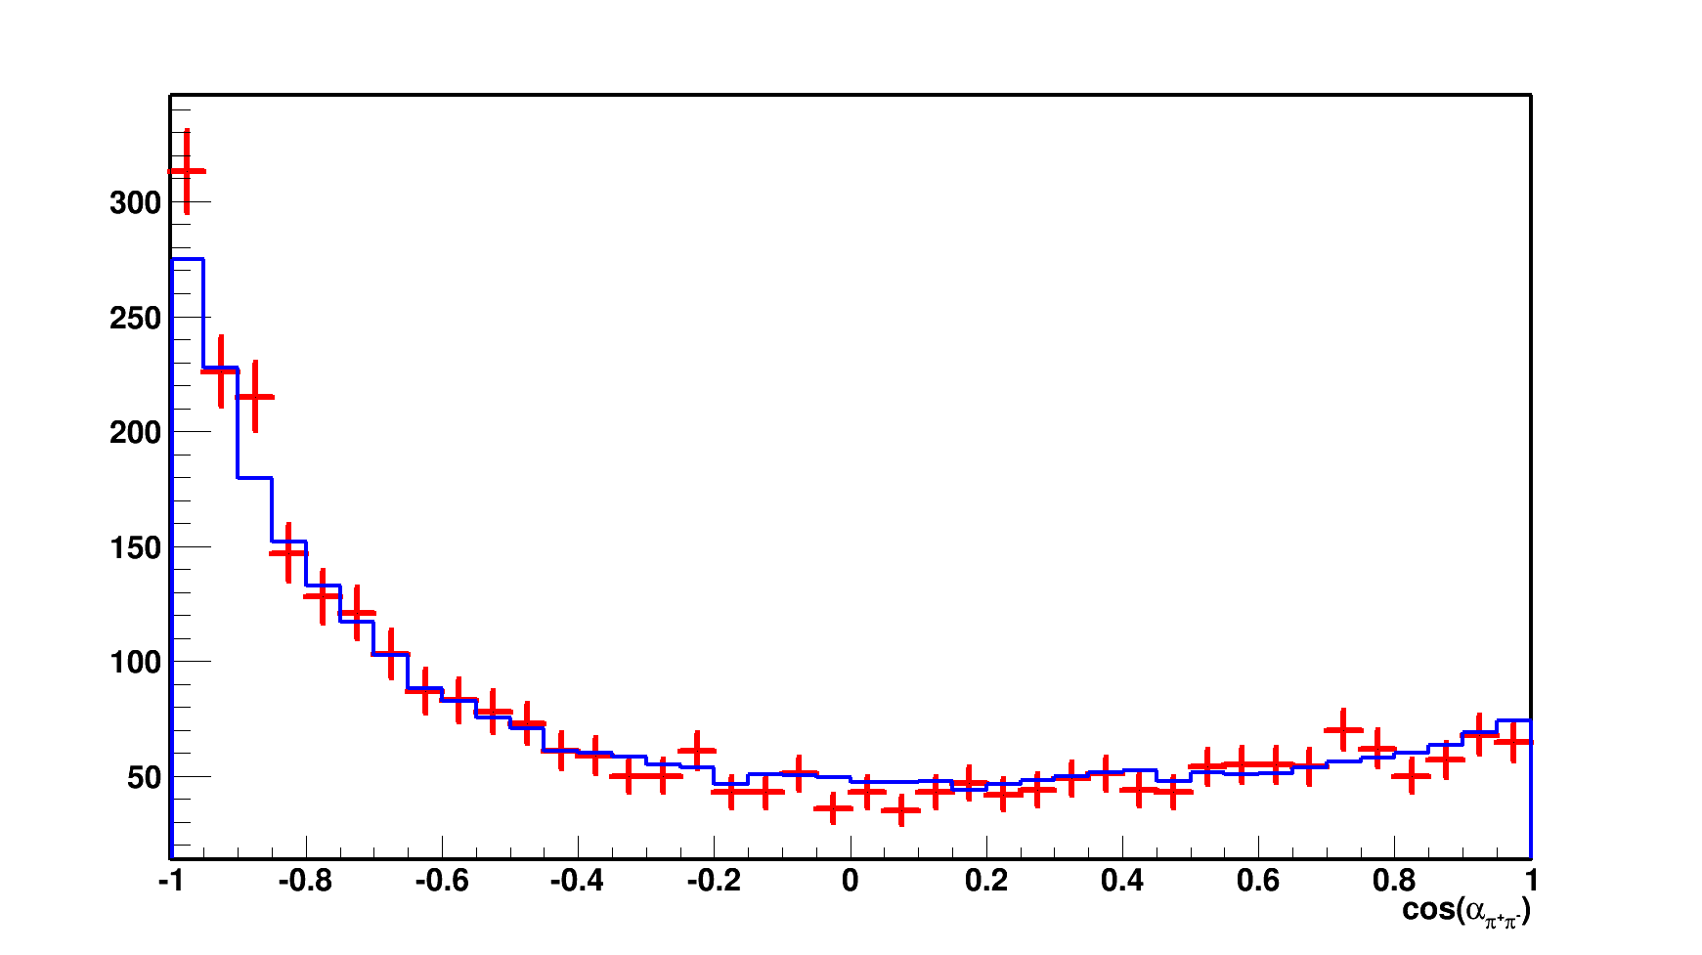
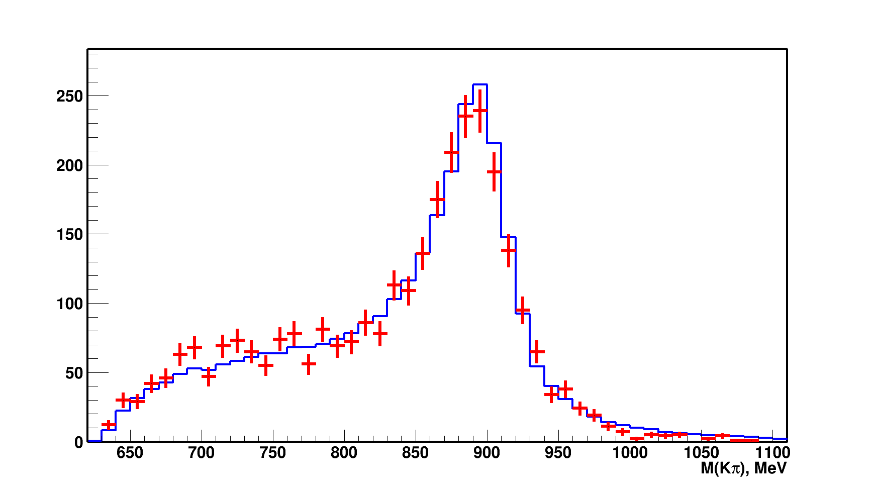
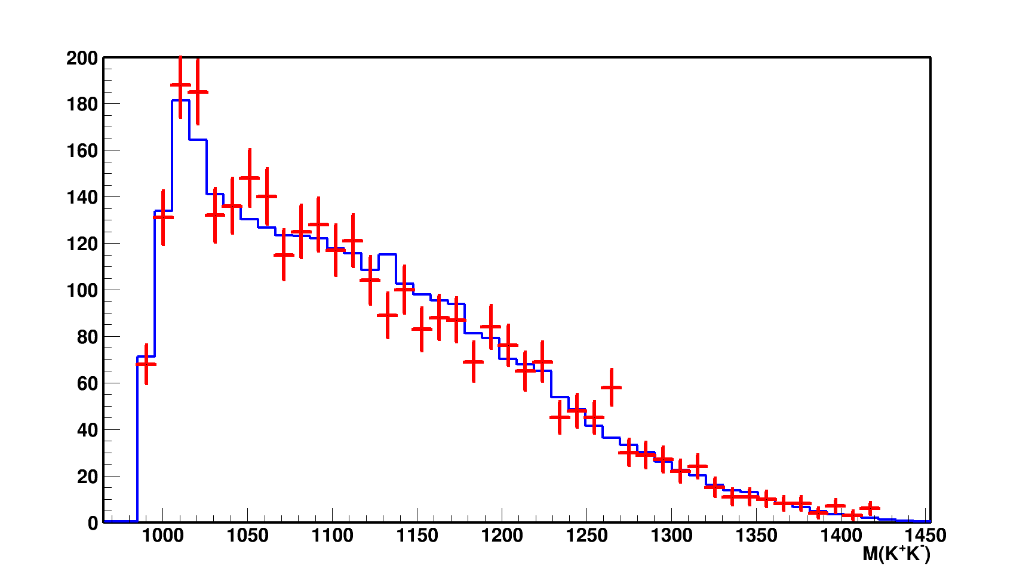
Simulation vs Experiment
Comparison of the experimental angular and momentum distributions with simulation at energy 1800 MeV in the center of mass.
Red – experimental blue – simulation

Slide 26
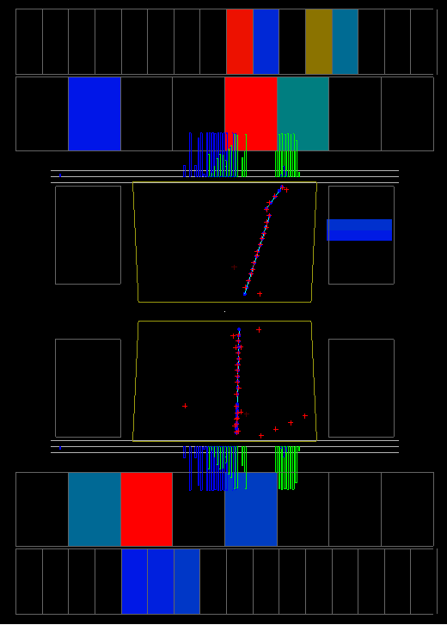
Back slides

Slide 27
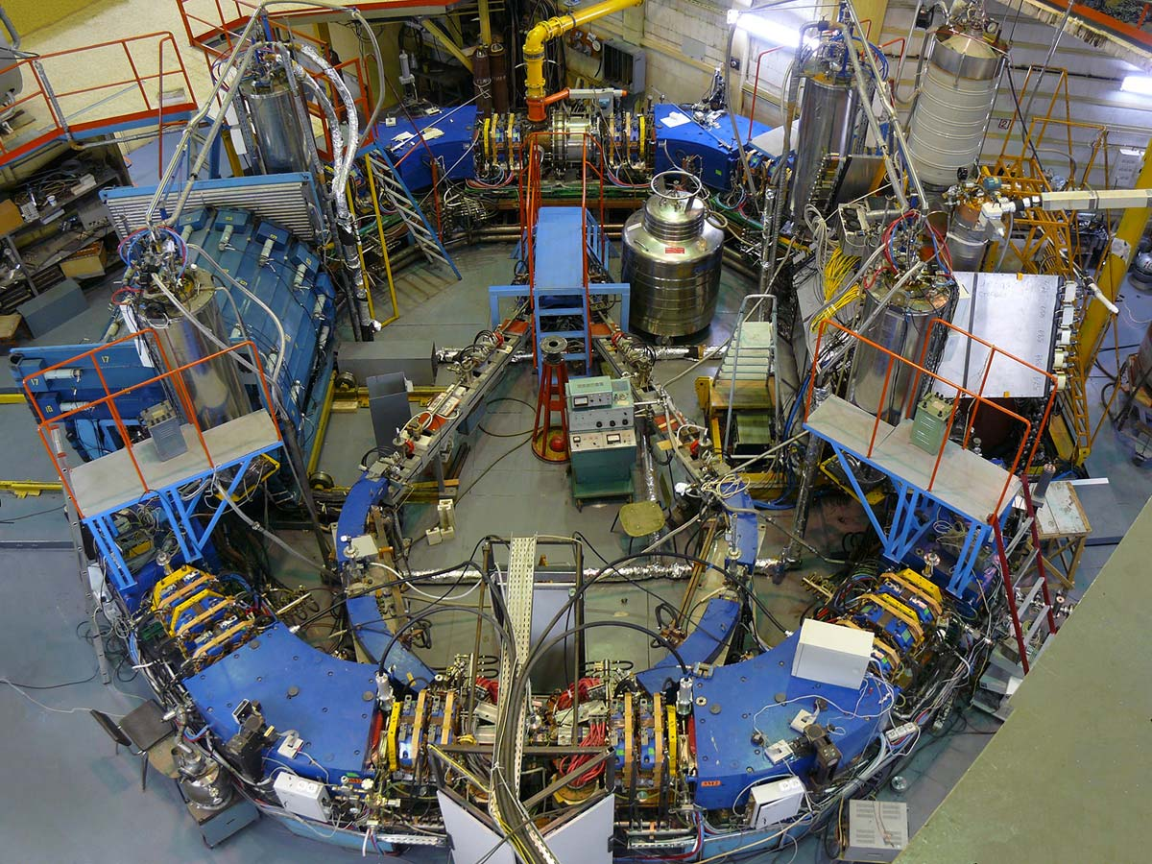
VEPP-2000
SND
CMD-3

