Slide 1



Simulations of BH Collisions in AdS Spacetimes
Paul Romatschke
CU Boulder & CTQM & JET Collaboration
Based on arXiv: 1410.4799 with Hans Bantilan

Slide 2
Outline
Motivation
Simulating BH Collisions
Conclusions

Slide 3
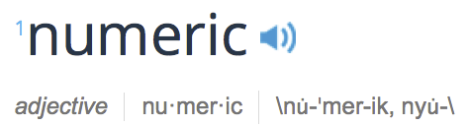
A theorists’s way to conduct experiment
“Experimental challenges”: need to be careful about errors (“bugs”), numerical convergence, accuracy, infinite volume limit, continuum limit.
“Experimental rewards”: give answers in situations where analytic approximations fail/very difficult.
Difference to real experiments: with numerics we can study systems not realizable in nature.

Slide 4
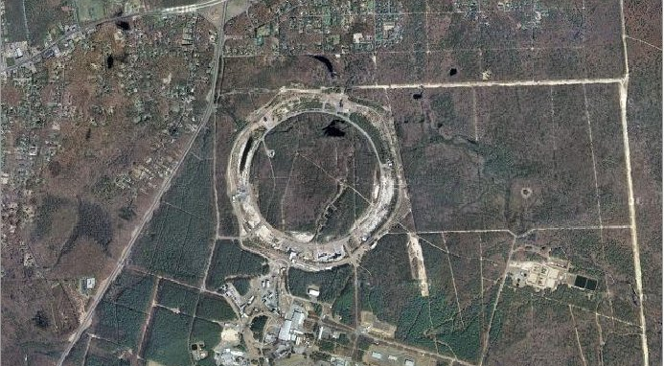
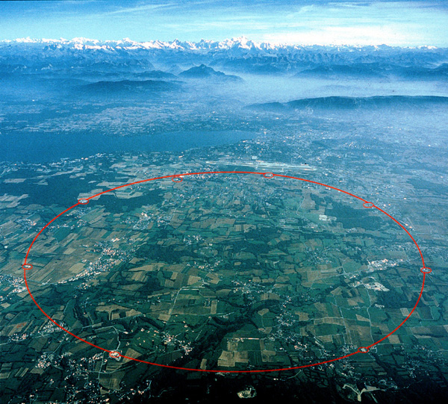
Motivation
Relativistic Ion Collisions
LHC
RHIC

Slide 5
Heavy-Ion Collisions
2003-present: QCD matter behaves fluid-like, not gas-like (despite asymptotic freedom)
Large “flow” signals, e.g. v₂, v₃, v₄, v₅ in Pb+Pb collisions at LHC (correspond to l=2..5 in CMB Background)
Hydrodynamic models correctly describe 99% of particles registered in experimental detectors

Slide 6
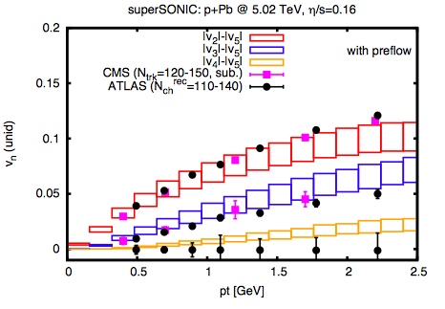
Light-on-Heavy-Ion Collisions
Large “flow” signals, e.g. v₂, v₃ also found in d+Au, p+Pb collisions
[PR, 1502.04745]

Slide 7
QGP: Matter @ 4 Trillion K
Temperature: 4x10¹² K
Lifetime: 10⁻²³ sec
Size: 10⁻¹⁴ ^{m}
Gradients are large!
Why does hydrodynamics apply at all?
Even for small systems (p+Pb)?
Can we understand equilibration?

Slide 8
Motivation
Understand equilibration in relativistic ion collisions using AdS/CFT

Slide 9
Goal
Solve dynamical Einstein Equations (w/ or w/o additional fields) in asymptotic AdS for strong gravity situations (BH formation, BH collisions, etc.)

Slide 10
Choices
Analytic versus numerical?

Slide 11
Choices
Analytic versus numerical? Here: Numerical!
Algorithm: Infalling EF (Chesler/Yaffe) or Generalized Harmonics (Choptuik/Pretorius)?

Slide 12
Choices
Analytic versus numerical? Here: Numerical!
Algorithm: Infalling EF (Chesler/Yaffe) or Generalized Harmonics (Choptuik/Pretorius)?
CY: Planar Horizons, extremely effective (computationally cheap) for certain applications
GH: General (non-planar or no horizons), computationally more expensive, generally applicable

Slide 13
Choices
Analytic versus numerical? Here: Numerical!
Algorithm: Here: Generalized Harmonics
Gives us a general-purpose tool!

Slide 14
Choices
Analytic versus numerical? Here: Numerical!
Algorithm: Here: Generalized Harmonics
Gives us a general-purpose tool!
Study Relativistic Ion Collisions via simulating BH collisions in AdS₅
Study stability of global AdS₄ & AdS₅ (or others) via simulating scalar field collapse
Study Holographic Turbulence
Fate of unstable BHs, entanglement entropy,…

Slide 15


Einstein Field Equations in GH
Slides from Hans Bantilan, CU Boulder, Oct 2014

Slide 16
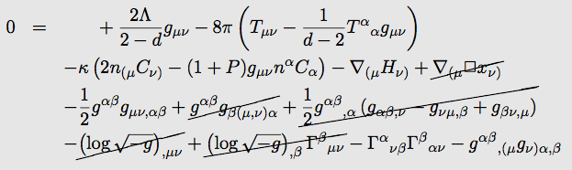
Einstein Field Equations in GH
Slides from Hans Bantilan, CU Boulder, Oct 2014

Slide 17
Einstein Field Equations in GH
We solve these numerically
Slides from Hans Bantilan, CU Boulder, Oct 2014

Slide 18
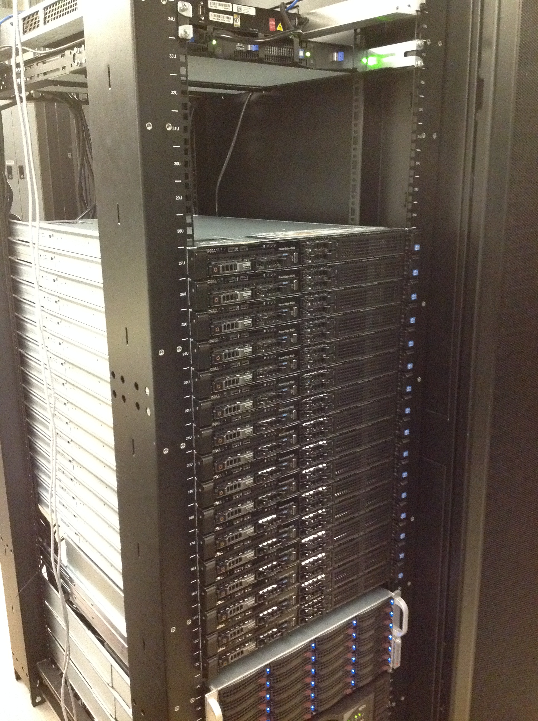
Numerics/Hardware
C,C++, Fully parallel (openMPI)
Hardware used:
Eridanus cluster (CU Boulder, 192 cores @ 2 GHz/core), Infiniband interconnections
Orbital cluster (Princeton, ~3700 cores @ 3.5 GHz/core), Infiniband interconnections

Slide 19
Simulations of BH Collisions in Global AdS₅
Head-on Collisions
Global AdS rather than Poincare patch
Initial Data: pure AdS + massless scalar field (Coulomb branch), quickly collapsing to form BHs (non-planar horizon!)
Use excision to simulate space-times with BHs

Slide 20
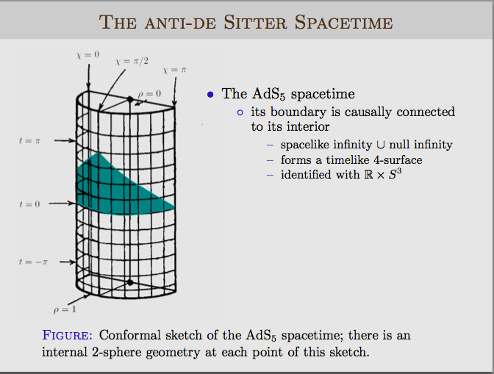
Hans Bantilan, CU Boulder, Oct 2014

Slide 21
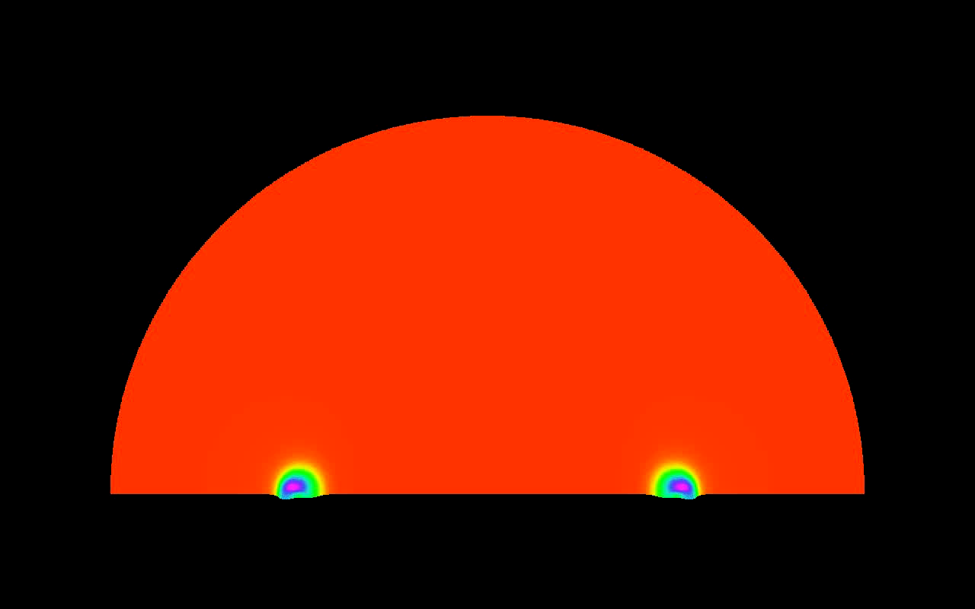
Metric, separation D=0.5

Slide 22
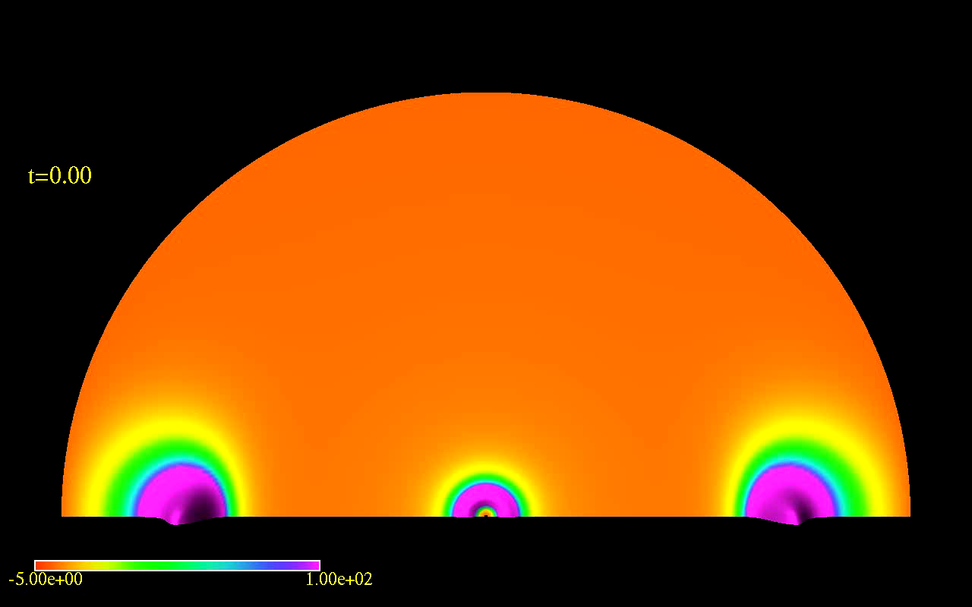
Metric, separation D=0.7

Slide 23
Hans Bantilan, CU Boulder, Oct 2014

Slide 24
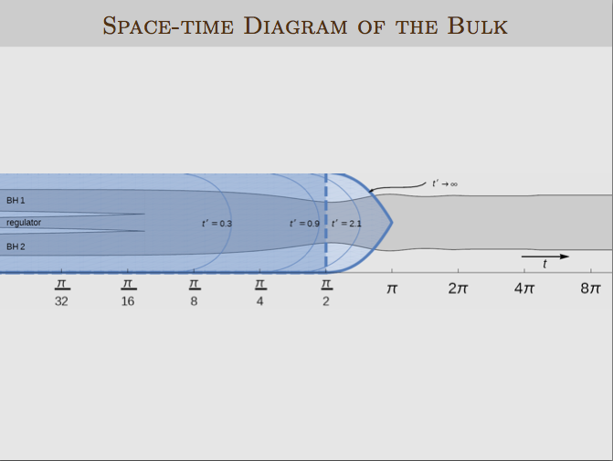
[Bantilan and PR, 1410.4799]

Slide 25
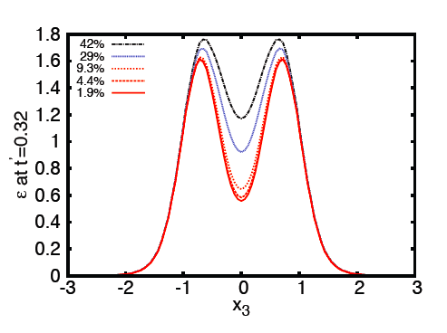
Relevance of the regulator BH
[Bantilan and PR, 1410.4799]

Slide 26
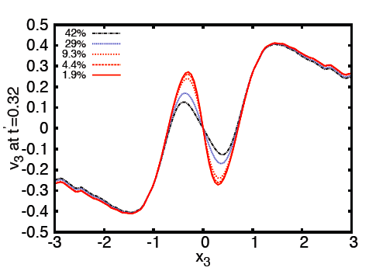
“Collision” velocities
[Bantilan and PR, 1410.4799]

Slide 27
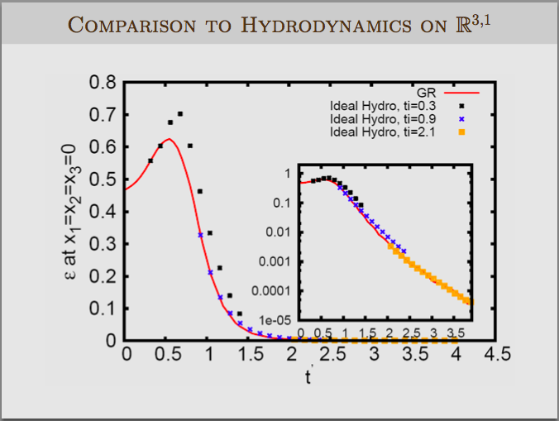
[Bantilan and PR, 1410.4799]

Slide 28
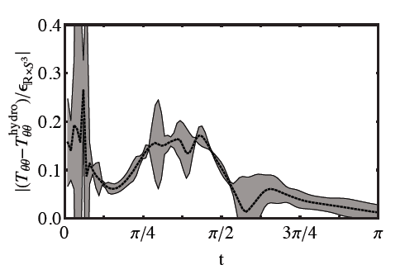
[Bantilan and PR, 1410.4799]

Slide 29
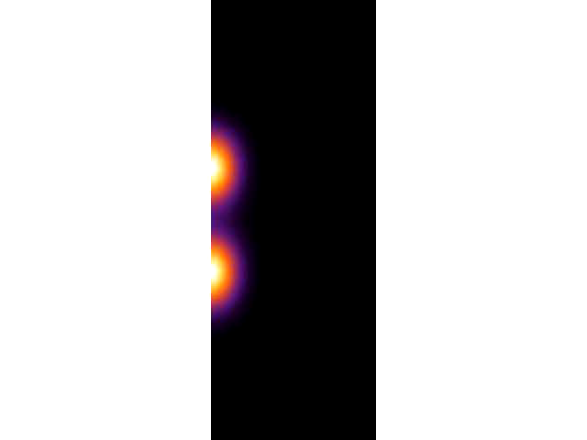
Boundary Energy Density
[Bantilan and PR, 1410.4799]

Slide 30
Simulations of BH collisions
We have numerical results for metric in all of space-time, including boundary data
We have metric data (a bit) inside trapped surfaces: could be useful for entanglement entropy calculations (?)
Metric data/boundary data could be used for comparison to analytic results (cf Shiraz’s talk)
This data is publicly available. If you can’t find something on our website, just ask!

Slide 31
Can AdS/CFT dynamics be experimentally probed in relativistic ion collisions?

Slide 32
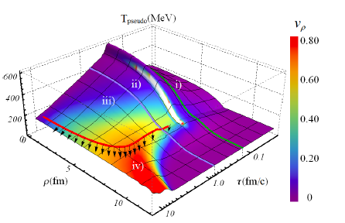
AdS+hydro+cascade (“SONIC”)
[van der Schee, PR & Pratt, PRL111 (2013)]

Slide 33
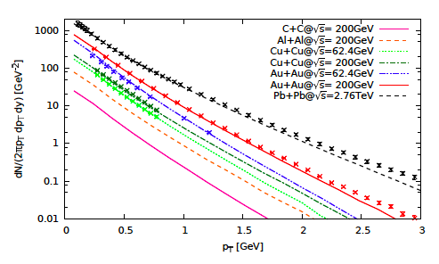
SONIC works well for describing exp’ data in AA
[Habich, Nagle and PR, 1409.0040]

Slide 34
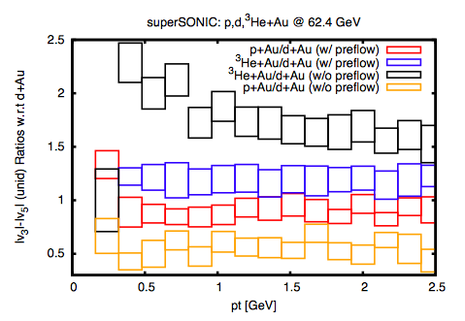
A way to probe QCD pre-eq flow?
[PR, 1502.04745]

Slide 35
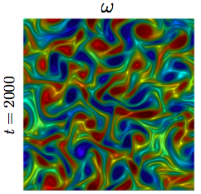
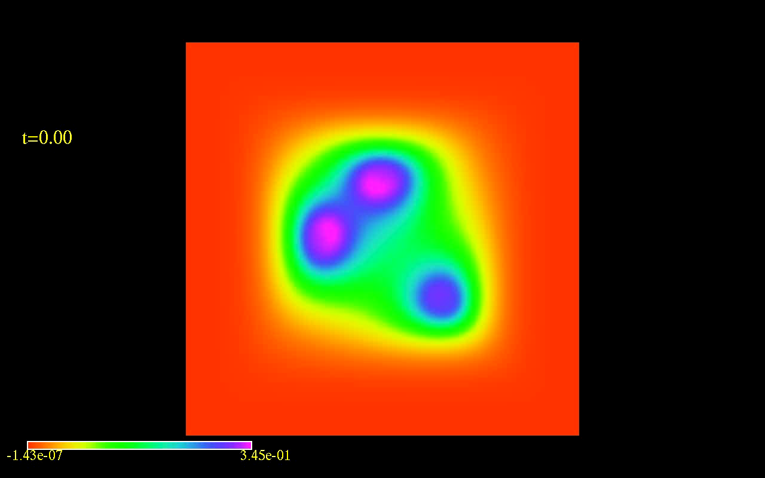
Turbulent Gravity
[Adams, Chesler, Liu 2013]
[Gorda & Bantilan, unpublished]
Planar Horizon (Black Brane)
No/Poincare Horizon

Slide 36
Turbulent Gravity
[Gorda & Bantilan, unpublished]

Slide 37
Summary/Conclusions
General Purpose numeric solutions to Einstein Equations in asymptotic AdS using GH
Successful numerical solutions for BH collisions in global AdS₅
AdS (preeq)+Hydro(eq)+Hadron Cascade works surprisingly well in describing experimental data
More results (e.g. AdS stability) coming soon!

Slide 38
Bonus Material

Slide 39
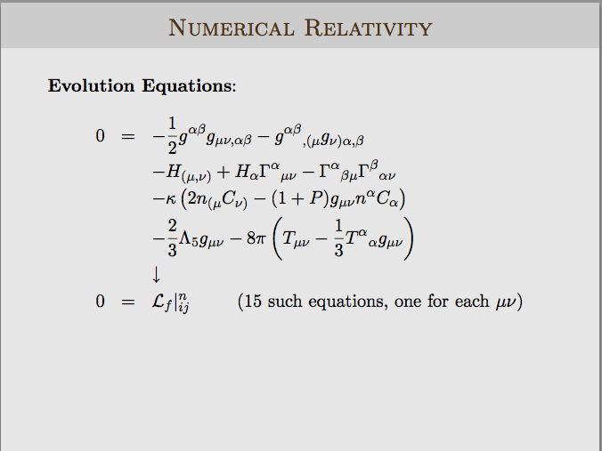
Use second-order differencing to discretize these
Hans Bantilan, CU Boulder, Oct 2014

Slide 40
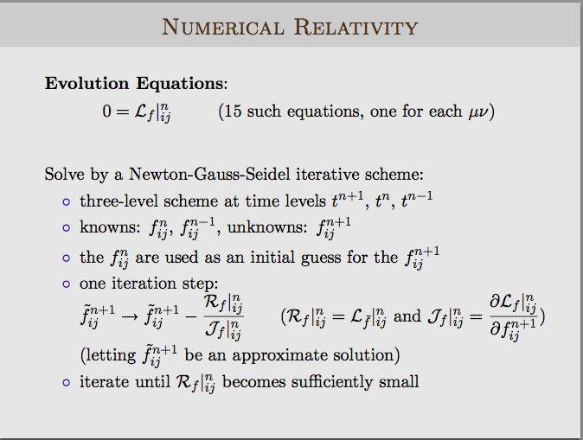

Slide 41
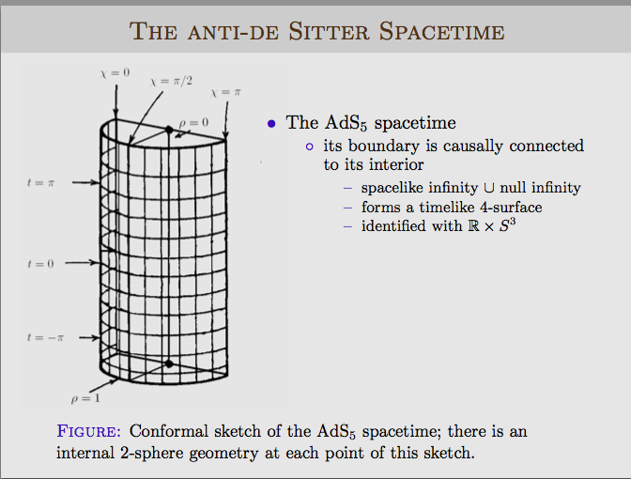
Hans Bantilan, CU Boulder, Oct 2014

Slide 42
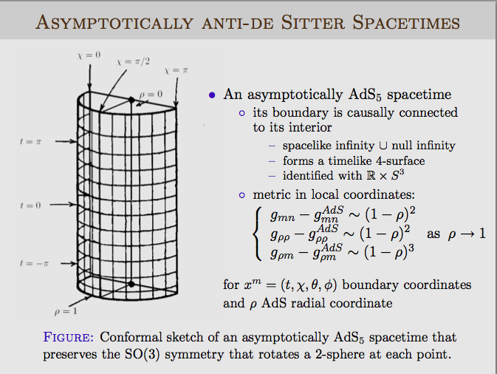
Hans Bantilan, CU Boulder, Oct 2014

Slide 43
Hans Bantilan, CU Boulder, Oct 2014

Slide 44
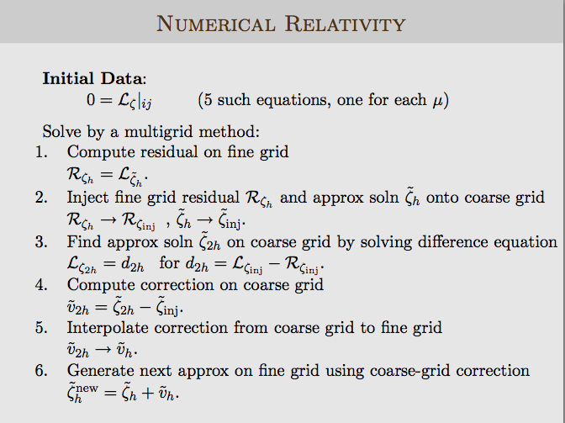
Hans Bantilan, CU Boulder, Oct 2014

Slide 45
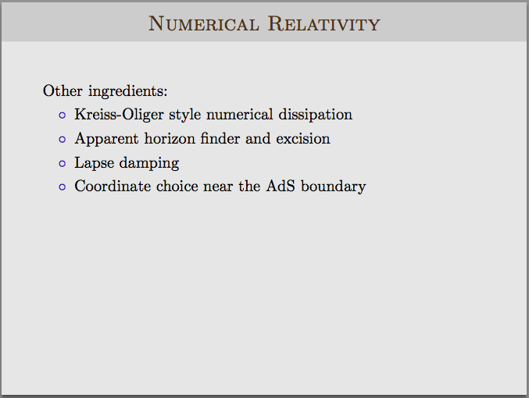
Hans Bantilan, CU Boulder, Oct 2014

Slide 46
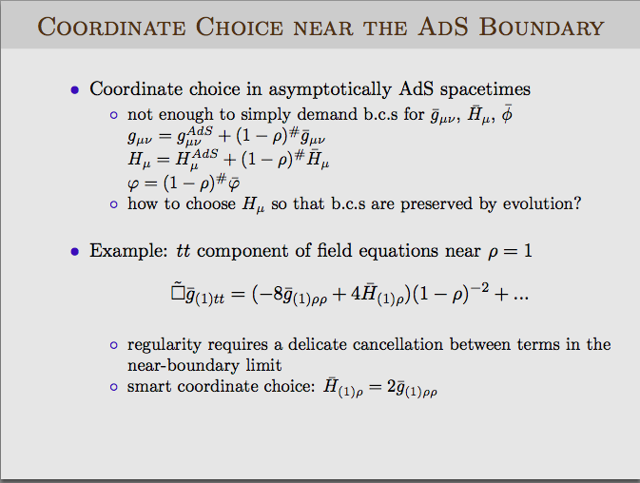
Hans Bantilan, CU Boulder, Oct 2014

Slide 47
Infiniband connections essential
Lnxfarm: single node, multiple cores used
Eridanus: single core on different nodes used

Slide 48
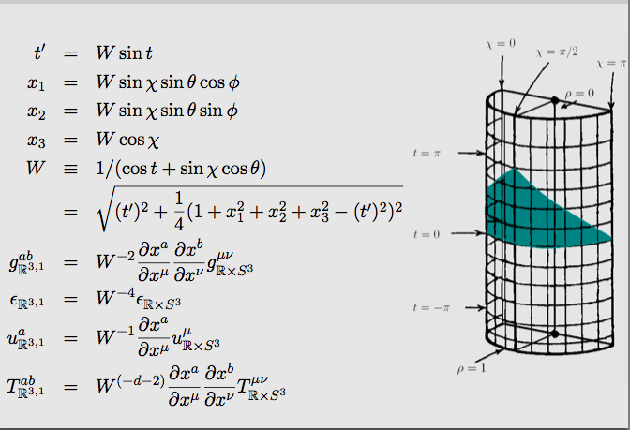
From Bulk to Boundary
Hans Bantilan, CU Boulder, Oct 2014

Slide 49
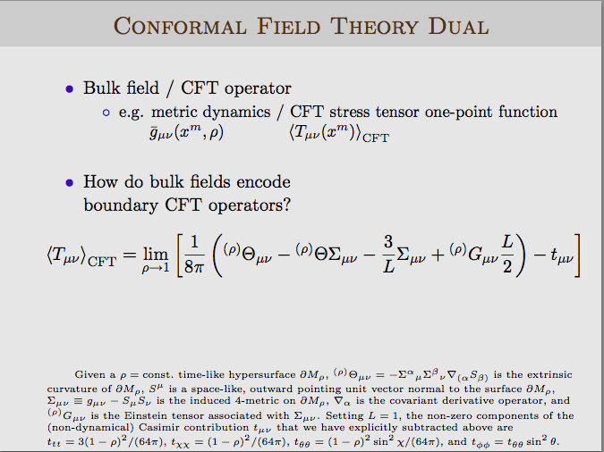

Slide 50
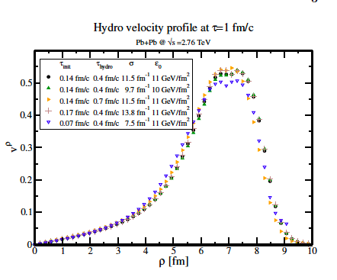
Shocks with Transverse Profiles
[van der Schee, PR & Pratt, 2013]

Slide 51


Use AdS/CFT initial conditions and compare to data
Idea: pre-equilibrium flow for smooth, central collisions is simple
Parametrize as
and use for different collision systems (Pb+Pb, Au+Au, Cu+Cu, Al+Al, C+C, p+p)
Compare:
[Habich, Nagle and PR, 1409.0040]
[Scott & Vredevoogd, PRC79 2009]

Slide 52
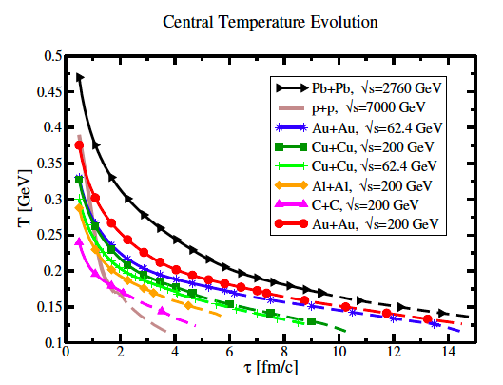
[Habich, Nagle and PR, 1409.0040]

Slide 53
SONIC: AdS+Hydro (eta/s=0.08)+Hadron Cascade
[Habich, Nagle and PR, 1409.0040]

Slide 54
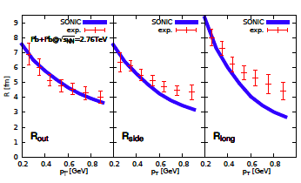
SONIC: AdS+Hydro (eta/s=0.08)+Hadron Cascade
[Habich, Nagle and PR, 1409.0040]

Slide 55
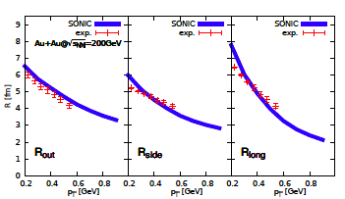
SONIC: AdS+Hydro (eta/s=0.08)+Hadron Cascade
[Habich, Nagle and PR, 1409.0040]

Slide 56
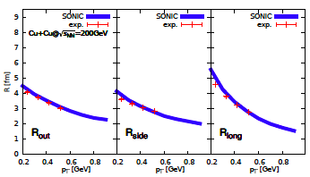
SONIC: AdS+Hydro (eta/s=0.08)+Hadron Cascade
[Habich, Nagle and PR, 1409.0040]

Slide 57
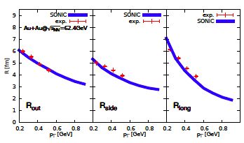
SONIC: AdS+Hydro (eta/s=0.08)+Hadron Cascade
[Habich, Nagle and PR, 1409.0040]

Slide 58
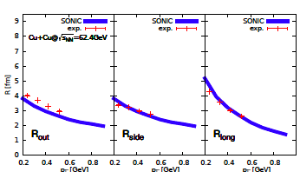
SONIC: AdS+Hydro (eta/s=0.08)+Hadron Cascade
[Habich, Nagle and PR, 1409.0040]

Slide 59
SONIC: AdS+Hydro (eta/s=0.08)+Hadron Cascade
[Habich, Nagle and PR, 1409.0040]

