Slide 1
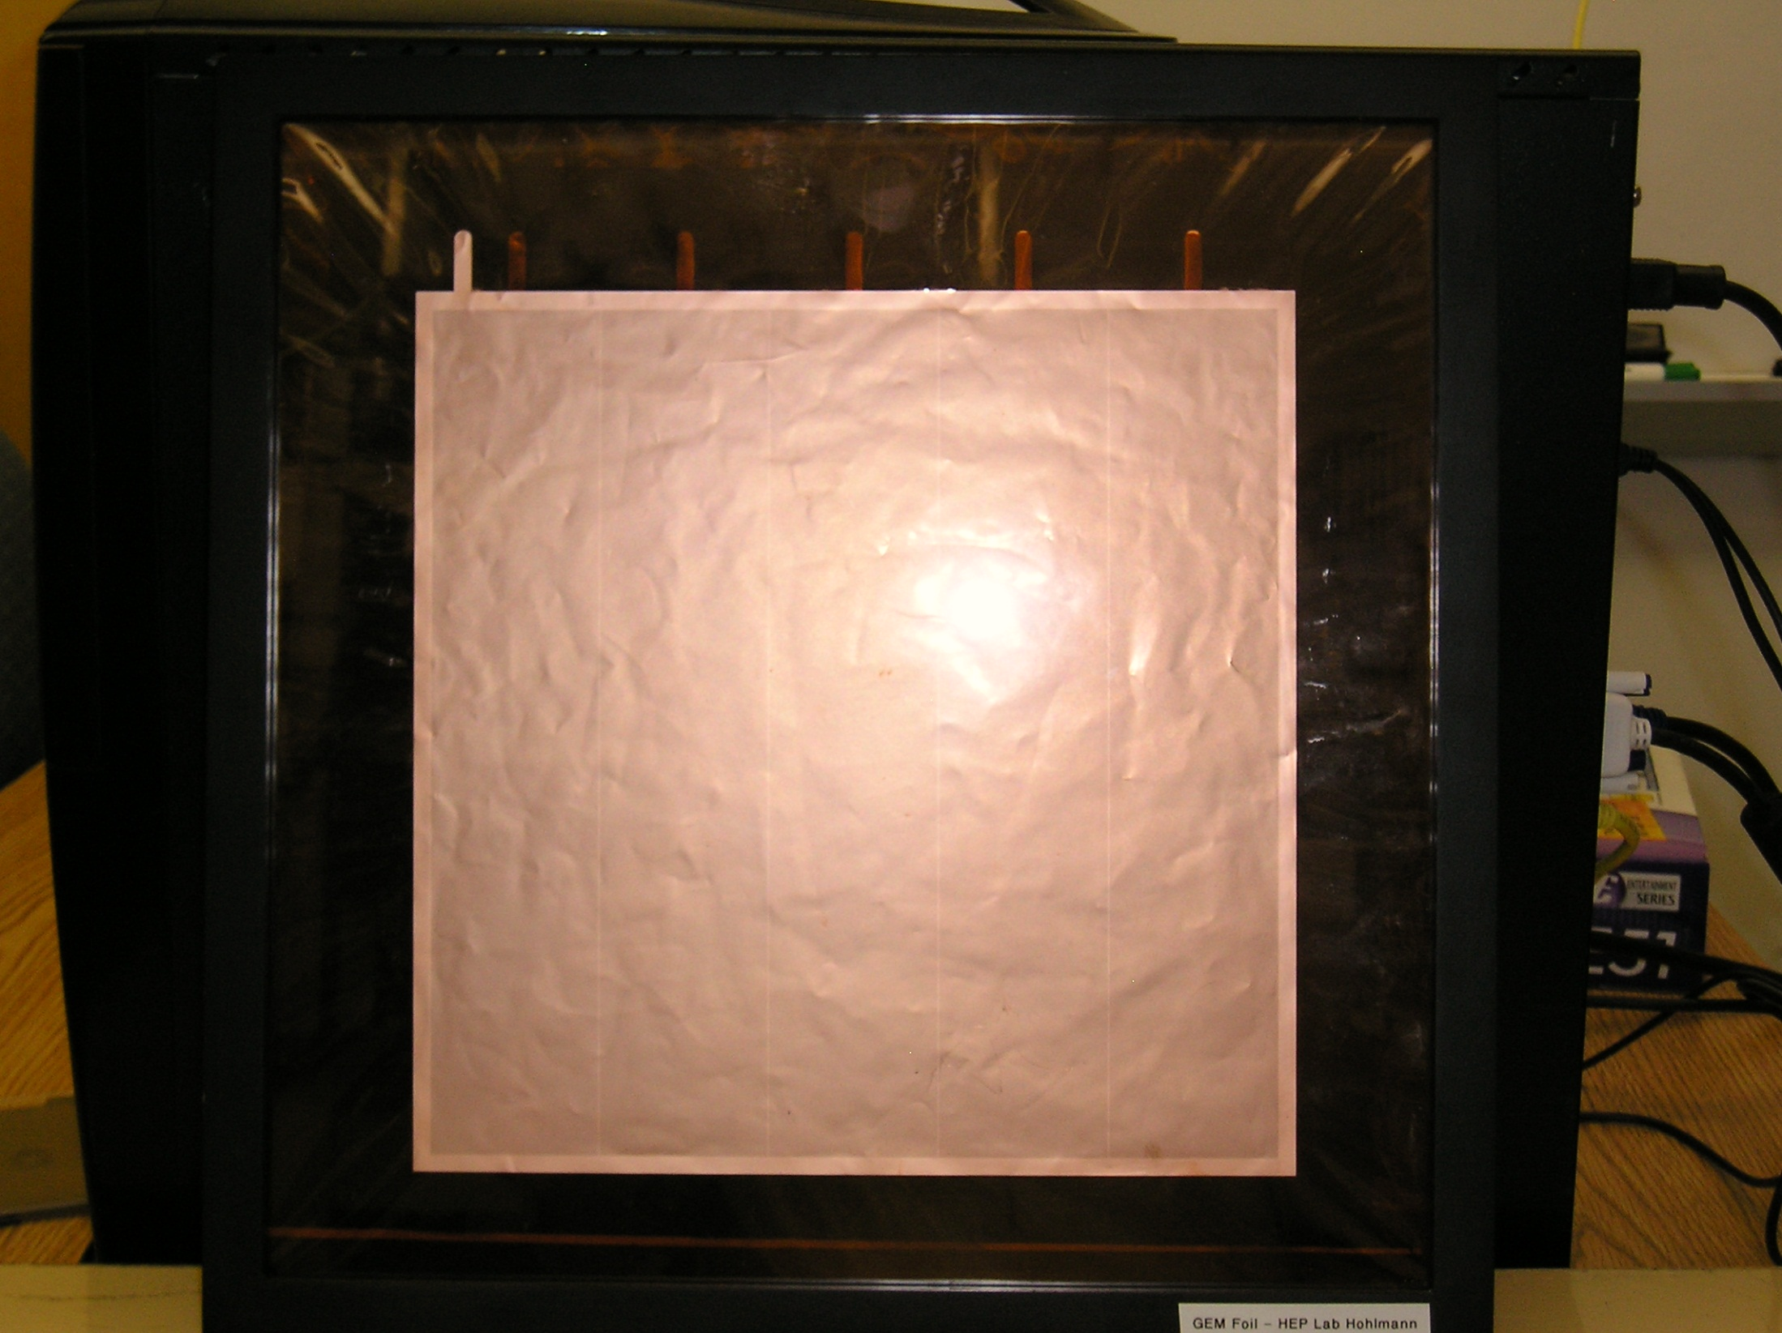
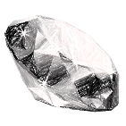
Two GEM Applications:
Forward EIC Tracker with Zigzag-Strip Readout
&
Muon Tomography for
Homeland Security
Marcus Hohlmann
Florida Institute of Technology
Seminar, Laboratori Nazionali di Frascati, July 11, 2014

Slide 2
GEMS for EIC:
ZIGZAG STRIP readout
Part One

Slide 3
Overview
Brief introduction to Electron-Ion Collider (EIC)
Zigzag-strip readout concept
Design and construction of a 1-m long GEM detector with zigzag-strip readout
Beam test at Fermilab
  Test setup
  Performance results for zigzag GEM detector
    basic performance
    cross talk measurement
    angular resolution
    corrections for non-linear strip response

Slide 4
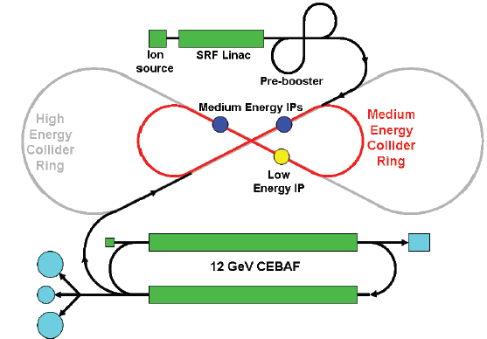
Electron Ion Collider
The next QCD frontier can be explored at a new Electron-Ion Collider (EIC).
Proposed EIC candidates are eRHIC at BNL & MEIC at J-Lab:
EIC design at Brookhaven National Lab (eRHIC)
EIC design at Jefferson Lab (MEIC)

Slide 5
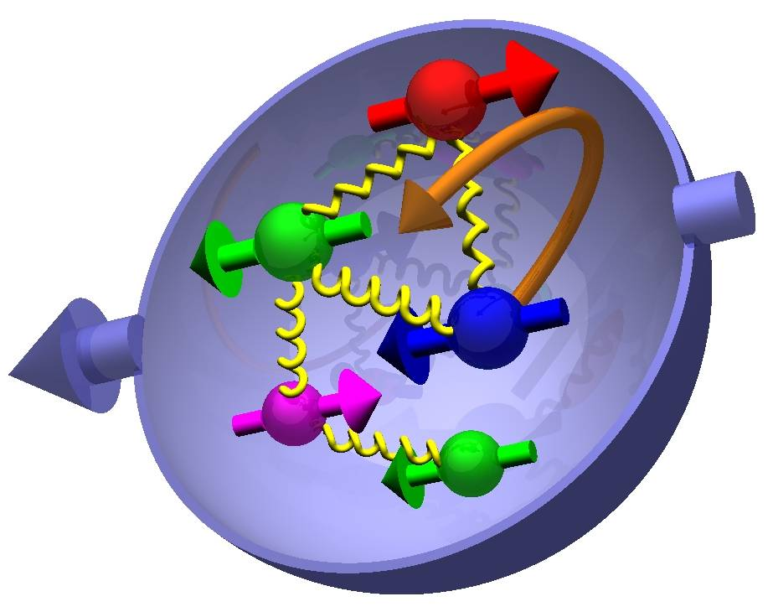

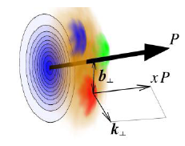

One Slide on EIC Physics
Most compelling science questions that EIC can answer:
How are sea quarks and gluons and their spins distributed
in space and momentum inside the nucleon?
How are these quark and gluon distributions correlated with the
over all nucleon properties, such as spin direction?
What is the role of the motion of sea quarks and gluons
in building the nucleon spin (→ angular momentum)?
only at
EIC
How does the nuclear environment affect the distribution
of quarks and gluons and their interaction in nuclei?
only at
EIC
How does the transverse spatial distribution of gluons compare to that in the nucleon?
How does matter respond to fast moving color charge passing through it?
Is this response different for light and heavy quarks?
γ*
h
e’
q
e
E. Aschenauer, EIC Users Meeting, Stony Brook, June 2014

Slide 6
Conceptual EIC Detector Design
Forward and Backward
GEM Tracker Disks
Si
0.8m
~ 2m
B ~ 3T

Slide 7
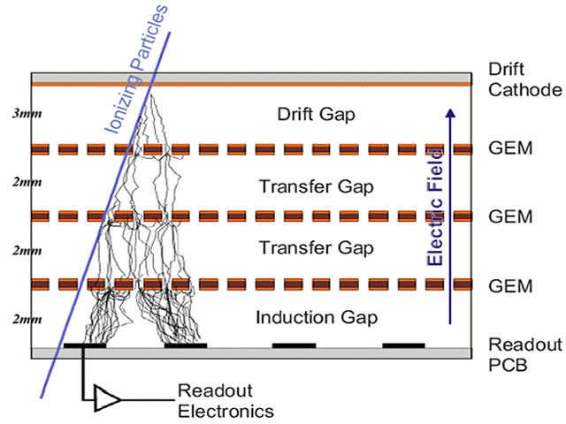
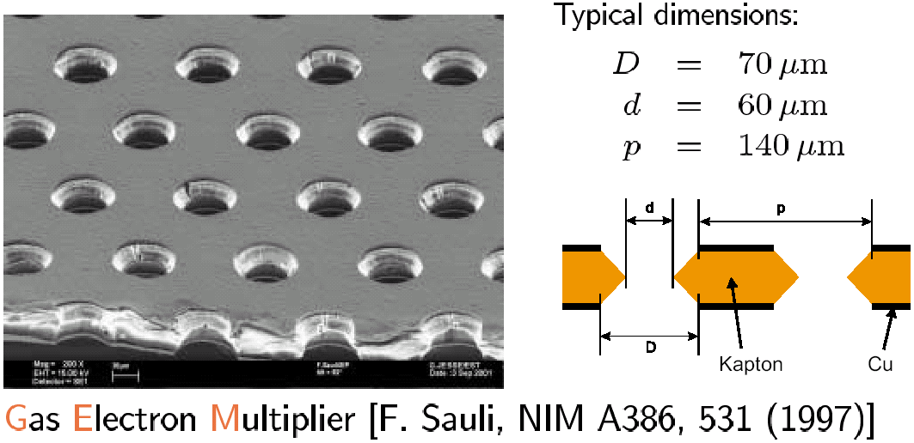
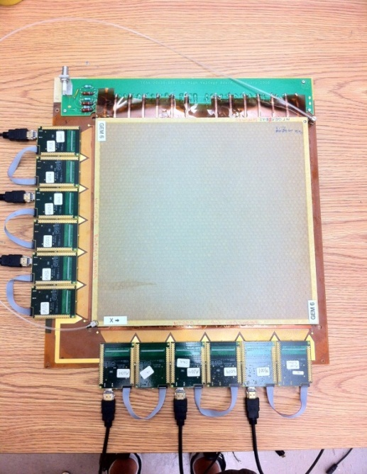
How a GEM Detector Works
Copper-clad polyimide foil
μ±
Detector volume filled with
Ar/CO₂ 70:30 gas mixture
Ar+
CO₂+
e-
Micro-pattern gas detector (MPGD)
-
300 – 500 V (on each of 3 GEMs)
1cm
+
Example:
Florida Tech
Triple-GEM
detector
for MTS
128 el. channels
(400 μm pitch)
~ 30 cm
Anode strips
detects an electronic pulse

Slide 8
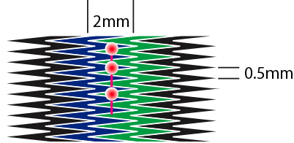
Zigzag-strip Readout: Concept
Zigzag strips:
Previous BNL studies showed <100 µm resolution for
parallel zigzag strips with 2 mm strip pitch is possible:
BNL
y
electron avalanche
x (measured coordinate)
Charge sharing among adjacent zigzag strips allows sensitive position-interpolation in x
Avalanche covers several zigzag pitches along the strip and is insensitive to pos. along strip
The zigzag-strip approach is applicable to detectors intended for 1D-coordinate measurements
We are sacrificing the measurement of the 2nd coord. (y) to gain precision in the 1st coord. (x)
The number of strips needed to read out a GEM detector can be reduced substantially.
This in turn reduces the overall cost of the detector system.

Slide 9
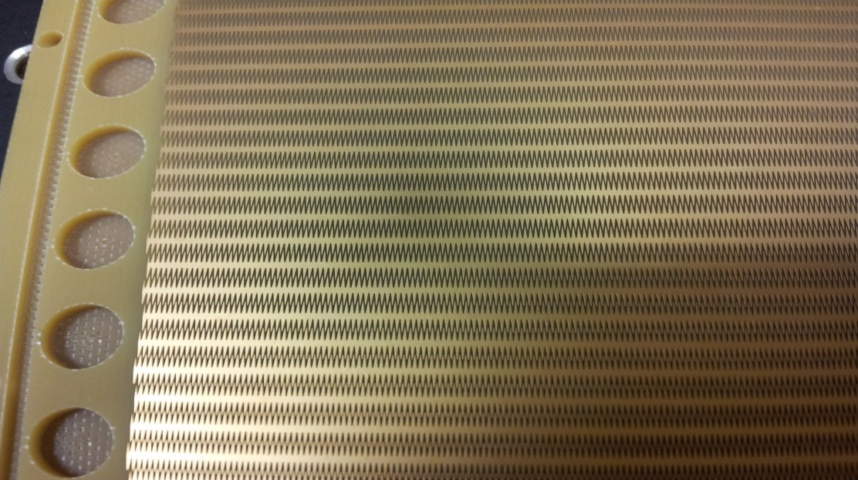
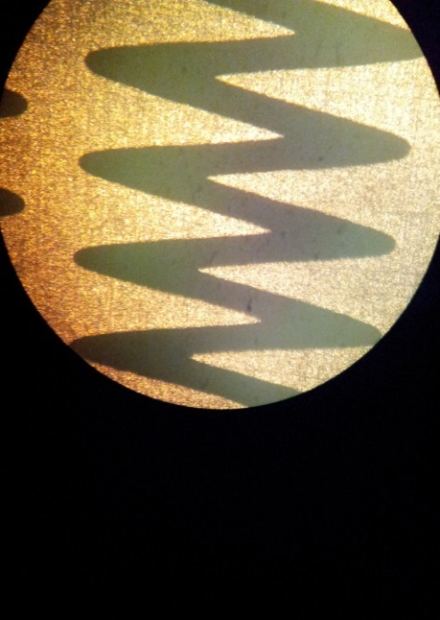
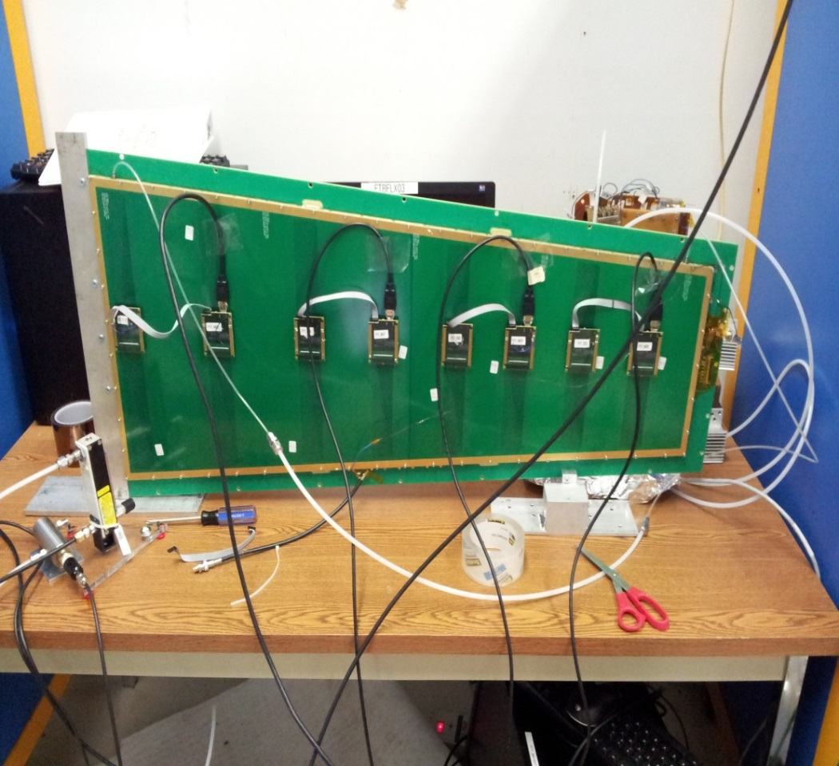
Readout with Radial Zigzag Strips
Zigzag strips, 1.37mrad pitch
Trapezoidal Readout Board
designed at FIT for 1-m long
trapezoidal CMS GEM detector
1.37 mrad
0.5mm
0.1mm
The zigzag strips run in radial direction and measure the azimuthal angle ϕ. Opening angle is 10 degrees; angular strip pitch is 1.37mrad.
The readout board is designed to fit a 1-m long trapezoidal GEM prototype (originally for CMS muon upgrade). It is divided into 8 η-sectors with radial length of each sector ~12cm, and 128 strips/sector.
For the same GEM prototype with straight strips, 24 APV chips are needed to fully read out the chamber. With zigzag strips, only 8 APV chips can fully read out the entire chamber. Number of channels is reduced by factor of 3!

Slide 10
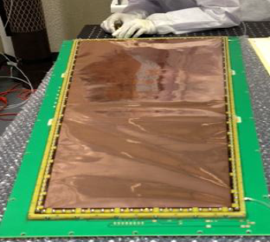
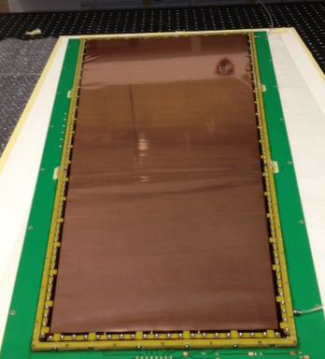
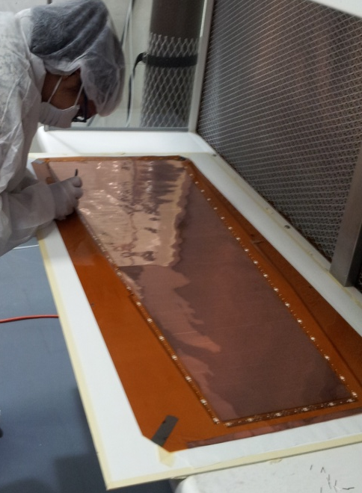
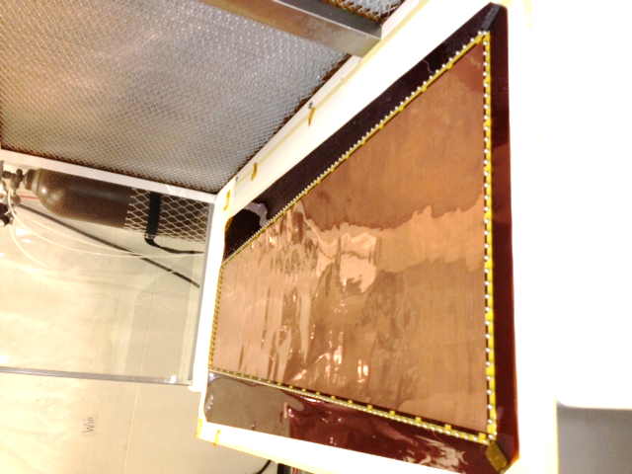

Assembly of Large-area GEM Detector
Total assembly time at Florida Tech: 3 hrs 40 mins with 2 people
Step I :
GEM foil assembly with inner frames
Stack of
GEM foils with inner frames; ready to be placed on drift electrode
Step II :
Stretching GEM foils by providing tension
Stretched GEM foils with inner and outer frames
Based on CMS GE1/1 forward muon prototypes: “self-stretched, sans spacers”
Internal gap configuration: 3/1/2/1 mm
GEM foils produced by single-mask etching technique at CERN
Active area: 99 × (28 - 45) cm²
Step III : Finished zigzag GEM detector
8
7
6
5
4
3
2
1
η-sectors
1D zigzag readout board with 1,024 radial zigzag strips connected via 8 Panasonic connectors to 8 APV hybrids

Slide 11
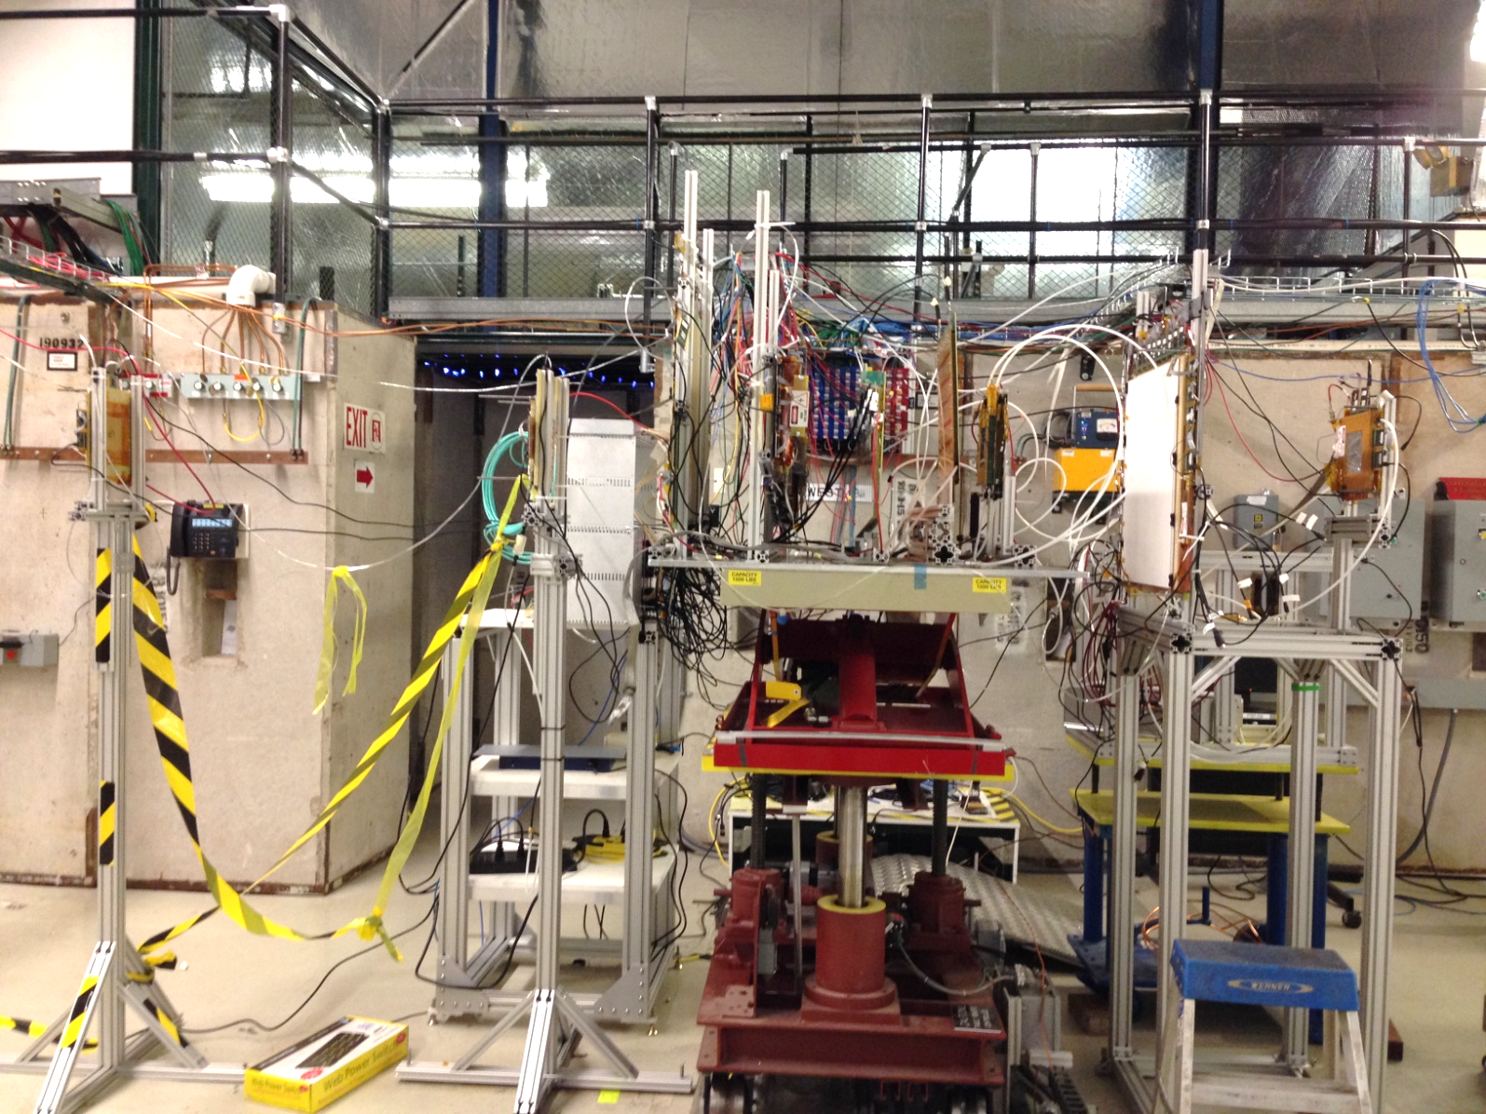
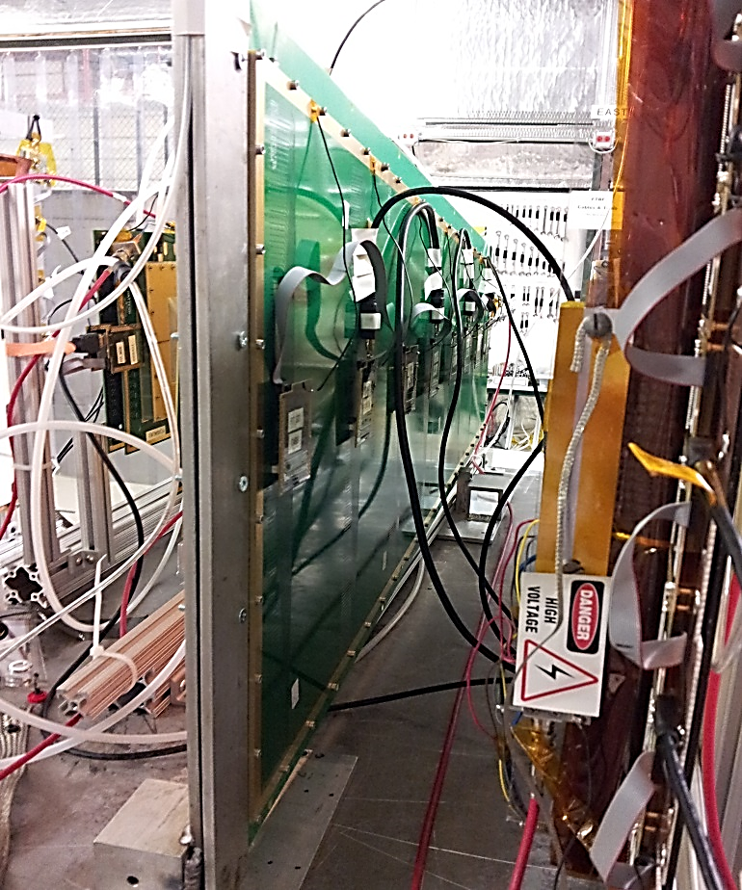
Beam Test Setup @ FNAL
Trackers
Trackers
1-m GEM w/ zigzag readout
The EIC FLYSUB consortium conducted a three-week beam test at Fermilab (Meson Test area 6) in Oct 2013; operated ~20 GEM detectors total
The FIT group and U. Virginia group tested 10 GEMs in a tracking setup
4 reference tracking detectors with 2D readout (3/2/2/2 mm gaps)
All detectors operated with Ar/CO₂ 70:30
DAQ: RD51 SRS with SRU to read out 4 FECs & 64 APVs simultaneously

Slide 12
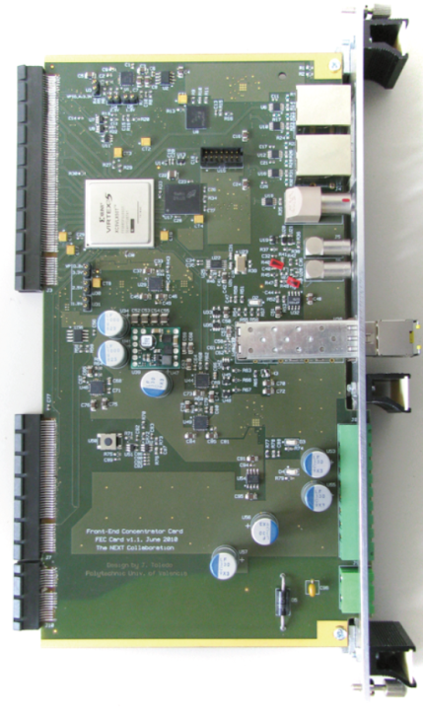
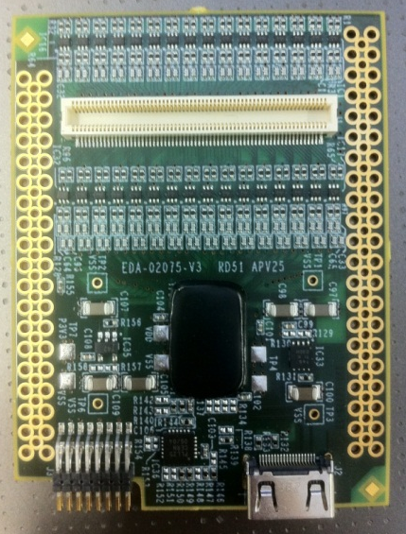
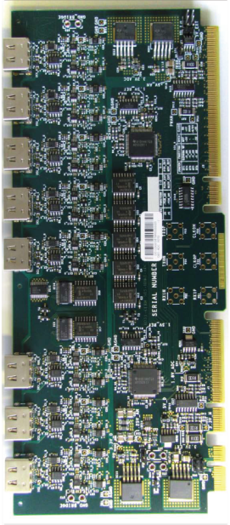
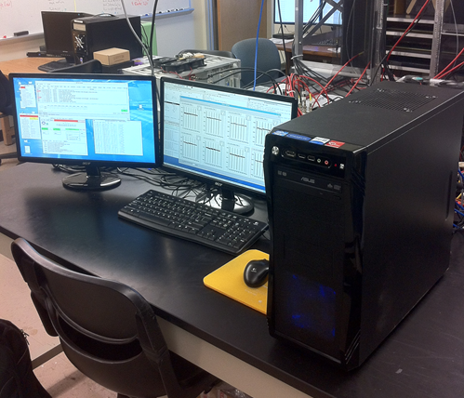
RD51 Scalable Readout System
128 ch.
Gb
Ethernet
HDMI
APV25 Hybrid
ADC
FrontEnd Concentrator
DAQ Computer
128 channel APV25 chip
192-deep analog sampling memory
Master/slave configuration
Diode protection against discharge
RD51 standard 130-pin Panasonic connector interfaces to detector
HDMI mini (type C) connector
2 x 12-Bit Octal ADC
8 x HDMI input channels (16 APV hybrids)
Virtex LX50T FPGA
SFP/Gb Ethernet/DTC interface
NIM/LVDS GPIO (trigger, clock synch, etc.)
Data Acquisition using DATE (ALICE @ CERN)
Support added for data transfer via UDP
Slow control via ethernet
Online and offline analysis using custom package for AMORE (ALICE @ CERN)
J. Toledo, et al., "The Front-End Concentrator card for the RD51 Scalable Readout System,"
in Topical Workshop on Electronics for Particle Physics, Vienna, 2011.

Slide 13
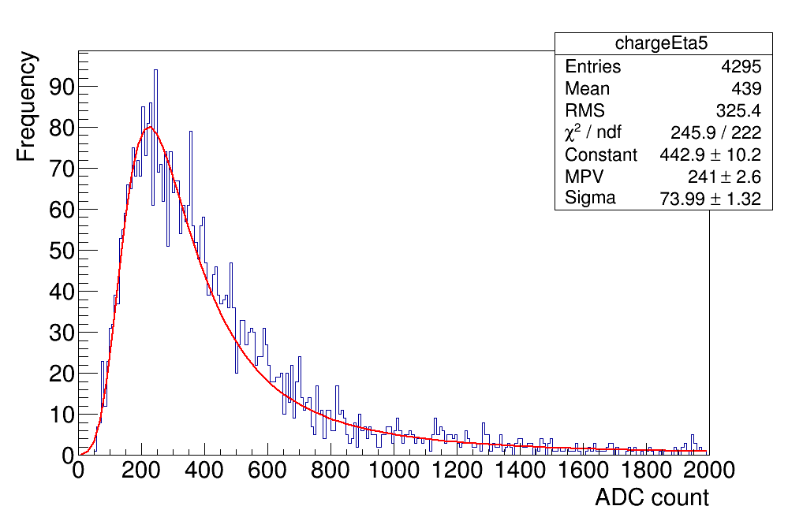
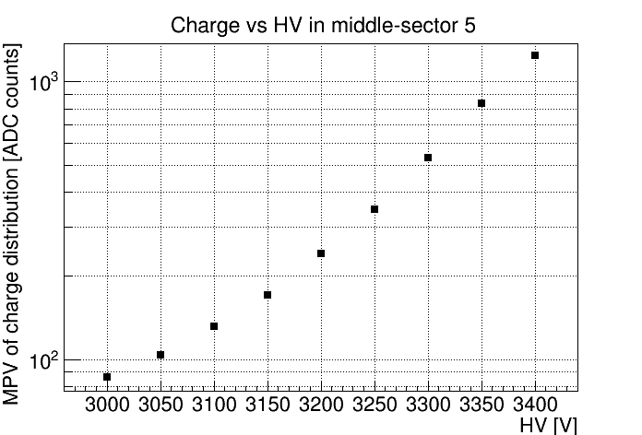
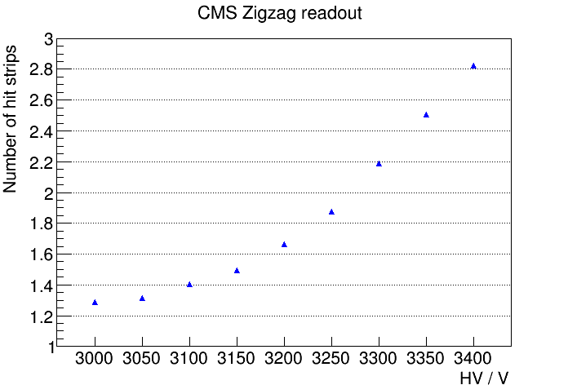
Test Results: Basic Zigzag Performance
Cluster charge distribution w/ Landau fit
Landau peak value of charge distribution vs. HV
peak pos.
in sector 5 at 3200V
Stat. errors smaller than marker size
Mean cluster size vs. HV on sector 5
Cluster charge distribution fits well to a Landau function
Landau peak position (“gain”) increases exponentially with HV
Mean cluster size (strip multiplicity) increases monotonically with HV
Stat. errors smaller than marker size

Slide 14
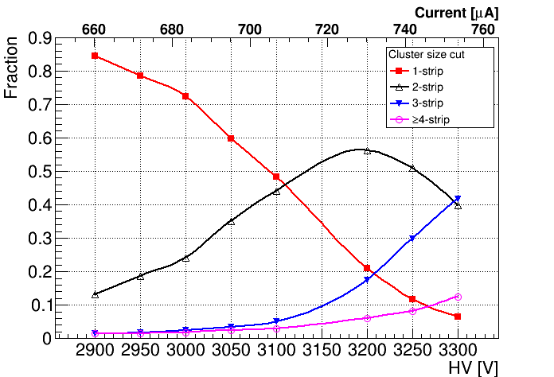
Cluster Strip Multiplicity vs. HV
Efficiency Plateau

Slide 15
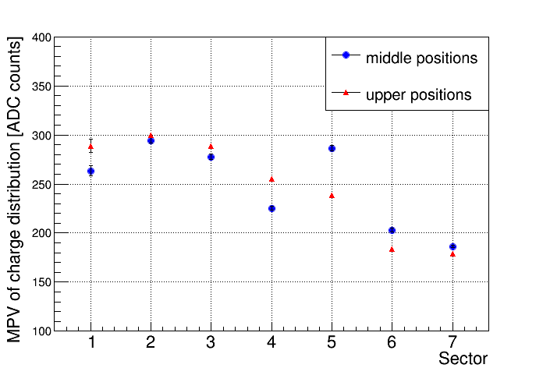
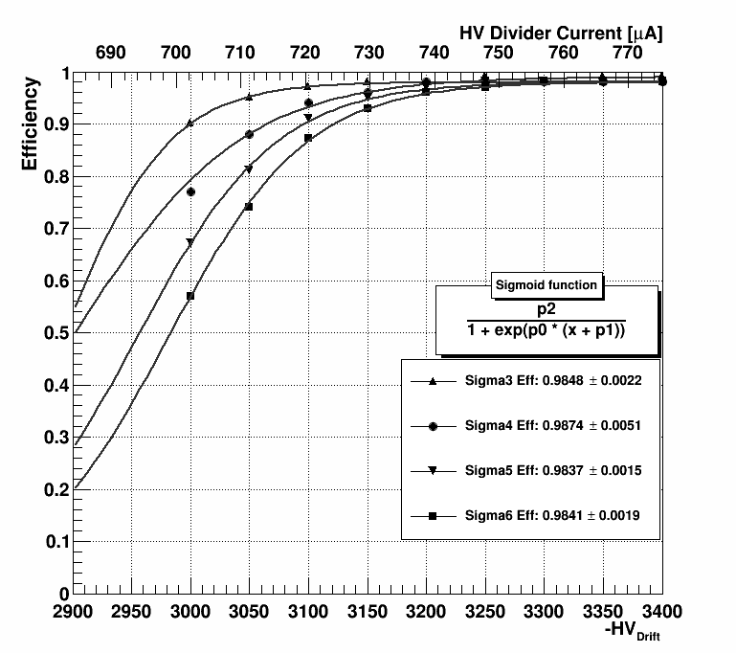
Uniformity & Efficiency
To test the overall response uniformity, two points were measured in each η-sector.
The response from sector to sector varies by ~ ± 20%.
The non-uniformity is caused by known bending of the pc board. The CMS-GEM coll. has improved the design to avoid this bending.
Detection efficiency in sector 5 fitted with a sigmoid function
Plateau efficiency is ~ 98.4%.
Different thresholds (N=3,4,5,6 times the pedestal width) were tested; the efficiency plateau is not affected.

Slide 16
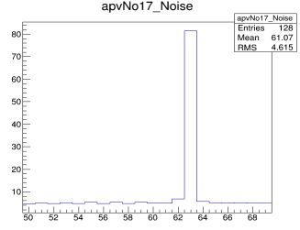
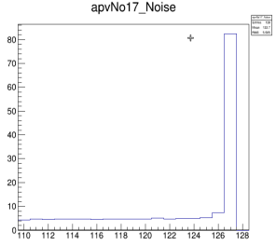
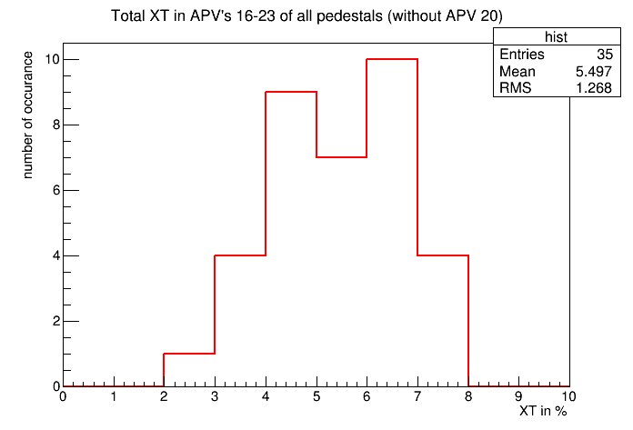
Crosstalk Measurement
Due to a mistake in the production of the zigzag pcb, two strips in each sector were erroneously connected to a large ground plane that presented a large input capacitance to the readout channel. This caused large noise in the two channels (63, 127) that is evident in the pedestals widths:
Crosstalk
“Aggressor”
Crosstalk
“Aggressor”
number of occurrences
pedestal width (rms) [ADC counts]
pedestal width (rms) [ADC counts]
Crosstalk
“Victims”
Crosstalk
“Victim”
Strip Number
Strip Number
Crosstalk in victims [%]
Neighboring channels are victims of crosstalk from two noisy channels
Allows us to actually measure the mean crosstalk in zigzags strips: 5.5%

Slide 17
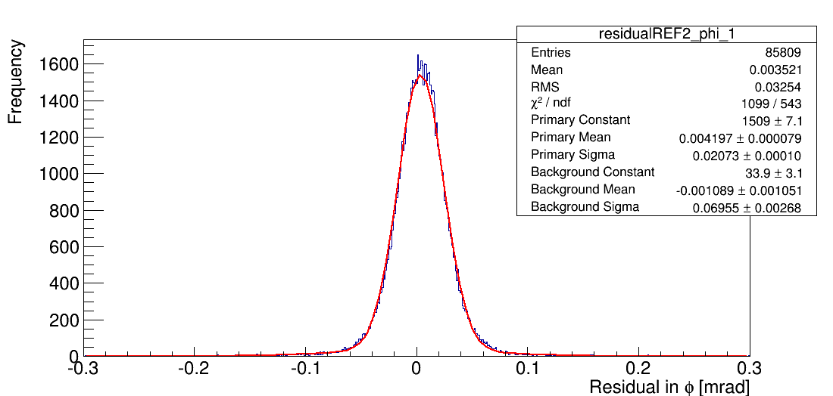
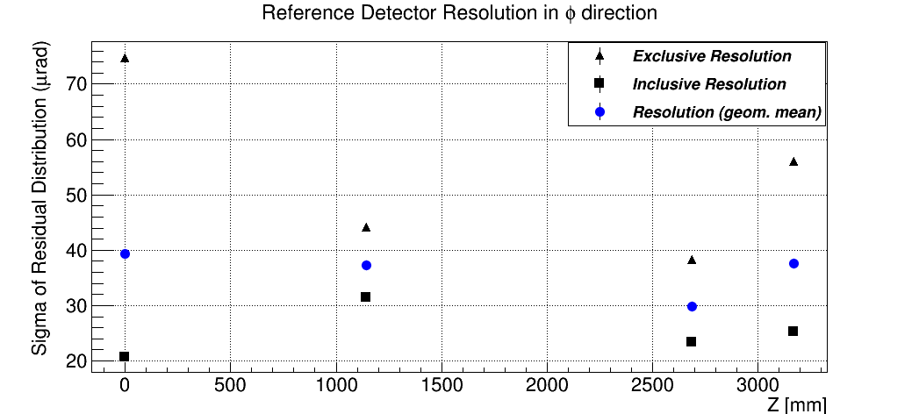
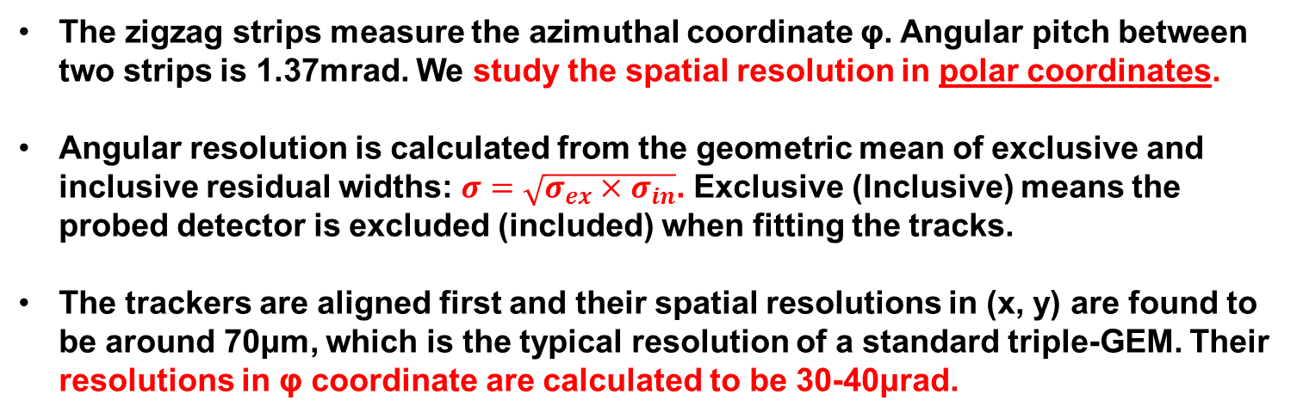
Angular Resolution Studies
Aligning trackers to zigzag GEM det.
Inclusive residual for 1st tracker
Resolution in φ for trackers
σ=21μrad
10°
Eta5
Y offset
vertex
tracker
X offset
Errors smaller than marker size
The zigzag strips measure the azimuthal coordinate φ. Angular pitch between two strips is 1.37mrad. We study the spatial resolution in polar coordinates.
Angular resolution is calculated from the geometric mean of exclusive and inclusive residual widths: $σ=\sqrt{σ_{ex}×σ_{in}}$. Exclusive (Inclusive) means the probed detector is excluded (included) when fitting the tracks.
The trackers are aligned first and their spatial resolutions in (x, y) are found to be around 70μm, which is the typical resolution of a standard triple-GEM. Their resolutions in φ coordinate are calculated to be 30-40μrad.

Slide 18
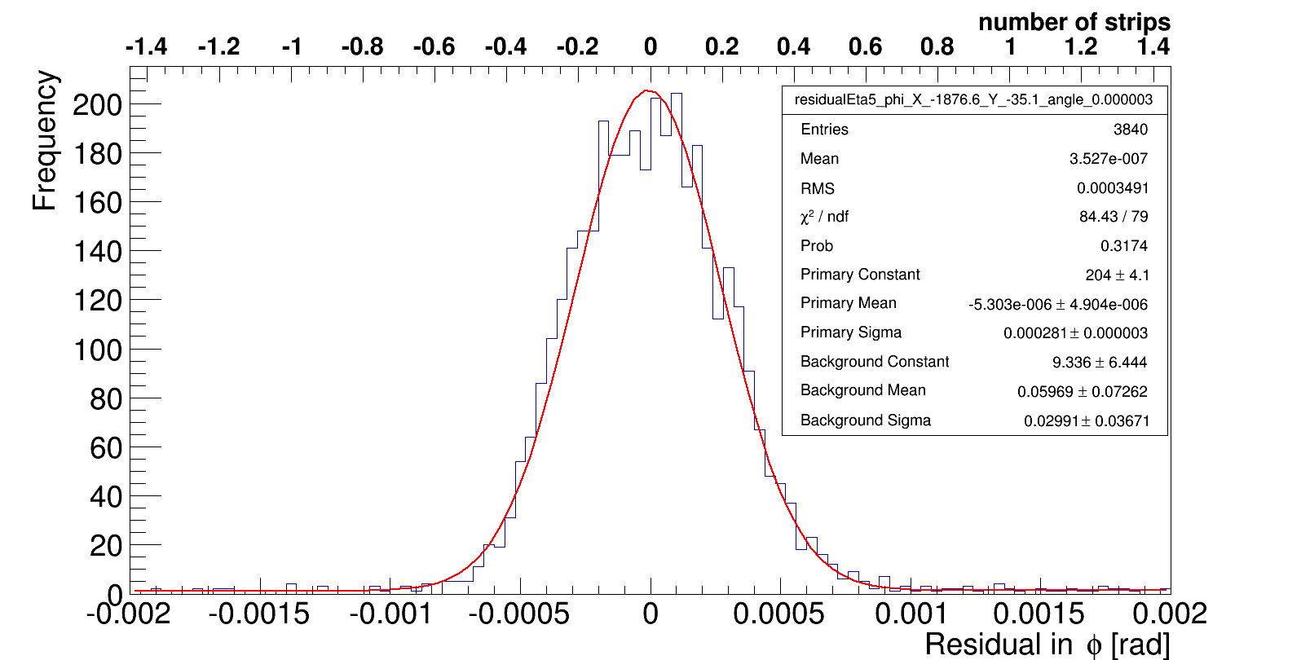
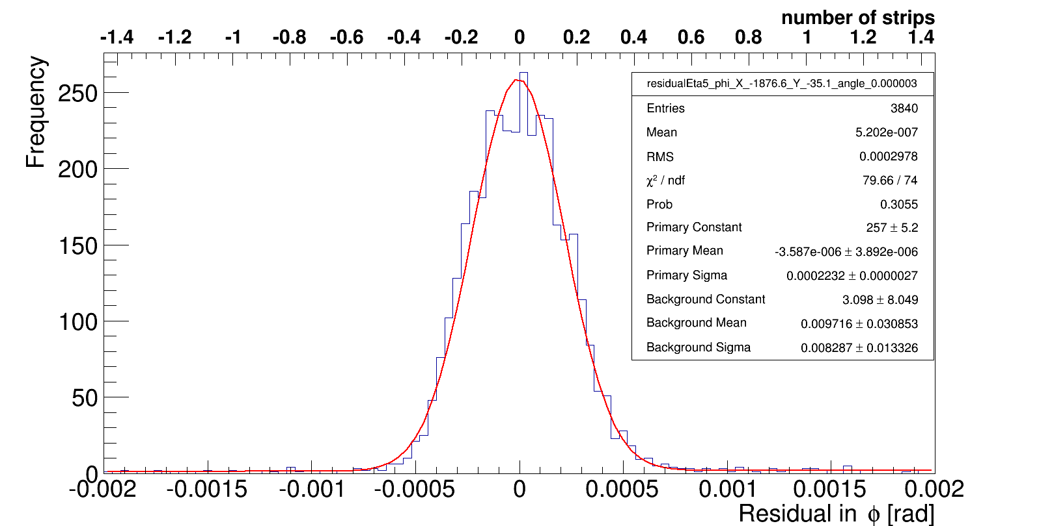
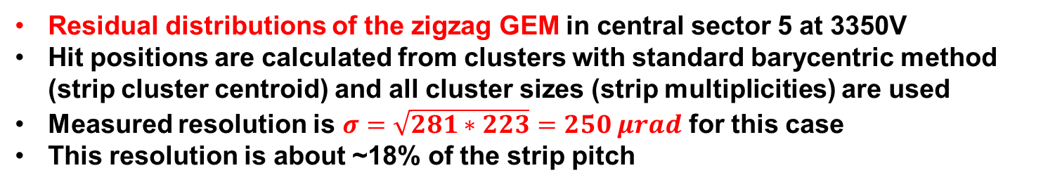
Track Residuals
Exclusive residual
σ=281μrad
Inclusive residual
σ=223μrad
Residual distributions of the zigzag GEM in central sector 5 at 3350V
Hit positions are calculated from clusters with standard barycentric method (strip cluster centroid) and all cluster sizes (strip multiplicities) are used
Measured resolution is $σ=\sqrt{281∗223}=250 μrad$ for this case
This resolution is about ~18% of the strip pitch

Slide 19
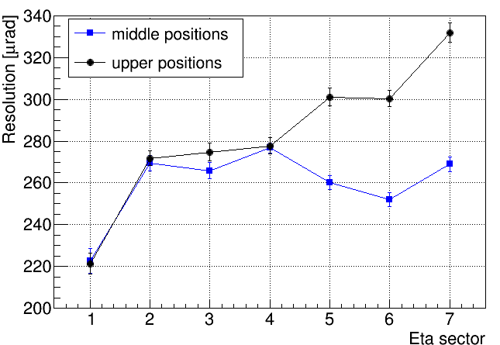
Resolution Variation
Resolution of the zigzag-GEM in different sectors at 3200V

Slide 20
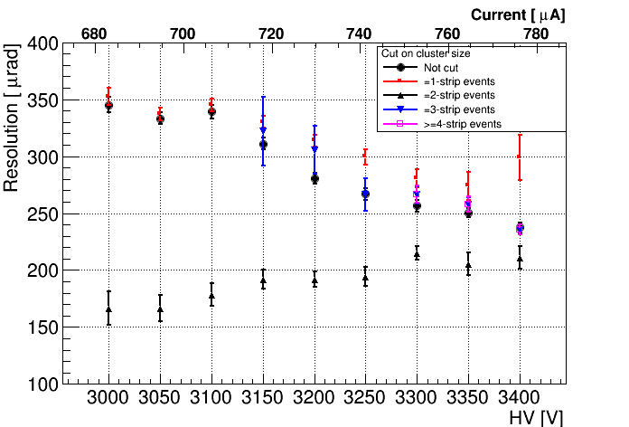
Zigzag Angular Resolution (cont.)
2-strip clusters
Resolution of the zigzag-GEM vs. HV
Overall resolution is ~240 μrad at highest tested voltage
For 2-strip clusters, the resolution is better (especially at lower voltages)
Strip
Multiplicity

Slide 21
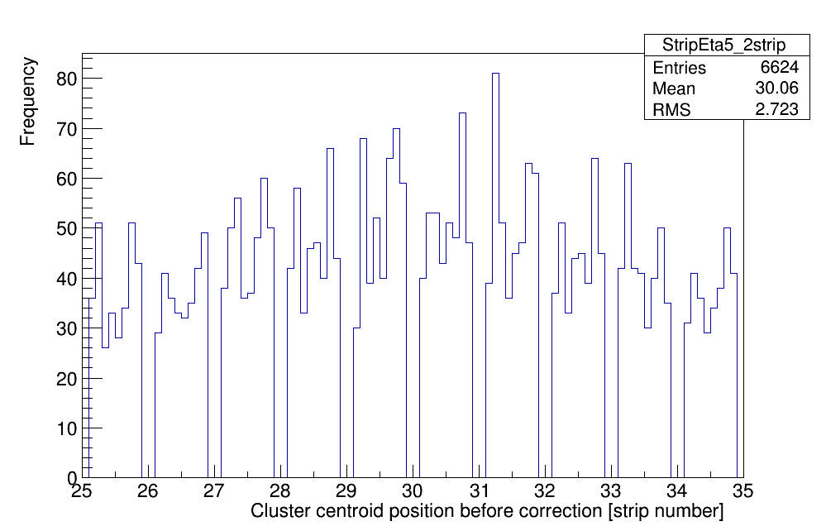
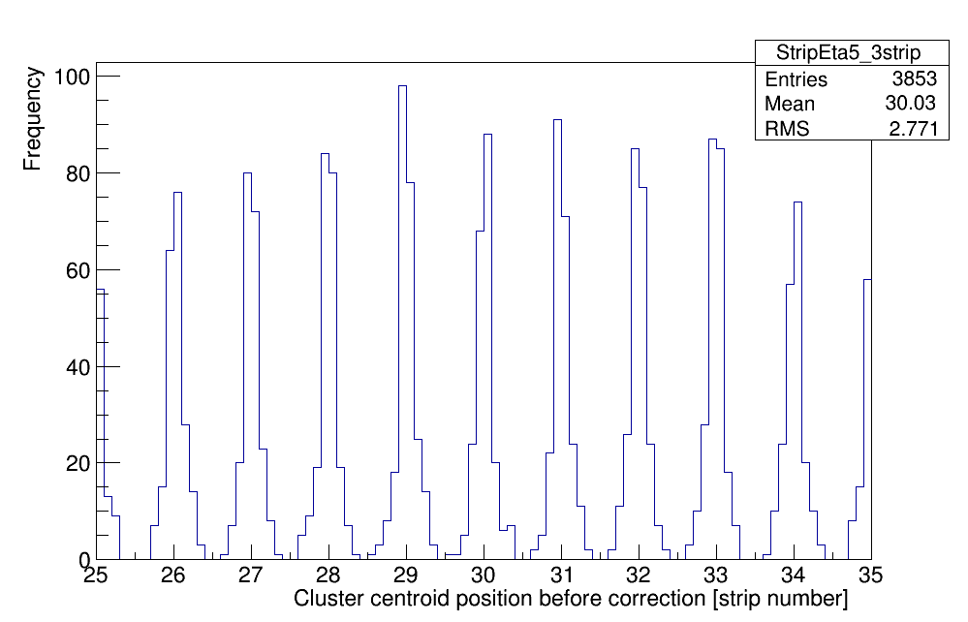
Strip Cluster Position Corrections
Centroid position distribution from barycentric method
2-strip events
3-strip events
By further checking the centroid position distributions of fixed cluster size events, we observe that these distributions show “picket fence structures” due to the discretized strip structure
This motivates us to study the impact of this non-linear strip response on the position reconstruction
Goal is to make these distributions flat and improve the angular resolution

Slide 22
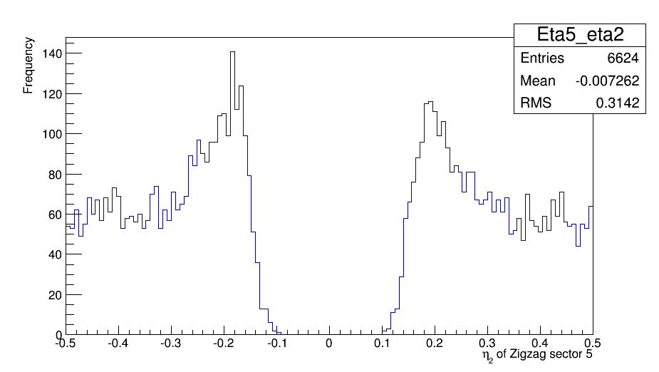
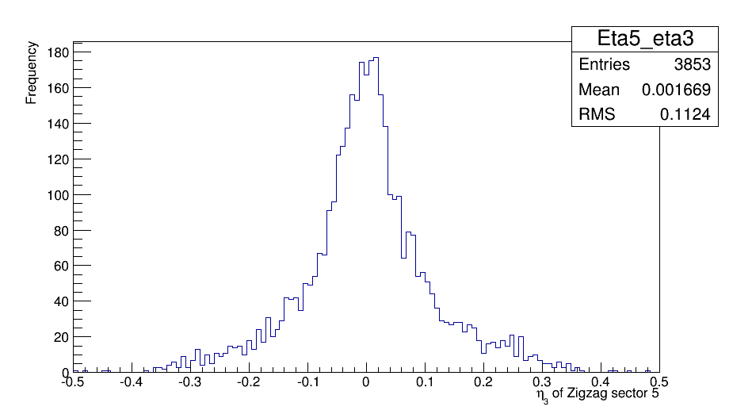
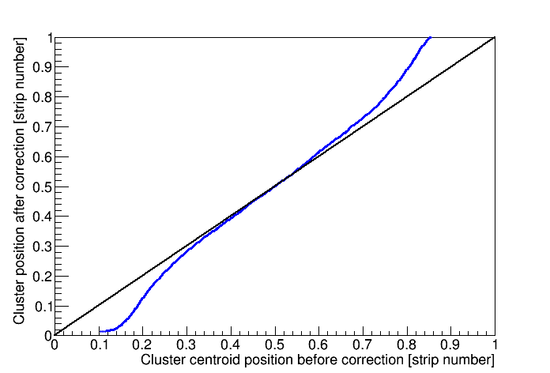
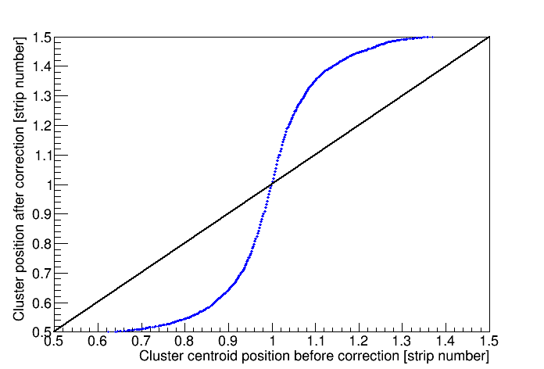
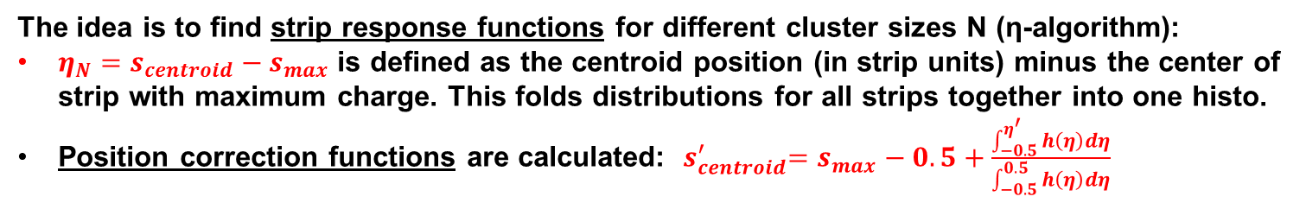
Cluster Position Corrections (cont.)
The idea is to find strip response functions for different cluster sizes N (η-algorithm):
$η_{N}=s_{centroid}−s_{max}$ is defined as the centroid position (in strip units) minus the center of strip with maximum charge. This folds distributions for all strips together into one histo.
Position correction functions are calculated: ${ s}_{centroid}^{′}=s_{max}−0.5+\frac{\int_{−0.5}^{η^{′}}{h\left(η\right)dη}}{\int_{−0.5}^{0.5}{h\left(η\right)dη}}$
Ref.: M. Villa,
Dissertation,
U. Bonn, 2014
h(η₂)
distribution
h(η₃)
distribution
center of
strip with
max. charge
in cluster
center of
strip with
max. charge
in cluster
Correction function
for 2-strip events
Correction function
for 3-strip events

Slide 23
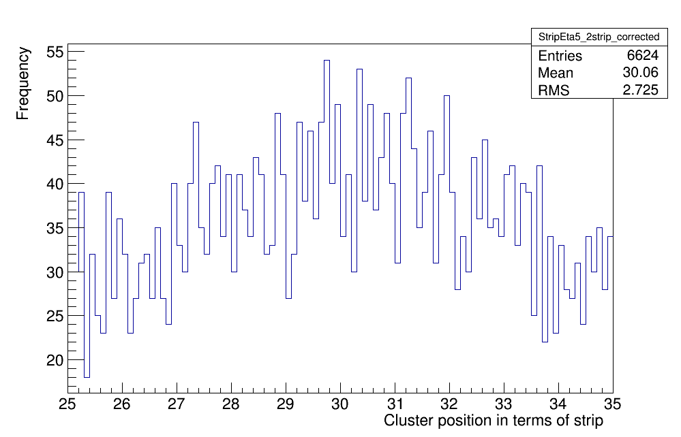
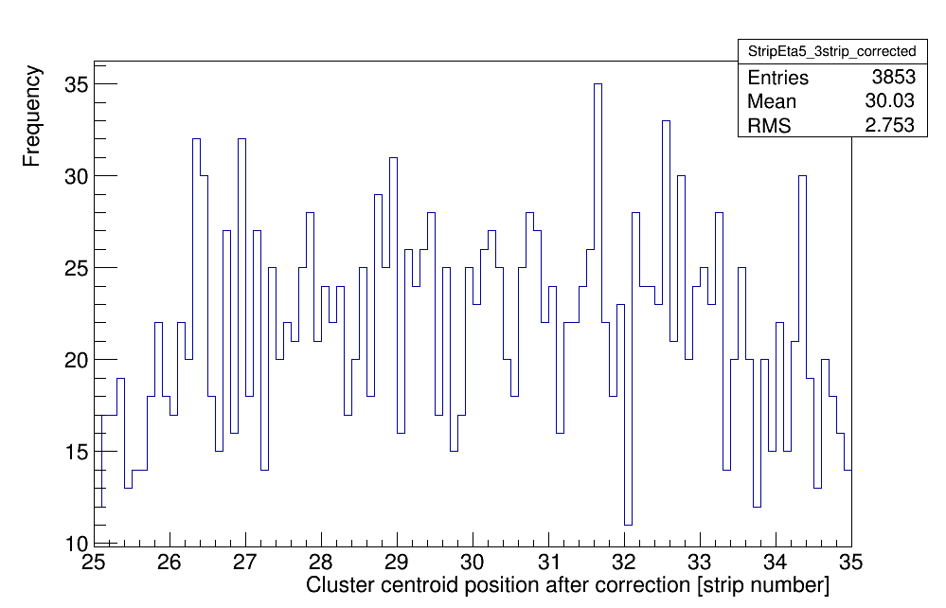
Cluster Position Corrections (cont.)
After correction functions are obtained, the centroid position of a cluster can be corrected. Only clusters with 2,3 and 4 strips are used because of good statistics (they make up ~90% of all clusters when operating GEM on the efficiency plateau).
2-strip before correction
2-strip after
correction
more uniform
3-strip before correction
3-strip after correction
more uniform

Slide 24
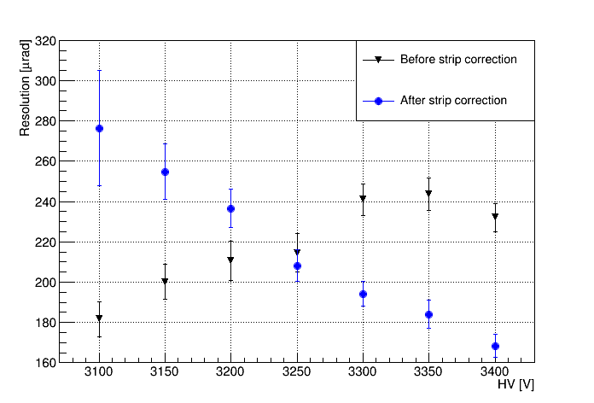
Angular Resolution after Correction
Resolution vs. HV in sector 5 after position correction (for 2, 3, 4 strip clusters)
Efficiency Plateau
With corrections overall resolution improves on the efficiency plateau,
e.g. from ~ 230 μrad to ~ 170 μrad (- 26%) at 3400V.
Note that corrections are calculated individually for each HV point here.

Slide 25
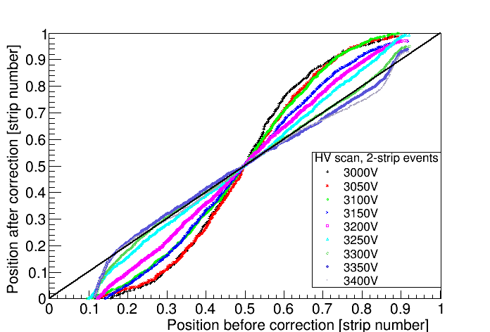


Cluster Position Corrections at Different High Voltages
2-strip clusters
3-strip clusters
A closer look at the corrections…
2-strip & 3-strip clusters behave differently:
For 2-strip events, corrections become smaller with increasing HV
For 3-strip events, similar corrections at all HV values
4-strip clusters
(statistics-limited)

Slide 26


Angular Resolution after Correction
2-strip clusters
3-strip clusters
factor 2
improvement
2-strip clusters: only at voltages high up on the eff. plateau does the resolution
improve slightly; in that range corrections are also more gentle
3-strip clusters: significantly improved for all HV points!

Slide 27
Next Steps for Corrections
Some Ideas:
Could be pragmatic and correct only 3-strip clusters, but not 2-strip clusters. This should make resolution mostly independent of HV.
Fit correction functions to sigmoid functions and then try to tune the parameters of the functions until optimal corrections are found that give the best resolution.
Work in progress…

Slide 28
Summary & Conclusion for Zigzag GEM
The zigzag-GEM detector worked well in the beam test at FNAL. A >98% detection efficiency is observed. Crosstalk is tolerable.
Corrections for non-linear strip responses bring the resolution from ~240 μrad down to ~ 170 μrad on the eff. plateau. This corresponds to only 12% of the angular strip pitch.
We conclude that a readout with zigzag strips is a viable option for cost-efficient construction of a forward tracker with GEMs for a future EIC detector.
The zigzag structures can presumably still be optimized by interleaving zigs and zags more tightly to improve charge sharing and consequently resolution performance even further. Stay tuned…

Slide 29
GEMs for muon tomography
Part Two

Slide 30
An old problem…
Senator Eugene Millikin pressed Oppenheimer about how to find a bomb hidden in a city:
Sen. Millikin: “We... have mine-detecting devices, which are rather effective... I was wondering if anything of that kind might be available to use as a defense against that particular type of use of atomic bombs.”
Dr. Oppenheimer: “If you hired me to walk through the cellars of Washington to see whether there were atomic bombs, I think my most important tool would be a screwdriver to open the crates and look. I think that just walking by, swinging a little gadget would not give me the information.”
Transcripts from the U.S. National Archives
“That candid assessment shocked the senators, who then asked the Atomic Energy Commission to examine the problem. Robert Hofstadter and Wolfgang Panofsky, a veteran of the Manhattan Project team that built the atomic bomb, produced a still-classified assessment, which came to be known as the Screwdriver Report.
Panofsky, now the director emeritus of the Stanford Linear Accelerator Center, says the assignment was to detect 1 cubic inch of highly enriched uranium or plutonium hidden inside a crate and smuggled across a land border. `The conclusions of that report are still valid because the laws of physics have not changed one bit,’ Panofsky tells U.S. News. ‘You still can't detect a nuclear device unless you are, say, 10 feet away from it - and even then it can be quite easily shielded.’ “
US News & World Report, 2/18/07

Slide 31








Towards a Solution
μ
μ
Incoming muons (from natural cosmic rays)
Muon Tomography Concept
μ
μ
Uranium
Iron
μ
μ
Fe
U
Small
Scattering
Small
Scattering
Large
Scattering
Large
Scattering
Note: Angles Exaggerated!
Tracking detectors
Multiple Coulomb scattering to 1st order produces Gaussian distribution of scattering angles Θ with width Θ₀:
Where $X_{0}$ may be approximated by
$$Z→\text{Charge} \text{Number}$$
$$X_{0}→\text{Radiation} \text{Length}$$
$$βc→\text{Velocity}$$
$$x→\text{Width} \text{of} \text{Medium}$$
$$p→\text{Momentum}$$

Slide 32

GEM Muon Tomography Station
HEP Lab
at Fl. Tech
Targets
8 GEM Detectors
12,288
readout
channels

Slide 33




Scattering Reconstruction
Detector hits formed from clusters
All hit combinations within each of the four tracking stations (t, b, l, r) → track segment candidates
Track with smallest distance of closest approach (DOCA) of incoming and exiting segments in 3d is selected as best track
Detector alignment using tracks crossing an empty MT station
Remove low-angle scattering (< 2º)
Scattering point reconstruction using Point Of Closest Approach of incoming and exiting segment in 3d
Find <Θ_{scatter}> in voxels in volume
Remove isolated scattering pixels; keep clustered scattering pixels
DOCA
exclusive
residuals
Number in Neighboring Pixels (NNP): add number of POCA in 8 voxels surrounding voxel V
If NNP < some
threshold, remove
contents of V.
Repeat for all voxels
DOCA
Object
V
measured
scattering
angle
Ref.: Michael Staib, M.S. thesis

Slide 34





Imaging Unshielded Materials
Mean
Scattering
Angle
(2mm×2mm×40mm voxel)
Top View
→
Pb
W
→
U
164,323 total reconstructed tracks
Number Neighboring Pixel Cut > 5
Integration time: ~ 2 days continuously
→
Sn
Fe
6mm Al cladding for U
Side views in 3 vertical planes:
Pb
W
U
Sn
Fe

Slide 35







Horizontal Imaging Resolution
0 mm
2 mm
0 mm
8 mm
115,834 Tracks
94,719 Tracks
Lead
Lead
Separate blocks in 2 mm increments
Tungsten
Tungsten
115,834 Tracks
4 mm
6 mm
8 mm
111,036 Tracks
107,506 Tracks
121,634 Tracks
Gap begins to
become visible
with ≥ 6 mm
spacing in y
Gap starts to become
visible with ≥ 6 mm spacing
M. Staib, M.S. thesis

Slide 36



Vertical Imaging Resolution
Analogous test with vertical gaps (Pb cube stacked on top of W cube):
15 mm vertical gap
30 mm vertical gap
45 mm vertical gap
Z
Z
Z
Gap begins to
become visible
with ≥ 45 mm
spacing in z
160,096 tracks
235,836 tracks
201,836 tracks
We conclude that the lower limit on the spatial imaging resolution in the ZX plane with ~200k total reconstructed MTS tracks is currently 45 mm.

Slide 37



Uranium Shielded w/ Medium-Z
40 mm XY slices descending in Z by 5 mm per frame
Shielding made of tin-bronze
(83% Cu, 7% Sn, 7% Pb, 3% Zn)
with X₀ = 1.29 cm & 1.7 cm walls
DU
1.7cm
187,731 reconstructed tracks
Number Neighboring Pixel Cut > 10
2 mm x 2 mm x 40 mm voxels
M. Staib, M.S. thesis

Slide 38


With Lead Shielding
Lead shielding box with 3.4mm thick walls
Tantalum
Lead
Tungsten
now placed inside
Tin
Uranium
Iron

Slide 39


Muon Tomogram of Shielded Objects
40 mm XY slices descending in Z by 5 mm per frame
The shielded targets are clearly visible in the reconstruction
Lead
Tantalum
Tungsten
Tin
Uranium
Iron
292,555 reconstructed tracks
NNP cut = 5
2 mm x 2 mm x 40 mm voxels
M. Staib, M.S. thesis

Slide 40



More Pb Shielding
Add two more Pb plates to the top of the box, for a total of 10mm of Pb top shielding:
397,362 reconstructed tracks
NNP cut = 5
Well imaged in x-y plane

Slide 41



3mm vs. 10mm Pb Top Shielding
Vertical slice in this plane
Lead
Tantalum
Tungsten
Side views:
3.4 mm top shielding
10 mm top shielding
Tin
Uranium
Iron
outline of Pb shielding box
Pb
W
Ta

Slide 42

Z-discrimination for Shielded Cubes
Define a “simple scattering density” to discriminate shielded target materials:
Sum of all scattering angles measured within a target / volume of target cube (normalized to # of rec. tracks)
Fit to 1/√X₀
normalized to
1000 rec. tracks
X₀ (
)

Slide 43




Where is the Limit?
Place U cube inside a shielding structure with ~ 2cm Pb plates at top, bottom, and 2 sides:
335,410
rec. tracks
NNP cut = 5
Top View
Side View
U cube still discernible

Slide 44
Summary & Conclusion for GEM MT
Without shielding, U can clearly be discriminated from Pb, quite possibly from W
High-Z materials are clearly discriminated from medium-Z materials even when (moderately) shielded
Imaging resolutions measured to be ~6 mm in the horizontal and ~45 mm in the vertical (w/o shielding)
Muon Tomography is a proven technology for imaging high-Z materials through shielding

Slide 45
Thank you for your time!

Slide 46
BACKUP SLIDES

Slide 47



Typical 2D Muon “Hit” in GEM Detector
pulse
height
(ADC
counts)
y
GEM Detector
30cm × 30cm
(1536 strips)
X-Strip Cluster
X
X-Strip Number
pulse
height
(ADC
counts)
gives position measurement in x and y with 100-200 µm precision
Y-Strip Cluster
Strip
Y-Strip Number

Slide 48





Zigzag Strip Readout Board
2 sets of 10cm zigzag strips with different zigzag pitch (along strip)
Au plated
24 coarse
zigzag
strips
24 fine
zigzag
strips
LEMO footpads
CAD Design by C. Pancake, Stony Brook
Readout Board
for std. CERN
10cm×10cm
Triple-GEM Det.
2 mm
2 mm
BNL / Fl. Tech / Stony Brook Collaboration

Slide 49




Back up – align the zigzag detector
Aligning trackers to zigzag GEM det.
vertex
10°
Eta5
Chi2 vs. Y offset
Y offset
tracker
Residual mean
vs. Y offset
X offset
At a fixed X offset, check residual mean and chi-2
Residual sigma vs. X offset
Chi2 vs. X offset
At a fixed Y offset, check residual sigma and chi-2
After checked (X,Y) groups in reasonable ranges, an intersecting point can be found from the scattering plot.

Slide 50






Drift Tube Muon Tomography
INFN
4.3 m
Pb
W
1.4 m
Brass
Cu
Fe
Al
3
2
1
Decision Sciences Corp.: Multi-Mode Passive Detection System, MMPDSTM
Reconstruction of 1 inch thick Pb letters
CMS
Original idea from Los Alamos (2003): Muon Tomography with Drift Tubes
INFN : Muon Tomography with spare CMS Muon Barrel Chambers (Drift Tubes)
Decision Sciences prototype using drift tubes large enough to scan a vehicle.
J.A. Green, et al., “Optimizing the Tracking Efficiency for Cosmic Ray Muon Tomography”, LA-UR-06-8497, IEEE NSS 2006.
S. Presente, et al., Nucl. Inst. and Meth. A 604 (2009) 738-746.
C. Milner, et al., “Non-Invasive Imaging of Reactor Cores Using Cosmic Ray Muons”, SMU Physics Department Seminar, March 2012.

Slide 51


MT of “Real-World” Objects
Three identical lead-acid UPS batteries in MTS:
Top View
Geometric acceptance effect leads to lower
sensitivity near the edges of probing volume.
Shapes clearly imaged. Indication of some
sectioning inside the batteries (arrows).
102,679 reconstructed tracks
NNP cut = 1

Slide 52







GEM Muon Tomography
Pb
W
U
≈1 ft³
^{active}
^{volume}
Sn
Fe
30 cm × 30 cm GEMs
Top View
Point-of-closest-approach reconstruction for incoming & exiting track
Side views
Fl. Tech Cubic-Foot MT Prototype
30cm × 30cm
Triple-GEMs

Slide 53

MT of “Real-World” Objects
Concrete Cylinders:
Regular
Concrete
Lightweight Concrete
¾” Steel Rebar
(held up
by foam)
Concrete +
¾” Rebar
embedded
Potential Application: Monitoring of corrosion in concrete structures over long-term, e.g. bridges

Slide 54


Concrete w/ and w/o Rebar
Circ
Test objects: Various 120mm long concrete cylinders, steel reinforcement bars (“rebar”)
Number of muon scattering points reconstructed in x-y plane
Muon scattering angles reconstructed in x-y plane
Plain Concrete
Lightweight Concrete
Plain Concrete
Lightweight Concrete
¾” Steel
Reinforcement bar (Rebar)
¾” Rebar
Concrete + embedded rebar
Concrete +
embedded rebar
Circles indicate actual size of test objects
# of muon Cut: ≥ 4
NNP Cut: ≥ 3

