Slide 1
A Time Driven Readout Scheme For PET and CT…
…using APDs and SiPMs
F. Powolny¹⁾, E. Auffray¹⁾, G. Condorelli²⁾, S. Brunner¹⁾, M. Despeisse¹⁾, G. Fallica²⁾, H. Hillemanns¹⁾,
P. Jarron¹⁾, A. Kluge¹⁾, P. Lecoq¹⁾, M. Mazzillo²⁾, T. C. Meyer^{1,3)}, M. Morel¹⁾, D. Sanfillipo²⁾, G. Valvo²⁾
¹⁾ CERN, European Organization for Nuclear Research, 1211 Geneva 23, Switzerland, ²⁾ STMicroelectronics, R&D DSG, 95121 Catania, Italy, ³⁾ Presenter
NINO
PADJK
APD/SiPM
LSO
1
NINO
PADJK
APD Array
NINO
NINO
LSO
PADJK
PADJK
APD Array
APD Array
LSO
LSO
Fig. 5: Functional diagram of the photon detection and signal processing layout
Fig. 5: Functional diagram of the photon detection and signal processing layout

Slide 2
Outline of Presentation
Why a new readout technique?
2005

Slide 3
Outline of Presentation
Why a new readout technique?
The “Time Based” approach.
2005
2006

Slide 4
Outline of Presentation
Why a new readout technique?
The “Time Based” approach.
APD detector & TB readout.
2005
2006
2007

Slide 5
Outline of Presentation
Why a new readout technique?
The “Time Based” approach.
APD detector & TB readout.
TOF capability?
2005
2006
2007
2008

Slide 6
Outline of Presentation
Why a new readout technique?
The “Time Based” approach.
APD detector & TB readout.
TOF capability?
SiPMs and TB readout.
2005
2006
2007
2008
2009

Slide 7
Outline of Presentation
Why a new readout technique?
The “Time Based” approach.
APD detector & TB readout.
TOF capability?
SiPMs and TB readout.
Summary.
2005
2006
2007
2008
2009

Slide 8
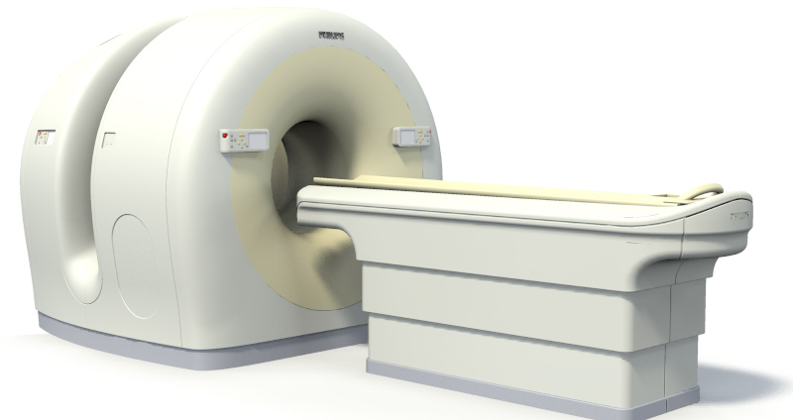
Why a New Readout?
Clinical goals:
  Multimodality: CT, PET, MRI, US, ...
    Reduce patient exposure time;
    Compensate for patient/organ motion;
    Facilitate image fusion (PET/CT);
    Simultaneous imaging of tumor response and responsiveness, as well as dose delivery in vivo.
PHILIPS GEMINI TF™

Slide 9

Why a New Readout?
Clinical goals:
  Multimodality: CT, PET, MRI, US, ...
    Reduce patient exposure time;
    Compensate for patient/organ motion;
    Facilitate image fusion (PET/CT);
    Simultaneous imaging of tumor response and responsiveness, as well as dose delivery in vivo.
Technical goals (“From HEP to PET”):
  Use technologies & techniques devel’d for HEP
    State-of-the-art electronics;
    Compact and reliable data processing;
    System integration and cost.
PHILIPS GEMINI TF™
CERN CMS

Slide 10
Why “Time” Based?
Leads to simple readout architectures:
  Only digital pulses ⇒ simple electronics
  No flash ADCs (running at > 500MHz, power)
Simple timing circuits:
  Need only discriminators and TDCs;
➔ Derive time and energy information from one digital pulse.
  Time over threshold (T.o.T.), pulse width modulation;
Build on in-house experience from large experiments.

Slide 11
Time Based Readout: How?
P.A.
i(t)
Discr.
V(t)
FEDC05
NINO
t
Threshold
i(t)
V(t)
t

Slide 12
Time Based Readout: How?
P.A.
i(t)
Discr.
V(t)
LSO-like Test Pulse
FEDC05
NINO
t
Threshold
i(t)
V(t)
t
Time Walk

Slide 13
Time Based Readout: How?
P.A.
i(t)
Discr.
V(t)
LSO-like Test Pulse
FEDC05
NINO
t
Threshold
i(t)
V(t)
t
Time Walk

Slide 14
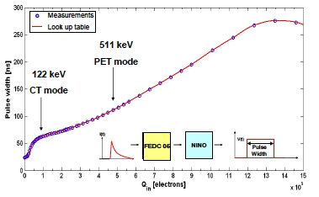
Time Based Readout: How?
P.A.
i(t)
Discr.
V(t)
LSO-like Test Pulse
FEDC05
NINO
t
Threshold
Non-Linearity Correction
i(t)
V(t)
Pulse Width
t
Time Walk Correction
Time Walk
Timestamp from leading edge after time walk correction.
Photon energy from falling edge (pulse width).
Need only discriminator and TDC for both.

Slide 15


APD Detector w/ LHC-Electronics
SIXTH FRAMEWORK PROGRAMME
PRIORITY 1
FP6-2002 LIFESCIHEALTH
Proposal 505785
i(t)
V(t)
i(t)
APD
P.A.
Discr.
Hamamatsu S8550
FEDC05 (ATLAS)
NINO (ALICE - TOF)
FEDC05 chip:
  Preamplifier developed for ATLAS
  Silicon Tracker
  400 electrons ENC (r.m.s.)
  Gain = 4mV/fC
  16 channels
  13ns peaking time
NINO
FEDC05
APD
LSO
(2 x 2 x 10 mm³)
²²Na-Source
NINO chip:
  Very fast discriminator (3GHz BW)
  Signal peaking time: <1ns
  Output time jitter: ≤ 25ps
  8 channels
  Power consumption: 27mW/ch.
APD
LSO
FEDC05
NINO

Slide 16


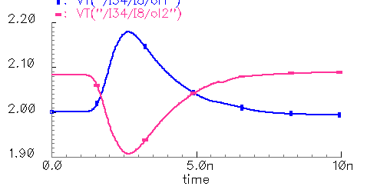
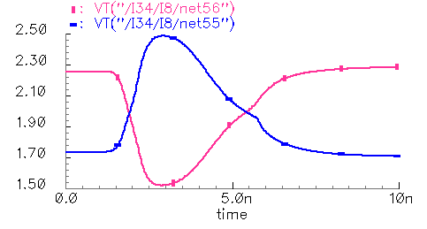
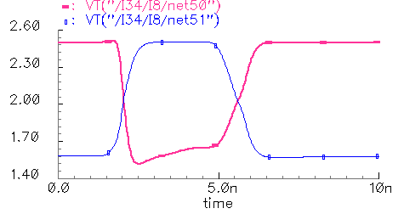
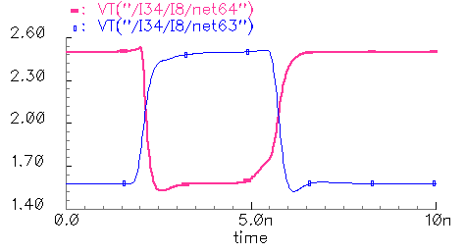
The NINO Chip
TH+
TH-
threshold
V_{dd}
In +
Out1 +
Out A1 +
Out A2 +
Out A3 +
Out A4 +
Vout +
R
R
Input
stage
x6
x6
x6
x6
M6
In -
Out1 -
Out A1 -
Out A2 -
Out A3 -
Out A4 -
Vout -
M7
4 Cascaded amplifiers
Output buffer
Out1+
Out1 -
M5
M0
V_{dd}
2.20
2.50
Inth1
BiasN3
Inth2
2.10
Out A1 +
2.30
Out A2 +
BiasN2
R
R
2.10
M4
M1
2.00
1.90
Out A1 -
1.70
Out A2 -
In+
In-
OutA+
OutA-
1.90
1.50
BiasN1
0
5ns
10ns
0
5ns
10ns
2.60
time [s]
2.60
time [s]
M3
M2
InA+
M6
M7
InA-
2.30
Out A3 +
2.30
Out A4 +
2.00
2.00
M8
BiasN5
1.70
Out A3 -
1.70
Out A4 -
1.40
1.40
Cascade amplifier
0
5ns
10ns
0
5ns
10ns
time [s]
time [s]

Slide 17
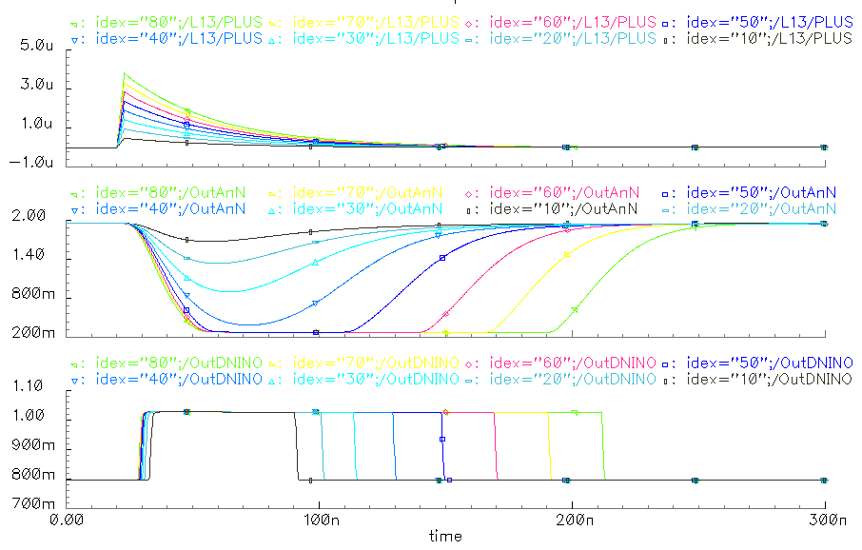
“SPICE” of Readout Chain
i(t)
V(t)
i(t)
APD
P.A.
Discr.
Hamamatsu S8550
FEDC05 (ATLAS)
NINO (ALICE - TOF)
LSO-APD Pulses
FEDC05 Output
Time
Stamp
Energy
NINO output (+)

Slide 18
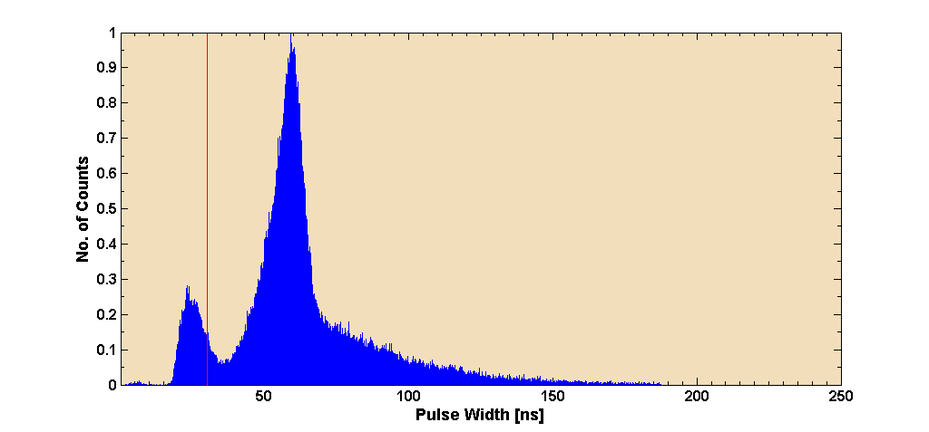
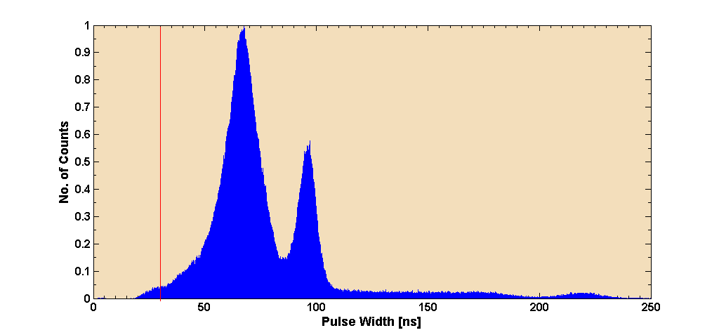
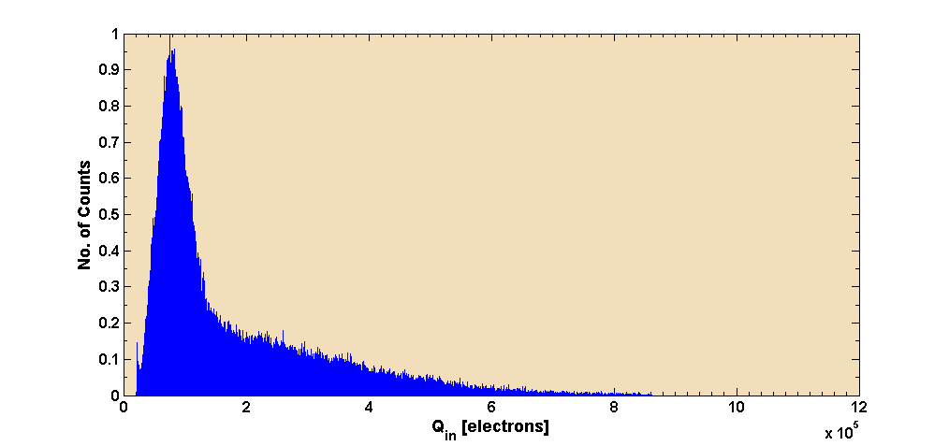
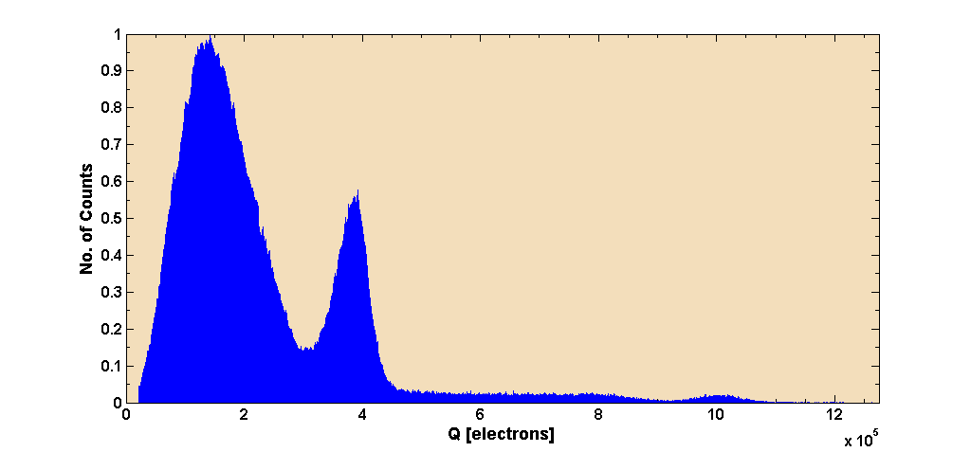
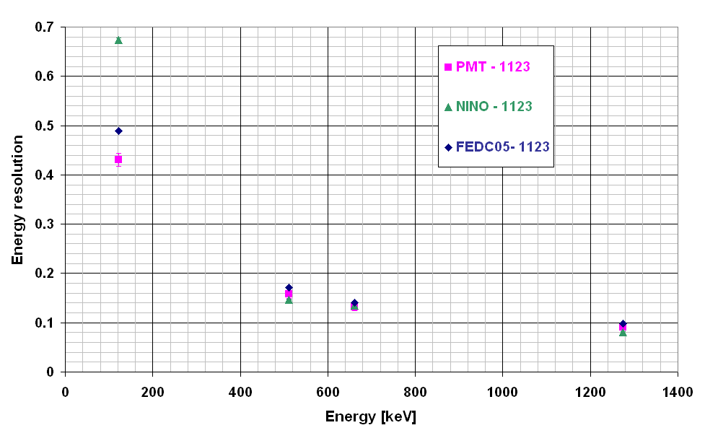
Energy Resolution & Dynamic Range With APDs & NINO
122keV
⁵⁷Co
Raw data
[Pulse Width]
²²Na
511keV
¹⁷⁶Lu Background
1275keV
Look-up Table
122keV
511keV
¹⁷⁶Lu Background
Corrected data
[Charge/
Energy]
1275keV
Linearity after correction
Energy resolution
²²Na
²²Na
¹³⁷Cs
⁵⁷Co

Slide 19
Timing Resolution With APDs & NINO
How “fast” are APDs in the time encoded ‘NINO’ setup?
What are the limitations?
What are the alternatives?
The road to TOF-PET…

Slide 20
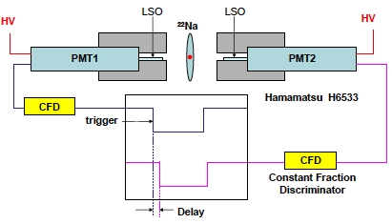
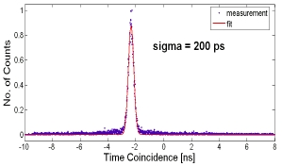
Timing Resolution With PMT (Reference)
No corrections applied;
CFD is free of Time Walk.
470ps FWHM

Slide 21
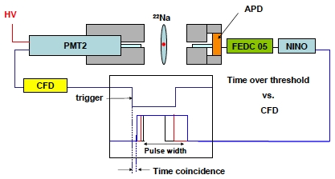
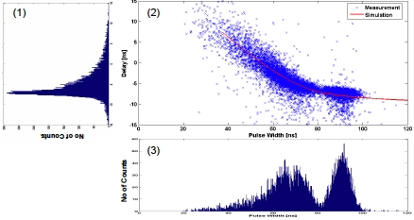
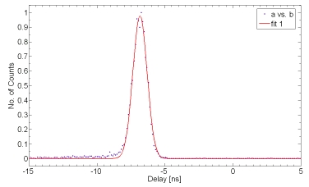
Timing Resolution With PMT–APD
Photo-peak Selection
And
Time Walk Correction
on APD Setup
470ps FWHM
1180ps FWHM

Slide 22
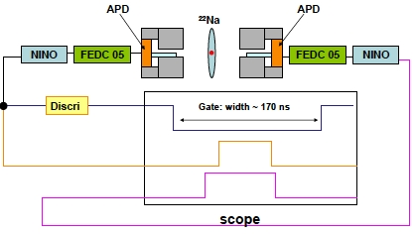
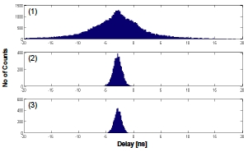
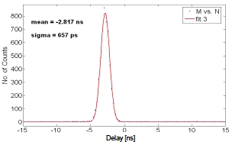
Timing Resolution With Dual APD
Photo-peak Selection
And
Time Walk Correction
on both APD Setups
470ps FWHM
1180ps FWHM
Raw data
1600ps FWHM
After photo-peak selection
+ Time walk correction

Slide 23
Time Jitter of Detector and Readout
NINO
TOTAL | Crystal | APD | Electronics
480 | 340 | 230 | 220
1130 | 800 | 540 | 517
100 | 50 | 30 | 20
PADJK
[ps] rms
[ps] FWHM
[%]
Front end electronics noise together with the APD dark current contribute ~ 20% to the total time jitter.

Slide 24
Time Jitter of Detector and Readout
NINO
TOTAL | Crystal | APD | Electronics
480 | 340 | 230 | 220
1130 | 800 | 540 | 517
100 | 50 | 30 | 20
PADJK
APD
[ps] rms
[ps] FWHM
[%]
Front end electronics noise together with the APD dark current contribute ~ 20% to the total time jitter.
Non-uniformities in avalanche amplification in the APD
account for ~ 30%.

Slide 25
Time Jitter of Detector and Readout
NINO
TOTAL | Crystal | APD | Electronics
480 | 340 | 230 | 220
1130 | 800 | 540 | 517
100 | 50 | 30 | 20
PADJK
APD
[ps] rms
LSO
[ps] FWHM
[%]
Front end electronics noise together with the APD dark current
contribute ~ 20% to the total time jitter.
Non-uniformities in avalanche amplification in the APD
account for ~ 30%.
The principal jitter component of the total jitter is attributed to
  the Poisson-like photon production in LSO within the crystal decay time of 40ns, and
  the high threshold sensitivity of the APD being N ~ 20 p.e.
  (R = 2200 p.e., t_{N} = 340ps, τ = 40ns)

Slide 26
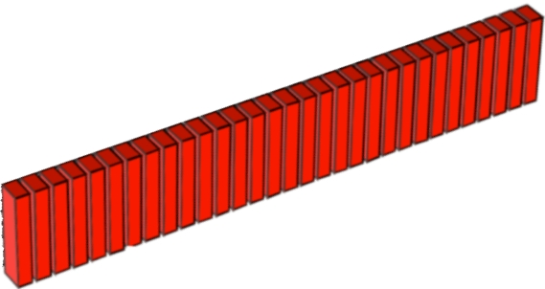

TOF in PET: Why?
w/o TOF
with TOF
t₂
γ
γ
t₁
γ
LOR (z)
γ
Conventional Back-Projection
“Space” coordinate from t₂ – t₁
100ps → 15mm
From HEP we know:
  Event patterns congested by background;
  “Space” points help to remove confusion and improve reconstruction efficiency;
  Charge division, Stereo view, delay lines, cathode readout are known methods;
In PET similar problems arise:
  Count rate contaminated with scattered and random photons;
  TOF reduces randoms and increases sensitivity.
Lesion Detectability
D = 35cm
D = 27cm
SiPM
APD
Data courtesy of J. S. Karp, IEEE, Trans. Med. Imag. Vol. 10
(D denotes patient diameter)
“S”catter
“R”andom
“T”rue

Slide 27
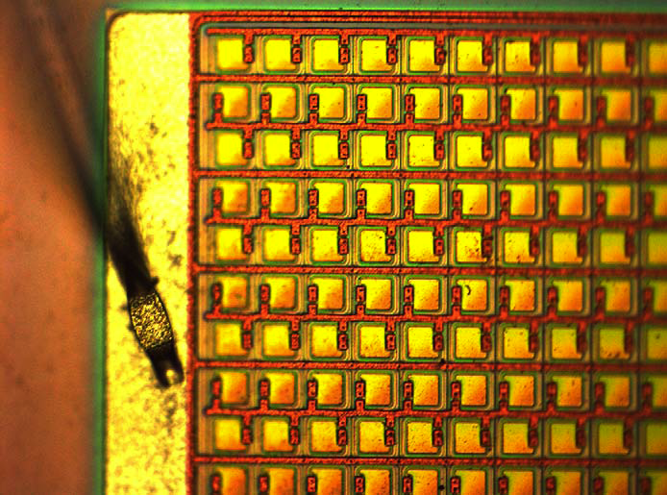
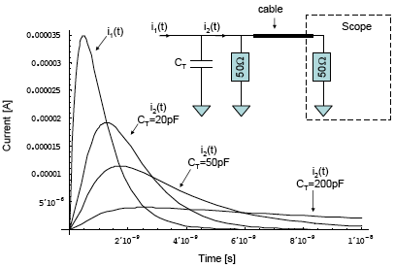
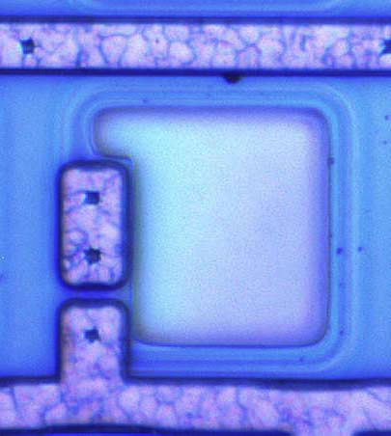
SiPMs for TOF-PET?
SiPMs (MPPCs, etc.)…
  combine the advantages of conventional PMTs: fast and high gain, and
  those of solid state devices: compact, insensitive to magn. fields, low cost;
  are sensitive to single photo-electrons;
  are binary devices (photon counting)
But have …
  low fill factors;
  high thermal (dark current-) count rates;
  high terminal capacitance.
SPAD^{*)}
Pixel structure of a ST-Microelectronics 1 x 1mm² SiPM
^{*)} SPAD = Single Photon Avalanche Diode
SiPM pulse degradation for several terminal capacitances

Slide 28
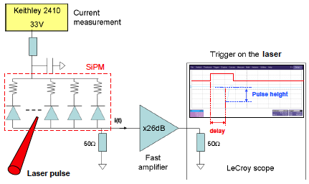
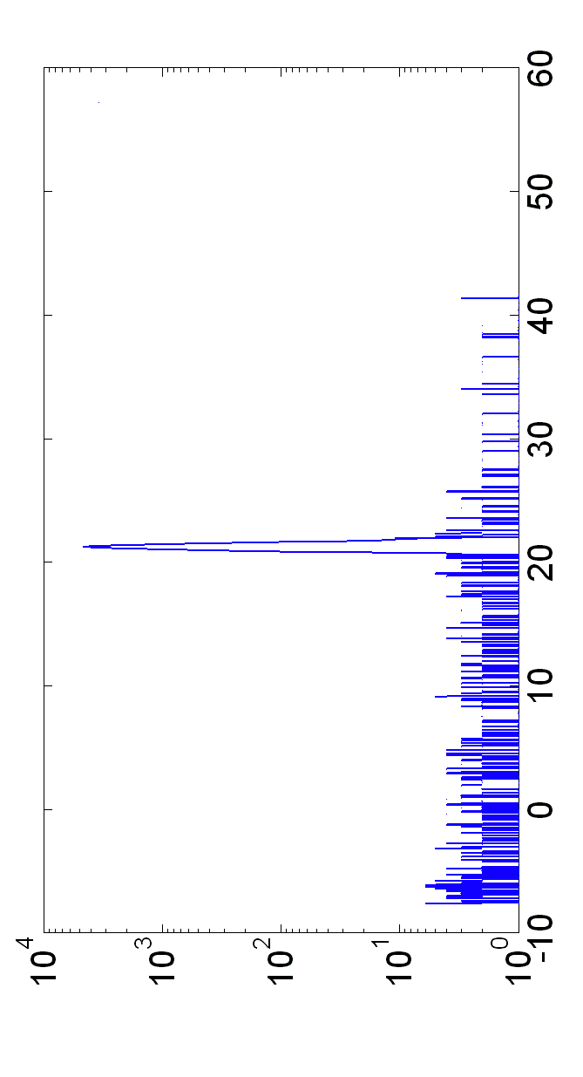
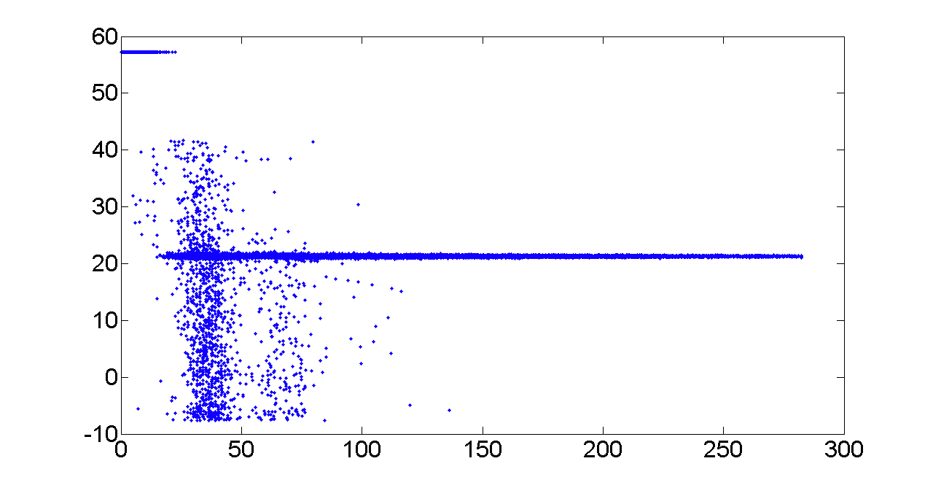
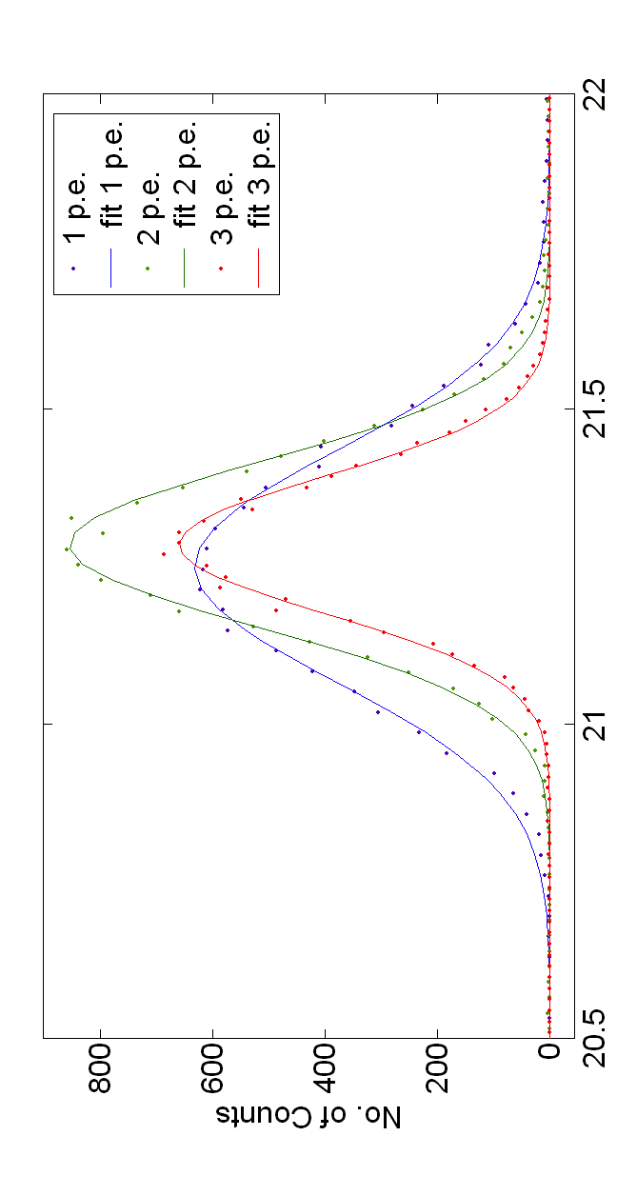
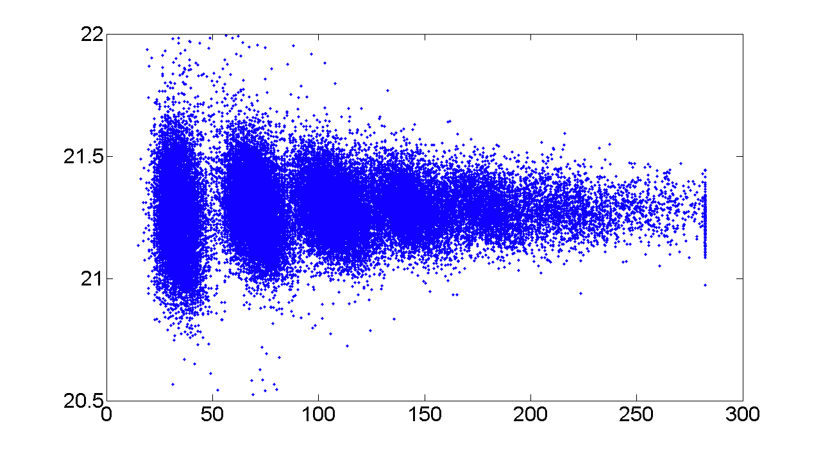
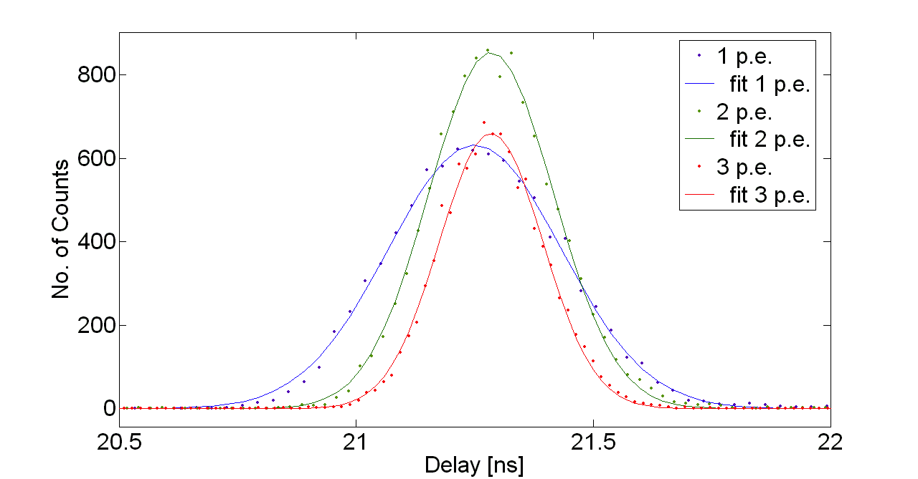
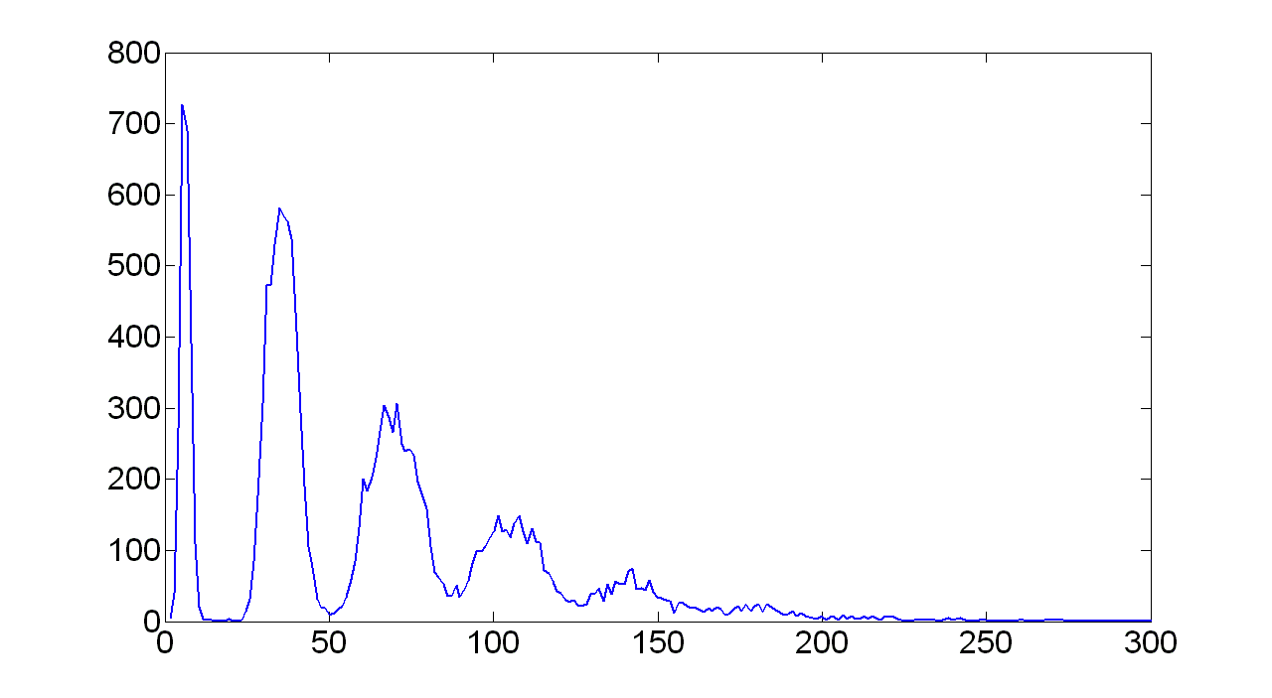
Time Response With Laser Pulses
Non-commercial 1 x 1mm² (400 pixels) SiPM test structure of STM – Catania:
Test Setup
Dark noise (1p.e.)
“Cross talk” (2p.e.)
Delay [ns]
Laser events
Pulse height [µA]
Laser pulse: 50ps, 405nm
Delay [ns]
σ₁ = 181ps
σ₂ = 130ps
σ₃ = 109ps
Pulse height [µA]
FWHM:
425ps (1p.e.)
306ps (2p.e.)
256ps (3p.e.)
Noise
1 SPAD
2 SPADs
3 SPADs
4 SPADs

Slide 29
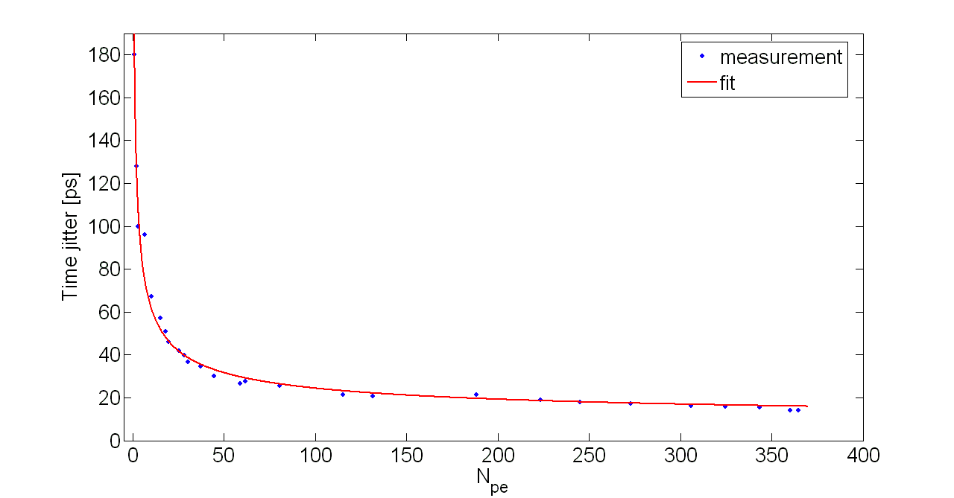
Time Jitter vs. N_{p.e.}

Slide 30
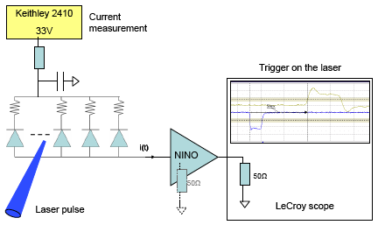
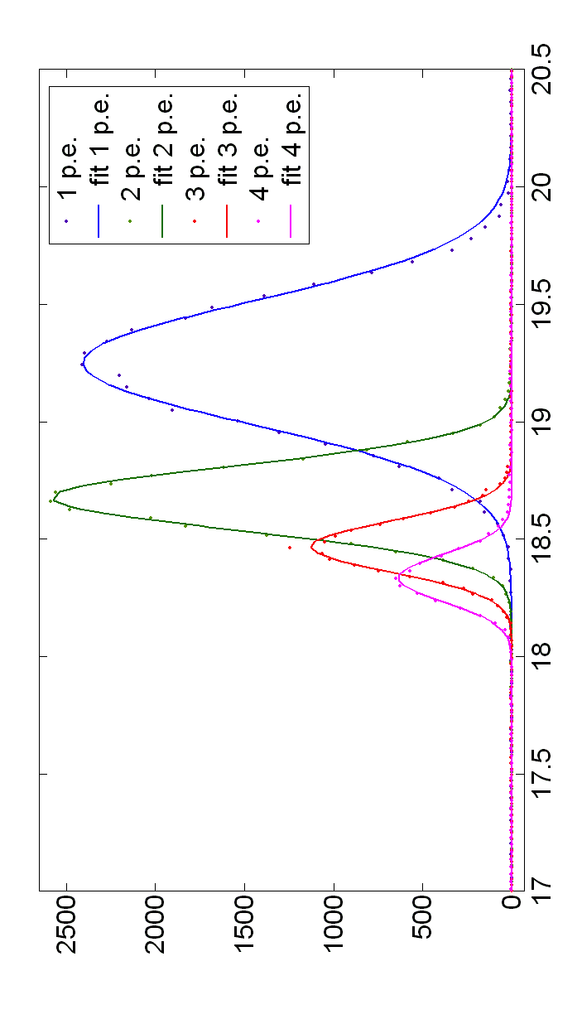
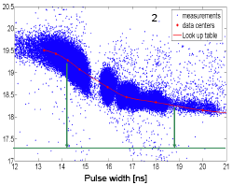
Laser Timing With NINO
Non-commercial 1 x 1mm² (400 pixels) SiPM test structure of STM – Catania:
Without
time walk corrections:
Use look-up table for correcting data.

Slide 31
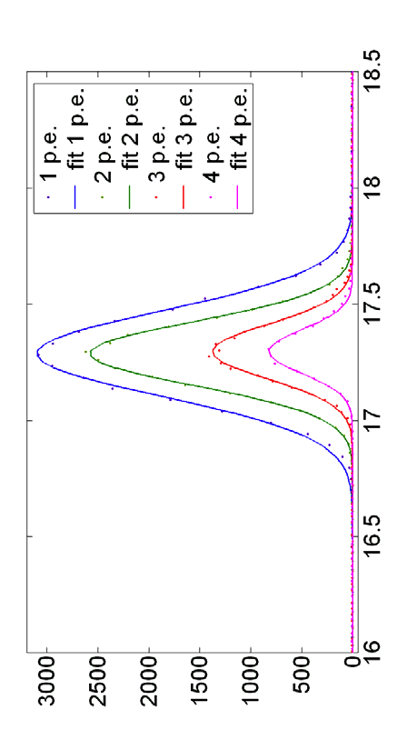
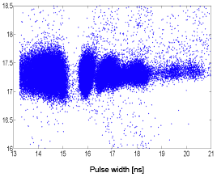

Laser Timing With NINO
Non-commercial 1 x 1mm² (400 pixels) SiPM test structure of STM – Catania:
With
time walk corrections:
NINO has little if any influence on timing precision.
FWHM:
430ps (1p.e.)
320ps (2p.e.)
275ps (3p.e.)
221ps (4p.e.)

Slide 32
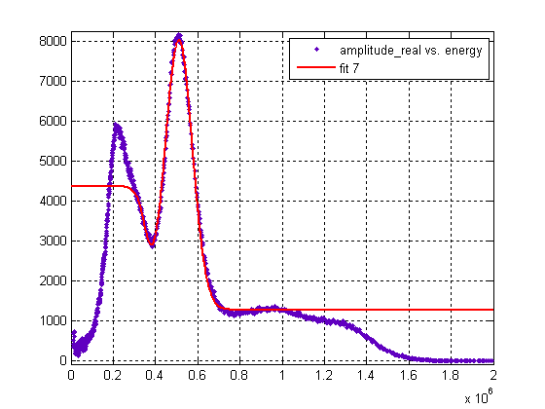
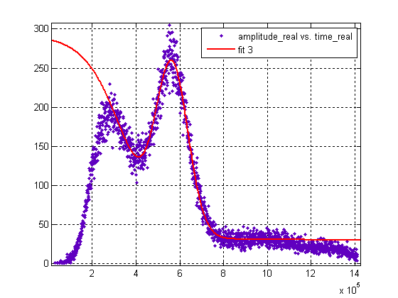
SiPM: Energy Resolution
Hamamatsu S 10931-050 P: 3 x 3mm², 3600 pixels
LSO 3 x 3 x 20 mm³ crystal
²²Na-Source
NINO spectrum normalized from pulse width to energy
(algorithm derived from SPICE simulations).
LSO
(3 x 3 x 20 mm³)
SiPM^{**)}
NINO
NINO output
SiPM output
FWHM: 29%
FWHM: 30%
Energy x 10⁶ [eV]
Energy x 10⁵ [eV]

Slide 33
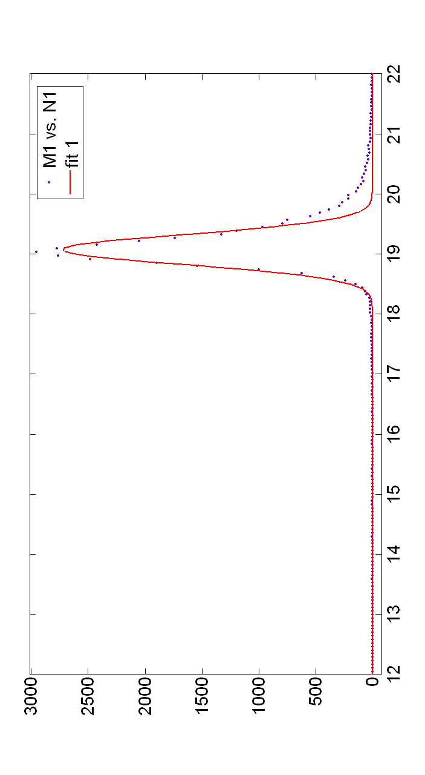
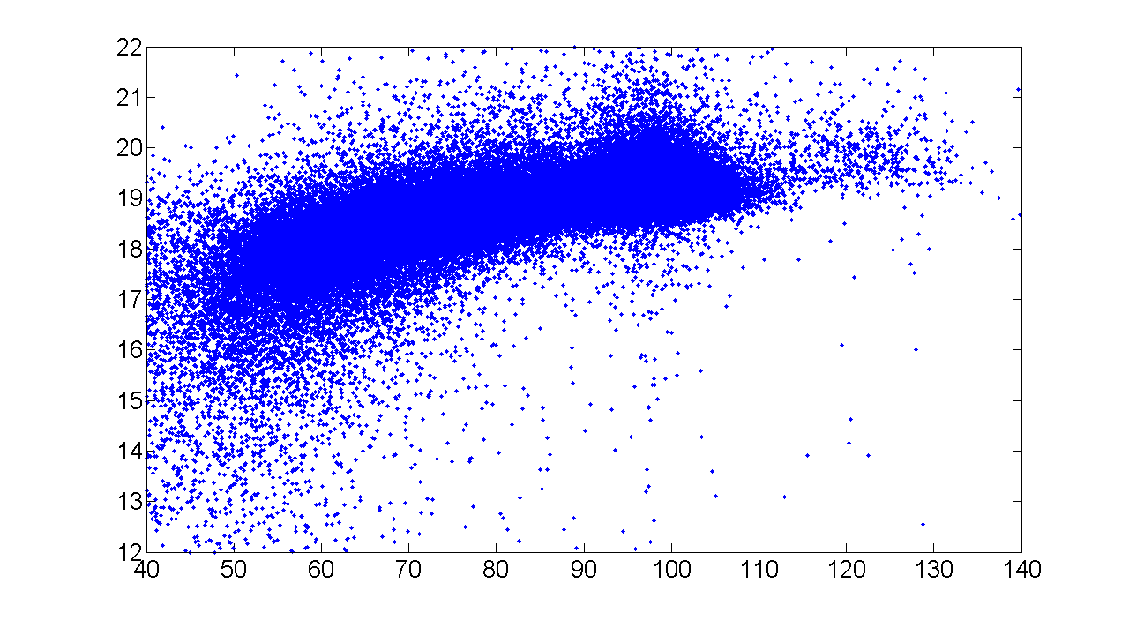
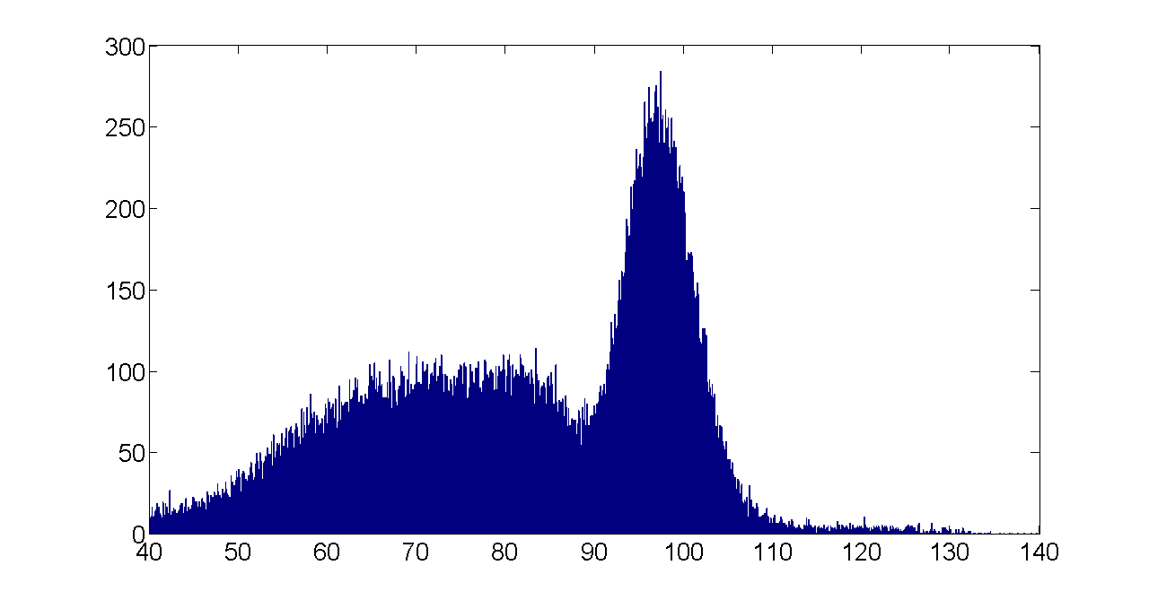
SiPM: Timing Resolution
Hamamatsu S 10931-050 P: 3 x 3mm², 3600 pixels
HV
²²Na
SiPM
Selection from 90ns to 110ns
PMT
CFD
NINO
After photopeak
selection:
Delay [ns]
LSO 3x3x20 mm³
SiPM 71V
Preliminary conclusion:
SiPM timing resolution better than that of fast PMTs.
SiPM resolution still contaminated by jitter from time walk (corrections to come).
Width [ns]
FWHM_{SiPM} = 400ps
Time walk in energy window, expected from SPICE, to be σ ∼ 120ps (280ps FWHM)

Slide 34
Summary
Experience from BioCare (FP6) Work:
  Validation of Time based Readout Scheme (patented).
  Understand limitations in sensor performance (PMTs & APDs).
  ➔ Timing resolution intrinsically limited by photon statistics and
  insufficient APD gain.
CERN time-based electronics well adapted to SiPMs:
  Simple architecture around NINO discriminator (no additional amplification needed);
  Single detector time resolution of ≤400ps FWHM (σ = 170ps) achieved.
  Time walk corrections (~280ps FWHM) still pending;
  Resolution intrinsically limited by photon velocity in crystal (~200µm/ps)
  ➔ 100ps maximum in 20mm ➔ 50ps FWHM in chosen LSO crystal.

Slide 35
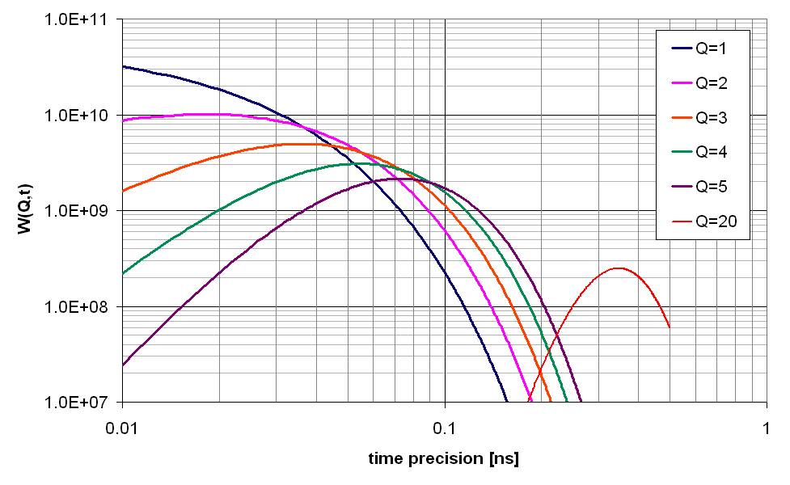
“Timing Precision” vs. N_{p.e.} (Q)
APD
.34
(σ)
(Westcott, Knoll, Lynch, Wright)

Slide 36
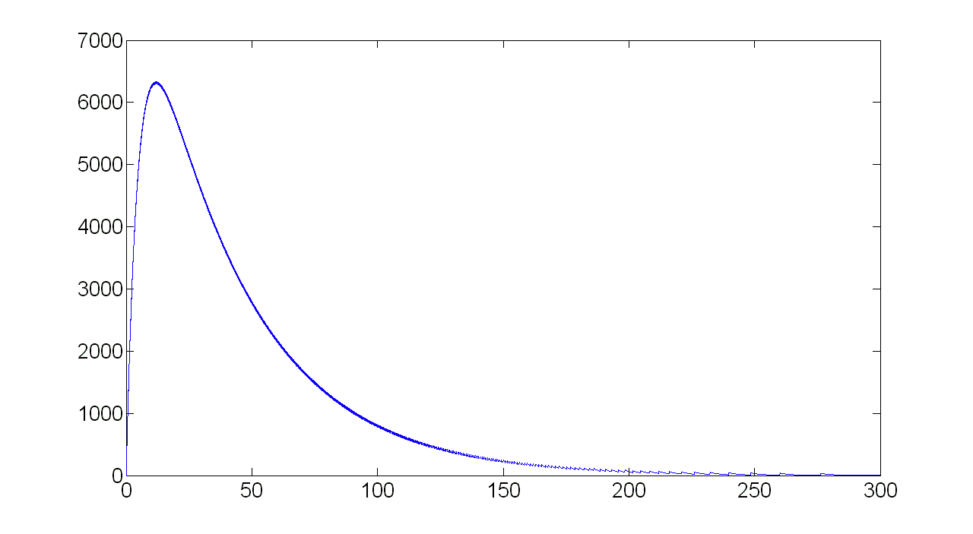
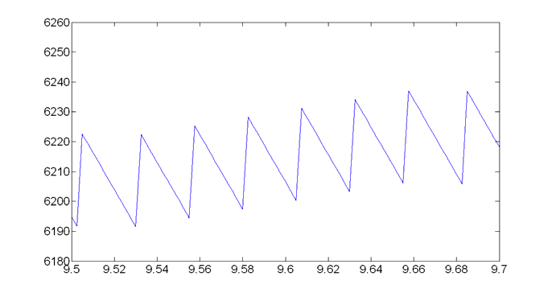
Time Evolution of SiPM Signal
1 p.e. response
I_{SiPM}(t) [uA]
I_{o} = 34 μA
N_{pe} = 2000
τ_{crystal} = 40 ns
τ_{RC} = 5 ns
Time [ns]

