Slide 1

The EXO-200 Detector
Razvan Gornea for the EXO Collaboration
LHEP, Center for Research and Education in Fundamental Physics, Bern University
Frontier Detectors for Frontier Physics
11th Pisa meeting on advanced detectors
24-30 May 2009

Slide 2
Double Beta Decay …
Rare nuclear transition between same mass nuclei
  Energetically allowed for even-even nuclei
Allowed in SM and
already observed!
Neutrinos are Majorana particles!

Slide 3
... and its Role in Neutrino Physics
Double beta decay experiments are part of a massive effort to determine
the nature and properties of neutrinos!
Cosmological Constraints
Beta Decay
Endpoint
Neutrino Oscillations
Atmospheric and Reactor
Neutrino Oscillations
Reactor and Beam
CP
violation
Neutrino Oscillations
Solar and Reactor
Neutrinoless
Double Beta Decay
Only!

Slide 4
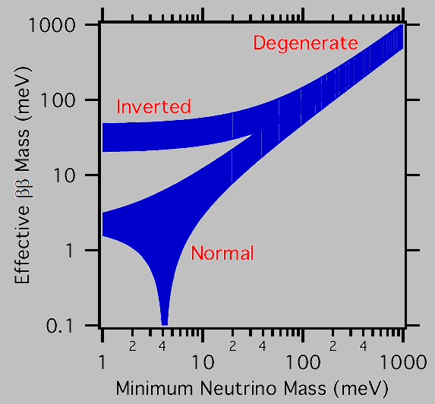
Experimental Requirements
Large Mass: at least 100 kg of source isotope
  Scanning the quasi degenerate region
  Ton scale for the inverted hierarchy region
  Enrichment helps minimizing volume and improves source purity
Very Low Background: 1 count per ton per year range
  Survey, selection and purification of materials and components
  Cleanroom assembly and detector operation
  Deep underground installation and muon veto required
Very Good Energy Resolution: in the 1% range
  Limits the allowed double beta decay background
  Increases signal to radioactive background ratio
And …
  Large Q_{ββ} to have the signal out of the region densely populated by radioactive background for natural chains
  Tagging the daughter isotope would eliminate most radioactive background or event topology and advanced kinematics details
Effective neutrino mass as a
function of the smallest neutrino
mass for various scenarios
today
ton class

Slide 5


EXO Project & EXO-200 Phase
EXO project searches for double beta decay using ¹³⁶Xe
  Ton scale implementation either as liquid or gas phase TPC
  Relatively large Q value and straight forward enrichment technique
  ¹³⁶Ba daughter tagging either in-situ or in external RF cage
EXO-200 is the first phase using 200 kg of 80% enriched Xe
  Major R&D effort precursory to the ton-scale experiment
  Exploration of the quasi-degenerate region with ¹³⁶Xe
  Allowed double beta decay never observed in xenon!
  No tagging but massive progress for radioactive background reduction and energy resolution improvement (easily scalable to future detectors)
No Background!

Slide 6
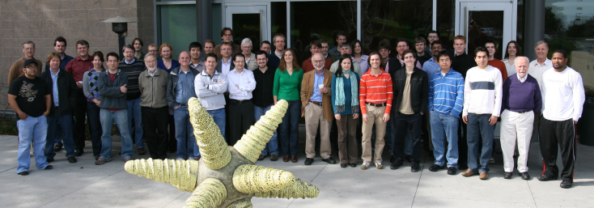
EXO Collaboration
K.Barry, D.Leonard, E.Niner, A.Piepke from Physics Dept, University of Alabama, Tuscaloosa AL, USA
P.Vogel from Physics Dept Caltech, Pasadena CA, USA
A.Bellerive, M.Bowcock, M.Dixit, C.Hargrove, E.Rollin, D.Sinclair, V.Strickland from Carleton University, Ottawa, Canada
C. Benitez-Medina, S.Cook, W.Fairbank Jr., K.Hall, B.Mong from Colorado State University, Fort Collins CO, USA
M.Moe from Physics Dept, UC Irvine, Irvine CA, USA
D.Akimov, I.Alexandrov, A.Burenkov, M.Danilov, A.Dolgolenko, A.Kovalenko, V.Stekhanov from ITEP Moscow, Russia
J.Farine, D.Hallman, C.Virtue, U.Wichoski from Laurentian University, Canada
H.Breuer, C.Hall, L.Kaufman, S. Slutsky, Y-R. Yen from University of Maryland, College Park MD, USA
K.Kumar, A.Pocar, T. Daniels from University of Massachusetts, Amherst, USA
M.Auger, R.Gornea, F. Juget, G. Giroux, M. Weber, J-L.Vuilleumier, J-M.Vuilleumier from LHEP, Bern University, Switzerland
N.Ackerman, M.Breidenbach, R.Conley, W.Craddock, J.Hodgson, D.McKay, A.Odian, C.Prescott, P.Rowson, K.Skarpaas, J.Wodin, L.Yang, S.Zalog from SLAC, Menlo Park CA, USA
J.Anthony, L.Bartoszek, R.DeVoe, P.Fierlinger, B.Flatt, G.Gratta, M.Green, S.Kolkowitz, F.LePort, M.Montero-Diez, R.Neilson, A. Rives, K.O’Sullivan, K.Twilker from Physics Dept, Stanford University, Stanford CA, USA

Slide 7
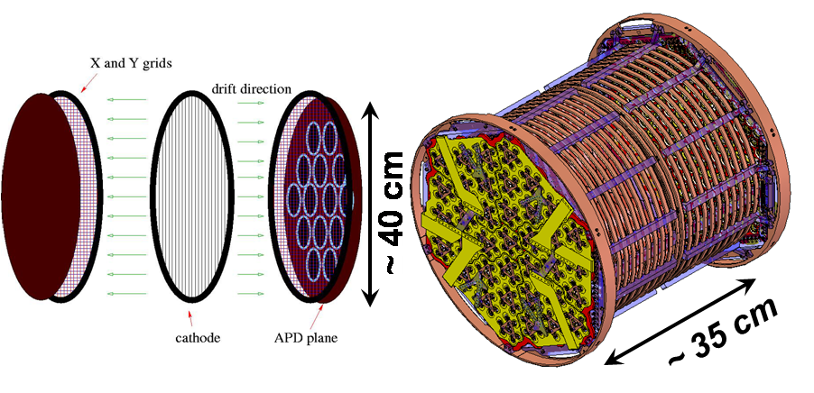
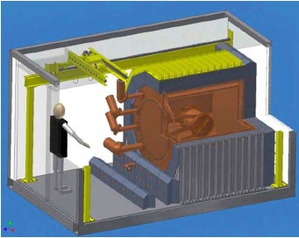
EXO-200 Detector
Liquid xenon TPC with two cylindrical drift volumes
  Charge collection using 114 by 114 wire planes (at 60º pitch)
  Scintillation light readout using 37 groups of 7 bare LAAPD (Large Area Avalanche Photodiodes) at both end caps
High purity copper cryostat with external refrigeration-based cooling
~ 115 kg fiducial mass

Slide 8
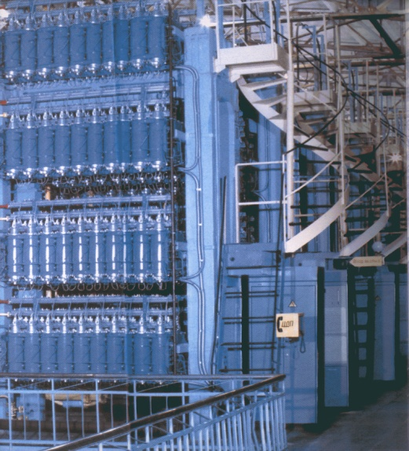
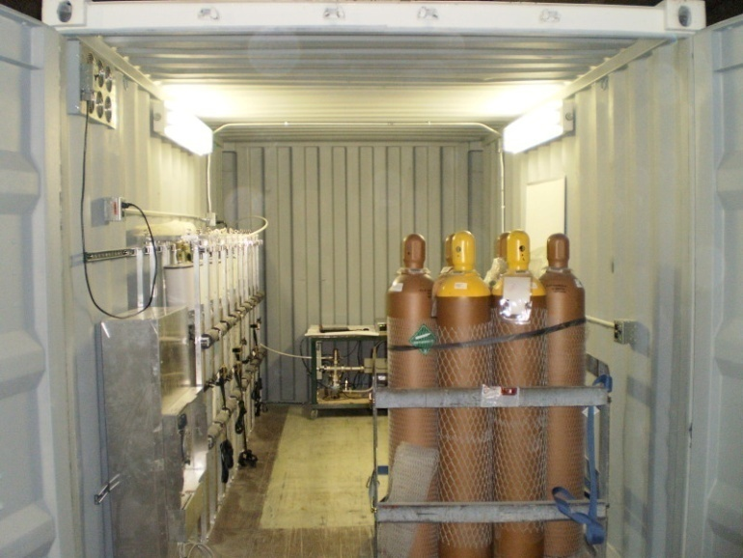
Successful Enrichment Program
200 kg of 80% enriched Xe delivered in 2003!
Used mass-separating centrifuges in Russia
The other isotopes can be returned to provider!

Slide 9
Radio-Purity Survey
Large effort to determine the residual radioactive contamination of the materials employed for the construction of EXO-200 detector
  Mass spectrometry (MS)
  Neutron activation analysis (NAA)
    Very sensitive but expensive, potential background from main elements
  Alpha counting (evaluation of the ²¹⁰Pb concentration in the shield lead)
  Glow discharge MS (GD-MS), inductively coupled plasma MS (ICP-MS)
    ICP-MS has better sensitivity when pre-concentration procedures are employed but the samples have to be soluble in acids (preferably HNO₃)
  Direct gamma counting
    Large mass samples and long duration exposures are necessary
Published database of characterized materials
  Nucl. Instr. Meth. A 591, 490-509, 2008
Detailed Monte Carlo simulation of expected background

Slide 10
Improving the Energy Resolution
Strong anti-correlation between ionization and scintillation signals in liquid xenon has been observed!

Slide 11
EXO-200 Detector

Slide 12
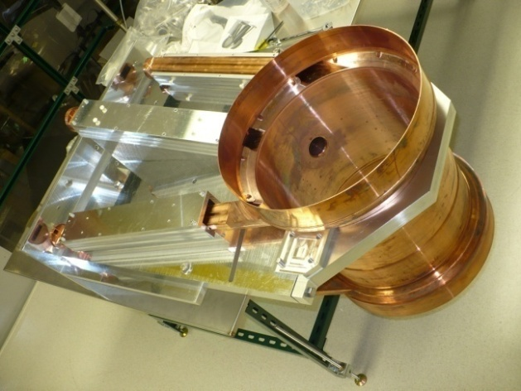
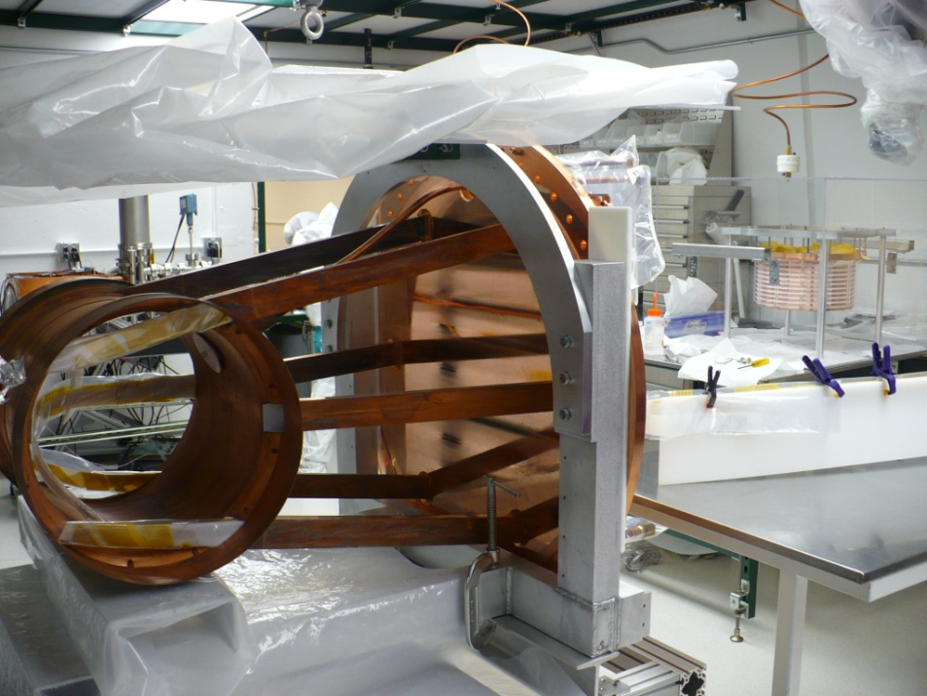
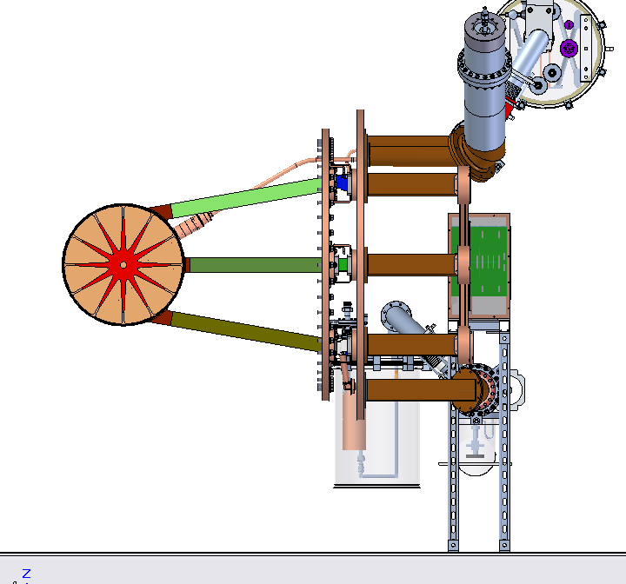
EXO-200 Chamber
Ultra low radioactivity copper!
Shielded surface transport and storage
Only 1.5 mm thickness to reduce mass
PLC-based real-time pressure control
e-beam welded components
TIG welding for the final assembly

Slide 13
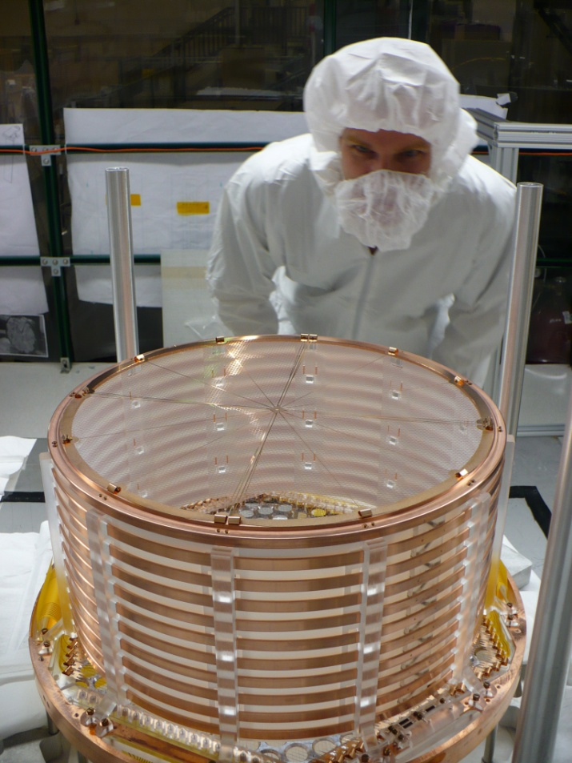
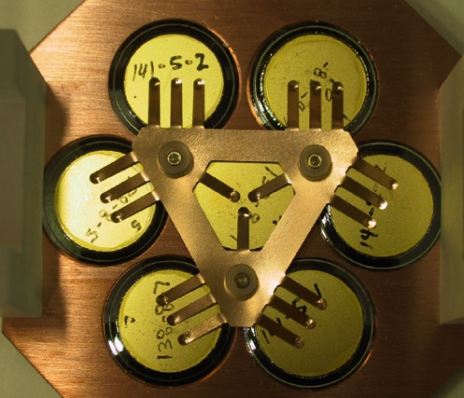
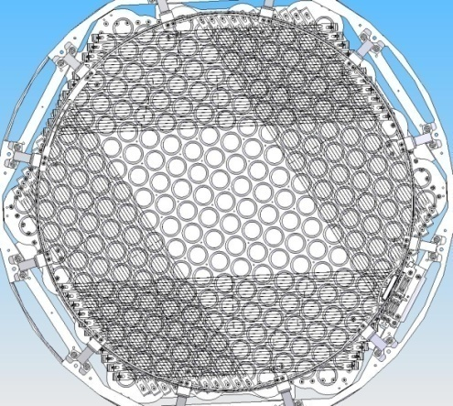
Charge and Light Readout
Photo-etched phosphor-bronze cathode
Induction & charge collection wire grids
259 LAAPD (37 groups of 7) per plane
- 1.6 cm active diameter
- very clean and low mass
- QE > 1 @ 174 nm
- gain 100× to 150× @ ~ 1500V
Radial Teflon UV light reflectors

Slide 14
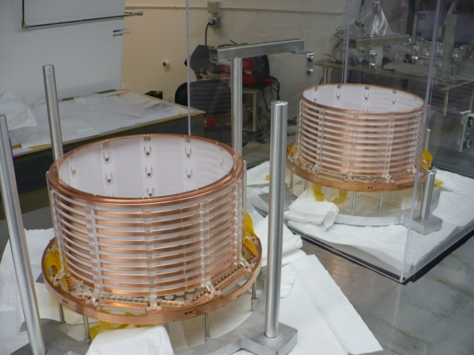
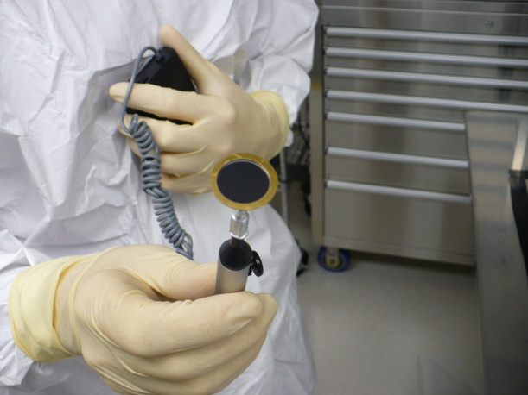
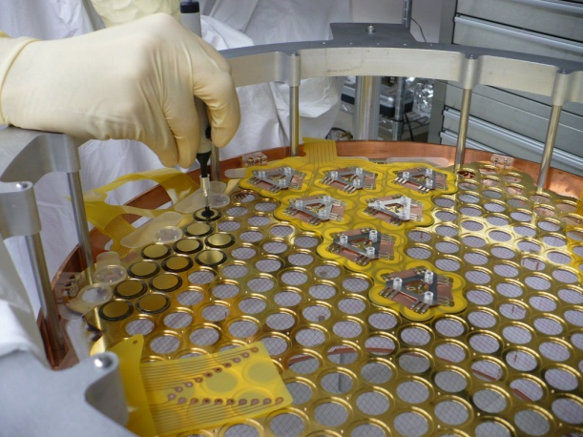
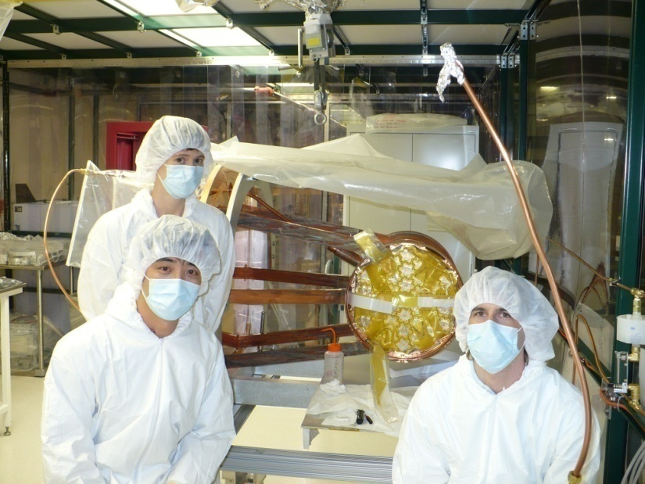
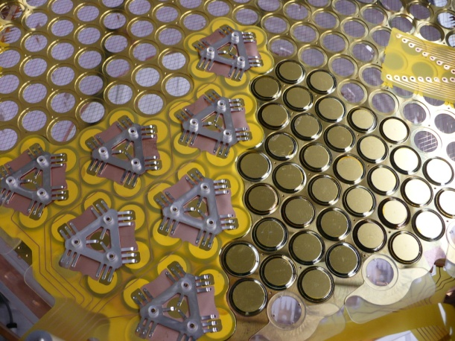
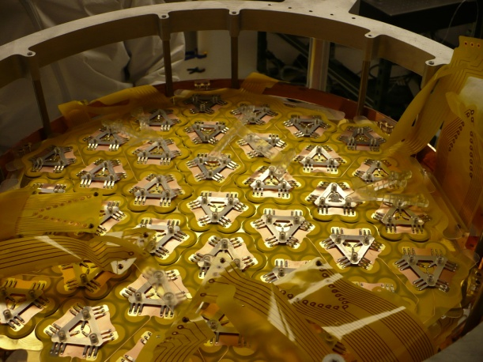
Chamber Assembly

Slide 15
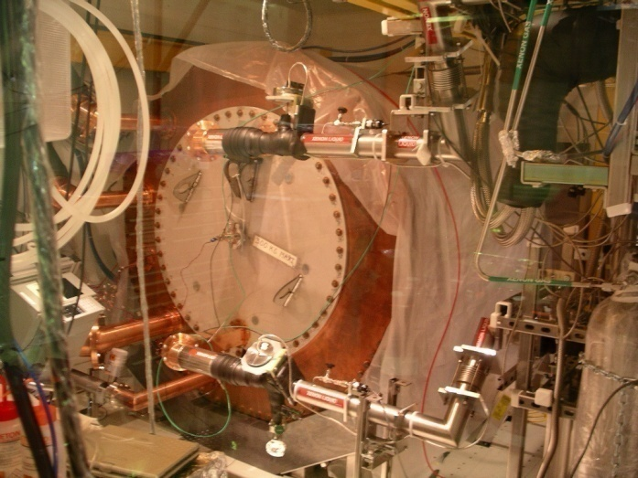
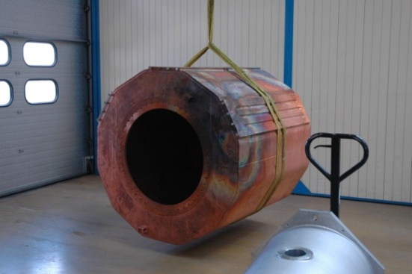
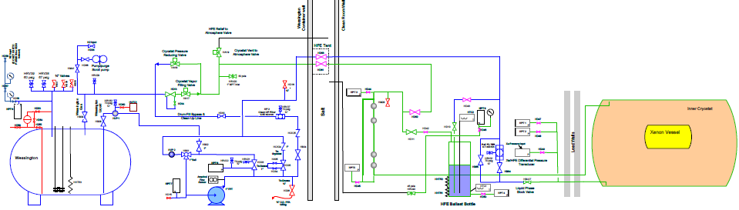
Cryostat and Cooling System
Refrigeration based cooling (3 × 1500 W PolyCold units)
4.2 tons of high purity heat transfer fluid (3M HFE-7000)
Serves also as inner shield!

Slide 16
WIPP Installation

Slide 17
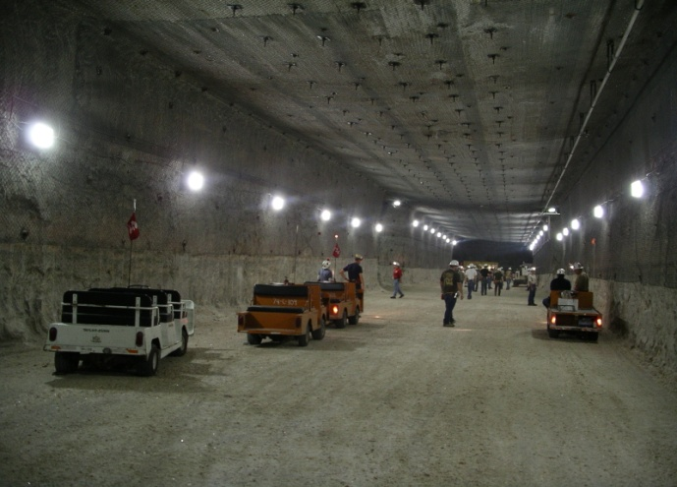
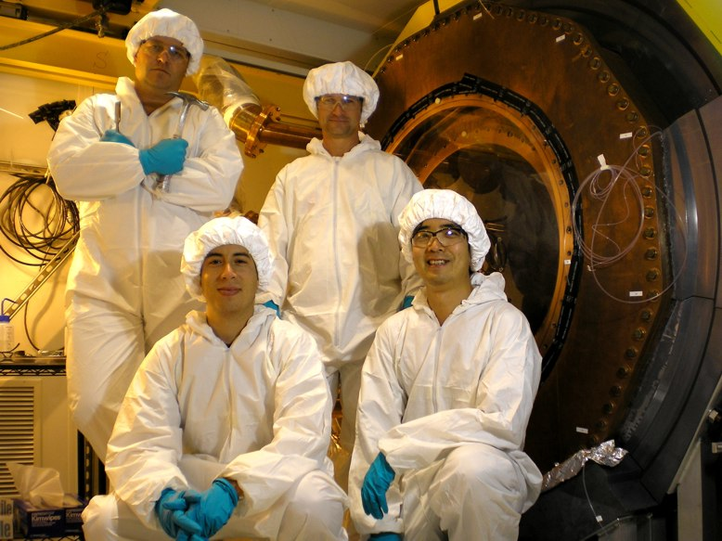
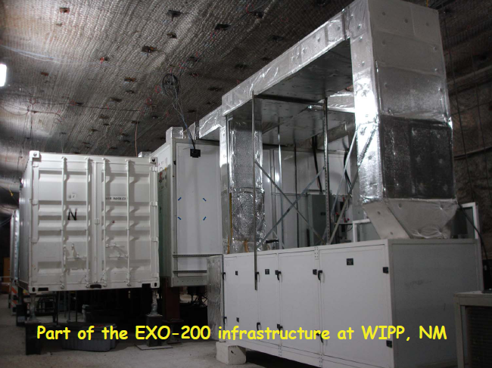
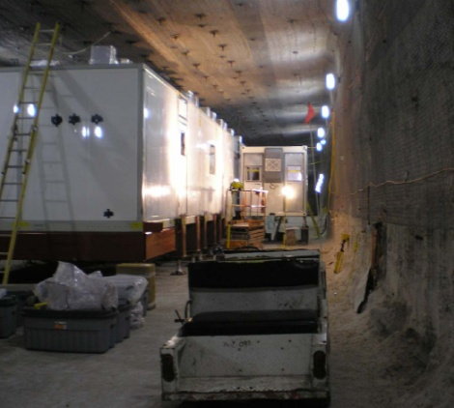
Experimental Area
Waste Isolation Pilot Plant, Carlsbad, New Mexico
~ 1600 m.w.e. (muon flux reduction by ~ 10×)
Large and wide remote experimental area available!

Slide 18
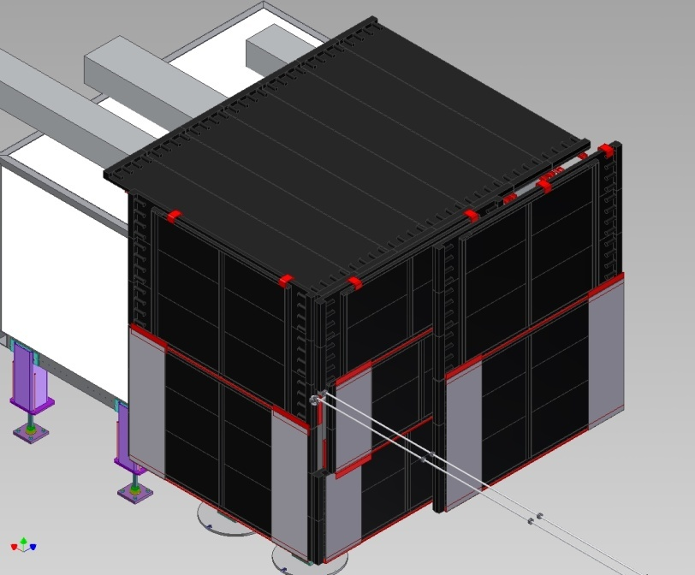
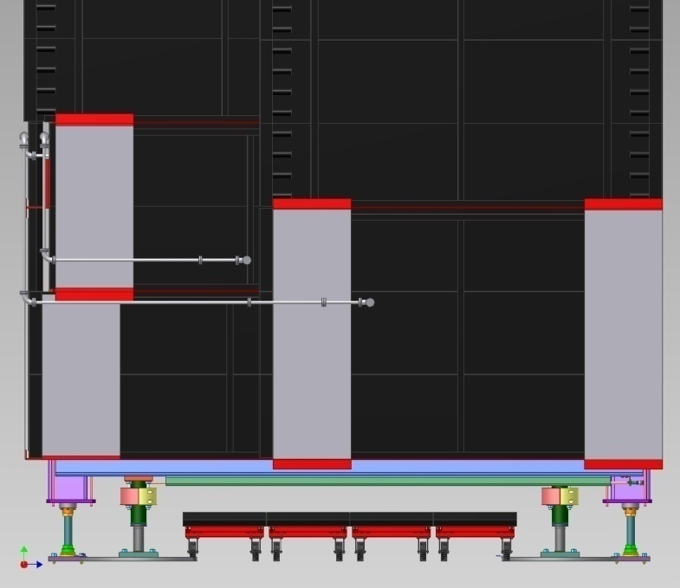
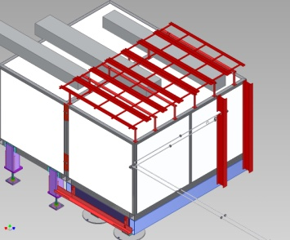
Muon Veto
20× muon induced background reduction (99,7% detection efficiency)
Extensive Monte Carlo simulations to optimize
the veto configuration!

Slide 19

Expected Performance
Very low radioactive background
  Careful selection of materials, optimized custom design
  Manufacturing, handling and installation in cleanrooms
Very good energy resolution
Chamber underground installation in august 2009
Physics runs starting in 2010, 2 years run time!
Case
Mass
(ton)
Eff.
(%)
Run Time
(yr)
σ_{E}/E
@ 2.5 MeV
(%)
Radioactive
Background
(events)
T_{1/2}^{0ν}
(yr, 90%CL)
Majorana mass
(meV)
QRPA¹ NSM²
EXO-200
0.2
70
2
1.6
40
6.4*10²⁵
133
186
1) Rodin et. al., Nucl. Phys. A 793 (2007) 213
2) Caurier et. al., arXiv:0709.2137v1

Slide 20
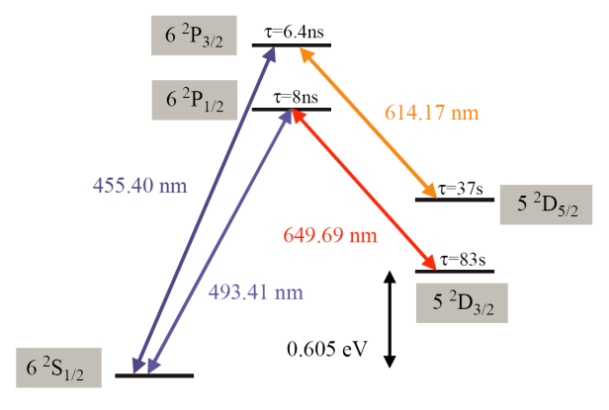
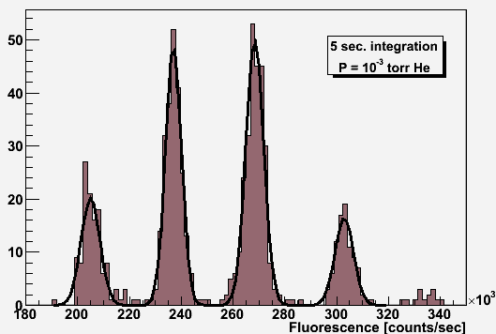
Ba⁺ Tagging
Ba⁺⁺ → Ba⁺ conversion expected
  Ionization potentials:
    Xe⁺ = 12.13 eV vs. Ba⁺ = 5.21 eV
    Xe⁺⁺ = 21.21 eV vs. Ba⁺⁺ = 10.00 eV
  Solid Xe band gap (Phys. Rev. B10 4464 1974)
    E_{G} = 9.22 +/- 0.01 eV
  “Liquid Xe ionization potential” close to E_{G} (J. Phys. C: Solid State Phys. Vol. 7 1974)
    9.28 to 9.49 eV range
  Use of additives for gas based detectors
RF cage with low pressure buffer gas

Slide 21
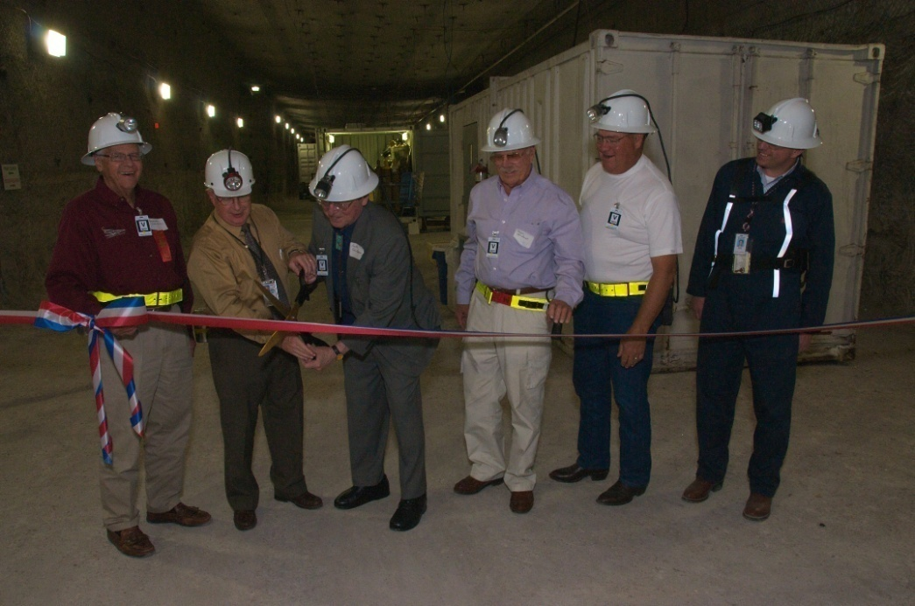
Conclusion
EXO-200 detector soon operational!
The largest neutrino-less double beta decay detector!
Successful large scale xenon enrichment proven!

