Slide 1
IFD 2014
INFN Workshop on Future Detectors for HL-LHC
Vertexing & Tracking Detectors
Local mechanical supports
and cooling systems
Simone Coelli
I.N.F.N. - SEZIONE DI MILANO

Slide 2
SUMMARY:
STAVE DESIGN
EVAPORATIVE PROCESS
DETECTORS COOLING PLANT
CERN TRACKERS UPGRADE OVERVIEW (FROM THE POINT OF VIEW OF THE COOLED SUPPORTS)
R&D WORK IN PROGRESS

Slide 3
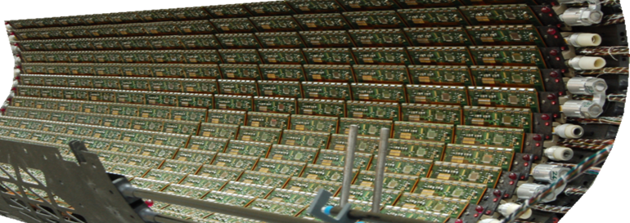
TRACKERS LOCAL SUPPORTS: THE CHALLENGE
USUAL STAVE REQUIREMENTS:
TAKE IN PLACE WITH PRECISION THE TRACKER SENSORS
THERMAL MANAGEMENT: EXTRACT THE DISSIPATED POWER (>1 W/cm²)
SUB-ZERO WORKING TEMPERATURES (WHEN IN HARD RAD. ENVIRONMENT)
HOMOGENEOUS AND CONSTANT OPERATING TEMPERATURES
ROBUST SYSTEM - AFFORDABLE - MAINTENANCE FREE
LOW MATERIAL BUGET - GOOD X₀ – MINIMUM MASS SYSTEM
STRUCTURAL STIFFNESS - NO VIBRATIONS
LOW DEFORMATION – LOW C.T.E. MATERIALS – LOW MISMATCH (AMB. TO -40 °C)
ELECTRIC AND FLUID CONNECTIVITY
CORROSION COMPATIBILITY (COOLANT)
PERFECT INTEGRATION SCHEME – ONE-STAVE-REMOVAL WHEN POSSIBLE

Slide 4
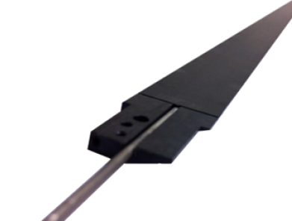
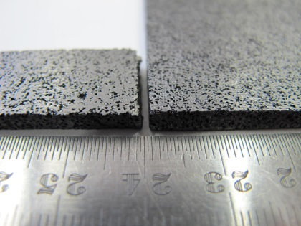
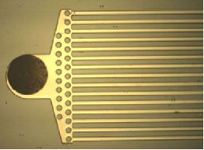
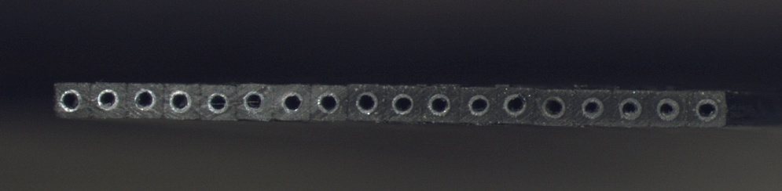
TECHNOLOGICAL OPTIONS MOSTLY PURSUED
«SUPPORT + COOLING SYSTEM» INTEGRATION
CFRP CARBON FIBERS ULTRA-LIGHT SUPPORT STRUCTURES (HIGH RIGIDITY AND STRENGHT, LOW DENSITY, VERY LONG RAD. LENGTH, LOW %X0)
CARBON FOAM MATERIALS (HIGH THERMAL CONDUCTIVITY, LOW DENSITY)
EVAPORATIVE COOLING
SMALL PIPES (F1-2 mm), EMBEDDED IN THE SUPPORT
IMPROVED GLUE THERMAL CONDUCTIVITY (ADDITIVES EPOXY + BN, THIN LAYERS 50 µm)
FLEX-BUS INTEGRATED IN THE STAVE
SOME EXPERIMENT ALREADY EXPLOITING MICRO-CHANNELING:
  SILICON MICRO-CHANNEL
  CARBON MICRO-CANNELS
12.8 mm
700 µm

Slide 5
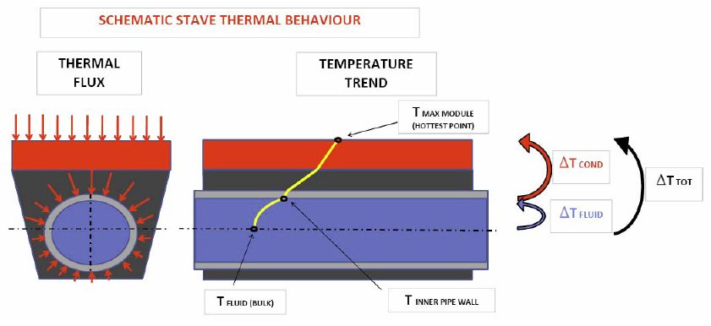
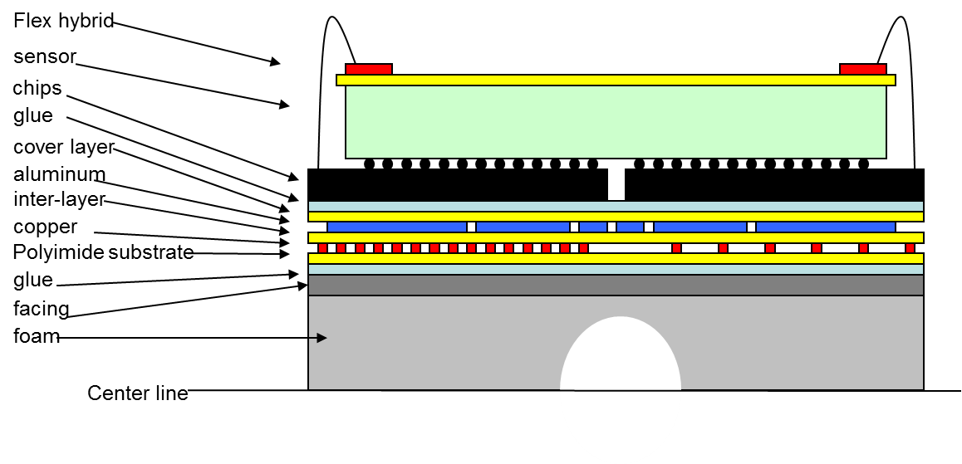
TYPICAL STAVE‏ SECTION
STAVE DESIGN GOAL
  MANAGE THE THERMAL LOADS
  EXPLOITING THE BEST MATERIALS THERMAL CONDUCTION
  THERMAL CONVECTION TOWARDS THE FLUID
  PHASE CHANGE WHEN USING THE EVAPORATING COOLANT
THERMAL FLOW
THERMAL GRADIENTS
REQUIREMENT WITH HIGHLY IRRADIATED SENSORS
TO AVOID THERMAL RUNAWAY
=> OPERATIVE TEMP.ERATURE < - 5 °C

Slide 6
CHARACTERISTICS OF THE EVAPORATIVE PROCESS
NEAR ISO-THERMAL => SMALL DT ALONG THE STAVE (LOW TEMP.GRADIENTS)
EFFICIENT: high heat transfer coefficient (W/m²K)
ALLOWS SMALL TUBES: low material; easy bending; low forces due to CTE mismatch
COOLANT => BOILING AT – 20 °C / - 40 °C inside the channel
DETECTOR COOLING FLUIDS
(RAD HARD, DIELECTRIC)
FLUOROCARBONS
C₂F₆
C₃F₈
C₄F₁₀
C₆F₁₄ => USED IN SINGLE PHASE FLOWS ONLY (NEED TO BE UNDER VACUUM FOR TEMPERATURES LOWER THAN 56 °C)
PURE OR BLENDED TO OBTAIN SPECS.
CARBON DIOXIDE CO₂ => HIGH LATENTHEAT, LOW PRESSURE DROP, more environmentally friendly and less expensive
MOST LIKELY CANDIDATES FOR LOW-TEMPERATURE OPERATION

Slide 7
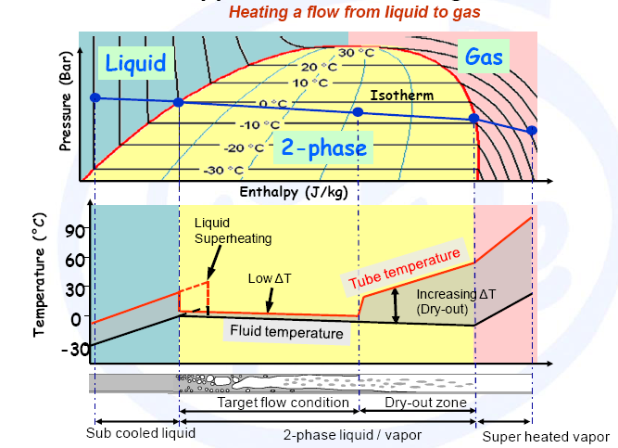
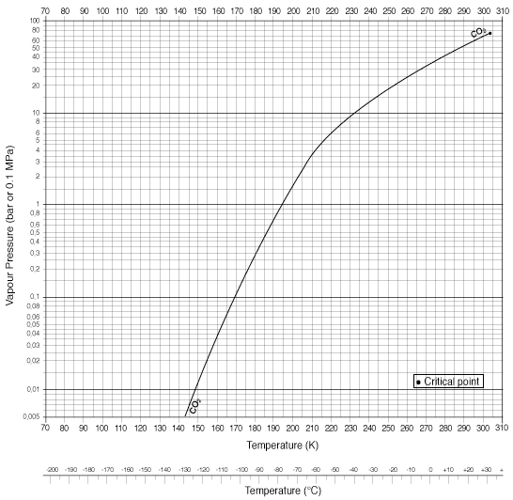
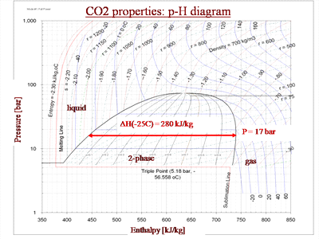
THERMODYNAMICS OF THE EVAPORATIVE PROCESS
THE PURE CO2 SATURATION CURVE
CORRELATES TEMPERATURE AND PRESSURE INSIDE THE EVAPORATION CHANNEL
  => 10 TO 20 bar COOLING FLUID
  OPER. PRESSURE
  COOLING FLUID OPER. TEMP.
  - 20 / - 30 °C
LATENT HEAT OF VAPORIZATION FOR CO2
IN THE RANGE OF INTEREST
DELTA H liq.=> vap. = 280 kJ/kg

Slide 8
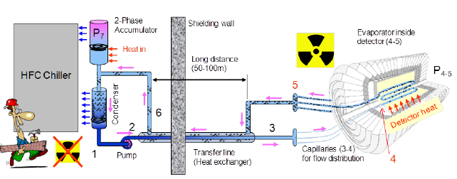
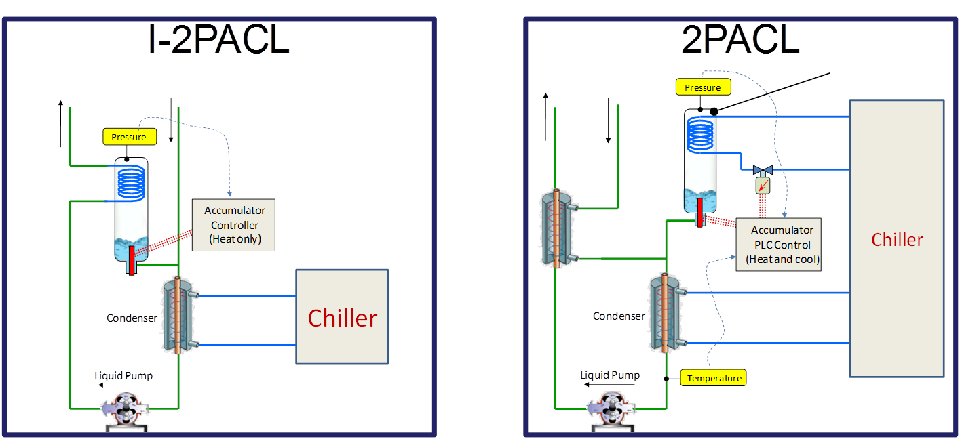
CERN EXPERIMENTS COOLING PLANT
2 PACL = 2-Phase Accumulator Controlled Loop
USES ONLY PASSIVE SYSTEMS IN THEUNACESSIBLE AREA
CERN EXPERIMENT DETECTOR COOLING CIRCUIT SKETCH
Used at CERN for:
LHCb Velo
Atlas Pixel IBL
CMS Pixel upgrade
LHCb UT upgrade
LHCb Velo microchannel upgrade
TRACI UNITS
NEW INTEGRATED SYSTEM
patented: CERN & NIKHEF

Slide 9
DETECTOR COOLING PLANT
THE DETECTOR IS A PRESSURE SYSTEM
CO₂ DESIGN PRESSURE ~ 100 bar (Safety Factor above the Critical Point pressure)
Pipe material baseline: Stainless Steel or Titanium ~ 0.1 mm wall thickness
NOTES:
OPERATIVE CONDITION LESS DEMANDING THAN TRANSIENTS => DESIGN
THERMO-HYDRAULIC INSTABILITIES
THE PROCESS IS DRIVEN BY MANIFOLDING AND CONNECTION DESIGN
PRESSURE DROP AT THE INLET OF THE BOILING CHANNELS ALWAYS BENEFICIAL FOR STABILITY => CAPILLARY PIPES / FLOW RESTRICTIONS IN SILICON MICROCHANNELS
TYPICAL DESIGN SPECIFICATION FOR A PIPE JOINT

Slide 10
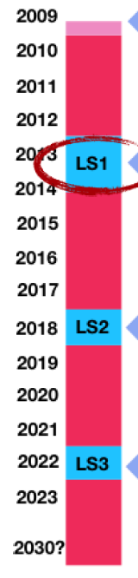
UPGRADE OF THE CERN TRACKERS: TIMESCALE OVERVIEW
EXPERIMENT TRACKER | ACTUAL 2009-2012 | long shutdown 2013/2014 | Shutdown 2017/2018 | long shutdown 2017/2018 => PHASE-II
ATLAS | PIXEL Evaporative fluorocarbon system | + IBL PIXEL CO2 1.5 kW < BEAMPIPE DIAM |  | NEW TRACKER ALL SILICON CO2 > 200 kW
CMS | PIXEL Mono-phase fluorocarbon system |  | + PIXEL REPLACEMENT CO2 15 kW < BEAMPIPE DIAM | NEW TRACKER ALL SILICON CO2
LHCb | VELO FIRST 2PACL AT CERN CO2 1.5 KW GOOD EXPERIENCE! |  | VELO FIRST SILICON MICRO-CHANNEL CO2 4 KW UT TRIGGER (STRIPS) CO2 4 KW
ALICE | ULTRALIGHT SUPPORTS |  |  | => VERY ULTRALIGHT ENHANCED COOLING < BEAMPIPE DIAM
NA-62 GTK | SILICON | MICRO-CHANNEL | CO2

Slide 11
COMMON CONSIDERATIONS
in some cases:
PHASE-I UPGRADES
=> produce detectors that can operate successfully throughout PHASE-II
in other cases:
PHASE-I UPGRADES
provide an infrastructure that can facilitate the additional modifications necessary for PHASE-II
R&D for PHASE-II
=> builds on the design of the PHASE-I UPGRADES
demands of PHASE-II
=> may require the COMPLETE REPLACEMENT of some detectors
R&D for PHASE-II and PHASE-I UPGRADES
take place over the same 5 year period 2011-2016
=> .. competion for human and financial resources ..

Slide 12
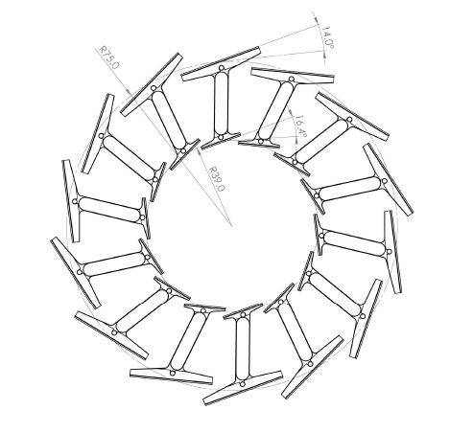
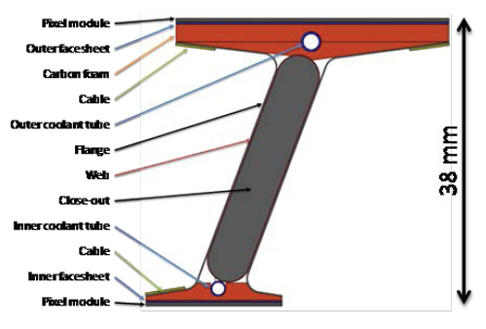
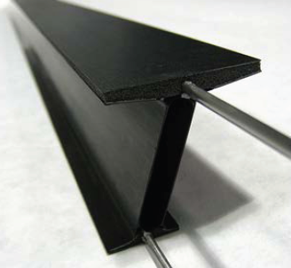
OVERVIEW OF THE TRACKER UPGRADES: SOME CLUES FROM THE LOCAL SUPPORT AND COOLING POINT OF VIEW
I-BEAM SOLUTION
baseline for the innermost two layers
different module sizes in the two layers
not need an external support structure
bare stave contribution to the material budget is only 0.43 % X0 per layer (normal)
inherent stiffness
end-supported
allows fast replacement
can be mounted as “clam shells” for extraction without breaking the LHC vacuum.
ATLAS
PIXEL
System
layout of I-beams for two inner pixel layers
I-beam concept prototype
with CO2 cooling

Slide 13
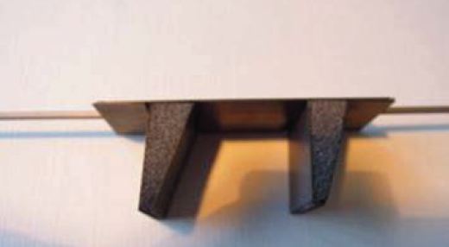
ATLAS PIXEL system
ALPINE ALTERNATIVE SOLUTION
new design NO BARREL & DIS
=> USE OF STAVES WITH SENSORS FACING THE I.P.
Prototype of an alpine stave
with CO2 cooling

Slide 14
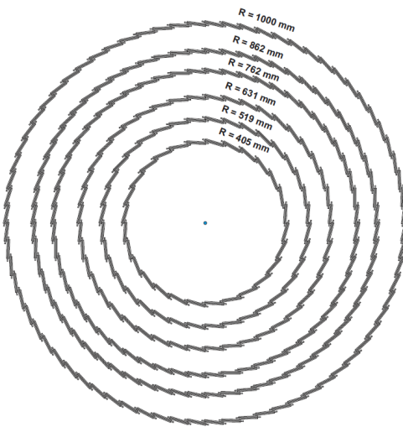
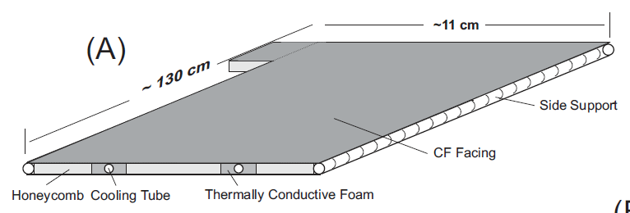
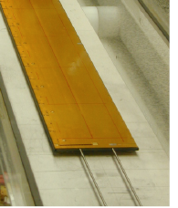
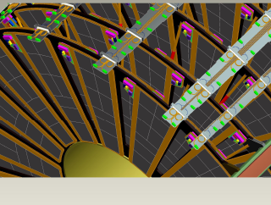
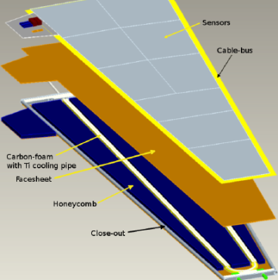
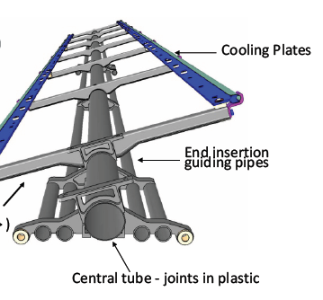
ATLAS STRIP system
Extensive use of Sandwich technology
carbon fibre facings
core honeycomb/carbon foam
embedded cooling pipe(s)
TYPICAL BARREL STAVE
TYPICAL DISK PETAL
with CO2 cooling

Slide 15
COOLING SYSTEM FOR ATLAS PHASE-II
ITK
coolant temperature of - 35 °C
ESTIMATED POWER TO BE EXTRACTED
180 kW nominal
240 kW with safety-factors
large development needed
scale up an IBL-like design to about 20 Kw
and then install 10 or so identical copies
back-up option of using fluorocarbon cooling
will require a mixture of C₂F₆ / C₃F₈
to achieve the required temperatures

Slide 16
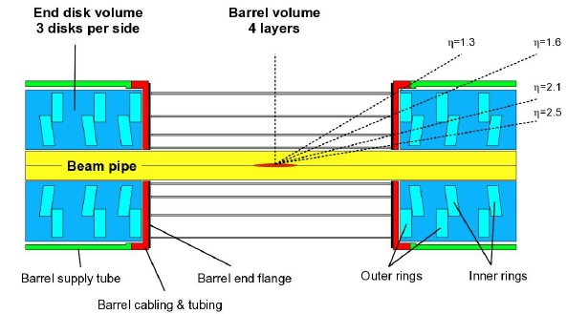
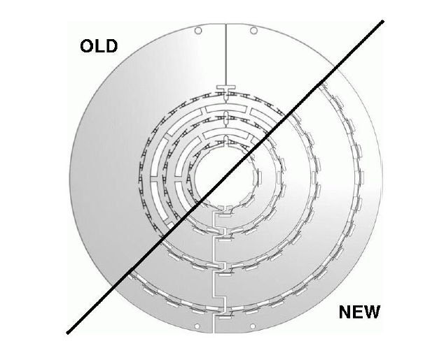
CMS Upgrade
With CO2 cooling
15 kW
will replace the current single phase C₆F₁₄
A fullscale system has been built in the CERN CryoLab

Slide 17
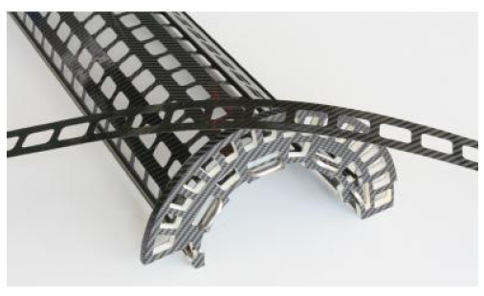
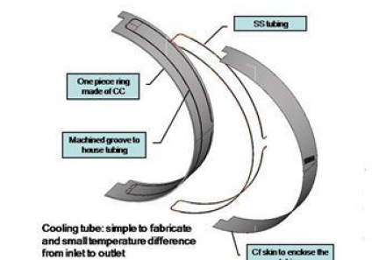
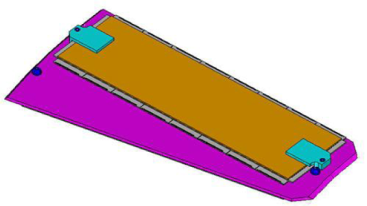
CMS Pixel System Upgrade
Edge Cooling Concept:
carbon fiber skins
carbon-carbon ring
cooling tube captured inside
Prototype of the mechanical structure for the innermost layer
mechanical stability of the ladder
is given by the cooling tubes
Solid TPG*(0.68 mm thick)
encapsulated with carbon-fiber facings (0.06 mm thick)
TPG =thermo-pyrolitic graphite
Thermal conductivity
Can reach 1500/1500/20 W/mK

Slide 18
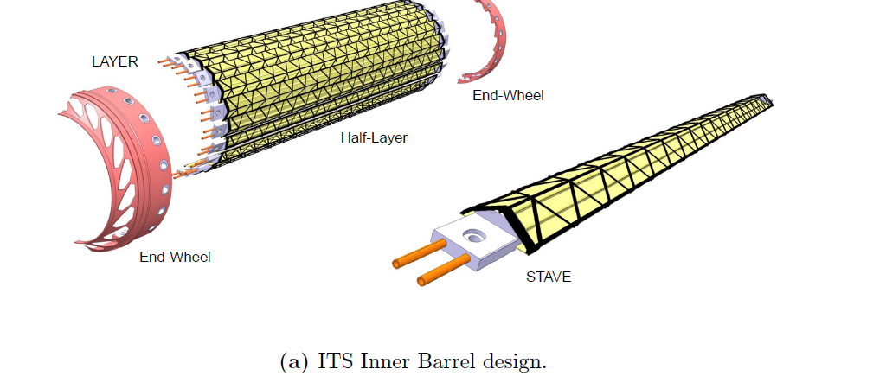
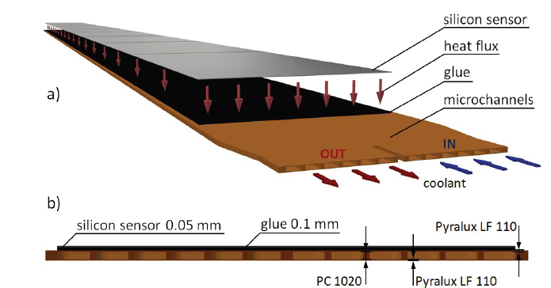
ALICE Upgrade
NEW ITS DETECTOR:
MATERIAL BUDGET => VERY STRINGENT REQUIREMENTS => ULTRALIGHT
THE DETECTOR WILL BE OPERATED AROUND ROOM TEMPERATURE (+ 30 °C)
COOLING SYSTEM 15 KW
water flow leakless (below atmospheric pressure)
for the Inner Layers alternative coolants sconsidered C₄F₁₀
Microchannel cooling systems
array fabricated either in:
polyimide substrate
silicon substrate

Slide 19
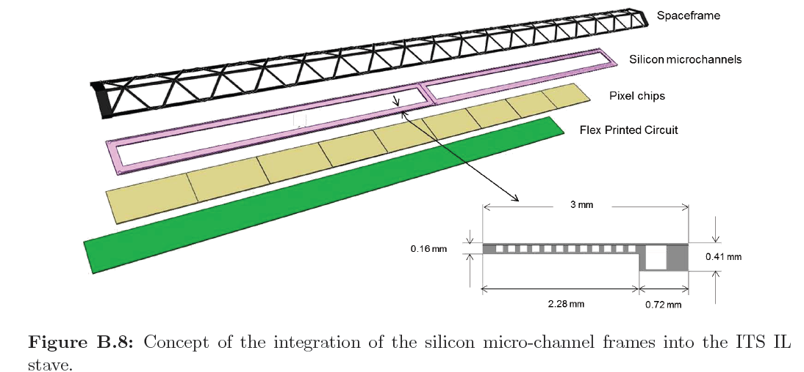
ALICE Upgrade
minimization of the material budget
Silicon microchannel cooling

Slide 20
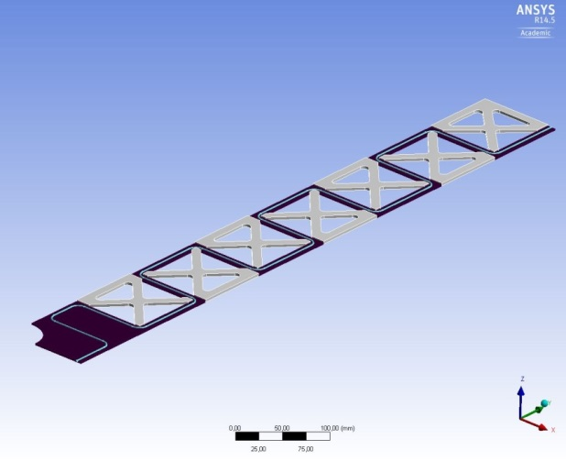
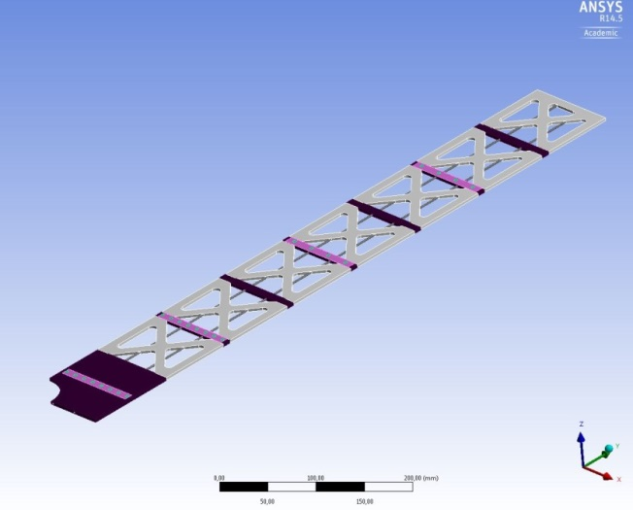
LHCb Upgrade
  VELO UPGRADE
  => SILICON MICRO-CHANNEL
FOR THE NEW VELO AND UT DETECTORS
4000 W @ – 30 °C EACH
PLANNED DEVELOPMENT AND ONSTRUCTION
OF A COMMON PLANT
with CO2 cooling
  UT UPGRADE
  DESIGN OPTIONS UNDER STUDY
with CO2 cooling
SNAKE PIPE DESIGN
MORE THERMALLY EFFICIENT
STRAIGHT PIPES DESIGN
NEEDING DOUBLE PIPE AND TPG INSERTS
BENDED PIPE, PARALLEL CHANNELS
=> FLOW DISTRIBUTION ISSUES
TRACI COOLING SYSTEM TEST PLANNED

Slide 21
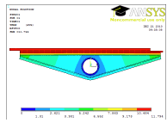
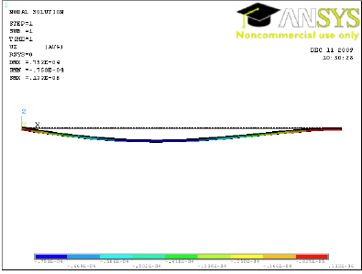
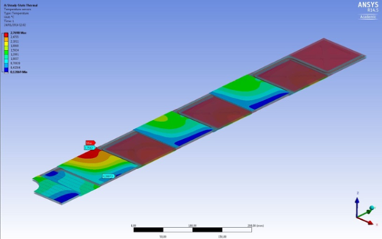
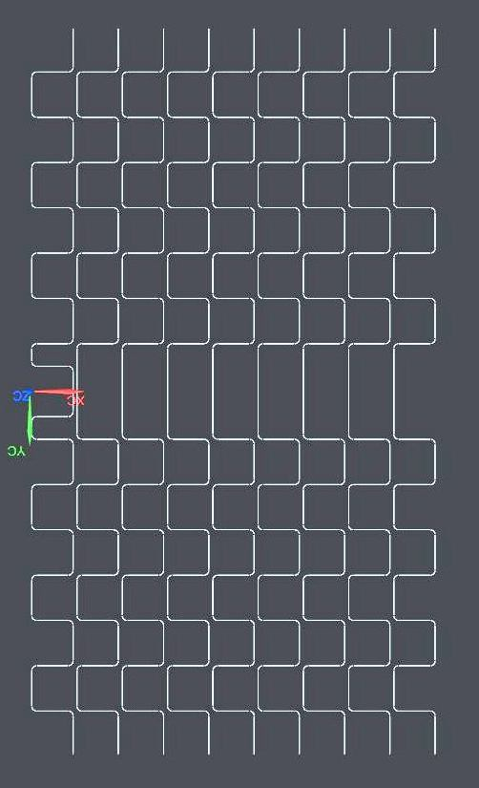
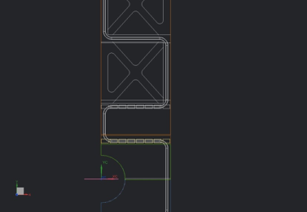
REQUIRED KNOW-HOW AND INNOVATIVE MATERIALS
  DESIGN:
  FINITE ELEMENT ANALYSIS
  THERMAL AND THERMO-MECHANICAL SIMULATIONS
  NEED CHARACTERIZATION TO HAVE REALISTIC MATERIAL PROPERTIES IN THE MODELS
  EXPERIENCE IN MESHING TECHNIQUES FOR VERY MULTY-THIN LAYERED OBJECTS (GLUE LAYERS)
  ANISOTROPIC MATERIALS, LAYERED CFRP MATERIALS
  THERMOHYDRAULIC CALCULATION
  FOR THE COOLING CIRCUIT
  CoBRA (CO2 BRANCH CALCULATOR)
  SPECIAL ATTENTION TO INSTABILITIES
  IN 2-PHASE EVAPORATING SYSTEMS

Slide 22
REQUIRED KNOW-HOW AND INNOVATIVE MATERIALS
  PROTOTYPE & DETECTOR REALIZATION:
  CO₂ PIPING MATERIALS (MDP = 100 bar)
  TITANIUM: low CTE, high rad length, high strenght / pipe acquisition not easy
  STAINLESS STEEL
  ALUMINUM: used in the actual detector, not considered for upgrades
  CARBON BASED MATERIALS
  CFRP
  CARBON FOAMS
  GLUING IMPROVEMENTS
  TECHNOLOGY TO OBTAIN CALIBRATED GLUE LAYERS
  SUFFICIENT FOR STRUCTURAL AND THERMAL CONTACT
  NOT MORE THAN REQUIRED (MINIMIZING MATERIALS)

Slide 23
Cooling
R&D steps
characterizing heat transfer in small channel through laboratory measurements
deriving guidelines for detector cooling optimization
developing numerical models that correctly describe the flows and heat transfers
design and engineering of the system
analysis of system aspects such as manifolding
novel challenges due to the much larger scale of the system

Slide 24
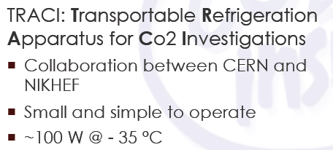
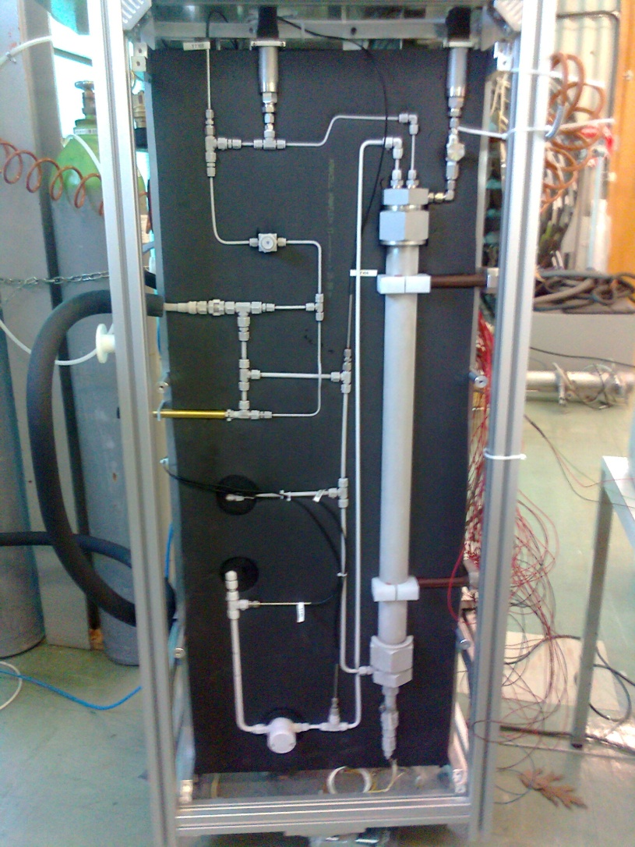
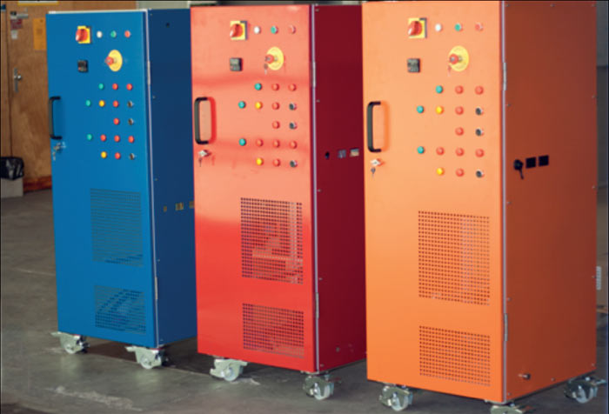
R&D IN PROGRESS
Development of a portable CO₂ laboratory cooling unit called Traci
  TRACI=Transportable Refrigeration Apparatus for Co2 Investigation.
Development in AIDA framework together with interested partners
  Nikhef & CERN lead development
  Co-funding from clients
  Collaboration with Sheffield, Oxford, Liverpool and Milano
AIDA funds => TRACI SYSTEM
FIRST UNIT will be identified as “the” final AIDA deliverable for WP 9.3.
AIDA-2
WILL CONTINUE THE COOLING ACTIVITIES IN PROGRESS..

Slide 25
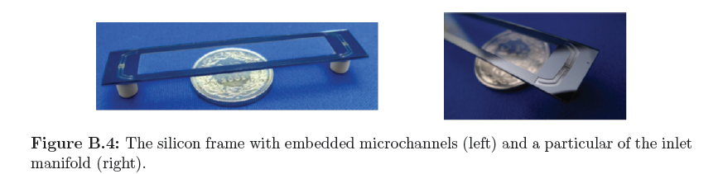
R&D
  FULL SILICON STAVE
  SILICON PACKAGE INCLUDING:
  ELECTRONICS
  STRUCTURAL SUPPORT / SELF SUPPORTING SYSTEM
  COOLING CHANNELS
  VELO LHCb
  ALICE ITS
  NA62 GTK
  … ATLAS & CMS FOR PHASE-II
SILICON MICROCHANNEL PROTOTYPE
  CARBON MICRO CHANNEL COOLING
  => See details in the 2 last slides
  from Filippo Bosi (INFN PISA)
  ADDITIVE TECHNOLOGY
  PEEK PIPE INTO CFRP
SupeB SVT LAYER-0 PROTOTYPE

Slide 26

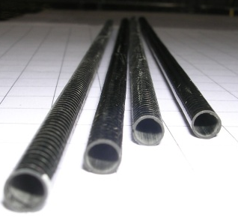
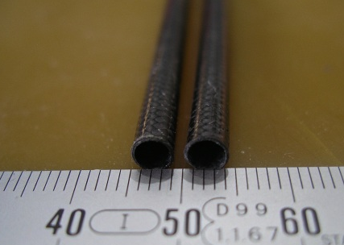
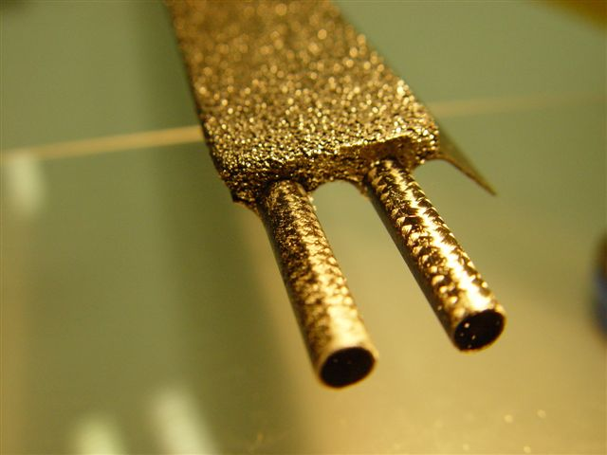
R&D
The Homogeneous Stave
ALL CARBON STAVE
Wrapping
Braids
α
USING A CARBON-FIBER COOLING PIPE
COMPLIANT FOR FOR A CO2 PRESSURE SYSTEM
considered as an option for ATLAS IBL
.. and HL-LHC upgrade structures?
  VERY GOOD RAD LENGTH
  ALMOST ZERO CTE
  PRESSURE SYSTEM WITH MDP 100 BAR
  THICKNESS OF MATERIAL
  LOW TRANSVERSAL THERMAL CONDUCTIVITY => NEED R&D TO IMPROVE
  DEDICATED CONNECTIONS DEVELOPED
several pipes have been produced that meet the specs and, at the moment, two are the validated techniques
Institutes and collaborators (2008)
IVW : Institut für Verbundwerkstoffe GmbH Kaiserslautern
IFB :Institut für Flugzeugbau Universitat Stuttgart
Wuppertal University
INFN Milano
CPPM Marseille
LAPP Annecy
BERCELLA Carbon Fiber (Parma IT)
full homogeneous stave

Slide 27
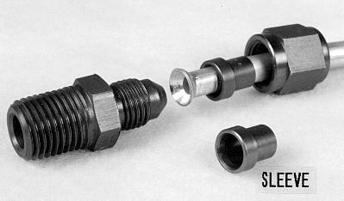
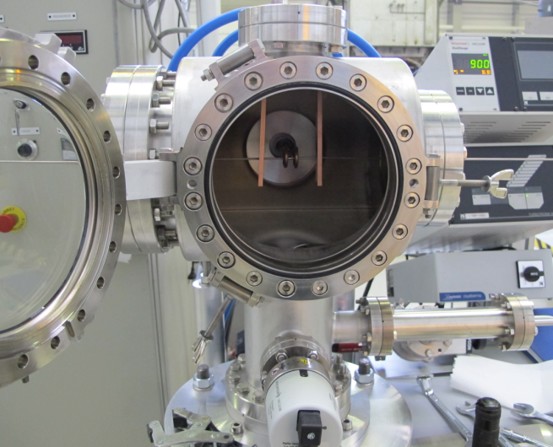
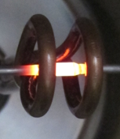
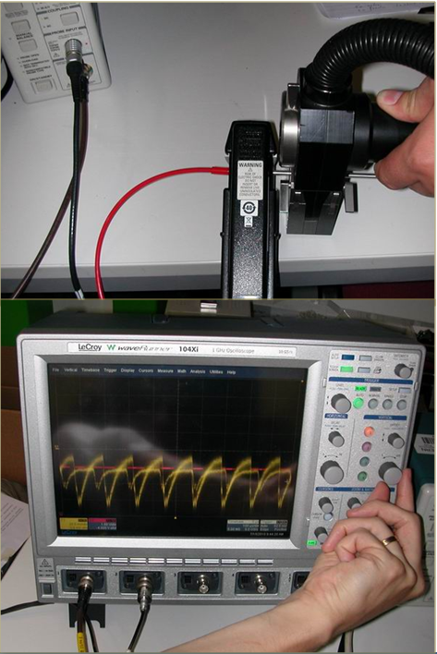
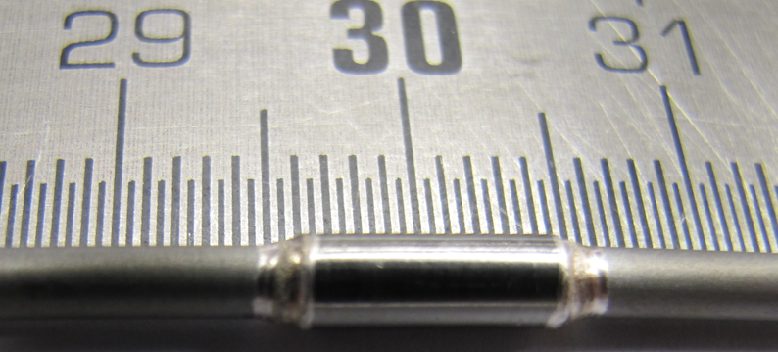
R&D
JOINING TECHNIQUES
Swaging
IBL Brazing activity
Brazing work fine on a lot of material (Stainless steel, Ceramics, Titanium …)
compatible with modules on local supports during operation
permit mixture of materials
helpful for electrical breaks for example
Orbital welding
Not for small 1.5 mm pipe

Slide 28
COLLABORATION WITH INDUSTRIES
Peculiarity of the present systems:
“Small”detector => Small quantity of material required
Not very attractive business for industry
always needed:
custom design and prototype qualification
custom production of detector components
=> expensive (small scale) material acquisition and external works
COLLABORATION BETWEEN INSTITUTES
DESIDERABLE COLLABORATION INSIDE INFN
TO JOIN EFFORTS IN COMMON R&D
SOFTWARE SIMULATION CODES:
ALREADY DONE (NATIONAL CONTRACT) FOR:
CAD SYSTEMS
FEM ANSYS
ESACOMP
NOW NEED CoBRA code (CO2 BRANCH CALCULATOR)
PROTOTYPE TESTING R&D RESULTS & INDICATIONS
SHARING OF TECHNOLOGIES DEVELOPMENT AND LABORATORY INFRASTRUCTURES

Slide 29
Thank you
for your attention
BACK-UP
SLIDES

Slide 30



Le linee R&D proposte per il Tracker: Micro Channel Cooling
COURTESY OF FILIPPO BOSI (INFN PISA)
CMS PIXEL TRACKER FASE 2: proposal R&D presentata alla CSN1 febbraio 2014
I rivelatori a pixel per Fase-2 necessitano di un raffreddamento efficace:
  potenza dissipata dall’elettronica di front end con elevata densità di interconnessione (>1 W/cm²);
  danneggiamento da radiazione che implica condizioni di lavoro dei sensori a bassa temperatura ( -20° C);
  Localizzazione in rivelatori vicini al punto di interazione :
    Material budget minimizzato
    Distribuzione uniforme della potenza di raffreddamento con ponti termici tali da garantire temperatura costante del sensore;
    Sistema robusto e “maintenance-free” (zona sperimentale inaccessibile)
Micro-channel Cooling + CO₂ a transizione di fase: soluzione promettente per il tracciatore di Fase-2.
  Metodo ed apparato sperimentale già parzialmente sviluppati a Pisa (per scambio termico monofase liquido con punto di lavoro a 30° e 2W/cm² di dissipazione) per avere un cooling efficiente e con bassa quantità di materiale in zona attiva .
Micro tubi Compositi
- Carbon Fiber Reinforced Plastic
Eventuale sviluppo con FBK di micro-canali in Silicio
Tecnologia DRIE (Deep Reactive Ion Etching) , le stesse usate per i pixel 3D
12.8 mm
Silicon buried channels for pixel detector cooling : M.Boscardin et al., Nucl.Instrum.Meth. A718 (2013) 297-298
700 µm
150 µm
Peek pipe
500/300 µm
700 μm
700 μm
Dh=300 μm
Carbon Fiber Pultrusion
Silicon oxide sealing

Slide 31

Programma di lavoro Micro Channel Cooling
COURTESY OF FILIPPO BOSI (INFN PISA)
  Progettazione e produzione di sistema a CO₂ evaporativo per la verifica della fattibilita’ di cooling a microchannel su supporti a microtubi costruiti in CFRP.
    Soluzione conservativa per questo R&D
    Focalizzazione a design specifici per un rivelatore plausibile per il vertex detector di CMS
  Ottimizzazione/minimizzazione delle dimensioni dei micro-tubi a partire da valori sperimentati: sezione < 700 x 700 μm² e diametro idraulico < 300 μm.
  Riduzione del material budget: < 0.15% X₀ - ottimizzazione in funzione della temperatura di lavoro.
Light prototype support using micro-channel technology as high efficiency system for silicon pixel detector cooling : Nucl.Instrum.Meth. A650 (2011) 213-217
  Progettazione e produzione di un layout sperimentale per prototipi di supporto con lunghezza dei canali ottimizzata per un rivelatore di vertice (30-60 cm) con connessioni idrauliche idonee (alto ΔP e miniaturizzazione)
12.8 mm
700 µm
Support Cross Section
Radiation lenght 0.15%X₀

Slide 32
Outlook
The upgrade of the Tracker for the high-luminosity operation of the LHC is a formidable challenge. A substantial amount of R&D is already ongoing, and all major aspects are receiving attention. Some of the developments, in particular those addressing the most advanced technologies, may soon be confronted with the lack of financial resources. Together with the R&D on the components, design, modelling and simulation studies (for tracking and trigger) are the key for an optimal choice of detector concept. The progress in the next two years will be crucial for the project, as it will lead to the choice of the detector concept to be designed and built.

