Slide 1
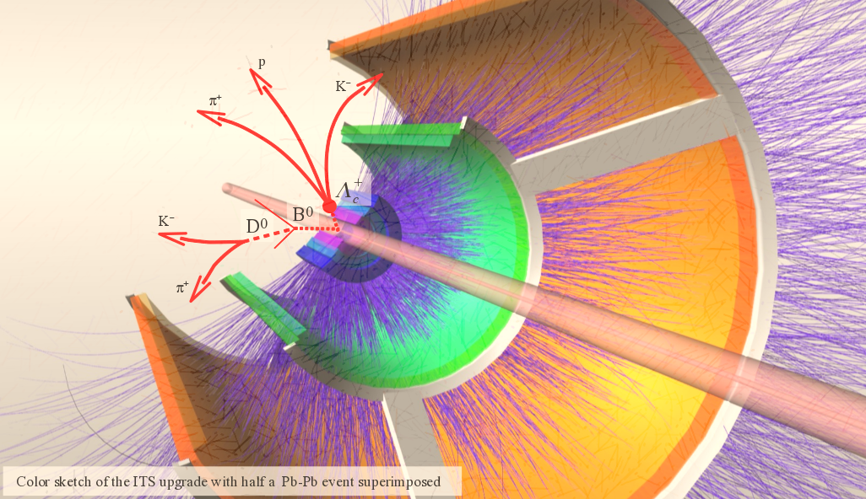




Monolithic and HV/HR‐CMOS Active Detectors
Gianluca Usai, Giovanni Darbo
Notes:
Ho aggiunto il logo di ATLAS e messo uno trasparente INFN. Ho tolto quello di Cagliari. Se ci tieni a quello dell’Università puoi anche insrirlo nel template (barre orrizontali che hai in ogni slide)..

Slide 2
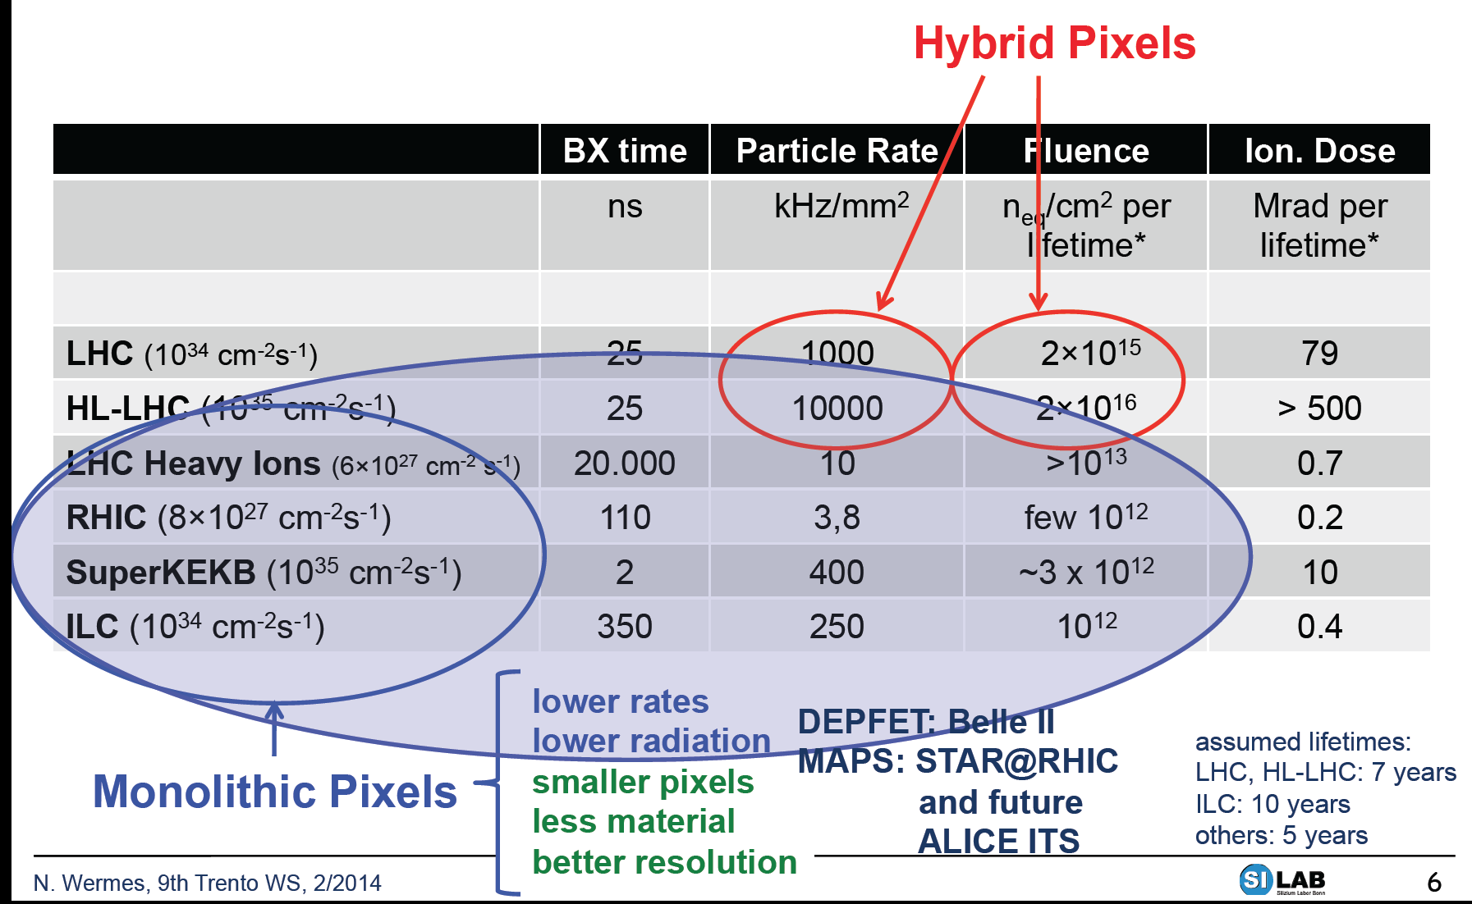
New pixel sensors for LHC upgrades
Rate and radiation challenges at the innermost pixel layers
Monolithic pixels for heavy ion experiments
Monolithic pixels also for HL-LHC? Issues related to:
  Radiation tolerance
  Speed

Slide 3
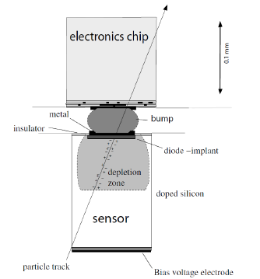
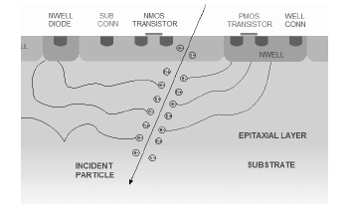
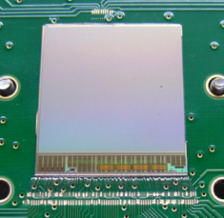
Pixel choice: hybrid vs monolithic options
Hybrid pixel sensors
Monolithic pixel sensors
ULTIMATE sensor for STAR HFT
(MIMOSA family, Strassbourg)
Traditional MAPS:
  all-in-one, detector-connection-readout
  very small pixel size O(20 µm²)
  thin devices: small material budget (X/X₀)
  low power
  cost effective (standard IC technologies)
charge collection → diffusion
  more prone to radiation damage
  smaller readout speed
Chosen for ALICE upgrade
  2 components: CMOS chip and sensor connected via bump bonds
  min pixel pitch O(50 µm)
  material budget
  expensive
charge collection → drift
  significant radiation tolerance
  higher readout speed
HVCMOS:
  charge collection → drift
  radiation tolerant and faster
  issue of of power
ATLAS R&D for upgrade

Slide 4
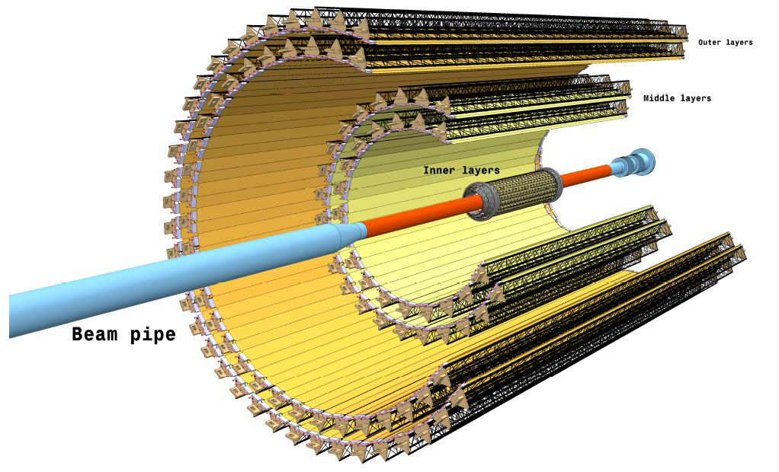
ALICE ITS Upgrade
Objectives
record collisions:
  Pb-Pb at 50 kHz
  pp at 1MHz
improve impact parameter resolution by a factor 3
improve standalone tracking efficiency and p_{T} resolution
fast insertion/removal for yearly maintenance
installation 2017-2018
New layout
7 layers (3 inner, 4 middle+outer)
reduce:
  X/X₀ per layer from 1.14 to 0.3%
  pixel size from 400x50 to O(30x30) μm²
  first layer radius from 39 to 22 mm
beam pipe outer radius: 19.8 mm
Upgrade of the Inner Tracking System Conceptual Design Report http://cds.cern.ch/record/1475244
Technical Design Report submitted to LHCC on Nov. 2013

Slide 5
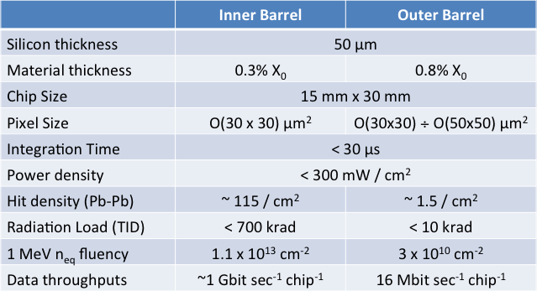
Pixel choice: requirements for ALICE upgrade
Low integration time: significant bkg reduction
Low power: needed to keep material budget small
UPPER LIMIT
Nr of bits to code a hit : 35
Fake hit : 10⁻⁵ /event
Monolithic pixels: the technology of choice for ALICE

Slide 6
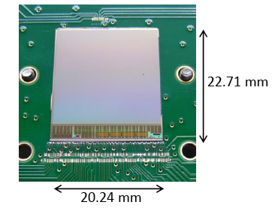
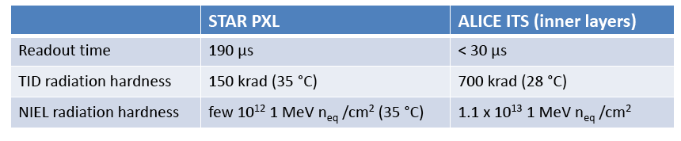
ULTIMATE chip in STAR
Developed by IPHC Strasbourg
0.35 μm OPTO process
Rolling shutter and correlated double sampling
20.7x20.7 μm² pixel size
Power consumption 130 mW/cm²
Deeper submicron technology + development to meet ALICE specifications

Slide 7
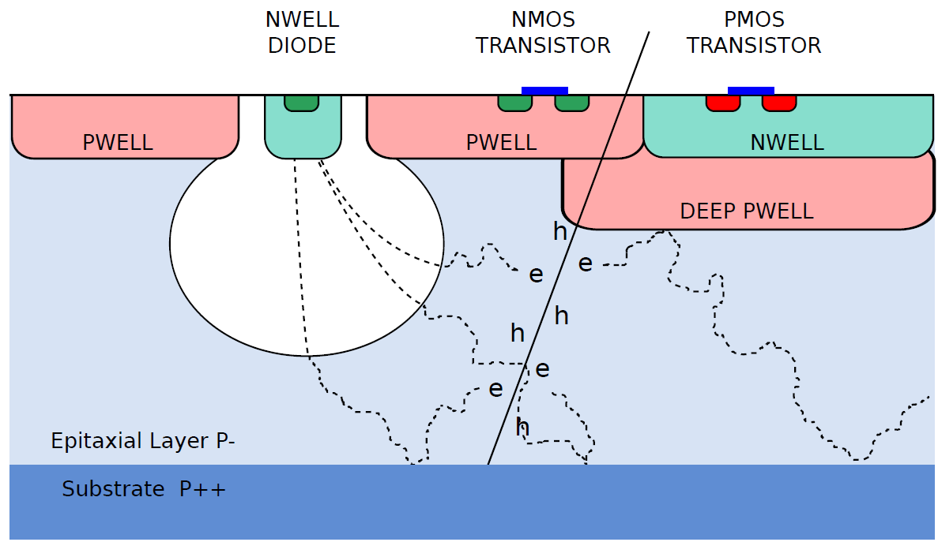
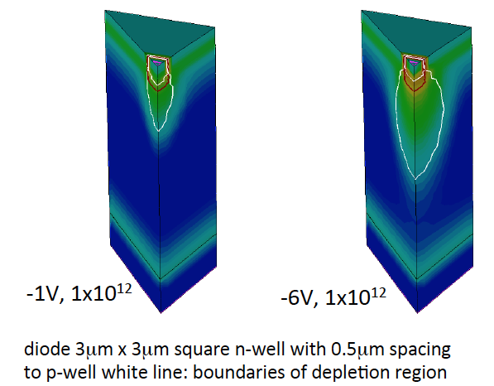
Monolithic Pixels in TowerJazz 180 nm technology
Technology chosen for the ALICE experiment
Small pitch (20 μm x 20 μm)
Gate oxide < 4 nm ➔ better transistor radiation tolerance
High resistivity epi layer:
- thickness 18-40 μm
- resistivity 1-6 kΩ cm
6 metal lines
Stitching technology
Deep p-well layer to shield pMOS transistors
(truly CMOS circuitry possible)

Slide 8
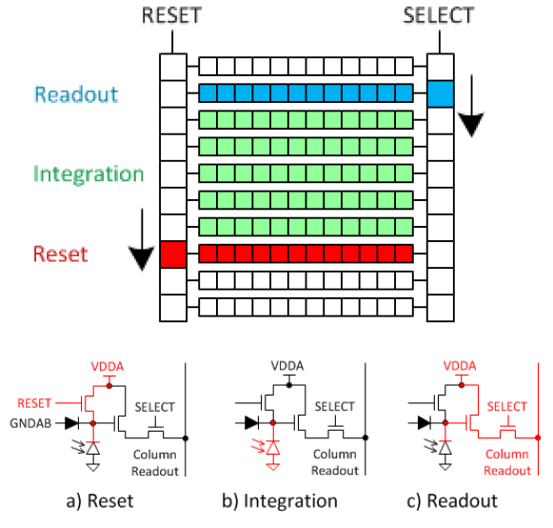
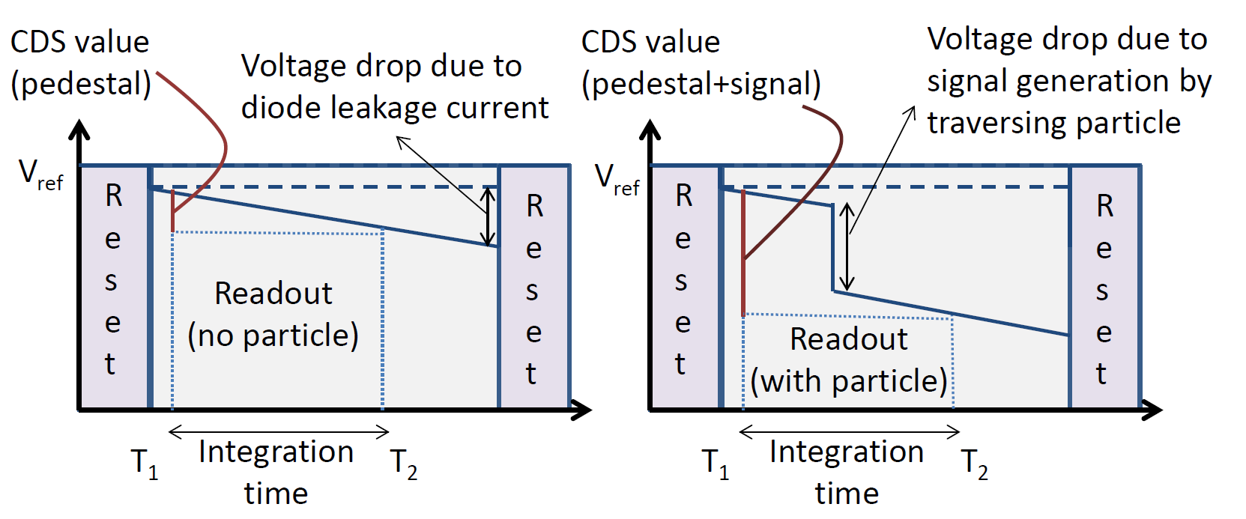
Rolling shutter architecture (IPHC Strasbourg)
Rolling shutter: rows read one after the other and applying a reset shortly after: each row integrates the signal between two consecutive passings of the row select signal (the shutter)
ASTRAL chip: Rolling shutter with in-pixel amplification, correlated double sampling (CDS), and discrimination
Can be operated in trigger-less mode
Dead-time free
Intrinsically slow: potential pile-up issue

Slide 9
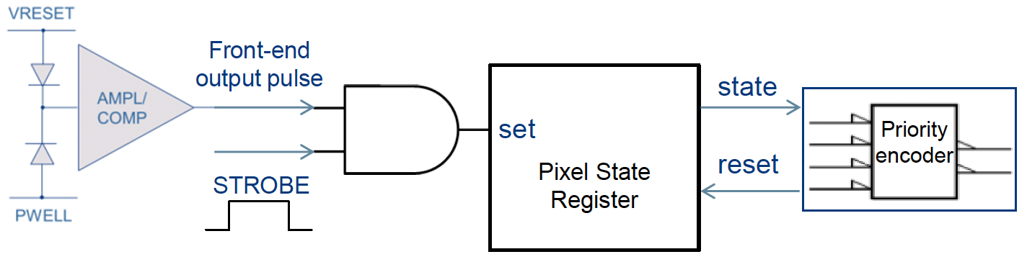
Sparsified readout (CERN/INFN/Wuhan)
Low power analog front-end (<40 nW/pixel): single stage amplifier/current comparator (settling time ≈4 μs)
ALICE Pixel Detetor (ALPIDE) chip
Memory cell: hit enabled during the strobe window
Priority encoder/reset decoder: only zero suppressed data transferred to periphery
Triggered mode operation: upon arrival of a trigger, comparator output captured into a local memory simoultaneously in all pixels
Integration time of circuit output minimized: significant reduction of number of spurious hits generated by electronic noise or beam background
In-column priority encoder: only-zero suppressed data transferred – pixel reset from periphery logics

Slide 10
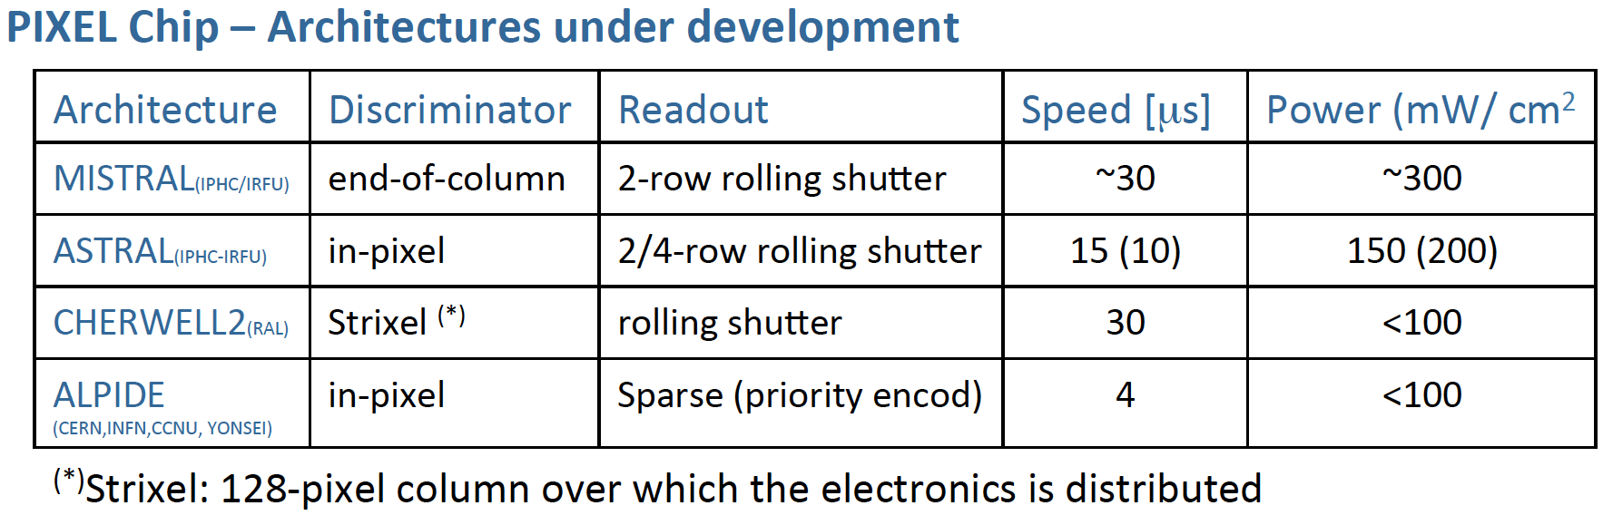
Summary of architectures under development
40
≈200
≈200
20
≈100
INFN groups involved in pixel chip design:
  Cagliari (digital end-of-column front-end)
  Torino (high speed serializer and LVDS driver)

Slide 11
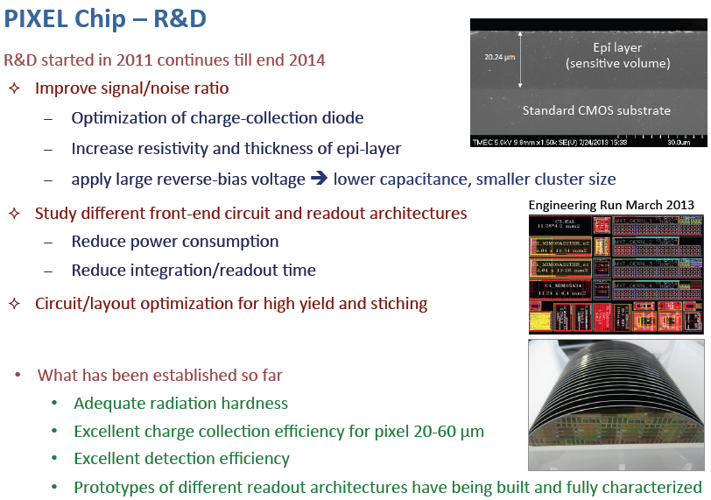
Pixel chip - R&D
R&D started in 2011 and will continue till end 2014
Improve signal/noise ratio
  Optimization of charge-collection diode
  Increase resistivity and thickness of epi-layer
  Apply large reverse-bias voltage ➔ lower capacitance, smaller cluster size
Engineering run 2013
Study different front-end circuit and readout architectures
  Reduce power consumption
  Reduce integration/readout time
Circuit layout optimization for high yield and stitching
What was established so far
  Adeguate radiation hardness
  Excellent charge collection efficiency for 20-60 μm pixels
  Excellent detection efficiency
  Prototypes with different readout architectures built and fully characterized

Slide 12
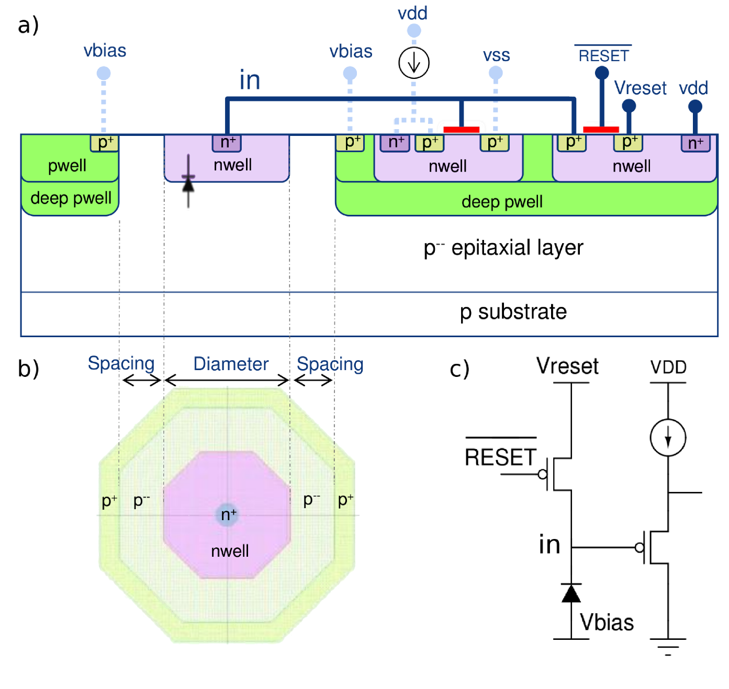
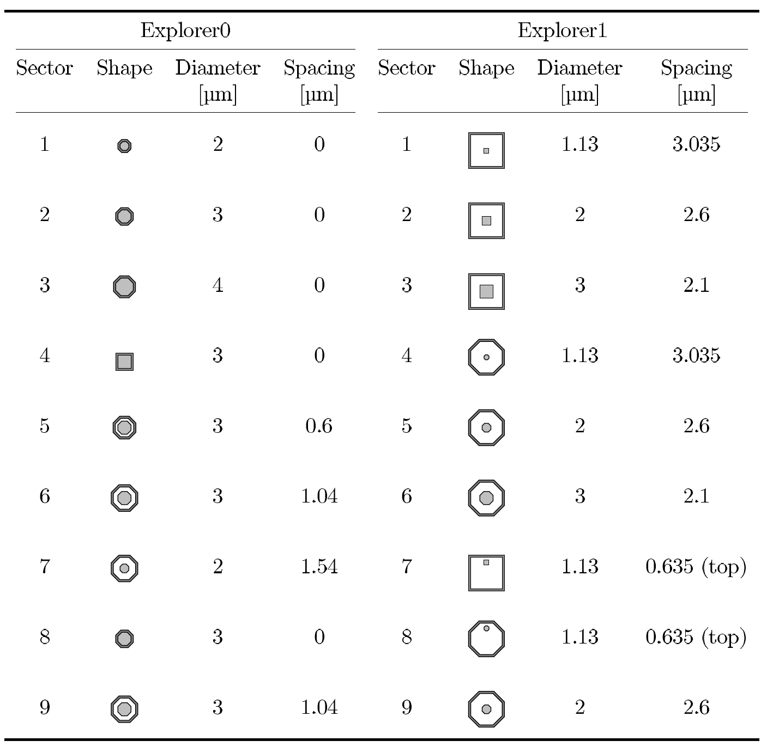
Prototypes
Relatively small matrices with different pixel structures. Example: Explorer 0/1
Explorer 1 vs 0: reduction of sensor C by a factor 2.5
Study effects of Vbias, diode geometry, starting material, epi-layer thickness

Slide 13
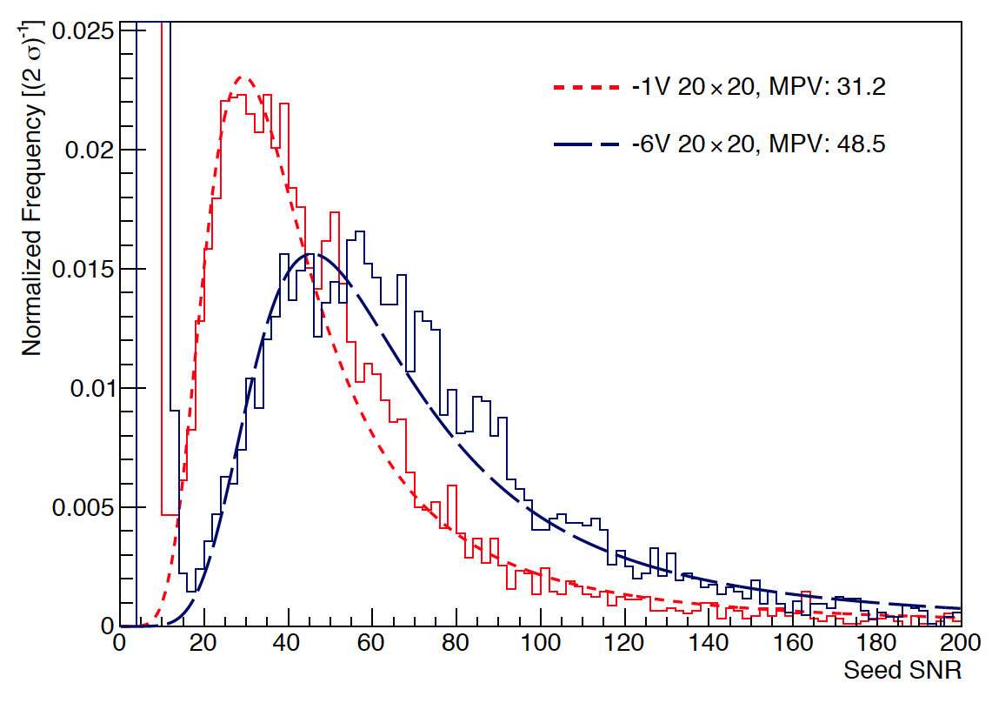
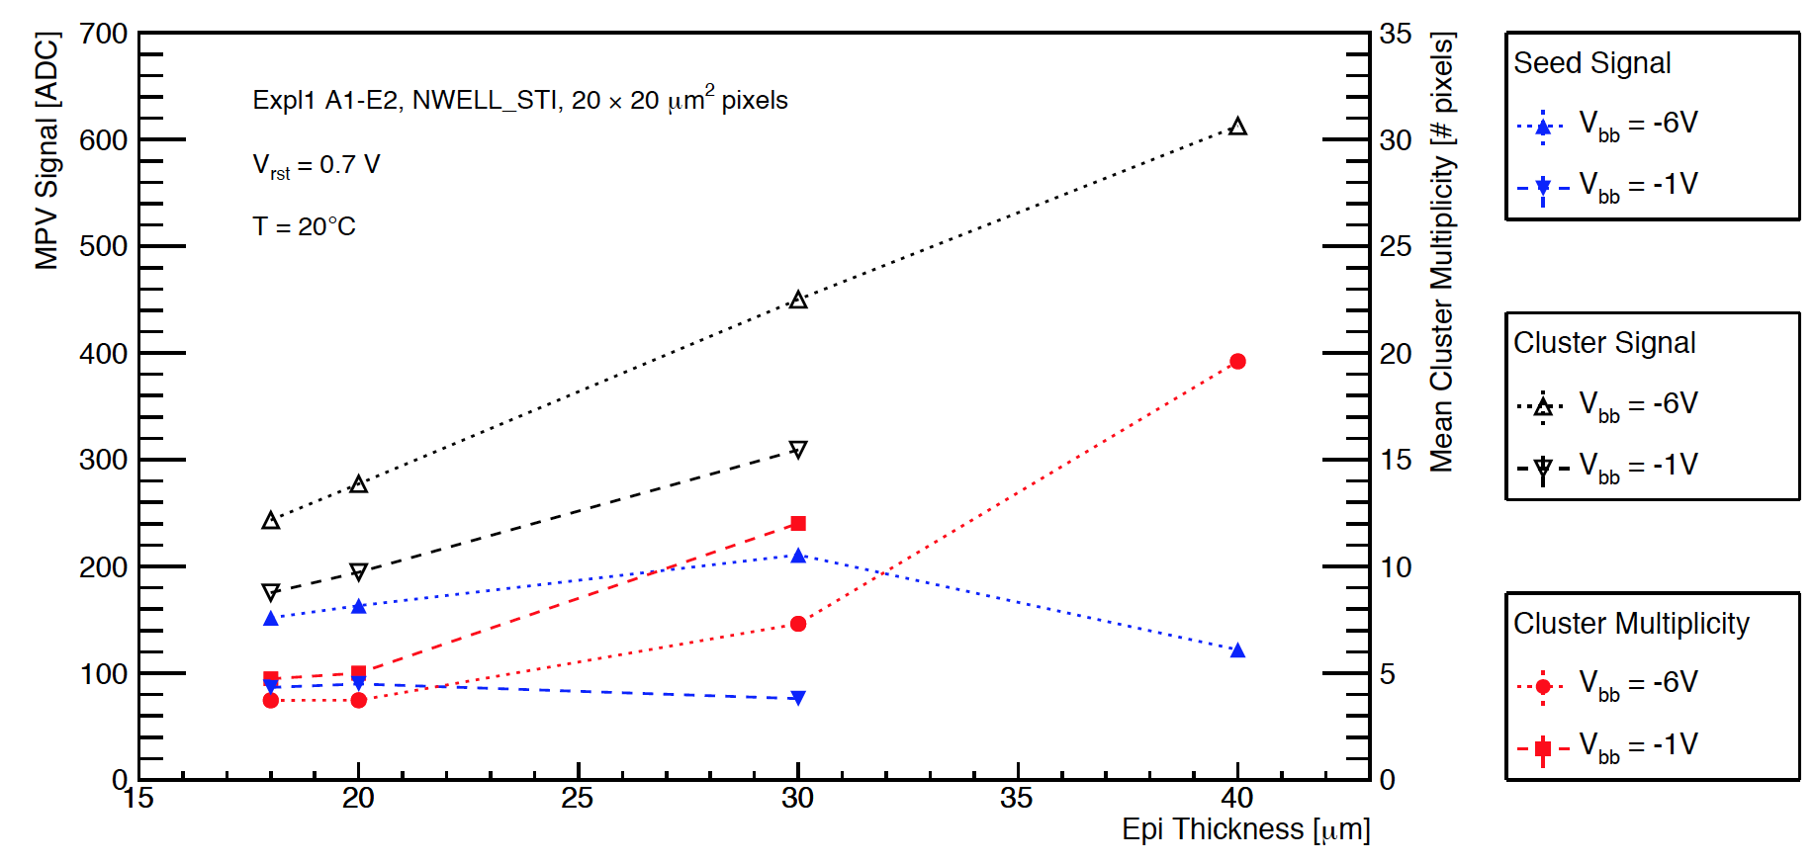
Back-bias V and epi thickness dependence
Back-bias V dependence
Performance for different epi layers
Explorer 1
Explorer 1
Response to 4 GeV/c electron beam
7.6 μm² octagonal nwell diode
2.1 μm spacing between nwell and pwell
3.2 GeV/c positron beam
20 μm² pixels
Linear increase of generated charge and of cluster size (competing influence)
Seed signal:
- optimum -6V back-bias for 30 μm epi layer
- optimum -1 V back-bias for 20 μm epi layer

Slide 14
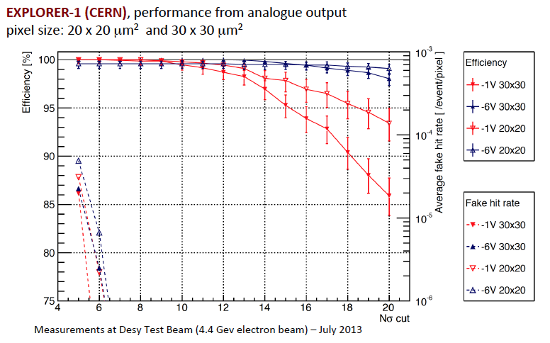
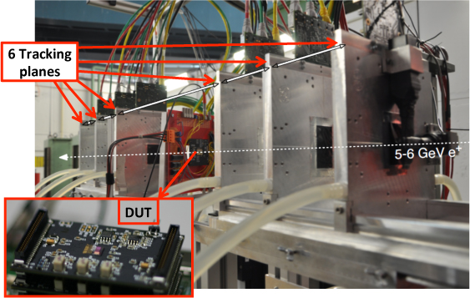
Efficiency and fake hits measurements (Explorer 1)
After irradiation (≈1 Mrad) drop of 10 - 20% in CCE, recovered with back bias
Better performance of larger diodes with larger spacing to electronics
Wider distance → wider depletion volume → lower input capacitance
Better performance of 20 x 20 µm² at low back bias voltage
Detection efficiency above 99% up to 10σ cut, also after irradiation

Slide 15
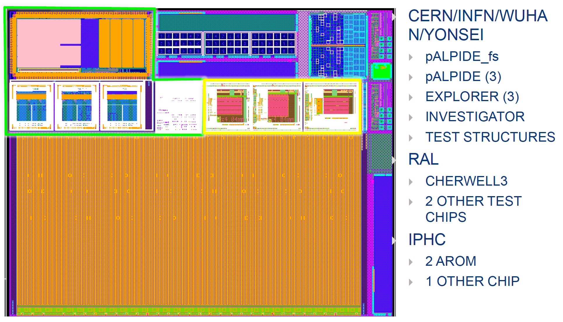
Latest engineering run (dec 2013 submission): first full scale chip
30 mm

Slide 16
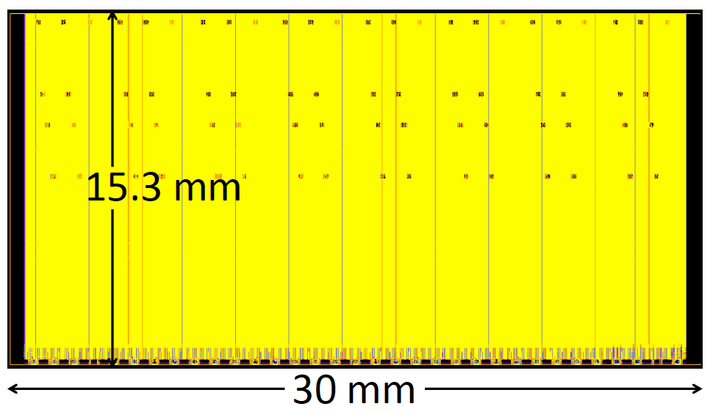
ALPIDE full scale sensor prototype
Design of a full scale prototype representative of the final chip for system studies
1024 x 28 μm
chip floorplan
Matrix
Region
0
(512 x 32)
Matrix
Region
1
(512 x 32)
Matrix
Region
30
(512 x 32)
Matrix
Region
31
(512 x 32)
512 x
28 μm
digital logic: column steering, cluster compression, multi-event buffers, readout logic
150 μm
ANALOG BIAS
ANALOG BIAS
Readout
Logic
Readout
Logic
Readout
Logic
Readout
Logic
450 μm
Periphery Readout Logic
200 μm
Power, Analog Pads, Digital Pads

Slide 17
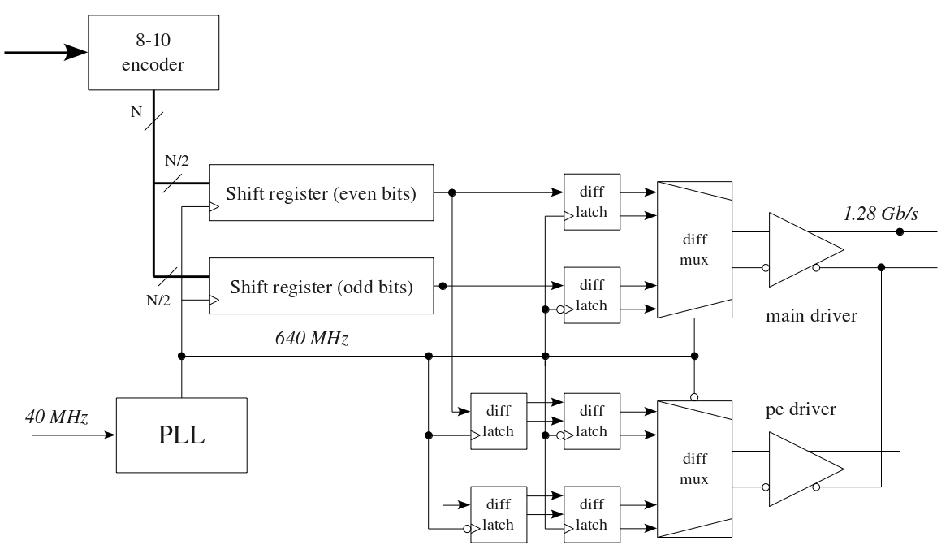
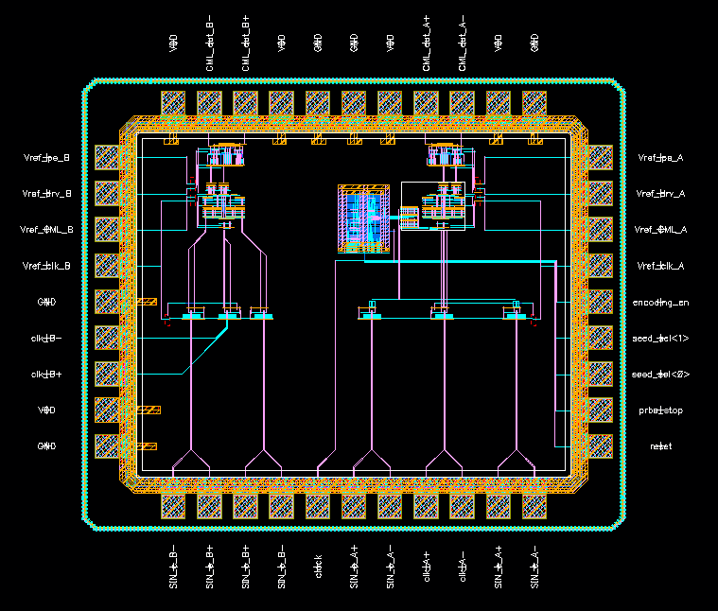
Pixel data transmission: high speed serializer
Serializer design goal: 1-1.28 Gb s⁻¹ / chip
Input clock | 40 MHz
Transmission clock | 500-640 MHz
Transmission type | DDR
Line rate | 1-1.28 Gb/s
Electrical protocol | LVDS
Test chip submitted December 2013 (die size 1.8x1.5 mm²)
CML driver with pre-emphasis
20-bit serializer
DDR logic
8b/10b encoder
PRBS generator (for test purposes)

Slide 18
HV-CMOS Monolithic Pixels
Original idea (I. Peric - 2007) based on use of standard (HV-)CMOS technologies:
High voltage to deplete the sensor volume – charge collection by drift
CMOS electronics inside the deep n-well-collecting electrode – “Smart diode”
PMOS
NMOS
Deep n-well
Shallow p-well
~60 V
P-Substrate
Limitations of monolithics:
Standard substrates have relative low resistivity (~20 Ωcm)
Depleted region up to ~15 µm (relatively weak MIP signals ~1800 e)
Collection electrode: PMOS bulk → strong capacitive crosstalk from PMOS transistors to detector input
Complex in-pixel electronics leads to increased detector capacitance (if in the same n-well) or to decreased electrode/pixel-size ratio (if separated n-wells in the pixel)

Slide 19
The hybrid solution: CCPD HV-CMOS
Hybrid detector with a “smart” HV-CMOS sensor and capacitive signal transmission to the readout ASIC (capacitive coupled pixel sensor – CCPD):
Overcomes drawback of monolithic detector: CCPD has small pixel and high
electrode-/pixel-size ratio
digital outputs of three pixels are multiplexed to one pixel readout cell
HV-CMOS pixel contains an amplifier and a comparator
CCPD advantage for ATLAS:
Performance:
Smaller and thinner pixels improve
  Space resolution and cluster separation
  Material budget
Standard IC technology:
Faster production for a large area detector
Cost:
Cheaper technology than used for
conventional silicon detectors,
easier hybridization: bump-bonding ➔ glue

Slide 20
CCPD HV-CMOS – improvements
Isolated PMOS: Eliminates PMOS to sensor crosstalk, allows more freedom when pixel electronics is designed
  High resistive substrates: around 80 Ωcm looks optimal:
Uniformly doped substrate 80 Ω cm
Signal: ~ 2700e-4500e (estimation)
Particle
NMOS
PMOS
Deep-n-well
Primary signal
100% - Signal collection:
drift
+-
+-
Deep p-well
+-
+-
Deep n-well
+-
Depleted 24µm
(@ equal bias voltage)
Depleted 48µm
(@ equal field, doubled bias voltage)
Shallow n-well
+-
+-
+-
+-
+-
+-
+-
+-
+-

Slide 21
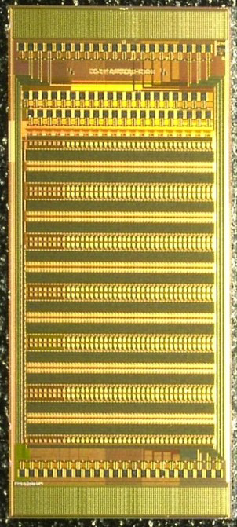
CCPD HV-CMOS – hybridization
Active sensor HV-CMOS coupled to FE:
Capacitive coupling through bump pads
dielectric layer very thin (~5 µm)
Bump-pads are 18 µm diameter
Cheap process to be developed
HV-CMOS need signal/power:
Use TVS to bring signal to opposite chip side
Spin SU-8 photoresist
Pattern pillars by mask
R/O CHIP
Glue deposition
R/O CHIP
Align & pressure
DETECTOR CHIP
Low Tempreature Detector facility – LTD Genova
Ref.: M. Biasotti et al., 9th “Trento” Workshop – Genova 26-28/2/2014
R/O CHIP
The tiny HV2FEI4p1 prototype glued on the large FE-I4
2x2 pillar height test:
distance 4 mm
height in µm
FE-I4
Pillar 1 | 5.92
Pillar 2 | 6.07
Pillar 3 | 5.92
Pillar 4 | 5.92
HV2FEI4
2.2 × 4.4 mm²
60 columns × 24rows

Slide 22
CCPD HV-CMOS – prototype results
The HV2FEI4 chip works coupled with FE-I4
Seen signal from sources
Measured detector efficiency at test-beam: 85-90% efficiency seen
Missing collected charge at the pixel edge or timing / threshold tuning - to be understood
Timing response issue:
Not yet understood if related to a poor design (NMOS amplifier and discriminator)
Need to understand & improve…
⁹⁰SR
1bin=25ns

Slide 23
HV2FEI4 chip: radiation tolerance
Chips have been irradiated and annealed up to 860 Mrad
The amplifier recovers up to 90% their original gain
The design uses circular transistors to withstand radiation damage

Slide 24
Monolithic / CCPD pixels: a technology inventory
AMS C35 OPTO
  STAR sensors and other early ALICE prototypes
TowerJazz 180 nm High Resistivity Process
  ALICE technology. Bonn testing for HVCMOS
AMS H35
  Early HVCMOS prototypes done in this process. High breakdown voltages (> 100V) – somewhat high power consumption
AMS H18/IBM 7HV
  HV2FEI4 and other chips: currently the main development process
GF 130nm HV
  HV process by GlobalFoundries in even smaller feature size, used to implement the HV2FEI4_GF. Actual experimental breakdown voltage is ~30 V before irradiation.
IBM 130 nm with Triple Well (T3) Process
  Process of the FE-I4 readout chip - not an HV/HR process and therefore does not allow high bias voltages leading to rather low signal-to-noise values
STMicroelectronics BCD8 160 nm process
  HV process (70 V, 3.5 nm oxide) – Visit last week with R&D group in Agrate – Possible interest in technology variation: Epitaxial wafer → 60 ÷ 100 Ωcm bulk wafer substrate

Slide 25
ALICE and ATLAS upgrade timeline
ALICE:
End of 2014: completion of R&D
Summer/fall 2014: internal review on different RO architectures on the basis of R&D
End of 2014/beginning of 2015: final decision on sensor
2015/16: production
ALICE ITS Collaboration:
  CERN, China (Wuhan), Czech Republic (Prague), France (Strasbourg, Grenoble), Italy (Alessandria, Bari, Cagliari, Catania, Frascati, Padova, Roma, Torino, Trieste), Netherlands (NIKHEF, Utrecht), Pakistan (Islamabad), Rep. of Korea (Inha, Yonsey, Pusan), Russia (St. Petersburg) Slovakia (Kosice), Thailand (Nakhon), UK (Birmingham, Daresbury,RAL), Ukraine (Kharkov, Kiev), US (Austin, Berkeley, Chicago)
ATLAS:
2014-17 devoted to RD – looking also to external funds: e.g. H2020 in AIDA2 and FET
2018-20 pre-production – 2018-22 production
ATLAS HV-CMOS R&D Groups:
  CERN, France (Marseille), Germany (Bonn, DESY, Göttingen, Heidelberg), Italy (Genova, Milano, … others under discussion), UK (Glasgow, Liverpool), US (Berkeley, Santa Cruz) – the collaboration is rapidly increasing!

Slide 26
Backup

Slide 27
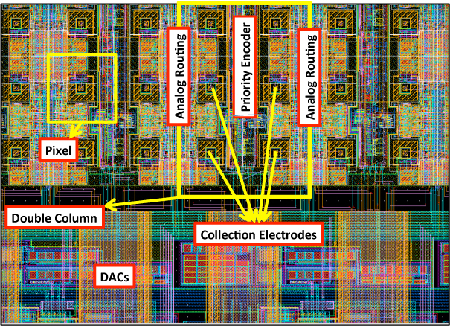
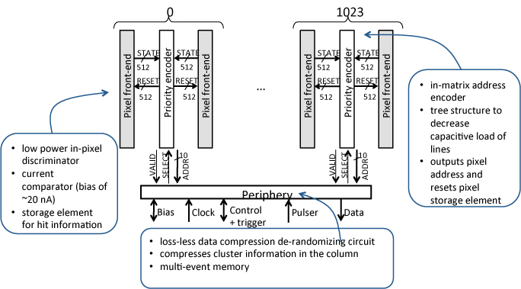
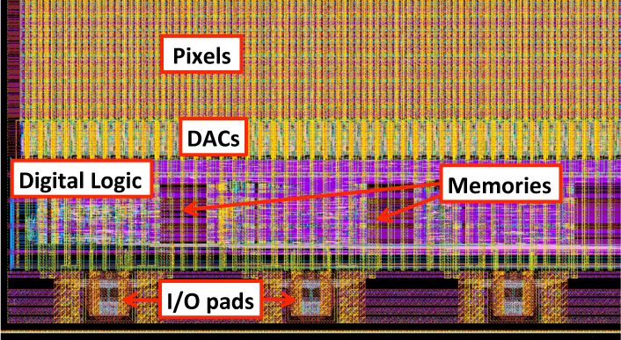
Full scale prototype: functional diagram and layout view
Effective scheme: only hit pixels are readout
Typical readout time (time to transfer the information from the in-pixel storage elements to the periphery memory for central Pb-Pb) is 100 ns

Slide 28
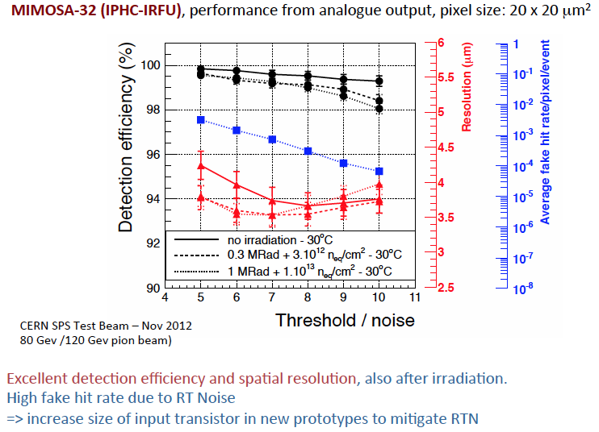
Performance after irradiation (MIMOSA-32)

Slide 29
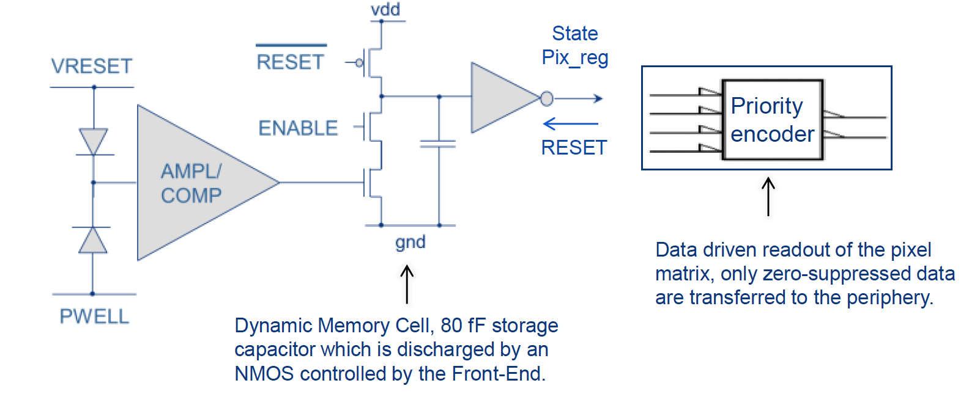
Sparsified readout (CERN/INFN/Wuhan)
Low power (20.5 nA) in-pixel hit discriminator (settling time ≈4 μs)
ALICE Pixel Detetor (ALPIDE) cihp
Data driven readout of pixel matrix – only zero suppressed data transferred to the periphery
Dynamic memory cell, 80 fF storage capacitor discharged by an NMOS controlled by Front-End
Triggered mode operation: upon arrival of a trigger, comparator output captured into a local memory simoultaneously in all pixels
Integration time of circuit output minimized: significant reduction of number of spurious hits generated by electronic noise or beam background
In-column priority encoder: only-zero suppressed data transferred – pixel reset from periphery logics

