Slide 1
The LHCb upgrade
U. Marconi, INFN Bologna
IFD2014
Trento, March 2014

Slide 2
The LHCb experiment
LHCb is a high precision experiment devoted to the search for New Physics beyond the Standard Model by
  studying CP violation and rare decays in the b and c-quark sectors;
  searching for deviations from the SM due to virtual contributions of new heavy particles in loop diagrams;
  being sensitive to new particles above the TeV scale not accessible to direct searches.
Past and running experiments have shown that:
  flavour changing processes are consistent with the CKM mechanism;
  large sources of flavour symmetry breaking are excluded at the TeV scale;
  the flavour structure of the NP, if it exists, would be very peculiar at the TeV scale (MFV).

Slide 3
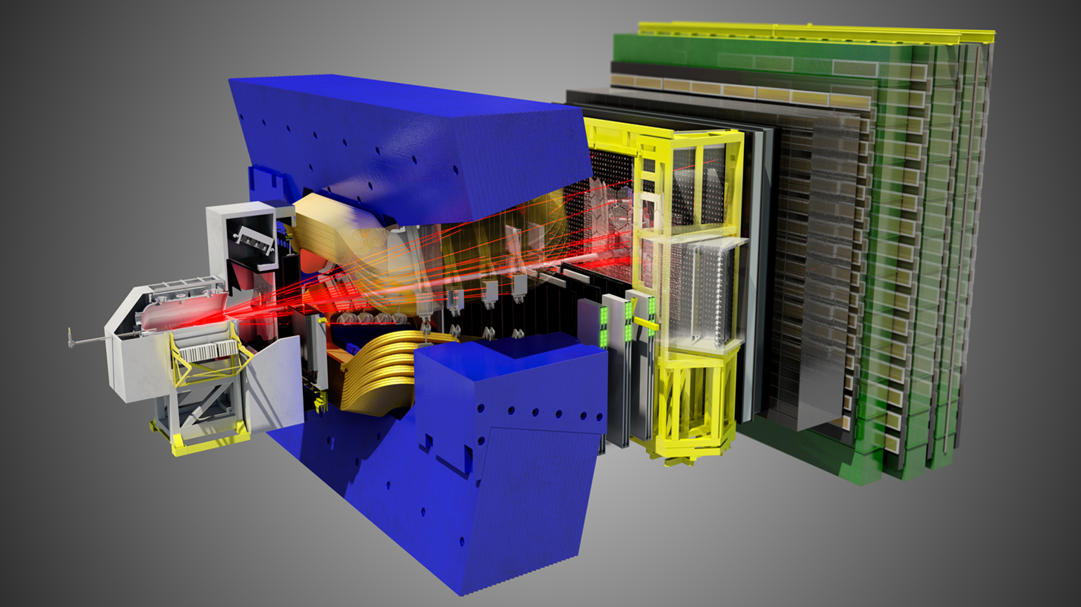
The LHCb Detector
Experiment optimized for beauty and charm physics:
– efficient trigger for hadronic and leptonic modes
– precision tracking and vertexing (mass, proper time)
– excellent particle identification

Slide 4
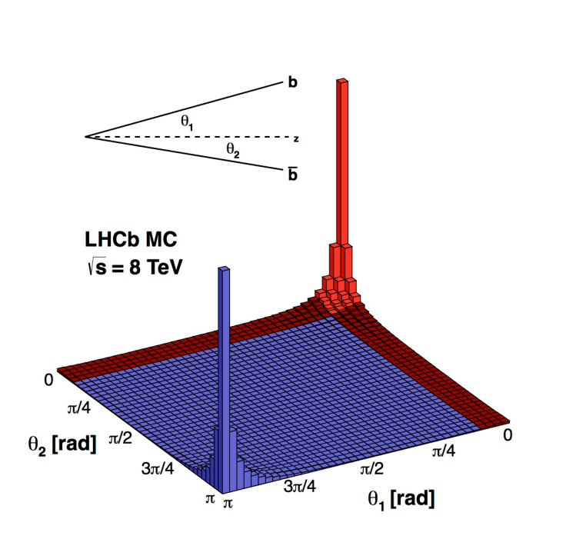
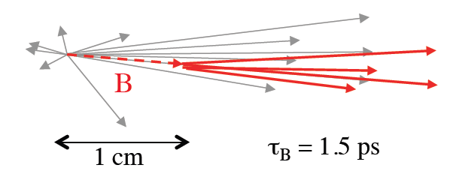
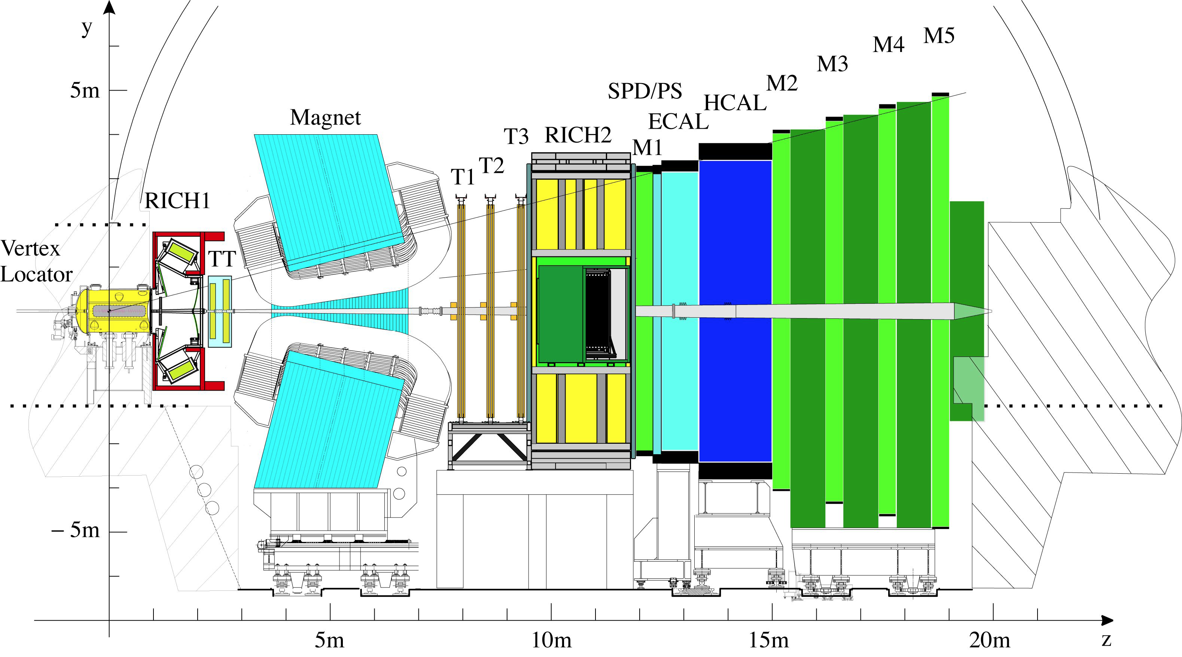
The LHCb detector
Decay time resolution Δt: 30-50 fs
Δp/p = 0.4-0.6%
Δm = 10-20 MeV/c²
Muon ID: ε(μ/μ) = 95%, mis-ID ε(π/μ) ~ 1%
RICH ID π/K: ε(K/K) = 95%, mis-ID ε(K/π) ~ 5%
CALO ID: : ε(e/e)=90%, mis-ID ~ 5%
B field polarity can be reversed
“The LHCb Detector at CERN”; The LHCb Collaboration, JINST 3, S08005 (2008)
Notes:
Let’s start with a short description of the present detector.
First, you know that heavy quark production (beauty and charm) at the LHC is peaked forward/backward. This is the reason why we built a forward single arm spectrometer consisting of:
VELO around the interaction region;
Tracking system upstream and downstream the magnet;
Two RICH for low and high momenta particles identification;
CALO and MUON.
Main features are summarized in the synoptic tables above.
The detector is optimized for beauty and charm physics:
Efficient trigger on hadronic and leptonic decay modes;
Precision tracking and vertexing for good mass a proper time measurements;
Excellent PID, achieved by means two RICH, CALO system and MUON detector.
Performance you can read here.

Slide 5
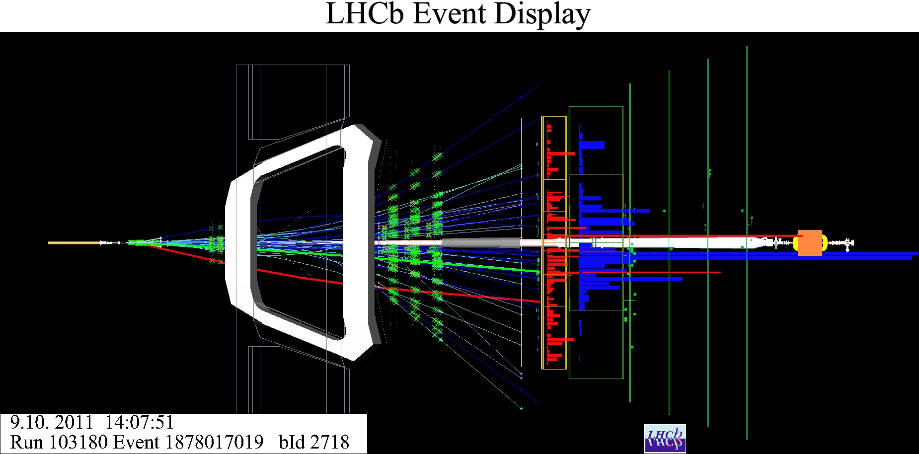
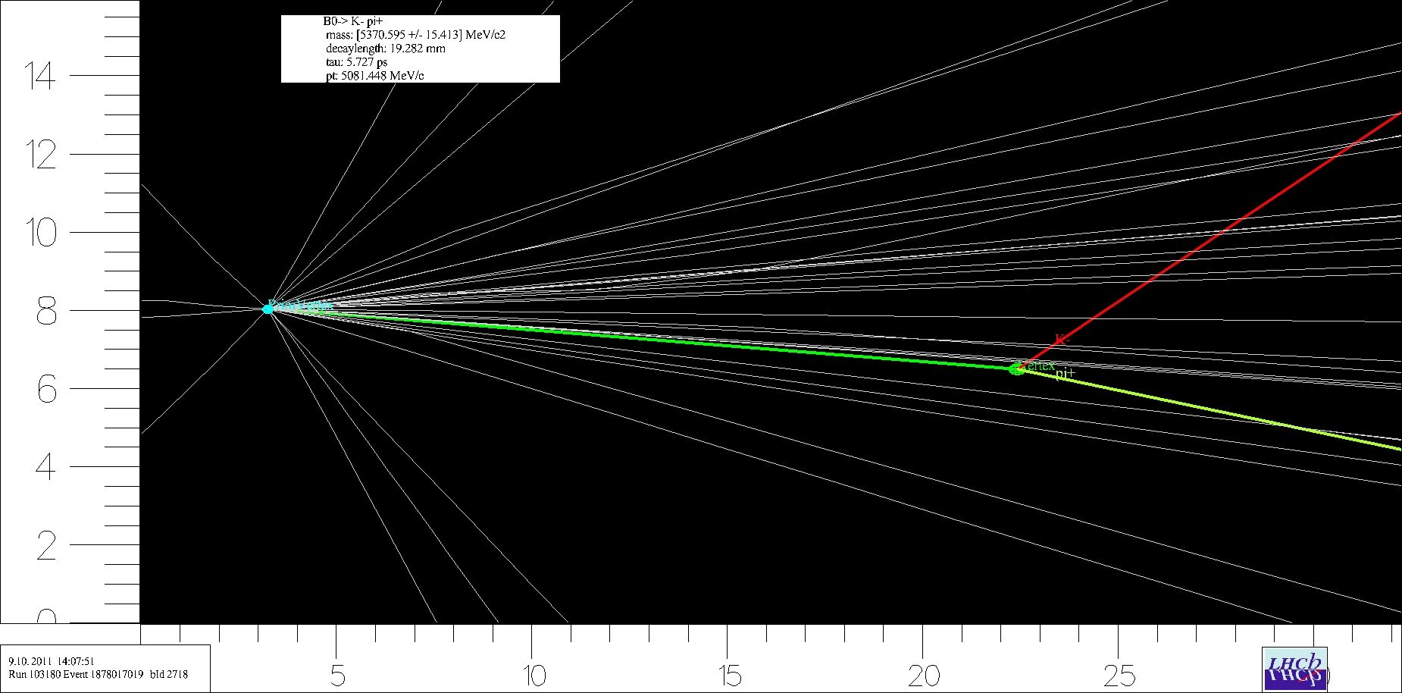
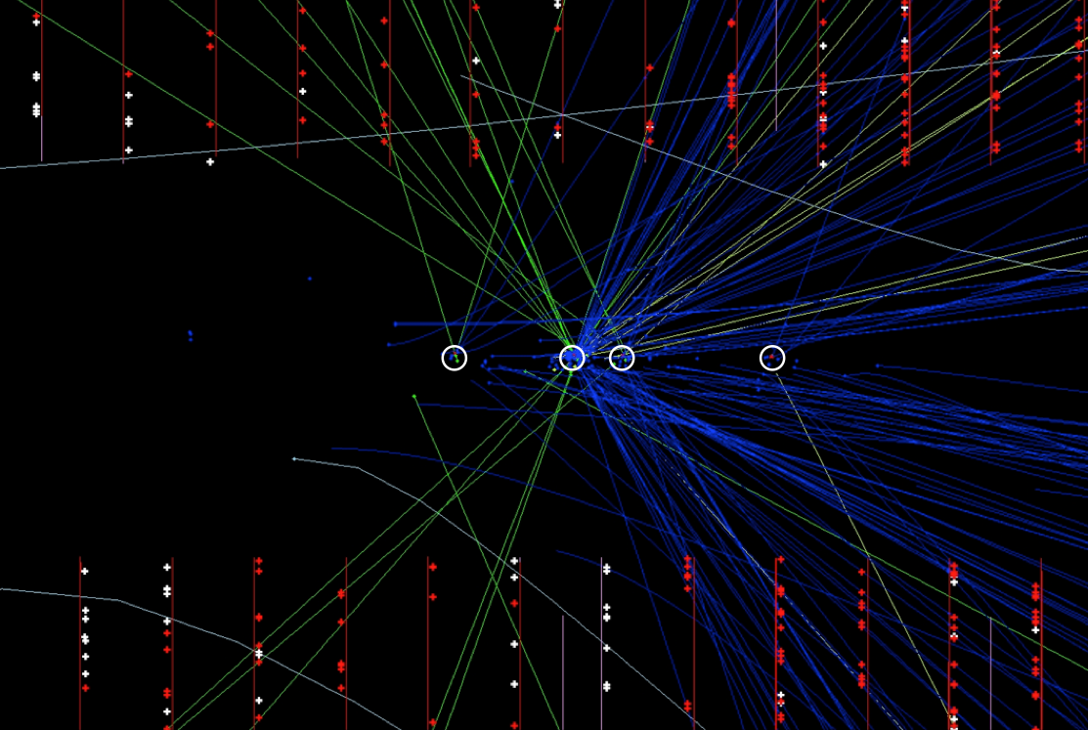
LHCb events
B⁰→K⁻ π⁺
decay length: 19.282 mm
tau: 5.727 ps
p_{T}: 5081.448 MeV/c
mass: (5370.595±15.413) MeV/c²
RICH-1
CALORIMETERS
MUON
T1,T2,T3
RICH-2
VELO
TT
Primary vertices

Slide 6
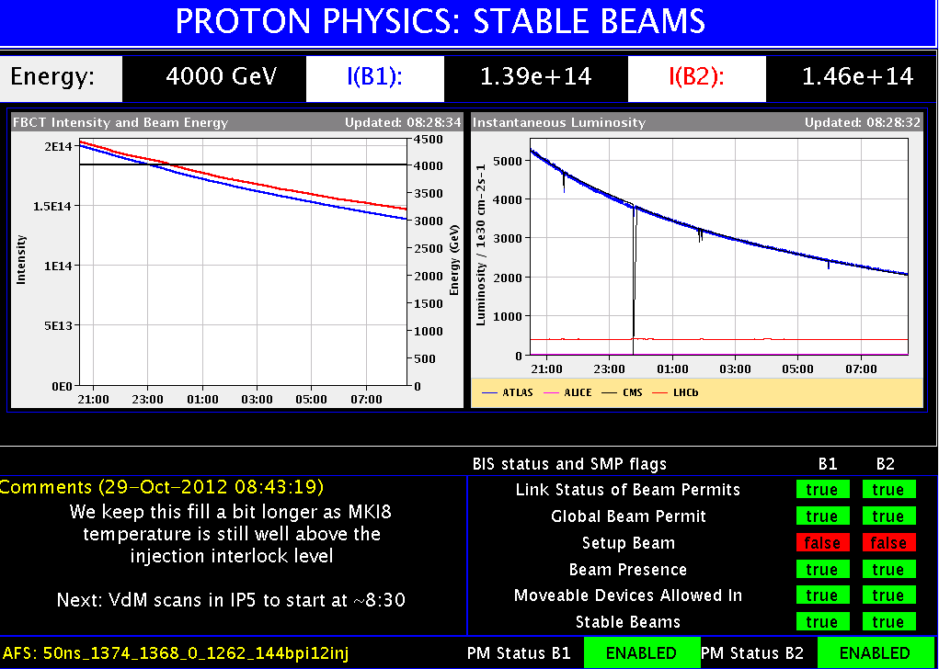
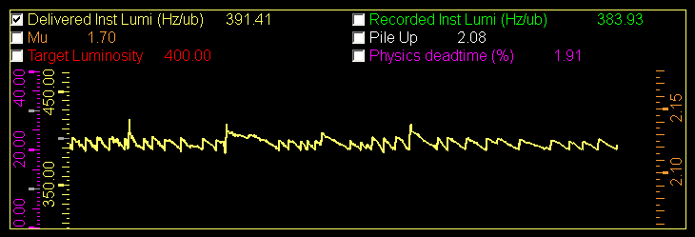
Instantaneous Luminosity
Instantaneous luminosity leveling at 4. × 10³² cm⁻² s⁻¹, ±3% around the target value
LHCb
LHCb was designed to operate with a single collision per bunch crossing, running at a instantaneous luminosity of 2. × 10³² cm⁻² s⁻¹ (assuming about 2700 circulating bunches).
  At the time of design there were worries about possible ambiguities in assigning the B decay vertex to the proper primary vertex among many.
Soon LHCb realized that running at higher multiplicities would have been possible. In 2012 we run at 4. × 10³² cm⁻² s⁻¹ with only 1262 colliding bunches.
  50 ns separation between bunches while the nominal 25 ns (will available by 2015).
  4 times more collisions per crossing than planned in the design.
  The average number of visible collisions per crossing in 2012 raised up to μ > 2.5
  (μ: average n. of visible interactions)
Notes:
This concept is illustrated in this pictures here. In the left top plot you see the luminosity monitored by ATLAS and CMS and the one seen by LHCb.
The current value, as you can see in bottom plot, can be adjusted to the target value within just few percent.
Thanks to the luminosity leveling we can keep our data condition stably centered around the optimal working point. Moreover we are therefore decoupled from the working condition of the other experiments.

Slide 7
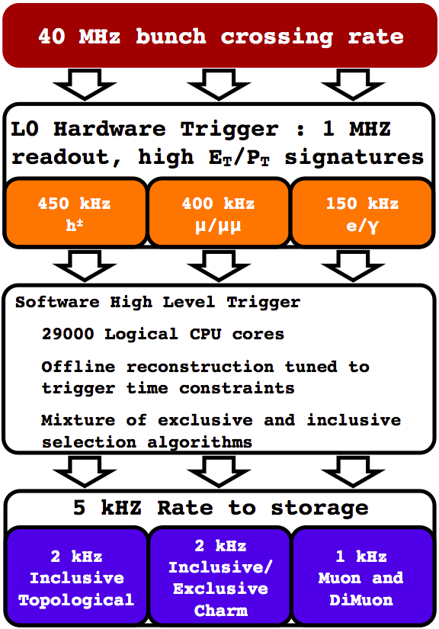
The LHCb Trigger
The Level-0 trigger based on the signals from ECAL,
HCAL and MUON detectors read at 40 MHz, operates
on custom electronics, with a maximum output rate
limited to 1.1 MHz.
  Fully pipelined, constant latency of about 4 µs.
  Bandwidth to the HLT ~ 4 Tb/s, GOL serdes, optical links.
  High p_{T} muon (1.4 GeV) or di-muon.
  High p_{T} local cluster in HCAL (3.5 GeV) or ECAL (2.5 GeV)
  25% of the events are deferred: temporarily stored on
  disk and processed with the HLT farm during the
  inter-fills.
HLT is a software trigger.
  Reconstruct VELO tracks and primary vertices
  Select events with at least one track matching
  p, p_{T} , impact parameter and track quality cuts.
  At around 50 kHz performs inclusive or exclusive
  selections of the events.
  Full track reconstruction, without particle-identification.
  Total accept rate to disk for offline analysis is 5 kHz.
deferred
Notes:
The LHCb trigger is structured in two levels.
The first level trigger, called the Level-0, is an hardware trigger, implemented on custom electronics, based on signals generated by ECAL, HCAL and MUON detectors,
to select events with high pT objects in the final state.
L0 is there to limit the acquisition rate to about 1 MHz. The bandwidth to the next trigger level in this case is limited to just 4 Tb/s: this was the main technical constraint at the time of the LHCb design.
The second level is the High Level Trigger, a versatile, adaptable software trigger implemented as algorithms running on a computing farm. Consider that there are order of 20 thousand instances of the HLT algorithms running on the farm CPUs.
The output rate to disk is about 5 kHz.
The software trigger is the key point of the LHCb strategy in pursuing for heavy flavour physics at the LHC.

Slide 8
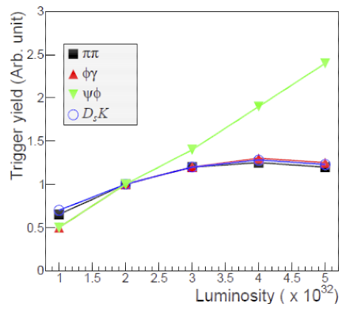
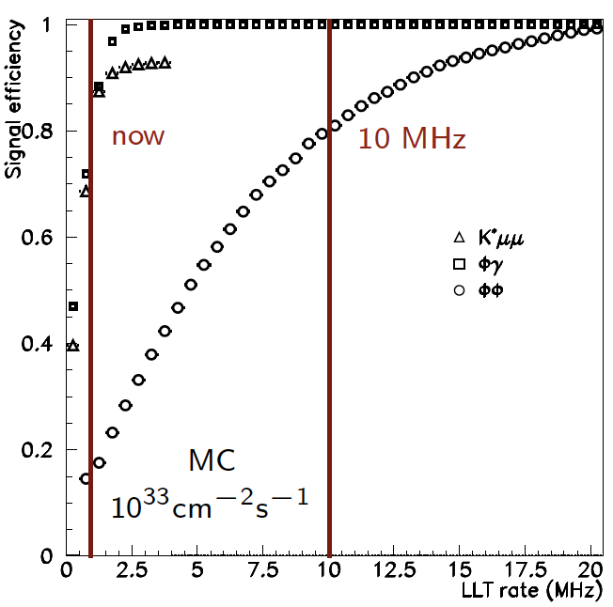
The 1MHz L0 rate limitation
“Framework TDR for the LHCb Upgrade: Technical Design Report”; The LHCb Collaboration,CERN/LHCC-2012-007, LHCb-TDR-12 - 2012
Due to the available bandwidth and the limited discrimination power of the hadronic L0 trigger, LHCb experiences the saturation of the trigger yield on the hadronic channels around 4. ×10³² cm⁻²s⁻¹
Increasing the first level trigger rate considerably increases the efficiency on the hadronic channels.
Notes:
The Level-0 trigger unfortunately does not allow for efficient triggering on decays which only have hadronic content. It turns out that as the luminosity increases so does the inefficiency
in the hadronic triggers and the net yield of hadronic events levels off, while the yield of events
with leptonic content scales with the luminosity increase.

Slide 9
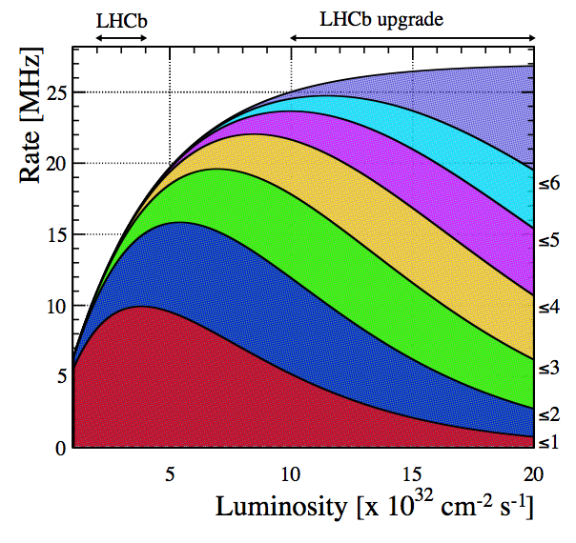
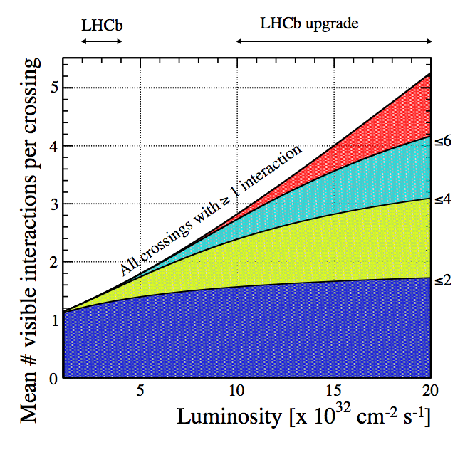
The LHCb upgrade
Readout the whole detector at 40 MHz.
Trigger-less data acquisition system.
  Use a Low Level Trigger as a throttle
  mechanism, while progressively increasing
  the power of the event filter farm
  to run the HLT up to 40 MHz.
We have foreseen to reach 20. × 10³² cm⁻²s⁻¹ and therefore to prepare the sub-detectors on this purpose.
  pp interaction rate 27 MHz
  At 20. × 10³² cm⁻² s⁻¹pile up μ ≅5.2
  Increase the yield in the decays with muons
  by a factor five and the yield of the hadronic channels by a factor ten.
Collect 50 fb⁻¹ of data over ten years.
  8 fb⁻¹ is the integrated luminosity target,
  to reach by 2018 with the present detector;
  3.2 fb⁻¹ collected so far.
The upgrade shall take place during the
Long Shutdown 2 (LS2) in 2018.
Mean visible interactions per crossing

Slide 10
LHCb upgrade: consequences
The detector front-end electronics has to be entirely rebuilt, because of the output rate requirements.
  No more buffering in the front-end electronics boards.
  Data need to be zero suppressed and formatted before transmission to optimize the number of required links
  A lot more optical links to get the required bandwidth, needed to transfer data from the front-end to the read-out boars at 40 MHz.
New HLT farm and network to be built by exploiting new LAN technologies and powerful many-core processors.
Rebuild the current sub-detectors equipped with embedded front-end chips.
  Silicon strip detectors: VELO, TT, IT
  RICH photo-detectors: front-end chip inside the HPD.
Consolidate sub-detectors to let them stand the foreseen luminosity of 20. × 10³² cm⁻² s⁻¹

Slide 11
LHCb upgrade: TDRs
Letter of Intent for the LHCb Upgrade.
CERN-LHCC-2011-001 ; LHCC-I-018. - 2011.
Framework TDR for the LHCb Upgrade : Technical Design Report
CERN-LHCC-2012-007 ; LHCb-TDR-12. - 2012.
LHCb VELO Upgrade Technical Design Report
CERN-LHCC-2013-021 ; LHCB-TDR-013. - 2013.
LHCb PID Upgrade Technical Design Report
CERN-LHCC-2013-022 ; LHCB-TDR-014. - 2013.
LHCb Tracker Upgrade Technical Design Report
CERN-LHCC-2014-001; LHCB-TDR-015. – 2014
Online and Trigger TDR in preparation.

Slide 12
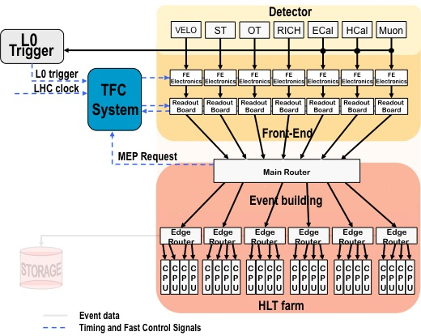
LHCb DAQ today
Push-protocol with centralized flow-control
Readout boards: 313 x TELL1
2 x F10 E1200i
# links (UTP Cat 6) | ~ 3000
Event-size (total – zero-suppressed) | 65 kB
Read-out rate | 1 MHz
# read-out boards | 313
output bw / read-out board | up to 4 Gbit/s (4 Ethernet links)
# farm-nodes | 1500 (up to 2000)
max. input bw / farm-node | 1 Gbit/s
# core-routers | 2
# edge routers | 56
56 sub-farms
IFD2014

Slide 13
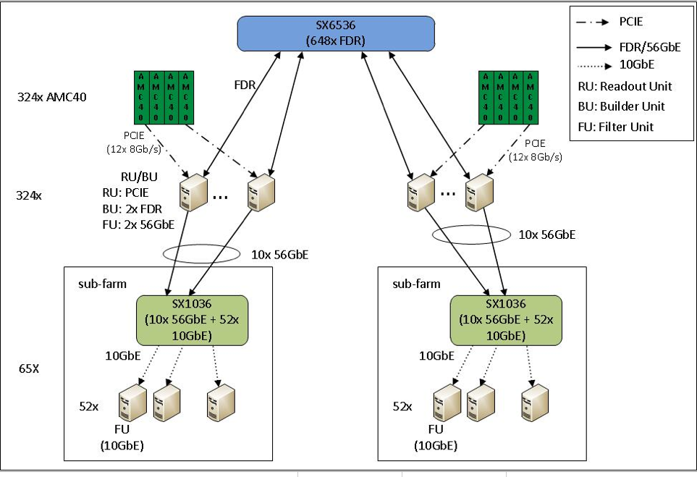
LHCb upgrade: DAQ
Event builder
High speed network
P
C
I
e
4
0
P
C
I
e
4
0
P
C
I
e
4
0
P
C
I
e
4
0
P
C
I
e
4
0
P
C
I
e
4
0
P
C
I
e
4
0
P
C
I
e
4
0
16-lane PCIe-3
16-lane PCIe-3
U. Marconi et al. The PCIe Gen3 readout for the LHCb
upgrade, CHEP2013
HLT Event filter
IFD2014
Silvia Amerio, HLT for HL-LHC, Technology and architecture for next decade TDAQ
Notes:
We need a packed switched newtork: many sources to a single and variable destination server, where event building will take place.
We are evaluating new LAN protocols like InfiniBand in a fully meshed conenction.
A Infiniband FDR core port is cheaper than 40 GbE by a factor two at least.
The architecture we envisage is very efficient since for the event-building we fully expoit the bidirectionality of the IB core port.

Slide 14
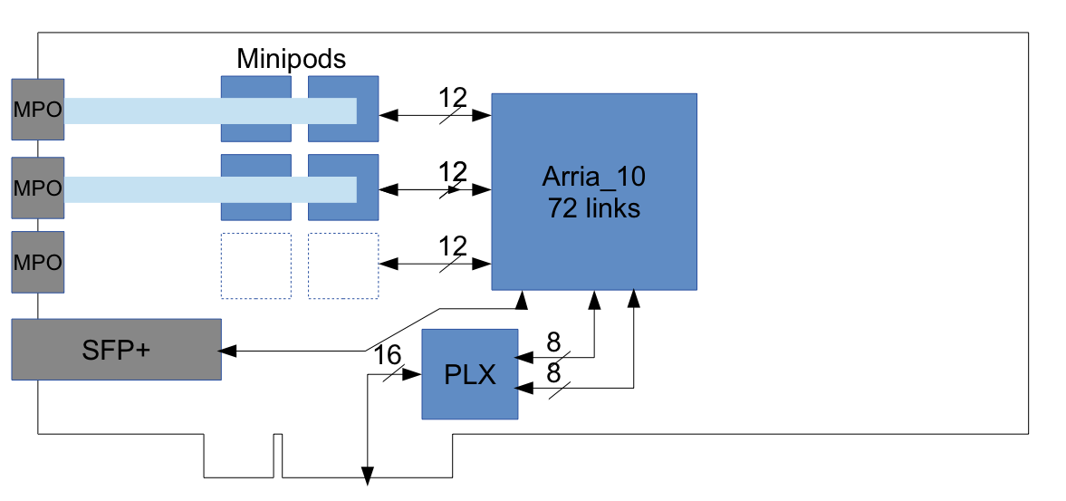
PCIe Gen3 based readout
A main FPGA manages the input streams and transmits data to the event-builder server using PCIe Gen3.
PCIe Gen3 throughput: 16-lane × 8 Gb/s/lane = 128 Gb/s
The readout version of the board uses two de-serializers.
24 optical links
from the FEE
DMA over 8-lane
PCIe-3 hard IP blocks
16-lane PCIe-3 edge connector
to the motherboard of the host PC

Slide 15
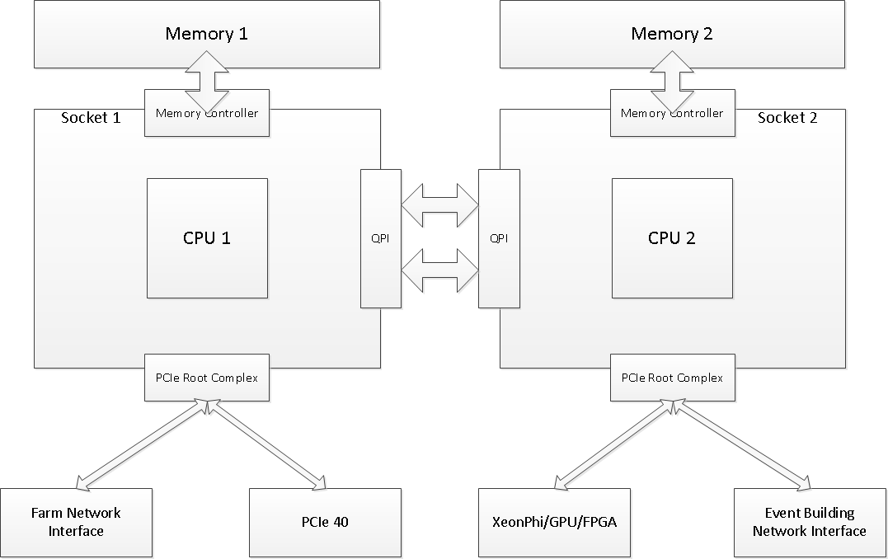
Event builder node
DDR3
40-50 GB/s
Half duplex
DDR3
40-50 GB/s
Half duplex
events that are being
built on this machine
opportunity for doing
pre-processing of
full event here
2x50 GB/s
Full duplex
empty
Event Building
Network Interface
PCIe40
data from
the detector
~ 100 Gb/s
to the HLT
from the
event builder
to the
event builder
Dual-port
IB FDR – 110 Gb/s

Slide 16
LHCb upgrade: HLT farm
Trigger-less system at 40 MHz:
A selective, efficient and adaptable software trigger.
Average event size: 100 kB
Expected data flux: 4 TB/s
Total HLT trigger process latency: 15 ms
  Tracking time budget (VELO + Tracking + PV searches): 50%
  Tracking finds 99% of offline tracks with p_{T} >500 MeV/c
Number of running trigger process required: 4.×10⁵
Number of core/CPU available in 2018: ~ 200
  Intel tick-tock plan: 7nm technology available by 2018-19, the n. of core accordingly scales as 12. × (32 nm/ 7 nm)² = 250
Number of computing nodes required: ~ 1000

Slide 17
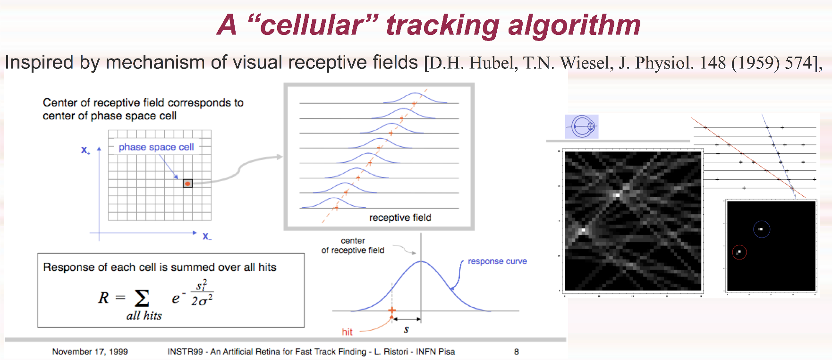
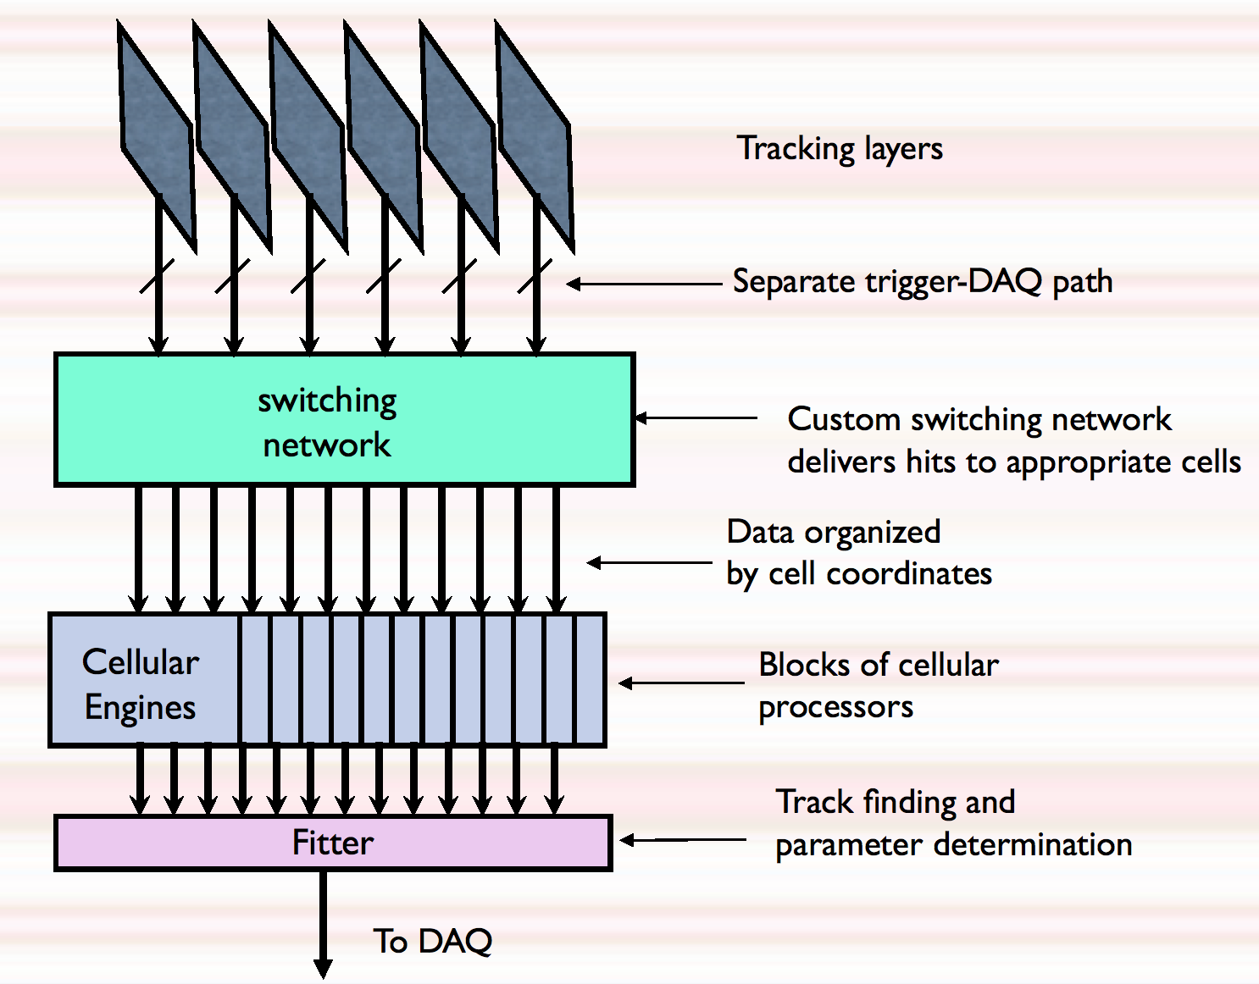
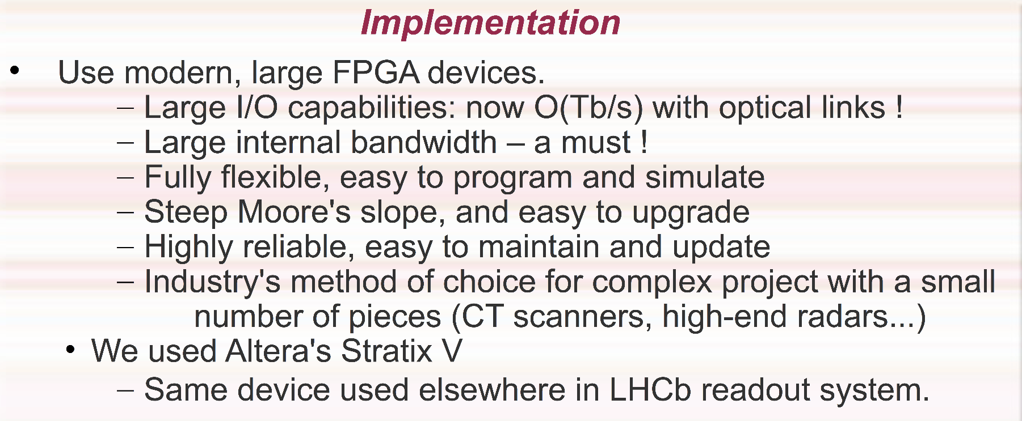
TPU: HLT assisted tracking
“A specialized processor for track reconstruction at the LHC crossing rate”.
Presented by G. Punzi, INSTR 2014
https://indico.inp.nsk.su/contributionDisplay.pycontribId=129&sessionId=6&confId=0
“We have shown with a realistic detector arrangement that it is possible to reconstruct tracks and measure their parameters very well with a “brain inspired” cell-matrix method.”

Slide 18
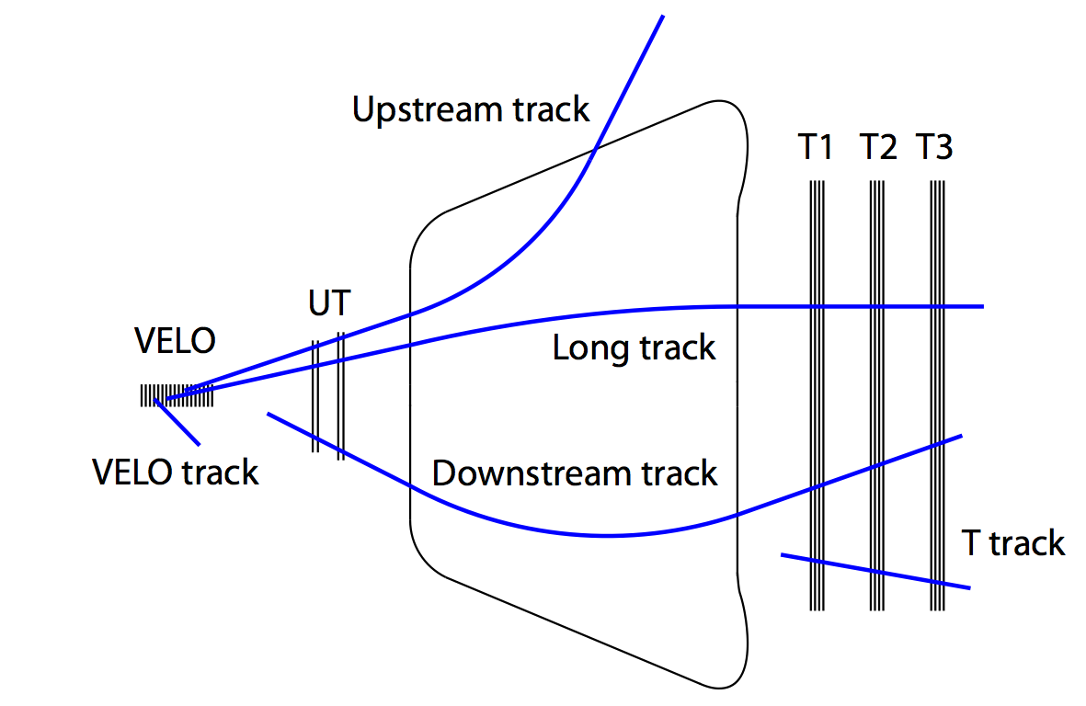
Upgrade of the tracking system

Slide 19
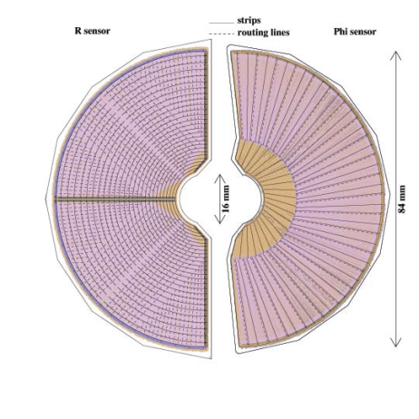
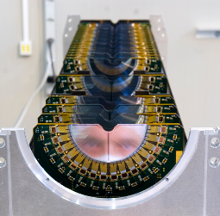
The current VELO
21 stations of silicon micro-strip
sensors, located nearby the
interaction region.
  R and ϕ geometry modules
  44 mm external radius
  Left and right halves of the modules can be moved inward/outward the beam lines: modules open and close at each fill. Distance from the beam line 5.5 mm
  Position centred around the current beam
  position. Modules do not move during a fill.
  Positions reproducible within
  5 µm: measured as the average
  distance between right-side PV
  and left-side PV.
Primary (beam) and secondary
vacuum are separated by a thin
Al box (“RF foil”).
±5 µm
Notes:
Current VELO cosists of 21 stations along the beam-pipe, planes ortogonal to the beam, od micro-strip sensors, shaped to provide r and phi coordinates of the hits.
Each station is made of two halves which can be moved inward/outward the beam and positioned close to the beam (interaction region) with high accuracy:
the closer you are to the beam more precisely you can measure track parameters.
Sensors are separated by the primary vacuum by a thin Aluminum box.

Slide 20
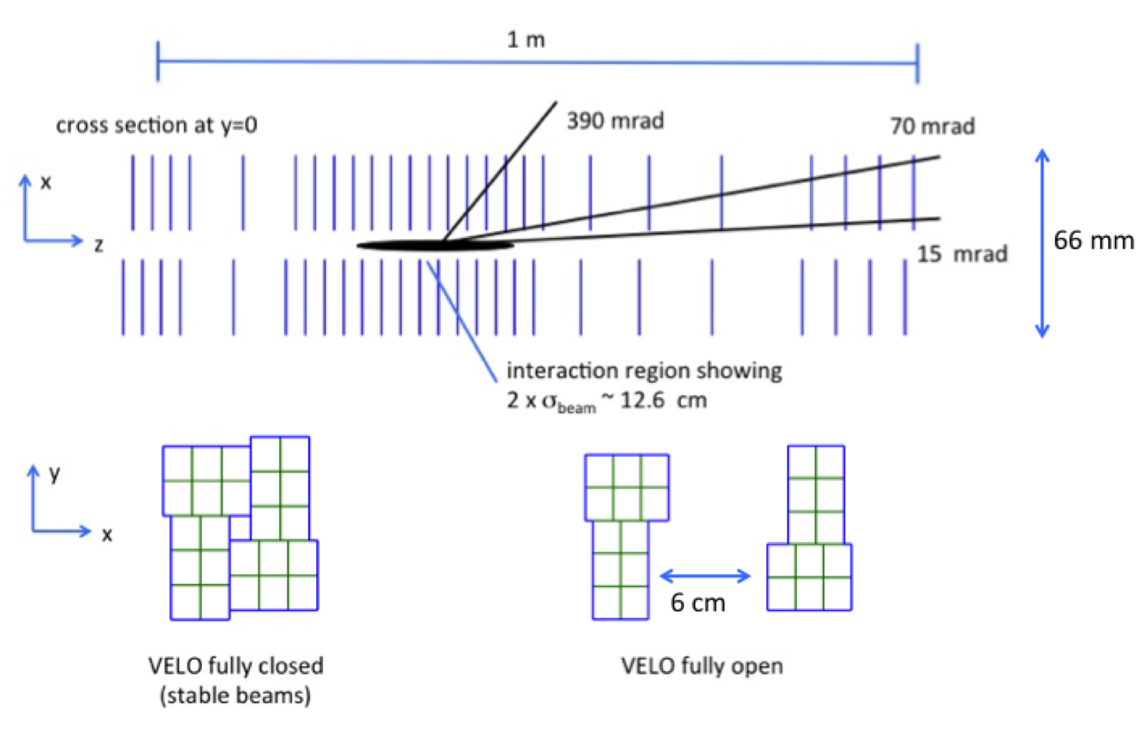
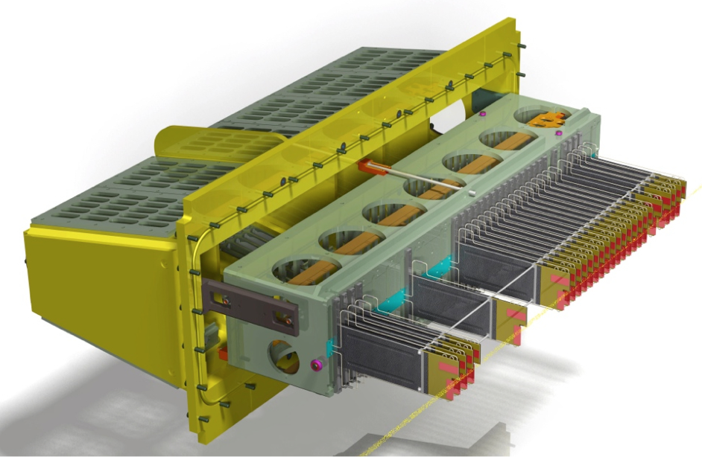
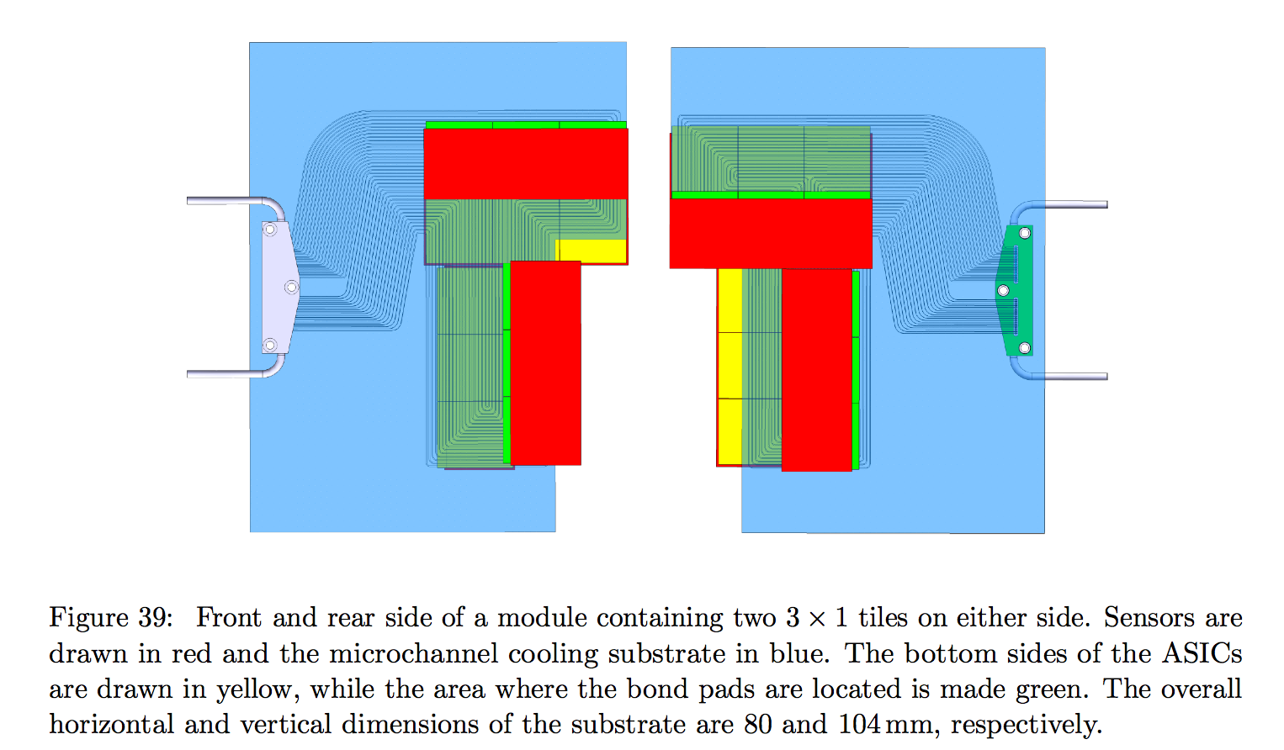
The VELO upgrade
Silicon pixels with a surface area of 55x55 μm²
Lower material budget:
Sensor thickness: 300 μm → 200 μm
RF Aluminium foil thickness: 300 → ≤ 250 μm,
Enlarge acceptance
Inner foil radius: 5.5 mm → 3.5 mm
first sensitive pixel edge at a radius of 5.1 mm, which is about the limit for the pixel chip as determined by the data rate from detailed simulations
26 stations
http://cds.cern.ch/record/1624070/files/LHCB-TDR-013.pdf

Slide 21
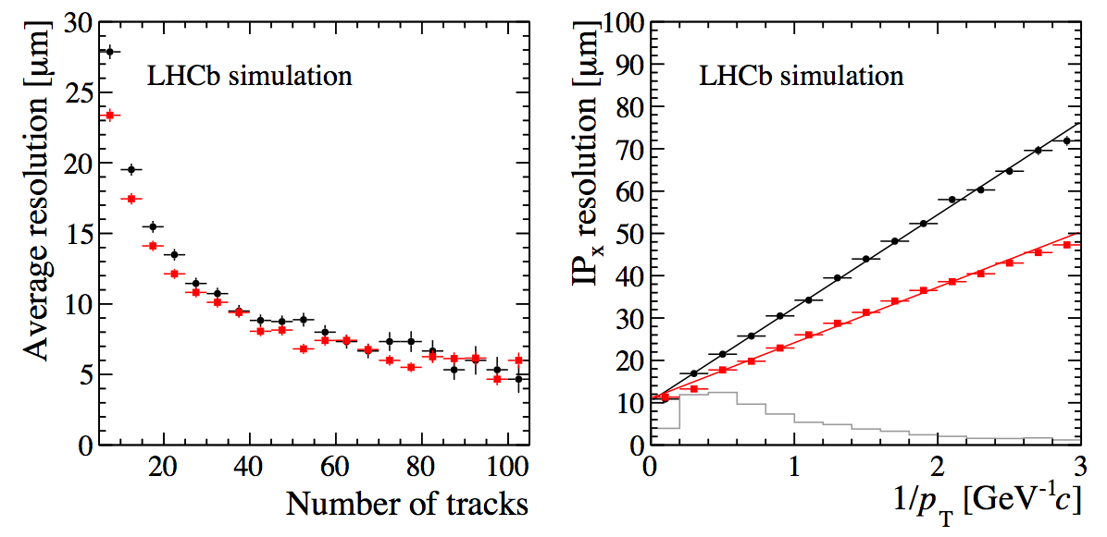
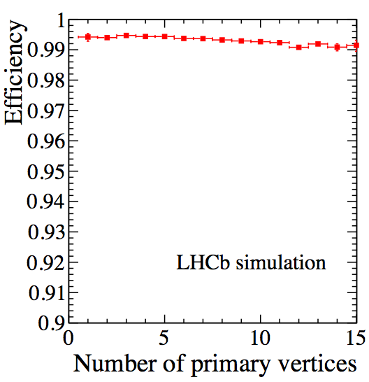
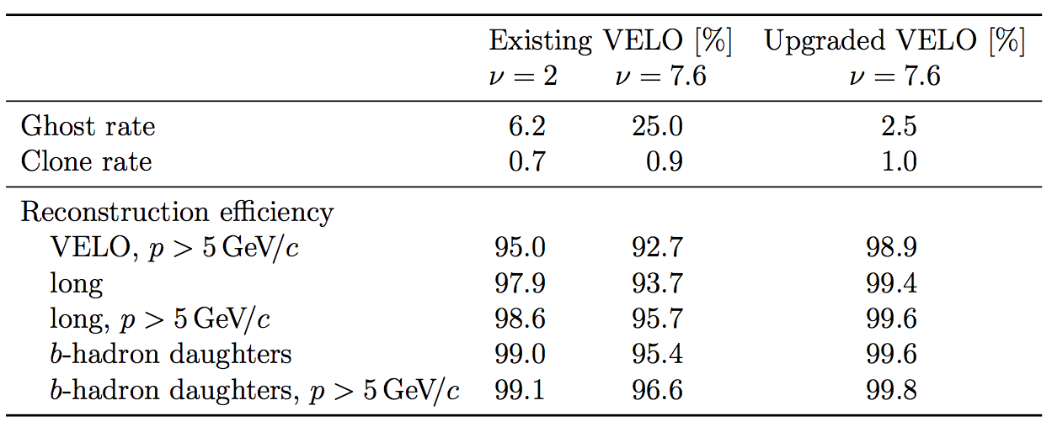
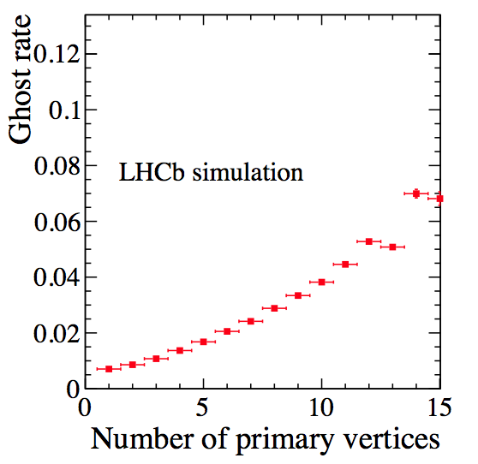
The VELO upgrade
PV resolution in x as function of the number of reconstructed tracks in the vertex
IP resolution in x
(resolutions in x and y are similar)
Tracking efficiency
current
upgrade
ν: pp interactions per crossing
μ: visible interactions
Ghost rate
strip
pixel
Total output data rate: 3 Tb/s

Slide 22
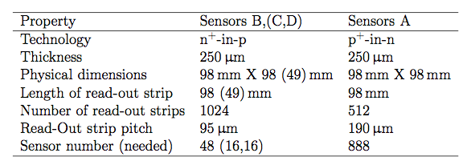
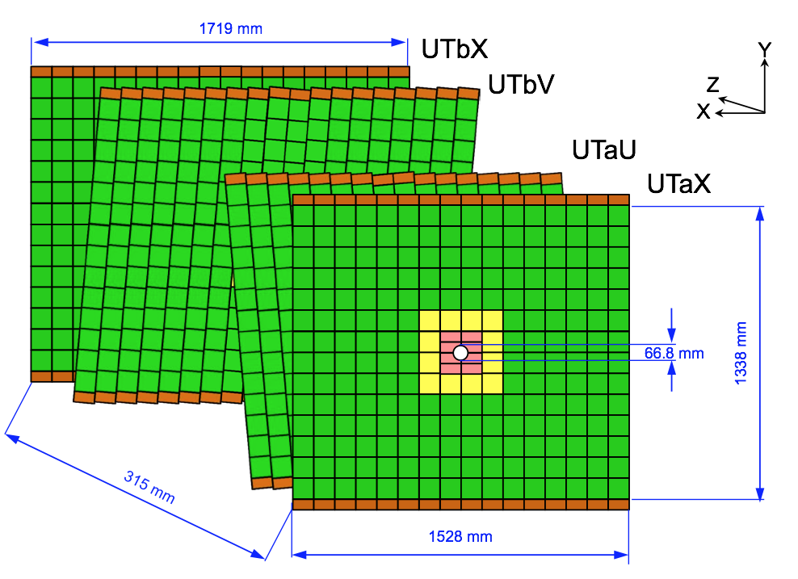
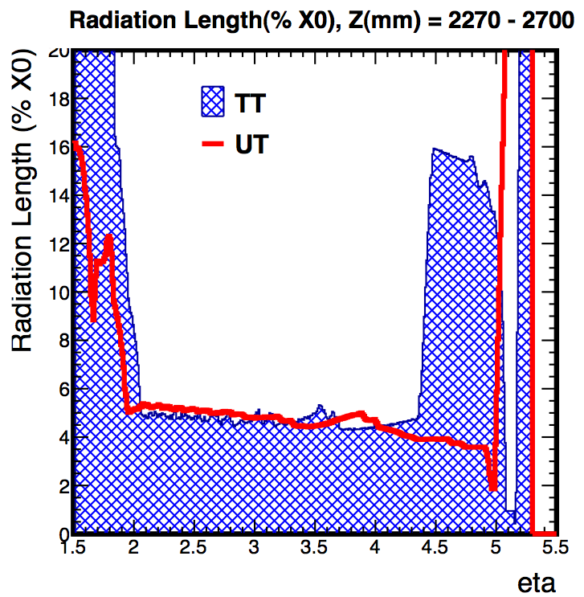
Upstream Tracker
Silicon Strip detector
The first and the last planes have vertical strips, whereas the middle two are at ±5◦.
The current TT read-out strip geometries (length of about 10 cm and a strip pitch of 183 μm) will lead to unacceptably high occupancies under the foreseen running conditions.

Slide 23
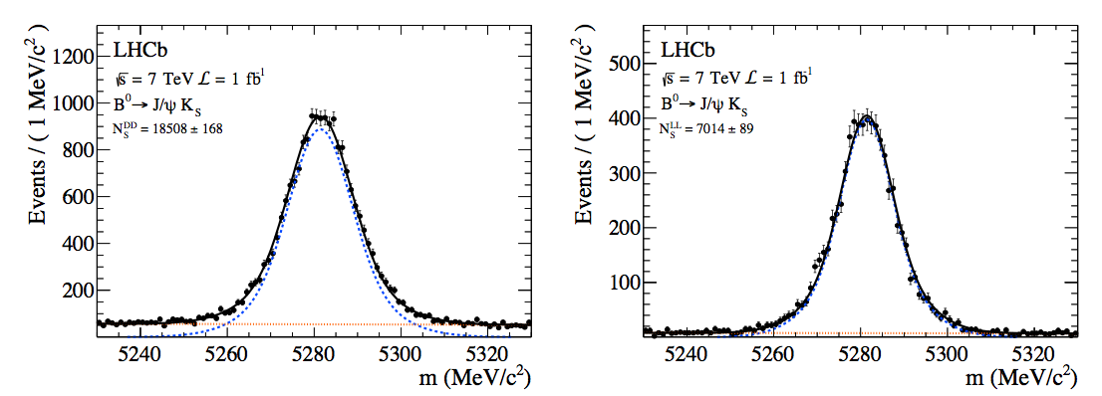
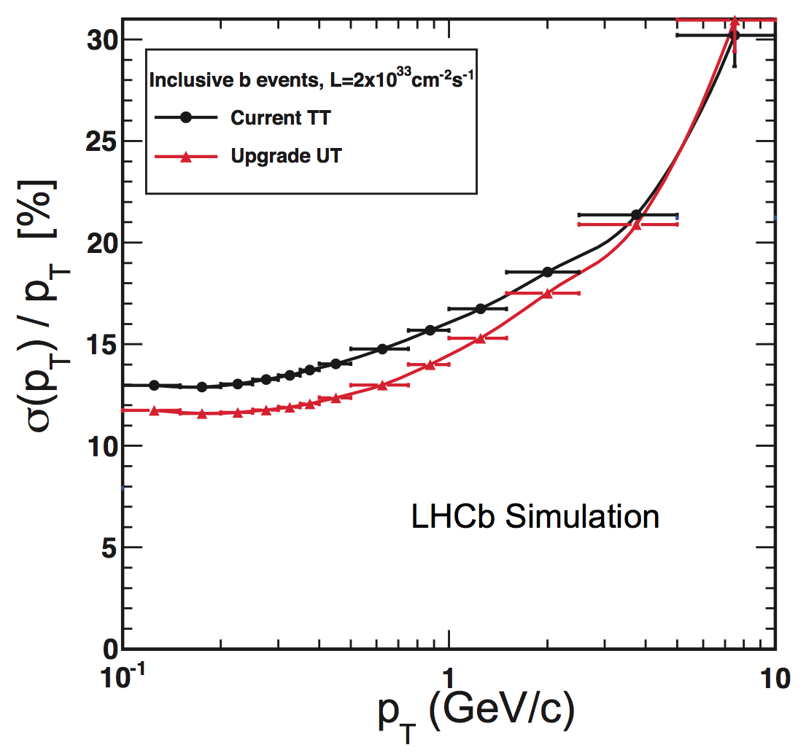
Upstream Tracker
Downstream Tracks
Long Tracks
Trigger: p_{T}
Bd→J/ψ K_{S}
Bd→J/ψ K_{S}
M. Ullan et al., Embedded pitch adapters for the ATLAS Tracker Upgrade, Nucl. Instrum. Meth. A732 (2013) 178.
Most of the B→J/ψ K_{S} events, 73%, are reconstructed from decays downstream using the UT and the tracker. Momentum resolution of long tracks is significantly improved, by ∼25%, if the tracks have UT hits.
For triggering it is possible to use the stray magnetic field of 0.02 T between the VELO and the UT to measure the track momentum σ(p_{T})/p_{T} ≈ 15%, good enough to measure the sign of the charge.

Slide 24
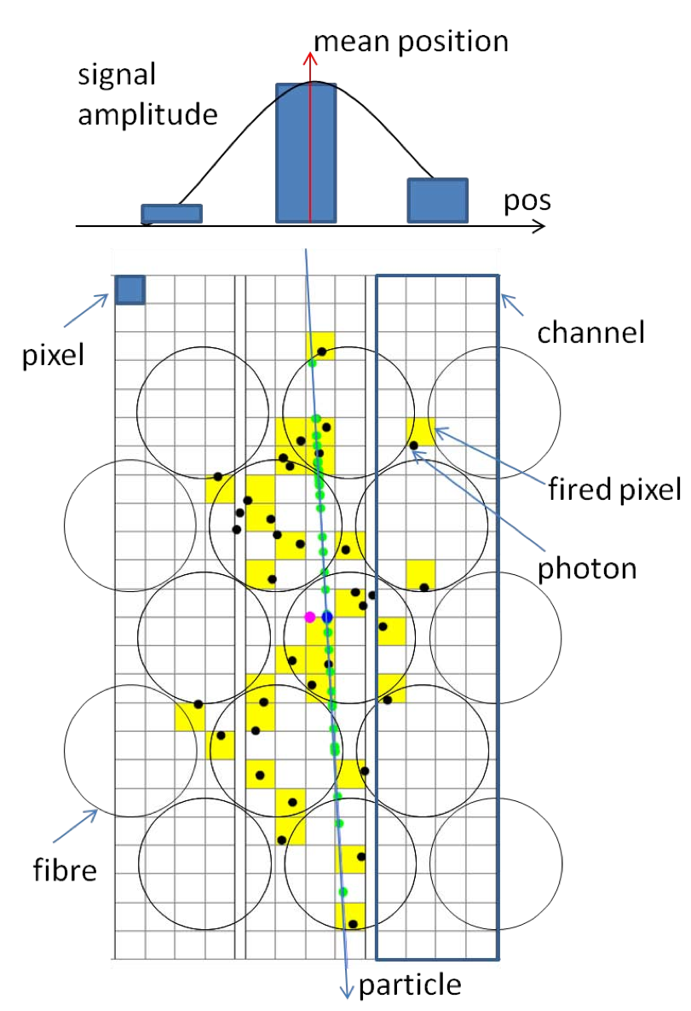
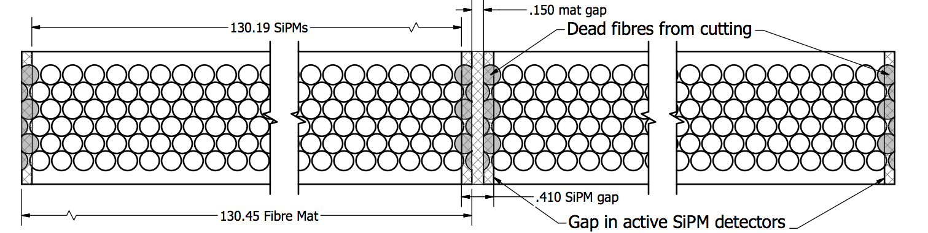
Scintillator Fibre Tracker
The SCSF-78MJ, 250 μm diameter scintillating fibre, by Kuraray, produces a sufficient light yield and has a long enough attenuation length for this detector.
Radiation damage to the fibre material results in degraded transmission, but it is expected to result in less than 40% loss of signal from
the worst regions near the beam-pipe after 50 fb⁻¹
The fast signal response and recovery time of the detector
makes the SiPM particularly suitable for the fast interaction
rate.

Slide 25
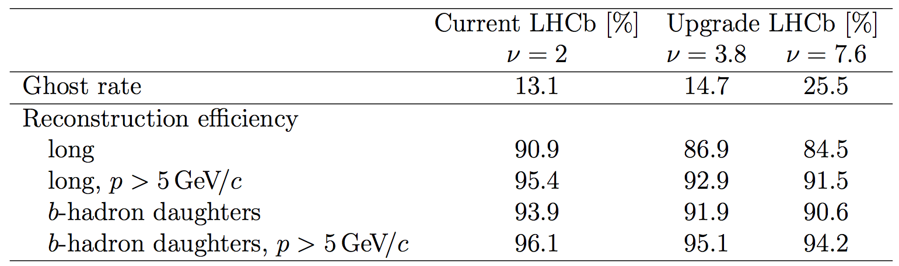
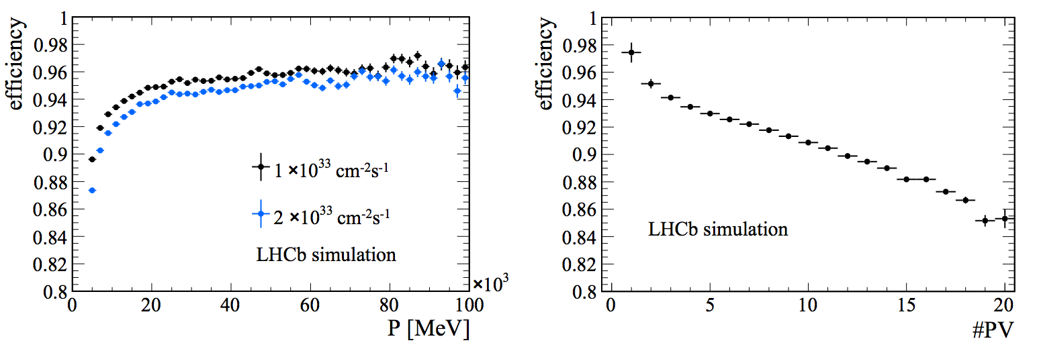
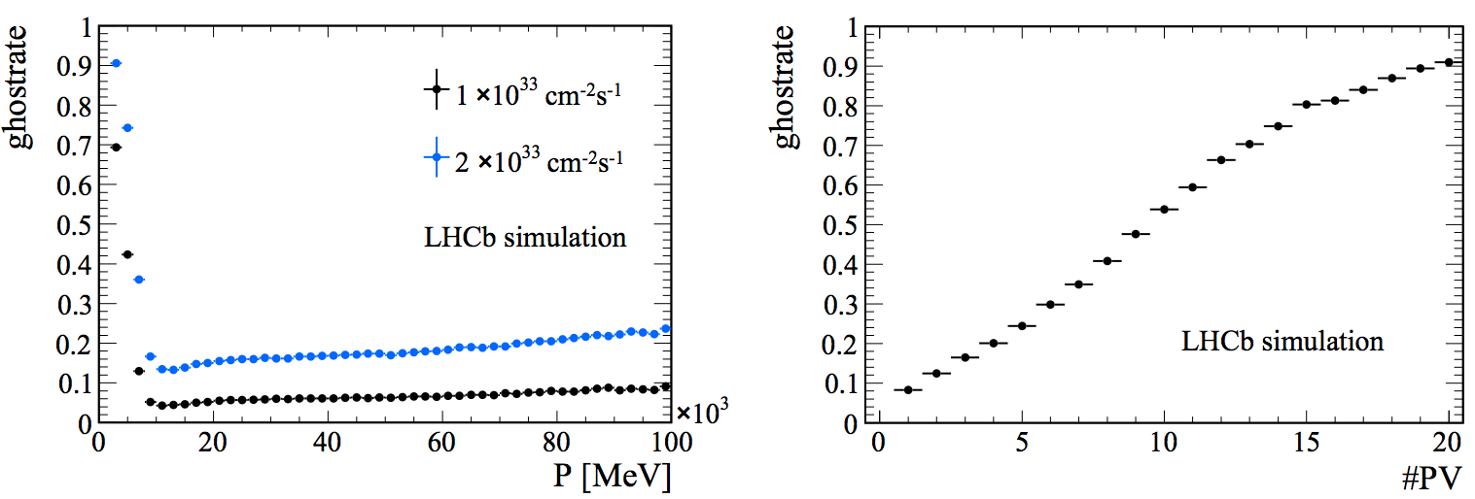
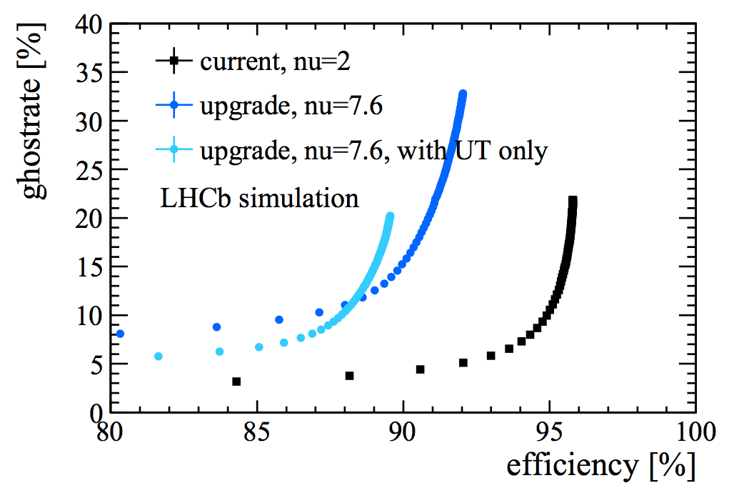
Tracking performance
Bs → φφ events
Clear degradation of the performance as function of the number of primary vertices is observed
Different points varying the χ² cuts after the Kalman filter
To achieve similar ghost rates for the upgrade experiment at ν = 7.6 as in the current experiment at ν = 2, a drop in efficiency of 5% would be required

Slide 26
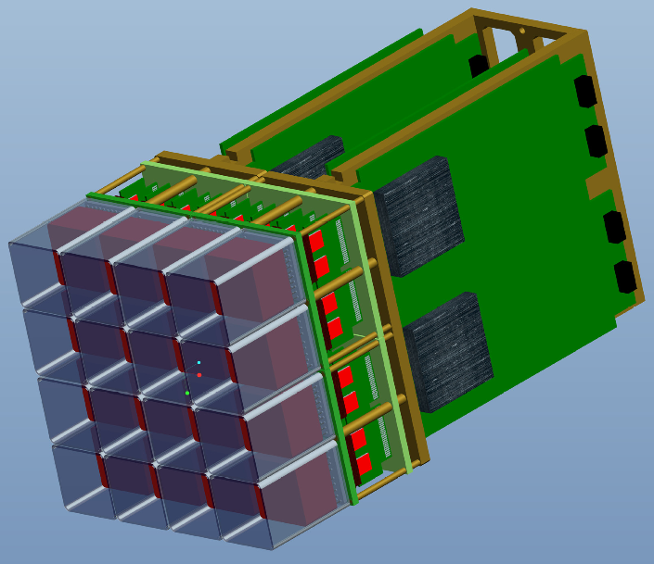
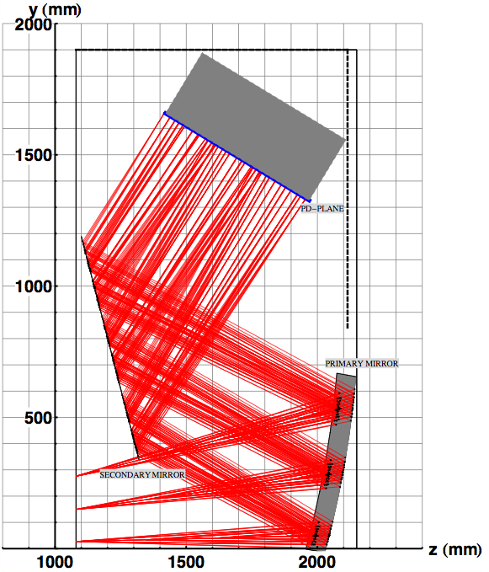
PID performance
The customized ASIC readout chip, “CLARO”:
comprised of an analogue pulse shaper amplifier
and a binary discriminator.
Photon detectors must be replaced, since the current hybrid photon detectors (HPDs) have their 1 MHz read-out electronics encapsulated within the tube.
The overall structure of both RICH detectors will remain unchanged.
The optical layout of RICH 1 has to be modified to reduce the otherwise prohibitively large hit occupancy in the central region of the detector.
  Increasing the the focal length of the spherical mirrors halving the occupancy.
  The gain is also achieved by removing the Aerogel radiator material (∼3.5% of X₀).
  K (π) threshold in C₄F₁₀ is 9.3 (2.6) GeV/c .
It is proposed to replace the HPDs with commercial multi-anode photomultipliers (MaPMT) with external readout electronics (1920 in RICH 1 and 2560 in RICH 2).
R11265 MaPMT from Hamamatsu.
PDM size of 116 × 116 mm²
PDM matrix is 6 columns × 12 rows.
RICH-1
C₄F₁₀

Slide 27
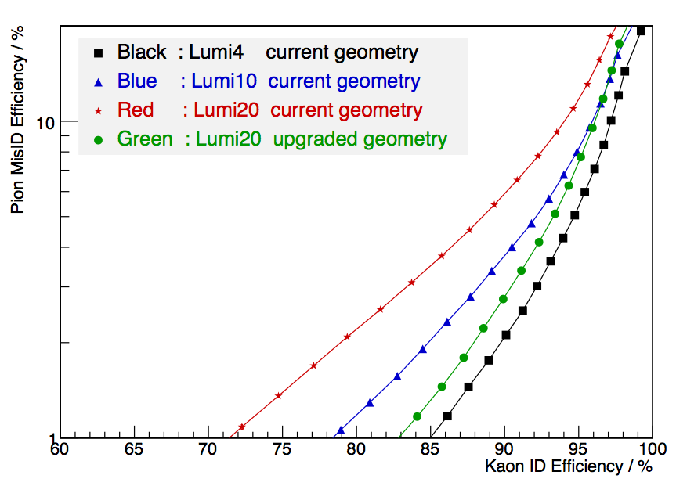
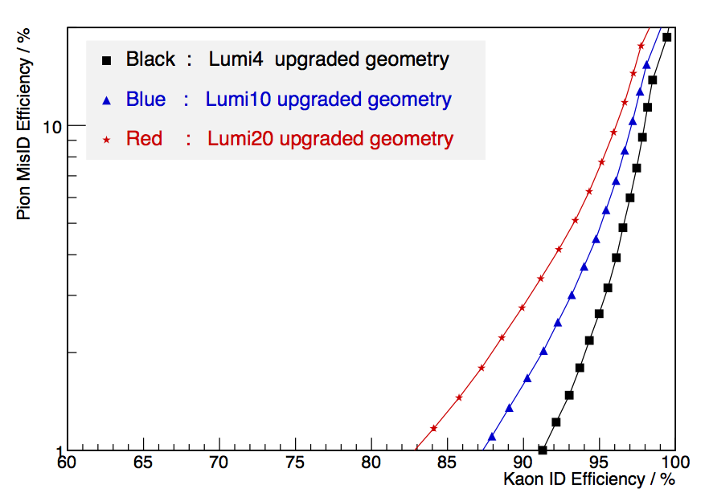
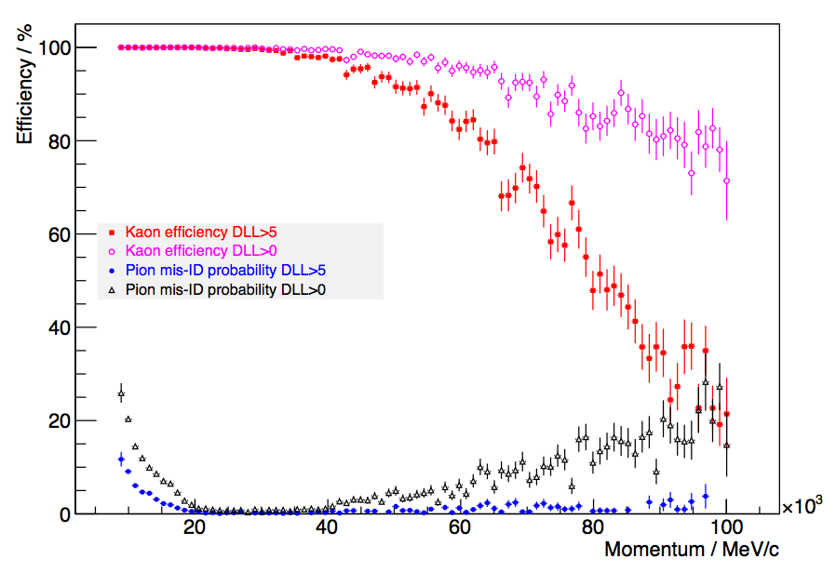
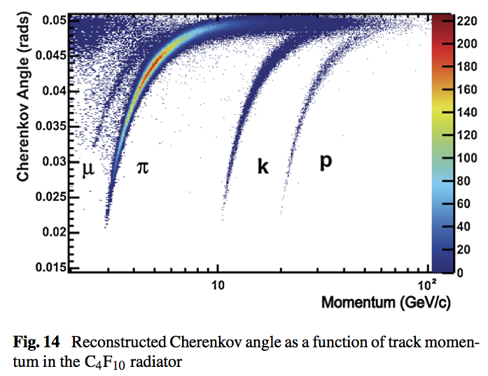
PID performance
Running the full simulation and reconstruction chain in B_{s} → φφ
Performance of the LHCb RICH detector at the LHCThe European Physical Journal CMay 2013, 73:2431,
The PID performance of the current
geometrical layout and the upgraded superimposed
The PID performance of the upgraded
geometrical layout at various luminosities.

Slide 28
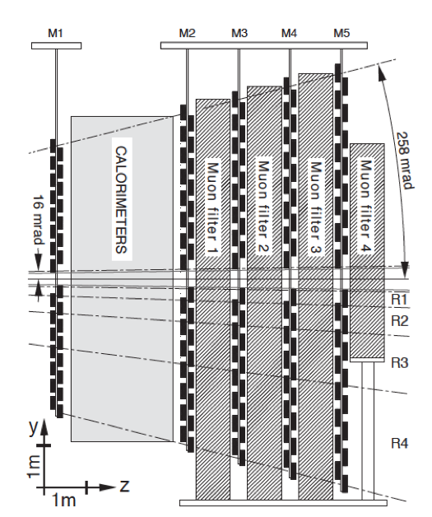
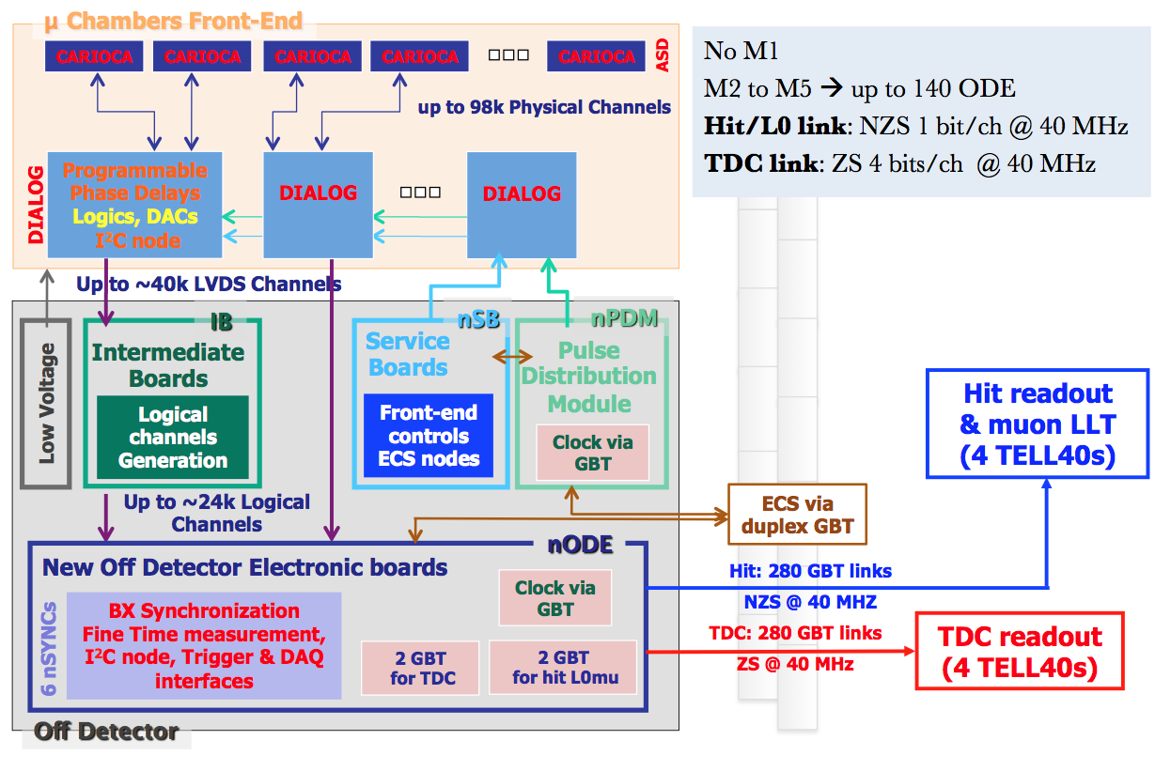

MUON system
M1
The baseline detectors currently foreseen are anode-pad triple-GEM detectors for the R1 regions and cathode-pad MWPCs for the external regions.
The MWPCs chambers are composed of four gaps, which provide the necessary redundancy in the system.
M1 will be removed in the upgraded experiment.
The particle flux in the innermost regions of station M2 is expected to be very high, and so additional shielding will be installed around the beam-pipe behind the HCAL to reduce the occupancy in these regions.
Design of new off-detector readout electronics compliant with full 40 MHz readout and the new GBT–based communication protocol: nODE, new radiation tolerant custom ASIC.
R&D of new high granularity detectors for regions R1-R2 of stations M2 and M3 and of their front-end electronics.

Slide 29


MUON ID Performance
Efficiency
Pion MisID
The efficiency is obtained from a simulated sample of B_{s} → μ⁺μ⁻ events and is evaluated for single muon.
DLL_{μπ} variable based on the distance of matching hits from the extrapolated track in the muon stations combined with the information coming from RICH and calorimeter detectors

Slide 30



Calorimeters
The scintillating pad detector (SPD) and the pre-shower (PS) of the current detector will be removed.
The “shashlik” ECAL calorimeter modules, are expected to suffer from radiation damage as the integrated luminosity received by the LHCb detector increases.
The effect of the removal of the SPD/PS on photon selection for candidates with p_{T} ≥ 200 MeV/c: an absolute reduction of 10 to 15% in the efficiency is observed at a fixed background retention
For the higher electron momentum sample p > 10 GeV/c the absence of the SPD/PS has very little effect.
Photon selection

Slide 31
INFN group items
MUON detector:
  Cagliari, Ferrara, Firenze, Frascati (LNF), Roma1, Roma2
Online, readout electronics, software trigger:
  Bologna, Padova
Computing:
  Bologna, Ferrara, Padova
RICH:
  Ferrara, Genova, Milano-Bicocca, Padova
Tracking:
  Milano
Trigger GPU, TPU:
  Padova, Pisa

Slide 32

The LHCb upgrade: physics
LHCb upgrade: statistical sensitivity to key observables
EPJ C (2013) 73:2373

Slide 33
Conclusions
The concept of the LHCb experiment, we believe, is definitely proved: a dedicated experiment for heavy flavour physics, exploiting a forward spectrometer at a hadron collider.
  Many world leading results and many more to come with the 3.2 fb⁻¹ full data set collected.
    Standard Model still survives.
    We are now on probing regions where new physics effects might appear.
LHCb plans the upgrade, to be installed in 2018: the upgrade is an essential next step forward for flavour physics.
TDRs are all ready, but one, concerning “Trigger and DAQ”, on the way to come: is planned for the next June.

Slide 34


Features of current LHCb DAQ
Push-protocol with centralized flow-control (throttle)
Connection-less, unreliable protocol from FPGA source directly through DAQ network (2 hops) to PCs → losses in network must be very small → buffering important
Very lean cost-effective system. Total DAQ cost < 2 MCHF (2009) excluding readout-boards and farm)
# links (UTP Cat 6) | ~ 3000
Event-size (total – zero-suppressed) | 65 kB
Read-out rate | 1 MHz
# read-out boards | 313
output bw / read-out board | up to 4 Gbit/s (4 Ethernet links)
# farm-nodes | 1500 (up to 2000)
max. input bw / farm-node | 1 Gbit/s
# core-routers | 2
# edge routers | 56
Very compact system all installed in UX85A on 3 floors
Max cable distance 36 m –> uses cheap UTP Ethernet everywhere, practically no optical links in the DAQ
IFD2014

Slide 35

The DMA PCIe-3
effective bandwidth
DMA over 8-lane
PCIe-3 hard IP blocks
ALTERA Stratix V
IFD2014

