Slide 2


LHC Machine Upgrade
Gianluigi Arduini – CERN - BE/ABP
on behalf of the HL-LHC Team
Acknowledgements: M. Benedikt, O. Brüning, S. Fartoukh, M. Giovannozzi, M. Lamont, E. Métral, T. Pieloni, S. Redaelli, L. Rossi, G. Rumolo, D. Schulte, R. Steerenberg, A. Valishev, J. Wenninger, F. Zimmermann

Slide 3
Contents
The LHC: the challenges
The next 10 years
HL-LHC: why and how?
Beyond the Upgrade: FCC-hh
Disclaimer: I will focus on the LHC/FCC although a lot of work is on-going/will be needed for the Injectors both for HL-LHC and the future Colliders

Slide 4
Contents
The LHC: the challenges
The next 10 years
HL-LHC: why and how?
Beyond the Upgrade: FCC-hh

Slide 5


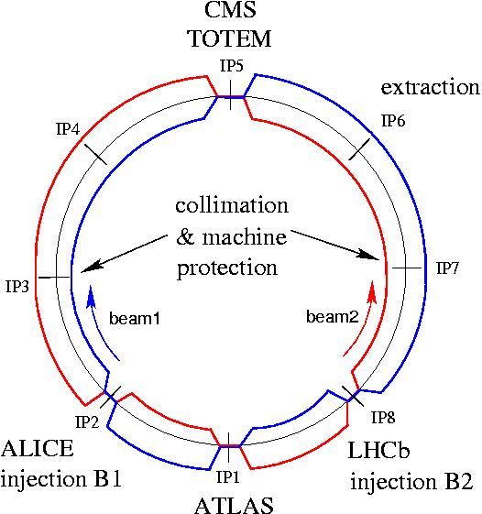




LHC layout
Total length: ~26.7 km
  8 arcs (aka sectors): ~2.8 km each
  8 long straight sections: ~700 m each
2-in-1 magnet design with separate vacuum chambers
  p-p, ion/ion, or p/ion collisions
  beams cross in 4 points
RF

Slide 6
Interaction regions geometry
In the IRs, the beams are first combined into a single common vacuum chamber and then re-separated in the horizontal plane,
The beams move from inner to outer bore (or vice-versa),
The triplet quadrupoles are used to focus the beam at the IP.
Machine geometry in H plane
D2
D2
beam1
D1
D1
beam2
Triplet
Triplet
IP
194 mm
~ 40 m
beam2
beam1
~ 260 m
D1,D2 :
separation/recombination dipoles
Common vacuum chamber

Slide 7
Separation and crossing
Because of the tight bunch spacing and to prevent undesired parasitic collisions in the common vacuum chamber:
  Parallel separation in one plane, collapsed to bring the beams in collision
  Crossing angle in the other plane
4 mm (450 GeV)
1.3 mm (4 TeV)
~ 8 mm
θ
Not to scale !

Slide 8
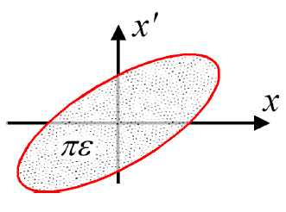
The quest for Luminosity
(Round beams)
To maximize L:
  Many bunches (k) ➔ tight bunch spacing
  Many protons per bunch (N_{b})
  Small emittance ε*
  Small β*
  Maximize the parameter F (<1) depending on the crossing angle
High beam “brightness” N_{b}/ε*
(particles per phase space volume)
Injector chain performance !
Preservation in the LHC !!
LHC Optics/Configuration

Slide 9
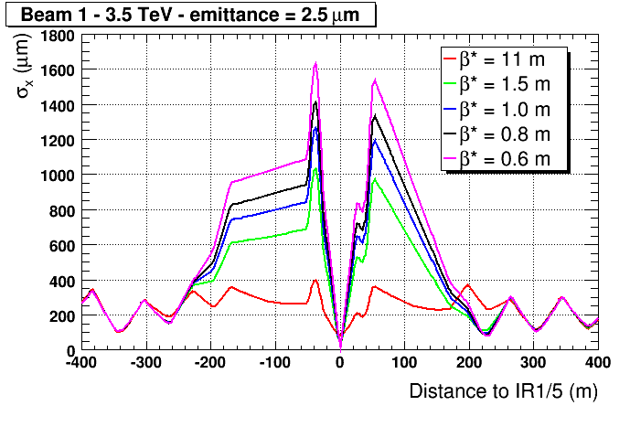
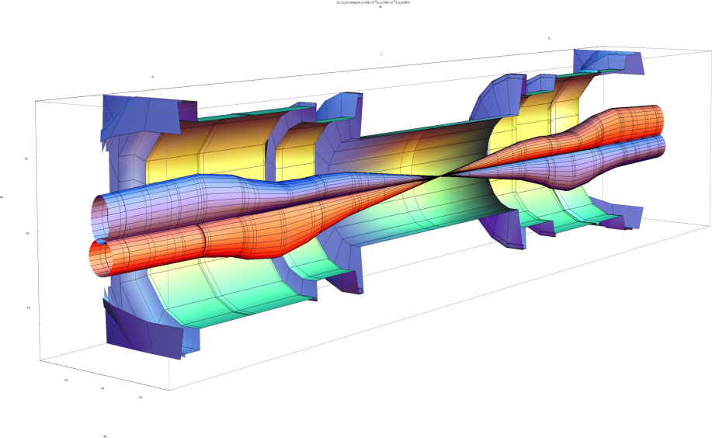
What limits β*?
The triplet quadrupoles in the high luminosity IRs define the machine aperture limit for squeezed beams, β* is constrained by:
  the beam envelope
  the crossing angle
β* = 60 cm
β_{triplet} ~ 4 km
John Jowett

Slide 10
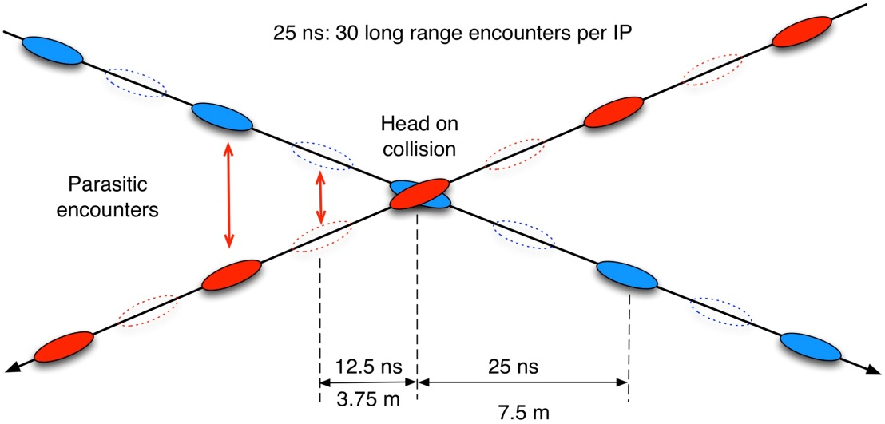
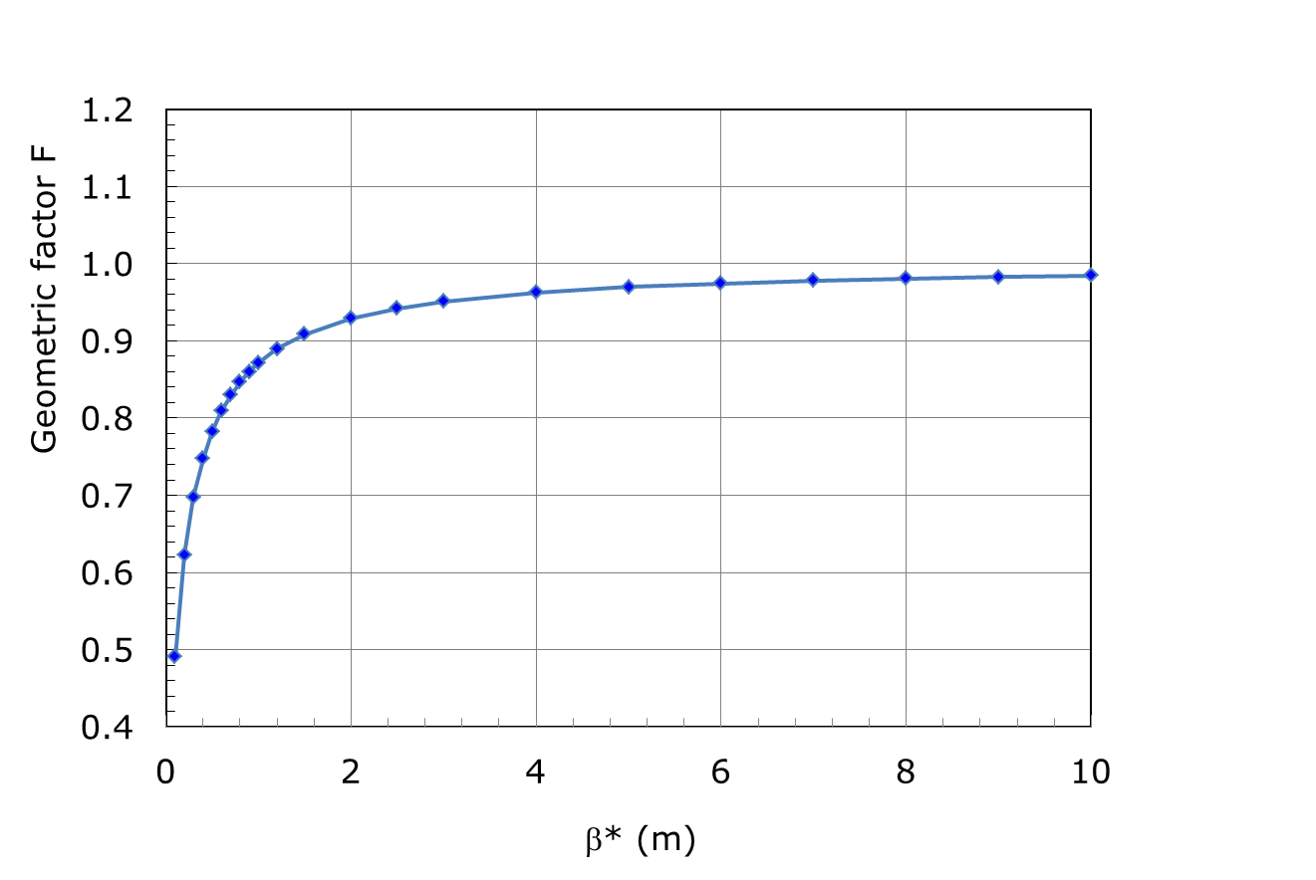
Crossing angle
Needed to minimize beam-beam effects
Drawbacks:
  luminosity geometric reduction factor due to bunch length σ_{s} and crossing angle becomes significant for low β*
  Reduction of the aperture
2θ
β* = 0.6 m → F = 0.81
ε = 2.5 μm
θ = 145 μrad

Slide 11
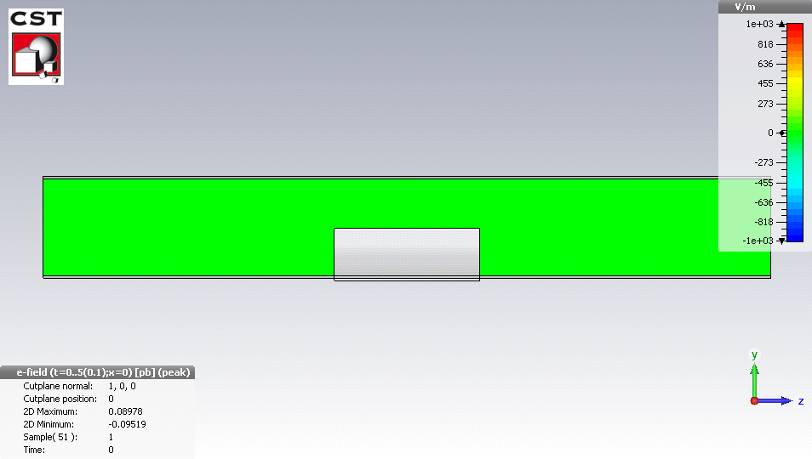
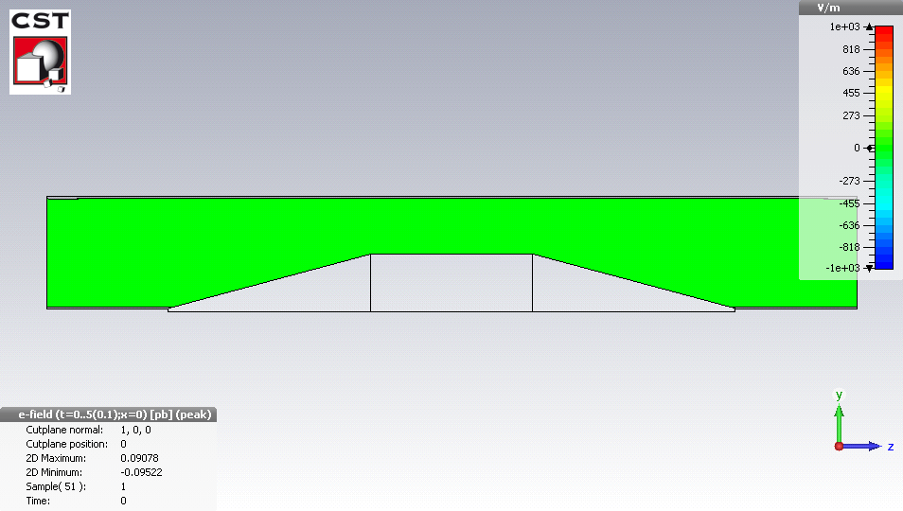
Wake fields and Impedances
Intense bunches generate electromagnetic fields when passing inside a structure (in particular Carbon collimators – opening of ~1 mm!!!)
→ results in an EM force, called wake field in time domain coupling with the beam
Avoid the abrupt transition for the beam fields at the location of the beam passage (taper)
Reduce the resistivity of the material
Abrupt transition
With taper
B. Salvant

Slide 12
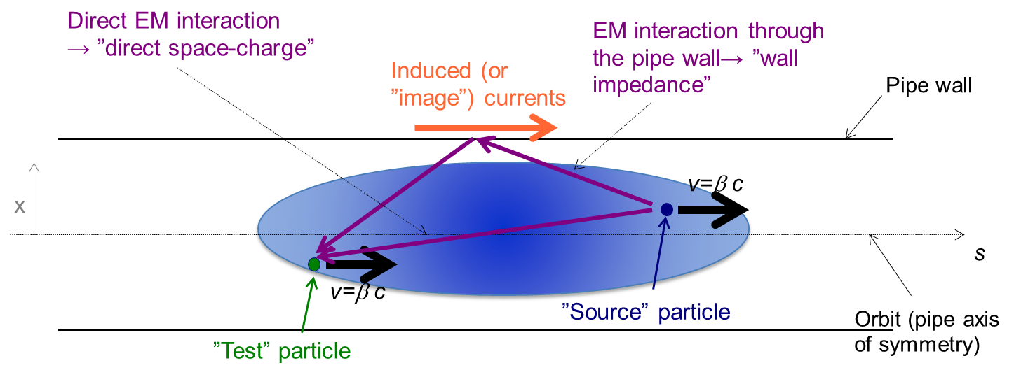
Wake fields and instabilities
Wake fields can couple the head and tail of a bunch or consecutive bunches leading to instabilities
~36 cm
~15 m
v
~1.6×10¹¹ p
s

Slide 13
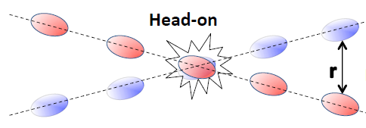
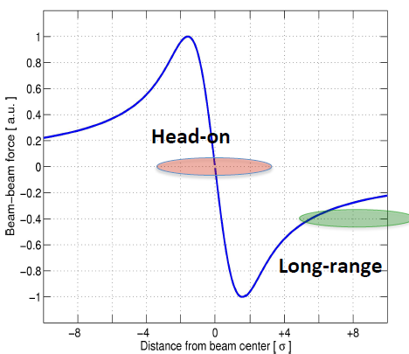
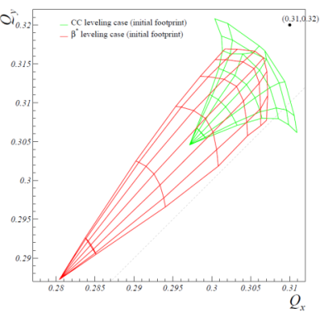

Beam-beam effects
Long-range
Strong non linear fields when counter-rotating beams share vacuum chamber.
➔ spread in betatronic frequencies ➔ risk of overlapping resonances driven by magnetic errors
Head-on
T. Pieloni
$$∆Qbb∝\frac{Nb}{εn}$$
Minimize magnetic errors ➔ Paid off for the LHC
Devise correction schemes and sorting ➔ Paid off for the LHC
Initially expected to have limit at ΔQ_{BB} ~ 0.003/IP
S. Fartoukh

Slide 14
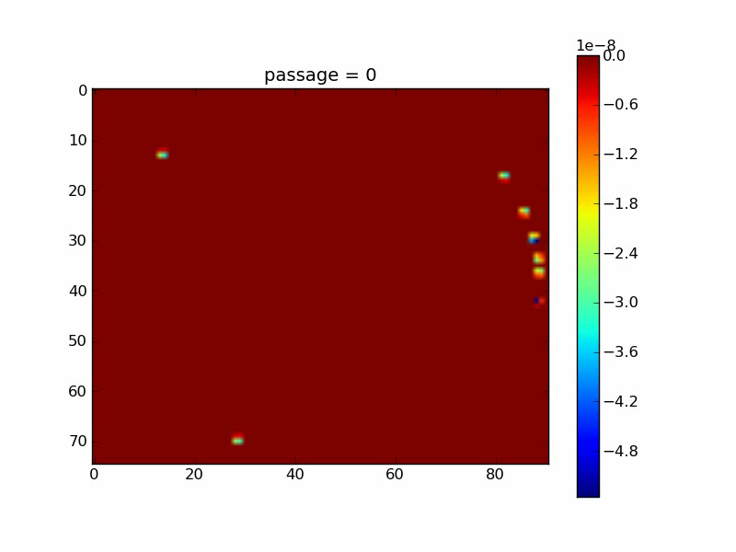
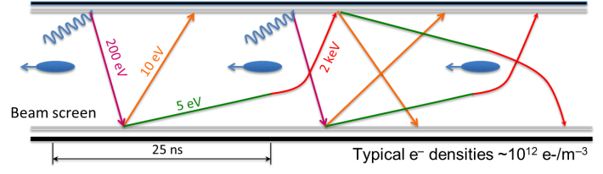
Electron cloud effects
G. Iadarola, G. Rumolo
Secondary emission yield [SEY]
SEY>SEY_{th} ➔ avalanche effect (multipacting)
SEY_{th} depends on bunch spacing and population
Possible consequences:
  instabilities, emittance growth, desorption, vacuum degradation, background
  excessive energy deposition in the cold sectors
Electron bombardment of a surface has been proven to reduce secondary electron yield (SEY) of a material as a function of the delivered electron dose. This technique, known as scrubbing, provides a mean to suppress electron cloud build-up.

Slide 15
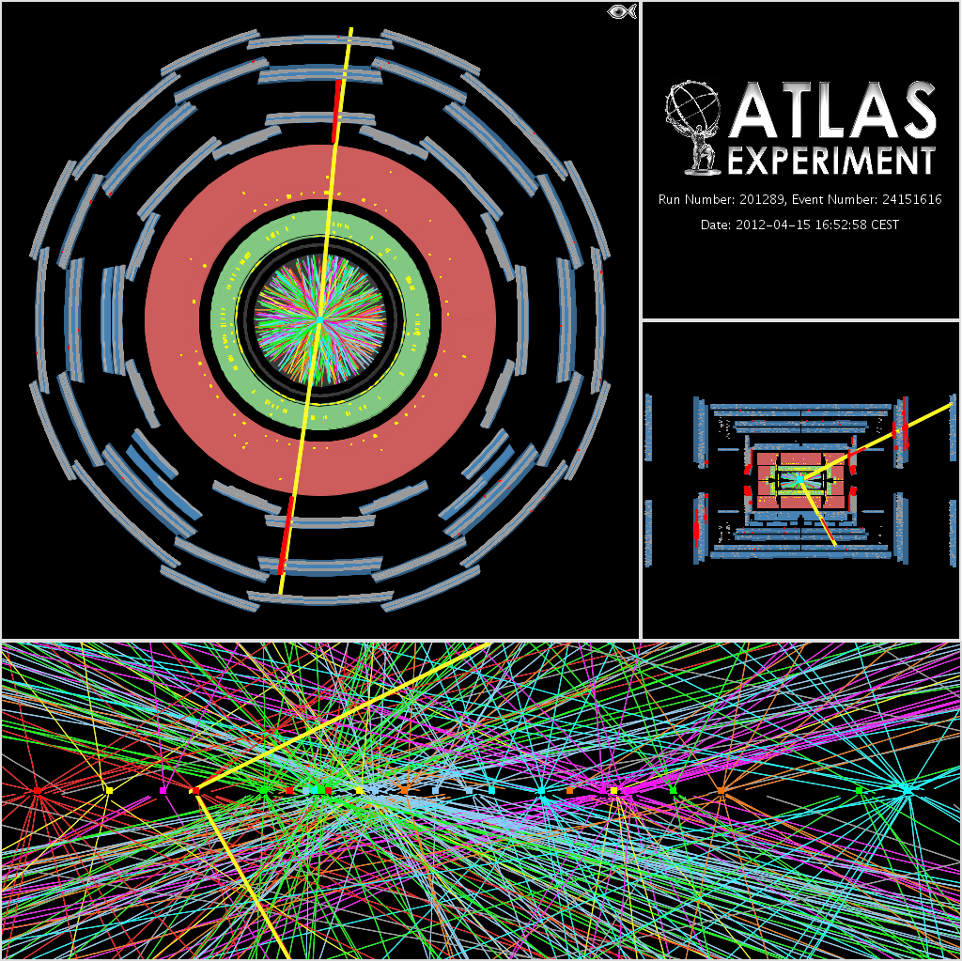
Pile-up density
25 reconstructed vertices – in a luminous region of 4.3 cm r.m.s. length
Peaks of >40 events per bunch crossing observed with luminosities in the range of 7x10³³ cm⁻²s⁻¹
That is why we are here…
Pile-up proportional to luminosity per bunch ➔ more bunches (i.e. 25 ns) is better
Z➔ μμ

Slide 16
Summary: 2010 to 2012
Parameter | 2010 | 2011 | 2012 | Nominal
Energy [TeV] | 3.5 | 3.5 | 4.0 | 7.0
N_{b} [10¹¹ p/bunch] | 1.2 | 1.45 | 1.6 | 1.15
k (no. bunches) | 368 | 1380 | 1380 | 2808
Bunch spacing [ns] | 150 | 75 / 50 | 50 | 25
Stored energy [MJ] | 25 | 112 | 140 | 362
ε∗ [μm] | 2.4 | 2.4 | 2.5 | 3.75
β* [m] | 3.5 | 1.5 → 1 | 0.6 | 0.55
Crossing angle [μrad] | 200 | 240 | 290 | 285
L [10³⁴ cm⁻²s⁻¹] | 0.02 | 0.35 | 0.76 | 1.0
Beam-beam parameter/IP (ΔQ_{bb}) | -0.0054 | -0.0065 | -0.0069 | -0.0033
Average Pile-up @ beg. of fill | 8 | 17 | 38 | 26

Slide 17
Contents
The LHC: the challenges
The next 10 years
HL-LHC: why and how?
Beyond the Upgrade: FCC-hh

Slide 18
Best performance for Run II/III (β*=40 cm)
 | N_{bcoll} [10¹¹] | ε*_{coll} [μm] | # Coll. pairs IP1,5 | B-B Sep [σ] | Full Xing angle [μrad] | L_{peak} [10³⁴ cm⁻²s⁻¹] | Max. Avg. Peak-pile-up density/Pile-up [ev./mm]/[ev./xing]
BCMS | 1.24 | 1.65 | 2592 | 12 | 295 | 2.1 | 0.46/45
Standard | 1.24 | 2.0 | 2736 | 12 | 320 | 1.8 | 0.46/45
Limited by:
  Inner triplet heat load due to collisions debris (1.7 x 10³⁴ cm⁻² s⁻¹ ± 20% )
  Pile-up (here assumed to be 45 events/crossing)
  Will need levelling
 | L_{lev} [10³⁴ cm⁻²s⁻¹] | Lev. time [h] | Opt. Fill length [h]
BCMS | 1.5 | 2.9 | 8
Standard | 1.6 | 1.7 | 8.1
Expect to produce ~45-55 fb⁻¹/year

Slide 19
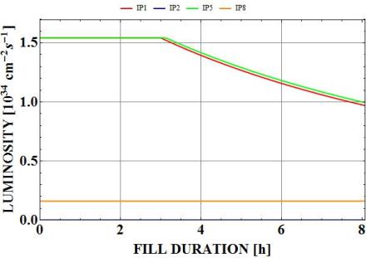
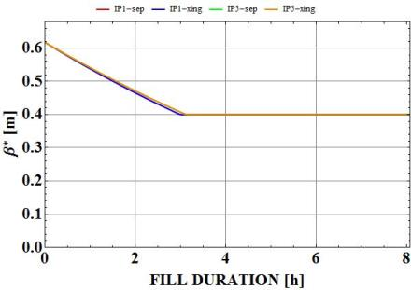
Best performance for Run II/III (β*=40 cm)
Variation of the β* during the fill (β* levelling) is the most likely technique to be applied for luminosity levelling

Slide 20
LHC Schedule beyond LS1
Physics
Shutdown
Beam commissioning
Technical stop
30 fb⁻¹
YETS
EYETS
YETS
LS 2
YETS
Run 2
Run 3
Run 2
LS 2
Run 3
YETS
LS 3
Run 4
YETS
LS 3
Run 4
300 fb⁻¹
LS 4
Run 5
LS 5
LS 4
Run 5
LS 5
(Extended) Year End Technical Stop: (E)YETS
3’000 fb⁻¹
LHC schedule approved by CERN management and LHC experiments spokespersons and technical coordinators (December 2013)

Slide 21
Contents
The LHC: the challenges
The next 10 years
HL-LHC: why and how?
Beyond the Upgrade: FCC-hh

Slide 22
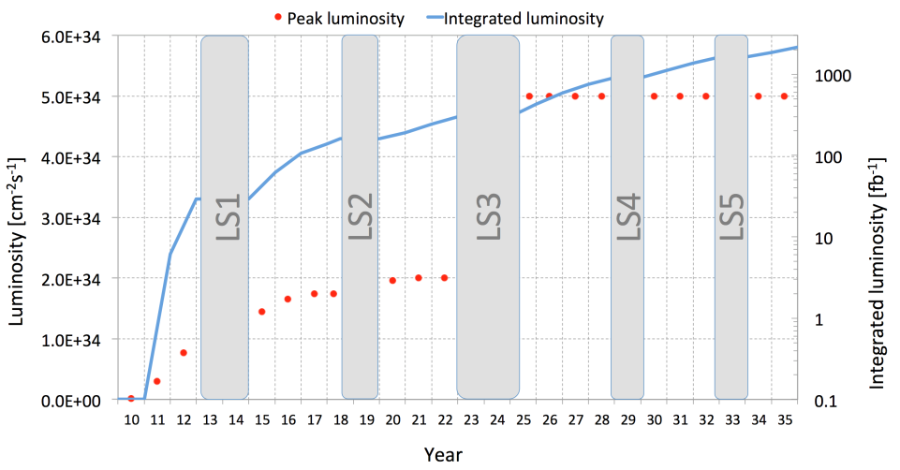
Why an LHC Upgrade?
What to do to make this jump ?
M. Lamont

Slide 23
Radiation damage to triplet
F. Cerutti, N. Mokhov, L. Esposito,…
Cold bore insulation
≈ 35 MGy
Q2
27 MGy
MCBX3 20 MGy

Slide 24
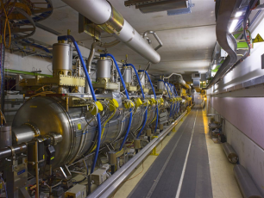
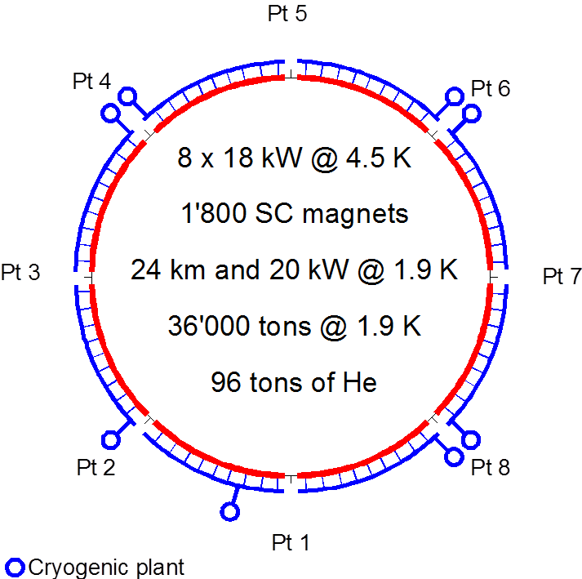
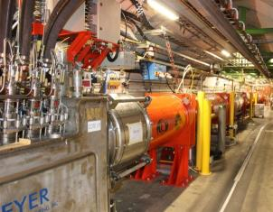
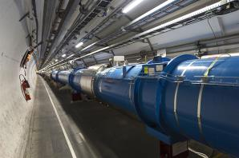
Technical bottlenecks: Cryogenics
Cryo power limitation in Pt 4, interdependency of different systems with different cool-down time, reduced flexibility and no/little redundancy
IT
IT
RF
RF
IT
IT
IT
IT
IT
IT

Slide 25
LHC Upgrade
Motivations:
  Target (very ambitious) of the upgrade: 200 – 300 fb⁻¹/y (×10 today)
  Radiation damage limit of IR quadrupoles (~400 fb⁻¹)
  Improve availability of the systems
2010-2012 experience:
  Head-on beam-beam limit higher than initially expected
  Single bunch with > 3x10¹¹ ppb with 2.5 μm emittance accelerated in the SPS
  Low β* optics successfully tested during Machine Studies
Pile-up/pile-up density HL-LHC beam physics constraint ➔ 25 ns operation:
  Electron cloud
  Total current: collimation efficiency, upper limits from: dump, vacuum, machine protection, RP, …

Slide 26
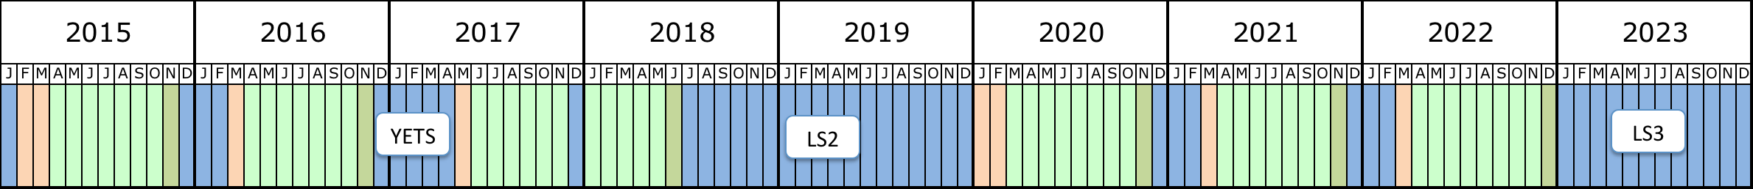
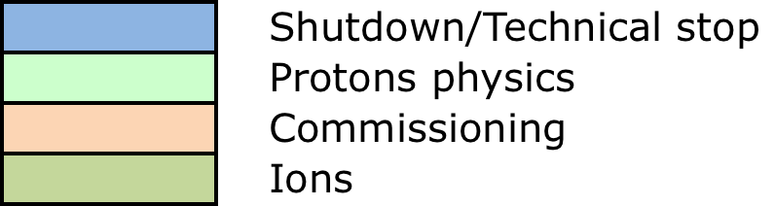
LHC and Injector Upgrade: when?
During Run II and Run III we will be limited by heat load in the triplet (luminosity debris) and pile-up at the experiments
Every 3 of 4 year a long shutdown period is planned for upgrade activities
Run II: 13 or 14 TeV c.m. with levelled luminosity of <1.7x10³⁴ cm⁻² s⁻¹
Run III: 14 TeV c.m. with levelled luminosity of <1.7x10³⁴ cm⁻² s⁻¹
~5 months
Longer end-of-year stop (CMS)
LS2: 18 months
Connection of LINAC4
LHC Injectors Upgrade
ALICE, LHCb Upgrade
LS3: 30 months
High Luminosity LHC
Machine and Experiments

Slide 27
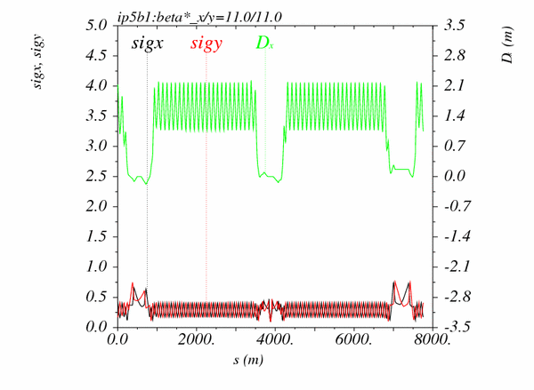
Ingredients for the Upgrade
β* [m]
IR4
IR5
IR6
ATS=Achromatic Telescopic Squeeze - S. Fartoukh
…of course it requires larger aperture triplets

Slide 28
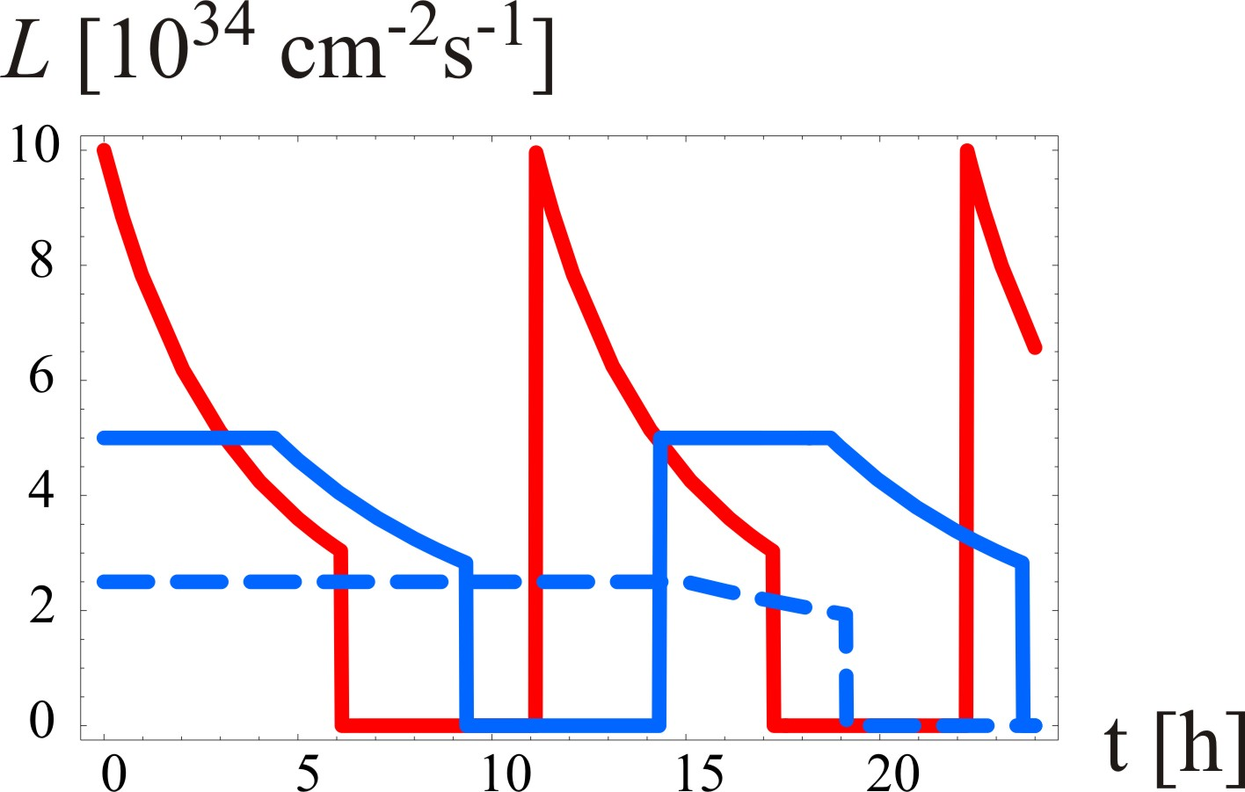
Ingredients for the Upgrade
L [10³⁴ cm⁻²s⁻¹]
Virtual peak luminosity (F=1)
leveling at
5x10³⁴cm⁻²s⁻¹
τ_{eff}=15 h, T_{ta}=5 h
leveling at
2.5x10³⁴cm⁻²s⁻¹
τ_{eff}=30 h, T_{ta}=5 h
t [h]
F. Zimmermann

Slide 29
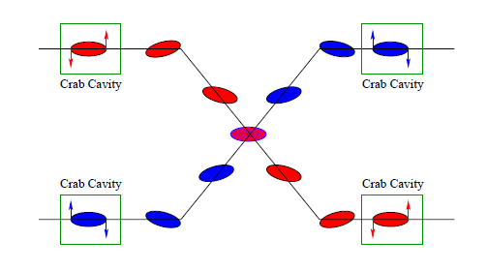
Ingredients for the Upgrade
Operation at pile-up/pile-up density limit:
  choose parameters that allow higher than design pile-up
    Low β*, Low Emittance, High Bunch population
    Crab Cavities as tool to maximize overlap among colliding bunches (i.e. virtual luminosity) and minimize pile-up density
  levelling mechanisms for controlling performance during run
    dynamic β* squeeze
    Long-range and beam-beam wire compensators to reduce crossing angle

Slide 30
HL-LHC Performance Estimates
Parameter | Nominal | 25ns – HL-LHC
Bunch population N_{b} [10¹¹] | 1.15 | 2.2
Number of bunches | 2808 | 2748
Beam current [A] | 0.58 | 1.12
Crossing angle [μrad] | 300 | 590
Beam separation [σ] | 9.9 | 12.5
β* [m] | 0.55 | 0.15
Normalized emittance ε_{n} [μm] | 3.75 | 2.5
ε_{L} [eVs] | 2.51 | 2.51
Relative energy spread [10⁻⁴] | 1.20 | 1.20
r.m.s. bunch length [m] | 0.075 | 0.075
Virtual Luminosity (w/o CC) [10³⁴ cm⁻²s⁻¹] | 1.2 (1.2) | 21.3 (7.2)
Max. Luminosity [10³⁴ cm⁻²s⁻¹] | 1 | 5.1
Levelled Pile-up/Pile-up density [evt. / evt./mm] | 26/0.2 | 140/1.25
Aim for ~250 fb⁻¹/y
ΔQ_{bb} ~ -0.01
Notes:
50ns beam option provides HL-LHC performance levels at ultimate total beam currents; only the ‘large beta*’ option reaches beam-beam limit; IBS growth rates are a concern!; low beta option has 50% higher performance potential

Slide 31
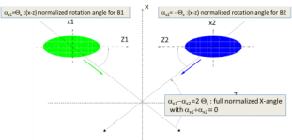

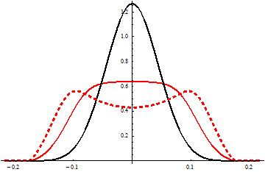
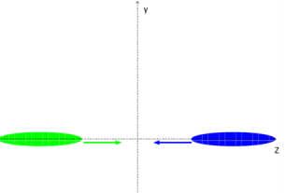
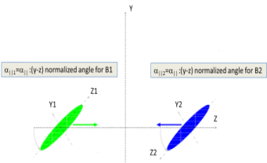

Pile-up density control
S. Fartoukh
Crab-kissing:
CC also in ||-plane
Baseline: CC in X-plane “only”
$\frac{∂μ}{∂z}$ [mm⁻¹]
z [m]
... Work on-going together with the experiments
(S. Fartoukh, A. Valishev, A. Ball, B. Di Girolamo, et al.)

Slide 32

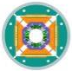

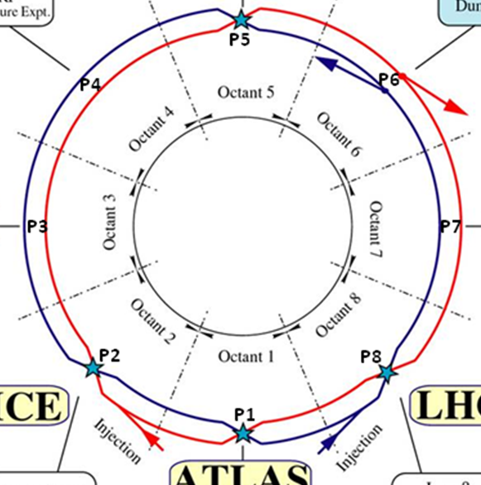




Hardware for the Upgrade
Main modifications:
  New high field/larger aperture interaction region magnets
  Cryo-collimators and high field 11 T dipoles in dispersion suppressors
  Crab Cavities to take advantage of the small β*
  New collimators (lower impedance)
  Additional cryo plants (P1, P4, P5)
  SC links to allow power converters to be moved to surface

Slide 33
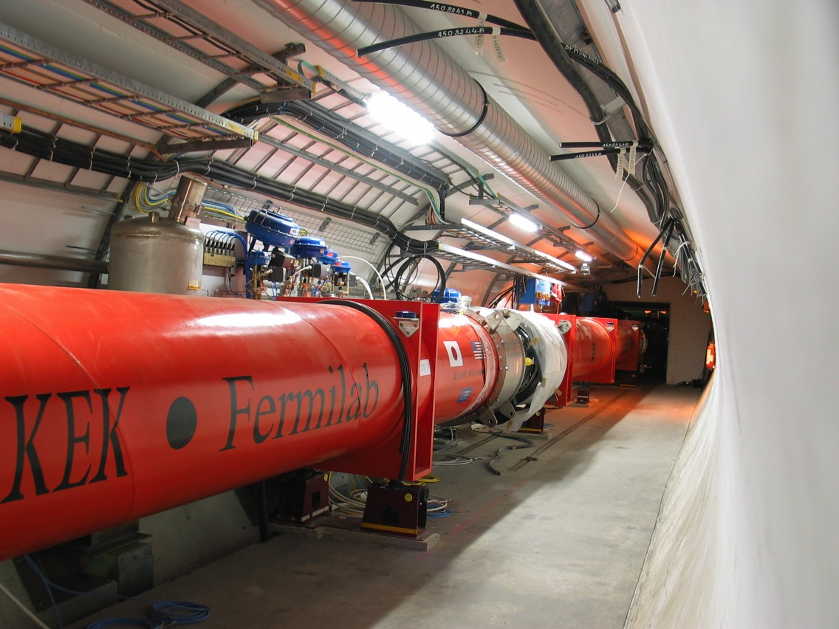
Triplet Area ATLAS/CMS
IP
LHC
Bore aperture : 70 → 150 mm.
Gain 3-4 in beam area (β* = 15 cm).
HL-LHC
LHC point 5

Slide 34
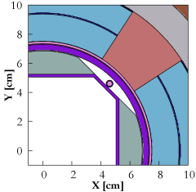
Shielding against Radiation Damage
Tungsten shielding on the beam screen 16 mm in Q1 and 6 mm elsewhere
More than 600 W in the cold masses as well as in the beam screen (i.e. 1.2-1.3 kW in total)!! ➔ Cryogenics
Expect same integrated radiation dose in HL-LHC after 3000 fb⁻¹ as in LHC after 300 fb⁻¹!!
F. Cerutti, L. Esposito

Slide 35

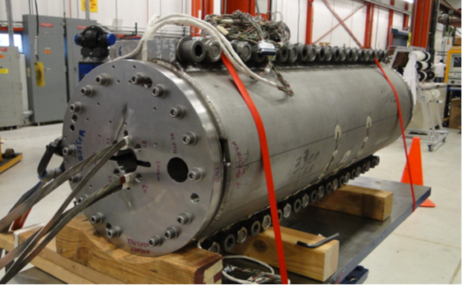
High field dipoles / Cryo collimators
15 m
NbTi 8.3 T
Same deflection !
FNAL prototype MBHSP02
reached 11 T in May 2013
Nb₃Sn 11 T
Collimator
The goal is to develop a 10 m long 11.2 T Nb₃Sn dipole to replace a standard LHC dipole and provide space for collimators downstream of the straight sections.

Slide 36
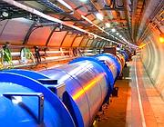
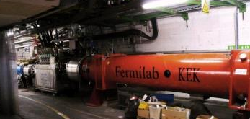
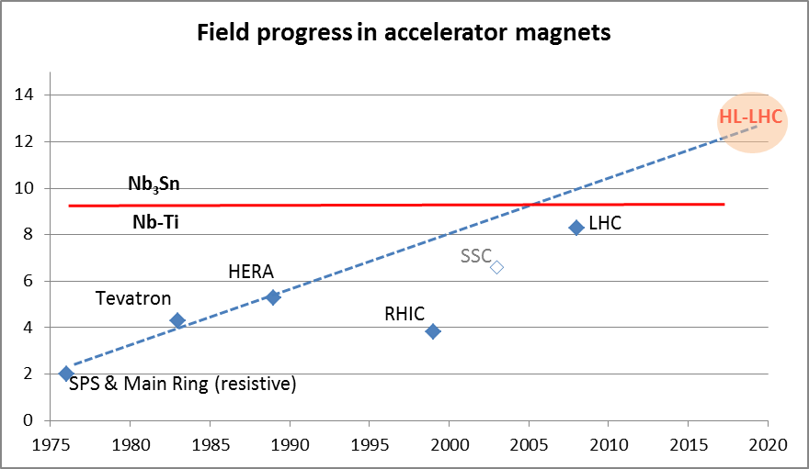
Magnet technology challenges
LHC dipoles feature 8.3 T in 56 mm (designed for 9.3 peak field)
LHC IT Quads features 205 T/m in 70 mm with 8 T peak field
HL-LHC:
  11 T dipole (designed for 12.3 T peak field, 60 mm)
  New IT Quads features 140 T/m in 150 mm > 12 T operational field, designed for 13.5 T).

Slide 37
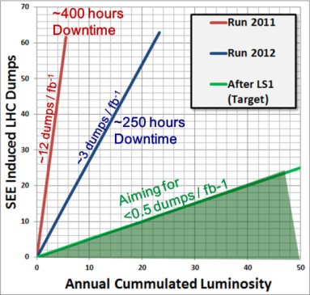
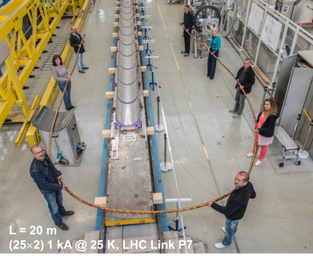
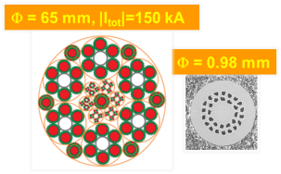
Radiation to Electronics (R2E)
R2E consolidation during LS1 not sufficient for the HL-LHC era (~2 fb-1/ day) ➔ 1 dump/day due to SEU
PC far from tunnel ➔ SC links (HTS)
QPS systems out of the tunnel
A. Ballarino
M. Brügger

Slide 38
Crab cavities: from drawings to reality…
LARP-BNL
LARP-ODU-JLAB
UniLancaster-CI-CERN

Slide 39
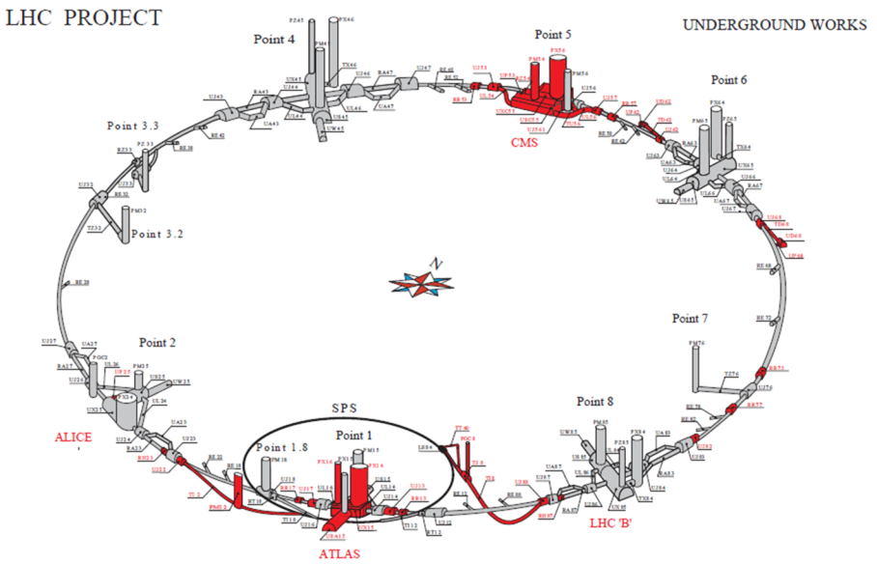
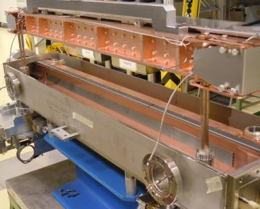
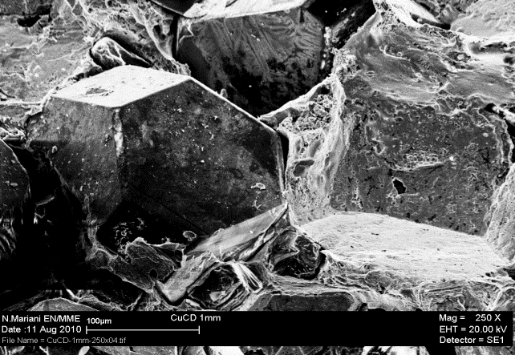
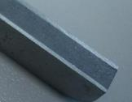
Low impedence collimators
New material: MoGr
S. Redaelli, A. Bertarelli

Slide 40
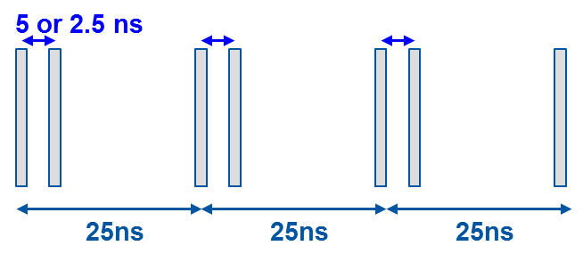
Electron cloud
Strategy for the arcs (to be validated in 2015):
  enhance electron cloud at 450 GeV to remove e-cloud in the dipoles “completely” with dedicated scrubbing
  Use of “doublet beam” to enhance scrubbing
  Need to leave with e-cloud in the quadrupoles (sufficient cryo-margin for that)
Strategy for the Insertion regions:
  Coat the beam screen of all new elements (triplets in particular) with materials with low SEY (amorphous Carbon) and install clearing electrodes

Slide 41
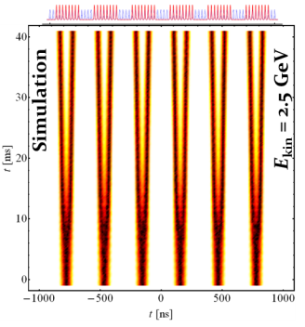
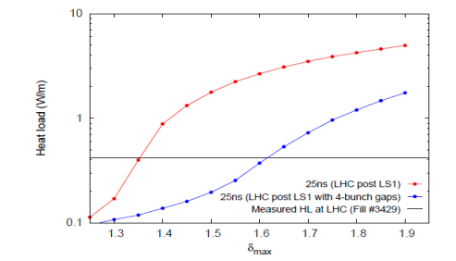
Electron cloud
Back-up scenario:
  Detrimental e-cloud effects can be mitigated by using specially conceived filling patterns: bunch trains with long enough gaps interspersed
  Reduction of the number of bunches and of colliding pairs by 25% ➔ corresponding reduction in luminosity
H. Damerau

Slide 42
Contents
The LHC: the challenges
The next 10 years
HL-LHC: why and how?
Beyond the Upgrade: FCC-hh

Slide 43

FCC Study Scope
CDR and cost review for the next European Strategy Update in 2018:
  pp-collider (FCC-hh): defining infrastructure requirements
    ~16 T ➔ 100 TeV pp in 100 km
    ~20 T ➔ 100 TeV pp in 80 km
  e⁺e⁻ collider (FCC-ee) as potential intermediate step
  p-e collider (FCC-he) option
80-100 km infrastructure in Geneva area

Slide 44
Main FCC-hh parameters
 | LHC (Design) | HL-LHC | FCC-hh
Main parameters and geometrical aspects
C.o.M. Energy [TeV] | 14 |  | 100
Circumference C [km] | 26.7 |  | 100 (83)
Dipole field [T] | 8.33 |  | 16 (20)
Straight sections | 8 |  | 12
Number of IPs | 2 HL + 2 LL |  | 2 HL + 2 LL
Injection energy [TeV] | 0.45 |  | 3.3
Physics performance and beam parameters
Peak luminosity [10³⁴ cm⁻²s⁻¹] | 1.0 | 5.0 (lev.) | 5.0
Pile-up (25 ns/5 ns) [evts./crossing] | 27 | 140 (lev.) | 171/34
Two main experiments sharing the beam-beam tuneshift
  Two reserve experimental areas not contributing to tuneshift
Currently assume 25ns as baseline

Slide 45
FCC-hh beam parameters
 | LHC (Design) | HL-LHC | FCC-hh (100/83)
Beam parameters
Number of bunches k (25 ns/5 ns) | 2808 | 2748 | 10600 (8900) / 53000 (44500)
N_{b} [10¹¹] | 1.15 | 2.2 | 1.0/0.2
ε* (25 ns/5ns) [μm] | 3.75 | 2.5 | 2.2/0.44
Maximum total b-b tune shift ΔQ_{bb}/IP | -0.003 | -0.01 | -0.005
Beam current [A] | 0.584 | 1.12 | 0.5
RMS bunch length [cm] | 7.55 |  | 8 (7.55)
β* [m] | 0.55 | 0.15 | 1.1
RMS IP spot size (25 ns/5ns) [μm] | 16.7 | 7.1 (min) | 6.8/3
Full crossing angle [μrad] | 285 | 590 | 74/ n/a
Rather conservative parameters as compared to HL-LHC

Slide 46
FCC-hh: Other parameters
 | LHC (Design) | HL-LHC | FCC-hh (100/83)
Stored Energy/beam [GJ] | 0.36 | 0.68 | 8.4
Arc SR heat load [W/m/aperture] | 0.17 | 0.33 | 28.4 (44.3)
Energy loss per turn [MeV] | 0.0067 |  | 4.6 (5.86)
Critical photon energy [keV] | 0.044 |  | 4.3 (5.5)
Total synchr. Power [MW] | 0.0072 | 0.0146 | 4.8 (5.8)
Long. emittance damping time [h] | 12.9 |  | 0.54 (0.32)
Hor. emittance damping time [h] | 25.8 |  | 1.08 (0.64)
Dipole coil aperture [mm] | 56 |  | 40
Huge beam (and magnetic) stored energy!!!!
Synchrotron radiation!!!
Half – way between a hadron and lepton machine

Slide 47
FCC-hh Challenges: Magnets
FCC-hh baseline 16T Nb₃Sn technology for 100 TeV in 100 km
  Develop Nb₃Sn-based 16 T dipole technology
    with sufficient aperture (~40 mm) and
    accelerator features (field quality, protectability, cycled operation) ➔ Nb₃Sn magnets in the LHC (HL-LHC 11 T dipoles)
    In parallel conductor developments
  Possible goal:
    16T short dipole models by 2018 (America, Asia, Europe)
  In parallel HTS development targeting 20 T:
    HTS insert, generating O(5 T) additional field
    in large aperture O(100 mm, 15 T)
  Possible goal:
    demonstrate HTS/LTS 20 T technology in two steps
    a field record attempt to break the 20 T barrier (no aperture), and
    a 5 T insert, with sufficient aperture (40 mm) and accel. features

Slide 48
FCC-hh Challenges
Energy in beam & magnets ➔ dump, collimation, quench protection
  Stored beam energy > 20 x LHC
  Beam losses, radiation effects ➔ collimation, shielding
High synchrotron radiation load on beam pipe
  Up to 26 W/m/aperture in arcs, total of ~5 MW for FCC-hh
  Heat extraction: photon stop, beam screen design, cryo load,
Synchrotron radiation damping
  controlled blow up, luminosity levelling, etc…
Impedances, instabilities, feedbacks
  Beam-beam, e-cloud, resistive wall, feedback systems design
Optics and beam dynamics
  IR design, dynamic aperture studies, SC magnet field quality

Slide 49
Concluding remarks
The progress in the performance of the LHC has been so far breath-taking
  Some of the (beam dynamics) challenges that had to be faced have been outlined
  With run II we will explore high energies and operation with 25 ns (all but trivial). Aim for 300 fb⁻¹ by the end of Run III
Luminosity performance and choices for the upgrade are now constrained by the acceptable detector pile-up/pile-up density
  To reach 3000 fb⁻¹ by ~2035 we are pushing even further the above challenges…
  Several Technologies/Techniques are being developed to provide margin for the achievement of these challenging parameters
We start to look at the future beyond HL-LHC (it is time to do it to be ready…)

Slide 51
Very First Ion Considerations
 | Unit | LHC Design | FCC-hh | FCC-hh
Operation mode | - | Pb-Pb | Pb-Pb | p-Pb
Number of bunches |  | 592 | 432 | 432
Part. P. bunch | [10⁸] | 0.7 | 1.4 | 115(1.4)/1.4
β-function at the IP | [m] | 0.5 | 1.1 | 1.1
RMS beam size at IP | [] | 15.9 | 8.8 | 8.8
Initial luminosity | [10²⁷cm⁻²s⁻¹] | 1 | 3.2 | 267(3.2)
Peak luminosity | [10²⁷cm⁻²s⁻¹] | 1 | 12.7 | 5477(3356)
Integr. lumi. per fill | [μb⁻¹] | <15 | 83 | 30240
Total cross-section | [b] | 515 | 597 | 2
Initial luminosity lifetime | [h] | <5.6 | 3.7 | 3.2 (10.6)
Much more work to be done: Improved injectors, integration into interaction region, …

Slide 52
Cures for electron cloud effects
At the time of the construction of the LHC:
  NEG coating ➔ would require activation to >200 ºC ➔ impractical
  Conditioning by beam-induced electron bombardment (“scrubbing”) leading to a progressive reduction of the SEY as a function of the accumulated electron dose ➔ tested in the laboratory (on Cu surfaces) and in the SPS (Stainless Steel vacuum chambers) ➔ Chosen strategy for the LHC operation with bunch trains – but it takes time!! (in particular for 25 ns operation)
More recently a-C coating has been successfully tested in the SPS showing SEY as low as 1.1 ➔ possible implementation for HL-LHC (interaction regions)

Slide 53
Issues: electron cloud
2012 Experience:
  Scrubbing lowers SEY below SEY_{th} (~1.45) at injection in the dipoles
  Not in quadrupoles (due to a significantly lower SEY_{th} ~1.2)
  Despite 2-beam-50 ns operation in triplet for ~ 2 years, e-cloud still present in triplets, due to the presence of the two counter-rotating beams
Significant increase of heat load (~ factor 4) in the arcs during ramp:
  From e-cloud in the dipoles due to reduction of beam size/bunch length at the beginning of the ramp (SEYth decreasing to <1.4).
  No change in quadrupoles, always above threshold

Slide 54

Issues: “Unidentified Falling Objects” (UFO)
Very fast and localized beam losses observed as soon as the LHC intensity was increased.
Traced back to dust particles falling into the beam – ‘UFO’.
If the losses are too high, the beams are dumped to avoid a magnet quench.
  ~20 beams dumped / year due to UFOs.
100µm
10µm
In one accelerator component UFOs were traced to Aluminum oxide particles.

Slide 55
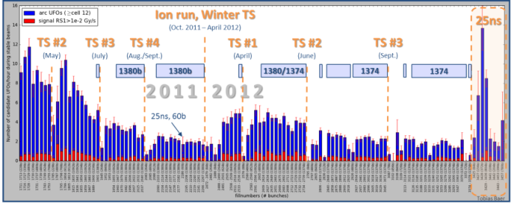
Issues: UFOs
Extrapolation to 7 TeV: ~100 beam dumps from UFOs
UFO rate depends on bunch spacing, stronger with 25 ns.
  fast conditioning observed over a few fills in 2012
  We have to expect serious deconditioning after LS1.
Quench tests: quench limits likely too pessimistic (x 2) at 4 TeV for UFO timescales.
T. Bär

Slide 56


Beam-Beam long range compensator (BBC)
R. Steinhagen
Initial proposal in 2001 (J.-P. Koutchouk)
Proof-of-principle requires BBLR prototype into machine well before HL-LHC
Operation close to MP envelope:
  Need to embed wire in collimator jaw type structure
Wire parameters:
  Solid wire radius of ~1mm → 1kW power dissipation
  sub-σ level of hor./ver. position control

Slide 57



Beam-Beam Long Range Compensator (BBC)
Can re-use nearly 100% of existing TCTP design (with BPMs).
Remaining challenge: finding space for the wire current feed-through amongst the cooling circuits and BPM button feedthroughs.
Aiming for installation during 2015-16 Technical Stop
S. Redaelli
Notes:
Timescale: installation of infrastructure and installation after LS1 (Stefano?)
Technical stop 2015-16

