Slide 1
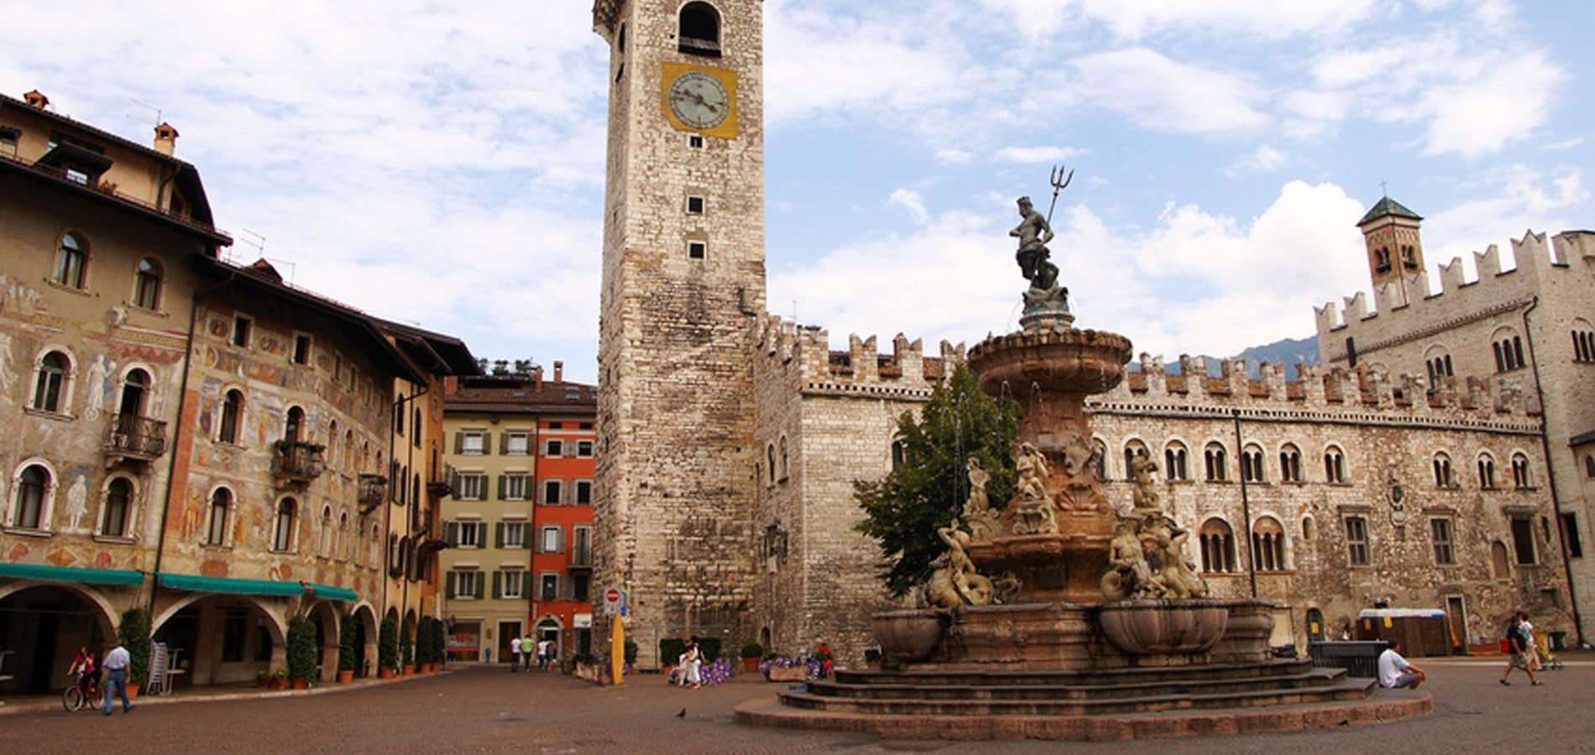
The evolution of the computing infrastructure to cope with technology innovation and future experiments needs
G. Carlino – INFN Napoli
The evolution of the Computing Models
The role of network and cloud computing
The present Italian Computing Infrastructure
A new model of Computing Infrastructure in Europe
The evolution in Italy

Slide 2
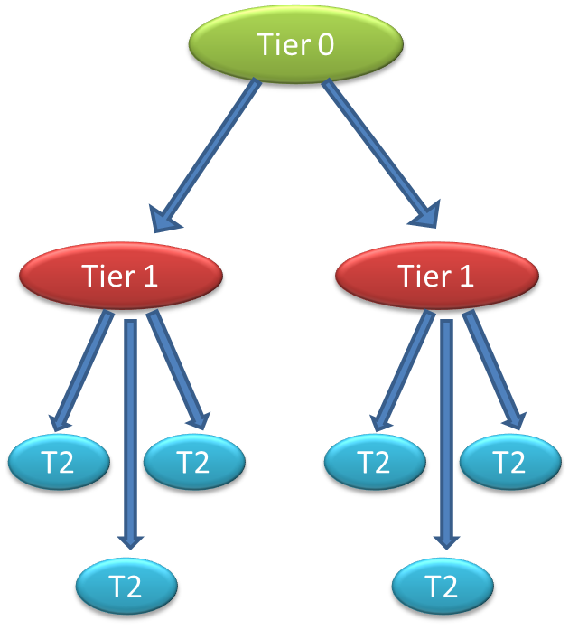
A bit of history - Monarc and LHC GRID
In 1998 MONARC project defined tiered architecture deployed later as LHC Computing Grid
a distributed model
Integrate existing centres, department clusters, recognising that funding is easier if the equipment is installed at home
local physics groups have more influence over how
local resources are used, how the service evolves
a multi-Tier model
Static strict hierarchy. Multi-hop data flows
Network costs favour regional data access. Lesser demands on Tier2 networking
Static data pre-placement
Hierarchy in data placement.
Data flow via the hierarchy

Slide 3
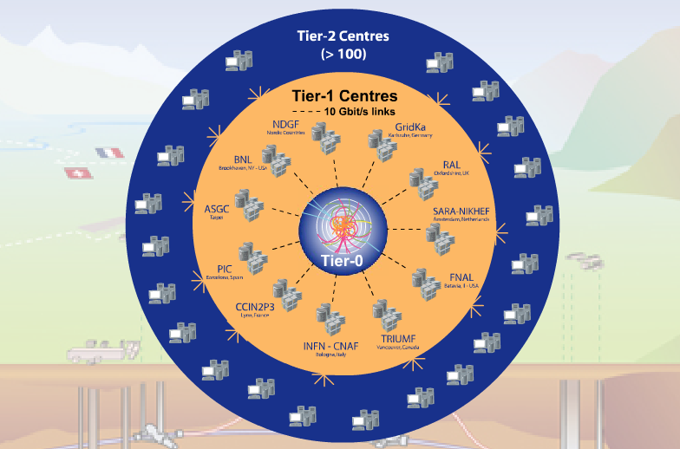
The LHC WLCG Tier Model
WLCG is a distributed computing infrastructure to provide the production and analysis environments for the LHC experiments. More than 200 centres in ~40 countries
Tier-0 (CERN): (15%)
Data recording
Initial data reconstruction
Data distribution
Tier-1 (11 centres): (40%)
Permanent storage
Re-processing
Analysis
Connected by direct 10 Gb/s network links
Tier-2 (~200 centres): (45%)
Simulation
End-user analysis
CERN15%
Tier-2s
45%
Tier-1s 40%

Slide 4
WLCG related projects
Many projects have been funded by the European Community in order to build the LHC computing infrastructure.
HEP has been the major community even if other scientific communities were involved
The EGI Projects (European Grid Infrastructure), based on NGI e-infrastructure), ends April 2014
HEP can’t play a major role in the coming H2020 IT calls.

Slide 5
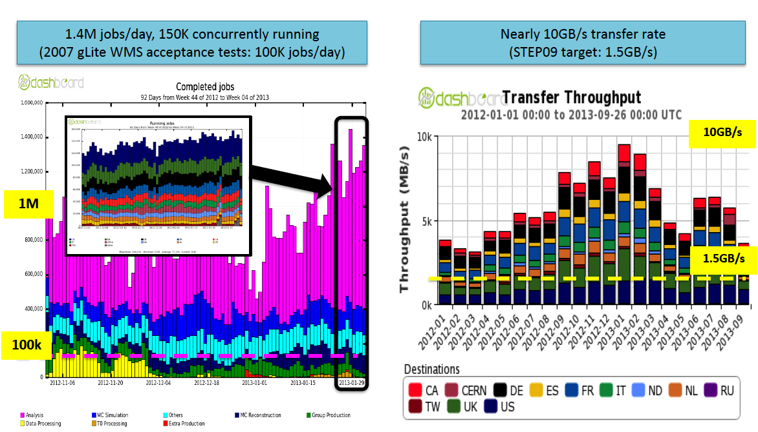
The Evolution of the CMs
CM are not static. Continuous evolution
since the beginning of the data taking, the “ideal” CMs have been replaced by realistic ones exploiting the technology and infrastructure improvements
In Run-1 the LHC experiments have been able to cope with an unforeseen amount of data transferred and analysed

Slide 6
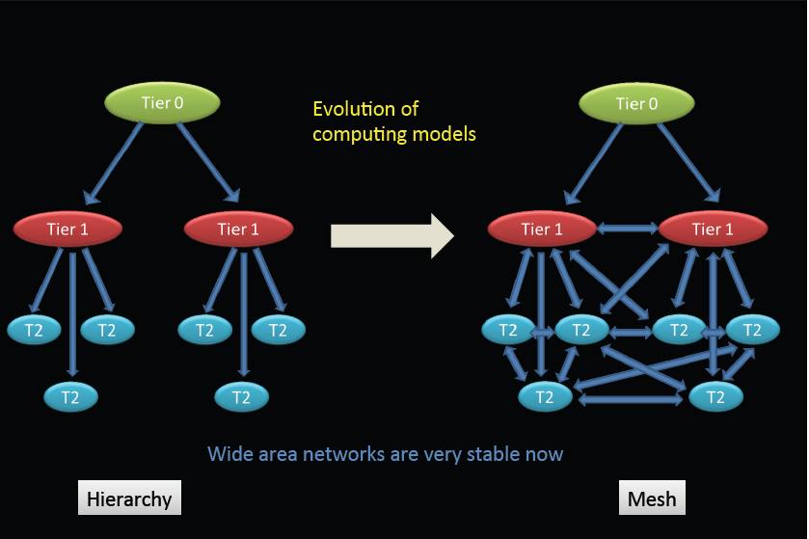
Evolution in Networking
Network is as important as site infrastructure:
Key point to optimize storage usage and jobs brokering to sites
At the beginning network was the bottleneck. The hierarchical model was based on the assumption of a rather limited connectivity between computing centres. Only links between well connected sites (Tier0 and Tier1s) were dedicated to cover fundamental roles.
Network capacity improved very fast
WAN is very stable and performance is good
It allows to relax MONARC model: migration from hierarchy to full mesh model: sites are all directly interconnected and independent of the Tier1s
Data management based on popularity concept
Dynamic storage usage
Reduction of data replicas. Only data really needed is sent (and cached)
Network awareness
Workload management systems and data transfers will use networking status/performance metrics to send jobs/data to sites
It’s much cheaper to transport data than to store it

Slide 7
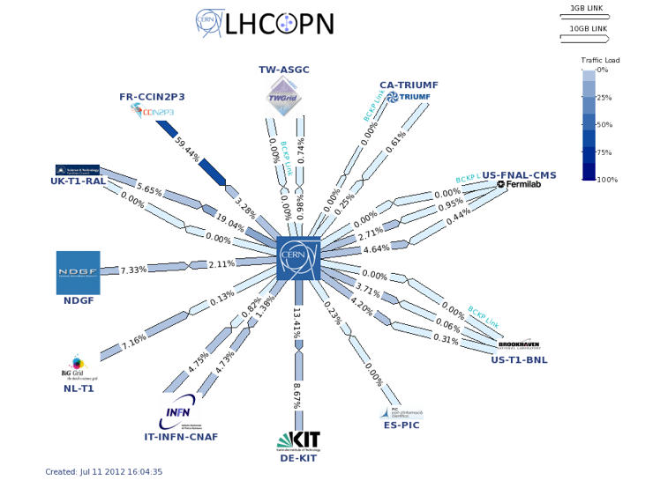
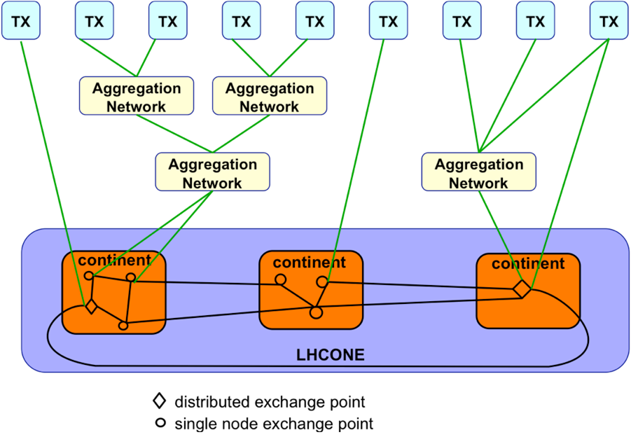
The LHC backbone
LHCOPN
LHCOPN collaboration with CERN & GEANT
Private, closed, infrastructure with primary purpose to provide dedicated connectivity between Tier0 and Tier1s.
13 Tier1s connected directly to CERN
Capacity used also for Tier1-Tier1 traffic, via CERN or additional links, and transit to Tier0 via other Tier1s
LHCONE an initiative for Tier2 Network
Network providers, jointly working with the experiments, have proposed a new network model for supporting the LHC experiments, known as the LHC Open Network Environment (LHCONE)
LHCONE is a reserved network to LHC Tier1/2/3 sites, the goal is to provide some guarantees performance protecting the infrastructures against potential “threats” of very large data flows
Private IP overlays on NRENs, GEANT, ESnet, Internet2 interconnected via Open Exchanges
LHCONE will complement LHCOPN.
LHC Open Network Environment

Slide 8
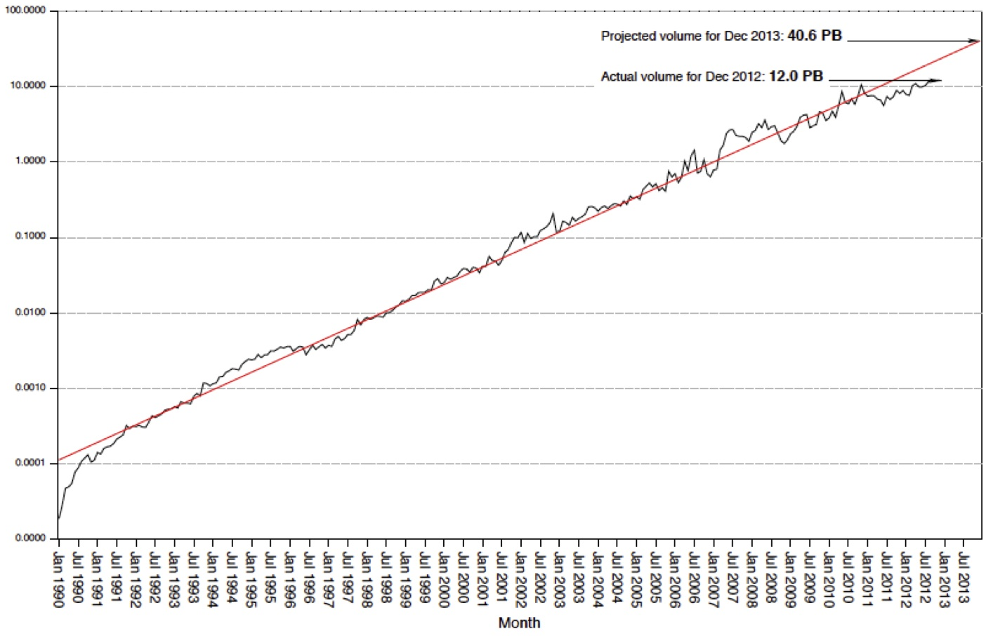
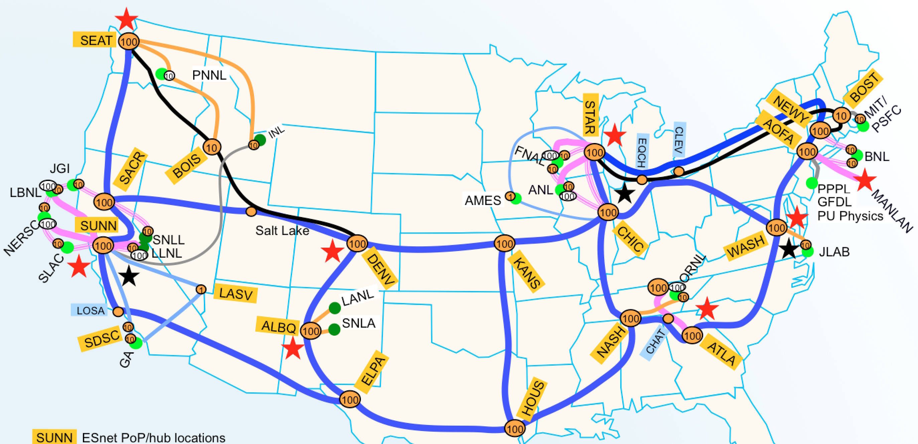
Network growth
US ESnet as an example: log plot of monthly accepted traffic 1990-2013
10x every ~ 4.3 years for 20+ years
Projection to 2016: 100 PBy/month
Actual Nov 2013
100 PB
10 PB
1 PB
100 TB
10 TB
1 TB
100 GB
17.2 PBy/mo
ESnet March 2013
Bytes/month transferred
Exponential fit
The Energy Sciences Network (ESnet) is a high-performance network built to support scientific research funded by DOE. ESnet provides services to more than 40 DOE research sites, including the entire National Laboratory system, its supercomputing facilities, and its major scientific instruments
W. Johnston, G. Bell

Slide 9
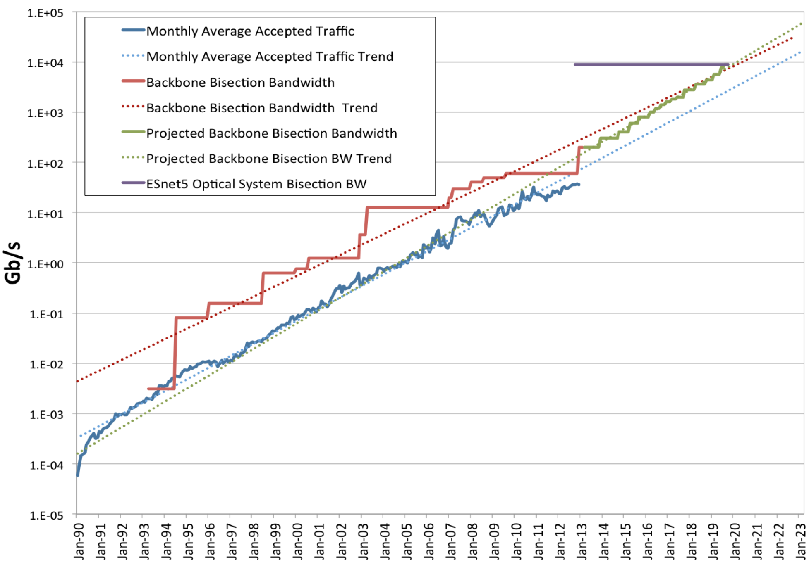
Traffic vs Backbone capacity
ESnet planned capacity growth sustains the traffic trend: projection to 2020 sustains the 10x every ~4 years growth
100 TB/s
10 TB/s
1 TB/s
100 GB/s
10 GB/s
1 GB/s
100 MB/s
10 MB/s
10 TB/s
Greg Bell: ESnet History
+ Projected Roadmap

Slide 10
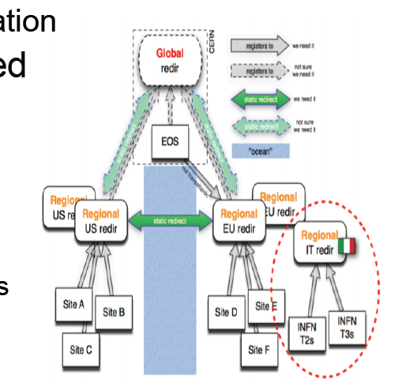
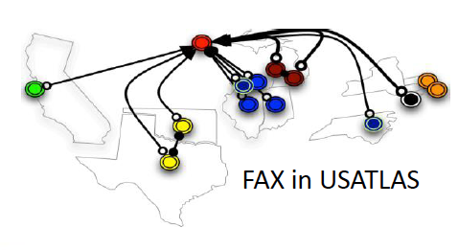
Storage Federation
How to exploit such a performing network?
Remote access via WAN is a reality: Storage Federation
The LHC experiments are deploying federated storage infrastructures based on xrootd or http protocols
Provide new access modes & redundancy
Jobs access data on shared storage resources via WAN
Relaxes CPU-data locality opening up regional storage models: from ”jobs-go-to-data” to “jobs-go-as-close-as-possible-to-data"
Failover capability for local storage problems
Dynamic data caching based on access
A data solution for computing sites without
storage: opportunistic, cloud, Tier3
Disk can be concentrated only in large sites
Reduction of operational load at sites
Lower disk storage demands

Slide 11
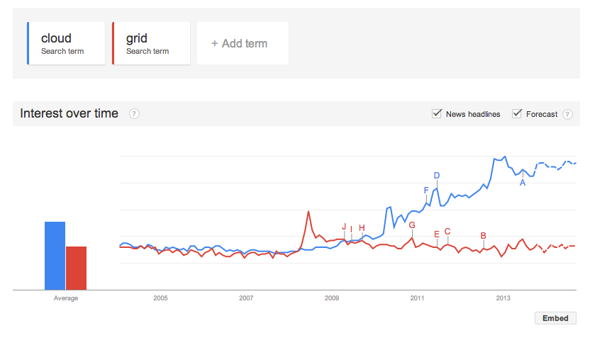
Grid to Cloud
The transition from Grid to Cloud (and virtualization) is also leading to an important infrastructural change and a new way for the procurement of the resources
Cloud is not a revolution
Associated to virtualization in computing, storage and network (concepts non really new in IT)
General-purpose infrastructure, used to give people uniformity and transparency in using the resources
Same aim of the Grid, but much easier: access to the cloud in less complex

Slide 12
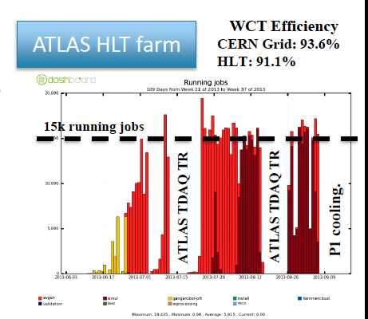
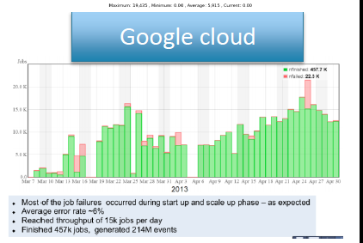
Grid to Cloud
New way for the procurement of the resources
Through an established interface can be accessed
Free opportunistic cloud resources
HLT farms accessible through cloud interface during shutdowns or LHC inter-fill (LHCb since early 2013, ~20% of their resources in 2013)
Academic facilities
Cheap (?) opportunistic cloud resources
Commercial cloud infrastructure (Amazon EC2, Google): good deal but under restrictive conditions
about 450k production jobs from Google over few weeks

Slide 13
Grid to Cloud
From the infrastructure administration point of view, administration of cloud sites is easier than traditional grid centres.
Load from sites to central services:
All the experiment software delivered by central services to sites
Servers configurations supplied as images directly from central experiment support
Very few services still at the level of the site
Not a solution for everything (so far at least): not yet addressing completely the needs of I/O intensive tasks from the storage point of view
GRID is still the baseline, anyway Network & Cloud are pushing towards a simplification of the computing infrastructures

Slide 14
Distributed Tier2s
Exploiting the potentiality of the Cloud and the Network
A feasibility study: NA and RM1 ATLAS Tier2s are experimenting a distributed Tier2 environment on dedicated VLAN segment over WAN
Dedicated VLAN (courtesy of GARR)
1 Gbps shared connection between the two sites
Latency < 4ms (should be enough)
Isolated traffic
Replicated storage (glusterFS-based)
OpenStack Cloud infrastructure to provide services in HA mode
Where may this experience lead?
The aim is at providing an High-Available, single entry point multi-site
Centralization (and simplification) of the sites administration
Extensions to other sites, extending the Cloud infrastructure and network

Slide 15
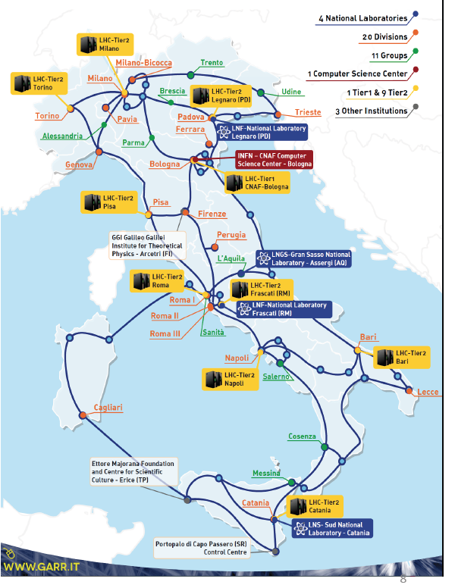
The INFN Computing Infrastructure
The INFN Distributed Computing Infrastructure is composed of:
1 Tier1 at CNAF
10 Tier2s serving the 4 LHC experiments
LHC Tier3s in almost all groups
many experiment farms in all the universities
Network connection provided by GARR (GARR-X):
10 Gbps WAN connection for all the Tier2s
CNAF 3x10 Gbps WAN connection
100 Gbps transition starting from south sites

Slide 16
ReCaS
Not only Tier1/2/3 sites, many centres are growing thanks to external funding:
ReCaS is a project funded by MIUR under the PON 2007-2013
The goal is to create or strengthen grid/cloud infrastructures in four sites: BA, CS, CT, NA (three of them already hosting a Tier2)
Three institutions involved:
INFN
Federico II University (NA)
Aldo Moro University (BA)
INFN resources mainly dedicated to LHC but also:
Other HEP experiments (Belle2, Km3net)
Other sciences (engineering, chemistry, biology)
Industries and non-scientific users
Good example of multidisciplinarity (not only HEP) and regionalization of the computing centres

Slide 17
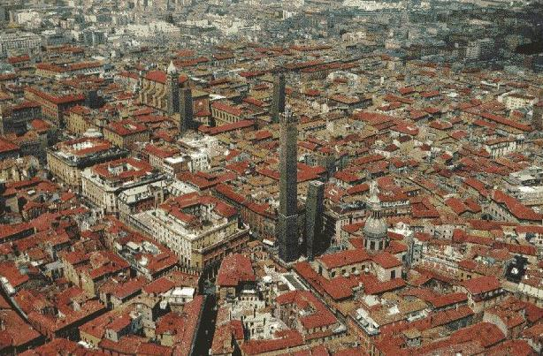
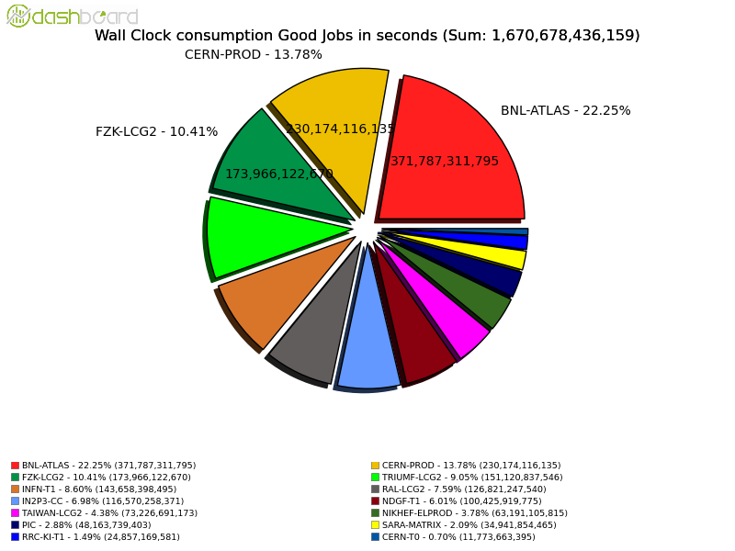
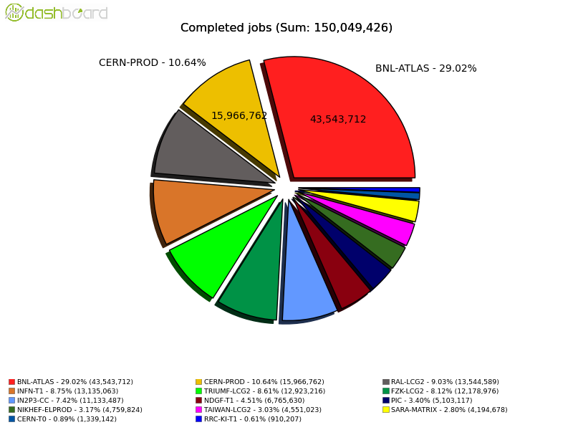
The INFN Tier1 @ CNAF
Main Italian computing centre for LHC experiments and several others:
Particles: Kloe, LHCf, Babar, CDF, Belle2
Astroparticles: ARGO, AMS, PAMELA, MAGIC, Auger, Fermi/GLAST, Xenon ….
Neutrino: Icarus, Borexino, Gerda
Gravitation: Virgo
Bologna/CNAF
Available resources: ~140 kHS06, ~13 PB of disk, ~16 PB of tape
Important contribution to LHC activities (ATLAS from 1/1/2013 to 3/8/2014 )
INFN-T1 – 8.75%
INFN-T1 – 8.60%

Slide 18
The Tier2s
Global amount of resources: ~125 kHS06 CPU and ~10 PB disk
Is the current computing infrastructure performing well satisfying the experiment needs and the WLCG requirement?
Tier2 Review held in January
Outcome:
All the sites are well integrated in the experiment activities providing the pledged resources and supporting the Italian activities
Good or excellent performance
Good synergy with the Universities
The current distributed infrastructure model, based on medium-small sites hosted in Universities and run by local groups (experiments and IT experts together), has proven to fulfil the requirements (even more than expected) and not to be too expensive for INFN.
Moreover, it has allowed the growth and dissemination of computing expertise in all the groups and the creation of a strong link with the analysis activities

Slide 19
Evolution of the Computing Infrastructure
But …
The future will be different, an evolution in the computing infrastructure is foreseen to cope with:
Huge amount of data expected from Run2 to Run4
throughput x2 in 2015, x50 (?) in 2025 (jump never experienced in the past)
Reduction in funding
HEP benefitted greatly from funding from EC (and US) largely stopped now
for future funding it is necessary to demonstrate the benefit for other sciences and society and to collaborate with industry
Manpower issues

Slide 20
Evolution of the Computing Infrastructure
A look at what is happening in EU
CERN, together with the EIROforum organization, proposed last year a model based on the concept of the Research Accelerator Hubs reducing the number of sites and implementing a pay-per-usage business model
CERN prototype using the resources installed at the Wigner Research Centre for Physics in Budapest
Some Funding Agencies found this CERN-centric model not able to fully exploit the existing large and performing European computing infrastructure
INFN and IN2P3 started working on an alternative model: EU-T0
EU-T0, Data Research and Innovation Hub: Integrated Distributed Data Management Infrastructures for Science and Technology
EIROforum is a partnership between eight of Europe’s largest inter-governmental scientific research organisations that are responsible for infrastructures and laboratories: CERN, EFDA-JET, EMBL, ESA, ESO, ESRF, European XFEL and ILL.

Slide 21
EU-T0 Federation
Current status:
on February 11, the representatives of INFN, IN2P3/CNRS, CERN, KIT, STFC, DESY, IFAE, CIEMAT signed a “position statement” on the “EU-T0 Federation”
Authors of the statement: D. Lucchesi and G. Lamanna (IN2P3)
Collaboration Agreement under review of FA to be signed very soon
Main objectives:
Federate the major computing and data processing centres into a coherent and cost-effective pan-European Integrated Distributed Data Management Infrastructure
Be the virtual European Tier0 computing centre around which all other national centres revolve and from which all concerned national e-infrastructure radiate
Develop modern data management services and solutions, deploy and operate the federate computing infrastructure and interoperate services to support research workflows, improve networking capability and software development, at the service of science, technology and society
Working groups being formed to
Collaborate on common area of interest
Prepare H2020 calls

Slide 22
Evolution of the Italian infrastructure
Technological evolution: the trend is towards a concentration of the activities and “regionalization” of the sites
concentration of the local activities in central farms
diskless small sites (e.g. Tier3s) concentrating the storage in few big sites
Reduction of manpower needs and storage costs
Distributed sites
Sharing of large sites’ computing infrastructures with non HEP and/or non scientific activities to ensure the auto-sustainability. ReCaS is be a good example for that
Governance: a discussion is starting in order to evaluate the possibility of creating an INFN Federation of sites similar to Eu-T0. Possible tasks:
Coordination of the computing and software activities
Interaction with all the Italian institutions involved in computing: GARR (CSD department), INAF, INGV, CNR …..
Coordination of the activities for the participation to H2020 calls
Creation of a task force to study the evolution of the INFN tiered infrastructure taking into account the LCH CM modifications and the technological evolutions

Slide 23
Last but not least: the Environment
An example of “greening” the Computing Infrastructure: LNF
Data Center waste heat recovery
About 400 kW of waste heat, coming from the cooling system of the data centre and other technological equipment, will be used to heat some buildings in the winter season.
This activity aims at saving 55 k€ per year of natural gas, and to avoid expensive extraordinary maintenance activities on a very old heating plant.
With this action, in the winter season, Frascati DC will have: PUE = 1,24.
This work will be carried out during the year 2014 with ordinary funds
Fuel cell Integrated power and cooling system for a data centre
LNF has also submitted a more ambitious R&D project, in cooperation with some firm, whose aim is at delivering an innovative powering, cooling and continuity system, to serve the data center, based on the usage of molten carbonate fuel cells.
The idea would allow the maximum exploitation of the primary energy (methane) for the powering of the DC equipment, their cooling and the power supply continuity.
Also under evaluation is the possibility of carrying out the project with available financial incentives.

Slide 24
Conclusions
The LHC Computing Infrastructure based on the GRID paradigm satisfied completely the needs of the experiments in Run1
GRID will remain the baseline model for Run2, anyway, new software and technologies are helping us in the evolution towards a more cost-effective and dynamic model
We need to be ready for next runs: the possible solution is to federate sites at Europe and Italian level
In Italy we have to find out the best evolution of our tiered structure and the best way to collaborate with all the entities involved in computing
Next months will be decisive!

