Slide 1
Computing challenges of the LHC high luminosity runs Impact on resource needs and on computing models
Tommaso Boccali
INFN Pisa

Slide 2
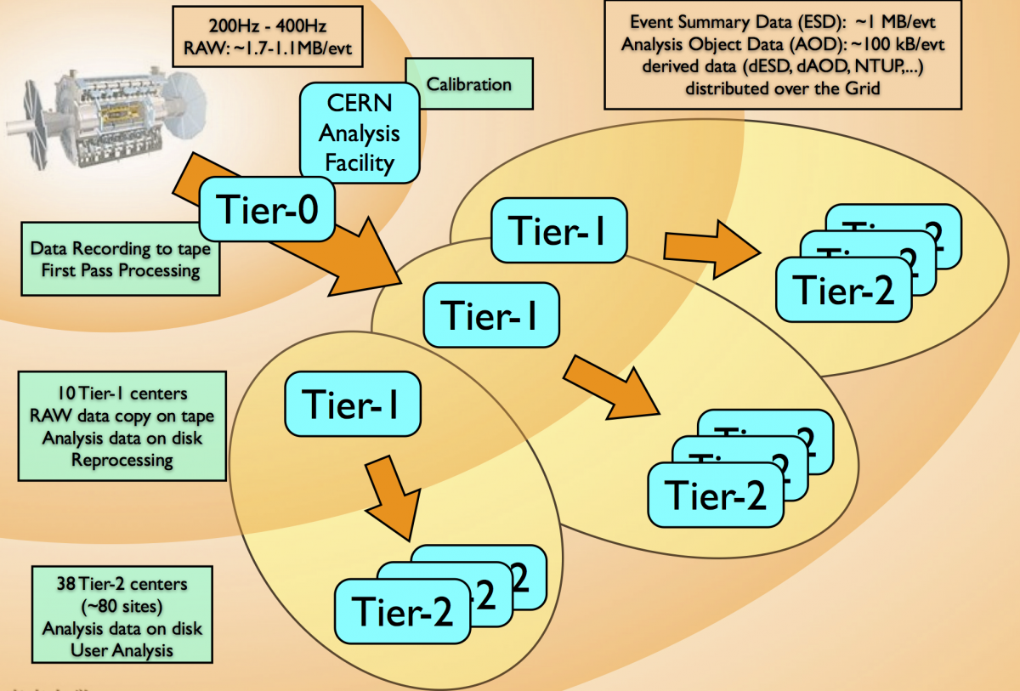
Computing Models for LHC
Why is this interesting at all?
All the recent (pp) experiments are “computing limited”
With infinite offline resources, trigger rate could be easily enhanced 10x (and even: if you can afford to save more, triggers are easier)
Detectors / triggers can output at rates much higher than we save today
We simply do not save more, because we would not have the chance to use the data for years
Current Computing Models (in 2 min)
Distributed:
As for MONARC(1999), political decision NOT to have all in a single place.
Tiered:
Not all sites are equal, they live in a hierarchy. One reason is Networking, not believed sufficient/affordable to guarantee the full mesh of connections between the (~200) sites.
Other reason is to share responsibilities with FA
Using Grid as the MiddleWare which glues sites together.
Have WLCG taking care of Support/Debug/Implementations

Slide 3
Run 1+

Slide 4
Run#, terminology (pp, for ATLAS and CMS)
Run2: 2015-2018
Up to 1.5e34, 25 ns, 13-14 TeV – up to 50 fb⁻¹/y
<PU> = 40
Run3: 2020-2022
Up to 2.5e34, 25 ns, 13-14 TeV - up to 100 fb⁻¹/y
<PU> = 60
Run4: 2025-2028
Up to ~5e34, 25 ns 13-14 TeV – up to 300 fb⁻¹/y
<PU> = 140+
1 y
6 y
11 y
This is “Phase2” for pp

Slide 5
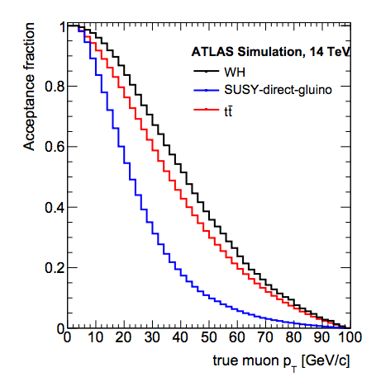
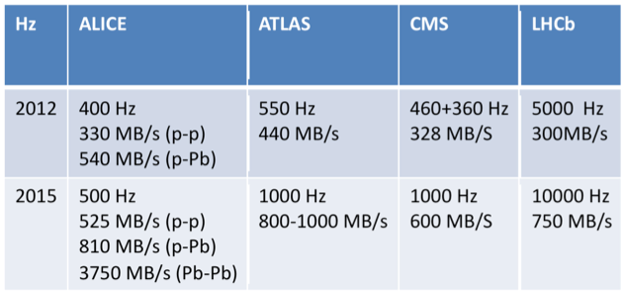
Drivers from physics (ATLAS + CMS)
If you want to do Higgs Physics and Searches, you cannot increase too much the threshold of single leptons
Otherwise you start to lose reach
20-30 GeV is deemed as necessary
You cannot limit the trigger rate by just increasing thresholds …
To maintain a level close to 2012 with this, you need(ed)
O(400 Hz) in 2012
O(1 kHz) in 2015-2018
O(5-10 kHz) in 2025+

Slide 6
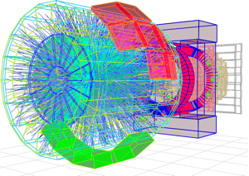
ALICE
Huge change in DAQ+Offline model for 2020+
Input to HLT form O(100) to O(50kHz) peak: which is …”everything”
40% of it to offline
HLT/offline get mixed (O²): HLT effectively does Reconstruction, not selection
To allow for this, use of GPUs (TPC reco) needed soon
(and to a good extent already tested)
2015+: up to 0.5 nb-1 (PbPb)
2020+: up to 10 nb-1 (PbPb)
1 TB/s
13 GB/s to tape
50 kHz
Reconstruction
+
Compression
50 kHz (1.5 MB/event)
Storage
80 GB/s

Slide 7
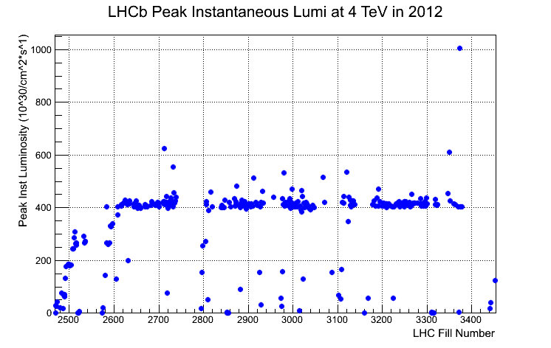
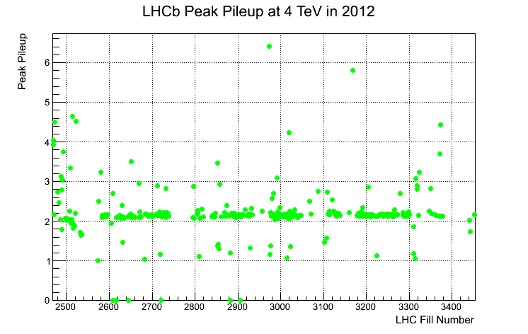
LHCB
Upgrade @ Run3 (2020+)
Essentially trigger-less (40 MHz to HLT)
Able to sustain 2x10³³ cm⁻²s⁻¹ (25 ns), this is 5x wrt to 2012 (with 50 ns); <PU> > 2
Up to 20 kHz “on tape” 2018+
It was 5,12,20 kHz in 2012,2015
20kHz*5Msec = 100B events/y !
(but just 100 kB/ev)
No resource to plan reprocessing: prompt Reconstruction has to be ok

Slide 8
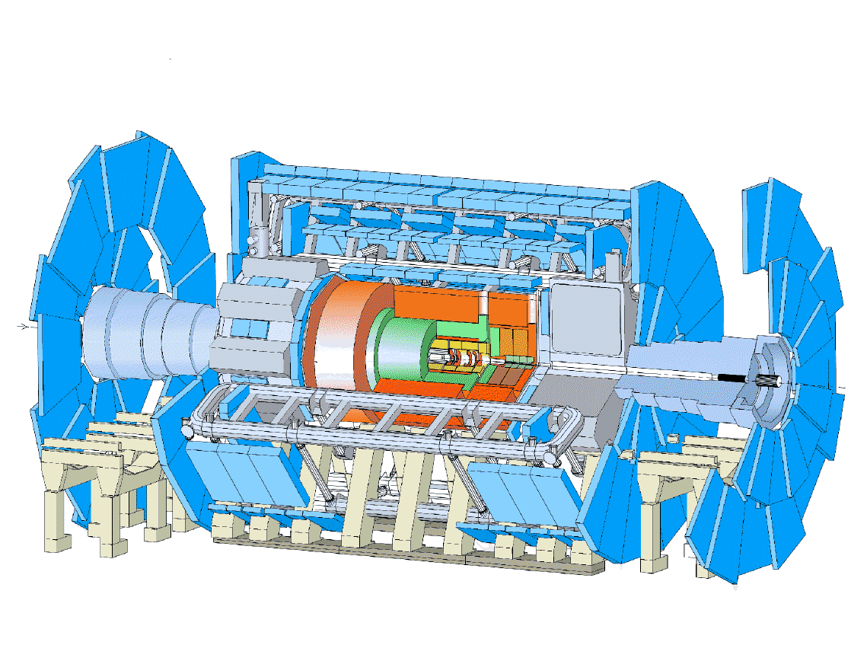
Computing Resource scaling
CPU: scales
Linearly with trigger rate (if you process everything you collect)
More than linearly with <PU>, # tracks, …
Scales with data integrated over ~2 years
Analysis: scales also with # of concurrent analyses, unless Analysis Trains are used
Storage: scales
Linearly with trigger rate
Less than linearly with <PU>, …
Scales with data integrated since the start …
If you plug in rates, event complexity, σ, etc, you end up with
Totals wrt Run1: Run2(3) = ~6-10, Run4 >100
OFFLINE
Various Trigger Levels
Rate
#sec/year
Event Size
<PU>

Slide 9
The different experiments have different timing:
ATLAS/CMS: Run4 is the inflation
LHCb/ALICE: Run3
Buncic™
PB
RAW DISK/TAPE
Very rough estimate of a new RAW data per year of running using a simple extrapolation of current data volume scaled by the output rates.
To be added: derived data (ESD, AOD), simulation, user data (which is easily a big factor)

Slide 10
What if we do nothing?
Sit & wait approach: technology evolution will work for you
The (in)famous scaling Laws…

Slide 11
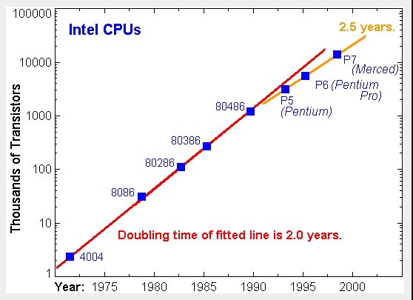
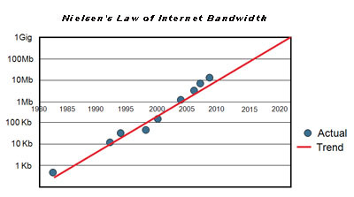
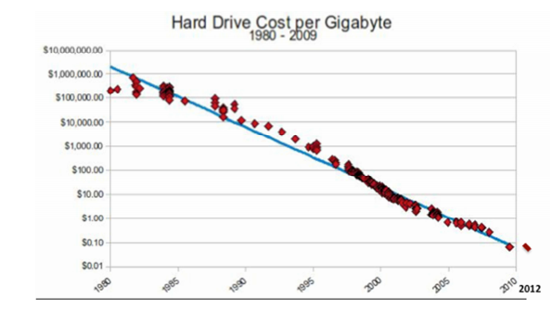
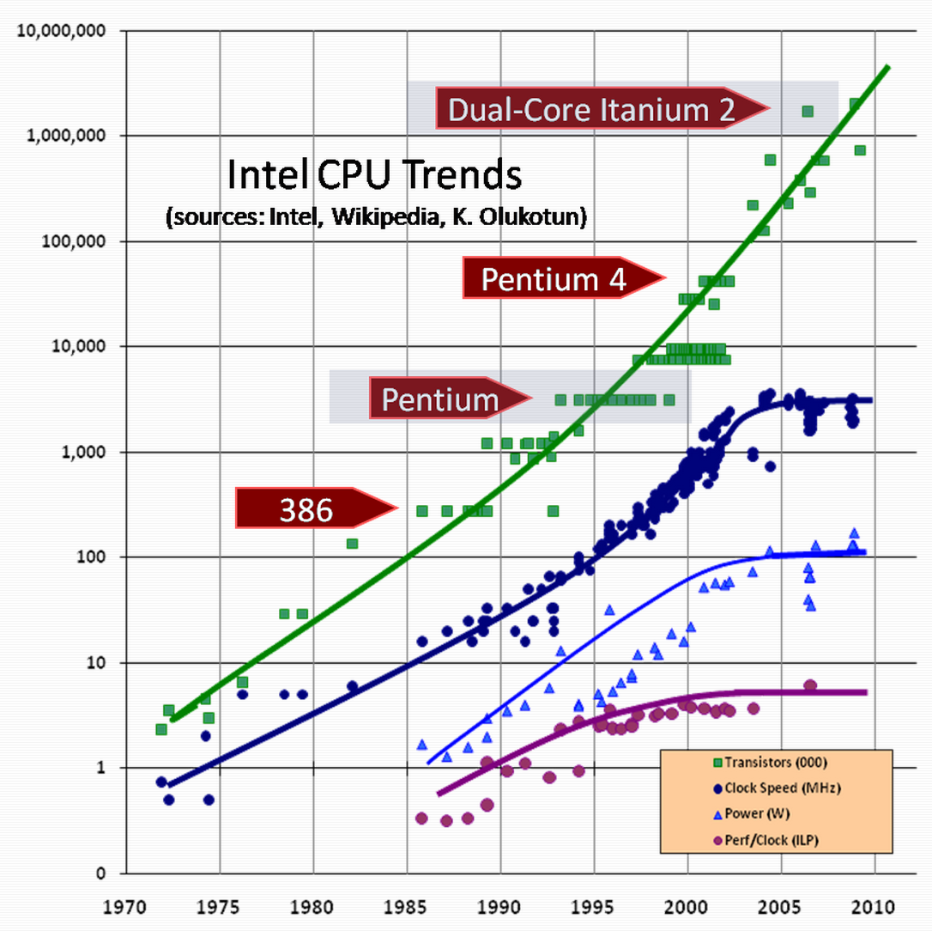
Moore and Friends
Moore’s law: “The number of transistors on integrated circuits doubles approximately every two years”
Usually, translates to “every two years for the same $$ you get a computer twice as fast”
Kryder’s law: “the capacity of Hard Drives doubles approximately every two years”
Butter’s law of photonics: “The amount of data coming out of an optical fiber doubles every nine months” and Nielsen’s law: “Bandwidth available to users increases by 50% every year”

Slide 12
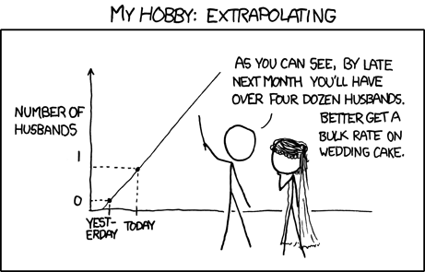
These “laws” are just empirical, a posteriori assessments of what happened
We do see signals of slowdown

Slide 13
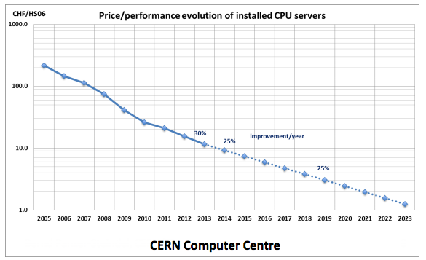
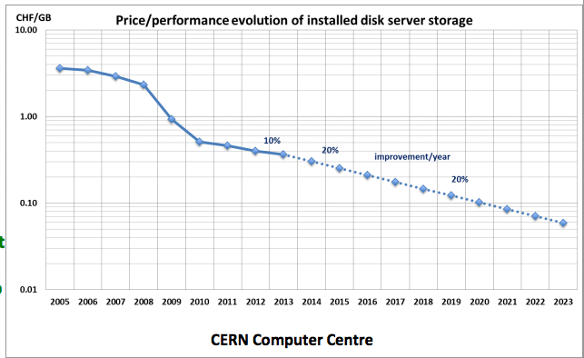
More recent (worse? realistic?) estimates
B.Panzer/CERN (2013):
CPU +25%/y
Storage +20%/y
(includes ~reasonably timed resource retirement)
Means ~ doubling every 3-4 years
Over 3 years (2013-2015): a factor 2
Over 7 years (2013-2020): a factor 5
Over 13 years (2013-2026): a factor 10-15
CPU
Disk
We are here

Slide 14
We are already in troubles with 2015(pp)
Expected increase in CPU needs (pp): ~6x, Moore driven increase is just 2x
Current approach: try and limit to “flat funding figures” (constant $/year)
Not clear it is really possible
Run4 more problematic than Run3 (assuming we can survive Run2…)
What to do?
Convince the FAs to increase the funding
Improve the Computing Models in order to alleviate the deficit, in two possible ways
With no/scarce impact on physics
With impact on physics
Do the same better
Do less but no physics impact

Slide 15
Only existing numbers from experiments: Run2
CPU
CPU
CPU
CPU
These can be read as “fixed budget” (with some caveats)

Slide 16
Requests 2012-2017
All together:
Not all categories are below fixed budget curve, but the SUM per experiment should be
These numbers do not go beyond 2018, but the feeling that it will be difficult to ask for more remains
Rule of thumb:
2015/2013 < 2
2018/2013 ~ 3

Slide 17
(Some) available handles
Use more efficiently the resources you are given
Find free resources (or resources for free…)
Improve the algorithms
Change technology (CPUs to GPUs, ARM,…)
Do less (w/o physics impact)
Do less. Period.

Slide 18
1.a Use more efficiently resources
LHC Experiments are recognized to use to a very good level, with T0, T1s and T2s used at 90% or better.
The rest is difficult to squeeze, due to MONARC limitations
i.e., the T0 can be free at moments, but can be difficult to feed it with analysis jobs, since input data is not available at CERN.
T2s could reprocess data during Xmas break, but they have no RAW data.
Can we flatten MONARC (even if only in these phase space corners)?
YES, network has improved:
All T1s exceed 10 Gbit/s, and are planning for 40+ Gbit/s
All the major T2s have at least 10 Gbit/s

Slide 19
Full network mesh
Tier-0
CAF
Tier-1
Tier-1
Tier-1
Tier-1
Tier-1
Tier-1
Tier-1
Tier-2
Tier-2
Tier-2
Tier-2
Tier-2
Tier-2
Tier-2
Tier-2
Tier-2
Tier-2
Tier-2
Tier-2
Thanks to the (unexpected) evolution of general IP connectivity
Any job can run anywhere
Any transfer line can be used
Remote access allowed
PROs: you get back O(10%) resources
CONSs: your DM/WM must be more complex

Slide 20
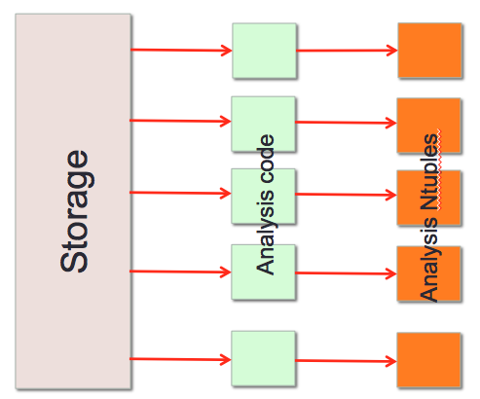
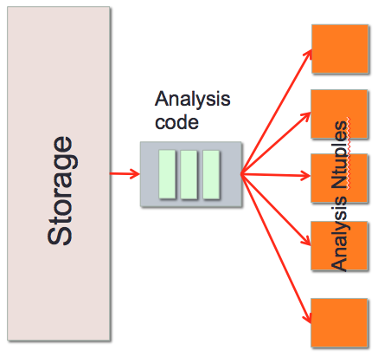
1.b Use more efficiently ICT resources
Use Analysis Trains:
Instead of running N analysis jobs on a single input file, N being the number of ongoing analysis,
Run a single job, centrally managed, which executes N analysis modules
(ALICE already does this)
What do you gain?
I/O can be provisioned and planned
Fewer jobs in the system, easier to manage
Analysis trains are run by operators, not physicists
Divide by N also all the overheads (startup time, access to conditions, …)
The train gets much more resources than single user jobs … can be much faster
What do you lose?
Well, you can lose the train! When is the next one?
In general, less controlled by the users
Not guaranteed a a single train is ok for everyone
Not optimal for late moment analysis code changes or last minute emergencies (i.e. Conf panic)

Slide 21
2. Grab more resources (for free…)
We DO have other resources outside TX hierarchies:
the filter (HLT) farm is a specialized system, difficult to turn into an offline capable system on short notice
HLT is NOT used at all for what is it paid for
~ 3 months a year (Winter shutdown)
2 weeks every couple of months (MD)
For roughly 50% of the Run time (typical Interfill/Total in Run1)
More generally issue: how to use a big resource
You cannot control (decide which OS, which network configuration, …)
Comes and goes fast
(Hopefully you did not pay)
Opportunistic Resource usage
All together, ~ 3x a standard T1

Slide 22
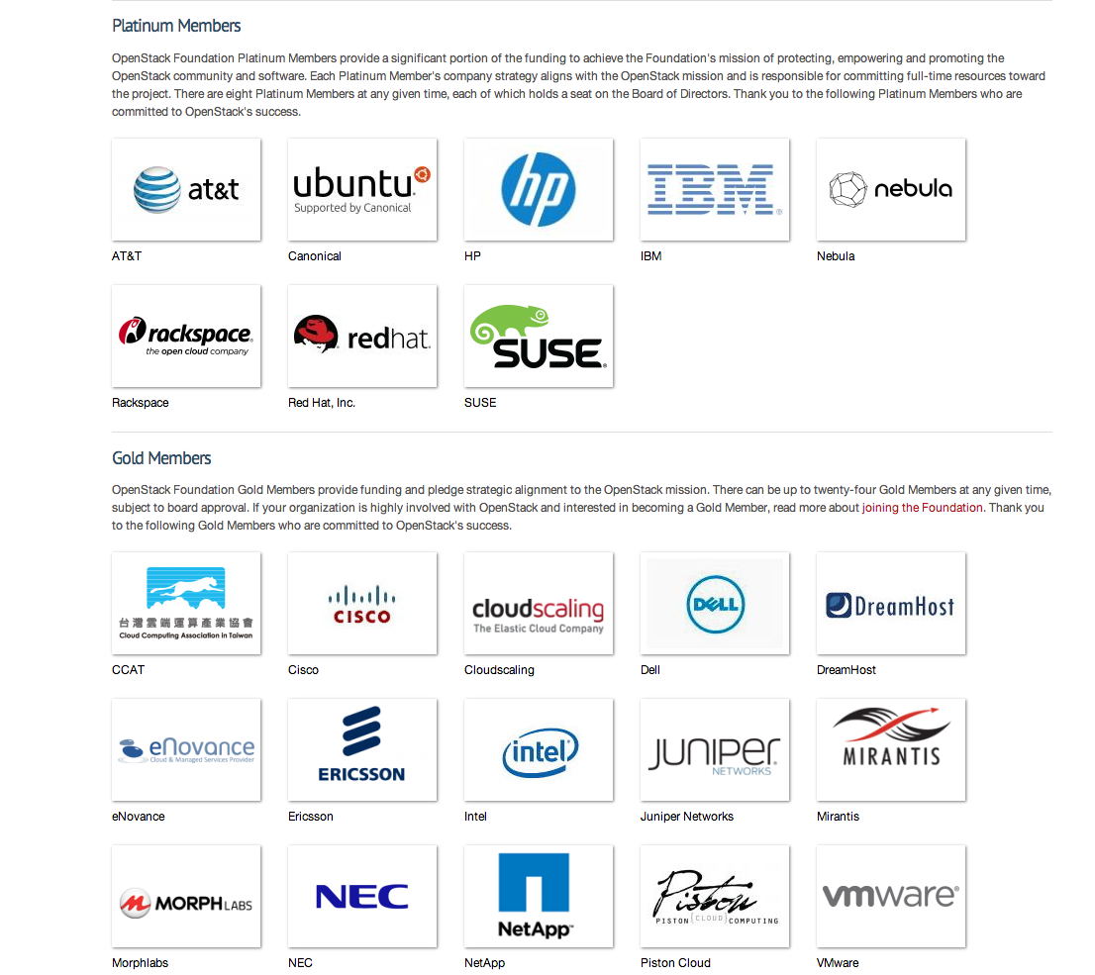
Opportunistic usage
While we are very good in using out offline resources, the same cannot be said for other (scientific) fields
HPC centers are often keen to offer cycles to HEP (not CINECA, currently)
Google/Amazon are interested in experimenting our workflows (hoping for future contracts)
Some commercial entities seem to have spare cycles to offer (reward = PR)
Use Clouds to exploit them!
Reasons: (I leave it to Gianpaolo’s talk…)
PROs:
they can increase substantially the available resources;
2015 estimates are at the 10% level (excluding HLT)
unlike the GRID, you do not have to pay for the development of the Cloud
CONSs:
again, you need to have an agile DM/WM system, which accepts high failure rates

Slide 23
3. Improve the algorithms
We are not IT scientists, and in the pre Run1 phase focus was to have a running software
Since then, large effort spent on optimization of critical part, with huge success (not uncommon 2x per year)
Much more difficult in the future, low hanging fruits are gone

Slide 24
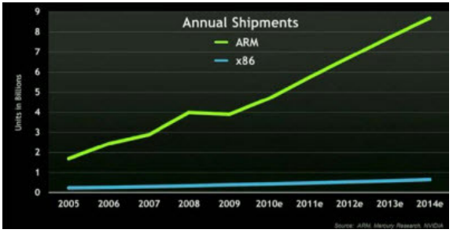
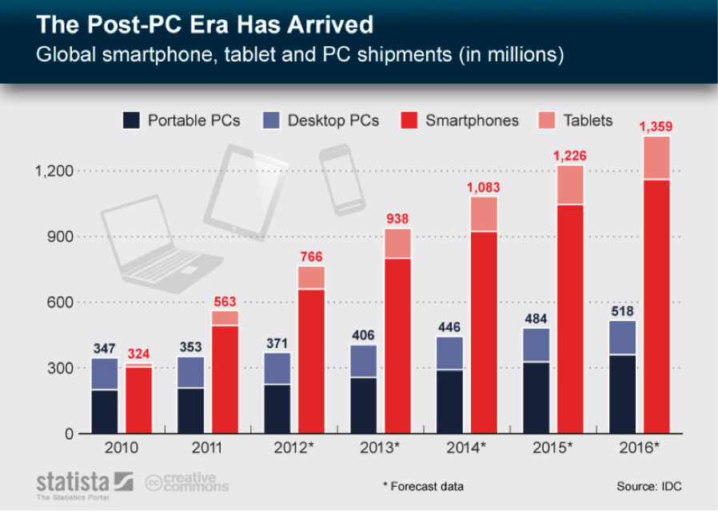
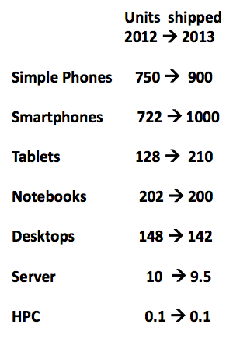
4 . Change technology (CPUs to GPUs, ARM,…)
To get the most performance per $, we need to stay at the top of the commodity wave
M
HEP!

Slide 25
What drives the market?
Videogames
High level GPUs
Smartphones / Tablet
Low consumption CPUs, low cost (50$ each vs 1000$ for a Xeon)
In both cases, expect many cores CPUs, O(1000) if you include GPU cores
Nvidia GTX Titan 4500 Gflops
250 W
(~1000$)
Xeon E5-4650L
1000 Gflops
115W
3000$
Tegra K1
365 Gflops
5 W (includes also 2 ARMv8 cores)
($50?)

Slide 26
We need to play this game …
(Many of us need to) Gain expertise in Multicore programming
Concurrency Forum evolving in HEP SW Collaboration next month; let’s see which is the proposal
(Few of us need to) Gain Expertise in GPU programming
For time critical tasks, like tracking @ HLT (ALICE already does, ATLAS has shown numbers)
PROs: more performance per $ sure helps to fill the gap
CONSs: we already suffered Fortran to C++, this is much more difficult; we need years of preparation, and good software frameworks

Slide 27
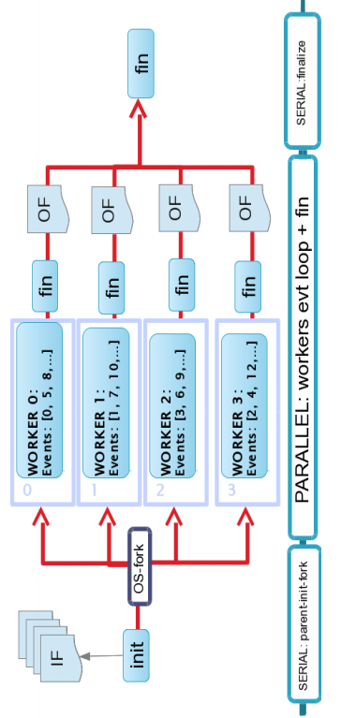
(a note of optimism…)
At least at the level of Frameworks (not of Algorithms), all the Collaborations already have Multicore / Thread safe Frameworks
AthenaMP (ATLAS), CMSSW (CMS), AliROOT (ALICE), Gaudi(LHCb)
But also toolkits are migrating:
Geant4-MT, and eventually GeantV
ROOT6
Generally already ok, not currently in production (but they will by late 2014)

Slide 28
5. Do less (w/o physics impact)
Less
If RunX+1 detector is ~ identical to RunX: you already commissioned it
You expect to need fewer data reprocessings on top of Prompt Reco
Or even no reprocessing at all (LHCb)
You already tuned MC for Detector response, and with 7-8 TeV data
You expect to need fewer MC events (from 2x to 1x the Data)
ALICE (Run3): MC is 0.1x the data
Distribute fewer copies of the Analysis datasets
Rely on remote data access (network!) to feed CPUs
Save on storage:
Some objects can be redone on the fly efficiently, not using storage
Save on CPU:
Save but not process: already done in 2012, “parked” data sets reserved for the future. In this case, future is 3 years!
PROs: (only spend less?)
50% less MC ~ 15% less resources
1 less reprocessing ~ 15% less resources
CONSs: potentially many
Less understood detector and poor Physics performance
Delays

Slide 29
6. Do Less. Period
If we are not able to convince FAs to extend funding
If we are not able to live with less MC, less reprocessing, …
If we are not able to improve continuously our software
Do less, which can mean
Collect fewer events
Increase thresholds offline (i.e. tracking)
Collect events, but process “later” (which given the schedule can mean MUCH later)
Tape is cheap, we can park 30B events/y with ~5 M$/y today, much less then
10 kHz * 3Ms

Slide 30
A caveat: what is not even considered in the requests …
The requests are for the resources you need to run in year X (which means Data Processing, Monte Carlo, Analysis)
Given the upgrade schedule, at any given time you will be also preparing a TP, TdR, … for the next phase (and you need simulations!)
Assumption up to now:
These simulations live in the shadow of the standard processing
What is shadow? Is a 10% of total resources expendable?
Not clear if this can continue. Factors which can help
Use LSes for this (when shadow can be eventually 100%)
Use FastSimulation for Physics related stuff, Full simulation needed for detector characterization and FastSim validation

Slide 31
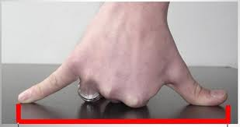
Some back of the envelope estimates (highly unofficial)
ATLAS+CMS (before Run4):
With today’s software, a 140 PU (14 TeV) event takes (digitization + reconstruction) ~300s, a factor ~ 2x ATLAS. Let’s say 1000 s/ev including also simulation and analysis.
If you need to characterize the detector, O (100M) events can be a good starting point – remember, @2025 you expect 10kHz*3Ms = 30B events
So 1e11s, which is 3000 cores*y
Or 6000 cores*6 months, or 12000 cores*3months, or …
Scenarios
During a LS (as now) you can use a sizeable fraction of the resources for this (currently, we have ~ 60000 cores)
Not a problem, by factors
During data taking
not negligible, but not a disaster either….
This a a perfect task to be sent to an HPC Center …
ALICE (Before Run3):
O(+1 MEvent/y) FullSim expected (no huge impact)
O(0.1-1 BEvent/y) FastSim expected (~comparable with above)

Slide 32
Conclusions (?)
Two tensions working
Spend less (which translates in ~ fixed budget)
Use the experiment you built (and paid for)
For Run2, looking at 2015 requests, the tension seems to have stabilized on a 50%-100% increase
Compatible with flat budget? Opinions may vary ….
Run3 (given we survive Run2) seems not critical for ATLAS/CMS, but is a major change for ALICE/LHCb
Run4 (ATLAS/CMS) is still in good part to be sketched, but it is clear that a major development effort (== people) is needed
To keep living in the best performance/cost market phase space
To optimize resources, and to be able to grab
To optimize our algorithms

Slide 33
BACKUP

Slide 34
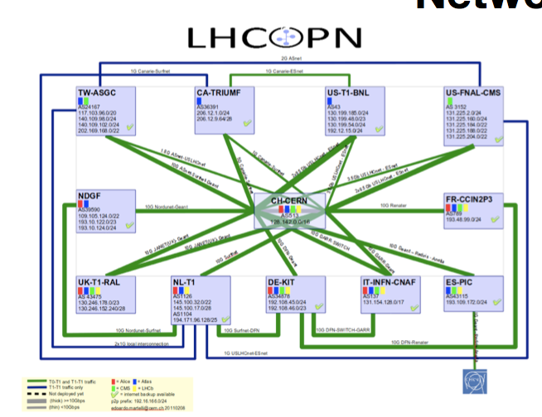
The guaranteed network…

Slide 35
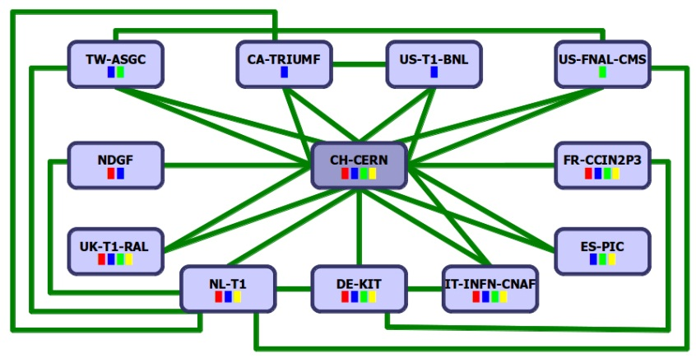
35
And the general IP one…
CERN Computer Center
500-10,000 km
50 Gb/s (25Gb/s ATLAS, 25Gb/s CMS)
Universities/
physics groups
Universities/
physics groups
LHC Tier 1 Data Centers
Universities/
physics groups
Universities/
physics groups
Universities/
physics groups
Universities/
physics groups
Universities/
physics groups
Universities/
physics groups
The LHC Open Network Environment
(LHCONE)
Universities/
physics groups
Universities/
physics groups
Universities/
physics groups
Universities/
physics groups
The LHC Optical Private Network (LHCOPN)
Universities/
physics groups
Universities/
physics groups
Universities/
physics groups
Universities/
physics groups
Universities/
physics groups
LHC Tier 2 Analysis Centers
This is intended to indicate that the physics groups now get their data wherever it is most readily available

Slide 36
You need | GRID | Cloud
A computer connected to network, with conditioning and power | Local site staff | Local site staff
An operating system “compatible” with the application | Local site staff, after negotiation with experiments | Comes as a virtual image from the experiment central infrastructure
A local installation of the experiment software (and a local area where to store it) | Local site staff provides area, Experiment support installs software (ok, we have CVMFS now …) | Downloaded on demand from the experiment central infrastructure
Machines for local experiment facilities (voboxes etc) | Local site staff provide them. | Also deployable as virtual images
A local storage containing the input data | Local site staff needs to have bought storage for the experiment | Data can be accessed remotely OR via cloud storage (efficiency price?)
A configuration to be executed | User! | User!
Site support needed
Exp support needed

Slide 37
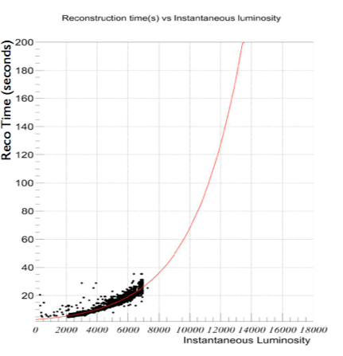
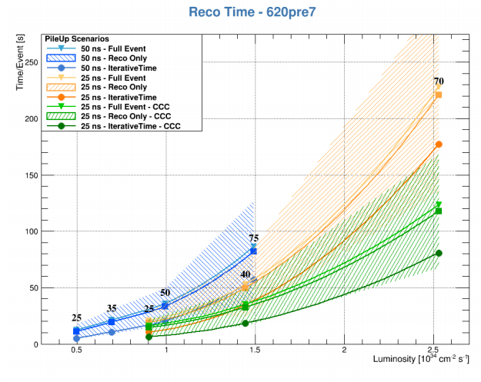
Scaling of RECO time
20->40->140 PU

Slide 38
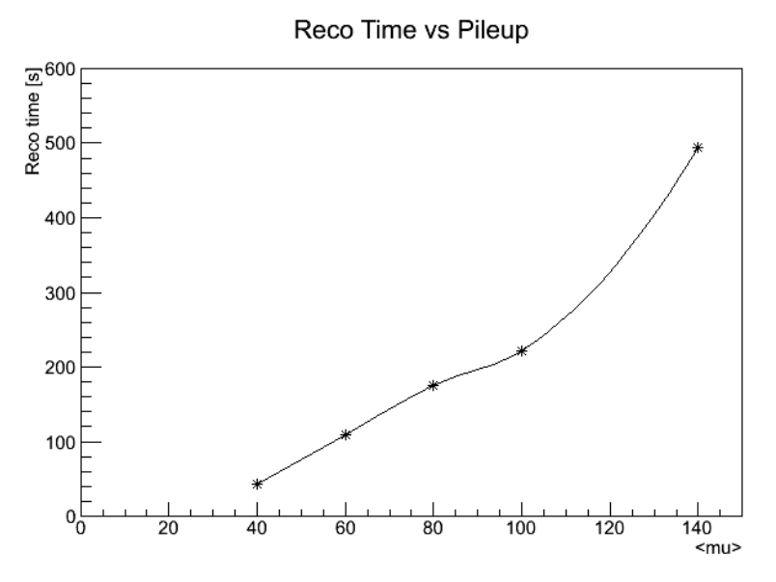

Slide 39
MONARC: Tiered hierarchy on Computing Centres
Tier 0
CERN
Master copy of RAW data
Fast calibrations
Prompt Reconstruction
Tier 1
A second copy of RAW data (Backup)
Re-reconstructions with better calibrations
Tier 1
Tier 1
Tier 1
Tier 1
Analysis Activity
Dimensioned to help ~ 50physicists in their analysis activities
Tier 2
Tier 2
Tier 2
Tier 2
Tier 2
Tier 2
Tier 2
Tier 2
Anything smaller, from University clusters to your laptop
Tier 2
Tier 3,4
39

Slide 40
ALICE
Data reduction:
 | Data Format | Data Reduction Factor | Event Size (MByte)
 | Raw Data | 1 | 700
FEE | Zero Suppression | 35 | 20
HLT | Clustering & Compression | 5-7 | ~3
 | Remove clusters not associated to relevant tracks | 2 | 1.5
 | Data format optimization | 2-3 | <1

Slide 41
To be compared with …
LHC data ~ 1/10000 of the HDDs by 2020

Slide 42
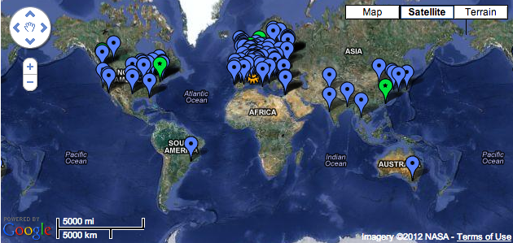
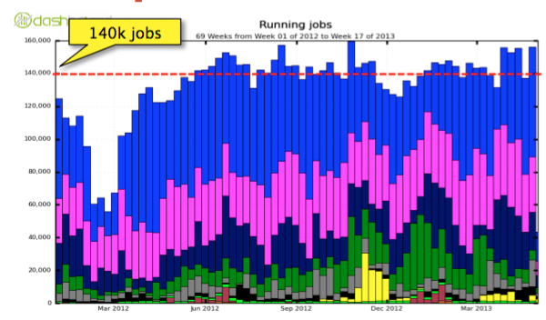
WLCG as the orchestrator
WLCG governs the interoperation since 2002 between the number of “concrete GRID implementations” (a number of, the main ones being OSG, LCG, NurduGrid, …)
WLCG was crucial in planning, deploying, and testing the infrastructure before 2010, and is crucial for operations now
As of end 2012, from REBUS
CPU 1.8 MHS06 (~180k computing cores)
DISK 175 PB (~80k HDDs)
TAPE 170 PB (20-80k tapes)
# Sites exceeding 200
ATLAS 2013: ~140k concurrent analysis jobs

Slide 43
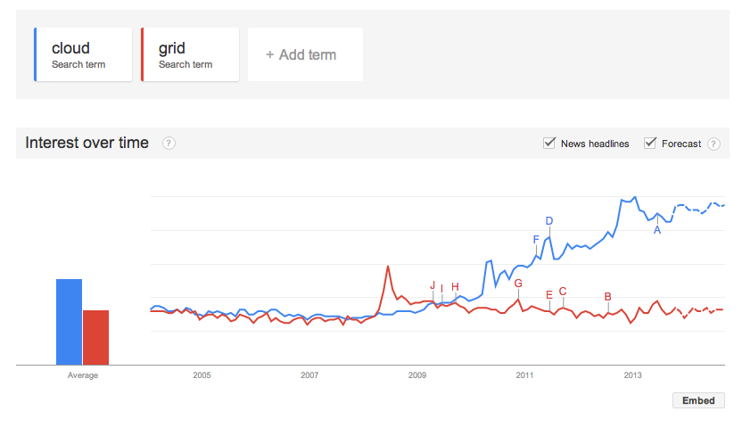
General statement
All of this is ongoing, but
2015-2018: the GRID remains essential, it is the baseline model. Clouds are going to be used to squeeze resources otherwise difficult to reach (HLT, Opportunistic), but sites are expected not to move out of GRID
CERN can be a different story, but CERN was not actually a GRID site from the operational point of view
2020+: wait&see. Some more organized Cloud movement expected, can at some point used to access the majority of the resources…

Slide 44
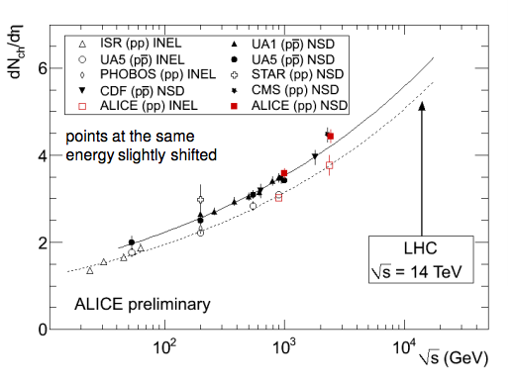
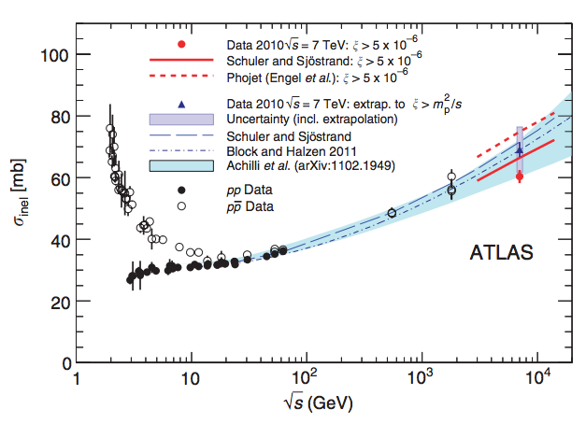
So, which are the CM factors?
(I limit to offline…)
Event complexity (more-than-linear scaling with PU) – pp
0.7e34 to 1.5e34 – at least a factor 2.5x
1.5e34 to 5e34 – at least a factor 5x
dN/deta, increase in σ_{inel}
O(20%)
<PU> @ 13 TeV
1e34 = ~30
5e34 = ~140
Increased trigger rates
2.5x Run2(3) to Run1
10x Run4 to Run2(3)
Totals wrt Run1: Run2(3) = ~6-10, Run4 ~ 200 (??)

Slide 45
Do more efficiently what you do …
Write a better software (see later)
We are somehow counting on a Moore-like law for (our) SW performance
Improve resource usage, but
HLT and Tier0 fully booked in data taking
(which is ~ 9/12 of the year)
Tier1s and Tier2s usage level > 80% of the pledge on average
These available % cannot be easily used today, since MONARC limits the type of tasks possible at sites
For example, a free Tier1 cannot in principle be used for analysis
Flatten MONARC!

Slide 47
The software side of the story
Up to here, it was about: “how to run our software”
The other not trivial question is “what is our software”
And: can we expect a Moore-like improvement there?
Our software circa 2013
Sequential x86 code, C++ / Python
In some cases our C++ is “1-to-1 translated Fortran”
2-3 GB per process
Single processes even on Multi Core CPUs
Very few parts of vectorized code, mostly just via “compiler smartness”
Some usage of GPU, but for very specific use cases (ALICE trigger)

Slide 48
Algorithmic improvements still exist!
Example by CMS: 20-40% yearly improvement, all the rest being equal
(but needs more effort every time since low hanging fruits are gone)

Slide 49
MONARC: Tiered hierarchy on Computing Centres
Tier 0
CERN
Master copy of RAW data
Fast calibrations
Prompt Reconstruction
Tier 1
A second copy of RAW data (Backup)
Re-reconstructions with better calibrations
Tier 1
Tier 1
Tier 1
Tier 1
Analysis Activity
Dimensioned to help ~ 50physicists in their analysis activities
Tier 2
Tier 2
Tier 2
Tier 2
Tier 2
Tier 2
Tier 2
Tier 2
Anything smaller, from University clusters to your laptop
Tier 2
Tier 3,4
49

Slide 50
All in all…
Factor required Run2/Run1 can be reduced 6->~2
LHCC PLOTS!!!!!!
Anche se donatella dira’ che non sono veri, io li metterei

Slide 51
… and a last thing!
Resources needed for “next” Phase, some maths:
Suppose you want to simulate the physics in year X, 4 years before.
In year X you will have resources sufficient to run, and process N events of data and N of MC
4 years before (y=X-4), you will have ½ of the resources (Panzer’s scaling), which you will need to process y=X-4 running.
If you can devote 10% of those resources to upgrade studies, you will have 10% of y=X resources, so in principle you can use them to process 1/10 of the y=X statistics
BUT: your software will generally be slower (as in last slide), so there is another factor we assume as 2. So most probably 5%
This (back of the envelope ..) estimate tells that you can “shadow” upgrade studies in standard running if 4 years before you can live with 5% of the events you expect to take then.

Slide 52
Do more efficiently what you do …
Write a better software (see later)
We are somehow counting on a Moore-like law for (our) SW performance
Improve resource usage, but
HLT and Tier0 fully booked in data taking
(which is ~ 9/12 of the year)
Tier1s and Tier2s usage level > 80% of the pledge on average
These available % cannot be easily used today, since MONARC limits the type of tasks possible at sites
For example, a free Tier1 cannot in principle be used for analysis
Flatten MONARC!

Slide 53
The software side of the story
Up to here, it was about: “how to run our software”
The other not trivial question is “what is our software”
And: can we expect a Moore-like improvement there?
Our software circa 2013
Sequential x86 code, C++ / Python
In some cases our C++ is “1-to-1 translated Fortran”
2-3 GB per process
Single processes even on Multi Core CPUs
Very few parts of vectorized code, mostly just via “compiler smartness”
Some usage of GPU, but for very specific use cases (ALICE trigger)

Slide 54
Algorithmic improvements still exist!
Example by CMS: 20-40% yearly improvement, all the rest being equal
(but needs more effort every time since low hanging fruits are gone)

Slide 55
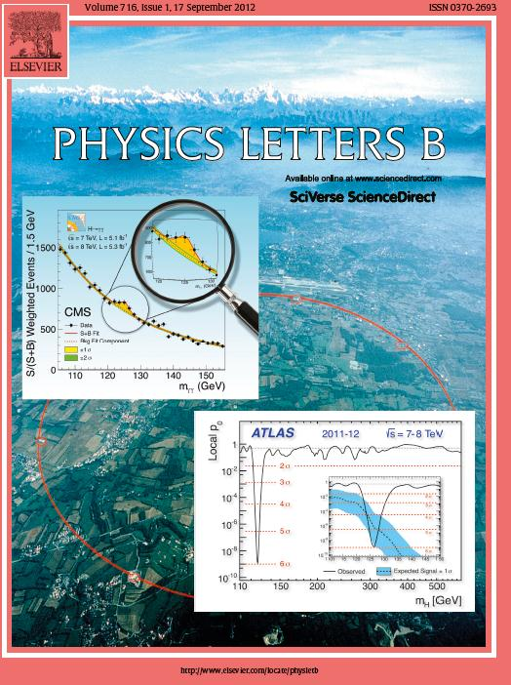
Did it work?
(meaning Off/Cmp were was not felt as showstoppers)

Slide 56
Storage
Analysis code
Analysis Ntuples
Analysis code
Storage
Analysis Ntuples

Slide 57
5. Do less (w/o physics impact…)
Main areas
Run2 detector is ~ identical to Run1: you already commissioned it
You expect to need fewer data reprocessings on top of Prompt Reco
Or even no reprocessing at all (LHCb)
You already tuned MC for Detector response, and 7-8 TeV data
You expect to need fewer MC events (from 2x to 1x the Data)
Distribute fewer copies of the Analysis datasets
Rely on remote data access to feed CPUs
Save on storage:
Some objects can be redone on the fly efficiently, not using storage
Save on CPU:
Save but not process: already done in 2012, “parked” data sets reserved for the future. In this case, future is 3 years!

Slide 58
Is Flat funding enough with current assumptions?
yes
Happy Physicist!
no
Can you recover the missing part via optimization/improvements?
yes
Happy (but tired) Physicist!
no
Do less (with impact on physics)
Sad (and tired) Physicist!

Slide 59
From Batch to Multi-thread
Up to now, our (HEP) use of multicore CPUs have been naïve at best
One core – one job in a batch like approach
(apart from some specialized GPGPU use cases)
Can we do better?
The place where a one core – one job approach is problematic is its anti-optimized memory usage

Slide 60
Many (many!) cores – how to handle them
How are our tasks using system memory?
Event data
(readout buffers + transient objects + final reco objects…)
Only this supposed to change event by event
~40%
Non Event data
(calibrations, geometry, cabling…)
CMS Reco
Total ~ 2 GB
~40%
Libraries, etc
~20%

Slide 61
Memory needed while processing reconstruction
Event data
(readout buffers + transient objects + final reco objects…)
Event data
(readout buffers + transient objects + final reco objects…)
Event data
(readout buffers + transient objects + final reco objects…)
Event data
(readout buffers + transient objects + final reco objects…)
Event data
(readout buffers + transient objects + final reco objects…)
With a batch-like approach (use N jobs on a N core machine) , you end up using N times the memory of the single task.
Apart from cost, there are issue of
Memory to CPU communications not remaining “flat”
HDDs reaching the IOPs limits
Frequent Cache miss (CPU remaining idle)
Non Event data
(calibrations, geometry, cabling…)
Non Event data
(calibrations, geometry, cabling…)
Non Event data
(calibrations, geometry, cabling…)
Non Event data
(calibrations, geometry, cabling…)
Non Event data
(calibrations, geometry, cabling…)
Libraries, etc
Libraries, etc
Libraries, etc
On a N core machines
N times the conditions in memory
N events in memory
Some versions of libraries etc

Slide 62
Multicore approach #1
Event data
(readout buffers + transient objects + final reco objects…)
Event data
(readout buffers + transient objects + final reco objects…)
Event data
(readout buffers + transient objects + final reco objects…)
Event data
(readout buffers + transient objects + final reco objects…)
Event data
(readout buffers + transient objects + final reco objects…)
A simple fork model:
A master process, starts, loads geometry, (initial) conditions, then forks N processes
Each then starts as a separate process, but payloads opened by the parent are shared until they change
Non Event data
(calibrations, geometry, cabling…)
Non Event data
(calibrations, geometry, cabling…)
Non Event data
(calibrations, geometry, cabling…)
Libraries, etc
On a N core machines
1..N times the conditions in memory
N events in memory
1 version of libraries

Slide 63
Multicore approach #2
Event data
(readout buffers + transient objects + final reco objects…)
Real multithreaded applications:
Generally running on 1 event at a time
And as such on a single set of conditions
And on a single version of the libraries
Non Event data
(calibrations, geometry, cabling…)
Libraries, etc
On a N core machines
1 times the conditions in memory
1 events in memory
1 version of libraries

Slide 64
Exactly, where is the gain?
Today’s serial jobs (1 job / 1core) efficiently use 100% of the CPU, then what? Generally, if we could handle a single job/ Computer we would get
Better usage of CPU L3 caches -> more performance
More available memory -> we can design memory hungry algorithms, forbidden for the moment by RAM costs
Schedule on a same Computer CPU intensive applications and I/O hungry ones -> use all the resources a Computer can give (not only CPU)
Use of opportunistic resources with lower RAM -> easier to find opportunistic resources
And, the fact that the # of jobs the infrastructure has to handle decreases from 1/core to 1/computer (a factor ~50 today, many 100x tomorrow)
Less pressure on Central Experiment services

Slide 65
How to schedule true multicore jobs?
Solution #1 (forking) is completely transparent to the (physics) user
No need to learn parallel programming
Solution #2 can mean 2 different things
Having a Multicore aware Framework, which schedules in parallel reconstruction modules taking care of dependencies
Each algorithm is serial, and many algorithms run in parallel on the same event
Easy for physics users, they do not have to learn parallel programming
Needs a reconstruction workflow well separated into branches
Are we sure many modules can run at the same time? (satisfying dependencies…?)
Having parallelism at the single algorithm level
Needs to learn parallel programming
Not within the possibilities of the standard undergraduate student …
Generally to be needed only for critical cases

Slide 66
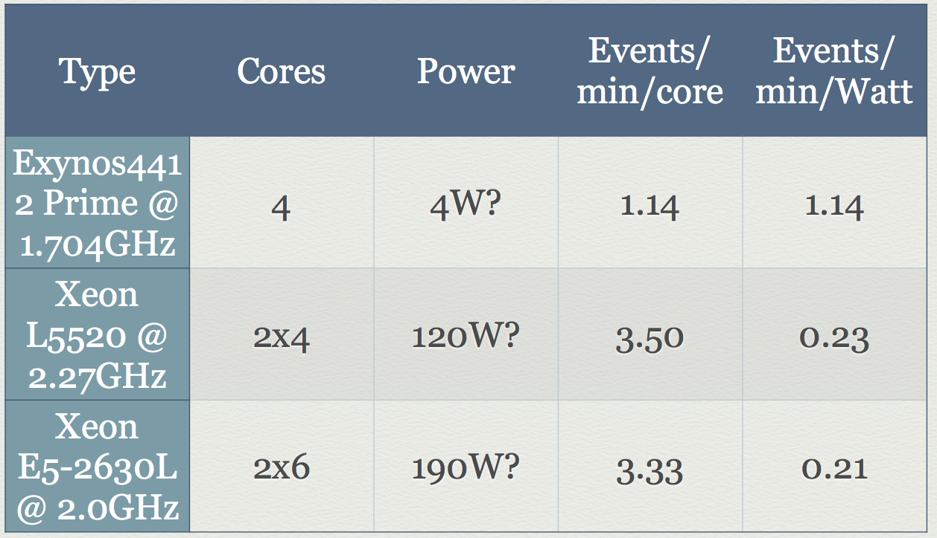
Good news: ARM porting not-so-difficult
LHCb + CMS: full offline SW stack already ported (many thanks to Linux and GCC!)
CMS: G4+digitization
Ev/min/W 5 times better
LHCb: 1000 Brunel events
ARM ~ 20 slower

Slide 67
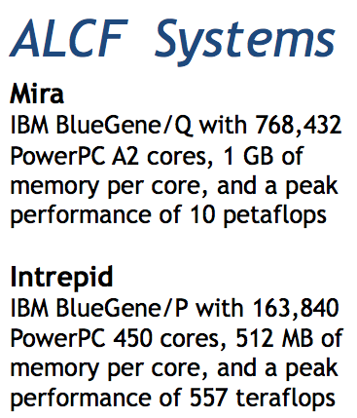
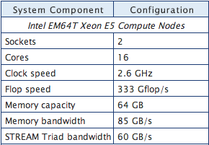
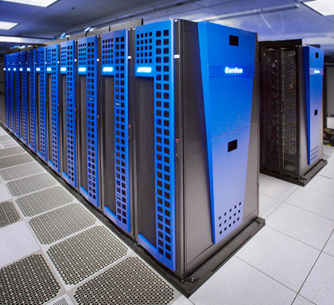
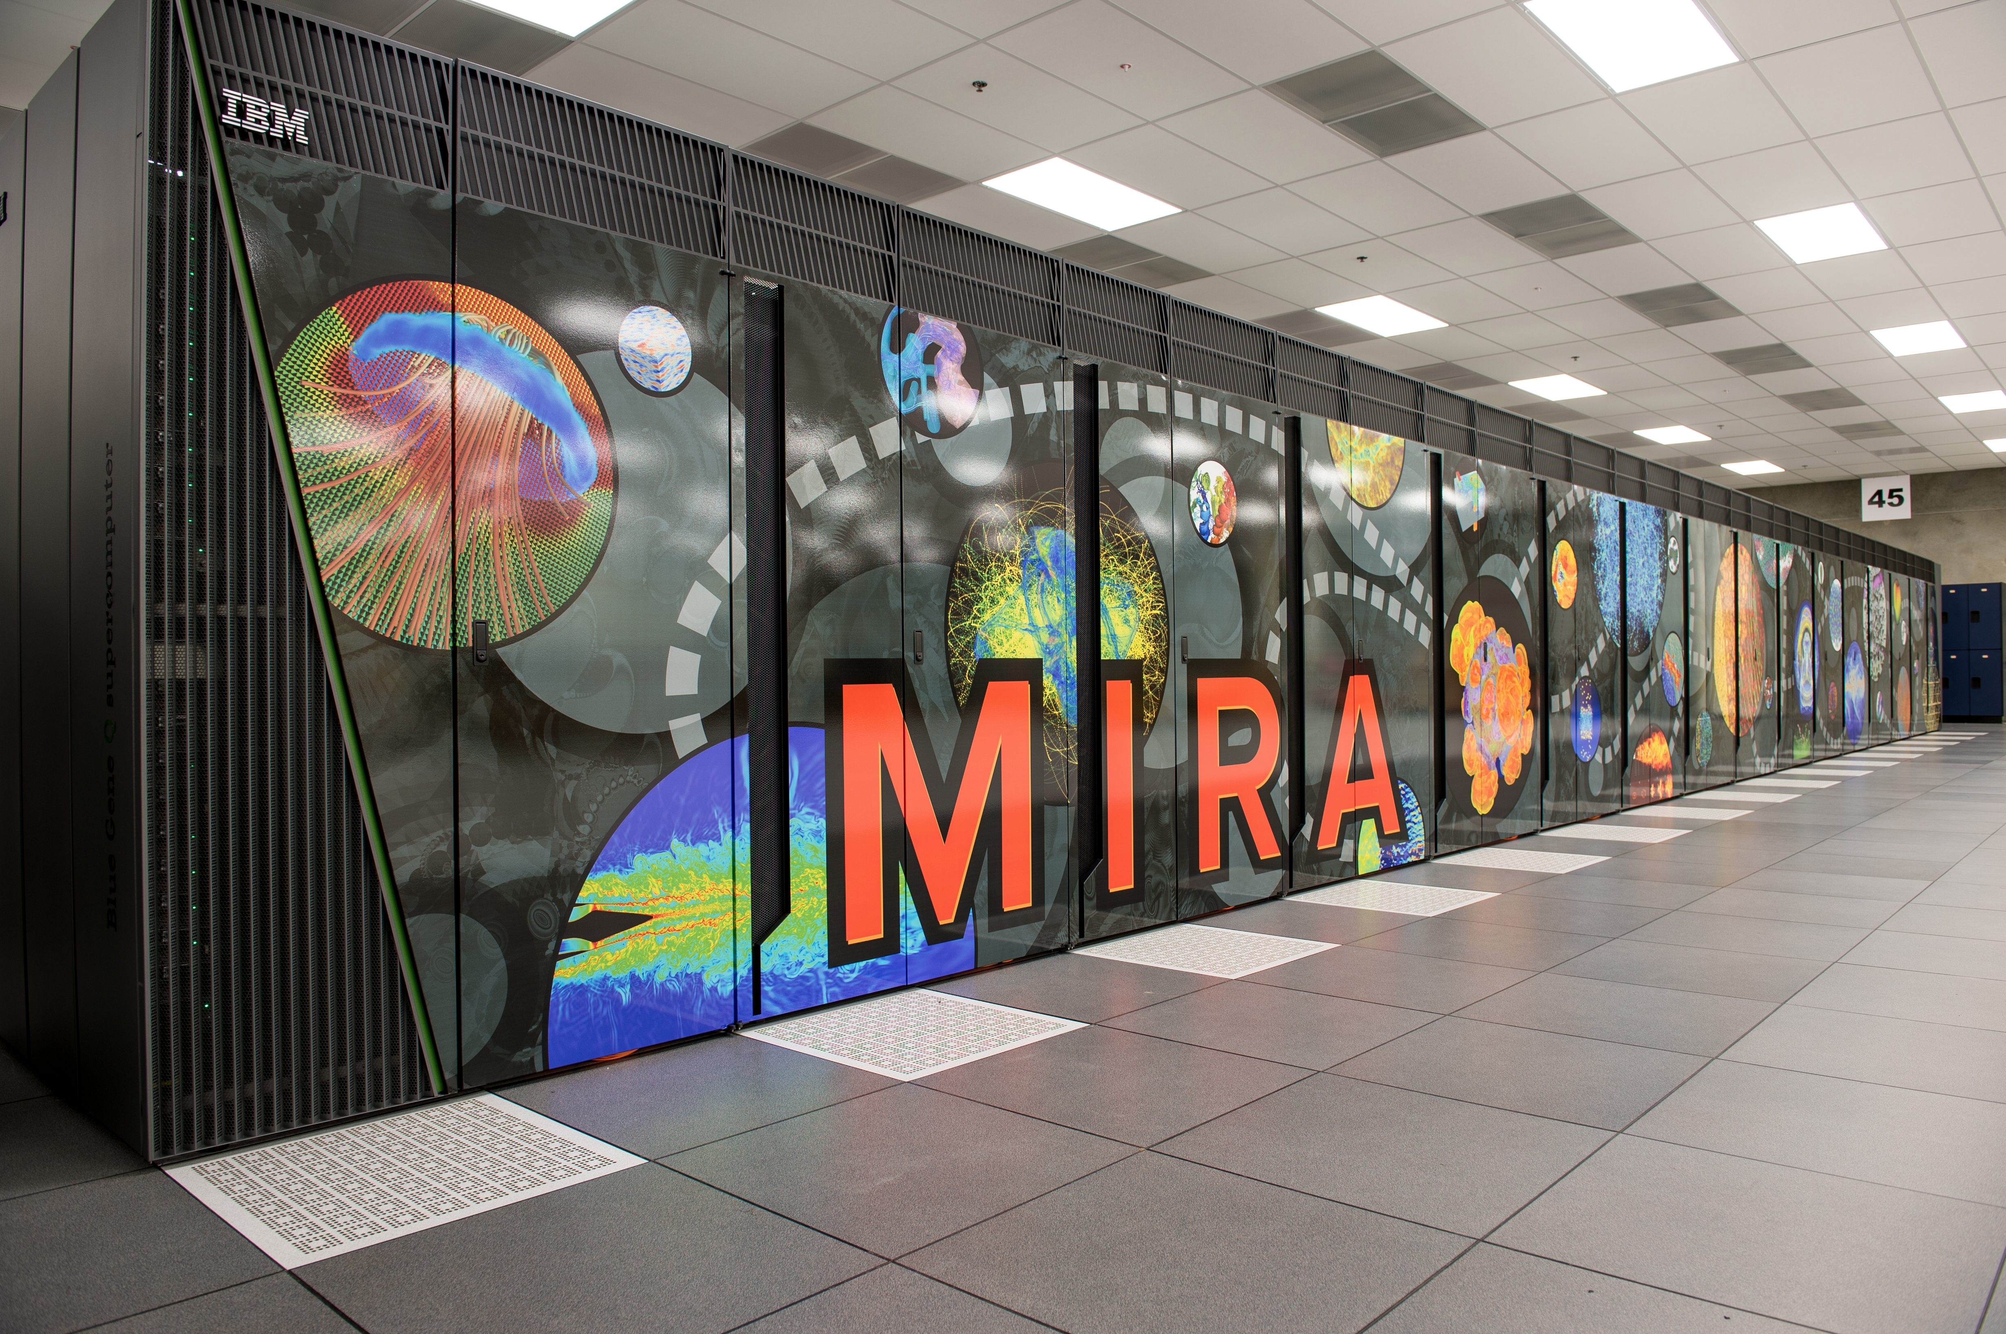
Opportunistic Computing – current experience
Every HPC center is unique (no standardization)
A direct effort needed to start using them; so a minimal availability to make it worth the effort
Gordon: 1024x
CMS @ SDSC
Full SW stack running
Using UCSD T2 Storage
Using BOSCO as interface to Local Batch System
Used to perform Parked data reconstruction
400M Events reconstructed
ATLAS @ Argonne
Used to Run mostly simulations (fewer interactions with Data Management)
Needed a custom interface between ATLAS Data Management and Local Batch Queues

