Slide 1
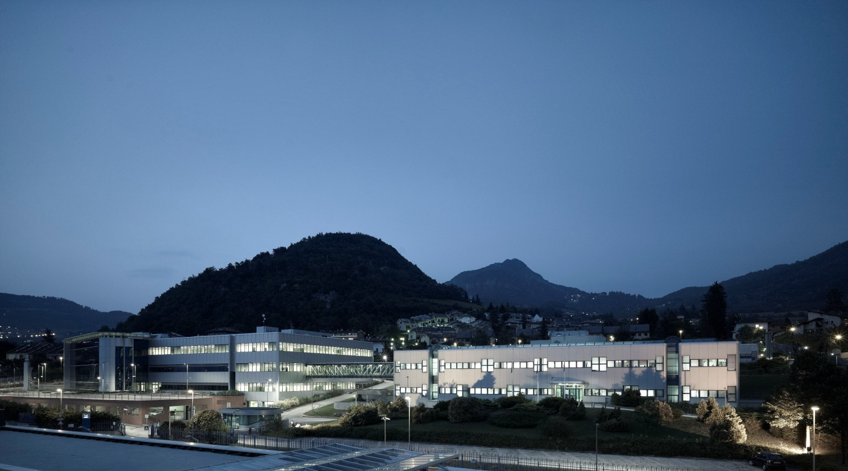
Fondazione Bruno Kessler
Centre for Materials and Microsystems

Slide 2
SiPM Technology at FBK
A. Gola, F. Acerbi, A. Ferri, A. Picciotto, C. Piemonte, G. Paternoster, G. Zappalà, N. Zorzi
gola@fbk.eu, piemonte@fbk.eu
IFD 2014 – Trento – March 11-13, 2014

Slide 3
FBK technology evolution
Original technology
2006
2010-11
2012
NUV-SiPM
(Near-UV SiPM)
excellent breakdown voltage uniformity
low breakdown voltage temperature
dependence
high efficiency in the near-ultraviolet
very low dark noise
RGB-SiPM
(Red-Green-Blue SiPM)
excellent breakdown voltage uniformity
low breakdown voltage temperature
dependence
higher efficiency
very low dark noise
new
junction
electric field
engineering
2012
RGB-SiPM HD
(Red-Green-Blue SiPM – high density)
small cell size with high fill factor
new cell
border
IFD 2014 – Trento – March 11-13, 2014

Slide 4
RGB-HD
high density
IFD 2014 – Trento – March 11-13, 2014

Slide 5
Why small cells?
1. Lower correlated noise, because of lower gain (lower C_{d}):
- lower afterpulsing
- possibly lower direct and delayed Optical CT
- lower external Optical CT (with scintillator).
2. Larger linear dynamic range.
3. Faster recharge time.
- reduced pile-up
- useful with «slow» scintillators (CsI) for further extended
dynamic range
All are important to optimize spectroscopic and timing
performance.
IFD 2014 – Trento – March 11-13, 2014

Slide 6
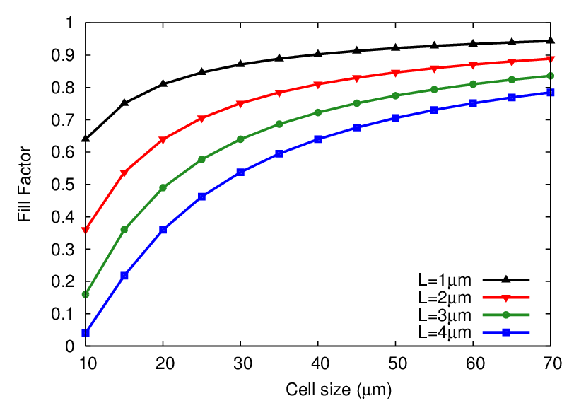
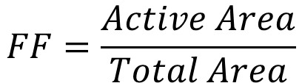
Difficult? Yes.
New Technology
Old Technology
L is the dead border region around a cell
The Fill Factor (FF), also called geometrical efficiency, is the ratio:
$$FF=\frac{Active Area}{Total Area}$$
We completely re-designed the cell border structure of the RGB technology to have small cells with high fill factor using trenches.
RGB-HD structure: L < 2 um (originally it was 7 um).
IFD 2014 – Trento – March 11-13, 2014

Slide 7
RGB-HD optimal cell size
For a given border dead space, the choice of the optimal cell size is not obvious:
Larger cells provide higher Fill Factor (FF) and thus higher PDE.
Smaller cells reduce the correlated noise, which ultimately limits the over-voltage and thus the PDE.
We produced many cell sizes and characterized their performance experimentally.
(measurements are ongoing)
IFD 2014 – Trento – March 11-13, 2014

Slide 8
RGB-HD Layouts
Very good linearity!
All are much smaller than the traditional 50 um (67 um) cells!
High Fill Factor
IFD 2014 – Trento – March 11-13, 2014

Slide 9
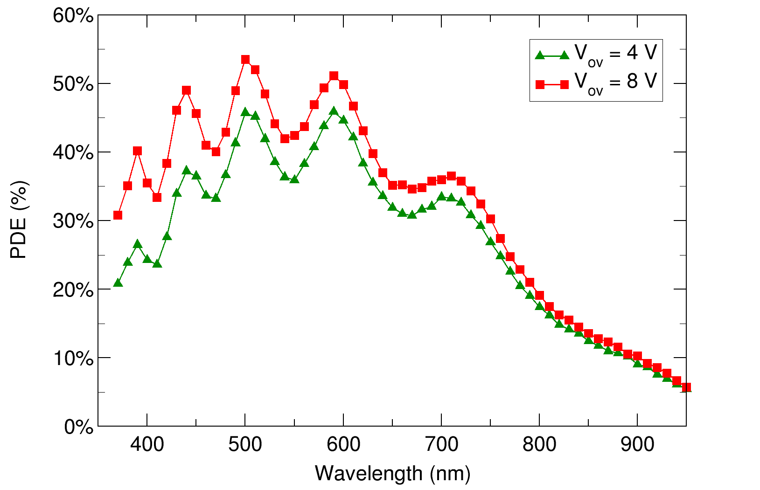
Photo Detection Efficiency (PDE)
RGB SiPM technology:
Peak PDE in the blue/green
30 um cell
Without correlated noise!
IFD 2014 – Trento – March 11-13, 2014

Slide 10
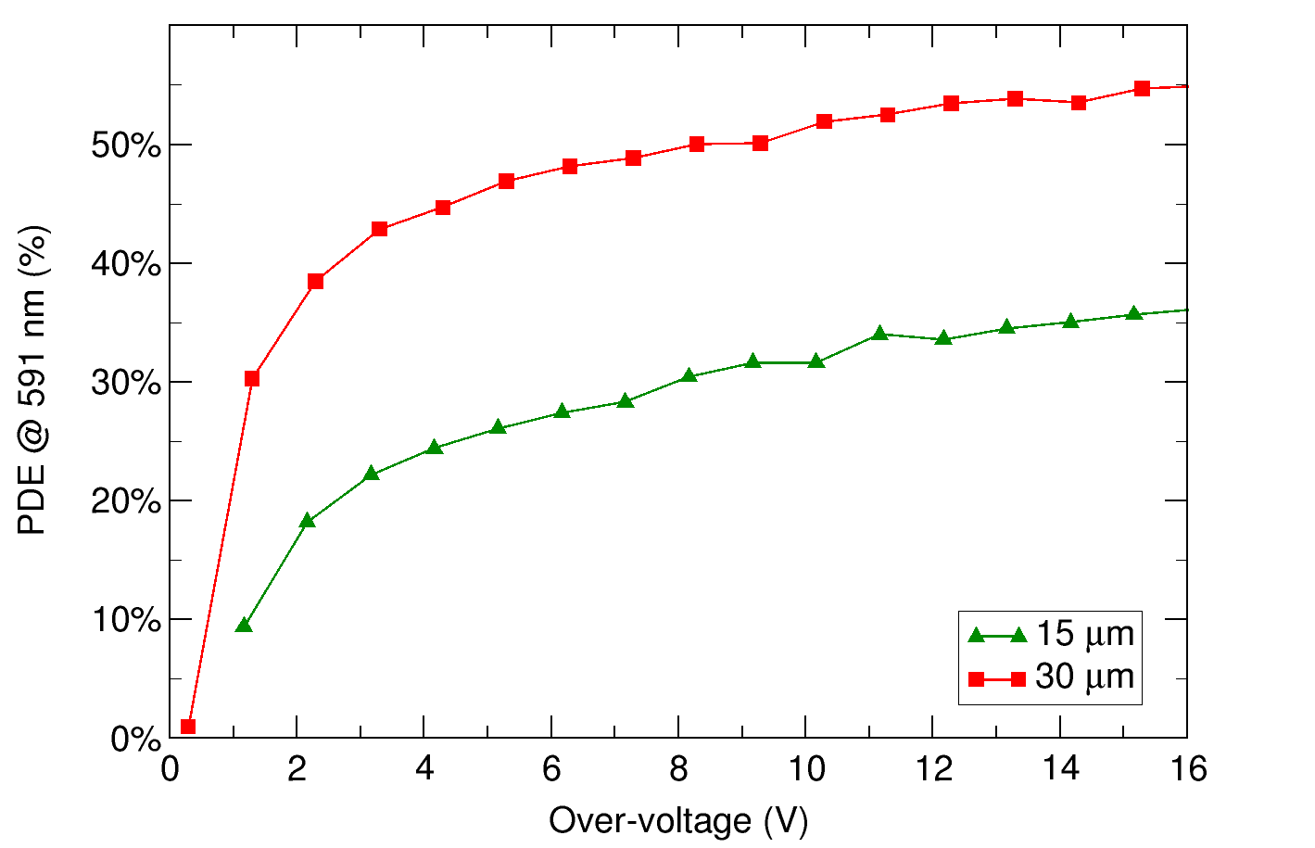
Photo Detection Efficiency
591 nm
Larger cells and FF, same technology
(without correlated noise)
IFD 2014 – Trento – March 11-13, 2014

Slide 11
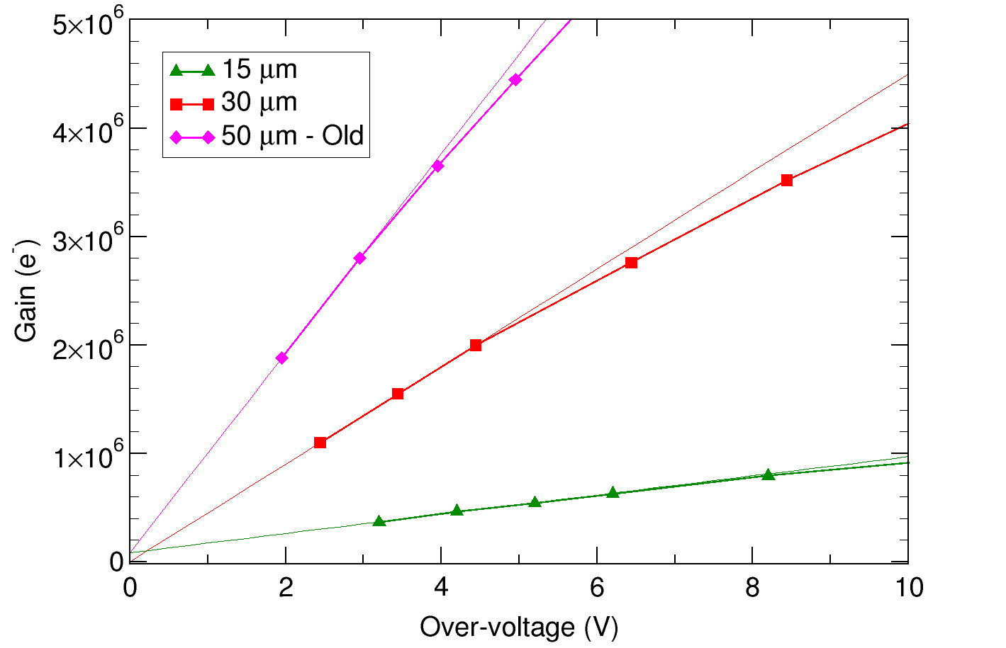
Gain
Old Technology
Smaller cells
IFD 2014 – Trento – March 11-13, 2014

Slide 12
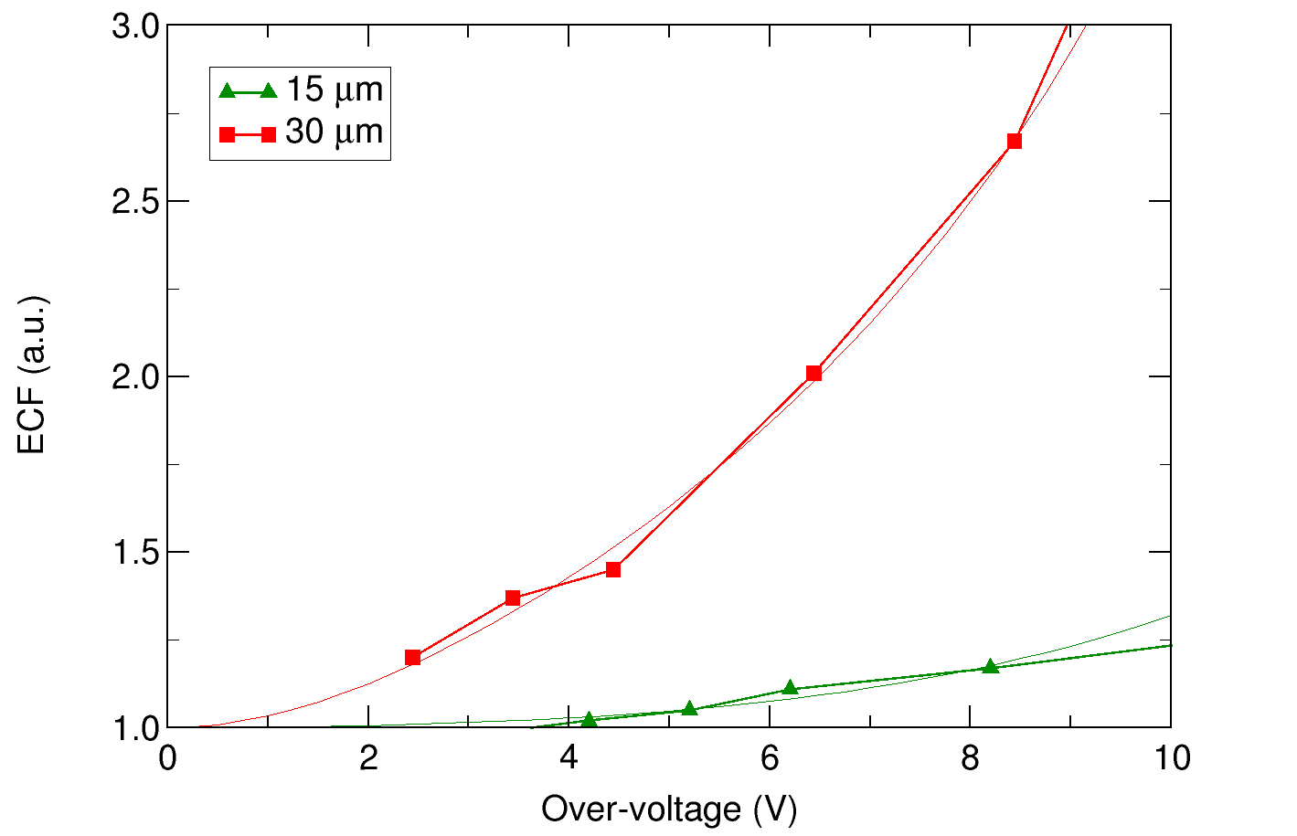
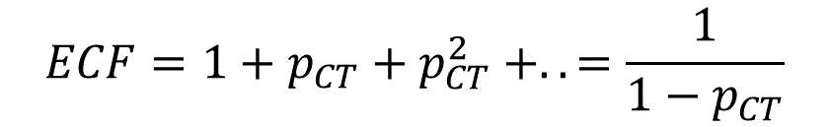
Excess Charge Factor (ECF)
The ECF can be considered an upper bound for the Excess Noise Factor.
$$ECF=1+p_{CT}+p_{CT}^{2} +..=\frac{1}{1−p_{CT}}$$
Smaller cells
IFD 2014 – Trento – March 11-13, 2014

Slide 13
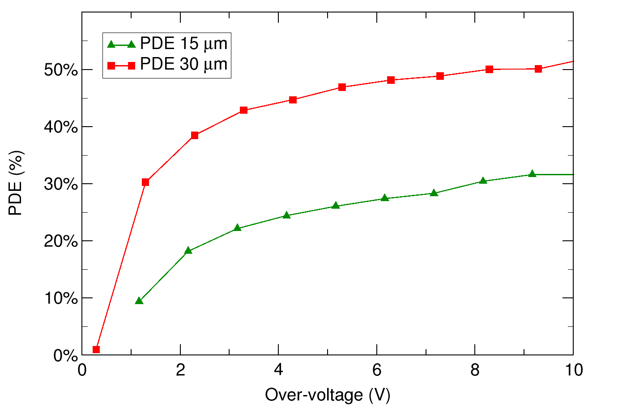
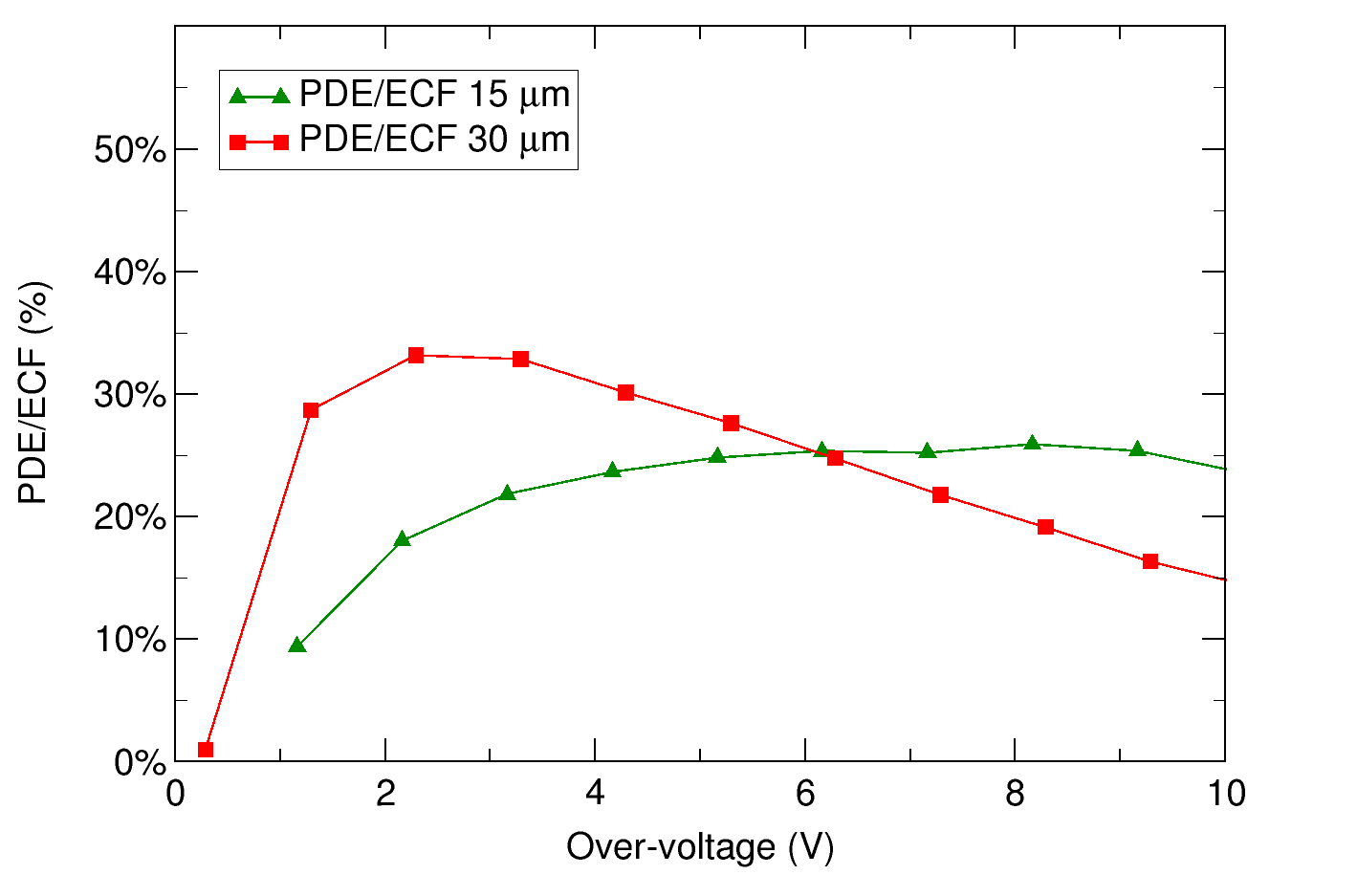
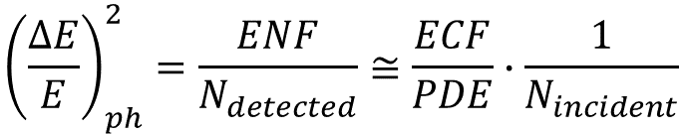
PDE/ECF
Quantifies the worsening of the Poisson statistics due to the photo-detector → “effective” PDE
$${\left(\frac{∆E}{E}\right)}_{ph}^{2}=\frac{ENF}{N_{detected}}≅\frac{ECF}{PDE}∙\frac{1}{N_{incident}}$$
591 nm
At high V_{OV}, smaller cells are more efficient than larger ones due to ENF
IFD 2014 – Trento – March 11-13, 2014

Slide 14
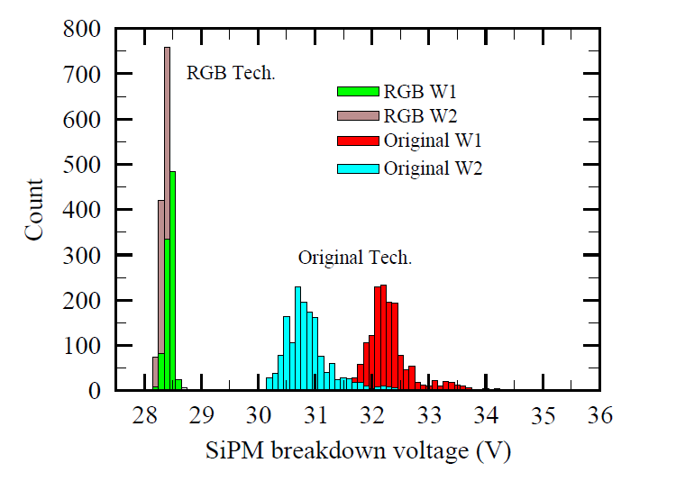
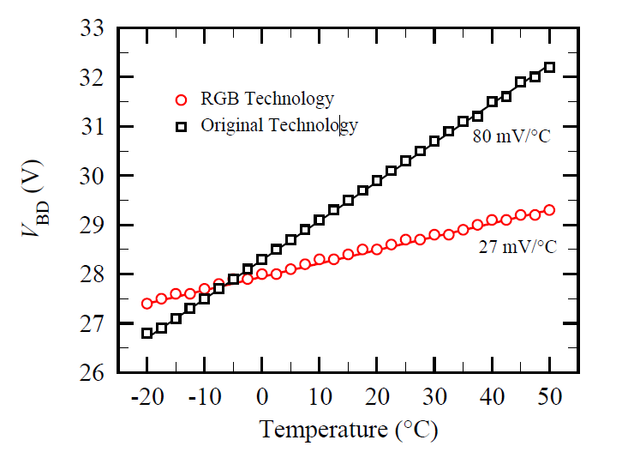
V_{BD} Uniformity and Temp. Stability
V_{BD} variations < ± 150 mV
inside the wafer and between
wafers.
Gain temperature stability
ΔG/G < 1%/°C is possible!
Important at the system-level
Breakdown voltage (V_{BD})
uniformity
Breakdown voltage
variations with T
IFD 2014 – Trento – March 11-13, 2014

Slide 15
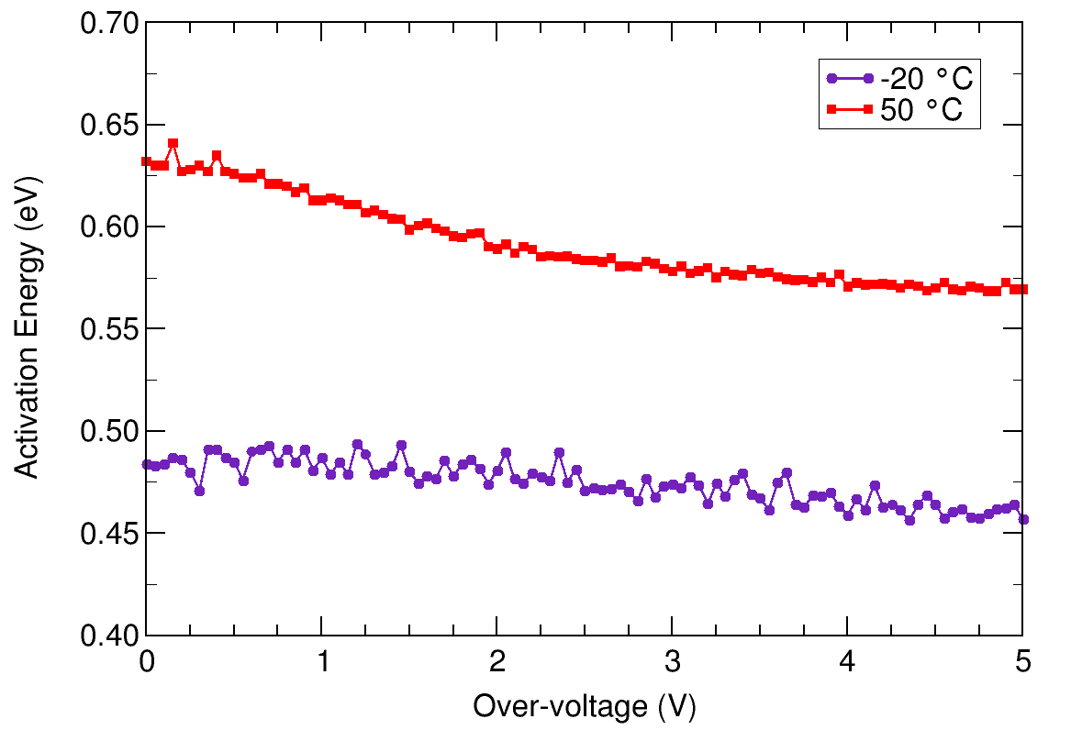
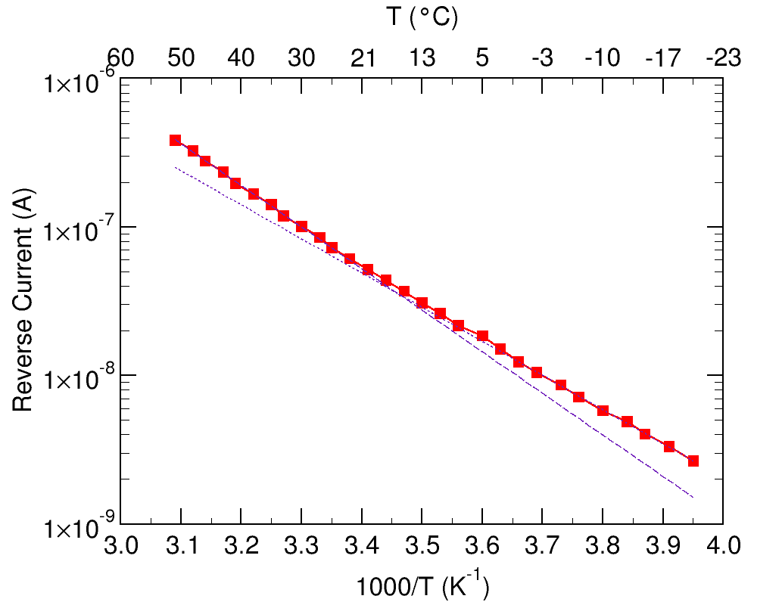
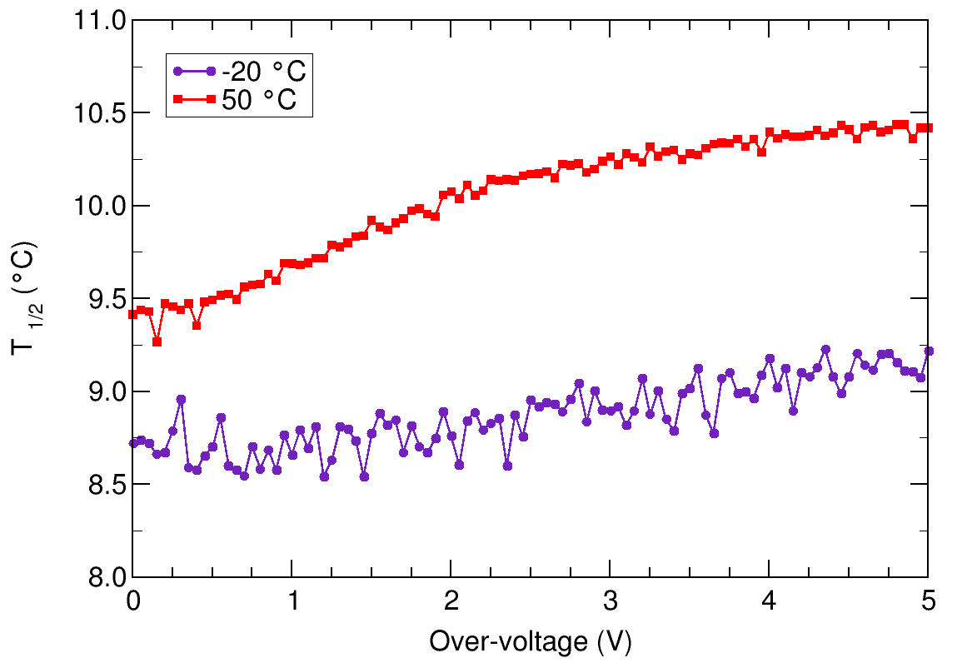
Temperature dependence of DCR
Electric Field Engineering for
low band-to-band tunneling
≈ E_{g}/2
20 um cell
4 V_{OV}
Fast DCR reduction with T
Arrhenius plot of SiPM reverse current
IFD 2014 – Trento – March 11-13, 2014

Slide 16
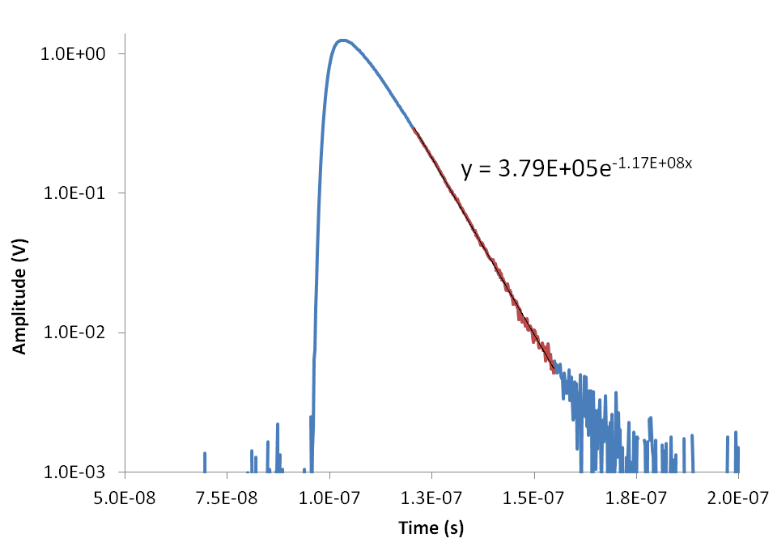
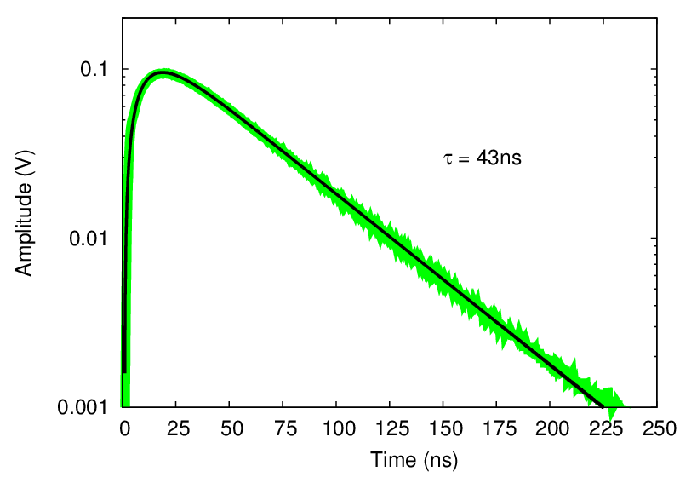
Signal Shape
15 um cell
Response to fast light
pulse from LED
Response to LYSO (511keV)
τ = 9ns
τ = 43ns
Very fast single cell response (SCR)
Thanks to the fast SCR, the LYSO decay time constant is preserved.
IFD 2014 – Trento – March 11-13, 2014

Slide 17
Radiation Damage in SiPMs
The main effects of radiation damage, in SiPMs, are:
Mitigation of the effects of rad. damage with RGB-HD:
Increase in the primary noise (DCR).
E field engineering allows a steeper reduction of DCR with cooling.
Increased afterpulsing (increased number of traps).
Low gain reduces afterpulsing (for a given number of traps).
PDE loss due to cells busy with dark counts.
Many, smaller cells with faster recharge are less sensitive to the phenomenon.
Increased power consumption due to higher DCR.
Lower gain means less current (for a given DCR).

Slide 18
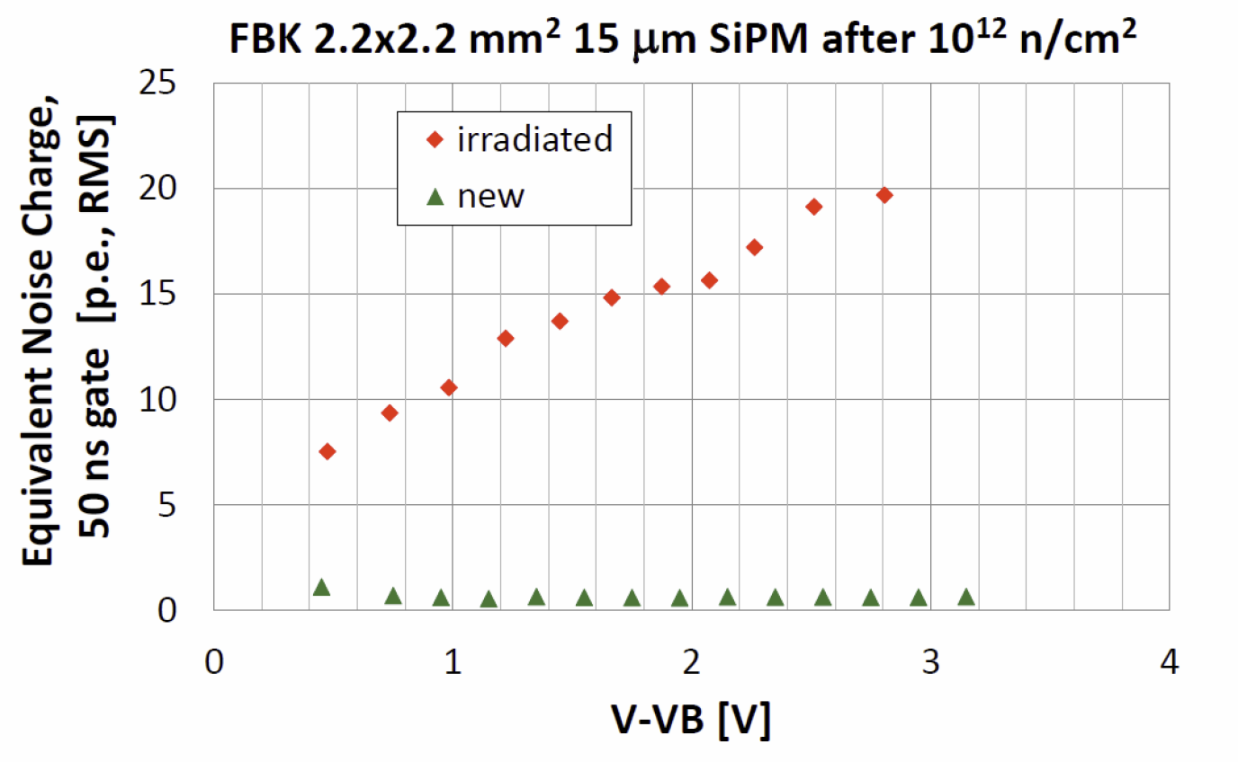
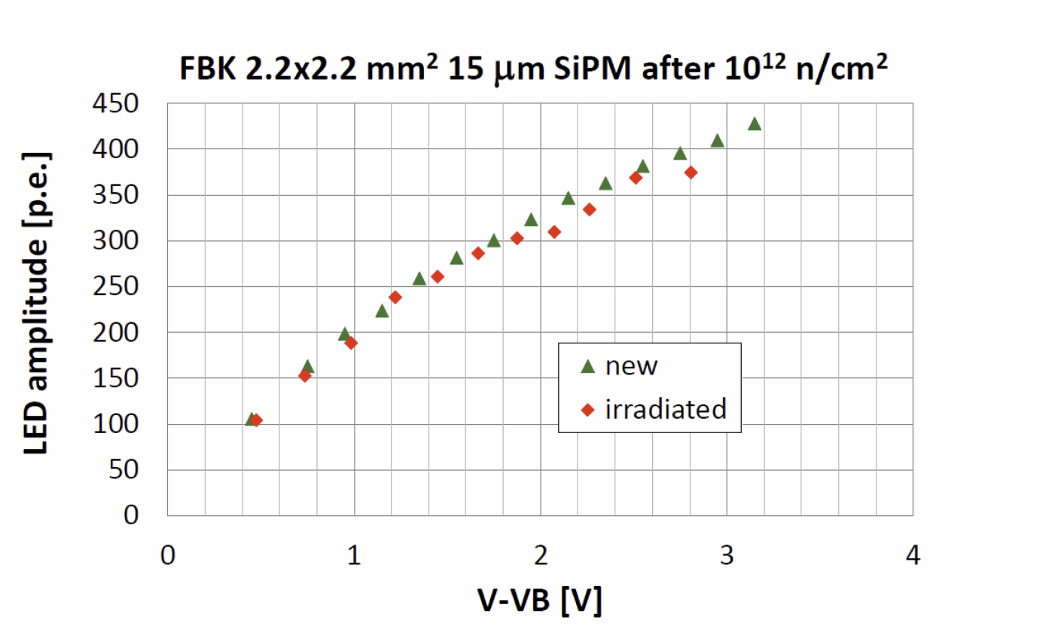
Measurements after Irradiation
Measurements carried out by Y. Musienko and A. Heering @CERN, with a dose of 10¹² n/cm².
After irradiation:
Dark current increased up to 450 μA
Gain*PDE change is < 10%
PDE change is < 10%
ENC(50ns gate) ~ 20 p.e. RMS
Noise increase
Parameters measured at V_{OV}=2.7 V (PDE(515 nm)=15%)
PDE loss
IFD 2014 – Trento – March 11-13, 2014

Slide 19
Thank you!

Slide 20
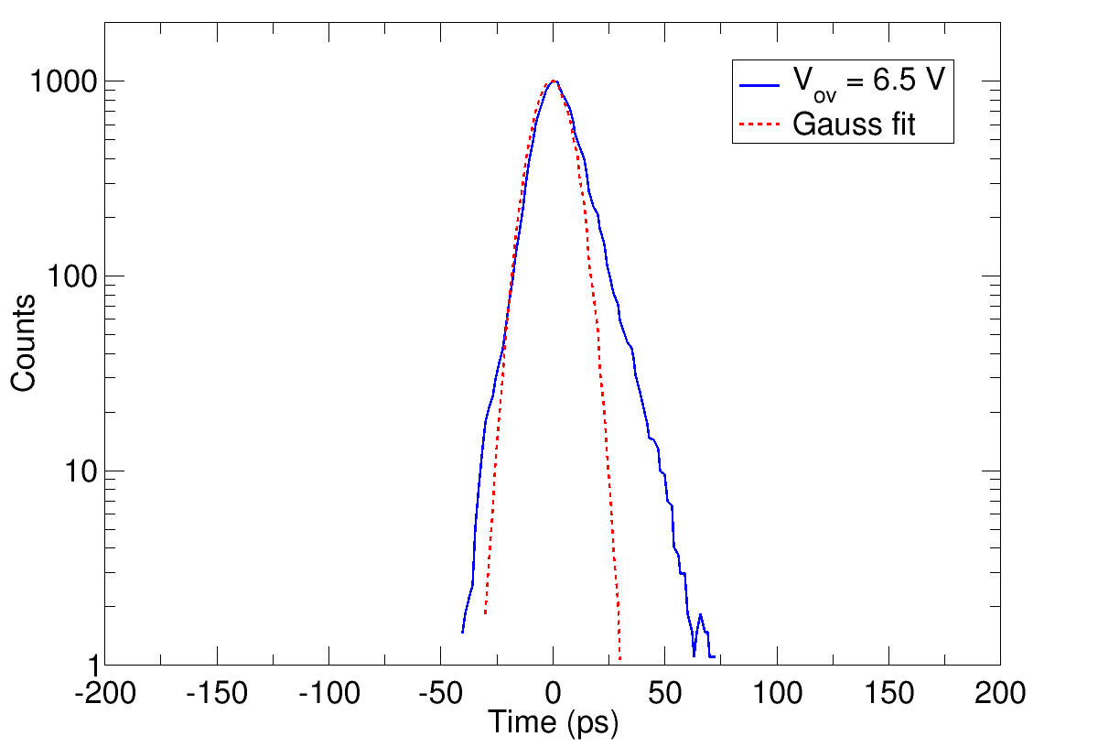
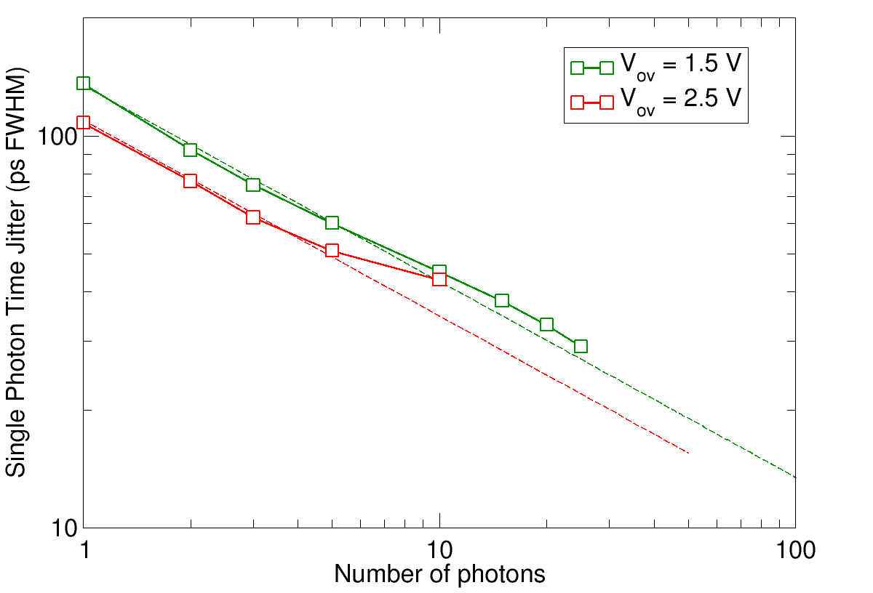
Timing Resolution (hints)
10 um SPAD
1x1 mm² SiPM – 50 um cell
FWHM ≈ 20 ps!
~1/sqrt(N)
30 ps FWHM
Single photon time resolution
Time resolution vs. number of photons
Measurements on older RGB-SiPM technology at 23 °C.

