Slide 1
SuperKEKB Status
Report del SuperKEKB Commissioning Workshop, KEK, Nov. 13th 2013
M.E. Biagini, INFN-LNF

Slide 2
Outlook
SuperKEKB Overview
Beam dynamics & backgrounds
Interaction region
Injection system
Commissioning plans
Conclusions

Slide 3
Workshop Talks
Overview of SuperKEKB, commissioning plan, issues, Y. Funakoshi (KEK)
Injector commissioning and issues, M. Satoh (KEK)
Photo-cathode RF gun, T. Natsui (KEK)
Positron source, T. Kamitani (KEK)
Timing synchronization, H. Kaji (KEK)
Linac alignment, T. Higo (KEK)
Beam optics design for simultaneous injection, T. Miura (KEK)
Injection, beam abort,T. Mori (KEK)
DR LTR, RTL, M. Kikuchi (KEK)
DR beam monitors, H. Ikeda (KEK)
DR tuning, Y.Renier (CERN)
Ring optics design and correction, H. Sugimoto (KEK)
Beam-beam + dynamic aperture, A. Morita (KEK)
Beam-beam + lattice nonlinear + space charge, D. Zhou (KEK))
Beam-beam and e-cloud,K. Ohmi (KEK)
Beam sizes, J. FLANAGAN (KEK)
HOM Effects in PEP-II, A. Novokhatski (SLAC)
Vacuum effects in PEP-II, U. Wienands (SLAC)
LHC Commissioning, F. Zimmermann (CERN)
Optics correction @ the LHC, R. Tomas (CERN)
CESR TA Overview, D. Rubin (Cornell)
Tau-Charm Plans at Tor Vergata, M. Biagini (INFN-LNF)
BEPC-II beam commissioning, D. Zhou (KEK)
PEP-II Beam Commissioning: Some Lessons Learned, M. Sullivan (SLAC)
IP feedback, T. Oki (KEK)
IR magnet measurements, Y. Arimoto (KEK)
Beam collimators, T. Ishibashi (KEK)
Background estimation, H. Nakayama (KEK)
Background experience at PEP-II, W. Kozanecki (CEA)
Overview of SuperB and Tau-Charm Factory Backgrounds and Lifetime, M. Boscolo (INFN-LNF)
Emittance tuning at CESR-TA, J. Shanks (Cornell)
Electron Cloud Induced Beam Dynamics Studies at CESR-TA, K. Sonnad (Cornell)
IBS studies at CesrTA, M. Ehrlichman (CLASSE)
Emittance tuning at ATF II and FACET, G. White (SLAC)
PEP-II rf system experience, C. Rivetta (SLAC)
Bunch-by-bunch feedback, M. Tobiyama (KEK) )
Bunch-by-bunch feedback experience at DAFNE, and DAFNE status report, A. Drago (INFN-LNF) )
Continuous injection experience at PEP-II, U. Wienands (SLAC) )
Collider commissioning strategies, J. Seeman (SLAC)

Slide 4
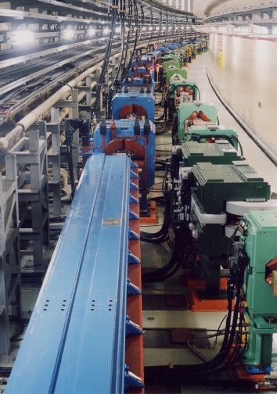

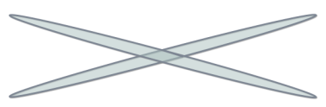
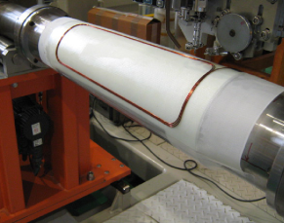
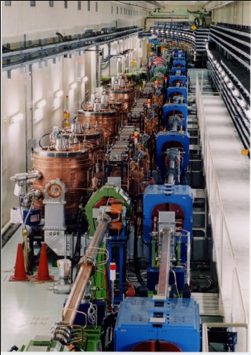


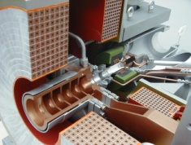
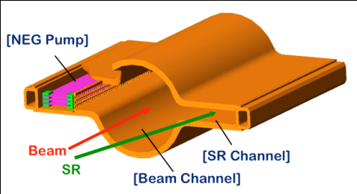
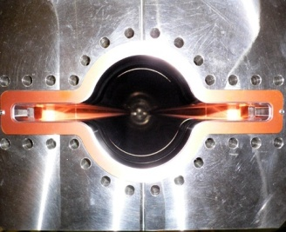

What’s new at SuperKEKB
Belle II
e⁺ 4GeV 3.6 A
Colliding bunches
New IR
e⁻ 7GeV 2.6 A
New superconducting final focusing quads near the IP
New beam pipe
& bellows
SuperKEKB
Replace short dipoles with longer ones (LER)
Add / modify RF systems for higher beam current
Low emittance positrons to inject
Positron source
Redesign the lattices of LER to squeeze the emittance
Damping ring
New positron target / capture section
TiN-coated beam pipe with antechambers
Low emittance gun
Low emittance electrons to inject
Target: L = 8x10³⁵/cm²/s

Slide 5
Machine Design Parameters
parameters |  | KEKB |  | SuperKEKB |  | units
 |  | LER | HER | LER | HER
Beam energy | Eb | 3.5 | 8 | 4 | 7.007 | GeV
Half crossing angle | φ | 11 |  | 41.5 |  | mrad
# of Bunches | N | 1584 |  | 2500
Horizontal emittance | εx | 18 | 24 | 3.2 | 4.6 | nm
Emittance ratio | κ | 0.88 | 0.66 | 0.27 | 0.25 | %
Beta functions at IP | βx*/βy* | 1200/5.9 |  | 32/0.27 | 25/0.30 | mm
Beam currents | Ib | 1.64 | 1.19 | 3.6 | 2.6 | A
beam-beam param. | ξy | 0.129 | 0.090 | 0.088 | 0.081
Bunch Length | σz | 6.0 | 6.0 | 6.0 | 5.0 | mm
Horizontal Beam Size | σx∗ | 150 | 150 | 10 | 11 | um
Vertical Beam Size | σy∗ | 0.94 |  | 0.048 | 0.062 | um
Luminosity | L | 2.1 x 10³⁴ |  | 8 x 10³⁵ |  | cm⁻²s⁻¹
x4
x1.4
/6
/40
/20
x2
/15
/20

Slide 6
Issues
IR design and dynamic aperture
Low emittance tuning
Magnet alignment strategy
Beam-beam related issues
IP orbit control
Beam loss and beam injection
Electron clouds
Detector beam background

Slide 7
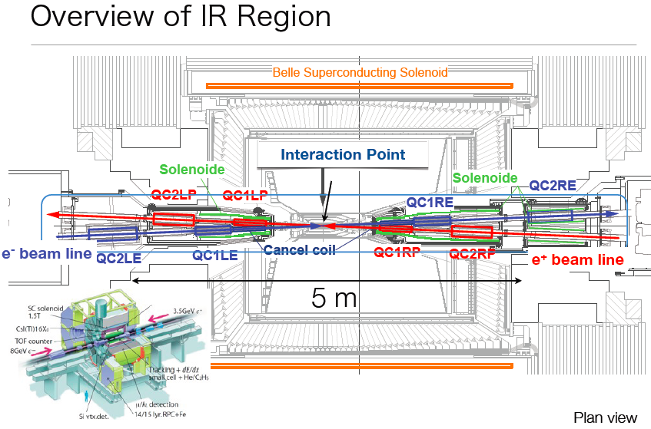

Slide 8
Interaction Region

Slide 9
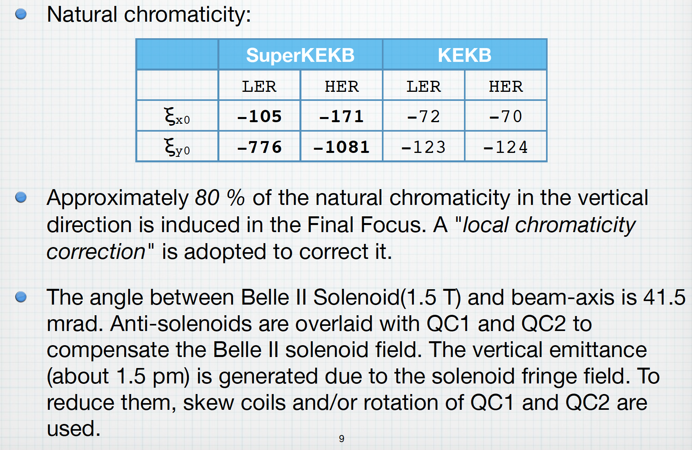
IR design features

Slide 10
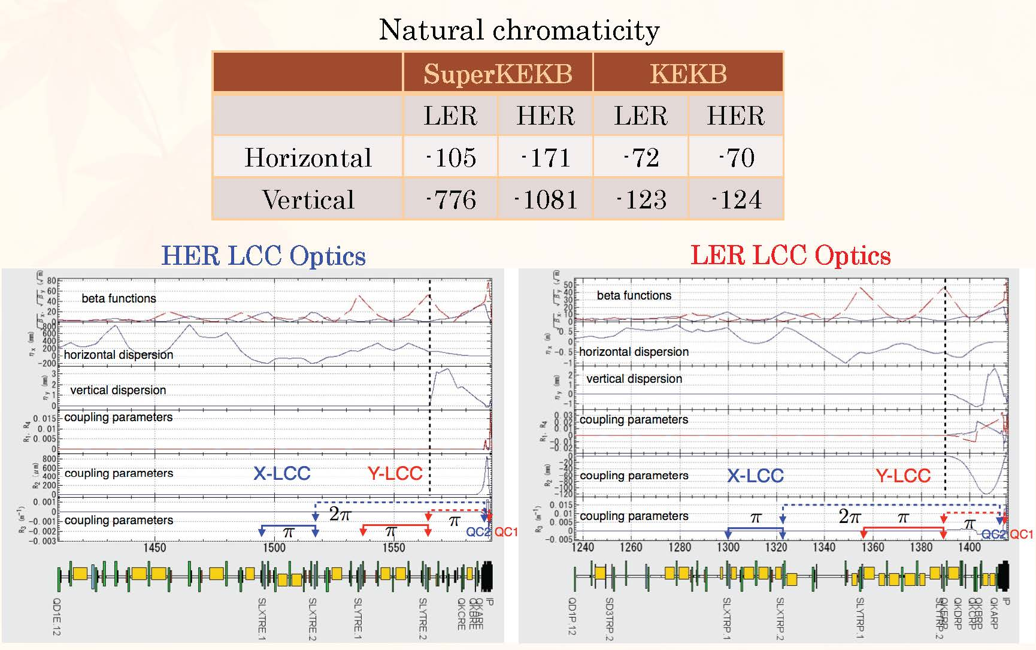
goal: β_{y}*=0.3 mm, ε_{y}≈3 pm, τ_{touschek}≥600 s
local
chromatic
correction
H. Sugimoto

Slide 11
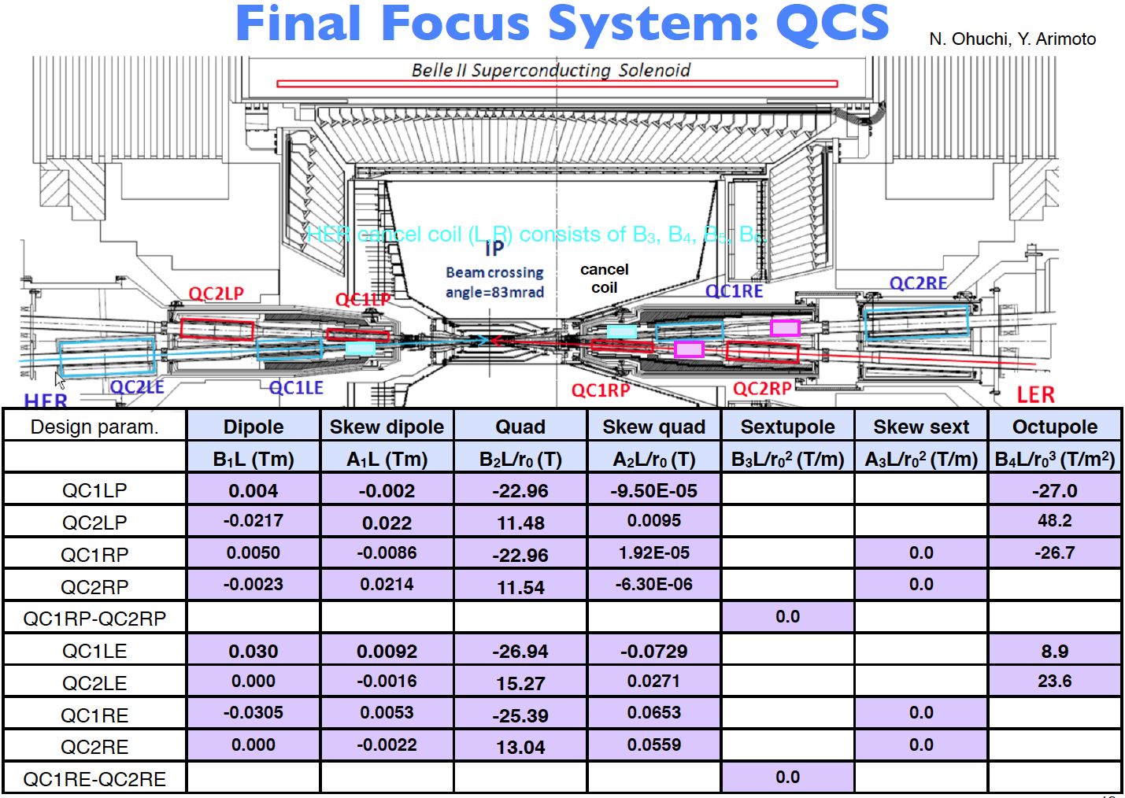
Y. Ohnishi

Slide 12
Corrector coils
Dipole and skew dipole coils make beam-line geometry and correct dispersions
Skew quadrupole coils correct x-y couplings
Sextupole and skew sextupole coils correct error field due to a misalignment of quadrupole coils. This error field affects the dynamic aperture significantly
Octupole coils at QC1 and QC2 enlarge the transverse aperture
HER cancel coils correct sextupole, octupole, decapole and dodecapole leakage field from QC1P in LER

Slide 13
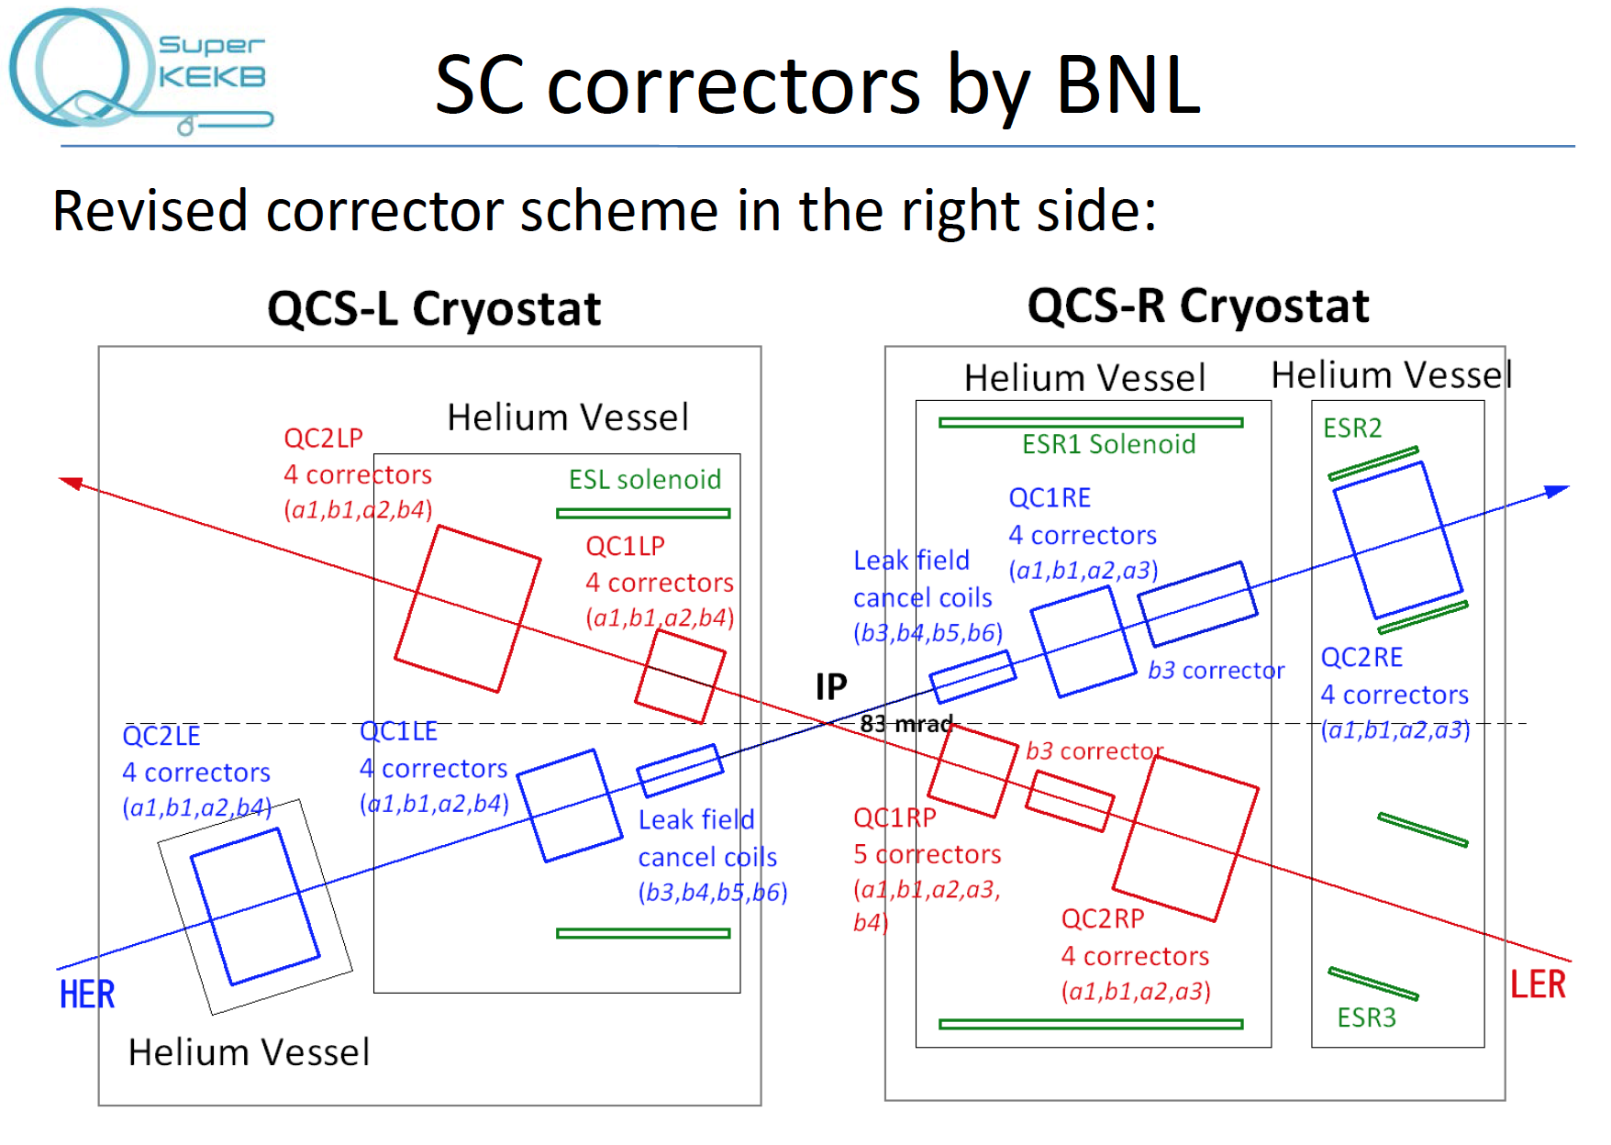

Slide 14
IR magnets measurements
Crowded IR, with 8 quadrupoles, 48 correcting coils, 4 antisolenoids, all superconducting and packed in 10 m
Magnets have to have high precise field with highly stable:
  Field harmonics components,
  Magnet axis center,
  Vibration of magnet and cryostat

Slide 15
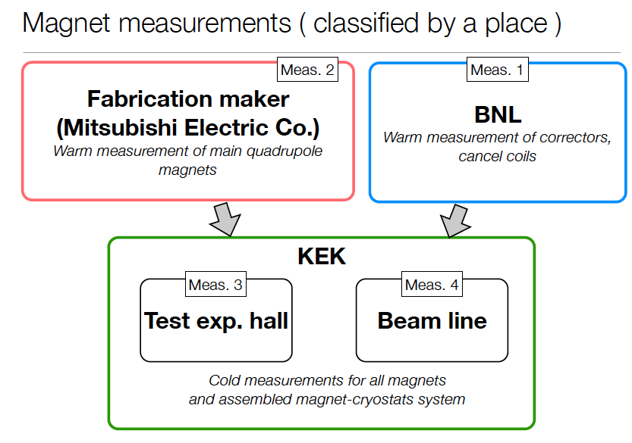

Slide 16
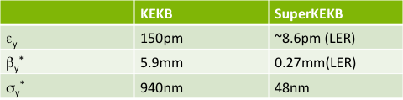
IP feedback
The IP orbit control to maintain an optimum beam collision is more difficult than the KEKB case
IP orbit is very sensitive to the vibration of QCS (QC1, QC2) magnets
For vertical offset and angle feedback:
  Orbital feedback system is under consideration. It was used for KEKB and is based on beam-beam kick calculated from the BPM readouts at both sides of the IP (4 BPMs at 0.5m from IP)
  Target resolution of BPM is the order of micrometer
  Prototype BPM was tested by using sinusoidal input signal and 0.1 mm resolution has been obtained, successfully
For horizontal offset feedback:
  Luminosity dither is being considered as used for PEP-II, because beam-beam kick will not be a sensitive parameter for monitoring collision due to small H beam-beam parameter
  Coils in construction at SLAC: designed for the maximum dithering amplitude, which corresponds to 10 % drop of the peak luminosity

Slide 17
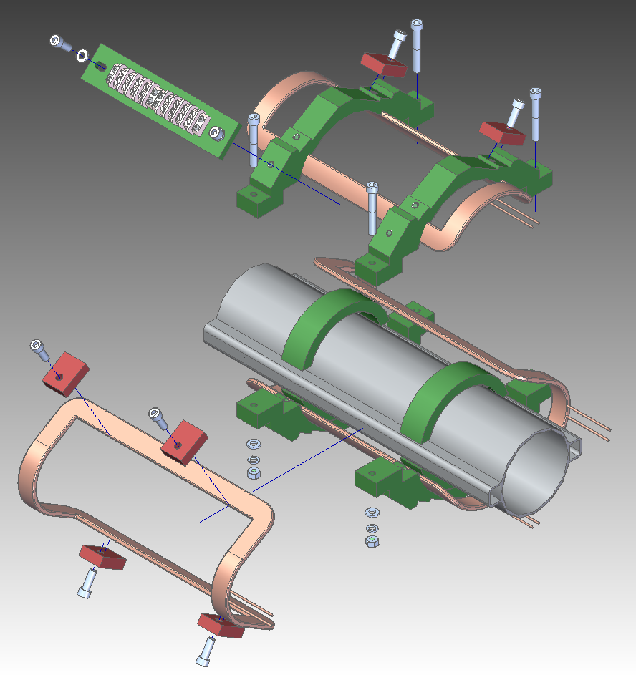
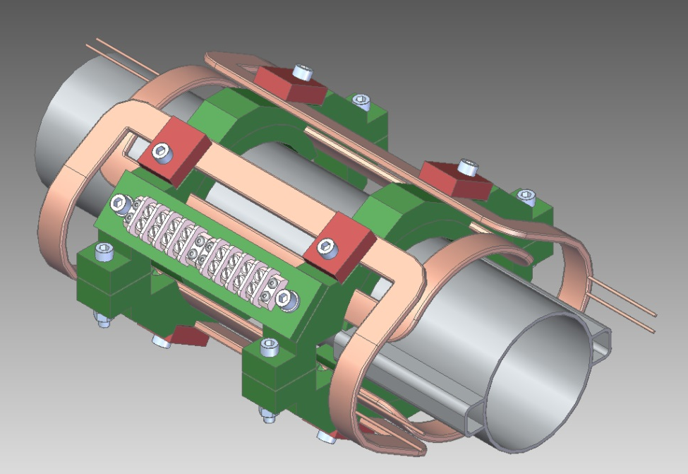
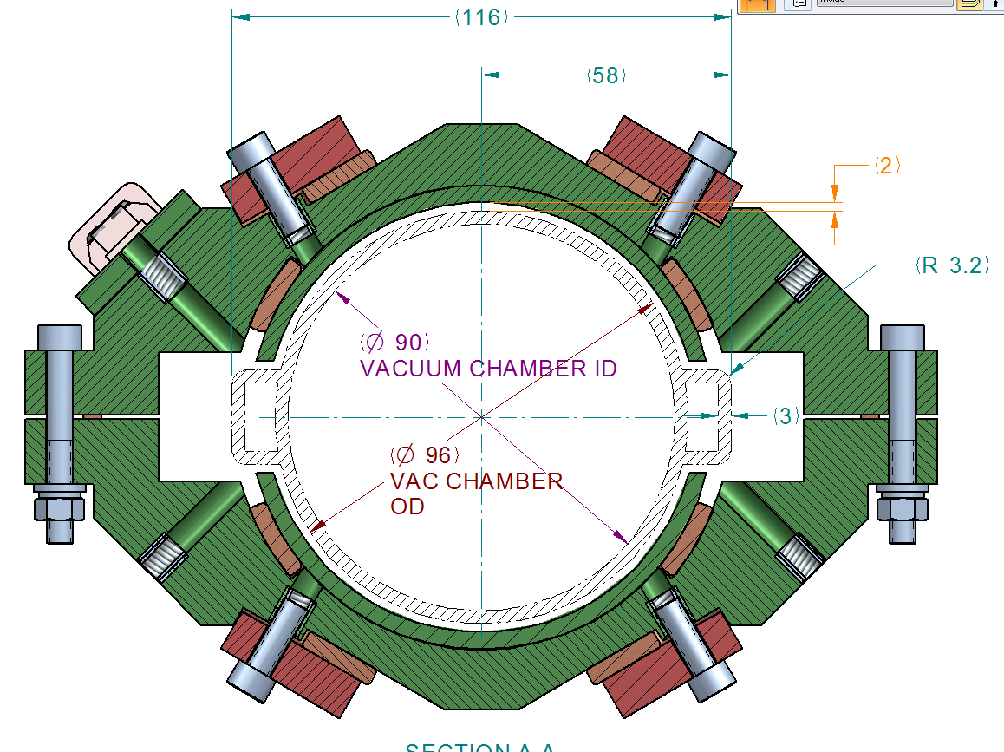
Coil mechanical design
Design work is under way.
Coils will be delivered to KEK
by the end of 2013 after field measurement.
M. Kosovsky, SLAC

Slide 18
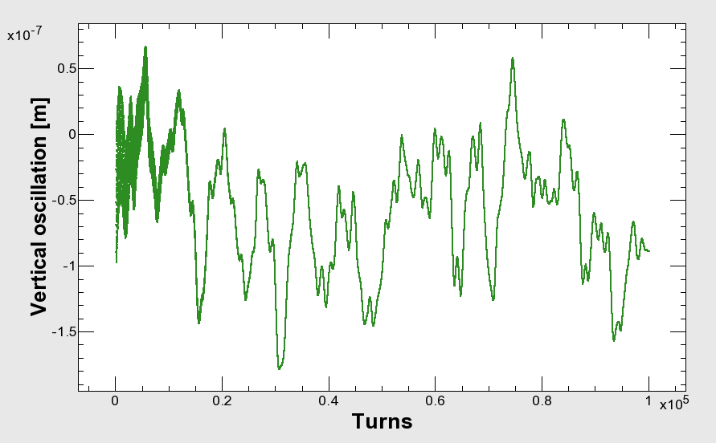
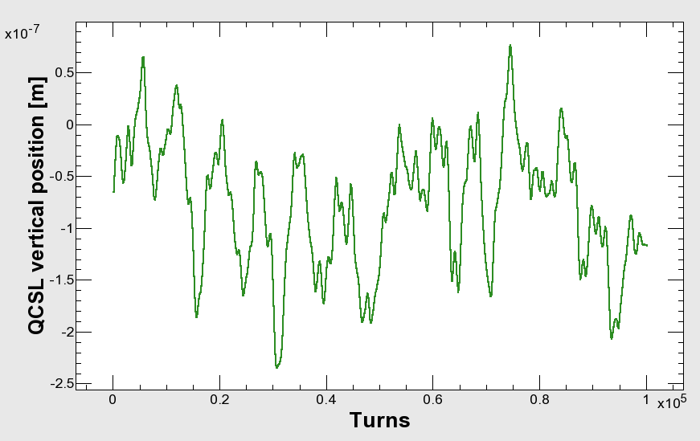
QCSL vertical position oscillation (measurement) and orbit change (tracking) : SuperKEKB HER
Vertical orbit at IP
(simulation)
QCSL vertical position
(KEKB measurement) → QC1L (HER)
200nm -> ~4σ_{y}*
If the QC1L magnets of SuperKEKB vibrates with the same amplitude
of the QCSL of the KEKB, the orbit change at IP amounts to 4σ_{y}*.

Slide 19
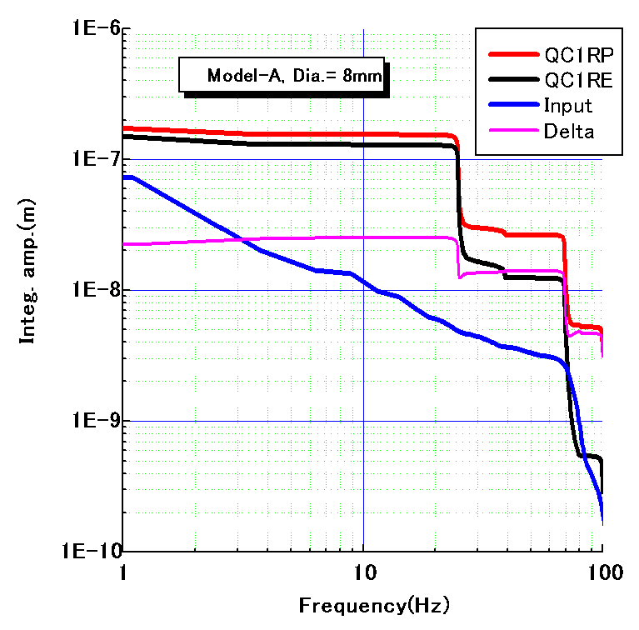
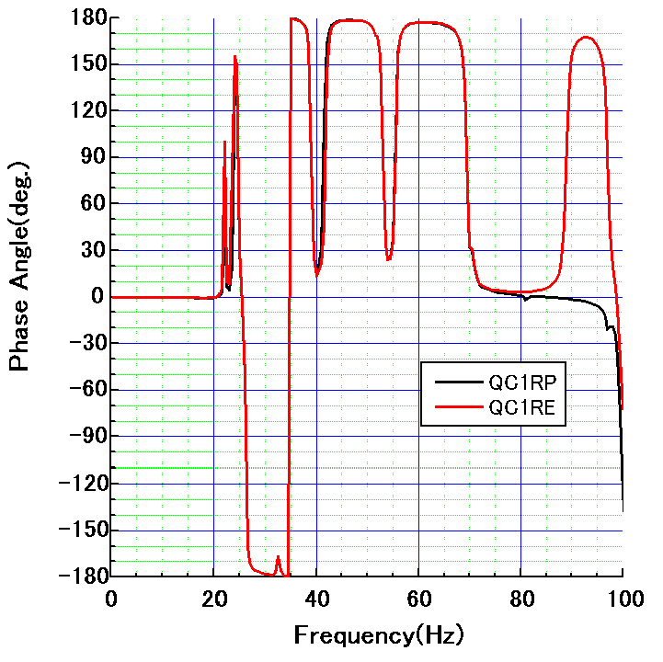
Estimation of QCS vibration and luminosity degradation
1000
100
10
1
0.1
(vertical)
Integral amplitude (nm)
Measured
ground motion
(input data)
Phase (deg.)
25 nm@25 Hz
H. Yamaoka
QC1RP and QC1RE vibrate with same phase,
but the amplitude difference still arises: 25 nm at 25 Hz…
Luminosity degradation (based on beam-beam simulation by K. Ohmi)
Freq. (Hz) | 24.85 | 38.93 | 69.34 | 99.60
Δy_{IP*}^{rms} (nm) | 18.63 | 1.72 | 8.29 | 3.14
L/L₀^{average} (%) | 95.4 | 99.8 | 99.7 | 99.7
Y. Funakoshi

Slide 20
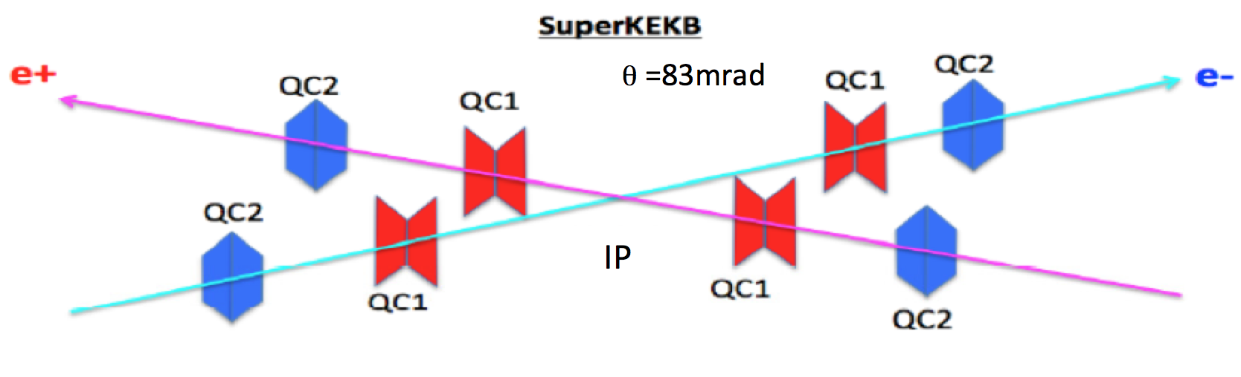
Countermeasures
Reinforcement of supports for QCS magnets
Rely on the coherency of the oscillation of QC1P and QC1E (QC2P and QC1E)
Fast orbit feedback

Slide 21
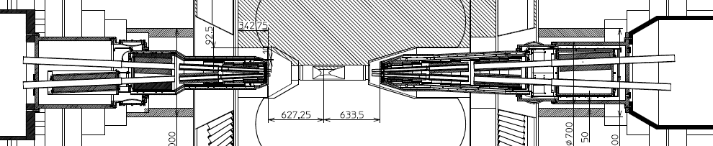
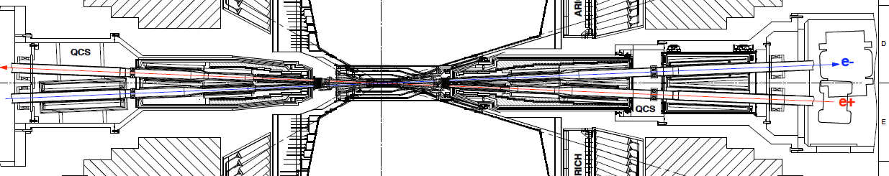
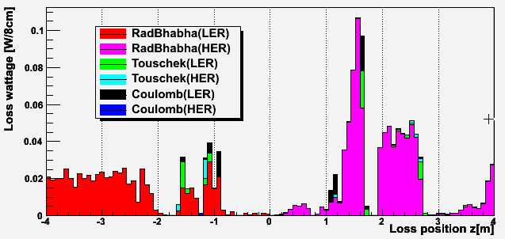
BG loss distribution
Ver. 2013.6.12
(6th campaign)
Loss wattage
= loss rate
* energy of loss particle
HER
(e-)
LER(e+)
1GeV ,1GHz
= 0.16W
 | LER (4GeV e+) | HER (7GeV e-)
Rad. Bhabha | 0.63 W (eff. 0.98GHz) | 0.88W (eff. 0.78GHz)
Touschek | 0.07 W (0.11GHz) | 0.02 W (0.02 GHz)
Coulomb | 0.07 W (0.10GHz) | 0.001W (0.001GHz)

Slide 22
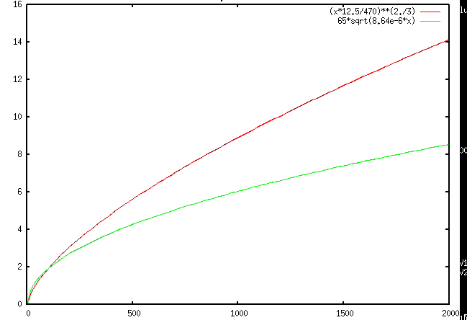
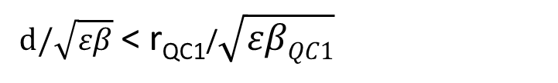
Where we should put vertical collimator?
Collimator position
Collimator aperture should be narrower than QC1 aperture.
d[mm]
TMC:
Aperture
TMC instability should be avoided.
Assuming following two formulae:
beta[m]
> 1.44 mA/bunch (LER)
taken from “Handbook of accelerator
physics and engineering, p.121”
Kick factor
(in case of rectangular collimator window)
We should put collimator where beta_y is SMALL!
Notes:
d[mm], beta[m]
beta* 12.5/sqrt(d^3) < 470 → sqrt(d^3) < beta * 12.5 / 470 → d < (beta*12.5/470)^(2/3)
d/1000/sqrt(8.64e-12*beta)) > 65 → d > 65 * sqrt(8.64e-6*beta)
betax8, dx4,Nsigmaxsqrt(2)

Slide 23
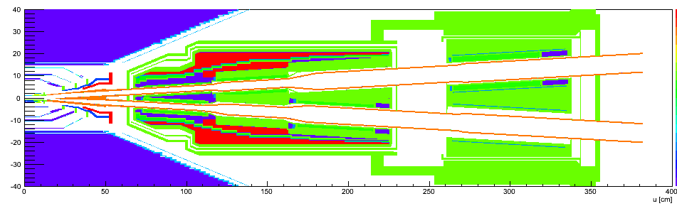
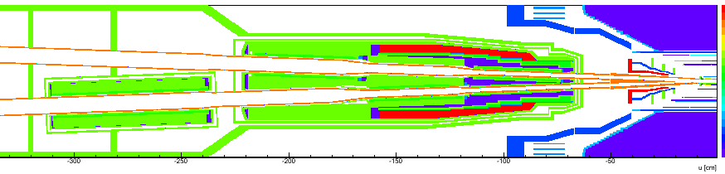
Tungsten shields inside QCS cryostat
tungsten (10mm t)
tungsten
(20~70mm t)
tungsten (50mm t)
QC2RE
e-
QC1RE
QC1RP
QC2RP
tungsten
e+
tungsten(~30mm t)
tungsten (10mm t)
e+
e-
Major beam loss position and
shower development direction

Slide 24
Beam lifetime
 | KEKB (design) |  | KEKB (operation) |  | SuperKEKB
 | LER | HER | LER | HER | LER | HER
Radiative Bhabha | 21.3h | 9.0h | 6.6h | 4.5h | 28min. | 20min.
Beam-gas | 45h^{a)} | 45h^{a)} |  |  | 24.5min.^{b)} | 46min. ^{b)}
Touschek | 10h | - |  |  | 10min. | 10min.
Total | 5.9h | 7.4h | ~133min. | ~200min. | 6min. | 6min.
Beam current | 2.6A | 1.1A | 1.6A | 1.1A | 3.6A | 2.6A
Loss Rate | 0.12mA/s | 0.04mA/s | 0.23mA/s | 0.11mA/s | 10mA/s | 7.2mA/s
4nC@25Hz
2.9nC@25Hz
a) Bremsstrahlung
b) Coulomb scattering, sensitive to collimator setting
As for loss rate, beam loss accompanied with the beam injection should be added.

Slide 25
Magnet alignment strategy
The target positions of the initial alignment of SuperKEKB is a smoothed curve made from present (2013 )magnet positions (not on a plane).
The tolerance of magnets alignment around the target curve is the same as KEKB.
  Position error: 100 μm (1 σ)
  Rotational error: 100 μrad (1 σ)
    We have to rethink about this?
We will need special care for the alignment of the magnets around the local chromaticity correction.

Slide 26
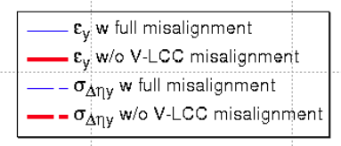
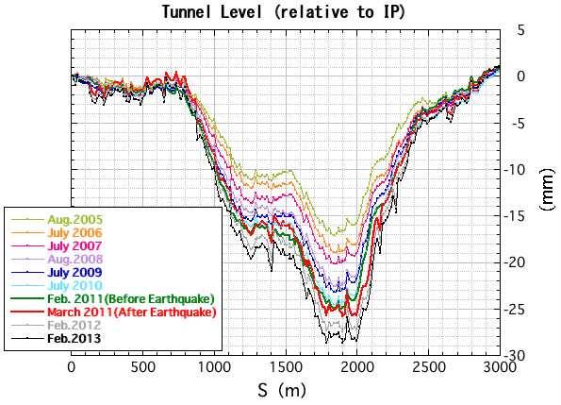
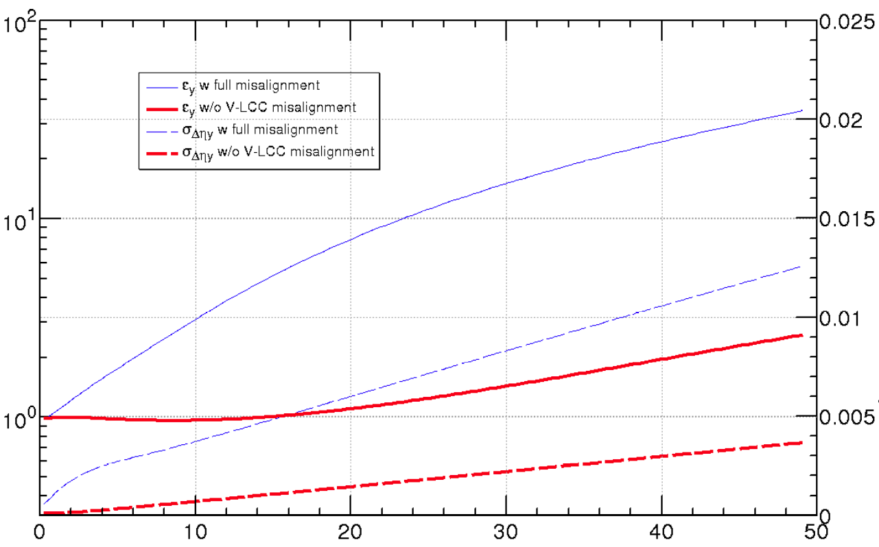



Effects of Tunnel deformation at SuperKEKB HER
Target (7.8pm)
A. Morita
Vertical emittance
-If the alignment error around the V-LCC
(vertical local chromaticity correction) area
is excluded, the vertical emittance can be
preserved well below the target value with
optics corrections.
- As for the alignment error of V-LCC, we
will need a special care. This is a remaining
problem.
Tunnel deformation observed at KEKB
- A large subsidence has been observed:
~ 2mm/year and still in progress.
- In the construction period of KEKB (1998),
all magnets were aligned on the same plane.

Slide 27
Simulation for SuperKEKB with machine errors
Simulation was done by H. Sugimoto in case of HER.
Assumed machine errors
Corrections
  Closed orbit, x-y coupling, beta-beat, dispersions (KEKB methods)
    SVD threshold = 10⁻²
 | σ_{x} = σ_{y} [μm] | σ_{θ} [μrad] | ΔK/K
Normal Quad | 100 | 100 | 2.5 x 10⁻⁴
Sextup | 100 | 100 | 2.5 x 10⁻⁴
Bend | 0 | 100 | 0
QC1, QC2 | 100 | 0 | 0
BPM | 0 | 10 x 10³ | 2μm (resolution)
Machine errors are created randomly with gaussian distributions.

Slide 28
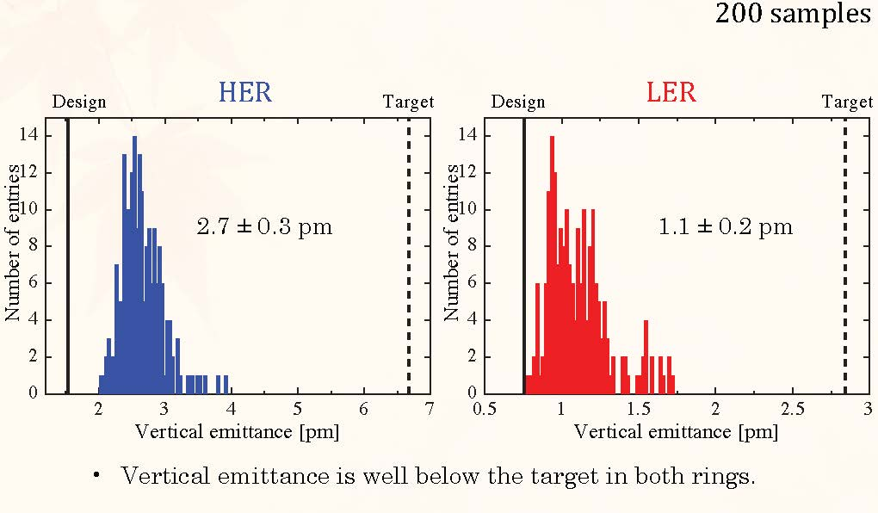
vertical emittance w errors & correction
OK!
H. Sugimoto

Slide 29
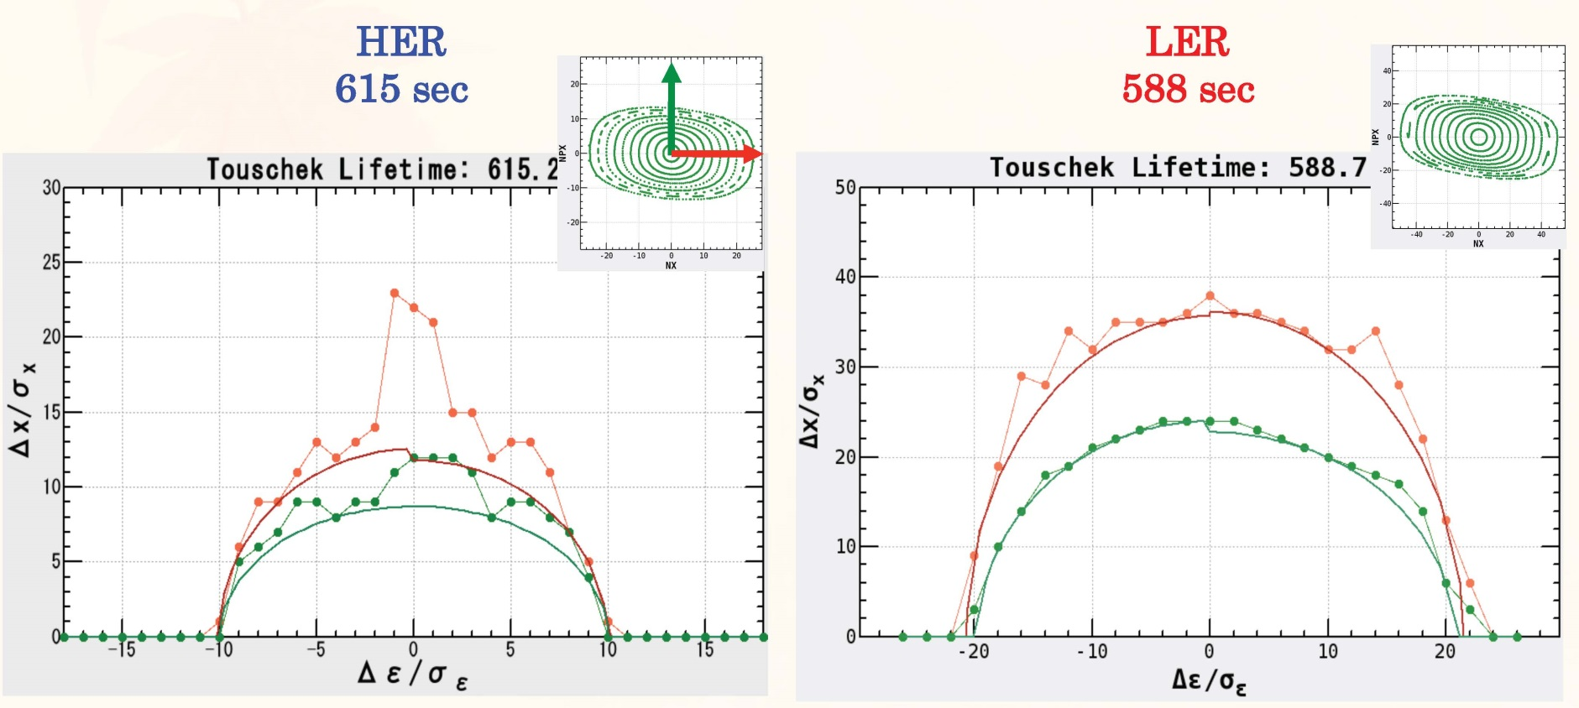
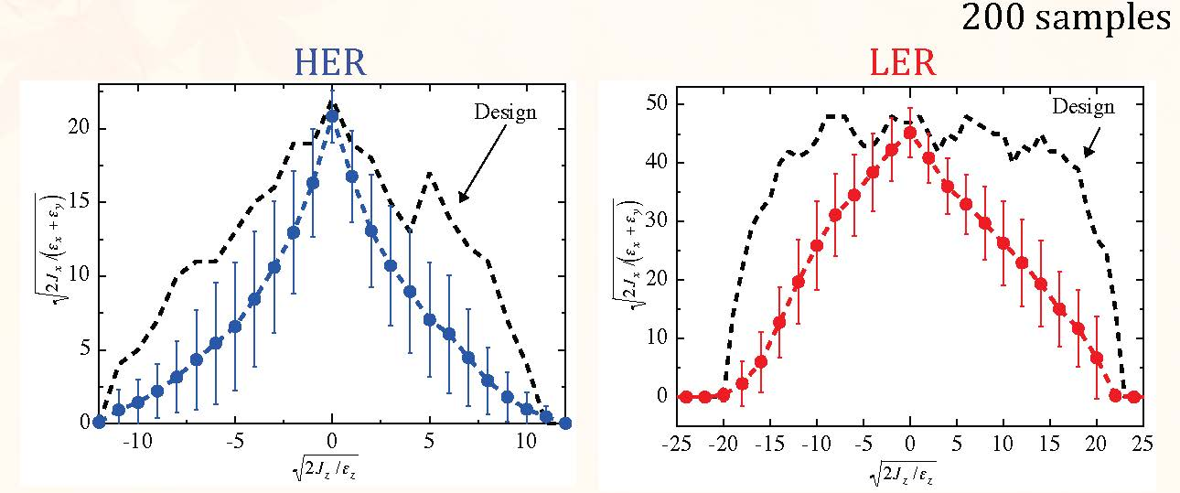
OK!
lifetime
ideal
lattice
OK!?
lifetime
w.
errors
&
cor-
rection
off-momentum
optics not recovered
H. Sugimoto

Slide 30
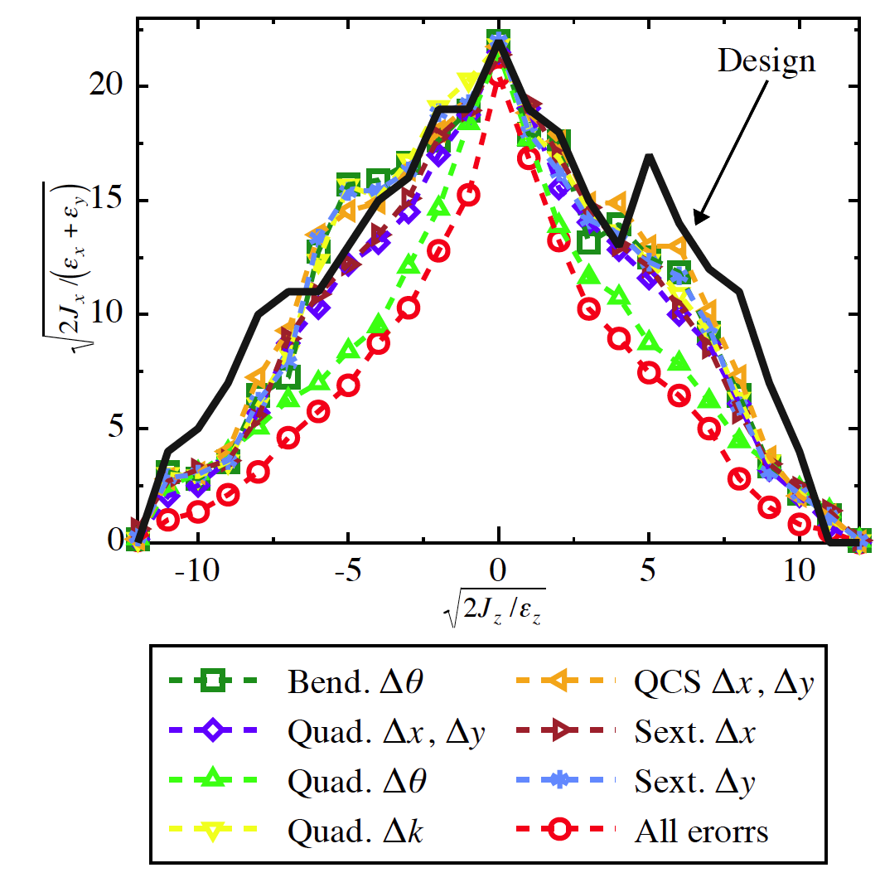
Dynamic aperture with different types of errors
No errors
Rotation errors of quadruples
seems most dangerous.
Each sextuple has a skew
quadrupole corrector coil.
We may have to rethink
tolerance of rotation errors
of normal quadrupoles.
H. Sugimoto

Slide 31
Beam-beam related issues
Beam lifetime shortening with beam-beam effects
Luminosity degradation
  The design luminosity was determined based on the strong-strong beam-beam simulation
  Beam-beam + lattice nonlinearity and space charge effect

Slide 32
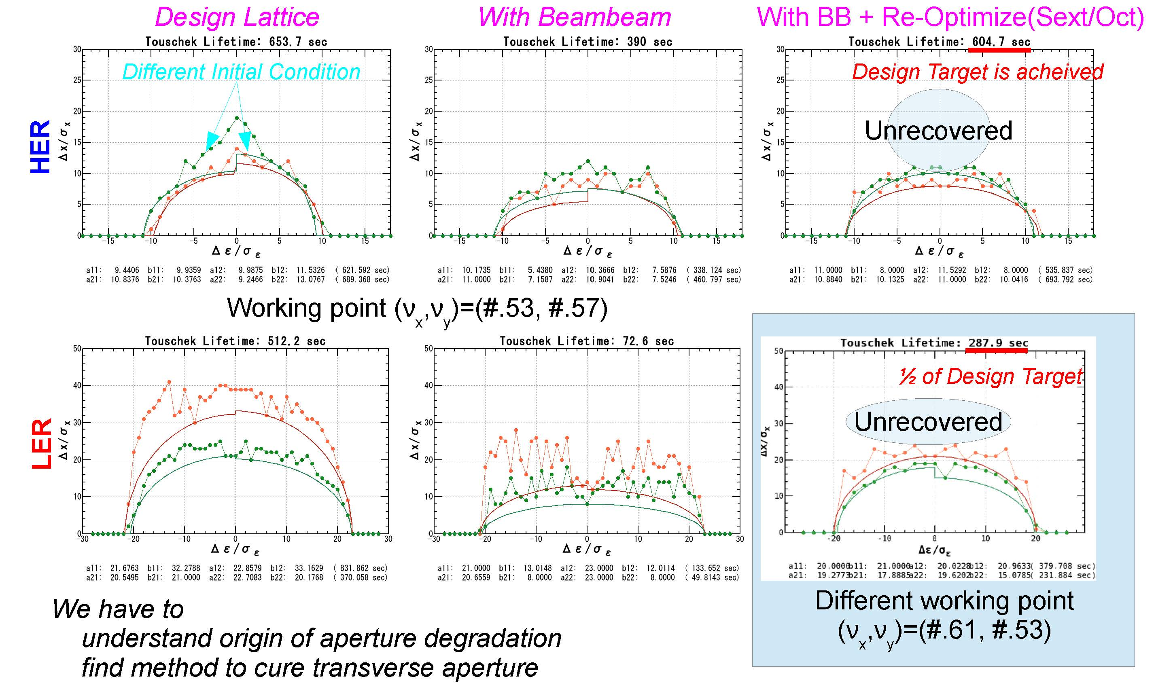
Beam-beam effect on Touschek lifetime
A. Morita
in LER τ≈300 s with beam-beam

Slide 33
SuperKEKB beam-beam simulation
SuperKEKB design
 | LER | HER
ε_{x} [nm] | 3.2 | 4.6
ε_{y} [pm] | 8.64 | 11.5
κ [%] | 0.27 | 0.25
SuperKEKB design luminosity
Strong-strong method (PIC)
For the long-rage force, the gaussian
distribution was assumed.
Smaller (single beam ) vertical emittance gives higher luminosity.
Much lower vertical emittance than the design (about half) will be needed to achieve the design luminosity.
K. Ohmi

Slide 34
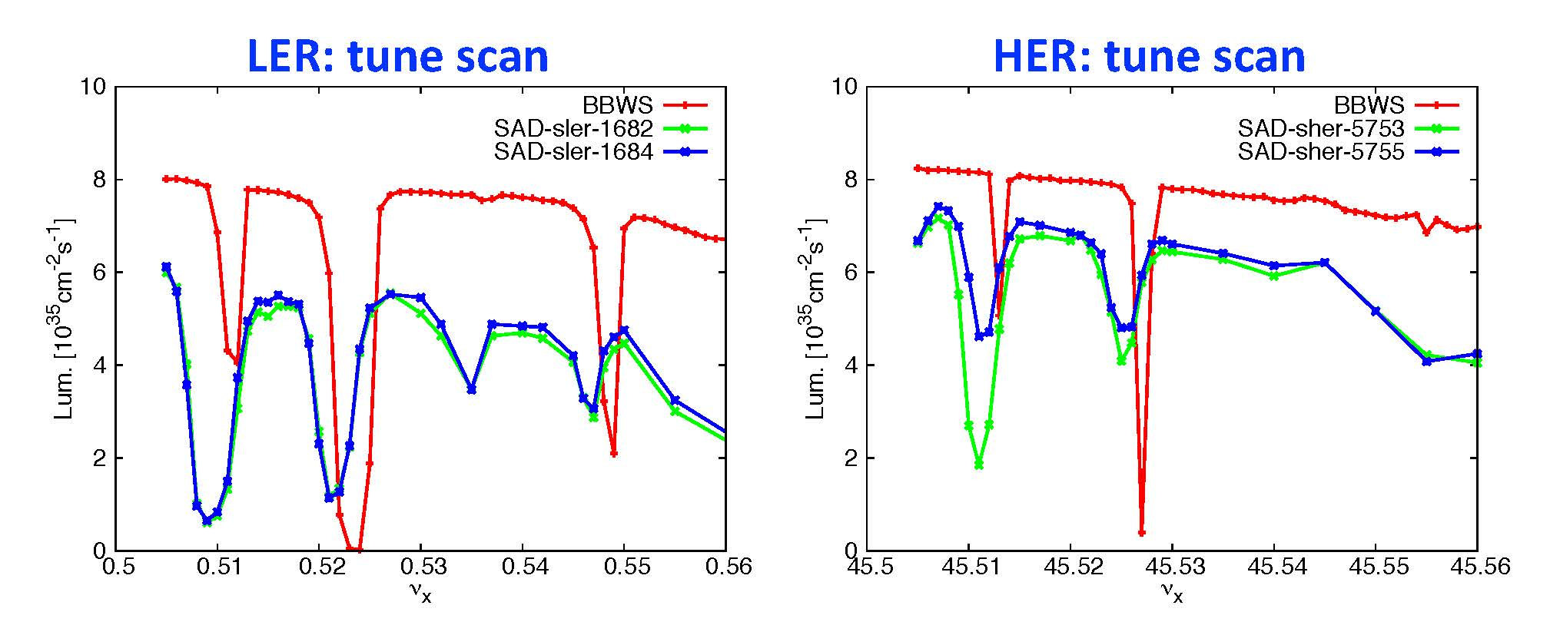
lattice-dependent effects reduce predicted luminosity by 10-30%
D. Zhou

Slide 35
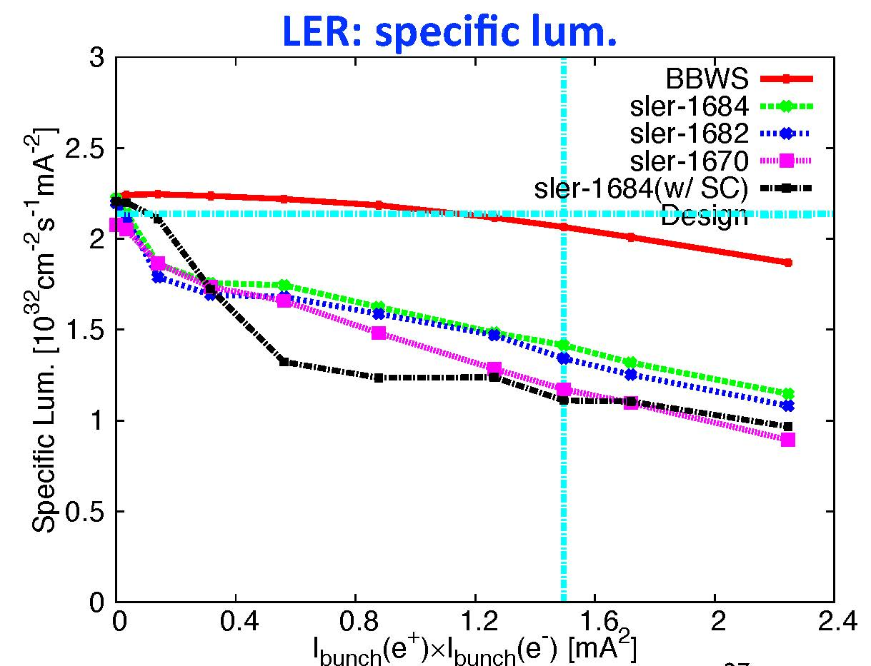
space charge reduces predicted luminosity by another 20%
further
degradation
from
space charge
strong lattice effect
already at low current
D. Zhou

Slide 36
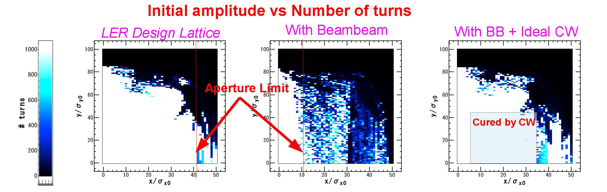
Ideal crab waist recovers dynamic aperture
A. Morita

Slide 37
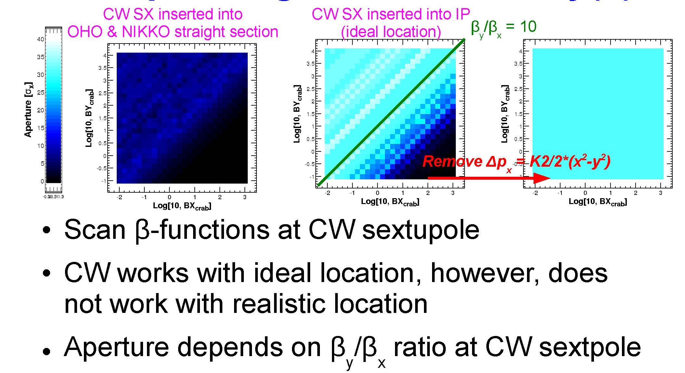
Realistic crab waist has less positive effect
A. Morita

Slide 38
Main obstacle: non-linear Maxwellian fringe of FF quadrupoles

Slide 39
Conclusions on DA & CW study
Beam-beam effect reduces dynamic aperture & Touschek lifetime
DA degradation by BB effect COULD be cured by crab waist if I-cell of CW was linear
Intrinsic non-linearity (Maxwellian fringe) blocks dynamic aperture of CW on our lattice
Achieving 40σ aperture by using octupole correctors is difficult without QCs allowed multipole suppression
Tuning K5 corrector on real machine WOULD be difficult because of fragmentation of good parameter region

Slide 40
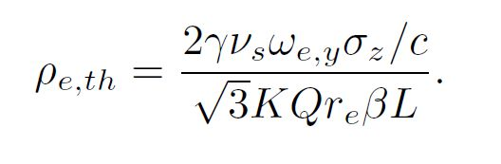
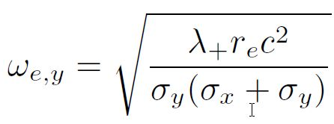
Electron cloud issues
Y. Suetsugu
The single bunch instability is main concern.
  Leads to increase in emittance
  Coupled bunch instabilities will be cured by feedback system.
Simulation and calculation by Ohmi, et al.
K. Ohmi , KEK Preprint 2005-100 (2006)
Threshold of density
  Here,
E [GeV] | = 4.0
γ | = 7828 | N_{b} | = 6.25E+10
ν_{s} | = 0.026 | Q_{b}[C] | = 1.4E-08 | (1.4 mA/bunch)
 |  | S_{b} [m] | = 1.2 | (4ns)
σ_{z} [m] | = 6.E-03 | λ [C/m] | = 5.2E+12 | (Q_{b}/2/σ_{z})
c [m/s] | = 3.E+08 | σ _{y} [m] | = 2.E-05
K | = 11 | σ _{x} [m] | = 2.E-04
Q | = 7
r_{e} [m] | = 2.80E-15 | ω_{e} | = 5.46E+11 | K = ω_{e} σ_{z}/c
β _{y} [m] | = 25 | ω_{e} σ_{z}/c | = 10.9 | Q = Min(Q_{nl}, ω_{e} σ_{z}/c)
L [m] | = 3016 |  |  | Q_{nl} ~7
ρ_{th} [e⁻/m³] =1.59E11
Target: 1E11

Slide 41
Latest simulation result on the threshold value of instability
Simulation with PEHTS2 by D. Zhou and K. Ohmi
  With uniform beta functions and uniform electron cloud density along the ring, the threshold for electron cloud density is about 5.0 x 10¹¹ m⁻³.
  With realistic beta functions and uniform electron cloud density along the ring, the threshold reduces to about 1.6 x 10¹¹ m⁻³.
  With realistic beta functions and estimated s-dependent electron cloud density along the ring, the threshold is about 5.0 x 10¹¹ m⁻³.

Slide 42
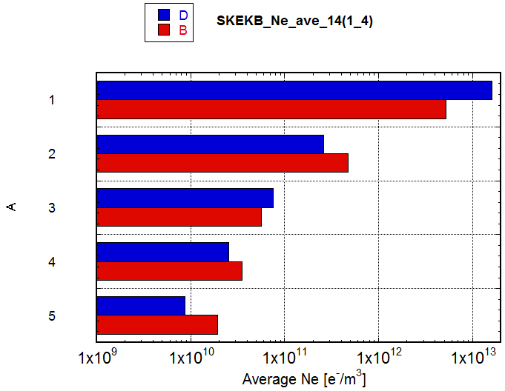
Expected electron density
Y. Suetsugu
n_{e} after applying countermeasures: estimated from experiments (Red)
Compared with results of CLOUDLAND (Blue)
  δ_{max}=1.2, Solenoid field=50G (→n_{e}=0), Antechamber; photoelectron yield =0.01 (1/10)
n_{e} of approx. 1/5 of the target value is expected.
Condition | ne [m⁻³]
Circular Cu chamber [KEKB beam pipe] | 5.2E12
+Solenoid at Drift (1/50) | 4.7E11
+Antechamber (1/5)+TiN (3/5) | 5.7e10
+Electrode in Wiggler (1/100) | 3.5e10
+Groove in Bend (1/4) | 2.0E10
Target value for ne: ~1x10¹¹
KEKB~3x10¹¹
If the latest simulation result on the threshold is true, there is a margin of a factor 25!

Slide 43
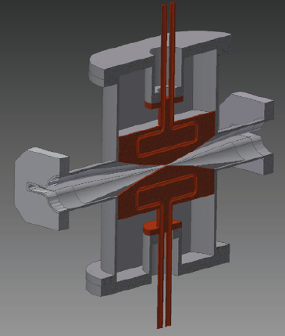
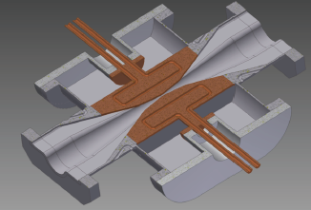
Beam collimators
New collimators (10 H, 3 V) to be installed in LER in Phase II, 2 H installed in Phase I
Old collimators kept in HER in Phase I, planned renewal in Phase II
New collimator H has part of the movable heads placed in the antechambers
New V collimator is similar, with the inside of the antechambers tapered to avoid trapped mode
Part of the movable heads is hidden inside the antechambers
to reduce the impedance and increase maintainability
by downsizing the collimators

Slide 44
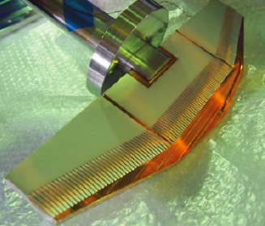
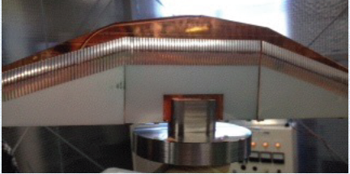
HOM absorbers
In Phase-I stage, no plan to install HOM absorbers because the loss factor is quite small (< 0.1 V/pC/collimator)
However, design of HOM absorbers is continuing (several materials tested for fingers and walls)

Slide 45
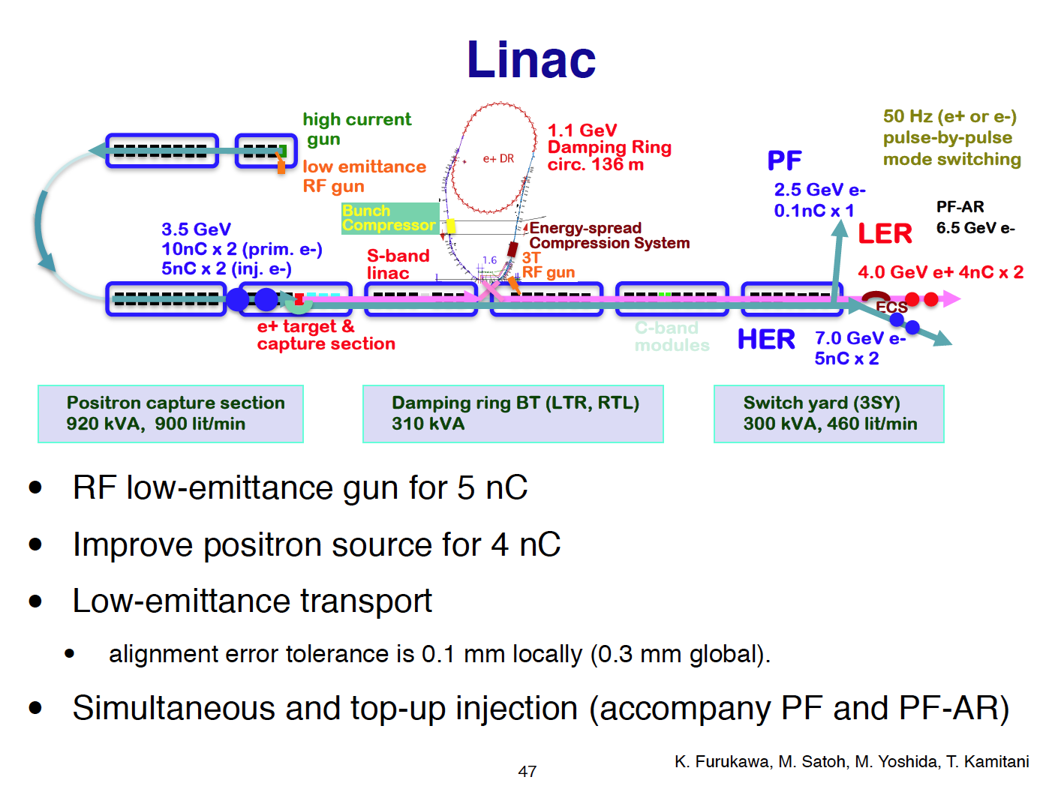
SuperKEKB requirements (tentative)
 | KEKB (e+/e-) | SuperKEKB (e+/e-)
Charge [nC] | 1/1 | 4/5
Normalized emittance[μm] | 2100/300 | 100/50 (H)
 |  | 20/20 (V)

Slide 46
Photo-cathode RF gun
High current : 5nC for e⁻ (~ >10nC for e⁺)
Low emittance : ~ < 10 μm.rad
Combination of unique technologies
  Laser system with Yb fiber oscillator, fiber amplifier, regenerative amplifier, multi-pass amplifier, pulse picker, frequency converter
  Quasi traveling-wave side coupled cavity
  Ir₅Ce photo cathode
Already obtained 3.5 ~ 5nC
Commissioning started
Temporal manipulation for lower energy spread
Cavity and cathode are mostly ready, laser system under improvement for higher charge

Slide 47
Positron Source
High current positron is required
Positron capturing with flux concentrator (FC) and large aperture S-band structure (LAS)
Deceleration field to reduce satellite bunches
Pinhole beside target for electron beam
Protection system with beam spoilers

Slide 48
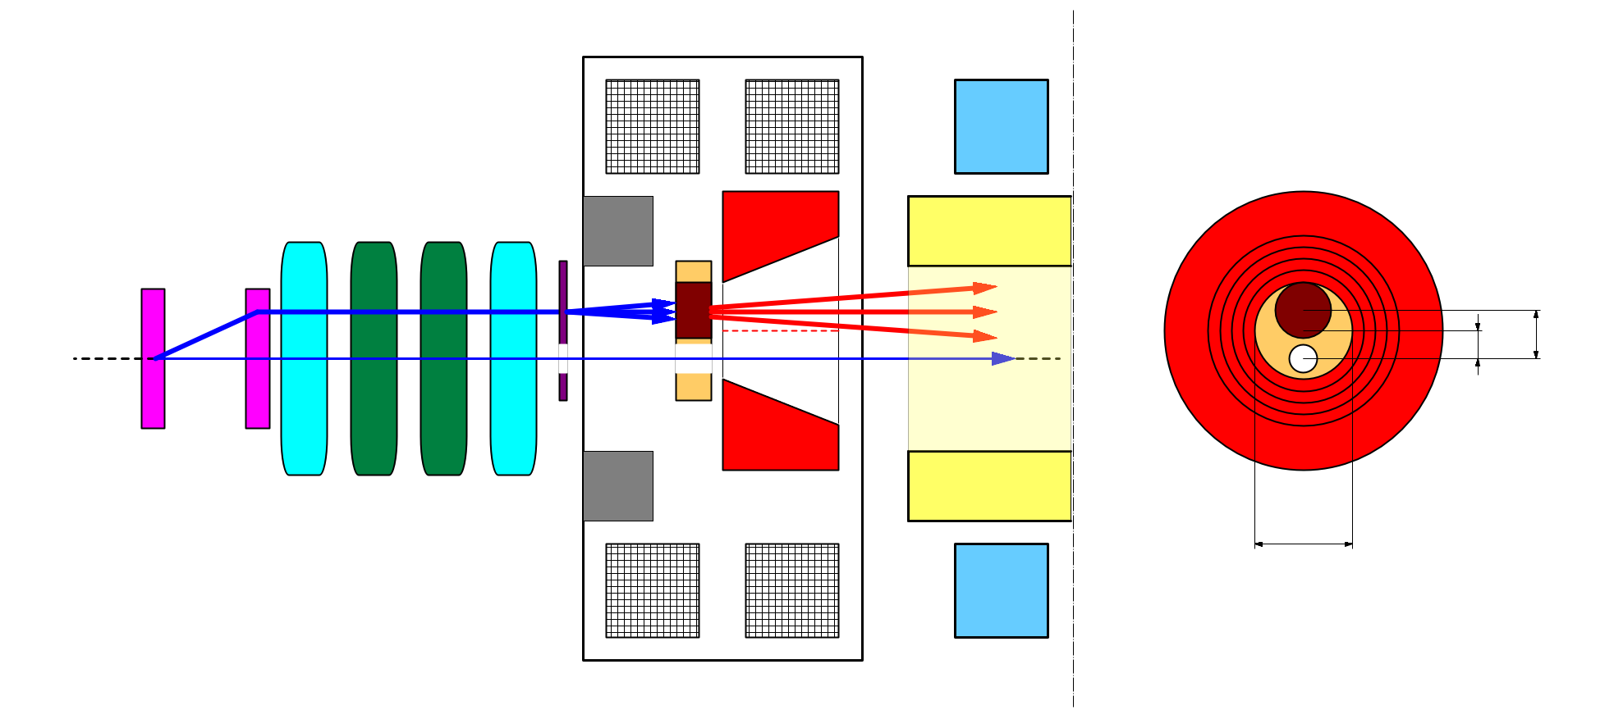
e+/e- beam switching at target
bridge coils
solenoid
side view
rear view
target
diameter
4.0 mm
10 nC
primary e-
DC QM
LAS Accel.
structure
spoiler
target
offset
3.5 mm
target
e+
beam
hole
5 nC injection e-
2.0 mm
FC offset
hole
diameter
2.0 mm
Flux
Concentrator
pulse ST
7.0 mm
FC aperture
pulse QM
Two possible schemes of beam switching by orbit bump
e+ on-axis, e- offset
→ e- emittance growth by solenoid kick induced orbit
e- on-axis, e+ offset
→ e+ yield degradation (50% → 10%)
we take this scheme.

Slide 49

Dynamic Aperture with beam-beam
LER : w/ damping
Injection efficiency: ~ 84%
w/o machine errors
Linac beam:
γε_{x} ~117μm , γε_{y} ~2.5μm
Δx / σ_{x}
ΔΕ / σ_{ε}
σ_{x}@Injection = 0.55mm
-> 12σ_{x} ~ 6.6mm
sler_1686

Slide 50
Beam injection issues
Dynamic aperture with beam-beam effect in LER
  Estimated injection efficiency with beam-beam
    ~84% w/o machine errors
    Requirements to Linac beam (emittance etc.) will be considered after we finish the investigation on dynamic aperture with beam-beam effects.
HER injection
  Transverse ring acceptance is marginal with the design optics to keep enough injection efficiency
  Maybe, we will need to switch to the “synchrotron injection” in the process of squeezing beta functions at IP
Synchronization issue between Linac and SuperKEKB rings
  Introduce damping ring

Slide 51
Summary
Injector commissioning started.
New Photo-cathode RF gun has successfully manufactured and installed.
  3 nC from New RF Gun
  0.05 nC, 5 GeV at end of Linac
First stage of commissioning:
  Gun commissioning (laser and cavity conditioning)
  High intensity charge
  Emittance preservation w/ low charge at Sector A, B

Slide 52

SuperKEKB Longitudinal FB plan
Install LFB in LER only. HER is optional.
Considering to use 4 DAFNE type kicker, with 2-input, 2-output ports for larger capture range.

Slide 53


Feedback kicker
Transverse kicker
  We will use similar transverse stripline kicker, at least, at the early stage of the commissioning.
    want to continue collaborate with SLAC for much larger power tolerant structure.
Longitudinal kicker
  Designed 2-in, 2-out DAFNE-type kicker with shunt impedance of around 1.6kΩ (Q seems a little bit higher, though)
  Will fabricate two-sets within this fiscal year

Slide 54

Notes:
The construction works for SuperKEKB is in full swing.

Slide 55
Commissioning phase 0 (2013 Sep. ~ 2014 Dec.)
Machine condition
  SuperKEKB rings: construction
  Linac commissioning in parallel with its construction
Summer shutdown (2013)
  Linac Alignment
  Remove e+ source and capture section
  New Chicane in A1 unit
  Install and Relocate many magnets and monitors
  Modify many parts of control software
Linac e- beam
  Commissioning of new photocathode RF gun
    Cavity conditioning
    Laser tuning
  Low emittance 5 nC
  10 nC (for e+ production primary electron)

Slide 56
Commissioning phase 1 (2015 Jan. ~ June)
Machine condition
  No QCS, No solenoid (no Belle II), No beam collision
Tuning items
  Linac tuning (if necessary)
  Basic commissioning of machine (~ 1.5 month)
    Injection tuning, Hardware check and bug fix, software bug fix
  Vacuum scrubbing (>~3 months)
    Belle II people request enough vacuum scrubbing in this stage (before Belle II roll-in). At least one month with beam currents of 0.5 ~ 1 A.
  Damping ring commissioning (start from May 2015)
    Beam injection with damping ring
  Detector beam background
    Study with Beast detectors, check of collimator system (two new-type collimators in LER)
  Some optics tuning
    With day-1 optics
    Low emittance tuning w/o Belle-II solenoid
  Study of beam instability (FII, e-cloud)
    Tuning on bunch-by-bunch feedback

Slide 57
Commissioning phase 2 (2016 Jan. ~ May)
Feb. ~ June
Machine condition
  w/ QCS, w/ Belle II (w/o VXD),TOP detectors partially installed, full accelerator tuning, no physics experiment
Tuning items
  Optics tuning
    Tentative target values of IP beta’s: βx*: x4, βy*: x8
    Optics tuning with QCS and Belle II solenoid
    Low emittance tuning w/ Belle II solenoid
    Optics tuning w/ beam collision
  Detector beam background
    Study with Belle II detector, test of continuous injection
  Increase of beam currents (instability, RF power, vacuum issues)
    Detector background may possibly give some restrictions
    Continue upgrade for RF system (support ~70% of design beam currents)
  Beam collision tuning
    Orbit feedback (fast feedback, dithering system)
    Collision tuning w/ “Nano-Beam” scheme
  Luminosity tuning
    Tuning knobs (x-y coupling at IP etc.)
    Target luminosity: 1 x 10³⁴ cm⁻² s⁻¹ (design of KEKB)

Slide 58
Commissioning phase 3 (2016 Oct. ~ )
Machine condition
  Full set of Belle II, Physics experiment will start
    Maybe some TOP counters will be delayed
Tuning items
  Optics tuning
    Toward design values of IP beta’s
      Maybe it will take several years
    Low emittance tuning:
      Design values for vertical emittances are very small. Demonstration of feasibility of TLEP
    Optics tuning w/ beam-beam effect
  Detector beam background
    Establishment of continuous injection (azimuthal VETO)
  Increase of beam currents
    Design values are as twice high as those of KEKB
  Luminosity tuning
    Study on effects of lattice non-linearity and space-charge
    Stability of tuning will be an important issue (continuous optics correction?)

Slide 59

SuperKEKB luminosity projection
Goal of Belle II/SuperKEKB
Integrated luminosity
(ab⁻¹)
9 months/year
20 days/month
Commissioning starts
in early 2015.
Shutdown
for upgrade
Peak luminosity
(cm⁻²s⁻¹)
Calendar Year

Slide 60
Overall budget (original)
Budget
  Total construction budget is 314 Oku-Yen for Rings, Injector, and Belle-II
  Most of the budget comes year-by-year based
  Operation budget is expected in FY2014 and later
410 M$
JFY2010
JFY2011
JFY2012
JFY2013
JFY2014
JFY2015
JFY2016
Very Advanced Research SP (100 Oku-Yen)
SuperKEKB commissioning
Other budgets for construction (214 Oku-Yen)
We are here
Operation budget (continues - - - )
Unit: Oku-Yen (~1.1M$)
JFY2010 | JFY2011 | JFY2012 | JFY2013 | JFY2014 | Total
75.0 | 10.5 | 14.5 | 0 | 0 | 100.0
0 | 41.6 | 40.2 | 61.6 | 46.7 | 190.0
0 | 4.5 | 12.4 | 7.2 | 0 | 24.1
75.0 | 56.6 | 67.1 | 68.8 | 46.7 | 314.1
Supplied | Supplied | Supplied
VARSP
Others
Buildings
Total
Status

Slide 61
Conclusioni
La costruzione di SuperKEB sembra essere a buon punto, anche se la strategia di commissioning in 3 fasi probabilmente dilatera’ i tempi
Ci sono criticita’ soprattutto negli anelli (IR, apertura dinamica, crab waist, beam-beam, iniezione nei rings, tolleranze agli errori, emittance tuning) che ancora necessitano studi e soluzioni
Un grande sforzo con un budget adeguato e risorse umane in qualche settore limitate

