Slide 1



First Cosmology Results from Planck
Alessandro Melchiorri
University of Rome La Sapienza
On behalf of the Planck collaboration

Slide 2
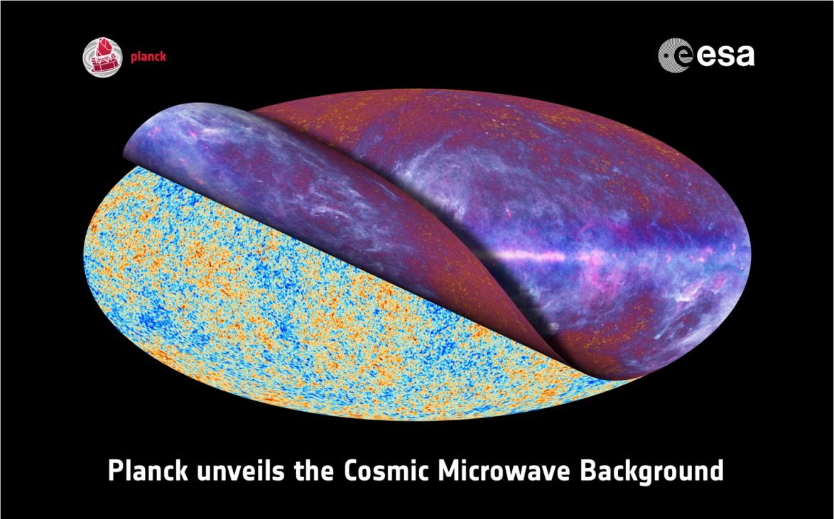

Slide 3
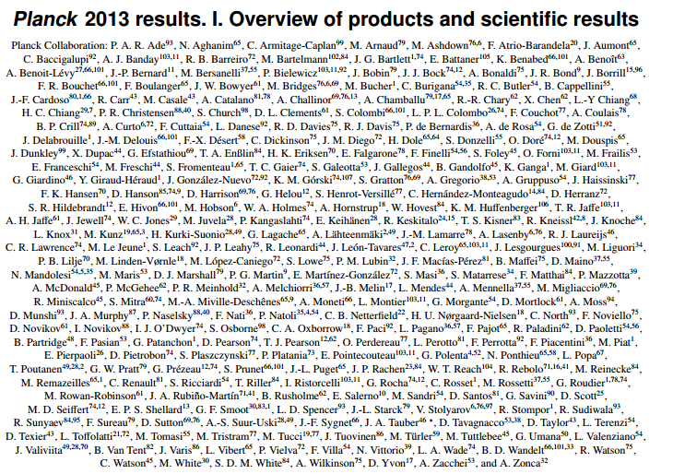
Planck Collaboration 300+ names

Slide 4
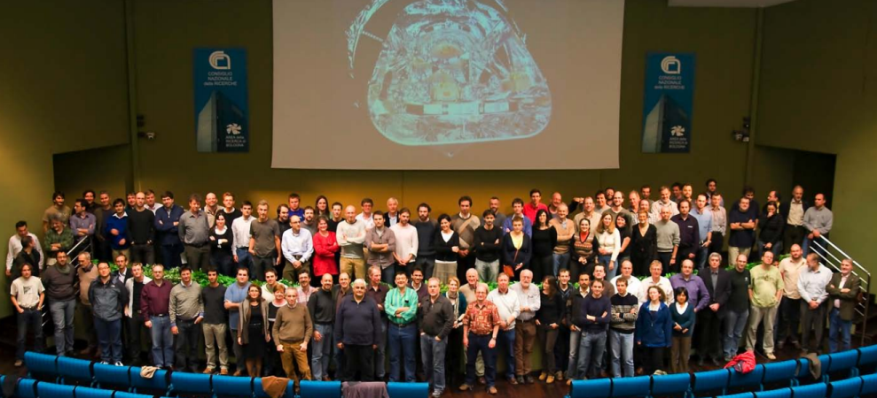
Planck Core-Team
(a fraction of it)

Slide 5
Planck History in Brief
First conceived in 1992, proposed to ESA in 1993
Payload approved in 1996
Launched in May 2009, started to survey the sky in August of the same year
Nominal mission completed at the end of 2010
  but continued to gather data with the full payload until January 2012
  … and it continues to gather data with LFI only until the fall (August end of 8 full sky survey)
Planck is an ESA mission: ESA, European industries, and the international technological and scientific community have contributed to its realisation and success
Planck has been founded by the European members state Space Agencies and by NASA: ASI and CNES are the leading Agencies.
  Thousands of engineers and scientists were involved from ~100 scientific institutes in Europe, the USA, and Canada
  Two scientific Consorzia (LFI led by N. Mandolesi and HFI by Jean Loup Puget) were responsible for the delivery of the Instruments to ESA, the mission data analysis and the delivery of the data and results to the open scientific community

Slide 6
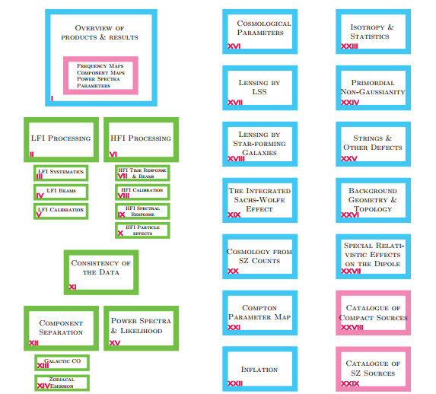
First cosmology release: 29 papers…about 1000 pages !!!!

Slide 7
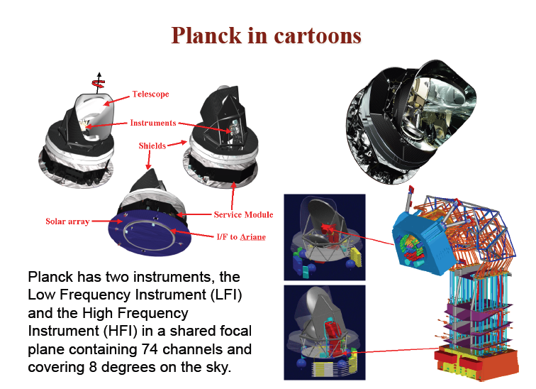

Slide 8
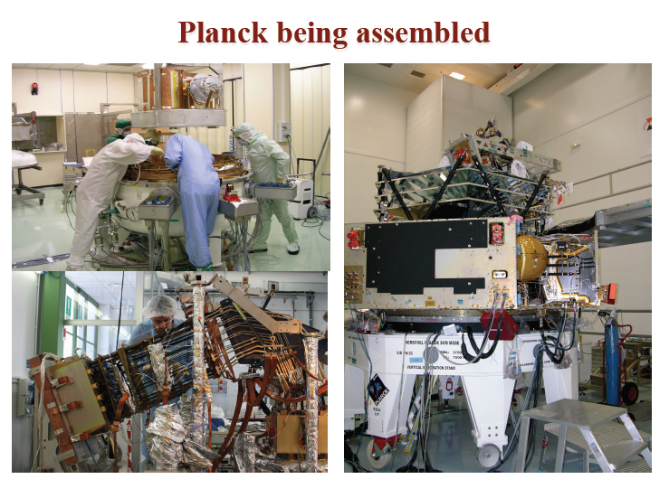

Slide 9
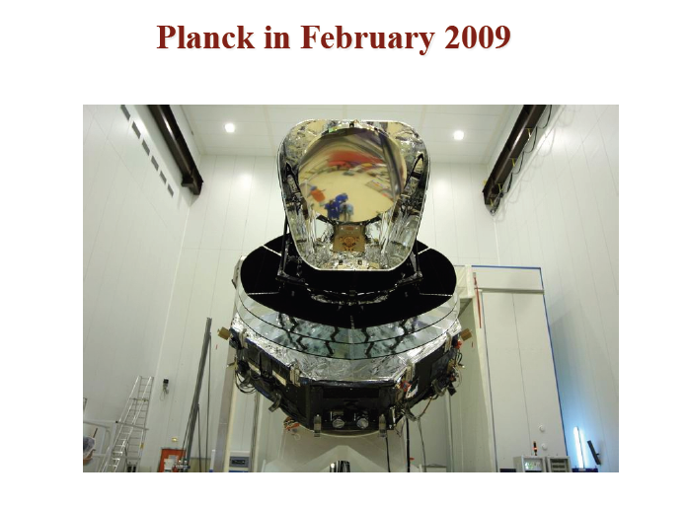

Slide 10
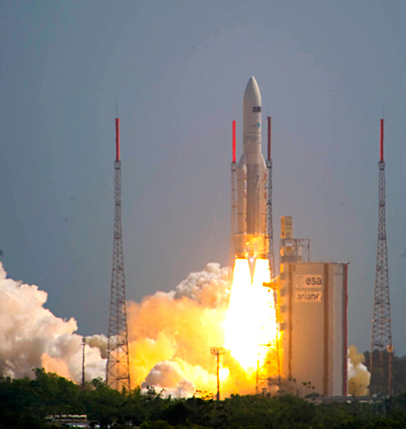
Planck
Satellite launch
14/5/2009

Slide 11
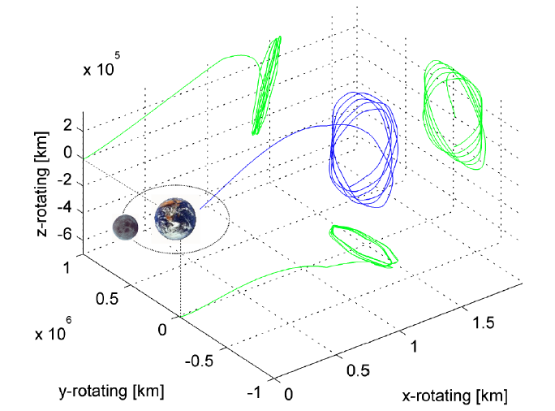
Planck in L2 Orbit since 7/2009

Slide 12
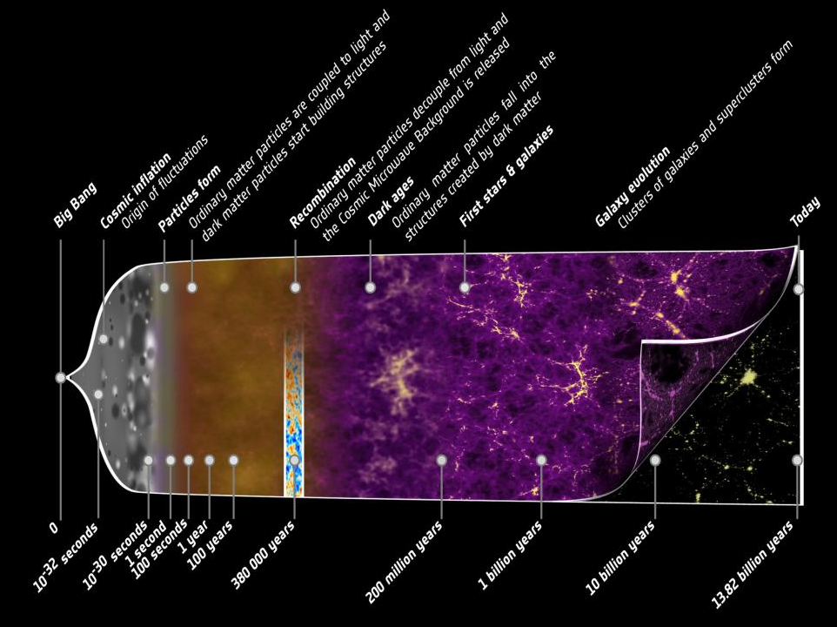

Slide 13
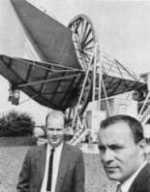
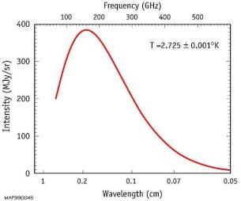
The Cosmic Microwave Background
Discovered By Penzias and Wilson in
1965.
It is an image of the universe at the
time of recombination (near
baryon-photons decoupling), when the
universe was just a few thousand years
old (z~1000).
The CMB frequency spectrum
is a perfect blackbody at T=2.73 K:
this is an outstanding confirmation
of the hot big bang model.

Slide 14
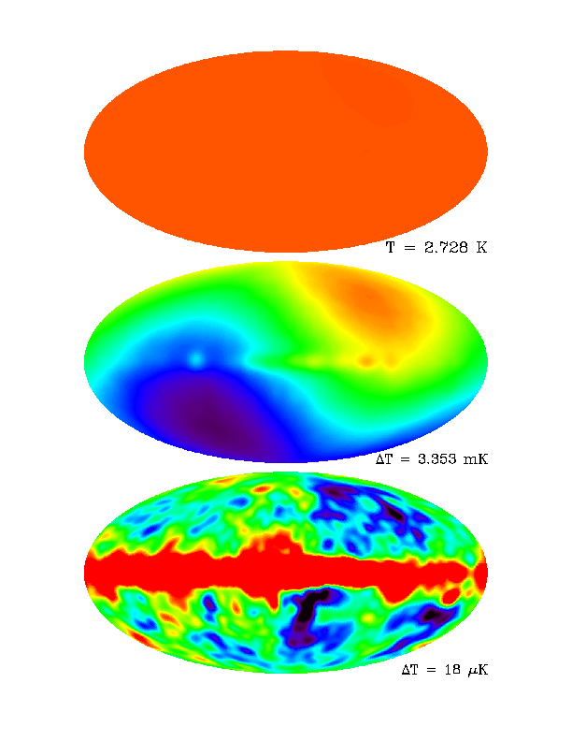
The Microwave Sky
COBE (circa 1995) @90GHz
Uniform…
First Anisotropy we see is a Dipole anisotropy:
Implies solar-system barycenter has velocity v/c~0.00123 relative to ‘rest-frame’ of CMB.
If we remove the Dipole anisotropy
and the Galactic emission, we see
anisotropies at the level
of (ΔT/T) rms~ 20 μK (smoothed on
~7° scale).
These anisotropies are the
imprint left by primordial tiny
density inhomogeneities
(z~1000)..

Slide 15
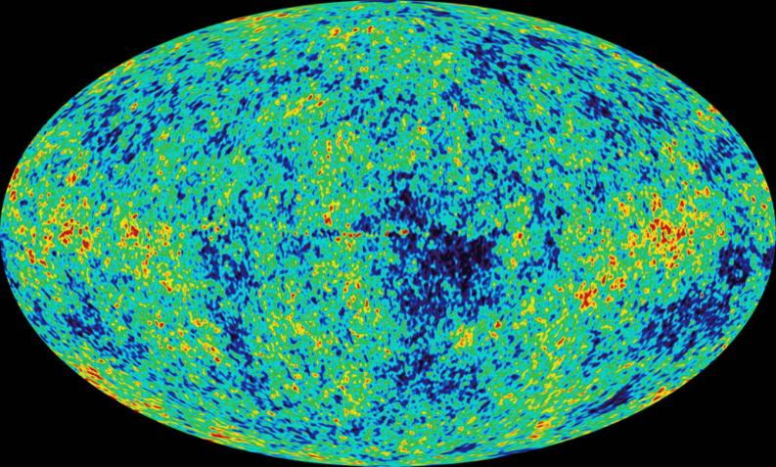
Best Full Sky Map of the CMB before Planck: WMAP satellite (2002-2010)
(linear combination of 30,60 and 90 GHz channels)

Slide 16
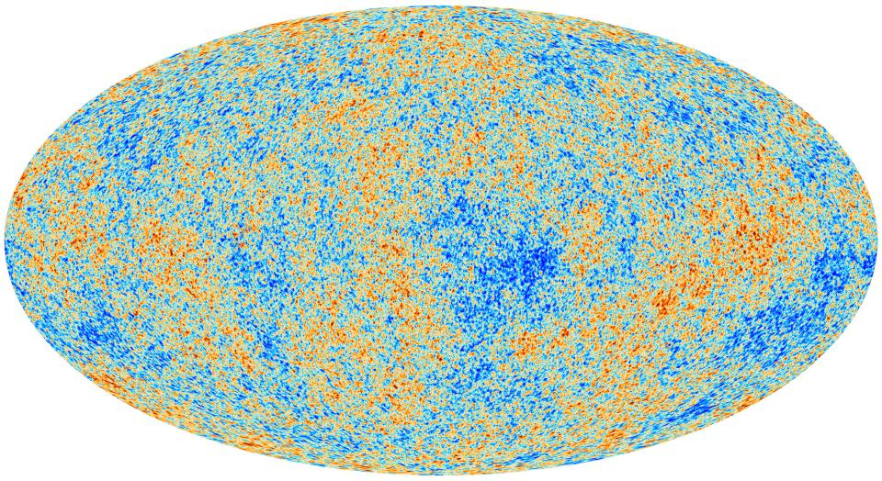
Planck 2013 CMB Map

Slide 17
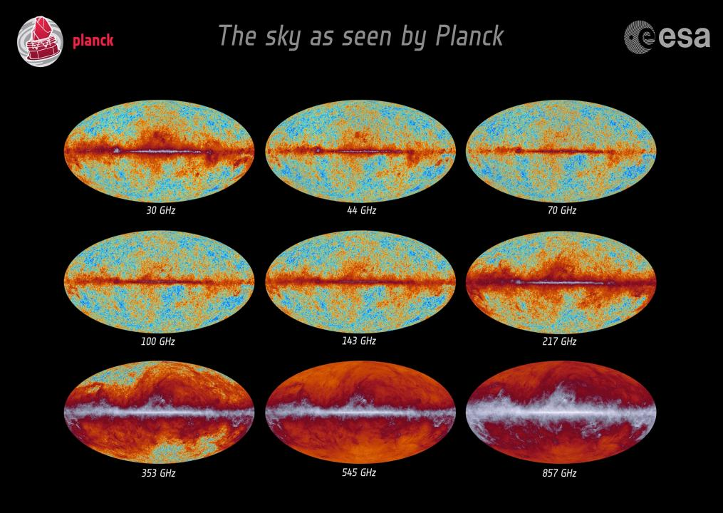
The Planck sky

Slide 18
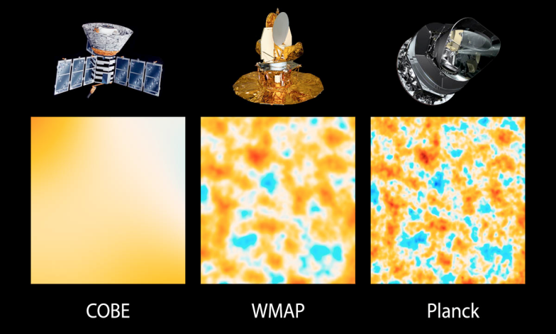
Comparison with COBE and WMAP

Slide 19
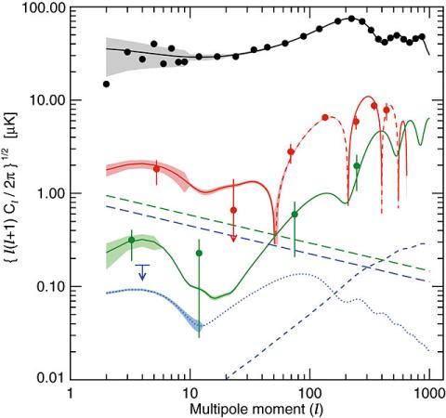
The CMB Angular Power Spectrum
R.m.s. of has
power per decade in l:
We can extract 4 independent angular
spectra from the CMB:
Temperature
Cross Temperature Polarization
Polarization type E (density fluctuations)
Polarization type B (gravity waves)
Planck 2013 release is only temperature ps.

Slide 20
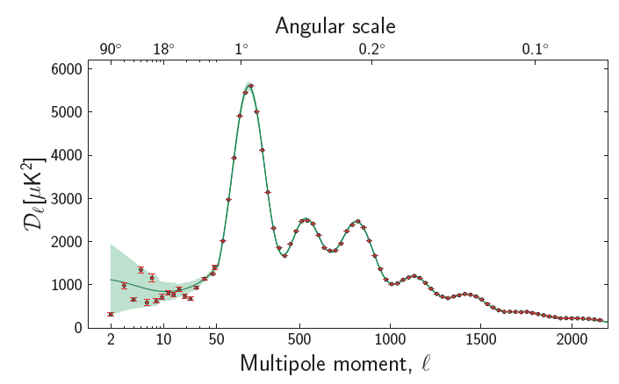
Planck 2013 TT angular spectrum

Slide 22
Cross Temperature-Polarization spectrum
(not present in this release)
Red line: best fit model from the temperature angular spectrum !!!

Slide 23
Polarization spectrum
(not present in this release)
Red line: best fit model from the temperature angular spectrum !!!

Slide 24
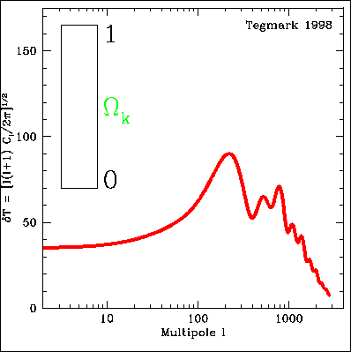
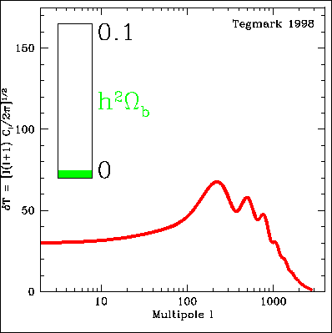
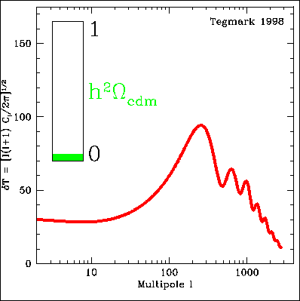
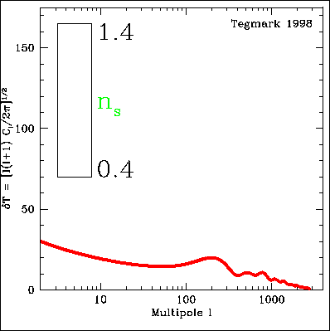
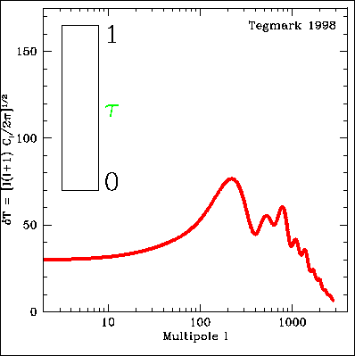
We can measure cosmological parameters with CMB !
Temperature Angular spectrum varies with
Ωtot , Ωb , Ωc, Λ, τ, h, ns, …

Slide 25


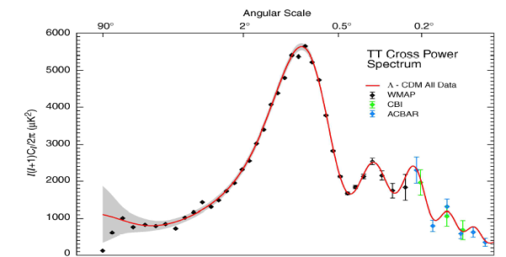
How to get a bound on a cosmological parameter
Fiducial cosmological model:
(Ω_{b}h² , Ω_{m}h² , h , n_{s} , τ, Σm_{ν} )
DATA
PARAMETER
ESTIMATES

Slide 26
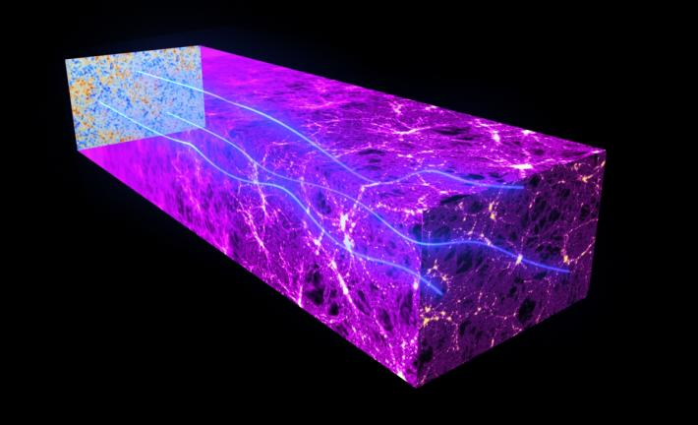
Gravitational Lensing
The gravitational effects of intervening matter bend the path of CMB light on its way from the early universe to the Planck telescope. This “gravitational lensing” distorts our image of the CMB

Slide 27
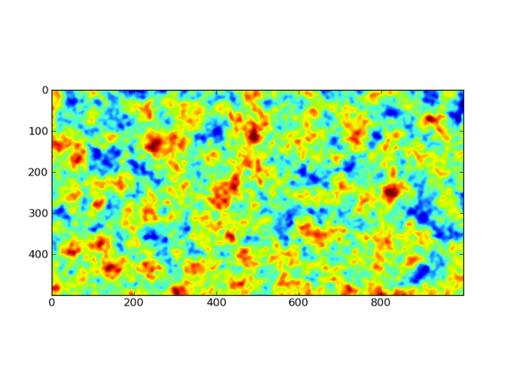
Gravitational Lensing
A simulated patch of CMB sky – before lensing
10º

Slide 28
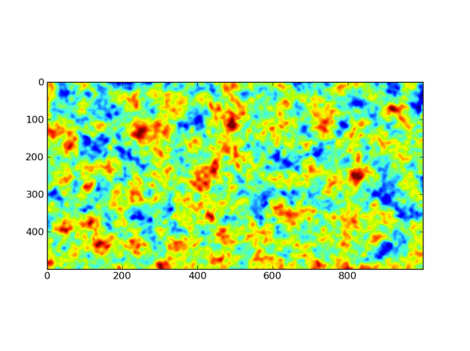
Gravitational Lensing
A simulated patch of CMB sky – after lensing
10º

Slide 29
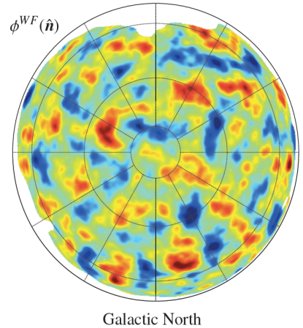
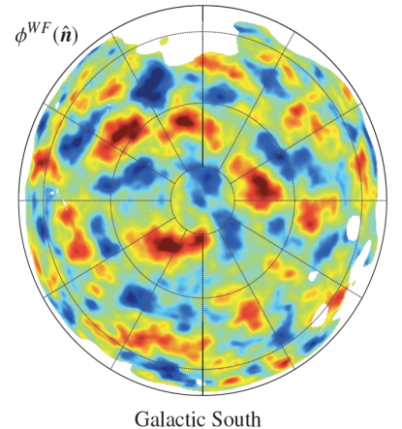
Planck dark matter distribution throught CMB lensing

Slide 30
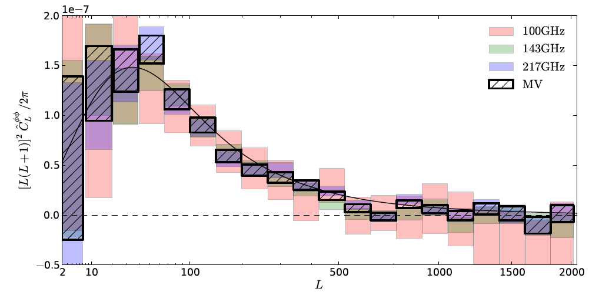
PLANCK LENSING POTENTIAL POWER SPECTRUM
Measured from the Trispectrum (4-point correlation)
2º
0.2º
prediction based on the primary CMB fluctuations and the standard model
It is a 25 sigma effect!!
This spectrum helps in constraining parameters

Slide 31
Constraints from Planck and other CMB datasets
We combine the constraints from the Planck temperature power spectrum with
the following datasets:
WP is WMAP Polarization. We include the large angular scale EE polarization data
from WMAP9.
highL includes the ACT dataset in the region 540 < l < 9440 (Das et al., 2013) and the
SPT dataset in the Region 2000 < l < 10000 (Reichardt et al., 2012). The ACT and SPT datasets
are used mainly for foregrounds subtraction. ACT dataset has also mild effects on cosmological
parameters.
Lensing includes information on the CMB lensing amplitude from Planck trispectrum
data (see Planck cosmology paper XVII).

Slide 32
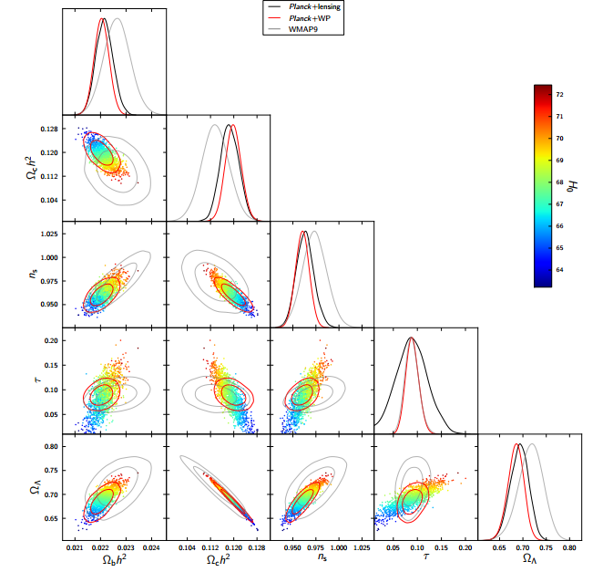
Constraints on LCDM
Planck improves the
constraints by a factor
2-3 respect to WMAP9
Lower
Baryon
Density
Higher
CDM
Density
Lower
Spectral
index
Smaller
Cosmological
Constant

Slide 33
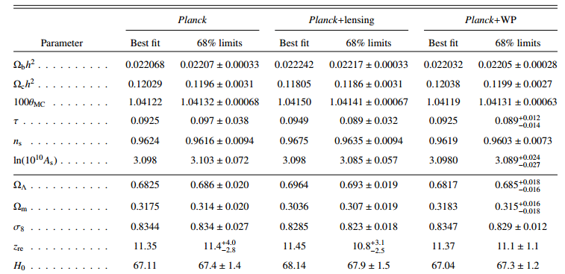
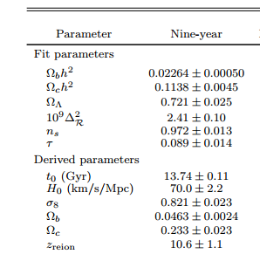
Constraints
WMAP9

Slide 34
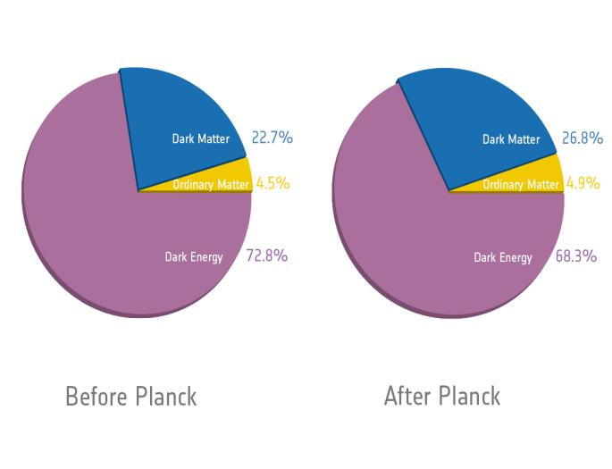
The basic content of the Universe
...has changed!

Slide 35
Comparison with other datasets: Hubble Constant
The value of the
Hubble constant
from Planck is in
tension with the
Riess et al. 2011
result.

Slide 36
Comparison with SN-Ia data
The value for the matter density
inferred from SNLS survey is smaller
than what observed with Planck assuming
a flat universe.
Better agreement with the Union2 catalog.

Slide 37
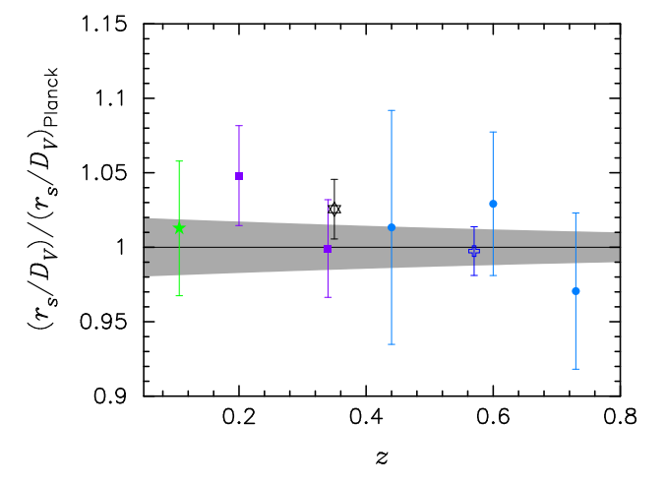
Comparison with BAO surveys
Acoustic scale – Distance
ratio from BAO and Planck.
Planck uncertainties are
in grey.
Very good agreement
with BAO surveys
and Planck data
in the LCDM
framework.
Green: 6df
Purple: SDSS DR7 (Percival)
Black: DR7 (Padmanabhan)
Dark Blue: BOSS
Light Blue: Wiggle-z

Slide 38
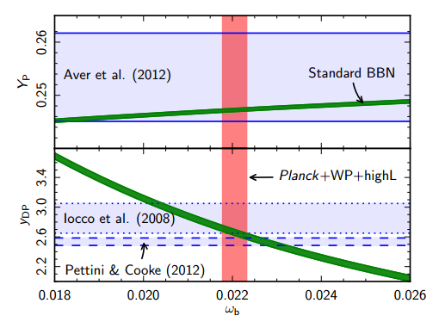
Comparison with BBN and primordial He and D
Very good agreement. Lower baryon density. Recent Pettini and Cooke D
measurement maybe a bit too low for Planck (1 sigma tension).

Slide 39
Standard Model Extensions
Planck CMB dataset alone does not provide any evidence for extensions of the standard LCDM model.
Planck+BAO is also in perfect agreement with LCDM.
However we see tensions on the Hubble parameter. The CMB determination of H0 is model dependent. Hints for new physics ?

Slide 40
Cosmological (Massless) Neutrinos
Neutrinos are in equilibrium with the primeval plasma through weak
interaction reactions. They decouple from the plasma at a temperature
We then have today a Cosmological Neutrino Background at a temperature:
With a density of:
for a relativistic neutrino translates in a extra radiation component of:
Standard Model predicts:

Slide 41
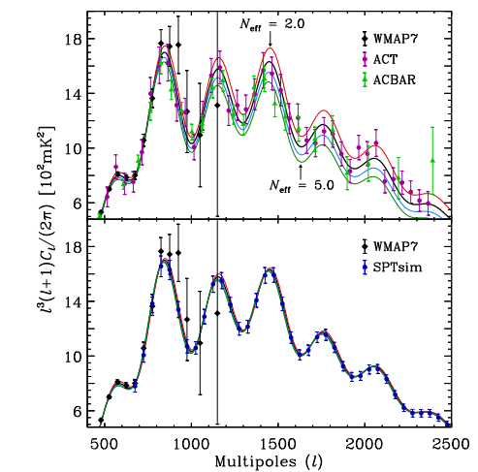


Probing the Neutrino Number with CMB data
Changing the Neutrino effective number
essentially changes the expansion rate
H at recombination.
So it changes the sound horizon at
recombination:
and the damping scale at recombination:
Once the sound horizon scale is fixed, increasing
Neff decreases the damping scale and
the result is an increase in the small angular scale anisotropy.
We expect degeneracies with the Hubble constant and the Helium abundance.
(see e.g. Hou, Keisler, Knox et al. 2013, Lesgourgues and Pastor 2006).

Slide 42
Can we combine Planck and HST ?
Planck and HST give very different values for the Hubble constant (68% c.l.):
But the Planck result is obtained under the assumption of Neff=3.046.
If leave Neff as a free parameter we get:
That is now compatible with HST (but we now need dark radiation).
The CMB determination of the Hubble constant is model dependent.

Slide 43
Constraints from Planck + astrophysical datasets (95% c.l.)
Conclusions:
When the BAO dataset is included there is a better agreement with Neff=3.046.
When luminosity distance data are included (supernovae, HST) the data prefers
extra «dark radiation». Systematics in luminosity distances or new physics ?
With HST we have extra dark radiation at about 2.7 σ. This is clearly driven by
the tension between Planck and HST on the value of the Hubble constant in the
standard LCDM framework.

Slide 44
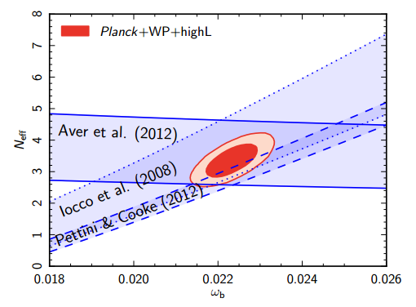
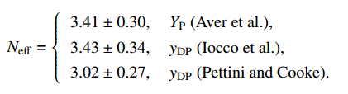
Constraints from BBN
BBN can constrain Neff around T≈ 1 Mev.
Helium and conservative deuterium
measurements agree with Neff ≈ 3.5.
New (single) D measurement by Pettini
and Cooke is in perfect agreement with
Neff=3.046.

Slide 45
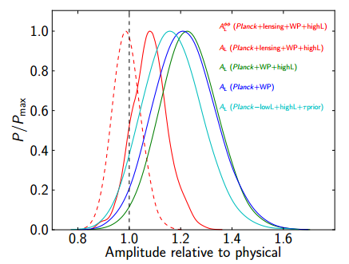
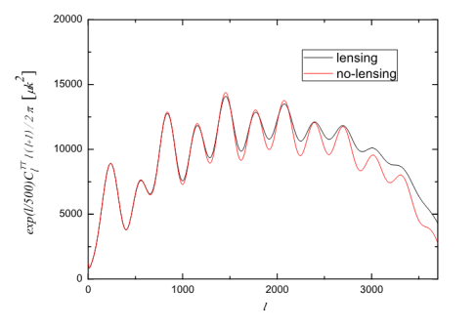
Anomalous Lensing Amplitude
Lensing also modifies the CMB angular spectrum.
It is possible to quantify the amount of lensing in the angular spectrum by introducing
an effective amplitude.
Planck sees a larger value of the lensing in the TT spectrum at 95% c.l. respect to
the expectations of LCDM.
This is in disagreement with the lensing trispectrum (TTTT) measurement that is
Consistent with LCDM. The origin of the anomalous TT lensing amplitude is unknown.

Slide 46
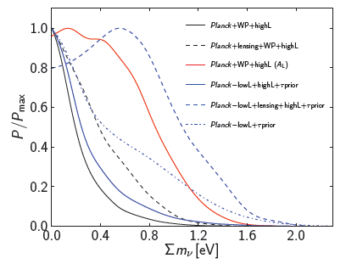




Constraints on Neutrino Mass (standard 3 neutrino framework)
Planck strongly improves previous constraints on neutrino masses.
Planck TT spectrum prefers a lensing amplitude higher than expected (ALENS=1.2).
Inclusion of lensing from TTTT weakens the Planck constraint by 20%
Including BAO results in the best current constraint on neutrino masses of 0.23 eV

Slide 47
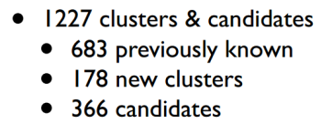
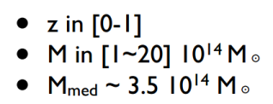
Clusters of galaxies

Slide 48
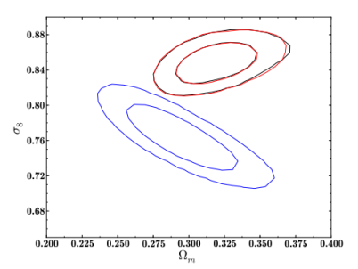
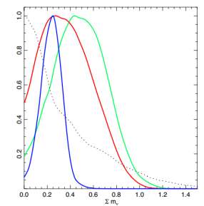
Evidence for a Neutrino mass from SZ Clusters counts ?
Dashed:
Planck CMB
Red:
Planck CMB+SZ
(1-b)=[0.7,1]
Green:
Planck CMB+SZ
(1-b)=0.8
Blue:
Planck CMB+SZ+BAO
(1-b)=[0.7,1]
Cosmological parameters as σ8 and Ωm derived from Planck SZ clusters number counts are in
strong tension with the parameters derived from CMB TT measurements.
Massive neutrinos could solve the tension.
Cluster counts results are however affected by a bias b between the X-ray determined mass
and the true mass. Assuming a flat prior of [0.7,1] on (1-b) we have from Planck+BAO+SZ
(68% c.l):
Agreement could also be obtained by assuming (1-b)=0.55, a bias that is difficult to reconcile
with numerical simulations and X-ray/weak lensing comparisons (see discussion in Paper XX).

Slide 49
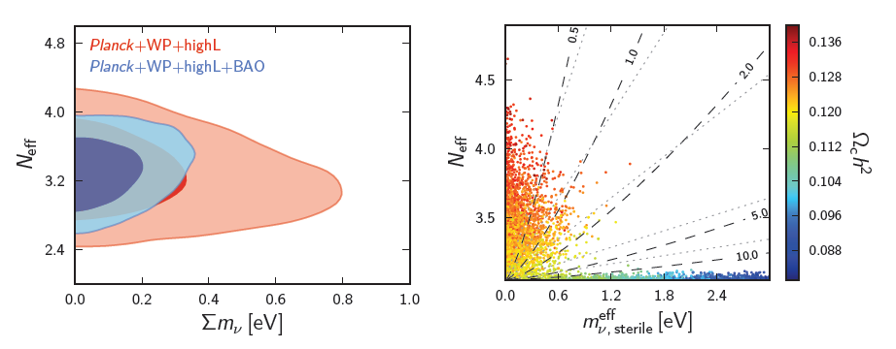

Constraints on Neutrino masses (sterile neutrinos)
No correlation between Neff and the mass of the 3 active massive neutrinos.
Considering one massive sterile neutrino with energy density given by Neff when is
relativistic and meff when is not relativistic we get:
That is marginally compatible with a fourth, fully thermalized, neutrino.

Slide 50
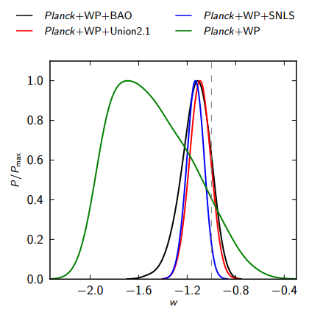
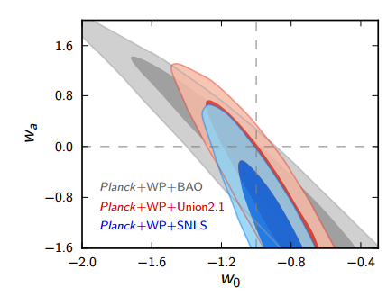
Constraints on Dark Energy
Planck in combination with SN-Ia datasets provides constraints on the dark energy
equation of state.
Planck+SNLS hints for w<-1 or for evolving w(z) at more than 95% c.l..
Similar conclusions from the Union2 dataset but with less statistical significance
(68% c.l.). However the SNLS will revise their data (Pain talk at ESLAB-47). !

Slide 51



Constraints on Curvature
Lensing breaks geometrical degeneracies and allows a precise measurement of
curvature at 1% level.
Universe is flat, no evidence for curvature.
When BAO data is included constraints are at the level of 0.3% on curvature !

Slide 52

Constraints on Variations of Fine Structure Constant

Slide 53



Should we care about a 3 σ signal ?
Discovery of the CMB was
made at 3.5 σ !
Discovery of the accelerating
universe was made at 2.8 σ !

Slide 54
Conclusions
The 2013 Planck T map anisotropy leaves behind it a legacy which will stay for many years (…before next Planck release) and will not be replaced easily.
Excellent agreement between the Planck temperature spectrum at high l and the predictions of the ΛCDM model.
But…anomalies are also seen and will be investigated
Planck 2014 data release will help in solving most of the issues…and maybe will open new ones !

Slide 55
Cosmological parameters
6-parameters model
Parameter |  | 2013 uncertainty (Planck+WP) | Expected 2014 (Planck T+P)
Baryon density today | Ω_{b}h² | 0.00028 | 0.00013
Cold dark matter density today | Ω_{c}h² | 0.0027 | 0.0010
Thomson scattering optical depth | τ | 0.013 | 0.0042
Hubble constant [km/s/Mpc] | H₀ | 1.2 | 0.53
Scalar spectrum power-law index | n_{S} | 0.007 | 0.0031
Constraints on other parameters
Parameter |  | 2013 uncertainty (Planck+WP) | Expected 2014 (Planck T+P)
Effective number of neutrino species | N_{eff} | 0.42 | 0.18
Fraction of baryonic mass in helium | Y_{p} | 0.035 | 0.010
Dark energy equation of state | w | 0.32 | 0.20
Varying fine-structure constant | α/α₀ | 0.0043 | 0.0018
→ Expected reduction in error bars by factors of 2 or more

Slide 56
The scientific results that we present today are a product of the Planck Collaboration, including individuals from more than 100 scientific institutes in Europe, the USA and Canada
Planck is a project of the European Space Agency, with instruments provided by two scientific Consortia funded by ESA member states (in particular the lead countries: France and Italy) with contributions from NASA (USA), and telescope reflectors provided in a collaboration between ESA and a scientific Consortium led and funded by Denmark.

Slide 57


Impressive impact on the international
press (with the exception of the italian one…)

