Slide 1
Two color FEL experiment
F. Villa on behalf of Sparc_lab

Slide 2
Outline
Scientific case
Linac operation
FEL results
Conclusions

Slide 3
Scientific motivation
Two color FELs are greatly discussed in literature for several applications (i.e. pump-probe)
They are limited by the natural bandwidth of the FEL amplifier
Two-bunches electron beam with given time and energy separation
Tailoring the time and frequency separation of the FEL pulses
Linac settings: laser comb technique in the velocity bunching
Explore FEL dynamics
Sub-ps FEL pulse at two different frequencies
Two color FEL radiation at two different times
One color FEL radiation at two different times

Slide 4
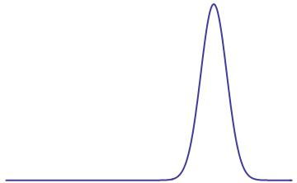
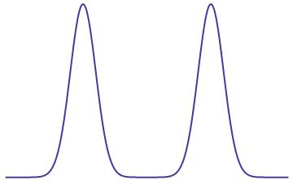
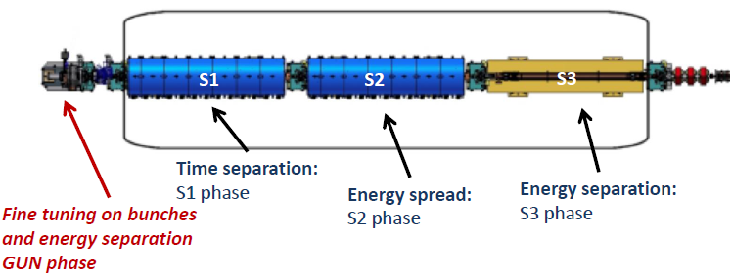
Electron comb generation
seed
CPA
0.09 ps rms
3rd HG
~50 uJ
266 nm
4.27 ps
αBBO
crystal
e⁻_{tot} ~160 pC

Slide 5
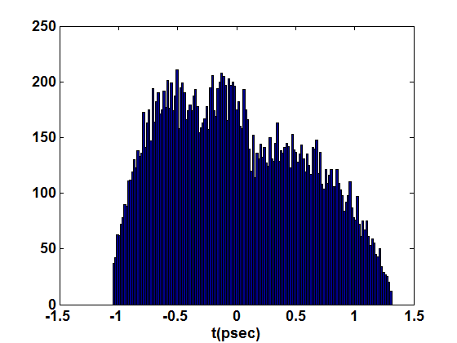
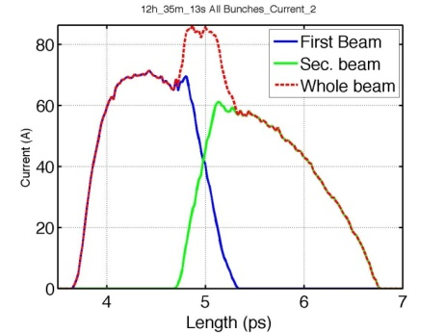
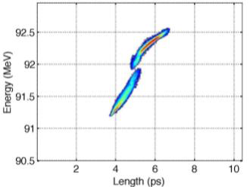
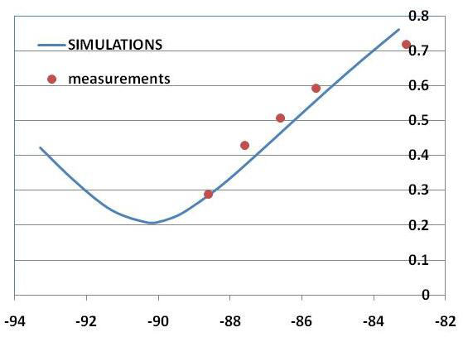
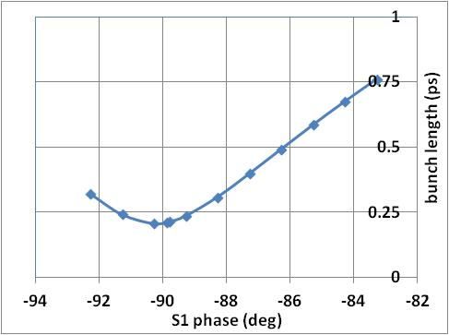
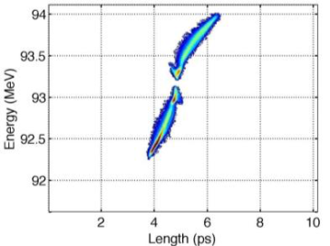
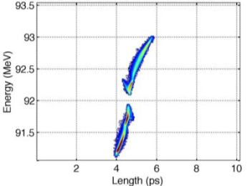
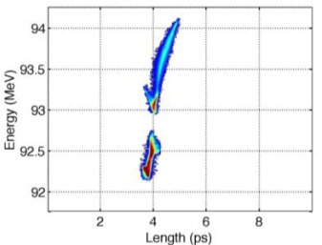
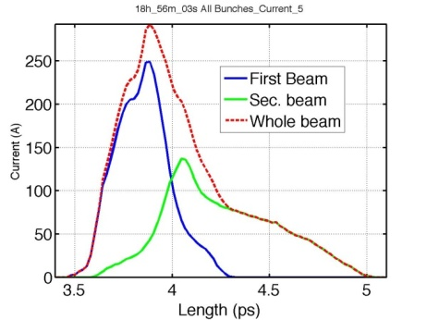
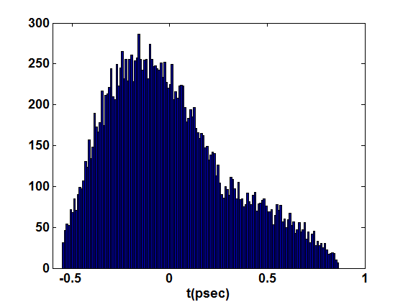
Linac working points
Measure
Simulation

Slide 6
FEL diagnostics
Diagnostic
Chamber VI
Filter Wheel
Chamber
Filters
Resolution 1.2 nm
Spectral window: 200-840 nm
Undulator VI
Fiber IR
spectrometer
Movable
Mirror
Joulemeter
Energy range 1pJ – 1 nJ
Grenouille
Time-bandwidth product <10
Spectral resolution 0.7 nm
Time window 1 ps

Slide 7
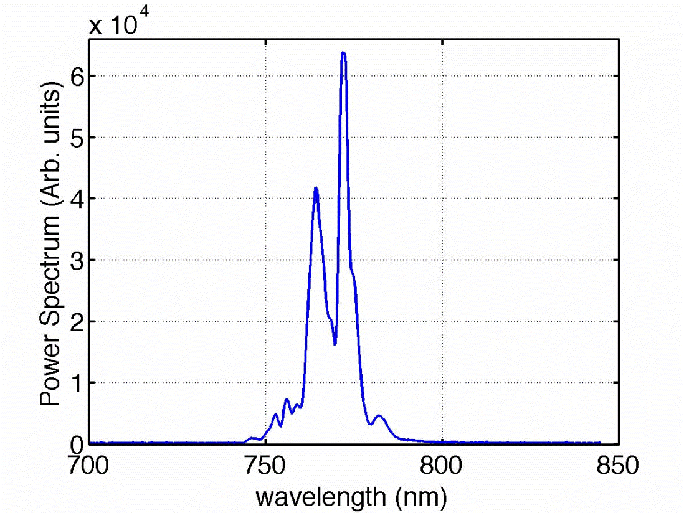
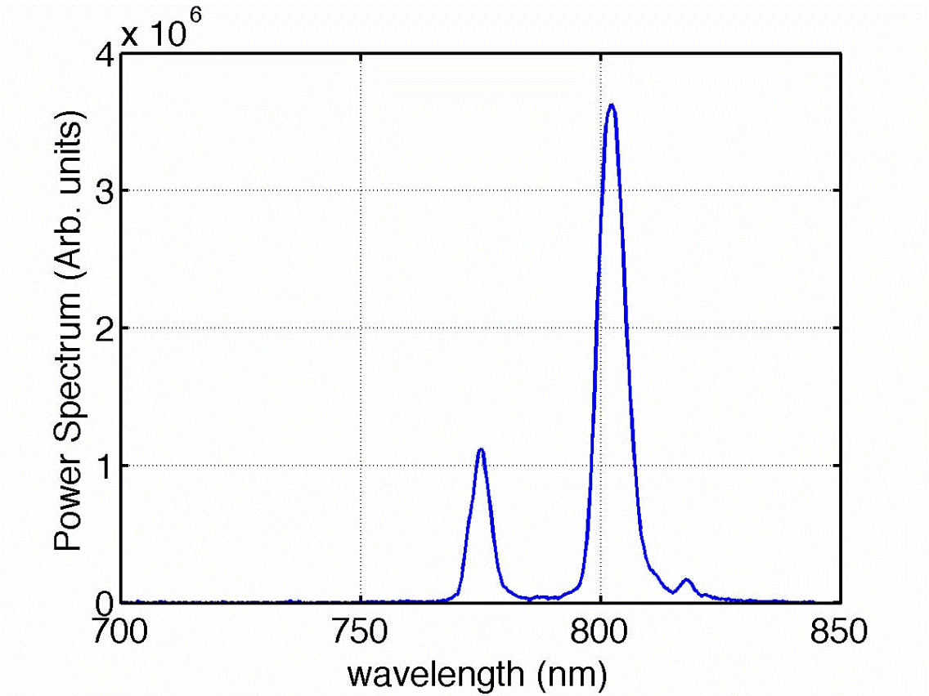
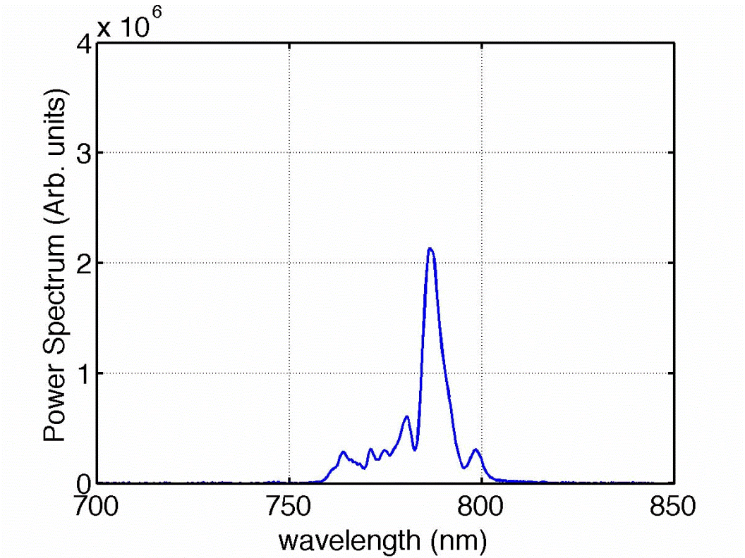
FEL spectra
-85.6
Quasi single spike regime
-88.6
-87.6

Slide 8
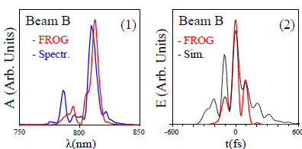
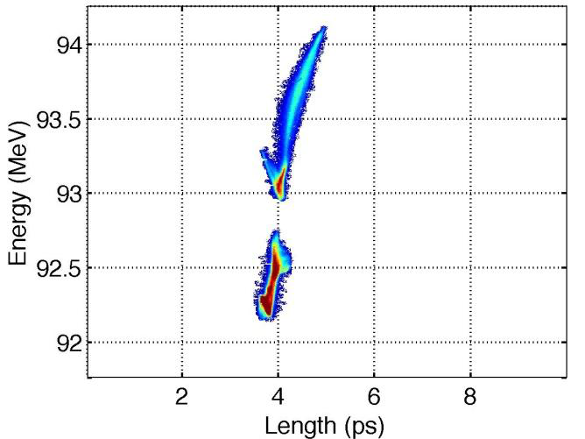
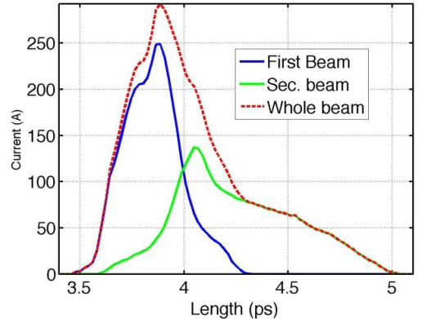
FEL time modulations
 | Energy (MeV) | E. spread (%) | Length (fs) | Charge (pC)
1st bunch | 92.52 (.03) | 0.174 (.005) | 147 (2) | 82.2 (1.6)
2nd bunch | 93.59 (.03) | 0.317 (.005) | 283 (3) | 77.9 (1.6)
Whole beam | 93.04 (.03) | 0.631 (.003) | 305 (4) | 160 (3)
spectrum
time (autocorr.)
110 fs
FEL radiation
Electron
Δλ (nm) | Time duration rms (fs) | Time separation (fs)
18 (4) | 77 (5) | 110 (26)
Energy separation (MeV) | 1.07 (0.05)
Time separation (ps) | 0.42 (0.03)

Slide 9
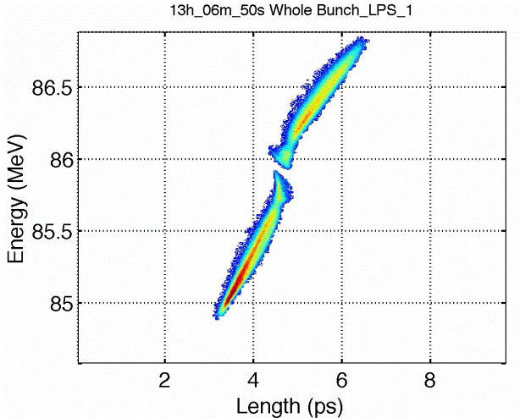
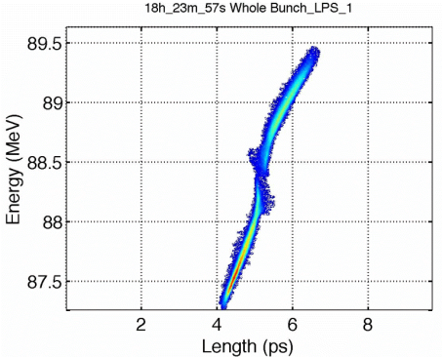
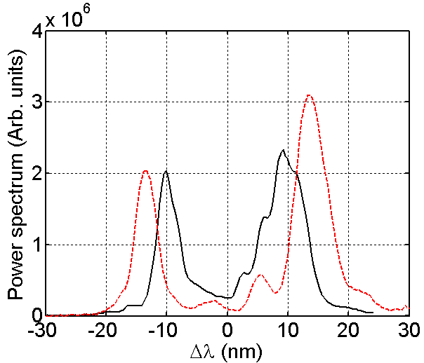
FEL tunability
ΔE (MeV) | 1.01 (0.03)
Δλ (nm) | 20.7 (1.7)
ΔE_{th} (MeV) | 1.07 (0.09)
ΔE (MeV) | 1.14 (0.06)
Δλ (nm) | 26 (3)
ΔE_{th} (MeV) | 1.35 (0.14)

Slide 10
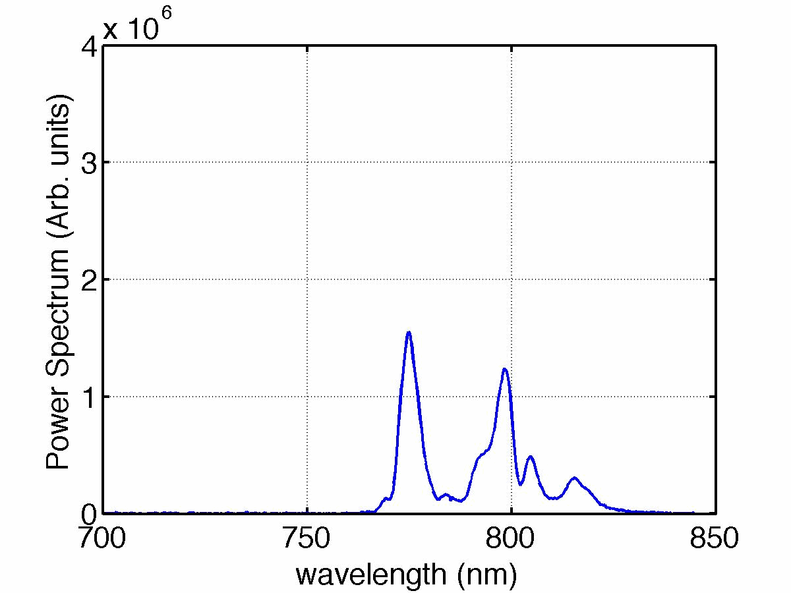
SASE spectrum instability
-88.6

Slide 11
Conclusions
Two pulse electron beam
tunable in time and energy separation
capable of FEL emission
Shorter or equal to the FEL coherence length (quasi-single spike regime)
FEL light
characterization of FEL radiation spectrum
production of train of short FEL pulses
Next developments:
FEL Seeding for better spectrum stability
New laser technique for laser comb generation

