Slide 1
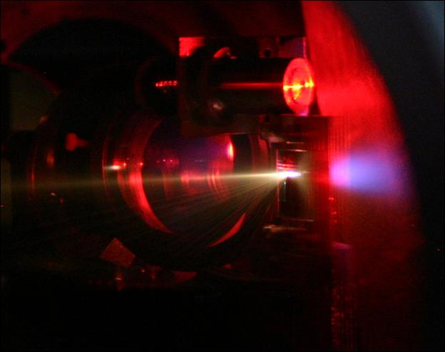
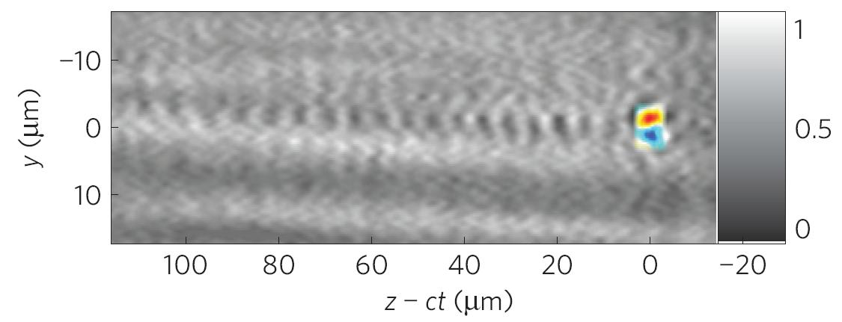
Optical Diagnostics for
Laser-Driven Plasma Accelerators
Malte C. Kaluza
Institute of Optics and Quantum Electronics
Helmholtz-Institute Jena
Friedrich-Schiller-University Jena, Germany

Slide 2
Outline
Conventional particle accelerators vs. laser-plasma accelerators
Generation of a synchronized optical probe pulse
“two-color” probing
shortening of the probe pulse (spectral broadening)
Probing of underdense plasma interactions – electron acceleration:
measure field- and plasma distributions
visualize electron acceleration online
monitor evolution of the “plasma wave“
determine structure of electron bunches
Probing of overdense plasma interactions – ion acceleration:
measure TNSA-electron sheath
measure ion acceleration fields
2

Slide 3
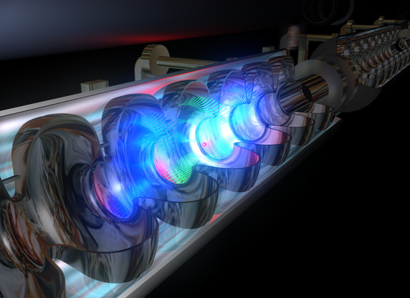
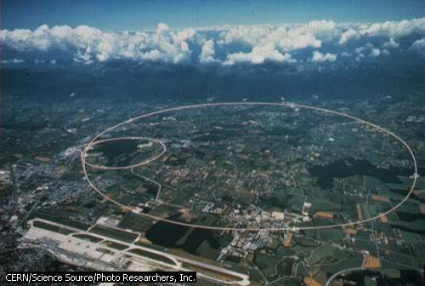
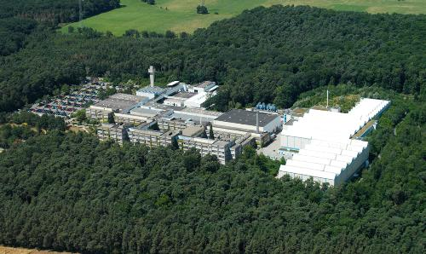
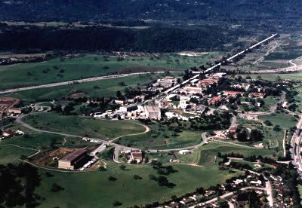
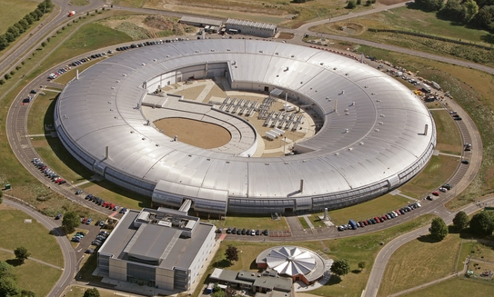
Conventional Particle Accelerators
High-energy particle accelerators
for protons,
heavy ions,
electron linacs,
electron synchrotrons,
are large because of limited
acceleration field strength:
avoid break-through or ionization
⇒ use laser-generated plasma as medium,
high-intensity laser driver
CERN
GSI
SLAC
Diamond
DESY
JETI
3

Slide 4
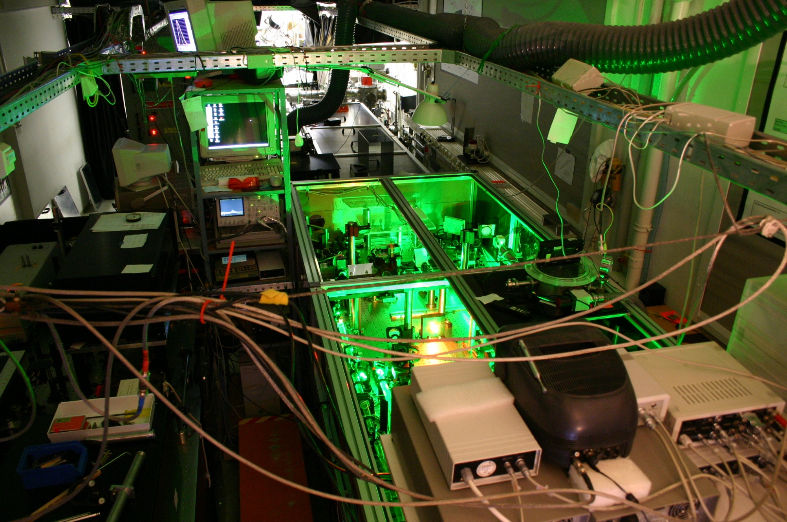
JETI – the JEna Multi-TW TI:Sapphire Laser
Ultra-Short Pulse CPA Ti:Sapphire Laser
wavelength: 800 nm
pulse duration: < 30 fs
pulse energy: > 900 mJ
peak power: > 30 TW
focal spot area: < 5 µm²
repetition rate: 10 Hz
max. intensity: > 10²⁰ W/cm²

Slide 5
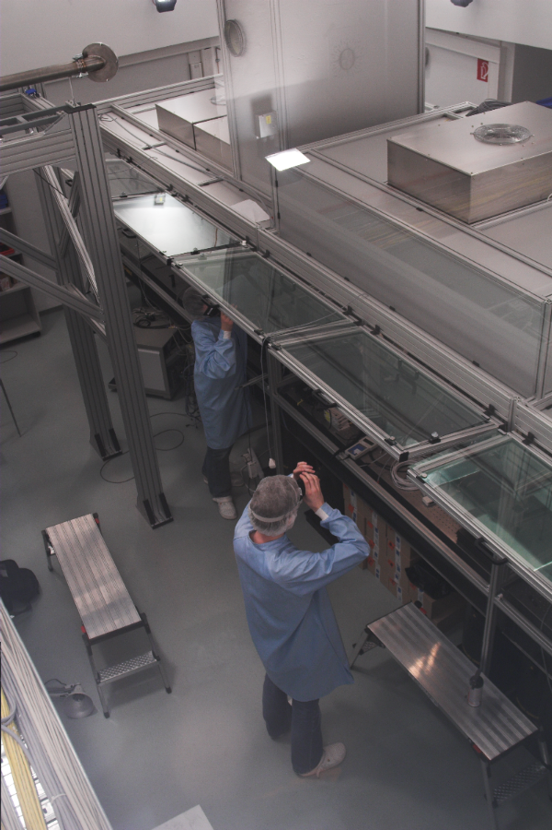
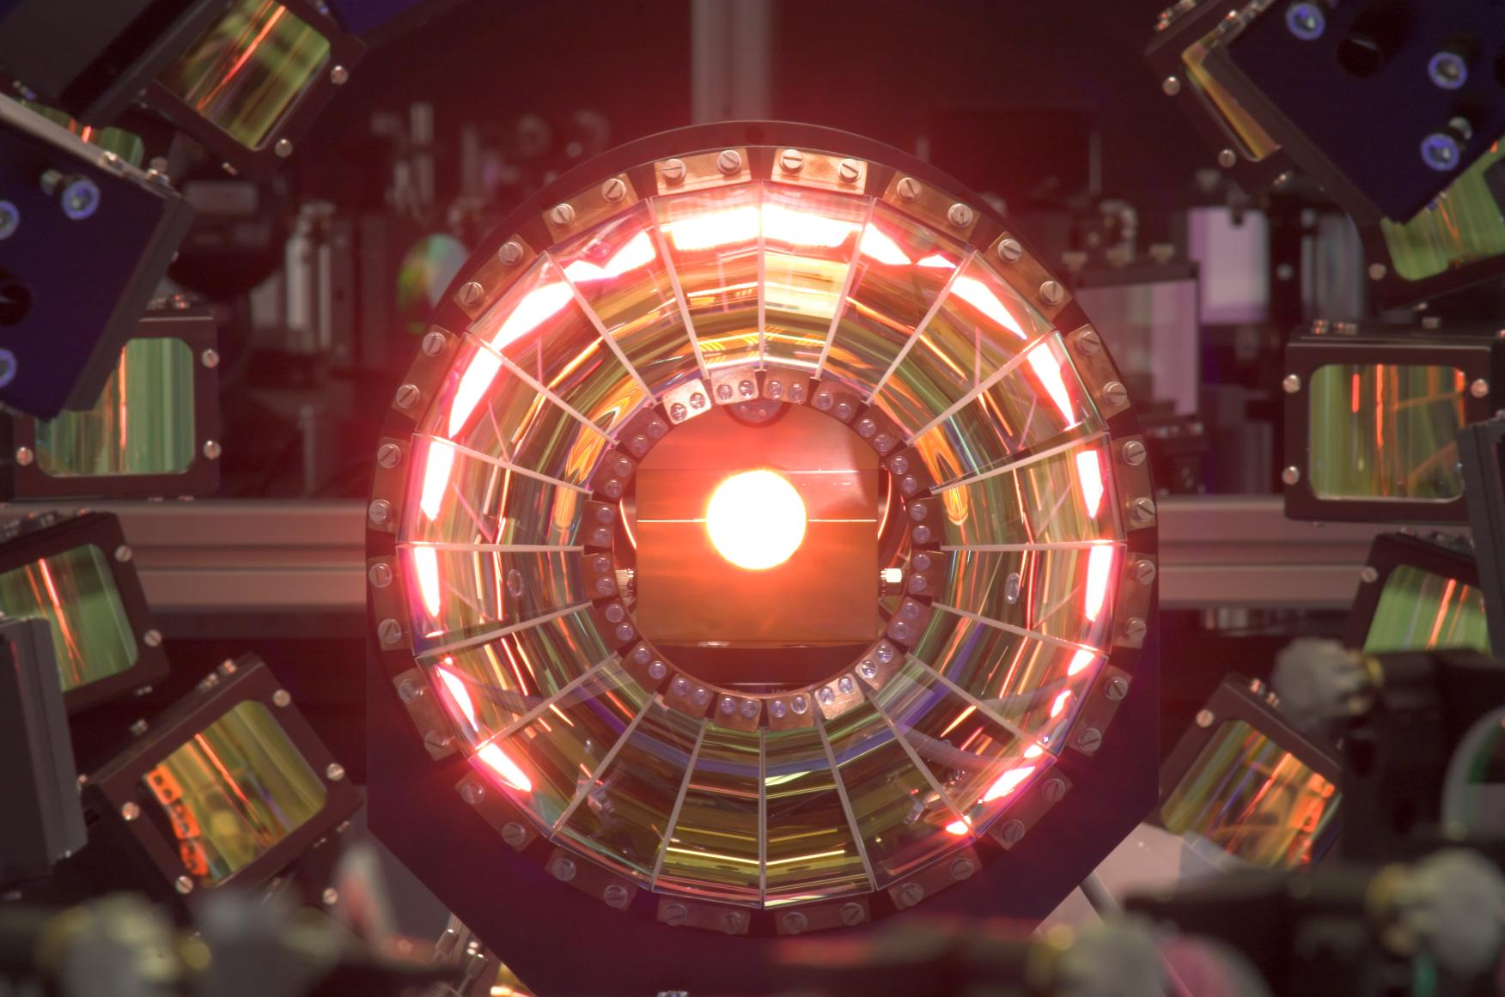
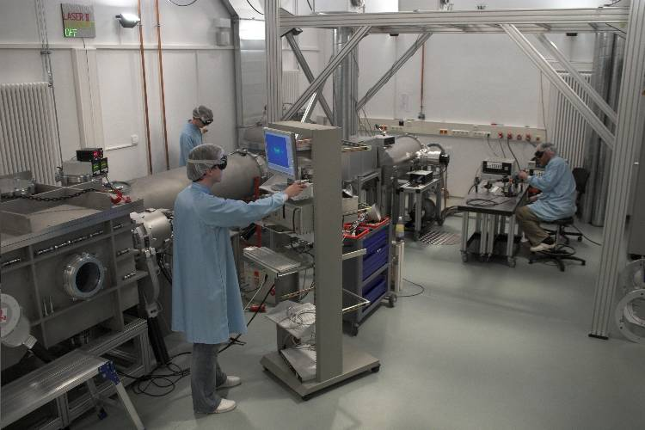
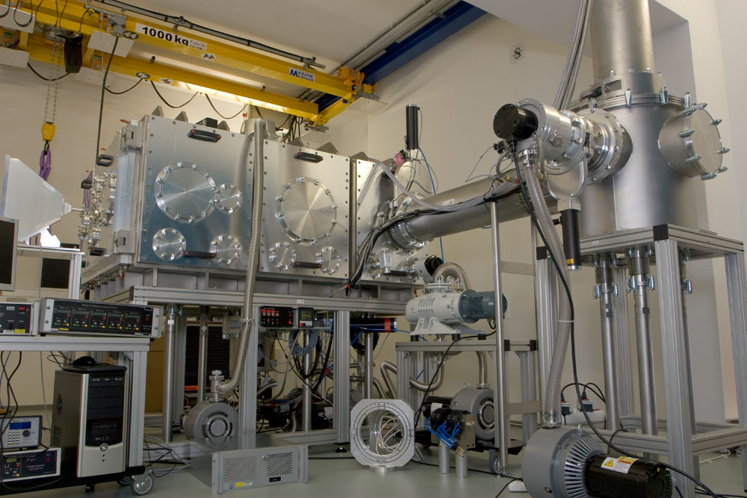
POLARIS – Petawatt Optical Laser Amplifier for Radiation Intensive experimentS
Ultra-Short Pulse CPA Yb:Glass Laser
wavelength: 1030 nm
pulse duration: < 150 fs
pulse energy: 10…75 J
power: 50 TW…0.5 PW
focal spot size: < 10 µm²
repetition rate: 1/40 Hz
max. intensity: > 10²¹ W/cm²

Slide 6

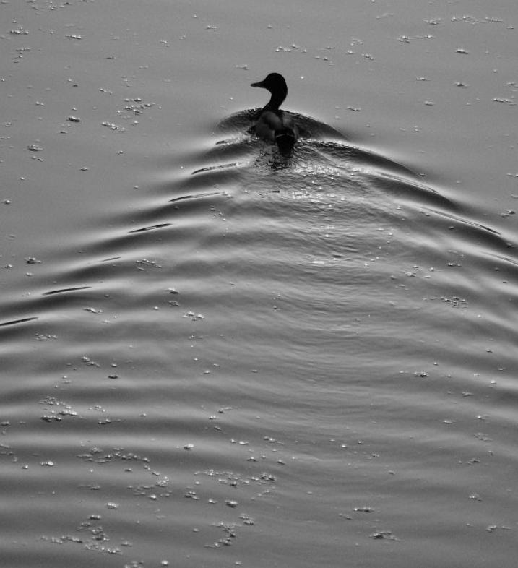
Laser-Driven Electron Acceleration
6

Slide 7
Laser-Driven Electron Acceleration
Plasma wave generation by laser pulse
≡ modulation of n_{e} against ion background (v_{ph,plasma} = v_{gr,laser})
longitudinal E-fields (~ 0.1 TV/m)
Image courtesy of A.G.R. Thomas
Injection of electrons into the wave
⇒ relativsitic electron current ⇔ azimuthal B-fields
7

Slide 8
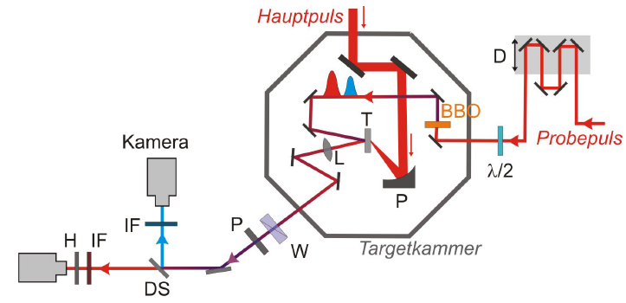
Generation of Synchronized Probe Pulses
Split off part of the compressed main pulse
main pulse
glass block
CCD camera
probe
pulse
target chamber
dichroic mirror
1 or 2 pulses (τ_{pr} ~ τ_{L}) @ 1 or 2 colors (e.g. 1ω and 2ω) @ 2 different times (Δt ~ ps) ⇒1 or 2 snap-shots of same interaction
spectral broadening (e.g. gas-filled hollow fiber) + chirped mirrors → ultra-short probe pulse with τ_{pr}<τ_{L}
MCK et al., Applied Physics B 92, 475 (2008)
M. B. Schwab et al., submitted (2013)
8

Slide 9
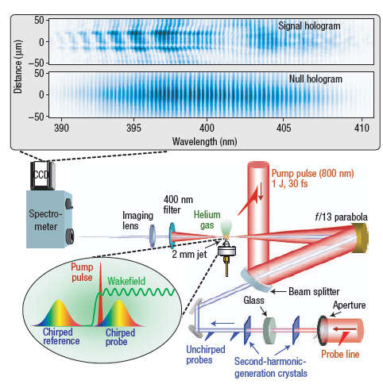
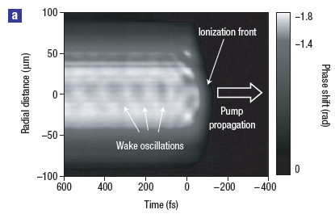
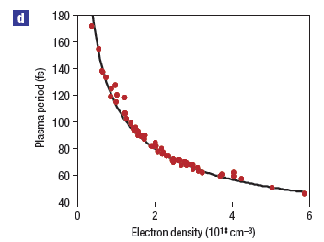
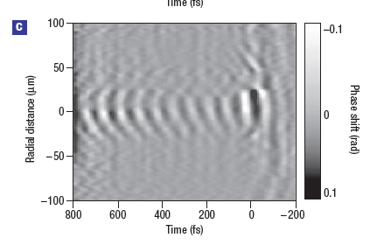
Frequency-Domain Holography @ HERCULES
Split off part of the compressed main pulse, chirp it and let it co-propagate
Visualization of (time-integrated) shape of plasma wave
N. Matlis et al., Nature Physics 2, 749 (2006)
9

Slide 10
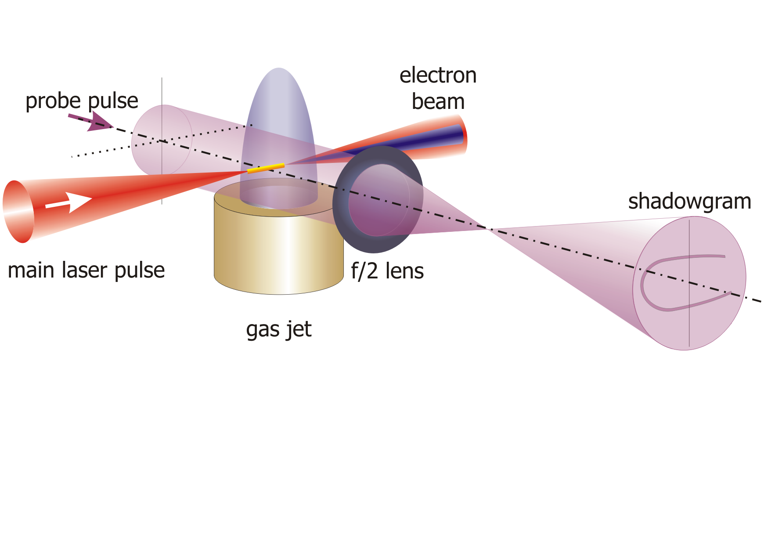

Transverse Optical Probing ⇒ Resolve Transient Processes?
JETI parameters:
E_{laser} = 800 mJ, τ_{laser} = 85 fs,
f/6 OAP, I_{laser}  3×10¹⁸ W/cm²
LWS-20 parameters:
E_{laser} = 80 mJ, τ_{laser} = 8.5 fs,
f/6 OAP, I_{laser}  6×10¹⁸ W/cm²
probe pulse:
τ_{probe}  100 fs @ 1ω
probe pulse:
τ_{probe}  8.5 fs @ 1ω
10

Slide 11
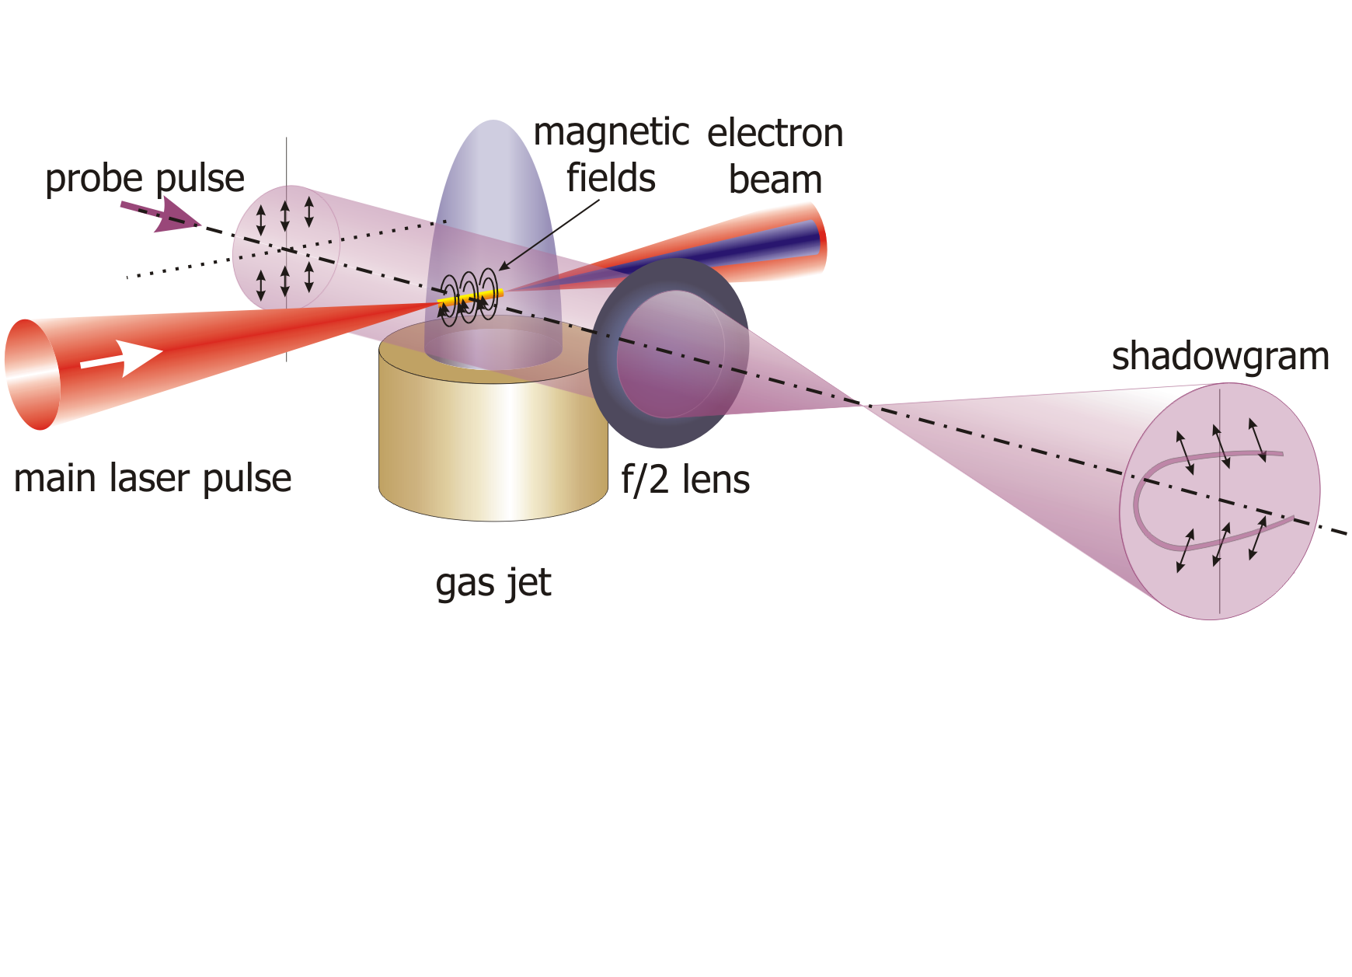
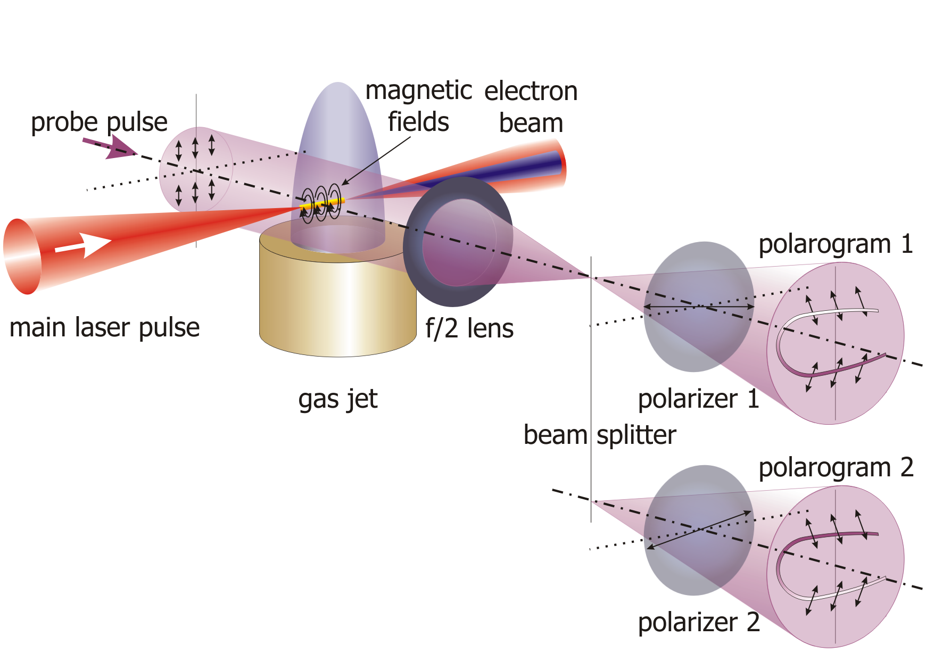
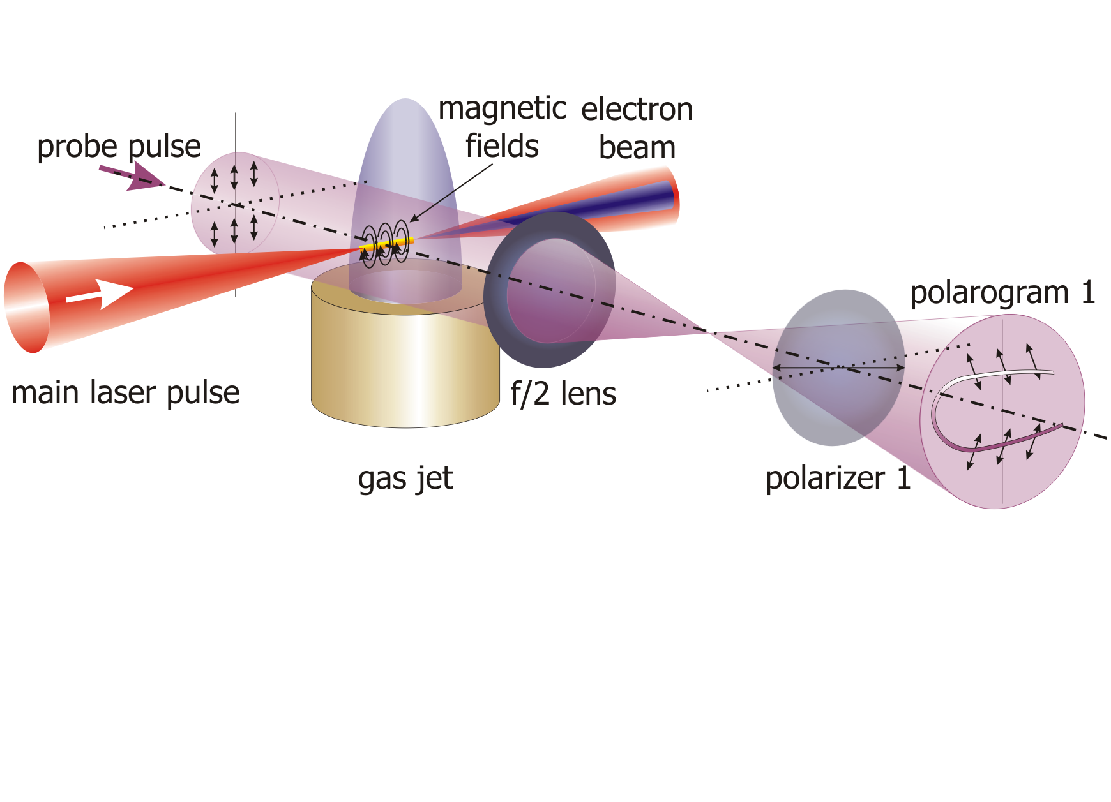
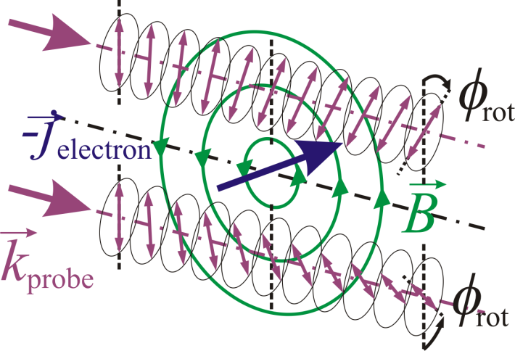
Transverse Optical Probing ⇒ Resolve Transient Processes?
11

Slide 12
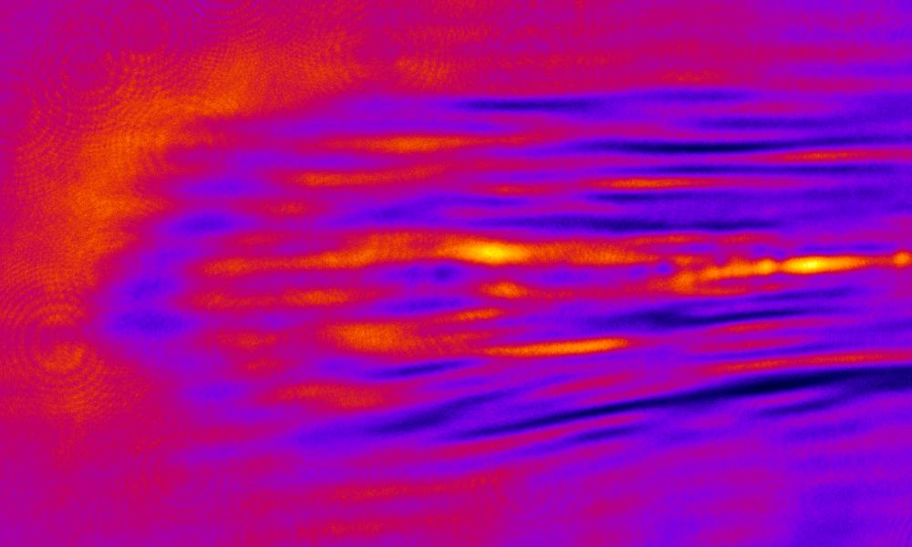
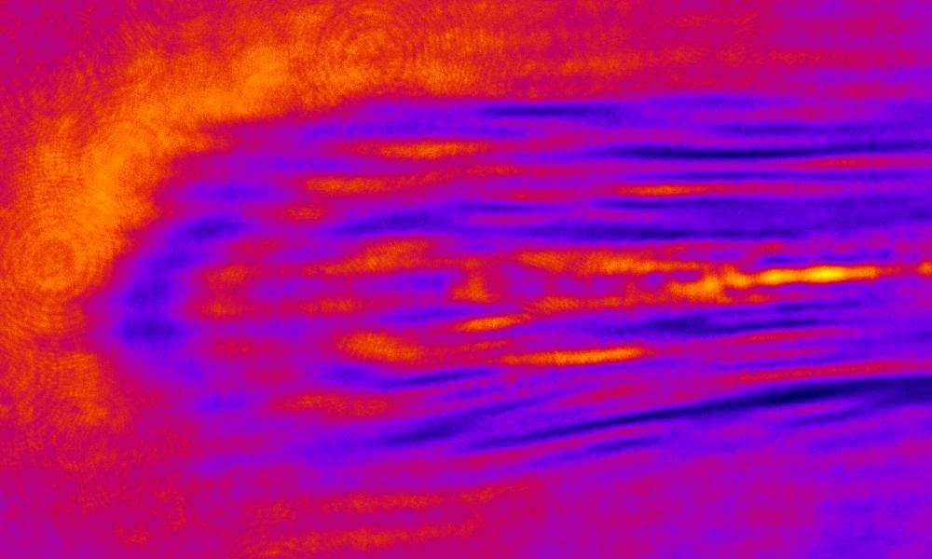
Faraday-Rotation with 100 fs @ JETI
Two polarograms from two (almost) crossed polarizers:
340 µm
polarogram 1
polarogram 2
560 µm
12

Slide 13
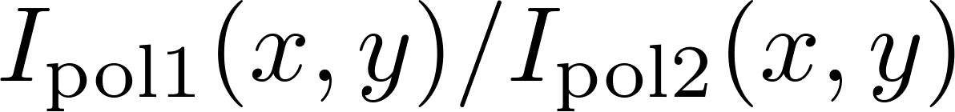
Faraday-Rotation with 100 fs @ JETI
Two polarograms from two (almost) crossed polarizers:
340 µm
polarogram 1
polarogram 2
560 µm
Deduce rotation angle φ_{rot} from pixel-by-pixel division of polarogram intensities:
13

Slide 14
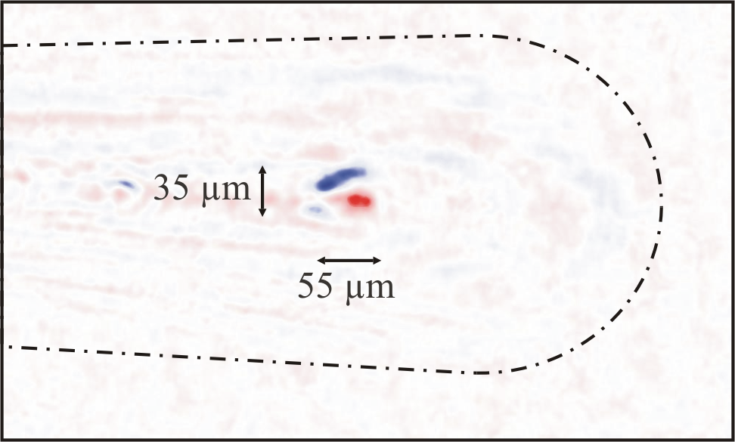
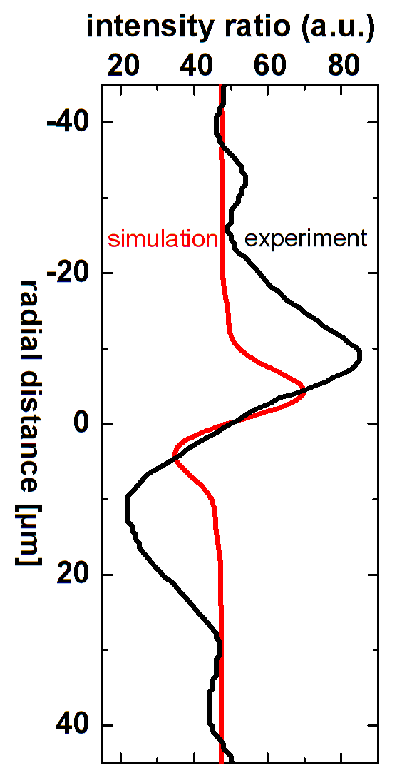
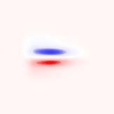
Faraday-Rotation with 100 fs @ JETI
simulated
feature
340 µm
polarogram 1
polarogram 2
560 µm
experimental Faraday feature
Experimental evidence for B-fields from MeV electrons and bubble!
MCK et al., Physical Review Letters 105, 115002 (2010)
14

Slide 15
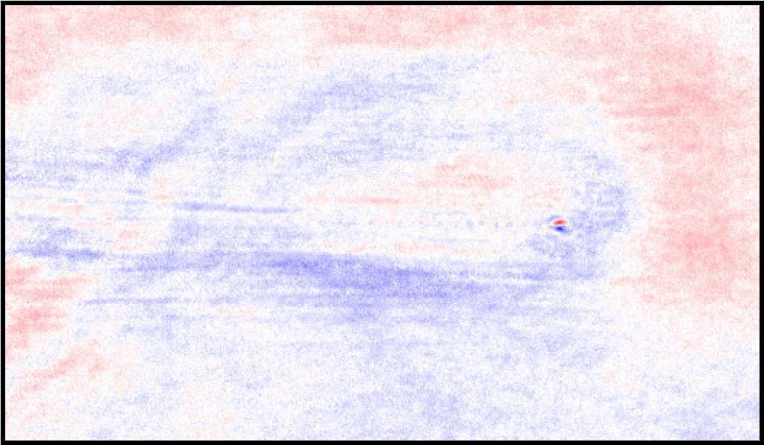
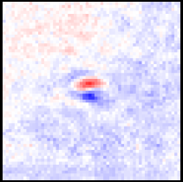
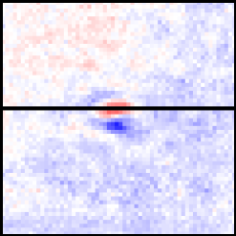
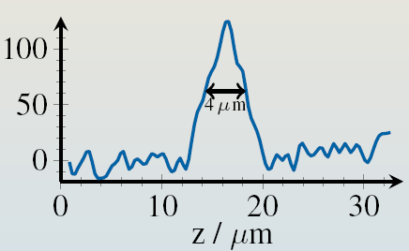
Faraday-Rotation with 8.5 fs @ LWS 20
polarogram 1
polarogram 2
Electron bunch length: Δz = 4 µm
τ_{FWHM}= (6±2) fs, τ_{RMS}= (2.5±0.9) fs
15
A. Buck et al., Nature Physics 7, 543 (2011)

Slide 16
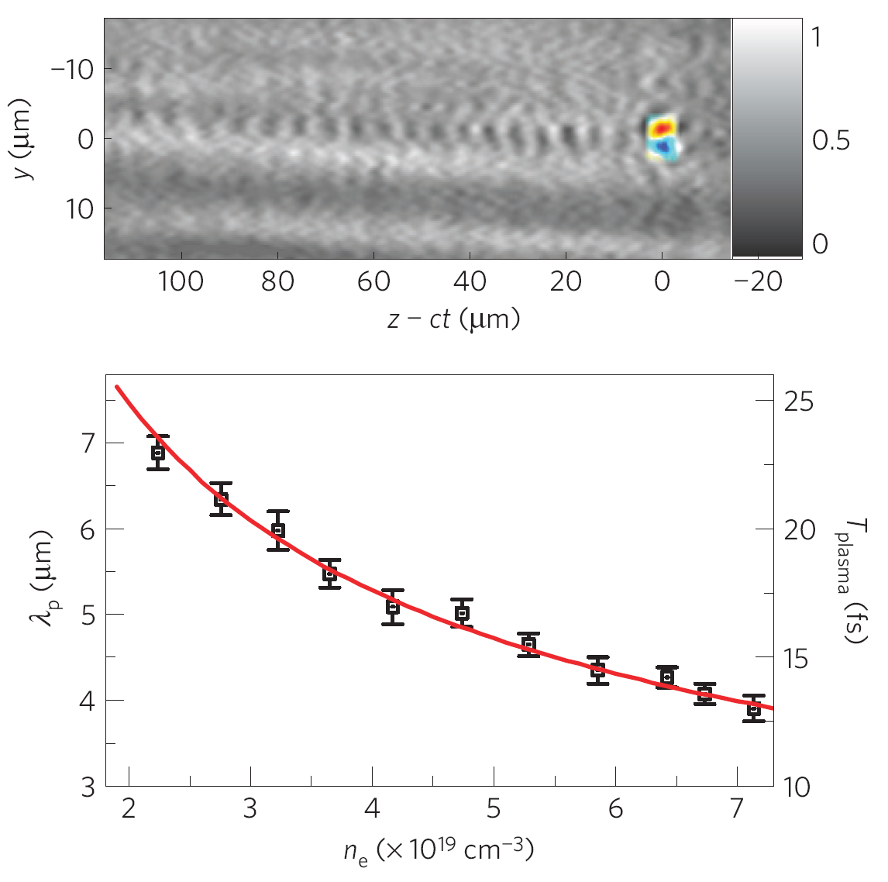
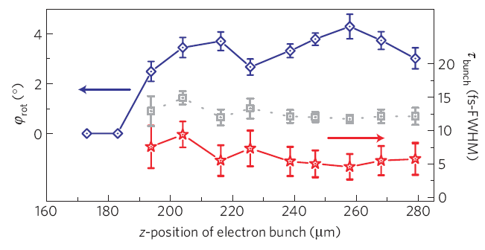
Faraday-Rotation with 8.5 fs @ LWS 20
Polarimetry:
visualize e-bunch via associated B-fields
change delay between pump and probe
⇒ movie of e-bunch formation
observe e-bunch formation on-line!
16
A. Buck et al., Nature Physics 7, 543 (2011)

Slide 17
Shadowgraphy with 8.5 fs @ LWS 20
Polarimetry:
visualize e-bunch via associated B-fields
change delay between pump and probe
⇒ movie of e-bunch formation
Shadowgraphy:
visualize plasma wave
change electron density ⇒ change plasma wavelength
observe e-bunch formation on-line!
17
A. Buck et al., Nature Physics 7, 543 (2011)

Slide 18
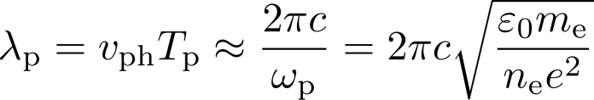
Shadowgraphy with 8.5 fs @ LWS 20
Shadowgraphy:
visualize plasma wave
change electron density ⇒ change plasma wavelength
18
A. Buck et al., Nature Physics 7, 543 (2011)

Slide 19
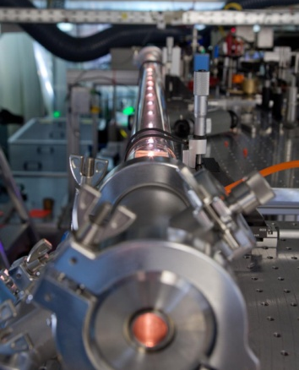
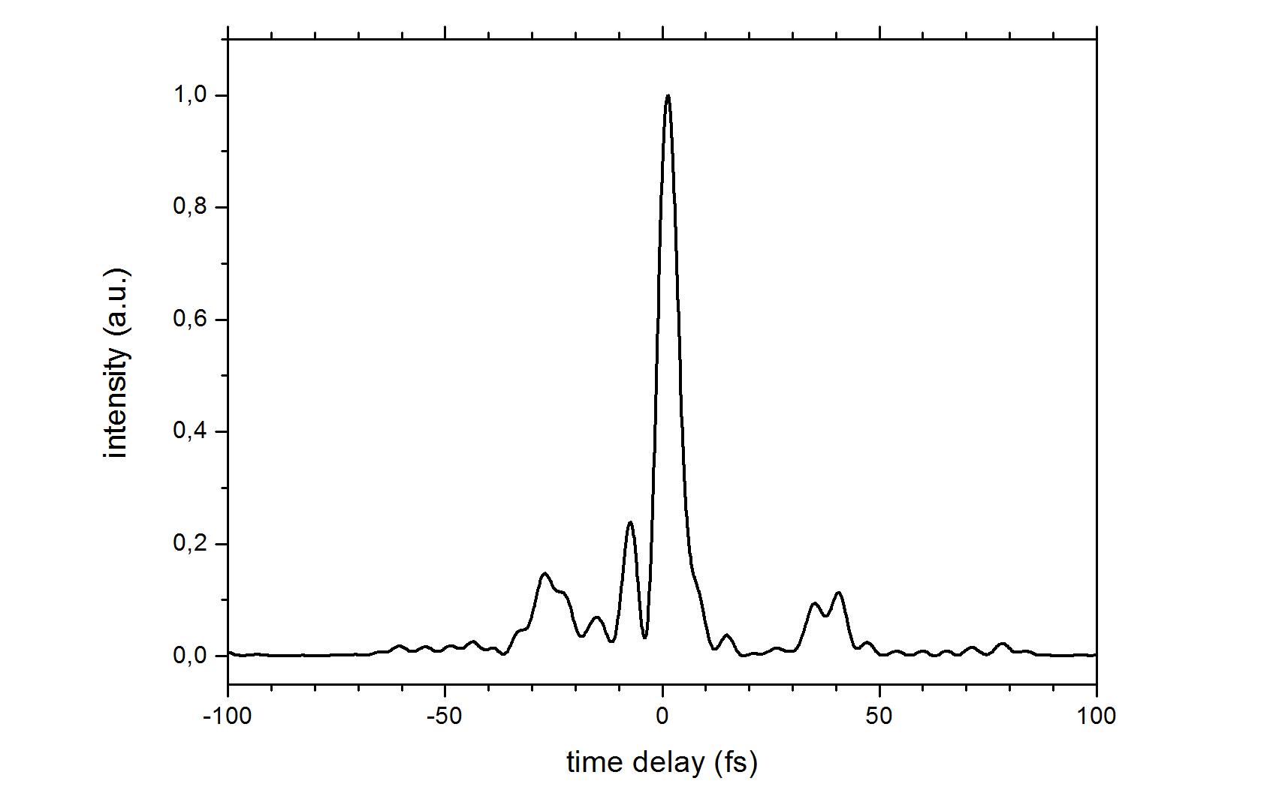
Transverse Probing with Few-Cycle Probe Pulse @ JETI
Improve resolution of probing:
frequency-broadening of probe pulse
(in gas-filled hollow fiber)
⇒ shorter τ_{probe}
  sub-main pulse temporal resolution,
  1.1 µm spatial resolution of optimized imaging system
τ_{probe} = 5.5 fs
19

Slide 20
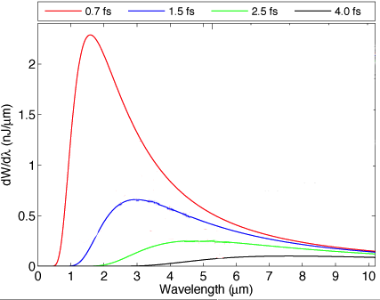

Measurement of Electron Pulse Duration with IR-CTR @ LOA
Results courtesy of V. Malka, LOA
Analytic CTR model
Gaussian pulse shape,
measured e-beam:
  charge,
  energy,
  divergence.
Bunch duration
from peak wavelength,
peak intensity
Spectral features
TR peaked at 3 μm,
coherent
τ_{RMS} = 1.5 fs ⇒ peak current I_{max} = 4 kA
O. Lundh et al., Nature Physics 7, 219 (2011)
20

Slide 21
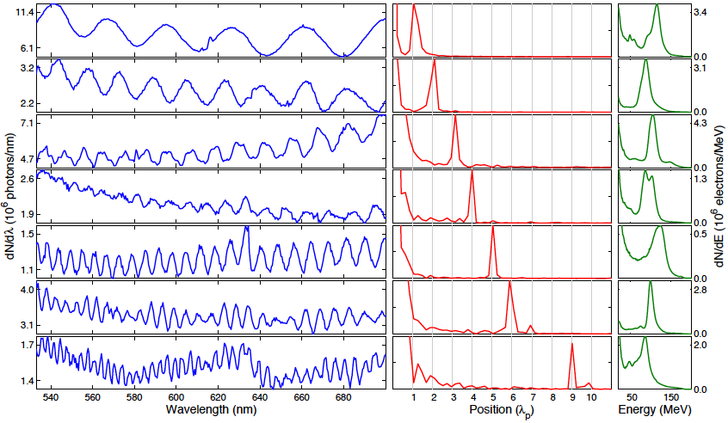
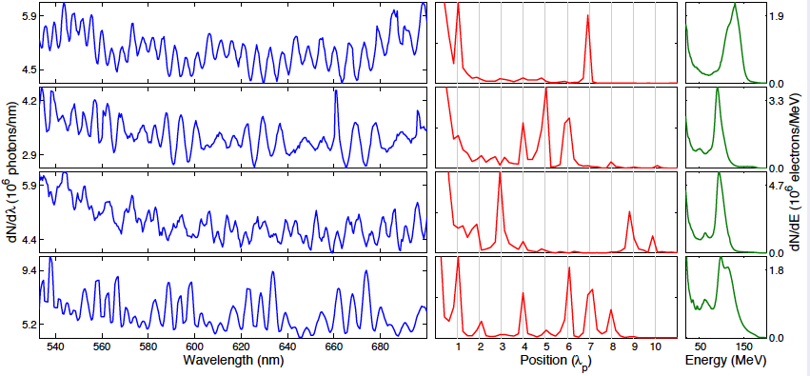
Visible-CTR Spectra: Single vs. Multi Bunches @ LOA
Results courtesy of V. Malka, LOA
Visible spectra
Fourier transform
e-spectra
# of visible e-bunches
2
2
3
4
more details:
talk by O. Lundh,
WG 5 (Tuesday)
4
6
Peaks in Fourier transform always coincide with m × 𝜆p
O. Lundh et al., Phys. Rev. Lett. 110, 065005 (2013)
21

Slide 22
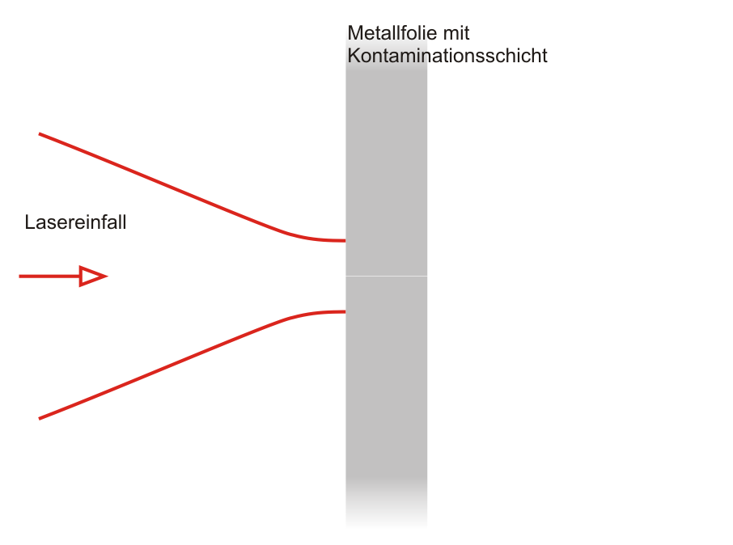
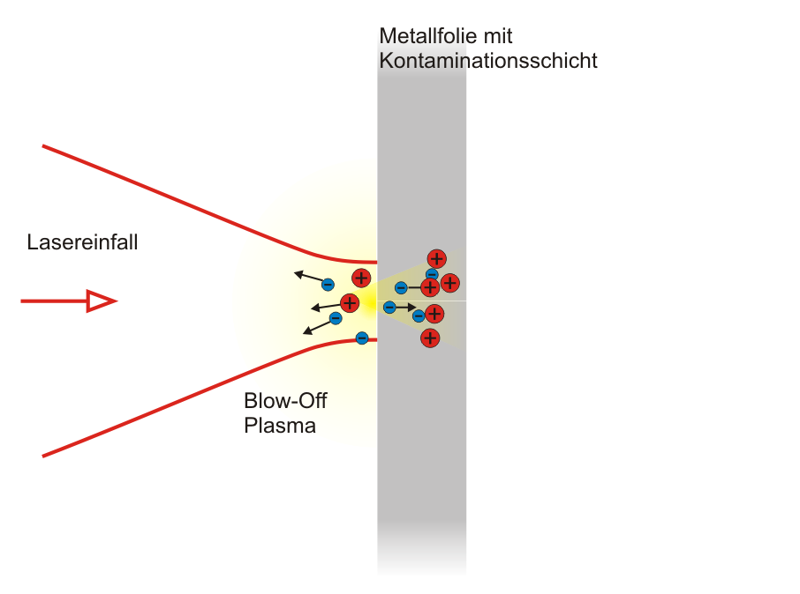
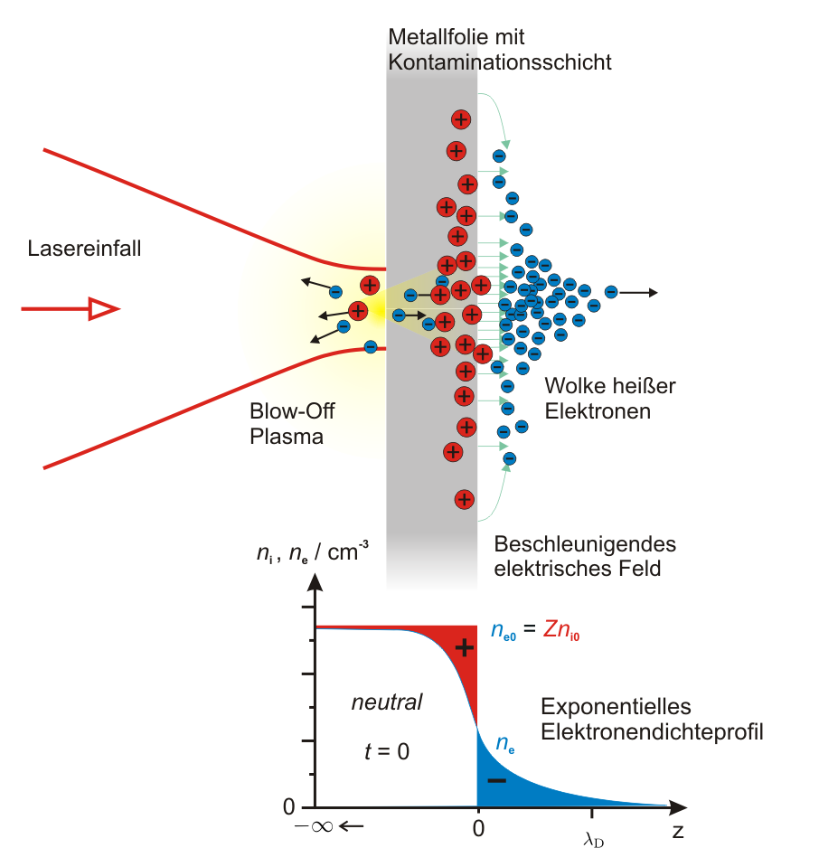
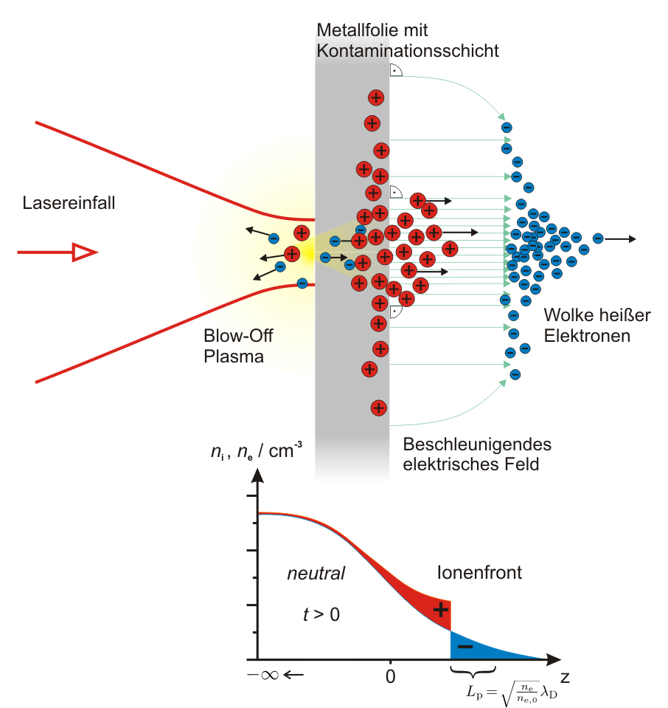
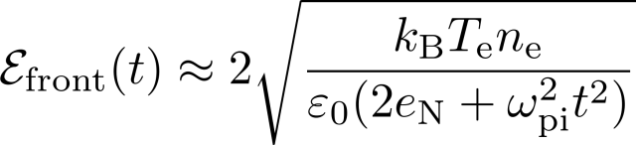
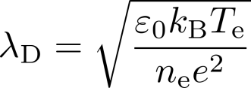
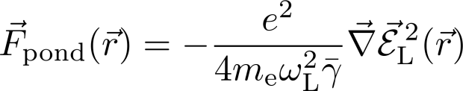
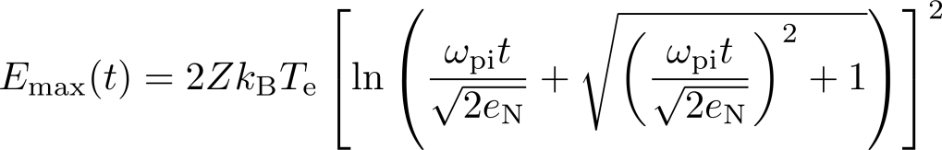
Laser-Driven Ion Acceleration
TNSA (Target Normal Sheath Acceleration)
metal foil with contamination layer
laser pulse generates relativistic electrons,
they propagate through the foil and
form an electric sheath field
~ TV/m
charge distribution starts to expand,
acceleration length ~ µm
~ Debye-length
lifetime of electric field ~ f (τ_{L})
max. ion energies
laser incidence
I_{L} ~ 10¹⁹ W / cm²
hot electron cloud
hot electron cloud
blow-off plasma
accelerating electric field
ion front
exponential electron density profile

Slide 23
Laser-Driven Ion Acceleration
metal foil with contamination layer
laser incidence
I_{L} ~ 10¹⁹ W / cm²
blow-off plasma
hot electron cloud
accelerating electric field
ion front
exponential electron density profile

Slide 24
Laser-Driven Ion Acceleration
metal foil with contamination layer
laser incidence
I_{L} ~ 10¹⁹ W / cm²
blow-off plasma
hot electron cloud
accelerating electric field
ion front
exponential electron density profile

Slide 25
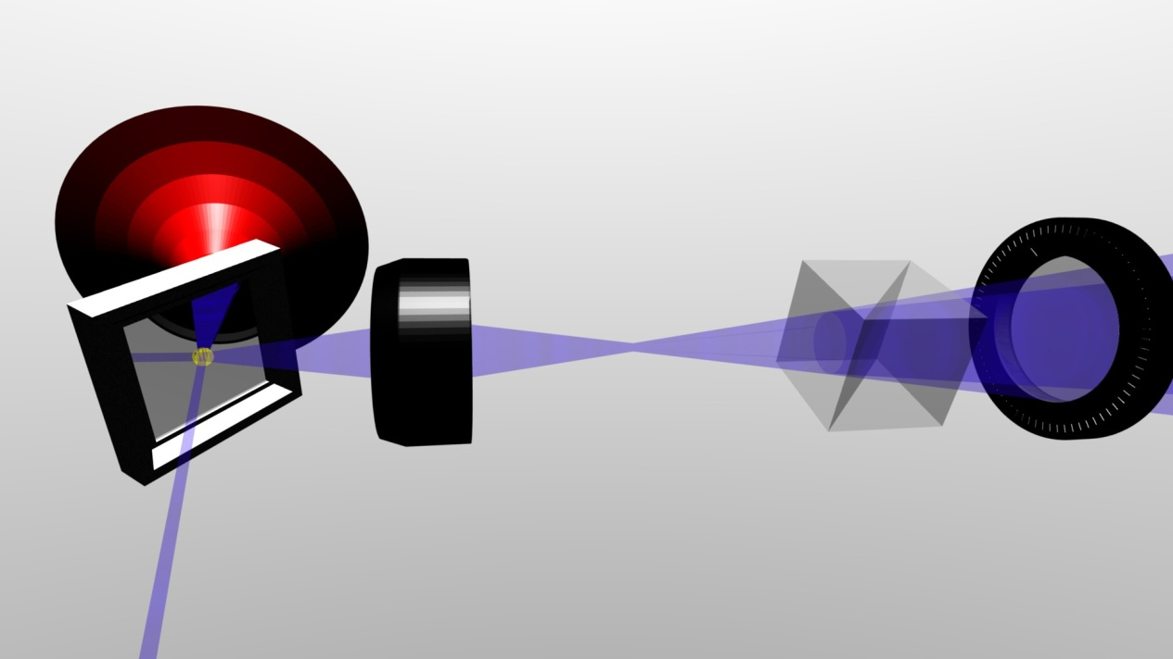




Optical Probing of Ion Acceleration @ JETI
sheath build-up
rarefaction
of sheath
main pulse arrival
t = 0
prepulse
activity
without main pulse
with main pulse
25

Slide 26
Short-Pulse Timing in Dual-Beam Experiments @ ARCTURUS
Results courtesy of M. Swantusch and O. Willi, University of Düsseldorf
Issues using multiple beams
online temporal scan – temporal overlap
unstable beam pointing – spatial overlap
⇒ interferometry
chirped probe
beam 1
beam 2
to TASRI
beam 1: 25 fs
beam 2 : 35 fs
chirped probe: up to 30 ps
Confirm delay between both beams
beam 1
beam 2
Variation of focus position
over 20 measurements
early
-100 fs
0
100 fs
late
26

Slide 27








Short-Pulse Timing with Spectral Interferometry @ ARCTURUS
Results courtesy of M. Swantusch and O. Willi, University of Düsseldorf
Timing of probe and beam 2:
Czerny-Turner
~30 ps
S
CCD
interferograms
Mach-Zehnder
G
sph. mirror
Time- And Space-Resolved Interferometry,
P. Antici et al., PRL 101, 105004 (2008)
Reference signal ⇒
temporal & spatial resolution
phase map
~ 8 ps
~300 µm
~ 4 ps
~ 0 ps
~30 ps

Slide 28




Temporal and Spatial Overlap of both Beams @ ARCTURUS
Results courtesy of M. Swantusch and O. Willi, University of Düsseldorf
Single-beam interaction
Dual-beam interaction
Beam1
Beam1+Beam2
x
t
Δt = 700 fs
31.10#66
Δx = 25 µm
31.10#67
Beam2
31.10#49
Beam1+Beam2 overlapped
31.10#10
Increasing temporal resolution possible by using less chirped probe pulse

Slide 29




Probing of the TNSA-Sheath @ JETI
phase shift (measured
tangentially) ⇒ 2D signal
bent thin foil target
Abel inversion
3D electron density distribution
(cylindrical symmetry)
Nomarski interferometer:
f/2 imaging onto 12-bit CCD
Wollaston prism + polarizer
spatial resolution ~ 1.1 µm
temporal resolution ~ 100 fs
⇒ match dimensions of acceleration process!
R. Benattar et al. (1979); G. Pretzler et al. (1992)

Slide 30



Probing of the TNSA-Sheath @ JETI
First optical measurement of n_{e}-distribution driving laser ion acceleration!
J. Crow et al., J. Plasma Phys. (1975)
electron density / cm⁻³
electron density / cm⁻³
radial extent / µm
longitudinal distance z to target / µm
longitudinal distance / µm
at t = 0
(onset of acceleration process)
O. Jäckel et al., New Journal of Physics 12, 103027 (2010)

Slide 31





Probing of the TNSA-Sheath @ JETI
Energy content and conversion efficiency
Energy content of electron sheath:
Conversion efficiency E_{laser} ⇒ hot electrons:
(deduced from sheath’s electron density and radial extent, assuming similar hot-e-density inside the target)
O. Jäckel et al., New Journal of Physics 12, 103027 (2010)
31

Slide 32
Conclusions and Outlook
Optical probing for high-intensity laser-plasma interactions established as a non-invasive diagnostic with high temporal and spatial resolution.
Probing of underdense plasma interactions:
    visualize electron acceleration process:
    evolution of B-fields
    non-linear evolution and breaking of plasma wave
    sighting of the “real bubble”
    measurement of ultra-short electron bunch duration
Probing of overdense plasma interactions:
    measure TNSA-sheath evolution,
    get primary parameters for ion acceleration (n_{e}, T_{e}, λ_{D}),
Additional information about the interaction
→ possibility to improve the acceleration process
32

Slide 33





Collaborators
A. Sävert, M. Nicolai, M.B. Schwab, M. Reuter, M. Schnell, A. Kawshik, H.-P. Schlenvoigt, O. Jäckel, S. Pfotenhauer, J. Polz, J. Heymann, S. Weber, F. Ronneberger, B. Beleites, C. Spielmann, G.G. Paulus
Institute of Optics and Quantum Electronics, Friedrich-Schiller-University Jena,
Helmholtz-Institute Jena
A. Buck, K. Schmid, C.M.S. Sears, J.M. Mikhailowa, F. Krausz,
L. Veisz
Max-Planck-Institute of Quantum Optics, Garching
S.P.D. Mangles, K. Poder, J. Cole, A. E. Dangor, Z. Najmudin
Imperial College London, UK
A.G.R. Thomas, K. Krushelnick
Center for Ultrafast Optical Science, Michigan, US
V. Malka and O. Willi for slides
33

