Slide 1


Primary Beam Lines for the
Project at CERN
C.Bracco, F.M. Velotti, J. Bauche, A. Caldwell, B. Goddard, E. Gschwendtner, G. Le Godec, L.K. Jensen, M. Meddahi, P. Muggli, J.A. Osborne, A. Pardons, A. Petrenko

Slide 2
Outlines
AWAKE p+ beam line
  Present CNGS layout
  Needed lattice modifications for AWAKE beam
  Optics
  Beam instrumentation
AWAKE e- beam
  Geometric layout and optics
  Preliminary results on space charge effects

Slide 3
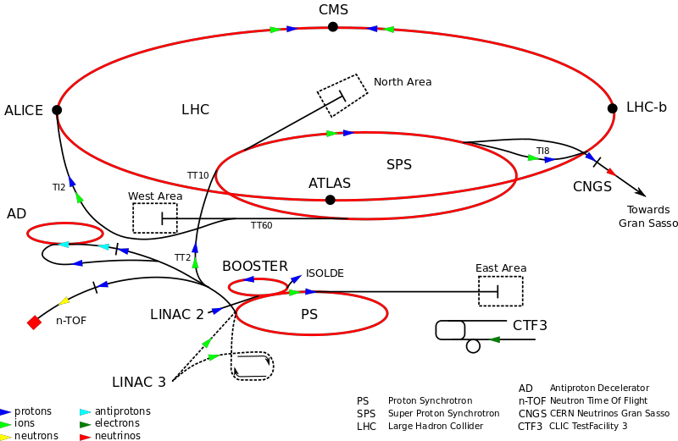
AWAKE in the CERN Accelerator Complex

Slide 4
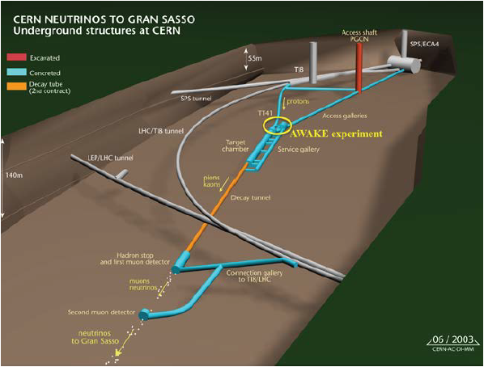
AWAKE in the CERN Accelerator Complex
CNGS
AWAKE experiment will be installed @ the end of the CNGS beam line

Slide 5
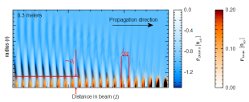
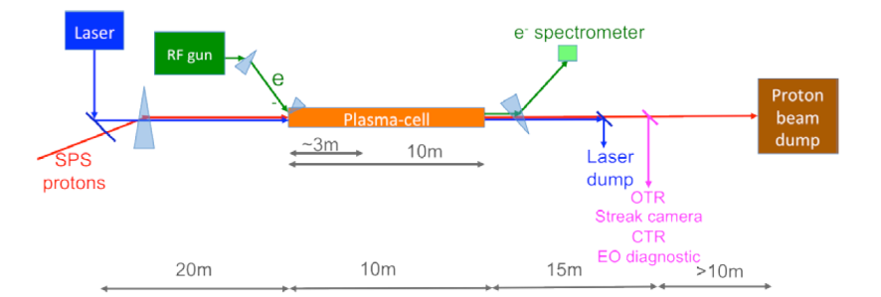
Experimental Layout
Self-modulation instability (SMI)
p+ bunches produced by the CERN SPS enters the plasma cell ➔ self-modulation instability (SMI) ➔ microbunches spaced at the plasma wavelength (~ 1 mm) .
2 TW laser pulse, co-propagating and co-axial with the p+ beam ➔ plasma ionisation + controlled SMI.
Witness bunch of 1.25·10⁹ e- injected downstream of the SMI saturation ➔ up to 40% e trapped and accelerated from 20 MeV up to 2.1 GeV over a 10 m plasma cell.

Slide 6
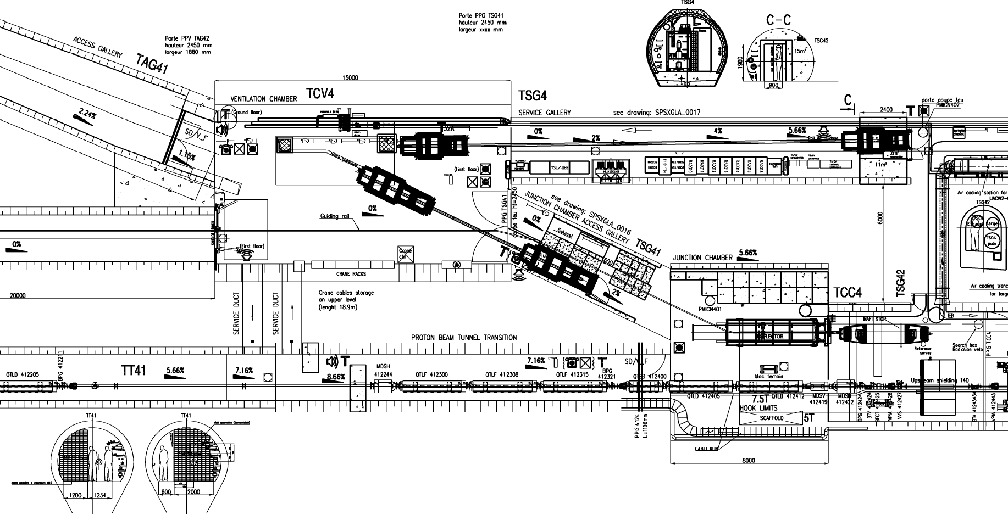
End of CNGS Proton Beam Line
p+ Beam from SPS
TARGET area
Final focusing quadrupoles + trajectory correctors + Beam instrumentation

Slide 7
End of CNGS Proton Beam Line
7.16 %
p+ Beam from SPS
Plasma cell
TARGET area
Final focusing quadrupoles + trajectory correctors + Beam instrumentation
The end of the present CNGS line has to be modified to install the AWAKE plasma cell: new final focusing system + laser integration

Slide 8

Lattice Modifications
Present Layout (end of the line)
FODO
Final Focusing

Slide 9
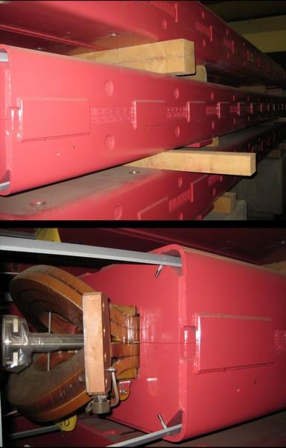
Lattice Modifications
Present Layout (end of the line)
FODO
Final Focusing
MBG dipoles:
Length [m] | 6.3
Aperture Width [mm] | 140
Aperture Height [mm] | 37
Max.Magnetic Field [T] | 1.91

Slide 10
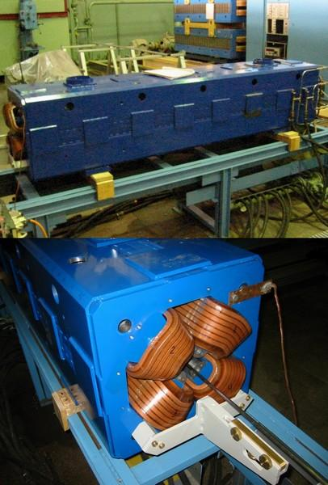
Lattice Modifications
Present Layout (end of the line)
FODO
Final Focusing
QTG quadrupoles:
Length [m] | 2.2
Aperture Width [mm] | 45
Aperture Height [mm] | 45
Max.Magnetic Field [T/m] | 34

Slide 11
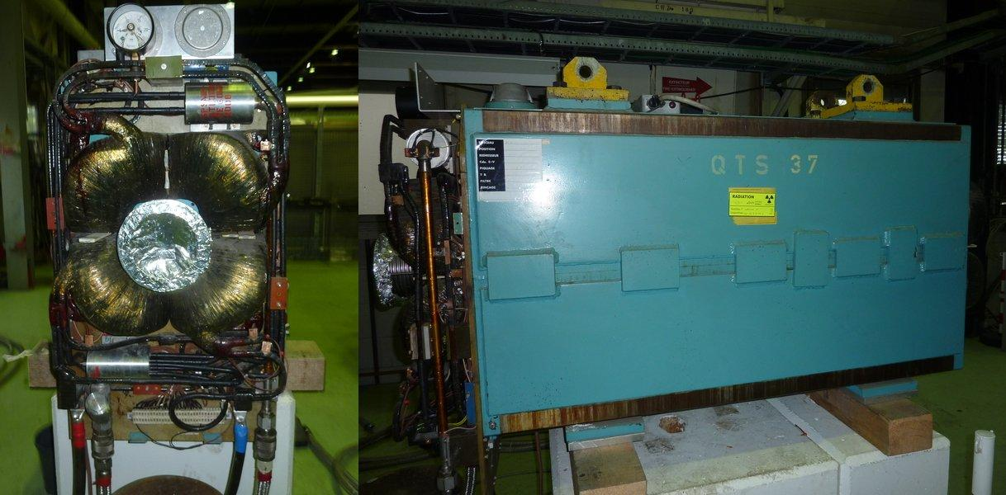
Lattice Modifications
Present Layout (end of the line)
FODO
Final Focusing
QTS quadrupoles:
Length [m] | 1.5
Aperture Width [mm] | 80
Aperture Height [mm] | 80
Max.Magnetic Field [T/m] | 24

Slide 12
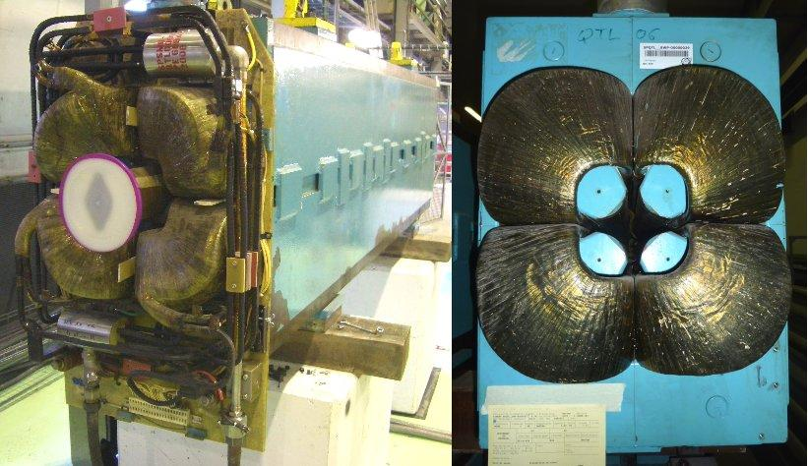
Lattice Modifications
Present Layout (end of the line)
FODO
Final Focusing
QTL quadrupoles:
Length [m] | 3.0
Aperture Width [mm] | 80
Aperture Height [mm] | 80
Max.Magnetic Field [T/m] | 24

Slide 13

Lattice Modifications
Present Layout (end of the line)
FODO
Final Focusing
X
X
Future Layout
Plasma cell
2 quads (1 QTG + 1 QTS) are removed

Slide 14
Lattice Modifications
Present Layout (end of the line)
FODO
Final Focusing
Future Layout
Plasma cell
2 quads (1 QTG + 1 QTS) are removed
7 left quads are displaced and reshuffled for the new final focusing

Slide 15
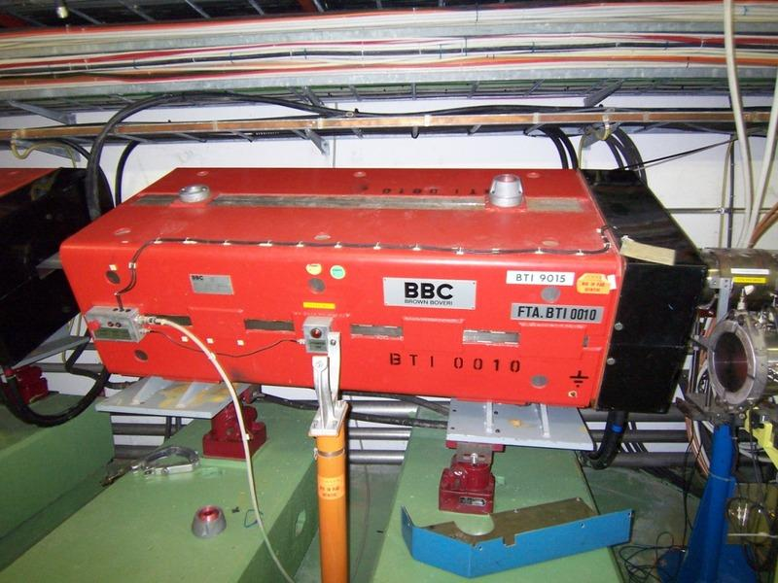
Lattice Modifications
Present Layout (end of the line)
FODO
Final Focusing
Future Layout
Plasma cell
2 quads (1 QTG + 1 QTS) are removed
7 left quads are displaced and reshuffled for the new final focusing
1 MBG is displaced + 4 B190 are added to create the chicane for laser integration (1.9 m long, 1.6 T max. magnetic field)

Slide 16
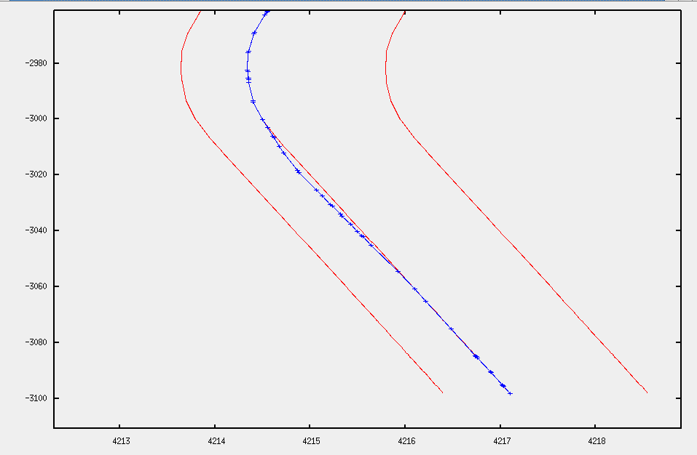
Chicane for Laser Integration
-2980
-3000
2 × B190
-3020
CNGS Tunnel wall
y [m]
Present Beam
-3040
New Beam
2 × B190
-3060
CNGS Tunnel wall
-3080
Plasma cell
-3100
4213
4214
4215
4216
4217
4218
x [m]
MAD-X conversion of CERN Coordinate System

Slide 17
Chicane for Laser Integration
12 m
B190
1 mrad kick
B190
1 mrad kick
-2980
Laser
-3000
p+ beam
2 × B190
-3020
CNGS Tunnel wall
y [m]
Present Beam
-3040
New Beam
2 × B190
-3060
Offset between proton beam and laser axis = 24 mm
@ Mirror:
Beam size ~ 5 mm (6 sigma envelope + 3.5 mm mrad emittance + 1 mm orbit + 1 mm mechanical misalignment )
Laser spot size ~ 4.3 mm (1 sigma)
Mirror radius= 13.0mm (3 sigma, 0 angle, 9.2 mm for 45° angle)
Mirror thickness= 6 mm (4.2 mm for 45° angle)
Total needed offset ~ 18.4 mm
CNGS Tunnel wall
-3080
Plasma cell
-3100
4213
4214
4215
4216
4217
4218
x [m]
MAD-X conversion of CERN Coordinate System

Slide 18
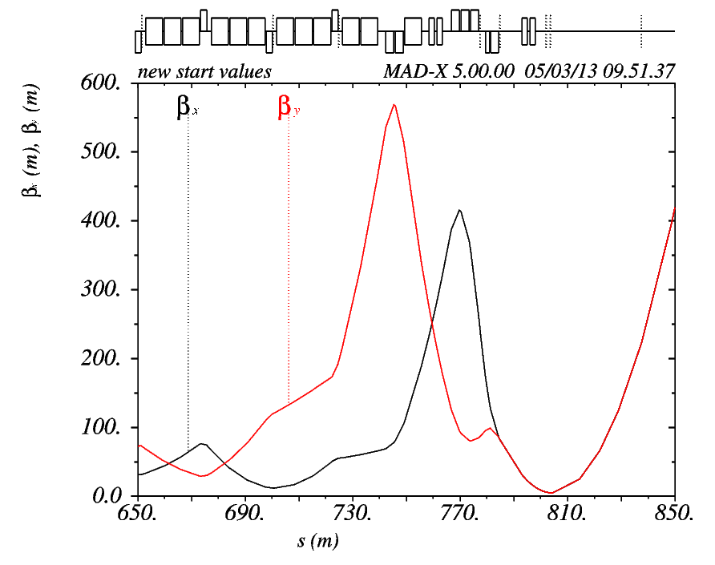
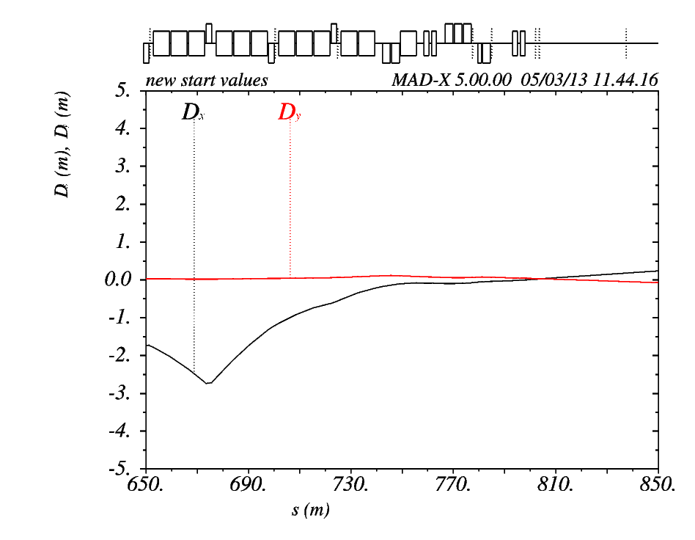
Final Focusing and Dispersion Matching
Experiment requirements:
round beam, beam size @ plasma cell entrance 1 σ = 200 ± 20 μm ➔ β_{x} = β_{y} = 4.9 m & D_{x} = D_{y} = 0 (400 GeV, 3.5 mm mrad normalised emittance, Δp/p =1 ‰)
Achieved:
β_{x} =β_{y} = 4.9 m
Plasma cell
Plasma cell
D_{x}= 0.029 m
D_{y} = 0.029 m
σ_{x} =σ_{y} = 224 μm

Slide 19
Beam Instrumentation
 | # bunches | # p+ per bunch | Repetition Rate [s] | Energy [GeV]
CNGS | 2100 | 1.05 × 10¹⁰ | 6 | 400
AWAKE | 1 | 3.00 × 10¹¹ | 30 | 400
Existing CNGS beam instrumentation + suitable modifications due to different intensity and bunch structure:
Beam Position Monitors (BPM):
  Exchange electronics
  Add two high precision BPM (50 μm) around the plasma cell to check the pointing precision (±100 μm and ±20 μrad, plasma and proton beam coaxial over the full length of the plasma cell) ➔ interlock to stop extraction from the SPS if beyond tolerances
2 Optical Transition Radiation (OTR) screens around plasma cell for p+ beam setup (out when TW laser on!)
Cable lengths and signal filtering optimisation for Beam Current Transformers (BCT)
Present Beam Loss Monitors (BLMs) Ok.

Slide 20
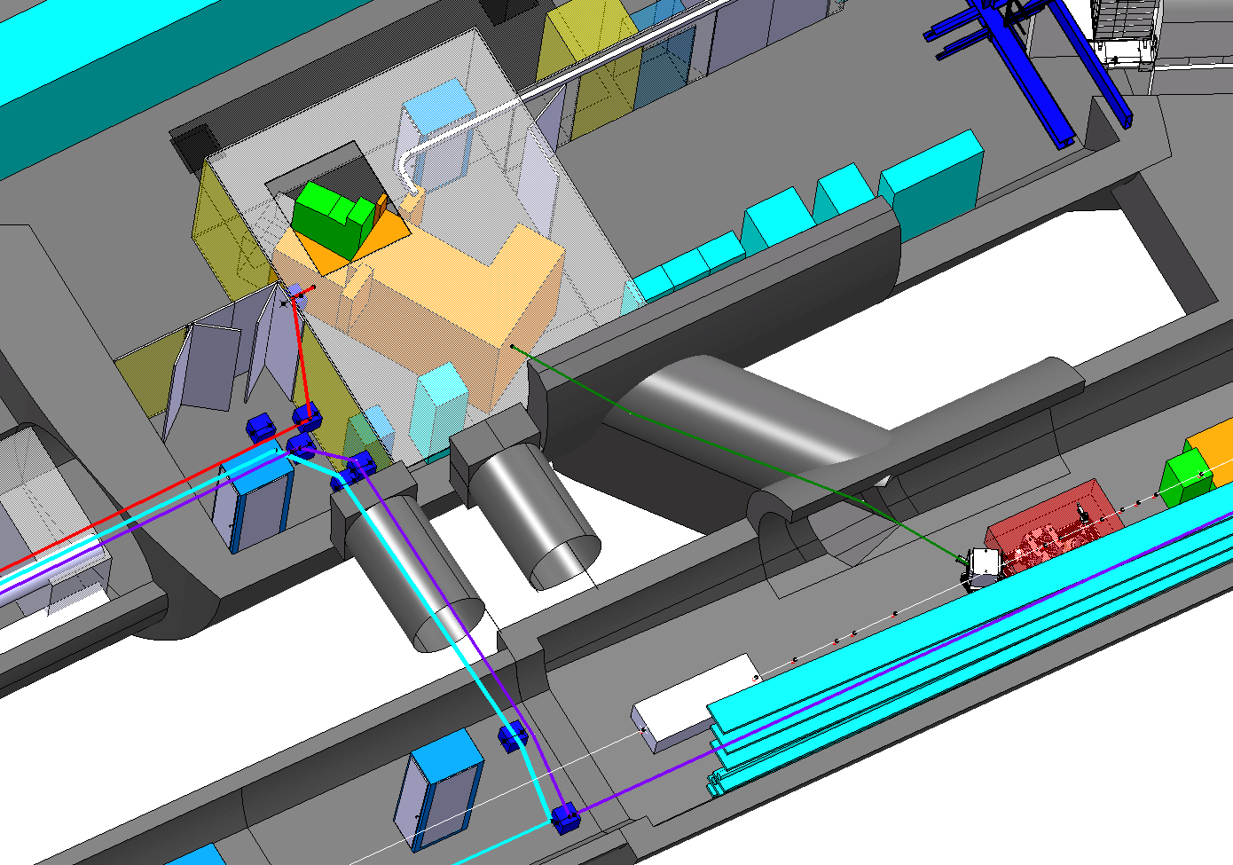
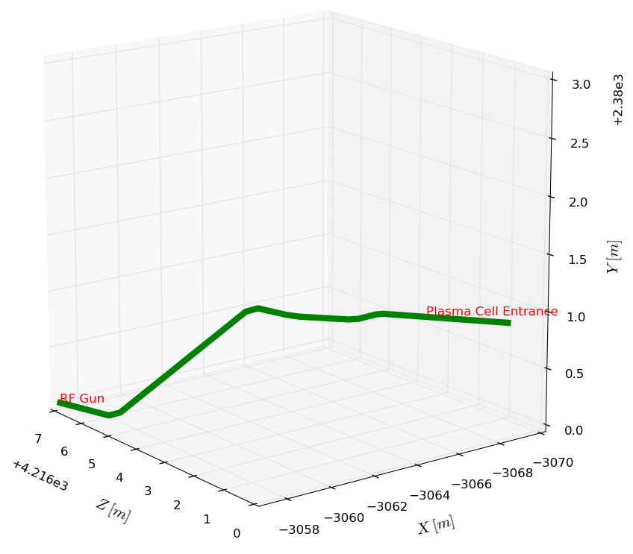
Electron Beam Line: Geometry
12.2 m long e- beam line from RF gun to plasma cell (tunnel for e-beam)
e- beam impinging perpendicularly w.r.t. plasma cell window
RF Gun
Plasma Cell
e- beam
7.16 %
Line design based on Fermi@ELTTRA magnets
MAD-X conversion of CERN Coordinate System

Slide 21
Electron Beam Line: Geometry
12.2 m long e- beam line from RF gun to plasma cell (tunnel for e-beam)
e- beam impinging perpendicularly w.r.t. plasma cell window
e- beam
V bends
7.16 %
H bends
Line design based on Fermi@ELTTRA magnets
MAD-X conversion of CERN Coordinate System

Slide 22
Electron Beam Line: Geometry
12.2 m long e- beam line from RF gun to plasma cell (tunnel for e-beam)
e- beam impinging perpendicularly w.r.t. plasma cell window
H bends
e- beam
7.16 %
Line design based on Fermi@ELTTRA magnets
MAD-X conversion of CERN Coordinate System

Slide 23
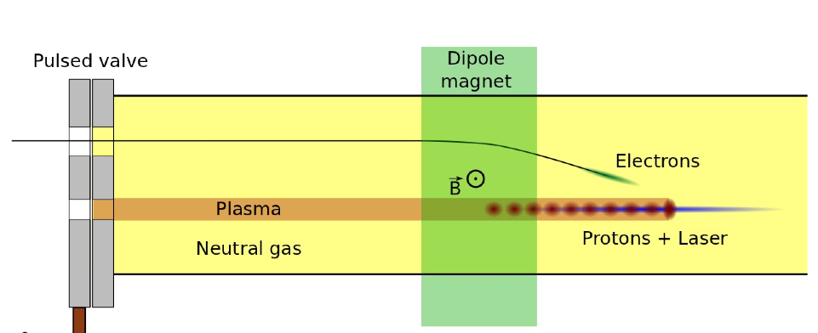
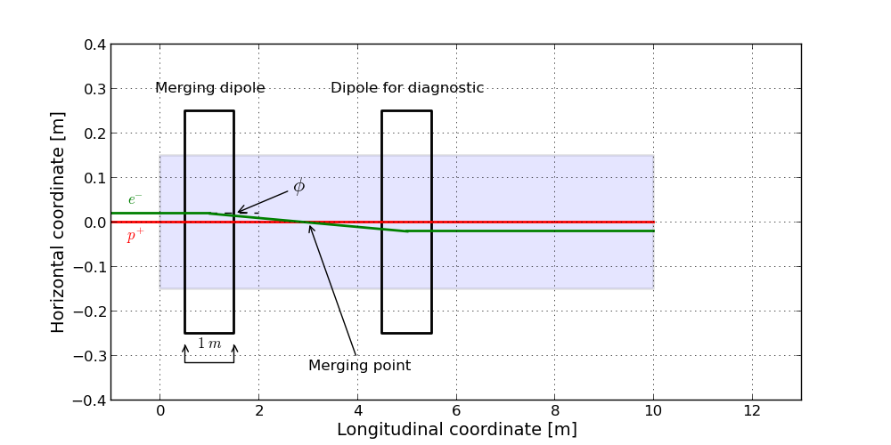
Electrons Merging Point
Energy [MeV] | 10-20*
Bunch population | 1.25 × 10⁹
Normalised emittance [mm mrad] | 0.5**
Bunch length [ps] | 0.3 – 10***
Ideally possible to move merging point (2-5 m) and angle (5-20 mrad) ➔ movable dipoles ?
30 cm max. aperture !!
~13 G m (1 m long dipoles, for 20 mrad)
To be studied!
Plasma cell
Diagnostics
* Studies shown in the following refer to 16 MeV
** Emittance blowup in plasma➔ 2 mm mrad @ merging point
*** Bunch compression option to be studied

Slide 24
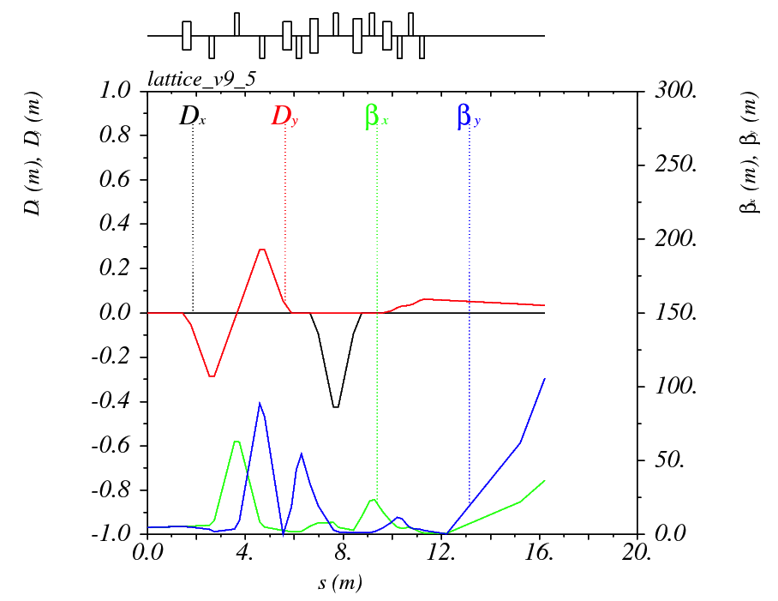
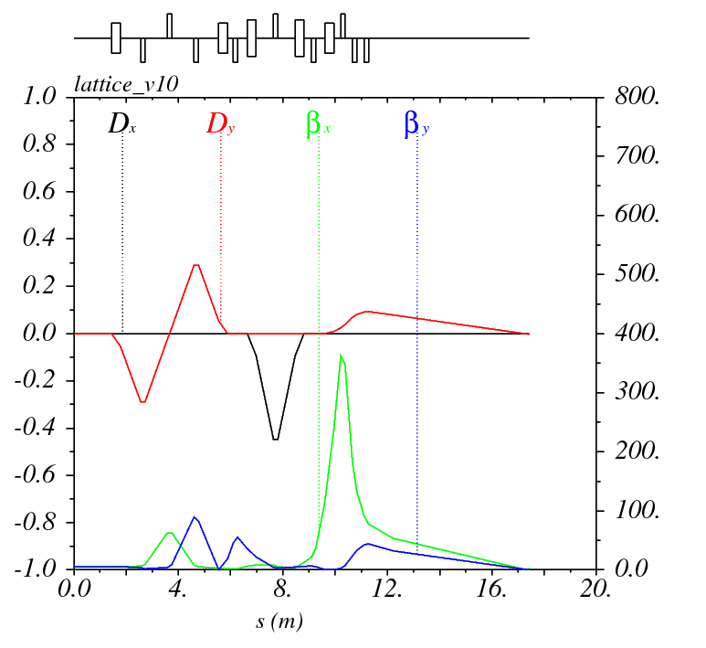
Electron Beam Optics
V bends
H bends
Quads
Experiment requirements:
Round beam, Beam size 1 σ < 250 μm,
Δp/p < 1%
Achieved @ merging point*:
σ_{x} = 126 μm σ_{y} = 126 μm
(0.5 mm mrad norm. emittance)
σ_{x} = 251 μm σ_{y} = 253 μm
(2 mm mrad norm. emittance)
Plasma cell
* 5 m from plasma cell entrance, no merging dipole (several optics to be studied)

Slide 25
Space Charge Studies: Assumptions
Tracking simulations:
  Code: PTC-ORBIT
  Initial distribution:
    Transverse plane: Gaussian (1 σ cut) x-x’, y-y’
    Longitudinal plane: uniform in Δφ and Gaussian in Δp/p
  200 000 Macroparticles
Assumed RF frequency ω_{RF} = 3 GHz:
  10 ps ~ Δφ = 188.5 mrad
  0.3 ps ~ Δφ = 5.7 mrad
  Filled bucket area Δφ⋅Δp/p = constant
  (Δp/p = 1% @ 0.3 ps)
Δφ = 2π for full bucket ➔ Δt ~ 1 ns
p
Δp
φ
Δφ

Slide 26
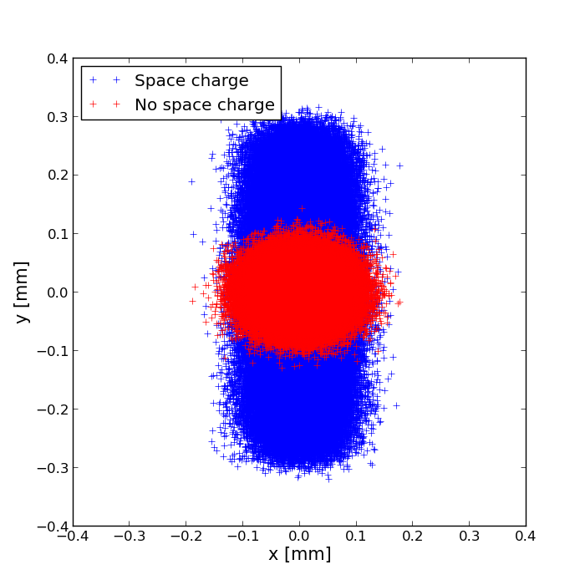
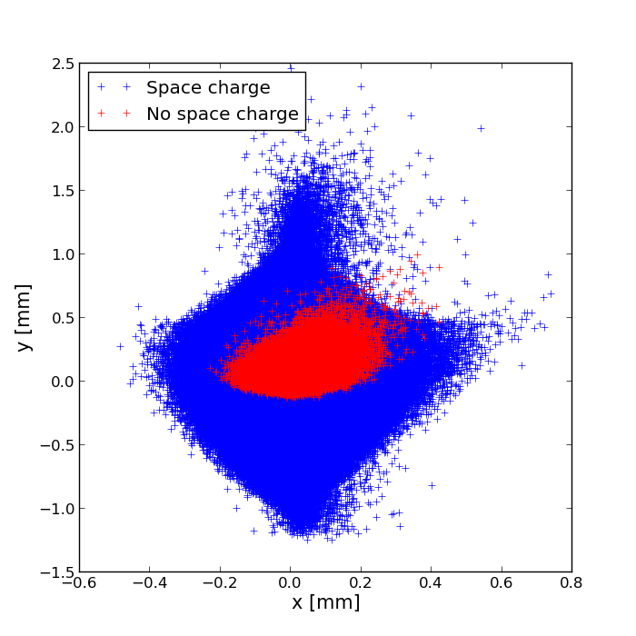
Space Charge Effects
Beam distribution @ merging point (5 m from beginning of plasma cell)
Preliminary results
10 ps, 0.3‰ Δp/p
0.3 ps, 1% Δp/p

Slide 27
Space Charge Effects
Beam distribution @ merging point (5 m from beginning of plasma cell)
Is this physical?
Preliminary results
10 ps, 0.3‰ Δp/p
0.3 ps, 1% Δp/p

Slide 28
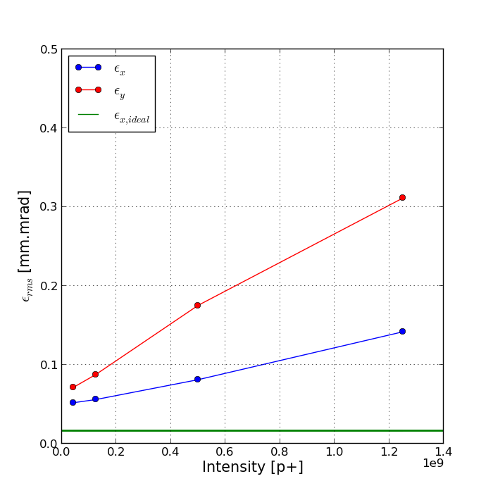
Space Charge Effects
Beam distribution @ merging point (5 m from beginning of plasma cell)
Is this physical?
Expected emittance growth when increasing e- beam intensity
Preliminary results
10 ps, 0.3‰ Δp/p
0.3 ps, 1% Δp/p

Slide 29
Conclusions
AWAKE p+ beam line:
  Experiment at the end of CNGS beam line
  Minor modifications of existing lattice to fit plasma cell and fulfill geometric and optics requirements
  Existing magnet hardware and beam instrumentation can be used (suitable changes due to different intensity and bunch structure)
AWAKE e- beam line
  Geometric layout defined
  Optics requirements fulfilled (matching for different optics needed)
  New hardware needed + dedicated studies for magnets around plasma cell (feasible changing merging point and angle? precision?)
  Very preliminary studies for space charge effects ➔ need experts input for next steps:
    Other codes for benchmarking (TRACE-3D?)
    Bunch compression....

Slide 30
THANK YOU FOR YOUR ATTENTION

Slide 31
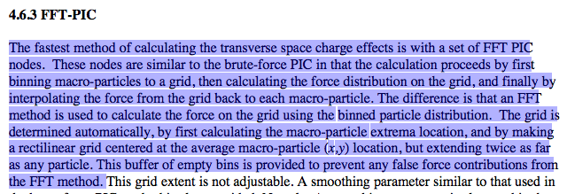
FFT Method for SC Calculations in Orbit

