Slide 1
Inverse Free Electron Lasers for advanced light sources
P. Musumeci,
Joe Duris and Josh Moody
UCLA Department of Physics and Astronomy
European Advanced Accelerator Concepts,
La Biodola, Elba, Italy, June 2-6 2013

Slide 2
Outline
IFEL scheme: mature, compact, high gradient acceleration scheme
Recent experimental results !
  Radiabeam-UCLA-BNL IFEL COllaboratioN (RUBICON) experiment. Helical geometry
  LLNL IFEL experiment. Short pulse.
“green-field” 1 GeV IFEL accelerator
  Advanced bunching schemes
  Longitudinal emittance control
  Efficiency considerations
Light source integration: IFEL driven modelocked FELs
Conclusions and future plans

Slide 3
IFEL Interaction
In an FEL energy in the e-beam is transferred to a radiation field
In an IFEL the electron beam absorbs energy from a radiation field.
High power laser
Undulator magnetic field to couple high power radiation with relativistic electrons
Significant energy exchange between the particles and the wave happens when the resonance condition is satisfied.

Slide 4
What you should know about IFELs ?
IFEL scales ideally well for mid-high energy range (50 MeV – up to few GeV) due to
  high power laser wavelengths available (10 um, 1 um, 800 nm)
  permanent magnet undulator technology (cm periods)
Simulations show high energy/ high quality beams with gradients >500 MeV/m achievable with current technology!
  70 MeV/m gradient already demonstrated at UCLA
  70 % trapping already demonstrated at BNL.
  Preservation of e-beam quality/emittance and high capture.
Microbunching: still the preferred interaction for longitudinal phase space manipulation at optical scale
Efficient mechanism to transfer energy from laser to electrons
Plane wave or far field accelerator : minimal 3D effects.
  Transverse beam sizes can be mm for um accelerating wavelength!

Slide 5
What you should know about IFELs?
Complicate experiment. Difficult requirements on laser and magnet technology.
Synchrotron losses at high energy. NOT feasible for HEP multi-TeV machines.
Gradient is energy dependent. Ion linac-like dynamics.
Dwarfed by successes of laser/plasma and beam/plasma schemes.
Anybody interested in a compact 1-2 GeV injector?
  Injector + (phase-locking) microbuncher for other kinds of advanced accelerators
  Injector for advanced light sources (ICS or FELs)
  Laser-plasma accelerators. Main competitors.
    Need > 40-50 TW laser power to accelerate beams to 1 GeV.
    Strongly non-linear injection mechanism. Controlled injection still an open issue.
    Beam quality and reproducibility ?

Slide 6
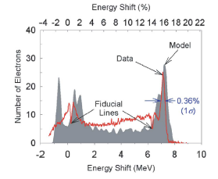
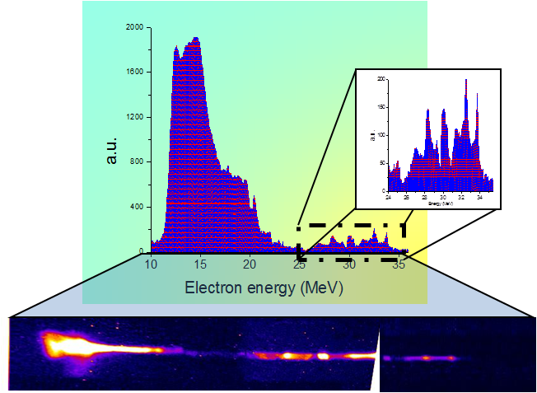
IFEL experiments
STELLA2 at Brookhaven
- Gap tapered undulator
- 30 GW CO2 laser
- 80% of electrons accelerated
UCLA Neptune IFEL
- Strongly tapered period and amplitude planar undulator
- 400 GW CO2 laser
- 15 MeV -> 35 MeV in ~25 cm
- Accelerating gradient ~70 MeV/m
W. Kimura et al. PRL, 92, 054801 (2004)
P. Musumeci et al. PRL, 94, 154801 (2005)
Notes:
old but not forgotten note vs has a niche

Slide 7
From proof-of-principle to next generation IFEL experiments
Proof-of-principle experiments successful
Upgrade to significant gradient and energy gain
  Technical challenges:
    staging
    very high power radiation
    strong undulator tapering
  Physics problems:
    microbunching preservation
    include diffraction effects in the theory
    beyond validity of period-averaged classical FEL equation

Slide 8

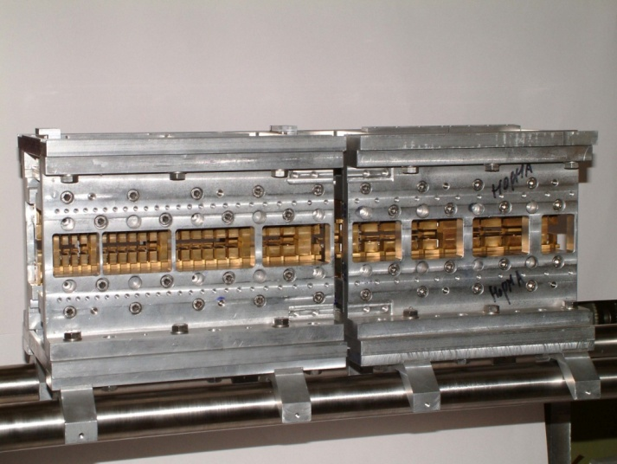
High Gradient High Energy Gain
Inverse Free Electron Laser
From AAC
Renovated interest in IFEL acceleration scheme
Applications as compact scheme to obtain 1-2 GeV electron beam for gamma ray (ICS) or soft x-ray (FEL) generation.
Radiabeam UCLA BNL IFEL Collaboration
Strongly tapered optimized helical permanent magnet undulator
ATF @ BNL
0.5 TW CO2 laser
50 MeV -> 180 MeV in 60 cm
130 MeV energy gain
220 MV/m gradient
LLNL-UCLA IFEL experiment
Reuse UCLA- Kurchatov undulator
Use 5 TW 10 Hz Ti:Sa
50 MeV -> 150 MeV in 50 cm
High rep rate allows beam quality measurement
GeV IFEL experiment
If current experiments succesfull
Looking for access to facility with 50 MeV beam+20 TW laser
(BNL, LLNL, LNF-Italy)
Praesodymium based cryogenic undulator
New results!
J. Duris
New results!
J. Moody

Slide 9
Radiabeam Ucla Bnl IFEL COllaboratioN
RUBICON
The experiment main goal is to achieve energy gain and gradient significantly larger than what possible with conventional RF accelerators to propose IFEL as a viable technology for mid-high energy range accelerators.
Combine ATF e-beam and high power CO2 laser system
TOGETHER WITH
Helical geometry.
Permanent magnet double tapered undulator.
Parameters for the RUBICON IFEL experiment
Input e-beam energy | 50 Mev
Final beam energy | 117 MeV
Final beam energy spread | 2% rms
Average accelerating gradient | 124 MV/m
Laser wavelength | 10.3 μm
Laser power | 500 GW
Laser focal spot size (w) | 980 μm
Laser Rayleigh range | 25 cm
Undulator length | 54 cm
Undulator period | 4 – 6 cm
Magnetic field amplitude | 5.2 – 7.7 kG
Resonant energy
Simulated LPS

Slide 10
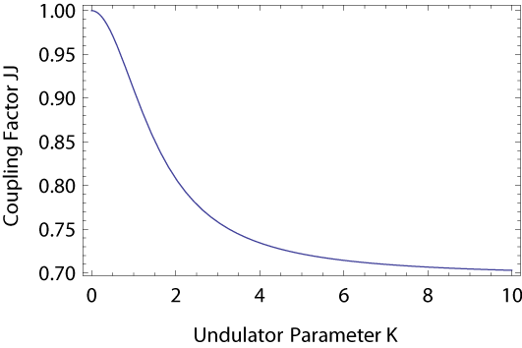

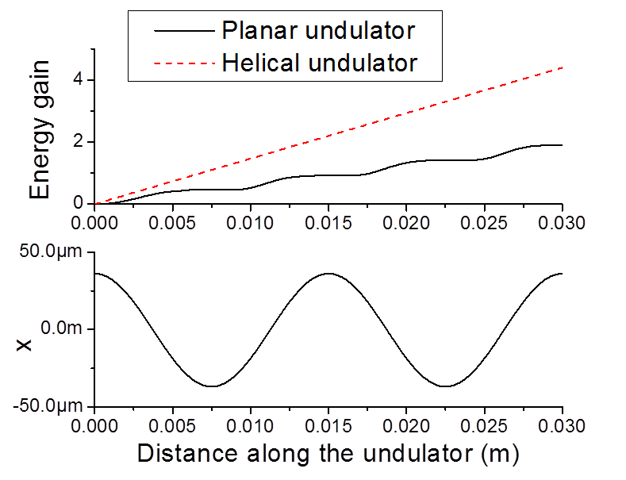


Helical undulator
Electrons always moving in helix so always transferring energy.
Helical yields at least factor of 2 higher gradient.

Slide 11
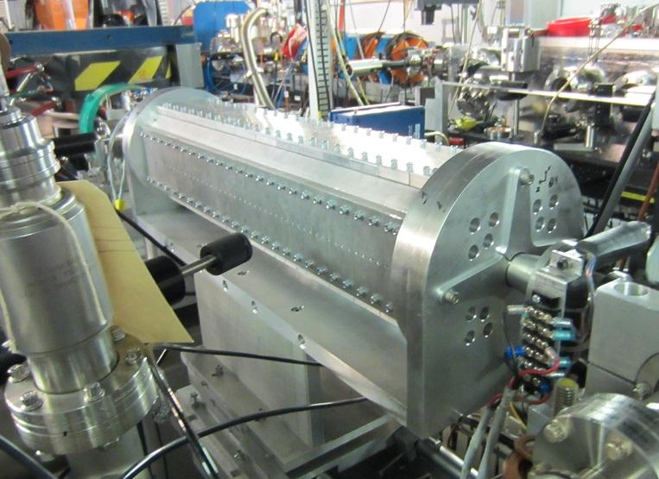
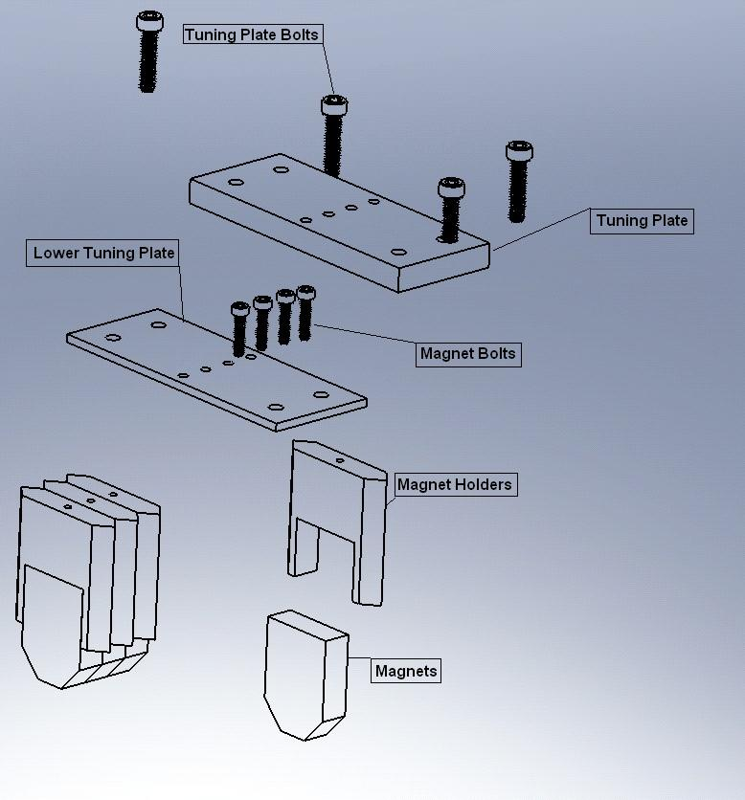
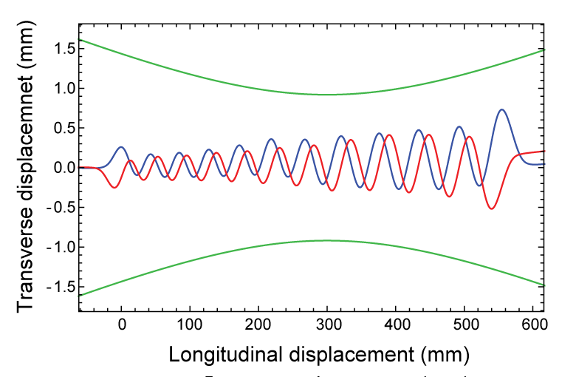
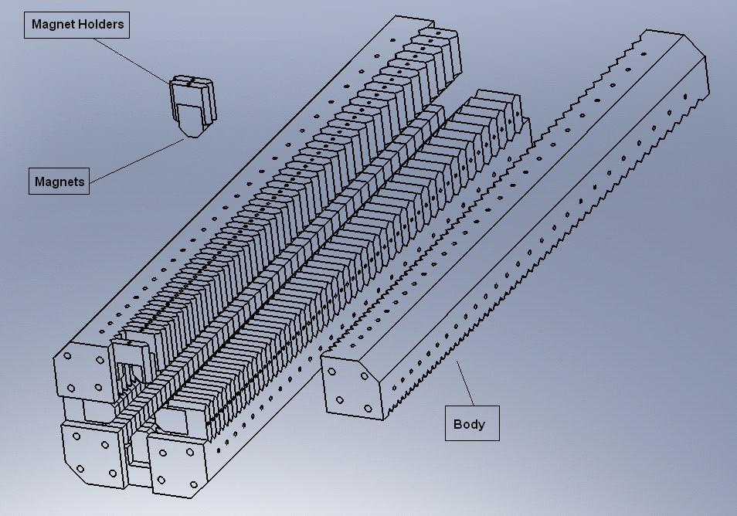
Helical undulator design
First strongly tapered high field helical undulator
2 orthogonal Halbach undulators with varying period and field strength
NdFeB magnets B_{r} = 1.22T
Entrance/exit periods keep particle oscillation about axis
Pipe of 14 mm diameter maintains high vacuum and low laser loses
Estimated particle trajectories
Laser waist

Slide 12
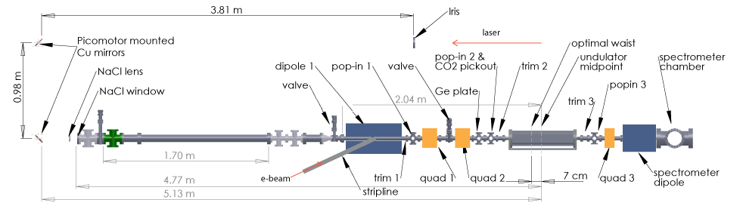
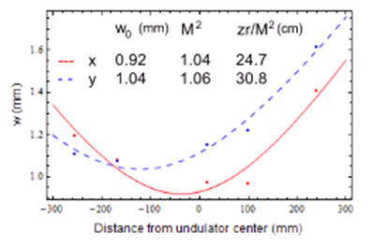
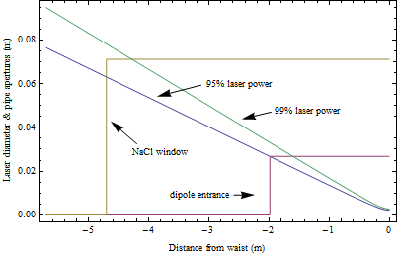
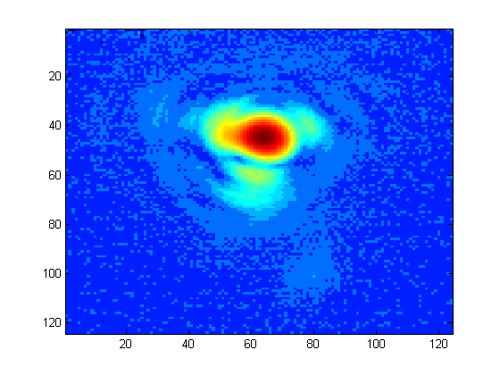
Beamline layout
CO2 laser
Laser image at focus

Slide 13
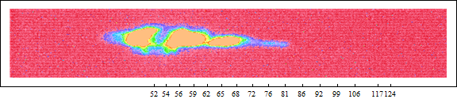
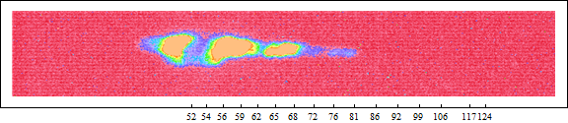
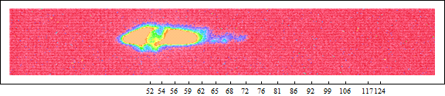
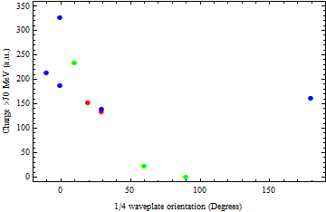
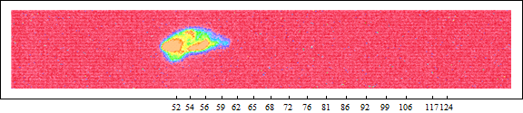
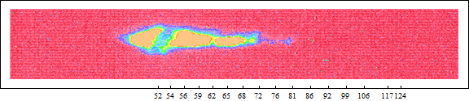
Polarization study
Quarter wave plate polarizes CO2 elliptically before amplification
One handedness matches undulator
0°, 4.6 J
30°, 4.4 J
60°, 5.52 J
> 5 J
> 4 J
< 4 J
90°, 6.11 J
180°, 4.5 J
All shots have delay 1854 and 800 pC charge
circular
polarization
linear
polarization
circular (opposite handedness)
circular
polarization
*Preliminary data

Slide 14

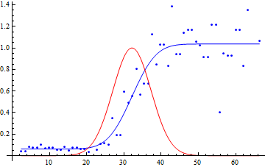
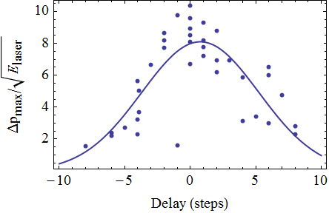


Laser-ebeam cross correlation
S0/Sref
Timing is initially found using e-beam controlled CO2 transmission through Ge
Cross correlation measurement of laser and 1 ps long e-beam using IFEL acceleration as a benchmark
Gradient scales proportional to the square root of the laser power so scale momenta
Estimated rms pulse width < 4.5 ps
Convolution of e-beam bunch length, CO2 laser pulse length and relative jitter.
FWHM=13 ps
Δt
sigma = 4.5 ps
Delay (ps)

Slide 15
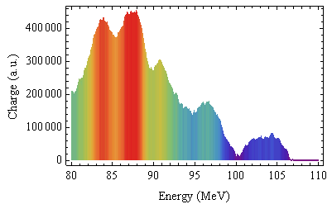
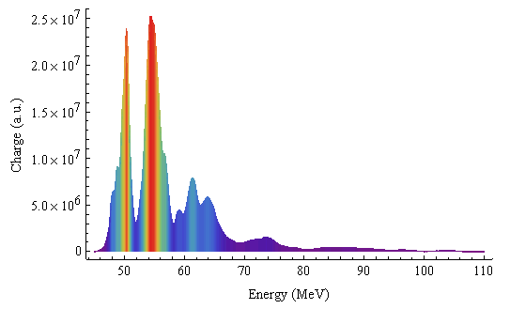
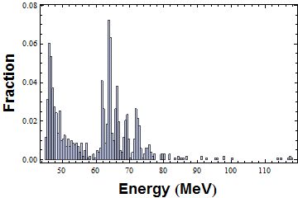
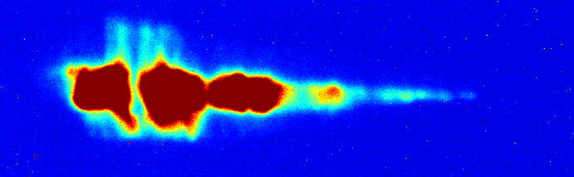
IFEL acceleration
105 MeV final energy.
> energy doubling
100 MV/m gradient
100% energy gain
Simulation using experimental parameters in good agreement
Readapted GENESIS
Fully self-consistent model
*Preliminary

Slide 16
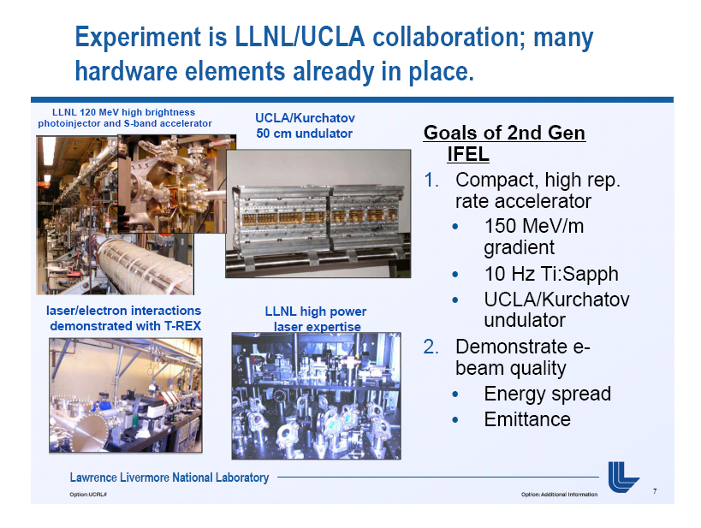
LLNL – IFEL experiment : first IFEL driven by Ti:Sa laser

Slide 17
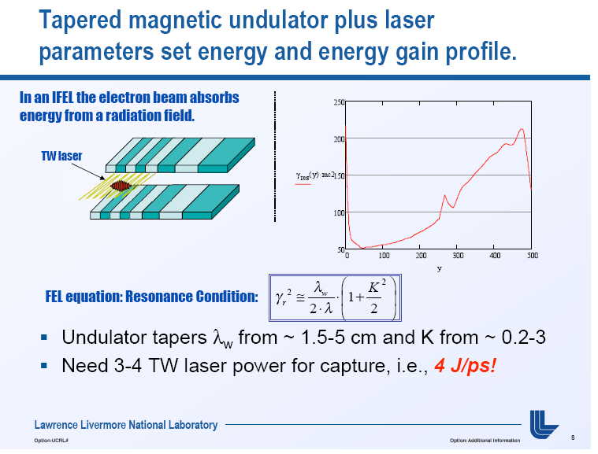

Slide 18
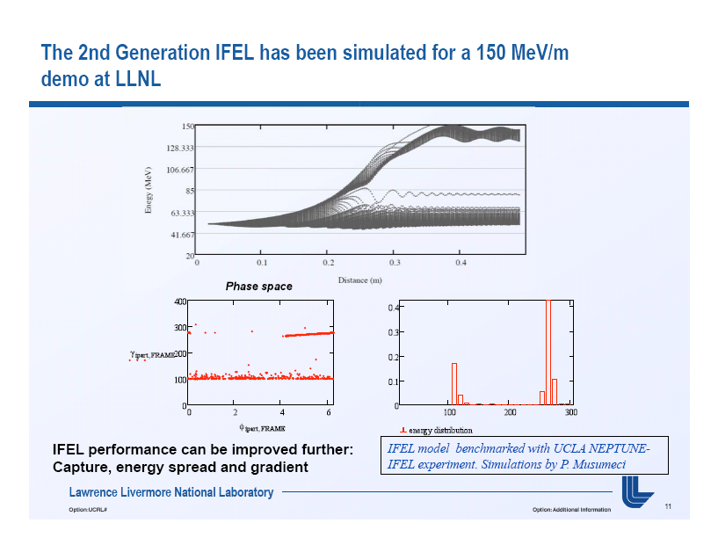
LLNL -IFEL

Slide 19
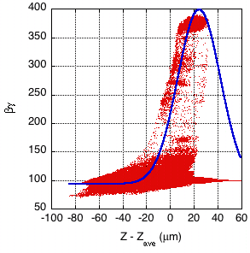
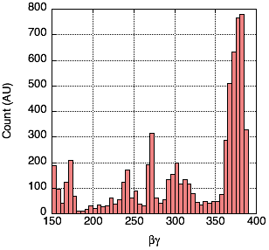
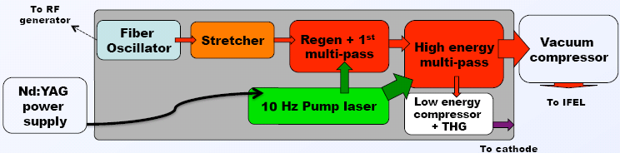
Compact, short-pulse laser driven IFEL
Gradient profile of undulator + 800 nm light requires > 3TW laser (4-5 TW preferred)
Laser system is CPA, flashlamp pumped, Ti:Sapphire
  100 fs fiber oscillator
  >500 mJ, <120 fs, 10 Hz
  100 μJ UV arm for photo-cathode
Undulator has 19 periods; requires ~50 fs slippage of on-resonance particles
  Significant laser intensity variation over interaction length!
100 fs
Laser Electric Field

Slide 20
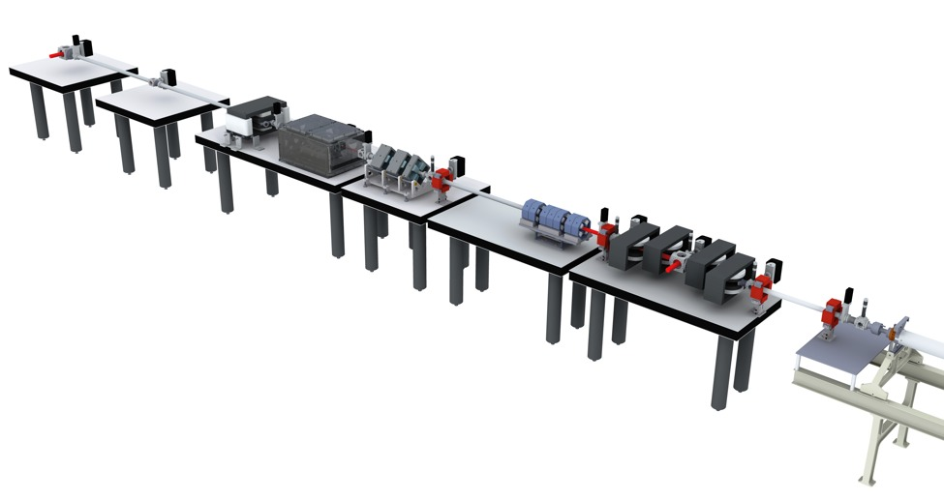
Beamline experimental setup
50 cm UCLA undulator
Chicane couples in IFEL drive laser and allows compression of blow-out mode electron bunch.
Spectrometer and diagnostic beamline
Quad triplets match into undulator
Laser entrance port; not shown is vacuum transport line from compressor
50 MeV beam from LLNL photo-gun/linac

Slide 21
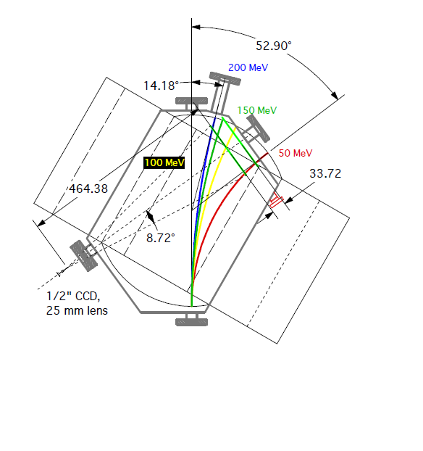
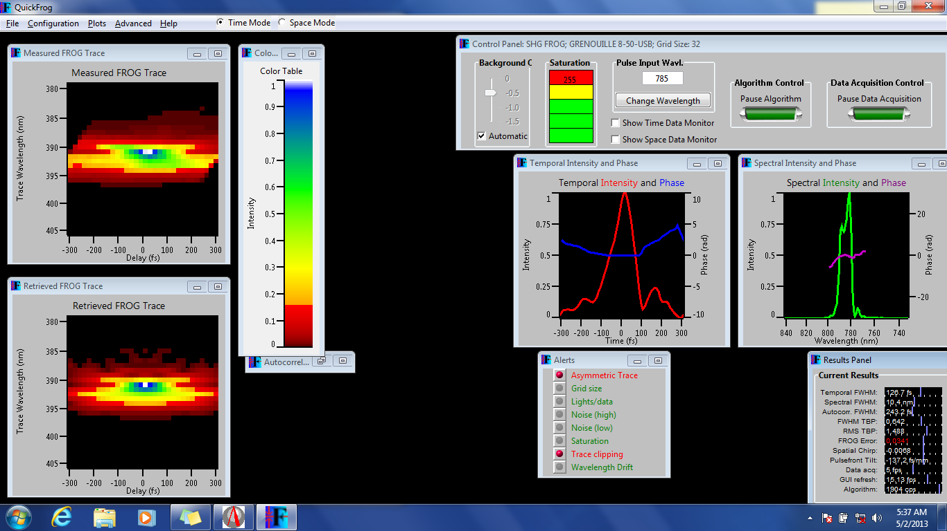
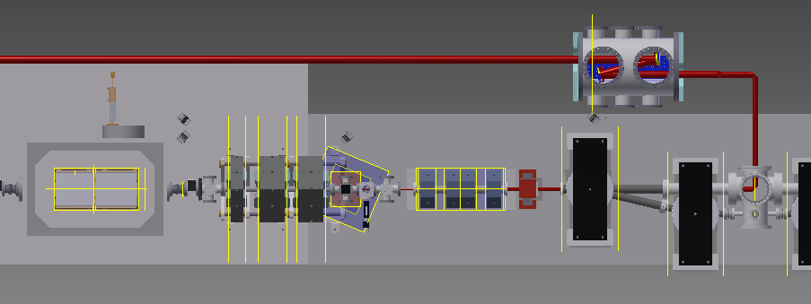
Laser accelerator subsystems
High acceptance spectrometer
Laser diagnostics: Grenouille
Focus measurements
Possibility of extracting accelerated electrons

Slide 22
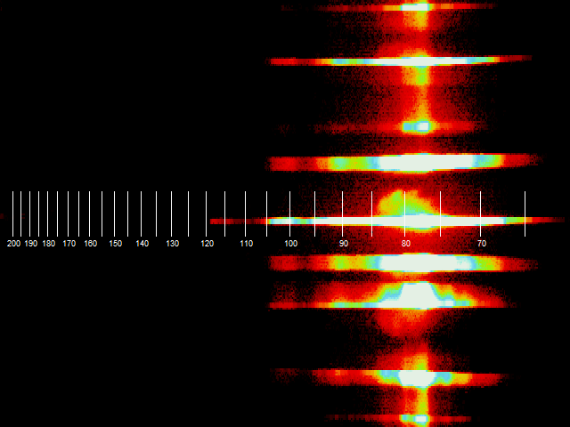
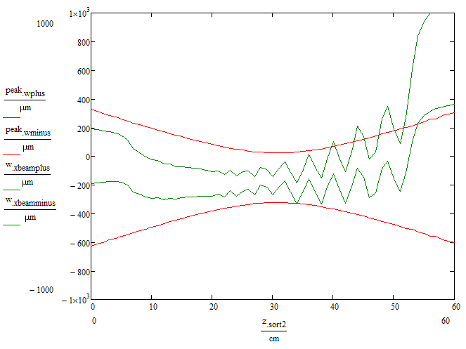
IFEL acceleration shots
75 MeV injection energy
Issues to be solved
Gun modulator stability problems
strong astigmatism
Quick estimate of interaction length says >220MV/m gradient !!!
3D cbeam model.
Higher order laser modes
full undulator magnetic field map
Not self consistent
Y (mm)
Injection Energy
End of Acceleration
Energy (MeV)

Slide 23
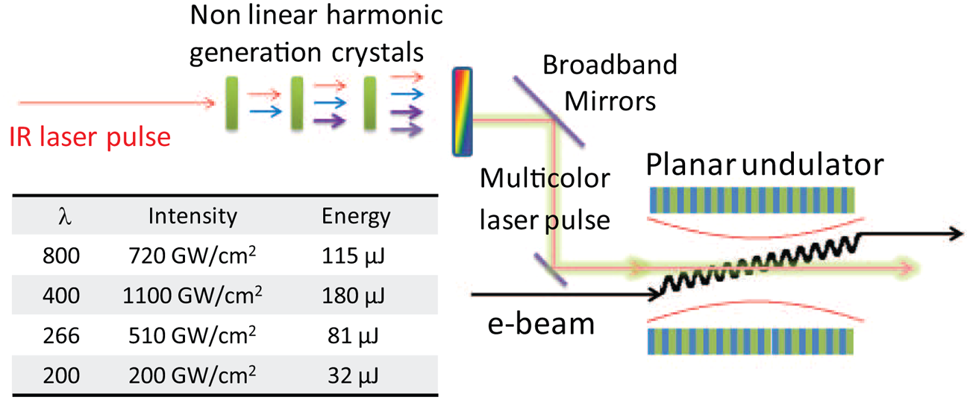
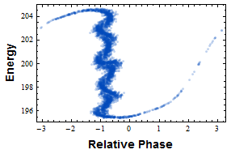
Advanced bunching schemes
Harmonic
prebuncher
B = 0.95 @ 800 nm nm
Linearize ponderomotive bucket using harmonics
40 cm
Adiabatic
prebuncher
Ramp up the field to capture all of the input phase space and preserve longitudinal emittance
Put laser focus at the end of long undulator

Slide 24
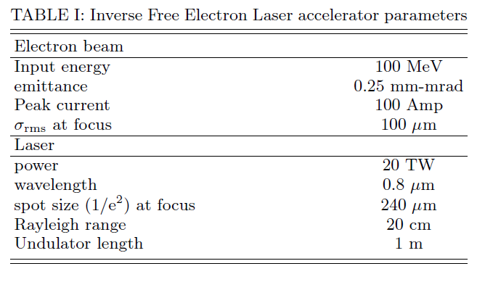
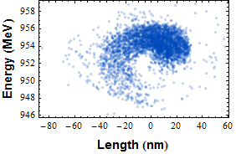
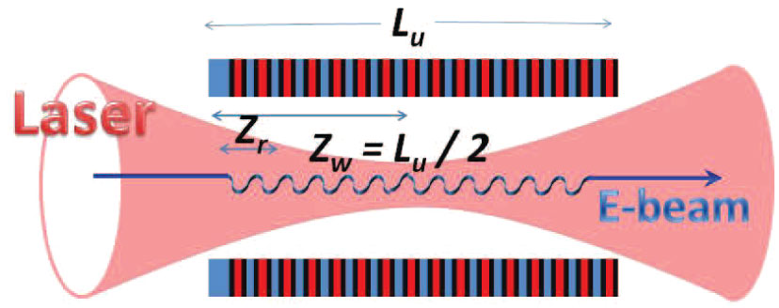
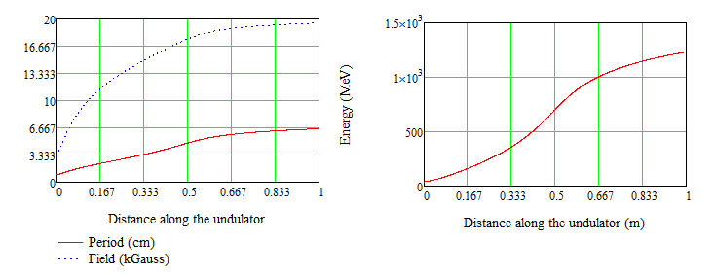
The next step: 1 GeV IFEL module
Combine helical geometry with high power Ti:Sa laser systems
Need 50(100) MeV high brightness linac + high power laser system
Demonstrate 1 GV/m gradient and 1 GeV output energy
With prebunching high phase space density possible
Final Long phase space
18 nm rms
0.18%
rms
up to 13 kA output current
100 MeV
20 TW Ti:Sa
954 MeV
98% capture
1 m

Slide 25
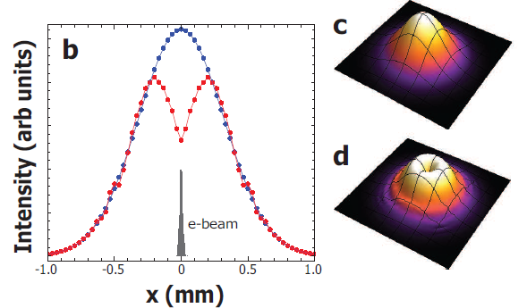
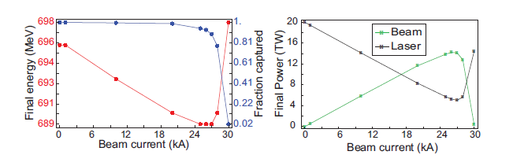
Efficiency of IFEL scheme
No medium or stored energy
Self consistent beam loading modeled thru GENESIS
Adapt tapering to compensate for pump depletion

Slide 26
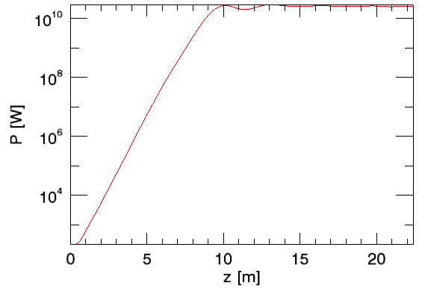
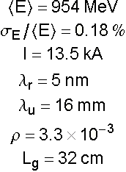

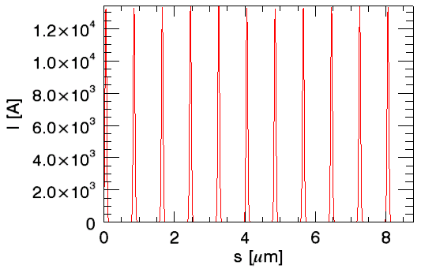
Soft x-ray FEL
5 nm SASE FEL saturates in 10 m with constant current beam
But IFEL beam is microbunched
Gain medium is short. Slippage dominated regime.
Some dielectric accelerators have similar bunch trains
Notes:
With this beam, we could generate a soft x-ray FEL

Slide 27
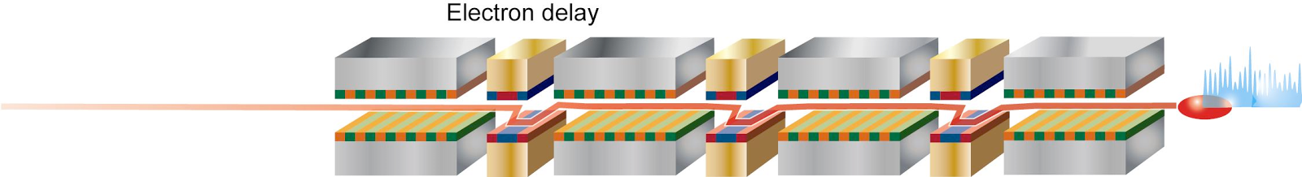
Mode locked FEL
slippage in
one undulator
Mode locked FEL's produce short pulses with controllable bandwidth*
Microbunched beam acts as a periodic lasing medium similar to a ring resonator
Can enhance slippage by using chicanes so that pulses always see gain medium
Slippage provided by chicanes between gain sections introduces mode coupling
Periodic resonance condition controlled by energy or current modulation
Micro bunches
Radiation after one undulator
Slippage in chicane
Radiation after next undulator
slippage in
one chicane
* Thompson and McNeil, Phys. Rev. Lett., 100, 203901(2008)

Slide 28
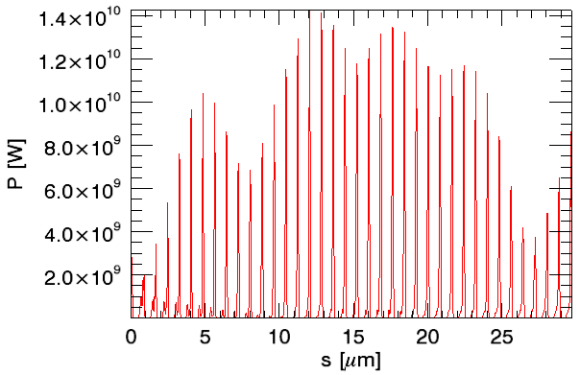



IFEL driven mode-locked FEL
A 5TH Generation light source
Energy | 954 MeV
Relative energy spread | 0.18 %
Bunching period | 800 nm
Peak current | 13 kA
Microbunch length (rms) | 18 nm
FEL wavelength | 5 nm
Undulator period | 16 mm
Periods per undulator | 16
Periods slipped per chicane | 144
Total slippage | 160
Slippage enhancement | 10
Undulator + chicane segments | 54
Temporal
Spectra
mode separation
266 as FWHM
number of sidebands
Pulse width controlled with number of periods per undulator
Spectral width controlled by number periods per undulator

Slide 29


Acknowledgements
Collaborators:
S. Anderson, A. Tremaine, S. Fisher, G. Anderson LLNL
I. Pogorelsky, V. Yakimenko, M. Fedurin, K. Kusche, M. Polyansky, M. Babzien BNL
A. Murokh, Radiabeam Technologies
E. Threkheld, O. B. Williams, Y. Sakai, R. Li, M. Westfall, J. B. Rosenzweig, UCLA
Funding agencies:
  DTRA
  DOE-HEP / DOE-BES
  University of California Office of the President

Slide 30
Conclusions and Future plans
The RUBICON and LLNL high gain IFEL experiments constitute a critical step, reaching gradient and gain significantly larger than what achievable with conventional RF technology suggesting IFEL as a competitive advanced accelerator technique for the mid-high energy range.
RUBICON second run under design. Doubled electron energy, now increase efficiency.
  Retune undulator for higher efficiency capture
  Measure transverse emittance
LLNL IFEL experiment to run until end of summer.
  Beyond longitudinal diagnostics (energy spectrometer, microbunching). Need a measurement of transverse beam quality.
Prebunching and longitudinal beam quality preservation
  Design pre-buncher to improve the capture efficiency and the output beam quality.
Fully exploit the progress in laser and magnet technology to build > 1 GeV IFEL accelerator for a 5th generation light source

