Slide 1
Advanced Positron Sources
Alessandro Variola, LAL Orsay in2p3 - CNRS

Slide 2
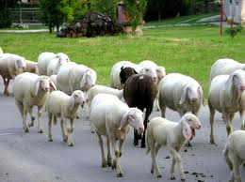
Outlook
Why positron sources are so important
Critical parameters
Classical sources. Schemes
Future colliders sources
Technology
What’s next?
Conclusions

Slide 3
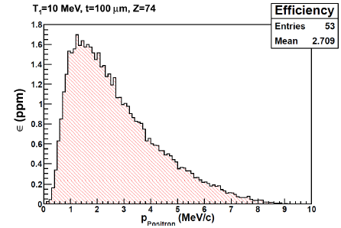
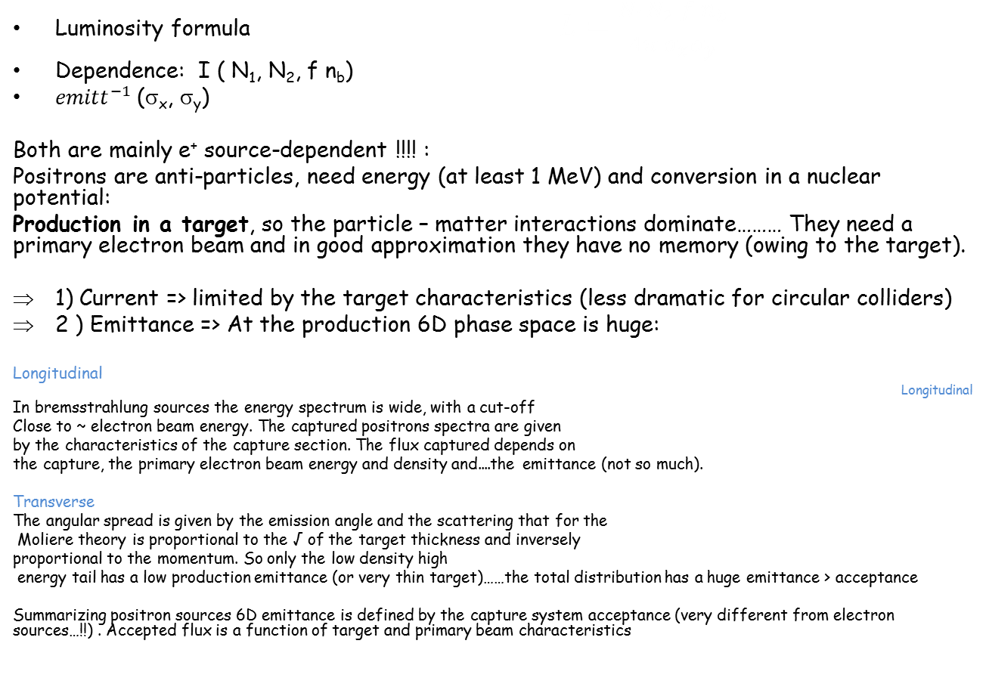
Why positron sources are so important for colliders?
Luminosity formula $L=\frac{N_{1}N_{2} f n_{b}}{4π σ_{x}σ_{y}}$
Dependence: I ( N₁, N₂, f n_{b})
${emitt}_{}^{−1}$(σ_{x}, σ_{y})
Both are mainly e⁺ source-dependent !!!! :
Positrons are anti-particles, need energy (at least 1 MeV) and conversion in a nuclear potential:
Production in a target, so the particle – matter interactions dominate……… They need a primary electron beam and in good approximation they have no memory (owing to the target).
1) Current => limited by the target characteristics (less dramatic for circular colliders)
2 ) Emittance => At the production 6D phase space is huge:
Longitudinal
Longitudinal
In bremsstrahlung sources the energy spectrum is wide, with a cut-off
Close to ~ electron beam energy. The captured positrons spectra are given
by the characteristics of the capture section. The flux captured depends on
the capture, the primary electron beam energy and density and....the emittance (not so much).
Transverse
The angular spread is given by the emission angle and the scattering that for the
Moliere theory is proportional to the √ of the target thickness and inversely
proportional to the momentum. So only the low density high
energy tail has a low production emittance (or very thin target)……the total distribution has a huge emittance > acceptance
Summarizing positron sources 6D emittance is defined by the capture system acceptance (very different from electron sources…!!) . Accepted flux is a function of target and primary beam characteristics

Slide 4
What are the main constraints?
Conversion target technology. High Z allows high conversion efficiency. Thermal, mechanical and Bfield characteristics.
1) Melting point. AVERAGE EFFECT
Examples:
2) PEDD, Peak energy deposition. INSTANTANEOUS EFFECT
Thermo mechanical stress due to temperature gradient
Phonon velocity propagation
Experimental limits, SLAC (W 26Re) 6 X0, (~35J/g)
Moreover, electromagnetic shower => Hardness variation
Emitt => Capture constraints AMD (R.Helm 1960), QWT, lithium lenses
Acceptance is proportional to B₀, B_{s} and the smallness parameter a (dB/dz)
Constraints: Pulsed Magnetic field B₀ and power supply. Immersed target (rotation?),
Bs on the sections (L/S band dependent)
Summarizing : Captured flux is a function of the target constraints (multiple scattering, production..), the transverse and longitudinal production and capture
Tungsten | Carbon | Titanium | Renhium
3695 | 3800 | 1940 | 3460

Slide 5
Classical sources, scheme
DUMP
Electron primary
beam source
Converter
Target
e⁻
Capture section
e⁻
e⁺
Electron primary
beam accelerator
e⁺
Post acceleration
AMD/QWT
Lens
e⁺-e⁻ separator
Beam shaping
Injection Line
Damping ring
Can the DR be considered as a part of the positron source?
In my opinion it can. Its parameters result from the positron source and vice versa

Slide 6
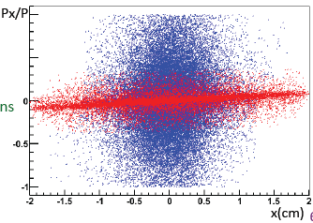
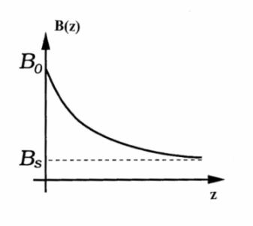
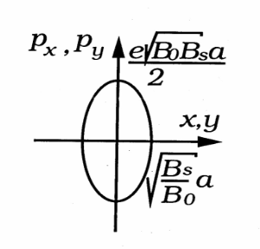
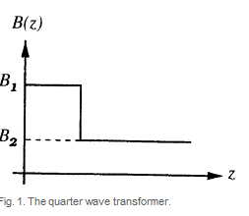
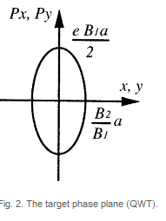
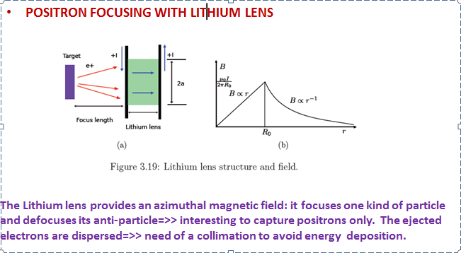
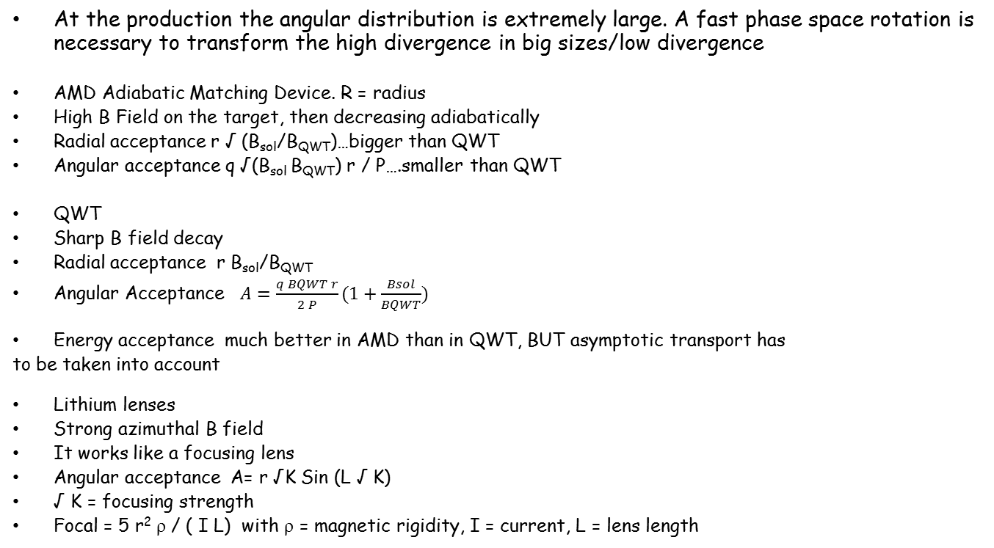
Classical sources, Capture
At the production the angular distribution is extremely large. A fast phase space rotation is necessary to transform the high divergence in big sizes/low divergence
AMD Adiabatic Matching Device. R = radius
High B Field on the target, then decreasing adiabatically
Radial acceptance r √ (B_{sol}/B_{QWT})…bigger than QWT
Angular acceptance q √(B_{sol} B_{QWT}) r / P….smaller than QWT
QWT
Sharp B field decay
Radial acceptance r B_{sol}/B_{QWT}
Angular Acceptance $A=\frac{q BQWT r}{2 P}(1+\frac{Bsol}{BQWT})$
Energy acceptance much better in AMD than in QWT, BUT asymptotic transport has
to be taken into account
Lithium lenses
Strong azimuthal B field
It works like a focusing lens
Angular acceptance A= r √K Sin (L √ K)
√ K = focusing strength
Focal = 5 r² ρ / ( I L) with ρ = magnetic rigidity, I = current, L = lens length

Slide 7
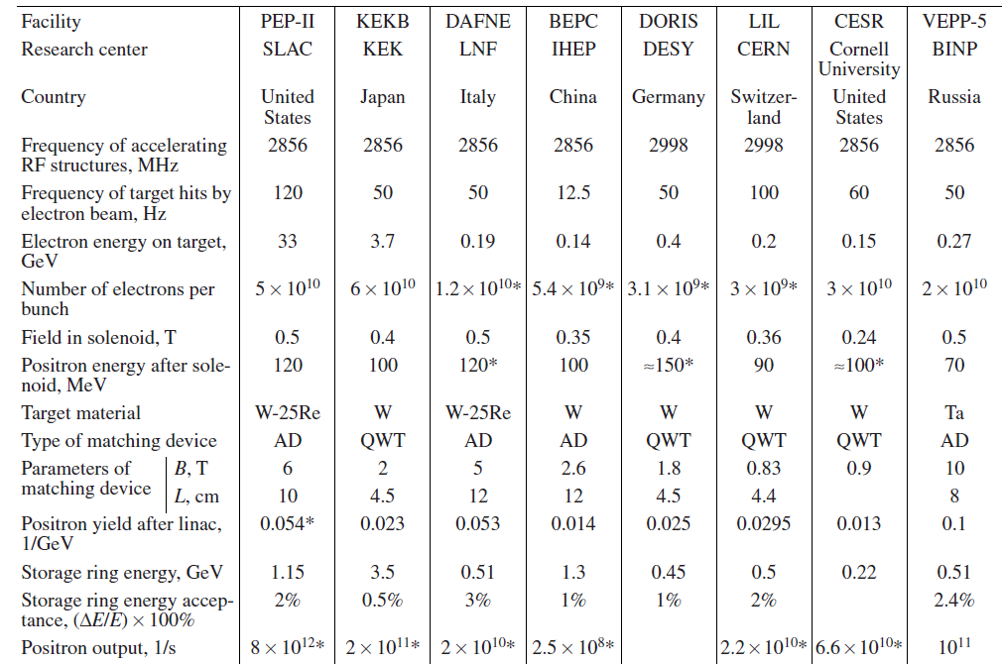
Classical sources / performances

Slide 8
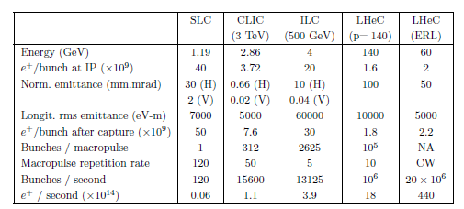
New colliders projects: challenges.
The Current and the Polarization
Linear Colliders
ILC ~30 % polarization
At least 2 orders of
magnitude…!!!
Circular colliders =>
SuperKEKb, 1-4 nC / 2 bunches @50 Hz,En 3.5-4 GeV. Emittance 2100->10 μm
TLEP 2 10¹⁰ e⁺ sec. Top up injection
Polarized bremsstrahlung. JLAB CEBAF. PEPPo experiment as a demonstrator

Slide 9
‘New’ schemes
How can the constraints be reduced during the design phase?
PEDD and melting => Separate the gamma production and the pair production, reduction of the ionization losses : ILC => Undulator, CLIC=> Hybrid. Alternative Compton sources
Injection in damping rings. Stacking and consequently beam shaping
Polarized bremsstrahlung for low polarized intensity sources
Beam shaping before DR injection

Slide 10
Sources

Slide 11
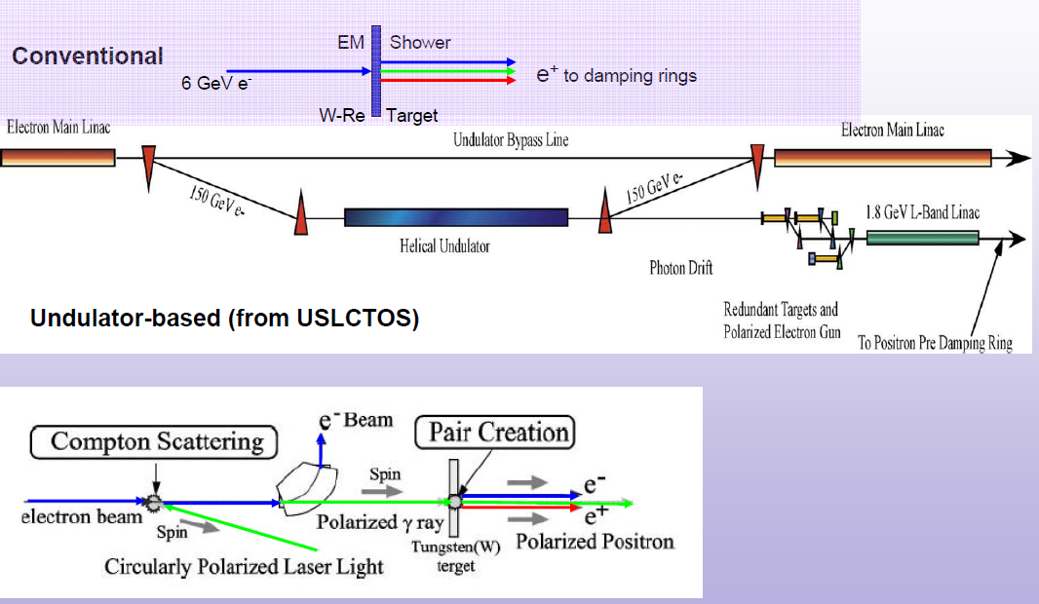
Gamma separation:
ILC Positron source schematic. Undulator
Undulator and laser => Polarization
Balakin, Mikhailichenko

Slide 12

Gamma separation:
ILC Positron source schematic. Undulator
Target for e+ production
Optical Matching Device for e+ capture enhancement
147 m helical undulator for photon production
Photon collimator for pol. upgrade
Positron Energy Booster (PBSTR): Cryo-modules to boost e+ energy from 400MeV up to 5GeV
g
Main e- beam from electron main linac
Damping ring
γ dump
e- dump
Positron Linac to damping Ring (PLTR): Energy compression and spin rotation
Main e- beam to IP
Used e+ production beam to dump
Positron Target Area Pre-Accelerator (PTAPA ): L-band normal conducting RF accelerator to accelerate e+ beam up to ~125MeV
Positron Pre-Accelerator (PPA): Normal conducting L-band RF accelerator to accelerate e+ beam from 125MeV up to 400MeV
Positron separation and capture section:
To separate e+ from e- and γ
To clean up e+ which will not be accepted by damping

Slide 13
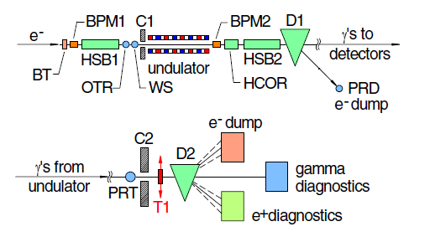
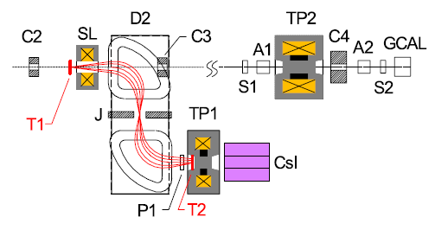
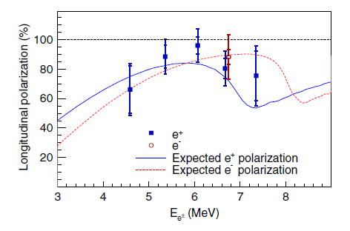
E166 – results!!!
Observation of Polarized Positrons from an Undulator-Based Source, G.Alexander et al. PRL 100, 210801 (2008)
46.6 GeV drive beam
10 Hz
109 e- pulse
Normalized emittance ~ 2 10⁻⁵ μm
Spot 35 μm
Undulator 0.9 m, aperture 0.9 mm

Slide 14
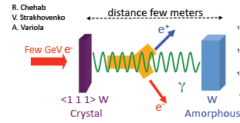

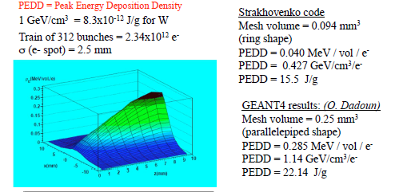
Gamma separation
CLIC Hybrid Source
1) Channeling

Slide 15
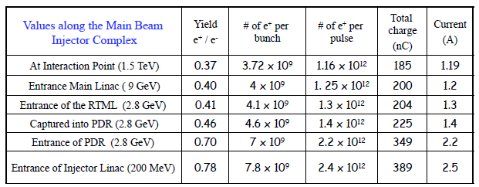
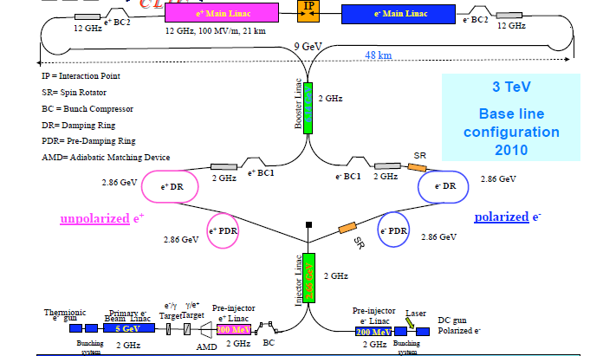
CLIC Positron source
Much more complex than the electron source !!!!!
L.Rinolfi

Slide 16
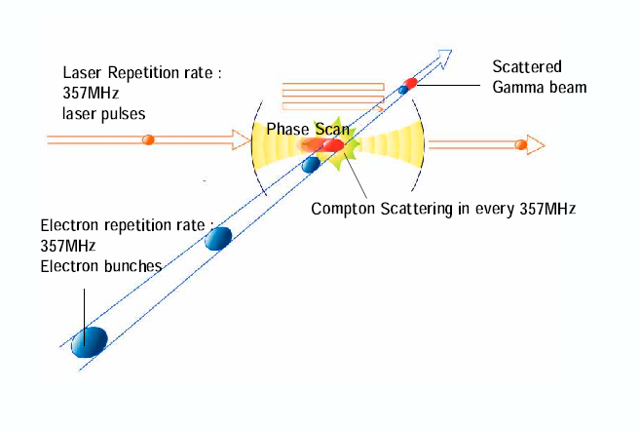
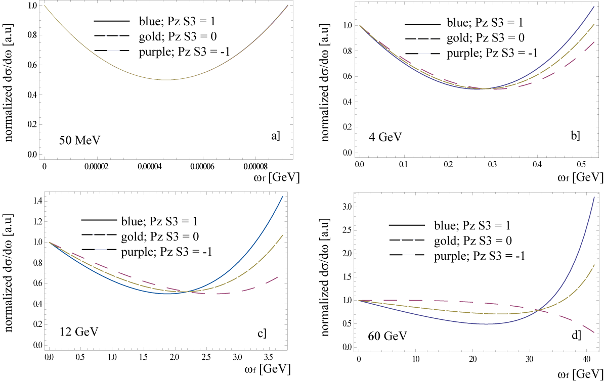
ILC-CLIC, Compton backscattering
T. Omori et al., Nucl. Inst. Meth. A500 (2003) 232. => CO2 lasers
S.Araki et al. arXiv:physics/0509016v2 [physics.acc-ph] 15 Sep 2005 => FP cavities
I Pogorelski, V Yakimenko, PAC 2007 proceedings, Albuquerque
I Chaikovska PhD Thesis
A laser can be seen, by the particle, as a ‘light’ undulator. The equation of motion is
the same as that of a helical undulator… so is the radiation field…linear and non linear
Pro : independent source (main beam few GeV), less thermal stress danger, easy in polarization handling
Main problem: for these applications the Compton cross section is extremely low….
Schemes :
CW => Compton Ring – ERL (FP cavities, high average power laser /stacking, multiple IPs)
Pulsed => Compton LINAC CO2 laser, regenerative, recirculator cavity – single shot
Alternative solutions for ILC and CLIC. A lot of R&D is needed….

Slide 17
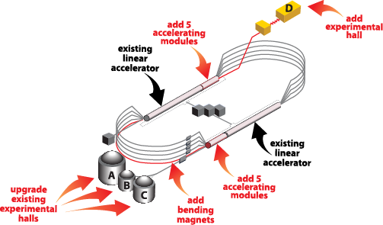
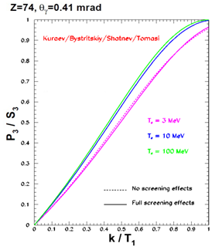
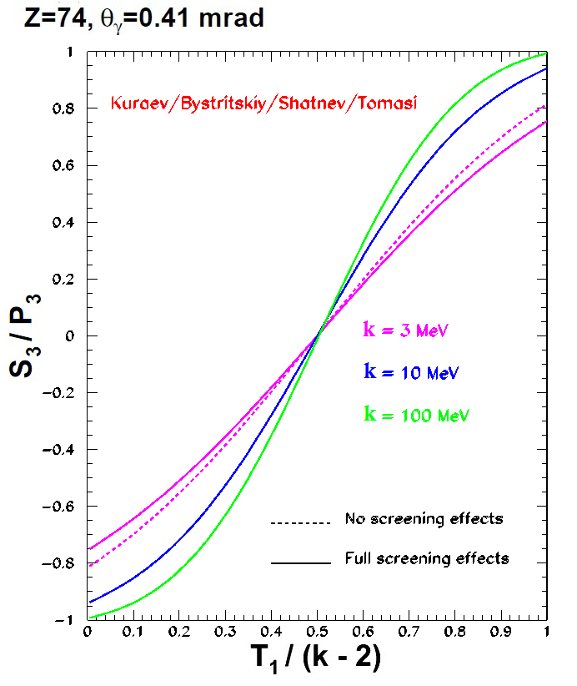
JLAB. Continuous Electron Beam Accelerator Facility
J.Grames
CW Electron beam in all Halls
Polarization: 85-90%
Max Energy: 11GeV(ABC) / 12GeV(D)
Max Current: 200 μA
So =>Polarized Bremsstrahlung & Pair Creation
Polarised bremsstrahlung. Polarization transfer in the high
energy tail. Good for capture but …low efficiency
E.G. Bessonov, A.A. Mikhailichenko, EPAC (1996)
A.P. Potylitsin, NIM A398 (1997) 395
3 existing end stations for nuclear physics experiments would benefit from a beam of polarized positrons:
  Parton Imaging
  Deeply Virtual Compton Scattering
  Two Photon Exchange
Other efforts may also benefit:
  Electron Ion Collider
  Materials Science Collaborations

Slide 18
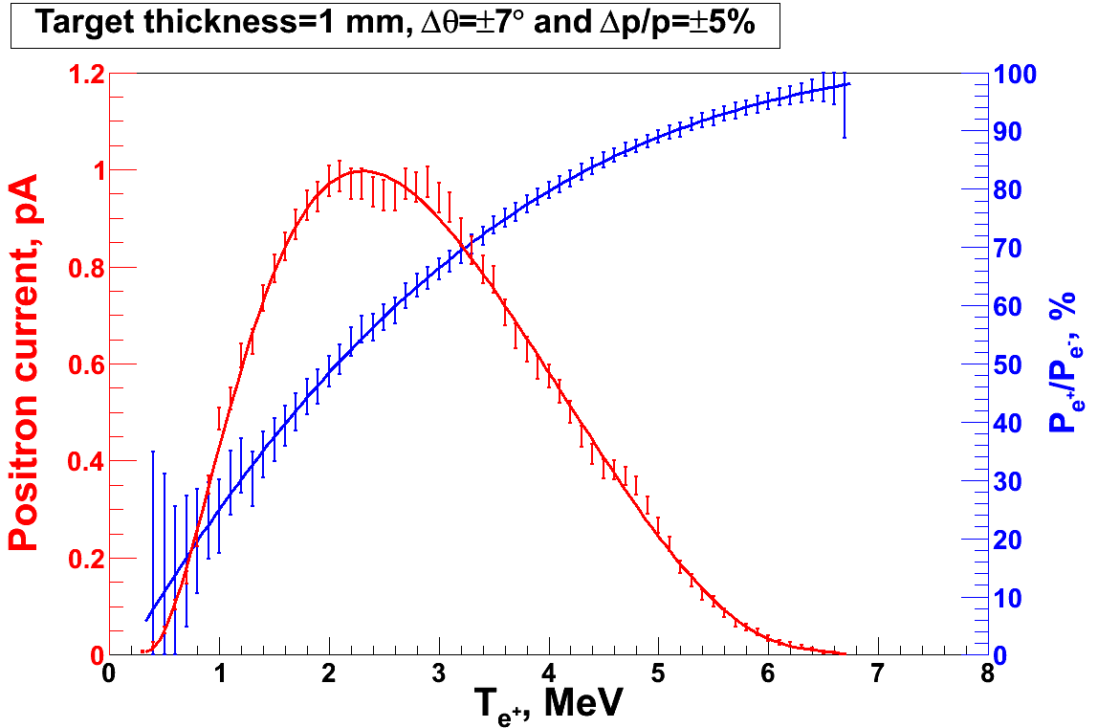
PEPPo Concept @ JLab
P_{e-}
S₁
I_{e} = 1 µA
T₁ = 1 mm
e⁻
D
T₁
PEPPo
Longitudinal e⁻ (P_{e-}) produce elliptical γ whose circular (P_{g}) component is proportional to P_{e-}.
P_{g} transfers to e⁺ into longitudinal (P_{e+}) and transverse (P_{t}) polarization components. On the average P_{t}=0.
S₂
P_{t}
D
e⁺
T₂
Calorimeter

Slide 19
Techniques

Slide 20
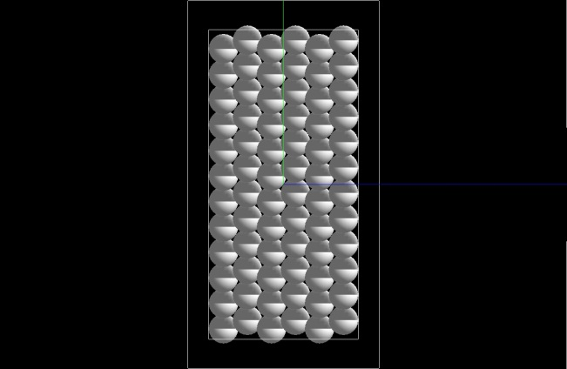
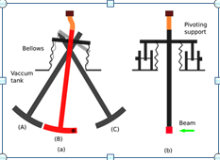
Target technology, some examples
ILC: Rotating wheel
Daresbury prototype
I.R Baley et al. EPAC 08 Proceedings
Granular Target
small spheres of W, 2 mm diameter
P.Sievers, R.Chehab
Pendulum Target
R.Chehab, P.Sievers
ILC Grenada
Main problems to be solved (again R&D):
Vacuum transition
Rotation (oscillation) speed
Cooling integration
Eddy current (Rotating Wheel)….

Slide 21
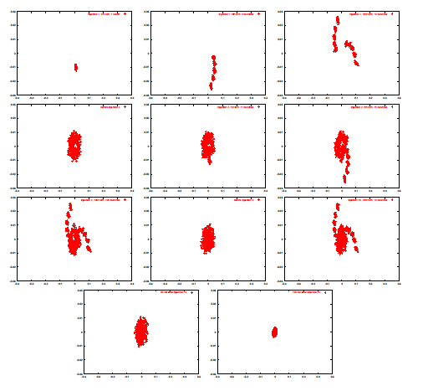
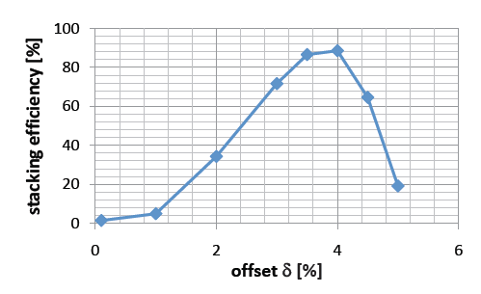
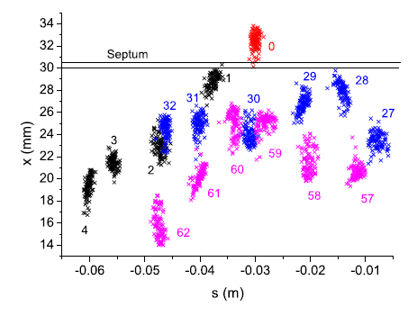
DR stacking and cooling
To increase the single bunch current it is possible to envisage a high frep production at low charge and stacking in the damping ring (or pre-damping ring)
K.Moenig
Simulation in the frame of the ILC-CLIC. For CLIC the pre damping ring is taken into account. For ILC different Compton sources are considered, Storage ring or ERL (Proceedings of PAC09, Vancouver, BC, Canada, F Zimmermann et al.)
Injection in Damping ring, ILC/CLIC – Superconductive DR. 95 % efficiency in simulations with a pre DR and a storage ring (see for example L.Rinolfi et al IPAC 11)

Slide 22
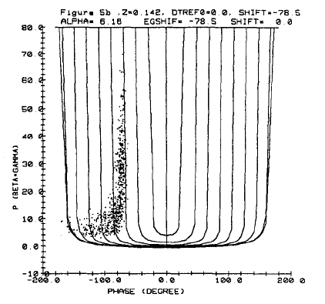
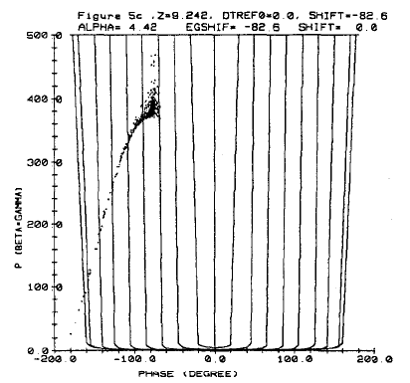
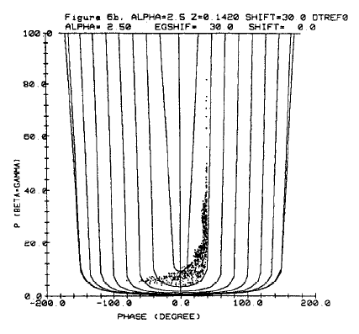
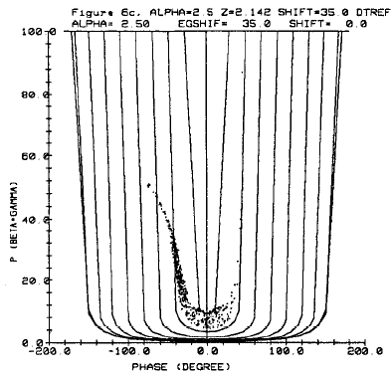
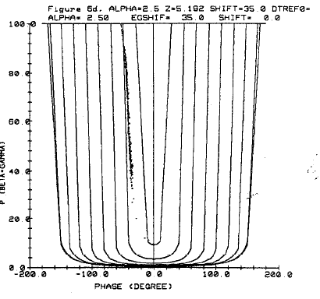
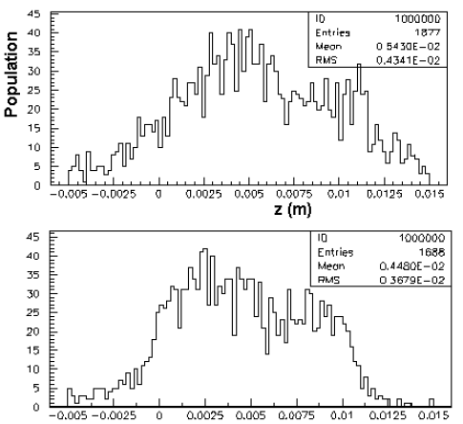
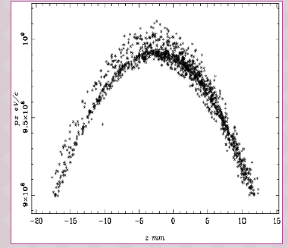
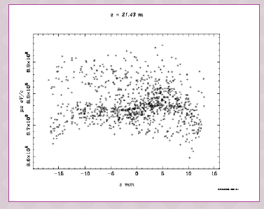
Capture and shaping
Deceleration strategy. Reduce bunch lentgh -> at the end reduces En spread.
B. Aune and R. H. Miller, “New Method for positron production at SLAC”, LINAC1979, SLAC-PUB-2393.
Studied for SuperB :
- Capture in L Band cavity in high order mode (or S band large iris)
Bunching effect increase with QWT and the reduction of En spread.
TM 020 preserves the transverse acceptance
-High order mode cavities can be used for linearization after L band Linac
T.Xenophonots stage report
High harmonics cavities
A.Variola et al. To be published
F.Poirier

Slide 23
Possible R&D…. A lot
Target and insertions (pendulum, granular, rotating wheel…)
AMD B Field. Peaked but also solenoid in RF sections!!!
RF Capture in AMD, bunching
Pulsed B Field, immersed target
Undulators
Warm and cold capture
Laser and optical cavities for CBS
Higher harmonic cavities for beam shaping
Lithium lenses / transitions windows and transverse electron flux
Etc….

Slide 24
Future…dreams?

Slide 25
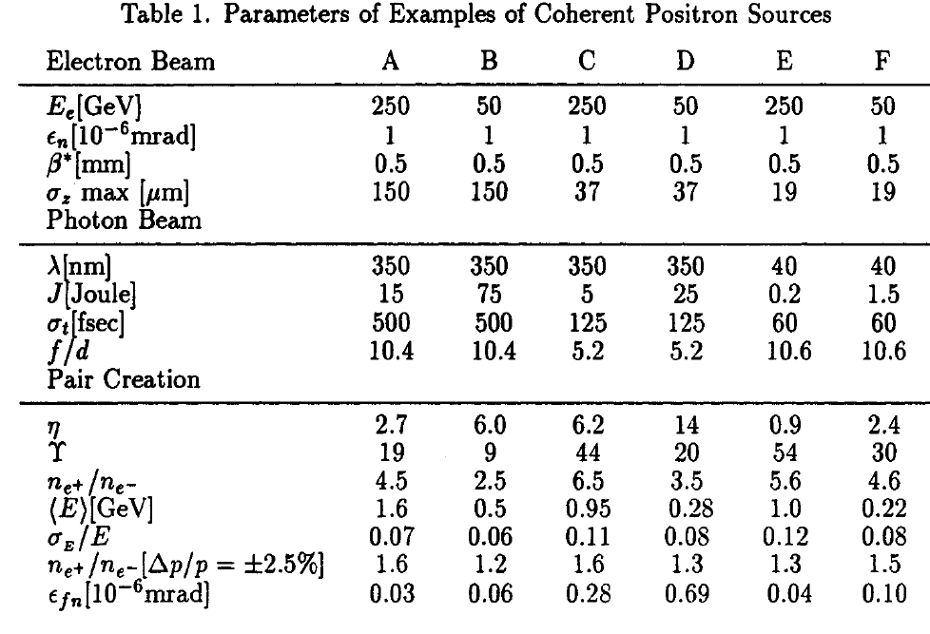
Ultimate idea. Schwinger limit
Coherent pairs production in vacuum….laser = target. High η parameter (coherence) in QED regime (large Γ parameter, hω> mc²) for pairs production.
Primary gammas created in the laser field by CBS (SLAC E144 PRL 79,1626,1997)
Need of a high pulse peak power X FEL coupled with high energy e beam

Slide 26
Positron sources and Plasma accelerators
A point of view
At present the plasma channels acceptance does not allows for ‘colliders’ positrons beam.
Positrons can be created by plasma focusing (undulator K=173!!) gamma emission and conversion (principle of gamma separation..), E167 SLAC. Focusing field 90 T on 28.5 GeV beam. Gamma @ 50 MeV cut. Ti target 4 X₀ 2.5 10⁶ – 10⁷ positrons with 1-3 10¹⁷ cm⁻³ plasma (D.K Johnson et al PAC proceedings, 2005 Knoxville)
Simulations of e⁻ driven capture and acceleration 1.75 GeV in 5 cm 10¹⁷ cm⁻³ plasma (with reasonable fluxes, 4 10⁶ captured, 0.05% efficiency. SLAC Pub 13102 X Wang et al…).
Experiment made in positron wake, capture and plasma acceleration (less efficient than electron drive). 58 MeV/m in ~1.5 m lithium plasma (excimer laser excited). Efficiency ~5 %. (SLAC) (B.E.Blue et al–PRL 90-21, 30/05/03)
Theoretical considerations on high direct pairs production in a plasma by trident process. Ponderomotrice force -> η laser (>5). For lower intensity lasers ->plasma wakefield acceleration but with a threshold on beam energy (η=0 E>3mc²) (K.T.McDonald, Princeton U. October29, 1996, http:// puhep1. princeton.edu / ̃mcdonald/ accel/positron.pdf)
So at present no ‘total plasma collider’ configuration is a reality…. A lot of R&D is needed.
R&D => Maybe external injection from a classical positron source has to be evaluated.
If R&D on external injection has to be carried out the cost is too high!!! My (?) suggestion is to implement a positron accumulator as in a non neutral plasma physics experiment (Na radioactive sources): few meters and ‘moderate cost’. Applying the rotating wall technique the ‘at rest’ bunch sizes can be drastically reduced. After this, an extraction and small post acceleration system can deliver a positron bunch for the external injection.
Cons => f_{rep} ……few minutes

Slide 27
Conclusions
Positron sources are a KEY element of past, present and future colliders.
The requirements for the future accelerators (especially for linear colliders) represent an incredible design and technological challenge. At present the constraints are imposed by the required current and the polarization.
Different ideas have been suggested and some of them have been successfully preliminary tested (undulator E166, Hybrid, Compton CO2, Mightylaser ).
The physics is amazing, the R&D needs are impressive but unfortunately little attention is devoted to this problem (difficult to find other applications). Only a prioritization policy on budget and manpower can improve the situation. 90 % is Technological R&D ($$).
Very appealing fundamental research can be associated (coherent pairs)
New acceleration techniques are far from an ‘all plasma collider’…Will it be possible in future…??? At present only an external injection can be envisaged -> my suggestion for R&D is to implement positrons accumulator line with rotating wall.

Slide 28
Thanks for your attention
Thanks to all the colleagues for the slides (borrowed or stolen…)
Special Thanks to R.Chehab

