Slide 1
Traveling-Wave Thomson-Scattering and optical FELs
K. Steiniger^{1,2}, R. Pausch^{1,2}, R. Widera², A. Debus², T. Kluge², M. Bussmann², T. Cowan², U. Schramm² and R. Sauerbrey²
¹ TU Dresden
² Helmholtz-Zentrum Dresden-Rossendorf

Slide 2
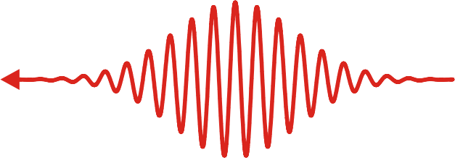
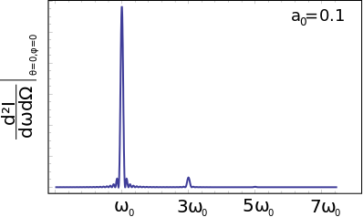
Lasers as compact sources of radiation
laser pulse (amplitude a)
electron pulse
(energy γ)
Thomson spectrum
10⁷ - 10⁸ photons/shot
$$ω_{sc}=\frac{{4γ^{2}ω}_{laser}}{(1+a^{2}/2)}$$
scattered radiation
Existing Thomson sources, e.g. PLEIADES provide
ultrashort
$$\sim fs$$
small bandwidth
$$\sim {10}^{−2}$$
X-ray pulses
$$\sim keV$$
with few tens of MeV electron energy.
High average photon flux through high repetition rates in laser and electron systems

Slide 3
Some applications require high per shot yields
Imaging ultrafast dynamical processes or producing small scale
structures requires high photon fluxes per shot
electron energy density
Understanding laser ion accelaration
from solids by probing electron energy
density in the target.
Timescale for oscillations $\sim 30fs$

Slide 4
How can we increase
the per shot yield?

Slide 5
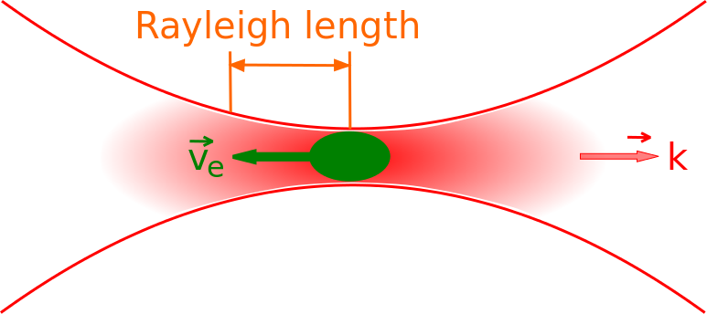
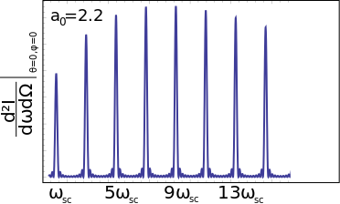
Head-on geometries are limited in per shot yield
The yield can be increased by increasing the interaction length or by increasing the laser power
1) Increasing the interaction length is limited by the Rayleigh length
Intensity is greatly reduced
out of focus:
$$z_{R}$$
2) Increasing the laser power is limited by nonlinear Thomson scattering
Nonlinear Thomson scattering
results in a large bandwidth

Slide 6
Head-on Thomson scattering can not be a high brightness source
For brilliant radiation sources we need:
long interaction length
at moderate laser intensities

Slide 7
Traveling-Wave Thomson-Scattering realizes long optical undulators
1) Reduce the local intensity
of a high power laser
by making the pulse wider
2) Increase interaction
duration by tilting the
laser pulse front
$$e^{−}$$
$$L_{int}$$
Interaction distance is determined by laser beam width
and hence limited by available laser power
laser pulse

Slide 8
Realizing optimal overlap at arbitrary interaction angles
$$e^{−}$$
$$φ$$
$$ω_{sc}=\frac{{2γ^{2}ω}_{laser}(1−\cos{φ})}{(1+a^{2}/2)}$$
$$φ/2$$
Pulse front tilt of $φ/2$ ensures overlap over whole laser beam width

Slide 9
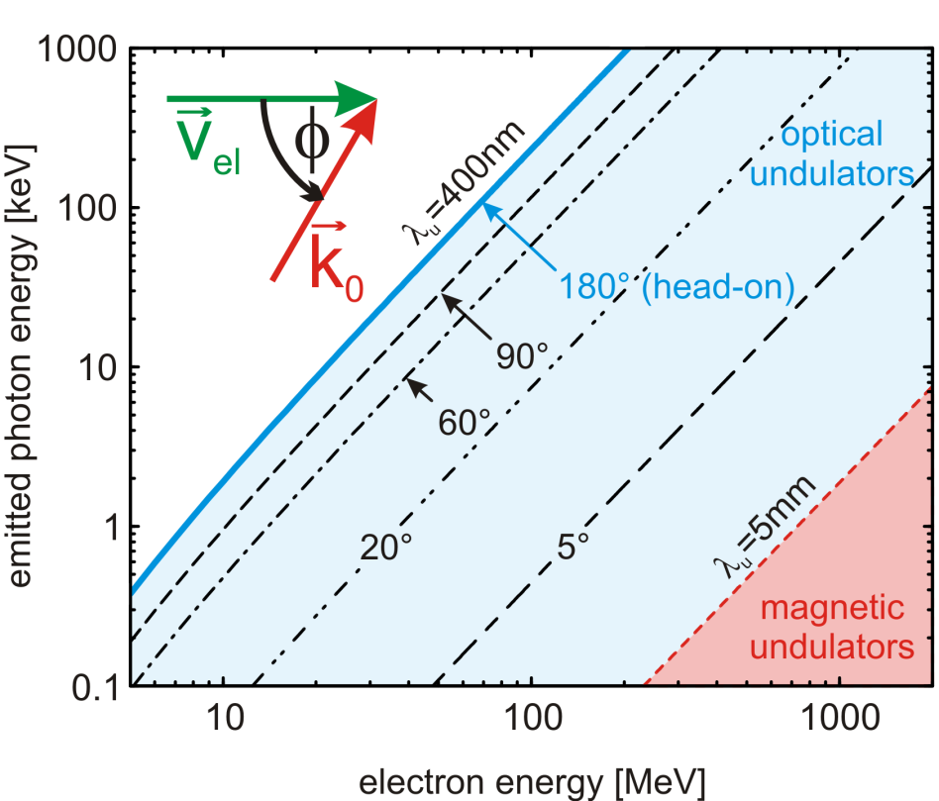
Controling bandwidth and radiated energy
Right: By increasing the interaction length, the spectral
photon density concentrates in a single peak
φ
Left: Variing the scattered photon energy over orders of
magnitude by changing the interaction angle

Slide 10
TWTS is a flexible light source
Variing the scattered wavelength over orders of magnitudes
by changing the interaction angle
photon energy
φ

Slide 11
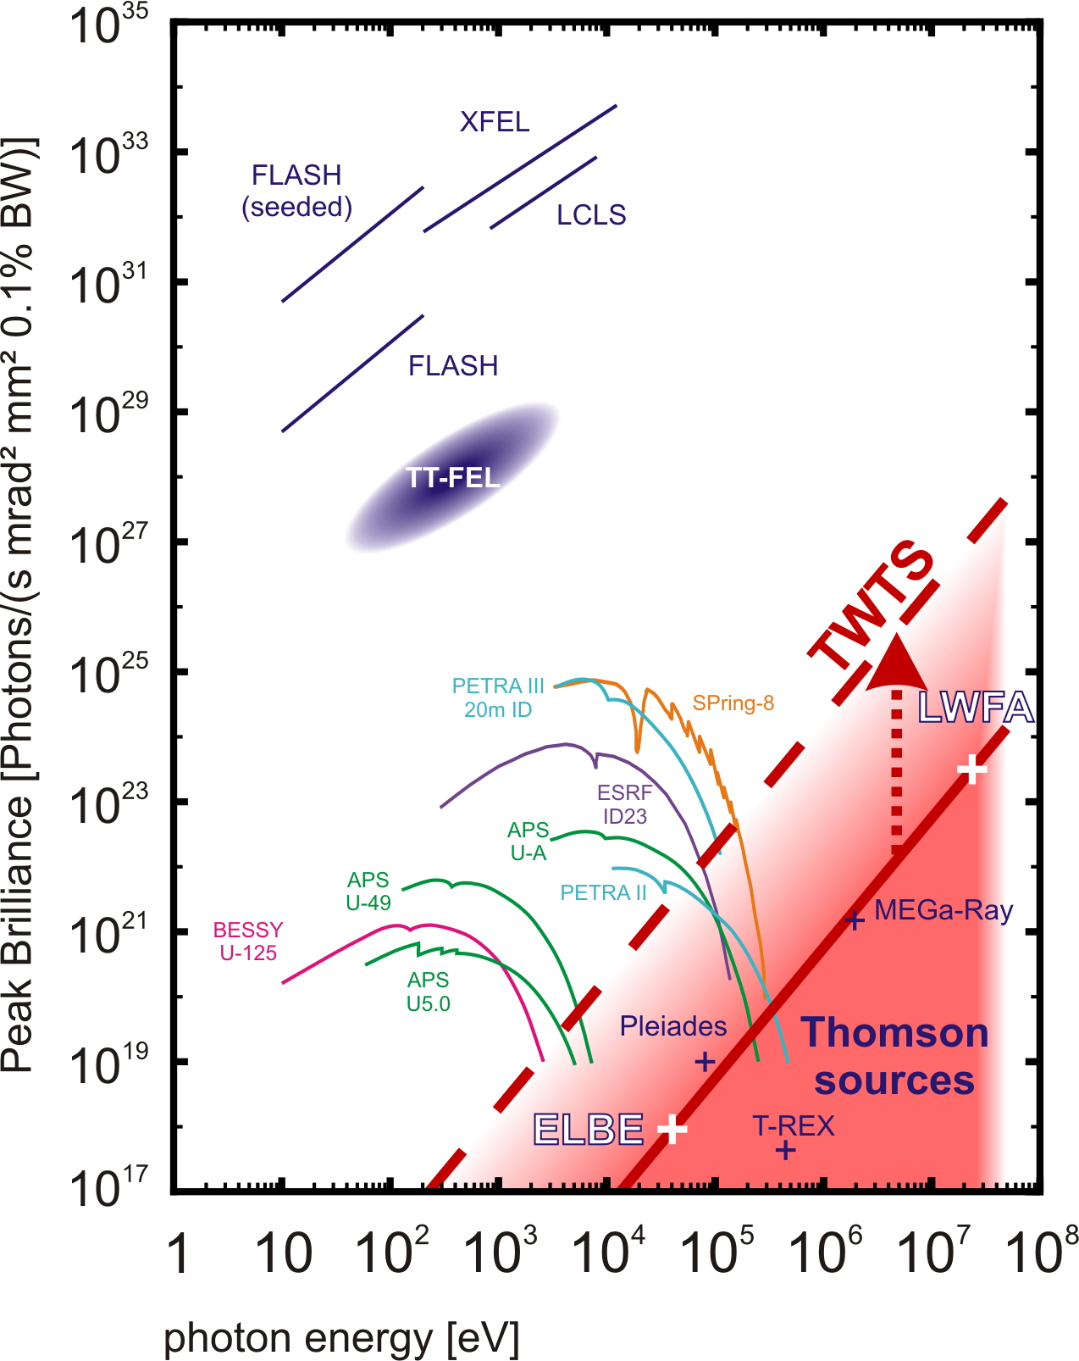
TWTS is a brilliant source for MeV photons
nonlinear Thomson limit
Notes:
11

Slide 12
How can we realize
an optical FEL with TWTS?

Slide 13
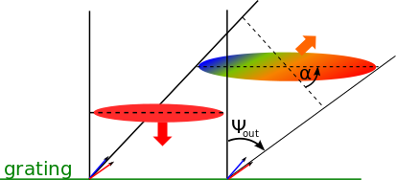
Making an optical TWTS-FEL
Laser beam must appear to the electrons as a monochromatic plane wave
until saturation in scattered radiation occurs
challenging since a pulse front tilt is connected to angular dispersion
grating
need to quantify and supress dispersion
Notes:
13

Slide 14
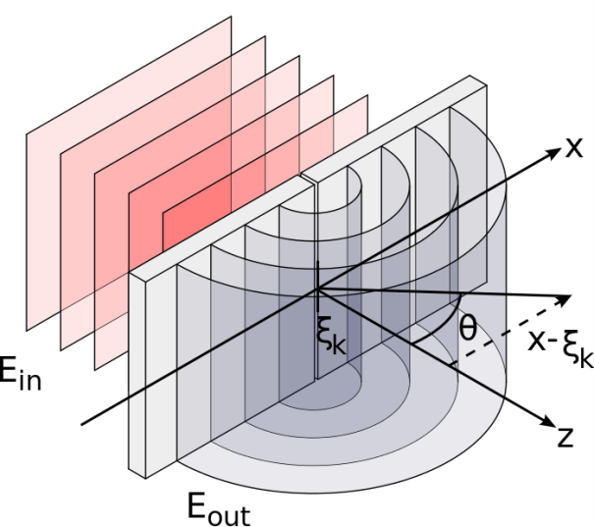
Full 3D wave-optical description of TWTS field
The laser field at the position of an electron is described as a superposition of all waves
originating from a single slit of the grating that introduces the pulse front tilt
Input field at
slit position
outgoing cylindrical wave

Slide 15
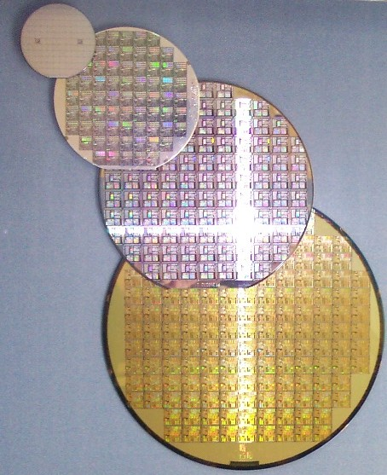
Small-angle TWTS example for EUV-lithography
$$λ_{sc}$$ | e-energy | $$φ$$ | $$w_{0}$$ | $$λ$$ | $$a_{0}$$ | $$τ$$
10nm | 100MeV | 3° | 1cm | 1µm | 0.35 | 120fs
Example setup:
image from http://commons.wikimedia.org
Notes:
600

Slide 16
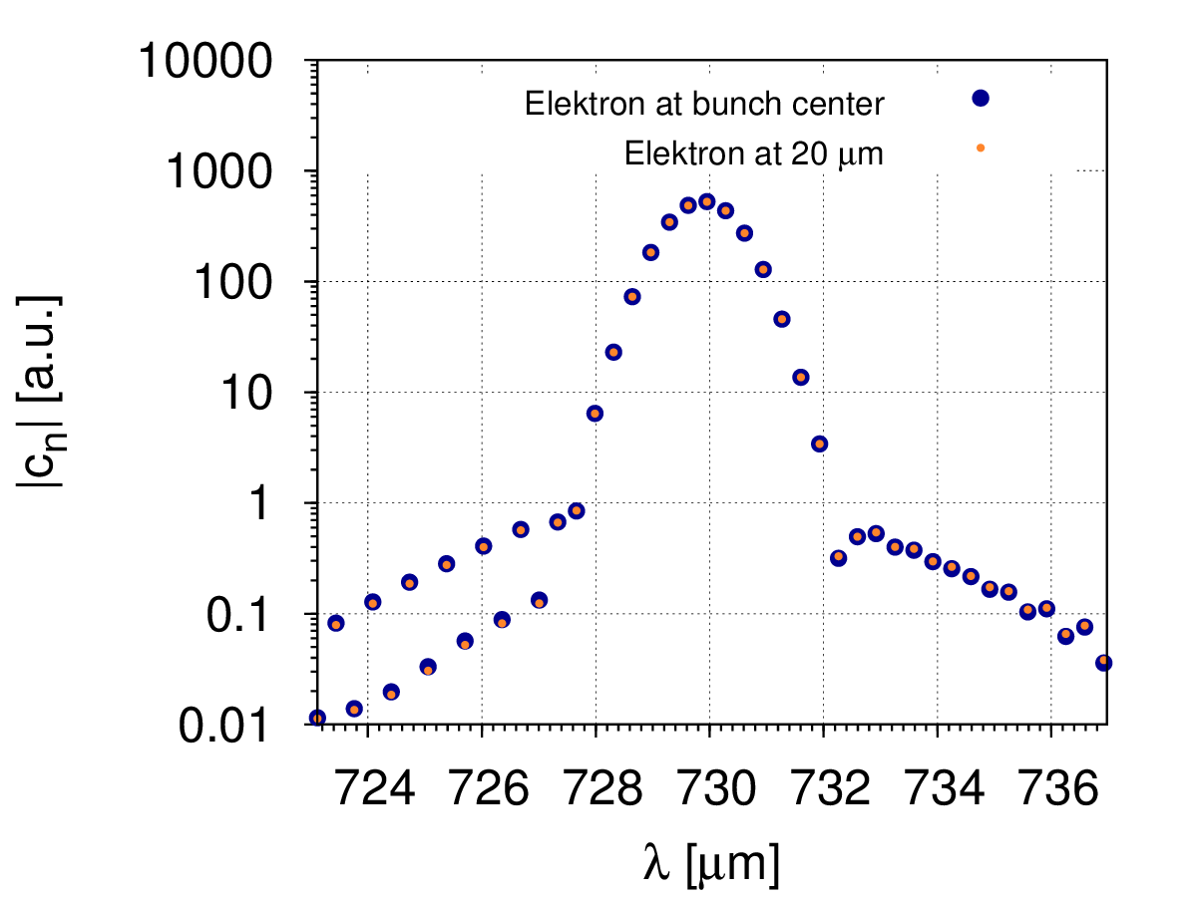
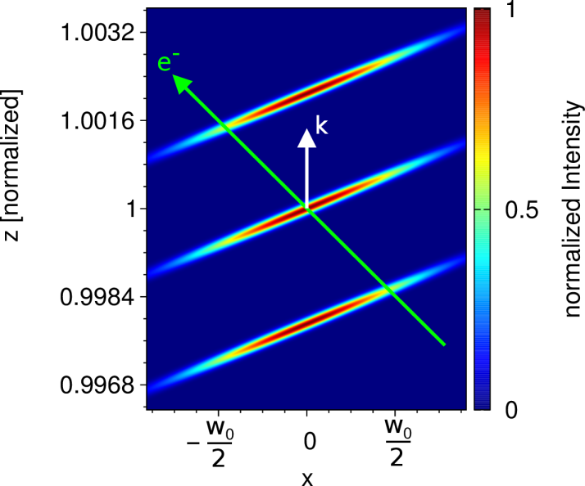
Small-angle TWTS provides monochromatic optical undulators
$$λ_{sc}$$ | e-energy | $$φ$$ | $$w_{0}$$ | $$λ$$ | $$a_{0}$$ | $$τ$$
10nm | 100MeV | 3° | 1cm | 1µm | 0.35 | 120fs
Example setup:
plot of interaction region
bandwidth of laser seen by electrons
c
c
FWHM
1.4µm
$$\frac{Δλ}{λ}=0.2\%$$
$$\frac{λ_{0}}{1−\cos\left(φ\right)}$$

Slide 17
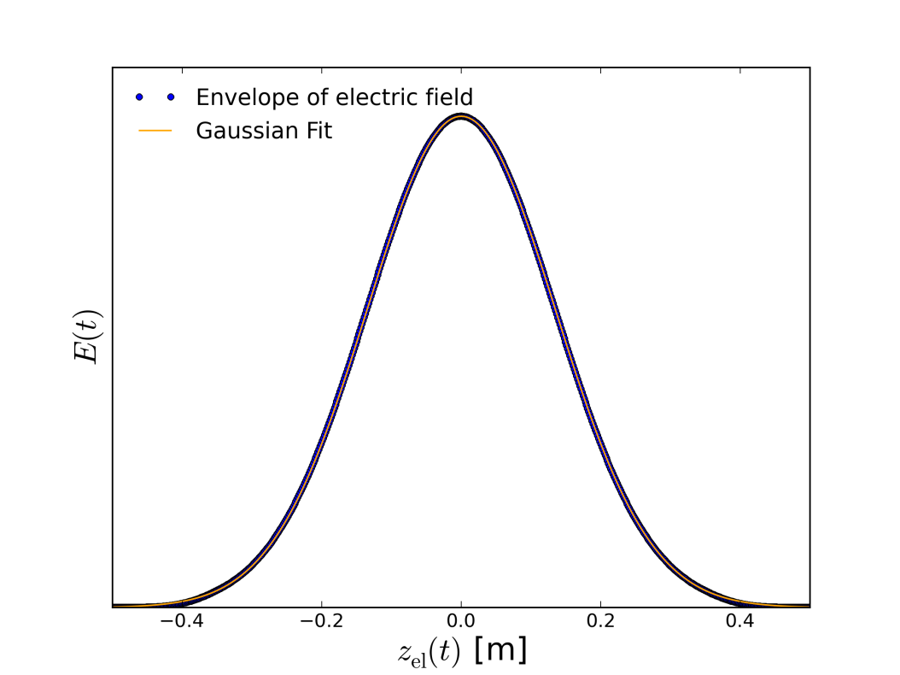
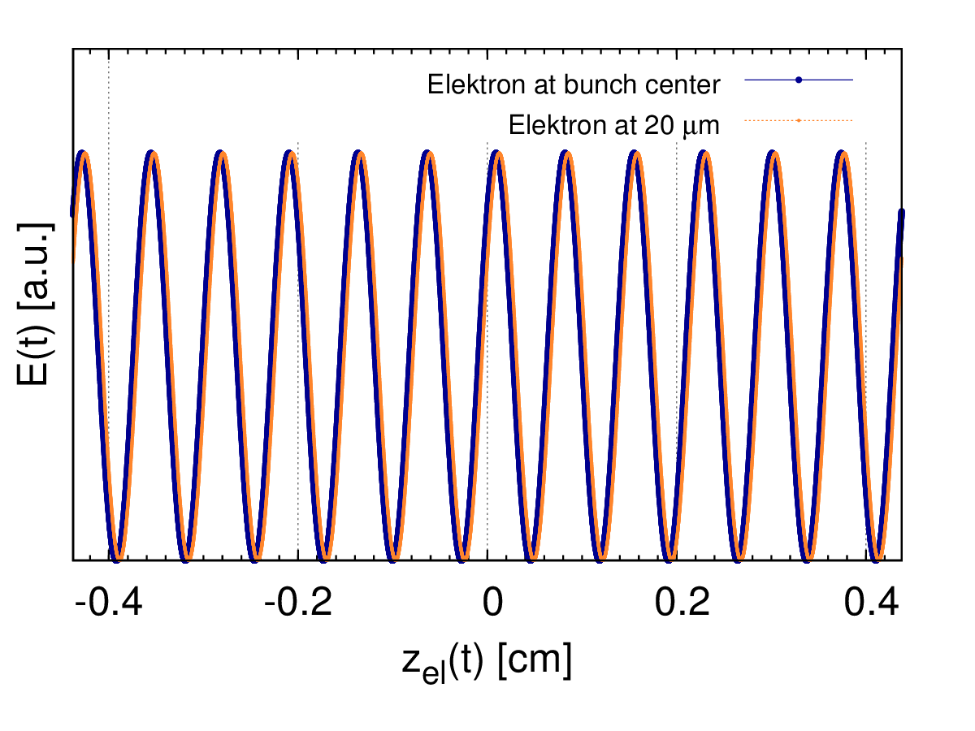
Small-angle TWTS provides long optical undulators
$$λ_{sc}$$ | e-energy | $$φ$$ | $$w_{0}$$ | $$λ$$ | $$a_{0}$$ | $$τ$$
10nm | 100MeV | 3° | 1cm | 1µm | 0.35 | 120fs
Example setup:
field envelope seen by the electrons
electric field seen by electrons
c
c
FWHM = 32cm
➔${ N}_{osc}^{}=\frac{32cm}{0.073cm}=438$

Slide 18
Small-angle TWTS provides optical undulators for a SASE-FEL
monochromatic and long optical undulators with TWTS
dispersion is under control

Slide 19
Can we describe the
TWTS-FEL using 1D theory?

Slide 20
We need a 1.5D-theory to describe the TWTS-FEL
side scattering causes effects not taken into account in
standard 1D theory
need a 1.5D theory

Slide 21
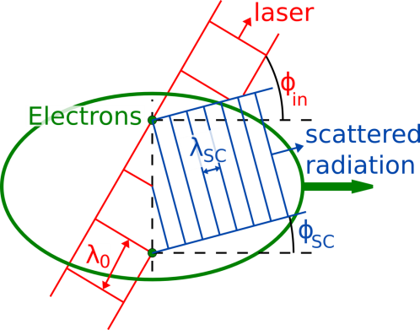
1.5D-FEL theory: Coherent amplification under an angle
Side scattering causes phase difference over electrons in transverse direction
Coherent amplification of scattered radiation under the angle $φ_{sc}$
$$φ_{sc}≈ \frac{1}{γ^{2}φ}=0.03° (EUV)$$

Slide 22
1.5D-FEL theory: Power loss due to amplification under angle
coherent amplification under angle causes notable radiation power loss
$$φ_{sc}$$
electrons
the loss can be taken into account by defining a critical angle $φ_{crit}$ into the power gain length
$$L_{G}^{′}= \frac{L_{G}}{1 − {φ_{sc}^{2}}/{φ_{crit}^{2}}}$$
$$L_{G}^{′}=1.43×L_{G} (EUV)$$
$$φ_{crit}^{2}=\frac{λ_{sc}}{L_{G}}$$
[T. Tanaka et al, Nucl. Instr. & Meth. Phys. Res., Sec. A 528, 172 (2004)]

Slide 23
1.5D-FEL theory: Electron motion in effective Undulator
Electron moves in the combined fields of laser and radiation
$$\frac{d γ}{d t}= \frac{q^{2}}{mc^{2}}\left({\vec{E}}_{L}+{\vec{E}}_{sc}\right)\vec{v}$$
Effective wiggle frequency is the combination of both frequencies
$$ω=ω_{0}\left(1−\cos{φ}\right)−ω_{sc}\left(1−\cos{φ_{sc}}\right)={0.99×ω}_{0}\left(1−\cos{φ}\right) (EUV)$$
$$\vec{v}$$
$$φ$$
$$\vec{k}$$
$$λ_{0}$$
$$e^{−}$$

Slide 24
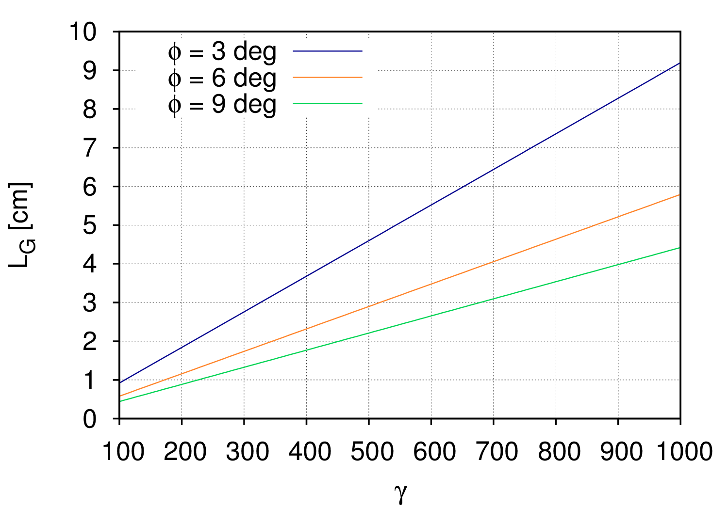
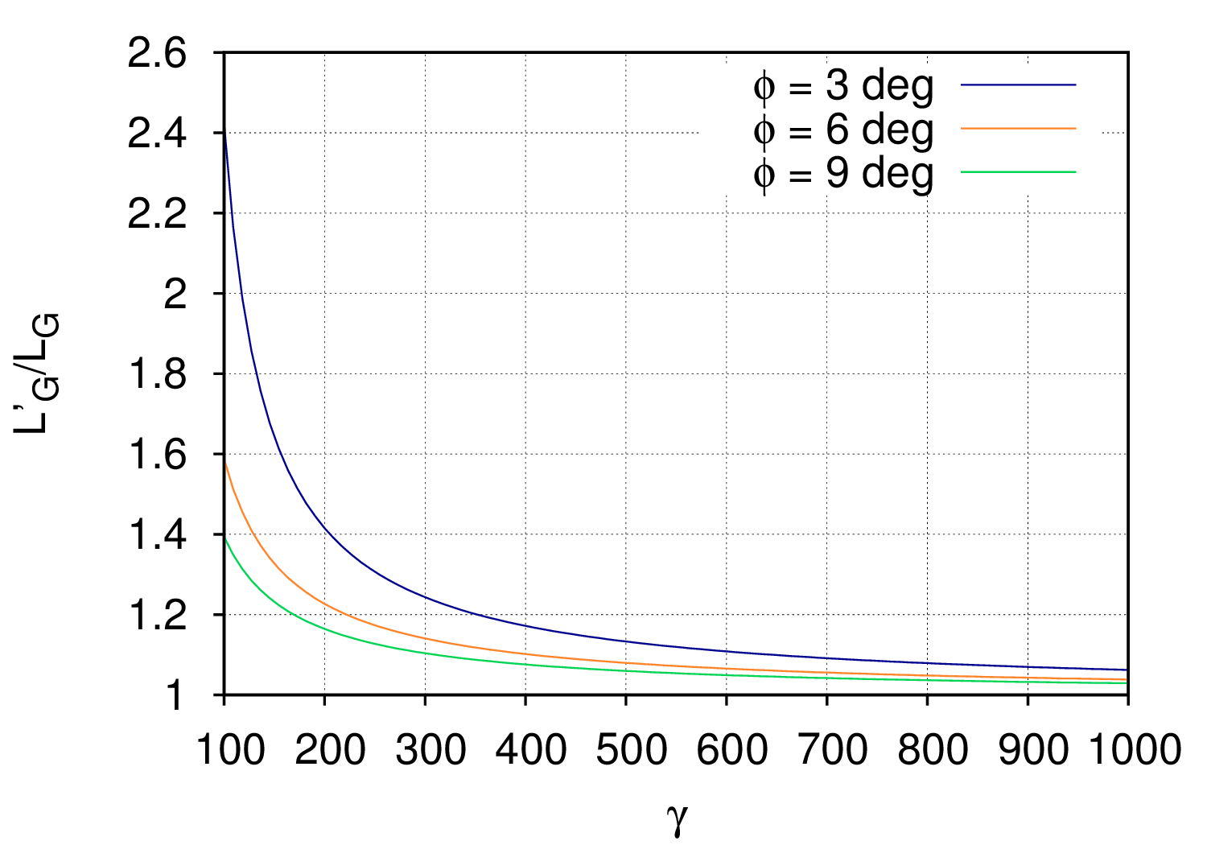
Finding experimental parameters
Optimizing the gain length by using larger angles for given electron energy
Elongation of the gain length
$$\frac{L_{G}^{′}}{L_{G}}∝γ^{−1}φ^{−2/3}$$
Gain Length
$$L_{G}∝γφ^{{−2}/3}$$

Slide 25
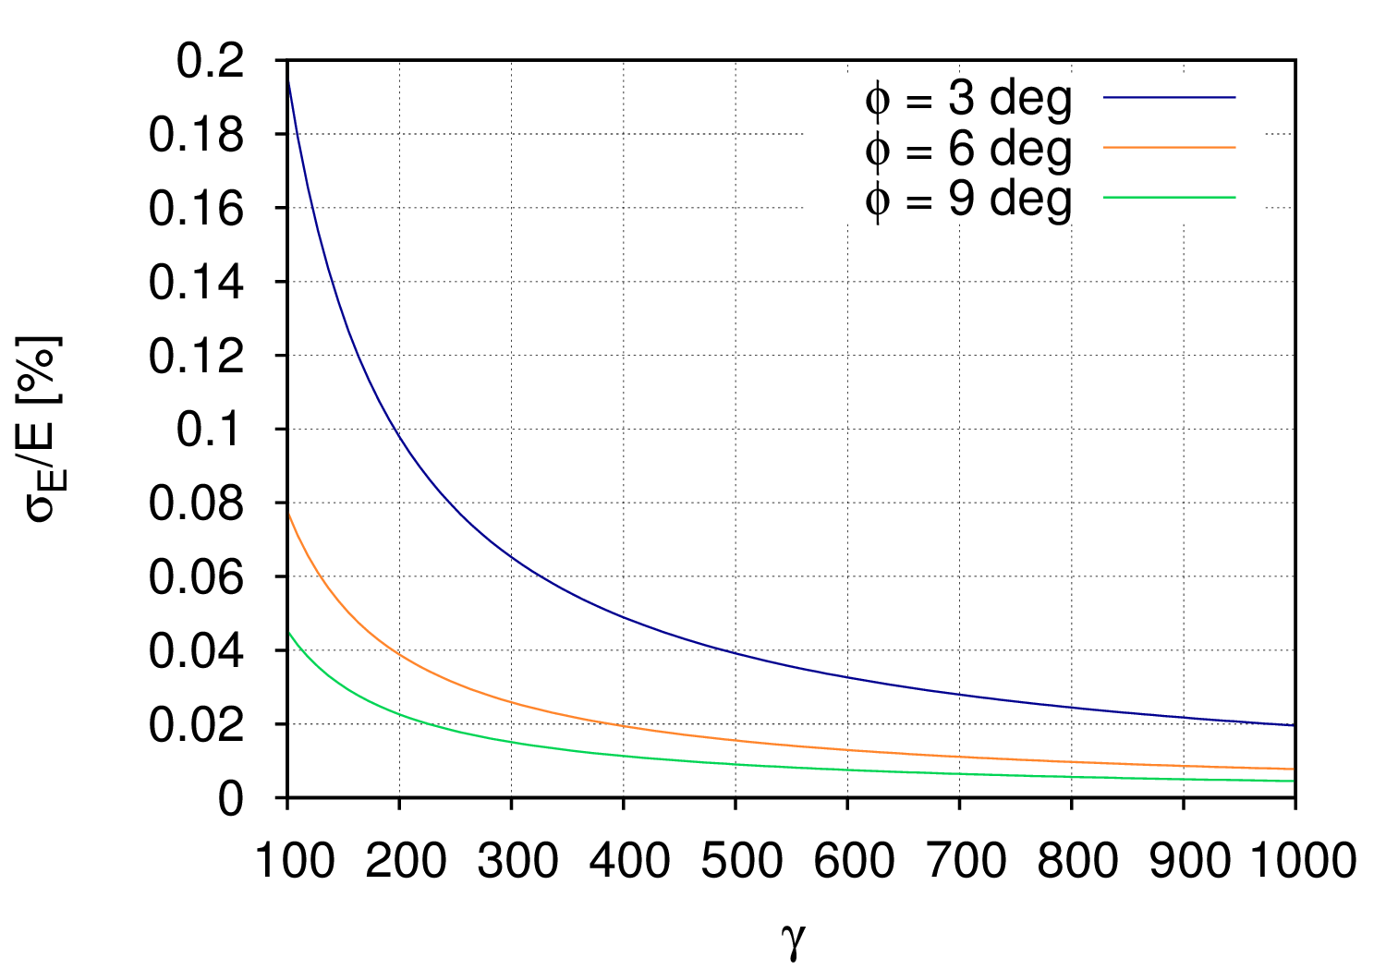
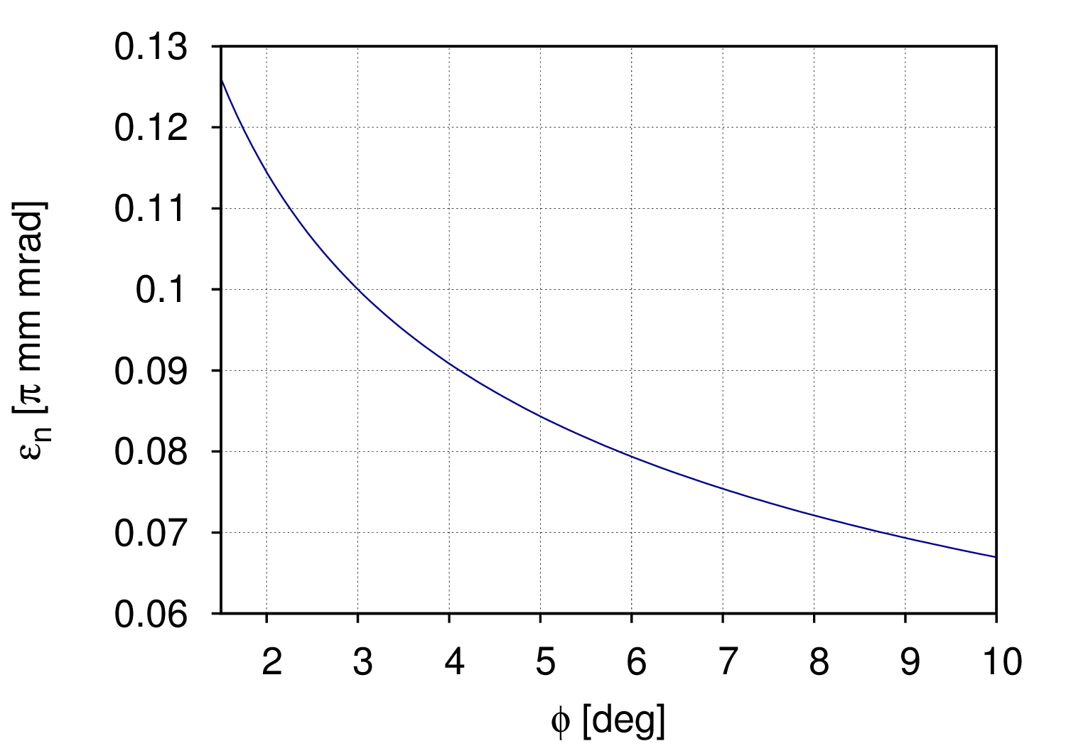
Finding experimental parameters
Weaker limits on energy spread and emittance with small angles
$$\frac{σ_{E}}{E}∝γ^{−1}φ^{−4/3}$$
$$ε_{n}∝γ^{0}φ^{−1/3}$$

Slide 26
Finding experimental parameters
smaller gain length with larger angles
electron bunch requirements less strict with smaller angles
in practice: take smaller interaction angles
for given electron energy
gain length increase is usually affordable

Slide 27
TWTS-FEL using LWFA electrons
Parameter | EUV | X-ray | LCLS
scattered wavelength [nm] | 10 | 0.1 | 0.1
electron energy [MeV] | 100 | 590 | 13800
peak current [kA] | 10 | 10 | 3
$$a_{0}$$ | 0.35 | 0.3 | 3.5
laser power [TW] | 450 | 1200 | -
interaction angle [deg] | 3 | 5 | -
gain length [cm] | 1.8 | 6 | $$3.5×{10}^{2}$$
interaction length [cm] | 39 | 131 | $$60×{10}^{2}$$
peak power [GW] | 2.7 | 1.2 | 40
A compact free electron laser!
$ε_{n}=0.1π$mm mrad, $σ_{e}=20$µm, $τ_{e}=10$fs

Slide 28
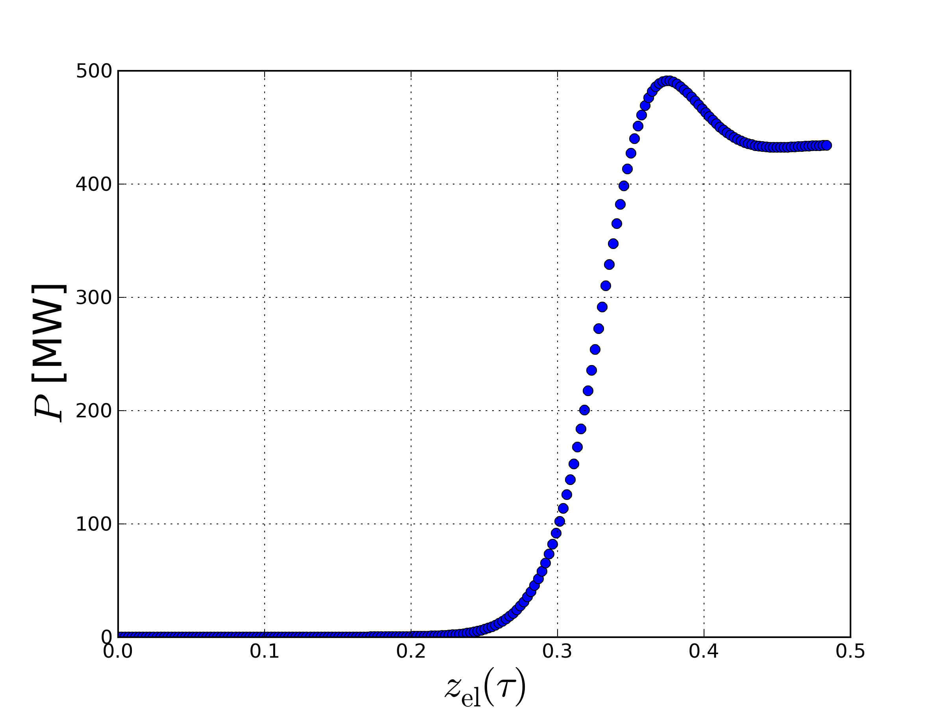
It‘s an FEL!
Saturation after 38cm
435 MW
$2.2×{10}^{11}$ photons
Taking laser field envelope into account

Slide 29
Thank you for your attention!

Slide 30
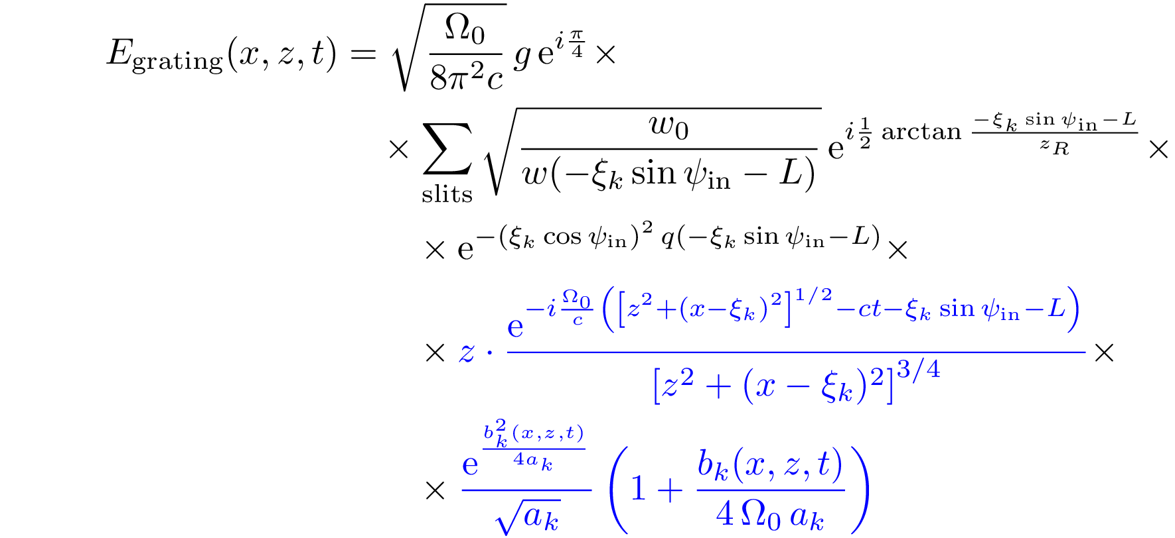
Analytical result of diffraction at arbitrarily spaced line gratings
starting amplitude
and phase
evolving pulse from
a single slit
$a_{k}$ complex constant, where ${\left|a_{k}\right|}^{2}$ represents the pulse duration
$b_{k}(x,z,t)$ propagation of envelope and phase evolution

Slide 31
Scaling of experimental parameters
efficient amplification of coherent radiation
$$\frac{1}{10γ^{2}φ^{2}ρ}≪1$$
electron energy spread
$$\frac{σ_{E}}{E}≤\frac{ρ^{eff}}{2}∝γ^{−1}φ^{−4/3}$$
transverse normalized emittance
$$ε_{n}≤ρ^{eff}γφσ_{e}\frac{(1+a_{0}^{2}/2)}{4+a_{0}^{2}}∝γ^{0}φ^{−1/3}$$
transverse laser profile variation
$$\frac{Δa_{0}}{a_{0}}≤ρ^{eff}\frac{(1+{a_{0}^{2}}/2)}{a_{0}^{2}}∝γ^{−1}φ^{−4/3}$$

Slide 32
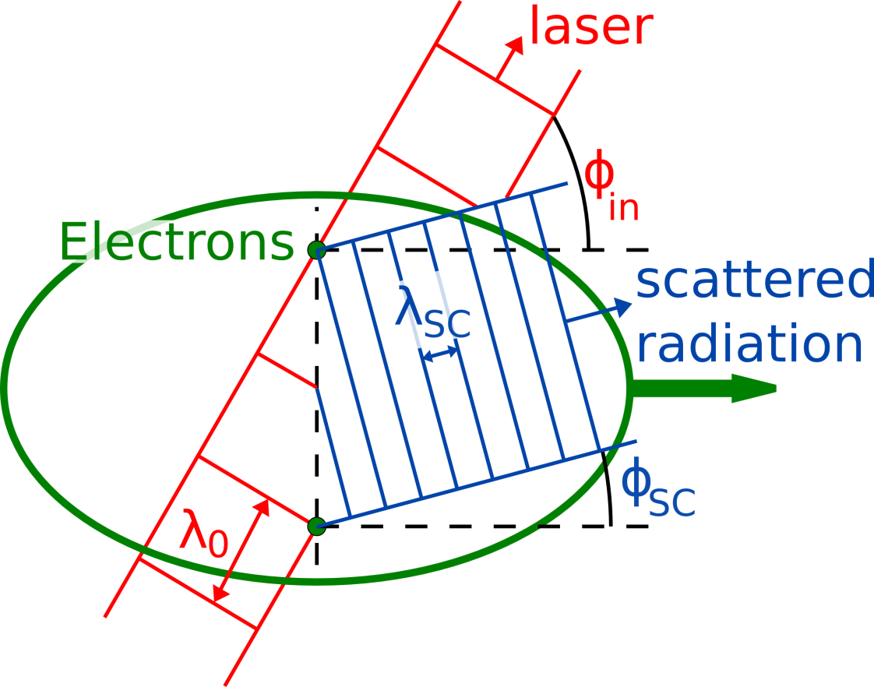
Efficient amplification of radiation under conditions
Coherent amplification under the angle
$$φ_{sc}≈ \frac{1}{γ^{2}φ_{in}}$$
Leakage of radiation out of interaction area if not
$$\frac{w_{0}}{γ^{2}φ_{in}^{2}}≪d_{beam}$$
$w_{0}$…laser beam width
Microbunching develops under same angle
Spatial and temporal intensity variation → intensity condition:
$$\frac{a_{0}^{2}/2}{1+a_{0}^{2}/2}≤ \frac{λ_{0}}{w_{0} tan\left(φ_{in}/2\right)}$$
$$d_{beam}$$

Slide 33
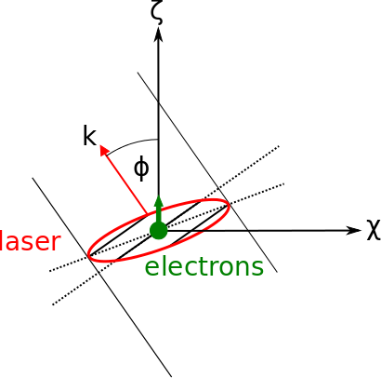
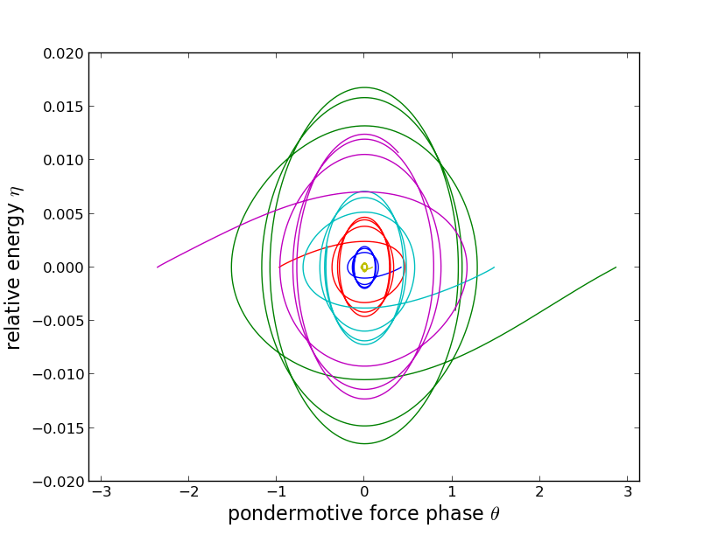
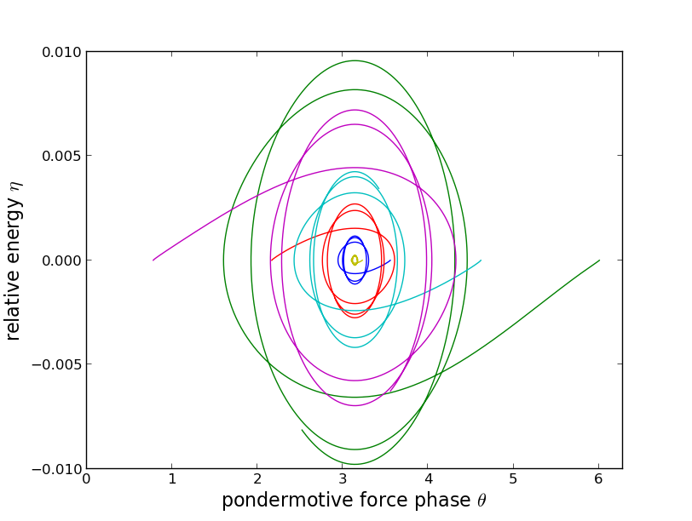
1.5D-FEL theory with TWTS geometry
Ansatz for undulator field:
envelope with
pulse front tilt
phase propagating
under angle
TWTS field causes only minor changes in 1D-FEL equations
Phase space comparison of TWTS-optical and magnetic undulator
real
magnetic
undulator
TWTS optical
undulator
In TWTS still bounded motions of electrons around a common ponderomotive force phase

Slide 34
Summary
Traveling-Wave Thomson Scattering provides optical undulators with length of several hundred undulator periods
Optical free electron lasers can be realized with TWTS in small interaction angle regimes

Slide 35
TITEL (22pt)
Subtitel (22pt)
Text (20 pt)
Titel Text (20 pt)
Folie 1 (18 pt)
Folie 1.1 (16 pt)
Folie 1.2
Folie 1.3
Schriftgrößen können angepasst werden!

