Slide 1
European Network for Novel Accelerators (EuroNNAc)
R. Assmann, DESY

Slide 2
What Is EuroNNAc?
A network that provides a platform for exchange, for definition of common goals, for lobbying, for collaborative funding requests on novel accelerators.
Build links between conventional and novel accelerator specialists.
Assumption: Together we are stronger!
Founded in 2011 in a meeting at CERN with immediate great interest from the community.
Sponsored by EU and big labs, interested in the success of novel accelerators for the future of HEP/photon/nuclear science and accelerator applications for society.

Slide 3
Organization
Coordinators: R. Assmann (DESY), B. Holzer (CERN), A. Specka (Ecole polytechnique), J. Osterhoff (DESY).
EuCARD1&2 “EuroNNAc WP” leader and central network budget: R. Assmann (DESY). Also deputy EuCARD2 coordinator.
Decisions from coordinators and member’s board: 1 person per participating institute.
We will continuously adjust our structure: discussion this Friday.
Investigating formal secretarial support from DESY.

Slide 4
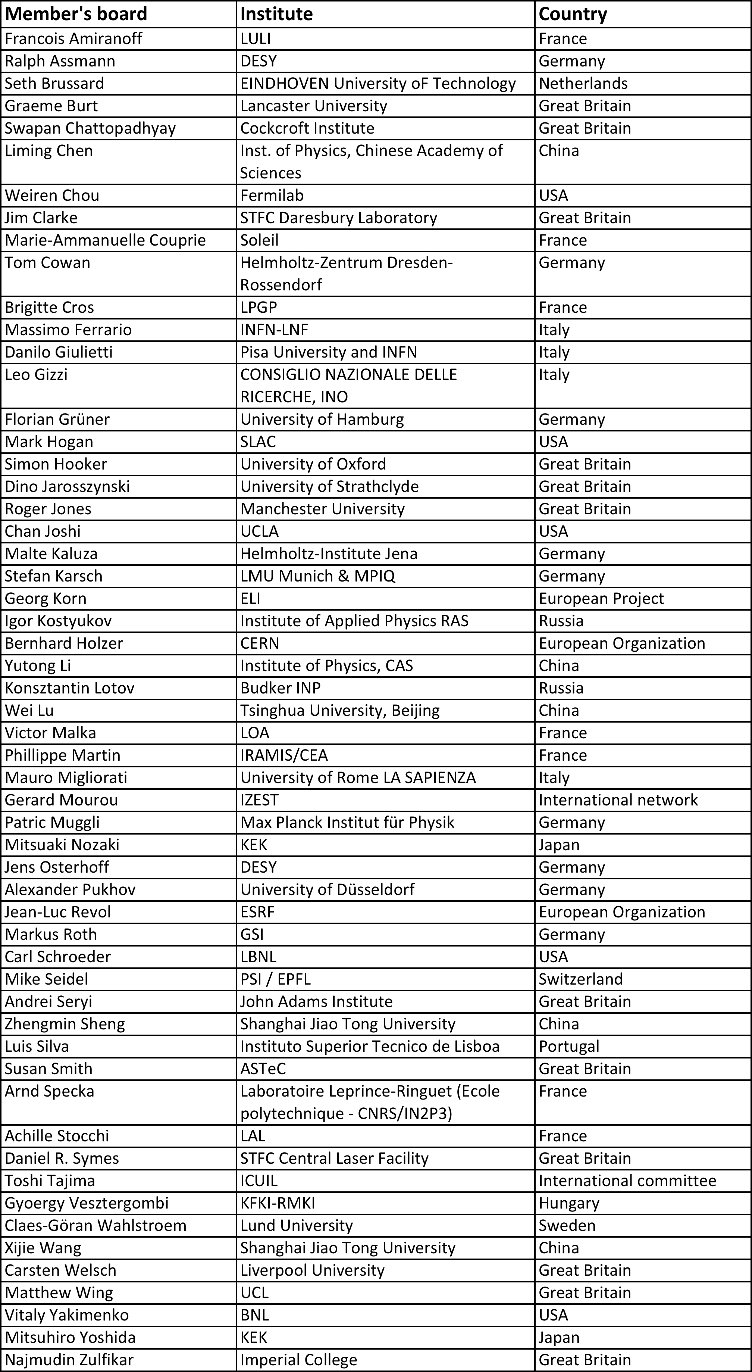
Member’s Board
Guidance, input, major decision. For example: act as International Advisory Board for
EAAC2013.

Slide 6
Remarks
Europe is small on this map…
World-class science is one of our big assets. We have a tradition here!
Many institutes active and interested in Europe: too big for self-organization → EU supported network EuroNNAc!
Crucial links to our friends in Asia and the US!

Slide 7
Participation
The network is an open activity that explicitly asks interested parties to join.
If your institute is not listed and you want to be part of this network, announcements, invitations, … then:
Send an e-mail with the name of the institute, name of a representative and e-mail contact to ralph.assmann@desy.de!
There is no direct financial support to the participating institutes.
The funding is too small to split over 50 institutes…
Network does fund network activities.

Slide 8
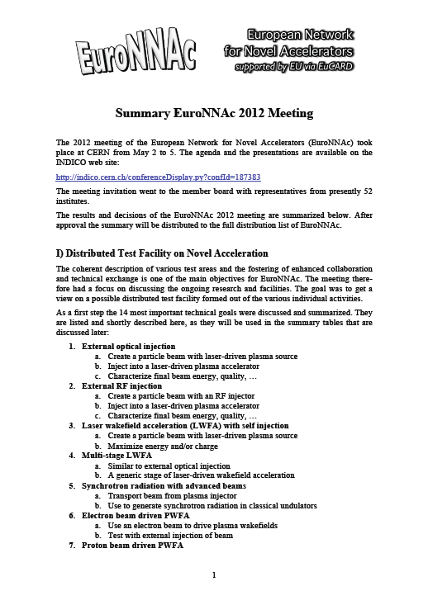
Activities
Yearly EuroNNAc Meeting
May 2 – 5, 2012 at CERN
Outcome documented in minutes, distributed to member’s board
First yearly meeting after founding workshop at CERN in 2011.
Our deliverable with EU…

Slide 9
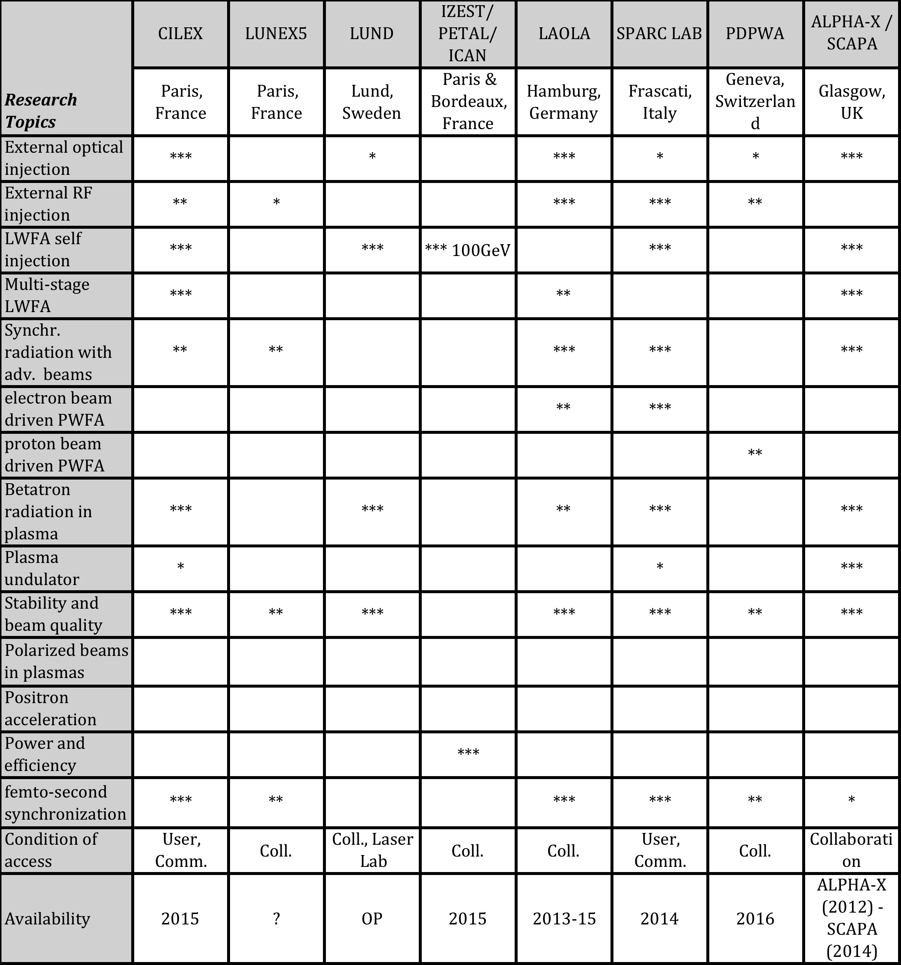
Activities
Analysis: Novel accelerator research activities and plans (May 2012)

Slide 10
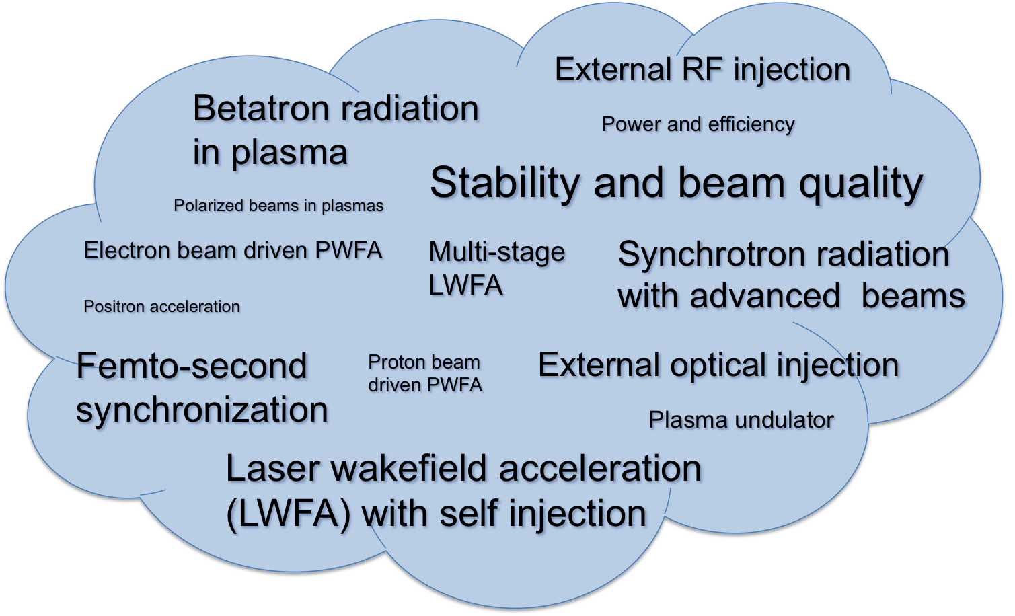
Activities
Analysis: Novel accelerator research activities and plans (May 2012)

Slide 11
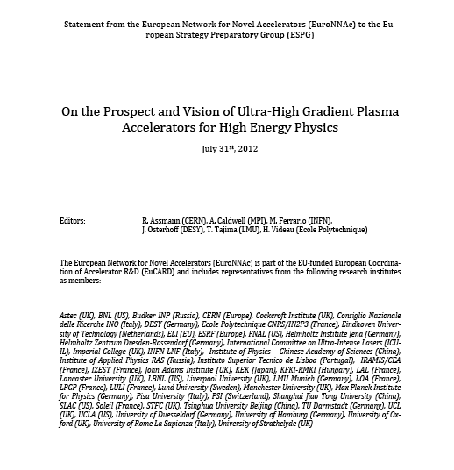
Activities
Lobbying: Input to the update of the European Strategy for Particle Physics
15 page report (July 31st, 2012)

Slide 12
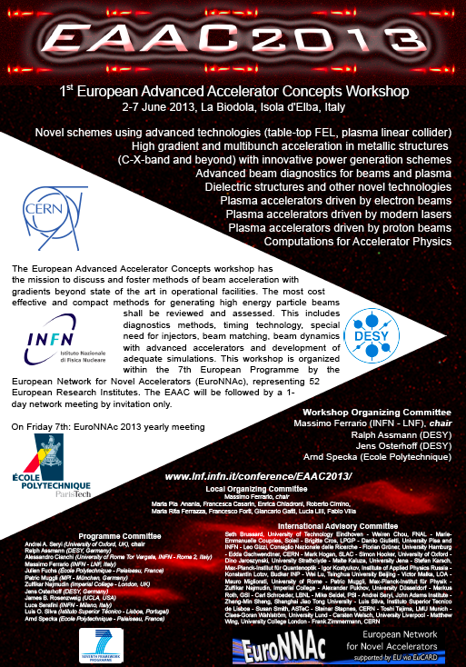
Activities
1st European Advanced Accelerator Workshop

Slide 13
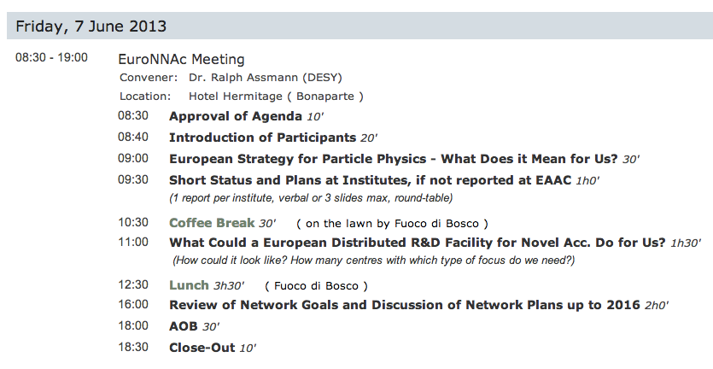
EuroNNAc Yearly Meeting 2013

Slide 14
Conclusion
EuroNNAc is an endeavor supported by the EU and remains open for new participants.
We are celebrating our 2nd birthday. The network is going strong with about 50 institutes as members.
Several network activities have been successfully realized. Comments and suggestions are welcome.
Tomorrow we discuss future plans, goals, review structure, …
Final goal: Prepare a coherent plan and common EU funding request on developing novel accelerators for users and society. Distributed European test facility. Significant extra funding required (≈50M€) to be competitive.

