Slide 1
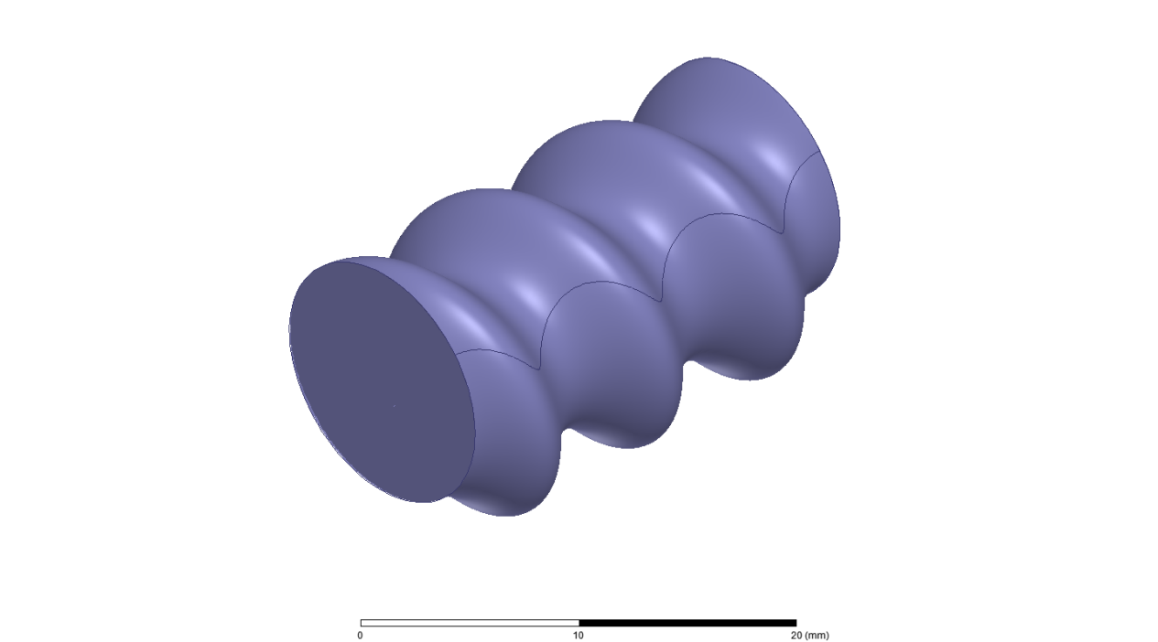
Helical Accelerating Structure with Controllable Beam Emittance
S.V. Kuzikov¹, A.A. Vikharev¹, J.L. Hirshfield^{2,3}
¹Institute of Applied Physics RAS, Nizhny Novgorod, Russia
²Yale University, New Haven, CT, USA
³Omega-P, Inc., New Haven, CT, USA
Outline:
A problem of beam cooling in accelerators
Damping rings
Helical accelerating structure with asynchronous transverse fields (HSFC)
Calculation methods: perturbation theory and HFSS simulations
Parameter optimization in comparison with classical structure
Beam dynamics simulation by CST Microwave Studio
Conclusion

Slide 2
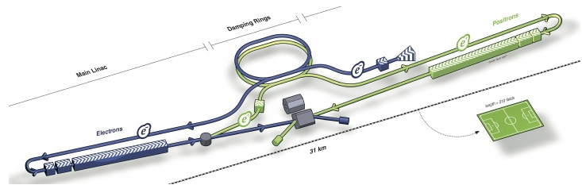
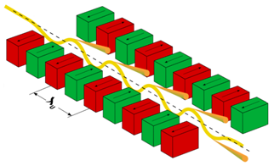
0.3 ТeV ILC collider
Wakefields cause growth of transverse emittances in accelerator behind damping rings.
Transverse emittances:
According to Liouville’s theorem the phase volume can be reduced, if only there are friction forces in a system.
Particles, moving in DC-magnet undulator,
produce synchrotron radiation which leads to cooling
Movement of particles in a focusing channel with dry friction

Slide 3
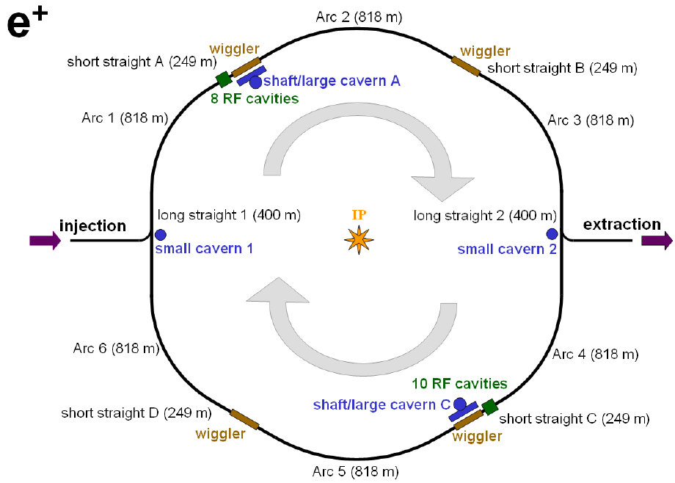
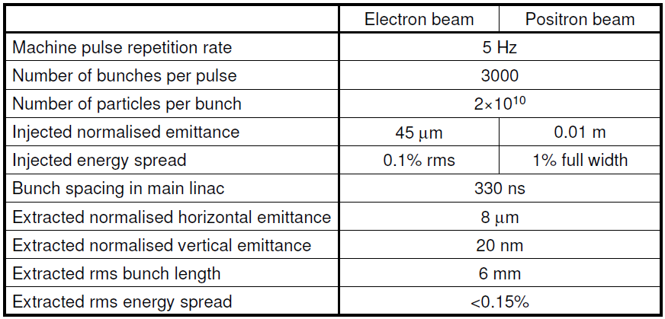
Low energy beams might be cooled in a damping ring:
ILC damping ring
Parameters:
W=5 GeV, I=400 mA, P=6700 m – total length of circumference, T=25 ms – transverse damping time.
In case of high energy particles the damping ring becomes too long.

Slide 4
- cooling rate in a periodic DC-magnet field.
, where W – particle energy.
Such accelerating structure is impractical, because DC magnet system conflicts with feeding, focusing, and diagnostic systems. Inevitably large period does not allow to reach small emittance, because the smallest achievable emittance is proportional to squared wiggler period L.
H.H. Braun et al. Potential of Non-standard Emittance Damping Schemes for Linear Colliders, 2004.
The accelerator with alternating accelerating sections and wigglers reduces effective gradient.

Slide 5

Helical Self Focusing and Cooling (HSFC) Accelerating Structure
HSFC = Accelerating structure + RF undulator + lens
transverse field components
(far from Cherenkov synchronism)
E – accelerating field (synchronous with particles)
Copper mandrel
Appealing features:
1. Non-synchronous transverse field components might provide: 1) emittance control (beam cooling due to synchrotron radiation of particles); 2) near axis beam focusing
2. A new structure has smooth shape of constant circular cross-section (no expansions or narrowings) and big aperture (no small irises)
3. A new technology of the mass production seems possible which allows avoiding junctions inside long accelerating section

Slide 6


Partial waves: 1) travelling TM₀₁ mode + 2) near to cut off rotating TM₁₁ mode
Vph≈c
Vph≤0
TM₀₁: E_{z}≠0 at axis,
TM₁₁: E_{z}=0 at axis, E ⊥ and H⊥ ≠0 at axis,
Partial waves
Normal waves
Slow normal wave 2 (vgr×vph>0) consists of partial TM01 and TM11 waves.
The wave 2 is the operating wave (might be in synchronism, it has low group velocity).
Dispersion curves: R=6.09 mm, P=8 mm, a=1.25 mm

Slide 7
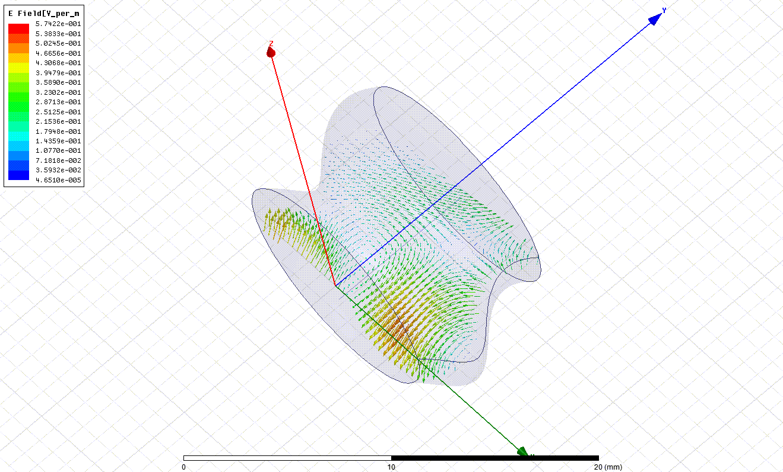
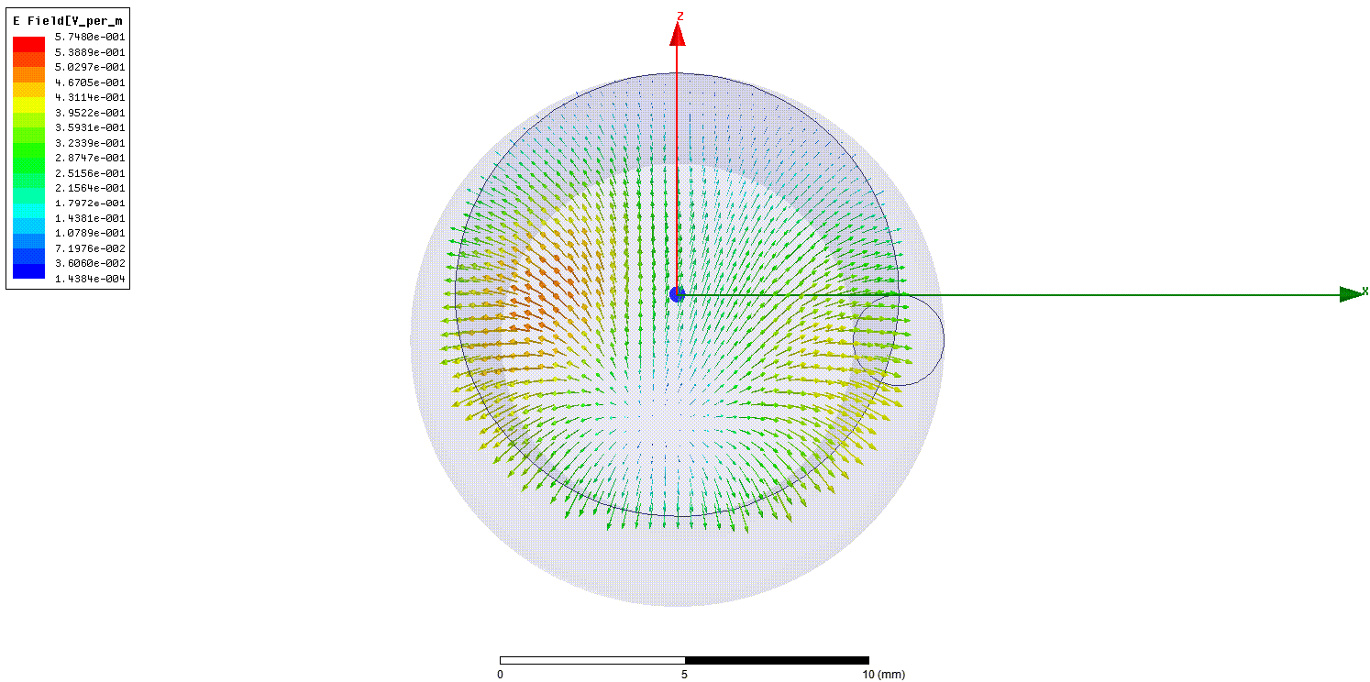
Electric field in HSFC accelerating structure. Calculation by HFSS.

Slide 8
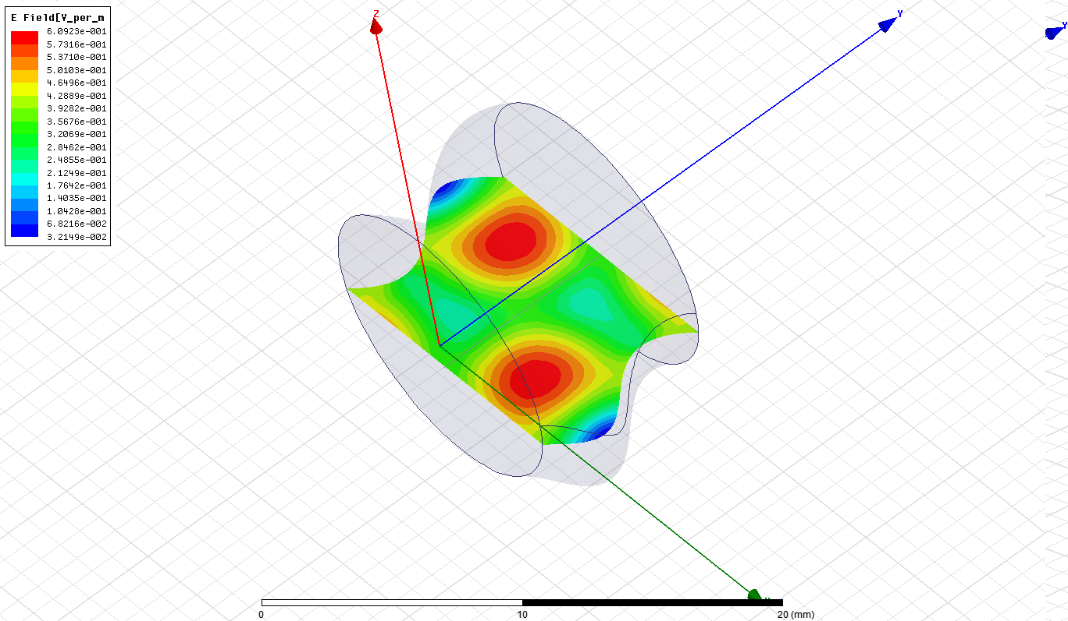
Beam line
Complex amplitude of the electric field

Slide 9
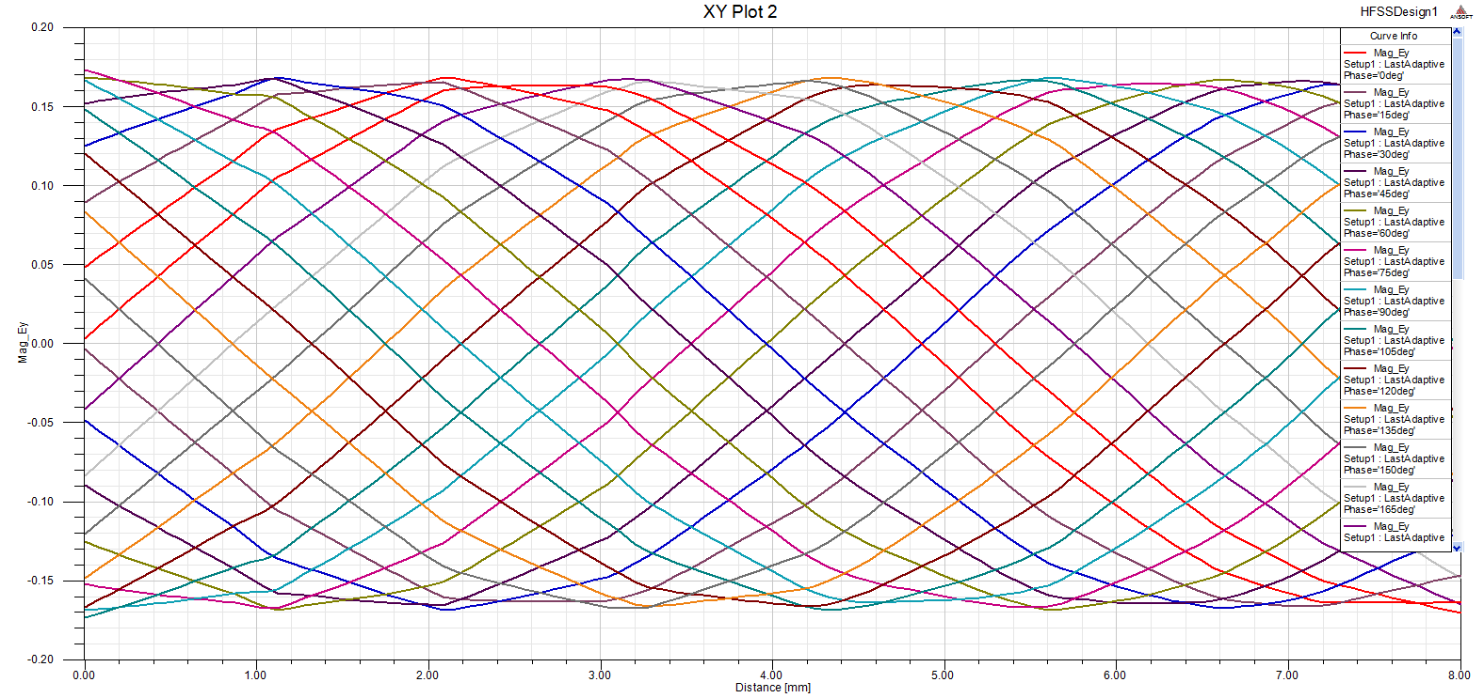
Accelerating field component vs longitudinal coordinate for different phases (with step 5°)
Accelerating component is uniform at beam line.

Slide 10
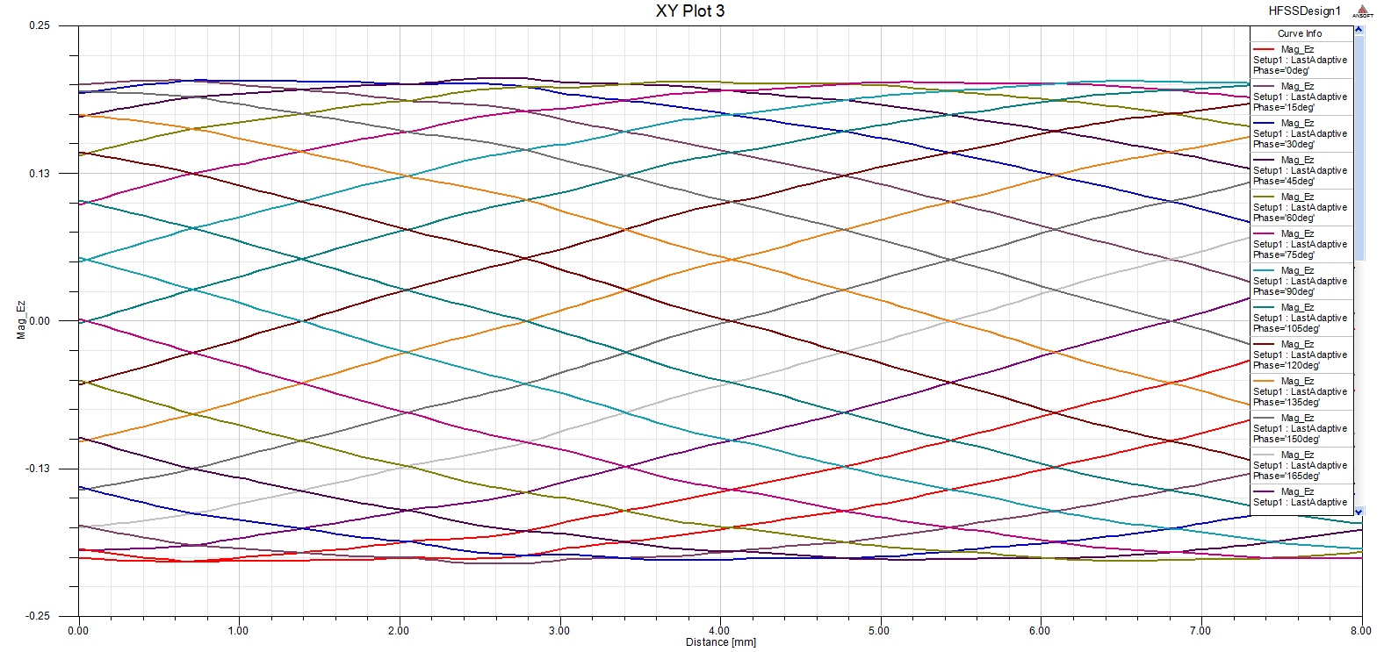
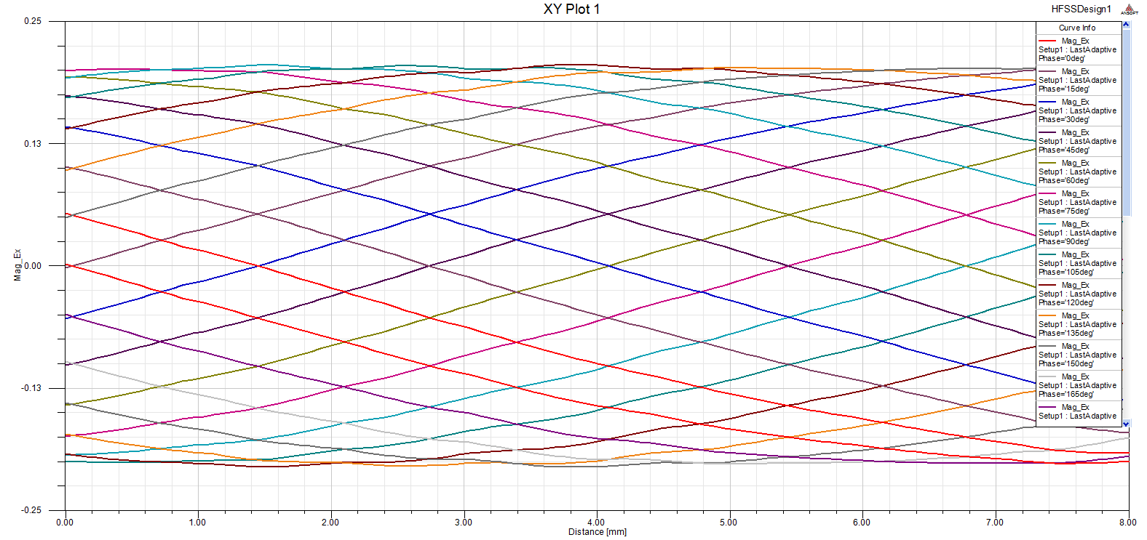
Transverse electric field components at beam line vs length for different phases
Transverse components are also uniform and have much longer spatial period in comparison with period of the accelerating component.

Slide 11
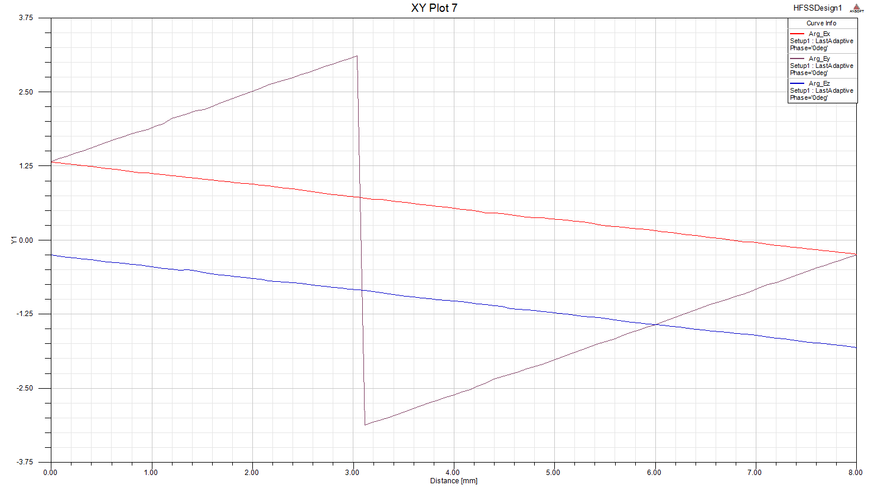
Phase of accelerating component
Phases of transverse components
Phases of electric field components at beam line
Accelerating E-field and transverse E-fields have opposite phase velocities!
Phase velocity of the accelerating component actually equals the light velocity.

Slide 12
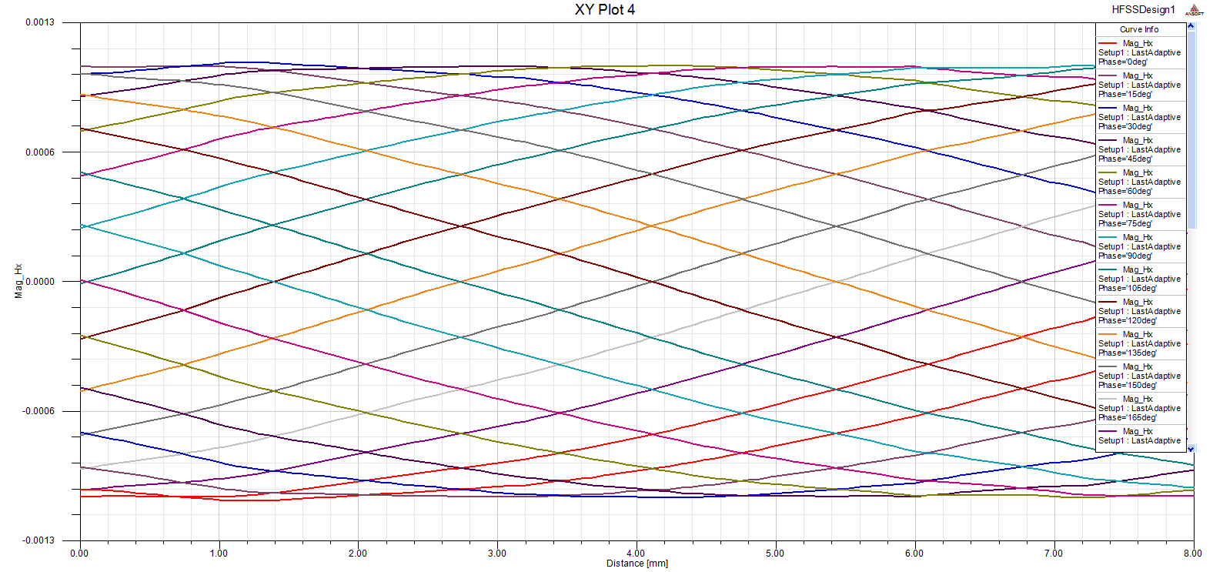
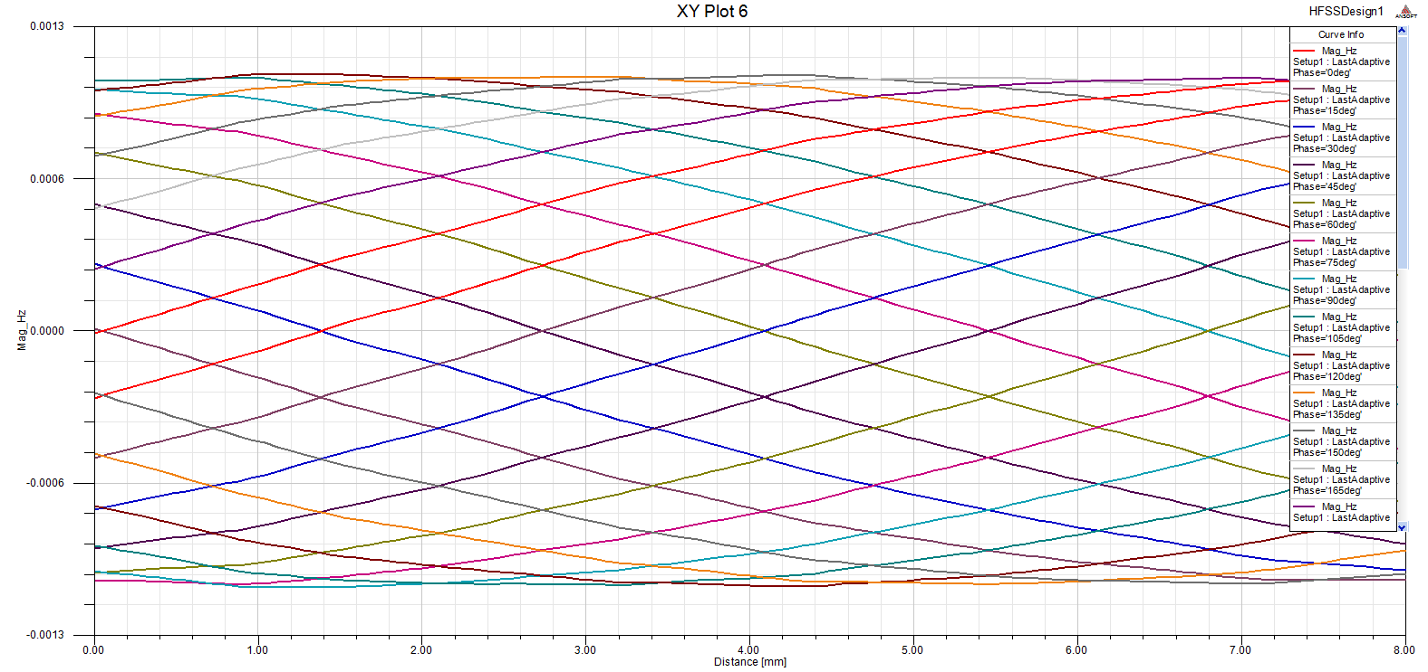
Transverse components of magnetic field at beam line
In HSFC structure both transverse electric and magnetic fields cause particle’s wiggling like in RF undulator.

Slide 13
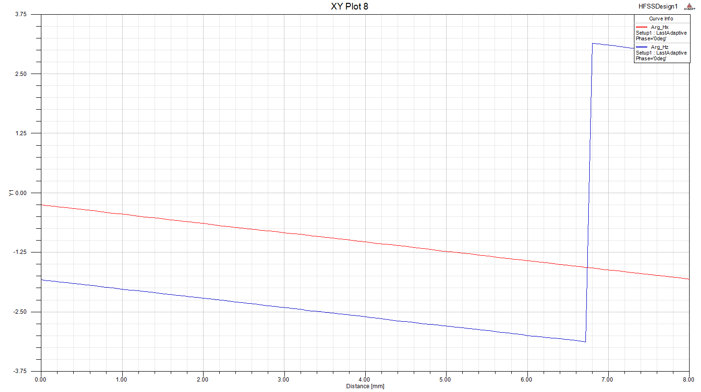
Phases of magnetic field components
Transverse magnetic fields together with transverse electric fields go toward electrons.

Slide 14
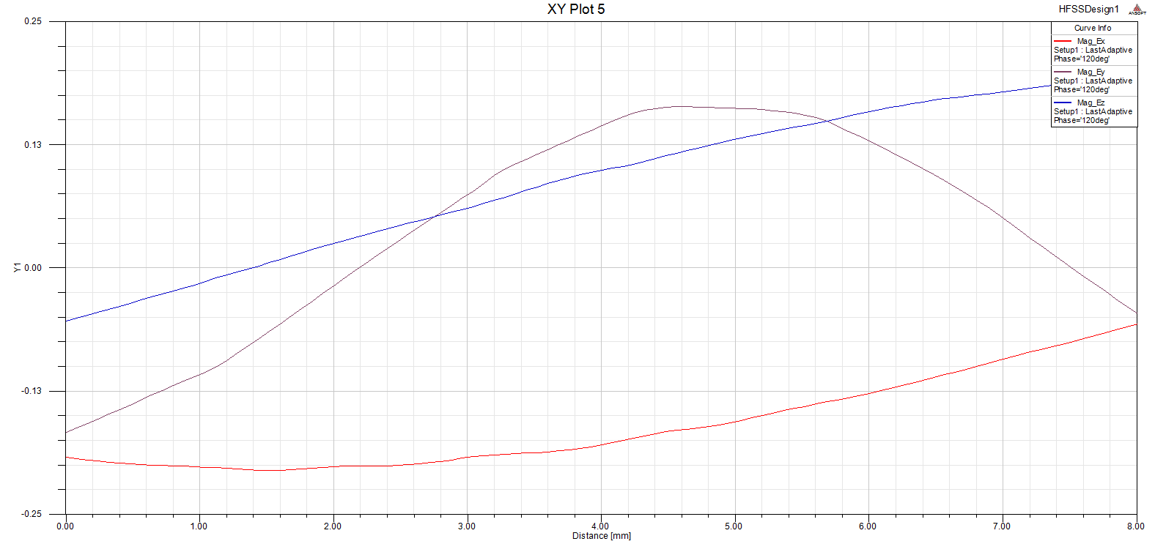
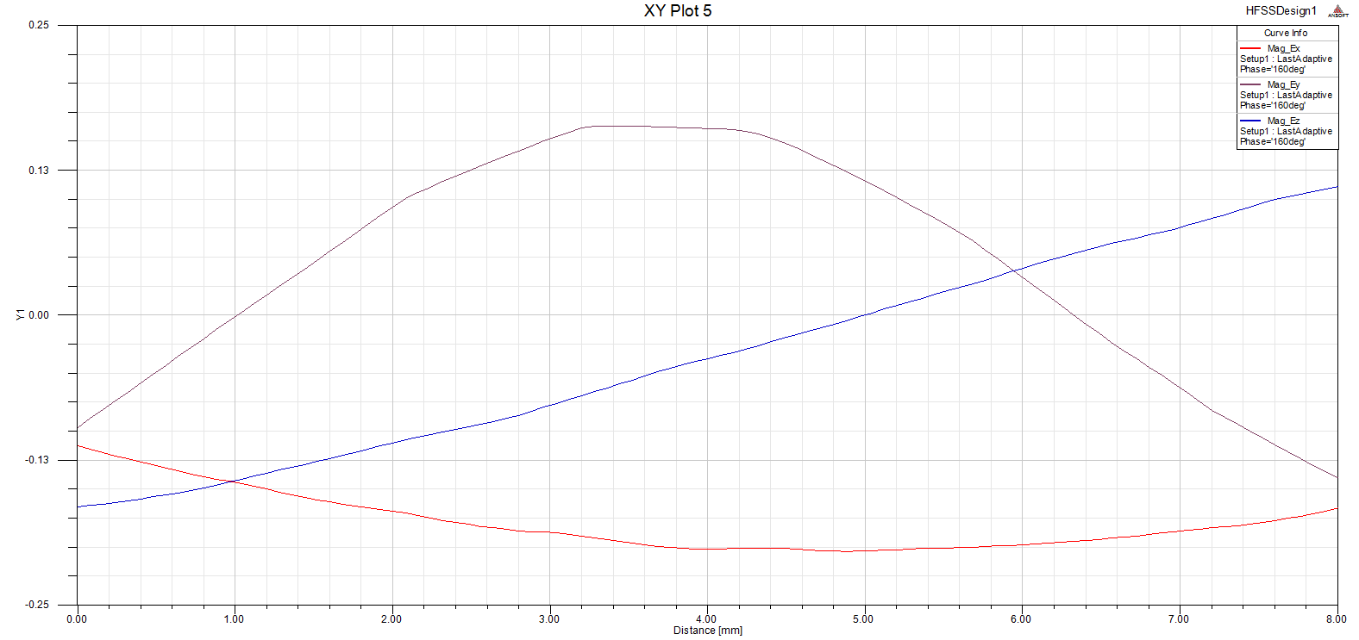
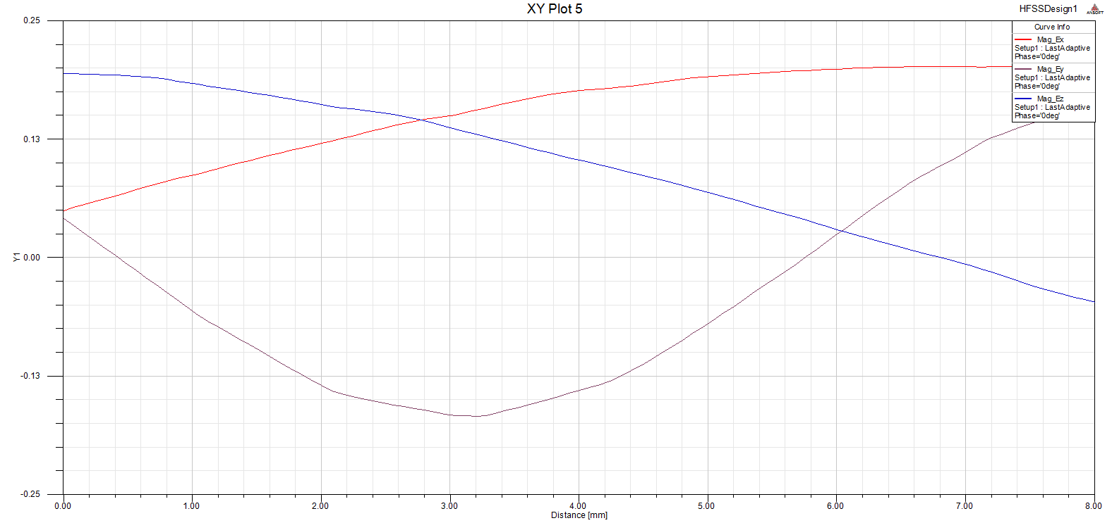
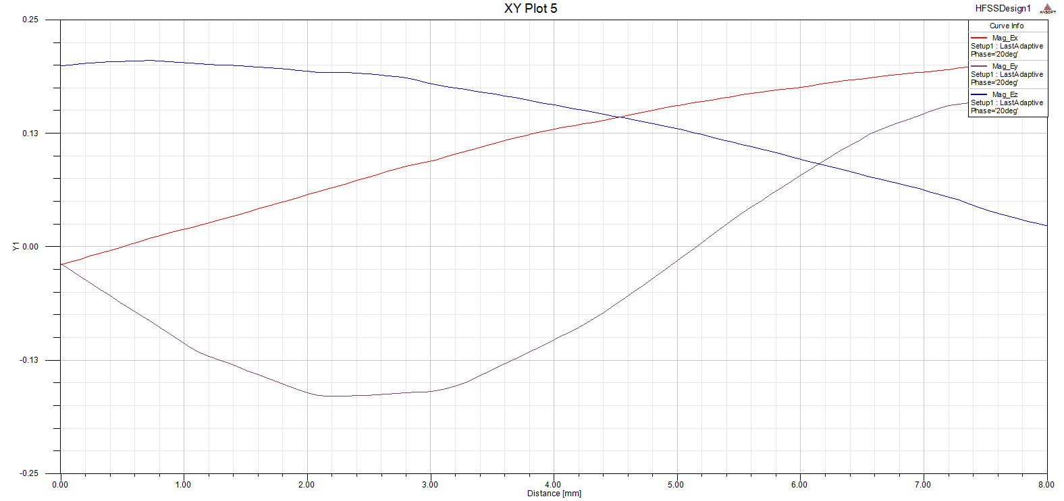
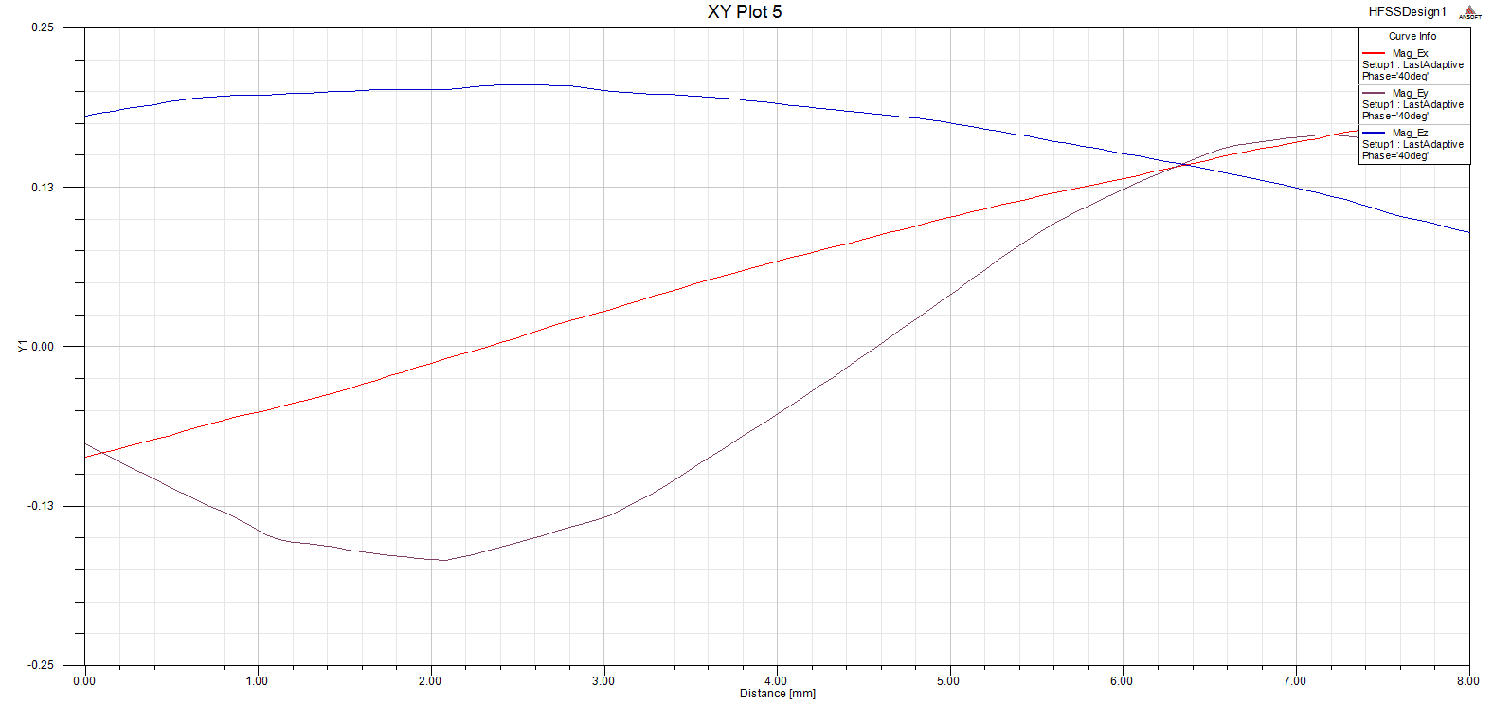
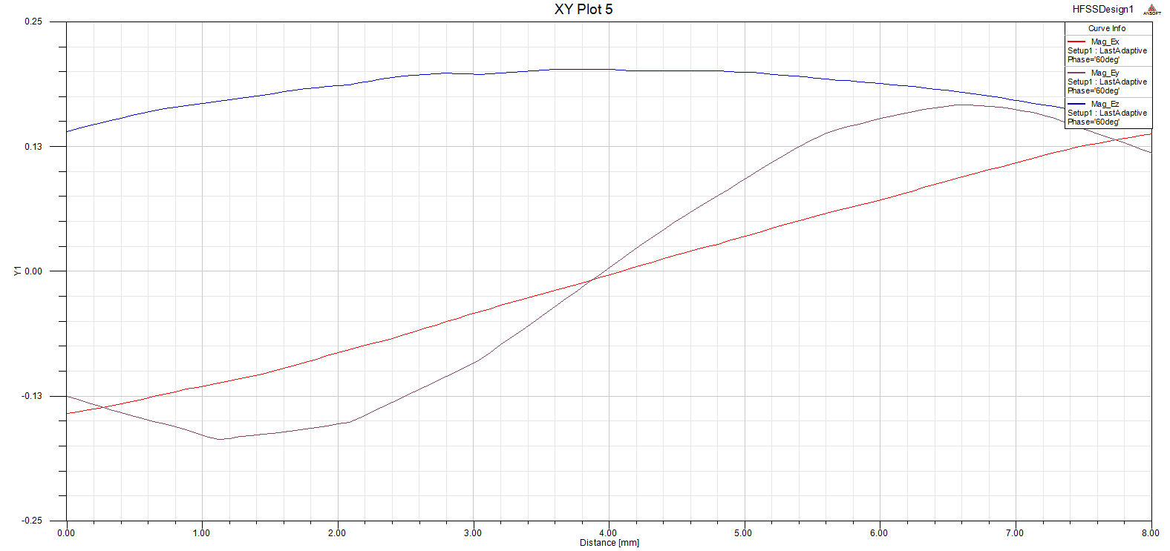
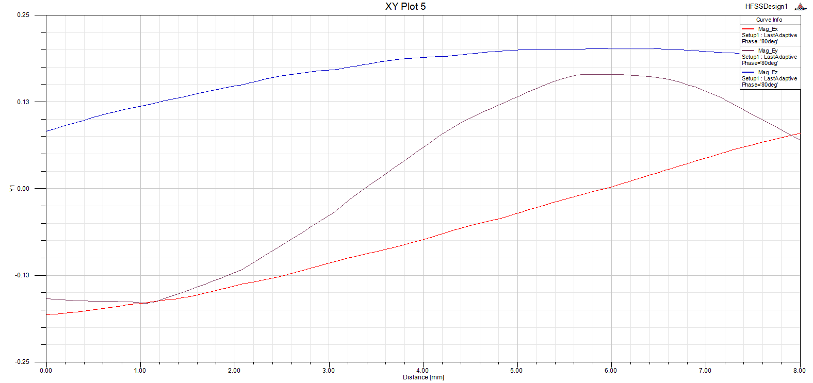
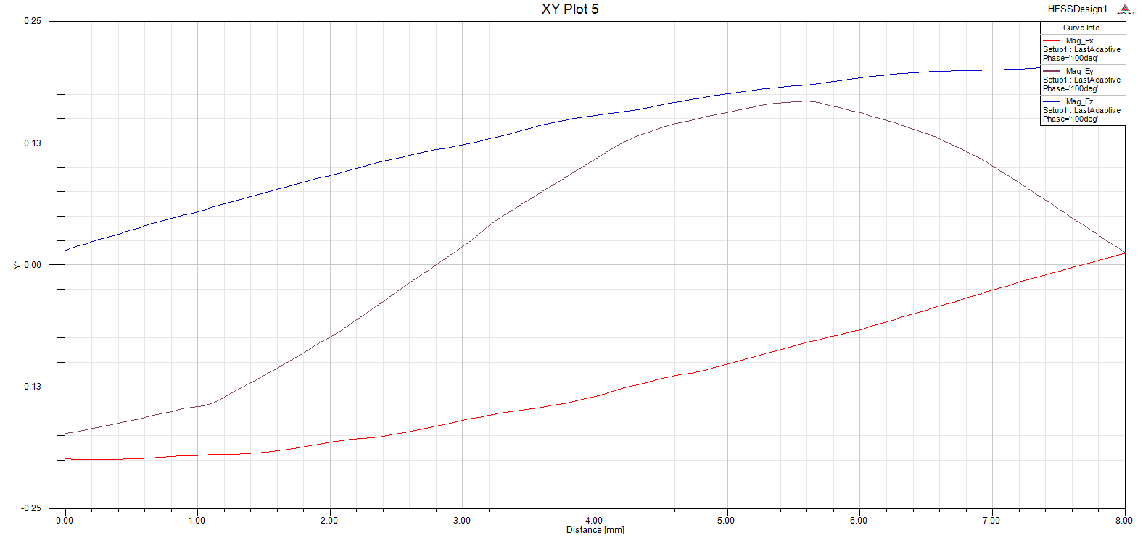
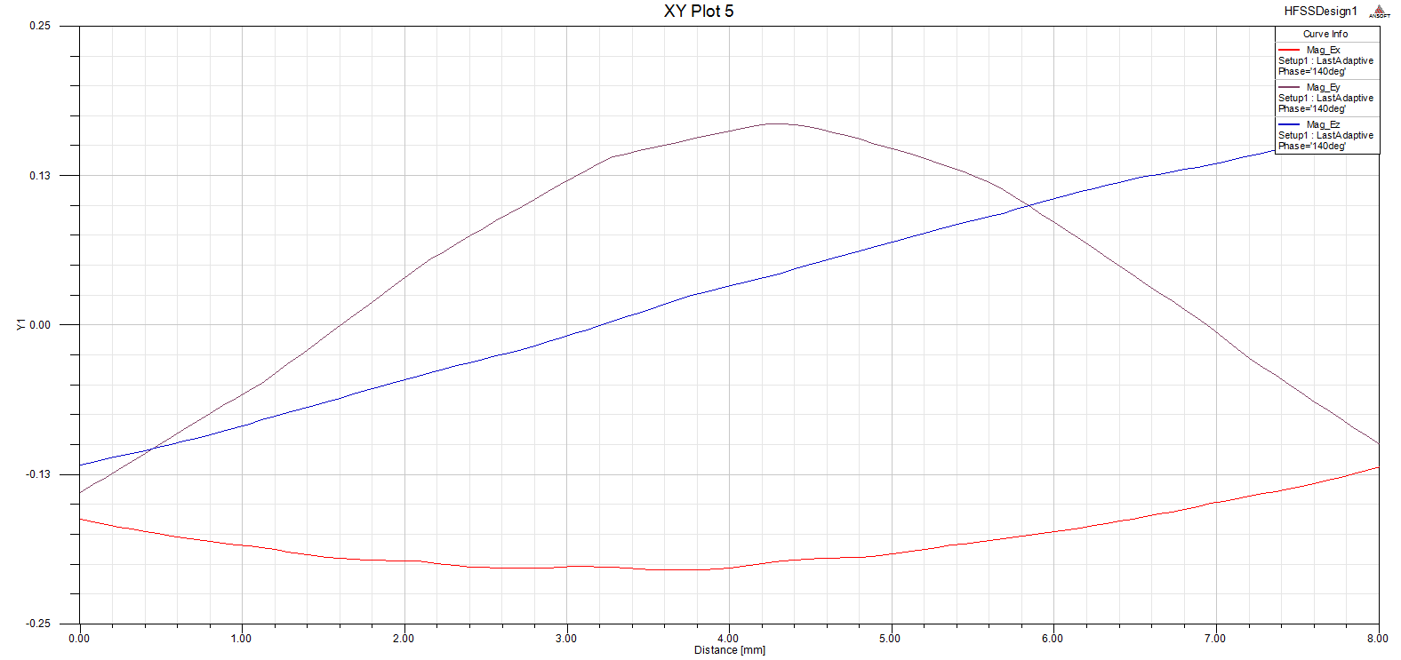
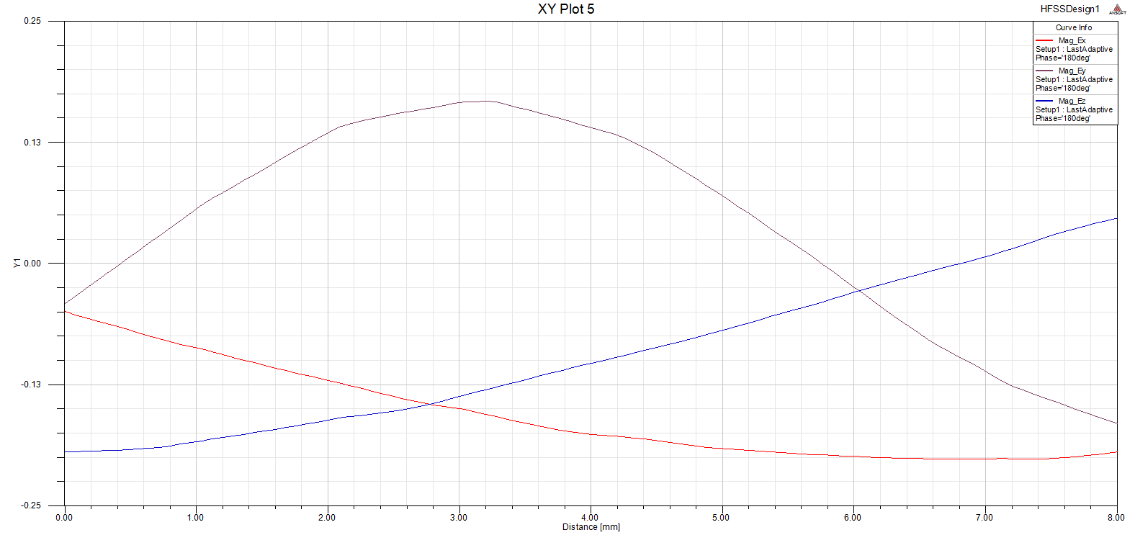
Simulation of electric field evolution at beam line vs length (phase step is 20°)
accelerating field
transverse fields

Slide 15
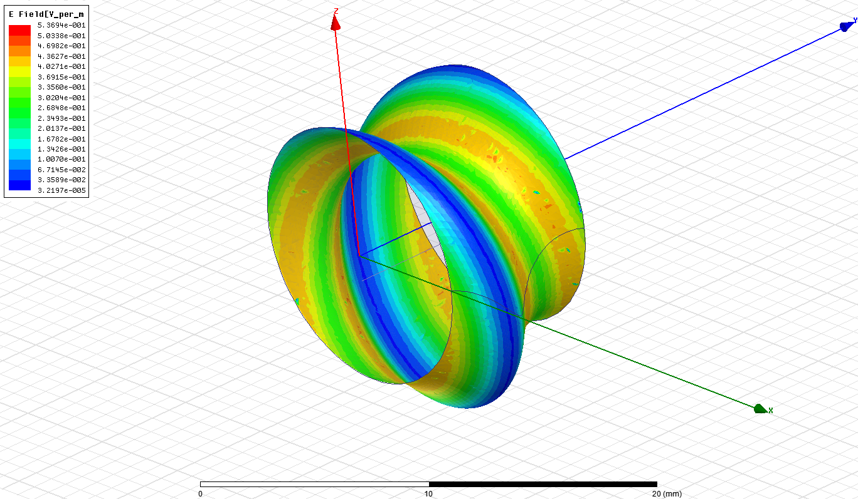
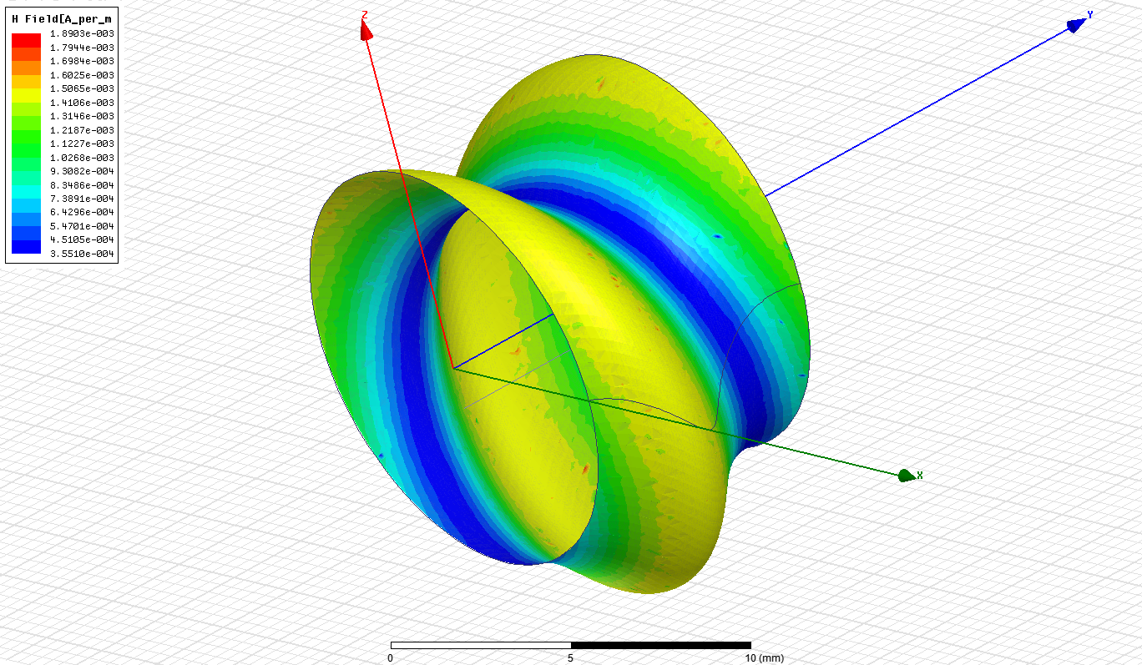
Optimization requires maximum of accelerating field normalized on maximum of surface field:
Also maximum of shunt impedance is necessary:
Here holes and/or absorbers could be inserted to improve mode selection
Surface electric field
Surface magnetic field

Slide 16
Results of HFSS optimization
R=6.09 mm
a=1.25 mm
P=8 mm
hP=4.727
f=28.2 GHz
Q=10800
Eacc/Esurf=0.307
Rsh/L=18.9 MOhm/m
Dispersion curve
Example:
f= 30 GHz structure, G=Eacc=100 MV/m, then B=0.75 T,
Beam energy W=25 GeV (γ=49000),
then necessary decay distance ≈ 2800 m.

Slide 17
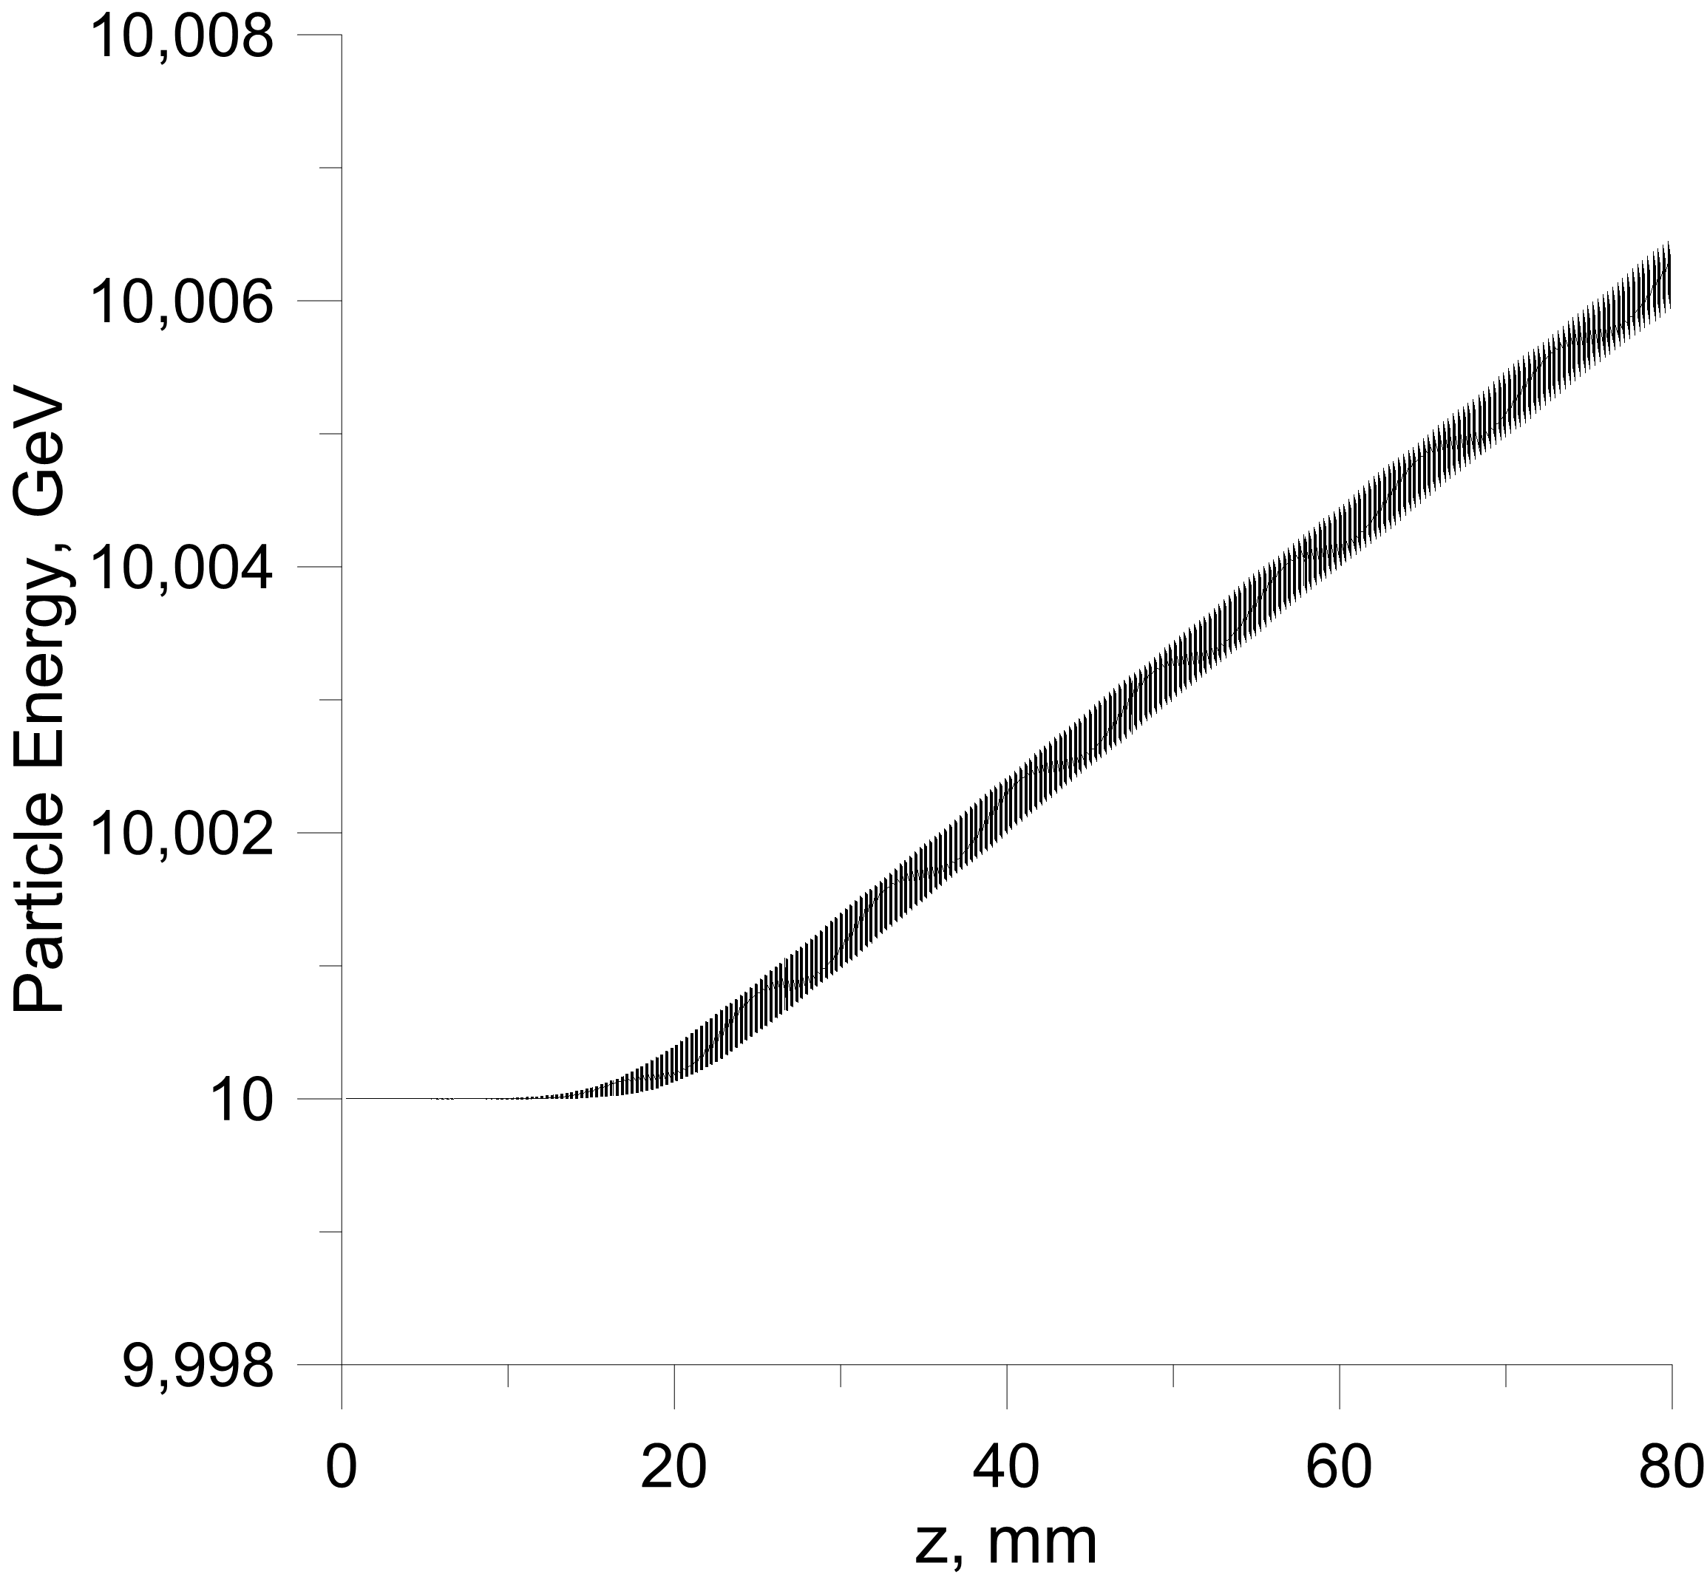
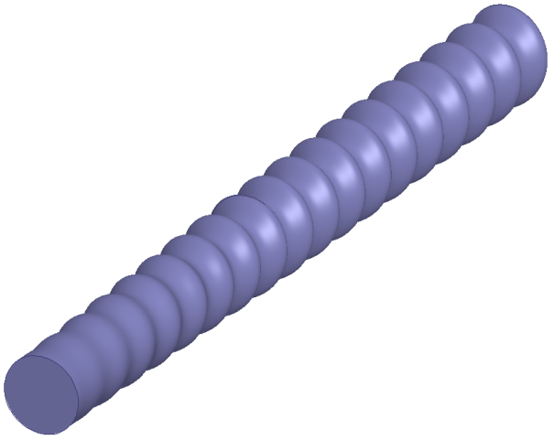
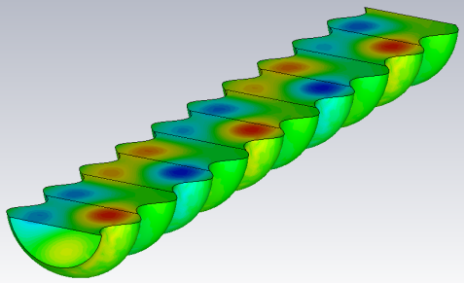
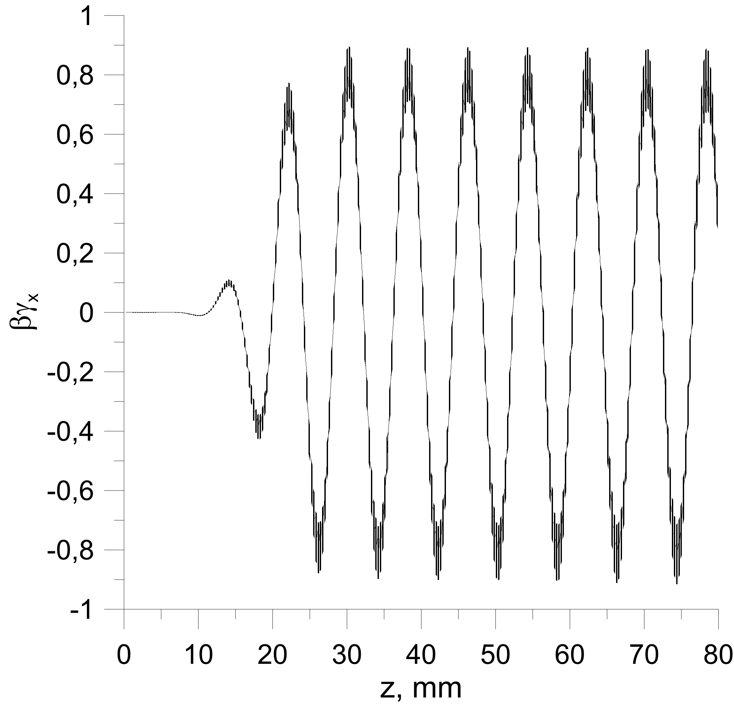
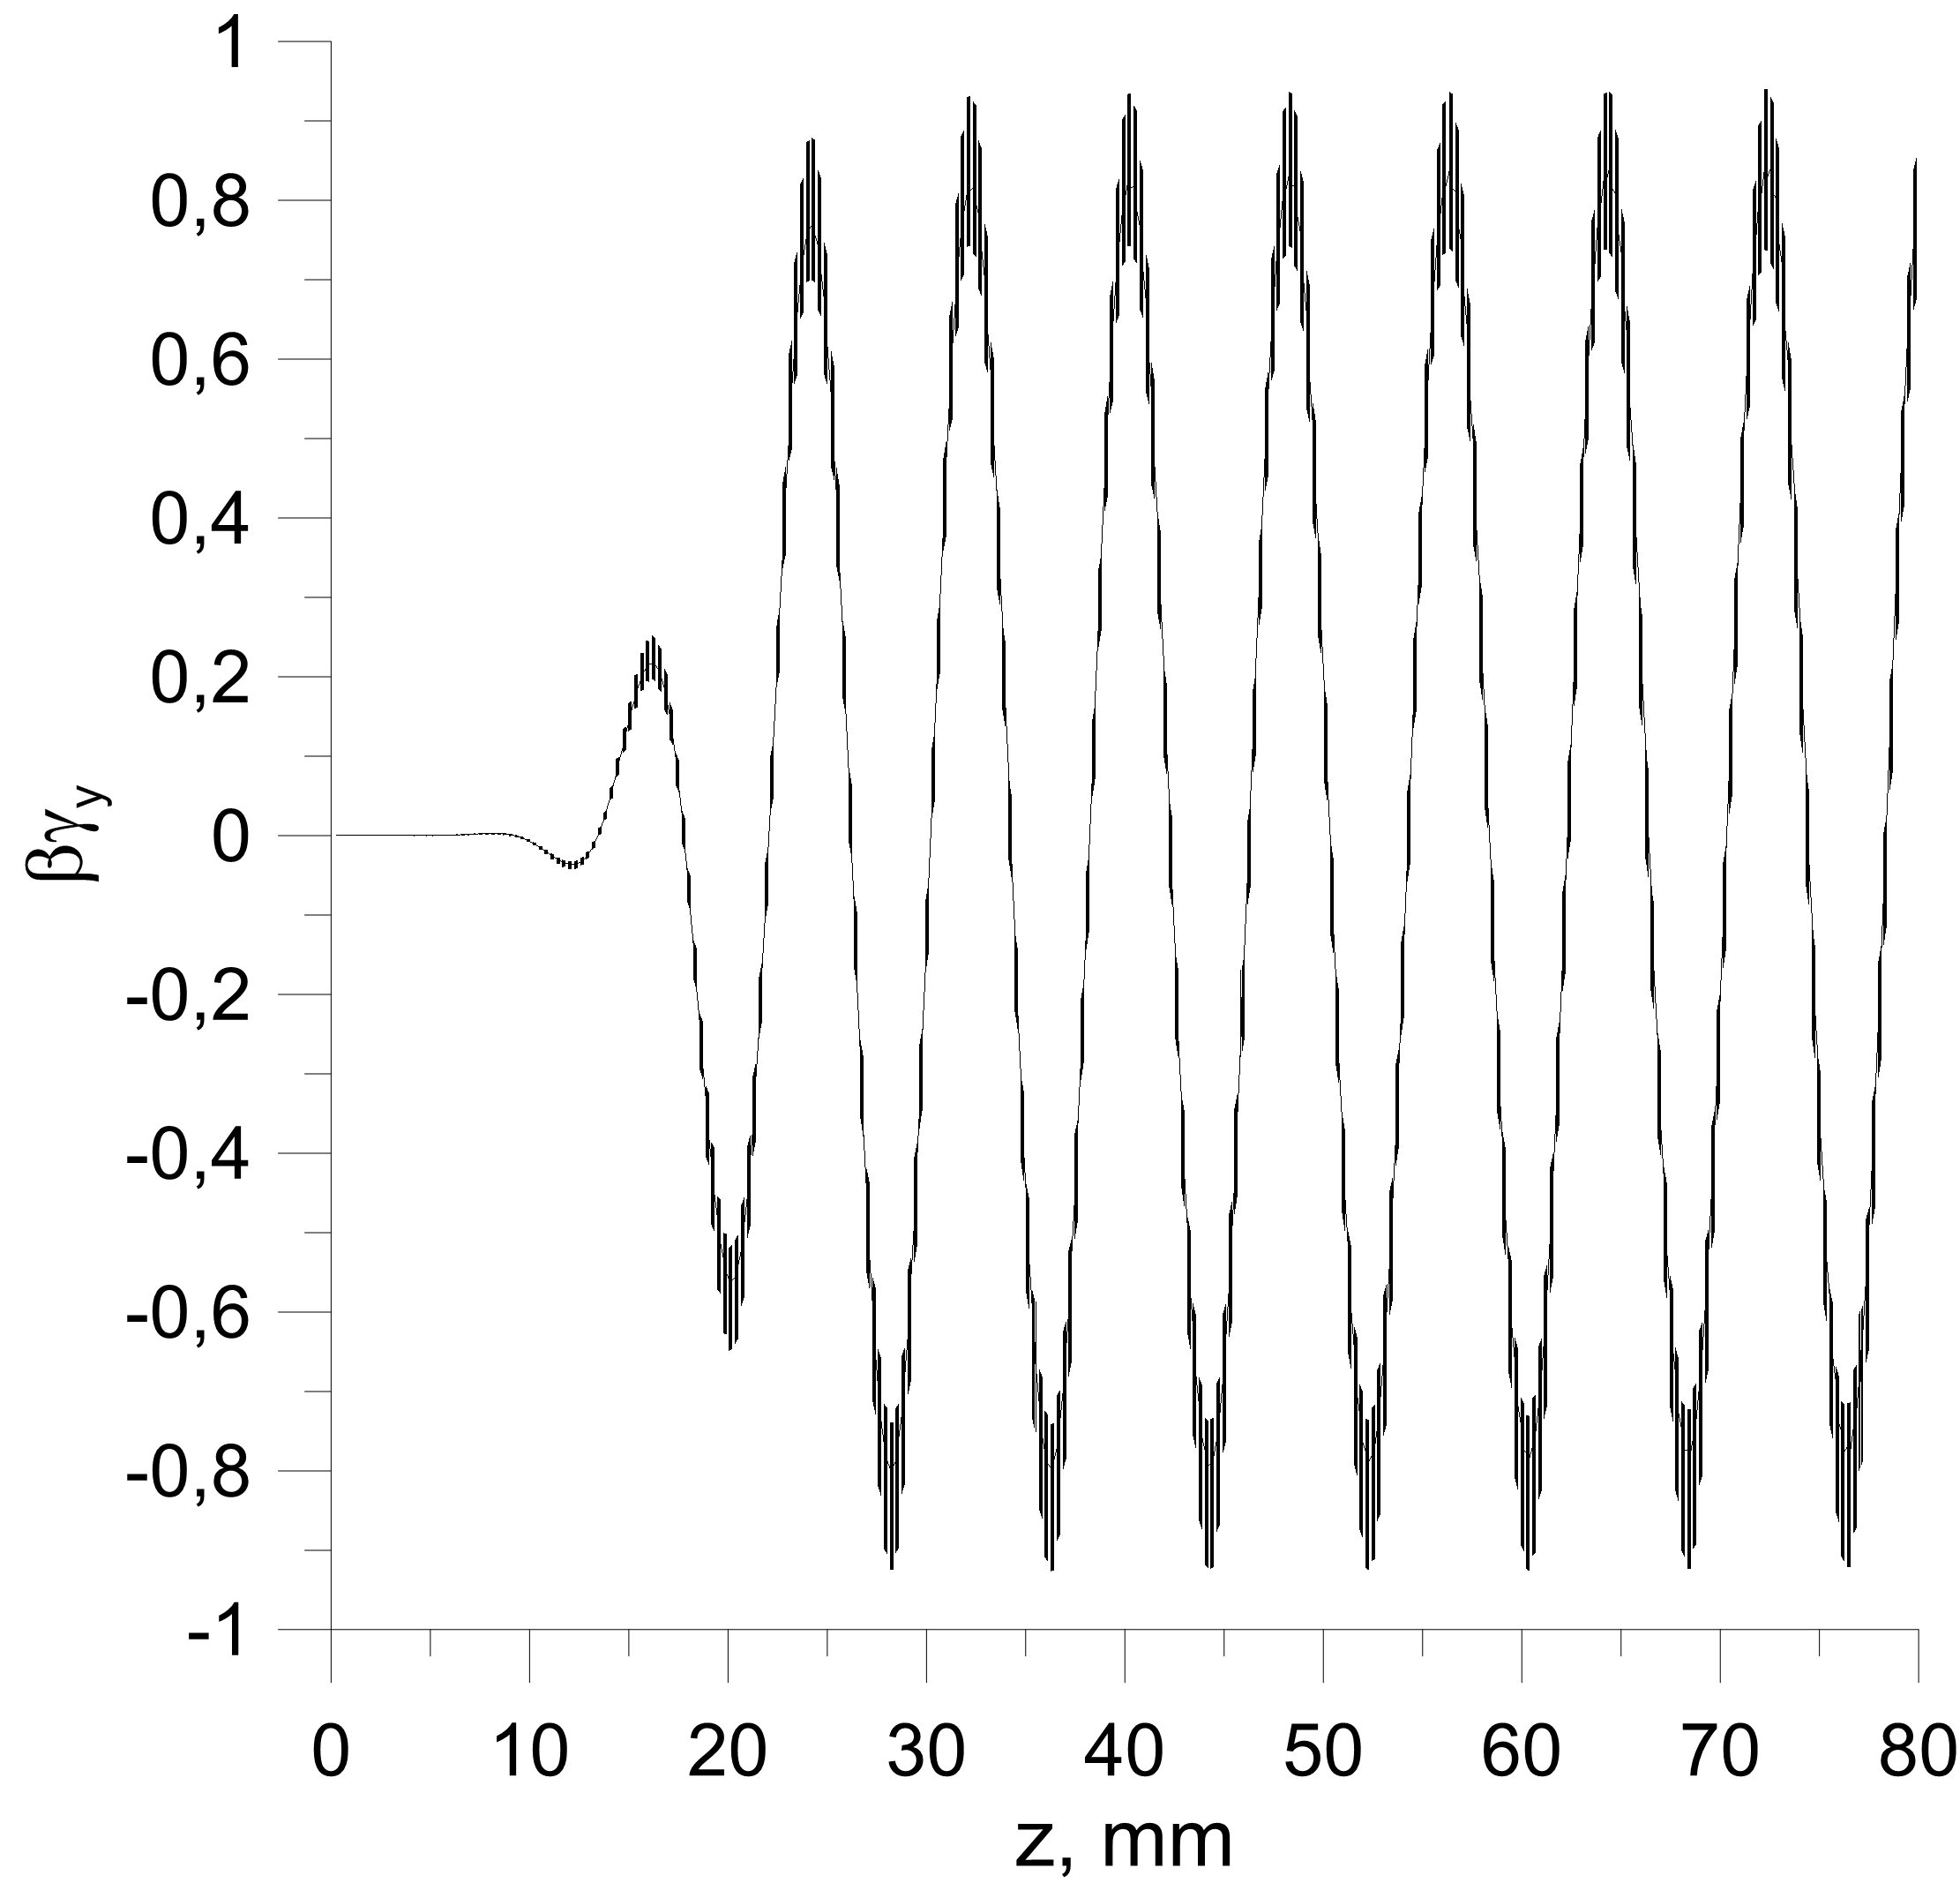
Simulation of particle motion in 100 MV/m HSFC accelerating structure by CST Microwave Studio
Normal wave
regular part
taper
regular part
taper
Total length =10 periods
TM01
taper
Transverse particle momentums

Slide 18
Parameters of cooling in 100 MV/m HSFC structure

Slide 19
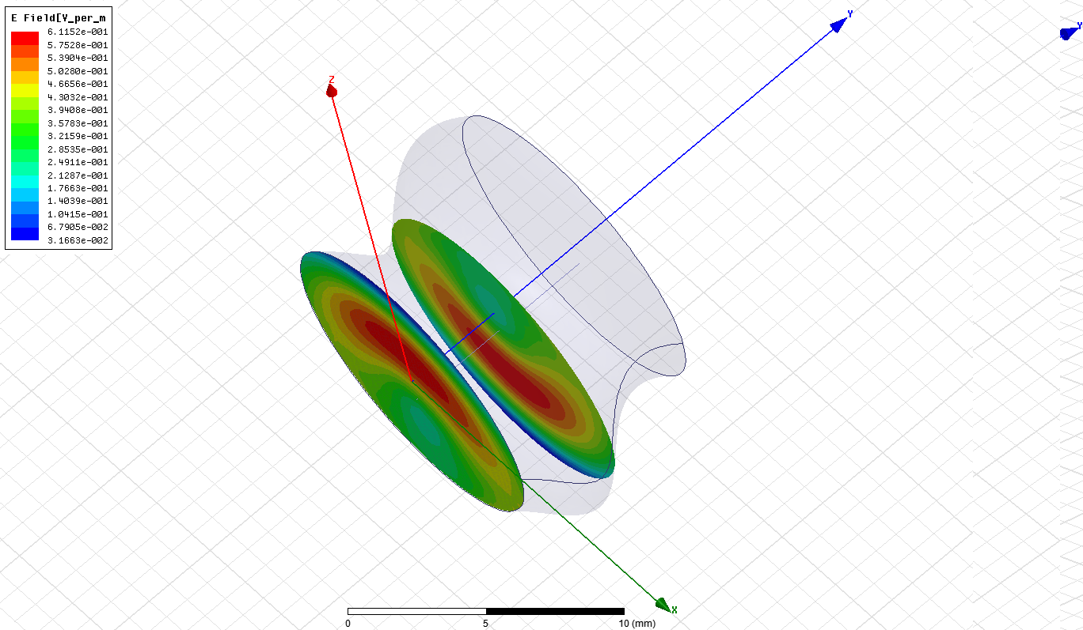
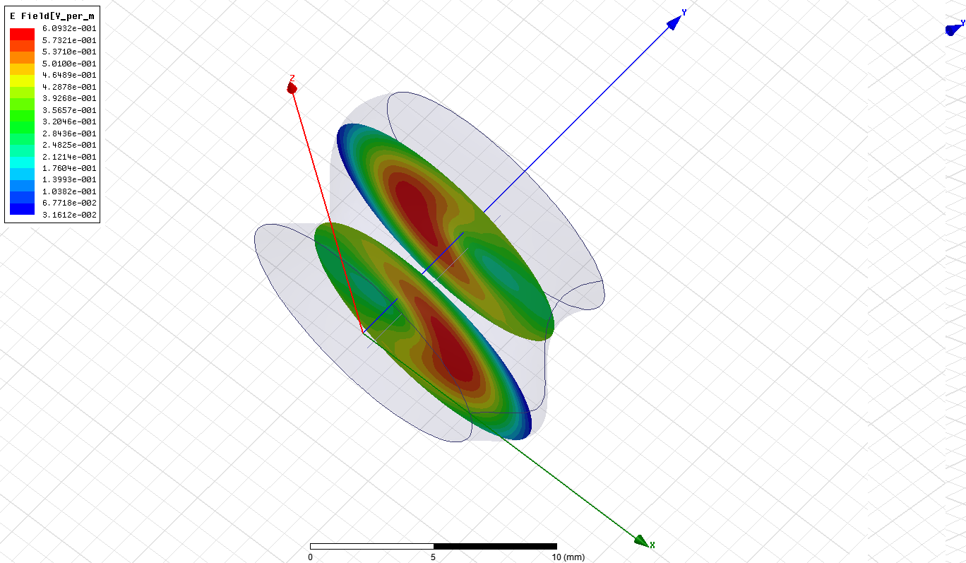
In HSFC structure there is gradient of the asynchronous fields which leads to appearance of the ponderomotive (Miller’s) force:
- frequency which electrons see.
Complex amplitude of electric field
at different cross-sections
The pondermotive force (due to longitudinal TM11 fields) in each cross-section is directed to the axis and provides beam focusing.

Slide 20
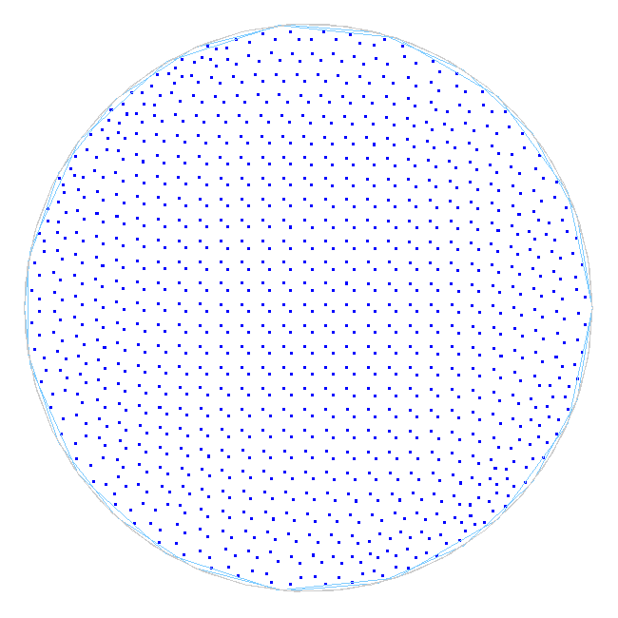
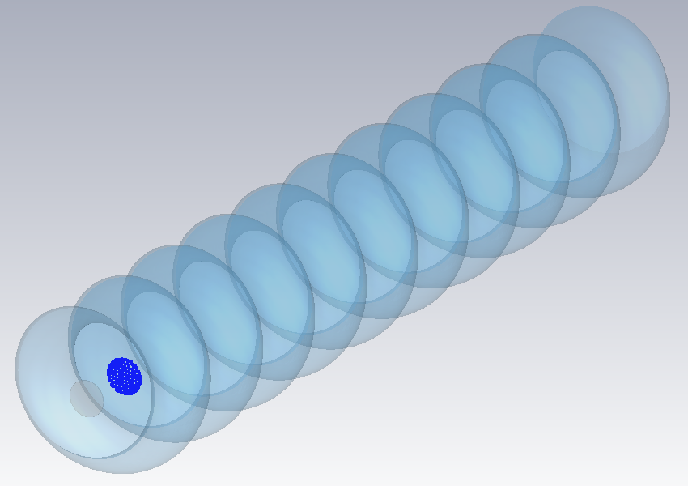
Simulation of ponderomotive force focusing in HSFC accelerating structure
by CST Microwave Studio
bunch
Bunch population during acceleration.
The blue color (at input) corresponds to low particle energy.
The red color (at output of structure) means the higher energy of the accelerated particles.
Parameters: initial energy 10 GeV, bunch length 1 ps, bunch diameter 3 mm, charge 100 nC, gradient 100 MV/m.

Slide 21
Conclusion
TM₀₁ – TM₁₁ HSFC accelerating structure has non-synchronous electric and magnetic field components to be used in order to preserve low beam emittance and small energy spread.
Smooth beam focusing due to the pondermotive (Miller’s) force might also be used.
The structure allows high enough accelerating gradient normalized on maximum surface field (>0.3).
Shunt impedance is slightly less than in conventional accelerating structures. In order to increase shunt impedance, one might either to go to higher frequencies (R_{sh}/L~ω^{3/2}) or to go to lower frequencies and to apply superconductivity .

