Slide 1

The European Perspective for Accelerator Research
M. Vretenar, CERN

Slide 2
EU and accelerators- 10 years of success
Capacity – research infrastructures
ESGARD
Integrating Activities
Design Studies,
Preparatory Phases
CARE
Coordinated Accelerator Research in Europe for Particle Physics
01/2004 – 12/2008 (5 years) 15.2 M€ EU contribution
FP6
EuroNu DS, 2008/12, 4M€
EuCARD
European Coordination for Accelerator Research and Development
04/2009 – 03/2013 (4 years) 10.0 M€ EU contribution
SLHC-PP, 2008/11, 5.2M€
ILC-HiGrade, 2008/12, 5M€
FP7
EuCARD-2
Enhanced Eur. Coordination for Accelerator Research and Development
05/2013 – 04/2017 (4 years) 8.0 M€ EU contribution
TIARA-PP, 2011/13, 3.9M€
HiLumi LHC, 2011/15, 4.9M€
Long series of projects co-funded by the European Commission since 2004:
56.2 M€ from the EU for the accelerator community in 2004/2017 with a peak of ~7 M€/year in 2011
(~5 M€/year in 2013).

Slide 3
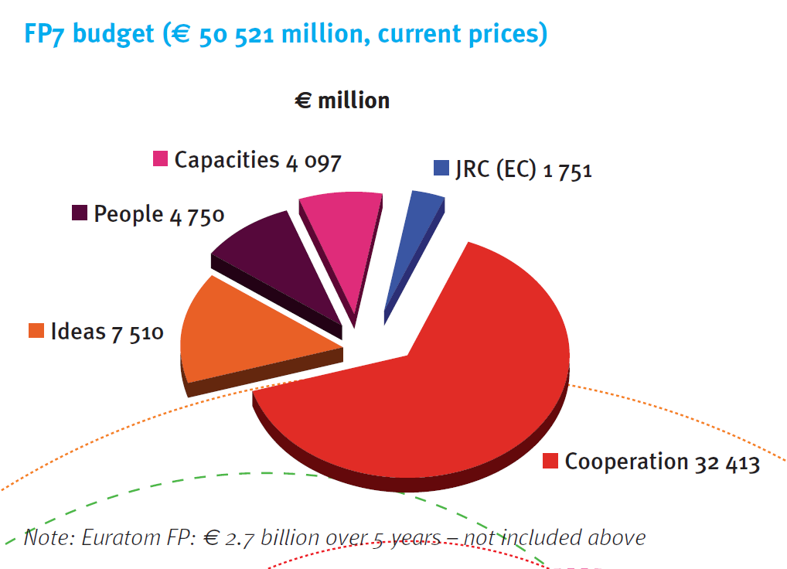
The tools
Framework Programmes for Research and Technological Development: co-financing of research-related activities (FP7: 50 B€ for 2007/13)
Projects with “European added value”: transnationality of actions, consortia with participants (university, labs, companies, international org., etc.) from different European (and other) countries.
Support to: 1) “cooperation” on selected themes; 2) “ideas” of excellence; 3) “people” mobility; 4) “capacities” strengthening research infrastructure; 5) JRC (nuclear).
Particle accelerator R&D is outside of the main cooperation themes; it can be funded only via the Capacities programme:
Integrating Activity Projects
Design Studies (for the upgrade of infrastructure)
Preparatory Phase Projects (for upgrade)

Slide 4
The dimensions
Some key ingredients for Capacity projects:
“cooperation”: multiple partners
“strengthening research infrastructure”: complementing large laboratories and smaller institutes/universities.
“co-funding”: EU contribution <50% (~33% for accelerators) of total cost
“impact on society”: innovation, applications, industry – new in last FP7 call, will be a key component for the next programme.
Large competition with all kind of projects (example: EuCARD-2 ranked 6th out of 14 supported projects for the last IA call of FP7, coming after projects for astronomy, archeology, biomedicine, material science, natural sciences) – all projects reviewed by a common panel.
Need of lobbying and support → ESGARD (European Steering Group for Accelerator R&D) set up by the Directors of EU large laboratories.
Need unity and good organization of the community

Slide 5
Integrating Activities
Integrating Activities include 3 components:
“Networks”: exchange discussion and collaboration platforms (for a community or to cross community borders), cross-participation to MD’s, exchange of experts, exploratory research work. Small budgets (only meetings and short exchanges), paper-only deliverables.
Example: The EuroNNAC Network of EuCARD-2 co-organizes this event.
“Transnational access”: open “unique” experimental facilities to outside users with the support of EC which pays for travel, hospitality, and a fraction of the operating cost.
“Joint Research Activities”: collaborative studies on specific topics. Have larger budgets and produce both hard and soft deliverables.
IAs are “general” projects, centered on few selected topics of excellence, useful to break ground preparing the way for a design study or a preparatory phase project or other.

Slide 6
EC projects: shadows and lights…
Wide success for these projects, notwithstanding that:
Globally, the EC funding amounts to only a few percent of the what the community invests on R&D.
Preparation of proposals is time-consuming, success is no guaranteed, if successful needs periodic reporting (745 pages in 5 years for a WP in CARE!), time sheets, deliverables.
The financial services have to guarantee a complicated accountancy.
The duration of projects is shorter than the R&D time constants;
But on the bright side:
A major added value is the cooperation itself leading to synergies, cross-fertilization, exchange of ideas and people → reach a critical mass.
In particular, the connection between large laboratories and smaller institutes is a major asset (infrastructure vs. intellectual potential).
The visibility provided by participation to the EU programs is an important added value, and a 4-year engagement with the EU is a way to protect an activity from reorganisations and budget reductions…
The 4-year duration allows redefining periodically the priorities, reorienting the needs of the accelerator community (and matching the EU priorities).

Slide 7
EuCARD-2 objectives
Scientific objectives:
Contributions to few R&D topics of excellence (high risk, high pay-off) on accelerators for research (HEP, nuclear physics, synchrotron lights, etc.).
(from this call) Include new dimension of innovation, applications, relations with industry (healthcare, energy, environment, etc.).
Political objectives:
For EU: strenghten collaboration and foster synergies, create a network of complementary scientific infrastructures, enhance EU competitiveness.
For large laboratories: attract EU partners into (long-term) projects, connect with high-level R&D, create a network of competences around the large laboratory.
For small Institutes: get access to big labs and to large scientific programmes, get the recognition (and the internal matching funds) related to EU projects.

Slide 8
EuCARD-2: motivations
Accelerators based activities are rapidly growing, in full transition from basic science to applied science, medicine and industry, but at the same time we reach a turning point: large projects start rising questions of sustainability and societal acceptance that will heavily influence the future of the field and can be addressed only at a global and cooperative level.
In the EuCARD-2 time span (2013/17) existing accelerators are being pushed to extreme performance (eg. LHC), new accelerators enter final design or construction phase and strategic decisions will be taken for the future projects.
In this rapidly changing situation, accelerator R&D tends to be second priority for large laboratories and is often left to small institutes and universities that do not have the critical mass for breakthrough achievements.
EuCARD2 as the previous accelerator R&D projects aims at filling this gap, joining the experience and infrastructure of the major labs with the intellectual potential and creativity of smaller universities and institutions on few research topics of excellence.

Slide 9
The EuCARD-2 Timeline
January/September 2011 Project definition (on priorities set by ESGARD)
September/November 2011 Nomination of coordinator, Project finalization
24.11.2011 Proposal submitted (10 M€ requested EU contribution)
08.03.2012 Evaluation Summary Report received: 14/15
30.03.2012 Favourable evaluation for funding, in stand-by for 2013 EC budget
16.07.2012 Invitation to negotiations received (8 M€ contribution)
27.08.2012 Negotiation meeting with EU officer
07.09.2012 Draft Annex1(reference document) submitted
19.10.2012 New version of Annex1 incorporating EC comments submitted
24.10.2012 Final Annex1 accepted by EC – end of negotiation phase
14.12.2012 All signed documents (Grant Preparation Forms) sent to Brussels
01.03.2013 Grant Agreement received from EU (after clearing technical details)
12.03.2013 Signed Grant Agreement sent to EU
22.04.2013 Signed Grant Agreement received from EU + autorisation 1st payment
01.05.2013 Start of the project

Slide 10
EuCARD-2 in numbers
48 months duration (01.05.2013 - 30.04.2017)
13 Workpackages (6 Networks, 2 Transnational Access, 4 JRAs)
40 beneficiaries (3 with 0 EU contribution)
14 countries (+ CERN)
23.5 M€ total cost (13.4 M€ direct costs, 10.1 M€ indirect+access cost)
8 M€ EC contribution (34% of total cost, 59.7% of direct cost)
1288 persons.month (average 8 pm/participant.year)
63 deliverables
94 milestones

Slide 11
EuCARD-2 WBS
Notes:
CERN 8/20, female 4/20

Slide 12
6 Networks
Extreme Beams (XBEAM) – coord.: F. Zimmermann (CERN) – 330 k€ EU contribution
Frontier performance of colliders and other accelerators (including SC linacs, polarisation,…). Interest for HL-LHC, ESS, FAIR, HE-LHC, LHeC, etc.). Continuation of EUROLUMI beyond the LHC needs.
Low emittance rings – coord.: Y.Papaphilippou (CERN), S.Guiducci (INFN), R.Bartolini (UOXF) – 330k€
New synergy between synchrotron light sources, storage rings, damping rings and lepton colliders facilities (activity started under ICFA, now integrated into EuCARD-2).
Novel Accelerators – coord.: R. Assmann (DESY) – 330k€
Federating the European effort in plasma-based accelerators, prepare a roadmap for an efficient use in full-scale accelerators (from acceleration to accelerators).
Energy Efficiency – coord.: M. Seidel (PSI) – 350 k€
Interest on optimized energy management for a sustainable accelerator science. Energy recovery from cooling, efficient klystrons, energy storage, virtual power plant, low-power transport channels.
Accelerator Applications – coord.: R. Edgecock (HUD) – 350k€
Reviewing and analyzing present applications, propose how to adapt existing accelerator technology to industry, health care, energy, security.
Catalysing Innovation – coord.: G. Anelli (CERN), P. Woodman (STFC) – 126k€
Technology transfer Network based on the existing CERN and STFC structures.

Slide 13
2 Transnational Access
Ion Cooling Test Facility (ICTF) at STFC – coord.: R. Preece (STFC) – 200 k€
Tests with high-quality low-energy beams (MICE and others)
HighRadMat and MagNet at CERN – coord.: A. Fabich and M. Bajko (CERN) – 500 k€
Measure performance of materials bombarded with intense proton beams (was in EuCARD, real start of access in EuCARD-2)
Open SM18 (superconducting cable and magnet test station) at CERN to external users.

Slide 14
4 Joint Research Activities
Future Magnets – coord.: L. Rossi (CERN) – 1.31 M€ - CERN, CEA, INFN, INP, BHTS &others
R&D towards a 20 T dipole magnet for the HE-LHC (2 x 16.5 TeV) based on High-Temperature Superconductors (10 kA). Magnet design, choice of HTS material, manufacturing and characterization at low field of an HTS coil as full-bore high-field insert of a 20 T dipole.
Collimator Materials for fast high dens. en. dep. – coord.: A. Rossi (CERN), J. Stadlmann (GSI) – 0.4 M€
Material studies and collimator tests. Building of samples made of new (and old) materials and test them under high energy beam impact. Material mechanical modelling; specification of materials using collimation simulation codes. CERN, GSI, KUG, POLITO, UM &others
Innovative RF Technologies – coord.: P. Macintosh (STFC) – 2.18 M€ - CEA, UNIMAN, ULANC, PSI, etc.
Multi-disciplinary (NC and SC) grouping a number of promising RF R&D activities: 1) thin film deposition technologies for SC cavities (CEA et al.); 2) advances in X-band technology: high-gradient, low-wakefield structures, novel power sources (CERN et al.); 3) HOM-based analysis for XFEL-type cavities (DESY et al.); 4) new RF photocathodes (NCBJ et al.).
Novel Acceleration Techniques – coord.: V. Malka (CNRS) – 0.927 M€
Selected R&D topics on laser plasma acceleration, ultra-fast accelerator science and long plasmas. Develop laser-driven and proton-driven plasma-wakefield acceleration, including femtosecond arrival time control. CNRS, INFN, UDUS, UCL, DESY, etc.

Slide 15
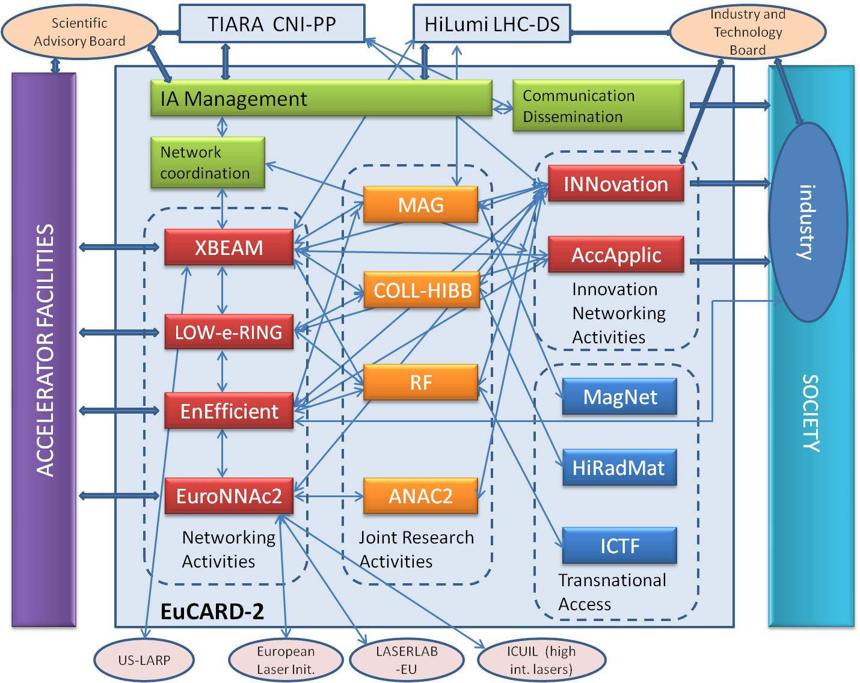
Internal and external links

Slide 16
The EuCARD-2 partners
40 partners from 15 European countries, including Russia

Slide 17
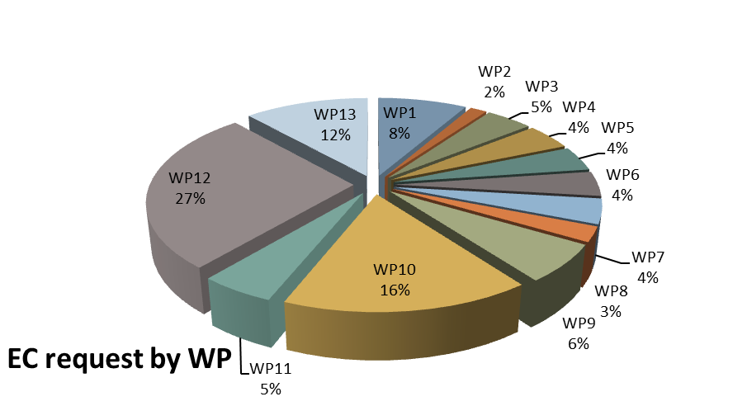
The Eucard-2 budget
Strong support by the reviewers and by the EC Officer to R&D for plasma-based accelerators: budgets for WP7 and WP13 were spared from major cuts when the EC contribution had to be reduced from 10 to 8 MEUR !

Slide 18
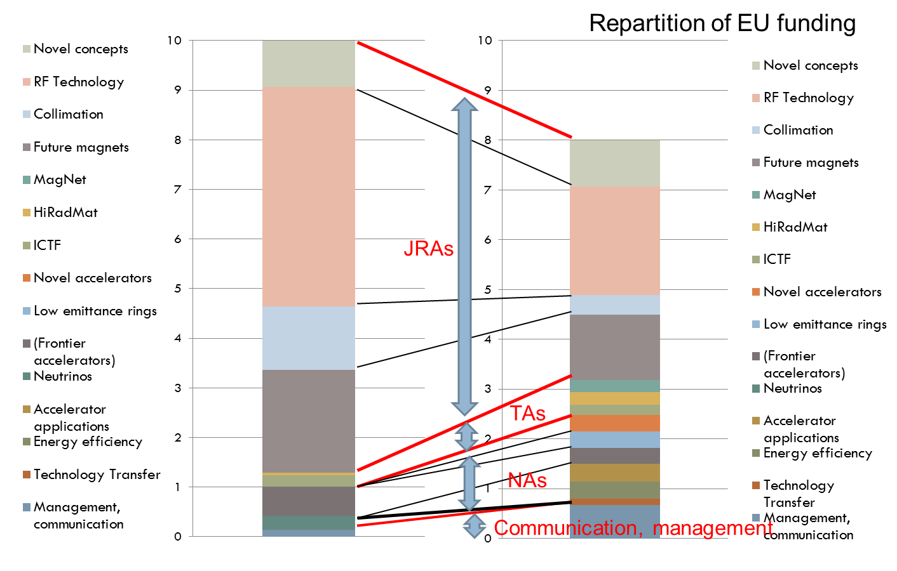
From EuCARD to EuCARD-2

Slide 19
Horizon 2020
Next EU Programme for research and innovation (2014 to 2020, €80 billion budget?).
Combines all research and innovation funding currently provided through: a) the FPs for Research and Technical Development (FPx), b) the innovation related activities of the Competitiveness and Innovation Framework Programme (CIP5), c) the European Institute of Innovation and Technology (EIT6) and d) the Structural Funds for innovation (ERDF).
Proposed Structure:
Industrial Leadership, €20.3 bn (IT, nanotech, materials, biotech, manufacturing, space).
Societal Challenges, €35.9 bn (health, food, energy, transport, climate, society)
Excellent Science, €27.8 bn (ERC, technologies, Marie Curie, Research Infrastructure for €2.8 bn, EIT, Euratom, JRC).
Funding for research and innovation aimed at bridging the “valley of death” dividing science from economy and society.
Increase in funding to the European Research Council (ERC) for targeted research, close link with National Research.
Keywords: Impact Impact Impact Impact… Innovation Innovation ….

Slide 20
Horizon 2020 - timeline
Ongoing: Parliament and Council negotiations on EU budget 2014-20 (including overall budget for Horizon 2020).
By end 2013: Adoption of legislative acts by Parliament and Council.
1/1/2014: Horizon 2020 starts; launch of first calls.
Accelerators already defined as topic with high potential and merit for Horizon 2020 Research Infrastructure. Consultation on possible topics for future activities for integrating and opening existing national research infrastructures (Feb. 2013): 7 domains, 245 topics assessed by an expert panel. 12 topics retained for physical science, including “Integration of research infrastructures for particle accelerator science and technology”.
In 2015 the accelerator community will start preparing the successor to EuCARD-2; the initial outcome of EuCARD-2 will be essential to define the high-priority subjects for the next programme.

Slide 21
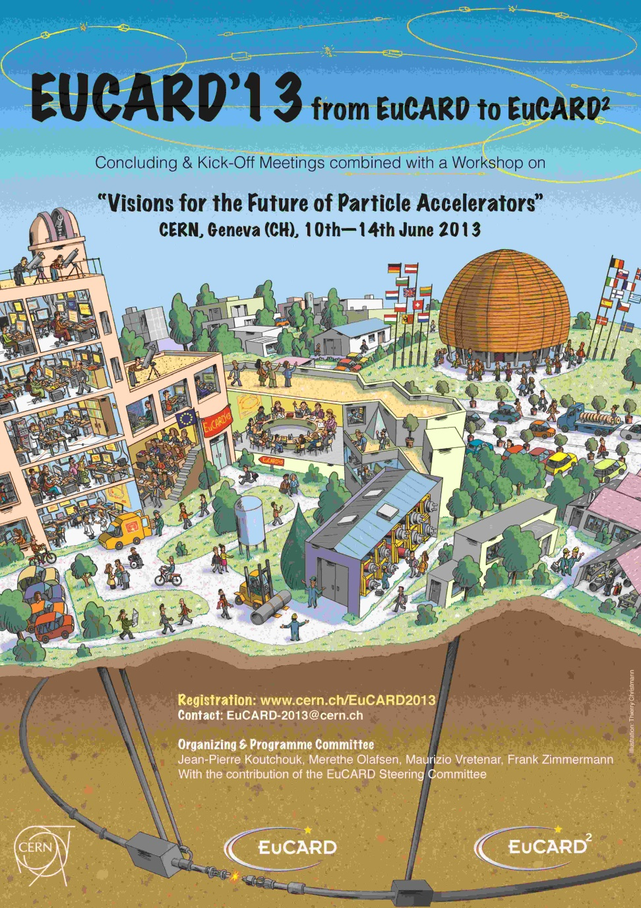
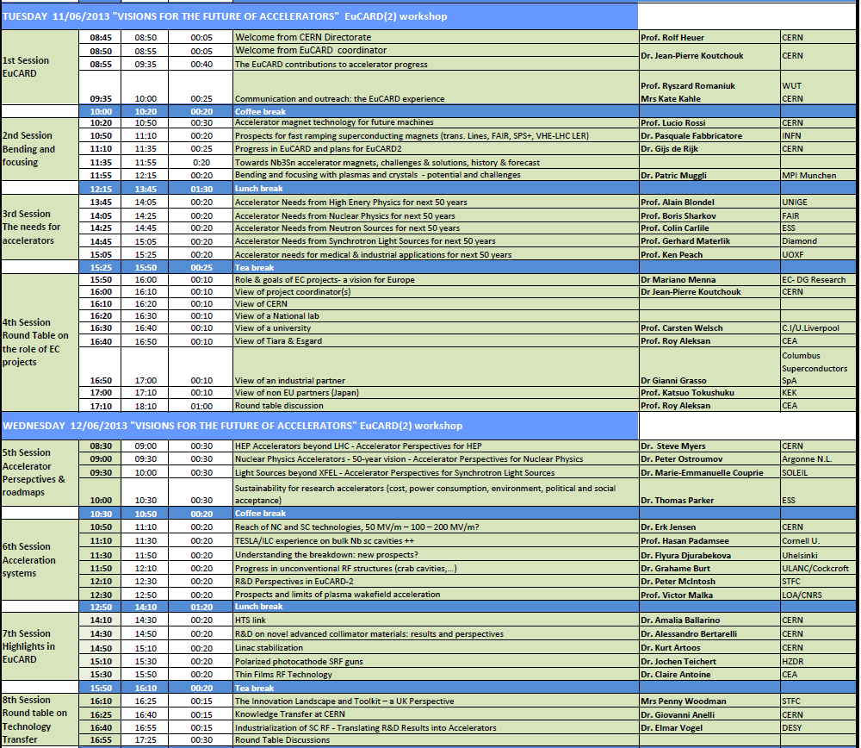
EUCARD13 at CERN
June 11 – 14 : Common EuCARD last Annual Meeting / EuCARD-2 kick-off Meeting – CERN Council Chamber
2-day Workshop «Visions for the Future of Particle Accelerators» (11.6-12.6).
https://espace.cern.ch/EuCARD/2013/annual-and-KickOff-meeting/default.aspx

Slide 22

Thank you for your attention and thanks to the organisers of this ground-breaking Workshop!
(and I hope to see many of you again in the frame of the EuCARD-2 activities)

