Slide 1
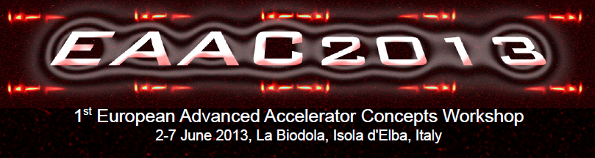
Towards a full C-band
multi-bunch/high rep. rate/high gradient injector linac
D. Alesini
(LNF-INFN, Frascti, Italy)
With the contribution of:
A. Bacci, T. Ronsivalle, L. Serafini, M. Ferrario, M. Migliorati, A. Mostacci (Beam Dynamics)
L. Piersanti, L. Palumbo (RF design)
V. Lollo (mechanical design)

Slide 2
OUTLINE
1. C-BAND ACCELERATORS (SPARC, PSI, SCSS, ELI_NP) AND C-BAND TECHNOLOGY
2. ELI-NP C-BAND ACCELERATING STRUCTURES FOR MULTI-BUNCH OPERATION
3. C-BAND GUN DESIGN
4. FULL C-BAND INJECTOR: THE NEXT AND DEFINITIVE STEP

Slide 3
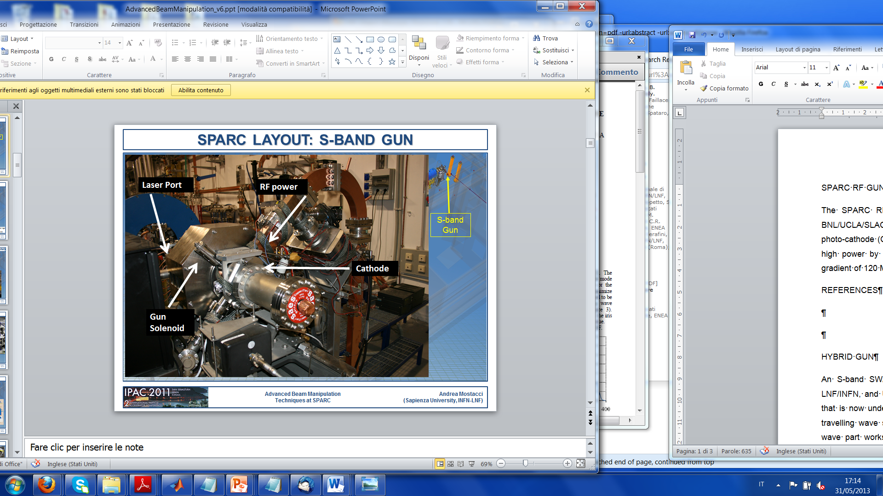
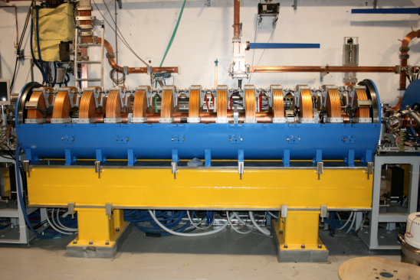
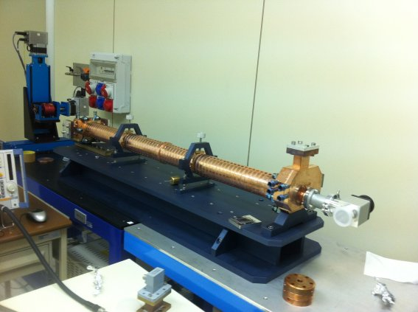
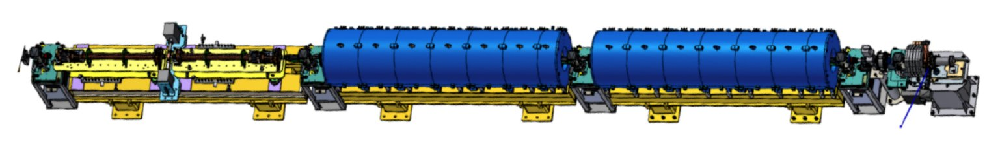
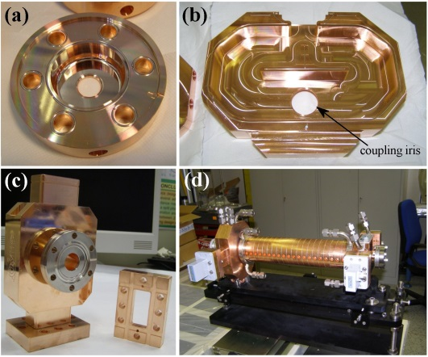
C-BAND SYSTEM @ SPARC
The energy upgrade of the SPARC photo-injector at LNF-INFN from 150 to more than 240 MeV will be done by replacing a low gradient S-Band accelerating structure with two C-band structures. The structures are TW and CI, have symmetric axial input couplers and have been optimized to work with a SLED RF input pulse. In the SPARC photoinjector the choice of the C-band for the energy upgrade was dictated by the opportunity to achieve a higher accelerating gradient, enabled by the higher frequency, and to explore a C-band acceleration combined with an S-band injector that, at least from beam dynamics simulations was very promising in terms of achievable beam quality.
S-Band injector
C-Band Booster
PARAMETER | VALUE
Structure type | TW CI LNF-type
Frequency (f_{RF}) | 5.712 [GHz]
Mode of operation | 2π/3
Accelerating voltage | 35-50 MV/m
# of structures | 2
-Prototype high power tested at >50 MV/m
-Final structures in production

Slide 4
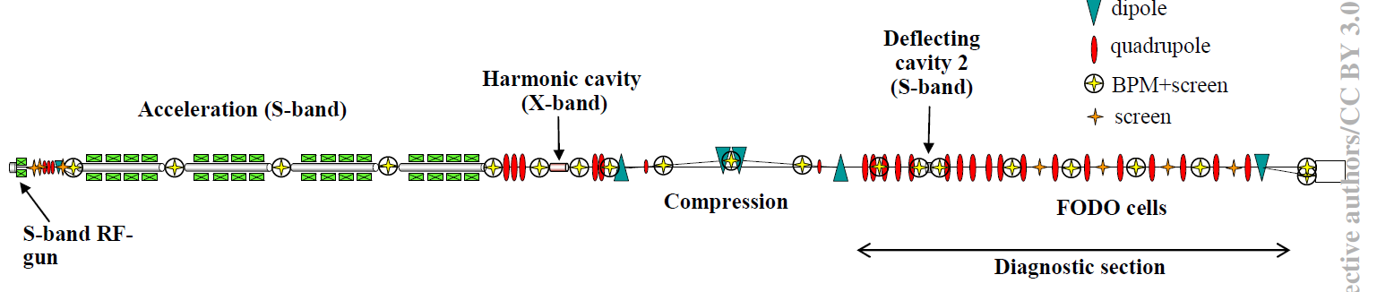
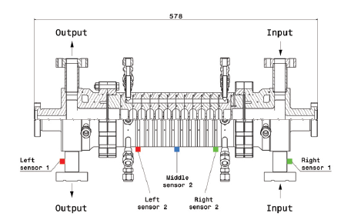
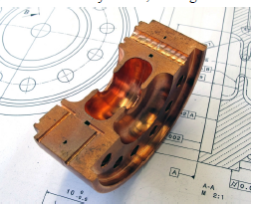
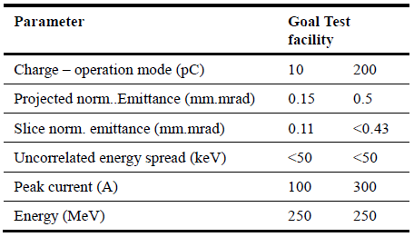
SWISS FEL: INJECTOR TEST FACILITY
To operate in the wave length range between 0.1 and 7 nm the compact X-ray FEL planned at PSI relies on low emittance electron beam and short period undulator. To investigate the generation, the acceleration, the transport and the stability of a high brightness beam sufficient to drive the main SwissFEL linac a flexible 250 MeV injector facility was built at PSI. As described schematically in Figure the injector layout starts with a 2.6 cells S-band RF photo-cathode aollowed by four S-band travelling wave (TW) accelerating structures surrounded by solenoid magnets. A magnetic chicane with bending angle adjustable between 0 and 5 degrees allows extensive studies and optimization of the bunch compression parameters. The chicane is preceded by a 4th harmonic cavity for linearization of the longitudinal phase space.
C-BAND LINAC
-Prototype high power tested at >50 MV/m
-Final structures in production

Slide 5
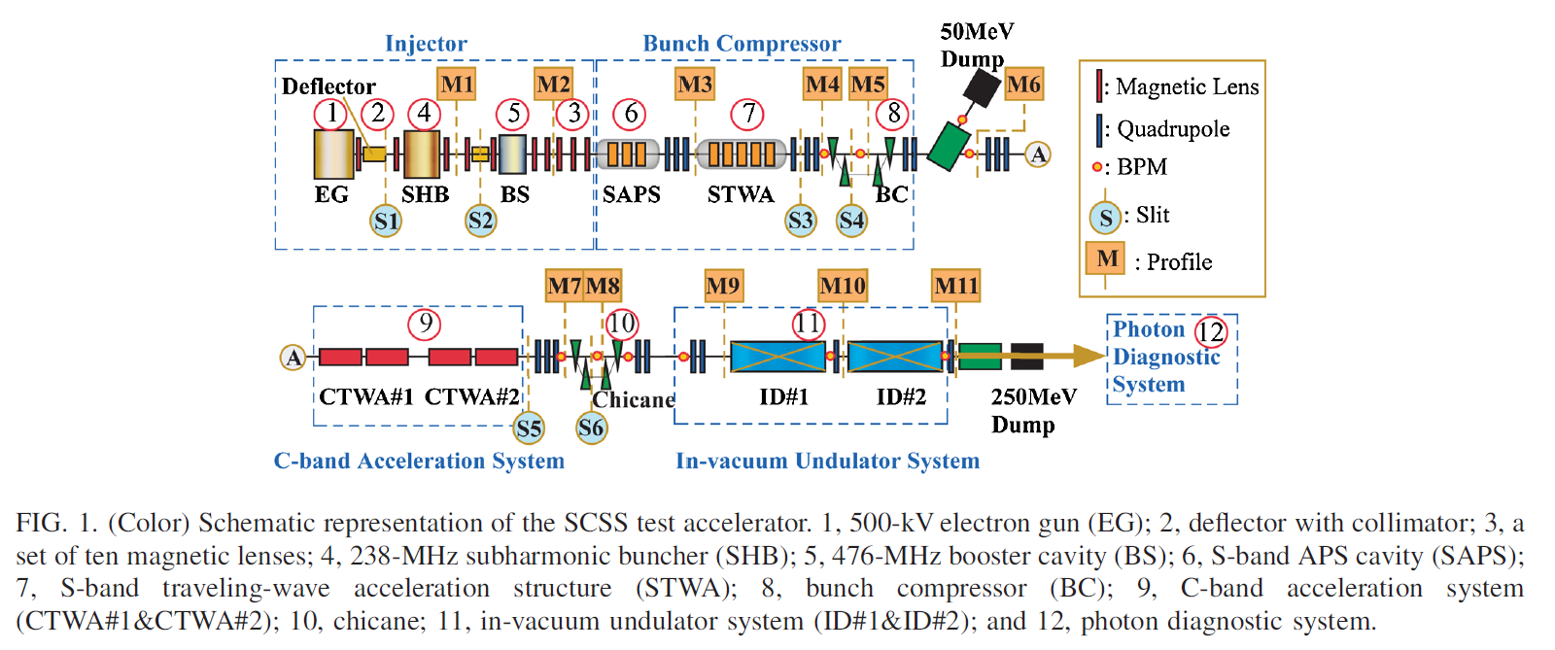
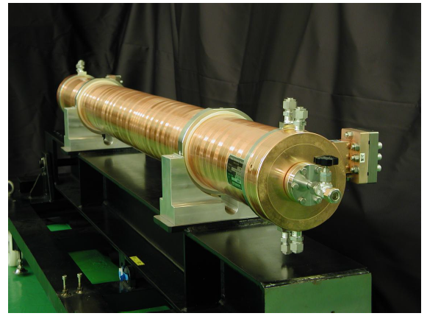
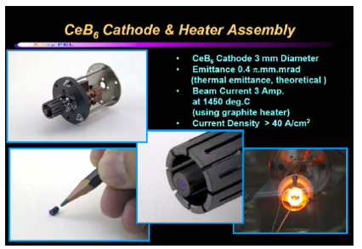
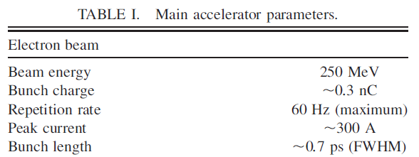
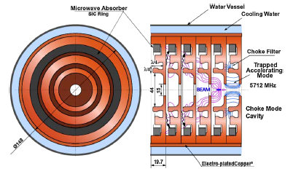
SPring-8 compact SASE source (SCSS)
A reduction of the machine size for widespread distribution of XFEL sources is the main idea for the SPring-8 compact SASE source (SCSS). Here, the use of an in-vacuum shorter-period undulator combined with a high gradient C-Band accelerator allows us to realize a compact XFEL machine with a lower-energy accelerator. Although a reduction of the facility scale gives a significant advantage, a new technical challenge was requested for generating and accelerating the extremely high-quality electron beam with a small normalized-slice emittance of less than 1 mm mrad. For this purpose, we proposed to use a thermionic cathode gun, which has a stable emission property and a long lifetime compared to photocathode rf guns. In order to make up for its low emission current, a velocity bunching section, which can push the total bunch compression factor up to a few thousands, was added to the injector.
-Nominal accelerating gradient up to 35 MV/m
-C-Band damped structures in operation

Slide 6
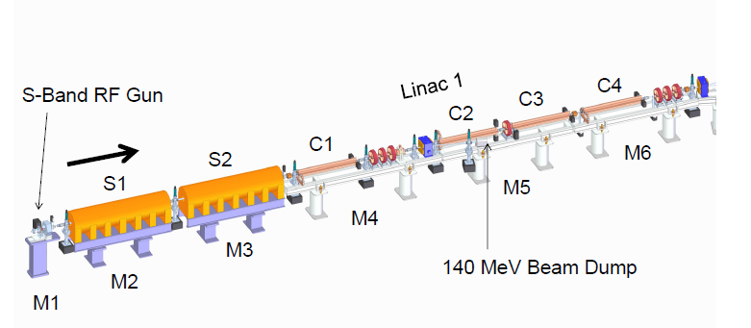
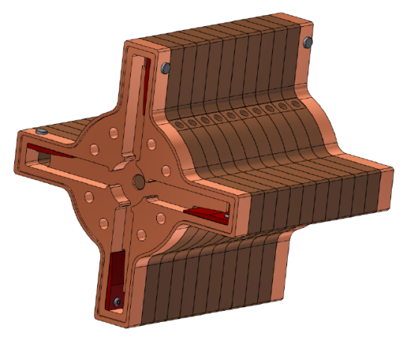
ELI_NP LINAC (COMPTON SOURCE)
The gamma beam system of the European ELI-NP proposal foresees the use of a multi-bunch train colliding with a high intensity recirculated laser pulse. The linac energy booster is composed of 12 travelling wave C-Band structures, 1.8 m long with a field phase advance per cell of 2π/3 and a repetition rate of 100 Hz. Because of the multi-bunch operation, the structures have been designed with a damping of the HOM dipoles modes in order to avoid beam break-up (BBU). In the paper we discuss the design criteria of the structures also illustrating the effectiveness of the damping in the control of the BBU. Prototype activity is finally illustrated.
C-Band Booster
S-Band injector
Bunch charge | 250 pC
Number of bunches | 32
Bunch distance | 16 ns
C-band average accelerating gradient | 33 MV/m
Norm. emittance | 0.2-0.6 mm⋅mrad
Bunch length | <300 μm
RF rep Rate | 100 Hz

Slide 7
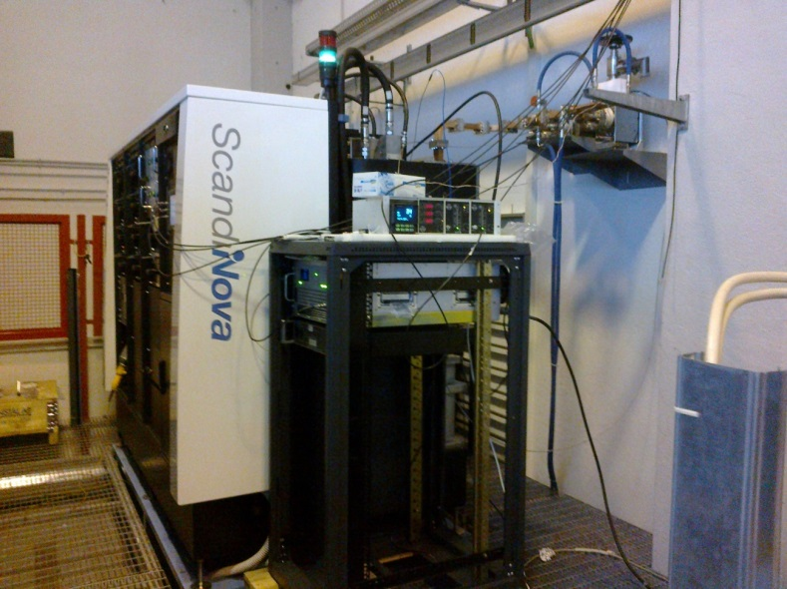
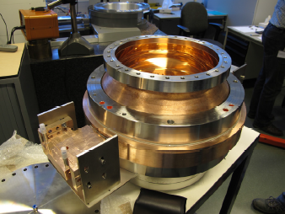
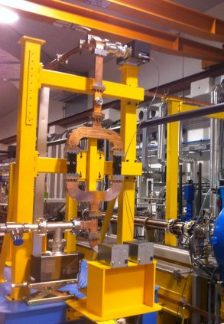
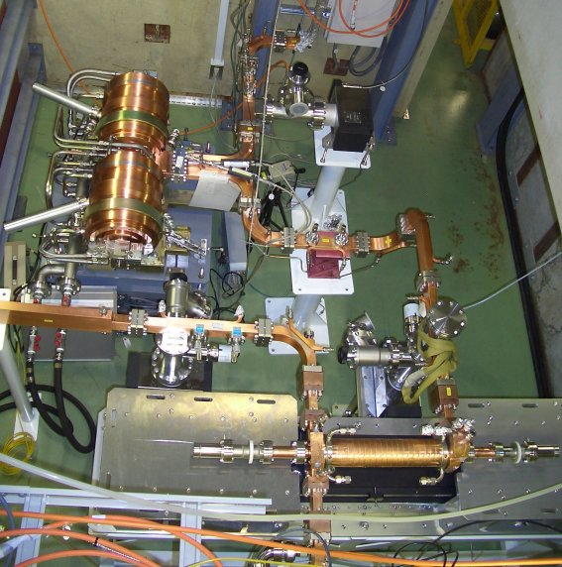
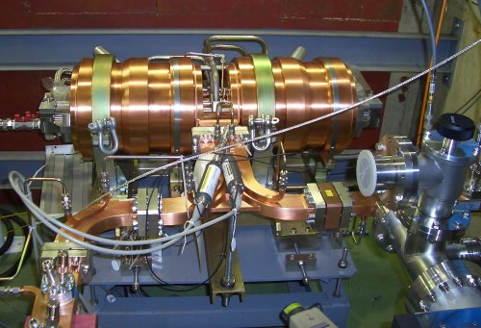
C-BAND TECHNOLOGY
The C-Band technology can be now considered “commercial”.
Klystrons (TOSHIBA)
RF pulse compression BOC (PSI)
Waveguides standard components
RF pulse compression SKIP (KEK)

Slide 8

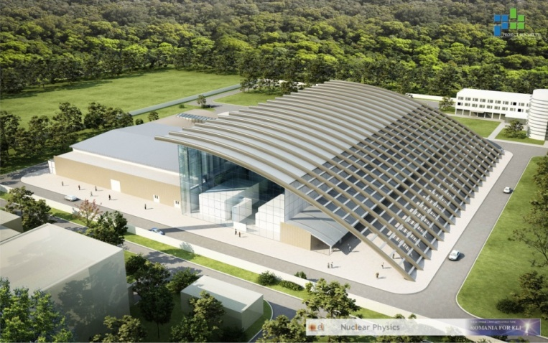
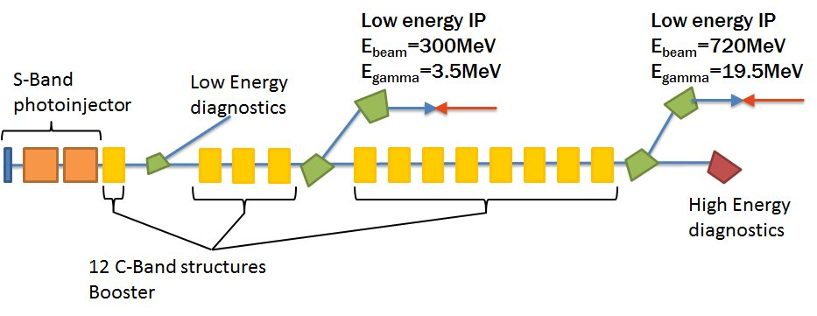
DEVELOPMENT OF ACCELERATING STRUCTURES FOR ELI-NP
In the context of the ELI-NP Research Infrastructure, to be built at Magurele (Bucharest, Romania), an advanced Source of Gamma-ray photons is planned, capable to produce beams of mono-chromatic and high spectral density gamma photons. The Gamma Beam System is based on a Compton back-scattering source. Its main specifications are: photon energy tunable in the range 1-20 MeV, rms bandwidth smaller than 0.5% and spectral density larger than 10⁴ photons/sec.eV, with source spot sizes smaller than 10-30 microns.
Bunch charge | 250 pC
Number of bunches | 32
Bunch distance | 16 ns
C-band average accelerating gradient | 33 MV/m
Norm. emittance | 0.2-0.6 mm⋅mrad
Bunch length | <300 μm
RF rep Rate | 100 Hz

Slide 9
MULTI-BUNCH ISSUES: BBU STUDIES
ELI-NP operates in multi-bunch mode. The passage of electron bunches through accelerating structures excites electromagnetic wakefield. This field can have longitudinal and transverse components and, interacting with subsequent bunches, can affect the longitudinal and the transverse beam dynamics.
LONGITUDINAL EFFECTS ⇒ beam loading
TRANSVERSE EFFECTS ⇒ Cumulative beam break-up (BBU)
-Analytical approaches can be used to evaluate the beam breakup effects (for example Mosnier theory).
-Tracking codes
Beam output positions
(y_{OUT},y’_{OUT})
E_{acc}=average accelerating field
Injector S-band
Ideal axis
E_{inj}=beam energy after injector
Booster LINAC (C-band)
y’_{OUT}
1st bunch of the train
Beam injection conditions at the entrance of the linac booster (y_{IN},y’_{IN})
Phase space @ LINAC exit
Other bunches
Equivalent beam emittance increase
y_{OUT}

Slide 10
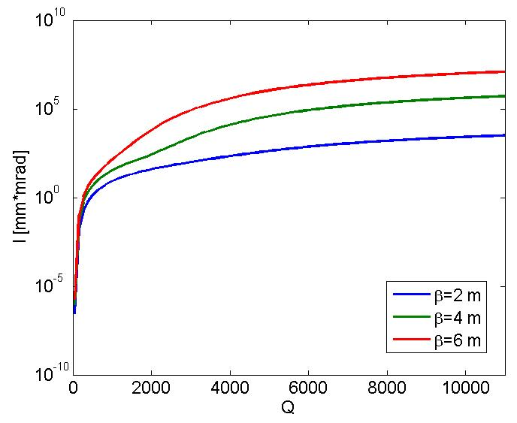
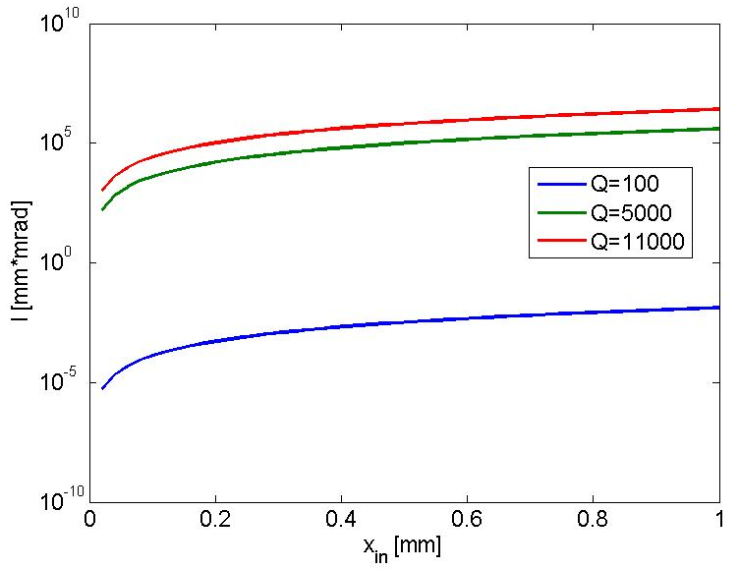
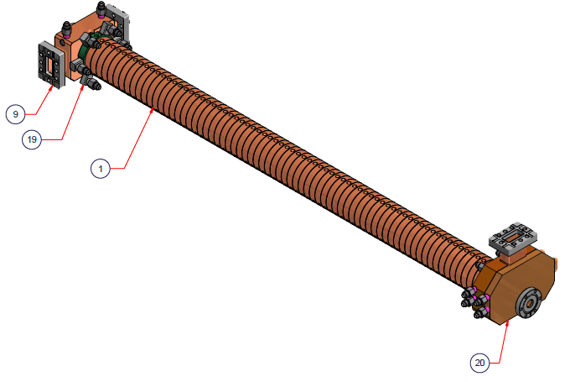
Mitigation of multi-bunch effect with damped structures
DAMPED STRUCTURES
C-band non damped
SPARC energy upgrade

Slide 11
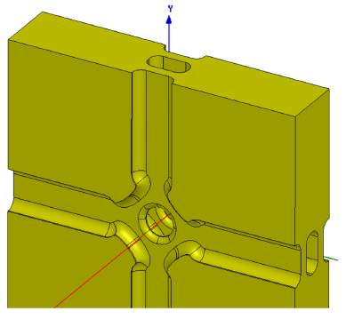
Damping of dipole modes choice
Dipoles modes propagate in the waveguide and dissipate
into a load
CLIC structures X-band, high gradient
C-Band structures Spring-8
Advantages
1. Strong damping of all modes above waveguide cut-off
2. Possibility of tuning the cells
3. Good cooling possibility
Disadvantages
Machining: need a 3D milling machine
Multipole field components (octupole) but not critical at least for CLIC
Advantages
Easy machining of cells (turning)
2D geometry: no multipole field components
Disadvantages
1. Critical e.m. design: notch filter can reflect also other modes.
2. Not possible to tune the structure
4. Cooling at 100 Hz, long pulse length (?)

Slide 12
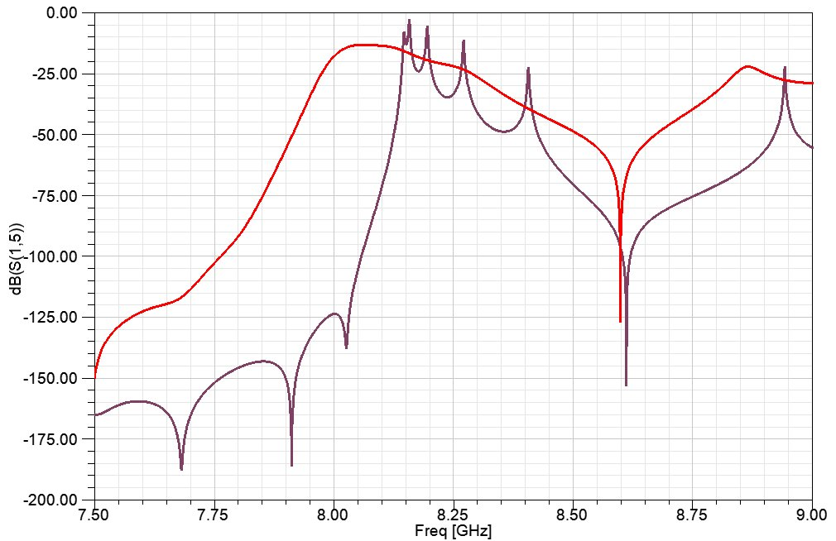
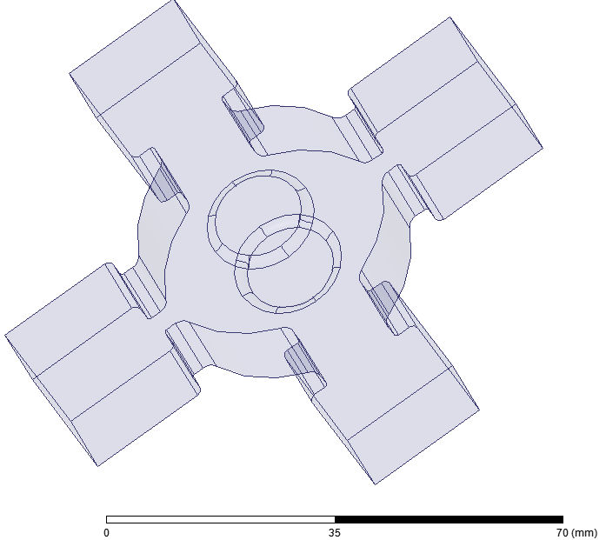
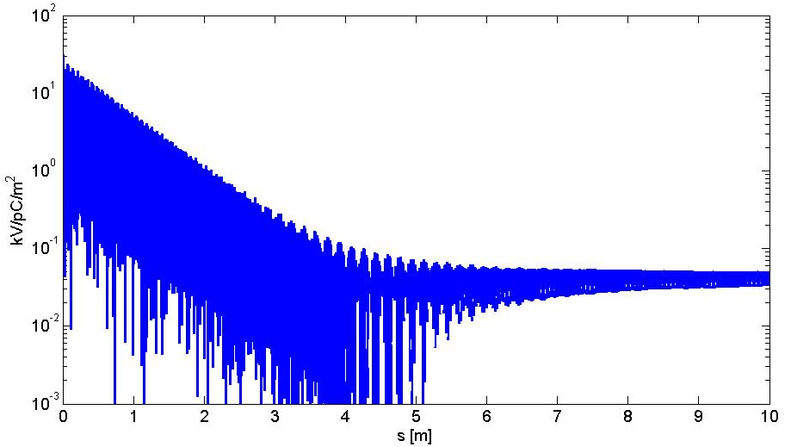
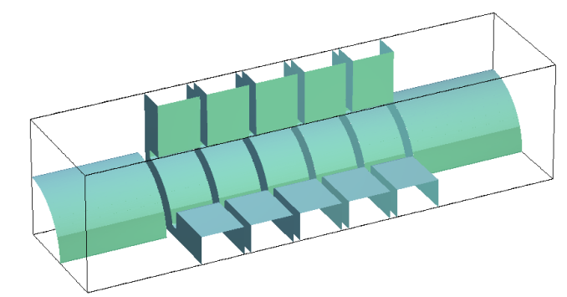
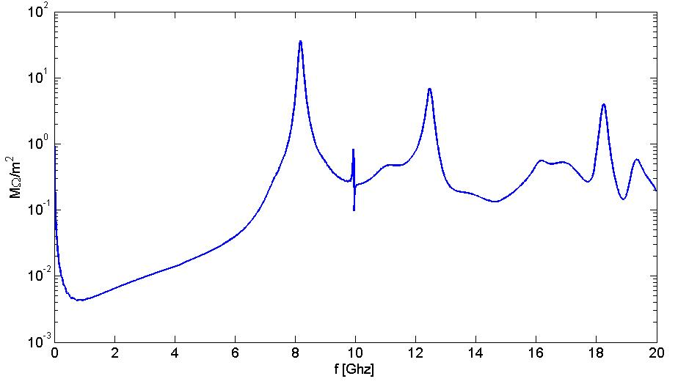
ELI Damped structure HFSS and GdFidL simulations
w=13 mm
w=7 mm
w
First dipole mode passband

Slide 13
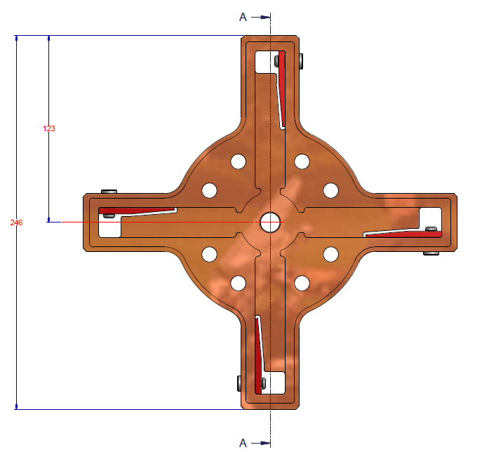
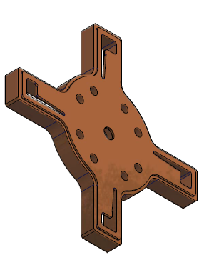
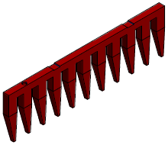
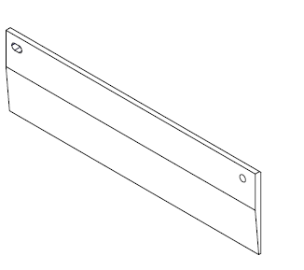
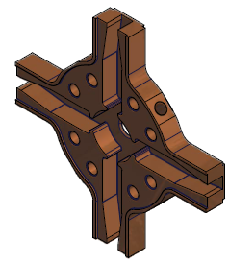

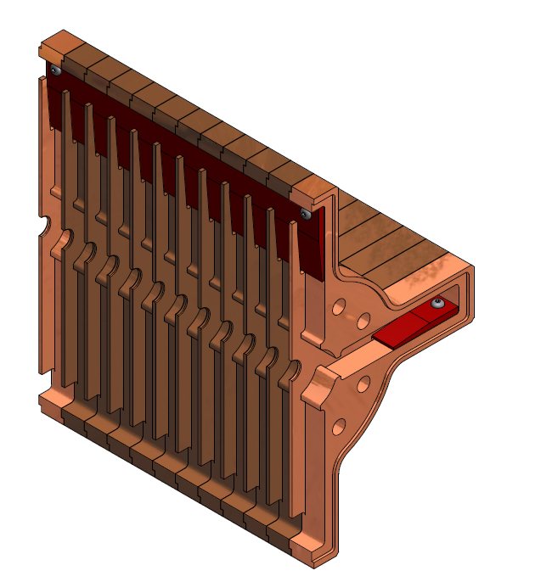
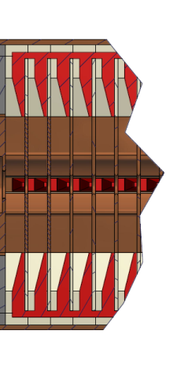
ACCELERATING STRUCTURES FINAL DESIGN
The power released by the beam on the dipole modes is dissipated into SiC absorbers. Several different solutions are possible to design the absorber. The final geometry has been optimized to:
simplify the realization procedure and the overall cost of the structures.
Reduce the transverse size dimensions to allow solenoids positioning
Previous solution (CLIC-type)
old absorber
New absorber

Slide 14
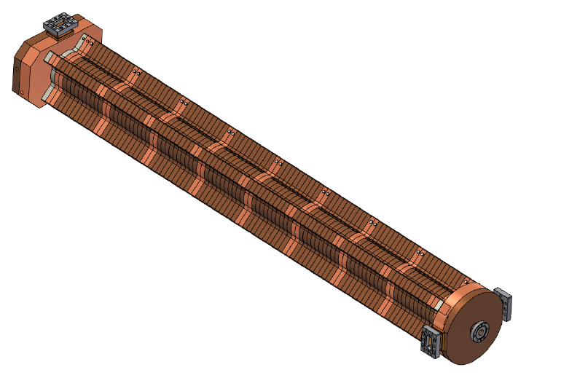
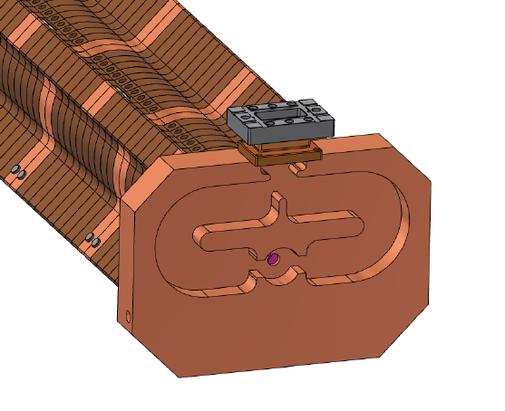
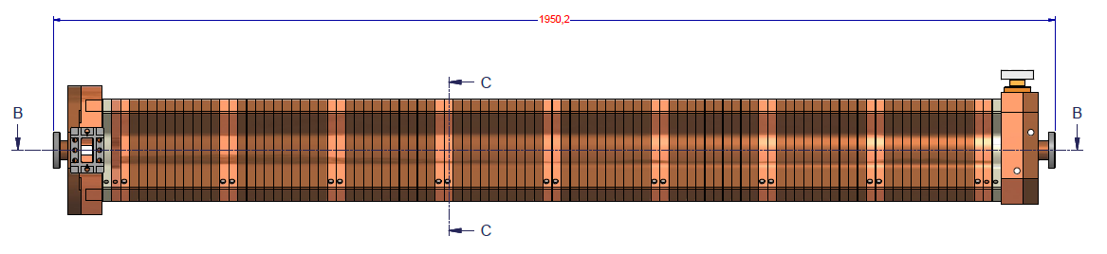
Input/output couplers
Integrated splitter

Slide 15
ELI Damped structure: parameters
PARAMETER | VALUE
Type | TW- quasi constant gradient 102 cells
Frequency (f_{RF}) | 5.712 [GHz]
Phase advance per cell | 2π/3
Structure Length included couplers (L) | 1.8 m
Iris aperture (a) | 6.8-5.8 mm
group velocity (v_{g}/c): | 0.034-0.013
Quality factor (Q) | 8800
Shunt impedance per unit length (r) | 67-73 [MΩ/m]
Filling time (τ) | 310 [ns]
E_{s peak}/E_{acc} | 2.1
H_{s peak}/E_{acc} | 4.3⋅10⁻³ [A/V]
RF input power | 40 MW
Pulse duration for beam acceleration (τ_{BEAM}) | <512 ns
Output power | 0.3⋅P_{in}
E_{ACC_average}@ P_{IN}=40 MW | 33 MV/m
Rep. Rate (f_{rep}) | 100 Hz
Average dissipated power @ 100 Hz, P_{IN}=40 MW | 2.3 [kW]

Slide 16
C-BAND STRUCTURE DESIGN: BBU STUDIES
ELI-NP operates in multi-bunch mode. The passage of electron bunches through accelerating structures excites electromagnetic wakefield. This field can have longitudinal and transverse components and, interacting with subsequent bunches, can affect the longitudinal and the transverse beam dynamics.
LONGITUDINAL EFFECTS ⇒ beam loading
TRANSVERSE EFFECTS ⇒ Cumulative beam break-up (BBU)
-Analytical approaches can be used to evaluate the beam breakup effects (for example Mosnier theory).
-Tracking codes
Beam output positions
(y_{OUT},y’_{OUT})
E_{acc}=average accelerating field
Injector S-band
Ideal axis
E_{inj}=beam energy after injector
Booster LINAC (C-band)
y’_{OUT}
1st bunch of the train
Beam injection conditions at the entrance of the linac booster (y_{IN},y’_{IN})
Phase space @ LINAC exit
Other bunches
Equivalent beam emittance increase
y_{OUT}

Slide 17
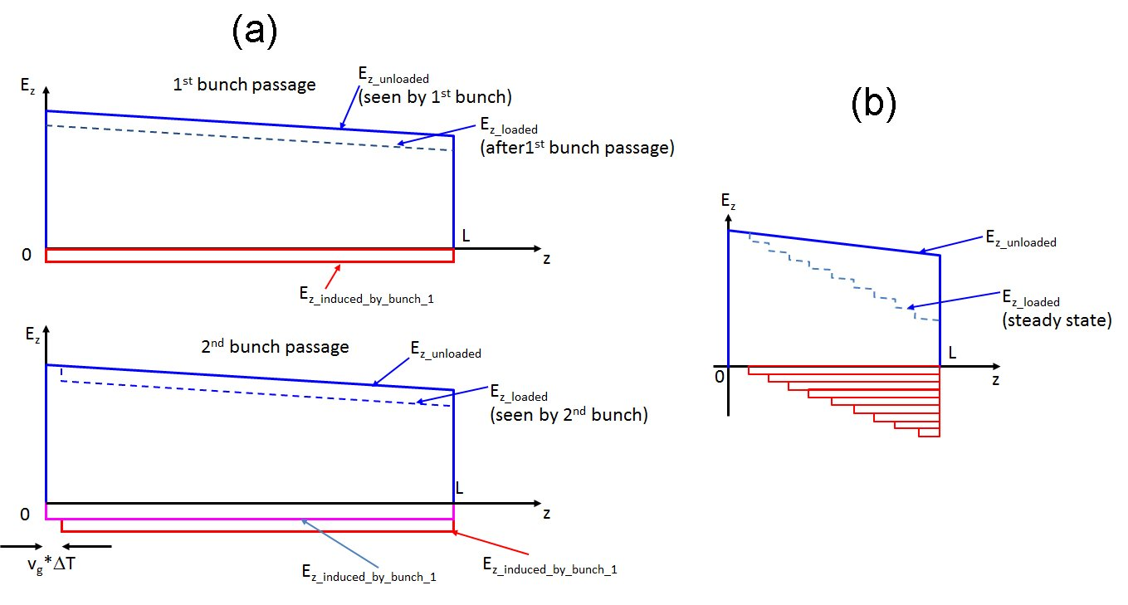
Beam loading: approach
The external voltage given by the RF generator and the beam induced voltage in CI structure can be analytically calculated un the frequency domain [Wang,…] and they are given by the following expressions:

Slide 18
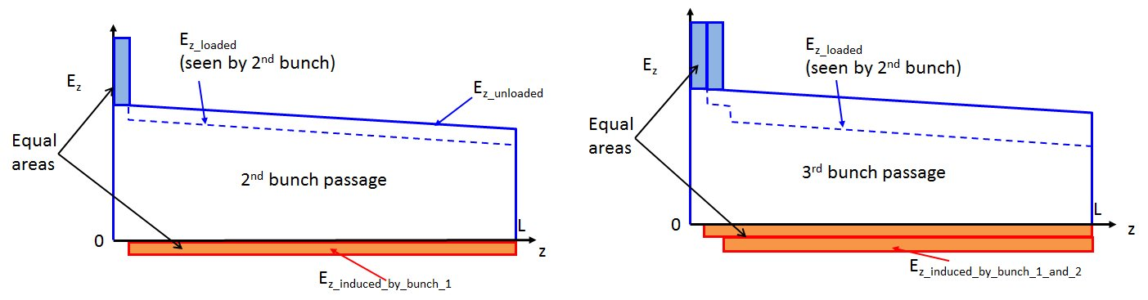
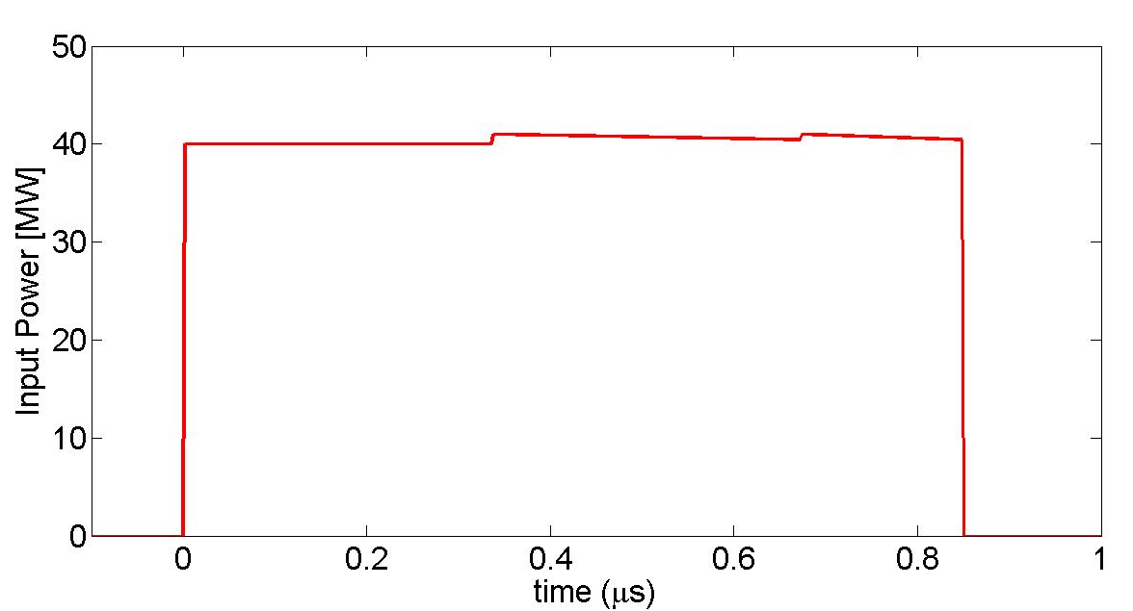
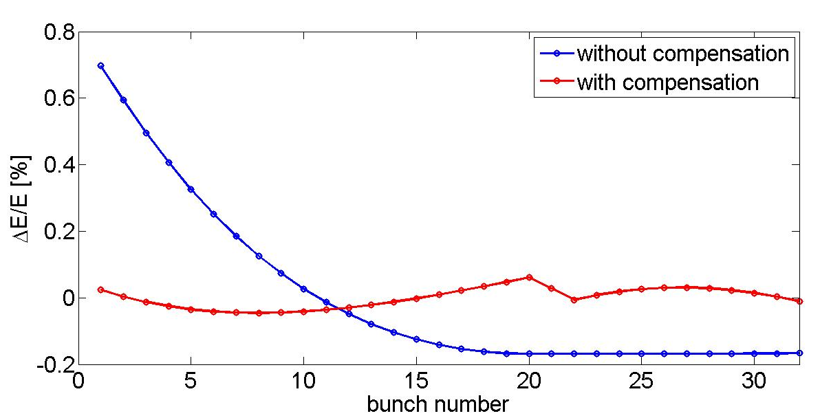
Beam loading: possible compensation

Slide 19
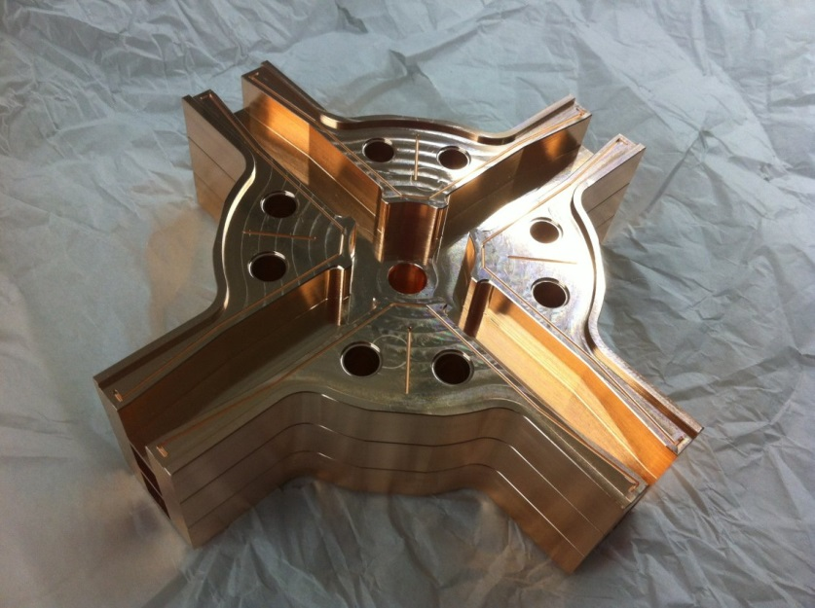
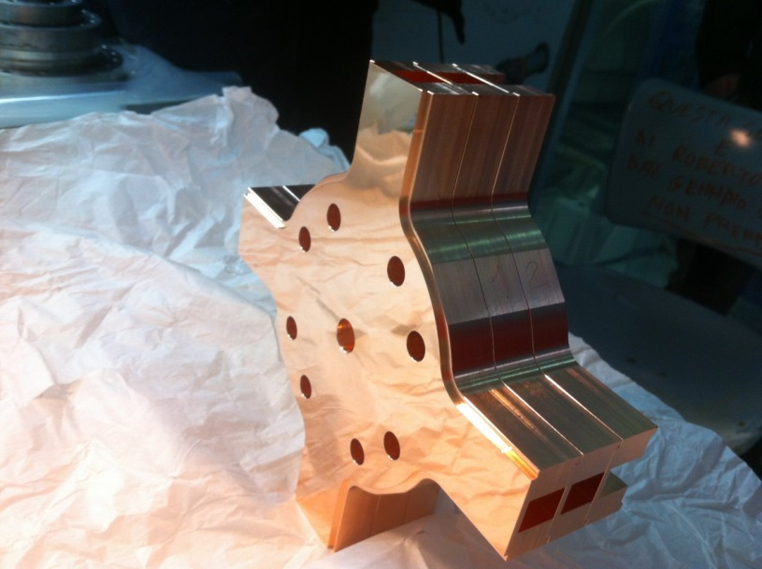
STRUCTURES REALIZATION AND PROTOTYPING
    Two lines of main activity:
    -prototype with a reduced number of cells to:
    ⇒Test the effectiveness of the dipole mode damping including the test the absorbing material performances
    ⇒ Test the vacuum properties of the structure with absorbing material
    ⇒ Perform the low power RF tests and the tuning of the structure
    ⇒Test the high gradient performances of the structure
    -prototype full scale w/o RF only for brazing/mechanical test
First complete prototype for ELI
(end 2013)

Slide 20
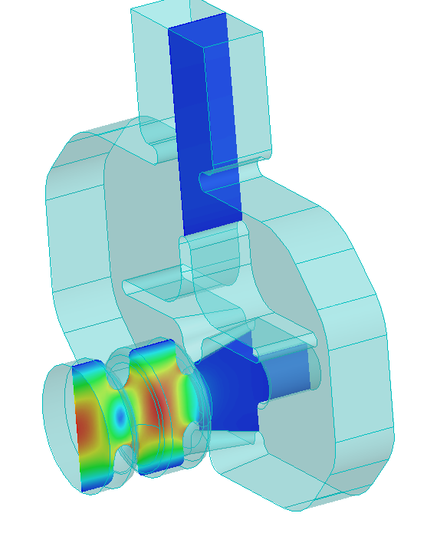

C-BAND GUN: EM DESIGN
A C-Band RF gun has been designed from the electromagnetic point of view and the mechanical drawing is almost completed. The gun integrate a waveguide coupler on the beam pipe that allows:
-high efficiency cooling of the accelerating cells
-low pulsed heating of the coupler surfaces
-arbitrary solenoids position around the accelerating cells and on the beam pipe
-100 Hz operation in multi bunch
PARAMETERS
f [GHz] | 5712
Q₀ | 10900
E_{cathode} / √P_{d} | 67 [MV/m/√MW]
Input coupling β | 2
Filling time τ | 200 [ns]
RF input power for 200 MV/m | 10 [MW]

Slide 21


C-BAND GUN DESIGN: compens. of the quad. components induced in the coupler
Ideal cavity
Waveguide coupler
Beam axis
H
ϕ
The coupler is a compact transition between a rectangular geometry (the waveguide) and a circular one (the cavity).
It introduces, in the waveguide region, multipolar field components.
Due to the symmetric feeding of the system this components have an even periodicity with respect to the azimuthal angle.
Pure circular component
A₂ quad. component
(A₂=gradient of the quad. component)

Slide 22



C-BAND GUN: MECHANICAL DESIGN
An optimized mechanical design has been done to:
-allow 100 Hz operation (thermal analysis) with long RF pulses for Multi-Bunch operation
-allow the fabrication of the gun without brazing processes (hard copper->higher gradients)

Slide 23


THE C-BAND INJECTOR
The final configuration of the C-band injector depends on the specific application. Compensating solenoids can be located both on the RF gun than on the accelerating structure depending on BD requirements.
solenoids

Slide 24


SINGLE BUNCH BD SIMULATIONS: THE ELI-NP CASE AS EXAMPLE
PARAMETER | S-BAND INJECTOR | C-BAND INJECTOR
Charge (pC) | 250 pC | 250 pC
Laser pulse length at the cathode (ps) | 8.5 | 8.5
Photocathode laser spot size (μm) | 250 | 250
Output energy (MeV) | 80 | 95
Output RMS proj. emittance (mm mrad) | 0.4 | 0.25
Output RMS bunch length (μm) | 280 | 240
Output RMS energy spread (%) | 1.75 | 0.38
# of structures | 2 (3 m long 23 MV/m) | 3 (1.5 m long 35 MV/m)
As an example the potentiality of a C-band injector have been explored for the ELI –NP beam. Comparing the S-band case with the C-band one
S-BAND
C-BAND
A. Bacci

Slide 25
COMPENSATION OF BEAM LOADING EFFECTS IN MULTI-BUNCH OPERATION
Beam loading effects in multi bunch operation can be compensated with a proper choice of the laser injection time. In this way, the exponential filling time of the gun compensates the reduction of the accelerating field in the TW structure.
E
head
tail
E
head
tail
t
t

Slide 26



EXAMPLE OF MULTI-BUNCH C-BAND INJECTOR
42 MW, 100 Hz
32 bunches
250 pC
16 ns bunch spacing
7 MW
35 MW
1.1 μs
Flat top
TOSHIBA
E37210
(Nominal output power 50 MW)
C
C
L=1.8 m
E_{_acc}=31 MV/m
E_{_cathode}=170 MV/m
60 MeV
beam

Slide 27
CONCLUSIONS
C-Band accelerators all over the world have made the C-Band technology accessible and commercial.
Gradients >50 MV/m in accelerating structures have been reached in several structures.
Damped C-band structures for multi-bunch acceleration of >100 Hz rep. rate linac have been developed for ELI-NP and are now under construction.
A C-Band RF GUN at gradients >170 MV/m has been designed.
The full C-band injector (>100 Hz, Multi-bunch) is now the “state of the art” and allows reaching excellent beam qualities usable in several applications.

