Slide 1


Laserwire: high resolution non-invasive beam profiling
for advanced accelerators
L. J. Nevay, S.T. Boogert, P. Karataev, K. Kruchinin,
JAI @ RHUL, Egham, UK
L. Corner, R. Walczak,
JAI @ Oxford University, UK
G. Blair,
STFC, UK
Aryshev, N. Terunuma, J. Urakawa,
KEK, Japan

Slide 2
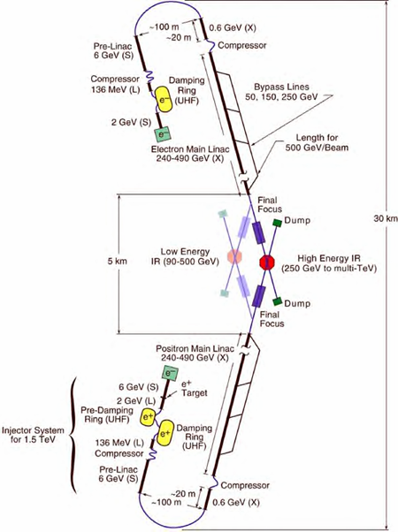
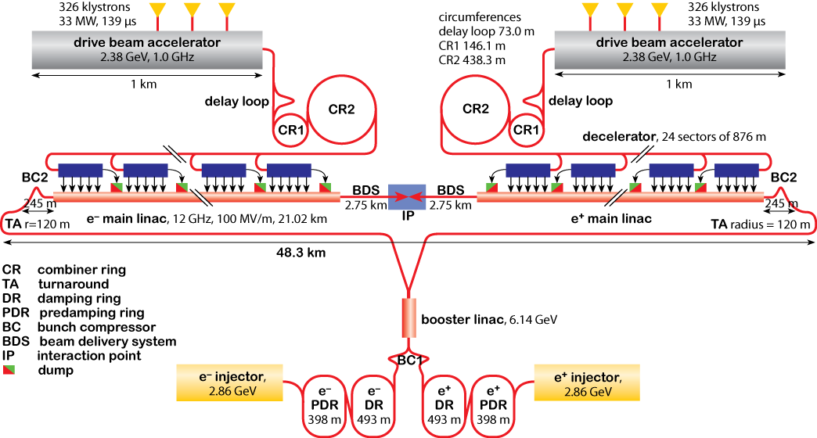
Linear colliders – ILC/CLIC
New colliders e⁻/e⁺ high precision machines.
Two main current designs - International Linear
Collider (ILC) and Compact Linear Collider (CLIC).
Extreme focusing/charge/luminosity requirements.
Making focussed beams of 1 – 5 nm.
Need high quality measurements of beam size,
emittance, position, charge, duration……….

Slide 3
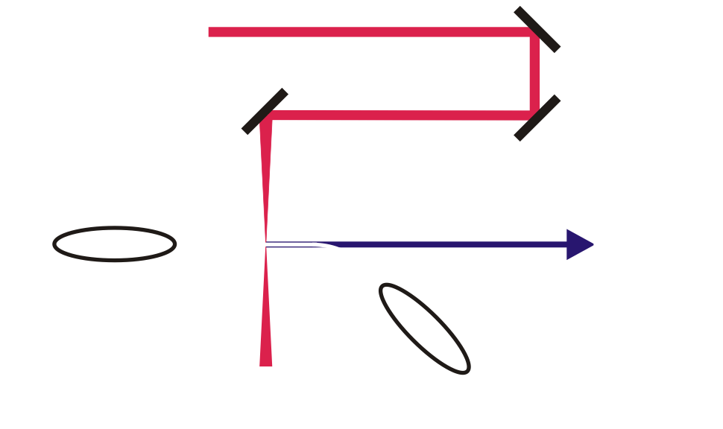
Laserwire beam size measurement
Focussed laser spot
translated across
electron beam
Compton scattered photons
detected downstream
after bending magnet
Measured scan is convolution of laser spot size and particle beam size
- small laser spot: good spatial quality, short λ, excellent focusing optics.

Slide 4
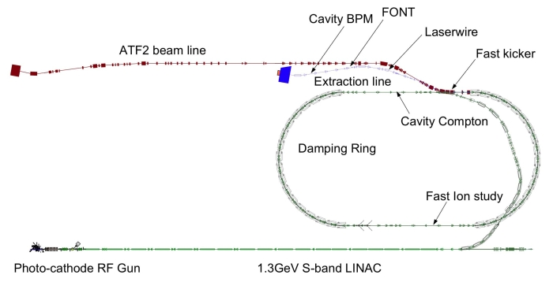
ATF2 laserwire
Charge | 1 – 8 x 10⁹ e
Energy | 1.28 GeV
Beam size (LWIP) | 100 x 1 μm
Bunch | 30 ps (3.12Hz, single bunch)
Laser (532nm, Nd:YAG) | 100 mJ, 77 ps
ATF2 major international collaboration – scaled test of ILC optics.
Aim – electron beam size < 40nm.
Major test of new diagnostics – high resolution (< 5nm) bpms, fast feedback etc.
Laserwire designed for highest resolution – measurement ~ 1μm.
Prototype installation – aim for turnkey operation.

Slide 5

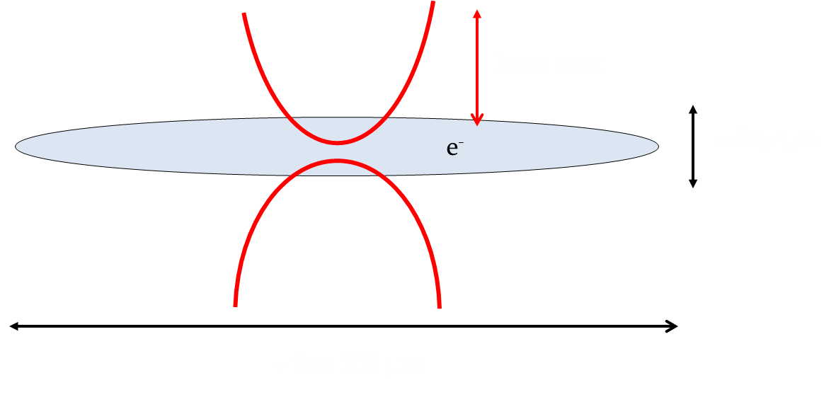
Layout of ATF2 laserwire
2z_{R} ~ 30 – 40 μm.
laser beam
actuator driven
mirrors
vacuum
chamber
Electron beam has large aspect ratio.
Difficult to accurately extract beam size – non
Gaussian convoluted scan.
Need to measure propagation properties of
laser and use these to fit H/V electron beam sizes.
electron beam
IP
post IP diagnostics
Beam input to
final focus lens
Laser has poor spatial quality
and is astigmatic – hard to model.

Slide 6
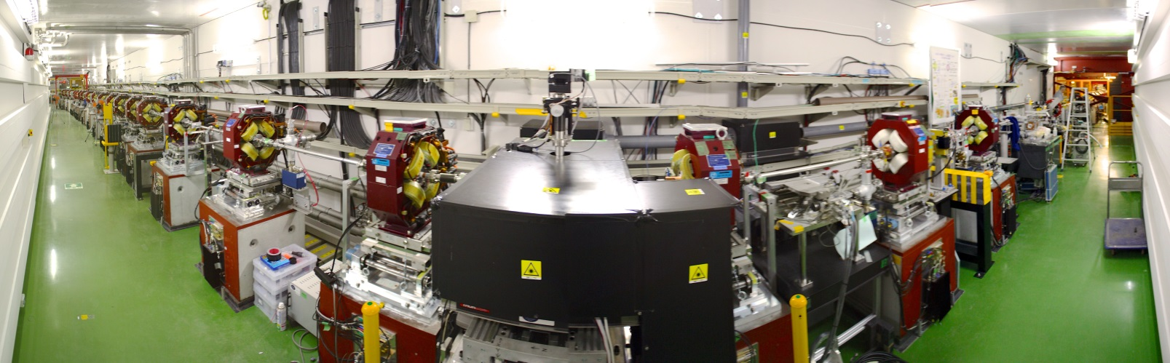
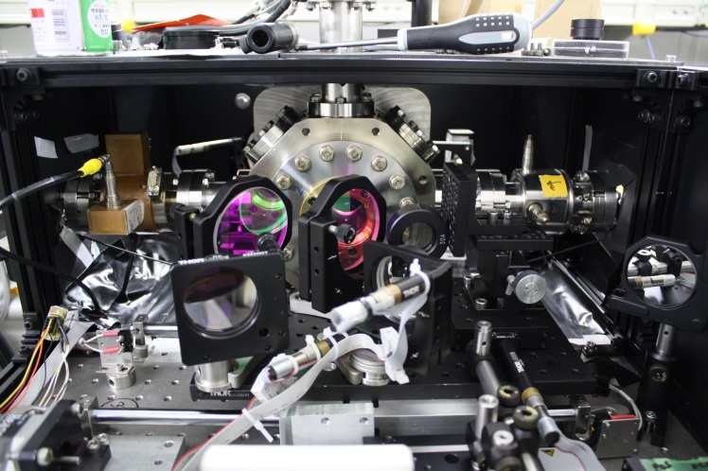
ATF2 laserwire experiment
Detector
Laserwire IP
Laser beam transport
Entire vacuum chamber + focusing lens
moves vertically and horizontally to scan
laser focus over electron beam.

Slide 7
Laserwire results
Initial alignment – temporal/spatial overlap of laser/electron beams:
10s ps, ~ 1μm.
Rough vertical scan over electron beam:
find centre, optimise nonlinear scan
Detailed scans over vertical/horizontal beam
Iteratively fit V/H size until converged.
Consistent measurement of vertical beam size = 1μm.
Analysis: L. Nevay

Slide 8
Other experiment/measurements
Stanford Linear Collider – beam scanned across laser spot 350nm THG Nd:YLF, 1mJ, 10MW, prototype - Alley et. al., NIM A 379, 363 (1996).
KEK ATF2 damping ring – cw - cavity on moveable table scanned through beam
532nm, stored power 1 – 3W, e⁻ σ = 9.8 ± 1.5μm - Sakai et. al., PR STAB 5, 122801 (2002).
Oak Ridge SNS – H⁻ ion laserwire, Nd:YAG, 1064nm, 30 Hz, 7ns
9 stations, 1 laser, beam sizes σ ~ 2 – 3mm - Liu et. al., NIM A 612, 241 (2010).
PETRA – 2D scanning, 6 GeV e⁺, 130kHz, 40ps, Q switched 6ns Nd:YAG, 532nm, 20Hz, convoluted beam size σ = 30μm (V) - Bosco et. al., NIM A 592, 162 (2008).
Measurements of source size for X-rays generated by scattering from laser plasma accelerated electrons – Chen et. al., PRL 110, 155003 (2013).

Slide 9
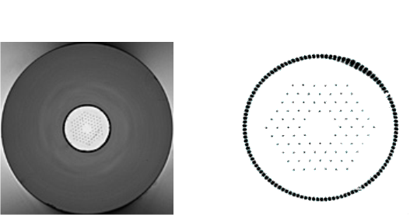
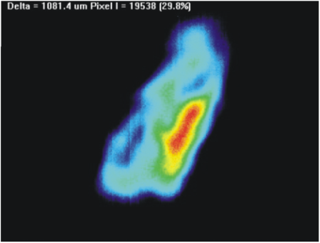
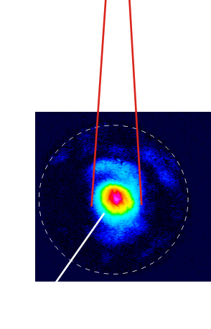
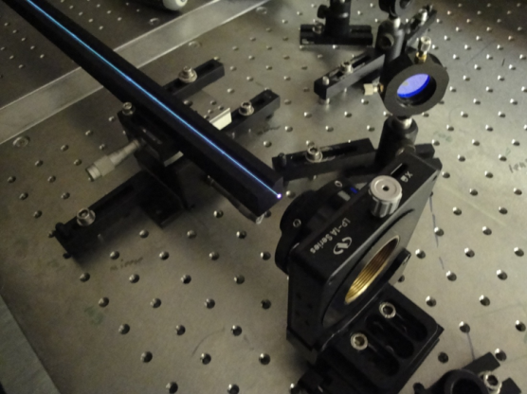
Laser improvements
Laser at the ATF not completely suitable for laser-wire.
Poor spatial quality – larger focus, worse resolution.
Temporal profile (77 ps) not ideally matched to electron bunch (30 ps).
Inefficient (flashlamp pumped), limited in repetition rate – no intratrain scanning.
Project in Oxford to develop
new fibre laser system for laserwire.
Fibres: efficient, waveguides, excellent spatial
mode quality, high repetition rate, diode pumped, no active cooling.
Standard SM fibre amplifiers – low energy.
Solution – very large mode area photonic crystal fibre – still single mode, energy 100uJs/pulse.

Slide 10
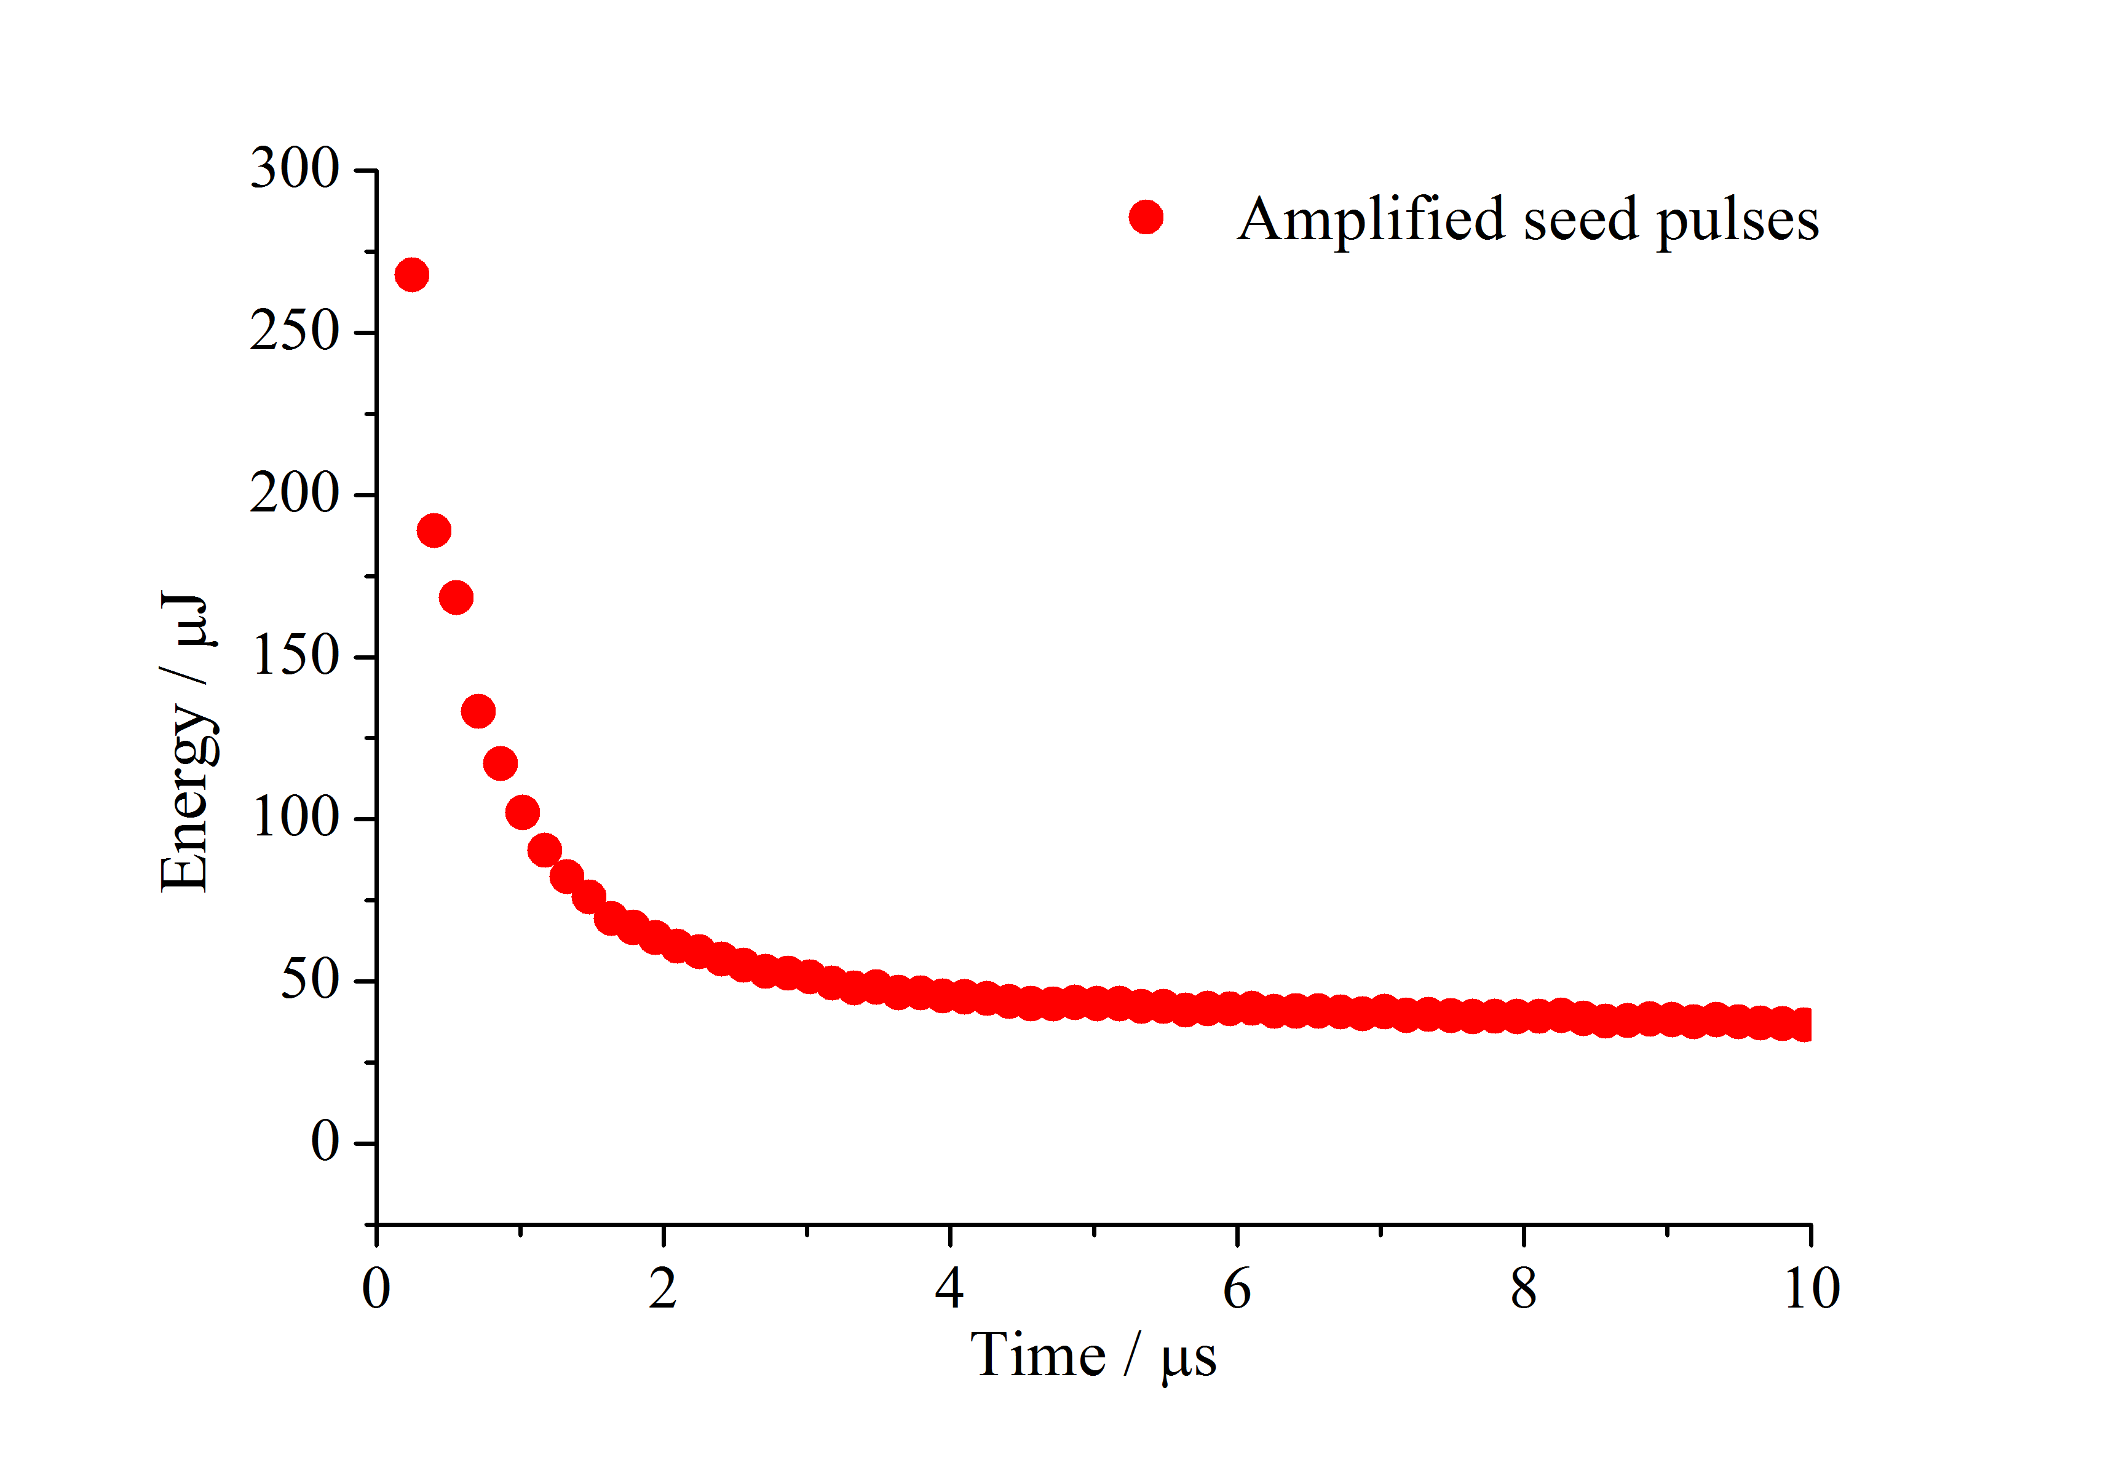
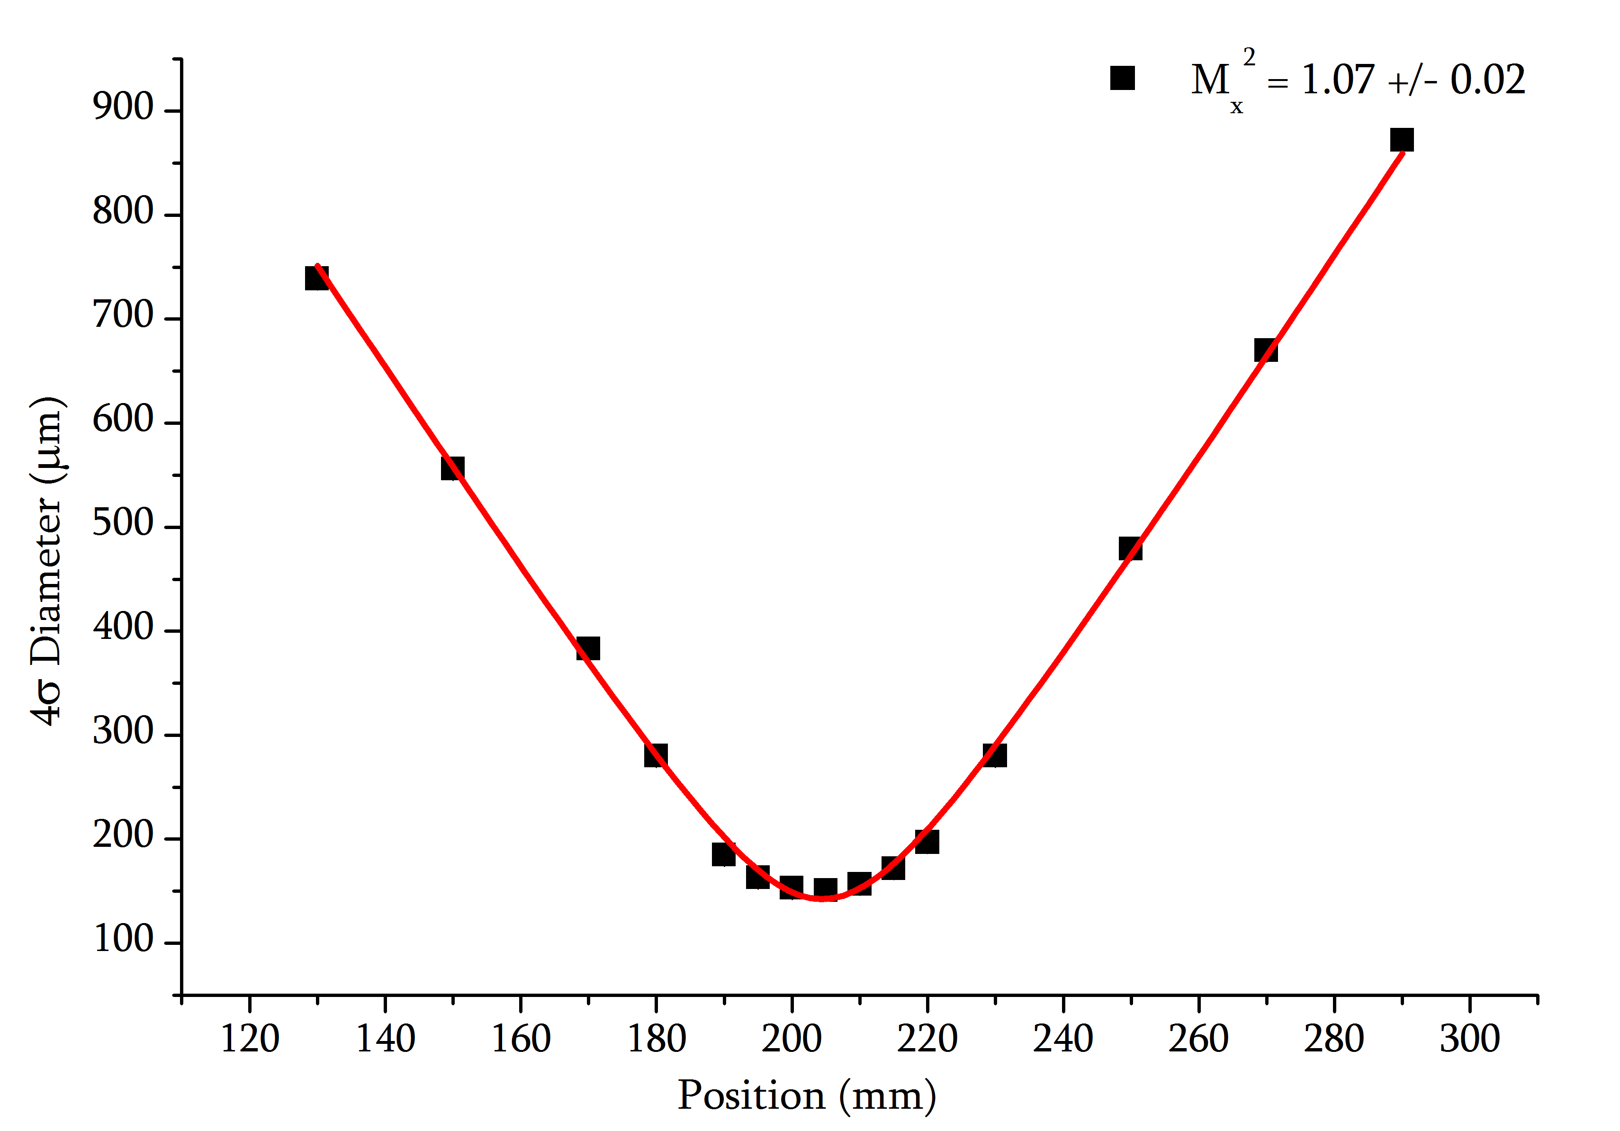
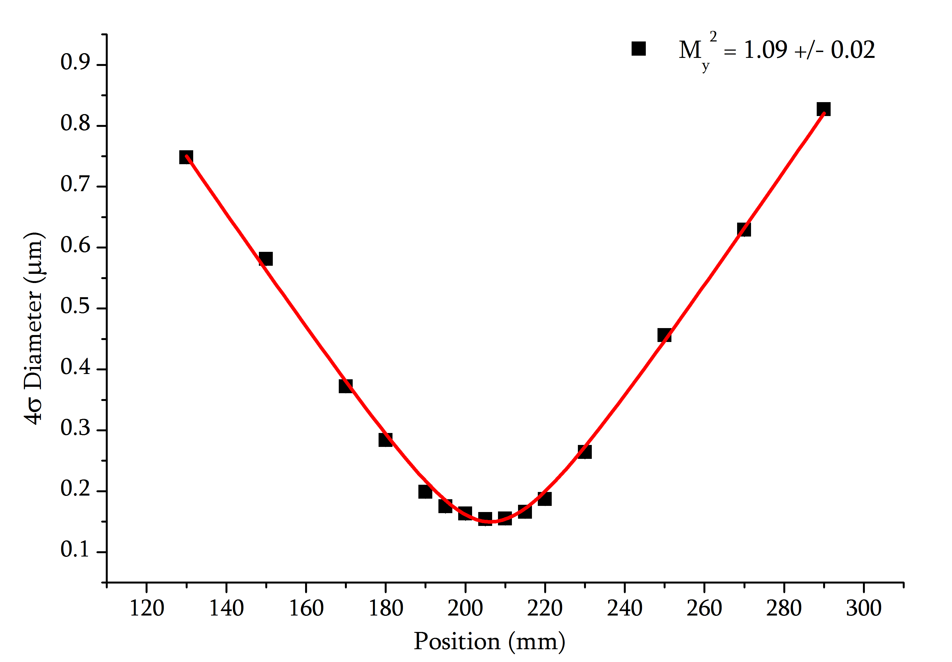
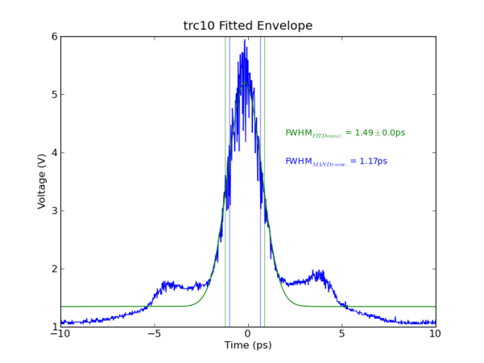
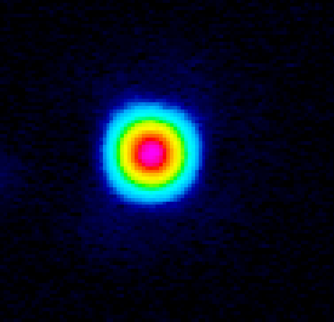
Fibre laser results
Aim – better laser source for laserwire, smaller laser spot, intratrain scanning.
Spec – 100μJ @ 6.49MHz ir, M² <1.1, < 10ps, Δλ < 1nm green.
Expt – amplify commercial fibre laser (Amplitude) in photonic crystal fibre, burst mode – pump first, then extract built up gain.
Results – pulses amplified from 1.4μJ to 268μJ in 70cm of PCF
M²_{x} = 1.07 ± 0.02, M²_{y} = 1.09 ± 0.02.
Lower energy pulse in green Δλ = 0.5nm.
Lower energy pulse compressed to σ < 1.5 ps.
Pulse trains inspired investigation of multiple pulse LWFA – see talks by Simon Hooker and Jens Limpert in WG1.
Beam at focus
Graphs: L. Nevay

Slide 11
Summary
New diagnostics required for advanced accelerators.
Laserwire high resolution, high repetition rate non-invasive alternative
to screens, wires.
High resolution prototype installed at the ATF in Japan.
System successfully running and consistently measures 1μm beam size.
Non-ideal laser source – fibre laser development in Oxford.
Fibre laser performing to specification and suitable for intratrain scanning.

