Slide 1
Future Linear Colliders
ILC, CLIC and the Linear Collider Collaboration (LCC)
    Linear collider possibilities the next decades
Brief physics reminders
ILC TDR – brief
CLIC CDR – brief
The years ahead – will ILC become a construction project ?
    Some key challenges and possibilities
Slides from many LC colleagues during the DESY ECFA LC WS last week (see names on slides): http://lc2013.desy.de/

Slide 2
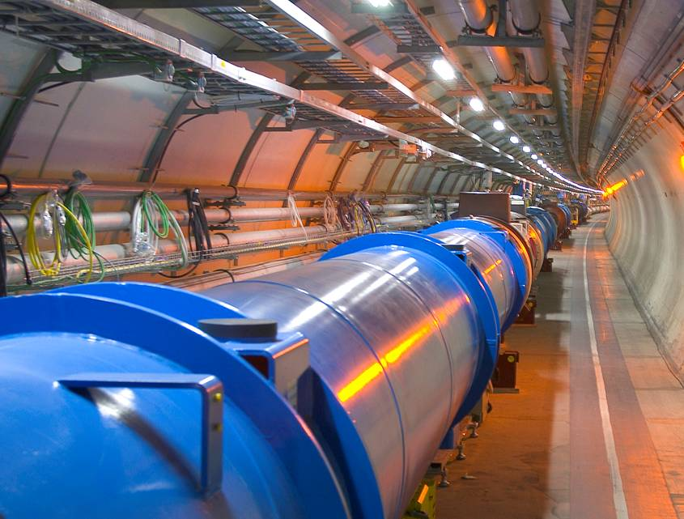
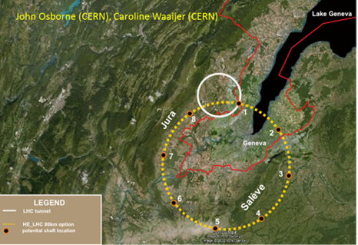
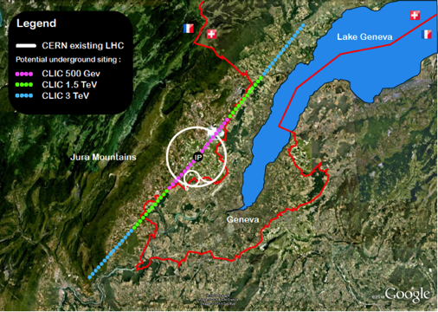
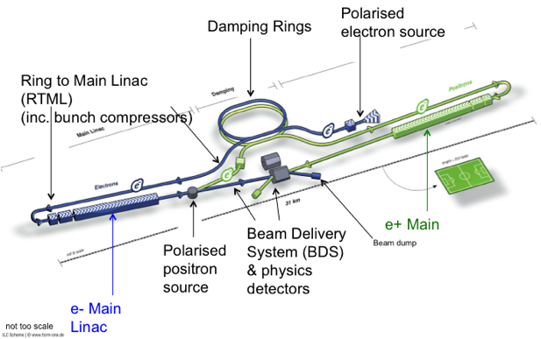
The context of the LC projects - strategies
European Strategy priorities related to the Energy Frontier:
LHC and LHC luminosity upgrades (until ~2030)
  Higgs and Beyond the Standard Model physics in long term programme
BSM – does it show up at LHC at 14 TeV, 2015 onwards ?
  What are the best machines to access such physics directly post-LHC …. we don’t know but we can prepare main options the next years towards next strategy update (~2018)
  Two alternatives considered; higher energy hadrons (HE LHC or VHE LHC), or highest possible energy e+e- with CLIC
ILC in Japan, a possibility for exploring the Higgs in detail, starting at 250 GeV
  If implemented a comprehensive programme that can map out the Higgs sector in particular
In accordance with this, pursue three connected activities in the period towards 2017-18 (when LHC results at nominal energy are becoming mature):
CLIC as option for the energy frontier
ILC project development - towards a construction project
Common activities wherever possible

Slide 3
Organization
ICFA
Program Advisory Committee
Linear Collider Board
FALC
Regional Directors
Brian Foster
Harry Weerts
Directorate
Lyn Evans
Deputy (Physics)
Hitoshi Murayama
ILC
Mike Harrison
CLIC
Steinar Stapnes
Physics & Detectors Hitoshi Yamamoto

Slide 4
LCC Objectives
Support long-term R&D on CLIC, the only credible way we have today to access multi-TeV leptons, as a possible future option after LHC.
Support the construction of a staged linear collider in Japan. Prepare a site-specific design of the machine and its detectors.
Exploit the synergy between ILC and CLIC. Prepare a plan for the sharing of the work.

Slide 5
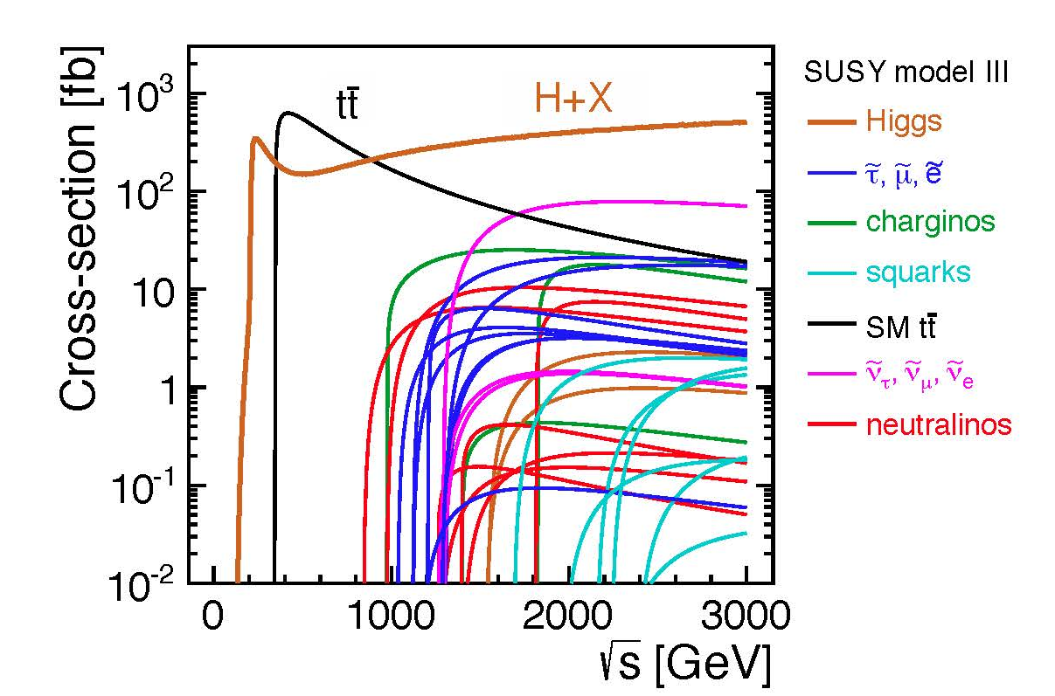
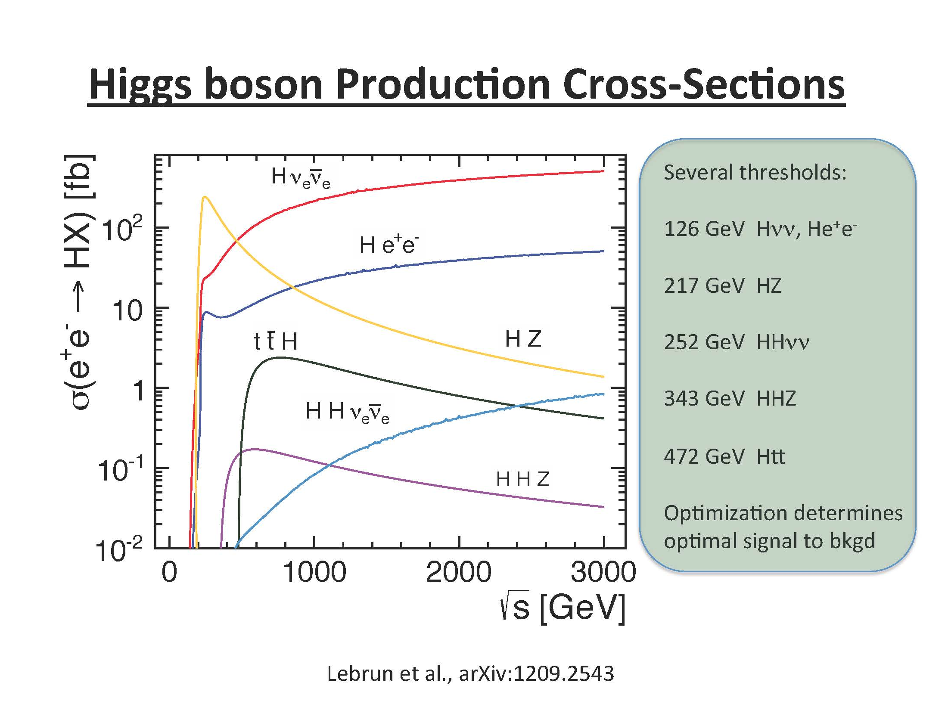
Physics at Linear Colliders from 250 GeV to 3000 GeV
Physics case for the Linear Collider:
  Higgs physics (SM and non-SM)
  Top
  SUSY
  Higgs strong interactions
  New Z’ sector
  Contact interactions
  Extra dimensions
  ….

Slide 6
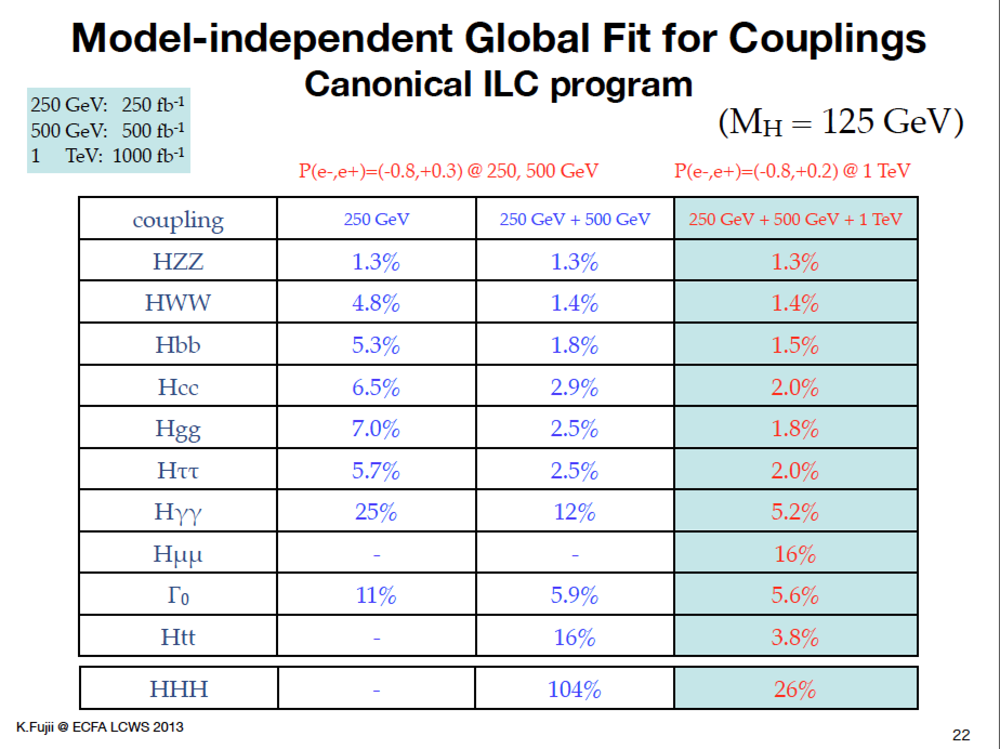
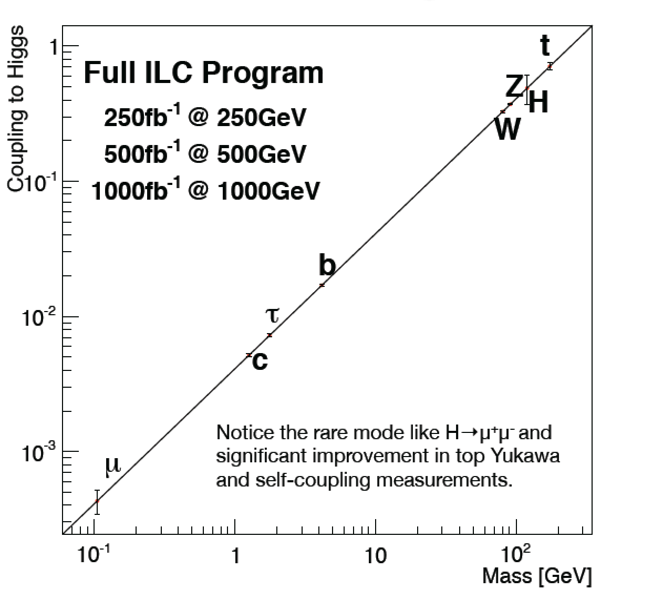

Slide 7
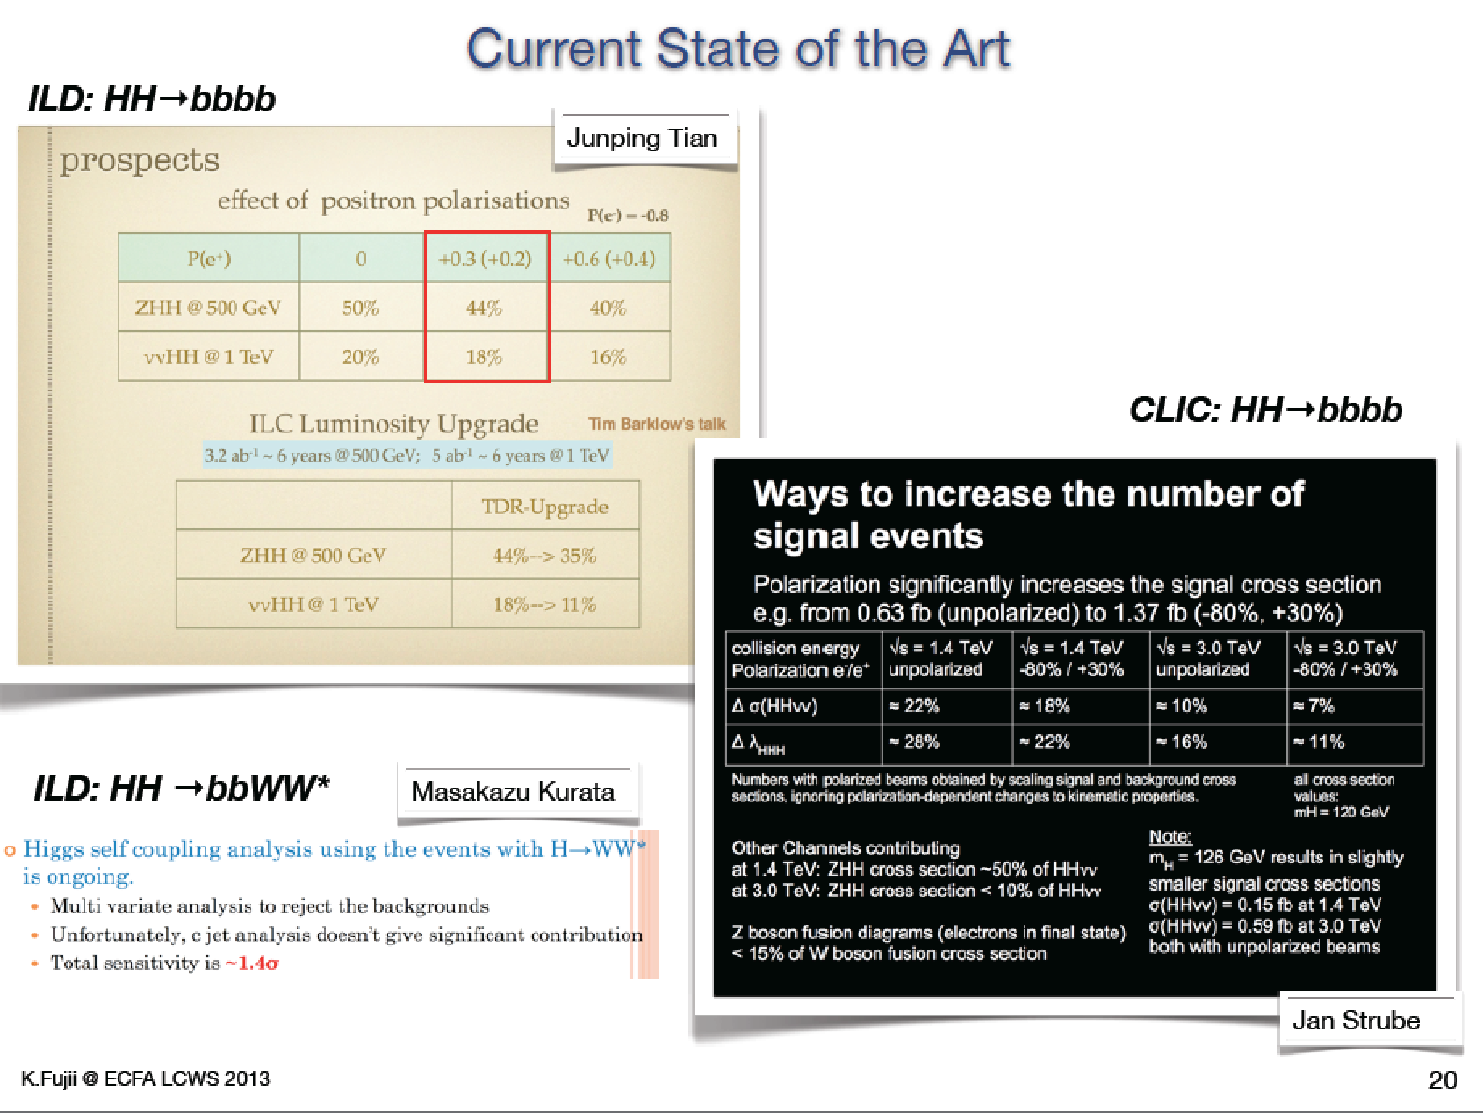
Higgs studies at higher energies

Slide 8
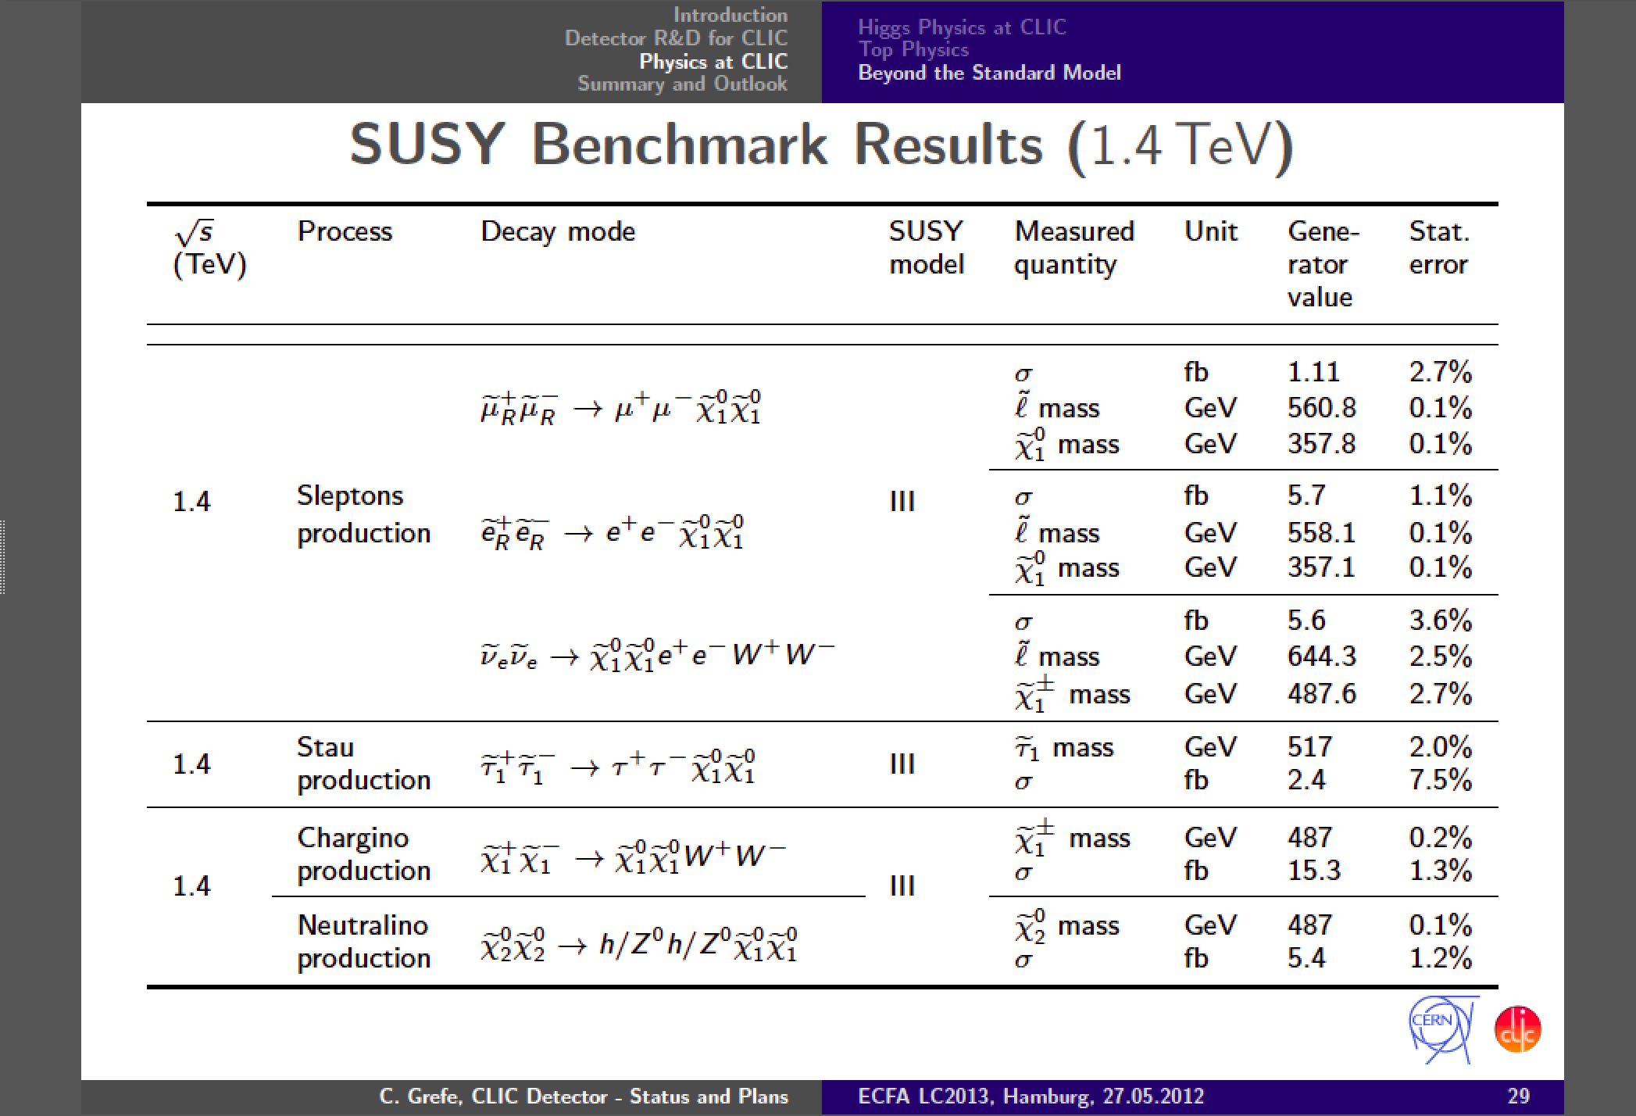
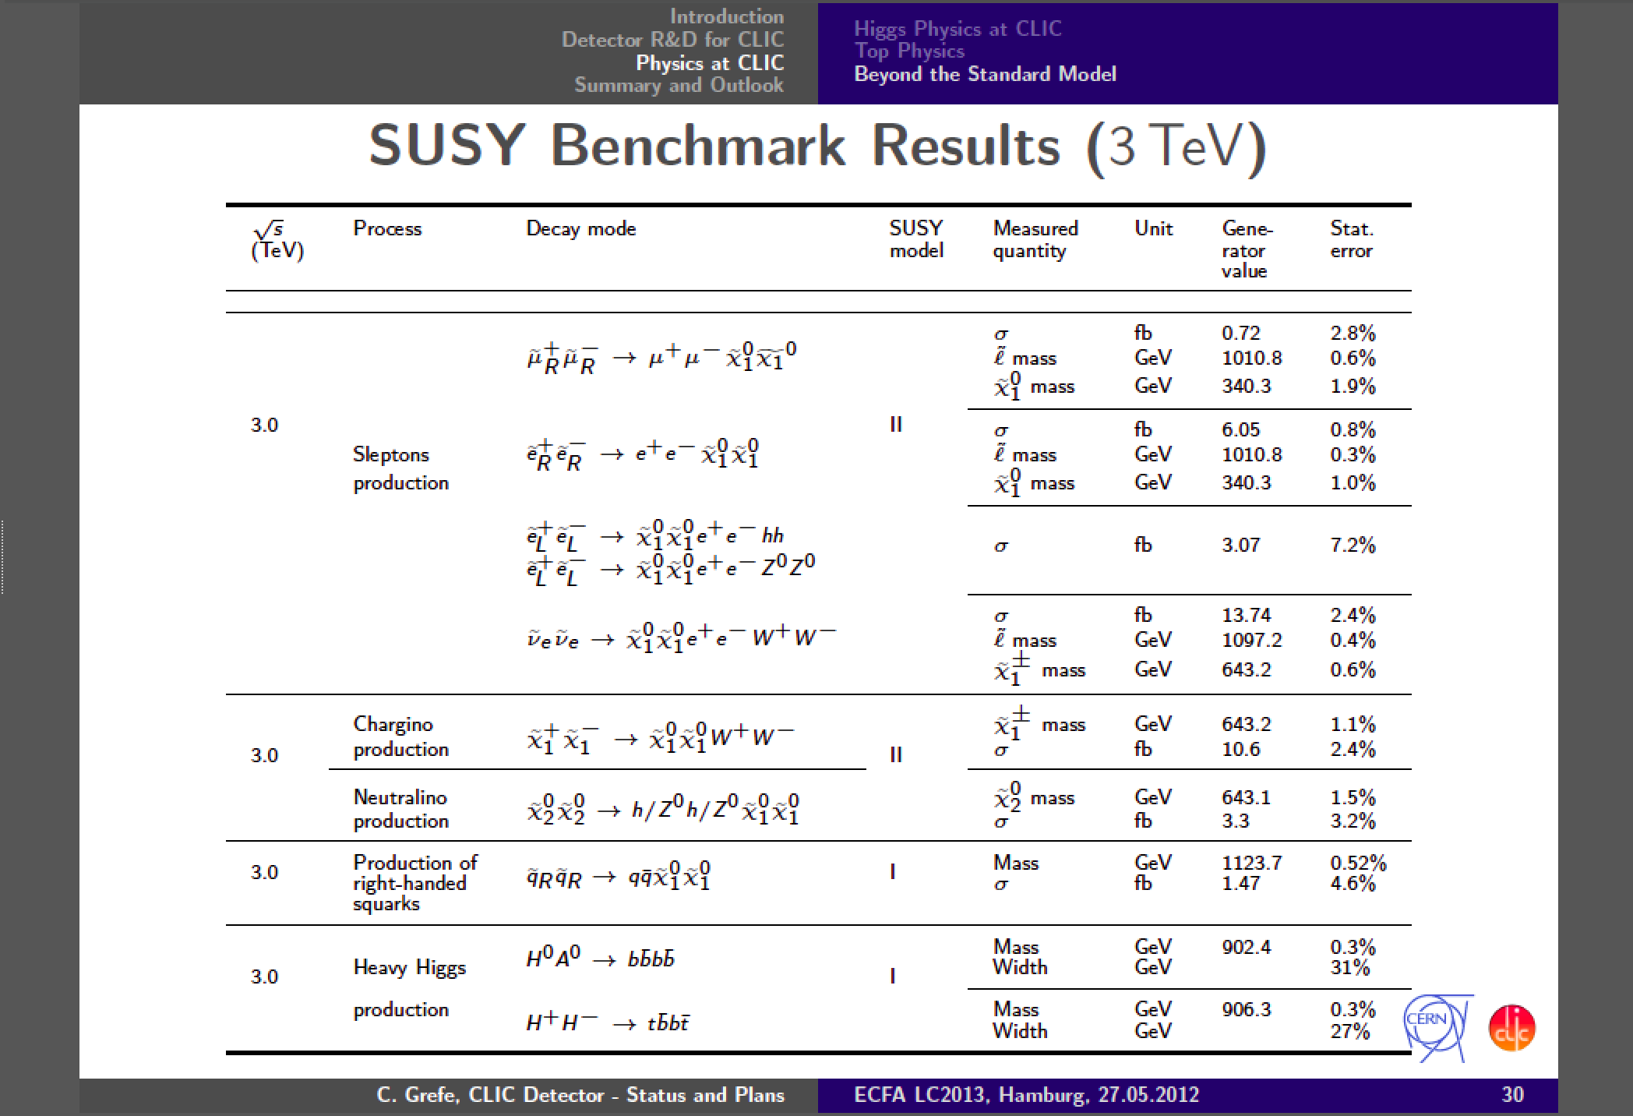

Slide 9
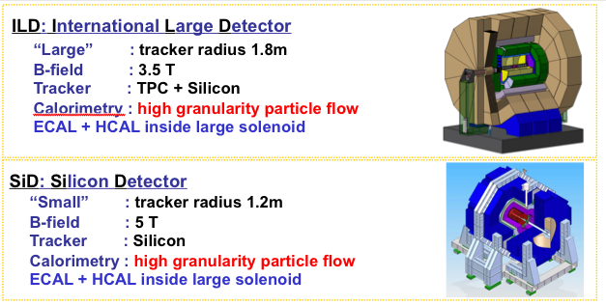
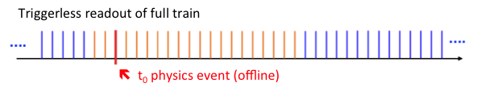
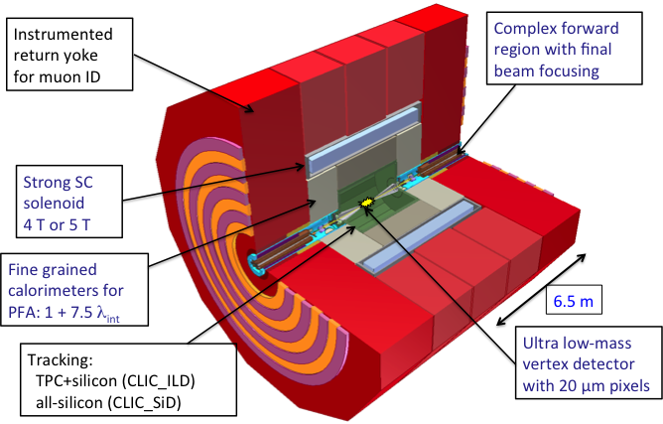
Detectors
CLIC detectors based on ILC concepts:
tCluster
CLIC timing structure demanding:
Detailed GEANT 4 simulation
  Consider in particular pair background and γγ-processes
Studied using full reconstruction with background
  Make full use of timing and fine granularity to reconstruct the physics objects with very high precision
Shown to be fully compatible with high precision e+e- physics

Slide 10
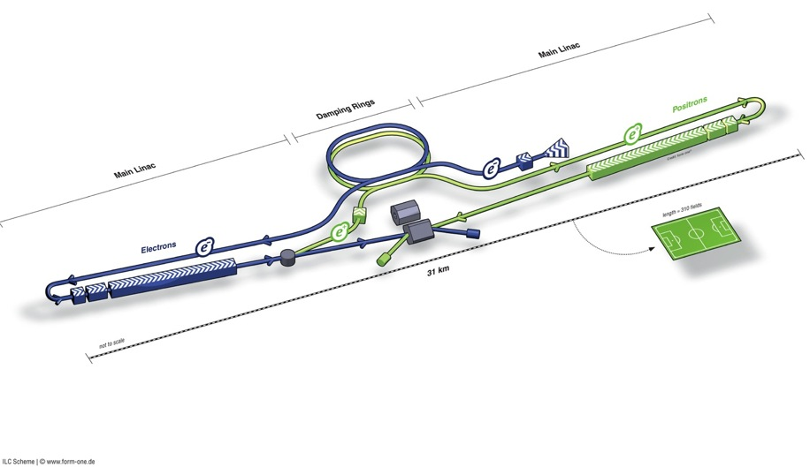
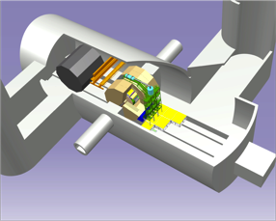
ILC TDR Layout
Damping Rings
Polarised electron source
Ring to Main Linac (RTML)
(including
bunch compressors)
e+ Main Linac
e- Main Linac
Parameters | Value
C.M. Energy | 500 GeV
Peak luminosity | 1.8 x10³⁴ cm⁻²s⁻¹
Beam Rep. rate | 5 Hz
Pulse duration | 0.73 ms
Average current | 5.8 mA (in pulse)
E gradient in SCRF acc. cavity | 31.5 MV/m +/-20% Q₀ = 1E10
E+ source

Slide 11
ILC Published Parameters
Luminosity Upgrade
Centre-of-mass independent:
Collision rate | Hz | 5
Number of bunches |  | 1312 | 2625
Bunch population | ×10¹⁰ | 2
Bunch separation | ns | 554 | 366
Pulse current | mA | 5.8 | 8.8
Beam pulse length | ms | 730 | 960
RMS bunch length | mm | 0.3
Horizontal emittance | mm | 10
Vertical emittance | nm | 35
Electron polarisation | % | 80
Positron polarisation | % | 30
http://ilc-edmsdirect.desy.de/ilc-edmsdirect/item.jsp?edmsid=D00000000925325

Slide 12
ILC-TDR: Baseline Parameters
Centre-of-mass dependent:
Focus of design (and cost!) effort
Centre-of-mass energy | GeV | 200 | 230 | 250 | 350 | 500
Electron RMS energy spread | % | 0.21 | 0.19 | 0.19 | 0.16 | 0.12
Positron RMS energy spread | % | 0.19 | 0.16 | 0.15 | 0.10 | 0.07
IP horizontal beta function | mm | 16 | 16 | 12 | 15 | 11
IP vertical beta function | mm | 0.48 | 0.48 | 0.48 | 0.48 | 0.48
IP RMS horizontal beam size | nm | 904 | 843 | 700 | 662 | 474
IP RMS veritcal beam size | nm | 9.3 | 8.6 | 8.3 | 7.0 | 5.9
Vertical disruption parameter |  | 20.4 | 20.4 | 23.5 | 21.1 | 24.6
Enhancement factor |  | 1.83 | 1.83 | 1.91 | 1.84 | 1.95
Geometric luminosity | ×10³⁴ cm⁻²s⁻¹ | 0.25 | 0.29 | 0.36 | 0.45 | 0.75
Luminosity | ×10³⁴ cm⁻²s⁻¹ | 0.50 | 0.59 | 0.75 | 0.93 | 1.8
% luminosity in top 1% DE/E |  | 92% | 90% | 84% | 79% | 63%
Average energy loss |  | 1% | 1% | 1% | 2% | 4%
Pairs / BX | ×10³ | 41 | 50 | 70 | 89 | 139
Total pair energy / BX | TeV | 24 | 34 | 51 | 108 | 344
http://ilc-edmsdirect.desy.de/ilc-edmsdirect/item.jsp?edmsid=D00000000925325

Slide 13
250 GeV staged (scenario 1)
15.4 km
1.1 km
5.1 km
1.3 km
2.2 km
Main Linac
BDS
e+ src
IP
bunch comp.
central region
Half the linac
Full-length BDS tunnel & vacuum (TeV)
½ BDS magnets (instrumentation, CF etc)
½ RTML LTL
Extended tunnel/CFS already 500 GeV stage
10Hz mode e- linac

Slide 14
250 GeV staged (scenario 2)
15.4 km
1.1 km
5.1 km
1.3 km
2.2 km
Main Linac
BDS
e+ src
IP
bunch comp.
125 GeV transport
central region
Half the linac
Full-length BDS tunnel & vacuum (TeV)
½ BDS magnets (instrumentation, CF etc)
1 RTML LTL
5km 125 GeV transport line
Extended tunnel/CFS already 500 GeV stage
10Hz mode e- linac
quasi-adiabatic energy upgrade?

Slide 15
Major R&D Efforts in TD Phase
SCRF technology and beam acceleration：
  Cavity Gradient required：31.5 MV/m
    ILC SCRF cavity R&D
      Effort for ~ 7 x Gradient (KEK-TRISTAN, CERN-LEP)
      Gradient Progress ： < 37 MV/m> （Record：46 MV/m at DESY)
      System engineering： S1-Global program with global effort
Electron Cloud Mitigation
Nano-beam handling :
  ILC requiring a beam size ~ 6 nm (vertical) and stability ~2nm:
    Progress in KEK-ATF:
      achieving ~70 nm (at 1.3 GeV),
      corresponding to 10 nm (at 250 GeV, ILC)

Slide 16
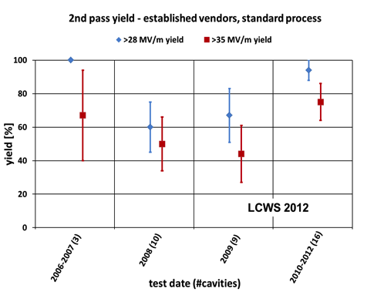
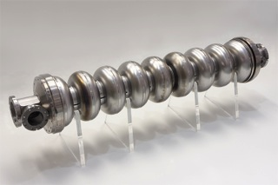
Progress in SCRF Cavity Gradient
Production yield:
94 % at > 28 MV/m,
Average gradient:
37.1 MV/m
reached (2012)

Slide 17
Progress in 1.3 GHz ILC Cavity Production
year | # 9-cell cavities qualified | Capable Lab. | Capable Industry
2006 | 10 | 1 DESY | 2 ACCEL, ZANON
2011 | 41 | 4 DESY, JLAB, FNAL, KEK | 4 RI, ZANON, AES, MHI,
2012 | (45) | 5 DESY, JLAB, FNAL, KEK, Cornell | 5 RI, ZANON, AES, MHI, Hitachi
Progress in EXFEL (800 cavity construction as of 2012/10):
(courtesy by D. Reschke: the 2nd EP at DESY)
  RI: 4 reference cavities with Eacc > 28 MV/m, (~ 39 MV/m max.)
  Zanon: 3 reference cavities with Eacc > 30 MV/m ( ~ 35 MV/m max.)

Slide 18
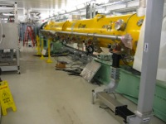

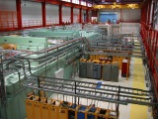
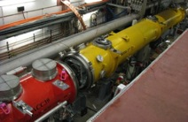
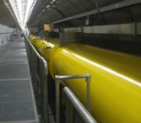
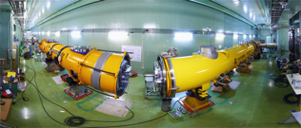
Accelerator System Tests
2009 ~
Full systems integration testing
FLASH (DESY)
NML (FNAL)
STF (KEK)
TDP focus
Under construction
Up to 6 cryomodules
Operation: end 2012
“Quantum Beam” experiment 2011
1 CM with beam 2013
7 CM → 1.2 GeV beam
photon user facility
(2 CM 2015)
(3 CM)

Slide 19
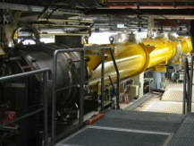
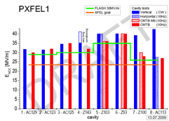
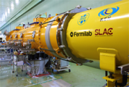
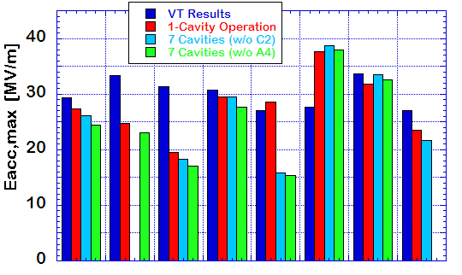

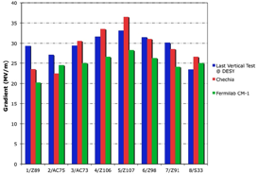
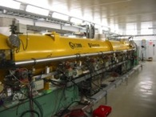
SCRF Beam Acceleration Test
DESY: FLASH
SRF-CM string + Beam,
  ACC7/PXFEL1 < 32 MV/m >
9 mA beam, 2009
800μs, 4.5mA beam, 2012
KEK: STF
S1-Global: complete, 2010
  Cavity string : < 26 MV/m>
Quantum Beam : 6.7 mA, 1 ms,
CM1 & beam, 2014 ~2015
FNAL: NML/ASTA
CM1 test complete
CM2 operation, in 2013
CM2 + Beam, 2013 ~ 2014

Slide 20
GDE 9mA experiment: Focus on ACC6 and ACC7
N. Walker
Operation with Gradient Spread
  From single RF source
  now ILC baseline
    Also expected for XFEL
Specifically: achieving constant gradients for each individual cavity during beam pulse
  to within few percent
  close to gradient limits
40.0
ACC6
ACC7
35.0
31.5 MV/m
30.0
25.0
20.0
15.0

Slide 21
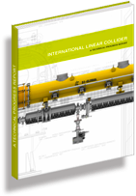
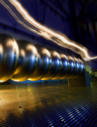
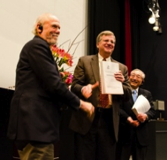
Technical Design Report Completed
2007
2011
2013*
TDR Part I:
R&D
~250 pages
Deliverable 2
ILC Technical Progress Report
(“interim report”)
AD&I
TDR Part II:
Baseline
Reference
Report
~300 pages
Deliverables 1,3 and 4
Technical Design Report
Reference Design Report
* end of 2012 – formal publication early 2013

Slide 22
ILC-TDR evaluation (2013-2)
 | M&S Value (Ratio) | M&S Value (GILCU) | M&S Value converted (GJY) | M&S Prem.: | Labor (M person-hr) | Labor Prem.:
RDR-2007 | 1 | 6.31 ¹⁾ | --- |  | 24.4
RDR-2012 (15% inflation) | 1.15 | 7.27 ¹⁾ | --- |  | 24.4
TDR-2012 average for 3 region | 1.23 | 7.78 ¹⁾ | --- |  | 22.6
TDR- (Asia) mountain site | 1.26 | 7.98 ¹⁾ | 830 ²⁾ | 26 % | 22.9 | 24 %
1) Estimated by using PPP (purchasing power parity) methodology established by OECD
2) Conversion to Japanese Yen: using currency exchange rates
- assuming a model with 100JYen/USD, 115 Jyen/Ero
＊Budget not incluced, above：
- Project preparation, Operation (0.39GILCU, 850 FTE) 、Detectors (~ 2 x 0.4 GILCU

Slide 23
Access Tunnel ex.
Beam Tunnel excavation
BDS Tunnel excavation
Survey & supports set-out
Concrete Lining
BDS Service Tunnel excavation
Electrical general services
Cavern ex.
Invert & Drainage
Piping & ventilation
Hall ex.
Shield Wall
Cabling
Supports
Machine installation
AH-4
AH-3
AH-2
AH-1
AH+1
AH+2
AH+3
AH+4
RTML
(1.35km)
e- Main Linac
(11.19km)
e-BDS
(3.33km)
e+BDS
(2.25km)
e+ Main Linac
(11.07km)
RTML
(1.35km)
1
2
3
4
5
61.9
61.9
62.0
60.3
61.9
61.9
6
7
120m/week
8
250m/week
9
100m/week
10
23

Slide 24
Further R&D/Engineering Study required
Positron source: Rotating target, alternate solution/backup
Damping ring: Undulators, 650 MHz SCRF
RTML: Quadrupole magnet with HTS?
ML: Cavity integration, CM design, HLRF demonstration…
BDS: Final focusing, alignment w/ tighter tolerance
Beam Dynamics: Accurate lattice design based on the specific site
CFS: Site specific work including Central Campus design and others
General engineering: such as drawing coordination (rules)

Slide 25

ILC Technical Board – in LCC phase
LCC Directorate
ILC Collaboration
“Technical Organization”
Director – Mike Harrison (BNL)
Deputy Director – Hitoshi Hayano (KEK)
Technical Board
Nobuhiro Terunuma (KEK)
Yasuchika Yamamoto (KEK)
Nick Walker (DESY)
Olivier Napoli (CEA)
Marc Ross (SLAC)
Nikolay Solyak (Fermilab)
KEK LC Project Office Organization at KEK
Head: Akira Yamamoto
Deputy: H. Hayano (Acc.)
K. Fujii (Phys/Det)
T. Shidara (General
Working Groups

Slide 26
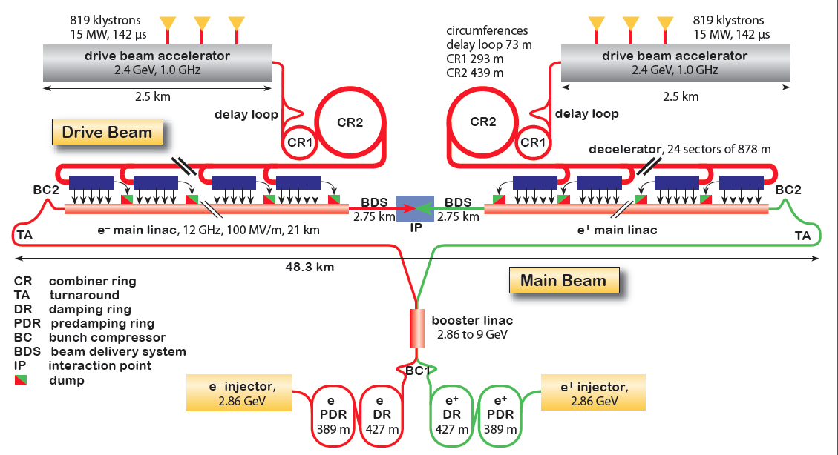
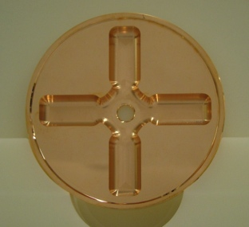
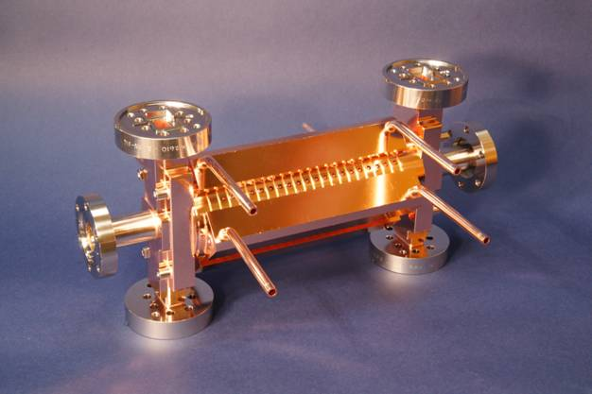
CLIC Layout at 3 TeV
Drive Beam Generation Complex
Drive beam time structure - initial
Drive beam time structure - final
240 ns
240 ns
5.8 μs
140 μs train length - 24 × 24 sub-pulses
4.2 A - 2.4 GeV – 60 cm between bunches
24 pulses – 101 A – 2.5 cm between bunches
Main Beam Generation Complex

Slide 27
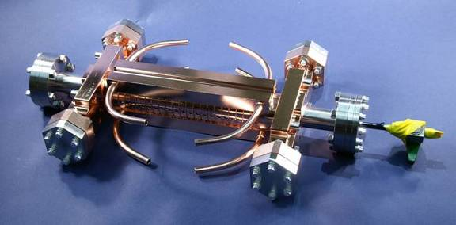
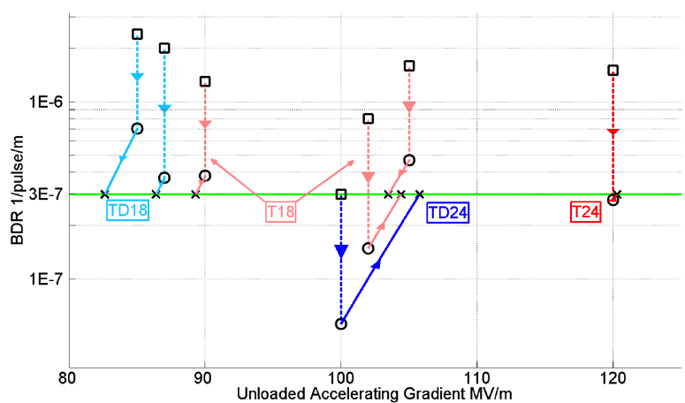
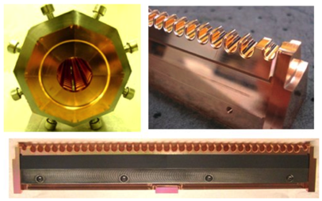
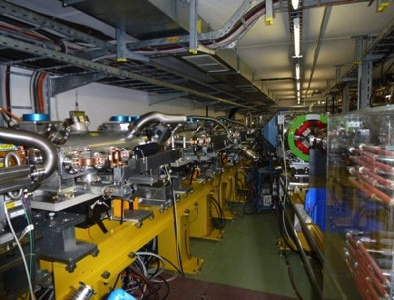
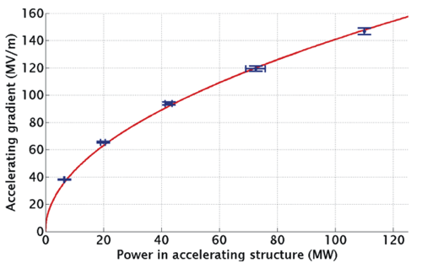
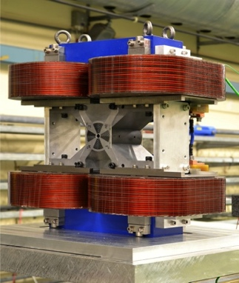
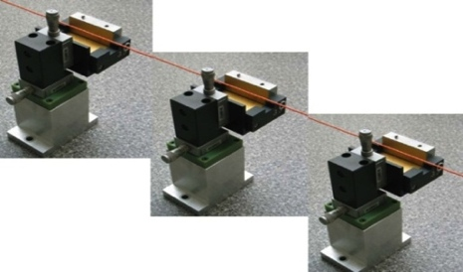
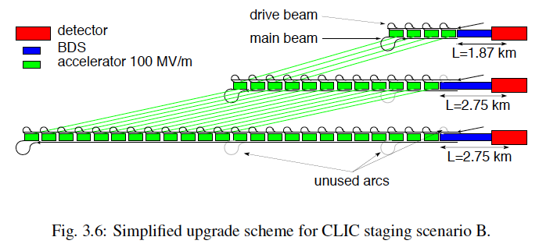
Conclusion of the accelerator CDR studies
Main linac gradient
Ongoing test close to or on target
Uncertainty from beam loading being tested
Drive beam scheme
Generation tested, used to accelerate test beam above specifications, deceleration as expected
Improvements on operation, reliability, losses, more deceleration studies underway
TD24 baseline: Unloaded 106 MV/m
Expected with beam loading 0-16% less
CLIC Nominal, unloaded
CLIC Nominal, loaded
Luminosity
Damping ring like an ambitious light source, no show stopper
Alignment system principle demonstrated
Stabilisation system developed, benchmarked, better system in pipeline
Simulations on or close to the target
Operation &
Machine Protection
Start-up sequence and low energy operation defined
Most critical failure studied and first reliability studies
Implementation
Consistent three stage implementation scenario defined
Schedules, cost and power developed and presented
Site and CE studies documented

Slide 28
The CLIC CDR documents
Vol 1: The CLIC accelerator and site facilities
- CLIC concept with exploration over multi-TeV energy range up to 3 TeV
- Feasibility study of CLIC parameters optimized at 3 TeV (most demanding)
- Consider also 500 GeV, and intermediate energy range
- https://edms.cern.ch/document/1234244/
Vol 2: Physics and detectors at CLIC
- Physics at a multi-TeV CLIC machine can be measured with high precision, despite challenging background conditions
- External review procedure in October 2011
- http://arxiv.org/pdf/1202.5940v1
Vol 3: “CLIC study summary”
- Summary and available for the European Strategy process, including possible implementation stages for a CLIC machine as well as costing and cost-drives
- Proposing objectives and work plan of post CDR phase (2012-16)
- http://arxiv.org/pdf/1209.2543v1
In addition a shorter overview document was submitted as input to the European Strategy update, available at:
http://arxiv.org/pdf/1208.1402v1
An input document to Snowmass 2013 has also been submitted:
http://arxiv.org/abs/1305.5766

Slide 29
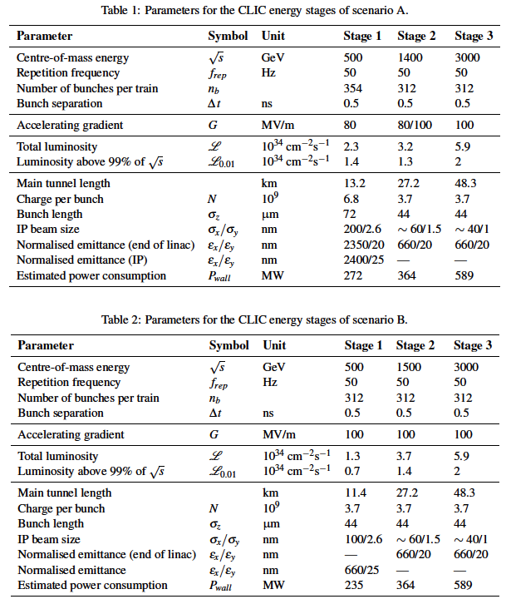
Possible CLIC stages studied
Key features:
High gradient (energy/length)
Small beams (luminosity)
Repetition rates and bunch spacing (experimental conditions)

Slide 30
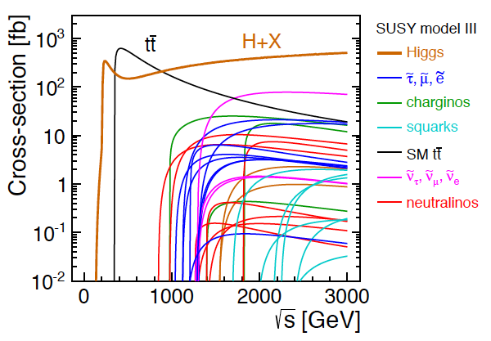
CLIC physics potential
LHC complementarity at the energy frontier:
How do we build the optimal machine given a physics scenario (partly seen at LHC ?)
Examples highlighted in the CDR:
Higgs physics (SM and non-SM)
Top
SUSY
Higgs strong interactions
New Z’ sector
Contact interactions
Extra dimensions
Detailed studies at 350 (500), 1400 and 3000 GeV for these processes
Operation at lower than nominal energy
Stage 1: ~350-375 GeV => Higgs and top physics
Stage 2: ~1.5 TeV => ttH, ννHH + New Physics (lower mass scale)
Stage 3: ~3 TeV => New Physics (higher mass scale)

Slide 31
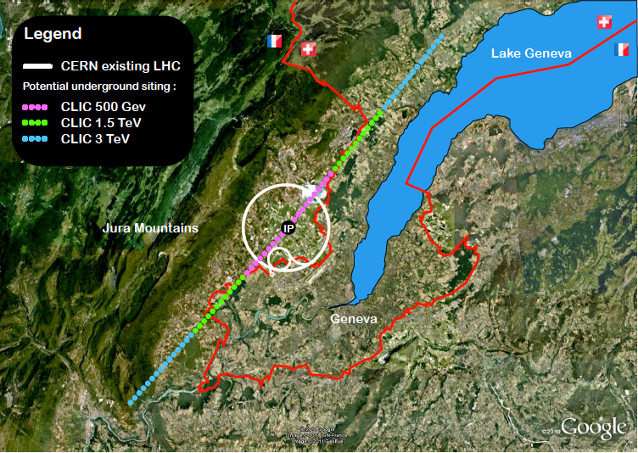
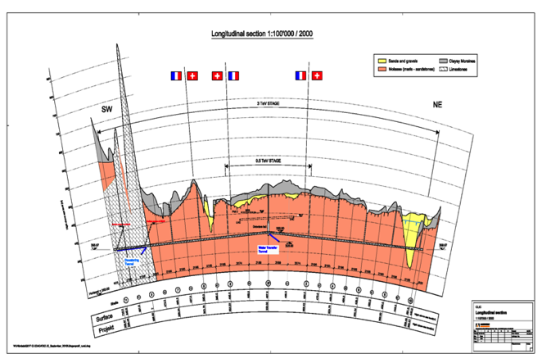
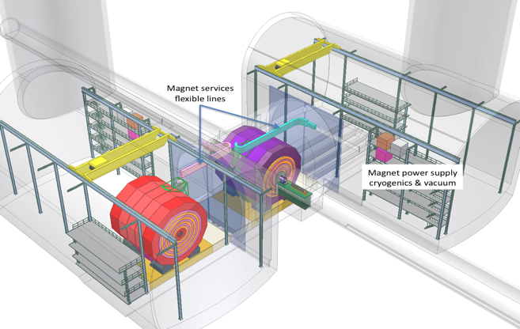
CLIC near CERN
Tunnel implementations (laser straight)
Central MDI & Interaction Region

Slide 32
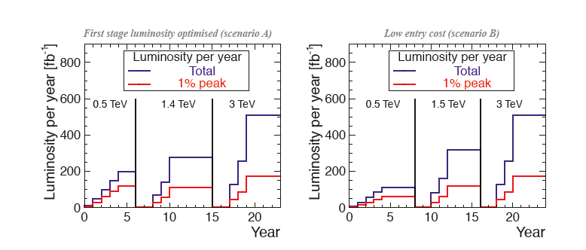
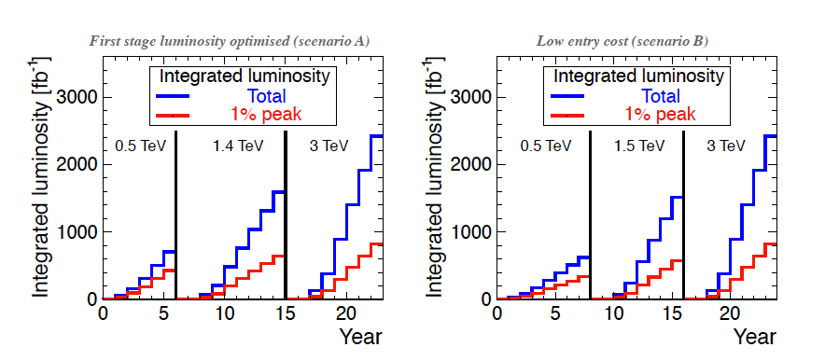


Possible luminosity examples
Based on 200 days/year at 50% efficiency (accelerator + data taking combined)
Target figures: >600 fb⁻¹ at first stage, 1.5 ab⁻¹ at second stage, 2 ab⁻¹ at third stage

Slide 33



Power/energy consumption
Considering 150 days per year of normal operation at nominal power and a luminosity ramp-up in the early years at each stage of collision energy, the development of yearly energy consumption can be sketched.
Re-optimize parts
  Reduced current density in normal-conducting magnets
  Reduction of heat loads to HVAC
  Re-optimization of accelerating gradient with different objective function
Efficiency
  Grid-to-RF power conversion
  Permanent or super-ferric superconducting magnets
Energy management
  Low-power configurations in case of beam interruption
  Modulation of scheduled operation to match electricity demand: Seasonal and Daily
  Power quality specifications
Waste heat recovery
  Possibilities of heat rejection at higher temperature
  Waste heat valorization by concomitant needs, e.g. residential heating, absorption cooling
Beyond:
Scale with inst. luminosity – i.e. running at the very end of the project lifetime might be power limited and require more time.
CERN energy consumption 2012: 1.35 TWh

Slide 34

Costs
First to second stage: 4 MCHF/GeV (i.e. initial costs are very significant)
Caveats:
  Uncertainties 20-25%
  Possible savings around 10%
  However – first stage not optimised (work for next phase), parameters largely defined for 3 TeV final stage

Slide 35




CLIC Accelerator Activities 2012-18
An optimised machine:
Higgs mass scale known and much improved cost and power models allow significant optimization
Re-baselining studies ongoing (~375 GeV, ~1.5 TeV, 3 TeV) – including more work on a klystron based initial phase
Overall design and system optimisation, technical parameters for all systems
Cost, power/energy optimisation, scheduling, site including specific developments/studies
Energy reach:
Increase test-capacity (several sites)
Detailed studies and optimisation of all the critical RF elements (main structures the most central) as well as further industrialisation
Luminosity performance:
Final focus optimisation and studies
Overall performance, reliability, robustness and risk studies
Linked to X-band technology development and industrialisation
Overall performance simulation and optimisation of each system – in some case linked to experimental benchmarking and/or tests (some examples below)
Damping ring designs including experimental development and studies
Main linac alignment and stability, wakefield studies, BBA alignment
CTF3+ programme
ATF, FACET for luminosity performance and various other smaller programmes for specific technology developments
System tests:
Studies of drive-beam stability and RF units, beam-loading experiments, deceleration, RF power generation and two beam acceleration with complete modules, as well as beam based alignment/beam delivery system/final focus studies
Continuing/increasing links to light source community related to low emittance rings and X-band based FELs design studies
Technical developments:
Critical elements, for performance, costs or power consumption, industrial developments or as needed for systemtest (some examples below)
Module development including complete modules (RF, alignment/stability, magnets, instrumentation, vacuum, cooling, controls) for lab and CTF3
RF power systems development (1 GHz)
Alignment and stability methods and hardware
Notes:
Key words for 2013:
rebaseling
power reduction studies
systemtests
structure testing capacity
drive beam power unit
common work with light source community

Slide 36


























Current CLIC Collaboration
CLIC multi-lateral collaboration - 48 Institutes from 25 countries
Over the last months increased to 48 institutes from 25 countries adding Jerusalem, Belgrade, Alba and Tartu to the list – linked to 2012-2017 work-programme
On-going discussions with 5 more groups … large interest for participation in development of this technology
Detector and Physics Studies for CLIC being organized in a similar manner, but with less formal agreements – yet allowing a collaboration like structure to organize the work, elections and making decisions about priorities and policies
ACAS (Australia)
Aarhus University (Denmark)
Ankara University (Turkey)
Argonne National Laboratory (USA)
Athens University (Greece)
BINP (Russia)
CERN
CIEMAT (Spain)
Cockcroft Institute (UK)
ETH Zurich (Switzerland)
FNAL (USA)
Gazi Universities (Turkey)
Helsinki Institute of Physics (Finland)
IAP (Russia)
IAP NASU (Ukraine)
IHEP (China)
INFN / LNF (Italy)
Instituto de Fisica Corpuscular (Spain)
IRFU / Saclay (France)
Jefferson Lab (USA)
John Adams Institute/Oxford (UK)
Joint Institute for Power and Nuclear Research SOSNY /Minsk (Belarus)
John Adams Institute/RHUL (UK)
JINR
Karlsruhe University (Germany)
KEK (Japan)
LAL / Orsay (France)
LAPP / ESIA (France)
NIKHEF/Amsterdam (Netherland)
NCP (Pakistan)
North-West. Univ. Illinois (USA)
Patras University (Greece)
Polytech. Univ. of Catalonia (Spain)
PSI (Switzerland)
RAL (UK)
RRCAT / Indore (India)
SLAC (USA)
Sincrotrone Trieste/ELETTRA (Italy)
Thrace University (Greece)
Tsinghua University (China)
University of Oslo (Norway)
University of Vigo (Spain)
Uppsala University (Sweden)
UCSC SCIPP (USA)

Slide 37

The CLIC Workshop 2013
(295 people signed up, 250 contributions - Open Session Monday morning)
ENERGY FRONTIER PROJECTS AT CERN AFTER LHC – THE CONTEXT OF THE CLIC ACTIVITIES
Monday afternoon:
Common session with main other alternatives for energy frontier projects at CERN after LHC (LHC energy upgrades), including presentations of what we can expect from LHC and a potential Higgs-factory
Status and very first focus on potential common or co-ordinated activities in the coming years (2013-2017)
CLIC PROJECT CORE ACTVITIES
Tuesday and Wednesday:
Parallel working groups for accelerator topics (3) and detector-physics (2)
Review of technical studies related to accelerator and detector and physics studies – with focus on ongoing and planned activities 2012-2017
Focus on the collaboration involvement and responsibilities
Define goals and milestones for end 2013 across project
Tuesday evening: Detector and Physics Institute Board
Friday AM: Accelerator plenary
Friday PM: CLIC Accelerator Collaboration Board
Many common developments between CLIC and ILC, related to accelerators and detector&physics
HIGH GRADIENT DAY
Thursday:
Presentation by labs/projects with core technology normal conducting high gradient structures and high efficiency power sources (11 project and 18 industry presentations)
Increase exchange of information between these activities, consider more common technical activities, and work towards increasing the industrial technology base for these projects

Slide 38







Geological Survey and
Common-Subject Study, going on, in japan
KEK
Tohoku U. G. Survey
Nomura Research Common Subject: Central Campus
Kyushu U. G. Survey.
Kitakami
Sefuri
-150m
Reports to be available in July, 2013
-300m

Slide 39


Relative Location ?
ILC Facilities
Daily life Zone
30-60 min.
Research Bases
Central Campus
Residence area
Living and City area
Existing City Area
A concept: Relative distance from main campus, for moving time: ≤ ~ 30 min.

Slide 40
An Assumption for Numbers of Persons at ILC (whole) Laboratory
(more than the number in TDR)
 | Under construction Peak (8Th year.) | Operation start (11Th year.) | In operation (15Th year.) | In operation (20Th year.)
Laboratory Staffs #1 | 1,600 | 1,200 | 1,200 | 1,200
Experiment participants #2 | 500 | 700 | 800 | 1,000
Laboratory Support #3 | 300 | 300 | 400 | 500
Total | 2,400 | 2,200 | 2,400 | 2,700
#1: including the regular/permanent staff and temporary staff (Post-Doc),
#2: including researchers, engineers and students for two experiments,
#3: including subcontracted specialist to support acc. & exp. activities

Slide 41
General Plan for ILC Central Campus
(major fraction of persons having working spaces there)
Classification | Assuming facilities
 | Facilities | Area(m²)
Offices | Research office University & Institute | 35,000
laboratory facilities | Control center Assembly hall Technology development hall | 33,000
meeting and exchange | Lecture hall Meeting room | 3,500
Accommodation | Dormitory Visitor accommodation | 23,000
Service facilities | Reception, Users office Library, exhibition hall Cafeteria, Convenient store Health care & Training center | 3,200
Transportation | Parking, Bus Terminal | -
Energy plant, etc. |  | 1,100
Total |  | 99,800
Major facilities:
Offices
Laboratory
Meeting rooms
Visitor’s accommodation
General services
Parking
Utility plant, etc.
Assuming:
~ 100,000 m²
in total floor area

Slide 42





Case studies : Zoning and Facility Layout
High-Rise Type
Flatter Type
More spatial design
Area: ~ 30,000 m² ~ 40,000 m² ~ 80,000 m²
(Floor area: commonly ~10,000 m²)
To be more discussed in the ADI/CFS session

Slide 43

XFEL challenges experience, test facility
New test infrastructure has been build:
  Cold RF test of all XFEL superconducting cavities before cryo module assembly, 800 cavities, rate 6/week, 2 of 2 vert. test stands under operation
  Complete cold performance test of all XFEL cryo modules before tunnel installation: RF, vacuum, cryo-losses, tuner, quad, 100 cryo modules, rate: 1/week, 1 of 3 test stands in cryo commissioning
  Cold test of all superconducting magnet packages before cryo module assembly 100 magnets, 1/week, 1 of 1 stand under operation
  Assembly and tests of RF Waveguides at Waveguide Assembly and Test Facility, under operation

Slide 44

XFEL challenges experience, module assembly
New and complex infrastructure build at CEA, Saclay
Clean Room Cold Coupler Area (IS04-CC-WS1)
  Cold coupler assembly
Clean Room String Assembly Area (ISO4-SA-WS1, ISO4-SA-WS2)
  String connections (1 gate valve + 8 cavities + 1 Qpole unit)
Roll-out Area (RO-WS1, RO-WS2)
  HOM tuning, magnetic shielding, tuners,…
  2Ph-tube welding, cold-mass connection
Alignment Area (AL-WS1, AL-WS2)
  Cavity and quadrupole fine alignment
  Coupler shields and braids, tuner electric tests
Cantilever Area (CA-WS1)
  Welding of 4K and 70 K shields, super insulation
  Quad current lead
  Insertion into vacuum vessel and string alignment
Coupler Area (CO-WS1, CO-WS2)
  Warm couplers + coupler pumping line
  Control operations (electrical, RF)
Shipment Area (SH-WS1, SH-WS2)
  CEA-Alsyom “acceptance test”
  End-caps closing, N2-insulation, loading.
In full production, this chain of workstations will be fully occupied with 7 cryomodules (XM_{n-6} @ WS1,…, XM_{n} @ WS7) stationed for one week.

Slide 45
  Obvious European contributions possible to ILC construction – based on XFEL construction (not only cryo-module examples shown on previous slides)
  Significant work and expertise – and huge common potential with CLIC related to “luminosity performance/critical systems and associated systemtests”:
  CERN, Spain, UK, Italy, France … : Sources, DR, beam-delivery systems, instrumentation, stability/alignment
Sources (common working group on positron generation)
Machine Detector Interfaces
Damping rings
Beam dynamics (covers along entire machine)
Beam delivery systems
Physics and detectors

Slide 46
Summary
Major milestones achieved for CLIC (CDR 2012) and ILC (TDR 2013)
The Higgs discovery – and future measurements – set up a clear scenario for linear colliders (maybe more to come from LHC – BSM?)
European Strategy positive with respect to both projects discussed, with different main goals and timescales
CLIC programme for 2018 defined (being revised now after the Strategy document), collaboration based developments of key aspects of the technology
ILC might enter construction (or preparation for construction) in Japan
  Site choice next, followed by statements by government ? Involvement by other regions a key
  Europe well prepared to contribute (technically) – finances another challenge

