Slide 1


An Overview of The Novel Accelerator Research Activities in Asia
Chuanxiang Tang (唐传祥）*
*Tang.xuh@tsinghua.edu.cn
Department of Engineering Physics, Tsinghua University, Beijing 100084, China
First European Advanced Accelerator Concepts Workshop (EAAC2013), June 2~7, 2013, La Biodola, Isola d’Elba, Italy

Slide 2
Outline
1. Introduction
2. High Gradient Accelerating Structures
3. Laser Wakefield Accelerators
4. ICS γ/x-ray Sources
5. Summary

Slide 3
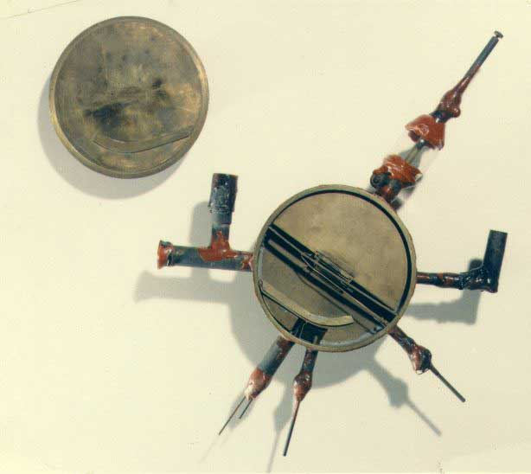
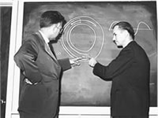
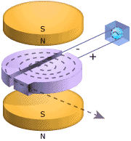
Past
A model of the first cyclotron of Livinston and Lawrence, which can accelerate protons to 80keV
Notes:
从加速器发展的历史，引出加速器的类型及其分类；从加速器的服务对象，给出加速器在各个领域的最新进展；
结论：加速器与激光技术的结合（激光加速、汤姆逊散射、自由电子激光、同步辐射的超快）；更高的加速梯度、更小型化的加速器

Slide 4

Now
LHC-a 27km proton synchrotron at CERN, 2x7TeV
Notes:
从加速器发展的历史，引出加速器的类型及其分类；从加速器的服务对象，给出加速器在各个领域的最新进展；
结论：加速器与激光技术的结合（激光加速、汤姆逊散射、自由电子激光、同步辐射的超快）；更高的加速梯度、更小型化的加速器

Slide 5
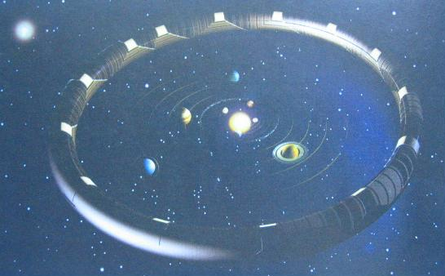
Future?
Sun
Without further novel technology, we will eventually need an accelerator as large as Hawking expected.
The Universe in a Nutshell, by Stephen William Hawking, Bantam, 2001
Notes:
从加速器发展的历史，引出加速器的类型及其分类；从加速器的服务对象，给出加速器在各个领域的最新进展；
结论：加速器与激光技术的结合（激光加速、汤姆逊散射、自由电子激光、同步辐射的超快）；更高的加速梯度、更小型化的加速器

Slide 6

Because of the synchrotron radiation, the next high energy electron accelerator may be a linear accelerator, may be ILC or CLIC, or Both
High gradient is essential for LC, no matter how to get it…

Slide 7
Develop Very High Gradient Accelerating Structures
From L-band and S-band, to C-band and X-band: achieve higher gradient
  Higher Frequency
  New Structure
  New Material
  New Manufacture Procedure
  New Understanding of Breakdown
Wakefield Accelerator
  Beam Driven Plasma Wakefield Accelerator
  Beam Driven Dielectric Wall Accelertor
Notes:
从加速器发展的历史，引出加速器的类型及其分类；从加速器的服务对象，给出加速器在各个领域的最新进展；
结论：加速器与激光技术的结合（激光加速、汤姆逊散射、自由电子激光、同步辐射的超快）；更高的加速梯度、更小型化的加速器

Slide 8
Combine Laser Technology with Accelerators
Acceleration-Laser Plasma Wakefield Accelerator,…
Beam Diagnostics-Laser Wire, …
Electron or Ion Source: Photocathode Gun, Laser Plasma Ion Source,…
Light Source-Inverse Compton/Thomson Scattering X-ray Source, Seeded Free Electron Laser,…
Notes:
从加速器发展的历史，引出加速器的类型及其分类；从加速器的服务对象，给出加速器在各个领域的最新进展；
结论：加速器与激光技术的结合（激光加速、汤姆逊散射、自由电子激光、同步辐射的超快）；更高的加速梯度、更小型化的加速器

Slide 9
A brief Overview of The Novel Accelerator Research Activities in Asia
High Gradient Accelerating Structures
Laser Plasma Wakefield Accelerators
Inverse Compton γ-ray/Thomson Scattering X-ray Sources
Notes:
从加速器发展的历史，引出加速器的类型及其分类；从加速器的服务对象，给出加速器在各个领域的最新进展；
结论：加速器与激光技术的结合（激光加速、汤姆逊散射、自由电子激光、同步辐射的超快）；更高的加速梯度、更小型化的加速器

Slide 10
The High Gradient Researches in Asia
X-band (11.424GHz) Structures development at KEK
Choked Mode Accelerating Structures
C-band (5.712GHz) at Spring-8
X-band (12GHz) at THU
Others :
SINAP-C Band Traveling Wave Disc Structures
Notes:
从加速器发展的历史，引出加速器的类型及其分类；从加速器的服务对象，给出加速器在各个领域的最新进展；
结论：加速器与激光技术的结合（激光加速、汤姆逊散射、自由电子激光、同步辐射的超快）；更高的加速梯度、更小型化的加速器

Slide 11
High gradient in linear colliders
GHz MV/m GeV
SLAC 3 17 50
ATF 3 30 1
VLEPP 14 100 1000
GLC 11 50 1000
CLIC30 30 150 3000
ILC 1 31.5 500
CLIC12 12 100 3000
80’ Started serious R&D for LC
90’s proof in high gradient and mass production
00’s transition from warm to cold but keep warm alive
10’s reinforcing high gradient + wake field
T. Higo, Invited Talk at Symposium on High Gradient Accelerating Structures, THU, Beijing, May 19th 2013

Slide 12
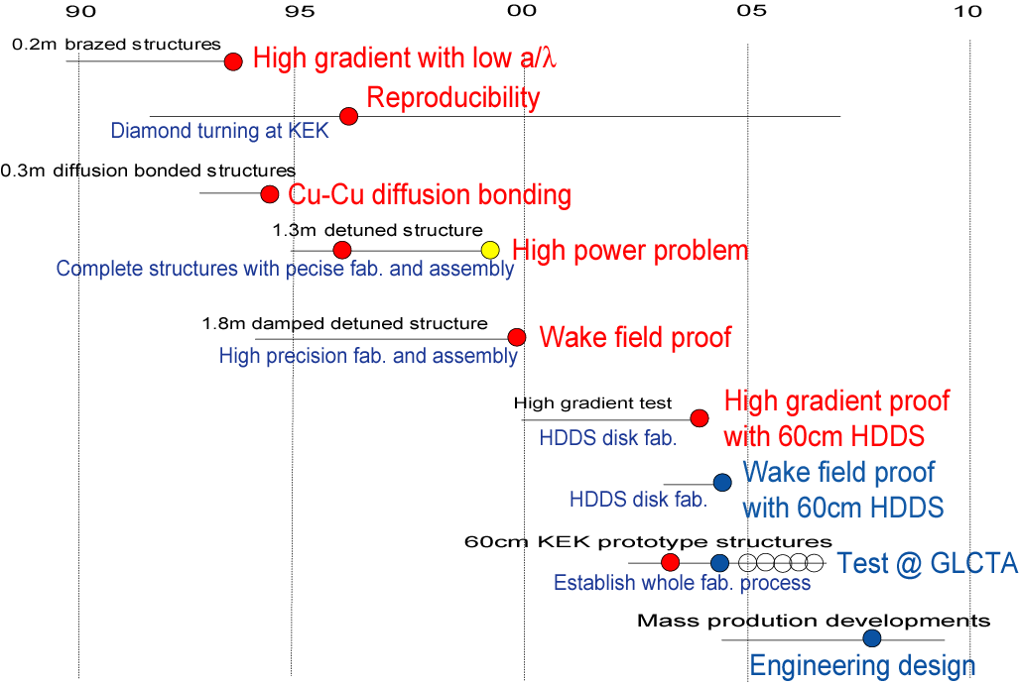
X-Band Accelerating Structure Development at KEK
Notes:
从加速器发展的历史，引出加速器的类型及其分类；从加速器的服务对象，给出加速器在各个领域的最新进展；
结论：加速器与激光技术的结合（激光加速、汤姆逊散射、自由电子激光、同步辐射的超快）；更高的加速梯度、更小型化的加速器

Slide 13
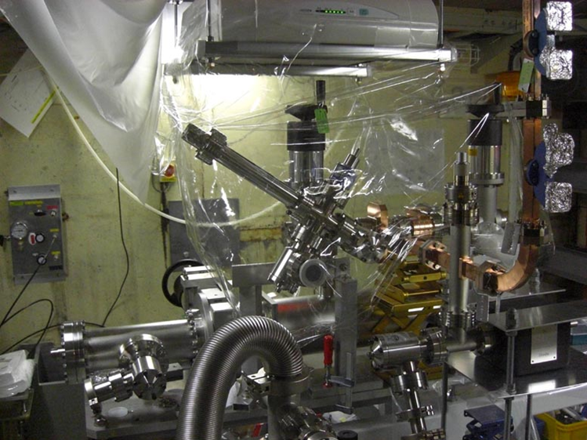
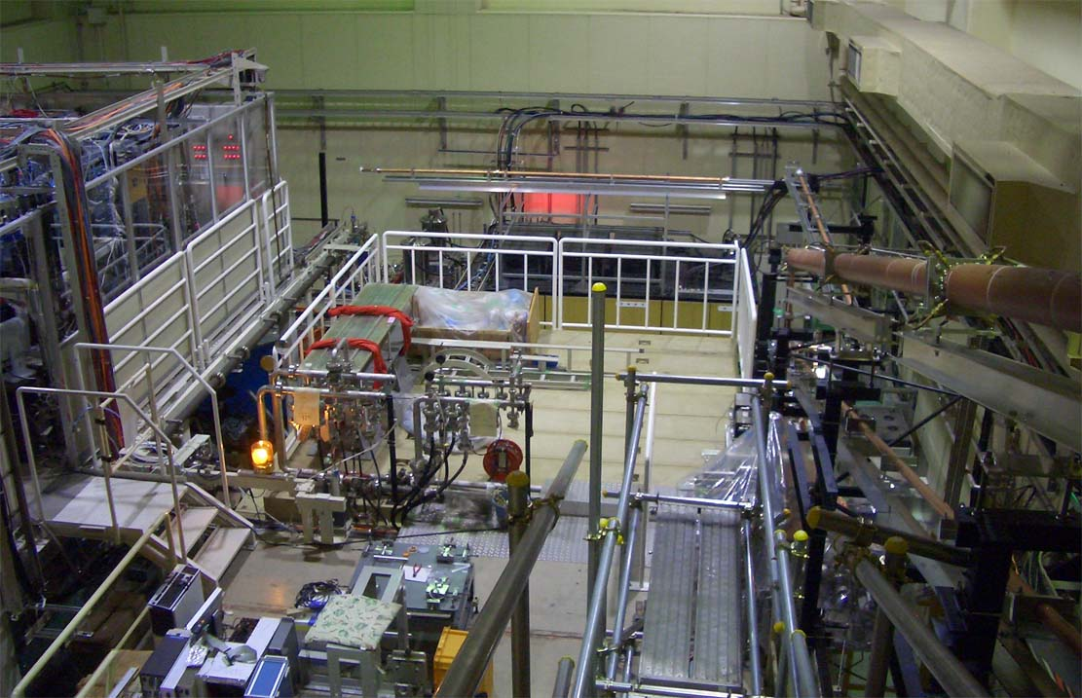
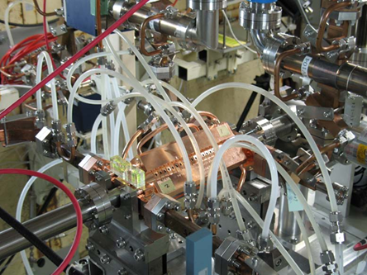
Nextef for high gradient R&D
RF source for A
Control
Shield B
B
A
Shield A

Slide 14
High-gradient test at Nextef
2008 2009 2010 2011 2012 2013
4 7 10 1 4 7 10 1 4 7 10 1 4 7 10 1 4 7 10 1 4 7 10 1
GLC
CLIC prototype tests
KX03 (60cm HDDS)
1
T18_Disk_#2
1.5
TD18_Quad_#5
Nextef
2
TD18_Disk_#2
3
T24_Disk_#3
4
TD24_Disk_#4
5
TD24R05 #2
Narrow waveguide test
TD24R05 #4?
High power components test
TD24R05(KEK)?
KT1
KT1 to shield-B
Replace klystron
Basic studies at shield-B
Shield-B

Slide 15
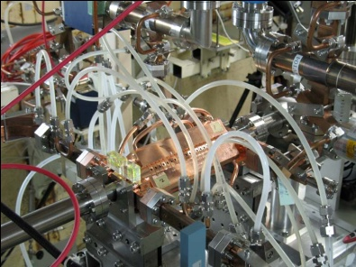
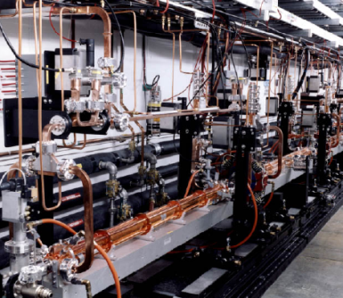
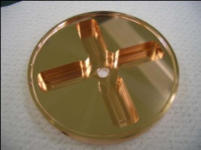
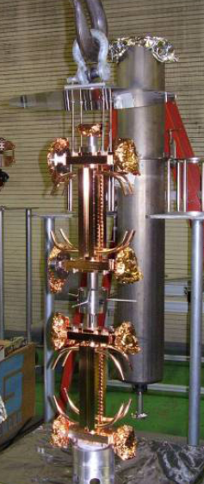
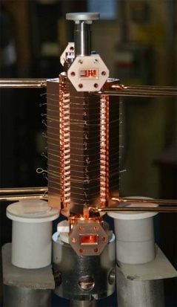
CERN/SLAC/KEK test flow (as usual)
Design for CLIC (CERN)
High power test (NLCTA-SLAC)
High power test (Nextef-KEK)
Fabrication of parts (KEK)
CP (SLAC)
VAC bake (SLAC)
Bonding (SLAC)
Notes:
プロトタイプの試験サイクル
ここでも 日米を基礎におく SLAC・KEK キープレーヤー

Slide 16
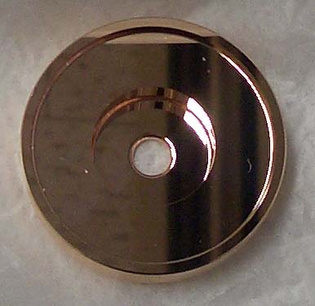

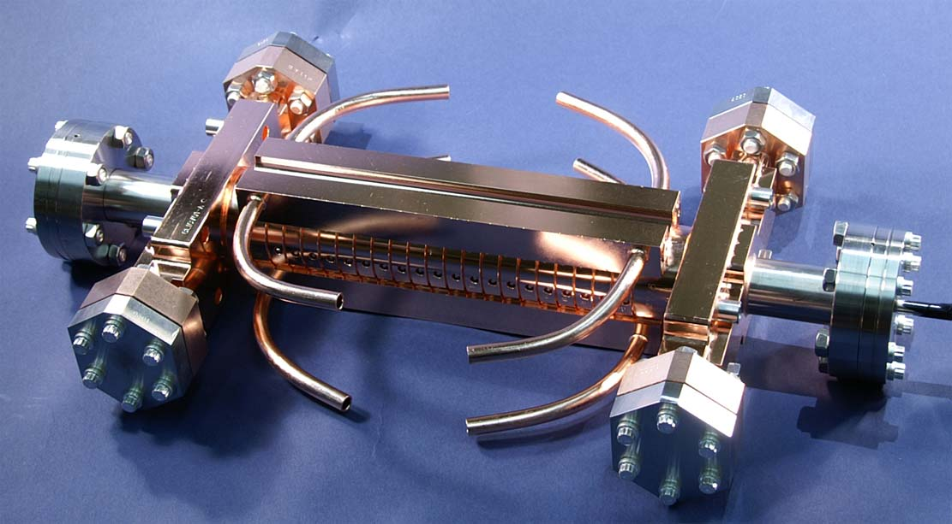
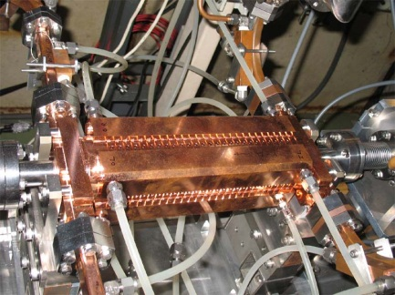
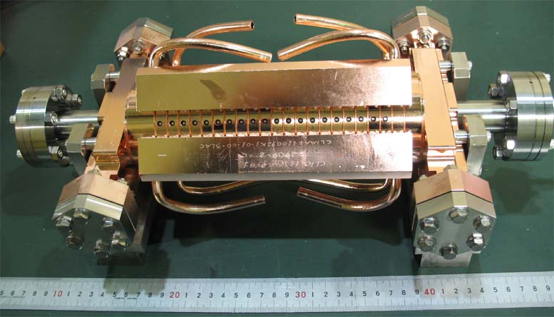
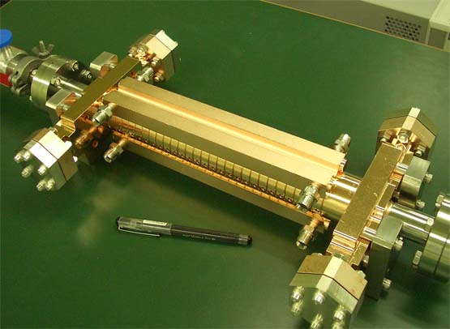
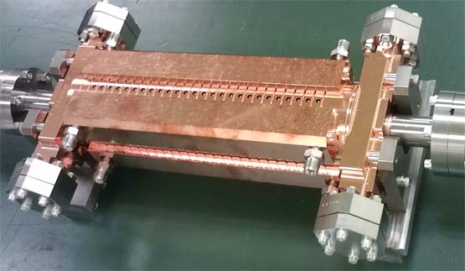
Fabrication and test of LC prototype structures
T18 →TD18→T24→TD24→TD24R05→TD24R05
2009
2013
Under vacuum balking at SLAC to be tested at KEK in April
d
2012
T18_Disk_#2
TD24R05_#4
2010
TD24R05_#2
2011
TD18_Disk_#2
2011-2012
d
d
T24_Disk_#3
TD24_Disk_#4

Slide 17
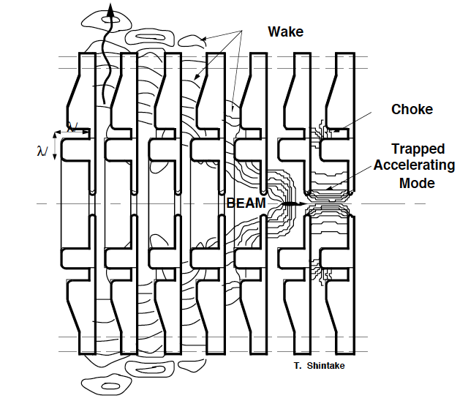
C-band Choke Mode Accelerating Structure for LC
T. Shintake, EPAC1996, C-BAND CHOKE MODE ACCELERATOR STRUCTURE FOR THE LINEAR COLLIDER
Notes:
从加速器发展的历史，引出加速器的类型及其分类；从加速器的服务对象，给出加速器在各个领域的最新进展；
结论：加速器与激光技术的结合（激光加速、汤姆逊散射、自由电子激光、同步辐射的超快）；更高的加速梯度、更小型化的加速器

Slide 18
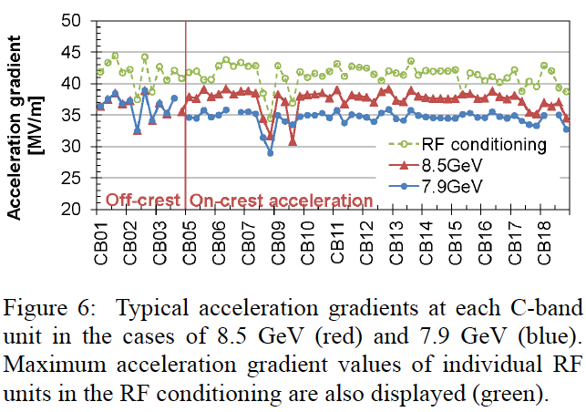
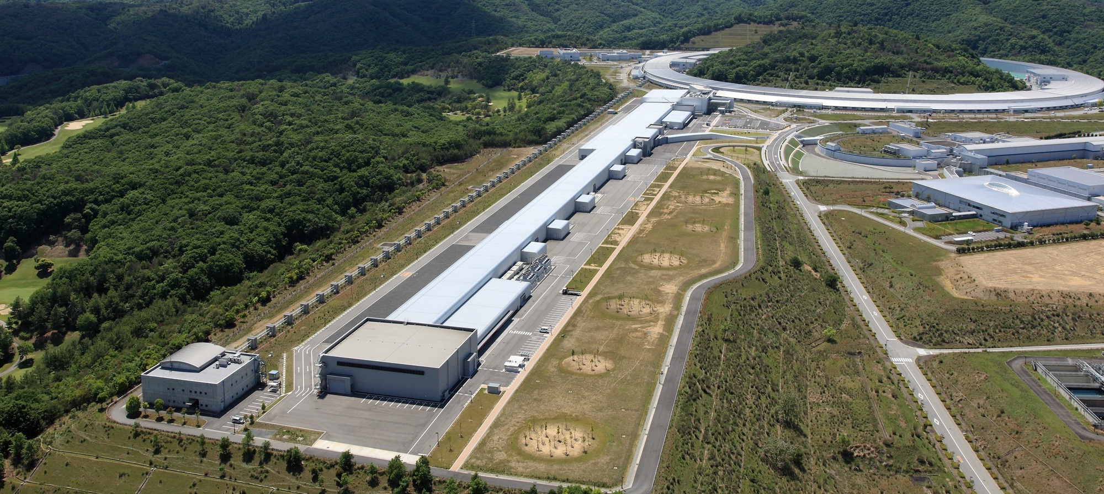

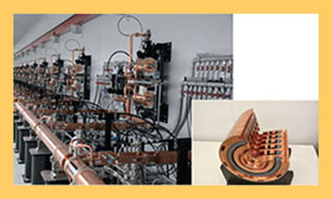
128 C-band Choke Mode Accelerating Structures of 5.7GHz Was Used at SACLA XFEL
Spectra of seeded (red lines) and unseeded (blue lines) conditions given by experiment (a) and simulation (b)
T. Inagaki, et al, MOPB005, Proceedings of LINAC2012, Tel-Aviv, Israel
http://xfel.riken.jp/eng/index.html,
http://www.s.u-tokyo.ac.jp/en/press/2011/01.html, May 31, 2013
Notes:
从加速器发展的历史，引出加速器的类型及其分类；从加速器的服务对象，给出加速器在各个领域的最新进展；
结论：加速器与激光技术的结合（激光加速、汤姆逊散射、自由电子激光、同步辐射的超快）；更高的加速梯度、更小型化的加速器

Slide 19
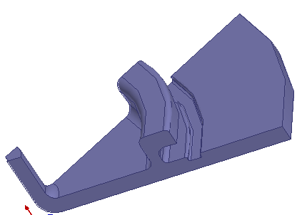
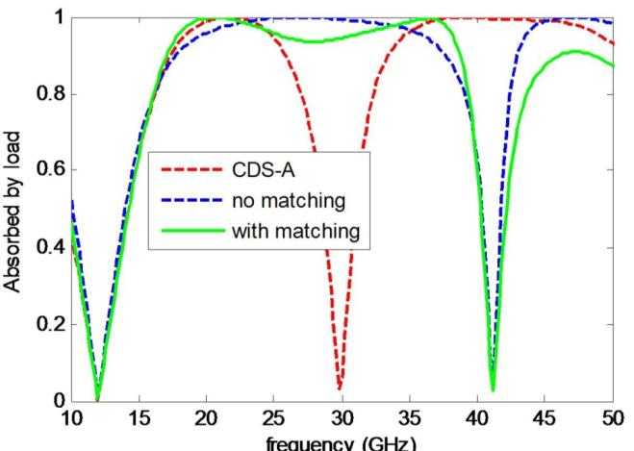

New Choke Mode X-band Structure Designing for CLIC (CDS-C) by THU/CERN
Features include “two-section”, “impedance matching”, “detuning”
2.0mm
1.2mm
1.6mm
Hao Zha, et al, PRST ACCELERATORS AND BEAMS 15, 122003 (2012)

Slide 20
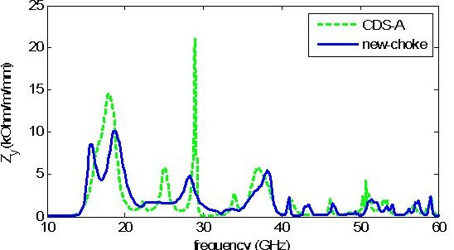
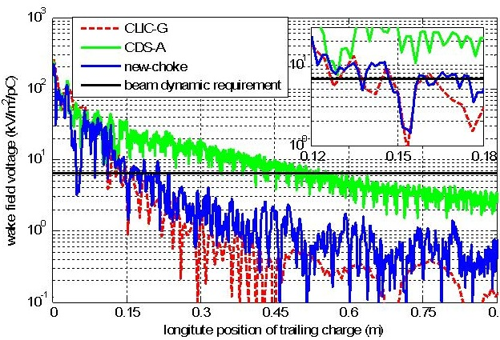
Damping Result of The CDS-C Compared with WDS
 | W⊥ (s=0.15m) V/m/mm/pC
WDS | 5
CDS-A | ~30
CDS-C | 4~5
Freq(GHz) | Q | (R/Q)⊥
15.7 | 5.4 | 80.3
18.6 | 6.9 | 63.2
23.7 | 3.8 | 14.8
28.4 | 12.4 | 10.9
38.2 | 11.6 | 9.9
s | CDS | WDS
Fc | 1 | 1
Frms | 4 | 5
Fworst | 25 | 20

Slide 21
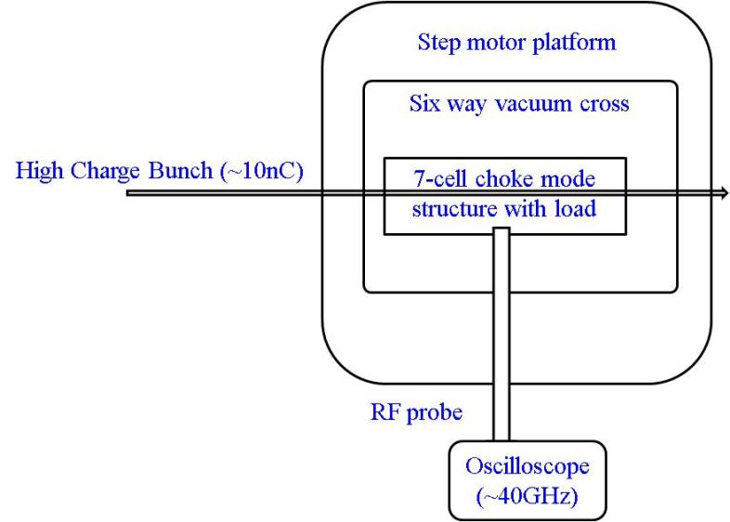
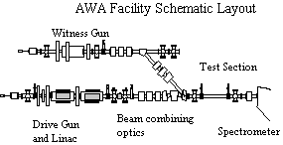
Bunch Excitation to Measure the Damping
AWA at ANL
Structure can be moved, driven by step motor
  Offset to excite dipole modes
(No following bunch at the moment)
Under construction

Slide 22
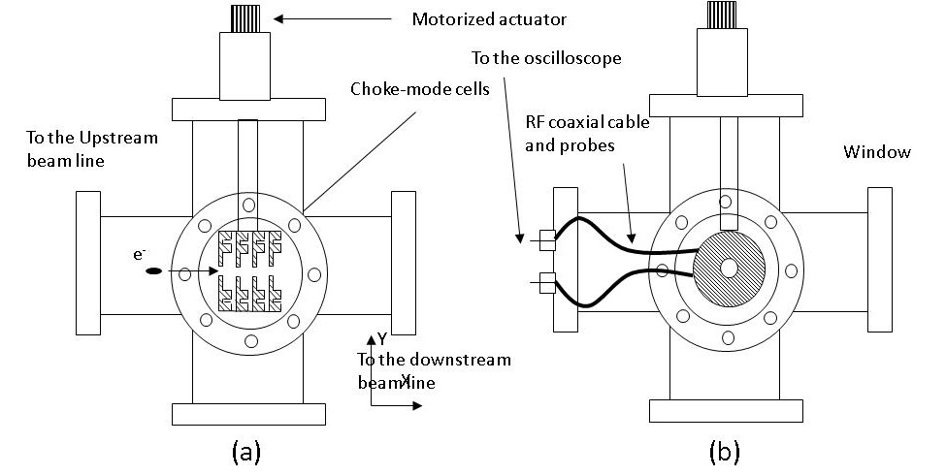
Experiment Layout
Time domain signal with fast scope (0~36GHz)
With -30dB attenuation signal strengh ~1V/nC/mm.

Slide 23
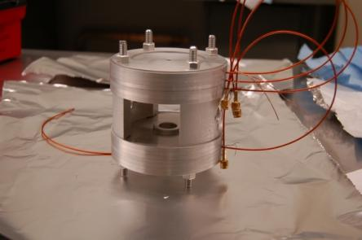
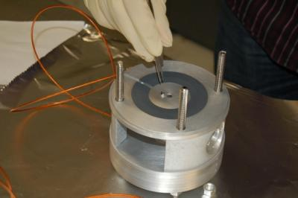
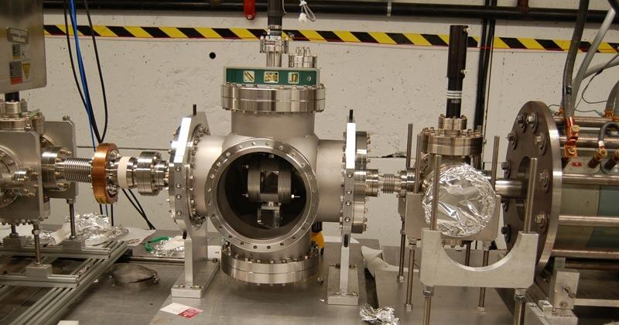
Everything is ready, except…
←3cells with SiC
←3cells without SiC
RF probe installed→

Slide 24
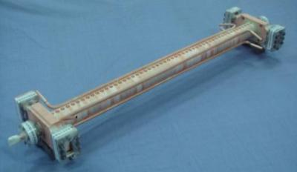
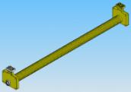
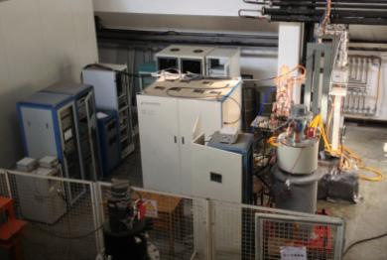
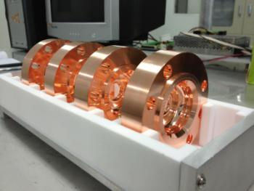
Status of C-band at SINAP
Prototype accelerating structure is high tested.
The new structure is designed and fabricated.
Pulse compressor is designed and partially tested.
The first high power test box is ready, and second one is planed.
WenCheng FAN, CLIC Workshop 2013

Slide 25
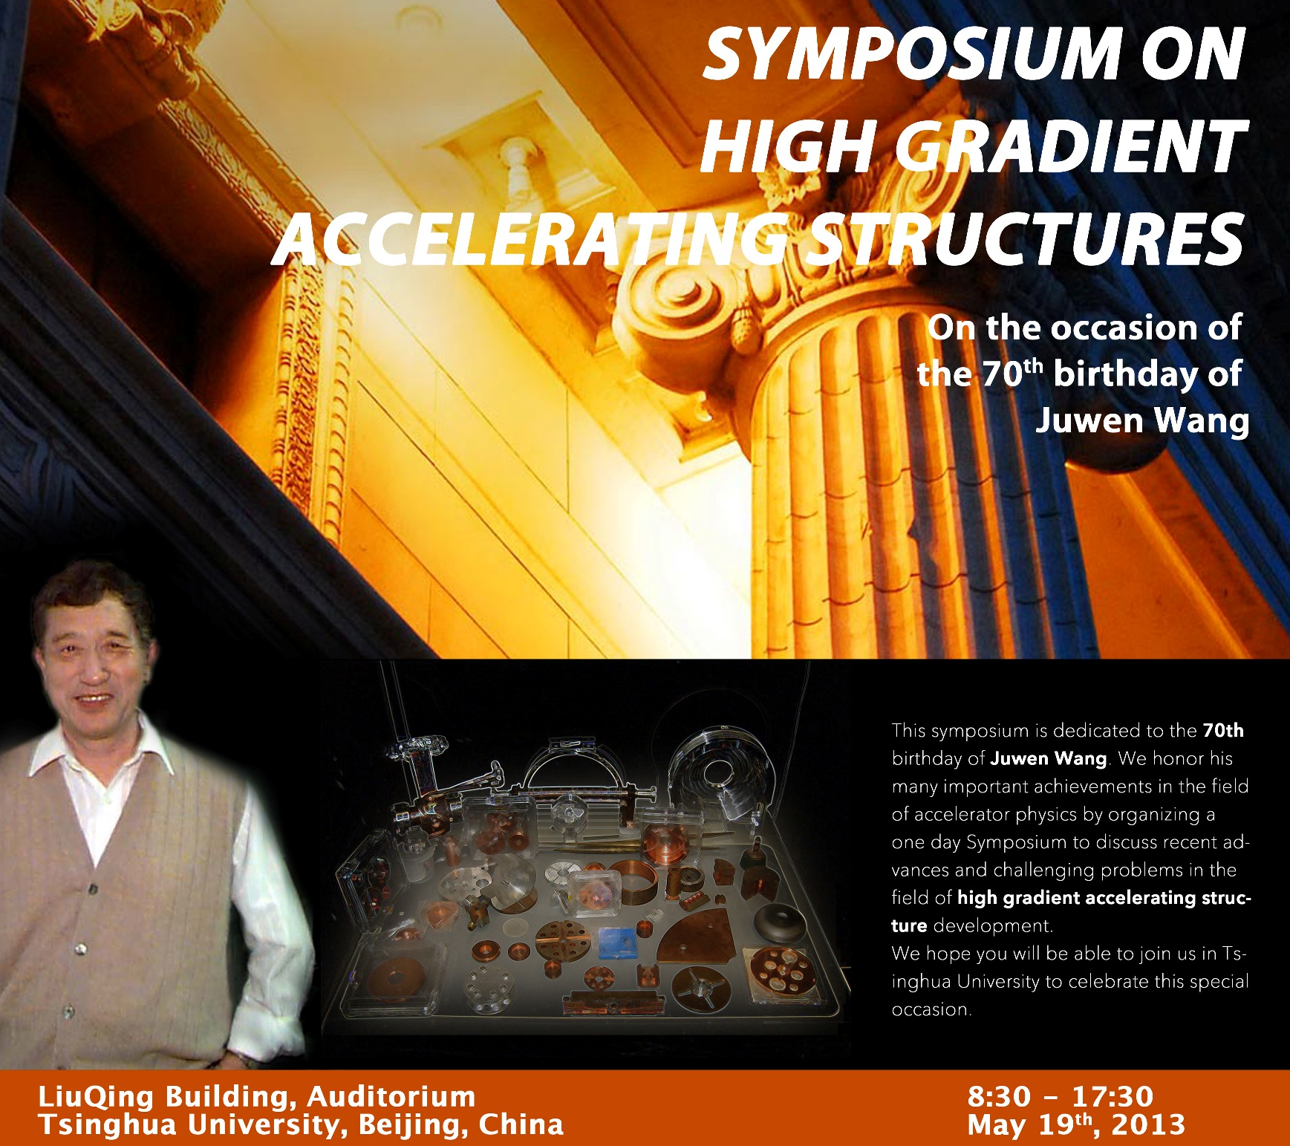

Slide 26

Laser Plasma Wakefield Accelerator Research Activities in Asia
KERI:20TW, 37fs
GIST:100TW, 75fs
IoP: 100TW
CIAE
JAEA:4TW,40fs
THU:20TW,30fs
OSAKA U.:
Gekko PW
CAEP:>100TW
Hamatsu 4TW, 150fs
SIOFM: 300TW,30fs
RRCAT:9TW, 45fs
NCU: 100TW,30FS
Simulations and Theoritial
Preparing Laser for LPWA
Experiments
Dates from published papers after 2009

Slide 27
More Universities and Institutes are involved in the LPWA .
SJTU and PKU have ordered their 200TW laser systems for LWFA studies.
THU/IHEP/CIAE/BNU
LZU
PKU: 200TW
USTC
FDU
SJTU: 200TW
NUDT
HZU
NCTU
Simulations and Theoritial
Preparing Laser for LPWA
With Experiment Systems

Slide 28
Electron Beam Quality Improvement Experiments

Slide 29
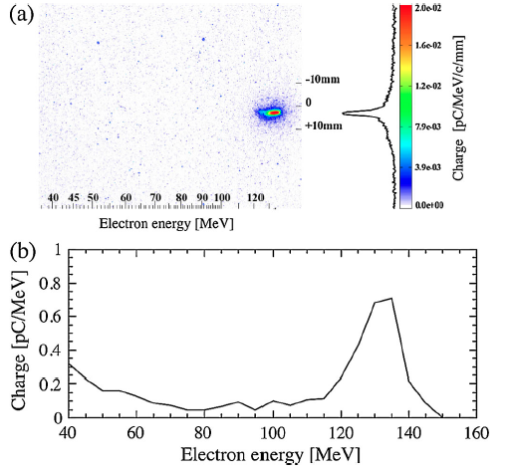
Electron Optical Injection Experiments at JAEA
Driver
a₀=1.2
Injecting
a₁=0.2
n_{e}=1.00 X10¹⁹ cm⁻³
Energy: 134MeV
E Spread: 3.5%
Charge: 8.7pC
Divergence: 4mrad
H. Kotaki, et al, PRL 103, 194803 (2009)
Notes:
从加速器发展的历史，引出加速器的类型及其分类；从加速器的服务对象，给出加速器在各个领域的最新进展；
结论：加速器与激光技术的结合（激光加速、汤姆逊散射、自由电子激光、同步辐射的超快）；更高的加速梯度、更小型化的加速器

Slide 30
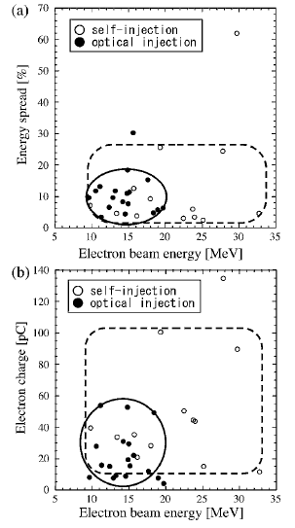
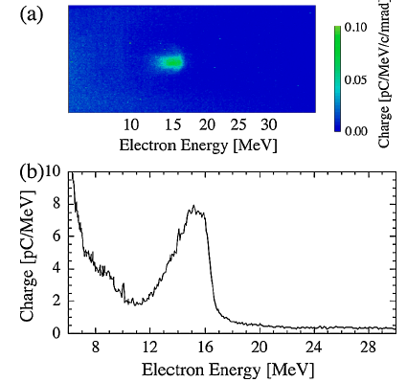
Driver
a₀=0.6
Injecting
a₁=0.1
n_{e}=3.95 X10¹⁹ cm⁻³
Countercrossing: 135°
Notes:
从加速器发展的历史，引出加速器的类型及其分类；从加速器的服务对象，给出加速器在各个领域的最新进展；
结论：加速器与激光技术的结合（激光加速、汤姆逊散射、自由电子激光、同步辐射的超快）；更高的加速梯度、更小型化的加速器

Slide 31
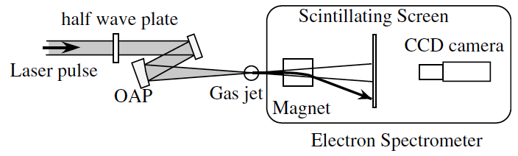
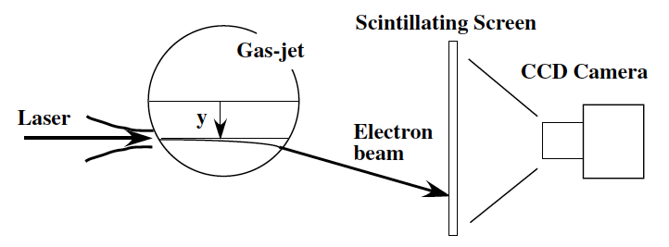
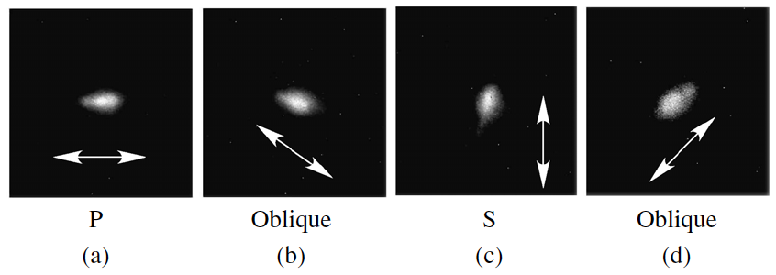
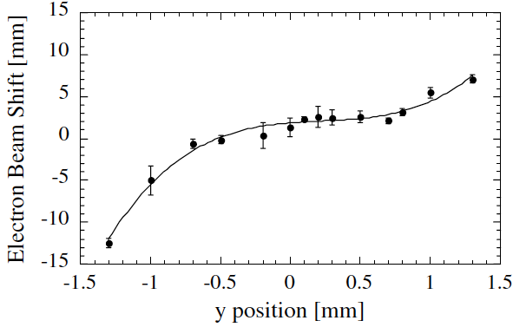
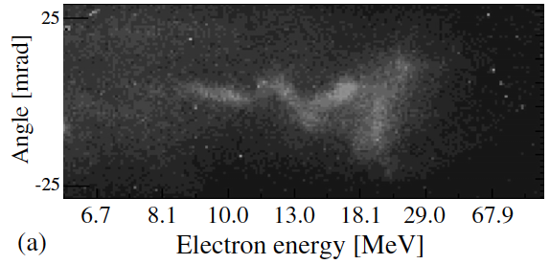
Manipulation of laser accelerated electron beams at JAEA
Electron beam direction
Electron beam profile according to laser’s polarization
H Kotaki, et al, Plasma Phys. Control. Fusion 53 (2011) 014009
Notes:
从加速器发展的历史，引出加速器的类型及其分类；从加速器的服务对象，给出加速器在各个领域的最新进展；
结论：加速器与激光技术的结合（激光加速、汤姆逊散射、自由电子激光、同步辐射的超快）；更高的加速梯度、更小型化的加速器

Slide 32
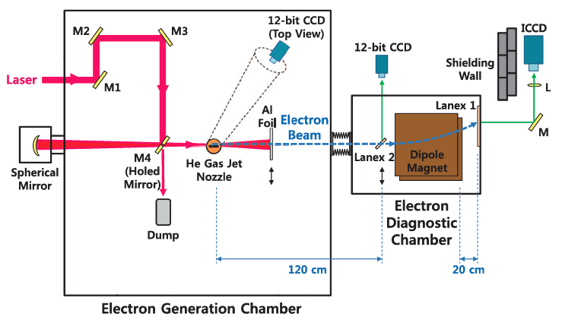
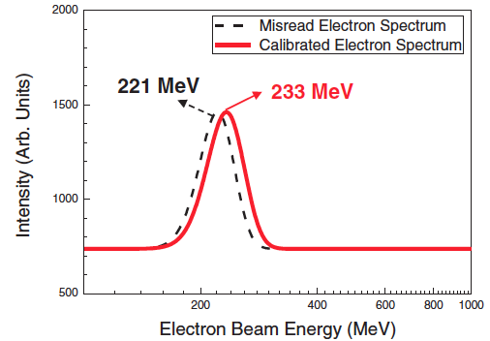
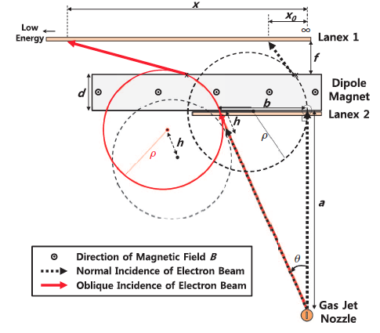
Electron beams pointing instability from LWFA and Influence to energy measurement
100TW laser at GIST
H. J. Cha, et al, RSI 83, 063301 (2012)
Nasr A.M. Hafz et al,NIM A 637(2011)
N.Hafz, et al, AAC 14TH Workshop, 2010
Notes:
从加速器发展的历史，引出加速器的类型及其分类；从加速器的服务对象，给出加速器在各个领域的最新进展；
结论：加速器与激光技术的结合（激光加速、汤姆逊散射、自由电子激光、同步辐射的超快）；更高的加速梯度、更小型化的加速器

Slide 33
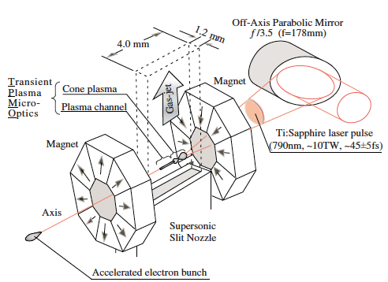




LWFA with external magnetic field and laser prepulses
Osaka U.
Magnetic field: 1T; Prepulse: ps~ns
Main Laser: 7TW
Electron energy :100 MeV, charge: 20 pC, emittance: 0.02 π.mm.mrad
Tomonao Hosokai, et al, APPLIED PHYSICS LETTERS 96, 121501 2010
Notes:
从加速器发展的历史，引出加速器的类型及其分类；从加速器的服务对象，给出加速器在各个领域的最新进展；
结论：加速器与激光技术的结合（激光加速、汤姆逊散射、自由电子激光、同步辐射的超快）；更高的加速梯度、更小型化的加速器

Slide 34




stable and low-divergence electron beam with Argon
4TW Laser
Helium
Argon
M. Mori, et al, PRST - ACCELERATORS AND BEAMS 12, 082801 (2009)
Notes:
从加速器发展的历史，引出加速器的类型及其分类；从加速器的服务对象，给出加速器在各个领域的最新进展；
结论：加速器与激光技术的结合（激光加速、汤姆逊散射、自由电子激光、同步辐射的超快）；更高的加速梯度、更小型化的加速器

Slide 35


LWFA experiments in at RRCAT (India)
Raja Ramanna Centre for Advanced Technology
Laser: 9~10TW, 45fs, 790~800nm
Helium Gas jet: 1-5x10¹⁹/cm³
Sanyasi Rao Bobbili et al , New Journal of Physics 12 (2010) 045011
Bobbili Sanyasi Rao, et al, PoP 18, 093104 (2011)
Notes:
从加速器发展的历史，引出加速器的类型及其分类；从加速器的服务对象，给出加速器在各个领域的最新进展；
结论：加速器与激光技术的结合（激光加速、汤姆逊散射、自由电子激光、同步辐射的超快）；更高的加速梯度、更小型化的加速器

Slide 36



Enhancement of injection and acceleration of electrons in a laser wakefield accelerator by using an argon-doped hydrogen gas jet and optically preformed plasma waveguide
NCU, at Taiwan
 | 800nm | 800nm | 900nm
Pulse Energy | 3.3J | 450mJ | 200mJ
Duration | 33fs | 27fs | 32fs
Power | 100TW | 16.7TW | 6TW
Ho et al, Phys. Plasmas 18, 063102 (2011)

Slide 37


Experimental and Simulation with XL-II OF IoP
IHEP & IOP
Plasma density and Laser pulse evolution
Beam quality:
23 MeV/~7%/4 pC/2 mrad
Normalized Emittance:
Courtesy of J. Gao

Slide 38
GeV Electron Beam

Slide 39


Cascaded LWFA Experiment at SIOFM
Shanghai Institute of Optics and Fine Mechanics
50TW laser
a 0.8-GeV quasi-monoenergetic electron beam
J. S. Liu, et al, PRL107, 035001 (2011)
Notes:
从加速器发展的历史，引出加速器的类型及其分类；从加速器的服务对象，给出加速器在各个领域的最新进展；
结论：加速器与激光技术的结合（激光加速、汤姆逊散射、自由电子激光、同步辐射的超快）；更高的加速梯度、更小型化的加速器

Slide 40


Numerical study of 1.1 GeV electron acceleration over a-few-millimeter-long plasma with a tapered density
GIST
M. S. Hur and H. Suk, PHYSICS OF PLASMAS 18, 033102 2011

Slide 41
New Ideas of LPWA Studies

Slide 42




Dense atto-second electron sheet generation from LWFA with a up-ramp plasma density
SJTU
t-=71T_{L}
t-=83T_{L}
10 Hz, Ti: Sapphire laser
@ LLP, SJTU
800 nm, 200 TW, 25 fs
up-ramp plasma density profile followed by a plateau;
a fairly large laser focus diameter;
different from the bubble (complete blowout) regime
ultrathin (atto-second duration), high charge ( ~nC)
Z.M. Sheng, et al, PRL110, 135002 (2013)
Notes:
从加速器发展的历史，引出加速器的类型及其分类；从加速器的服务对象，给出加速器在各个领域的最新进展；
结论：加速器与激光技术的结合（激光加速、汤姆逊散射、自由电子激光、同步辐射的超快）；更高的加速梯度、更小型化的加速器

Slide 43

High Brightness Electron Beams via Ionization Injection by Transverse Colliding Lasers in a Beam-Driven PWA
Tsinghua U.
Pre-ionized Plasma +He gas
x emittance | y emittance | z emittance
8.5 nm·rad | 6.0 nm·rad | 0.06 keV·ps
Energy | Slice energy spread | Correlated energy spread
5.3 MeV | ~12 keV | 0.2 MeV
Charge | Peak current | Brightness
4.6 pC | 0.44 kA | 1.7×10¹⁹A∙rad⁻² ∙m⁻²
W. Lu, et al, accepted by PRL;
TUPEA022, IPAC2013

Slide 44



Snapshots Plasma Wakefield Using Ultrashort Electron Probe
Tsinghua U.
Electric field
Electron density map of injection simulation
total injected charge (red filled circle) using the recovered electric field and the externally injected charge (blue filled square) we set in the simulation
Density variation of the probe on the screen
W. Lu, et al, TUPEA027, IPAC2013
Notes:
从加速器发展的历史，引出加速器的类型及其分类；从加速器的服务对象，给出加速器在各个领域的最新进展；
结论：加速器与激光技术的结合（激光加速、汤姆逊散射、自由电子激光、同步辐射的超快）；更高的加速梯度、更小型化的加速器

Slide 45
Proton or Ion Acceleration

Slide 46




Phase Stability Acceleration (PSA)
PKU
Conditions of the PSA:
XQ Yan, et al, PRL 100, 135003 (2008)
Notes:
从加速器发展的历史，引出加速器的类型及其分类；从加速器的服务对象，给出加速器在各个领域的最新进展；
结论：加速器与激光技术的结合（激光加速、汤姆逊散射、自由电子激光、同步辐射的超快）；更高的加速梯度、更小型化的加速器

Slide 47


PSA (II)
“a quasiequilibrium for the electrons is established by the light pressure and the space charge electrostatic field at the interacting front of the laser pulse. The ions within the skin depth of the laser pulse are synchronously accelerated and bunched by the electrostatic field, and thereby a high-intensity monoenergetic proton beam can be generated.”
XQ Yan, et al, PRL 100, 135003 (2008)
Notes:
从加速器发展的历史，引出加速器的类型及其分类；从加速器的服务对象，给出加速器在各个领域的最新进展；
结论：加速器与激光技术的结合（激光加速、汤姆逊散射、自由电子激光、同步辐射的超快）；更高的加速梯度、更小型化的加速器

Slide 48

GeV, Nanocoulomb, Collimated Proton Beam by PSA
XQ Yan, et al, PRL 103, 135001 (2009)
Notes:
从加速器发展的历史，引出加速器的类型及其分类；从加速器的服务对象，给出加速器在各个领域的最新进展；
结论：加速器与激光技术的结合（激光加速、汤姆逊散射、自由电子激光、同步辐射的超快）；更高的加速梯度、更小型化的加速器

Slide 49

Ultra-relativistic ion acceleration in the laser-plasma interactions
CIAE
An analytical relativistic model is proposed to describe the relativistic ion acceleration in the interaction of ultra-intense laser pulses with thin-foil plasmas. It is found that there is a critical value of the ion momentum to make sure that the ions are trapped by the light sail and accelerated in the
radiation pressure acceleration (RPA) region.
Huang et al. Phys. Plasmas 19, 093109 (2012)

Slide 50

LAser proton accelerator (LAPA) at PKU

Slide 51

Radiotherapy using a laser proton accelerator
M. Murakami, Y, Hishikawa, et al.
Notes:
从加速器发展的历史，引出加速器的类型及其分类；从加速器的服务对象，给出加速器在各个领域的最新进展；
结论：加速器与激光技术的结合（激光加速、汤姆逊散射、自由电子激光、同步辐射的超快）；更高的加速梯度、更小型化的加速器

Slide 52


ICS Sources Based on LPWA
LAL, LBNL,RAL Nature, Sept. 2004
P Catravas, E Esarey and W P Leemans, Meas. Sci. Technol. Vol.12 P1828, 2001
ICS X-ray

Slide 53



LWFA for ICS X-ray Sources of Hamamatsu
A Ti:sapphire laser (pulse energy: 500 mJ; pulse width: 150 fs)
Yoshitaka Mori, et al, Applied Physics Express 5 (2012) 056401
Notes:
从加速器发展的历史，引出加速器的类型及其分类；从加速器的服务对象，给出加速器在各个领域的最新进展；
结论：加速器与激光技术的结合（激光加速、汤姆逊散射、自由电子激光、同步辐射的超快）；更高的加速梯度、更小型化的加速器

Slide 54





TS of LWFA Exp. Proposla
Experiment at KERI
Experiment at GIST
N. Hafz, et al, IEEE Trans. On PLASMA SCIENCE, VOL. 31, NO. 6( 2003)
N. Hafz, et al, AAC 11TH Workshop, 2004
J. Kim, et al, Journal of the Korean Physical Society, Vol. 51, No. 1,2007
Notes:
从加速器发展的历史，引出加速器的类型及其分类；从加速器的服务对象，给出加速器在各个领域的最新进展；
结论：加速器与激光技术的结合（激光加速、汤姆逊散射、自由电子激光、同步辐射的超快）；更高的加速梯度、更小型化的加速器

Slide 55
ICS γ/x-ray Sources in Asia*
JAEA
KEK
Tsinghua U.
Tokyo U
KERI
SHI
Osaka U,
Nagoya U.
SINAP
HAMAMATSU
AIST
Waseda U.
*Not all of the ICS Sources in Asia, only some of those with papers published these years.

Slide 56
The ICS γ/x-ray Sources Experiments in ASIA Recent Years
 | Inst. | Acc. type | E-beam | Laser | X-ray | Appl.& Others
1 | SHI (JPN) | S-band, SW | 38MeV, 0,8nC, 3ps, 30um (rms), 3p.mm.mrad | 200mJ, 50fs(FWHM), 800nm | 165deg.:33.7keV, 2x10⁶ ph/p,3ps, 6%fluct., 10Hz. 90deg: 17.1, 5x10⁵, 150fs, 11%, 10 | Imaging
2 | JAEA (JPN) | Microtron | 150MeV, 60pC/pulse, 35(H)/8 (V) π.mm.mrad, 10ps (rms), 10Hz, 97umx72um, spatial jitter 12um, 32um | Nd:YAG 840mJ, 23ns, 1064nm, 10Hz, 27umx22um | ~400keV, 45±20ph/pulse, 10ps. | Imaging
1. Fumio Sakai, et al, International Journal of Modern Physics B, Vol.21, No 3&4(2007)
2. K. Kawase, et al, REVIEW OF SCIENTIFIC INSTRUMENTS 79, 053302 2008

Slide 57
 | Inst. | Acc. type | E-beam | Laser | X-ray | Appl.& Others
3 | KEK –STF QETP(JPN) | L-band, SRF | 23MeV, 0.9nC/bunch, 15ps, 150/train, 85/95um (rms),spacing 2.8ns | 4mirrors OC: 0.3mJ, 7ps(FWHM), 1064nm, 89/85um, Finesse 335 | 8~9keV, 5460ph./train, 8.2x10⁶ ph/s,8% bandwidth(FWHM) | Biology Material Imaging
4 | KEK-LUCX (JPN) | S-band, TW | 43MeV, 0.5nC/bunch, 100/train | 2-mirror OC, 110 uJ/pulse | 10⁴ph./train | Upgrading
5 | SINAP(China) | S-band, ther. gun | 108.1MeV, 2.5ns | 10MW, 35ns, 1064nm | 10²~10³ ph./s, ~30keV | Upgrading
6 | THU-TTX(China) | S-band, TW | 46.7MeV, 0.2nC/bunch,10Hz | 300mJ/pulse, 800nm, | 10⁶ph./pulse, 51.7keV, | Imaging, detector colli.
3. J Urakawa, IX International Symposium on Radiation from Relativistic Electrons in
Periodic Structures (2012); K. Sakaue,et al, WEPWA017, IPAC2013.
4. Masafumi Fukuda , et al, NIM A637(2011) S67-71
5. Courtesy of W. Xu (2012); and Proc. of SPIE Vol. 7385 73852D-3(2010)
6. C. Tang, et al, NIM A608, (2009) 70-74; Y. Du, et al, RSI, 84, 053301 (2013)

Slide 58

Tsinghua Thomson scattering X-ray source (TTX)
Parameters of Scattering X-ray
Photon energy | 24(90deg)~48(180deg)kev
Pulse duration | 0.16(90deg)~3(180deg)ps
Number photons | 8.4X10⁶(90deg)~5.5X10⁷(180deg)
Electron beam |  | Laser beam
Energy | 45MeV | Wavelength | 800nm
Bunch length | 1~4ps | Pulse duration | ~30fs
Charge | ~0.7nC | Pulse energy | ~500mJ
Beam size | 30(H)x25(V)um | Beam size | ~30um

Slide 59




Electron Linac

Slide 60

Laser System
RF Gun
TS IP
800nm, ~20TW, ~30fs
266nm, 1mJ, 30fs~10ps

Slide 61




Thomson Scattering Interaction Point
Laser compressor
electron
laser
Delay stage
Ground glass screen for beam profile measurement
Triplet
Dipole
Interaction chamber
The laser is focused by a parabolic mirror with 4mm hole in center.

Slide 62


Thomson Scattering and Background X-ray Signals
A light at 2011
Typical background and X-ray signal
Background x-ray from beam dump
The background from the beam is suppressed successfully.
Background x-ray from beam lost in the hole
Measured x-ray flux : ~1.0X10⁶;
Expected (simulated)flux of X-rays: ~2.5X10⁶;
Reasons:
misalignment in transverse and longitudinal?
Measured Electron and laser specifications
laser electron
Energy 800nm(1.55eV) 46.7MeV (spread 0.3%, rms)
Intensity 300mJ 0.2nC (~3mm.mrad)
Beam size ~100um (rms) ~35x40um^2(rms)
Pulse width ~70fs(FWHM) ~2.7ps

Slide 63
Measured X-ray pulse flux according to the laser power
X-ray signal according to the Laser power: Linearity is good between the laser power and the intensity of X-rays;

Slide 64

Stability of the X-ray Pulses
Instability (RMS) : 17%

Slide 65

X-ray Profile measured by CsI screen and EMCCD
Simulation
Experiment

Slide 66








X-ray pulse spectrum measurement
The scattered photon energy as a function of beam parameters for a head-on collision in Thomson scattering x-ray source can be written as
Scattering point
θ
Silicon film
CsI screen

Slide 67
X-ray pulse spectra

Slide 68
X-ray pulse relative average energy according to the scattered x-ray photon direction

Slide 69




X-ray imaging and other applications at TTX
X-ray detector calibration: time response, spectral response, polarization calibration (for astrophysics)
Mono-energy X-ray Imaging: small spot size; nm space resolution, PCI and other new imaging technologies.

Slide 70

Next step of TTX-Improving the average brightness

Slide 71


The mini electron storage ring
The electron storage ring is smaller, its physics more complicate, and more difficult to develop.
The circumstance of the mini-ring is 3.6m. Maybe it is too small…
Another 4.8m ring is under design.

Slide 72
The optic cavity design
This drawing is not on scale
TTX-p : Setup Diagram – Dimensions & Distances
A
B
C
D
E
F
G
H
I
J
K
L
M
N
O
P
Q
R
S
T
1
FSR=79.33MHz
TL-SPD
Coupling-PD
1
CCD
1.1m
A
PDH-PD
B
2
2
3
M4
M1
3
PD
TRANSMISSION
?cm
4
10cm
4
5
M2
M3
?cm
5
6
47cm
20cm
55cm
？cm
？cm
?cm
6
7
7
150cm
8
f1=40cm
λ/2
f2=-?cm
f3=?cm
7cm
8
Coherent
Verdi-V6
Coherent
MIRA oscillator
Faraday
Isolator
EOM
9
9
18cm
10
FS
10
11
38cm
11
12
λ/4
20cm
12
13
SLIT
13
M6
14
ρ=20cm
14
15
300cm
15
A
B
C
D
E
F
G
H
I
J
K
L
M
N
O
P
Q
R
S
T

Slide 73
Summary
HG x-band structures are producing and testing at KEK. Now THU is involved in the collaboration, and Choke mode structure is waiting for its first beam testing…
LWFA attracts lots of universities and institutes in Asia. Except for GeV beams, several experiments for improving the electron beam quality have been done. And big lasers have been bought specially for LWFA.
Several ICS x-ray sources have been developed, and used for different applications. Upgrading or new projects are putting forward.
There are lots of other Novel Accelerators Activities in Asia, which I am not mentioned here.

Slide 74

Thanks for Your Attention！

