Slide 1



Shortest Possible Beams from Conventional Accelerators
Generation of sub-fs electron beams
Klaus Floettmann
LAOLA Collaboration, Deutsches Elektronen-Synchrotron DESY

Slide 2
well…
as short as an electron!
Generation of very low charge, very high quality, very short bunches
~ 5 MeV
80 fC (5 ·10⁵ electrons)
transverse emittance < 50 nm
bunch length <10fs
for time resolved electron diffraction experiments
and
as probe for external injection experiments

Slide 3
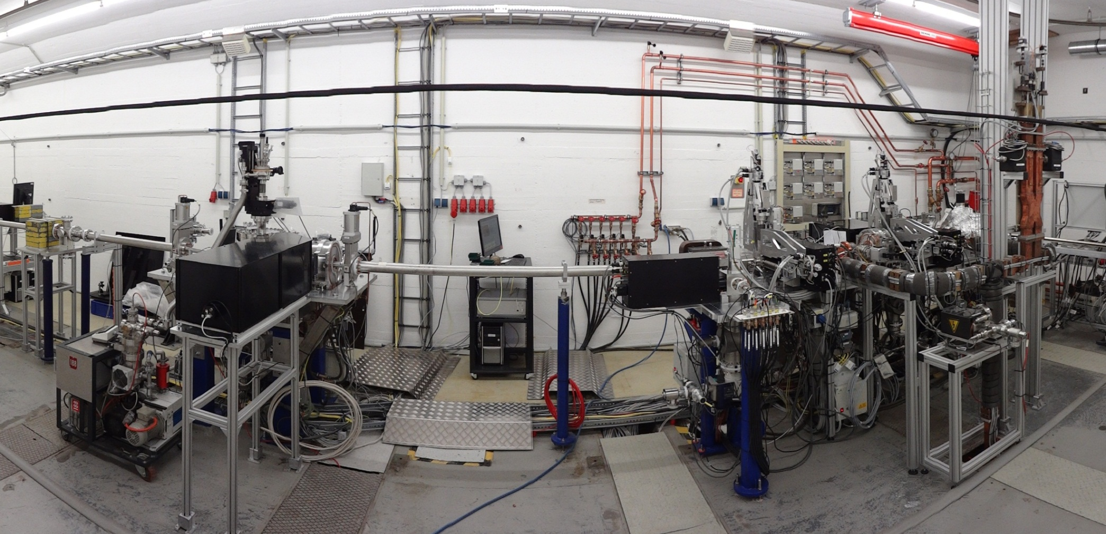

REGAE: The Relativistic Electron Gun for Atomic Exploration
Build in collaboration with University Hamburg and Max Planck Society

Slide 4
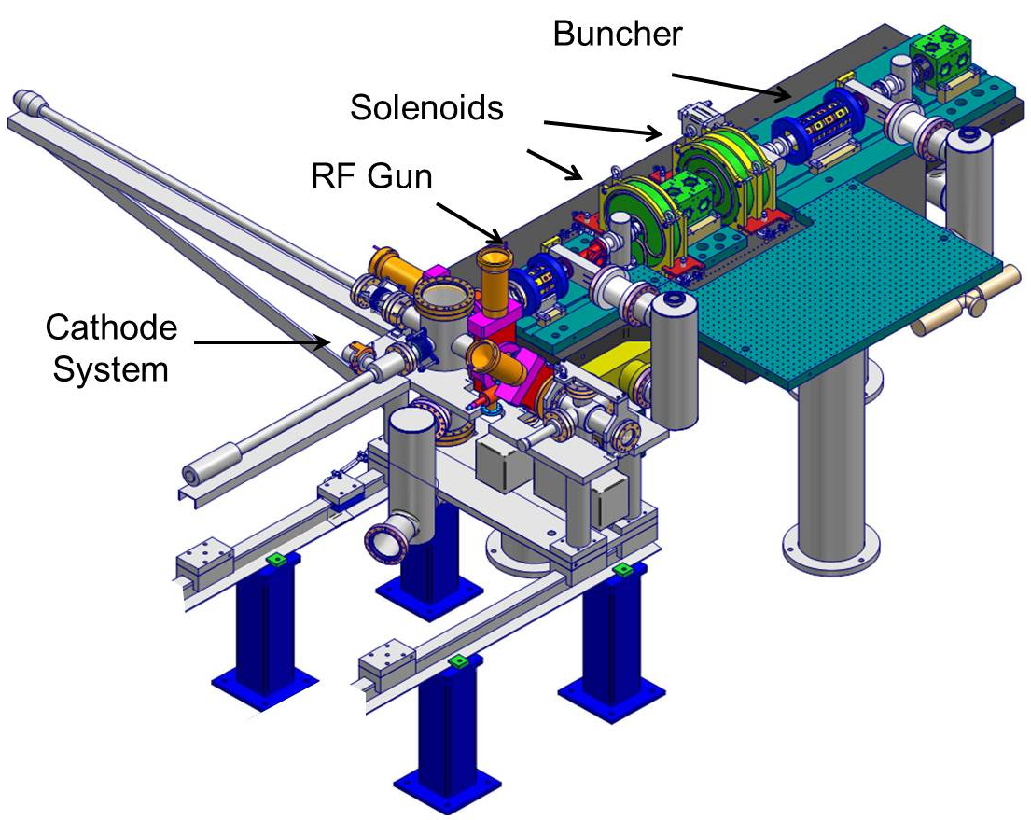
REGAE: The Relativistic Electron Gun for Atomic Exploration

Slide 5
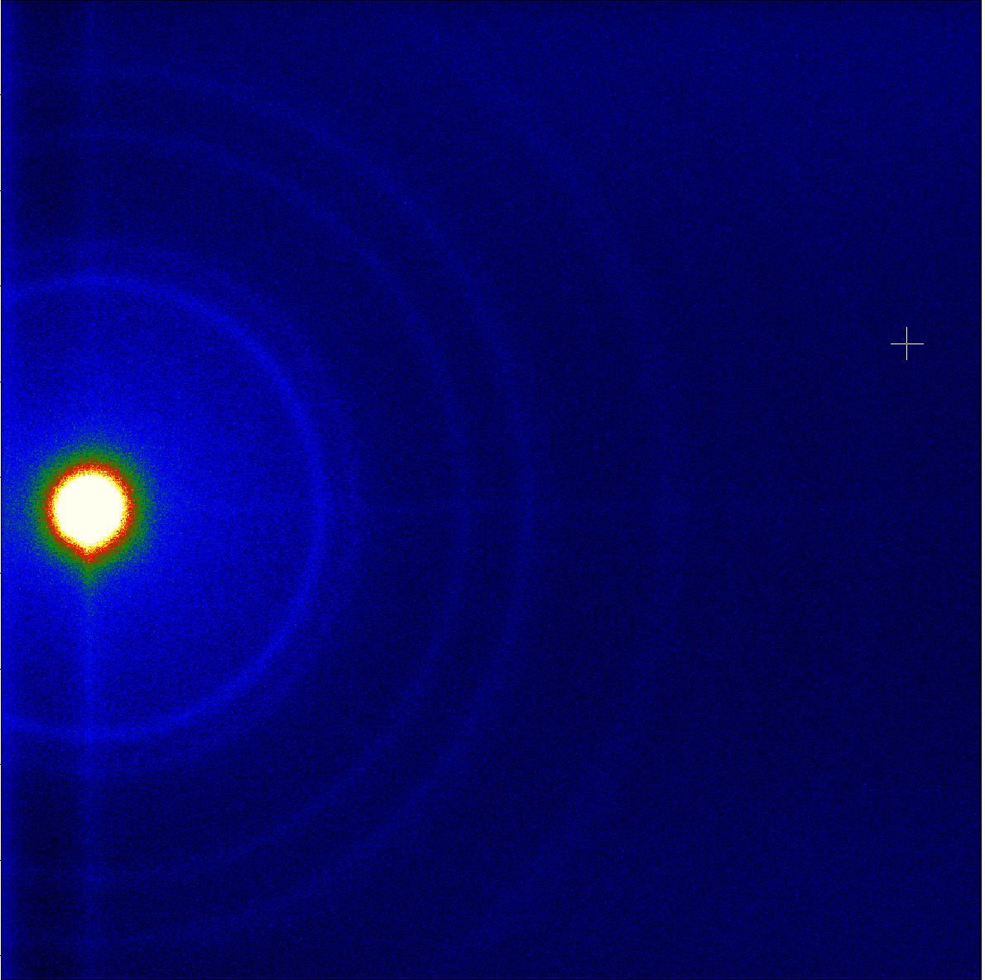
Time Resolved Electron Diffraction
static diffraction pattern of Gold sample

Slide 6
Simulation Example: 80 fC, 5 MeV
(opt. assump. for bunch shape and thermal emittance to explore the limits)
Simulation parameters:
Q = 80 fC
σ_{x}^{cath} = 7 μm
σ_{t}^{cath} = 500 fs
perfect cylindrical bunch
E_{kin} = 0.1 eV
Transverse emittance vs. longitudinal position

Slide 7
Simulation Example: 80 fC, 5 MeV
(opt. assump. for bunch shape and thermal emittance to explore the limits)
Simulation parameters:
Q = 80 fC
σ_{x}^{cath} = 7 μm
σ_{t}^{cath} = 500 fs
perfect cylindrical bunch
E_{kin} = 0.1 eV
Transverse beam size vs. longitudinal position

Slide 8
Simulation Example: 80 fC, 5 MeV
(opt. assump. for bunch shape and thermal emittance to explore the limits)
Simulation parameters:
Q = 80 fC
σ_{x}^{cath} = 7 μm
σ_{t}^{cath} = 500 fs
perfect cylindrical bunch
E_{kin} = 0.1 eV
7 fs
Bunch length vs. longitudinal position

Slide 9
What limits the compression?
induced RF chirp
defocussing space charge field

Slide 10
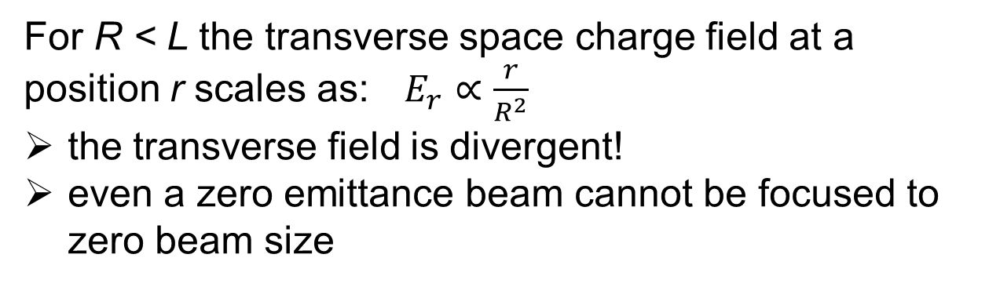
transverse space charge field (in the rest frame)
R
L
For R < L the transverse space charge field at a position r scales as:$E_{r}∝\frac{r}{R^{2}}$
the transverse field is divergent!
even a zero emittance beam cannot be focused to zero beam size

Slide 11
transverse space charge field
z
z
Focus without space charge
Laminar focus with space charge
over focused particles
z
Laminar focus with cross over trajectories
High charge calculation

Slide 12
Transverse focus for plasma experiment
x_{rms} = y_{rms} = 2.8 µm
z_{rms} = 5 µm
Courtesy Max Hachmann

Slide 13
Emittance growth due to strong transverse focus
Courtesy Max Hachmann

Slide 14
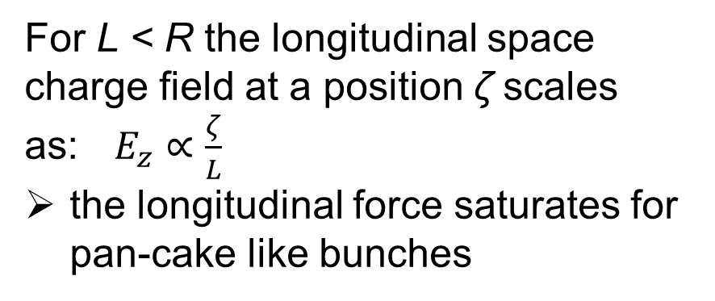
longitudinal space charge field (in the rest frame)
For L < R the longitudinal space charge field at a position ζ scales as:$E_{z}∝\frac{ζ}{L}$
the longitudinal force saturates for pan-cake like bunches
R
no problem with mixing of laminar and cross-over trajectories !
L

Slide 15
What limits the compression?
induced RF chirp
defocussing space charge field
longitudinal Emittance
  space charge
  RF curvature
  non-linear bunch compression

Slide 16
Long. emittance: Influence of the long. distribution
longitudinal phase space at the focus
uniform distribution
RF curvature & non linear compression
space charge
start a distribution with linear longitudinal field

Slide 17
Long. emittance: Influence of the long. distribution
influence of the longitudinal distribution on the rms bunch length is negligible, but …

Slide 18
Long. emittance: Influence of the long. distribution
uniform ellipsoid
parabola
start a parabolic beam and correct the curvature by a 3rd harmonic cavity

Slide 19
Correction of the curvature with a 3rd harmonic cavity
longitudinal phase space at the focus
parabolic distribution plus 3rd harmonic cavity
rms bunch length in the focus:
0.6 µm = 2 fs

Slide 20
Correction of the curvature with a 3rd harmonic cavity

Slide 21
Correction of the curvature with a 3rd harmonic cavity
3rd harm. cavity
long. focus
trans. focus

Slide 22
Correction of the curvature with a 3rd harmonic cavity

Slide 23
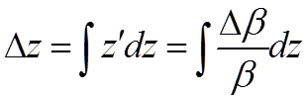
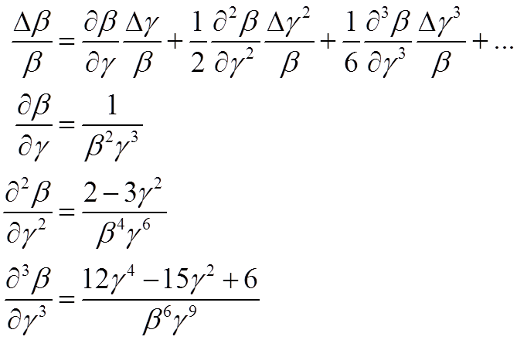
Non-linear bunch compression
The longitudinal shift of two particles in a drift is given by:
with

Slide 24
… with the correction cavity in place the compression is again emittance dominated. We can try to compress further by reducing the emittance and/or increasing the RF chirp …

Slide 25
Generation of incoherent energy spread at the cathode
r = 0
energy
head
r > 0
tail
emission time

Slide 26
Generation of incoherent energy spread at the cathode: uniform distribution
energy
longitudinal position

Slide 27
Generation of incoherent energy spread at the cathode: parabolic distribution
energy
longitudinal position

Slide 28
Generation of incoherent energy spread at the cathode: ellipsoidal distribution
energy
longitudinal position

Slide 29
Dependence on initial bunch parameters

Slide 30
Dependence on initial bunch parameters
uniform
parabola
ellipsoid

Slide 31
minimal bunch length as function of emission time
700 as

Slide 32
Longitudinal phase space for 2.0 ps emission time

Slide 33
Conclusion
generation of very low emittance, sub fs bunches seems possible even at low energies
similar bunch length with higher charges and slightly higher emittance reached at higher beam energy: Talk by Alberto Bacci, Monday WG1.
still more work: parameter (energy) dependence of compensation, ellipsoidal bunch?, include wake fields, electron - electron scattering…

