Slide 1
Working Group 3 Summary
Electron beams from electromagnetic structures, including dielectric and laser-driven
EAAC 2013
Manoel Conde
James Rosenzweig

Slide 2
Enhanced Cerenkov-Wake Amplification by Active Medium
Miron Voin Department of Electrical Engineering Technion - IIT, Haifa 32000 ISRAEL | Wayne D. Kimura STI Optronics, Inc. 2755 Northup Way, Bellevue, Washington 98004 USA | Levi Schächter Department of Electrical Engineering Technion - IIT, Haifa 32000 ISRAEL

Slide 3

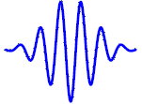

Structure-less Active Medium
In the Laser-driven plasma-based accelerators - an intense laser pulse is injected in a plasma and the particles are accelerated by the trailing space-charge wake
In the Beam-driven plasma-based accelerators intense electron beam is the energy source
A third possibility is to store the energy within the medium and the particles being accelerated by the field associated with the polarization Cerenkov-wake they generate
Plasma
Plasma
Active medium

Slide 4
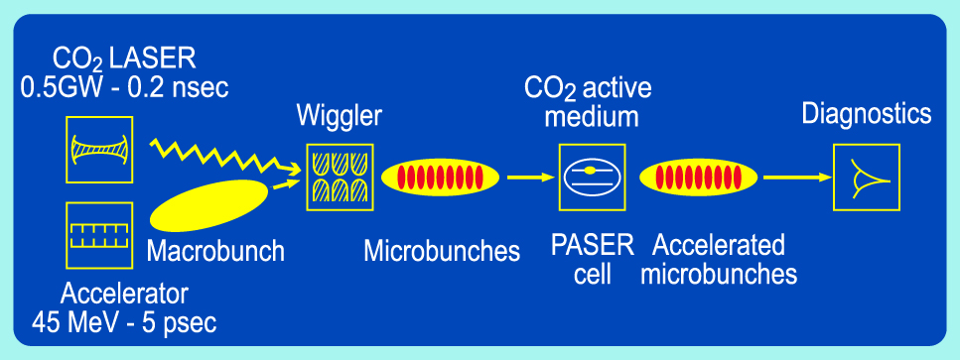
Proof of Principle Experiment
A 45MeV electron beam was velocity modulated by a 0.5GW CO2 laser in a wiggler
The beam was left to drift for 2.5m providing density modulation
The resulting beam was injected in a 30cm long vessel filled with [CO2:N2:He(2:2:3)] mixture at 0.25atm
A fraction of electrons gained 200keV corresponding to an accelerating gradient of slightly less than 1MV/m

Slide 5
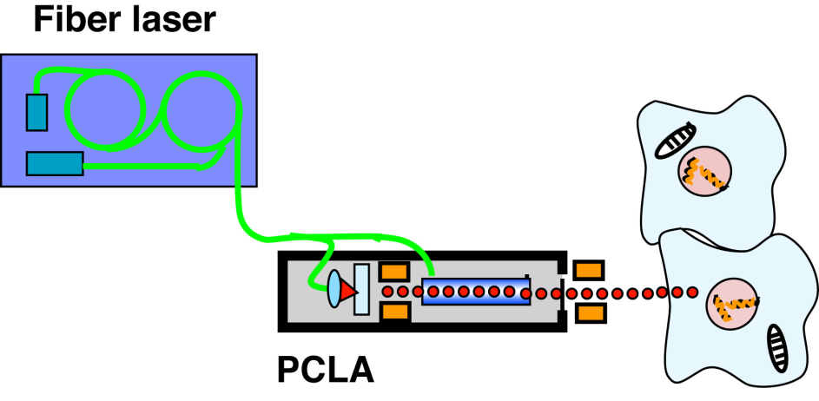
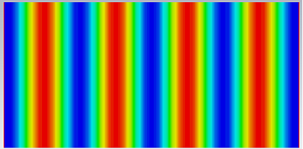
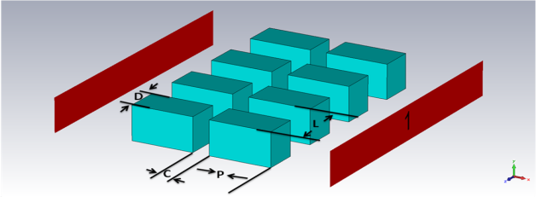
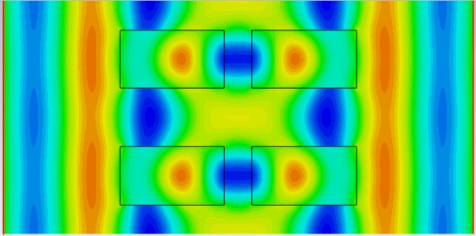
Fibre Laser Based Dielectric Gratings Accelerator
A. Aimidula, C.P. Welsch, Cockcroft Institute and the University of Liverpool, UK
G. Xia, The University of Manchester, UK
K. Koyama, Y. Matsumura, M. Uesaka, The University of Tokyo, Japan
T. Natsui, M. Yoshida, High Energy Accelerator Research Organization (KEK), Japan
Motivation
Objectives
In order to investigate fundamental processes of radiation effect and evaluate risks of manifestation of secondary cancer after the radiation therapy, well defined ultra-short beam pulses are required.
Beams can be manipulated under optical microscopes.
Electron bunch or X-ray pulse
Several hundreds keV
Sub-micron, sub-femtosecond
Acceleration mechanism
Illustration of dual-gratings structure.
The basic working principle of dual-grating structures is based on decreasing the phase velocity of the electric field, thereby synchronizing it with non-relativistic and relativistic electrons [1].
Laser field in vacuum
Simulated laser field in structure
[1] T. Plettner, P. P. Lu, and R. L. Byer, Phys. Rev. ST Accel. Beams 9, 111301 (2006)

Slide 6
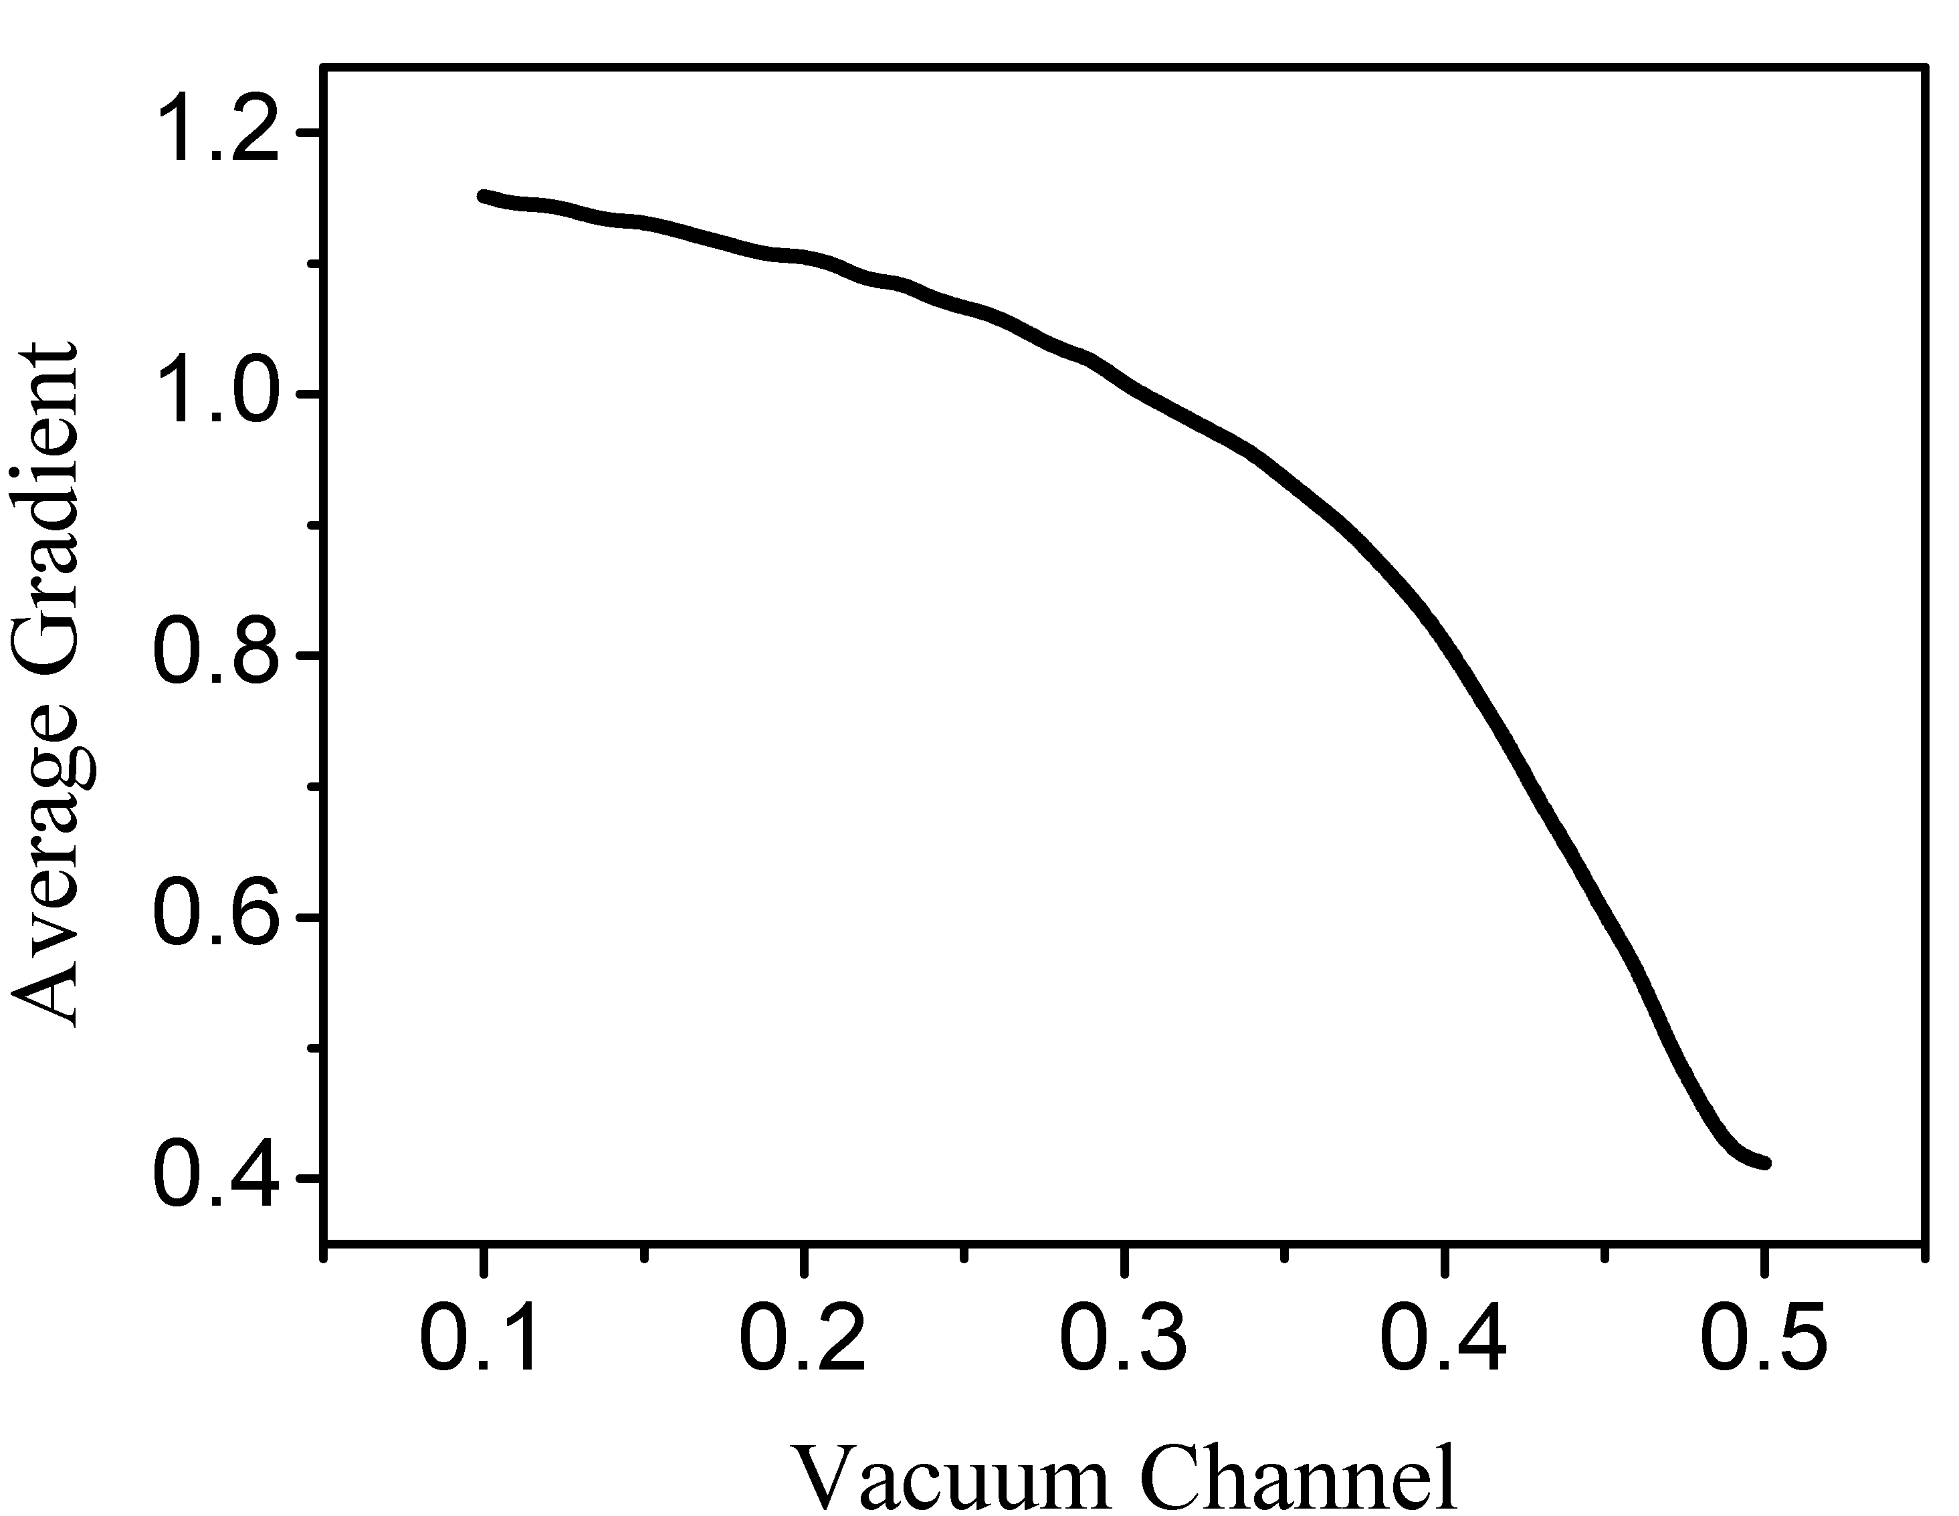
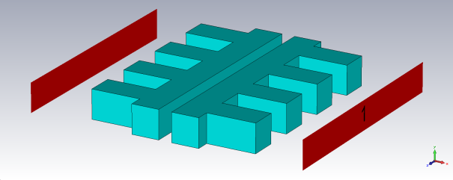
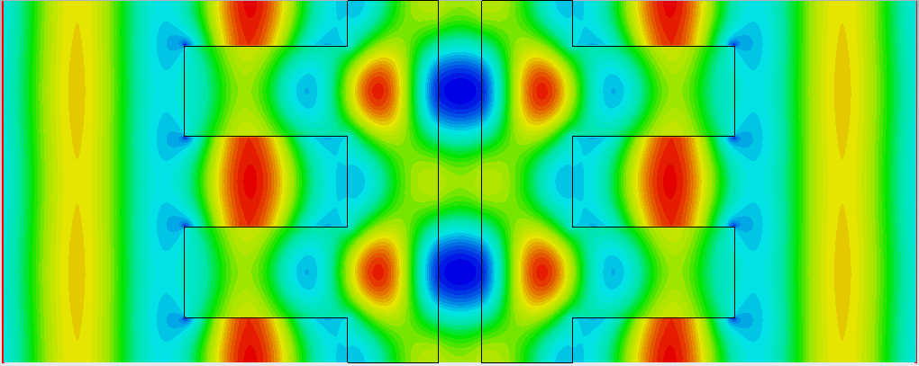
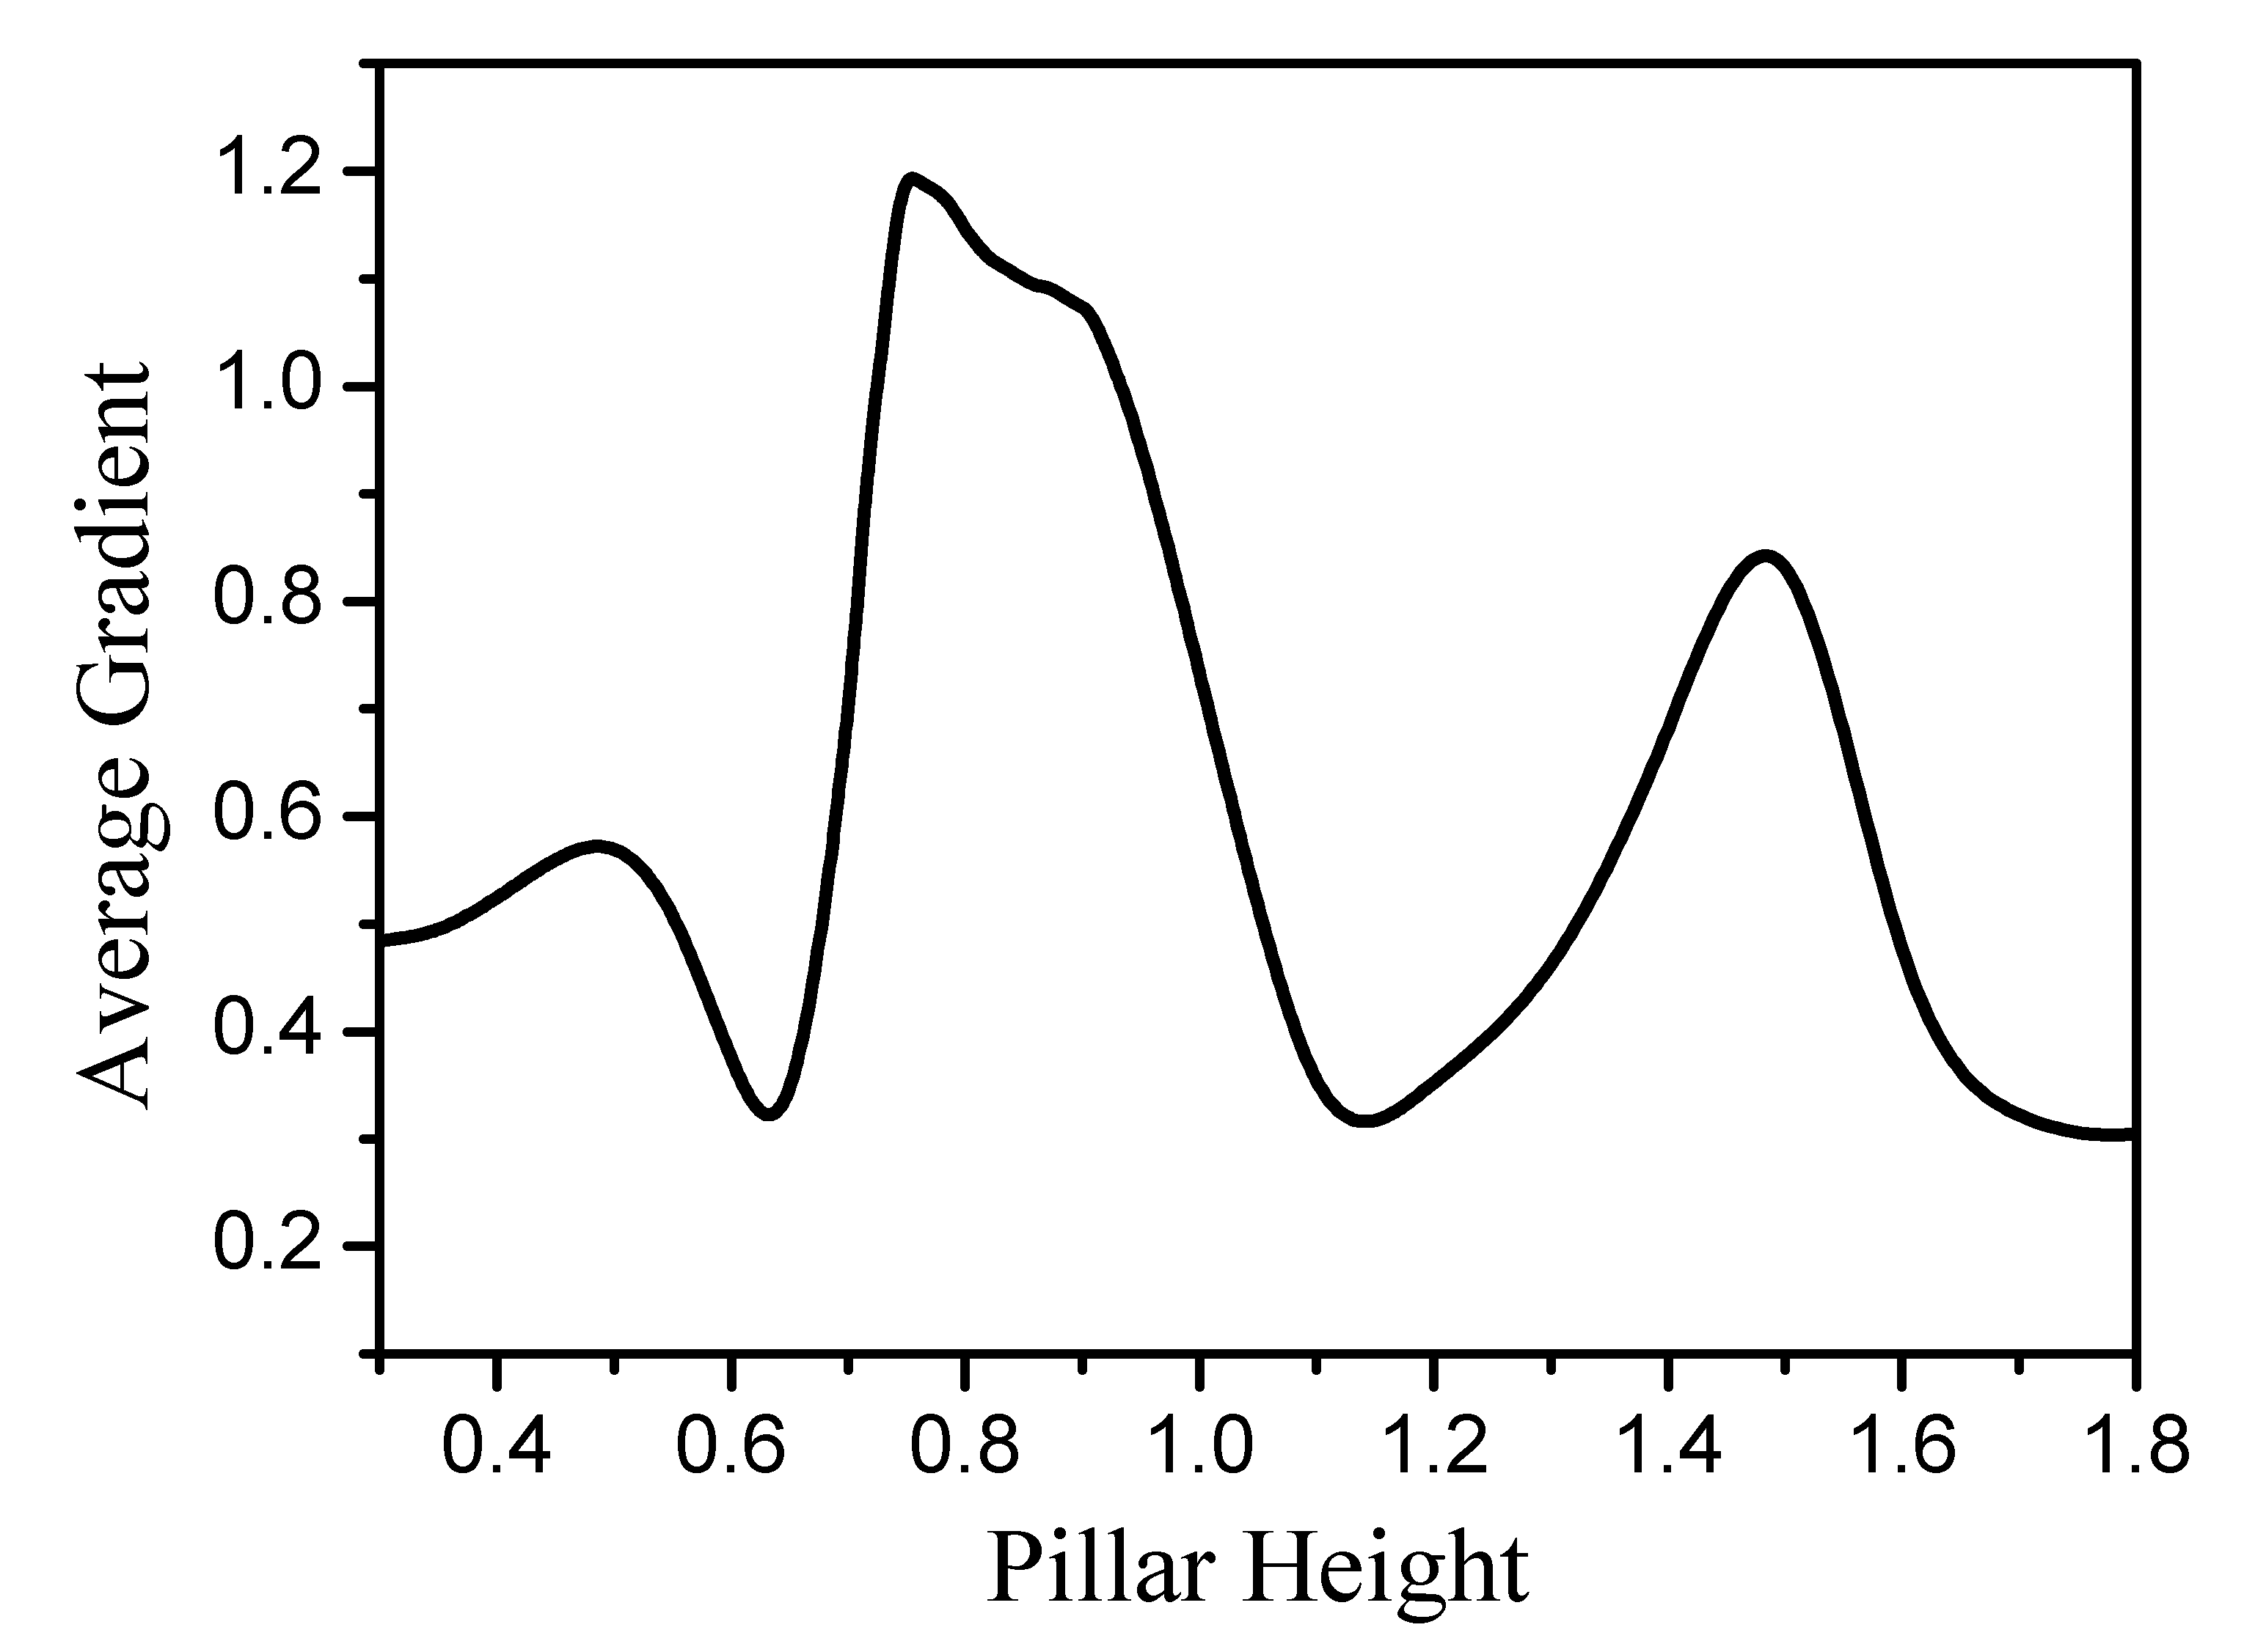
Proposed new structure for better beam confinement
When electrons travel along the channel, the space charge effect scatters the beam. The charges collected on the wall then provide a Coulomb force on the beam which pushes the charges back to the axis. Field distributions calculated by CST Microwave Studio.
Illustration of dual-gratings
structure with walls.
Simulated laser field in structure
Future Outlook
Accelerate low energy electrons:
Note minimum requirement for particle beam’s initial energy.
2. Multi-stage acceleration scheme:
Design of entire structure is under investigation.
Beam loading:
Focus and inject particles in hundreds-nm-wide vacuum cavity is a future challenge.
Code benchmarking
Compare CST output with results from Tech-X Vorpal code.
Optimized structure dimensions

Slide 7
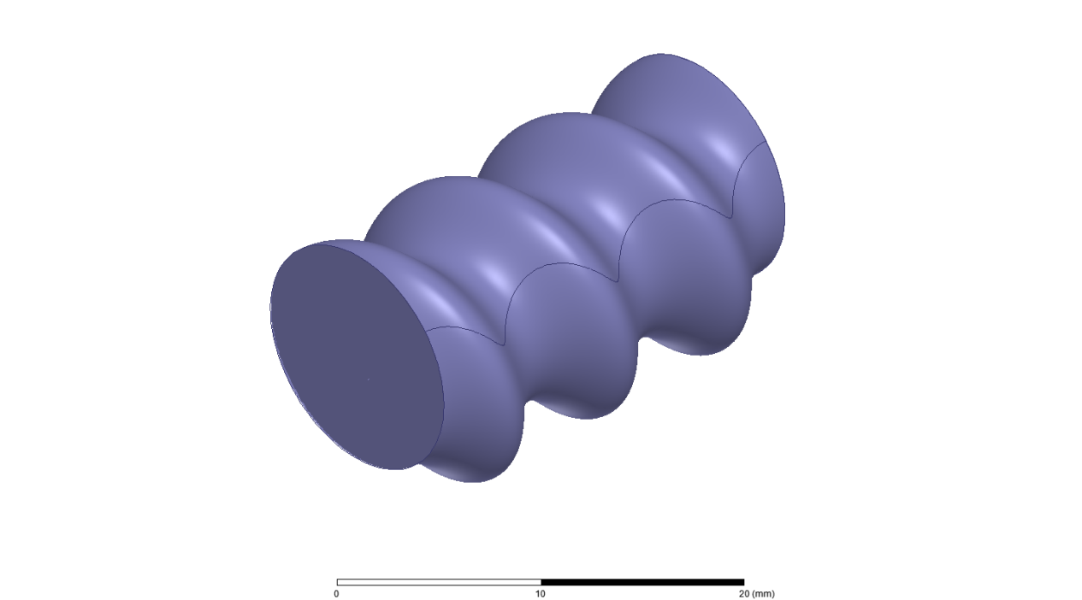
Helical Self Focusing and Beam Cooling (HSFC) Accelerating Structure
HSFC = Accelerating structure + RF undulator + beam lens
Sergey Kuzikov (Institute of Applied Physics, Russian Academy of Sciences)
transverse field components
(far from Cherenkov synchronism)
E – accelerating field (synchronous with particles)
Appealing features:
Non-synchronous transverse field components might provide: 1) emittance control (beam cooling due to synchrotron radiation of particles); 2) near axis beam focusing.
The structure allows high enough accelerating gradient normalized on maximum surface field (>0.3). Shunt impedance is about 20 MOhm/m.
A new structure has smooth shape of constant circular cross-section (no expansions or narrowings) and big aperture (no small irises)
A new technology of the mass production seems possible which allows avoiding junctions inside long accelerating section

Slide 8
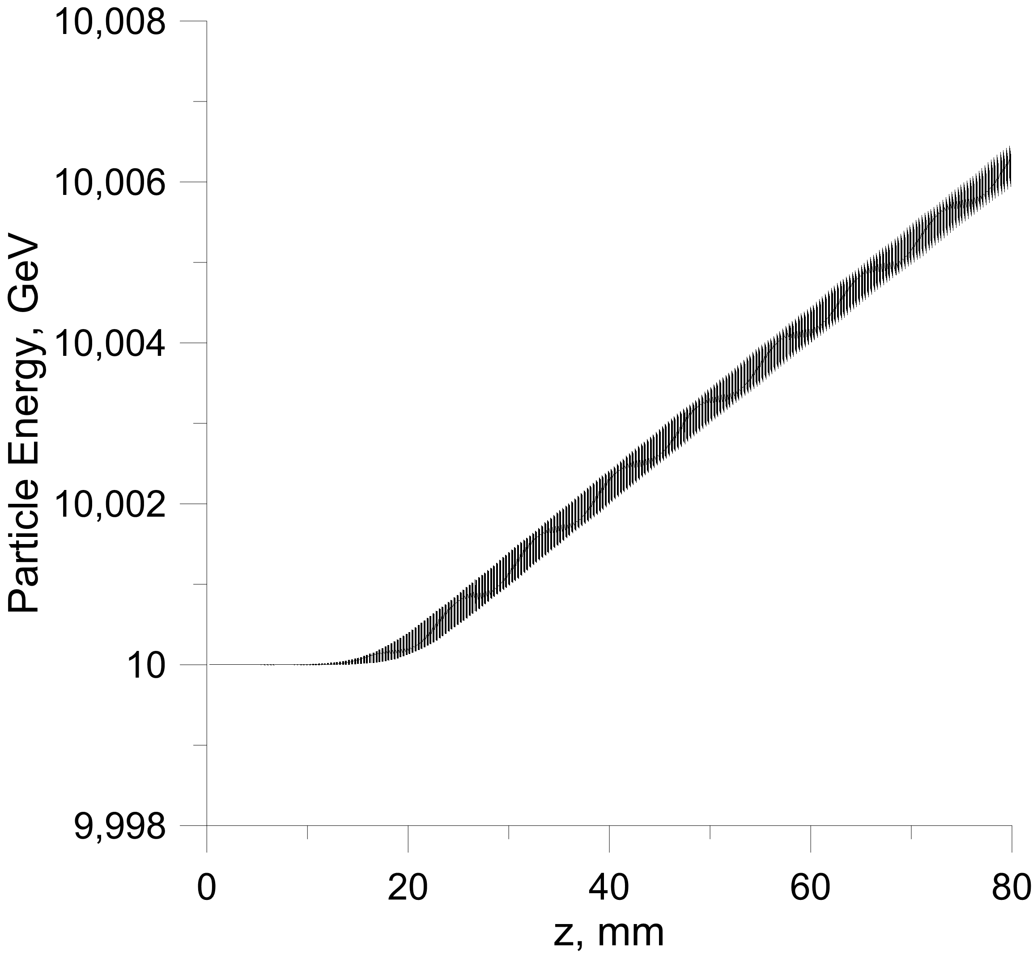
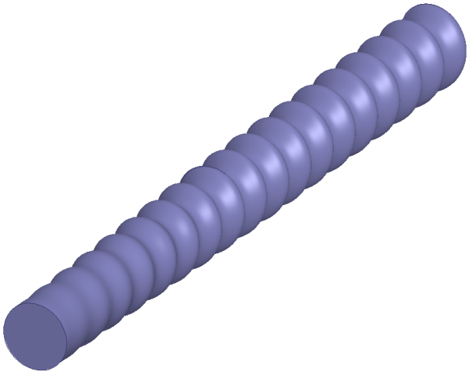
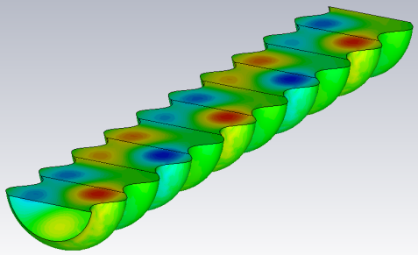
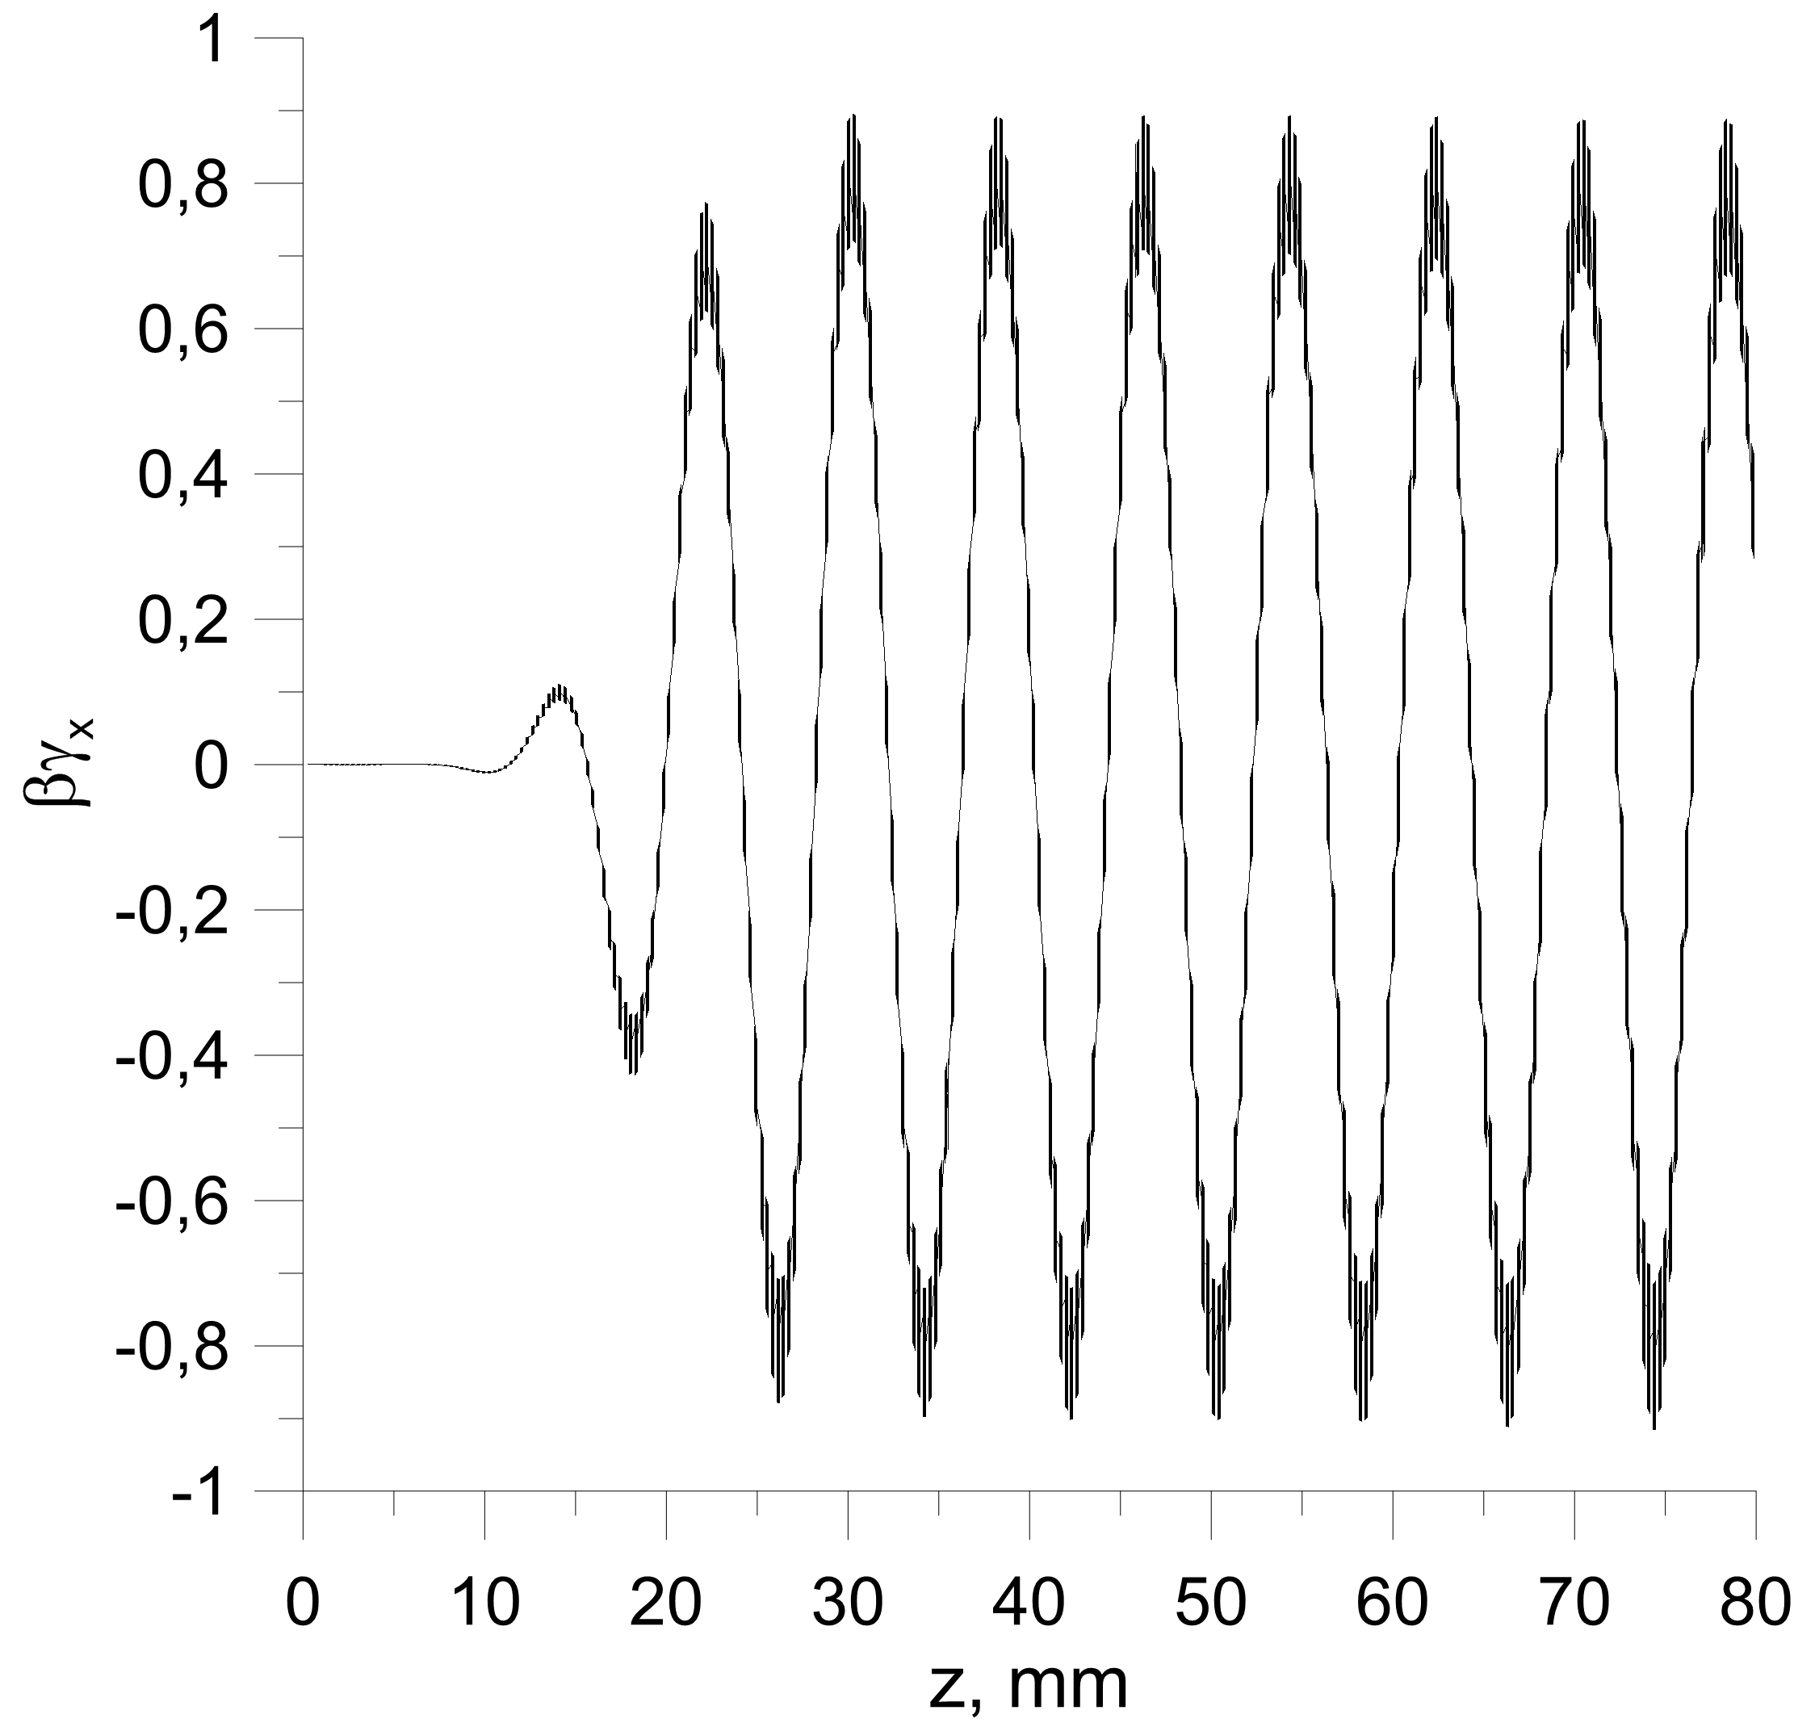
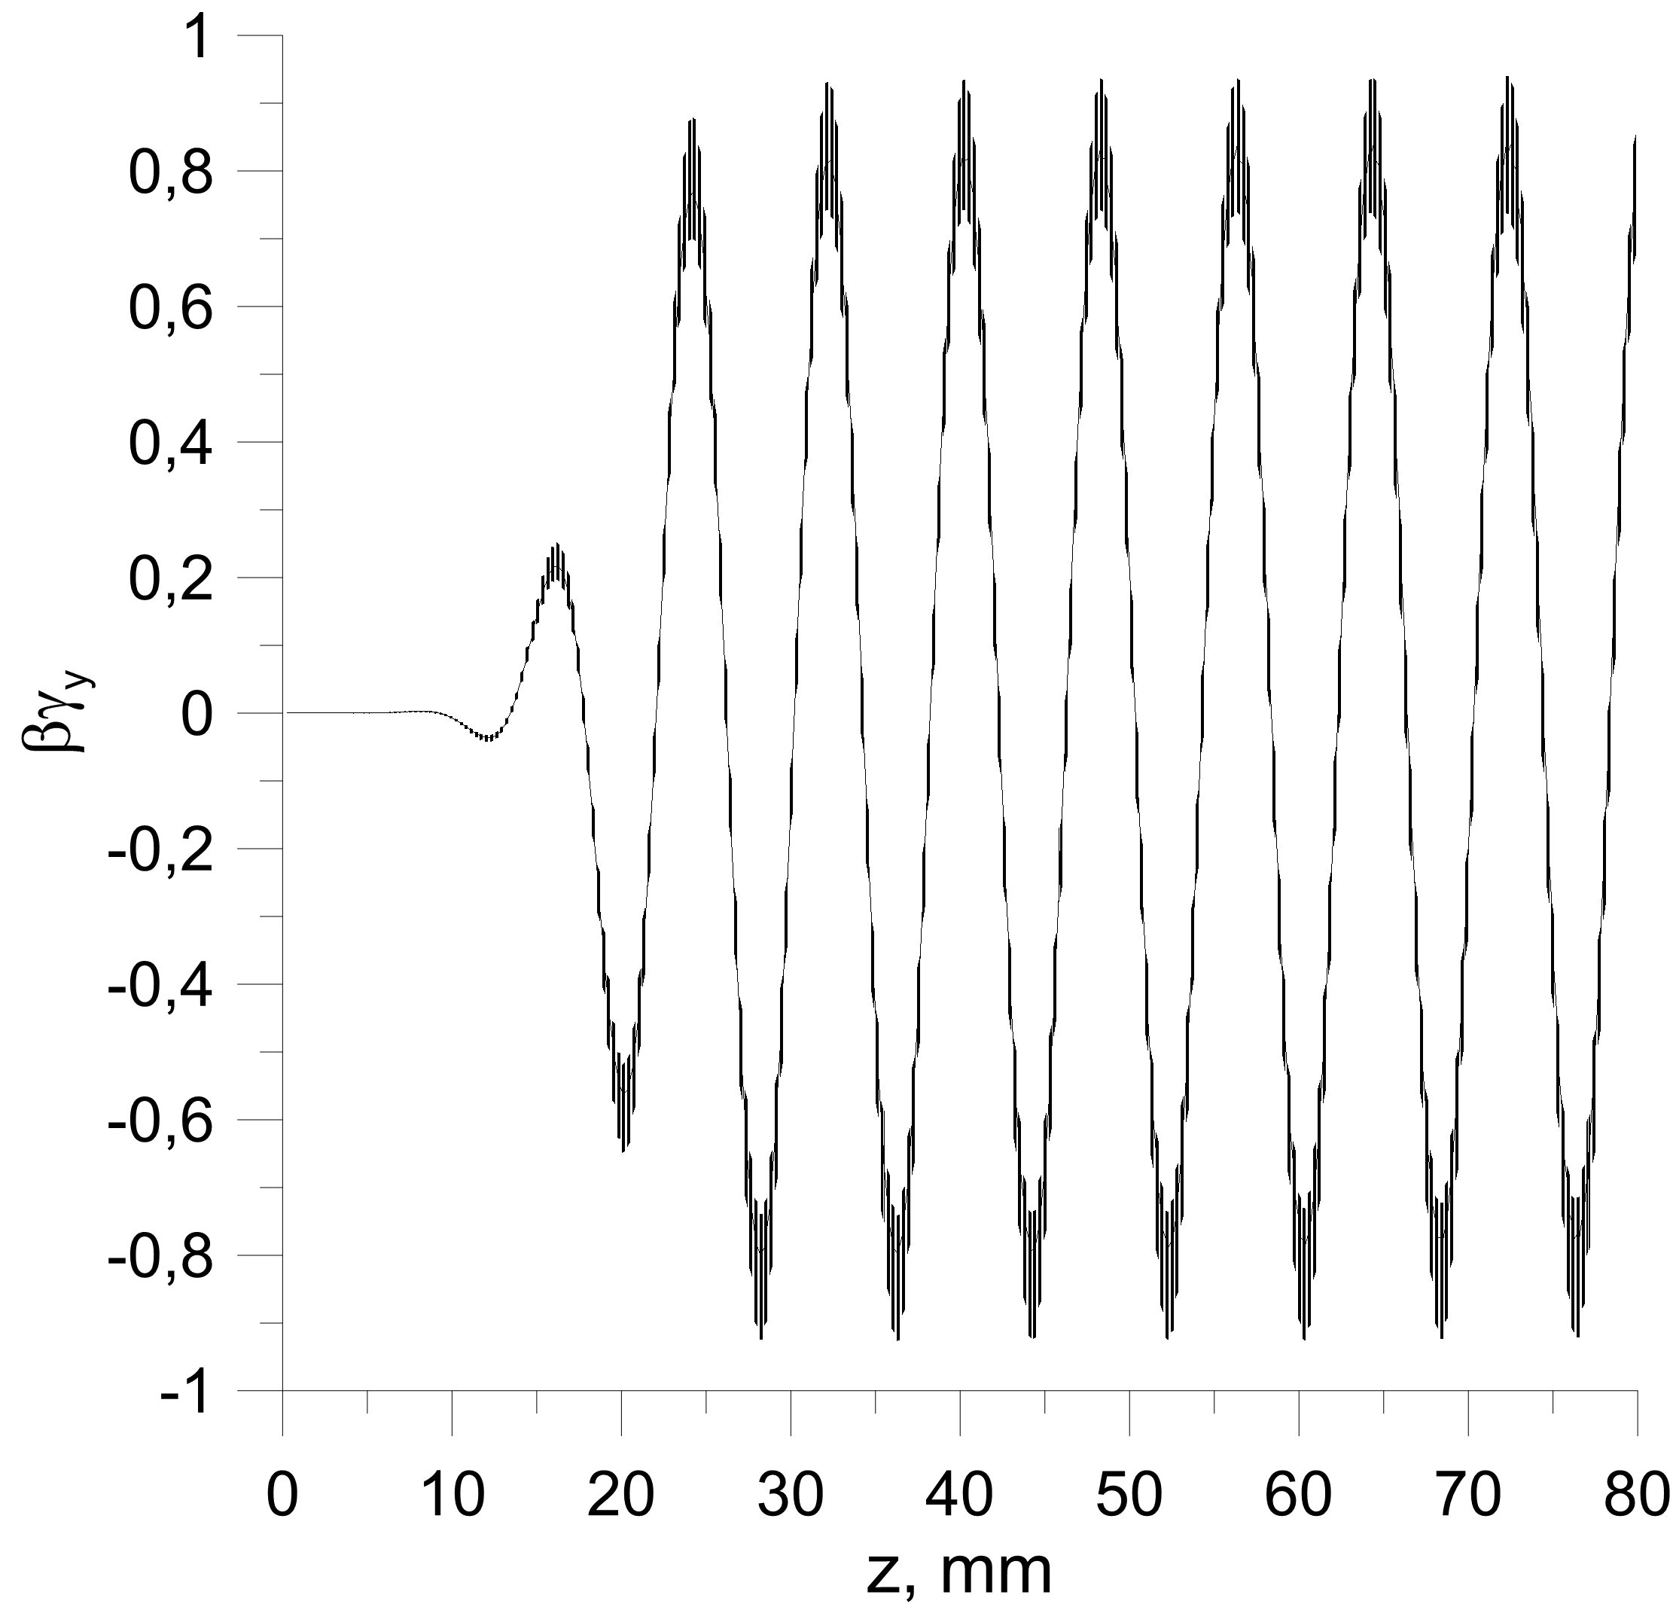
Simulation of particle motion in 100 MV/m HSFC accelerating structure by CST Microwave Studio
Normal wave
regular part
taper
regular part
taper
Total length =10 periods
TM01
taper
Transverse particle momentums

Slide 9
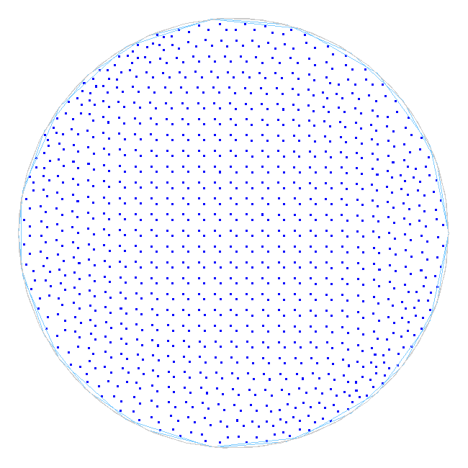
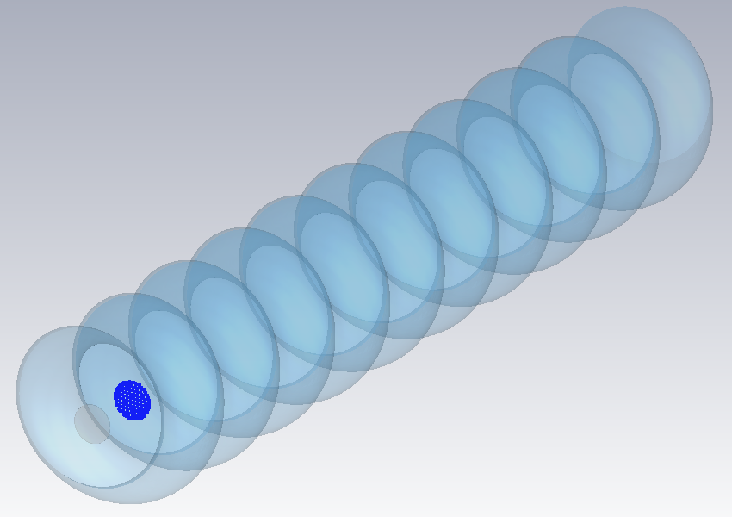
Simulation of ponderomotive force focusing in HSFC accelerating structure
by CST Microwave Studio
bunch
Bunch population during acceleration.
The blue color (at input) corresponds to low particle energy.
The red color (at output of structure) means the higher energy of the accelerated particles.
Parameters: initial energy 10 GeV, bunch length 1 ps, bunch diameter 3 mm, charge 100 nC, gradient 100 MV/m.

Slide 10

Towards a full C-band
multi-bunch/high rep. rate/high gradient injector linac
D. Alesini
(LNF-INFN, Frascti, Italy)
With the contribution of:
A. Bacci, T. Ronsivalle, L. Serafini, M. Ferrario, M. Migliorati, A. Mostacci (Beam Dynamics)
L. Piersanti, L. Palumbo (RF design)
V. Lollo (mechanical design)

Slide 11
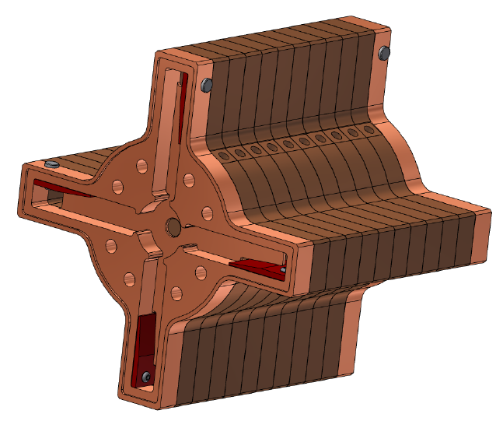
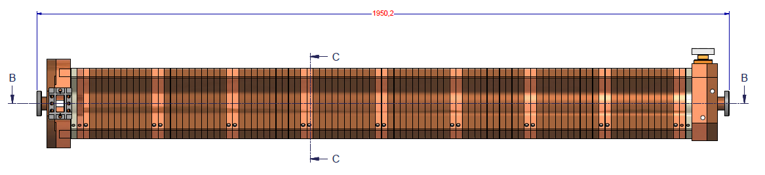
OUTLINE
1. C-BAND ACCELERATORS (SPARC, PSI, SCSS, ELI_NP) AND C-BAND TECHNOLOGY
2. ELI-NP C-BAND ACCELERATING STRUCTURES FOR MULTI-BUNCH OPERATION
3. C-BAND GUN DESIGN
4. FULL C-BAND INJECTOR: THE NEXT AND DEFINITIVE STEP

Slide 12
CONCLUSIONS
C-Band accelerators all over the world have made the C-Band technology accessible and commercial.
Gradients >50 MV/m in accelerating structures have been reached in several structures.
Damped C-band structures for multi-bunch acceleration of >100 Hz rep. rate linac have been developed for ELI-NP and are now under construction.
A C-Band RF GUN at gradients >170 MV/m has been designed.
The full C-band injector (>100 Hz, Multi-bunch) is now the “state of the art” and allows reaching excellent beam qualities usable in several applications.

Slide 13
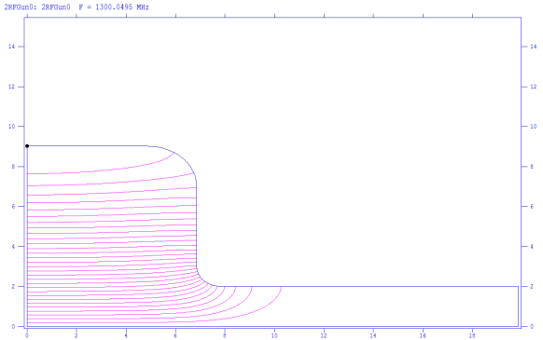
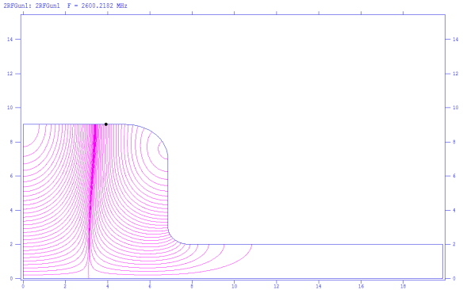
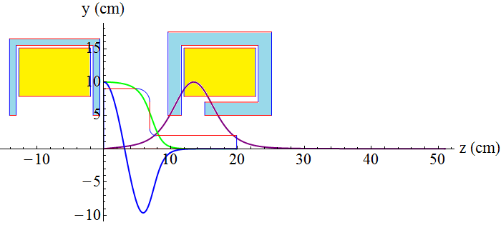
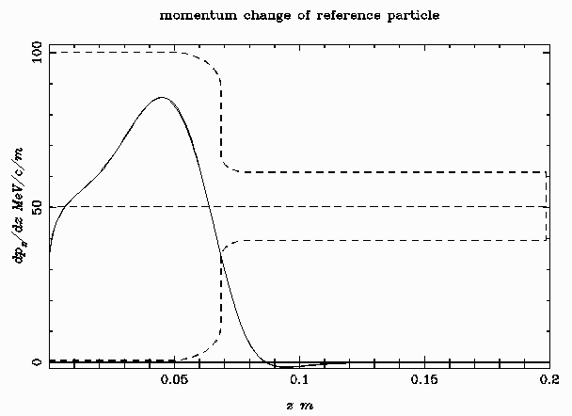
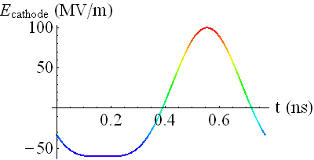
MUFFIN RF gun based on TM₀₁₀-TM₀₁₁ f+2f cavity
Sergey Kuzikov (Institute of Applied Physics, Russian Academy of Sciences)
Cathode wall
Anode wall
TM₀₁₀ eigen mode (E-field)
f=1.3 GHz, Q=2⋅10⁴
TM₀₁₁ eigen mode (E-field)
f=2.6 GHz, Q=2⋅10⁴
Anode-like fields
Cathode-like fields
Time dependence of electric field in MUFFIN gun
ASTRA simulation of a force experienced by an electron)

Slide 14
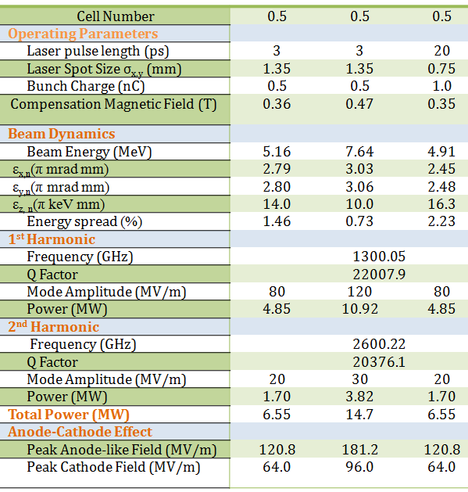
The TM₀₁₀-TM₀₁₁ f+2f MUFFIN has high acceleration gradient. This allows using 0.5-cell design instead of classical 1.5 cell design.
The MUFFIN gun in comparison with reference single-mode gun provides optionally:
- two times smaller transverse emittances at regime of 3 ps bunch in case of similar cathode field,
- better transverse and longitudinal emittances, and two times smaller energy spread at regime of 3 ps bunch in case of higher cathode field,
- smaller transverse emittances at regime of 20 ps bunch in case of similar cathode field.
3. Fast semiconductor switch, controlled by ~GHz repetition rate gun laser, allows to provide phase locking of the feeding RF source.

Slide 15
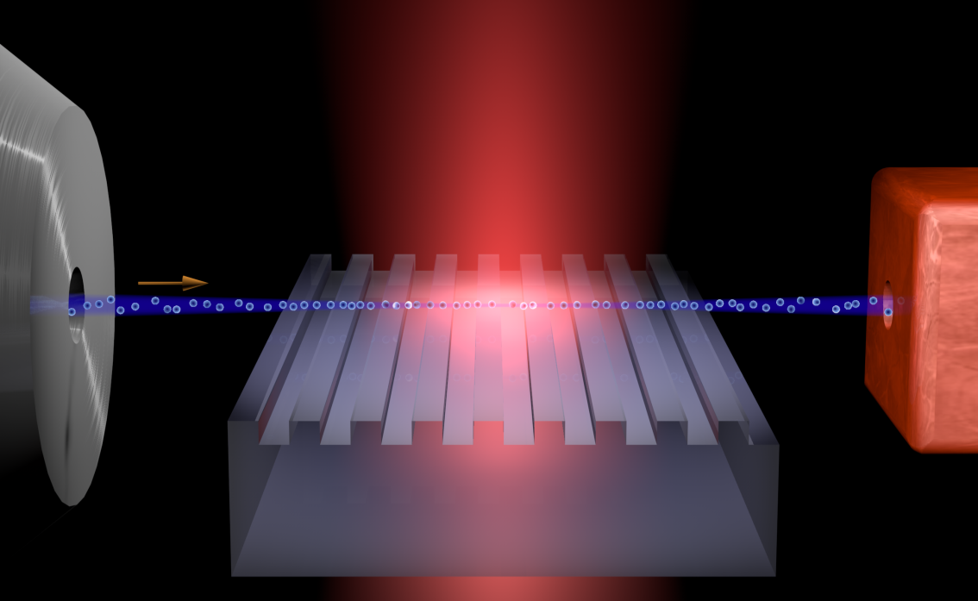
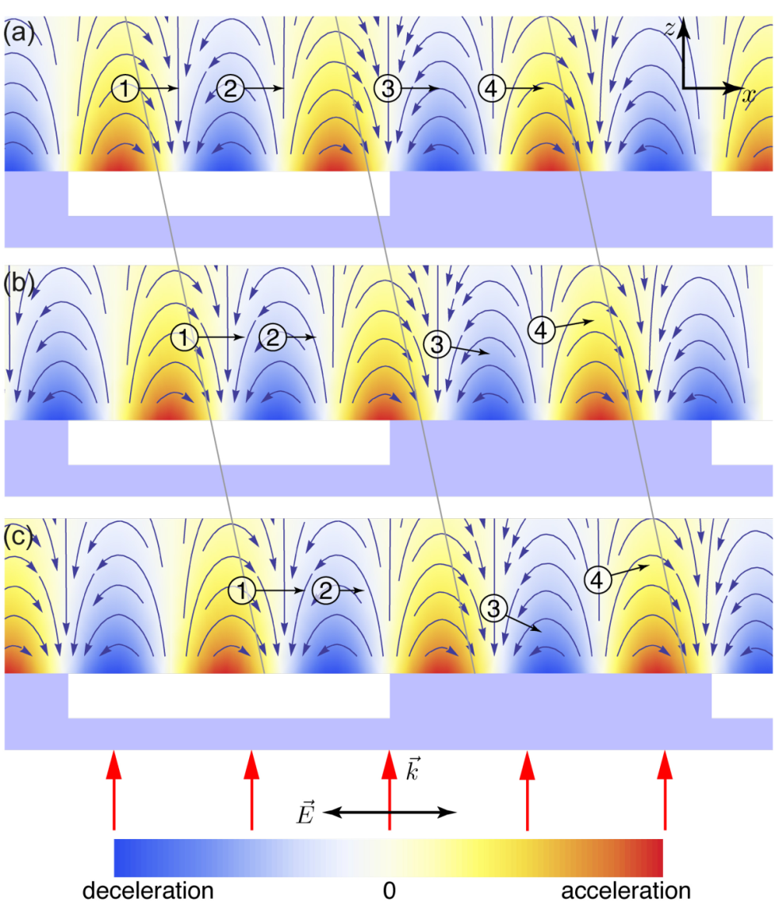
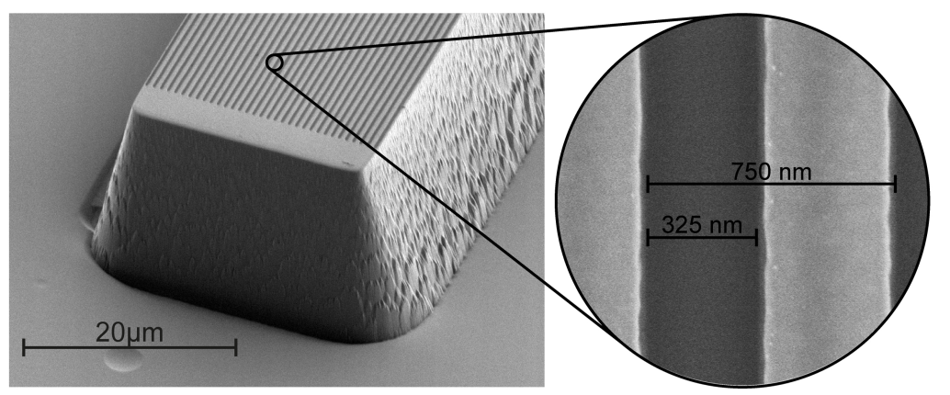
Dielectric laser acceleration of 28 keV electrons with the inverse Smith-Purcell effect
J. Breuer, P. Hommelhoff
Univ. of Erlangen & Max Planck Institute of Quantum Optics
transparent
grating
laser
Principle: phase synchronous acceleration of electrons with an optical surface mode co-propagating with the electrons at the transparent grating structure

Slide 16
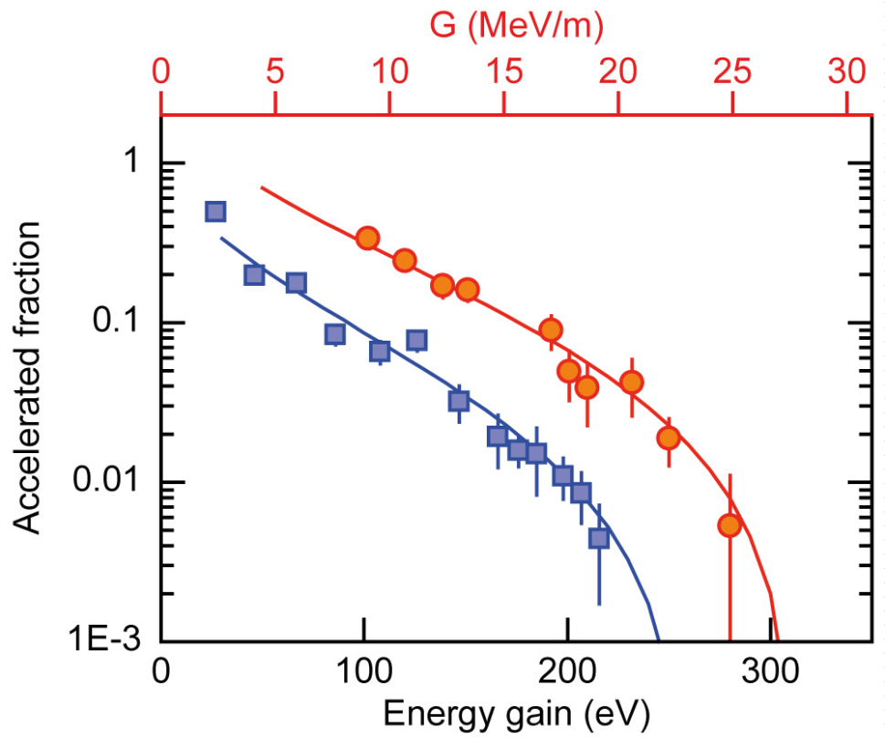
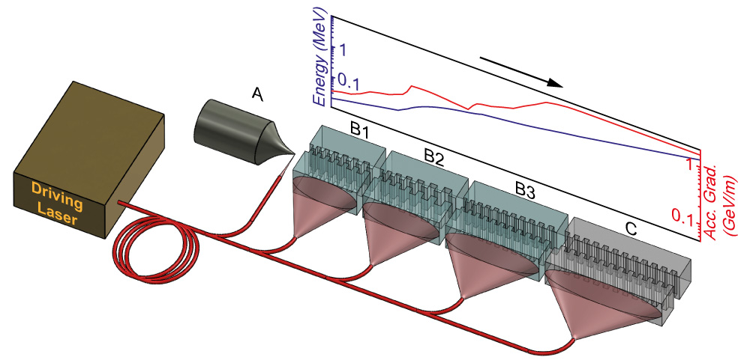
Demo of scalable acceleration of non-relativistic electrons. Compatible with relativ. dielectric laser accelerator structure.
Maximum acceleration gradient observed:
25 MeV/m for 28 keV electrons.
3 MHz, 800nm, 300mW avg. power, peak field 2.8 GV/m, 3rd spatial harm. (750nm grat. per.)
With relativistic e⁻ (simulations so far):
1.7 GeV/m
Excellent agreement with simulations
Ep=2.85GV/m
Ep=2.36GV/m
Sketch of a future coherently driven dielectric laser accelerator. B1-B3: non-relativistic stages, C: relativistic.
(Byer group, SLAC: demo of 300 MeV/m accel. w/ 60MeV electrons)

Slide 17
Argonne Wakefield Accelerator (AWA): a Facility for the Development of High Gradient Accelerating Structures and Wakefield Measurements
Manoel Conde, S. Antipov, D.S. Doran, W. Gai, C. Jing, R. Konecny, W. Liu, J.G. Power, E. Wisniewski, Z. Yusof
Argonne National Laboratory
Euclid Techlabs LLC
Illinois Institute of Technology
ε
2b
2a
Q
Cu

Slide 18
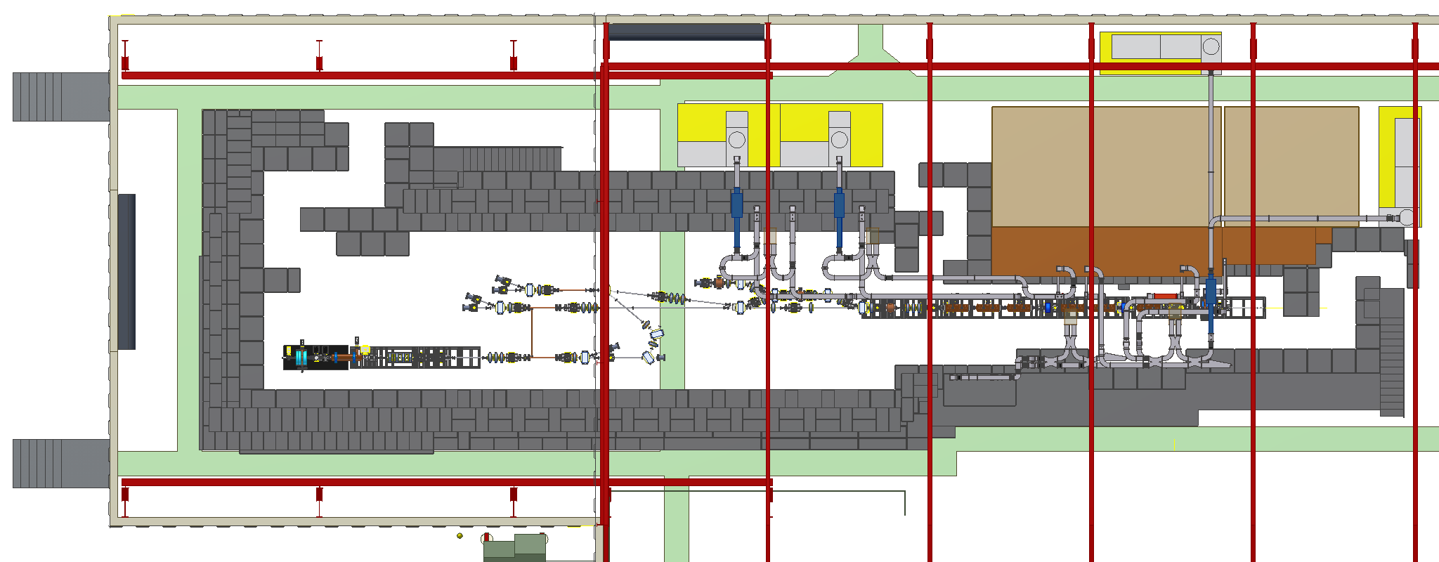
AWA Facility
75 MeV drive beam:
RF gun with Cs₂Te photocathode & six linac tanks; bunch train, up to 32 bunches spaced at 1.3 GHz; charge per bunch up to 100 nC
15 MeV witness beam:
RF gun with Mg photocathode & one linac tank; bunch charge 0.1 – 150 nC; generated 100 MV/m in dielectric wakefield structure
Beamline switchyard
(under construction)

Slide 19
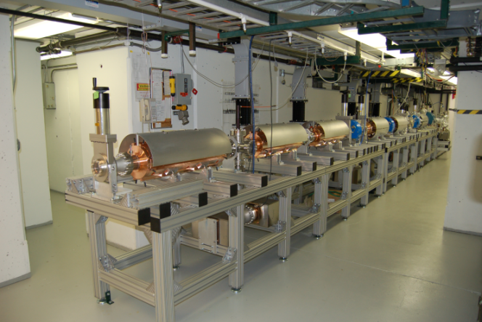
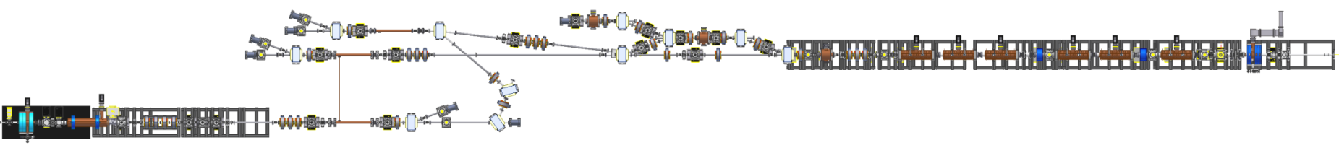
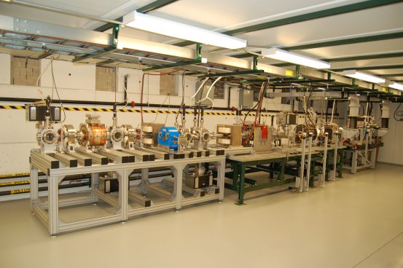
Overview of AWA Beamlines
experimental area
collinear & TBA
EEX & bunch compression
witness beam U-turn
75 MeV drive beam
15 MeV witness beam
Goals
Higher gradient excitation: ~ 0.5 GV/m
Acceleration of witness beam: ~ 100 MeV
Higher RF power extraction: ~ GW level

Slide 20
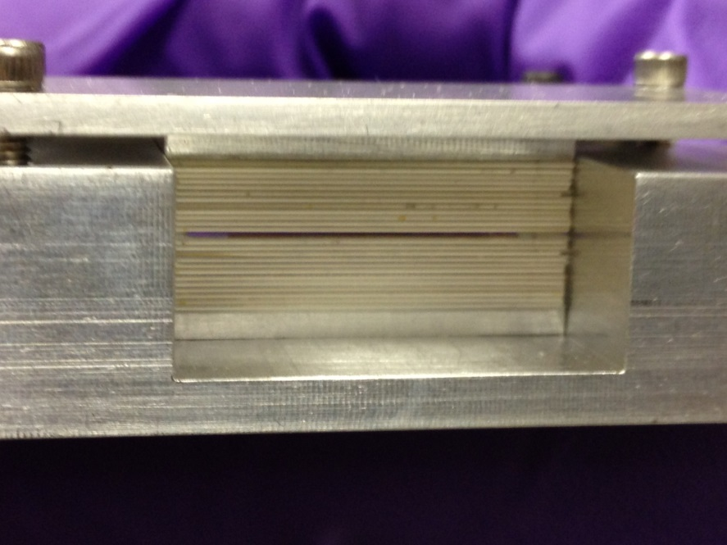
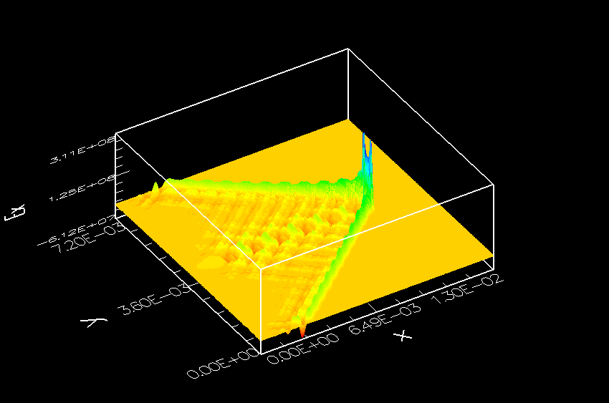
UCLA Bragg DWA experiment at ATF
First exploration of photonic confinement in DWA
J.B. Rosenzweig, et al.
E = 50 MeV
σ_{x}, σ_{y} = 60 µm
Q ~ 200pC
σ_{t} ~ 1ps
OOPIC Slab Simulation
ZTA – SiO2 layers
SiO2 “matching” layer

Slide 21
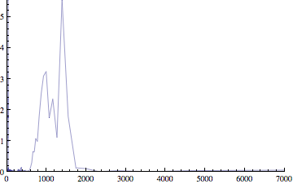
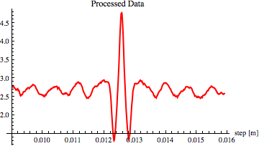
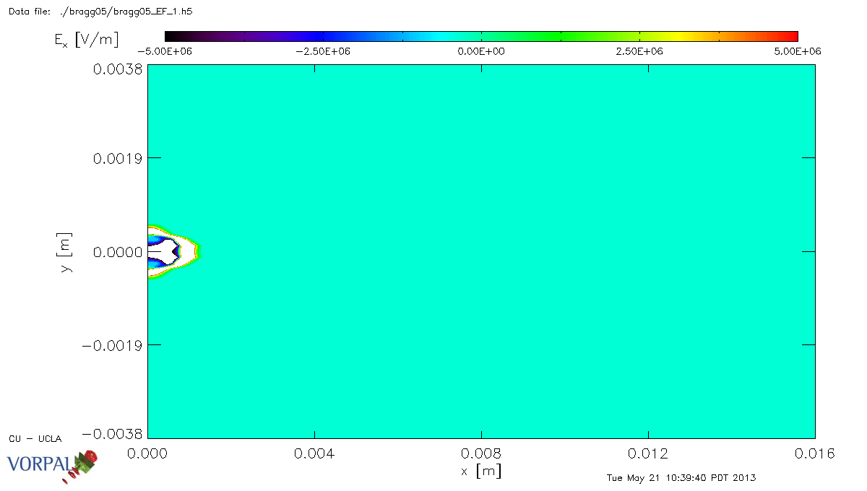
Experimental results and 3D sims
CCR
autocorrelation
Confined mode near 165 GHz,
per prediction of theory,
2D and 3D simulations
VORPAL 3D
Simulation

Slide 22
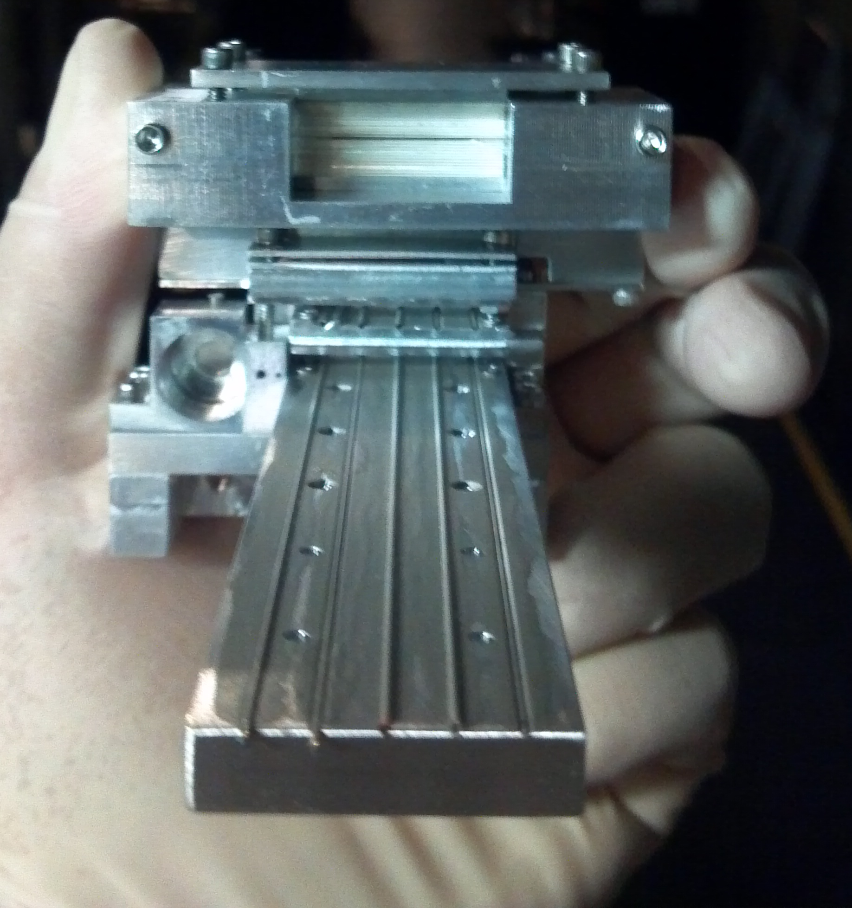
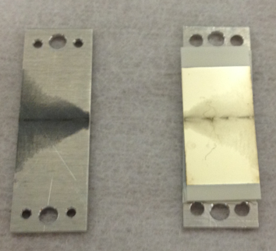
New E201 DWA results from FACET
Excellent metal cladding developed at UCLA
Applied to 10 cm tubes!
U=20 GeV
Q=3 nC
σ_{z}=40 um
Expected wake amplitude in tubes=1.2 GV/m.
Alumina slabs, with beam induced
scoring on metal boundary
10 cm long, 450 um ID SiO2 tube assy.

Slide 23
Recent results
Massive narrow band THz
signal detected
Correct fundamental
λ=750 um
Several 100 mJ energy
Median energy loss observed! Consistent
=with expected GV/m fields
Systematics analysis underway at UCLA
Next steps: longer, narrower tubes under
construction at UCLA (15-20 cm, 300 um ID)
-> 100 MeV average energy change
-> 2 beam experiments for acceleration

Slide 24
Presentation at EAAC, Elba, Italy June 2-6 2013
Dielectric Based Accelerator: Subpicosecond Bunch Train Production and Tunable Energy Chirp Correction
A.Kanareykin for
Euclid TechLabs LLC, Gaithersburg MD USA
in collaboration with ANL/AWA, BNL/ATF, UCLA and Eltech Universtity “LETI” , St.Petersburg, Russia

Slide 25
Dielectric accelerator:
presented materials available for the DLA applications and brief summary of the recently tested materials (quartz, ceramic, diamond)
presented software developed for the DLA analysis
recent experiments on the diamond based DLA structures at 26 GHz and 300 GHz ranges
- results on energy chirp compensation at BNL/ATF; factor of 5 compensation has been demonstrated
subpicosecond bunch train production at THz frequency range, BNL/ATF
Presented of the concepts of the beam based undulator: undulator is based on an electron bunch train powering a mm-wave/THz waveguide; the drive bunch train propagates towards the undulating beam inside a dielectric loaded structure

Slide 26

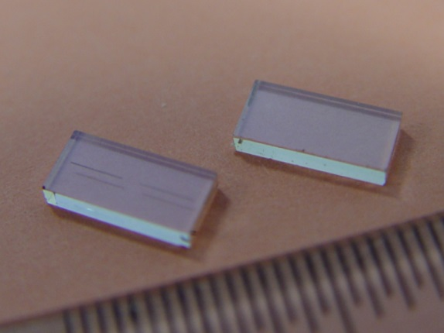
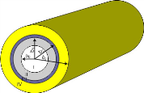
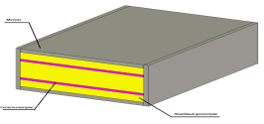
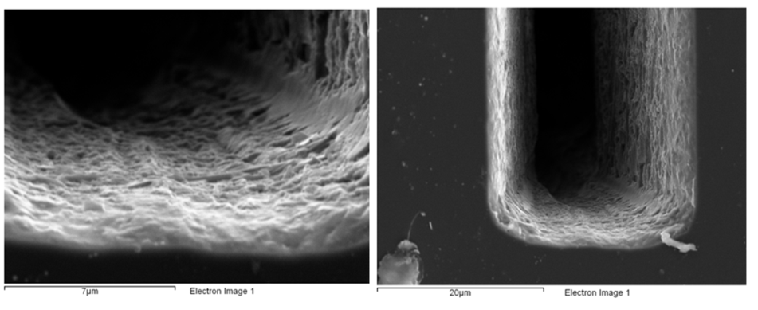

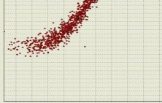
Diamond test at 26 GHz
Software:
Waveguide
300 MV/m at 36 ns pulse
Rectangular
Diamonds (E6) ...scratched
Multibunch
Annular
Multizone.
Beam Breakup
(BBU)

Slide 27

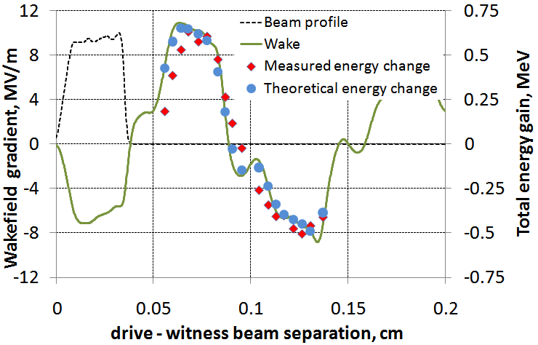
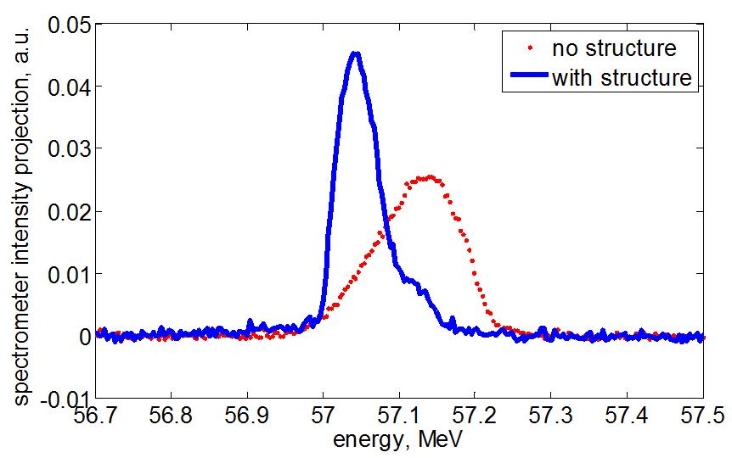
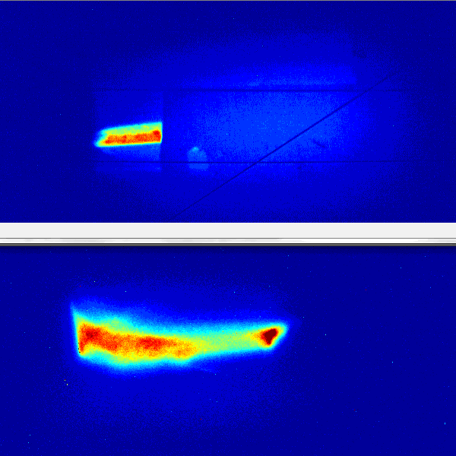

Energy chirp correction
First Beam Test of the Diamond Accelerating Structure

Slide 28




Energy Modulation Experiment
Beam Based DLA Undulator
a train of 4×75 MeV bunches of 25 nC each
λ_{u}=2.9 mm, B_{u}=24kG K=1.1

Slide 29

Analytical and Numerical Studies of Underdense and Overdense Regimes in Plasma-Dielectric Wakefield Accelerators
G.V. Sotnikov, R.R. Kniaziev, O.V. Manuilenko,
P.I. Markov, T.C. Marshall, I.N. Onishchenko
Analytical studies and PIC simulations of wakefields excited by an electron bunch in a single-channel Plasma Dielectric Wakefield Accelerator (PDWA) showed:
Filling up the dielectric waveguide vacuum transport channel with isotropic plasma having a specific density sets up a focusing wakefield for drive and witness bunches, and a witness bunch can be accelerated.
For the case of a linear plasma (“overdense” regime), the focusing of witness bunch particles is provided by the plasma wave, and acceleration is provided by the eigen waves of the empty dielectric waveguide.
The focusing mechanism is charge symmetrical in case (2): it can be used both for accelerating electron bunches and for accelerating positron bunches.
For the case of nonlinear plasma, focusing is provided by the plasma ions remaining in the transport channel after pushing out the plasma electrons. Acceleration, as before, is provided by the dielectric wave.

Slide 30


Overdense regime of PDWA: Axial profile of the axial force (black line) and transverse force (red line) at the distance r=0.45mm. Cyan rectangle shows possible location of electron witness bunch and green rectangles show possible location of positron witness bunch. OD=1.2mm. ID=1mm, nb/np=1/3, np=4.5∙1014 cm-3. Bunch energy is 5 GeV, bunch charge is 3nC. The focusing force amplitude is approximately 300MeV/m, which equals a focusing magnetic field induction ~1T. Drive bunch, which moves right to left, is shown as a yellow rectangle
Underdense regime of PDWA: Axial profile of the axial force (black line) and transverse force (red line) in the case of underdense (“blowout”) excitation regime of PDWA: Drive bunch moves from left to right, its location is shown as a green rectangle. OD=1.0mm. ID=0.4mm, Plasma density np=∙1014 cm-3 , nb/ np=30. Bunch energy is 5 GeV, bunch charge is 3nC. At plasma density np=4.5∙1014 cm-3 it is possible to expect amplitude of the focusing force ~530 MeV/m , corresponding to a focusing magnetic field ~1.8 T.

