Slide 1
WG4 Future accelerator concepts incl. gg, beam transport Summary
Andrei Seryi
John Adams Institute for Accelerator Science

Slide 2
WG4 Program

Slide 3
WG4 Program

Slide 4
WG4 Program

Slide 5
WG4 Program

Slide 7
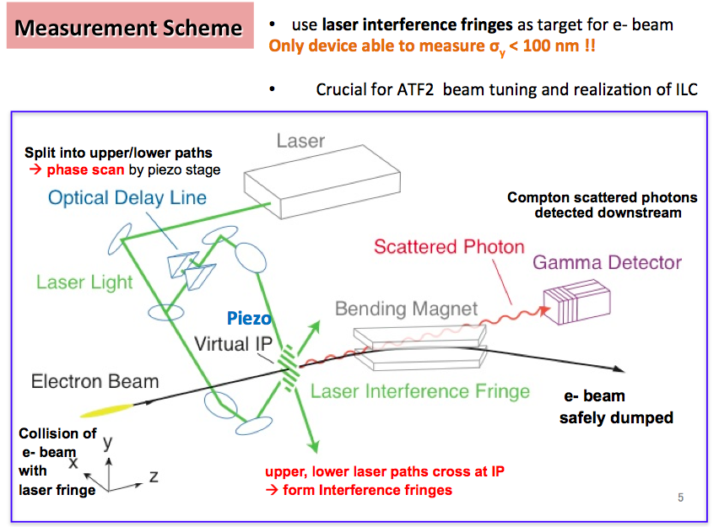

Slide 8
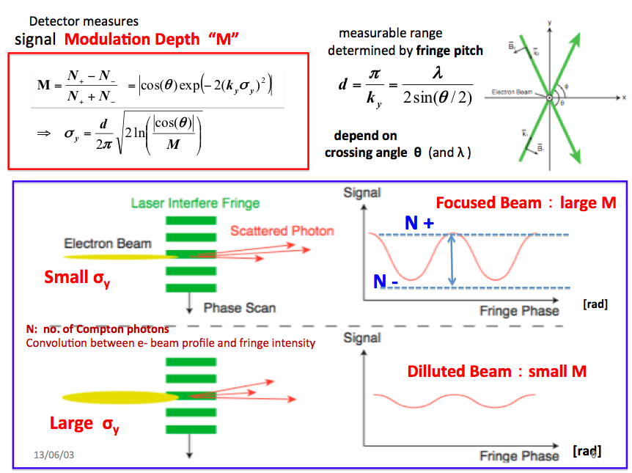

Slide 9
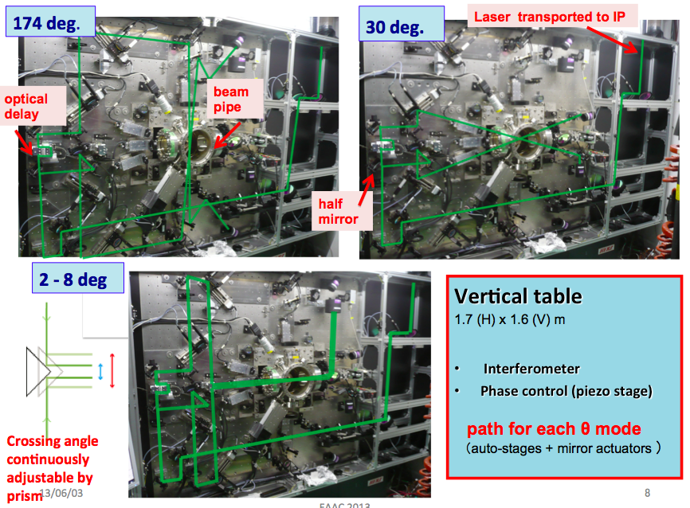

Slide 12
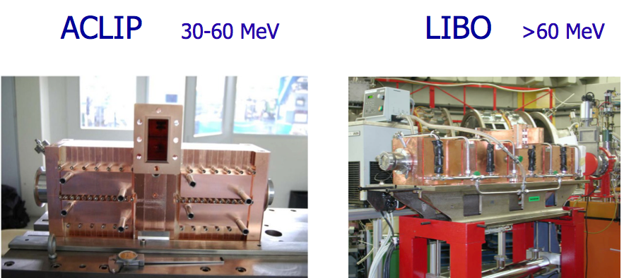

Slide 16
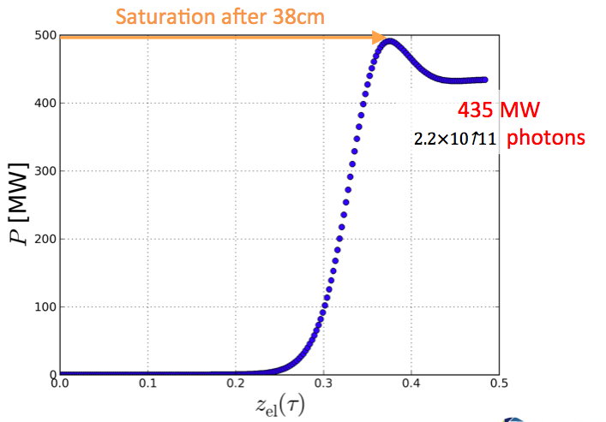
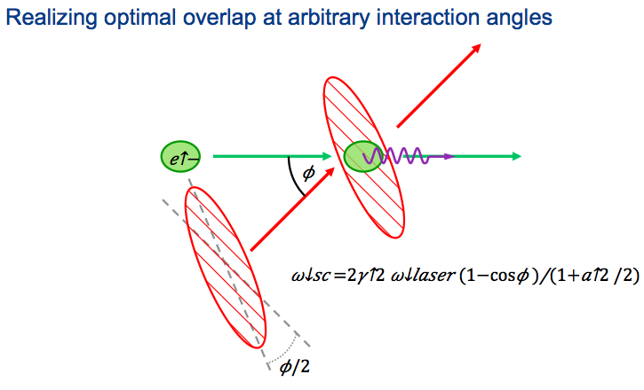

Slide 26
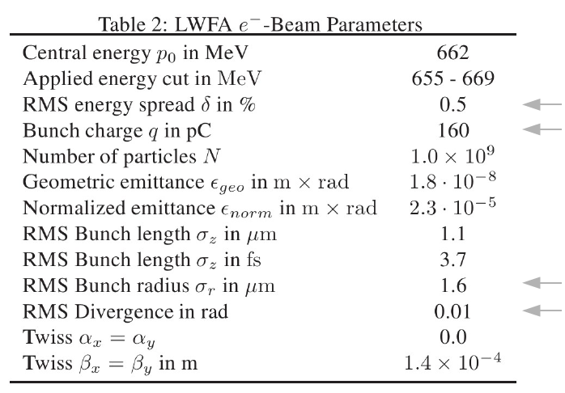
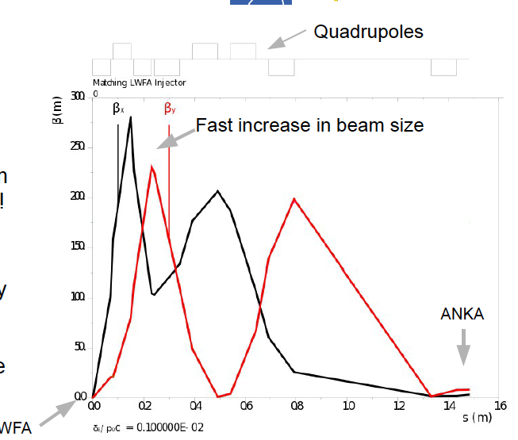

Slide 32
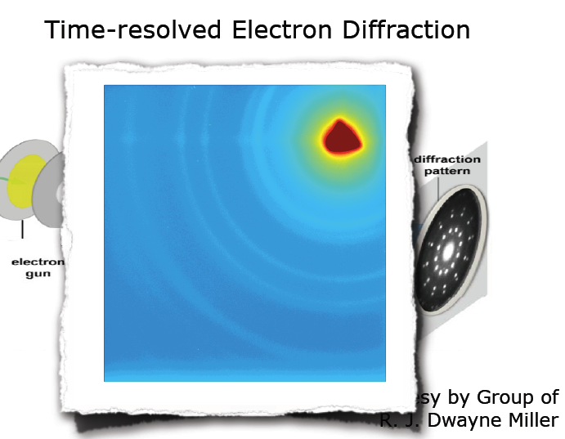
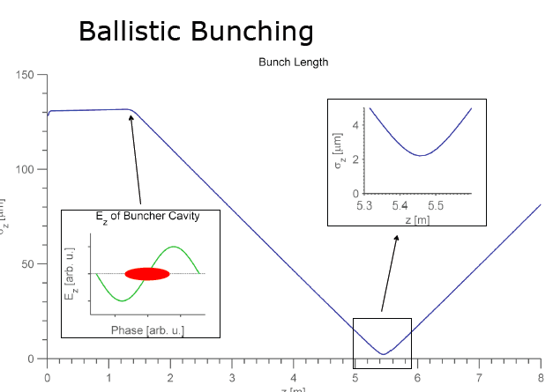

Slide 33
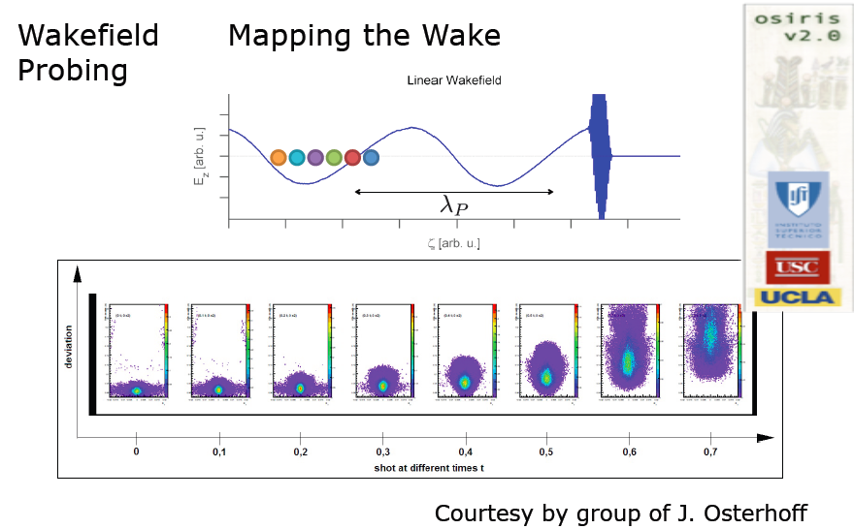

Slide 36
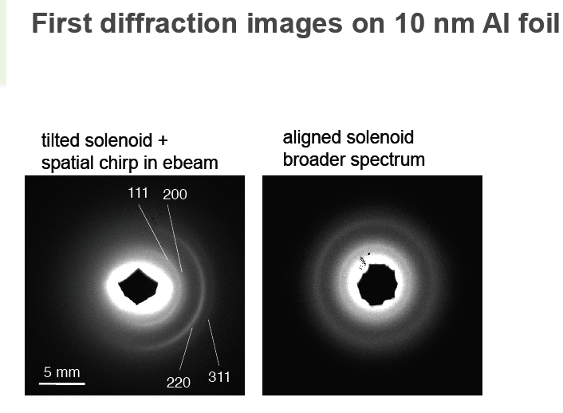

Slide 37
(triplet & achromat)

