Slide 1

g-2 at FNAL
Steve Maxfield for the E989 Collaboration
sjm@hep.ph.liv.ac.uk

Slide 2
OUTLINE
Why do it again?
Goals and how to achieve them:
  Brief recap of technique
  Upgrades!
    Beam, detectors, field
Status and Conclusions
† The material for this talk has been shamelessly stolen from many including: B. Lee Roberts, Leah Welty-Reiger, and Mark Lancaster, Thomas Teubner……

Slide 3
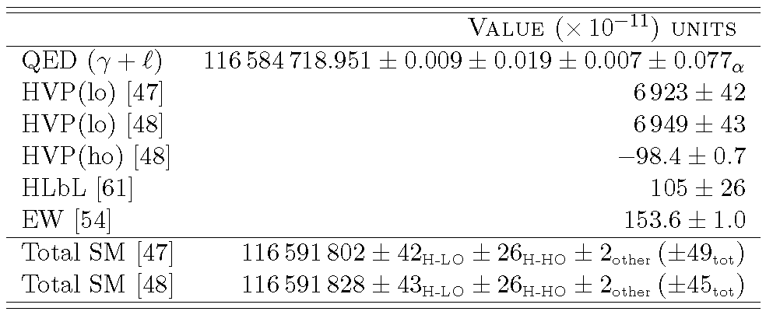
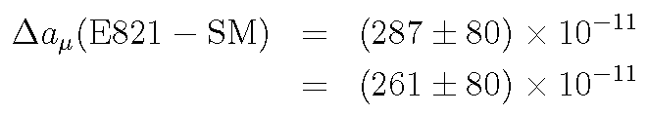
Why are we still measuring the anomalous magnetic moment of the muon?
There is ‘tension’ between the most accurate measurements of g-2 and the Standard model theoretical prediction:
DHMZ
HLMT
A tantalising but inconclusive 3.3-3.6 sigma discrepancy

Slide 4
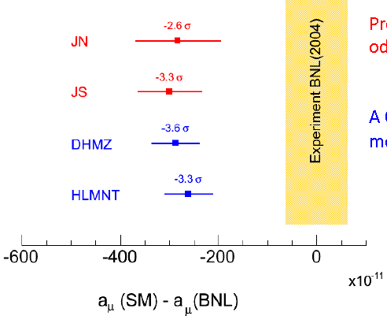
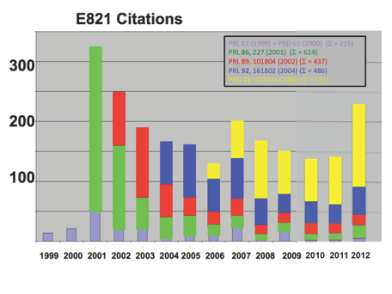
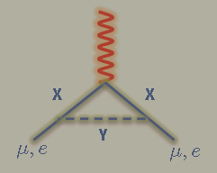
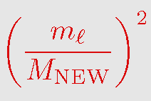
There is no shortage of interest in this intriguing result!
Were it to persist…
Strong indicator of BSM physics…
μ better than e

Slide 5
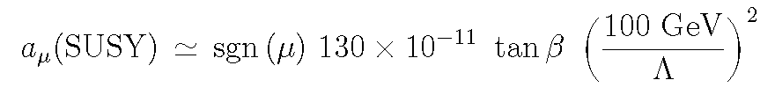
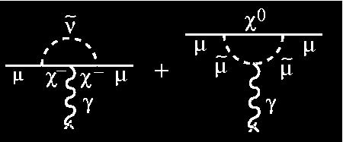
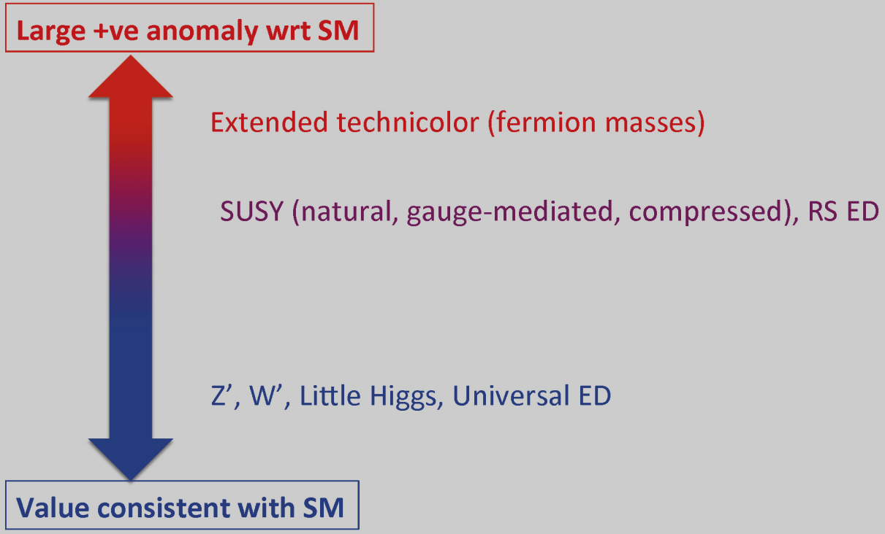
e.g. SUSY
But broad spectrum of sensitivity in TeV mass range…
…and…

Slide 6
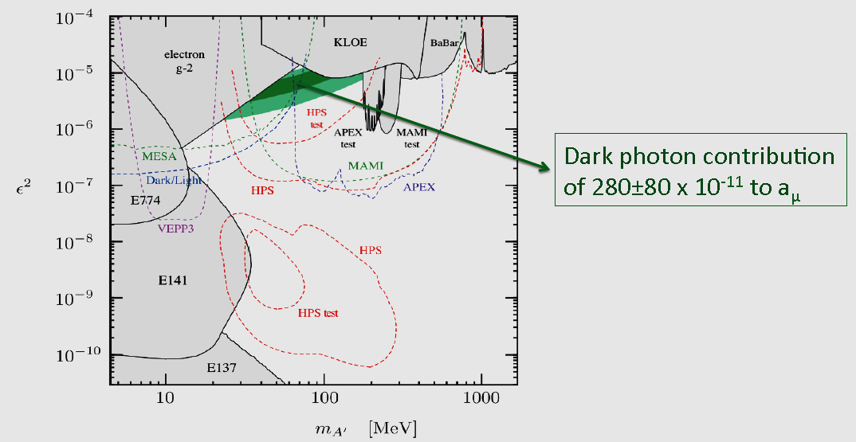
…low mass below LHC reach…
e.g. Dark photons:

Slide 7
…for details of the status of the SM predictions and theory, see elsewhere

Slide 8
…strong incentive to repeat the measurement with increased precision:
E989 Muon g-2 at FNAL aims to:
Build on BNL result and:
increase number of muons by factor ~21
reduce total systematics by factor ~3
i.e.

Slide 9
How these goals will be achieved:
Move the entire E821 storage ring to FNAL!
Use the same experimental technique as E821 but:
  exploit the unique FNAL facilities to deliver more muons
Reduce systematics by improving and refining
  the detectors
  the stored beam dynamics
  Uniformity and measurement of magnetic field

Slide 10

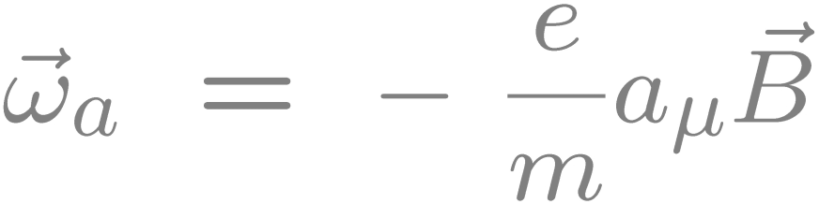
E821 Experimental Technique
25ns bunch of 5 X 10¹² protons from AGS
x_{c} ≈ 77 mm
θ ≈ 10 mrad
B·dl ≈ 0.1 Tm
Pions
Inflector
p=3.1GeV/c
Target
(1.45T)
Injection orbit
Muon polarization
Muon storage ring
injection & kicking
focus with Electric Quadrupoles
24 electron calorimeters
Central orbit
Storage
ring
Kicker
Modules
R=711.2cm
d=9cm
R
R
θ
Electric Quadrupoles
x_{c}
Notes:
Generate polarised muons from high momentum pion decays.
Inject into storage ring
During the fortunately long lifetime of the muons, measure precession frequency in the precisely known magnetic field.

Slide 11
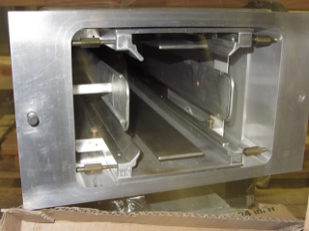
Magic γ
Vertical magnetic field – need vertical focussing to stop muons spiralling out of ring
Achieve using electrostatic dipoles
The E-field modifies the precession frequency:
Unwelcome source of additional systematics
Can be made to vanish for ‘magic’ γ.
…sadly, not every μ will be magic!

Slide 12
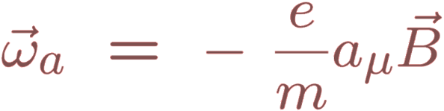
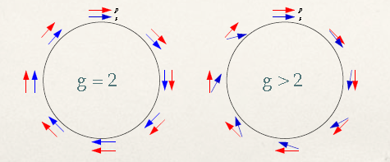
Tricks…
Polarised muons precess in magnetic field
Measure difference between spin precession and cyclotron frequencies:
Measure B-field in terms of Larmor frequency of the proton
λ=3.183345137(85) from muonium hyperfine structure

Slide 13
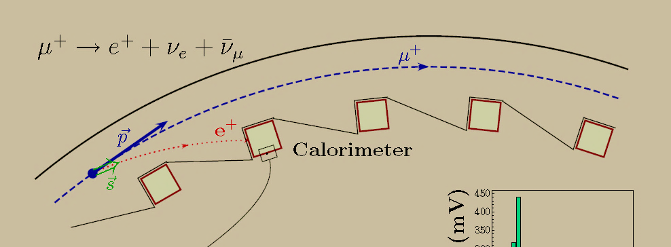
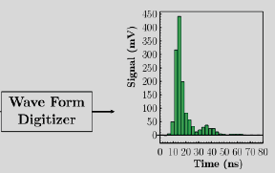
Measuring ω_{a}
Highest energy e⁺ emitted
along direction of μ⁺ spin
Use calorimeters to count
e⁺ above an energy threshold vs. t
Simulated for E989
High frequency modulation because muon bunch initially doesn’t fill ring…decays as bunch spreads
ω_{a}
Expected for E989: ω_{c} 149ns
Bunch length 120ns at injection

Slide 14
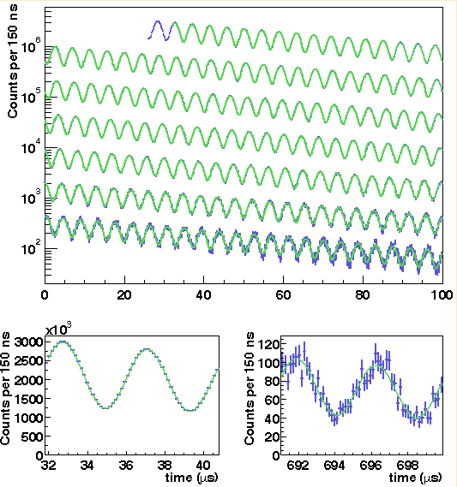
…an iconic plot
E 821

Slide 15
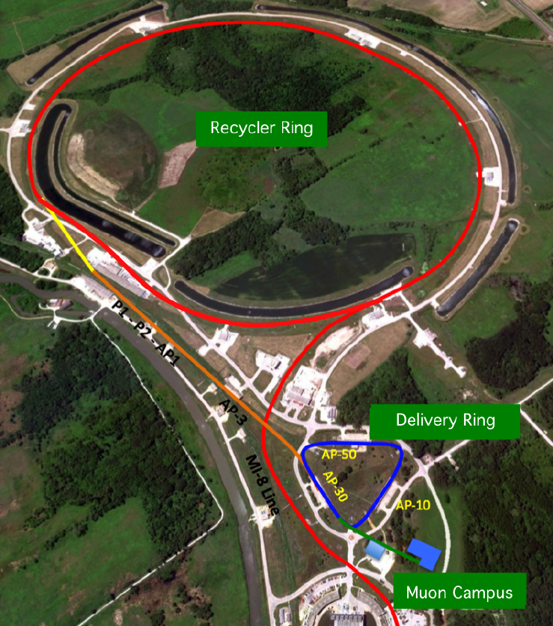
At FNAL…
Get more and cleaner beam:
~21 times statistics of E821 and
Use beam transfer and delivery as 1900m decay line ⇒ no pion background, no hadronic flash
Goal is
Detected decays
Systematic errors of better than: ±0.07ppm on ω_{a}
±0.07ppm on ω_{p}

Slide 16
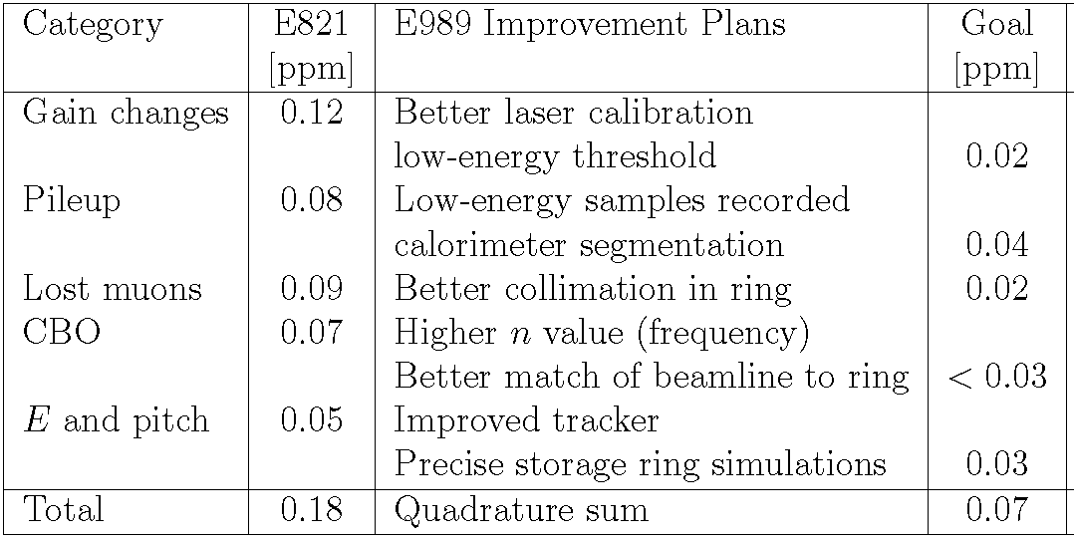
Factor ~3 reduction in systematics built from large number of individual improvements:
ω_{a}
calorimeter
beam
tracker
…and…

Slide 17
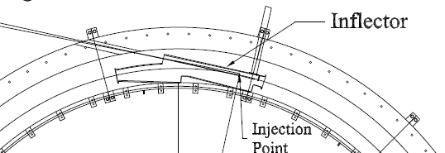
Beam Injection and Ring
Numerous Improvements in collimation, beam tune etc. New inflector, New kickers
→Reduction in muon loss
→Better control of coherent betatron
oscillations and their impact on ω_{a} .
e.g. Possible redesign of inflector
Replace with open ended design
and larger aperture. Shielding challenging.
Improved acceptance, improved matching between delivery and ring leading to more muons and reduced beam oscillations
→ possible factor ~4 in storage efficiency.

Slide 18
Calorimeters
New for E989:
Segmented: 6x9 PbF₂ crystals with SiPM readout. Attack pileup systematic.
Pileup: muon phase correlated with e⁺ energy
  overlapping pulses→ wrong phase shifts
  varying fraction of pileup within fill
  produces early→late shift in average phase→direct impact on ω_{a}.
one pulse should not affect gain of subsequent pulse on same channel. Should be able to separate at 5ns level
Fills ~ 700μs long
Gain variations and time shifts over this period feed into systematics. ΔG(t) < 0.1%
0.05 ppm systematic budget for ω_{a}

Slide 19
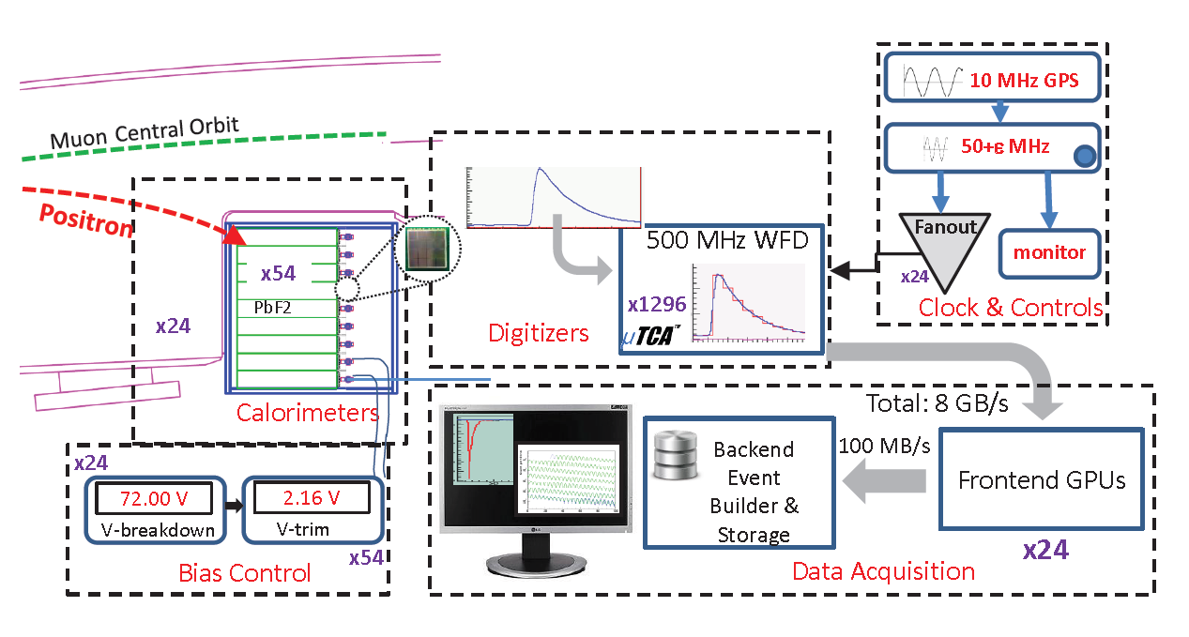
Calorimeters II
  Determine arrival time
  Determine energy
  Pileup separation
  Laser calibration system
Continuous distribution of muons with random decay probability
⇒ Wave Form Digitisation
Gain changes 0.12 → 0.02ppm pileup 0.08 → 0.04ppm

Slide 20
Tracking detectors
Measure beam profile at several locations as function of time in fill.
  Convolute μ spatial distribution with field to determine effective field seen by μ’s 0.03 → 0.01ppm
  Momentum spread and betatron oscillations lead to ppm corrections to ω_{α} from non-magic muons - E-field and pitch corrections…
  Beam dynamics corrections 0.05 → 0.03ppm
  Pileup identification. 0.08 → 0.04ppm
  Independent momentum measurement. Verify calorimeter gain
  Correct for acceptance changes in calorimeters from betatron oscillations. Validate calorimeter based determinations of pileup corrections, gain, muon loss. 0.12→0.02ppm
EDM measure positron vertical angle – asymmetry.
Design will allow a factor ~200/month increase in statistics over Brookhaven measurement ⇒ factor of 10 on EDM very quickly and ~100 eventually.
Notes:
Typical muon orbits 400 times. Average over azimuth, weight by profile.

Slide 21
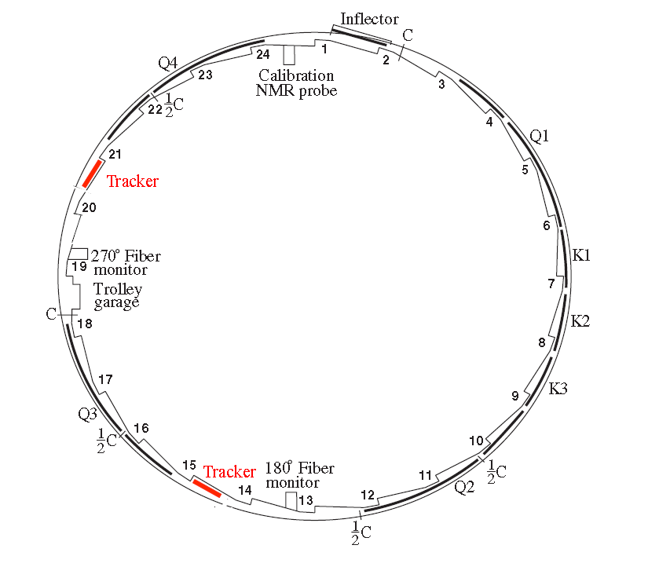
New Tracking detectors
Need: long lever arm ~1mm determination of muon decay up to 10m away
Continuously distributed decay points, muon momenta ⇒distributed detector
Straw chambers
In vacuum
2-3 locations round ring

Slide 22
Straws do the trick:
Low mass ~0.1X_{o} per station, non-magnetic, OK in vacuum
5mm diameter, 12cm long straws. Mylar coated with Al+Au.
25μ gold-plated tungsten wires
Based on Mu2e straws.
80:20 Argon:CO₂ gas
±7.5º UV layers to give vertical resolution

Slide 23
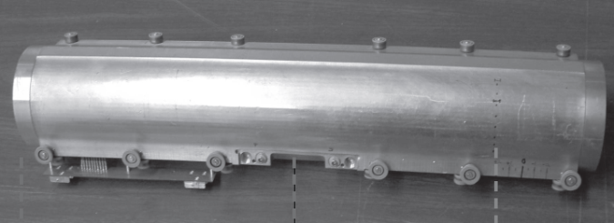
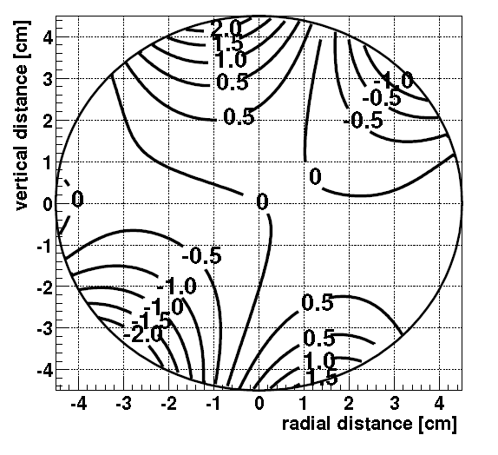
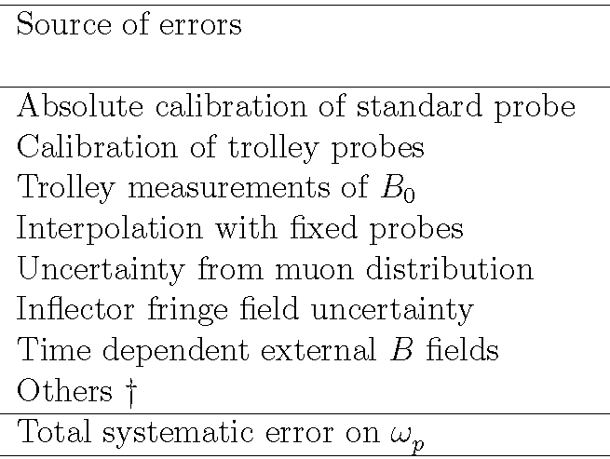
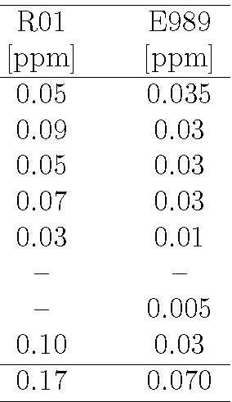
ω_{p}
Field measured with set of NMR probes
  fixed probes
  plunging probes
  trolley probes
Again, requires concerted attack to beat down systematics.
Improvements from reduced position uncertainties, more frequent measurements, better electronics etc.
e.g. Absolute Calibration
Dedicated 1.45T calibration magnet, more probes.
Possibility of using ³He as well as water-based NMR probes.
Notes:
B0 1,35T is central value

Slide 24
But first…Vital bits of E821 have to get from BNL to FNAL
The move…

Slide 25
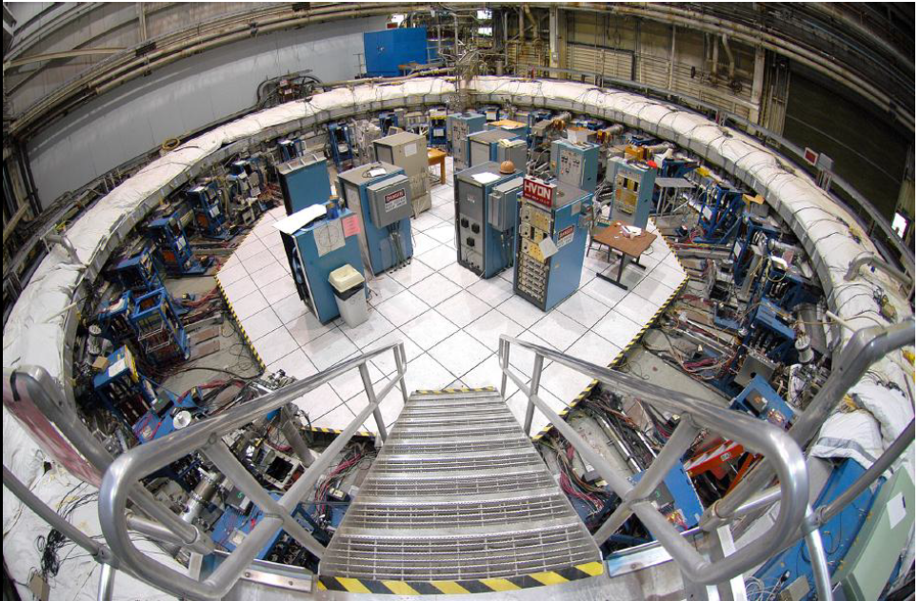

Slide 26
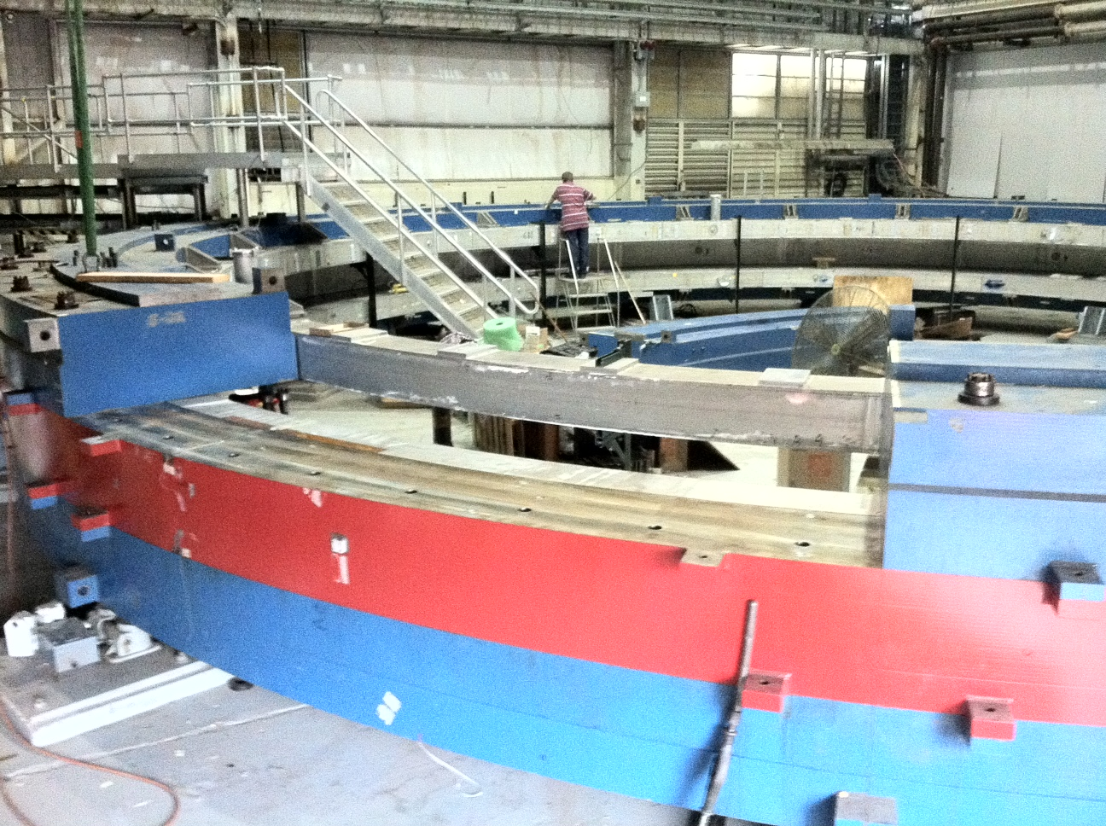
Disassembly September 2012

Slide 27
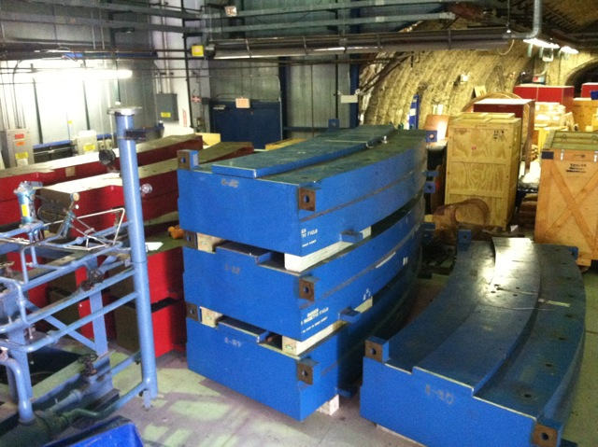
May 2013 : Yoke pieces arriving at FNAL

Slide 28
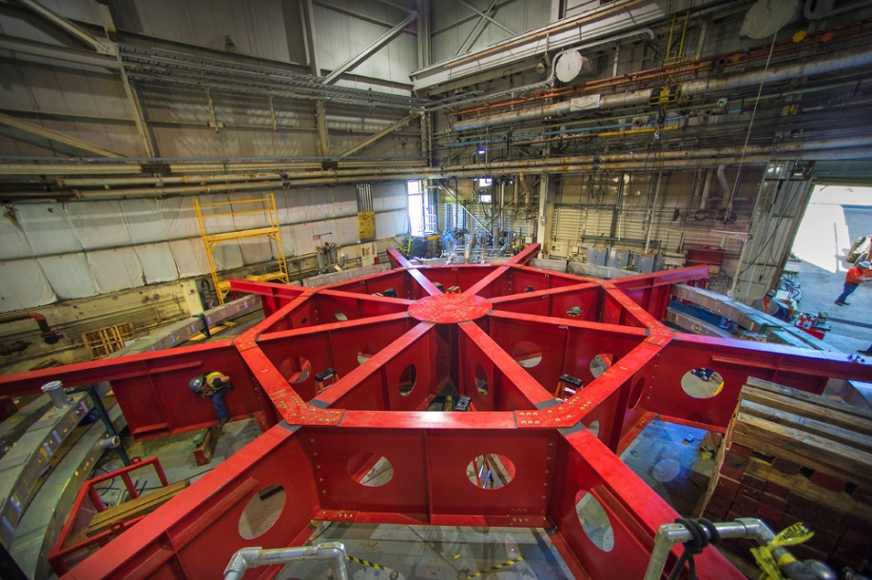
Building support structure…

Slide 29
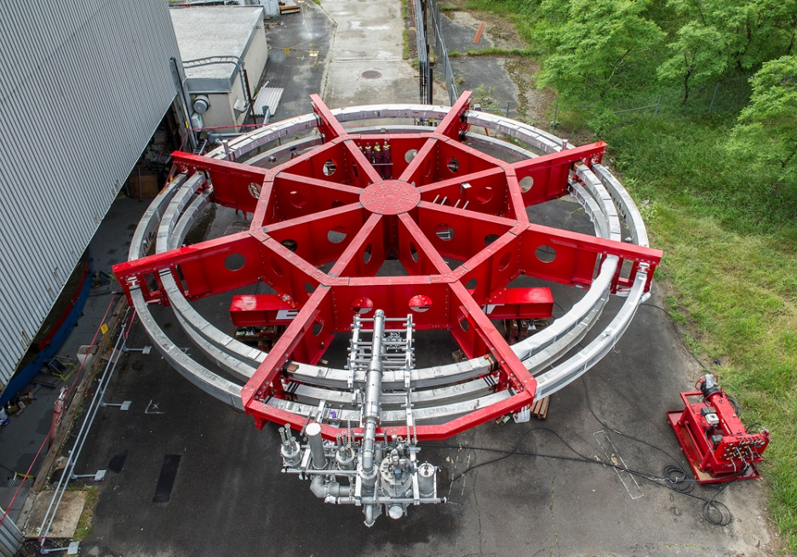

Slide 30

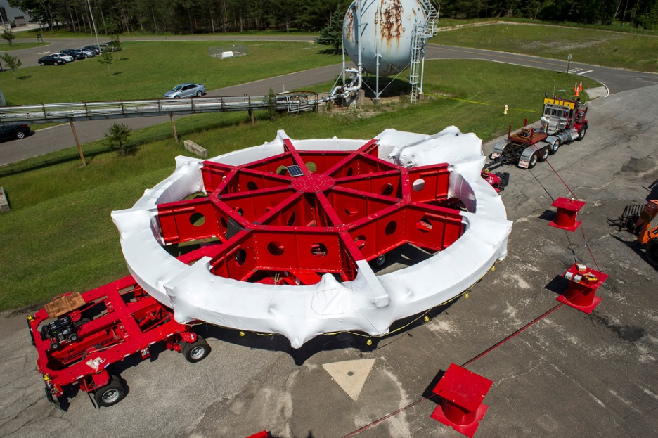
"Yeah,
We can move that "

Slide 31
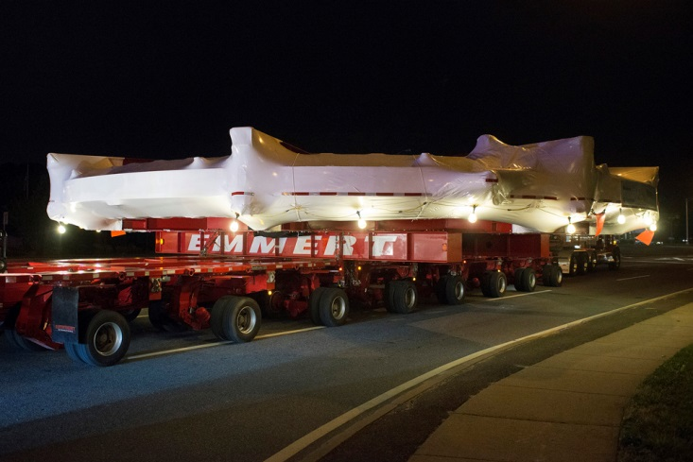

Slide 32
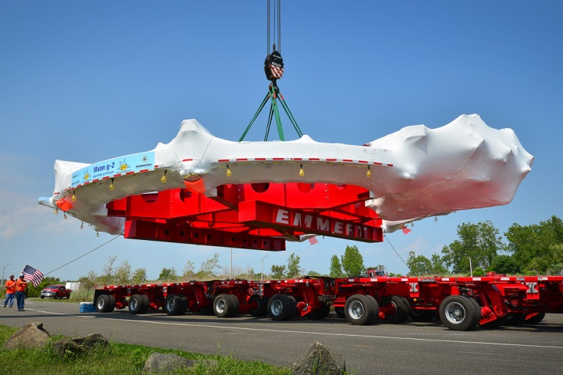

Slide 33

Big barge to limit pitch, roll and heave…

Slide 34
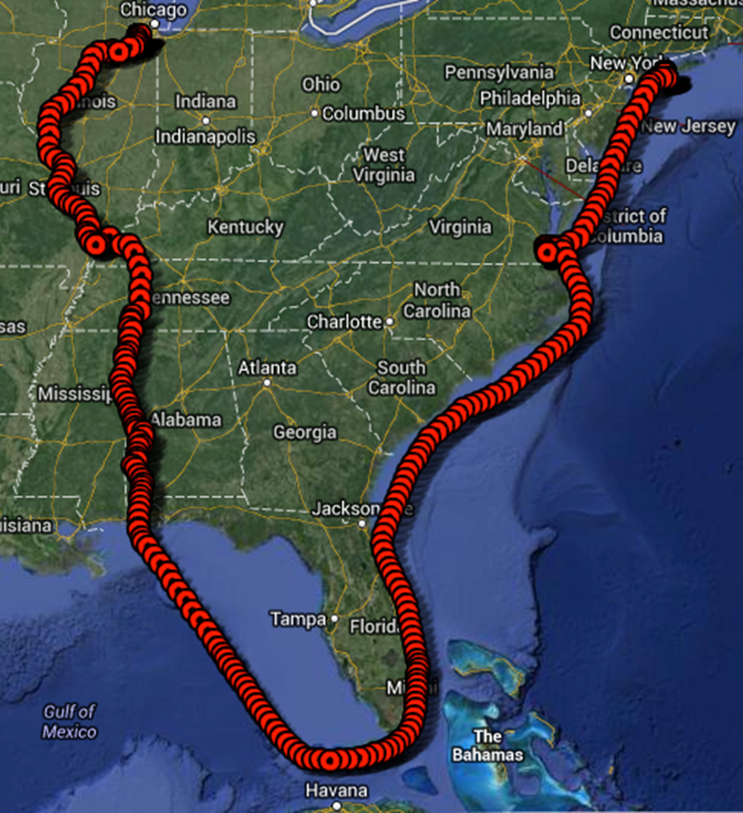
5 nights sheltering from Storm near Norfolk Virginia.
Tennessee-Tombigbee Waterway Mississippi, Illinois and
Des Plaines rivers.
25th June - July 20th

Slide 35
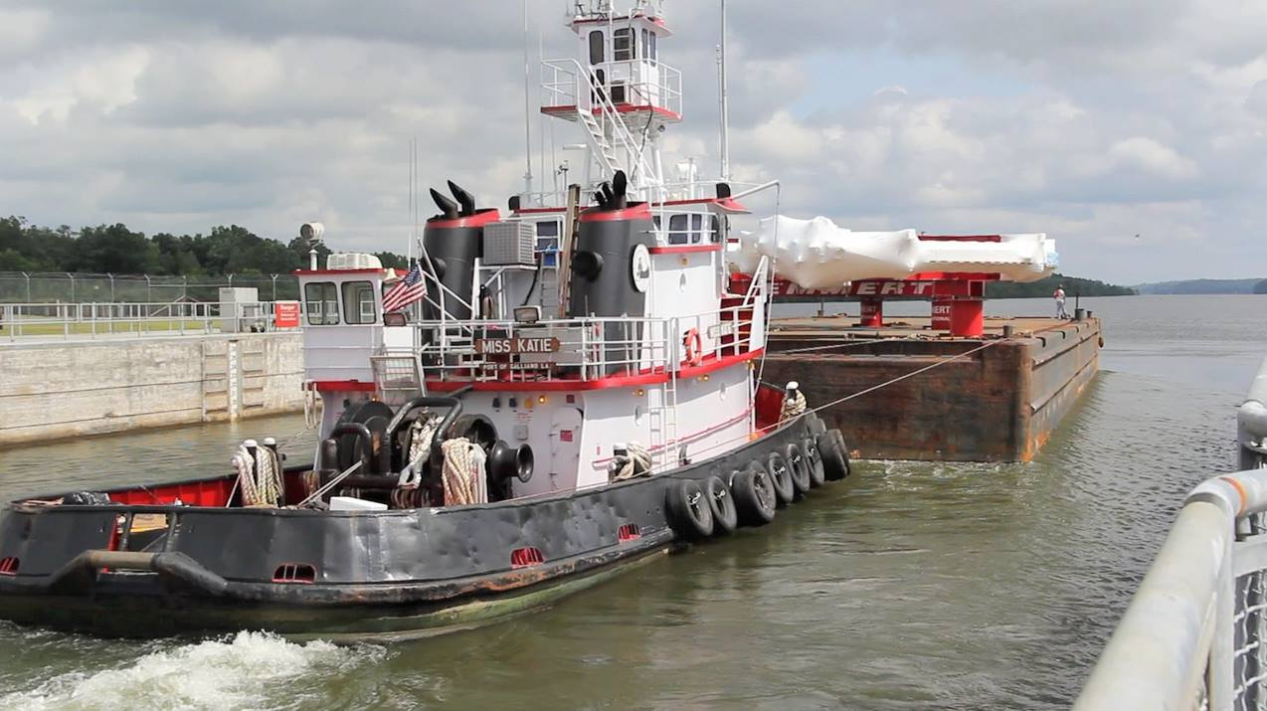
Miss Katie

Slide 36
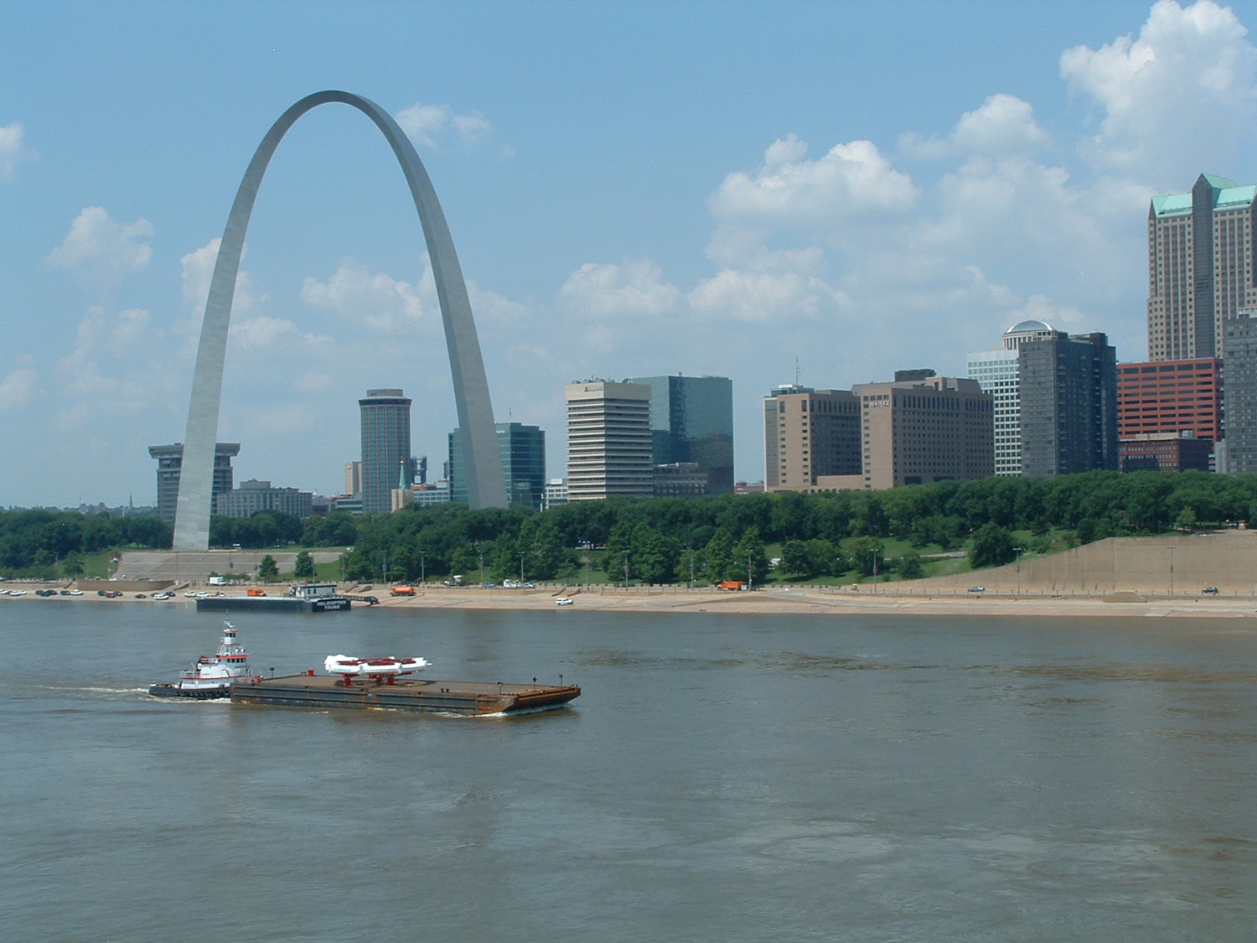

Slide 37
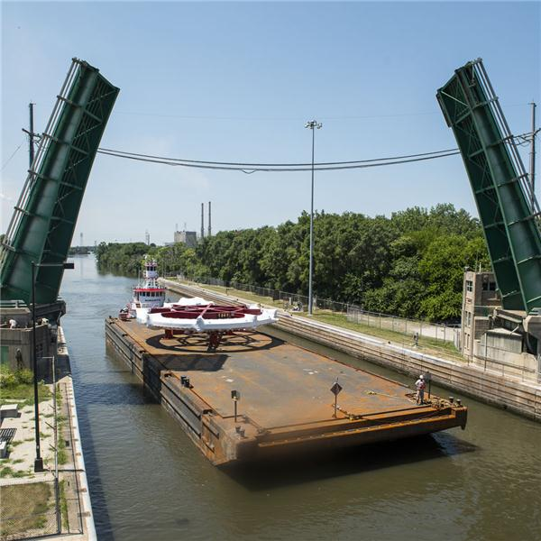

Slide 38

Lemont, IL. …safely ashore

Slide 39

It fits…

Slide 40
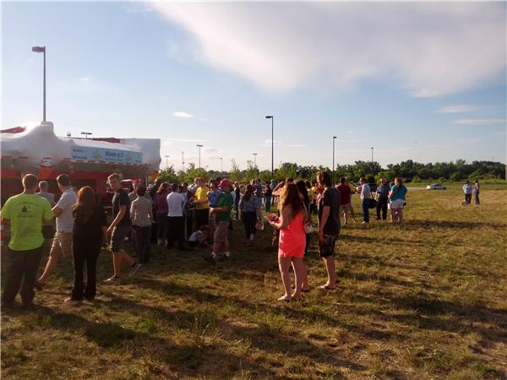
‘Overdaying’ at Costco’s supermarket!

Slide 41
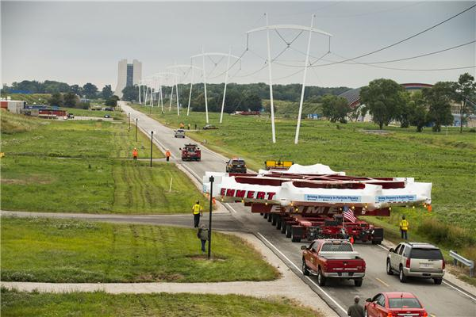

Slide 42
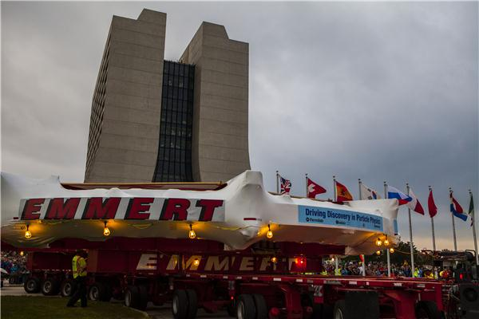
…after 3200 mile journey.

Slide 43
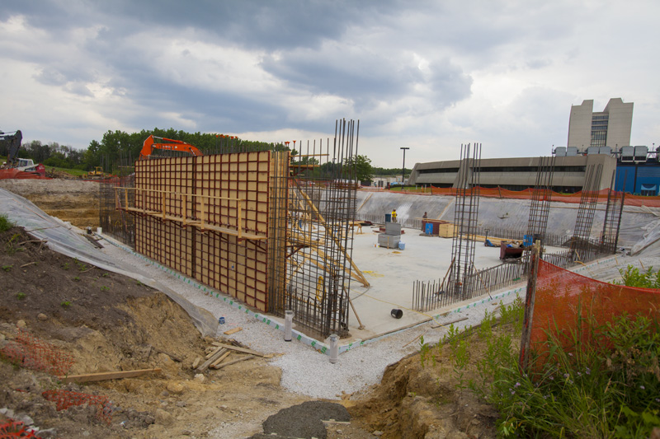
CONCLUSIONS/Timeline
Important bits of E821 now at Fermilab
  coils, ~2/3 steel
Building under construction
  expect beneficial occupancy February 2013
Arduous series of CD-1 reviews this year nearly over
  (then CD-2,… next year!)
Many upgrades well-underway
On-schedule for:
Magnet powered 2015
Beam in 2016 or 2017

Slide 44
Thank You

Slide 45
AUXILIARY SLIDES

Slide 46
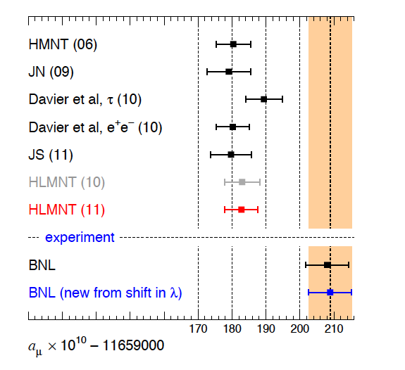
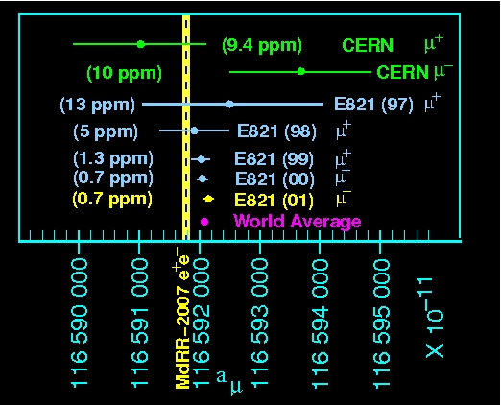
Exp. Vs. theory

Slide 47
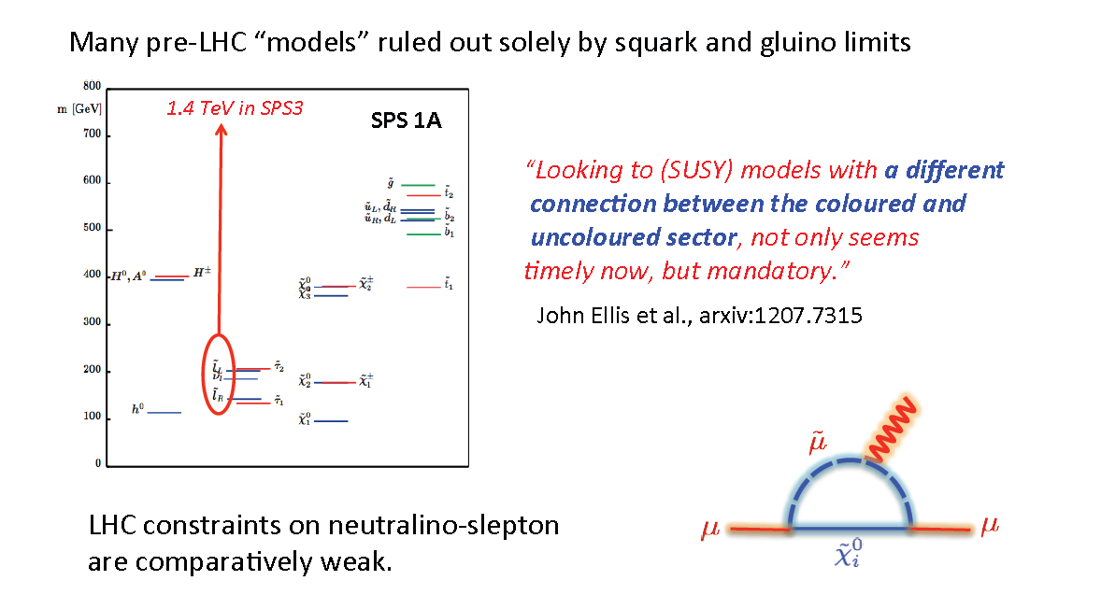
SUSY

Slide 48
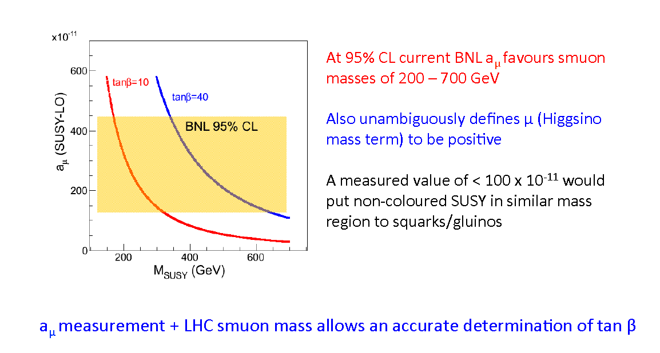
SUSY

Slide 49
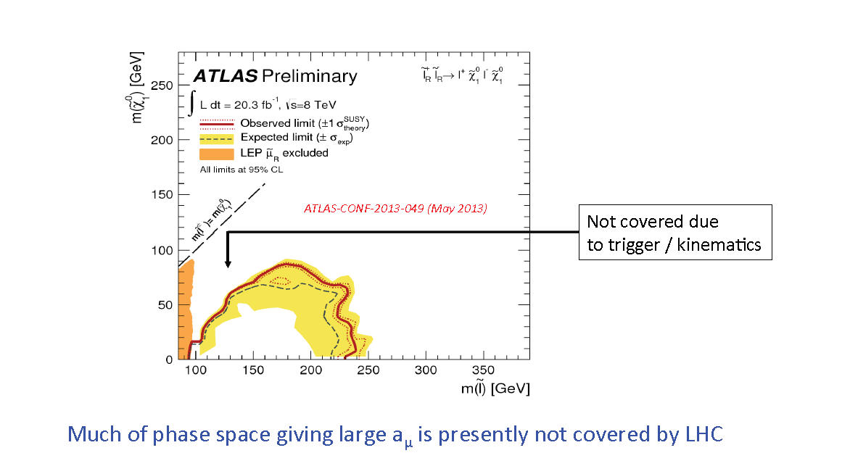
Slepton limits

Slide 50
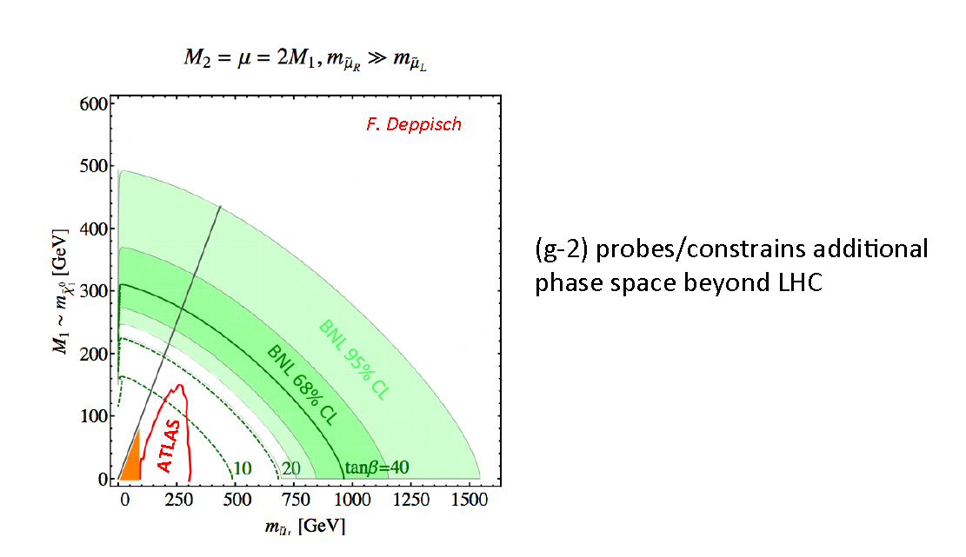
Beyond LHC

Slide 51
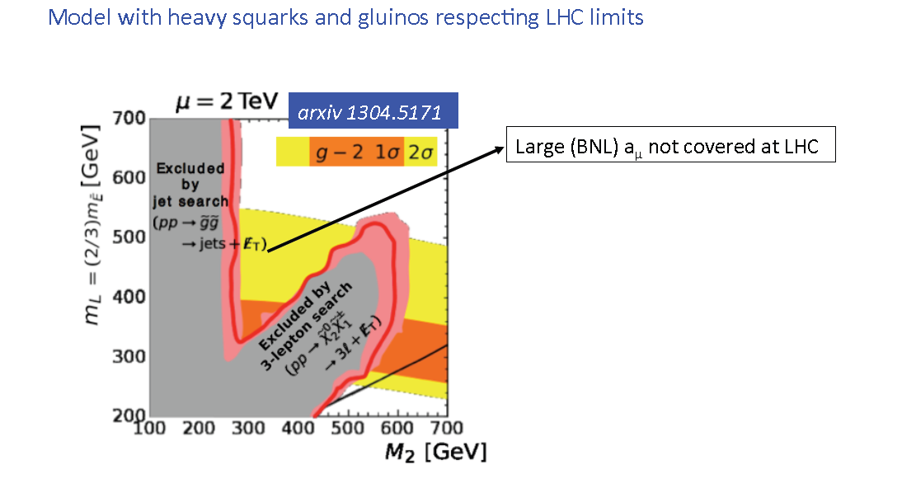
Beyond LHC constraints
Where BNL anomaly explained by

Slide 52
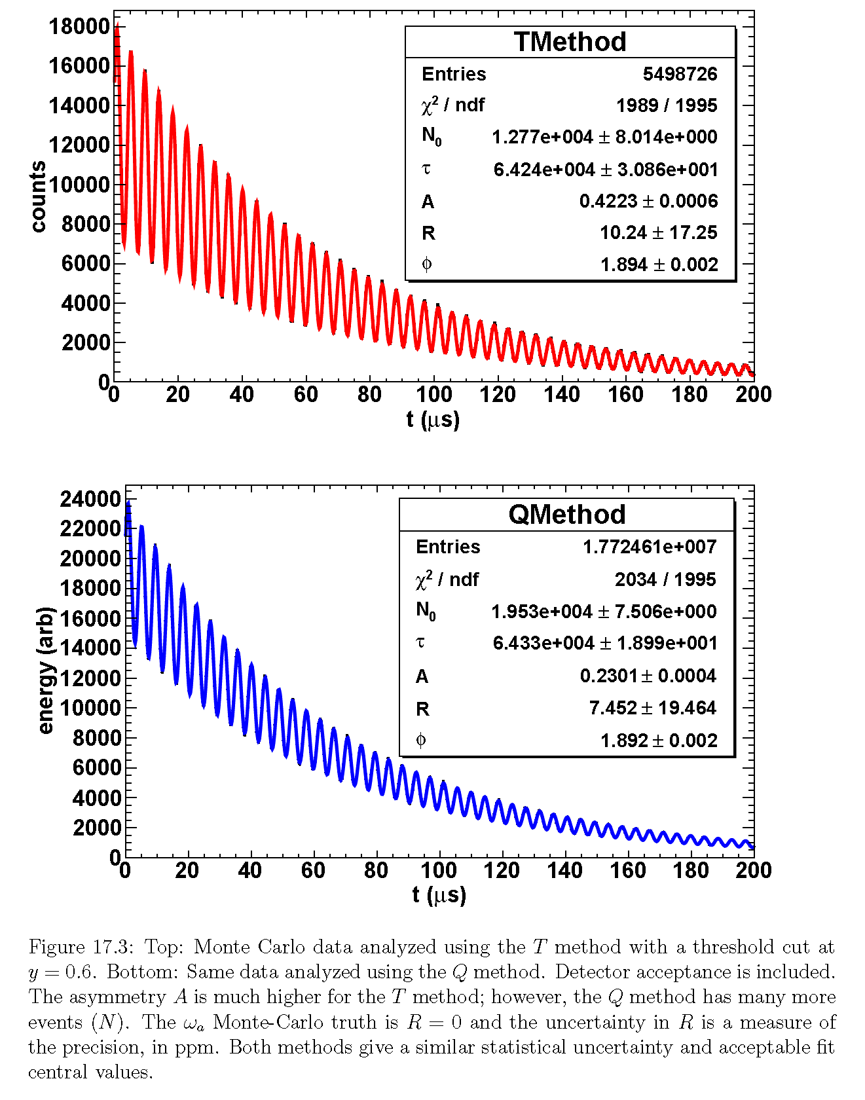
Two analysis techniques…

Slide 53

Calorimeter extras

Slide 54
E821 tracker

Slide 55

The tracker determines the ‘Radius of Tangency’.
Need ~ 1mm radial and vertical resolution at RoT
⇒ ~100μm per position
measurement

Slide 56


Slide 59



Slide 60

Magnetic Field improvements

