Slide 1
Exotic spectroscopy at B-Factories
Alex Bondar
BINP, Novosibirsk
International Workshop on e⁺e⁻ collisions from Phi to Psi,
(9 - 12, September, 2013, Rome, Italy)

Slide 2

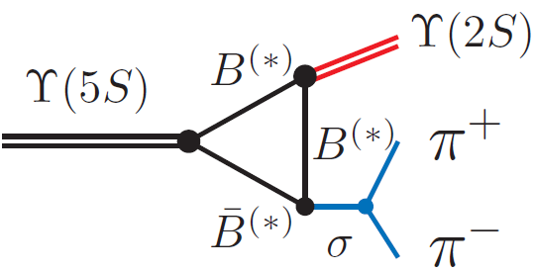

_
Anomalies in ϒ(5S)→(bb)π⁺π– transitions
ϒ(11020)
Belle: PRL100, 112001 (2008)
∼100
11.00
ϒ(10860)
Γ[ϒ(5S) →ϒ(1,2,3S) π⁺π–] >> Γ[ϒ(4,3,2S) →ϒ(1S) π⁺π–]
_
10.75
260
π⁺π–
⇐ Rescattering of on-shell B⁽*⁾B⁽*⁾ ?
2M(B)
ϒ(4S)
10.50
2
330
ϒ(3S)
Mass, GeV/c²
h_{b}(2P)
10.25
430
1
190
η_{b}(2S)
ϒ(2S)
Belle: PRL108, 032001 (2012)
10.00
h_{b}(1P)
expect suppression ∼Λ_{QCD}/m_{b}
290
spin-flip
6
Heavy Quark Symmetry
9.75
partial Γ(keV)
9.50
ϒ(1S)
ϒ(5S) → h_{b}(1,2P) π⁺π– are not suppressed
η_{b}(1S)
J^{PC} = 0⁻⁺ 1⁻⁻ 1⁻⁺

Slide 3
_
Anomalies in ϒ(5S)→(bb)π⁺π– transitions
ϒ(11020)
Belle: PRL100, 112001 (2008)
∼100
11.00
ϒ(10860)
Γ[ϒ(5S) →ϒ(1,2,3S) π⁺π–] >> Γ[ϒ(4,3,2S) →ϒ(1S) π⁺π–]
_
+
⇐ Rescattering of on-shell B⁽*⁾B⁽*⁾ ?
10.75
260
π–
Z_{b}
2M(B)
ϒ(4S)
10.50
2
ϒ(3S)
π⁺
Mass, GeV/c²
h_{b}(2P)
10.25
430
1
η_{b}(2S)
ϒ(2S)
Belle: PRL108, 032001 (2012)
10.00
h_{b}(1P)
expect suppression ∼Λ_{QCD}/m_{b}
290
spin-flip
6
Heavy Quark Symmetry
9.75
partial Γ(keV)
9.50
ϒ(1S)
ϒ(5S) → h_{b}(1,2P) π⁺π– are not suppressed
η_{b}(1S)
J^{PC} = 0⁻⁺ 1⁻⁻ 1⁻⁺
h_{b} production mechanism? ⇒ Study resonant structure in h_{b}(mP)π⁺π–

Slide 4
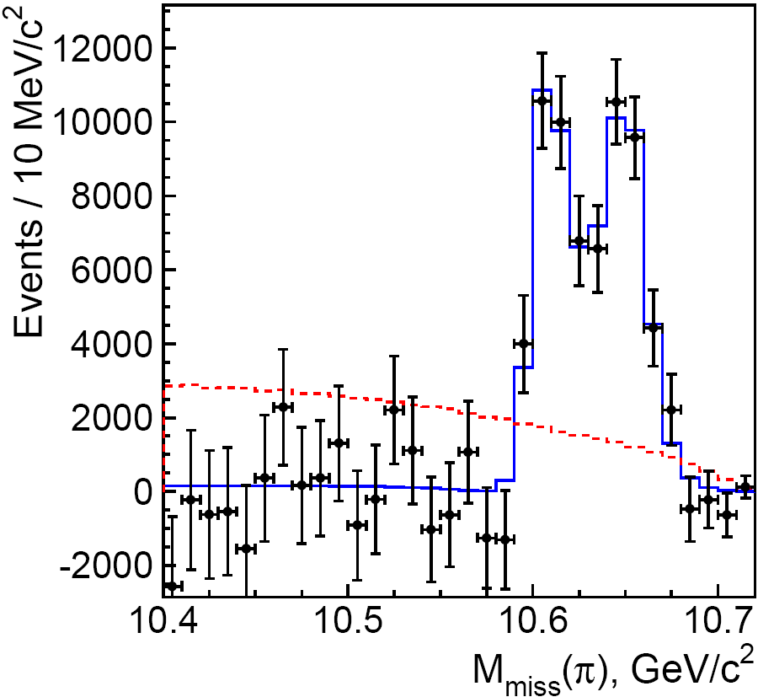
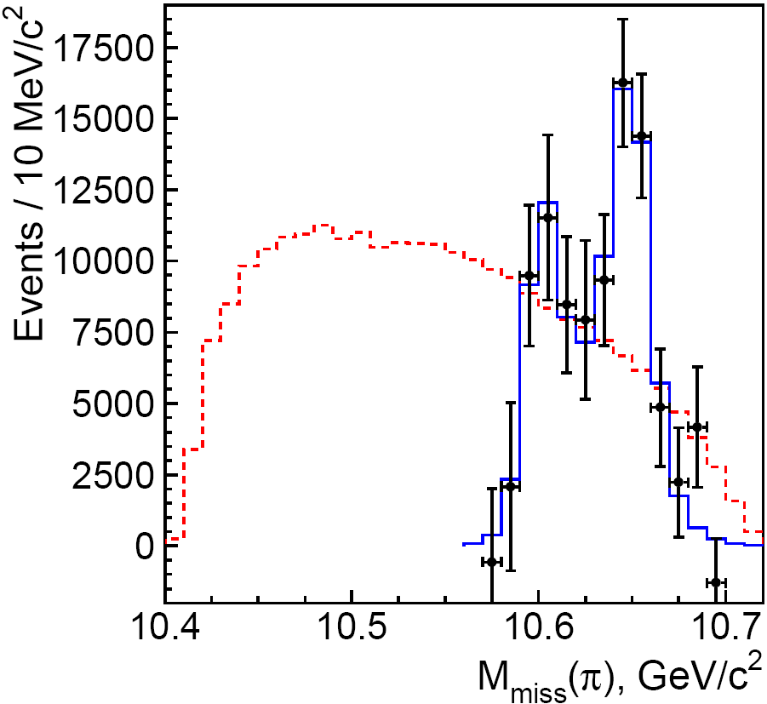

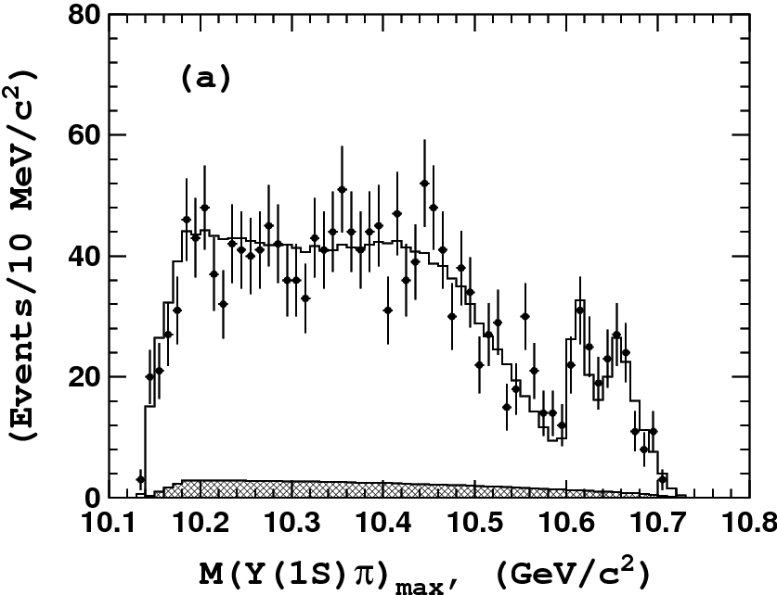
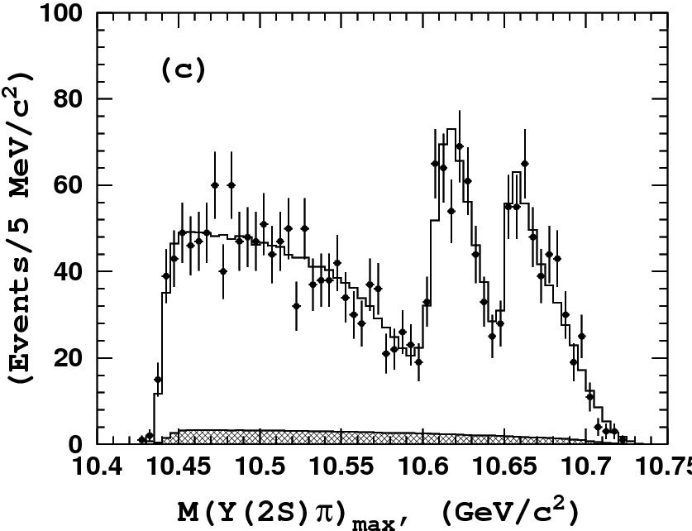
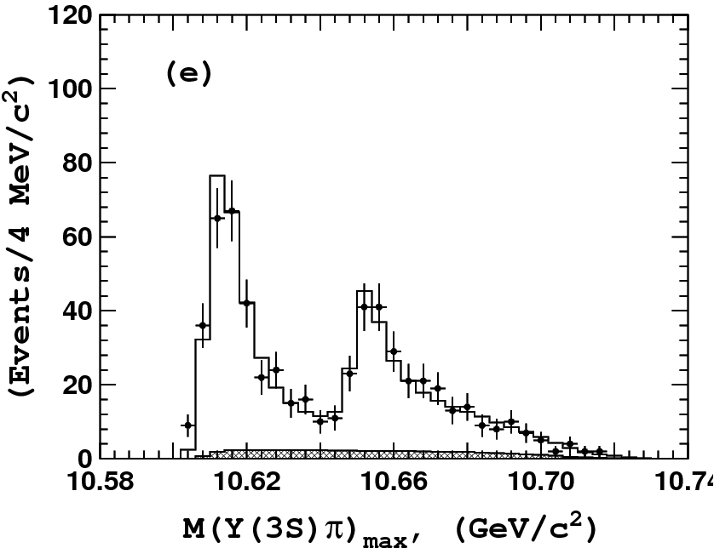
_
Resonant structure of ϒ(5S)→(bb)π⁺π–
ϒ(5S) → h_{b}(1P)π⁺π⁻
ϒ(5S) → h_{b}(2P)π⁺π⁻
Two peaks are observed
in all modes!
no non-res.
contribution
phsp
Belle: PRL108, 232001 (2012)
phsp
Z_{b}(10610) and Z_{b}(10650)
should be multiquark states
M[ h_{b}(1P) π± ]
M[ h_{b}(2P) π± ]
Dalitz plot analysis
ϒ(5S) →ϒ(1S)π⁺π⁻
ϒ(5S) →ϒ(2S)π⁺π⁻
ϒ(5S) →ϒ(3S)π⁺π⁻
note different scales

Slide 5
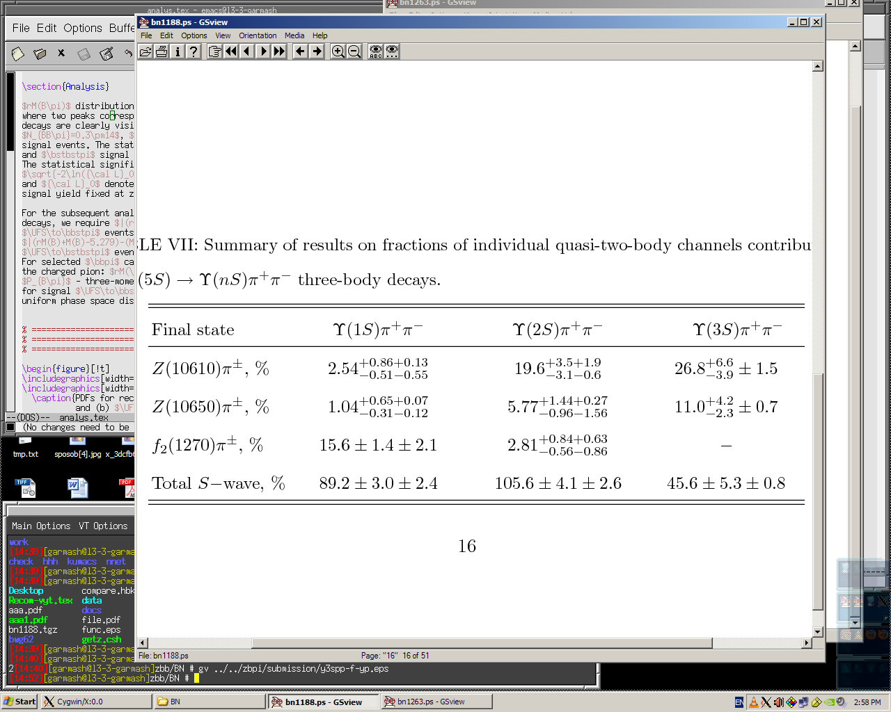
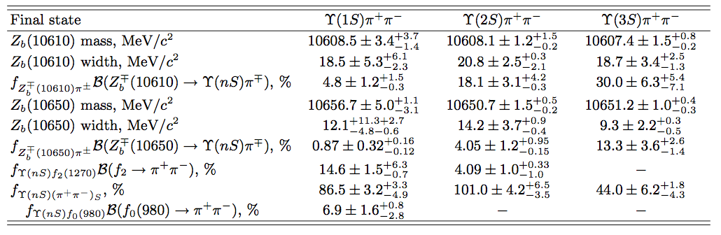
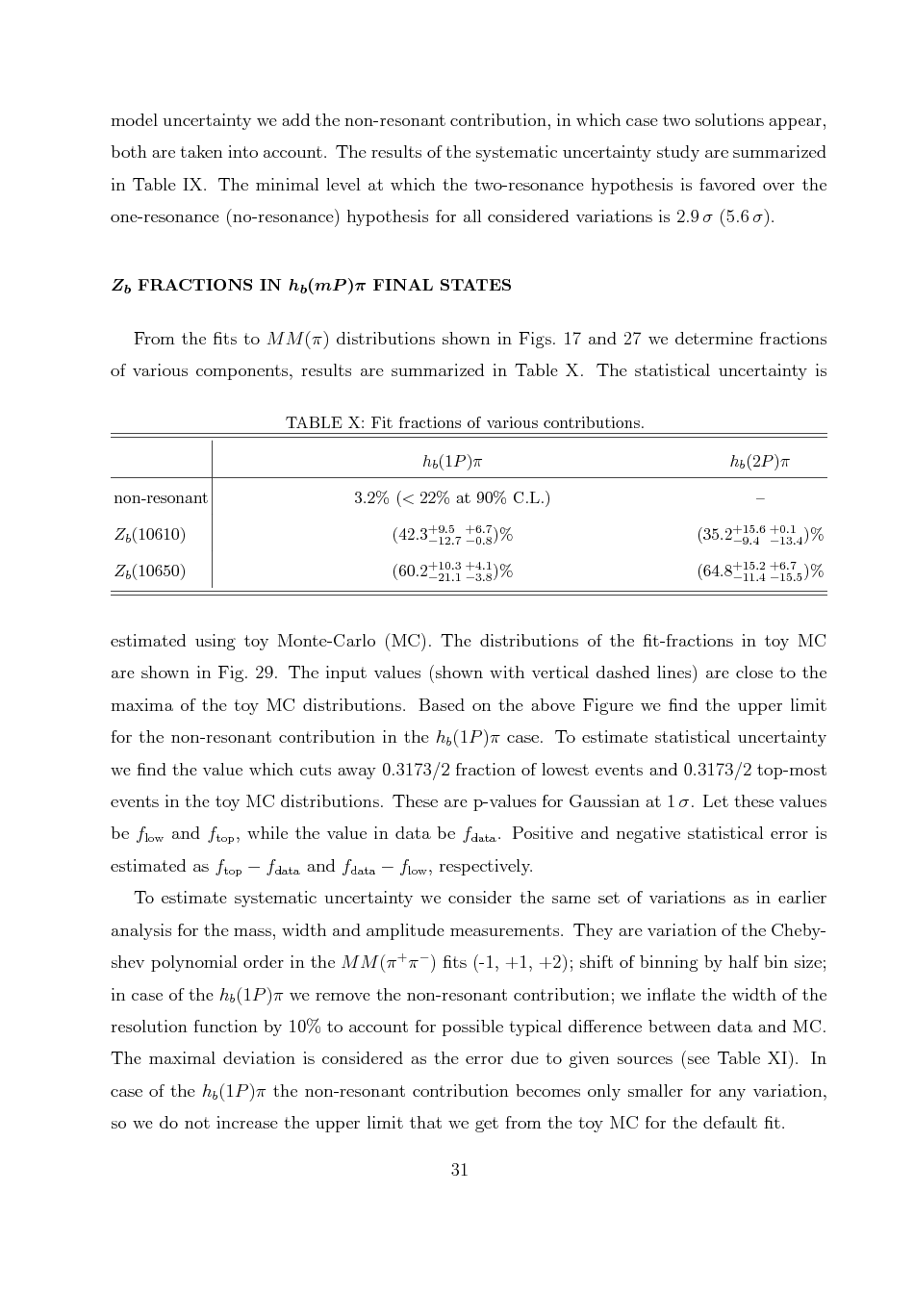
Branching Fractions
ϒ(nS)π⁺π⁻ production cross section (corrected for the ISR) at sqrt(s) = 10.865 GeV:
σ(e⁺e⁻→ ϒ(1S) π⁺π⁻ = [2.27 ± 0.12(stat.) ± 0.09(syst.)] pb
σ(e⁺e⁻→ ϒ(2S) π⁺π⁻ = [4.07 ± 0.16(stat.) ± 0.45(syst.)] pb
σ(e⁺e⁻→ ϒ(3S) π⁺π⁻ = [1.46 ± 0.09(stat.) ± 0.16(syst.)] pb
Fractions of individual sub-modes:
Belle PRELIMINARY

Slide 6
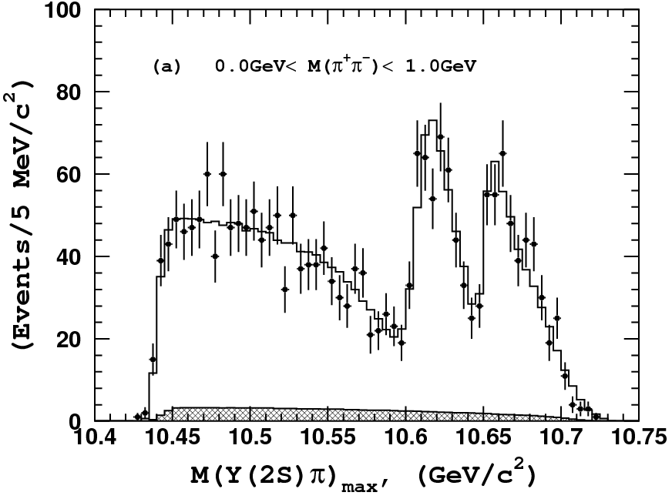
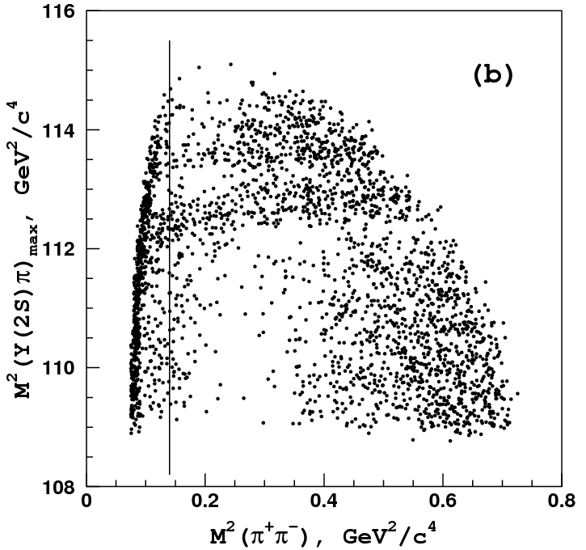
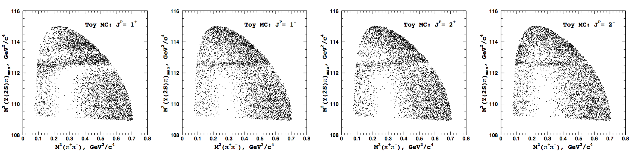
ϒ(5S)→ϒ(2S)π⁺π–: J^{P} Results
ϒ(2S)π⁺π Data
Toy MC with various J^{P}
J^{P} = 1⁺
J^{P} = 1⁻
J^{P} = 2⁺
J^{P} = 2⁻

Slide 7
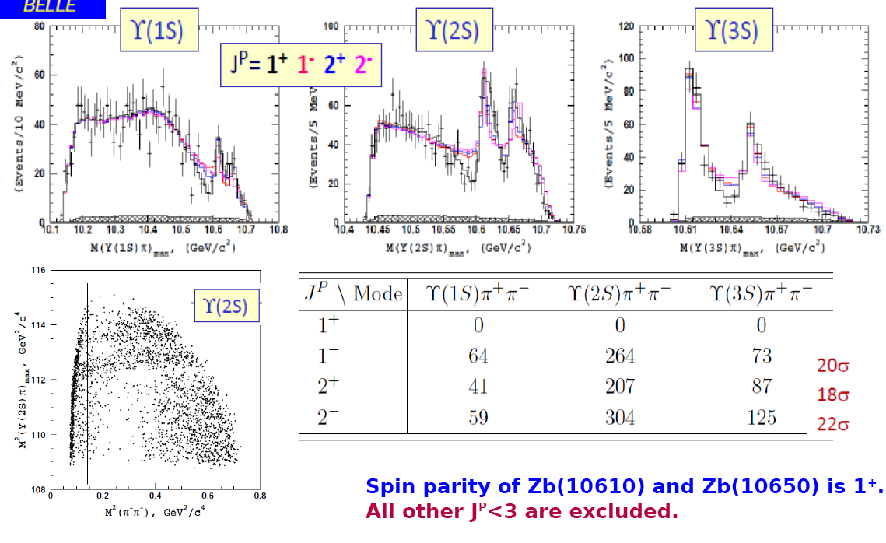

Slide 8
ϒ(5S)→Z_{b}⁻(10610)π⁺ → BB* π⁺
Z_{b}⁻(10650)π⁺ → B*B*π⁺

Slide 9
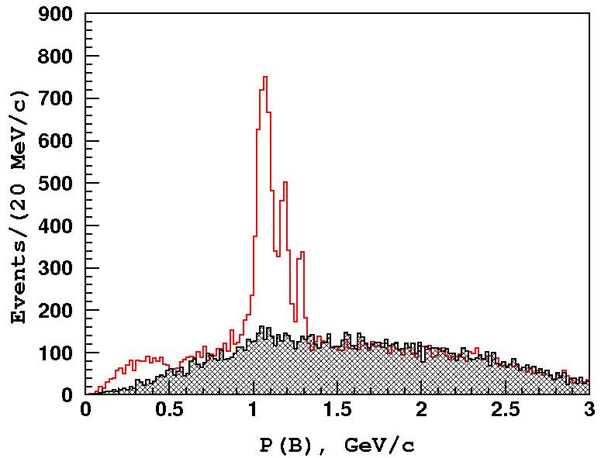
ϒ(5S)→B*B^{(*)}π: B Selection
2-body ϒ(5S) decays
Data (B signal)
B*B*
BB*
BB
Data (B side bands)
3-body ϒ(5S) -> B(*)B(*)π decays & rad. return to ϒ(4S): P(B)<0.9 GeV/c

Slide 10
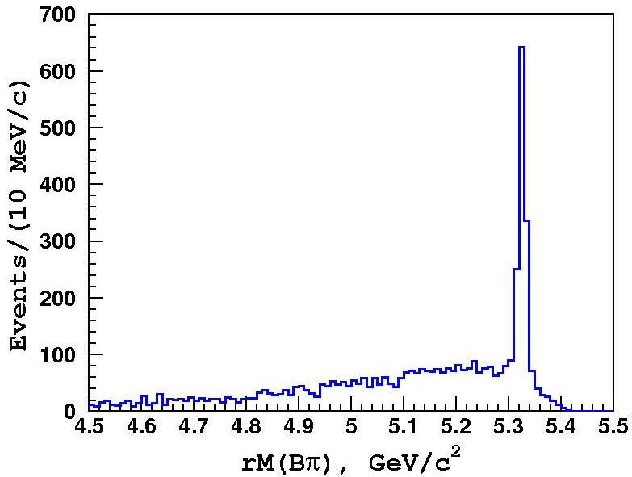
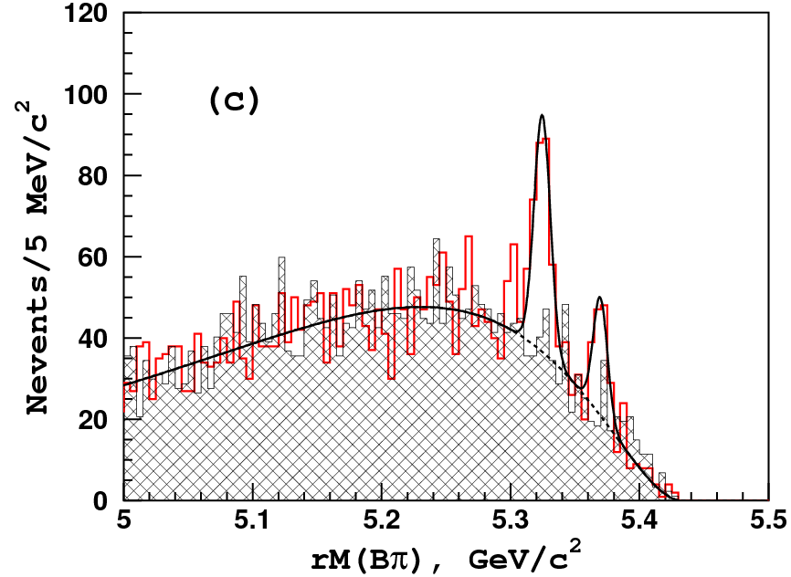
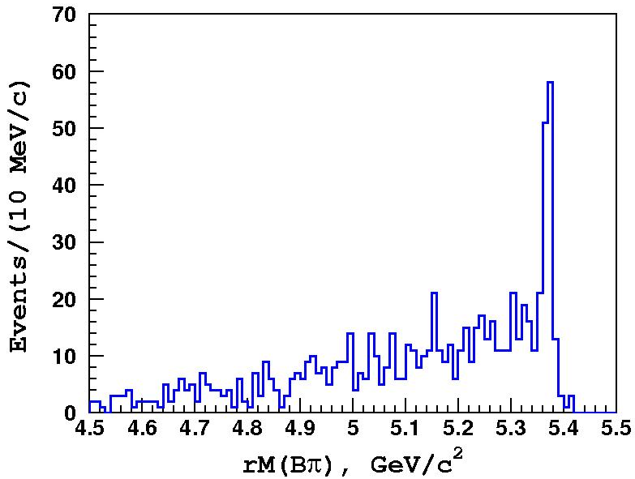
ϒ(5S)→B*B^{(*)}π: Data
MC: B*Bπ
Data
BB*π
B*B*π
MC: B*B*π
(shifted by 45MeV)
Red histogram – right sign Bπ combinations;
Hatched histogram – wrong sign Bπ combinations;
Solid line – fit to right sign data.
Belle PRELIMINARY
Fit yields: N(BBπ) = 0.3 ± 14
N(BB*π) = 184 ± 19 (9.3σ) N(B*B*π) = 82 ± 11 (5.7σ)

Slide 11
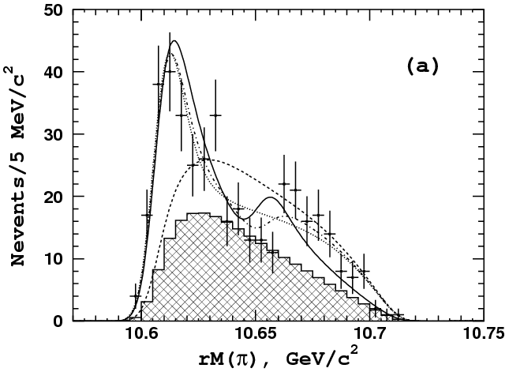
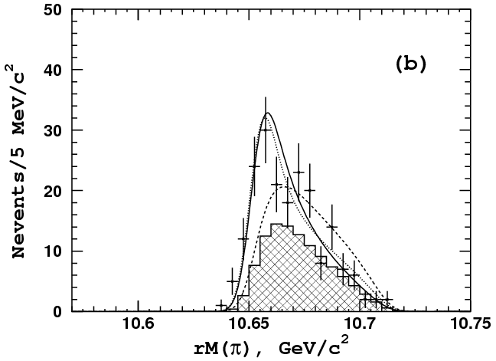
ϒ(5S)→B*B^{(*)}π: Signal Region
Z_{b}(10610)
BB*π
B*B*π
Z_{b}(10650)
8σ
6.8σ
Z_{b}(10610) +
Z_{b}(10650)
Z_{b}(10650)
alone
PhSp
Z_{b}(10610)+
PhSp
PhSp
Z_{b}(10610) +
Z_{b}(10650) +
PhSp
Z_{b}(10650)+
PhSp
Belle PRELIMINARY
points – right sign Bπ combinations (data);
lines – fit to data with various models (times PHSP, convolved with resolution
function = Gaussian with σ=6MeV).
hatched histogram – background component
B*B*π signal is well fit to just Z_{b}(10650) signal alone
BB*π data fits (almost) equally well to a sum of Z_{b}(10610) and Z_{b}(10650) or
to a sum of Z_{b}(10610) and non-resonant.

Slide 12
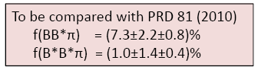
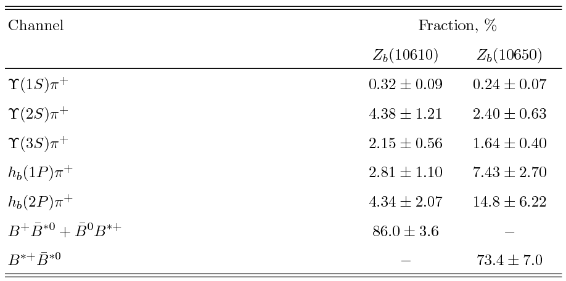
ϒ(5S)→B*B^{(*)}π: Results
Branching fractions of ϒ(10680) decays (including neutral modes):
BBπ < 0.60% (90%CL)
BB*π = 4.25 ± 0.44 ± 0.69%
B*B*π = 2.12 ± 0.29 ± 0.36%
Assuming Z_{b} decays are saturated by the already observed ϒ(nS)π, h_{b}(mP)π and B(*)B* channels, one can calculate complete table of relative branching fractions:
Belle PRELIMINARY
B(*)B* channels dominate Z_{b} decays !

Slide 13
Resonant structure of
ϒ(5S)→ϒ(nS)π⁰π⁰

Slide 14
ϒ(5S)→ϒ(nS)π⁰π⁰
ϒ(1,2,3S)→μ⁺μ⁻, e⁺e⁻, ϒ(2S)→ϒ(1S)π⁺π⁻
μ⁺μ⁻π⁰π⁰
e⁺e⁻π⁰π⁰
Y(1S)[l⁺l⁻] π⁺π⁻ π⁰π⁰
ϒ(2S)
ϒ(2S)
ϒ(1S)
ϒ(2S)
reflection
ϒ(1S)
ϒ(3S)
σ[e⁺e⁻→ϒ(5S)→ϒ(1S)π⁰π⁰] = (1.16±0.06±0.10) pb
σ[e⁺e⁻→ϒ(5S)→ϒ(2S)π⁰π⁰] = (1.87±0.11±0.23) pb
σ[e⁺e⁻→ϒ(5S)→ϒ(3S)π⁰π⁰] = (0.98±0.24±0.19) pb
Consistent with ½ of Y(nS)π⁺π⁻
arXiv:1308.2646, accepted for publication in Phys. Rev. D
14
Notes:
14

Slide 15
ϒ(2S)π⁰π⁰ Dalitz analysis
arXiv:1308.2646
with Z_{b}⁰
w/o Z_{b}⁰
with Z_{b}⁰
w/o Z_{b}⁰
Z_{b}⁰ resonant structure has been observed in ϒ(2S)π⁰π⁰ and ϒ(3S)π⁰π⁰
Statistical significance of Z_{b}⁰(10610) signal is 6.5σ including systematics
Z_{b}⁰(10650) signal is not significant (~2σ), not contradicting with its existence
Z_{b}⁰(10610) mass from the fit M=10609 ± 4 ± 4 MeV/c²
M(Z_{b}⁺)=10607±2 MeV/c²
15
Notes:
15
15

Slide 16
η_{b}(2S) versus X_{bb}

Slide 17
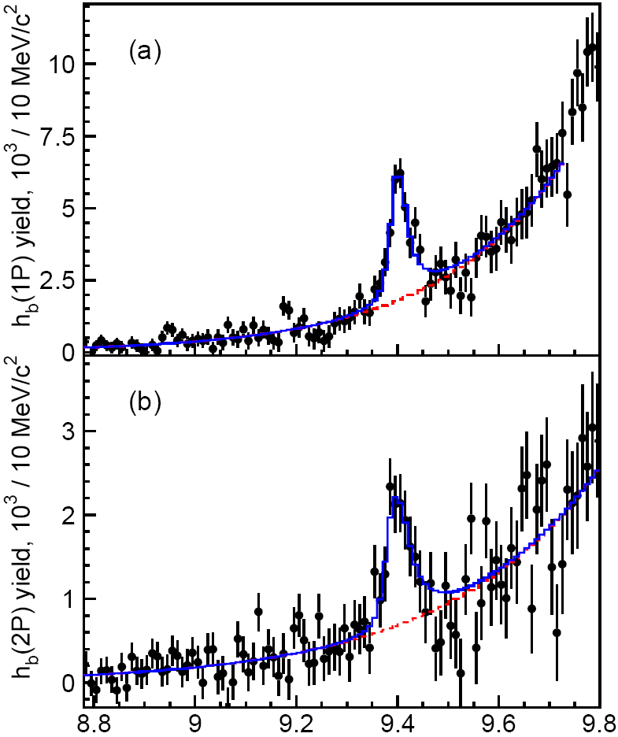
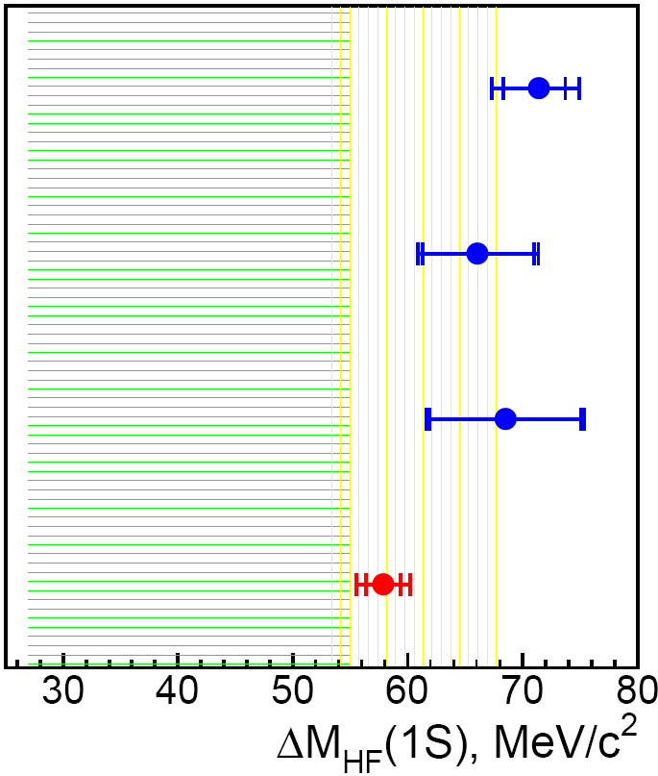
Observation of h_{b}(1P,2P)→ η_{b}(1S) γ
e⁺e⁻→ϒ(5S)→h_{b}(nP) π⁺π–
→ η_{b}(1S) γ
reconstruct
ΔM_{HF}(1S)
Belle : 57.9 ± 2.3 MeV
3σ
ϒ(11020)
arxiv:1205.6351
PDG’12 : 69.3 ± 2.8 MeV
11.00
ϒ(10860)
h_{b}(1P)
η_{b}(1S)
10.75
π⁺π⁻
BaBar ϒ(3S)
ϒ(4S)
2M(B)
BaBar ϒ(2S)
10.50
ϒ(3S)
η_{b}(3S)
h_{b}(2P)
χ_{b}(2P)
h_{b}(2P)
η_{b}(1S)
CLEO ϒ(3S)
10.25
η_{b}(2S)
ϒ(2S)
pNRQCD
LQCD
10.00
h_{b}(1P)
χ_{b}(1P)
γ
9.75
γ
Kniehl et al, PRL92,242001(2004)
M_{miss} (π⁺π⁻γ)
Meinel, PRD82,114502(2010)
^{(n)}
9.50
ϒ(1S)
η_{b}(1S)
ΔM_{HF}(1S)
Mizuk et al. Belle PRL 109 (2012) 232002
-
--
-
J^{PC} = 0 ⁺
1
1 ⁺
(0,1,2)⁺⁺
Belle result decreases tension with theory
First measurement Γ = 10.8 ^{+4.0} ^{+4.5} MeV
_{–3.7}
_{–2.0}
as expected

Slide 18
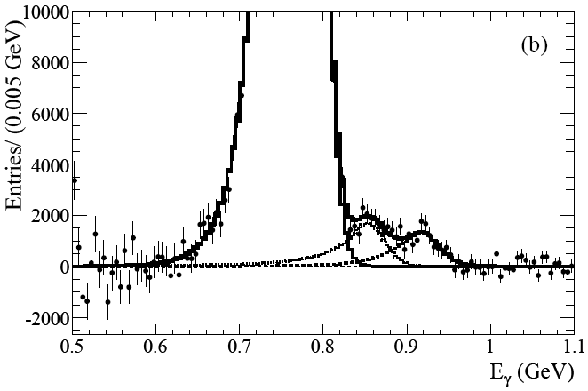
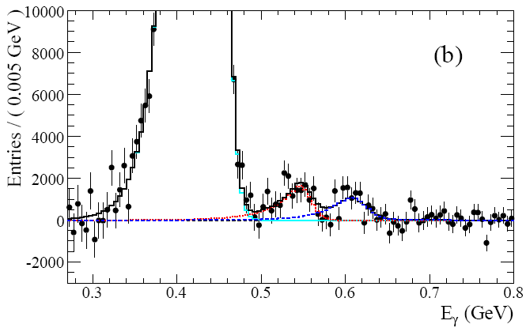
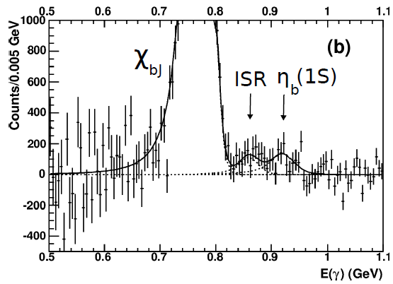
Observation of h_{b}(1P,2P)→ η_{b}(1S) γ
e⁺e⁻→ϒ(5S)→h_{b}(nP) π⁺π–
→ η_{b}(1S) γ
reconstruct
PRL101, 071801 (2008)
ΔM_{HF}(1S)
BaBar ϒ(3S)→γη_{b}(1S)
Belle : 57.9 ± 2.3 MeV
3σ
ISR
arxiv:1205.6351
PDG’12 : 69.3 ± 2.8 MeV
η_{b}(1S)
h_{b}(1P)
η_{b}(1S)
BaBar ϒ(3S)
χ_{b}(1P)
BaBar ϒ(2S)
PRL103, 161801 (2009)
BaBar ϒ(2S)→γη_{b}(1S)
h_{b}(2P)
η_{b}(1S)
CLEO ϒ(3S)
ISR
η_{b}(1S)
pNRQCD
LQCD
Kniehl et al, PRL92,242001(2004)
M_{miss} (π⁺π⁻γ)
Meinel, PRD82,114502(2010)
^{(n)}
PRD81, 031104 (2010)
Mizuk et al. Belle PRL 109 (2012) 232002
Belle result decreases tension with theory
First measurement Γ = 10.8 ^{+4.0} ^{+4.5} MeV
_{–3.7}
_{–2.0}
CLEO ϒ(3S)
as expected

Slide 19
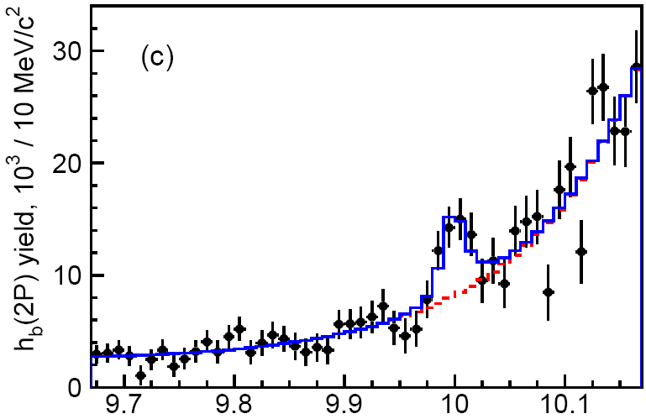
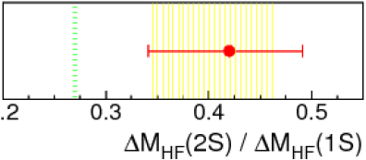
First evidence for η_{b}(2S)
e⁺e⁻→ϒ(5S)→h_{b}(2P) π⁺π–
→ η_{b}(2S) γ
Mizuk et al. Belle PRL 109 (2012) 232002
ΔM_{HF}(2S) = 24.3 ^{+4.0} MeV
_{–4.5}
arxiv:1205.6351 →PRL
First measurement
η_{b}(2S)
pNRQCD
LQCD
Belle
4.2σ
w/ syst
In agreement with theory
M_{miss} (π⁺π⁻γ)
⁽²⁾
Γ(2S) = 4 ± 8 MeV, < 24MeV @ 90% C.L.
expect ∼4MeV
Branching fractions
Expectations
BF[h_{b}(1P) → η_{b}(1S) γ] = 49.2±5.7^{+5.6} %
BF[h_{b}(2P) → η_{b}(1S) γ] = 22.3±3.8^{+3.1} %
BF[h_{b}(2P) → η_{b}(2S) γ] = 47.5±10.5^{+6.8} %
41%
13%
19%
_{–3.3}
Godfrey Rosner PRD66,014012(2002)
_{–3.3}
_{–7.7}
c.f. BESIII BF[h_{c}(1P) → η_{c}(1S) γ] = 54.3±8.5 %
39%

Slide 20
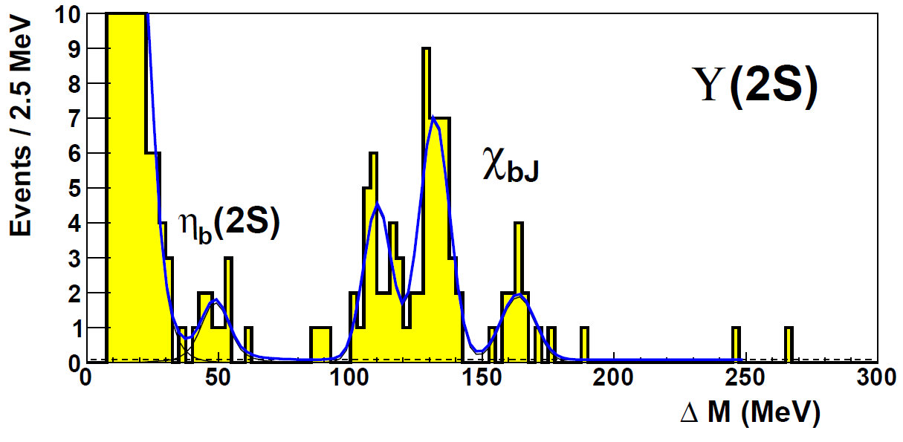
“Signal” of exclusively reconstructed η_{b}(2S)
Dobbs, Metreveli, Seth, Tomaradze, Xiao, PRL 109 (2012) 082001
CLEO data
_
e⁺e⁻ → ϒ(2S) → η_{b}(2S) γ, η_{b}(2S) → 4,6,8,10 π±, K±, p/p
ϒ(11020)
11.00
Slide from R.Mizuk talk at ICHEP2012 (Melbourne)
(26 channels)
ϒ(10860)
4.6σ
10.75
ϒ(4S)
2M(B)
10.50
ϒ(3S)
η_{b}(3S)
h_{b}(2P)
χ_{b}(2P)
10.25
Issues
Mass, GeV/c²
η_{b}(2S)
ϒ(2S)
Bg from final state radiation can mimic signal
e.g. ϒ(2S) → K⁺K⁻ n(π⁺π⁻) γ_{FSR}
power law tail instead of exponential
10.00
γ
h_{b}(1P)
χ_{b}(1P)
not discussed
9.75
hadrons
Large production rate: N η_{b}(2S) ∼ 0.2 N χ_{b1}
9.50
η_{b}(1S)
ϒ(1S)
factor 30
-
--
-
c.f. Γ(ψ’→η_{c}(2S)γ) = 0.007 Γ(ψ’→χ_{c1}γ)
J^{PC} = 0 ⁺
1
1 ⁺
(0,1,2)⁺⁺
BESIII arxiv:1205.5103 →PRL
Large ΔM_{HF}(2S)
CLEO 48.7±2.7 MeV
Belle
← strong disagreement with theory
5σ
24.3 ^{+4.0} MeV
← agrees with theory
_{–4.5}
_{–4.5}
Reported excess is unlikely to be the η_{b}(2S) signal

Slide 21

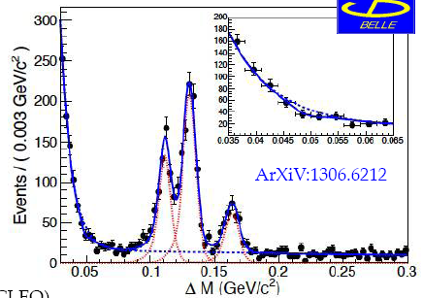
“Signal” of exclusively reconstructed η_{b}(2S)
Dobbs, Metreveli, Seth, Tomaradze, Xiao, PRL 109 (2012) 082001
CLEO data
_
e⁺e⁻ → ϒ(2S) → η_{b}(2S) γ, η_{b}(2S) → 4,6,8,10 π±, K±, p/p
ϒ(11020)
11.00
ϒ(10860)
(26 channels)
4.6σ
10.75
ϒ(4S)
2M(B)
10.50
ϒ(3S)
η_{b}(3S)
h_{b}(2P)
χ_{b}(2P)
10.25
Issues
Mass, GeV/c²
η_{b}(2S)
ϒ(2S)
Bg from final state radiation can mimic signal
e.g. ϒ(2S) → K⁺K⁻ n(π⁺π⁻) γ_{FSR}
power law tail instead of exponential
10.00
γ
h_{b}(1P)
χ_{b}(1P)
not discussed
9.75
hadrons
Large production rate: N η_{b}(2S) ∼ 0.2 N χ_{b1}
9.50
η_{b}(1S)
ϒ(1S)
factor 30
-
--
-
c.f. Γ(ψ’→η_{c}(2S)γ) = 0.007 Γ(ψ’→χ_{c1}γ)
J^{PC} = 0 ⁺
1
1 ⁺
(0,1,2)⁺⁺
BESIII arxiv:1205.5103 →PRL
Large ΔM_{HF}(2S)
CLEO 48.7±2.7 MeV
Belle
← strong disagreement with theory
5σ
24.3 ^{+4.0} MeV
← agrees with theory
_{–4.5}
_{–4.5}
Reported excess is unlikely to be the η_{b}(2S) signal

Slide 22
Summary
Branching fractions of the two charged bottomonium-like Z_{b}⁺ resonances
decays ϒ(1S)π⁺, ϒ(2S)π⁺, ϒ(3S)π⁺, h_{b}(1P)π⁺, h_{b}(2P)π⁺
Spin parity of Zbs is 1⁺
Observation of Zbs decays to BB* and B*B*final states
Z_{b}(10610) dominantly decays to BB*, but Z_{b}(10650) to B*B*
Decay fraction of Z_{b}(10650) to BB* is currently not statistically significant,
but at least less than to B*B*
First observation of ϒ(5S)→ϒ(nS)π⁰π⁰
First evidence for the neutral partners of Z_{b}(10610)/Z_{b}(10650)
⁰
Fit to the Z_{b}(10610) mass gives M = 10609 ± 8 ± 6 MeV
Studies of Z_{b}’s properties may help us to
understand exotic states in charm sector
Notes:
22

Slide 23
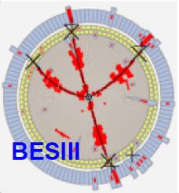
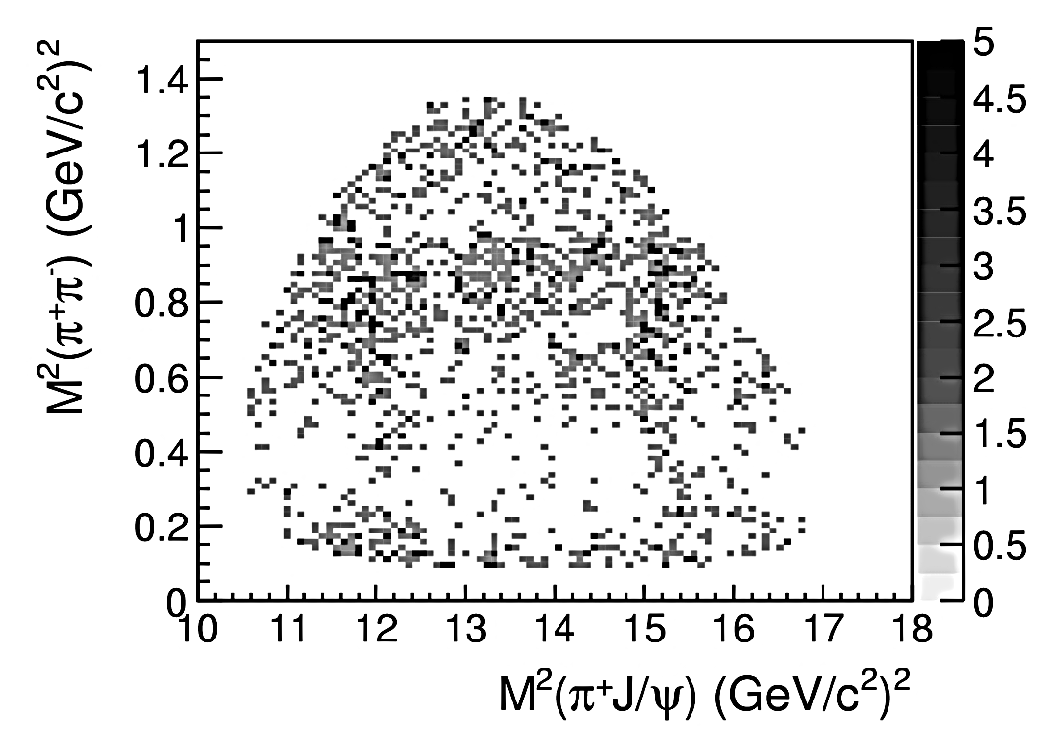
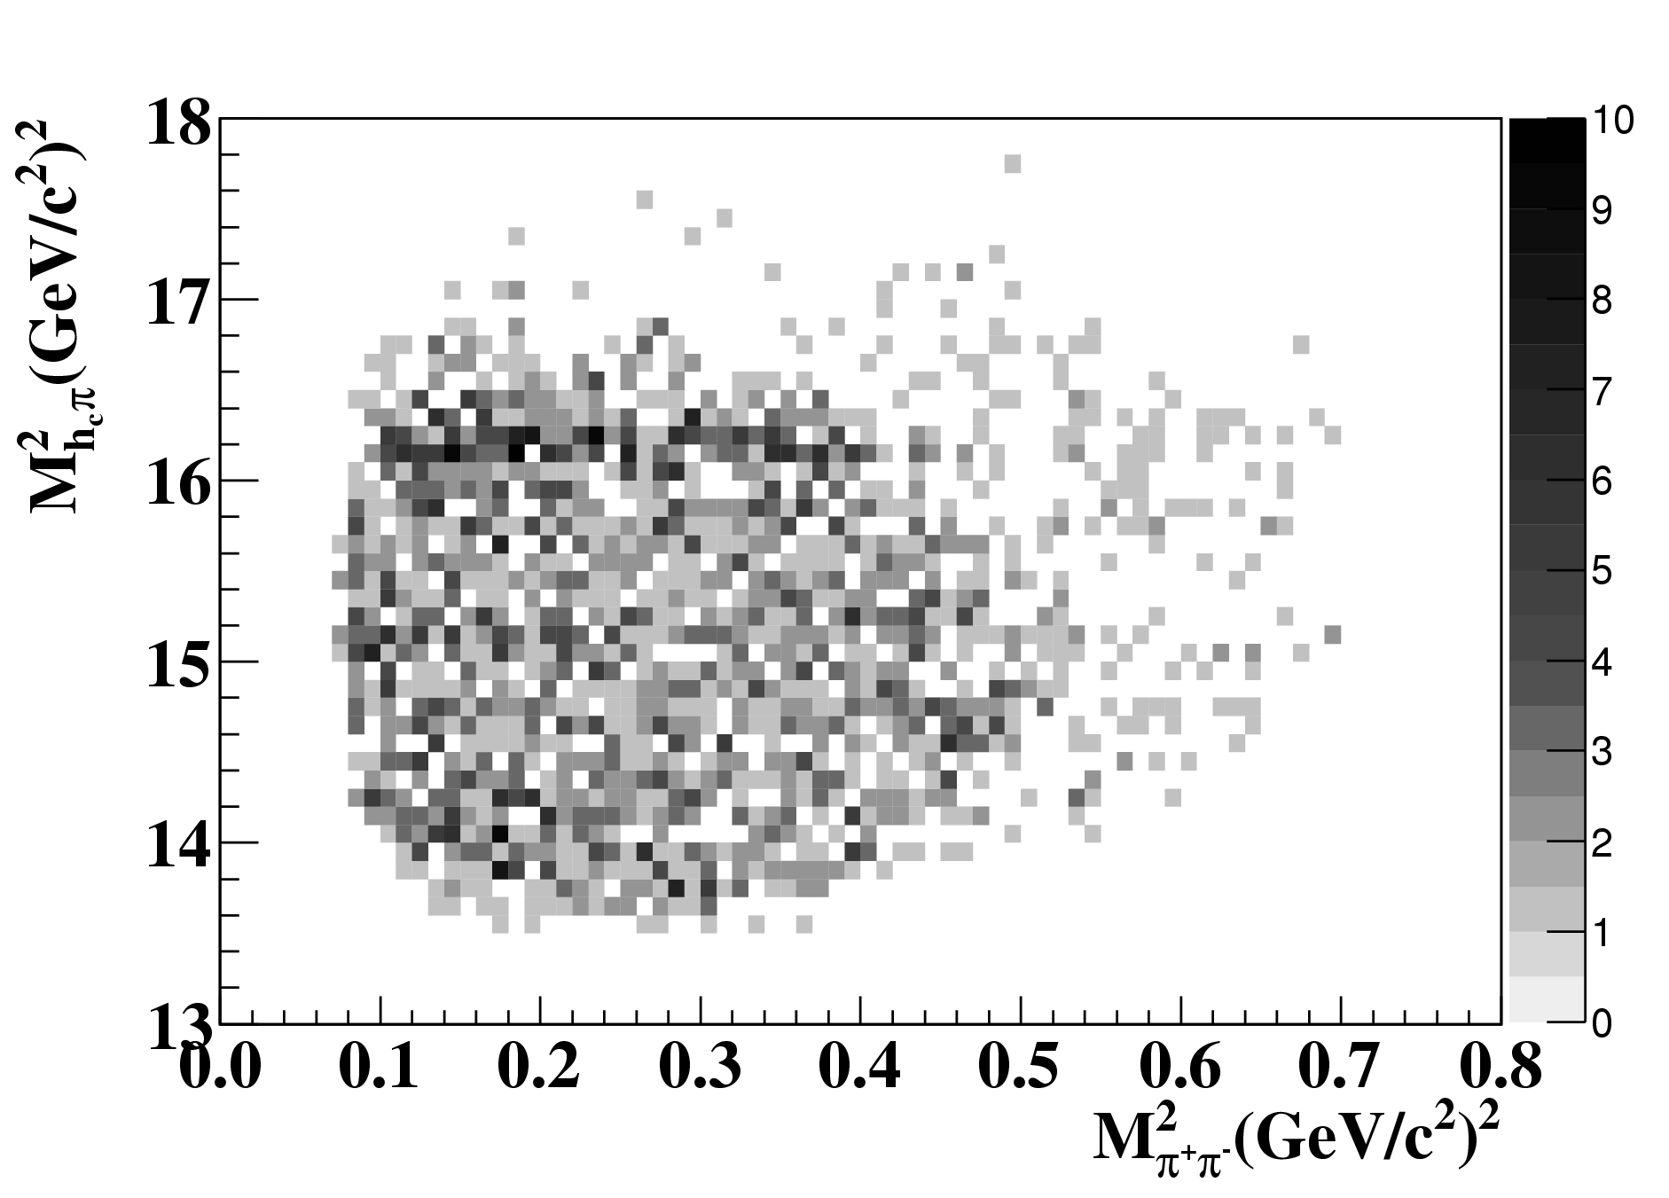
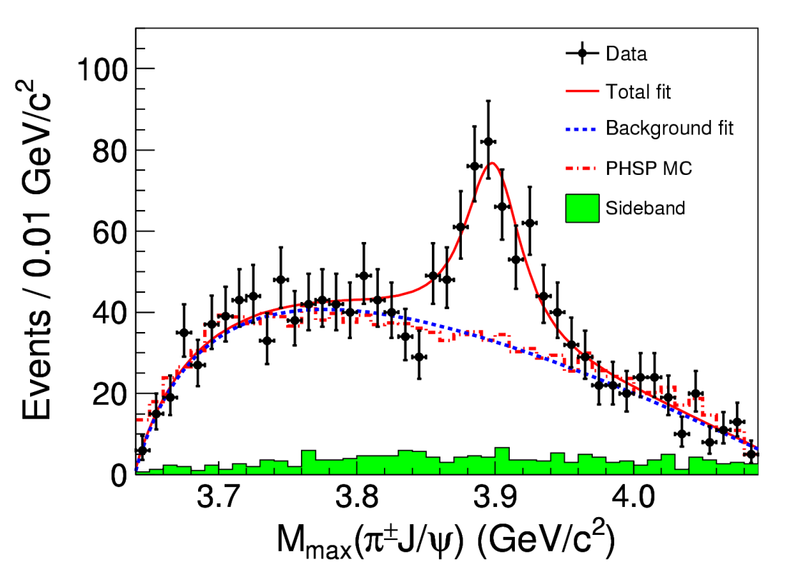
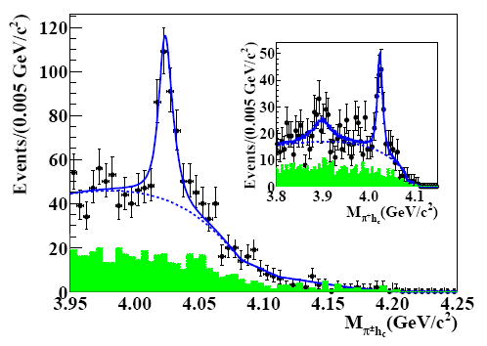
e⁺e⁻→ πZ_{c}(3900)→π⁺π⁻J/Ψ
e⁺e⁻→ πZ_{c}(4020)→π⁺π⁻h_{c}(1P)

Slide 24
Back up slides
Notes:
24

Slide 25
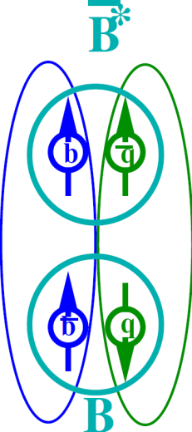
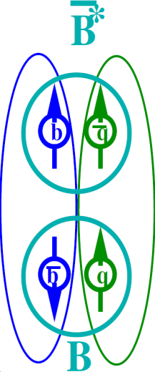
Heavy quark structure in Z_{b}
A.B.,A.Garmash,A.Milstein,R.Mizuk,M.Voloshin PRD84 054010 (arXiv:1105.4473)
Wave func. at large distance – B(*)B*
Explains
Why h_{b}ππ is unsuppressed relative to ϒππ
Relative phase ~0 for ϒ and ~180⁰ for h_{b}
Production rates of Z_{b}(10610) and Z_{b}(10650) are similar
Widths –”–
Existence of other similar states
Predicts
Other Possible Explanations
Coupled channel resonances (I.V.Danilkin et al, arXiv:1106.1552)
Cusp (D.Bugg Europhys.Lett.96 (2011),arXiv:1105.5492)
Tetraquark (M.Karliner, H.Lipkin, arXiv:0802.0649)
Notes:
25

Slide 26
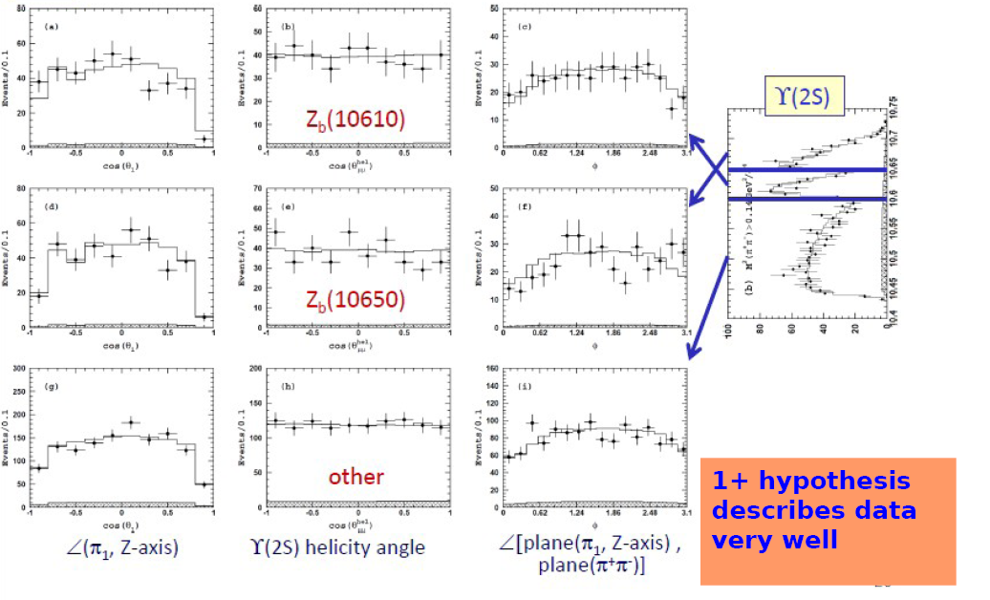

Slide 27
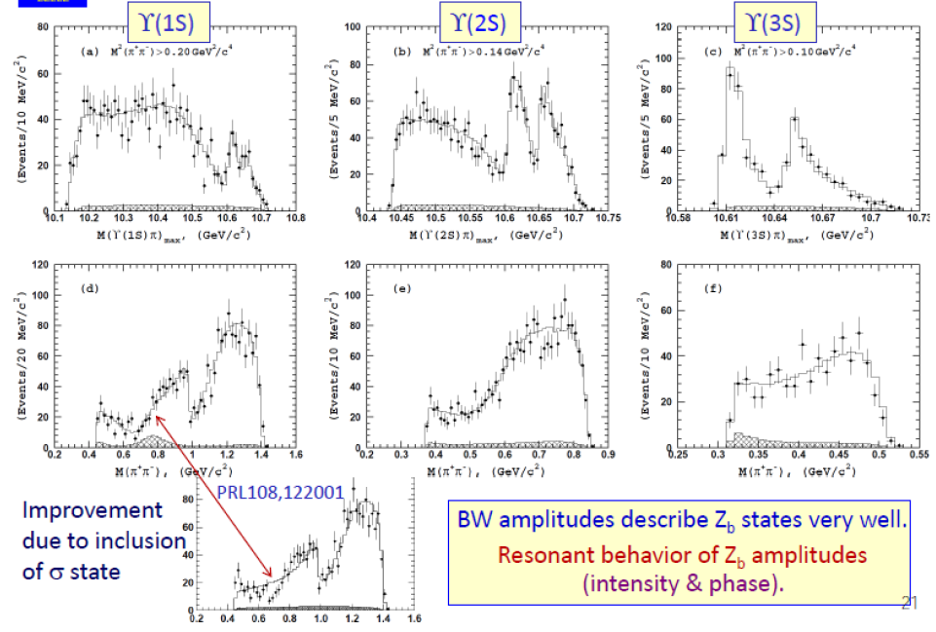

Slide 28
arXiv:1105.5829
12GeV
Υ(?S)
11.5GeV
Υ(6S)
η
Υ(5S)
ρ
ω
γ
ρ
ρ
π
γ
ω
ω
B*B*
Υπ h_{b}πη_{b}ρ
Υρ η_{b}π
Υρ
Υη η_{b}ω
Υω η_{b}η
γ
Υω
γ
Υρ
BB*
Υω
BB
Z_{b}
W_{b0}
X_{b}
W_{b1}
W_{b2}
0⁻(1⁺)
1⁺(1⁺)
0⁺(0⁺)
1⁻(0⁺)
0⁺(1⁺)
1⁻(1⁺)
0⁺(2⁺)
1⁻(2⁺)
0⁻(1⁻)
I^{G}(J^{P})

Slide 29
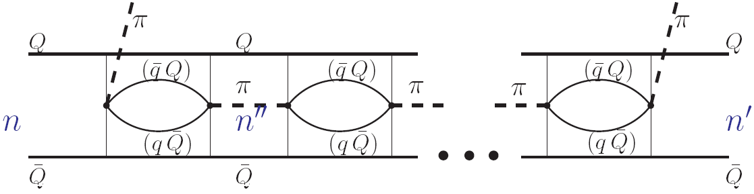
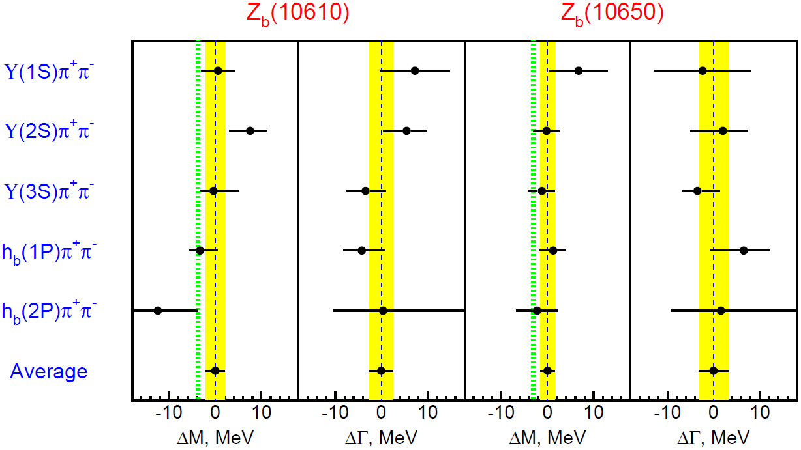
Coupled channel resonance?
I.V.Danilkin, V.D.Orlovsky, Yu.Simonov arXiv:1106.1552
No interaction between B(*)B* or ϒπ is needed to form resonance
No other resonances predicted
B(*)B* interaction switched on ⇒
individual mass in every channel?
Notes:
29

Slide 30
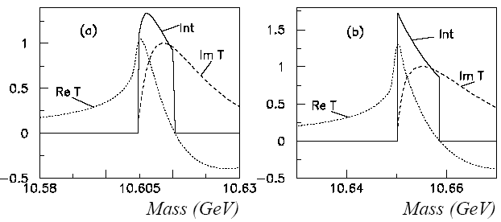
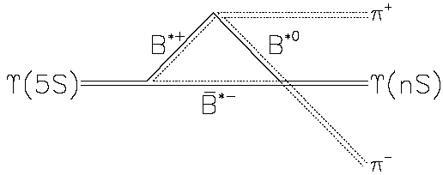
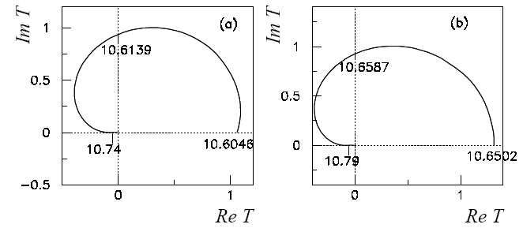
Cusp?
D.Bugg Europhys.Lett.96 (2011) (arXiv:1105.5492)
Line-shape
Amplitude
Not a resonance
Notes:
30

Slide 31
Tetraquark?
Ying Cui, Xiao-lin Chen, Wei-Zhen Deng,
Shi-Lin Zhu, High Energy Phys.Nucl.Phys.31:7-13, 2007
(hep-ph/0607226)
M ~ 10.2 – 10.3 GeV
M ~ 10.5 – 10.8 GeV
Tao Guo, Lu Cao, Ming-Zhen Zhou, Hong Chen, (1106.2284)
M ~ 9.4, 11 GeV
M.Karliner, H.Lipkin, (0802.0649)
Notes:
31

Slide 32
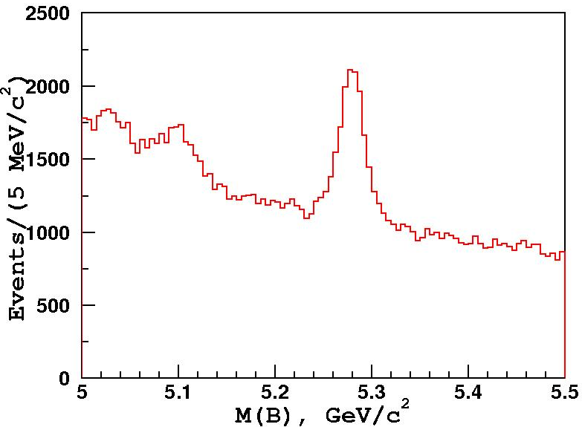
ϒ(5S)→B*B^{(*)}π: B Reconstruction
Data
Charged B:
– D⁰[Kπ,Kπππ]π⁻
– J/ψ[μμ] K⁻
Neutral B:
– D⁺[Kππ]π⁻
–
– J/ψ[μμ] K*⁰
– D*⁺[Kπ,Kππ,Kπππ]π⁻
Effective B fraction:
Br[B→f] = (143±15) x 10⁻⁵
B candidate invariant mass distribution. All modes combined. Select B signal within 30-40 MeV (depending on B decay mode) around B nominal mass.

Slide 33
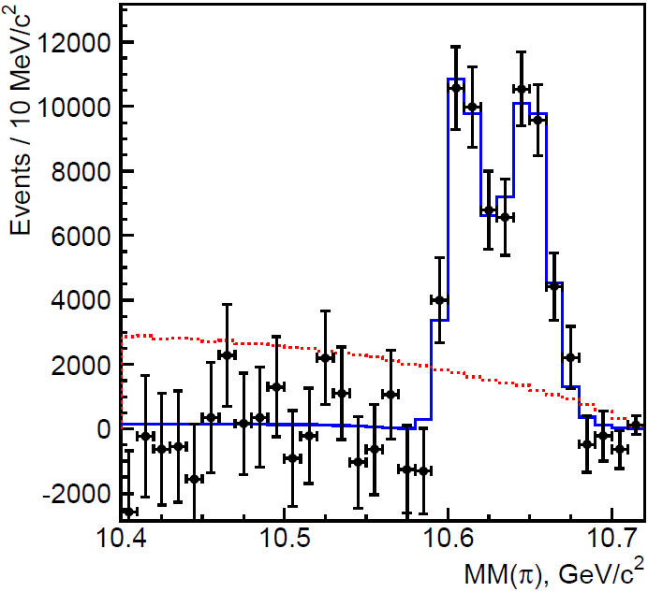
Selection
Decay chain
⁺
ϒ(5S) → Z_{b} π⁻
reconstruct
→ h_{b} (nP) π⁺
→ η_{b}(mS) γ
R₂<0.3
Hadronic event selection; continuum suppression using event shape; π⁰ veto.
Require intermediate Z_{b} : 10.59 < MM(π) < 10.67 GeV
bg. suppression ×5.2
Z_{b}

Slide 34
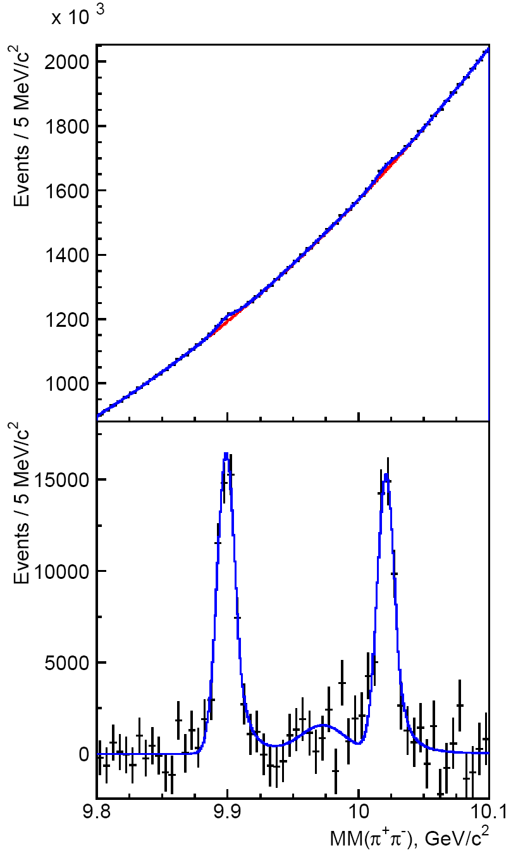


M_{miss}(π⁺π⁻) spectrum
requirement of intermediate Z_{b}
Update of M [h_{b}(1P)] :
ΔM_{HF} [h_{b}(1P)] = (+0.8 ± 1.1)MeV/c²
Previous Belle meas.:
arXiv:1103.3411
h_{b}(1P)
ϒ(2S)
ΔM_{HF} [h_{b}(1P)] = (+1.6 ± 1.5)MeV/c²
3S→1S

Slide 35

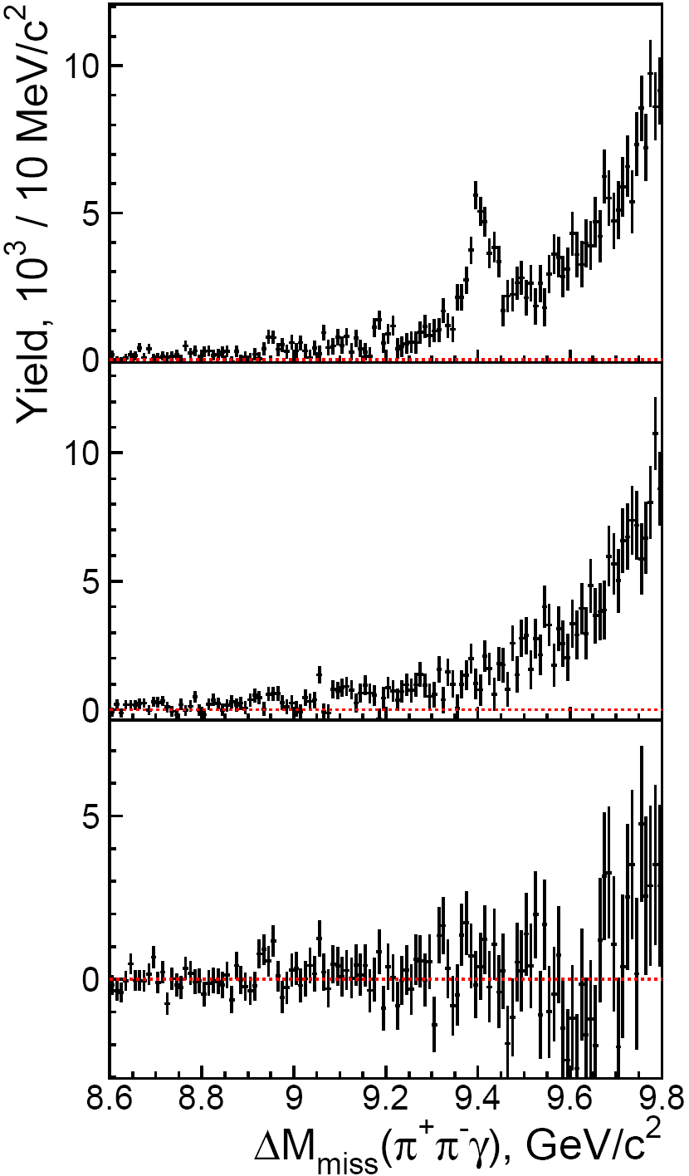
Results of fits to M_{miss}(π⁺π⁻) spectra
h_{b}(1P) yield
η_{b}(1S)
Peaking background?
MC simulation ⇒ none.
ϒ(2S) yield
no significant
structures
Reflection yield

Slide 36
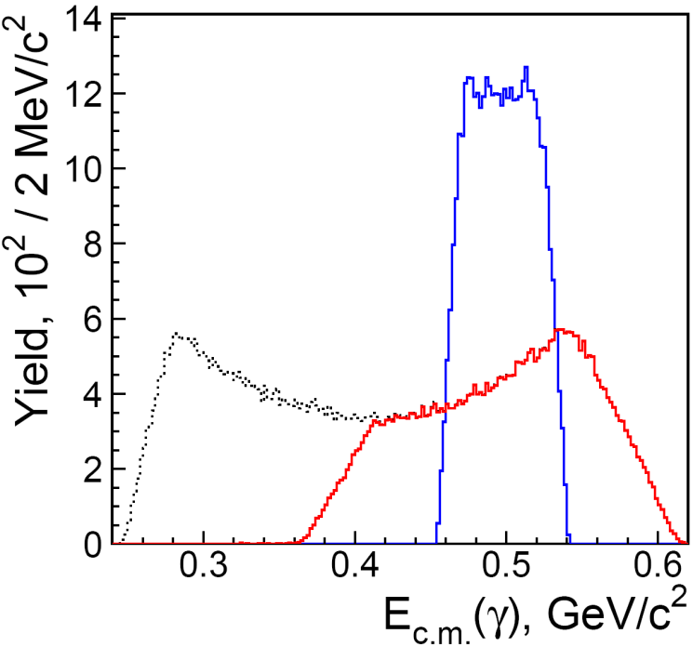
Calibration
Use decays
B⁺ → χ_{c1} K⁺ → (J/ψ γ) K⁺
Photon energy spectrum
MC simulation
h_{b}(1P) → η_{b}(1S) γ
χ_{c1} → J/ψ γ
cosθ_{Hel} > – 0.2
cosθ_{Hel} (χ_{c1})> – 0.2
⇒ match γ energy of signal & callibration channels

Slide 37
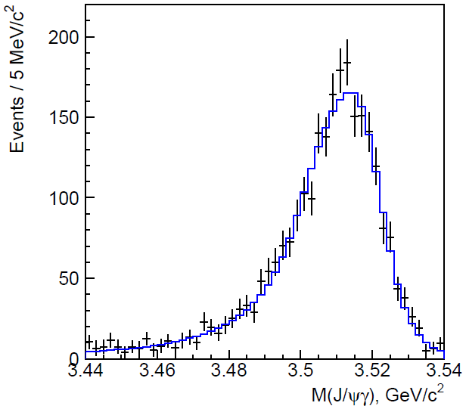
Calibration (2)
Resolution:
double-sided CrystalBall function with asymmetric core
data
ΔE s.b. subtracted
M(J/ψγ), GeV/c²
⇒ Correction of MC
mass shift –0.7 ± 0.3 ^{+0.2} MeV
_{–0.4}
fudge-factor
for resolution
1.15 ± 0.06 ± 0.06

Slide 38

Integrated Luminosity at B-factories
(fb⁻¹)
asymmetric e⁺e⁻ collisions
> 1 ab⁻¹
On resonance:
ϒ(5S): 121 fb⁻¹
ϒ(4S): 711 fb⁻¹
ϒ(3S): 3 fb⁻¹
ϒ(2S): 24 fb⁻¹
ϒ(1S): 6 fb⁻¹
Off reson./scan :
~100 fb-1
B_{s}
530 fb⁻¹
On resonance:
ϒ(4S): 433 fb⁻¹
ϒ(3S): 30 fb⁻¹
ϒ(2S): 14 fb⁻¹
Off reson./scan :
~54 fb-1

Slide 39


e⁺e⁻ hadronic cross-section
BaBar PRL 102, 012001 (2009)
ϒ(1S)
ϒ(5S)
ϒ(6S)
ϒ(4S)
ϒ(2S)
ϒ(3S)
ϒ(4S)
Belle took data at
E=10867± 1 MэВ
2M(B)
2M(B_{s})
_
e⁺ e⁻ ->ϒ(4S) -> BB, where B is B⁺ or B⁰
_
_
_
_
_
e⁺ e⁻ -> bb (ϒ(5S)) -> B⁽*⁾B⁽*⁾, B⁽*⁾B⁽*⁾π, BBππ, B_{s}⁽*⁾B_{s}⁽*⁾, ϒ(1S) ππ , ϒ X …
main motivation
for taking data at ϒ(5S)
Notes:
AAAA
A.Drutskoy, 32 Int'l Conference on HEP, August 16-22, 2004
39
e^+e^-\to\Upsilon(4S)\to B\bar B
B\bar B\ {\rm threshold}
b\bar b

Slide 40




Description of fit to MM(π⁺π⁻)
Three fit regions
Example of fit
1
2
3
BG: Chebyshev polynomial, 6th or 7th order
Signal: shape is fixed from μ⁺μ⁻π⁺π⁻ data
“Residuals” – subtract polynomial from data points
K_{S} contribution: subtract bin-by-bin
ϒ(1S)
Residuals
kinematic
boundary
M(π+π-)
Ks generic
ϒ(3S)
MM(π+π-)
MM(π+π-)

Slide 41





Results: Y(5S)→Y(2S)π⁺π⁻
41

Slide 42




Results: Y(5S)→Y(2S)π⁺π⁻
42

Slide 43





Results: ϒ(1S)π⁺π⁻
signals
M(ϒ(1 S)π⁺), GeV
reflections
M(ϒ(1S)π⁻), GeV
43

Slide 44




Results: ϒ(2S)π⁺π⁻
signals
reflections
M(ϒ(2S)π⁺), GeV
M(ϒ(2S)π⁻), GeV

Slide 45




Results: ϒ(3S)π⁺π⁻
M(ϒ(3S)π⁺), GeV
M(ϒ(3S)π⁻), GeV

Slide 46


Summary of Z_{b} parameters
Average over 5 channels
⟨ M₁ ⟩ = 10607.2±2.0 MeV
⟨ Γ₁ ⟩ = 18.4±2.4 MeV
⟨ M₂ ⟩ = 10652.2±1.5 MeV
⟨ Γ₂ ⟩ = 11.5 ± 2.2 MeV
Z_{b}(10610) yield ~ Z_{b}(10650) yield in every channel
Relative phases: 0º for ϒππ and 180º for h_{b}ππ
Notes:
46

Slide 47

Summary of Z_{b} parameters
Average over 5 channels
⟨ M₁ ⟩ = 10607.2±2.0 MeV
⟨ Γ₁ ⟩ = 18.4±2.4 MeV
ϕ = 180º
ϕ = 0º
⟨ M₂ ⟩ = 10652.2±1.5 MeV
⟨ Γ₂ ⟩ = 11.5 ± 2.2 MeV
h_{b}(1P) yield / 10MeV
M(h_{b}π), GeV/c²
Z_{b}(10610) yield ~ Z_{b}(10650) yield in every channel
Relative phases: 0º for ϒππ and 180º for h_{b}ππ
Notes:
47

Slide 48

R_{b} Measurements
121.4 fb⁻¹
NEW!
Better statistic errors, but covers a smaller energy range compared to Babar
R_{b} is slightly higher by 0.0185
No Ali’s Y_{b}(10900) (Phys.Lett. B 684, 28-39 2010) Γ_{ee}<36eV
48

