Slide 1
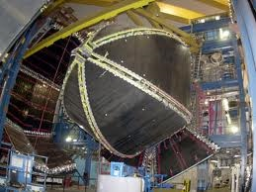
Meson photoproduction from the nucleon at CLAS
Dan Watts
University of Edinburgh
For the CLAS collaboration at Jefferson Lab

Slide 2
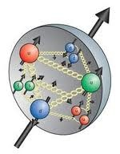
Outline
Outline
General motivations
Observables in meson photoproduction
Experimental details
Preliminary results for several polarization observables
Conclusions

Slide 3
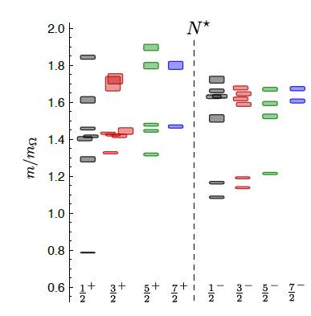
Motivation: nucleon excitation spectrum
Motivation: Baryon resonances
Masses, widths, and coupling constants not well known for many resonances
Many models: relativised quark model, Goldstone-boson exchange, diquark and collective models, instanton-induced interactions, flux-tube models, holographic dual, lattice QCD…
Big Puzzle: Most models predict more resonance states than observed
Lattice QCD predictions
Hadron spectrum collab.
Arxiv:1104.5152 (2011)
Notes:
New method overcomes cubic symmetry of lattice – pull out sion sates of all nucleons
Omeha mass 1672
Check what width of lines means

Slide 4
Outline
Outline
General motivations
Observables in meson photoproduction
Experimental details
Preliminary results for several polarization observables
Conclusions

Slide 5
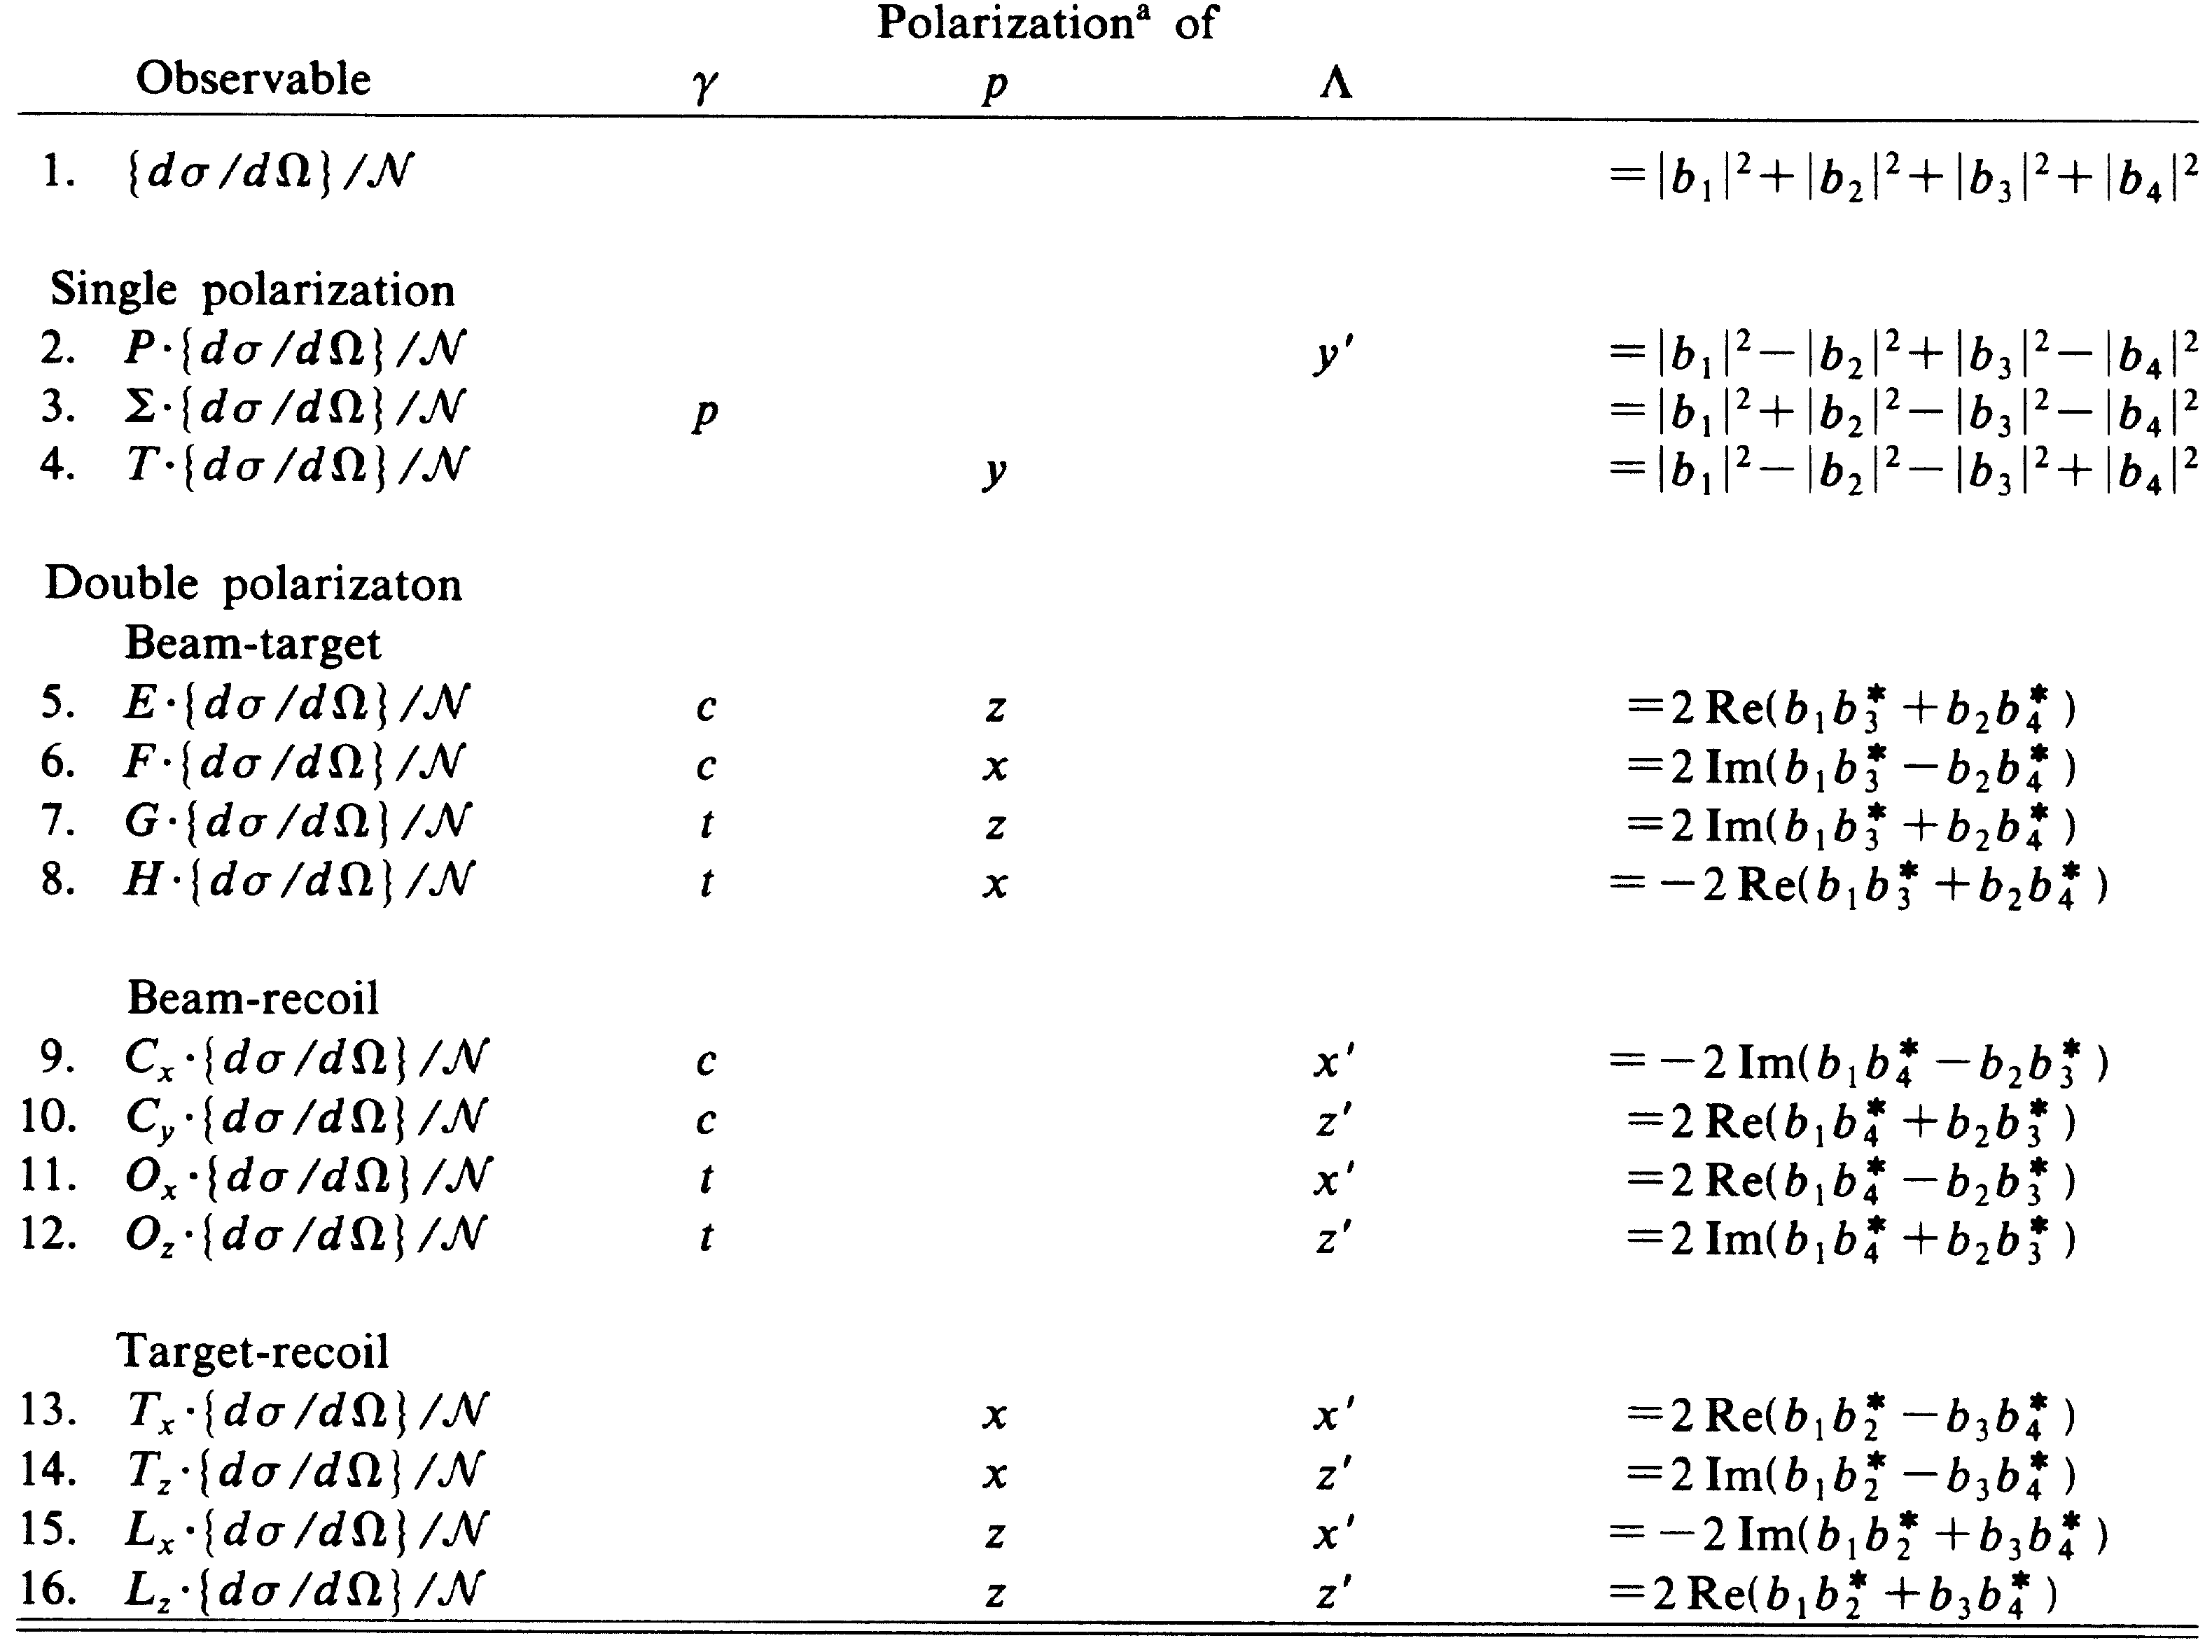
Observables in pseudo scalar meson photoproduction
Observable
Polarisation of
γ target recoil
combination of amplitudes
Notes:
Partial wave anlaysis – T-matrix dealing with transition. Can be separated into resononace and background parts

Slide 6
The task ahead
Finding missing resonances and better establishing the properties of “known” resonances requires an extensive measurement programme
Requires measurement of a complete or close to complete set of observables over a wide kinematic range
Need a wide range of final states – resonances have different couplings, isospin filtering
Such goals are finally coming within reach !
The CLAS facility will contribute a large fraction of the required high quality meson photoproduction data

Slide 7
Status of meson photoproduction at CLAS
 | σ | Σ | T | P | E | F | G | H | T_{x} | T_{z} | L_{x} | L_{z} | O_{x} | O_{z} | C_{x} | C_{z}
Proton target
pπ⁰ | ✔ | ✓ | ✓ | ✓ | ✓ | ✓ | ✓ | ✓
nπ⁺ | ✔ | ✓ | ✓ | ✓ | ✓ | ✓ | ✓ | ✓
pη | ✔ | ✓ | ✓ | ✓ | ✓ | ✓ | ✓ | ✓
pη’ | ✔ | ✓ | ✓ | ✓ | ✓ | ✓ | ✓ | ✓
K⁺Λ | ✔ | ✓ | ✓ | ✔ | ✓ | ✓ | ✓ | ✓ | ✓ | ✓ | ✓ | ✓ | ✓ | ✓ | ✔ | ✔
K⁺Σ⁰ | ✔ | ✓ | ✓ | ✔ | ✓ | ✓ | ✓ | ✓ | ✓ | ✓ | ✓ | ✓ | ✓ | ✓ | ✔ | ✔
K^{0*}Σ⁺ | ✔ | ✓ | ✓ | ✓ | ✓ | ✓ | ✓ | ✓
“Neutron” target
pπ⁻ | ✔ | ✓ | ✓ |  | ✓ | ✓ | ✓ | ✓
K⁺Σ⁻ | ✓ | ✓ | ✓ |  | ✓ | ✓ | ✓ | ✓
K⁰Λ | ✓ | ✓ | ✓ | ✓ | ✓ | ✓ | ✓ | ✓ | ✓ | ✓ | ✓ | ✓ | ✓ | ✓ | ✓ | ✓
K⁰Σ⁰ | ✓ | ✓ | ✓ | ✓ | ✓ | ✓ | ✓ | ✓ | ✓ | ✓ | ✓ | ✓ | ✓ | ✓ | ✓ | ✓
✔ - published ✔ - acquired

Slide 8
Outline
Outline
General motivations
Polarization observables to be discussed
Experimental details
Preliminary results for several polarization observables
Conclusions

Slide 9
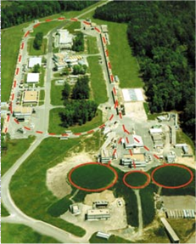
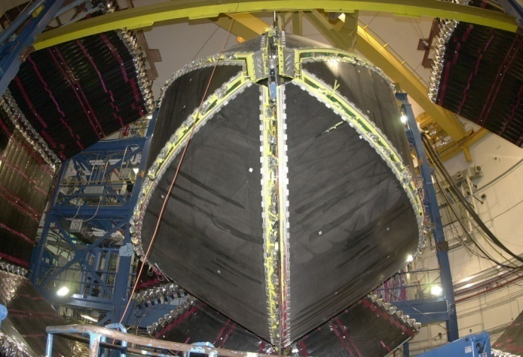
Jefferson Lab
CLAS:
Multi-layer large acceptance detector with tracking, calorimetry, time of flight
Near complete coverage in azimuthal angle and from 8° to 140° in polar angle.
CEBAF:
1.4 km racetrack electron beam accelerator with two LinAc sections.
Up to 6 GeV e- beam.
Up to 5.5 GeV polarised photon beam

Slide 10
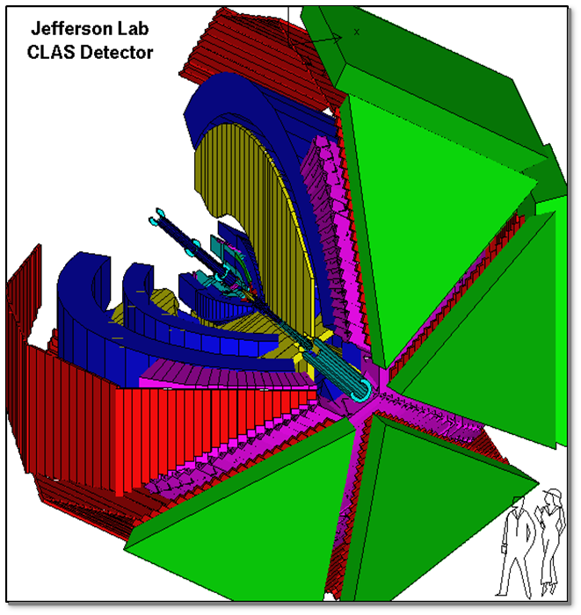
CLAS detector
Torus Magnet
6 Superconducting Coils
Electromagnetic Calorimeter
lead/plastic scintillator, 1296 PMTs
Target + start counter
Drift Chamber
35,000 cells
Cherenkov Counter e/π separation, 256 PMTs
Time of Flight
Plastic Scintillator,
Excellent charged particle ID and reconstruction

Slide 11
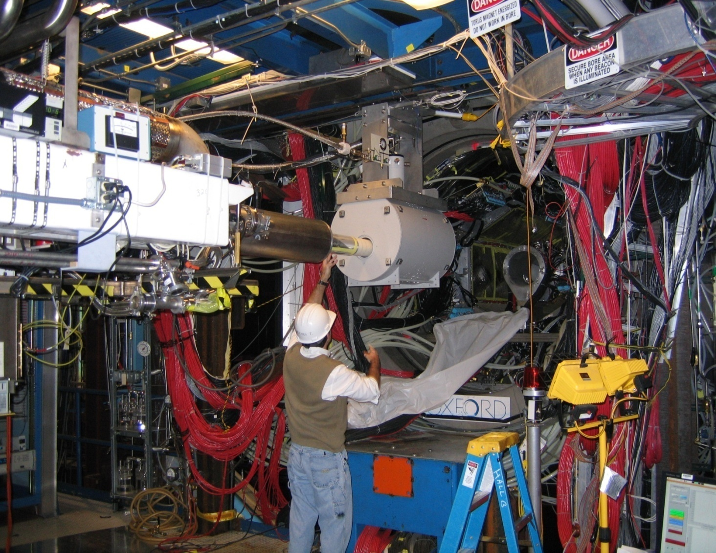
Frozen spin target (FROST)
Longitudinal nucleon polarisation (g9a) recently with Transverse (g9b)

Slide 12
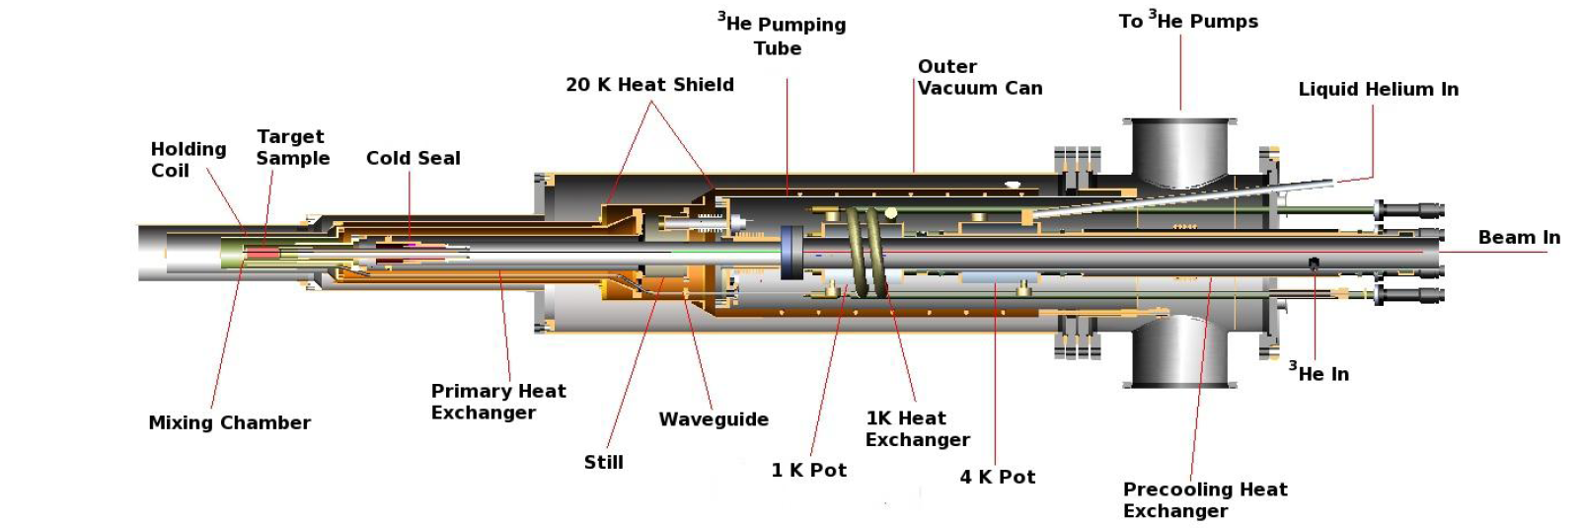
Frost target
Butanol (C₄H₉OH)
Butanol composition: C₄H₉OH
Carbon target used to measure bound nucleon contribution of butanol
Notes:
0.5% tempo – tetra methyl pipendine oxyl
He3/he4 dilution – below 0.87k will separate into He3 rich and 3He poor region. ->o get 3He liquid above 3He vapour. Remove gas 3He and travels over fom liquid to keep equilibrium – taking energy as it goes.
Frost polarising temperature 0.3K at 5T. Free elctrons alsmost completely polarised. Elecron polarisation transfered to the protons using microwave radiation. Dynamic nuclear polarisation. When protons polarised to over ~80% temperature dropped to 50mK to freeze in the spin. Thin superconducting solenoid provides 0.5 T holding field.

Slide 13
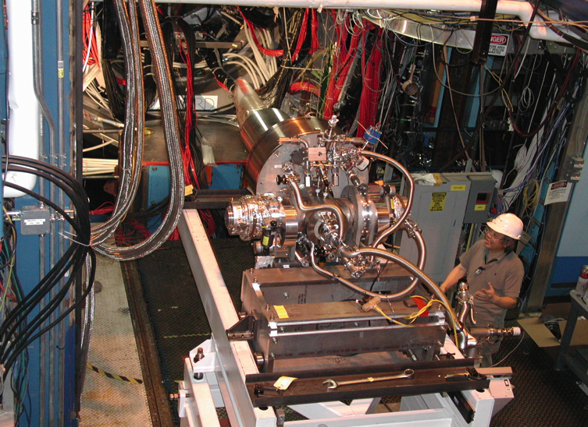
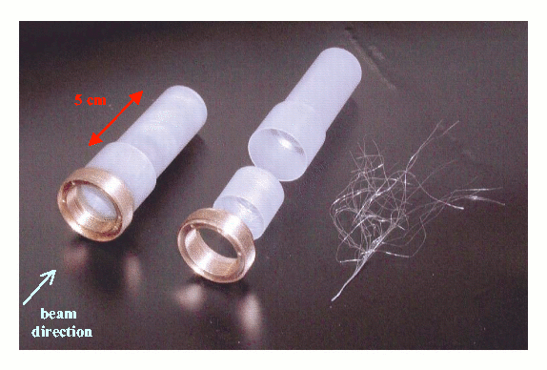
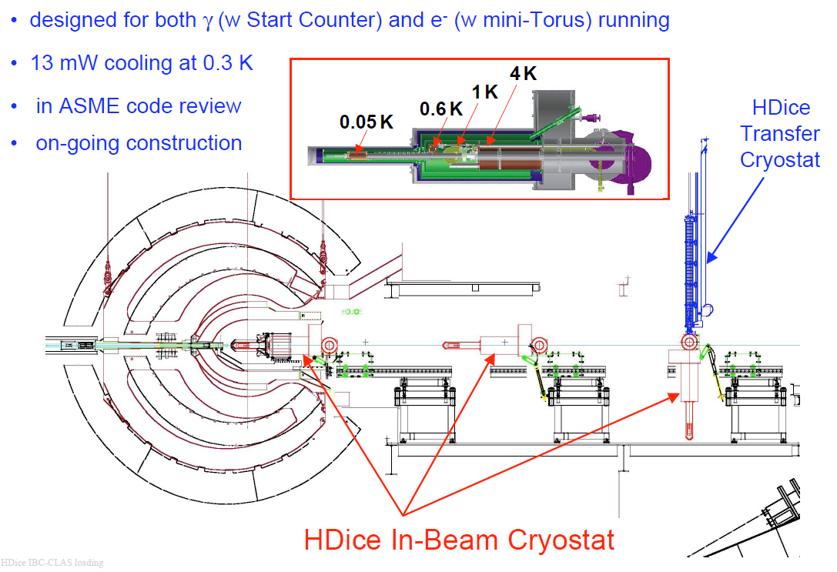
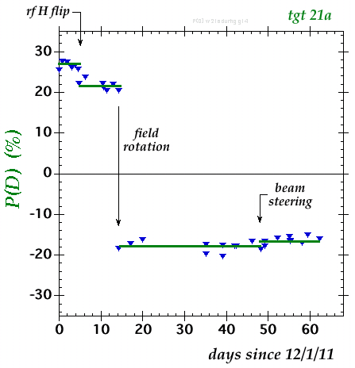
HDIce polarized target
HDice polarised target
Polarized at 15 Tesla and ~16mK
Polarise H2 and D2 rotational states – transfer spin to HD and repolarise
Transferred to in-beam cryostat – polarisation held with ~0.8T field

Slide 14
Outline
Outline
General motivations
Observables in meson photoproduction
Experimental details
Preliminary results for several polarization observables
Conclusions

Slide 15
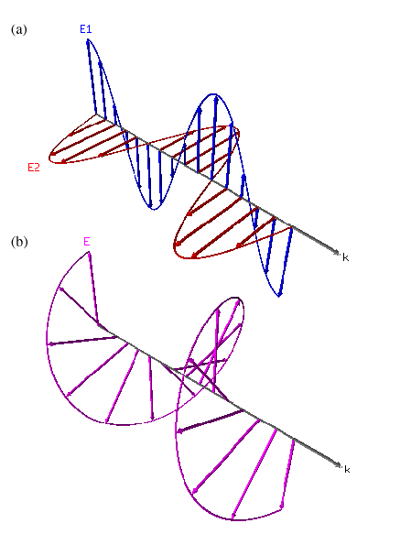
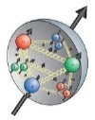


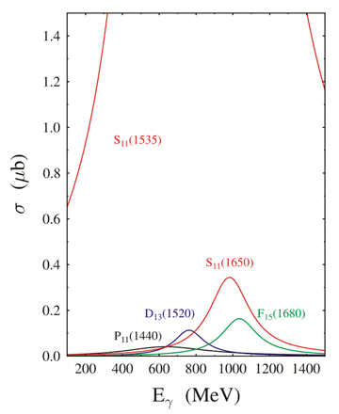
E – η photoproduction at threshold
S₁₁(1535) dominates at threshold
L=0, s = ½ → only helicity = ½ .
E ≈ 1.0 for all scattering angles
Provides an analytic check

Slide 16
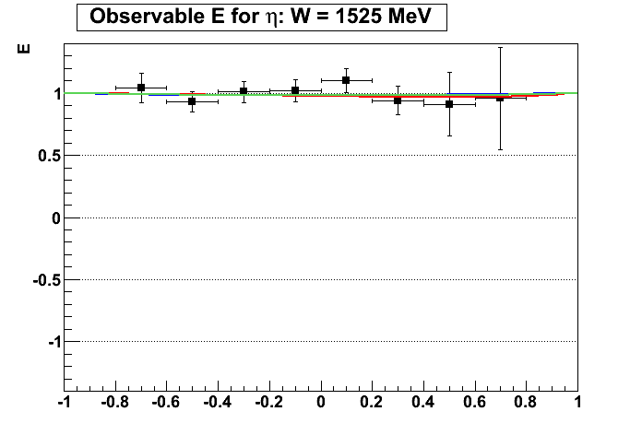

Helicity asymmetry E at threshold for p(γ,p)η
SAID
MAID
Bonn-Gatchina
γ+ p → p + η
p₀= 1.00 ± 0.04
W = 1525 MeV
E=1, within statistical uncertainties
☺
PRELIMINARY
cos(θ_{c.m.})

Slide 17
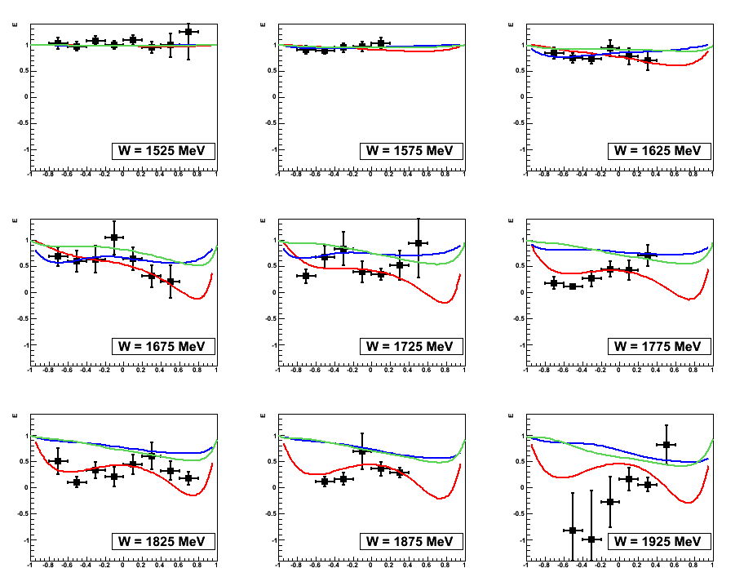
Helicity asymmetry E for p(γ,p)η
E
SAID
MAID
Bonn-Gatchina
PRELIMINARY
PRELIMINARY
PRELIMINARY
Preliminary data prefers SAID for W >1.75 GeV
PRELIMINARY
PRELIMINARY
PRELIMINARY
PRELIMINARY
PRELIMINARY
PRELIMINARY
cos(θ_{c.m.})

Slide 18
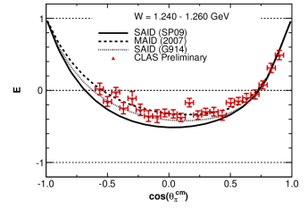
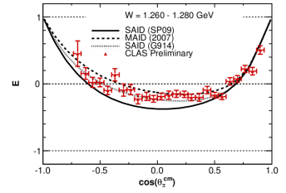
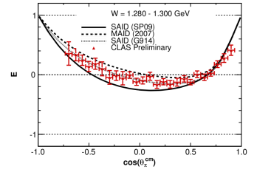
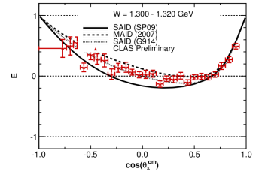
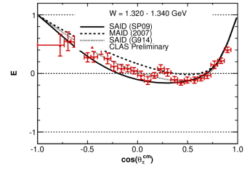
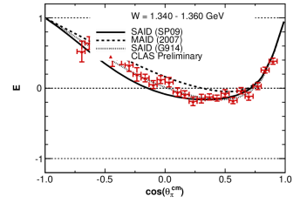
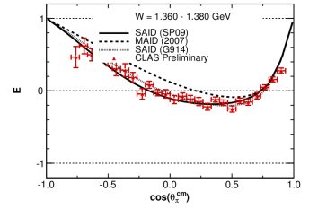
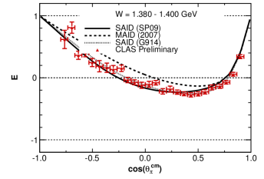
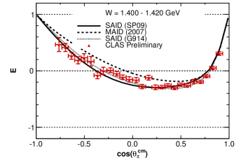
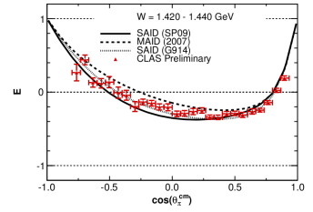
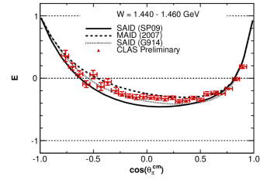
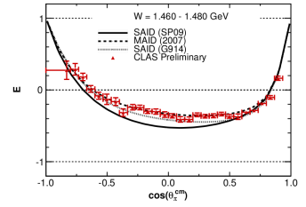
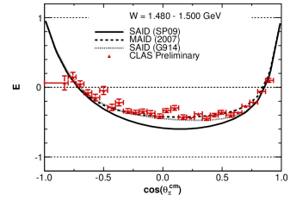
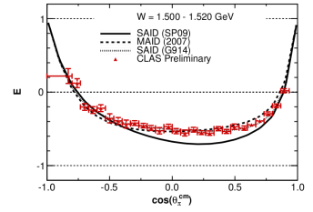
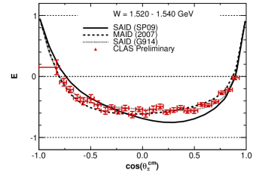
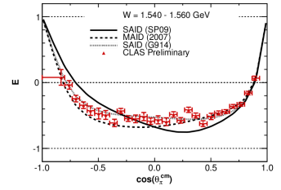
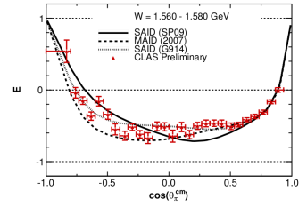
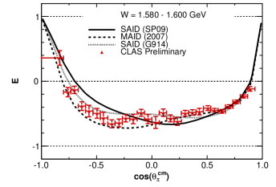
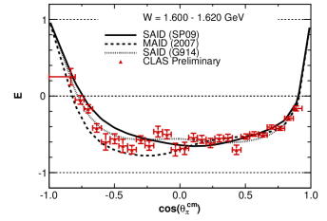
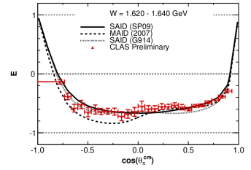
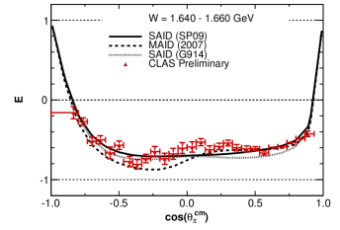
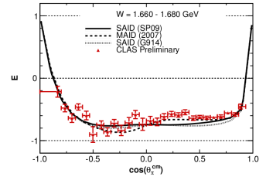
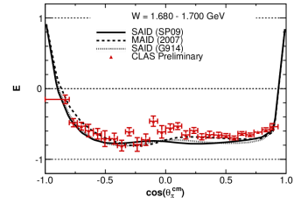
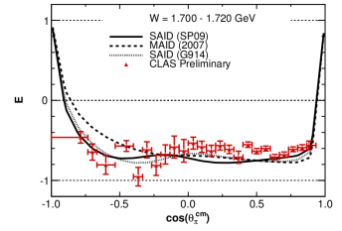
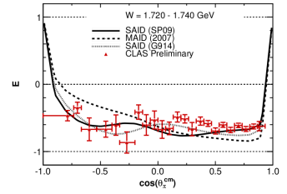
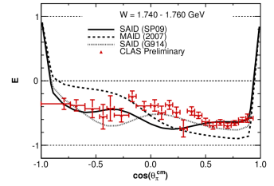
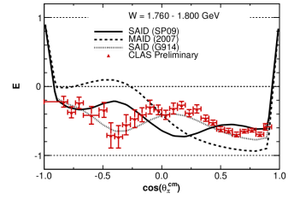
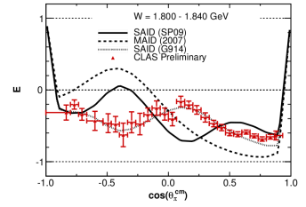
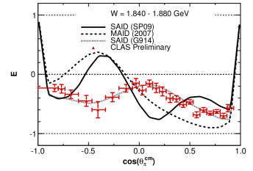
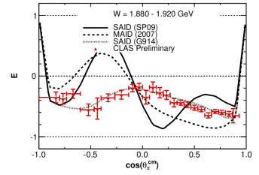
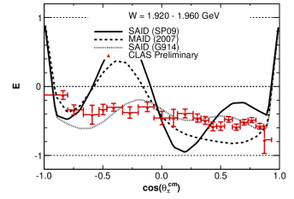
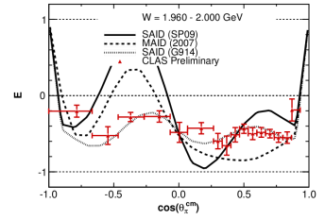




Helicity asymmetry: γ p→π⁺ n: W = 1.25 to 2.25 GeV
Helicity asymmetry E for p(γ,n)π⁺
PRELIMINARY
PRELIMINARY
PRELIMINARY
PRELIMINARY
PRELIMINARY
PRELIMINARY
PRELIMINARY
PRELIMINARY
PRELIMINARY
PRELIMINARY
PRELIMINARY
PRELIMINARY
PRELIMINARY
PRELIMINARY
PRELIMINARY
PRELIMINARY
PRELIMINARY
PRELIMINARY
PRELIMINARY
PRELIMINARY
PRELIMINARY
PRELIMINARY
PRELIMINARY
PRELIMINARY
PRELIMINARY
PRELIMINARY
PRELIMINARY
PRELIMINARY
PRELIMINARY
PRELIMINARY
PRELIMINARY
PRELIMINARY
PRELIMINARY
PRELIMINARY
PRELIMINARY
PRELIMINARY

Slide 19

Helicity asymmetry E for p(γ,p)π⁰
(new)
preliminary
Early stage results
Predictions agree better at lower energies
M. Dugger et al.

Slide 20





Helicity asymmetry E for K⁺ Λ
Helicity asymmetry E for p(γ,K⁺)Λ⁰
preliminary

Slide 21




Helicity asymmetry E for K⁺ Λ
Helicity asymmetry E for p(γ,K⁺)Λ⁰
Eγ = 1.5 GeV
Eγ = 1.6 GeV
preliminary
Eγ = 1.725 GeV
Eγ = 1.9 GeV
None of the models represents the data well

Slide 22





G observable for p(γ,n)π⁺
W=1475-1500 MeV
W=1640-1680 MeV
PRELIMINARY
◊ Bussey et al
preliminary
W=1840-1880 MeV
W=2030-2080 MeV
▬ SAID
-- MAID
-• Bonn-Gatch
Early stage results -approx. linear beam polarization values
cos(θ_{π})=0.6 to 1.0
PRELIMINARY

Slide 23




F for γp→K⁺Λ
Observable F for p(γ,K⁺)Λ⁰
★-CLAS
BnGa
kaonMAID
preliminary
N. Walford

Slide 24




Helicity asymmetry E from HDice
g14
preliminary
T. Kagea

Slide 25
Summary
CLAS will provide a good fraction of the quality data needed to better constrain the reaction amplitudes in meson photoproduction
→ Improve determination of “known” resonance properties and a basis to search for predicted but unobserved resonances
Preliminary beam-target data differentiates between models
No PWA models can describe the data for all mass regions and channels
→ implications for resonance properties to be assessed when data finalised!
An exciting time for nucleon spectroscopy !

Slide 26


Resonance status for N* and Δ*
Nearly half the states have only fair or poor evidence!
Most states need more work to learn details
Are there missing states?

Slide 27


Baryon Resonance Spectrum
Lattice QCD
N*
Mass(π) = 396 MeV
Masses, widths, and coupling constants not well known for many resonances
Most models predict more resonance states than observed
R.G. Edwards et al. Phys. Rev. D84 074508 (2011)

Slide 28

γ p → π⁺ n
University of South Carolina
Steffen Strauch

Slide 29
γ p → K⁺ Λ
Catholic University of America
Liam Casey and Franz Klein

Slide 30


HDICE target

Slide 31
γ p → π⁺ n
The University of Edinburgh
Jo McAndrew, Dan Watts, Derek Glazier

Slide 32
Helicity asymmetry E
Theoretically:
→
Experimentally:
where Y represents yield and d is the dilution, which is the ratio of hydrogen events to total events:
Note: Bound nucleons have no asymmetry → E_{bound} = 0

Slide 33



Accounting for unpolarised protons in the target
Butanol
γ p →p π⁺ π⁻ X
Counts
m²_{X}(GeV²)
Bound nucleon events
Butanol
Carbon
Counts
Proton momentum (GeV/c)
Scale factors = Butanol/Carbon
z (cm)
Proton angle (deg)
Notes:
Factor 10 in scale factors. Jo’s are 0.2 to 0.7

Slide 34
G observable
Σ is a single polarization observable (beam asymmetry)
G is a double polarization observable

Slide 35




Helicity asymmetry for K⁺ Σ⁰
preliminary
Models represent the data better than for K⁺ Λ
35

Slide 36

γ p → p π⁰
The George Washington University
Hideko Iwamoto and Bill Briscoe

Slide 37
First data with FROST
W = 1.465 GeV
W = 1.433 GeV
W = 1.497 GeV
W = 1.528 GeV
W = 1.558 GeV
W = 1.588 GeV

Slide 38
First data with FROST
W = 1.617 GeV
W = 1.646 GeV
W = 1.674 GeV
W = 1.702 GeV
W = 1.730 GeV
W = 1.809 GeV
W = 1.756 GeV
W = 1.783 GeV

Slide 39
First data with FROST
W = 1.835 GeV
W = 1.860 GeV
W = 1.885 GeV
W = 1.910 GeV
W = 1.934 GeV
W = 1.959 GeV
W = 1.994 GeV
W = 2.041 GeV
Agreement with models breaks down for W > 1850 MeV

Slide 40
Useful tools: Isospin decomposition
Differing isospin overlaps of N* and Δ⁺ for the π⁰ p and π⁺ n
final states
The π⁰ p and π⁺ n final states can help distinguish between
the Δ and N*
Δ⁺
N*
Notes:
3 amplitudes. Isoscalr I=0 and isovector I=0 or 1
Note these are both from the proton.
Say measuring off the proton and neutron needed to separate the isospin transition amplitudes

Slide 41



Example of extraction for G for π⁺ n
G Observable Extraction
Create an asymmetry and fit a function to obtain G:
p3 = p_{T}p_{z}fG
PRELIMINARY!
PRELIMINARY!
Asymmetry -ve polarised target
Asymmetry +ve polarised target

Slide 42

“Isospin filters”
Useful tools: Isospin filtering
Resonance spectrum has many broad overlapping states
The ηp, K⁺Λ and pω systems have I=½ and act as isospin filters to the resonance spectrum.
γ p → π⁺ n
γ p → η p

Slide 43


















Helicity asymmetry: γ p→π⁺ n: W = 1.25 to 1.70 GeV
Preliminary
Data
Preliminary
Data

Slide 44















Helicity asymmetry: γ p→π⁺ n: W = 1.7 to 2.25 GeV
Preliminary Data
For W< 1.75 GeV all of the models represent the data fairly well.
For W> 1.75 GeV none of the models represents the data well.

Slide 45

Useful tools: Multipion final states
64 observables, 8 reaction amplitudes
28 independent relations related to magnitudes of reaction amplitudes
21 independent relations related to phases of amplitudes
Results in 15 independent observables
Good for discovering resonances that decay into other resonances!

Slide 46





“G” observable for π⁺ n
cos(θ_{π})=-1 to -0.6
cos(θ_{π})=-0.6 to -0.2
cos(θ_{π})=-0.2 to 0.2
PRELIMINARY
PRELIMINARY
PRELIMINARY
cos(θ_{π})=0.2 to 0.6
cos(θ_{π})=0.6 to 1.0
PRELIMINARY
PRELIMINARY
Early stage results - only approx. linear beam polarization values

Slide 47
γ p → p π⁺ π⁻
Florida State University
Sungkyun Park and Volker Crede

Slide 48
γ p → p π⁺ π⁻
Notes:
Py, Py ,Oyy, I, Py , Py , and Oyy required to get magnitude of amplitudes.
Need 8 to get the magnitudes. 7 relative phases between the amplitudes. Total 15

Slide 49
γ p → p π⁺ π⁻

Slide 50


P○_{z} for p π⁺ π⁻
φ^{π+}

Slide 51

P_{z} for p π⁺ π⁻
φ^{π+}

Slide 52



P_{z} for p π⁺ π⁻
φ^{π+}

Slide 53

HD-Ice: Preliminary analyses

Slide 54
FROST target polarisation
Frozen spin butanol (C₄H₉OH)
P_{z} ≈ 80%
Target depolarization: τ ≈100 days
For g9a (longitudinal orientation) ~10% of time polarizing target
For g9b (transverse orientation) ~ 5% of time polarizing target

Slide 55
Frost – Stability of beam/target polarisation
S. Strauch

Slide 56

CLAS12
CLAS12
Large angle acceptance for charged and neutral particles
Excellent momentum resolution for charged particles
Forward Detector
TORUS Magnet
Forward silicon vertex tracker
HThresh Cerenkov Counter
LThresh Cerenkov Counter
Forward TOF System
Preshower calorimeter
E.M. Calorimeter
Central Detector
SOLENOID magnet
Barrel silicon tracker
Central TOF
Proposed updates
Micromegas (CD)
Neutron detector (CD)
Forward Tagger
Enable e- detection
below 5^{O}

Slide 57



GEANT4 simulation (GEMC)
Forward Tagger
Forward
Tagger
G4 simulation of the Forward Tagger Calorimeter based on the PbW0₄ crystals
470 crystals
10x10x200 mm size
Coverage from 1.8 to 5.2 deg.
Tungsten beam pipe to shield from beam halo
Moeller shield
e⁻ beam
Central solenoidal
field focuses
Em background

Slide 58

Forward Tagger Calorimeter
PbWO4
τ_{Decay} ~ 6.5 ns
R_{M} ~ 2.1 cm
Density ~ 8.3 g/cm³
X₀ ~ 0.9 cm
light yield 0.3% (LY NaI(Tl))
Requirements :
  Operate in high EM background
    Moeller (10MHz), Elastic Radiative (0.1MHz)
    Small Moliére radius
    Radiation hardness
  Fast timing
    Avoid pile-up
    Coincidence with CLAS12
  Energy resolution
    ID final states with missing mass
  Light read-out in magnetic field
    APD readout
Existing CLAS inner calorimeter
424 16cm PbWO4 crystals
σ_{E} ~ 3%E

Slide 59


Quasi Real Photon Tagging
Small angle e⁻ scattering
   Q²<0.1(GeV/c)² (almost) real photon
Tag γ* by measuring forward angle e⁻ (<5º)
0.5<E_{e'}<4 GeV 7<E_{γ} <10.5 GeV with 11 GeV beam
γ* are linearly pol. wrt. scattering plane
High e⁻ luminosity10³⁵ cm⁻²s⁻¹ or 10⁷ γs⁻¹
Only e⁻ contributing to hadronic interactions are
detected in coincidence with CLAS12
Cross section for
inclusive hadronic reactions
Hadronic rate 2-5^{O}=8.6kHz
5-20^{O}=3.8kHz

Slide 60

Cascade
Cascade production
Doubly strange members of SU(3)
Number of Ξ* should equal N* and Δ*
Currently 2, 4* and 4, 3* resonances measured - properties not well known
Advantages
Excited states narrow compared to N* (10MeV<100MeV)
Extraction of excitation spectrum relatively straightforward
2 detached vertices from decays
2 kaons in final state
Clean separation from
non-strange background
L. Guo et al. PRC 76, 025208 (2008)
Will cover masses from 1.5 to 3.8 GeV
Measure decay distributions
⇒Model independent extraction of properties
σ_{total}(γp -> 2K⁺Ξ⁻) ~ 10nb~1Hz production rate

Slide 61

Ω⁻ - the strangest baryon
The strangest baryon
Gell-Mann, Ne'eman prediicted, as part of quark model,
the Ω⁻ (1670) with S=-3, J^{P}=3/2+
Observed in 1964 BNL confirming SU(3)_{F}
σ_{total}(γp -> 3K⁺Ω⁻) ~ 1nb~0.1Hz production rate
Cross section measurement of γp→Ω⁻K⁺K⁺K⁰
Direct determination of quantum numbers with no assumptions
  BABAR → J=3/2 , parity unknown experimentally
Search for Ω⁻ excited states
  Only 3 possible resonances measured
Study of the photoproduction mechanism
  First baryon where no constituents come from target proton

Slide 62


Circularly polarised photons
Counts
Circular photon beam from longitudinally polarized electrons
Electron beam polarization > ~85%
Circular polarization from 100% polarized electron beam
Circular polarization
k = E_{γ}/E_{e}
H. Olsen and L.C. Maximon, Phys. Rev. 114, 887 (1959)

Slide 63

Linearly polarised photons
Coherent bremsstrahlung from 50 μ oriented diamond
Two linear polarization states (vertical & horizontal)
Analytical QED coherent bremsstrahlung calculation fit to actual spectrum

Slide 64

Real Photon Tagger
Real photons produced via bremsstrahlung in radiator
Momentum of degraded e⁻ analysed in dipole spectrometer
Characteristic 1/E distribution
Tagged range : 0.2<E_{e}<0.95
Linear polarised photons using coherent brem. on diamond radiator
High polarisation, up to 90%, at low E
Maximum W = 3.4 GeV
Intensity of 10⁷γ s⁻¹ integrated over full energy range
Within 3 years – JLAB upgrade to 11 GeV
But cannot use present tagger with 11 GeV e⁻ beam!!
Daniel Watts University of Edinburgh, for the CLAS collaboration QCD10, Montpellier

Slide 65

Bremsstrahlung photon tagger
61 Backing counters
(→ timing)
61
  E_{γ} = 20-95% of E₀ - up to ~5.5 GeV
  Unpolarised, circularly polarised or linearly polarised photons

Slide 66
Photoproduction with CLAS12
CLAS12 has evolved to study internal nucleon dynamics through GPDs, using high intensity 11 GeV e⁻ beam
Detector also meets requirements of measuring photoproduction reactions with multiparticle final states
  Many interesting physics possiblities :
Meson spectroscopy on H searching for exotic states
Spectroscopy on He4 and other nuclear targets
Heavy mass baryon resonances (Cascades and W)
Baryon spectroscopy (hyperon production)
Glueball search in k⁰k⁰ channel
Baryon/meson radiative decays
J/Psi photoproduction near threshold (on H and nuclei)
Just require tagged photon beam...
Daniel Watts University of Edinburgh, for the CLAS collaboration QCD10, Montpellier

Slide 67


Slide 70
Coherent production on nuclei
Production of mesons on light nuclei can help simplify PWA
  Significantly reduce s-channel resonance background
  S=I=0 target acts as spin and parity filter for final state meson
  Method requires detection of low energy recoil nucleus
    Thin gas target (need high luminosity)
    Time Projection Chamber e.g. GEMs (CLAS experiment EG6)
Incoherent production on nuclei
Can filter additional spin-parities of final state meson
  Identify final sate quantum numbers of recoil nucleus
    Tag with nuclear decay 
    e.g ¹²C(0) 0⁺ ¹²C(4.4 MeV) 2⁺
No threshold on recoil energy or t
Daniel Watts University of Edinburgh, for the CLAS collaboration QCD10, Montpellier
Can filter additional spin-parities of final state meson
  Identify final sate quantum numbers of recoil nucleus
    Tag with nuclear decay 
Can filter additional spin-parities of final state meson
  Identify final sate quantum numbers of recoil nucleus
    Tag with nuclear decay 

Slide 72

Ω⁻ - the strangest baryon
Gell-Mann, Ne'eman prediicted, as part of quark model, the Ω⁻ (1670) with S=-3, JP=3/2+
Observed in 1964 BNL confirming SU(3)_{F}
σ_{total}(γp -> 3K⁺Ω⁻) ~ 1nb~0.1Hz production rate
Cross section measurement of γp→Ω⁻K⁺K⁺K⁰
Direct determination of quantum numbers with no assumptions
  BABAR→J=3/2 , parity unknown experimentally
Search for Ω⁻ excited states
  Only 3 possible resonances measured
Study of the photoproduction mechanism
  First baryon where no constituents come from target proton
Daniel Watts University of Edinburgh, for the CLAS collaboration QCD10, Montpellier

Slide 73
Summary
JLAB e⁻ beam will be upgraded to 11 GeV for 2013
  12 GeV for new Hall-D (GlueX experiment)
The CLAS detector will undergo a complementary upgrade
  CLAS12 – excellent charged and neutral particle detection
A high luminosity (10³⁵cm⁻²s⁻¹) e- will be used on a hydrogen target for several years to meet the requirements of DVCS experiments
Addition of a quasi-real photon tagger will allow parasitic measurements in hadron spectroscopy
Exotic mesons, cascades, Ω⁻...

Slide 74
I^{S} for p π⁺ π⁻
φ^{π+}

Slide 75
Transversely polarised FROST (g9b)
FROzen Spin Target “FROST” (g9b)
Beam: Circular polarization; Linear polarization; Un-polarized
Data obtained for Σ, F, H, P and T (for pseudoscalars)
Data is in calibration phase right now
Beam Target Observable
Circular Transverse
Linear Transverse
σ₀ = unpolarized cross section, P_{T} = transverse beam polarization
P₀= circular polarization, P_{z}= longitudinal target polarizaion

Slide 76






Preliminary results of G for π⁺ n
cos(θ_{π})=-1 to -0.6
cos(θ_{π})=-0.6 to -0.2
cos(θ_{π})=-0.2 to 0.2
SAID
MAID
PRELIMINARY
G
PRELIMINARY
PRELIMINARY
PRELIMINARY
PRELIMINARY
cos(θ_{π})=0.2 to 0.6
cos(θ_{π})=0.6 to 1.0
Early stage results - only approx. linear beam polarization values
<1/2 available data
PRELIMINARY
PRELIMINARY
G
PRELIMINARY
Centre of mass energy (MeV)
Centre of mass energy (MeV)

Slide 77
A very early look at
T for γ p → π⁺ n
Arizona State University
Michael Dugger and Barry Ritchie

Slide 78
First glimpse of T from CLAS
Used only 2 uncalibrated runs
E_{γ} from 0.65 to 1.2 GeV
cos(θ^{π}_{c.m.}) = 0.95
Target offset (in φ) is within one standard deviation of the set value (-60 degrees)
The measured value of T is within 1.14 standard deviations of SAID
T = -0.34 ± 0.09
T_{SAID} = -0.440

Slide 79






Acknowledgements
NSF
DOE
CLAS Collaboration

Slide 80
Status of meson photoproduction
✔ - published, ✔ - acquired, ✔ - planned

Slide 82

Experimental observables
γ p → p π⁰ E
γ p → n π⁺ E, G
γ p → p η E
γ p → K⁺ Λ E, Σ, G
γ p → K⁺ Σ⁰ E
γ p → p π⁺ π⁻ I_{s}, P_{z}, P○_{z}
Single pseudoscalar photoproduction

Slide 83
Helicity amplitudes
Helicity amplitudes for γ + p → p + pseudoscalar
8 helicity states: 4 initial, 2 final → 4∙2 = 8
Amplitudes are complex but parity symmetry reduces independent numbers to 8
Overall phase unobservable → 7 independent numbers
HOWEVER, not all possible observables are linearly independent and it turns out that there must be a minimum of 8 observables / experiments
Initial helicity
Final helicity
helicity +1 photons (ε₊):
helicity -1 photons (ε₋):
Parity symmetry →

Slide 84

Helicity amplitudes and observables for single pseudoscalar photoproduction
Differential cross section
Beam polarization
Target asymmetry
Recoil polarization
Double polarization observables
Need at least 4 of the double observables from at least 2 groups for a “complete experiment”
π⁰p, π⁺ n, and η p will be nearly complete
K⁺ Λ will be complete!
g9b
g9a

Slide 85






G8b preliminary photon asymmetry results - K⁺Λ
(Craig Paterson, Glasgow)
Compared with previous results from LEPS (red)
  6 energy bins 100 MeV wide
  Range 1550 – 2050 MeV
  More bins for our data
Increase the angular coverage to backward angles
LEPS also recently have some consistent, new points at backward angles.
Hicks et al., PRC 76, 042201(R) (2007).
PRELIMINARY

Slide 86

G8b preliminary recoil polarisation results - K⁺Λ
(Craig Paterson, Glasgow)
PRELIMINARY
P (recoil polarisation)
P obtained from acceptance-corrected proton distribution
CLAS g8b
GRAAL
CLAS J.W.C. McNabb, et al. (CLAS) Phys. Rev. C 69, 042201(R) (2004)

Slide 87

G8b preliminary O_{x} results - K⁺Λ
(Craig Paterson, Glasgow)
Comparison with Regge-plus-Resonance model from Gent group
PRELIMINARY
Large Polarizations
Some evidence for an important role for missing D₁₃(1900) state
Poor agreement at low energy

Slide 88
γ p → K⁺ Λ
University of Glasgow
Stuart Fegan and Ken Livingston

Slide 89

Σ for K⁺ Λ
Since the beam asymmetry Σ does not rely upon target polarization, bound nucleons can have Σ ≠ 0
Dilution must be carefully determined
The beam asymmetry is used only for purposes of checking data consistency
PRELIMINARY
PRELIMINARY

Slide 90

P_{γ}P_{z}G for K⁺ Λ
E_{γ} = 1.5 GeV
Can clearly see sign change between +z and –z target polarization data
PRELIMINARY
PRELIMINARY

Slide 91



Sample η fits
W = 1525 MeV
cos(θ_{c.m.}) = -0.3
N_{1/2} + N _{3/2}
N_{1/2} - N _{3/2}
Counts
Counts
m_{X} (GeV)
m_{X} (GeV)
Scaled carbon
Counts
m_{X} (GeV)
M. Dugger, Jlab User Meeting, June 2012

Slide 92

Excitation spectrum for T=1/2 compared to quark model
Mass(MeV)
Existence is
uncertain
Many more states predicted
than observed ?
Why? Too many d.o.f, ?
insensitive data ?
D13(1900)
2q+q ×
3q
Hints of
narrow
Resonance at
1670 MeV??
P₁₁(440) Roper
Inconsistent with
all q models??
Exotic structure?
Large radial extent?
Γ=300±150 MeV
Also:
T=3/2 Δ resonances
States predited by Holographic dual
but not by quark model
J^{π}
Notes:
.

Slide 93
Why meson photoproduction?
Meson Photoproduction
Real photons – well understood EM interaction, giving access to EM properties of resonances.
Meson photoproduction – for pseudo-scalar mesons:
4 invariant complex reaction amplitudes
16 single and double polarisation observables
Partial Wave Analysis (PWA) fits used to extract amplitudes
-> resonance parameters (eg: angular momentum, parity).
Require measurements of cross-section and 7 additional, carefully chosen polarisation observables to remove ambiguities.
Different polarisation observables are extracted through different combinations of polarised beams and targets and measurements of recoil polarisation.

Slide 94
FROST running conditions
g9a: First running of FROST
g9b: Second running of FROST
Longitudinally polarized target
Circular and linear photon polarization
Transversely polarized target
Circular and linear photon polarization

Slide 95
Useful tools: Self analysing hyperons
Weak decay of hyperon -> polarization information in decay distribution of the baryon in the hyperon CoM:
Decay distribution of the baryon
α is the weak decay asymmetry (α_{Λ}= 0.642 and α_{Σ0} = -⅓ α_{Λ}),
P_{Yi} is the hyperon polarization.

Slide 96


















G13 preliminary beam asymmetry results – p π⁻
(Daria Sokhan)
PRELIMINARY
Previous data (Alspector, PRL 28, 1403 (‘72), Abrahamian,SJNP 32, 69 (‘80), Adamyan, JPG 15, 1797 (‘89)).
MAID 07
SAID 09

Slide 97

Motivation: Baryon resonances
Motivation: Baryon resonances
Masses, widths, and coupling constants not well known for many resonances
Many models: relativised quark model, Goldstone-boson exchange, diquark and collective models, instanton-induced interactions, flux-tube models, holographic dual, lattice QCD…
Big Puzzle: Most models predict more resonance states than observed
Lattice QCD predictions
PRD82 (2010) 014507

Slide 98


















G13 preliminary beam asymmetry results – p π⁻
(Daria Sokhan - Edinburgh)
PRELIMINARY
Previous data (Alspector, PRL 28, 1403 (‘72), Abrahamian,SJNP 32, 69 (‘80), Adamyan, JPG 15, 1797 (‘89)).
MAID 07
SAID 09

Slide 99
Frost target
Butanol composition: C₄H₉OH
Carbon target used to measure bound nucleon contribution of butanol

