Slide 1
TRACE Digitizers on FPGA Andrea Triossi, Marco Bellato, Roberto Isocrate, Fabio Montecassiano INFN – LNL – PD
Gaspard – Hyde – Trace Workshop
October 30 2012, Padova

Slide 2
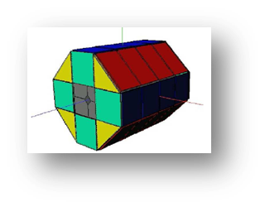
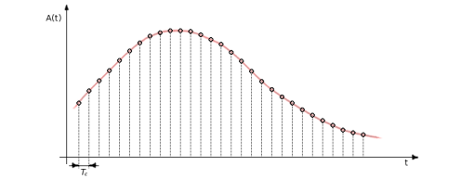
Outlines
Introduction
TRACE requirements
Digitalization in FPGA
Time to digital converter
Analog to digital converter
Characterization
Non-uniform sampling
Preliminary Results
How to improve

Slide 3
TRACE Requirements
ADC Goals
Fast signals (rising time 20-200 ns) high sampling rate
PSA good precision
Linear range: 1.5 V
Resolution: 10 mV
Levels: 1.5 V / 10 mV = 150
Induced signals x10 1500
10.5 bits ENOB
Thousands of channels high integration, low cost

Slide 4
FPGA as TDC
Nutt method
Counter
Interpolator tapped delay line
τ
τ
τ
τ
Signal
FF
FF
FF
FF
D
Q
D
Q
D
Q
D
Q
Q0
Q1
Q2
Q3
CLK
Modern FPGAs have:
Many dedicated carry lines which are designed to be as fast as possible to implement fast carry adders.
Very sophisticated clock distribution system with a minimal skew.

Slide 5
FPGA as ADC
FPGA
V/I AMP
TDC
From PA directly to FPGA differential inputs
External digital synthesizer used to produce a V_{REF} sinusoid
TDCs measure time differences further converted to voltage
V/I AMP
TDC
V/I AMP
TDC
V/I AMP
TDC
D D S
V₁
V₂
V₄
V₃
V₆
V₈
V₅
V₇
V₉
T₁
T₂
T₃
T₄
T₅
T₆
T₇
T₈
T₉
High integration?

Slide 6
TDC Core
From Xilinx timing model:
3.731 ns
SLICE
3.732 ns
3.752 ns CARRY4
3.773 ns
3.811 ns
3.812 ns
3.832 ns
3.852 ns
3.890 ns
3.891 ns
Clock freq 125-250 MHz
Course counter up to 134 ms
Carry chain 816 elements
Rearm time 3 cycles
Startup calib histogram
Online calib ring oscillator
Bubbles effect correction
LSB ~ 1 ps
Precision ~ 20 ps rms
0000000000000000
1110000000000000
1111110100000000

Slide 7
TDC Precision
ps

Slide 8
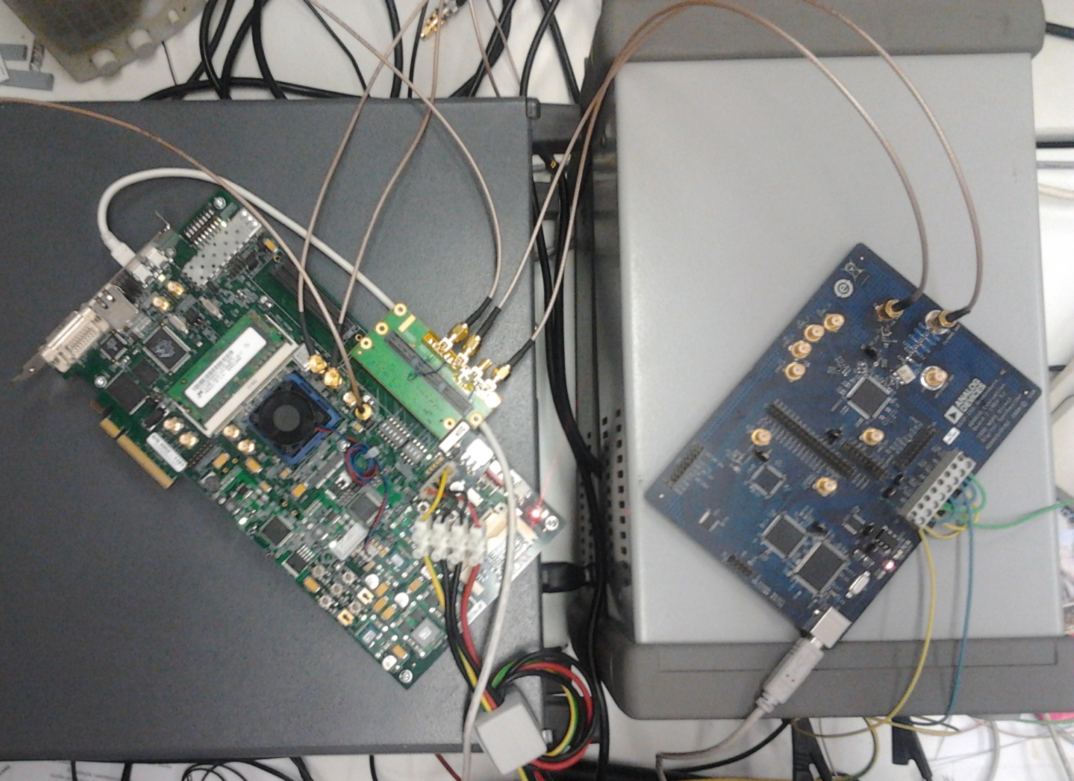
ADC Prototype
Signal
Reference
Sync
AD9910
V6-LX240
Calibration

Slide 9
ADC preliminary results
Up to 48 channels in a V6 LX240
Digitized data: sampled at 25 MS/s
Phase jitter (reference sine wave) OCXO 50ppb
LVDS inputs coupling V to F

Slide 10
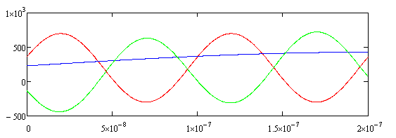
Equivalent Number of Bits
Noise and distortion
Uniform sampling
DFT
Equivalent number of bits
Non-uniform sampling
Non-uniform DFT

Slide 11
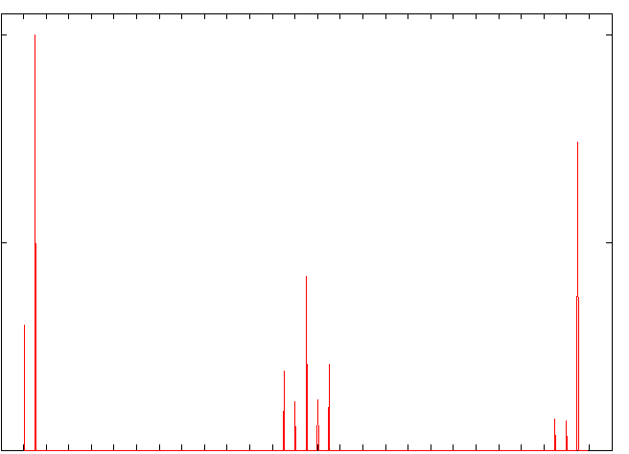
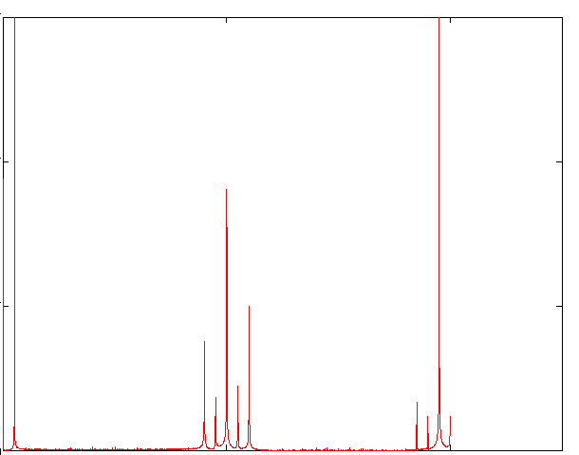
Equivalent Number of Bits
NDTF
ENOB
Depends on how the spectra are subtracted!
NDTF
From Mathcad simulation
to analysis on real data

Slide 12
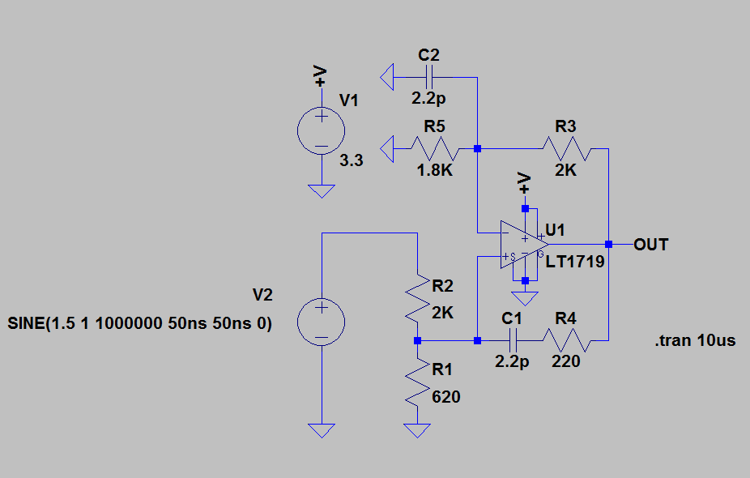
Voltage to Frequency
FPGA
TDC core
Reconstructed signal
Times measured by TDC

Slide 13
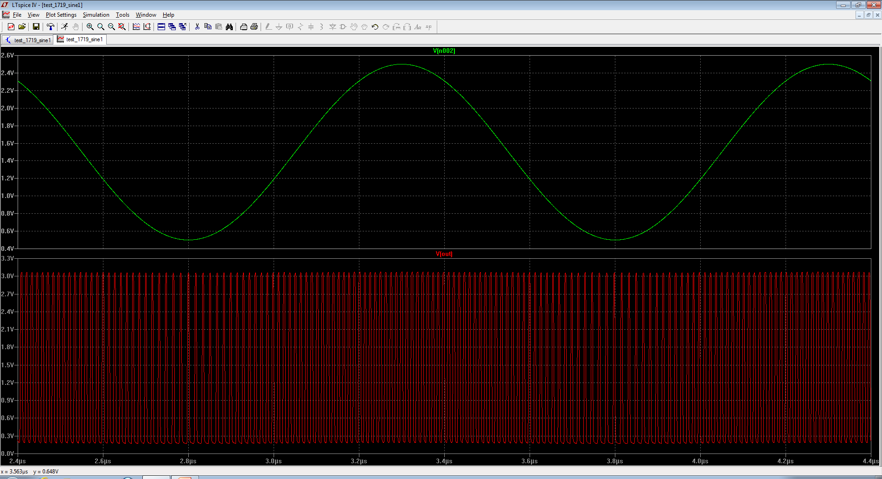
Voltage to Frequency

Slide 14
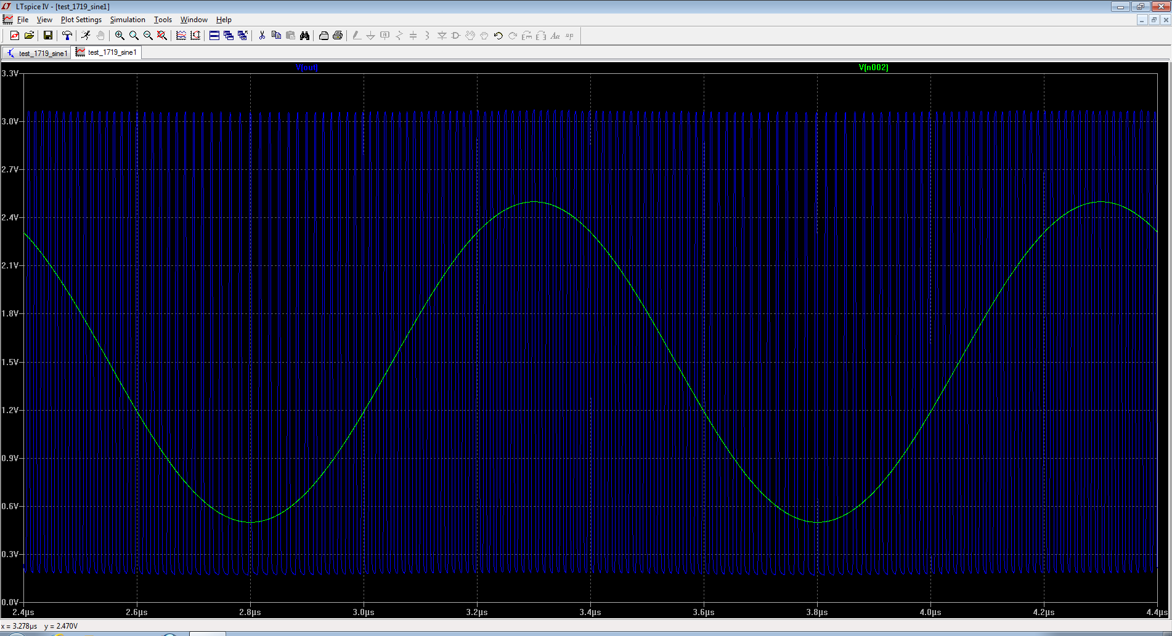
Voltage to Frequency

Slide 15
Conclusions
Achieved & Expected Activities
ADC Firmware √ tested
ADC Characterization O ongoing (ENOB, DNL, INL…)
Resolution improvement

