Slide 1
M. Assié (IPNO) on behalf of
N. de Séréville (IPNO) & A. Corsi (CEA Saclay) & M. Labiche (STFC Daresbury)

Slide 5
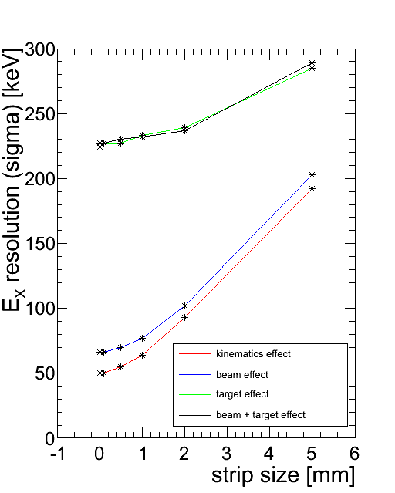
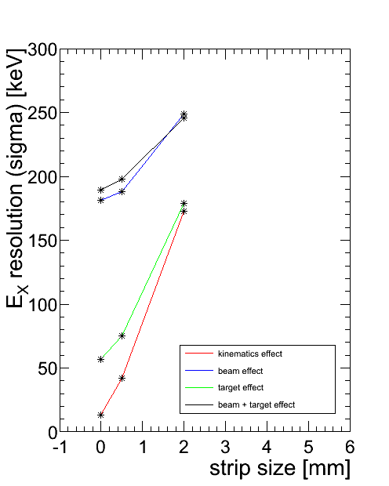
Importance of pitch for 1st layer of Si
d(132Sn,p)133Sng.s. @ 10 MeV/A
p(134Sn,t)132Sng.s. @ 10 MeV/A
Pitch of < 1 mm is OK in all cases

Slide 7
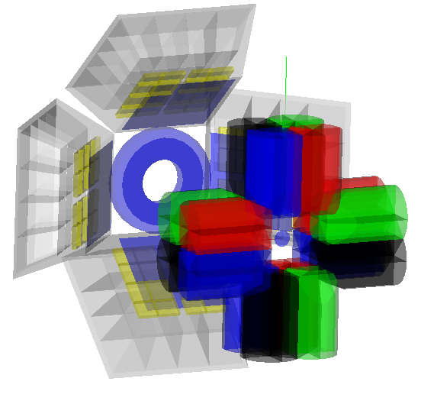
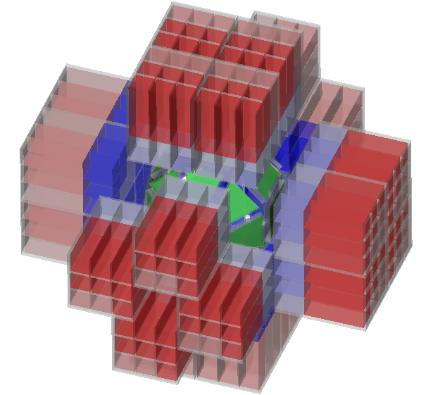
Particles and γ spectroscopy with GASPARD
AT GANIL:
AT GANIL/SPIRAL2:
MUST2
DSSD+
Si:Li+CsI
EXOGAM
HPGe
PARIS LaBr₃+NaI
GASPARD
DSSD+Si+Si
Notes:
Also agata
Know wich beam intensity needed for Q and transfer
Thin Si 20 um

Slide 8
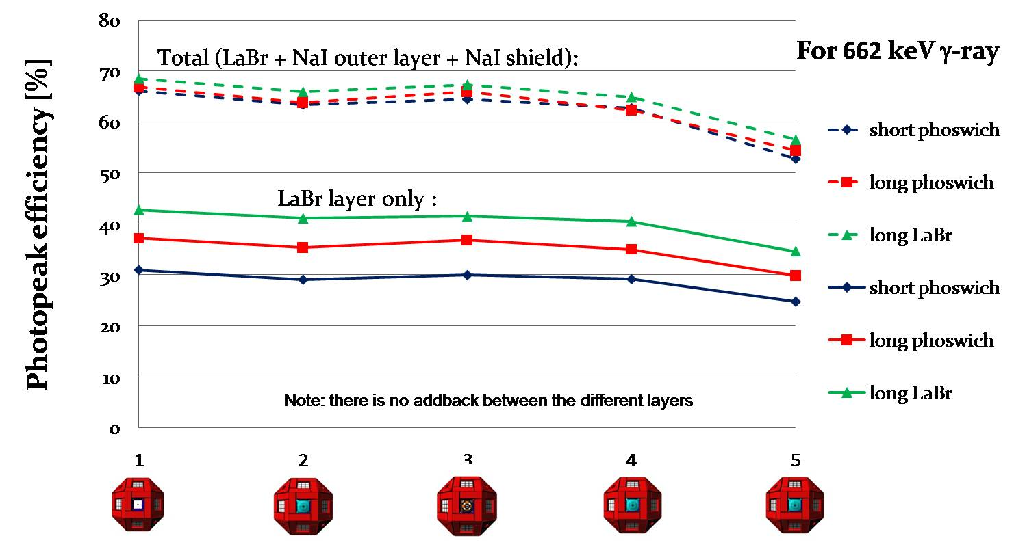
Transparency to gamma : PARIS
PARIS
+2mm Al
+GASPARD
+2mm Al
+GASPARD
+2mm Al+ 4mm Cu
+GASPARD

Slide 9
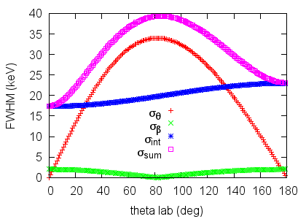
Gamma detection : ExoGam vs PARIS
1 MeV gamma, β=0.14
opening angle ≈ 13° (Paris)
≈ 30° (ExoGam)
Intrinsic resolution: LaBr3= 8.5keV
HPGe=2keV
ExoGam
PARIS
 | EXOGAM | PARIS
energy res (FWHM; %) | 5% | 4%
efficiency (%) | 43% | 50%
CONCLUSIONS:
Significative improvement in efficiency
Detectors at larger distance -> no geometrical constraint on particle detections
Notes:
LaBr crystals can’t be tapered means that we have to design an array which is further away from a perfect spherical shell.Similar eff if 1.3pi agata (20 clovers) forward and 2pi of gaspard
Worse res with exogam explained by larger aperture: about 30 vs 13deg

Slide 10
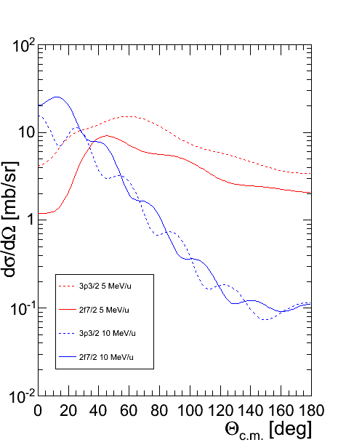
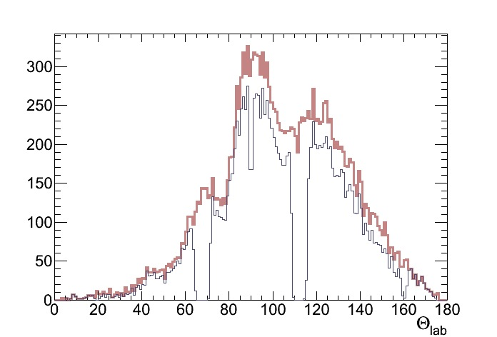
Importance of angular coverage
Simulations for ¹³²Sn(d,p)¹³³Sn
YIELDS
10 MeV/u
CROSS-SECTIONS
FRESCO (ZR-FRC)
angles of interest
3p3/2
2 f7/2
3p3/2
2f7/2
0 40 80 120 160
0 40 80 120 160
(5 MeV/u)
θ_{lab}
θ_{lab}
¹³²Sn (d,p) @ 10 MeV
GASPARD
70%
MUST2
17%
(10 MeV/u)
proton yield
Same E* resolution as MUST2
Gain in efficiency by a factor of 4 with Gaspard
N. de Séréville, IPNO
Notes:
Now concerning the design of future arrays, I show this slide to illustrate the interest of large angular coverage
through full simulation of the standard reaction at 2 incident energies
full simus require realistics diff cross-section

Slide 12
The
array : Gain in efficiency
GAmma SPectroscopy and PArticle Detection
4π silicon array fully integrable in PARIS, AGATA
4π PARIS cubic configuration
Photopeak efficiency
50%
Total
NaI
spherical config.
LaBr
1 2 3 4 5
Energy (MeV)
Efficiency gain ~20 for p-γ coincidences for ¹³²Sn(d,p) @ 10 MeV/u
w/r to previous MUST2 + EXOGAM setup (target moved backward -> EXOGAM= 10%)
Gamma Resolution: ~40 keV at 10 MeV/u with 2mg/cm² CD2 target (comparable to EXOGAM)
Large improvement in particle/gamma efficiency
Notes:
This is why Si-based projects usually aim 4 pi

Slide 13
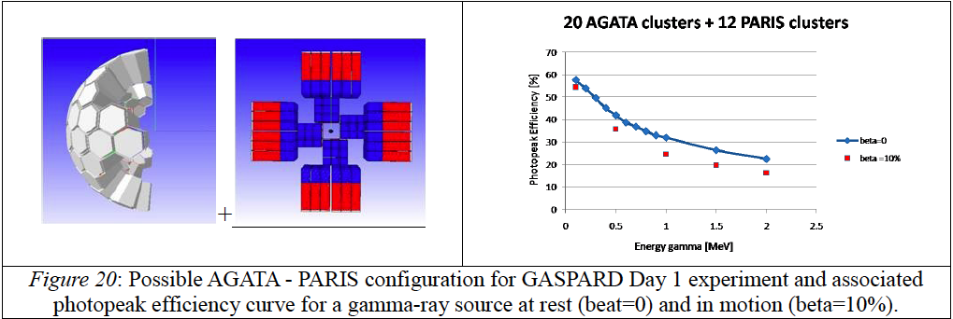
Efficiency of 20 AGATA+ 12 PARIS
Gain of a factor of 2 w/r EXOGAM

