Slide 1
GTS @ SPIRAL2 Andrea Triossi INFN - LNL
Gaspard – Hyde – Trace Workshop
October 31 2012, Padova

Slide 2
GTS: Functionalities
Common clock
Global clock counter
Global event counter
Trigger requests
Error reports
Trigger controls:
Throttling of the L1 validation signal
Fast commands (fast reset, initialization, etc.)
Fast monitoring feedback from the crystals
Calibration and test trigger sequence commands
Monitor of dead time
MGT
Local Tag
Generator
Trigger Request
TX
Local Tag
Uplink
RX
Valid / Reject
Trigger
Match
MEM
Val/Rej Tag

Slide 3
GTS: Current Limits
Serves just one trigger request
Interface for 16
Parameterized with GENERICs
Handles just one ID request
16 ID per GTS core
Parameterized with GENERICs

Slide 4
Requests Interface (1)
1010000000100000
3 requests

Slide 5
Requests Interface (2)
1010000000100000
3 requests

Slide 6
Requests Serializing
MGT
Local Tag
Generator
Trigger Request
Serializer
Buffer
TX
Local Tag
Uplink
RX
Valid / Reject
Trigger
Match
MEM
Val/Rej Tag

Slide 7
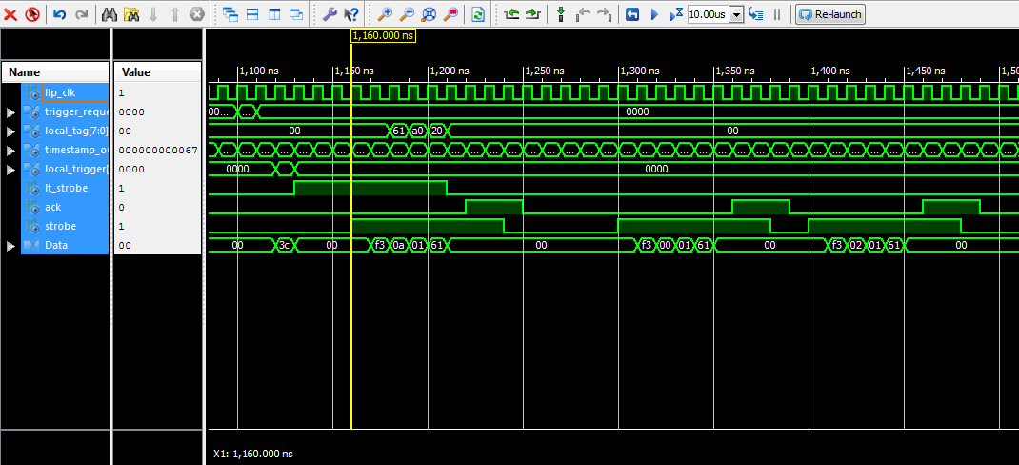
Multiple ID Requests
3 different IDs
1010000000100000
0123456789ABCDEF
START
LENGTH
COMMAND ID
LOCAL TAG (7:0)
LOCAL TAG (15:8)
TRIGGER ID

Slide 8
Constraints
Trigger IDs
Validations
256 trigger IDs
In triggerless mode (root node validates all)
Trigger processor limits the ID numbers to 40
The validation regards only local tag:
Many trigger requests with the same local tag but different ID generate only one validation/rejection
Complainant with the old GTS

Slide 9
Test bench
ROOT
Trigger Request
Packets
Trigger Validation
Packets
Implemented on a GTS mezzanine (V4)
Point to point connection
Root node validates every request
LEAF
Trigger Requests
Local Tag
Val/Rej Tag
ChipScope
Analyzer

Slide 10
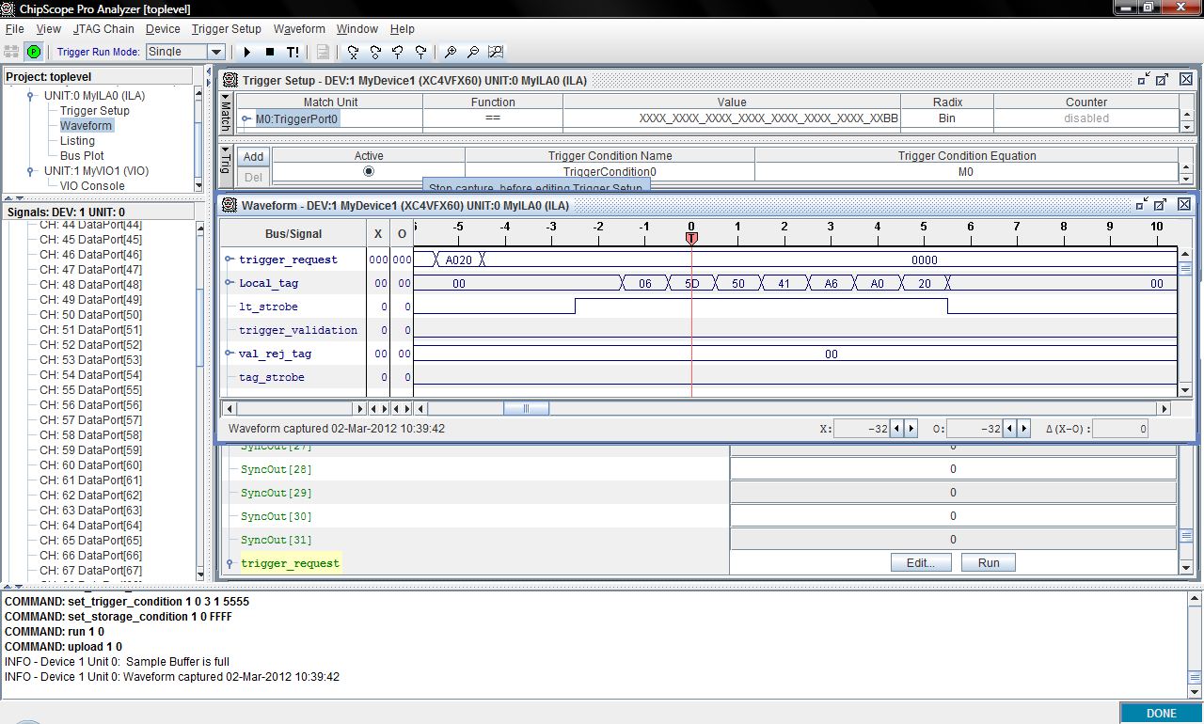
Test bench

Slide 11
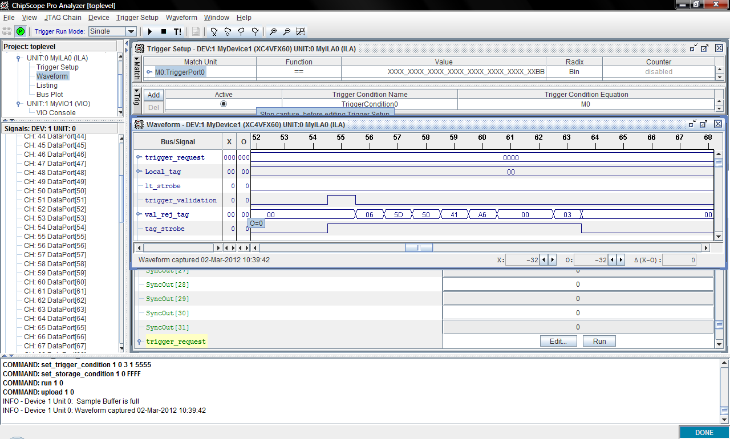
Test bench

Slide 12
Conclusions
Achieved & Expected Activities
New Firmware √ simulation & implementation (ChipS)
Test bench on a small tree O ongoing (trigger processor needed?)
Test on a Numexo carrier

