Slide 1
Meeting goals
Marcello A. Giorgi Università di Pisa & Pisa
4th Collaboration & General Meeting
La Biodola June 1, 2012

Slide 2
After March Meeting
Back again after one year in ELBA.
This meeting is devoted to:
Consolidation of SuperB Collaboration
Physics activity in preparation of the open symposium in Krakow, Poland, from Sept. 10-13, 2012, to update the European Strategy for Particle Physics.
Activity to complete TDR on physics,detector, computing.
Very little on accelerator

Slide 3
This Week
As you know the accelerator and technical departments are fully immersed in the preparation of documents on detailed and fully inclusive evaluation of costs for accelerator site and infrastructure as requested by the Ministry of Education, University and Scientific Research.
The technical activity in this period is reduced , so at this meeting there will be a design update and a presentation on the accelerator strcucture next Monday 4.
Roberto will also present the status of the Cabibbolab.

Slide 4
After March
EXEC BOARD of SuperB set up
Italy:
G. Batignani (Univ. of Pisa and INFN) R. Calabrese (Ferrara Univ. and INFN) L. Lanceri (Trieste Univ. and INFN) P. Lubrano (INFN - Perugia) N. Mazziotta (Univ. of Bari and INFN) C. Sciacca (Univ. of Naples and INFN)
Canada: M. Roney (Univ. of Victoria)
France: A. Stocchi (LAL)
Poland: T. Lesiak (INP- Krakow)
Russia: V. Druzhinin (Budker Institute - BINP)
UK: A. Bevan (Queen Mary Univ.)
USA: H. Jawahery (Univ. of Maryland)
The Chair of the Board was elected: Pasquale Lubrano
:
3/20/2012

Slide 5
Completion of Exec Board
Ex officio members of the Exec Board until the Spokesperson and the Technical Coordinator will be appointed are the two Detector Coordinators (Blair and Francesco).
One ex-officio member of the Executive Board designated by the Lab to guarantee bi-directional interaction between Community and laboratory Management.
Cabibbolab has designated M.G. as the Lab representative .
Another step moving from the previous structure made of a Steering Committee a TDR Project Office, a Project Board toward a “normal status of an experiment collaboration.
3/20/2012

Slide 6
After March
Last march the organization of the infrastructure area made of two departments:
Accelerator Department and Technical Department was shown by the DG Roberto Petronzio.
Now we have a similar organization for the Research Area:
Experimental Physics Department
Information Technology and Modeling Department
I have proposed as leaders Francesco Forti and Mauro Morandin.
They have accepted.
We expect soon the official appointment by the Assembly of the CabibboLab Consortium.
:
3/20/2012

Slide 7
After March
I have presented yesterday in a short meeting of the Exec Board the above scheme and I collected positive reactions.
:
3/20/2012

Slide 8
Collaboration Committees active
Membership Committee: Chris Hearty Chair
Speaker’s Bureau : After Popat Patel , Guy Wormser is the Chair and strongly active.
The presence of SuperB’ers in all the major conferences and workshops is ensured.
:
3/20/2012

Slide 9
After March Joint Integration Group
I proposed at the 3rd Collaboration Meeting of Frascati the formation of a joint Group between the experiment collaboration and the CabibboLab to address and solve common technical problems .
We had a meeting ( FORUM), now we go to the organization phase.
I consulted with Walter Scandale , Alessandro Variola and Claudio Sanelli.
Then with the Superb Executive Board.

Slide 10
The Joint Integration Group Goals
Facilitate and solve problems related to common fields:
Integration
Utilities
Experimental Areas and services.
Other spaces (Clean rooms, laboratories..)
Computing resources and needs.
Joint general meetings.

Slide 11
The Joint Integration Group
Technical issues will be examined and hopefully solved by ad-hoc technical subgroups.
Meetings are expected to become more frequent when approaching to the executive phase.
Frequency can only be determined by the agenda.

Slide 12
The Joint Integration Group
Research Director & Infrastructure Director (or proxies).
Experimental Physics & Information Technology leaders
Accelerator &Technical Leaders:
SuperB Spokesperson
SuperB Technical Coordinator

Slide 13
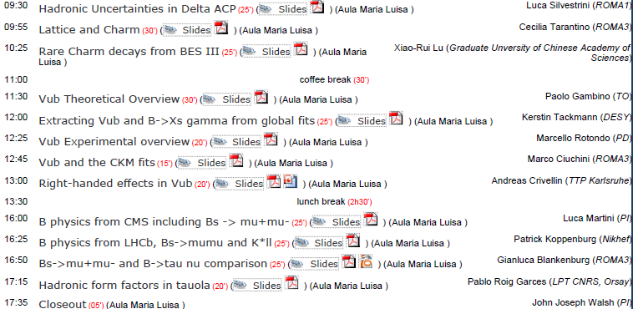
Comments on this Meeting Agenda
Yesterday May 31was devoted to the Physics Workshop:
3/20/2012

Slide 14
Comments on this Meeting Agenda
On Physics:
Attention focused on preparation of material for the the new European Strategy on Particle Physics. The section on Spectroscopy is ready, other in preparation.
The CERN Council is preparing, as announced Dec. 15,2011 the Open Symposium of Krakow, Poland, Sept. 10-13, 2012, to update the European Strategy for Particle Physics. The previous set of a strategy like this was in July 2006.
3/20/2012

Slide 15
Comments on this Meeting Agenda
On Physics:
Physics Groups and coordinators are working to thehe preparation of the TDR & “The SuperB Physics Book”.
I have set red arrows pointing to presentation from BES III, LHCb and CMS. We intend to continue our tradition of inviting speakers from different communities but on the same boat and rowing toward the New Physics harbor.
I expect a very interesting presentation from our competitor community of BELLEII today.

Slide 16
European Strategy
The CERN Council announced (Dec. 15) that it would hold an Open Symposium in Krakow, Poland, from Sept. 10-13, 2012, to update the European Strategy for Particle Physics. The previous set of a strategy like this was in July 2006.
Later SuperB was included in the European Strategy as a regional project. “ in the spirit of Lisbon”.

Slide 17
Comments on this Meeting Agenda
.
Detector activity :
Move on to the definition of the baseline of all the systems.
The writing of TDR is going on without major showstopper.
Yesterday there was an interesting Technical Board.
The activity on TDR that was started within the previous organization and supported by the INFN SuperB TDR Special Project . Now in the present phase the coordination is fully in the hands of technical coordinators. The research structure of Cabibbolab can help and will revuew the document.
Costing and schedule can only be ready by the fall.
MOU with SLAC about the reuse of Babar components is needed.
3/20/2012

