Slide 1
Quantum-classical transition in optical twin beams and experimental applications to quantum metrology
Ivano Ruo-Berchera
i.ruoberchera@inrim.it

Slide 2
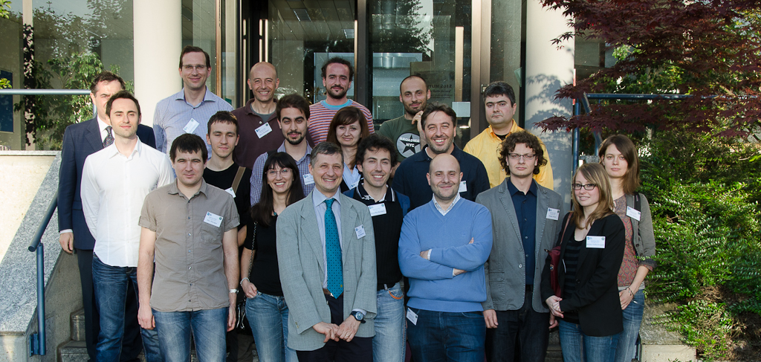
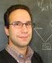
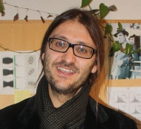
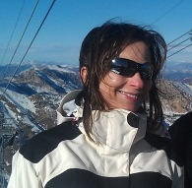
Giorgio Brida
Ivo. P. Degiovanni
Marco Genovese
Alice Meda
Lisa Lopaeva
Valentina Schettini
Stefano Olivares, Matteo Paris
(Univ. Milano)
Alessandra Gatti, Lucia Caspani,
Maria Bondani
(Univ. Insubria, Como)

Slide 3
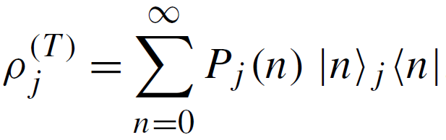

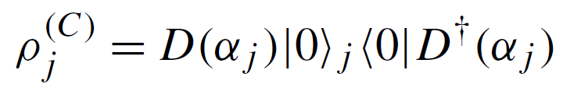
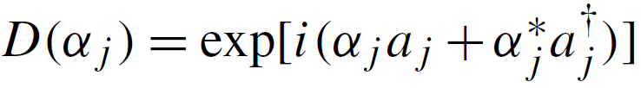
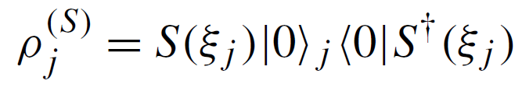
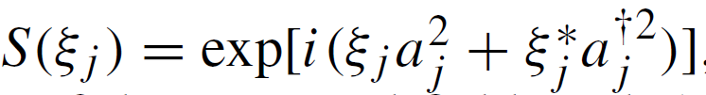

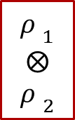

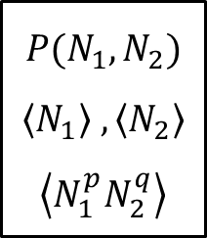




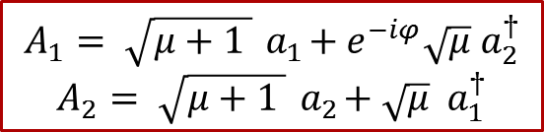
Single mode Seeded PDC
two mode squeezing
$$A_{1}= \sqrt{μ+1 }{ a}_{1}+e^{−iφ}\sqrt{μ} a_{2}^{†}$$
$$A_{2}= \sqrt{μ+1 }{ a}_{2}+\sqrt{μ} a_{1}^{†}$$
$$a_{1}$$
$$A_{1}$$
$$N_{1}=A_{1}^{†}A_{1}$$
$${P(N}_{1},N_{2})$$
$$\left\langle N_{1}\right\rangle ,\left\langle N_{2}\right\rangle$$
$$\left\langle N_{1}^{p}N_{2}^{q}\right\rangle$$
$${ρ }_{1}$$
$$⨂$$
$${ρ }_{2}$$
TW
$$a_{2}$$
$$A_{2}$$
$$N_{2}=A_{2}^{†}A_{2}$$
Thermal seeds:
Coherent seeds:
Squeezed seeds:

Slide 4

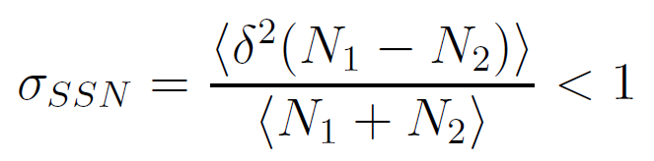


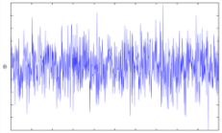


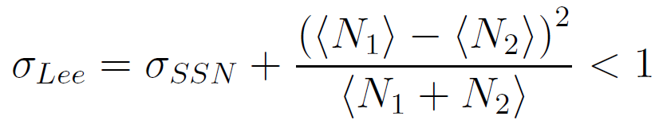

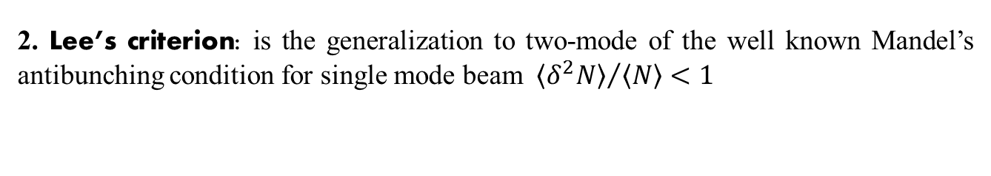
Photon counting based criteria
1. Sub-Shot-Noise Criterion: for classically correlated states the photodetecion noise is lower bounded by the shot noise
$$−$$
SHOT NOISE
2. Lee’s criterion: is the generalization to two-mode of the well known Mandel’s antibunching condition for single mode beam ${ \left\langle δ^{2}N\right\rangle }/{\left\langle N\right\rangle }<1$
Glauber-Sudarshan
Lee’s criterion is stronger than SSN condition!

Slide 5
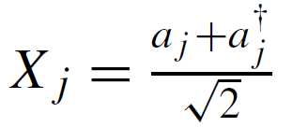
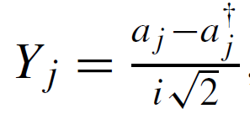

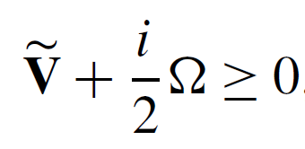

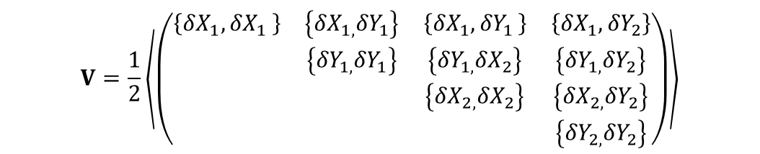

Entanglement criterion
3. Entanglement criterion: Positive-Partial-Transpose criteria for Gaussian states:
Quadratures:
$$V=\frac{1}{2}\left\langle \left(\begin{matrix}\left\{{δX}_{1}{,δX}_{1}\right\} & \left\{{δX}_{1,}{δY}_{1}\right\} & \left\{{δX}_{1}{,δY}_{1}\right\} & \left\{{{δX}_{1},δY}_{2}\right\} \\ & \left\{{δY}_{1,}{δY}_{1}\right\} & \left\{{δY}_{1,}{δX}_{2}\right\} & \left\{{δY}_{1,}{δY}_{2}\right\} \\ & & \left\{{δX}_{2,}{δX}_{2}\right\} & \left\{{δX}_{2,}{δY}_{2}\right\} \\ & & & \left\{{δY}_{2,}{δY}_{2}\right\}\end{matrix}\right)\right\rangle$$
Covariance matrix:
${Partial Transpose : \tilde{V}=V(Y}_{2}→−$ $Y_{2})$
Smallest simplettic eigenvalue $\tilde{d}<1/2$
In general:$\tilde{d}=\tilde{d} \left(\left\langle N_{1}^{p}N_{2}^{q}\right\rangle \right)$

Slide 6
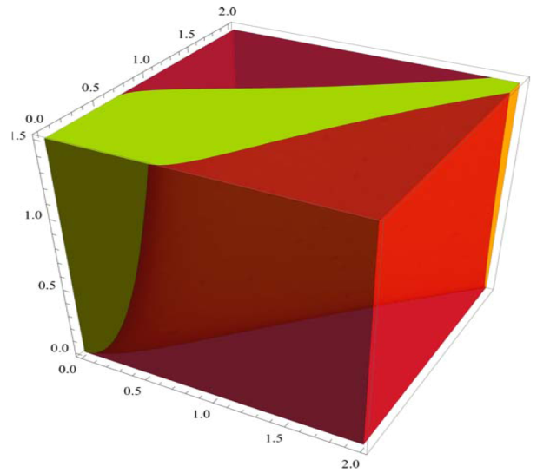
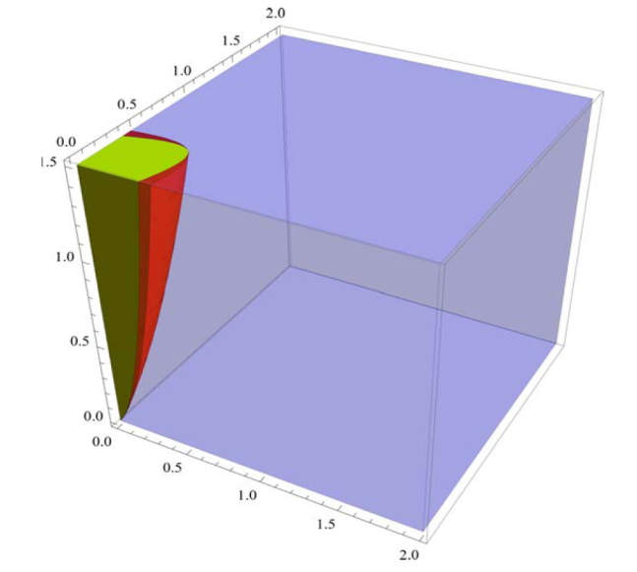
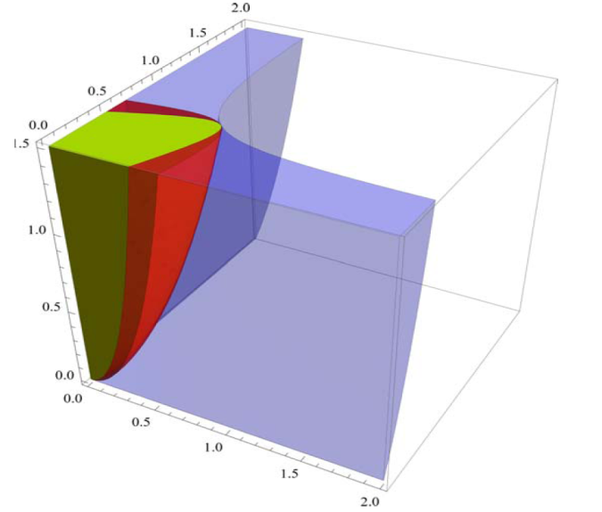







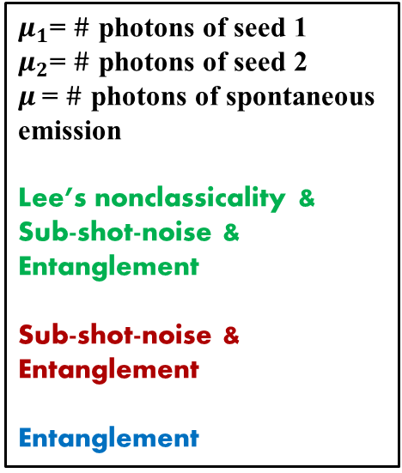





Non-classicality in the space of intensities
$$\log{μ_{1}}$$
$$\log{μ_{1}}$$
$$\log{μ_{2}}$$
$μ_{1}$= $\#$ photons of seed 1
$μ_{2}$= $\#$ photons of seed 2
$μ$= $\#$ photons of spontaneous emission
Lee’s nonclassicality &
Sub-shot-noise &
Entanglement
Sub-shot-noise &
Entanglement
Entanglement
$$μ$$
$$μ$$
Coherent seeds
$$\log{μ_{2}}$$
cos(γ1 +γ2 B− φ) = 1
cos(γ1 +γ2 B−φ) = -1
Foundations of Physics, 2011, 41, 305-316 (2011)
$$\log{μ_{1}}$$
$$\log{μ_{1}}$$
Squeezed seeds
Thermal seeds
$$μ$$
$$μ$$
Only for thermal seeded PDC there is a threshold
separabiliy-entanglement
$$\log{μ_{2}}$$
$$\log{μ_{2}}$$

Slide 7
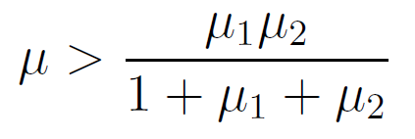
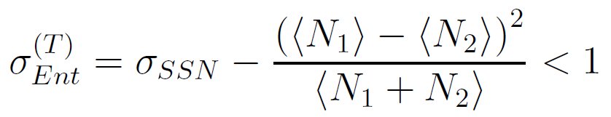



Entanglement criterion
Coherent seeds: always entangled!
Squeezed seeds: always entangled!
Thermal seeds:
$$μ_{1}$$
:
$$μ_{2}$$
TW
For thermal state the separabiliy-entanglement threshold can be monitored by photon counting!
Entanglement is the weakest criterion of non-classicality

Slide 8
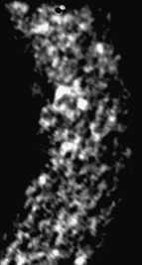
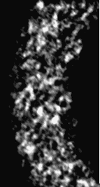
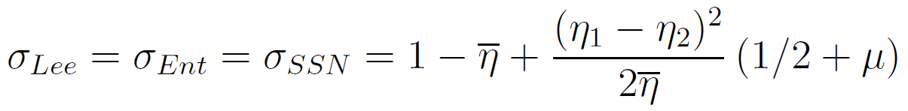
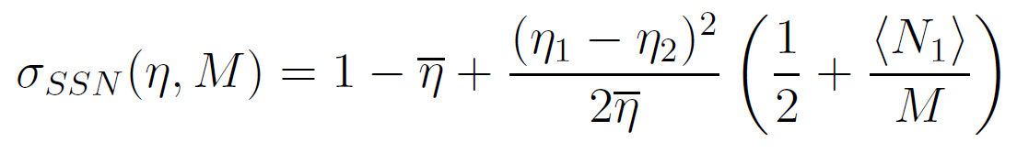

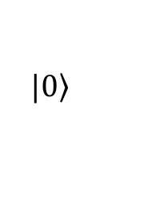


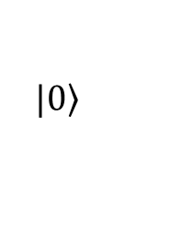




Spontaneous PDC (multimode and losses)
Overall transmission-collection-detection efficiency
Multi-mode intensity correlation in the Far field (10nm bandwidth)
$$η_{1}$$
$$\left.|0\right\rangle$$
$$N_{1}=μ$$
TW
$$\left.|0\right\rangle$$
$$N_{2}=μ$$
$$η_{2}$$
$$=0 for SPDC$$
$η_{1}$= $η_{2}=η$

Slide 9
Applications
1) Sub-shot noise Quantum Imaging
2) Quantum Illumination

Slide 10
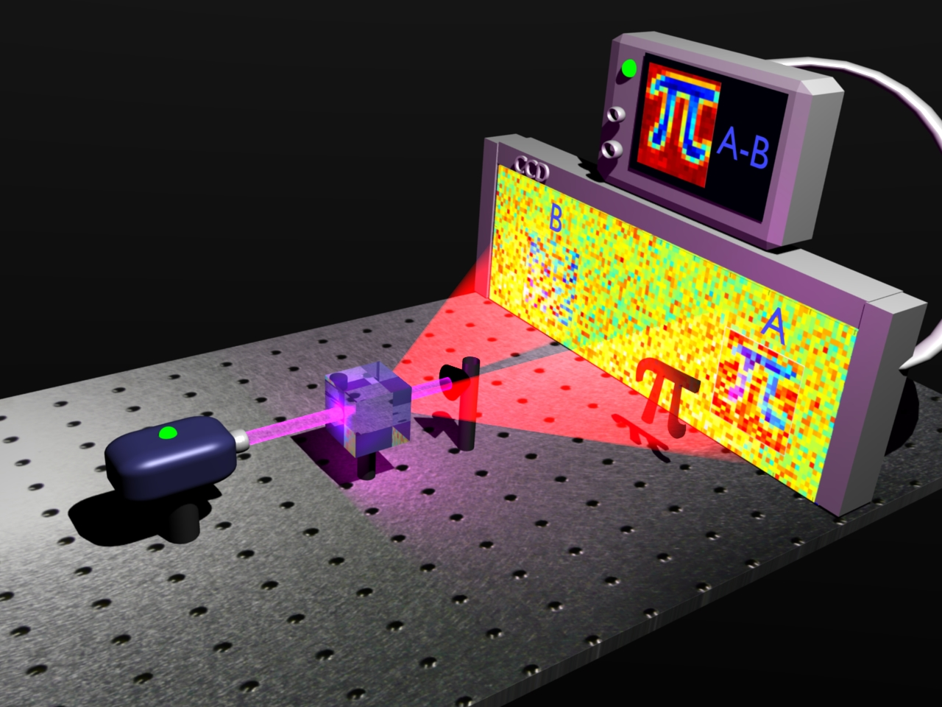
Sub Shot Noise Quantum Imaging: the idea
The image of the object in one branch, eventually hidden in the noise, can be restored by subtracting pixel-by-pixel the spatial noise pattern measured in the other branch. Useful application whenever one needs a weak illumination of the object (e.g. in biological samples).
Titanium deposition, thickness =8 nm Absorption coefficient α=5%
CCD array pixels size 240 μm
I.RB
Notes:
The image of an object in one branch, eventually hidden in the noise, can be restored by subtracting the spatial noise pattern measured in the other branch. Useful application wherever one needs a weak illumination of the object (e.g. in biological samples).

Slide 11

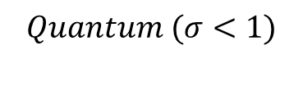

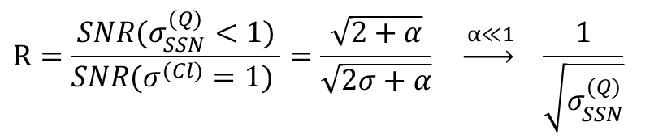
Sub Shot Noise Quantum Imaging
$$Quantum (σ<1)$$
$$Classical (σ=1)$$
PDC
-
-
$$R=\frac{SNR(σ_{SSN}^{(Q)}<1)}{SNR(σ^{(Cl)}=1) }=\frac{\sqrt{2+α}}{\sqrt{2σ+α}} \underset{→}{ α≪1} \frac{1}{\sqrt{σ_{SSN}^{(Q)}}}$$
Quantum enhancement
Brambilla et al., Phys. Rev. A. 77, 053807 (2008)

Slide 12
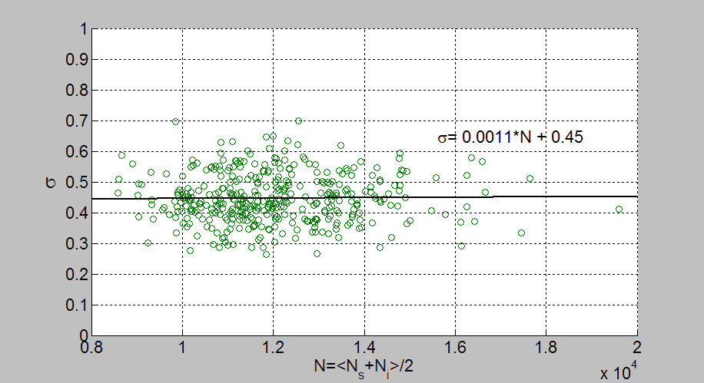
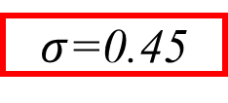
Sub Shot Noise Quantum Imaging
Each point refers to a single image, where $σ$is evaluated over 60 pixel pairs
μ
SNL
SQL
$σ$=0.45
No background noise subtraction (electronic noise of CCD, room light etc.)!
Nature Photonics 4, 227 - 230 (2010)
Phys. Rev. Lett. 102, 213602 (2009); Phys. Rev. A 83, 063807 (2011).

Slide 13
Sub Shot Noise Quantum Imaging

Slide 14

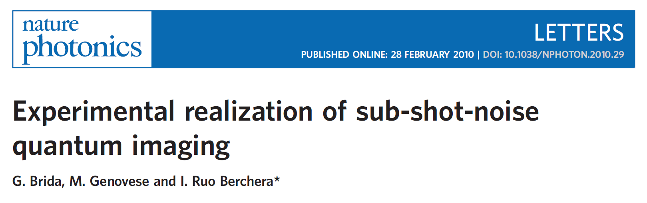
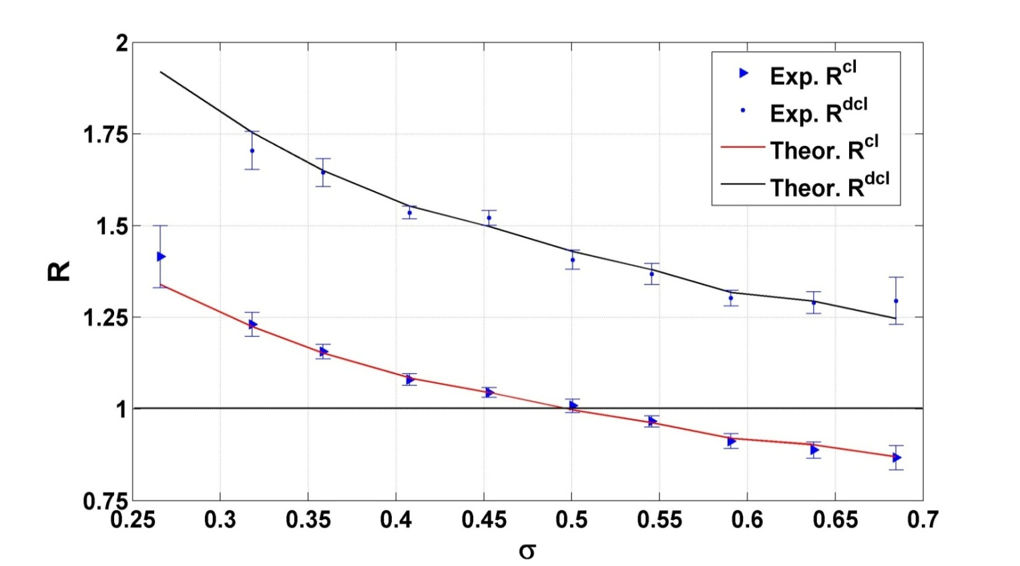




Sub Shot Noise Quantum Imaging
$$(2010)$$
$$\frac{1}{\sqrt{σ_{SSN}^{(Q)}}}$$
R(Cl)
Parameters:
R(Cl-)
R(Cl)
R(Cl-)
$$SNRPDC/SNRclass$$
$$\frac{1}{\sqrt{2σ_{SSN}^{(Q)}}}$$

Slide 15





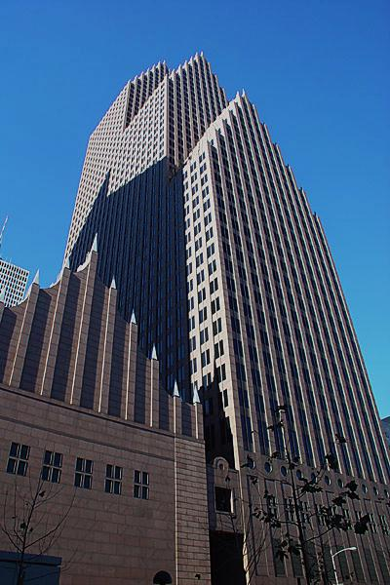


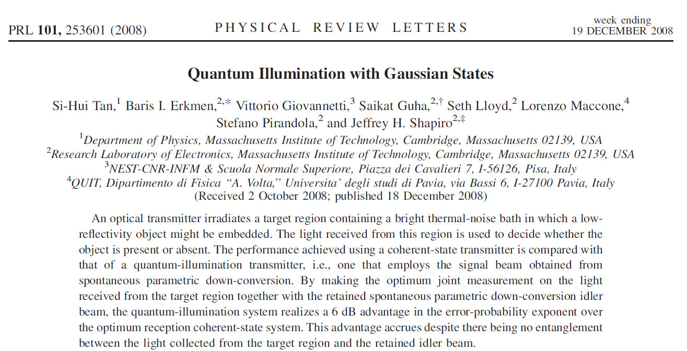
Quantum Illumination Scenario
noise
noise
target
Ancilla
Probe
QI: ancilla assisted scheme for target detection in a noisy environment
Frascati 21-06-2012 | Open Problems in quantum Mechanics | Ivano Ruo-Berchera
Notes:
An optical transmitter irradiates a target region containing a bright thermal-noise bath in which a low reflectivity
object might be embedded. The light received from this region is used to decide whether the
object is present or absent.

Slide 16
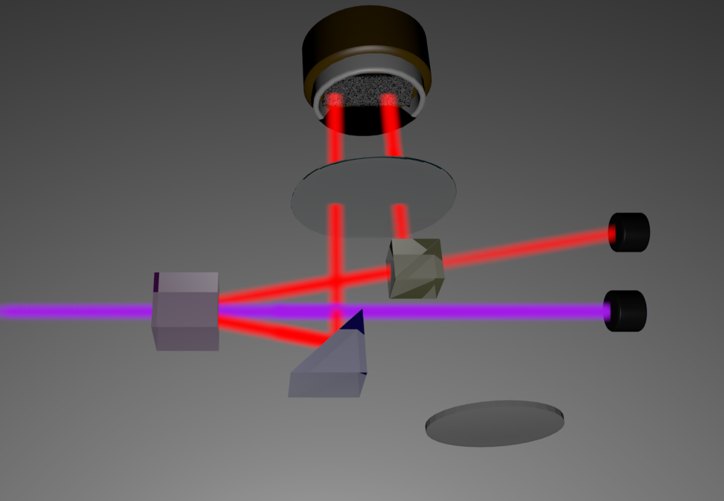
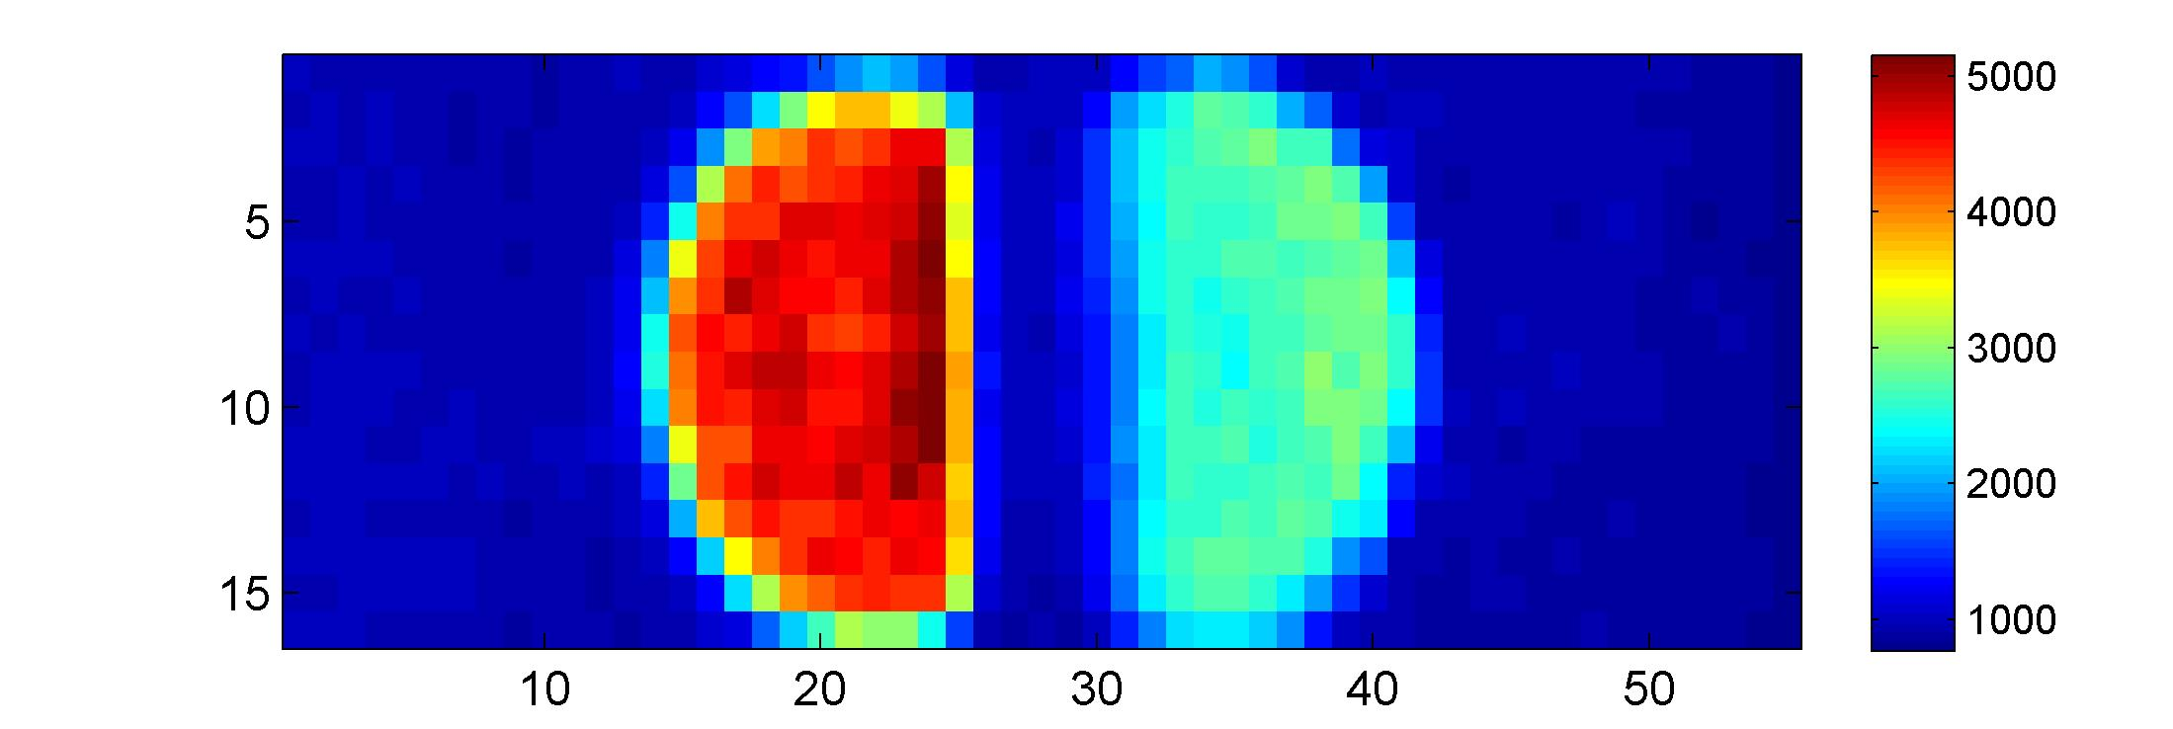
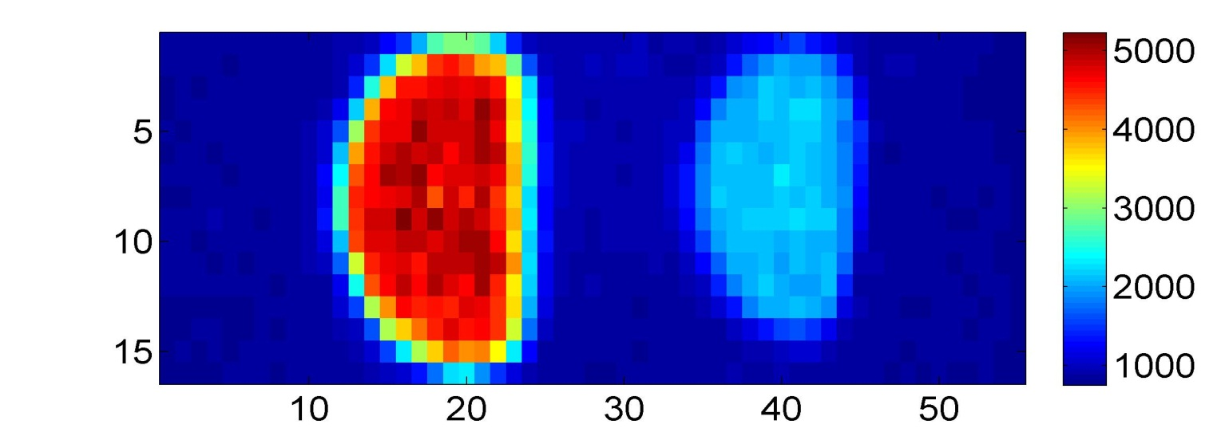
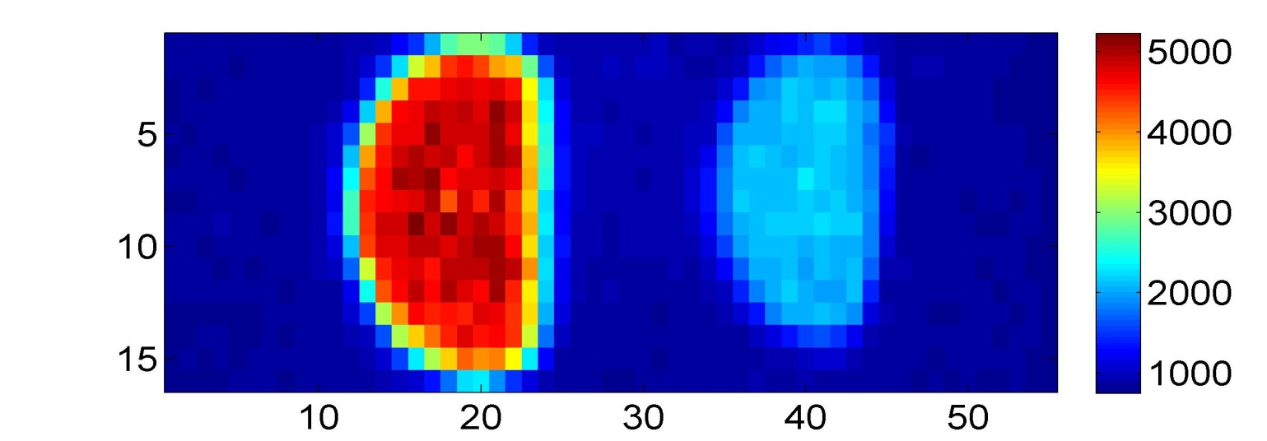


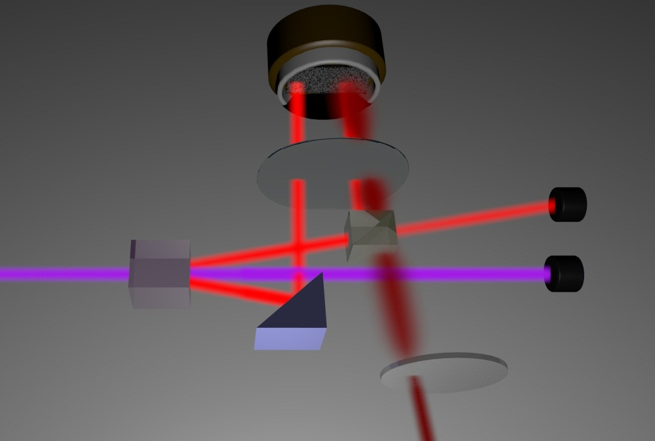
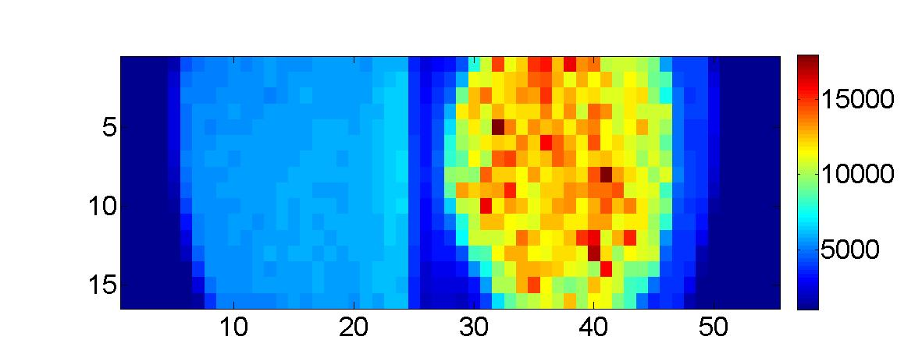
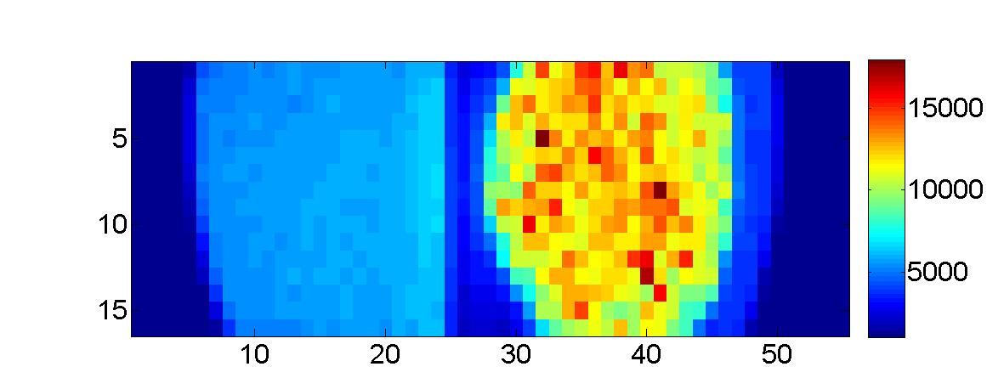
Experimental set up:Quantum
CCD
Interf. Filter λ=710±5 nm; thermal bath off
Object
(50%BS)
Lens f=10cm
BBO
Phot. Number
mirror
Arecchi disk
d)
Pump:
λ=355 nm
T=5 ns, F=10 Hz
CCD
No narrow filtering; thermal bath on -->
measurement condition
Object
(50%BS)
BBO
Phot. Number
mirror
Arecchi disk

Slide 17






Measurement strategy
In our approach, the ability to distinguish the presence/absence of the object depends on the possibility of distinguishing between the two corresponding values of the covariance
Phot. Number
The figure of merit is the SNR, defined as the ratio of the mean “contrast” to its standard deviation (mean fluctuation),
Notes:
Differenze col ghost imaging:
il fondo can have different properties, e.g.much more stronger and fluctuating (\mu>>1)
The aim is different, no spatial reconstruction,determination if the obgect is present.

Slide 18










Experimental results: signal-noise ratio
More than one order of magnitude of quantum enhancement!!
…Even if the correlation are above the standard quantum limit!
$$f_{SNR }$$
$$×14$$
$$N_{b }$$
$$σ_{SSN}$$
$M=9∗{10}^{4}$ number of modes per pixel
$μ=0.075$ number of photons per mode
SQL
$η_{a}=η=0.4$ ancilla detection probability
$$η_{2}=η r=0.4∙0.5=0.2$$
$$N_{b }$$

Slide 19





Elements of the theory
= ?
$$=\frac{1}{\sqrt{σ_{C−S}}}$$
Regardless the losses and noise level!
(noise, losses)
Violation of Cauchy-Schwarz inequality

Slide 20
Conclusions
Seeded Parametric down conversion is a suitable system for the experimental study of the quantum-classical transition:
            precise hierarchy between “quantumness” criteria! ☺
            just photon number measurement required (thermal seed) ☺
Applications of twin beams to quantum metrology (we review two of them) are behind the corner
            Sub-shot-noise quantum imaging, quantum illumination
            extremely robust against noise and loss!☺
            experimental feasibility!☺ ☺
Quantifying the quantum resources for the specific application is important for estimating a priori the advantage of using quantum light.

Slide 21
Thank you

Slide 22




Effects of Multimode and Losses
Multi-mode intensity correlation in the Far field Spontaneous PDC (10nm bandwidth)
$$η$$
TW
$$η$$
Experimentally, it is difficult to select a single spatio-temporal mode. Usually many modes ($M>1$) are collected!
Losses are also impossible to avoid and in general reduce the quantum correlations!

Slide 23
Motivation/Outlook
Motivations:
  fundamental understanding of the transition from classical to quantum world
  quantify the quantum resources available for specific applications in quantum metrology (quantum imaging and sensing)
We study the quantum-classical transition in twin beam generated by seeded parametric down conversion by three parameters based on Sub-Shot-Noise, Lee’s and Entanglement criteria
  the threshold can be at varying the mean photon numbers of the interacting fields
  …and can be observed experimentally by means of intensity measurements (thermal seeding).
Application experiments:
  quantum imaging and of weak absorbing objects
  quantum target detection in a strong background noise (quantum illumination)

Slide 24

MULTIMODE SPATIAL CORRELATIONS-SPDC
Transverse phase matching
Symmetrical point-to-point correlation in the far field
Pixels Array
signal(s)
q=0
Centr.Symm.
Multi-Mode Entangled State
pixel-pixel correlation
idler (i)

Slide 25

MULTIMODE SPATIAL CORRELATIONS-SPDC
Spatial correlations are naturally multimode in SPDC:
R_{s}
R_{i}
With spectral selection (10nm bandwidth)
No spectral selection
good for imaging, many spatial modes correspond to many resolution cells of the image can be restored from the noise at the same time.
parallelism means in principle faster measurement!
achieving a suppression of the noise only limited by the detection losses,
[Brambilla, Gatti, Bache, Lugiato, Phys Rev A 69, 023802 (2004)]
Notes:
ONE HAS A VERY LARGE NUMBER OF REPLICAS OF THE SAME SYSTEM (PAIR OF ENTANGLED SPATIAL MODES) IN A SINGLE PUMP PULSE. THIS PROVIDES A PARALLEL (“FAX”) CONFIGURATION FOR QUANTUM INFORMATION PROCESSING, ALTERNATIVE TO THE SEQUENTIAL (‘TELEPHONE”) CONFIGURATION OF THE REGIME IN WHICH ONE DETECTS
SINGLE ENTANGLED PHOTON PAIRS.

Slide 26


MULTIMODE SPATIAL CORRELATIONS-SPDC-Experimental set up
Type II BBO non-linear crystal ( L=7 mm )
plates selecting orthogonal polarization (T=97%)
CCD array (1340X400) pixels size 20 μm QE=80%
Spatial filter (f=50cm, φ=250μm)
w=1.25 mm
Half wave plate
UV mirror (T=98%)
Red filter (low pass)
(T=95%)
Lens (f = 10 cm)
Third harmonic selection
T_{pulse}=5 ns Rate=10Hz
E_{pulse} 200 mJ @ 355 nm
Q-switched Nd:Yag 355 nm

Slide 27

MULTIMODE SPATIAL CORRELATIONS-detection
A₁
A₂
CS
BEAM 1 (λ=710nm)
BEAM 2 (λ= 710nm)
If..
a) losses are minimized (overall η=0.62),
b) pixel size is larger than the size of transverse spatial mode[1,2],
c) the grid of pixel is centered with high accuracy with respect to the CS of the conjugated transverse modes (to reduce the fraction of uncorr. modes detected)[2,3]
Uncorr. Modes
# photons per mode
Corr. Modes
d) gradients and inhomogeneities of intensity are corrected [2]
[1] E. Brambilla et al., Phys. Rev. A. 77, 053807 (2008) ;[2]G.Brida et al., Phys. Rev. A 83, 063807 (2011) ; [3] Agafonov, Chekhova, Leuchs, arXiv:0910.4831
Notes:
E. Brambilla et al., Phys. Rev. A. 77, 053807 (2008

Slide 28




MULTIMODE SPATIAL CORRELATIONS – sub shot noise regime
The goal is to measure good squeezing in the difference N₁(x)-N₂(-x) for all the pairs of symmetric pixels in a certain large area of the CCD at the same time!
Noise Reduction Factor
Theoretical result for twin beams
Shot Noise level
For classical light….
SHOT NOISE
-

Slide 29
MULTIMODE SPATIAL CORRELATIONS-detection
A₁
A₂
CS
BEAM 1 (λ=710nm)
BEAM 2 (λ= 710nm)
If..
a) losses are minimized (overall η=0.62),
b) pixel size is larger than the size of transverse spatial mode[1,2],
c) the grid of pixel is centered with high accuracy with respect to the CS of the conjugated transverse modes (to reduce the fraction of uncorr. modes detected)[2,3]
Uncorr. Modes
# photons per mode
Corr. Modes
d) gradients and inhomogeneities of intensity are corrected [2]
[1] E. Brambilla et al., Phys. Rev. A. 77, 053807 (2008) ;[2]G.Brida et al., Phys. Rev. A 83, 063807 (2011) ; [3] Agafonov, Chekhova, Leuchs, arXiv:0910.4831
Notes:
E. Brambilla et al., Phys. Rev. A. 77, 053807 (2008

Slide 30

MULTIMODE SPATIAL CORRELATIONS – sub shot noise regime
Binning 8x8 (superpixel size = 160 μm)
μ
m)
NRF(ξ)
NRF(ξ_{x})
SQL
[Phys. Rev. Lett. 102, 213602 (2009)]
The NRF can be smaller than one (quantum) for several tens of independent pixels-pairs (50-200) at the same time
Really multimode squeezing
Other works on the subject: O. Jedrkievicz et al., Phys. Rev. Lett. 93, 243601 (2004); J.-L. Blanchet et al., Phys. Rev. Lett. 101, 233604 (2008).

Slide 31




QI Proposal
Source: signal and ancilla beams contain one photon $n=1$in a d-mode entangled state.
Noise: thermal noise bath with small number of photons $n_{b}≪1$
Strategy: optimal state discrimination theory
Object: reflection$r≪1$
Exponential enhancement! ☺
Extremely robust against noise and losses!☺
Entanglement do not survive!☺
No idea how to do it in practice!☹

Slide 32





QI with Gaussian states
Source: Gaussian twin beams (PDC)
Noise: thermal noise bath with large number of photons $n_{b}≫1$ mixed at the objet with the probe
Strategy: optimal state discrimination strategies (chernoff bound etc..)
Object: reflection$r≪1$.
Exponentil enhancement! ☺...
….Even if entanglement do not survive!
Extremely robust against noise and losses!☺
The source is experimentally trivial !☺ ☺
TW
$$r$$
But challenging receiver in practice!☹
$$n_{b}$$
S. Guha, B. I. Erkmen, Phys. Rev. A 80, 052310 (2009).
Notes:
The performance achieved using quantum-illumination transmitter , i.e., one that employs the signal beam obtained from
a coherent-state transmitter spontaneous parametric down-conversion, is compared with
that of a and classically correlated and coherence state trnsmitter.

Slide 33


Photon counting based QI:
Brida, Degiovanni,Genovese, Lopaeva, Olivares, Ruo Berchera, Submitted
Source: multimode parametric down conversion, number of photon per mode $μ≪1$
Noise: the most general multi-thermal bath
Receiver: is a CCD camera used as a photon number counter.
Strategy: measuring the correlation between the photon numbers distribution $N_{1} ,N_{2}$ of the two beams.
Hypothesis: no a priori information on the thermal bath-> the first order momenta of the distribution (mean values $\left\langle N_{1}\right\rangle$, $\left\langle N_{2}\right\rangle$) are not informative
Object: neither information on the reflectivity of the object nor on the position.
Exponential enhancement! ☺
Extremely robust against noise and losses!☺
Quantum correlations “hidden” (above the standard quantum limit)!☺
Go To Experiment!

Slide 34




Experimental set up:Classical
CCD
Interf. Filter λ=710±5 nm; thermal bath off
Object
(50%BS)
Lens f=10cm
Phot. Number
BBO
mirror
Pump:
λ=355 nm
T=5 ns, F=10 Hz
CCD
No narrow filtering; thermal bath on -->
measurement condition
Object
(50%BS)
BBO
Phot. Number
mirror
Arecchi disk

Slide 35







Sub-shot-noise correlations
Noise Reduction factor (NRF) quantifies the quantum correlations:
  For Twin Beams: $σ=1−\left(\overline{η}+…\right)<1$(Sub-Shot-Noise)
  For classical light: $σ≥1$
$$−$$
SHOT NOISE
In our setup $N_{2}$ contains the Photons of the probe beam $N_{p}$ but also the photon of the bath $N_{b}$
$$N_{2}=N_{p}+N_{b}$$

Slide 36






Elements of the theory
Tw. Beam
Th. Beams
Quantum correlation are larger than the classical ones when the number of photon per mode is $μ≪1$
Tw. Beam and Th. beams
When the noise of the environment $V\left(N_{b}\right)$ is dominant, the fluctuation of the covariance are the same for quantum and classical beams.

Slide 37






Experimental results: covariance
$∆_{1,2}^{}$ Quantum $Mb=1300$
$∆_{1,2}^{}$ Classical $Mb=1300$
$$∆_{1,2}^{(in)}$$
$$∆_{1,2}^{(in)}$$
$$∆_{1,2}^{(out)}$$
$$∆_{1,2}^{(out)}$$

Slide 38










Experimental results: covariance
$∆_{1,2}^{}$ Quantum $Mb=1300$
$∆_{1,2}^{}$ Quantum $Mb=57$
$∆_{1,2}^{}($in)
$∆_{1,2}^{}($in)
$$∆_{1,2}^{(in)}$$
$$∆_{1,2}^{(in)}$$
$∆_{1,2}^{}($out)
$$∆_{1,2}^{(out)}$$
$$∆_{1,2}^{(out)}$$
$∆_{1,2}^{}($out)

Slide 39

Experimental results: error probability
(N=10)
(N=100)

