Slide 1
Impatto delle architetture ibride sui modelli di programmazione e sulla gestione dell'infrastruttura.
(Towards exascale )
Carlo Cavazzoni, HPC department, CINECA

Slide 2
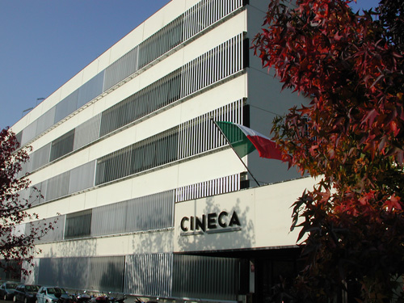
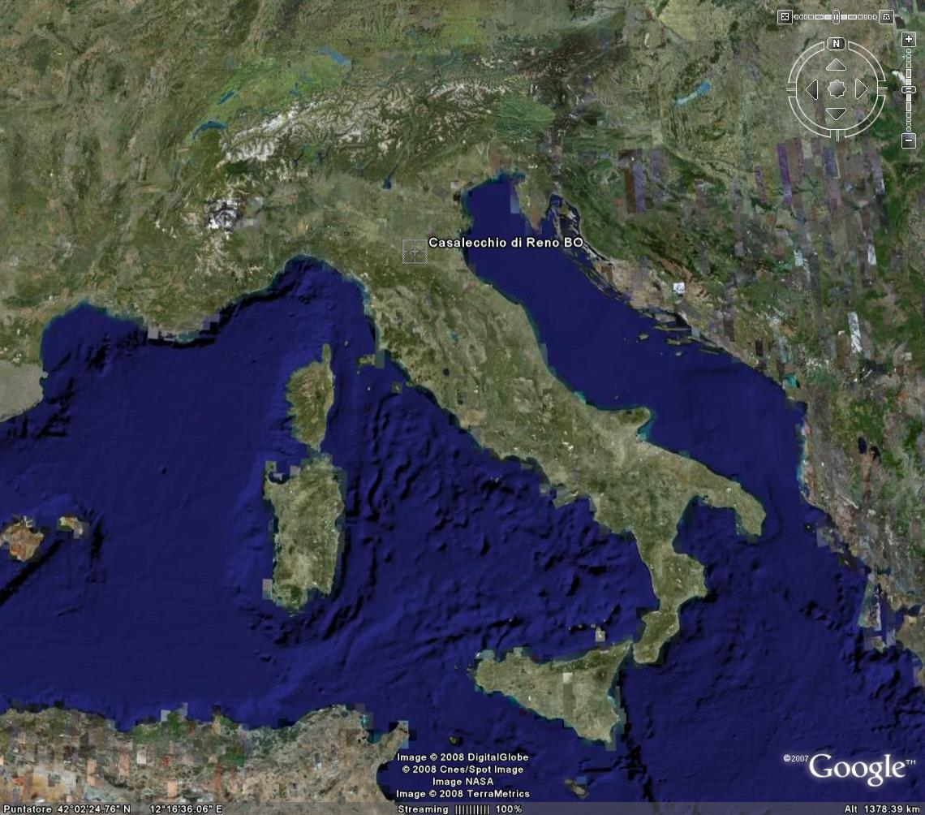
CINECA
CINECA non profit Consortium, made up of 50 Italian universities*, The National Institute of Oceanography and Experimental Geophysics - OGS, the CNR (National Research Council), and the Ministry of Education, University and Research (MIUR).
CINECA is the largest Italian computing centre, one of the most important worldwide.
The HPC department manage the HPC infrastructure, provide support to Italian and European researchers, promote technology transfer initiatives for industry.

Slide 3
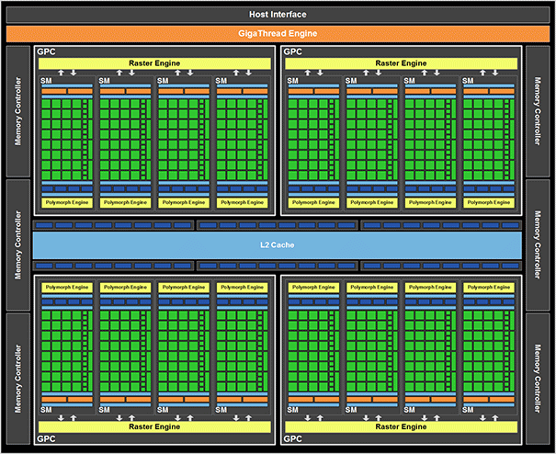
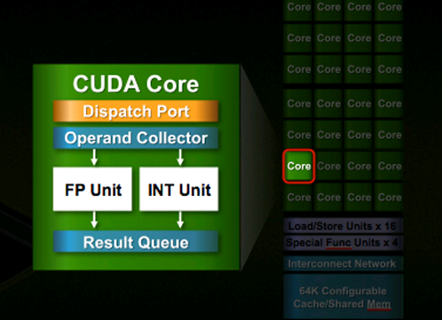
nVIDIA GPU
Fermi implementation will pack 512 processor cores

Slide 4

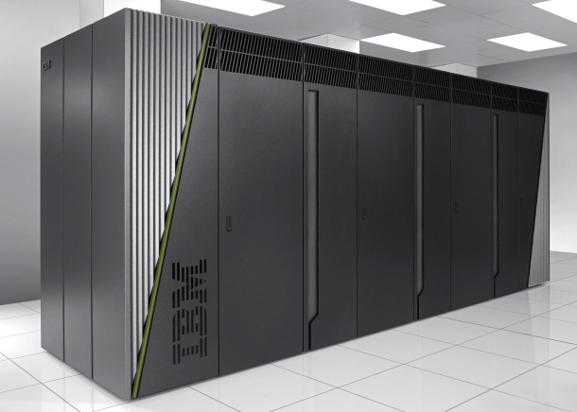
FERMI @ CINECA
PRACE Tier-0 System
Architecture: 10 BGQ Frame
Model: IBM-BG/Q
Processor Type: IBM PowerA2, 1.6 GHz
Computing Cores: 163840
Computing Nodes: 10240
RAM: 1GByte / core
Internal Network: 5D Torus
Disk Space: 2PByte of scratch space
Peak Performance: 2PFlop/s
ISCRA & PRACE call for projects now open!

Slide 5
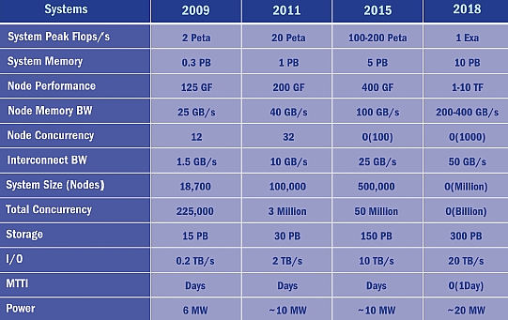
Roadmap to Exascale
(architectural trends)

Slide 6
Dennard Scaling law (MOSFET)
L’ = L / 2
V’ = V / 2
F’ = F * 2
D’ = 1 / L² = 4D
P’ = P
do not hold anymore!
The core frequency
and performance do not
grow following the
Moore’s law any longer
L’ = L / 2
V’ = ~V
F’ = ~F * 2
D’ = 1 / L² = 4 * D
P’ = 4 * P
CPU + Accelerator
to maintain the
architectures evolution
In the Moore’s law
Programming crisis!
The power crisis!

Slide 7
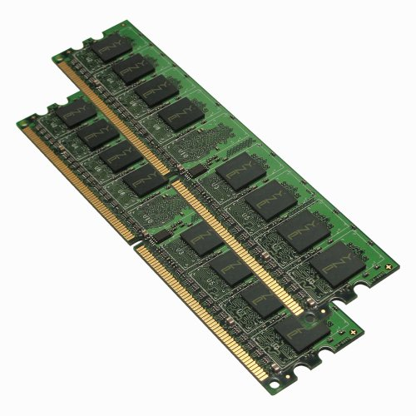
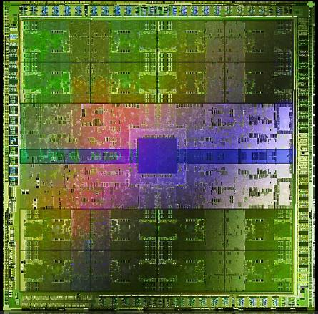
Where Watts are burnt?
Today (at 40nm) moving 3 64bit operands to compute a 64bit floating-point FMA takes 4.7x the energy with respect to the FMA operation itself
A
B
C
D = A + B* C
Extrapolating down to 10nm integration, the energy required to move date
Becomes 100x !

Slide 8
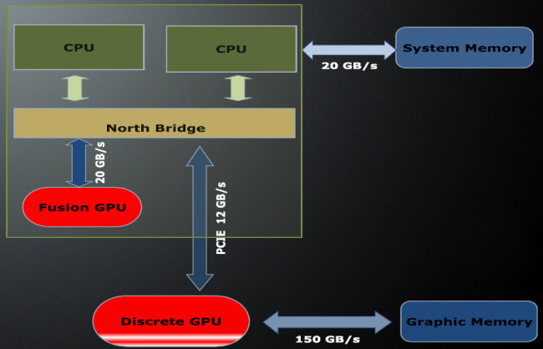
Accelerator
A set (one or more) of very simple execution units that can perform few operations (with respect to standard CPU) with very high efficiency. When combined with full featured CPU (CISC or RISC) can accelerate the “nominal” speed of a system. (Carlo Cavazzoni)
CPU
ACC.
Single thread perf.
throughput
CPU
ACC.
Physical integration
CPU & ACC
Architectural integration

Slide 9
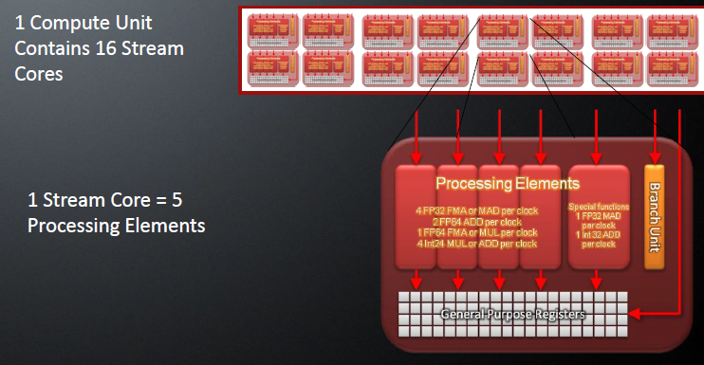
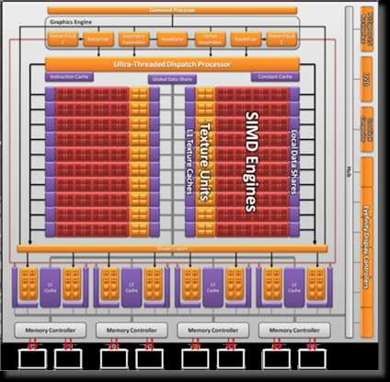
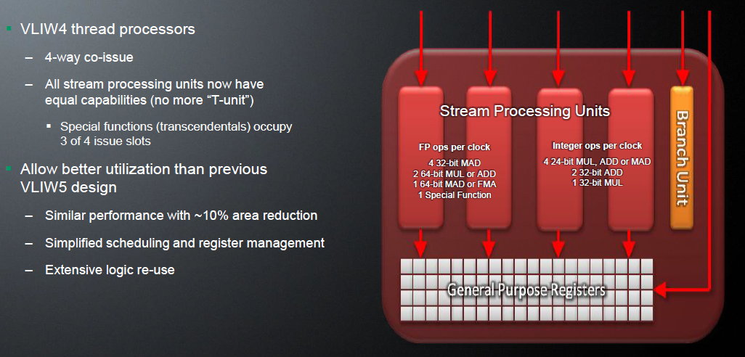
ATI FireStream, AMD GPU
2012
New Graphics Core Next “GCN”
With new instruction set and new SIMD design

Slide 10
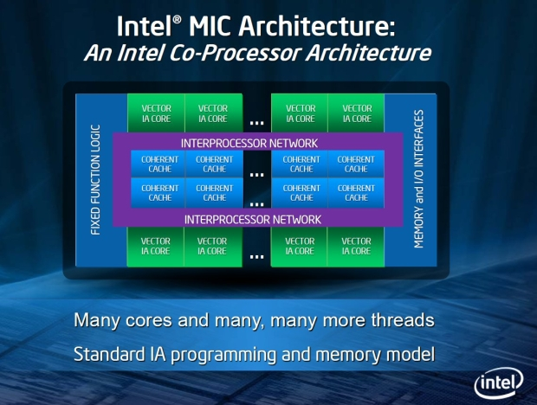
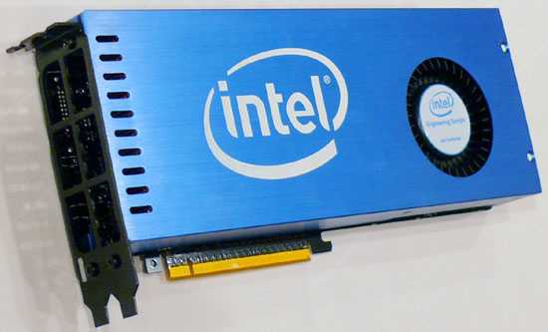
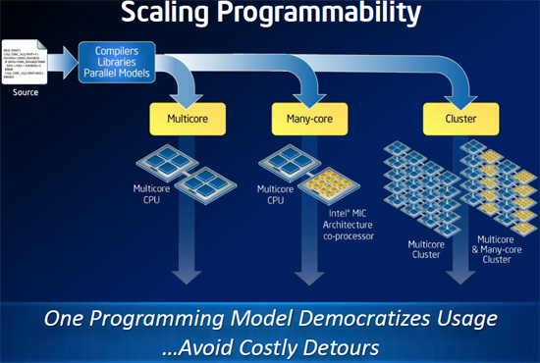
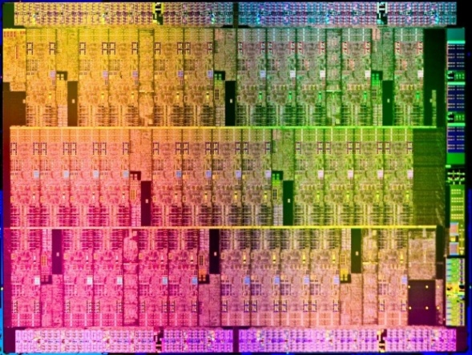
Intel MIC (Knight Ferry)

Slide 11
What about parallel App?
In a massively parallel context, an upper limit for the scalability of parallel applications is determined by the fraction of the overall execution time spent in non-scalable operations (Amdahl's law).
maximum speedup tends to
1 / ( 1 − P )
P= parallel fraction
1000000 core
P = 0.999999
serial fraction= 0.000001

Slide 12
Programming Models
Message Passing (MPI)
Shared Memory (OpenMP)
Partitioned Global Address Space Programming (PGAS) Languages
  UPC, Coarray Fortran, Titanium
Next Generation Programming Languages and Models
  Chapel, X10, Fortress
Languages and Paradigm for Hardware Accelerators
  CUDA, OpenCL
Hybrid: MPI + OpenMP + CUDA/OpenCL

Slide 13
Message Passing: MPI
Main Characteristic
Library
Coarse grain
Inter node parallelization (few real alternative)
Domain partition
Distributed Memory
Almost all HPC parallel App
Open Issue
Latency
OS jitter
Scalability
memory
memory
memory
node
node
node
CPU
CPU
CPU
Internal High Performance Network
memory
memory
memory
node
node
node
CPU
CPU
CPU

Slide 14
Shared Memory: OpenMP
Main Characteristic
Compiler directives
Medium grain
Intra node parallelization (pthreads)
Loop or iteration partition
Shared memory
Many HPC App
Open Issue
Thread creation overhead
Memory/core affinity
Interface with MPI
Thread 0
CPU
node
Thread 1
CPU
memory
Thread 2
CPU
Thread 3
CPU

Slide 15
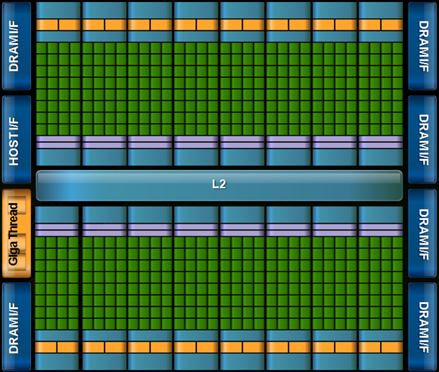
Accelerator/GPGPU
+
Sum of 1D array

Slide 16
CUDA sample
void CPUCode( int* input1, int* input2, int* output, int length) {
for ( int i = 0; i < length; ++i ) {
output[ i ] = input1[ i ] + input2[ i ];
}
}
__global__void GPUCode( int* input1, int*input2, int* output, int length) {
int idx = blockDim.x * blockIdx.x + threadIdx.x;
if ( idx < length ) {
output[ idx ] = input1[ idx ] + input2[ idx ];
}
}
Each thread execute one loop iteration

Slide 17
Codes becomes Hybrid too (MPI+OpenMP+CUDA+…
Take the positive off all models (Message Passing, Shared Memory, GPGPU)
Exploit memory hierarchy
Many HPC applications are adopting this model
Mainly due to developer inertia
Hard to rewrite million of source lines
…+python)

Slide 18
System Software Components:
Monitoring: HNagios (Nagios customized for HPC)
I/O: GPFS (Parallel filesystem, comparison with LUSTRE)
Resource Manager: PBSPro (focus on GPUs)
System PLX, PRACE tier1
Model: IBM PLX (iDataPlex DX360M3)
Architecture: Linux Infiniband Cluster
Nodes: 274 IBM iDataPlex M3
Processors: 2 six-cores Intel Westmere 2.40 GHz per node
GPU: 2 NVIDIA Tesla M2070 per node
RAM: 48 Gb/node
Internal Network: Infiniband with 4x QDR switches
Operating System: Red Hat RHEL 5.6
Peak Performance: 300 TFlop/s (152 TFlops sustained - Linpack benchmark)

Slide 19
Monitoring
Problem: manage the alarms with thousands of heterogeneous notes
Solution: Design, development and adaptation of Nagios for HPC clusters
Top level Server,
send messages and summaries
Secondary Server, hosts for primary server
Filters “local” messages
(node01, GPU0)
(node04, GPFS client)
(node01, GPU0)
(node04, GPFS client)
(node01, GPU1)
(node01, GPU1)

Slide 20
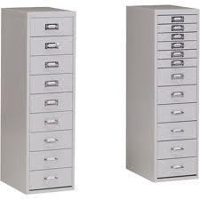
Parallel File Systems (Focus on GPFS and Lustre)
GPU codes tend to use less nodes (one or few)
require a larger node I/O bandwidth
Objective
Planning, installation and configuration of scalable parallel file systems in order to maximize performance and limit the impact of HPC infrastructure problems.
Solution adopted
GPFS
Testing of Lustre as a possible alternative (on different hardware/storage)
Main topics and results
Back-end storage scalability issues, management, high availability and reliability issues
General configuration and tuning issues
Solution design
  Separation of data and metadata
  File systems characterization (scratch, repo, home)
Scalability issues and limitations

Slide 21
Parallel File Systems (Focus on GPFS and Lustre)
Comparison - reliability/availability/maintainability
  GPFS more reliable than Lustre
  based on more sophisticated availability mechanisms and it is simpler to be maintained.
  all server functions are redounded, as many times one likes.
  metadata management is not centralized and metadata can be replicated across many disks
  data blocks can be replicated across disks
  disks can be emptied and replaced on the fly, simply invoking proper and simple management commands
  file system check operations are "one command shot" and can be performed on live file systems (with limitations)

Slide 22
Parallel File Systems (Focus on GPFS and Lustre)
Comparison - performance
Tested infrastructures are different, so direct comparison is impossible
GPFS is very sensitive to the file system block size expecially on SATA storage, because striping schema is perceived like a random access by backend storage
both technologies seems able to scale-up in terms of number of disk arrays and server nodes,
Scalability in terms of clients seems an issue in GPFS clusters, due to the token passing serialization protocol (clients holds locks for file system integrity)
Scalability in terms of servers seems an issue in Lustre clusters, due to the centralized metadata management

Slide 23

PBSPro (Resource Manager, focus on GPUs)
Two different configurations possible:
Basic GPU scheduling (configured as single custom resources)
GPUs are treated with equal priority (similar to the built-in ncpus PBS resource).
request 4 nodes with one GPU: qsub –lselect=4:ncpus=1:ngpus=1 myjob
Advanced GPUs scheduling (configured as vnodes)
Each individual GPU on a node can be separately allocated by a job (PBS knows that GPU have an ID).
request 4 nodes with GPU id 0: qsub –lselect=4:ncpus=1:gpu_id=gpu0 myjob
CPU
GPU
CPU
GPU
vnode0
CPU
GPU
CPU
GPU
vnode1
Node with resources
Node with vnodes
In both cases the placement/binding of tasks to the GPU is a responsibility of the application

Slide 24
PBSPro (Resource Manager, focus on GPUs)
Main results
Basic GPUs scheduling
  Easier to configure, administer and use (from end user point of view)
  More flexible with heterogeneous jobs (cpu only and gpu)
Basic and Advanced
  No binding between tasks and GPUs, no enforcing (neither with the advanced scheduling).
  Always conflicts when sharing nodes between jobs using GPUs

Slide 25

Conclusions
Hybrid clusters can bridge the gap with exascale machines
New hybrid programming models
Hierarchical monitor for hybrid and heterogeneous systems.
GPFS as a “reliable” parallel filesystem.
PBSpro, easy to manage GPU, but node sharing should be avoided
Contribution
Daniela Galetti
Marco Sbrighi
Federico Paladin
Fabrizio Vitale
thank you

