Slide 1
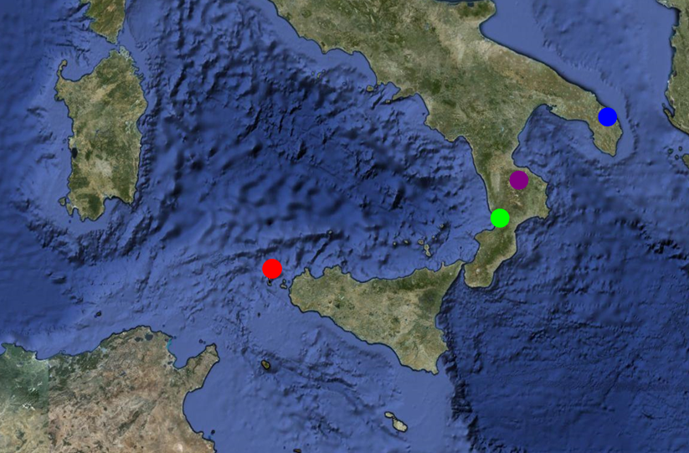







Workshop INFN CCR & GARR
Napoli 16/5/2012
People involved
G. Spezzano, P. Bonasoni, A. Marinoni, L. Giordano, G. Pappalardo, C. Calfapietra, P. Cristofanelli, G. Matteucci, A. Pauciullo, E. Vuillermoz, R. Bernini, V. di Fiore, G. D’Amico, N. Pirrone, F. Cairo, M. Manzo, O. Gavrichkova, L. Ferraro, T.C. Landi, A. da Polenza, E. Brugno
Notes:
Idea portante: monitoraggio clima e ambiente nella Regione del mediterraneo attraverso adeguamento e potenziamento di piattaforme integrate – sensoristica, stazioni di rilevamento mobile, strumentazione. Migliorare ricerche ambientali enti ricerca.

Slide 2

ERDF: European Regional Development Fund
Reduce the gap between the levels of development of the various European regions
Calabria, Campania, Puglia e Sicilia
3-year project (2012-2014)
Notes:
finalizzato alla promozione e sostegno finanziario di iniziative e progetti nei campi della ricerca scientifica, dello sviluppo tecnologico, della competitività e dell'innovazione industriale, da realizzarsi nel periodo di programmazione 2007-2013.

Slide 3
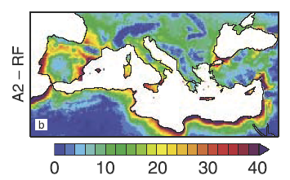
Mediterranean basin: hot spot area for climate change and pollution
La conoscenza accurata delle caratteristiche climatiche di una regione rappresenterà uno dei più importanti fattori di competitività negli anni futuri.
(UNEP “Advancing adaptation through climate information services” , 2011)
Increase of average temperature (+2 °C) to 2050
Sea level increase
Precipitation decrease
Frequency increase for heatwaves, long drought, heavy rain…
Notes:
Miglioramento capacità osservativa climatico-ambientale, monitoraggio di ecosistemi agroforestali e marino-costieri.
Estendere conoscenza puntuale del fenomeno a scala più vasta e generare modelli interpretativi dei fenomeni, analisi scenari per supportare decisioni per supportare politiche ambientali e di salvaguardia della salute pubblica.

Slide 4
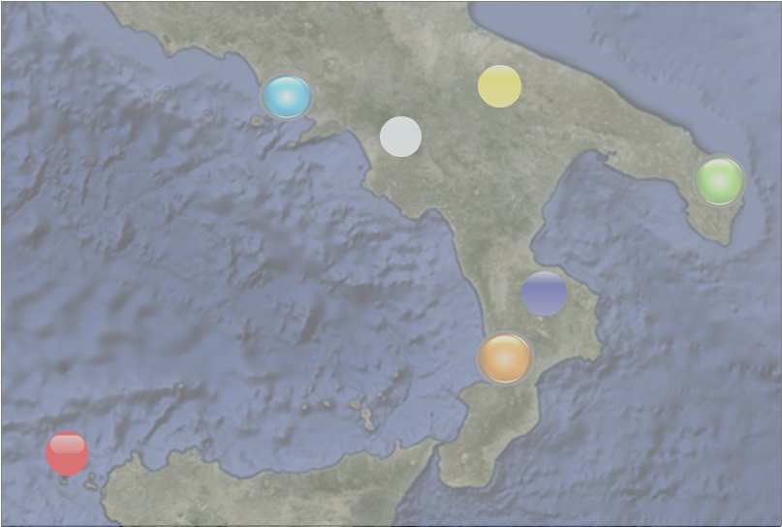
The Project is devoted to 4 Development Objectives:
OR1 – Infrastructures for the climate and environmental monitoring
OR2 – Tecnological innovation, development and transfer to enterprises
OR3 – Networking and integration with European/Global programme
OR4 – Technological applicatons and local services
Notes:
Rafforzare le strutture osservative per il monitoraggio climatico-ambientale
Promuovere innovazione, sviluppo tecnologico e trasferimento industriale
Rete osservativa climatico ambientale satellite di infrastrutture internazionali armonizzare attività osservative e protocolli
Applicazioni tecnologiche e servizi al territorio

Slide 5
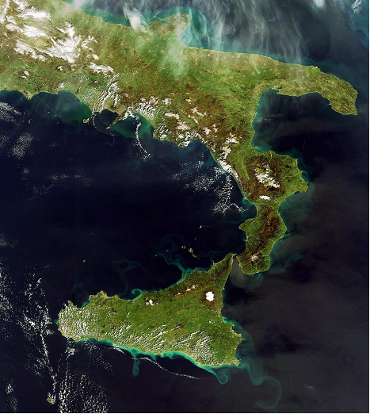


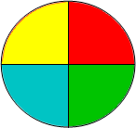

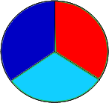
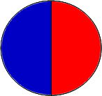
OR1 – Infrastructures for the climate and environmental monitoring Meteorological parameters, trace gases, aerosol properties in-situ and vertical profiling
Structural adjustement (urban area ):
Lecce
Structural adjustement (urban area):
Napoli
Murgia
Lecce
Napoli
Eboli
Sila
Structural adjustement (coastal)
Lamezia Terme
Structural adjustement (remote-mountain):
Longobucco (Cs)
Lamezia
New infrastructure (remote-maritime):
Marettimo (Tp)
Egadi
Notes:
I siti afferenti all’Infrastruttura AMICA, definiti per l’attivazione di interventi di adeguamento e
rafforzamento strutturale sono dislocati in tutte e quattro le regioni della Convergenza

Slide 6
OR1 – Infrastructures for the climate and environmental monitoring Crop and forest ecosystems
New site
(wildlife park):
Parco delle Murge (Puglia)
New site
(urban garden):
Parco di Capodimonte (Na)
Napoli
Murgia
Lecce
Eboli
Structural adjustement
(crop ecosystem):
Eboli – Borgo Cioffi (Sa)
Sila
Structural adjustement (forest ecosystem):
Bonis – Monti della Sila (Cs)
Lamezia
Egadi
Notes:
Scambi CO2,
interazione con inquinanti, Bilancio del carbonio e altri gas-serra
Gestione agricola
Scambi biosfera-atmosfera
Dinamiche uso del suolo, Bilancio Carbonio
Interazioni con ciclo H2O Idrologia e sistemi forestali

Slide 7
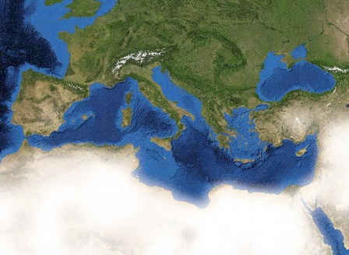





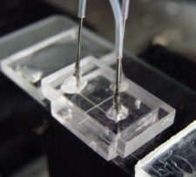
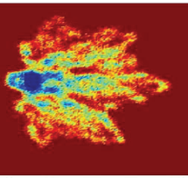
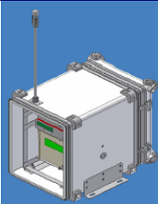
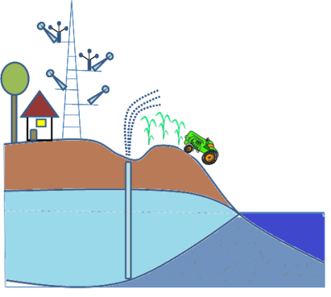
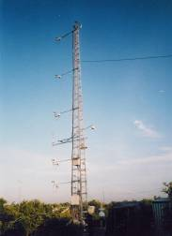
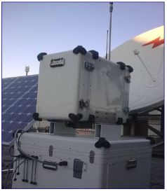


OR2 Tecnological innovation, development and transfer to enterprises
Structural adjustement of laboratories for technological reseraches
Laboratorio Scientifico & Tecnologico
OR 2.1
New technologies for atmospheric monitoring
OR 2.2
Optical, electromagnetic and sensors
OR 2.3
New technologies for crops, forest, costal ecosystems
Scientific activities
Industrial activities
Users
Notes:
Centri di eccellenza - potenziamento infrastrutturale dei laboratori dedicati alla messa a punto di
sensoristica innovativa di interesse per il settore climatico‐ambientale.

Slide 8
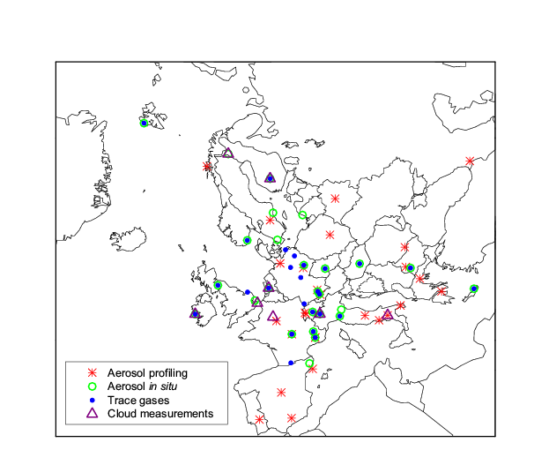

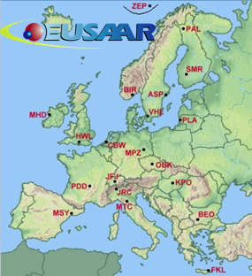

OR3 – Networking of climate-environmental infrastructures
Integration within ACTRIS/EARLINET/EUSAAR (European framework)
Integration of SOP, methodologies, calibration scales, data-bases.
ACTRIS (Aerosols, Clouds, and Trace gases Research InfraStructure Network)
Research Infrastructure project EU FP7
(2011-2015)
EARLINET (European Aerosol Research Lidar Network)
EUSAAR (European Supersites for Atmospheric Aerosol Research) )

Slide 9

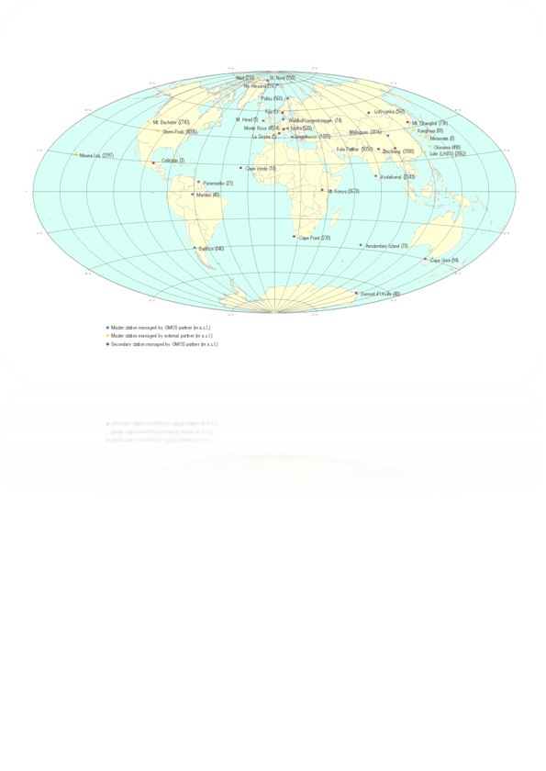


OR3 – Networking of climate-environmental infrastructures
Integration within GAW-WMO/GMOS/SHARE (Global scales)
Integration of SOP, methodologies, calibration scales, data-bases.
Global Atmosphere Watch (GAW) – WMO
Global Mercury Observation System
EU FP7(2010-2015)
Stations at High Altitudes for the Research on the Environment
EvK2CNR (2010-2014)
I-AMICA

Slide 10
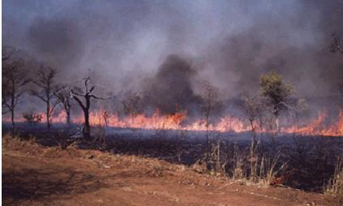
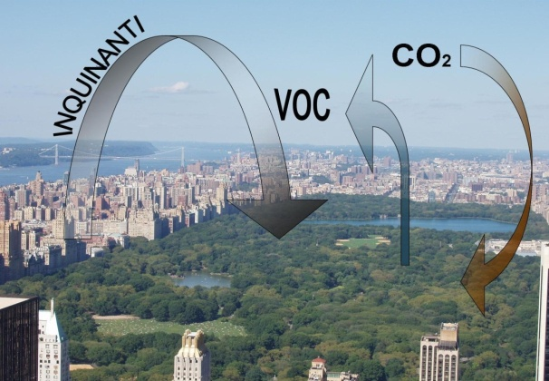
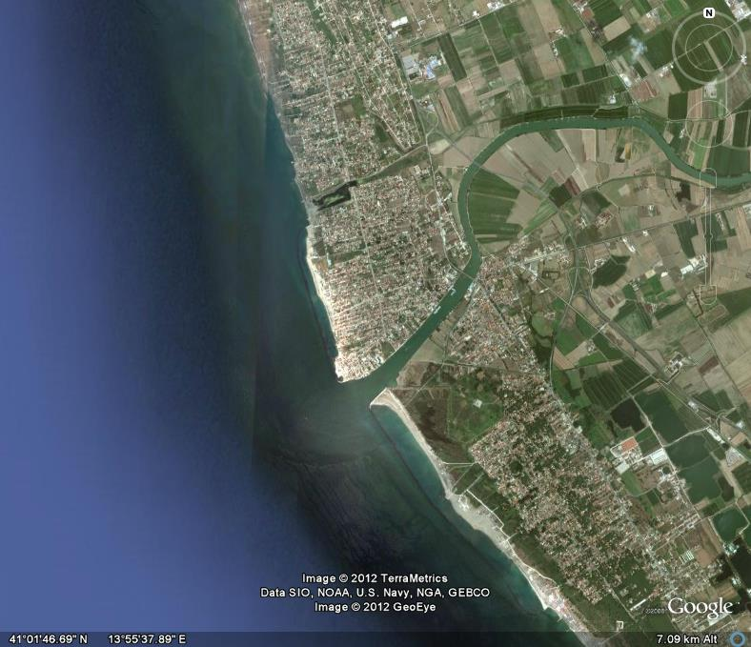
OR 4 – Technological applicatons and local services
Climate impacts and early warning
Biomass burning, mineral dust, volcanos, anthropogenic pollution
Mixing of sea water within fresh water stratum along coastline regions
Processess affecting maritime-coastal ecosystems
Monitoring of surface deformation along coastlines, sea beds and water column
Notes:
diversi processi climatico‐ambientali che hanno impatto su
diversi settori come ad esempio, navigazione marittima, trasporto aereo, circolazione stradale, l’allerta per
episodi di inquinamento, incendi boschivi, eruzioni vulcaniche, trasporti di sabbia dal deserto del Sahara.

Slide 11
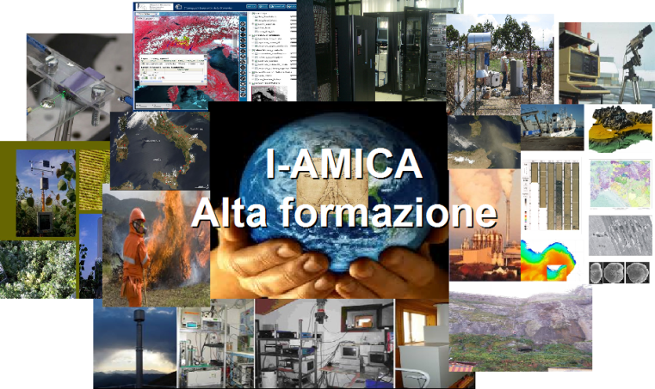
Investment in high education (research grants)
WWW.I-AMICA.IT
Un Paese che non investe sulla RICERCA e sui GIOVANI
è un paese senza futuro
Notes:
Borse di studio

Slide 12
Cyber-Infrastructure for the climate and environmental monitoring
Integrated environmental information intelligence
With the emergence of new methodologies and technologies it has now become possible to manage large amounts of environmental sensing data and apply new integrated computing models to acquire information intelligence.
Integrated environmental intelligence (IEI) can be described as the capability of a system to access, process, visualise and share data, metadata and models from various domains (such as land-use/cover, biodiversity, atmosphere and socioeconomic) for various purposes.
However, environmental data is continuously increasing and is mostly fragmented, unharmonised, it exists in proprietary and open systems, it is less compliant to standards and sometimes requires extensive computing capacity, which makes it difficult for it to be utilised across the platforms.

Slide 13

Cyber-Infrastructure for the climate and environmental monitoring
Cloud-based framework
This suggests that integrated environmental monitoring requires compliance to standards, data harmonization and service interoperability together with extensive on-demand processing and storage capacities in order to answer science and policy related questions.
A cloud-based framework enables data accessibility and storage across the platforms, and provides necessary on-demand computational resources for necessary processing, simulations and visualization tasks.

Slide 14
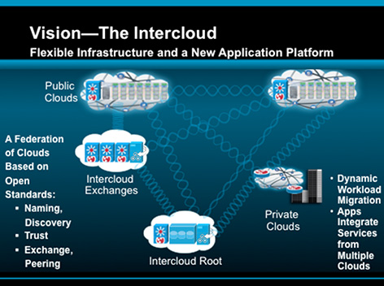
Cyber-Infrastructure for the climate and environmental monitoring
Cloud computing - SHAREGeoNetwork
Cloud computing for storage, processing and analysis of large amount of data.
Implementation of a “Spatial Data Infrastructure (SID)” to manage and share metadata and data “WEB portal” (SHARE GeoNetwork http://geonetwork.evk2cnr.org/ ).

Slide 15
Cyber-Infrastructure for the climate and environmental monitoring
Required Technical Capabilities for an IEM System
In general, the following capabilities should be considered as technical requirements for integrated intelligence in an integrated environmental monitoring system:
Data Acquisition: the ability to collect data from various sources including databases, flat files, web services, sensors networks and web portals (e.g. OGC’s Sensor Observation Service and Web Feature Service), participatory sensing and citizens' observations (e.g. using smart phones).
Schema mapping and transformations: the ability to perform schema mappings to reference data sets, to harmonize spatial schema based on ISO 19100 series of geographic information standards and INSPIRE specifications, for instance, coordinate transformation using different coordinate reference systems.
Service interoperability: the adoption of standards such as W3C's web standards, OASIS's RM-ODP and OGC's view, download, discovery, catalogue services.

Slide 16
Cyber-Infrastructure for the climate and environmental monitoring
Required Technical Capabilities for an IEM System
Data fusion, processing and synthesis: the ability to integrate data and apply computational processing steps e.g. using OGC Web Processing Service (WPS) standard, in order to generate desired results and build synthesis around gaps in data coverage.
Workflow management: the ability to design, compose and execute workflows, e.g. using Kepler, Taverna, LONI, Sunflower.
Provenance: the ability to preserve and track information about sources of data and processes.
Visualisation: the ability to generate data and processing outputs in an user-friendly i.e. human understandable way by using various GUI techniques (e.g. OpenGL standard), 2D/3D maps, simulations, gaming, etc.
Decision-making: the ability to enable users to take decisions based on the recommended ‘best-fit’ output from various scenarios using artificial intelligence (predicate, description, fuzzy logic), expert systems tools and techniques (DROOLS and JESS rule-based engines).

Slide 17
Cyber-Infrastructure for the climate and environmental monitoring
Required Technical Capabilities for an IEM System
Social-networking: the ability to enable users to interact with each other and share experiences (e.g. Web 2.0, forums, twitter, etc).
Feedback mechanisms: the ability to enable users to provide feedback/comments on results, annotate data and processing outputs (e.g. Web 2.0, Wikis, Issue Tracking).
Security and reliability: the ability to implement authentication, authorization, encryption, decryption, auditing and backup mechanisms to enable use of data and services by legitimate users and avoid loss of data.
Extensibility: the ability to add new users, new data sources and new application-specific models, etc.

Slide 18
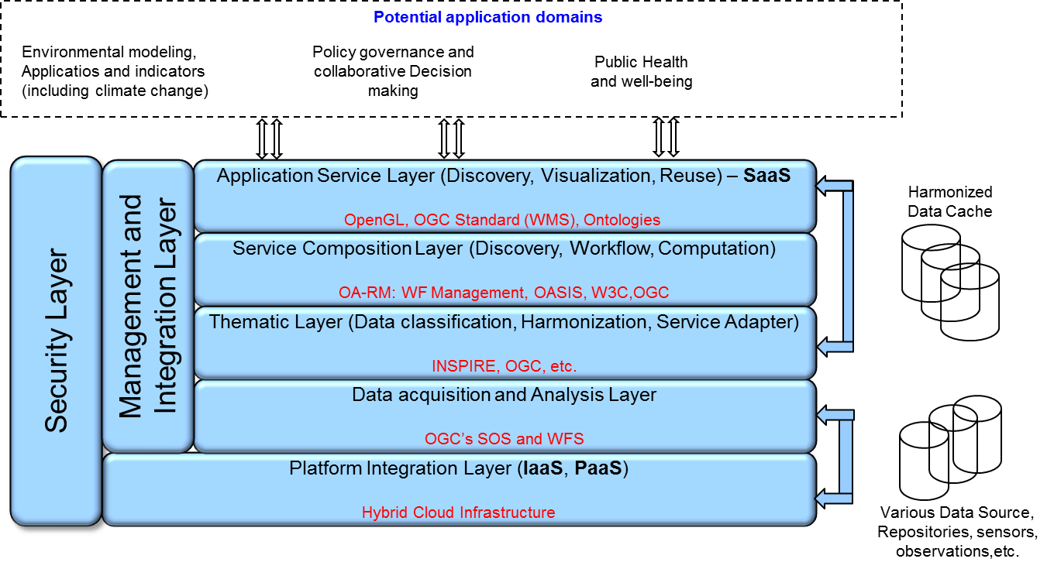
Cyber-Infrastructure for the climate and environmental monitoring
The Cloud-based architecture
The proposed architecture mainly consists of five horizontal and two vertical layers. The output from the first two bottom layers is generic which can be tailored to specific application needs in the above three layers.
, ISO 19100 Series

Slide 19
Cyber-Infrastructure for the climate and environmental monitoring
Horizontal layers
The platform integration layer depicts a cyber-infrastructure based on a inter-cloud environment that ensures cross-platform accessibility of environmental data.
The data acquisition and analysis layer is used to access environmental data from various sources including remote database repositories, sensor nets, citizens’ observations in the cloud environment. This layer also ensures the quality of data acquired and identifies the need for necessary data harmonization and data cleansing.
The thematic layer classifies the acquired data into application specific thematic categories and performs data harmonization and updates the data/service catalogues for further use of the data.
The service composition layer is needed to design workflows, identify data sources, and link necessary processing components to enact the workflows. Furthermore, necessary analytical analysis of the workflow outputs can be performed at this layer. This layer also ensures that the provenance of data and specific processes is maintained that can be utilized for analysis by different expert systems at the application layer.
The application service layer uses the outcomes from the service composition layer in application domain specific tools such as simulations and visual maps to perform analytical analysis for decision-making. Further, this layer enables stakeholders to use existing tools and develop new application domain specific components and services.

Slide 20
Cyber-Infrastructure for the climate and environmental monitoring
Vertical layers
The management and integration layer is used to automate the flow of data and information between the horizontal layers. It ensures that processed outputs from one layer to other are syntactically correct. It also aims to handle change management that occurs at different layers and intends to lessen the extent to which layered architecture requires management overhead.
The security layer ensures necessary authentication, authorization and auditing for the use of data and services by legitimate users.
Data may originate from different cloud infrastructures. However, each cloud infrastructure is unique and mostly incompatible with each other i.e. the underlying cloud architecture, data models and access mechanisms, and services vary from one cloud infrastructure to another.
The main challenge here is to test hybrid clouds for integrated information system by adopting INSPIRE and OGC standards.

Slide 21
Cyber-Infrastructure for the climate and environmental monitoring
Benefits of Cloud Computing
The benefit of a cloud environment for IEMS is twofold. Firstly the use of SaaS in cloud environment encapsulates the complexity of data acquisition, cross-thematic harmonized transformations, computer intensive processing, multidimensional modeling and visualization and collaborative decision support mechanisms for various stakeholders.
Secondly the extensibility and scalability characteristics of cloud platforms will accommodate continuously increasing data volumes and caching for visualization and user groups who can be involved for citizen science-based participatory environmental monitoring.
We proposed a layered architecture for IEMS using Clouds. However, it is not straightforward to realize the proposed model to its full potential due to certain technological challenges.

