Slide 1
Hybrid Data Infrastructures: concept, technology and the complex ENVRI RIs use case
Pasquale Pagano
Italian National Research Council (ISTI-CNR)
pasquale.pagano@isti.cnr.it

Slide 2
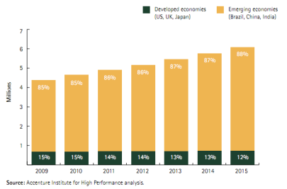
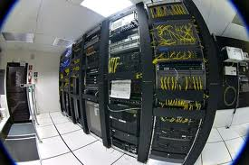
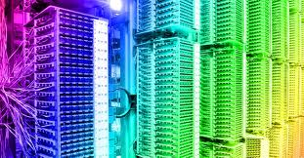
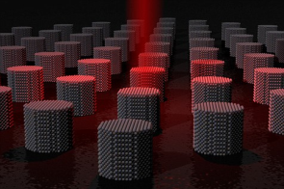
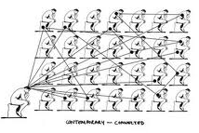
New Science Pattern
The Context
Science is increasingly global, multipolar, and networked
Data continue to grow in Volume, Variety, and collection, processing and consumption Velocity
The Needs
Computational environments dealing with the volume of the data
Efficient and tailored storage and access technologies dealing with the variety of the data types
Elastic management of the resources dealing with the innovative approaches for collection, processing and consumption of the data
World-wide collaborative environment between distributed scientific communities dealing with the federation of heterogeneous data sources
The Solution
Hybrid Data Infrastructures
integrated technologies supporting efficient data management

Slide 3
D4Science Hybrid Data Infrastructure
Availability of typical biodiversity processes running on computational and storage resources offered by grid and cloud resource providers
New technologies generally identified as no-sql databases as service
Accessibility of distributed computing platform supporting MapReduce
Porting to MapReduce of several algorithms for performing data analysis and mining
Geographical data management support
D4Science HDI hosts biodiversity communities federated by the iMarine and the EUBrazilOpenBio initiatives
D4Science HDI will provide ENVRI RIs with seed resources

Slide 4
D4Science Technology: the gCube system
gCube offers solutions to abstract over differences in location, protocols, and models by
scaling no less than the interfaced resources,
keeping failures partial and temporary,
reacting and recovering from a large number of potential issues.
gCube doesn’t hide infrastructures middleware and technologies.
gCube turns infrastructures and technologies into a utility by offering a single registration, monitoring, and access facilities.

Slide 5
gCube: Policy-oriented Security Facilities
Service Oriented Authorization, Authentication and Accounting (SOA3) is a security framework providing security services as web services, according to Security as a Service (SecaaS) research topic.
Security as a Service
Authentication and Authorization provided by web services called by resource management modules
Flexible authentication model
the user is not requested to have personal digital certificates
Attribute-based Access Control
a generic way to manage access: access control decisions are based on one or more attributes
user related attributes (e.g. roles, groups) and environment related attributes (e.g. time, date)
https://gcube.wiki.gcube-system.org/gcube/index.php/Data_e-Infrastructure_Policy-oriented_Security_Facilities

Slide 6
gCube: Policy-oriented Security Facilities [cont.]
SOA3 Authentication Module provides Authentication as a Service.
The module receives authentication requests, matches received information with an external identities repository and returns the response as SAML assertion.
Flexible authentication model
SOA3 provides a native authentication model based on userid/password: X509 certificate based authentication is also supported
RESTful interface
decouples the module from the underlying infrastructure according to the zero-dependencies model. Anyway the module is also usable as Java Library Based
Based on SAML
user attributes are inserted in a standard SAML Assertion

Slide 7
gCube: Policy-oriented Security Facilities [cont.]
SOA3 Authorization Module bases its decisions on stored policies by which it is able to determine if a subject can perform a certain action on a certain resource.
The subject is defined by a set of attributes referred to caller, call and environment: Attribute Based Access Control (ABAC)
Attribute-based Access Control Model
a generic and extensible model which base the decisions on a set of attributes from caller, call, and environment
Policy-driven decisions
the decisions are based on a set of pre-defined stored policies
Standard based architecture
the module is based on the standard eXtensible Access Control Markup Language (XACML) 2.0
Extensible set of attributes
possibility to configure the attributes set to be used for policies evaluation

Slide 8
ENVRI: Environmental Research Infrastuctures
ENVRI
Call Identifier: FP7-INFRASTRUCTURES-2011-1
Starting Date: 01/11/2011
Duration: 36 Months
Title: Common Operations of Environmental Research Infrastructures
Keywords: Environmental Research Infrastructures
Data processing, Interoperability, Reuse, GEOSS

Slide 9
Environmental Science
long-term development of the climate system
biodiversity
development of the cryosphere and lithosphere
oceanic and atmospheric processes
Earth as a single complex and coupled system

Slide 10
ENVRI Partners
Universities
University of Amsterdam
University of Helsinki
Cardiff University
University of Edinburgh
University of Bremen
Research Centers
Italian National Research Council (CNR)
Centre National de la Recherche Scientifique (CNRS)
Istituto Nazionale di Geofisica e Vulcanologia (INGV)
Koninklijk Nederlands Meteorologissch Instituut
Institut Francais de Recherche pour l’exploitation de la mer (IFREMER)
Agencies
CEA- Commissariat à l’energie atomoque te aux ènergies alternatives
ESA – European Space Agency
EAA – Environment Agency Austria
Others
CSC – Tieteen Tietotekniikan Keskus Oy Ltd.
EISCAT Scientific Association
EGI – European Grid Initiative

Slide 11
Goal
Enable multidisciplinary scientists to access, study and correlate data from multiple domains for “system level” research
by providing solutions and guidelines for the RIs common needs

Slide 12
ESFRI Environmental Research Infrastructures
COPAL
Tropospheric research aircraft
EISCAT-3D
Upgrade of incoherent SCATter facility
EMSO
Multidisciplinary seafloor observatory
EPOS
Plate observing system
EURO-ARGO
Global ocean observing infrastructure
IAGOS
Aircraft for global observing system
ICOS
Integrated carbon observation system
LIFEWATCH
Biodiversity and ecosystem research infra
SIOS
Svalbard arctic Earth observing system

Slide 13
ESFRI Environmental RIs: complex infrastructure
Data acquisition is continuous
Datasets are not static since data are continuously streamed from data sources
Data stored in multiple sites
Each site combines data from sources in different ways
Need a persistent identifier
Not true replication
Same data stream stored at different sites has a different persistent ID
Federated AAI
Each site is responsible for authentication and authorization
Common LDAP for users’ credential with Shibboleth on top
Different access rights
Anonymous for public data
Read-only for not-public data
Not-public data may become public after the embargo period is expired

Slide 14
RIs’ Heritage
A variety of data
complex and sometimes fuzzy
heterogeneous and distributed
primary and processed data
Analytical and modeling platforms
data driven methodologies
e-Laboratories
data exchange and integration
data acquisition, validation and staging policies
data consumption
Existing practices

Slide 15
Technical Foundations
Standards and Recommendations
e-Infrastructures
Technologies
INSPIRE Directive 2007/2/EC on environmental data sharing infrastructure
Open Geospatial Consortium (OGC W*S) standards
EGI, D4Science
GENESI-DEC, iMarine, EUDAT, …
Hadoop Map/Reduce
NoSql storage solutions

Slide 16
Approach
Provide software tools to
Promote Accessibility
discover data which are heterogeneous in format, content, and metadata description
Preserve Specificity
harmonise, integrate and analyse data across domains and RIs

Slide 17
Data Discovery and Access
Metadata Model
Core set plus customisable attributes
Tools
Metadata Catalogue Services (OGC OpenSearch, CSW)
Compliant with INSPIRE Implementation Rules for Metadata
Specific Gateways (to connect existing solutions not compliant with the adopted specifications)
Outreach
Register relevant components in GEOSS to interoperate with GEO-GEOSS
Register data resources in the GEOSS Common Infrastructure
OGC Web Coverage Service to extract spatial subset of data
Notes:
To develop software components to allow data discovery and access in a federation of digital repositories and interoperating infrastructures.
To develop software components to enable integration and harmonization of data resources from cluster’s infrastructures and publication according to unifying views.

Slide 18
Data Integration, Harmonization, Analysis and Publication
Approach
Exploit computational and storage capabilities of existing e-Infrastructures
Tools
Enable integration and harmonization
Outreach
Linked Data for publishing and connecting structured data with non-collaborative consumers
Frameworks + plugins supporting temporal and spatial analysis
RDF and OWL to describe relations between e-Infrastructures components
Notes:
To develop a suite of software components addressing the most common and pressing needs of ESFRI ENV infrastructures.
Software libraries for supporting capabilities (data format conversions, pre-processing, data transformation, data post processing)
Repositories for data, workflows, and workflow results; repository for tracking provenance and citation of data and workflows
Ability to view, visualize, explore discovered data

Slide 19
RIs Engagement
e-Infrastructures
EMSO
EPOS
EURO ARGO
EISCAT-3D
LifeWatch
ICOS

Slide 20
Prototype: from discovery to process and publication
Discovery
OpenSearch (OGC CSW 3.0)
Federation of Catalogue Services
Access
Web Coverage Service (OGC WCS)
THREDDS: implements access protocols to netCDF (v. 4.2.20) data, OpenDAP (v 2.2.2), WCS
Process
Web Processing Service (OGC WPS)
52North (2.0 RC8) framework: spatial resampling, temporal aggregation as WPS processes
Computing
Hadoop 0.20.2 (CDH3)
WPS processes as map/reduce pure implementations
Publish and Visualize
Web Map Service and Web Feature Service (OGC WMS, WFS)
Geoserver, GeoTools (v. 2.7.4)

Slide 21
ENVRI and D4Science
Data Access
Data Process
OGC
WCS
OGC
WPS
THREDDS
WPS 52N
P1
P2
P..
WPS Hadoop
Data Discovery
Data Visualization
OGC
OpenSearch
gCube Data staging
Hadoop Cluster
OGC
WMS, WFS
HDFS
Catalogue
Services
GeoServer
Geospatial Repositories

Slide 22
ENVRI and EGI
Data Access
Data Process
OGC
WCS
OGC
WPS
THREDDS
WPS 52N
P1
P2
P..
WPS Cloud
Data Discovery
Data Visualization
OGC
OpenSearch
gCube Data staging
Microsot Azure
OGC
WMS, WFS
Catalogue
Services
GeoServer
Geospatial Repositories

Slide 23
ENVRI and EGI
Data Access
Data Process
OGC
WCS
OGC
WPS
THREDDS
WPS 52N
P1
P2
P..
WPS EMI
Data Discovery
Data Visualization
OGC
OpenSearch
FTS v3.0
EGI e-Infrastructure
OGC
WMS, WFS
DPM
Catalogue
Services
GeoServer
Geospatial Repositories

Slide 24
Follow us at www.d4science.org www.gcube-system.org www.envri.eu
THANK YOU

Slide 25
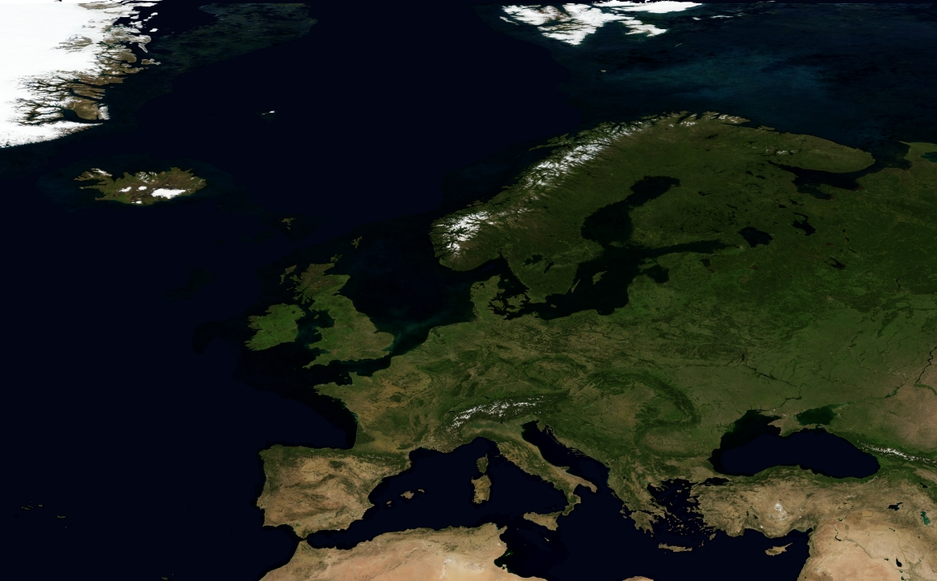
EMSO: European network of underwater observatories
Arctic
Norwegian Margin
Nordic Sea
Monitor environmental processes
Coordinate and Harmonize resources
Porcupine Abyssal Plain
Ligurian
Sea
Black Sea
Azores
Islands
Marmara
Sea
Iberian
Margin
Western
Ionian Sea
Hellenic
Arc

Slide 26
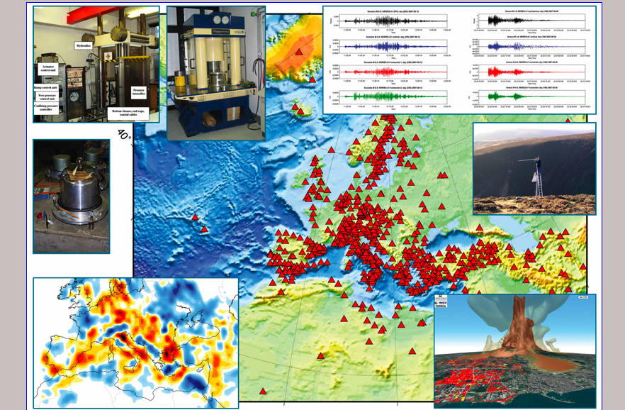
EPOS: Seismic and geodetic permanent national monitoring networks
Distributed storage and computing resources
Analysis, visualization, archiving and mining
Collaborative large-scale modelling

Slide 27
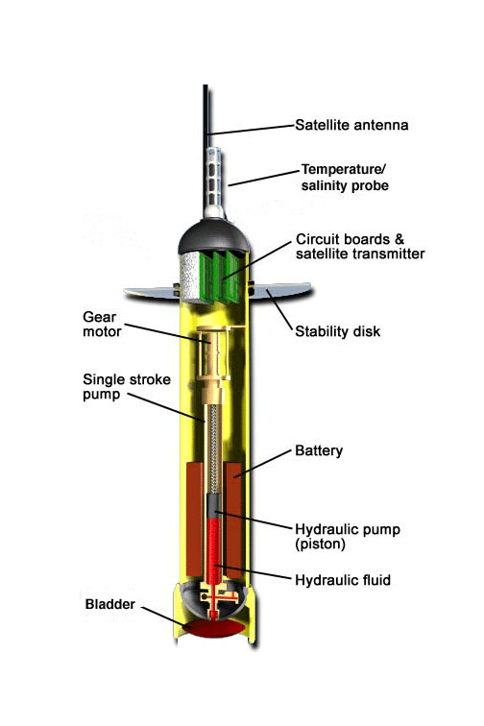
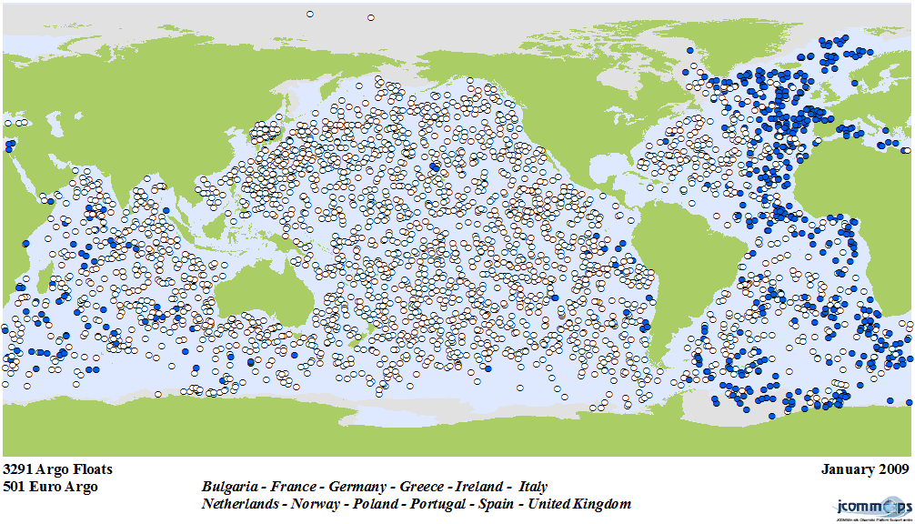
EURO ARGO: European component of a world wide in situ global ocean observing system
A dual use : research and environmental monitoring
Deploy, maintain and operate an array of 800 floats.
Provide services to the research (climate) and environment monitoring (e.g. GMES) communities
Notes:
27

Slide 28
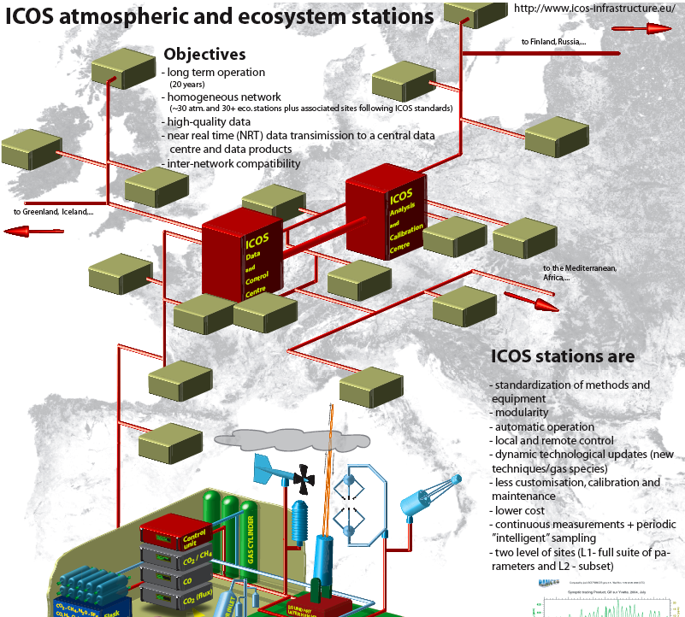
ICOS Network of standardized high precision integrated stations
Integrate terrestrial and atmospheric observations at various sites into a single, coherent, highly precise dataset.

Slide 29
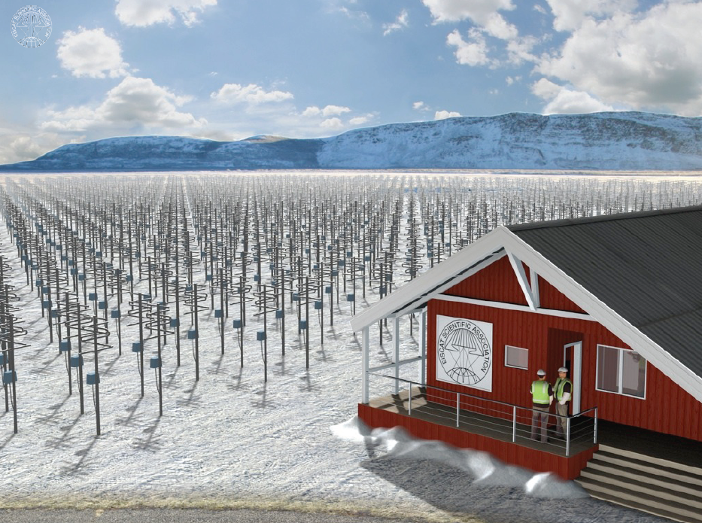
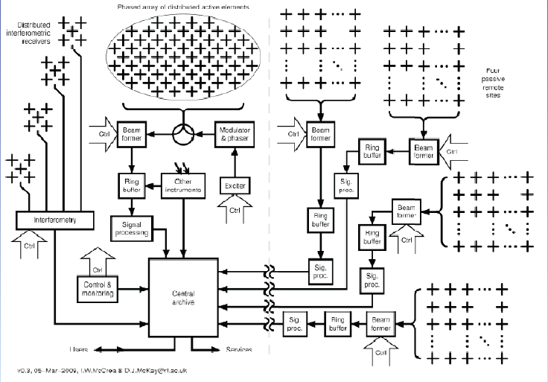
EISCAT_3D: System Design
Preparatory Phase to reach a sufficient level of maturity with respect to technical, legal and financial issues so that the construction of the EISCAT_3D radar system can begin

Slide 30
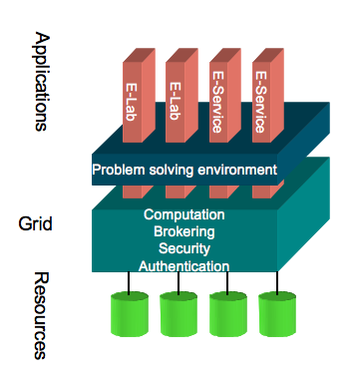
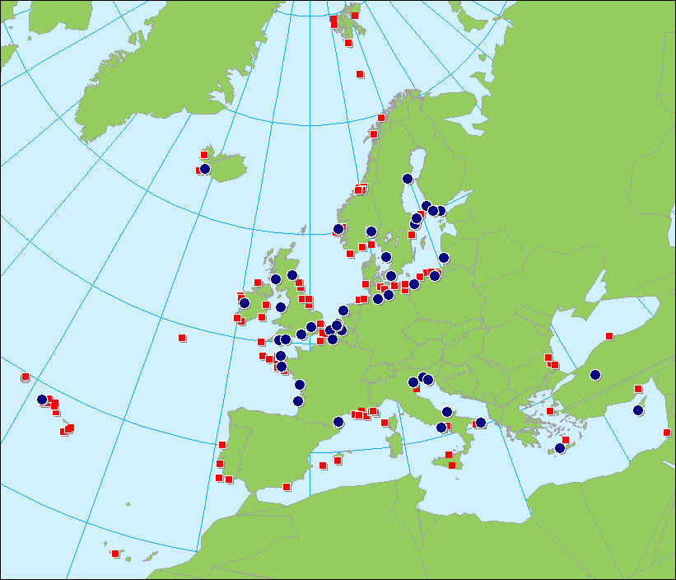
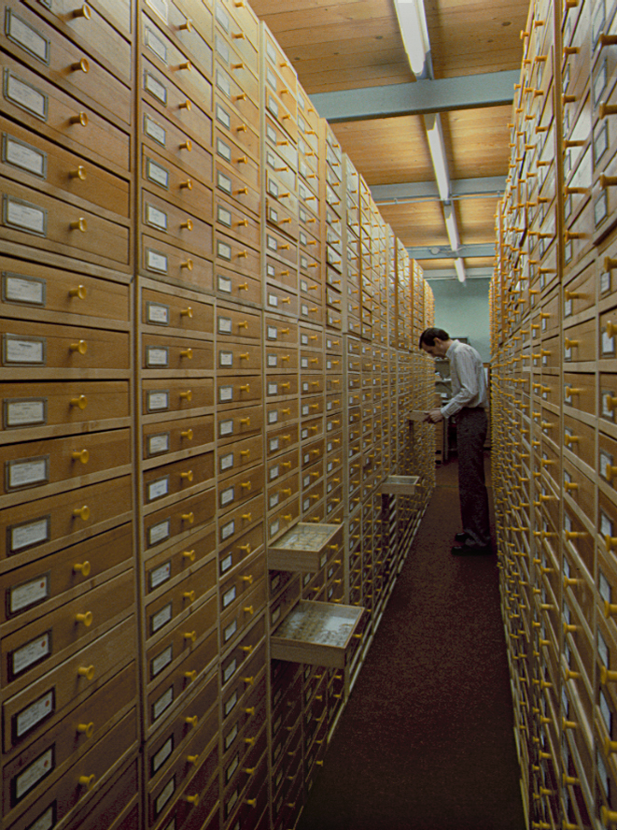
LIFEWATCH: European research infrastructure federating marine, terrestrial and freshwater observatories
Common access to interlinked and distributed databases and monitoring sites
Analytical and modeling tools

