Slide 1
LHC OPN and LHC ONE
”LHC networks”
Marco Marletta (GARR) – Stefano Zani (INFN CNAF)

Slide 2
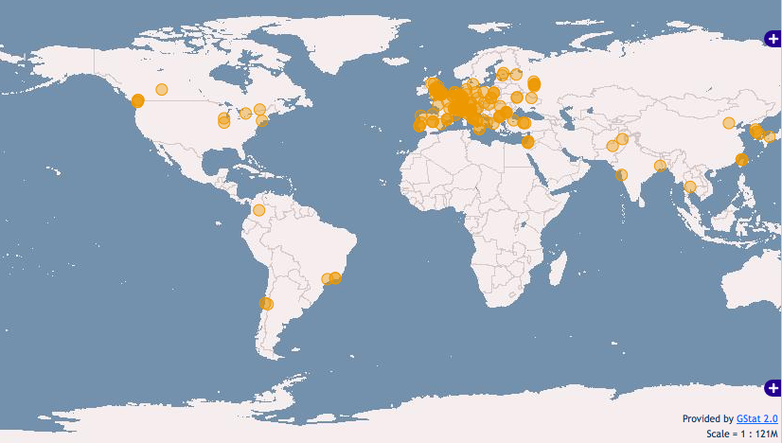
TIERs and data movement
T0 (CERN) Where data are generated
T1 (11 Sites all over the world) are the first level of data distribution in charge of safe keeping, sharing of data and reconstruction (not all data are replicated in every TIER1).
T2 (more than 140 sites all over the world) are sites more specifically dedicated to data analysis activity.
T3 (many hundreds) are little centers in charge of interactive analysis activity.

Slide 3
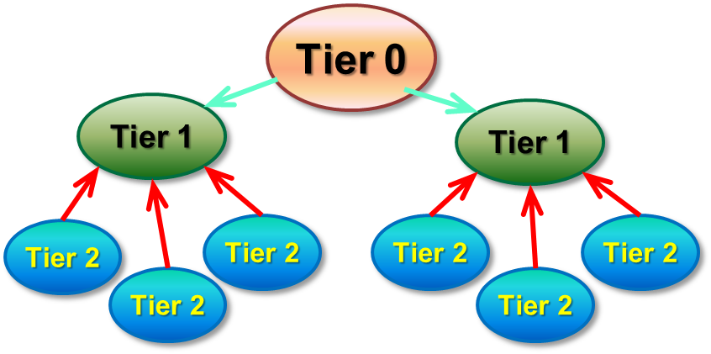
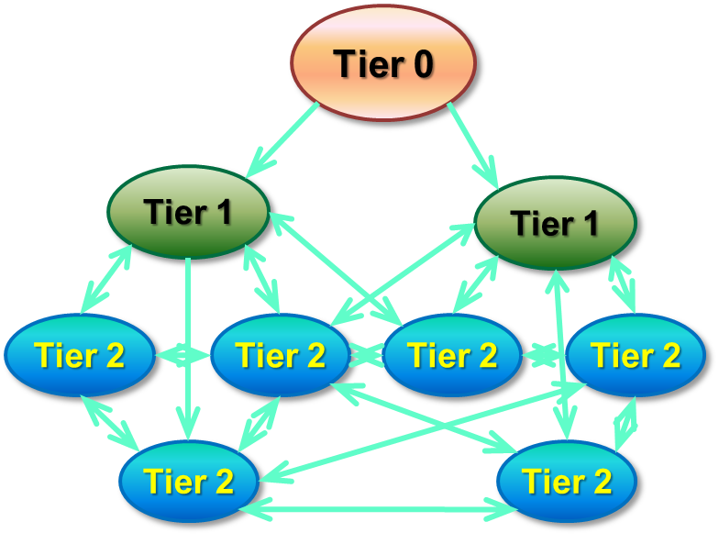
Main traffic flows
A) T0-T1 and T1-T1 (LHCOPN) IN PLACE AND STABLE
In order to address this type of traffic It has been created an Optical Private Network connecting CERN and the 11 National TIER1s (LHC-OPN)
B) T1-T2 and T2-T2 (LHCONE) IN IMPLEMENTATION PHASE
In the original design of data movements between tiers named MONARC each T2 was supposed to transfer data only from its national T1.
Last year experiments changed their computing model assuming each T2 could have access to data stored potentially in every T1 and also in any T2! To address this type of traffic a new network named LHC Open Network Environment (LHCONE) is in phase of implementation.

Slide 4
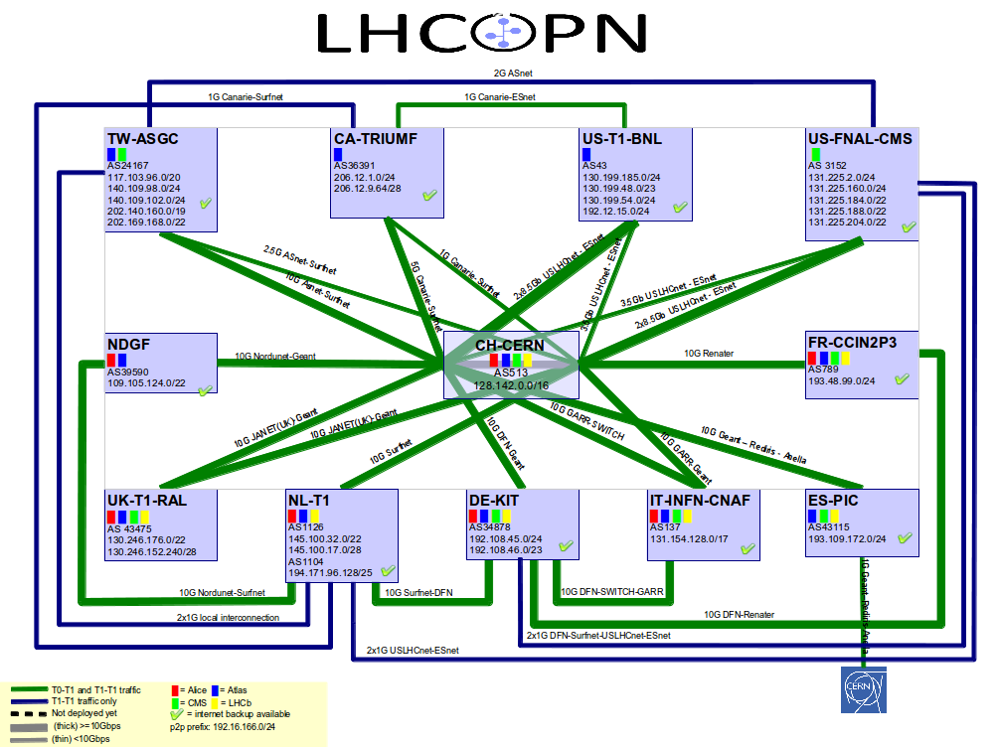

Slide 5
LHCONE General Concepts
LHCONE will implement different services:
Multipoint Connection Service (Entering in production PHASE)
Point to Point Service
  Static (Production technology available)
  Dynamic (R&D)
Any site connecting this network is generally named connector and could access LHCONE through its National Research Education Network or directly through an Exchange Point participating in LHCONE (Starlight, ManLan, NetherLight, CernLight, WIX).
T2
T2
T1
T2
T2
T1
T2
T2
T2
Aggregation
Network
Aggregation
Network
Aggregation
Network
Aggregation
Network
continent
continent
continent
LHCONE
distributed exchange point
single node exchange point

Slide 6
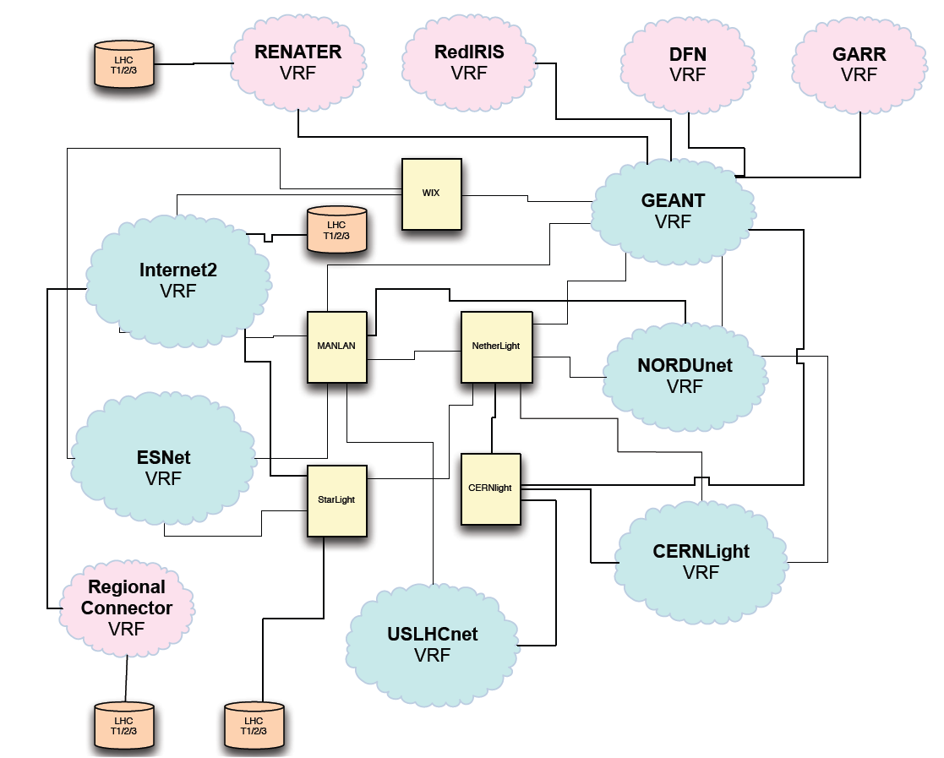
LHCONE Multipoint Connection Service
Multipoint Connection Service is an L3 VPN network based on routers and VRFs (Virtual Routing & Forwarding) instances.
For connectors works like a dedicated IP routed network.
This is the model of the current “Production” LHCONE implementation.

Slide 7




















LHCONE: A global infrastructure for the LHC Tier1 data center – Tier 2 analysis center connectivity
SimFraU
NDGF-T1a
UVic
UAlb
NIKHEF-T1
NDGF-T1a
NDGF-T1c
UTor
NORDUnet
Nordic
TRIUMF-T1
McGilU
SARA
Netherlands
CANARIE
Canada
Korea
CERN-T1
UMich
CERN
Geneva
KISTI
Korea
UltraLight
Amsterdam
TIFR
India
Geneva
Chicago
KNU
DESY
KERONET2
Korea
GSI
DE-KIT-T1
SLAC
DFN
Germany
ESnet
USA
BNL-T1
New York
India
Seattle
FNAL-T1
ASGC-T1
GÉANT
Europe
ASGC
Taiwan
UCSD
Caltech
NE
Washington
UWisc
UFlorida
SoW
CC-IN2P3-T1
NCU
NTU
PurU
UNeb
MidW
Sub-IN2P3
TWAREN
Taiwan
MIT
GLakes
GRIF-IN2P3
RENATER
France
CEA
Internet2
USA
Harvard
PIC-T1
INFN-Nap
CNAF-T1
RedIRIS
Spain
GARR
Italy
UNAM
LHCONE VPN domain
End sites – LHC Tier 2 or Tier 3 unless indicated as Tier 1
Regional R&E communication nexus
Data communication links, 10, 20, and 30 Gb/s
See http://lhcone.net for details.
CUDI
Mexico
NTU
Chicago

Slide 8
Point to Point service (R&D)
The basic idea is to provide a sheduled circuit on demand service to the LHC community.
Point-to-point circuit service should have
  guaranteed bandwidth
  Predictable delay
  No jitter
Scheduled in advance
Intrinsically non-redundant
Can be either
  Static (setup and don’t tear down for months or years)
  Dynamic (setup on demand, tear down as soon as it is not needed)
Application driven “circuit” creation
  A meeting with People from Experiments (Middleware developers) will be scheduled to understand if it is possible to integrate in the middleware and end to end circuit creation.
The goal is to find a possible production solution for the 2014

Slide 9
Point to Point service (R&D)
The main technologies for SDN (Software Defined Networks) used by network operators are:
DICE¹ IDCP (Inter Domain Controller Protocol) Solutions.
  ESnet OSCARS (On-demand Secure Circuits and Advance Reservation System)
  Internet2 ION (Interoperable Ondemand Network)
  GEANT AutoBAHN In europe
OGF NSI (Network Service Interface) is an effort to standardize the P2P services deployed by NRENs.
  OpenFlow: To build an end to end software defined network is essential to make the control plane to interact with Switch/Router devices and OpenFlow protocol is starting to be supported by many different switch/router manufacturer like Cisco, IBM (Blade Networks), DELL (Force10) and Brocade. There is an LHCONE Working group in charge of building a pilot based on the OpenFlow
1 (Dante, Internet2, CANARIE, and Esnet)

Slide 10
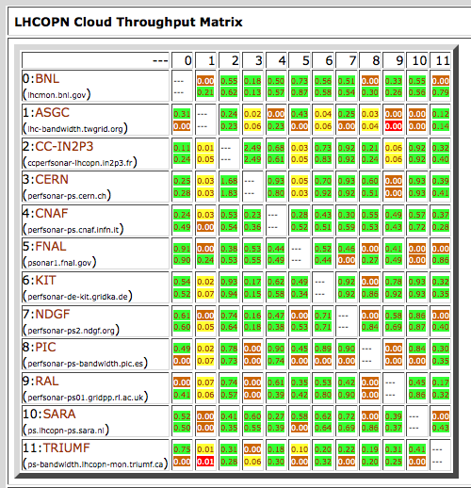
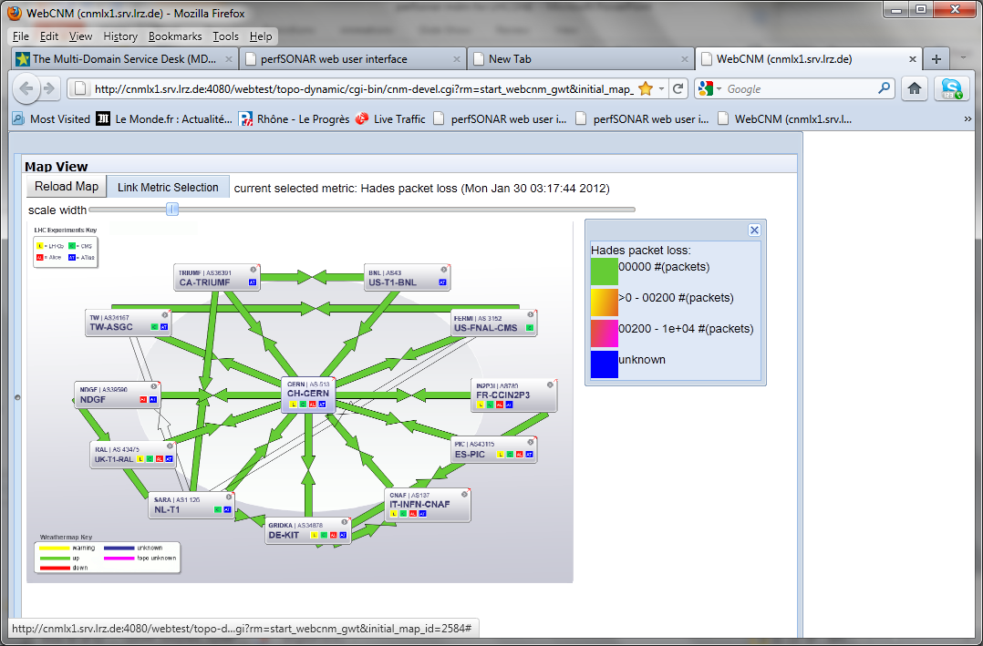
Monitoring
perfSONAR-MDM and perfSONAR-PS are the end to end tools currently in use in LHCOPN and LHCONE communities for Bandwidth and latency measurement.
perfSONAR-MDM (Hardware solution owned and managed by DANTE). In place in TIER1’s sites.
perfSONAR-PS (Software deployed on servers owned by sites): New DASHBOARDS based on perfSONAR-PS data are in development for LHCOPN and in a subset of ATLAS TIER2s as a pilot monitoring system for LHCONE.
perfSONAR-PS Toolkit Page:
http://psps.perfsonar.net/toolkit/
Tom’s Dashboard:
https://130.199.185.78:8443/exda/?page=25&cloudName=LHCOPN
perfSONAR-MDM (Multi Domain Monitoring) Toolkit Page:
http://www.geant.net/service/perfsonar/pages/home.aspx

Slide 11
Why LHCONE?
Better management of the LHC traffic on the national and international paths
  Using a VPN it is possible to engineer LHC traffic
Use of dedicated LHCONE network resources
  GEANT will install a new transatlantic 10 Gb/s link Geneva – Starlight (Chicago) (Before the end of June 2012)
  GARR-X will install dedicated capacity between GARR PoPs with T2 and Bologna

Slide 12
Transition to LHCONE network in Italy
TO
T2
T1
T1
GEANT
T1
T1
GEANT
LHCONE
VRF
T1
T1
1Gb/s
MI
T2
MI
T2
T1
1Gb/s
…
T1
LHCOPN
CERN
T0
3x10Gb/s
T1
GARR
General IP
Backbone
LNL
T2
T1
DE-KIT
2x1Gb/s
GARR
LHC-ONE
VRF
T0-T1
T1-T1
2x10Gb/s OPN
Via GARR
1x10Gb/s OPN
Via GARR
1Gb/s
PI
T2
PI
T2
T1-T2 LHCONE
T1-T2 General IP
CNAF
T1
10Gb/s
2x1Gb/s
1Gb/s
1Gb/s
3x1Gb/s
NA
T2
2x1Gb/s
NA
T2
RM
T2
CT
T2
BA
T2
LNF
T2
RM
T2
BA
T2

Slide 13
LHCONE site access
A is the main site («Sezione» or «laboratorio»)
A’ is the T2 or the «GRID farm»
Three different cases
  1 – A and A’ have separate routers
  2 – A and A’ have separate routers but A’ can’t do BGP
  3 – A and A’ share the same router
R&E IP
A
Site
LHCONE
A’

Slide 14
1 – A and A’ have separate routers
GEANT
LHCONE
routing instance
GEANT
GARR
LHCONE routing instance
GARR
IP service
T2 general purpose
link
Dedicated LHCONE
link
Can be a single physical link with VLAN trunk
Routing BGP
Routing statico o dinamico
Backup link
Accesso Tier2:
10GE in GARR-X
LAN Tier2
LAN Sezione
Accesso Sezione INFN:
1 x GE in GARR-X

Slide 15
2 - A and A’ have separate routers but A’ can’t do BGP
GEANT
LHCONE
routing instance
GEANT
Interconnection between instances
GARR
LHCONE routing instance
GARR
IP service
LHCONE
+
General purpose
link
Routing statico
Routing statico o dinamico
Backup link
Accesso Tier2:
10GE in GARR-X
LAN Tier2
LAN Sezione
Accesso Sezione INFN:
1 x GE in GARR-X

Slide 16
3 - A and A’ share the same router
GEANT
LHCONE
routing instance
GEANT
Interconnection between instances
GARR
LHCONE routing instance
GARR
IP service
Source-based routing
Routing statico
Routing statico
Accesso Tier2:
10GE in GARR-X
LAN Tier2
LAN Sezione
Accesso Sezione INFN:
1 x GE in GARR-X

Slide 17
Adding a new connection can cause problems
Asymmetric routing and stateful firewalls are natural enemies
If BGP routing is done by GARR (cases 2 and 3) you are safe (!)
If BGP routing is done by you (case 1) you can either
  avoid using firewalls (LHCONE is a circle of trust)
  Or take care asymmetric routing is not in place
Connection Recommendations to address Asymmetric Routing
(Quoting Mike O’Connor - ES-NET)
Define local LAN address ranges that will participate in LHCONE. Advertise these address range prefixes to LHCONE using BGP.
Agree to accept all BGP route prefixes advertised by the LHCONE community.
Ensure that the LHCONE defined ranges are preferred over general R&E IP paths.
Avoid static configuration of packet filters, BGP prefix lists and policy based routing, where possible.

Slide 18
LHCONE in Italy
Sede | Network | Joined LHCONE
CNAF Bologna (T1) | 131.154.128.0/17 | 26 oct 2011
Bari (T2) | 212.189.205.0/24 90.147.66.0/24 | 26 apr 2012
Catania (T2) | 192.84.151.0/24 | Not yet
Frascati (T2) | 192.84.128.0/25 | Not yet
Legnaro (T2) | 192.135.30.0/27 192.135.30.192/27 | Not yet
Napoli (T2) | 90.147.67.0/24 | 01 dic 2011
Milano (T2) | 192.135.14.0/24 | 10 may 2012
Pisa (T2) | 192.135.9.0/24 193.205.76.0/23 | 10 may 2012
Roma1 (T2) | 141.108.35.0/24 (LHC Services) 141.108.36.0/23 (CMS) 141.108.38.0/23 (ATLAS) | 07 may 2012
Torino (T2) | 193.206.184.0/26 193.205.66.128/25 | Not yet

Slide 19
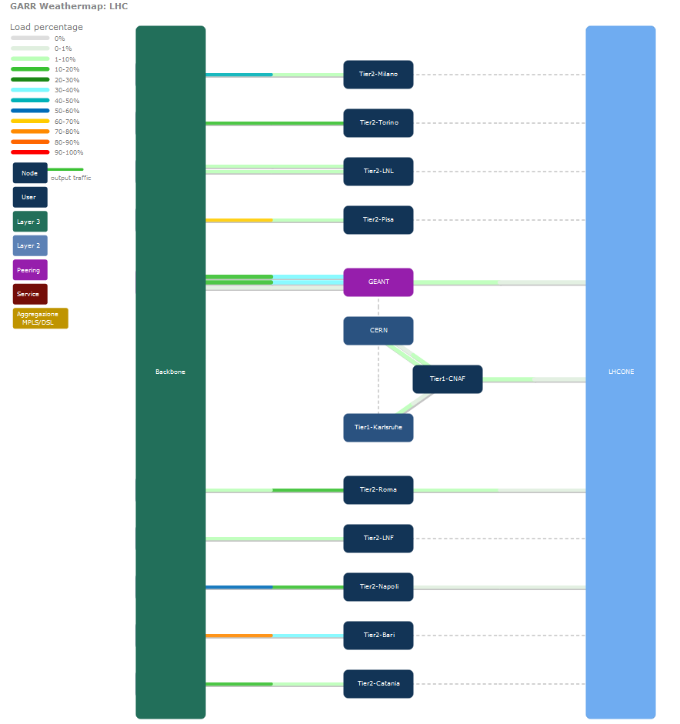
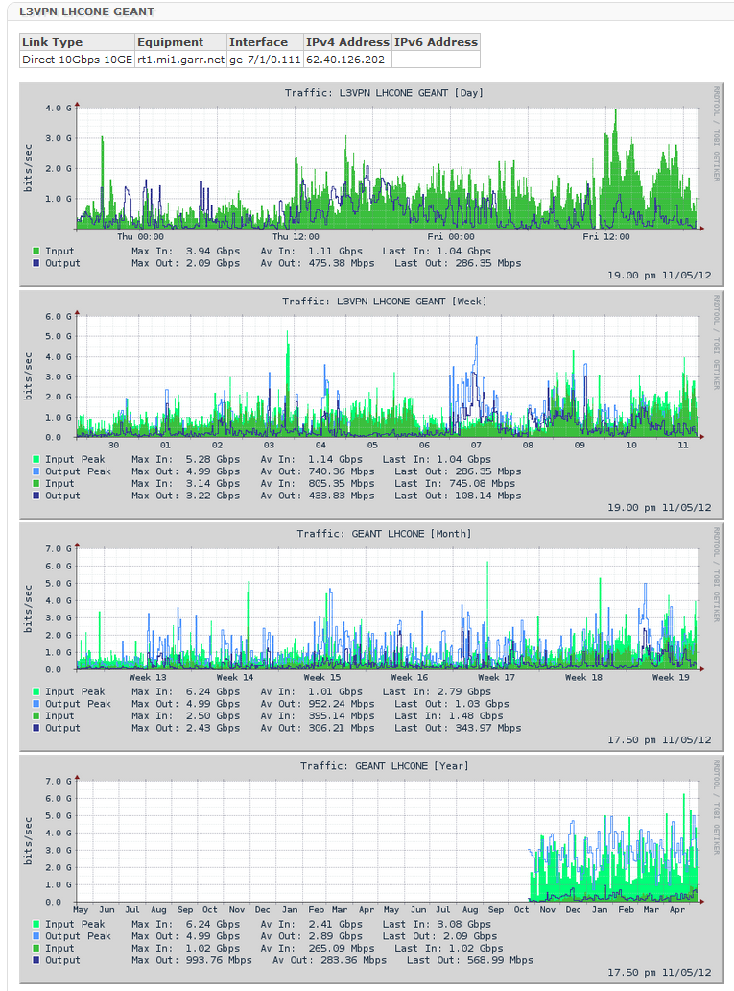
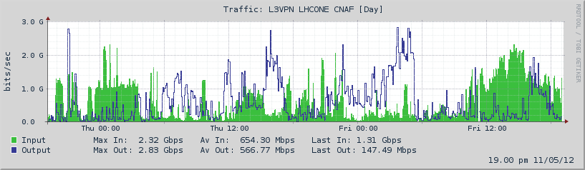
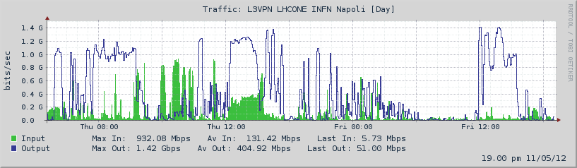
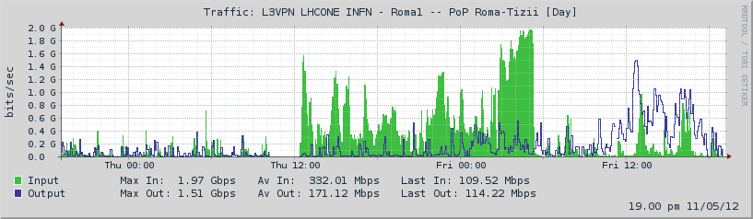
Traffic monitoring
Bari, Pisa, Milano, Roma1
Napoli
CNAF

Slide 20
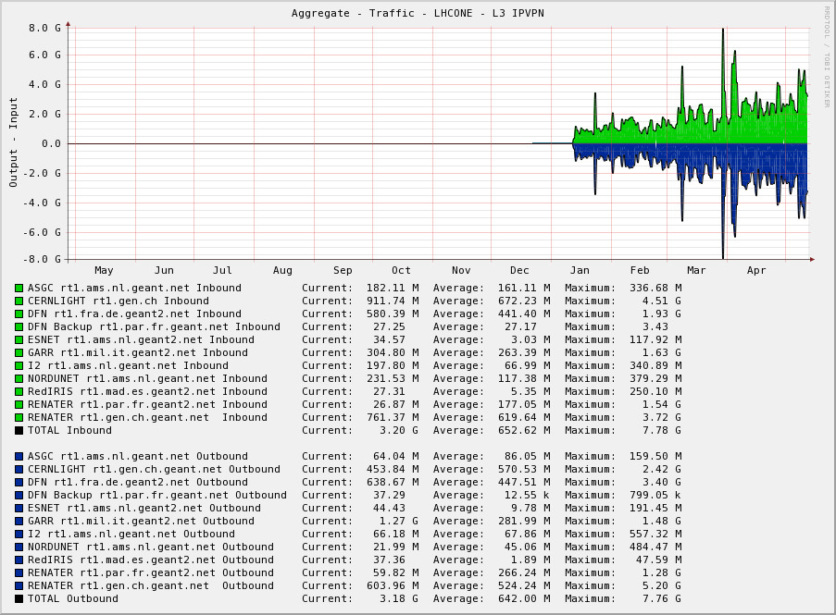
Aggregate GEANT traffic

Slide 21
Tn
Tn
Pv1
BB32
GARR-X
Network layout
BB33
Pv
Ts₁
Mi₃
BB10
Mi₃
BB29
C2-C3
C1
C4-C5
Mi₂
C37-C38-C39-C40
Mi₁
To₁
C23
Mi₂
Mi₁
C26
C21
8x10G
8x10G
C6+UP2
Pd₂
BB34
Pd₂
Ve
Ge1
Mi₂
C49-C50
Mi₁
C9
Ve
Ge1
C27
C20
Pi₁
BB4-1+C15
C33-C34-C35-C36
C41-C42-C43-C44
Bo₃
C47-C48
C51-C52
Rm₁
C22
C24
RM₂
Bo₁
RMT
A7T3
C45-C46
C7
A7T2
C19/TEMP
8x10G
8x10G
C8
RM1
RM₂
Bo₁
Fra
A7T1
RM₂
C29-C30-C31-C32
Bo₁
Fra
BB4-2
Ca₁
Ss
BB28
Ca₁
Ss
RM1
BB16
C18
C10
BB30*
C16
C12
C13
BB35
C17+UP3
C11+UP1
BB31
C14
BB17
BB15
BB14
Aq1
Aq1
Ba₁
Na₁
Ct₁
Pa₁
An
Fe
Pg
Ba₁
Na₁
Ct₁
Fi₁
Pa₁
An
Fe
Pg
BB20
BB21
BB22
da ord.
BB26
BB19
BB24
BB27
Br
Mt
Cz
Cs
Br
Mt
Cz
Cs
Le
Pz
Sa
Me
Le
Pz
Sa
Me
* - BB30 is landing in RM1, and will be extended up to RM2

Slide 22

Infrastruttura
Router+Switch
INFN-Tier2
1 | Milano | Mi3→Bo1
2 | Roma | Rm2 →Bo1
3 | Legnaro | Pd2 →Bo1
4 | Catania | Ct1 →Bo1
5 | Napoli | Na1 →Bo1
6 | Pisa | Pi1 →Bo1
7 | Frascati | Rm1 →Bo1
8 | Torino | To1 →Bo1
9 | Bari | Ba1 →Bo1
10 | CNAF | 4*10G
INFN-Milano
GEANT
LHCONE
INFN-Milano
Ts₁
Mi₃
INFN-LNL
INFN-LNL
Mi₂
Mi₁
To₁
Mi₂
Mi₁
INFN-Torino
INFN-Torino
Pd₂
Pi₁
LHCOPN
INFN-Pisa
INFN-Pisa
Bo₃
INFN-LNF
Rm₁
INFN-LNF
Fi₁
RM₂
Bo₁
RM₂
Bo₁
Ca₁
Bo₁
Aggregation Node
1 | A | Ba1 | Bari-Amendola
2 | A | Bo3 | Bologna-Gobetti
3 | A | Ca1 | Cagliari-Marengo
4 | A | Cti1 | Catania-Cittadella
5 | A | Fi1 | Firenze-Sesto
6 | A | Mi3 | Milano-Colombo
7 | A | Na1 | Napoli-Mt.S.Angelo
8 | A | Pa1 | Palermo-Scienze
9 | A | Pd2 | Padova-Spagna
10 | A | Pi1 | Pisa-S.Maria
11 | A | Rm1 | Roma-Sapienza
12 | A | To1 | Torino-Giuria
13 | A | Ts1 | Trieste-Valerio
INFN-CNAF
Tier1
INFN-CNAF
Tier1
INFN-Roma1
INFN-Roma1
Ba₁
Na₁
Ct₁
Pa₁
INFN-Bari
INFN-Bari
INFN-Catania
INFN-Catania
INFN-Napoli
INFN-Napoli

Slide 23
Italian Tier2 in GARR-X
INFN-Milano
LHCONE
LHCOPN
Mi₃
INFN-LNL
INFN-Torino
To₁
R
Pd₂
INFN-Pisa
Pi₁
INFN-LNF
Rm₁
RM₂
Bo₁
INFN-CNAF
Tier1
INFN-Roma1
Ba₁
Na₁
Ct₁
INFN-Bari
INFN-Catania
INFN-Napoli

Slide 24
Infrastruttura
Router+Switch
GEANT
LHCONE
Mi₂
Mi₁
Mi₂
Mi₁
LHCOPN
RM₂
Bo₁
RM₂
Bo₁
INFN-CNAF
Tier1
Ct₁
INFN-Catania

Slide 25
GEANT
LHCONE
General purpose
links
RM₂
Bo₁
INFN-CNAF
Tier1
LHCONE
dedicated
link
Ct₁
LHCONE link will be chosen using MPLS traffic engineering
Backup via GP will be provided at lower capacity
INFN-Catania

Slide 26
The End..
Thank You for your attention!

Slide 27
Backup Slides

Slide 28
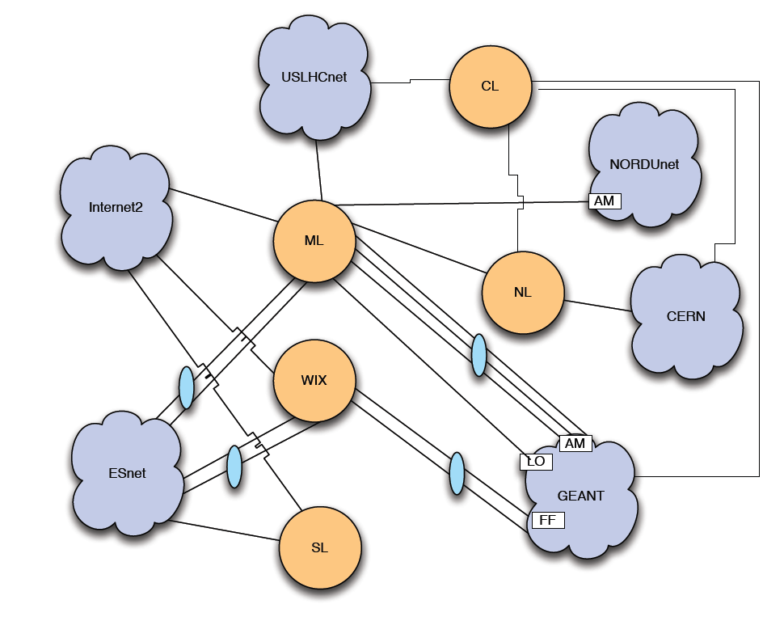
Plot of general Transatlantic Connectivity

Slide 29
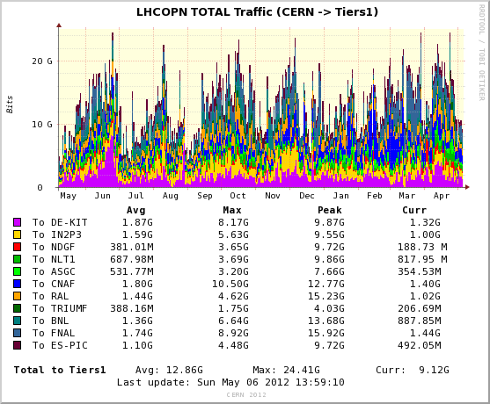
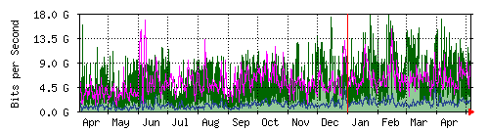
Some numbers on LHC OPN Connections
Globabl T0-T1s
INFN CNAF TIER1 T0-T1+T1-T1

