Slide 1
Next Generation HPC architectures based on End-to-End 40GbE infrastructures
Fabio Bellini
Networking Specialist | Dell

Slide 2
Next Generation HPC architectures

Slide 3
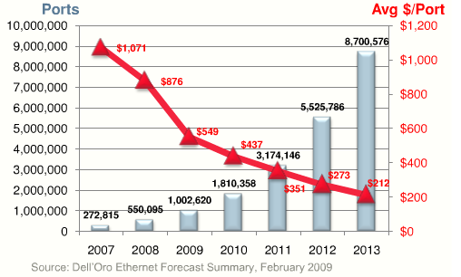
WHY 10G Ethernet ?
Technologies Trend
Multi-core processor Technology
Converged Ethernet and FCoE
Ip Storage
Virtualization
40Gb & 100Gb are now available
10G Ethernet price point are dropping
10G NICs
Switch si below 500$ per port
Very attractive price performance
Lower opex and implementation costs
Ethernet widly adopted: capitalize staff skill and management tools
10G Ethernet technology has matured
Reduced 10G internnection cost
Banchmark data available
Volume depolyment

Slide 4
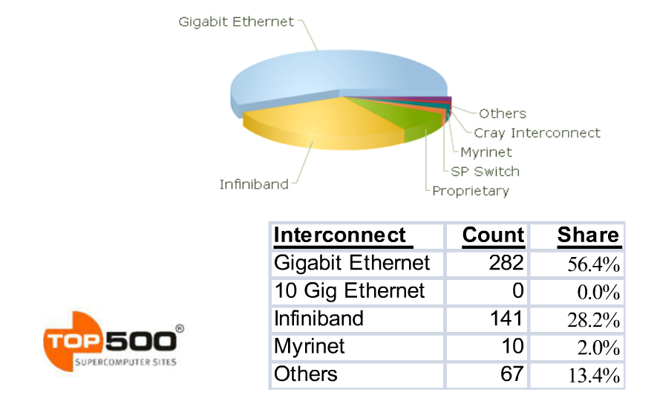
Is 10 Gigabit Ethernet Ready for HPC?
November 2008

Slide 5
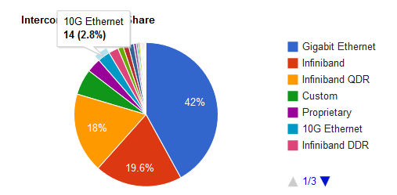
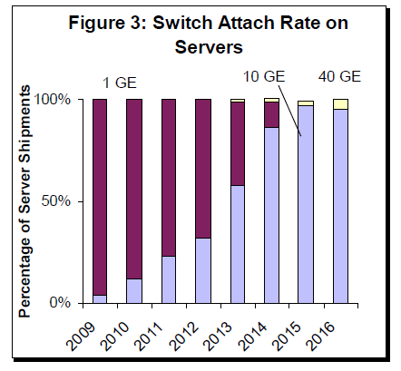
November 2011 10 Gigabit Interconnection
Interconnect | 2009 | 2010 | 2011
Gigabit Ethernet | 259 | 219 | 210
10G Ethernet | 1 | 7 | 14

Slide 6
10G Ethernet Issues
10G released 2002, What prevent faster adoption ?
10 Gig NIC
Price of Switch port
Switch Scaling (single device)
Media PYI limits & confusion
Proof of Performance
Architecture scaling

Slide 7
10G NIC
Price are dropping fast
New server stil support 1G, but has 10G as preferred interconnection
Multiple 10G ports per server/blade-server
Stable and mature for HPC application
TCP Off load Engine support, IWARP support

Slide 8
Price of 10G Ethernet switches
Initial cost of 10G ports used to cost more than server !
10G Ethernet switch price < $500/port

Slide 9
Switch Scaling
10G first released 2002
max density per single device 32 10G ports line rate per device
Nowadays single 1RU switch support up to 64 line rate 10G ports
Single ASIC switch
Sub uSec
< 500Watt
TOR
Leaf in 2 Layer semplified Clos Architecture
Chassis based devices able to scale up to few hundreds of 10G ports
Crossbar Switch Fabric
Clos Switch Fabric
VOQ to prevent HOLB
Single node 10G access Layer
10G Aggregation Layer in 2 Layer architecture
Spine in 2 Layer semplified Clos Architecture

Slide 10
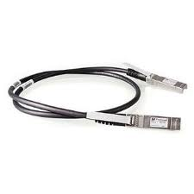
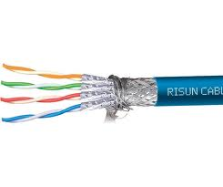
10G Media PYI limits & confusion
10G interconnection
Price reduction 10 to 1
SFP+ Direct Attached Cable
Passive/active cable with sfp+ end
High density same as rj45
10GBase-T
Cat 6a/7
Expensive
Power hungry
2,6uSec Latency
STD F.O. Type Dst.
10GBase-USR MM OM1,2,3 100mt
10GBase-SR MM OM3 300mt
10GBase-LRM MM OM1,2,3 220mt
10GBase-LR SM 10Km
10GBase-ER SM 40Km
10GBase-ZR SM 80Km
10GBase-LX4 MM/SM
STD C.Type Dst.
10GBase-CX4 15mt
10G SFP+ Direct Cable
Passive 7mt
Active 50mt
10GBase-T cat6a/7 100mt

Slide 11
Proof of Performance
10G Ethernet offres:
Same familiar operating enviromental ‘’evolving ethernet’
Ease of use, debug and management
Path to 40 and 100G Ethernet
10x bandwidth and 8x better latency compared to 1G Ethernet
Application performance proofed

Slide 12
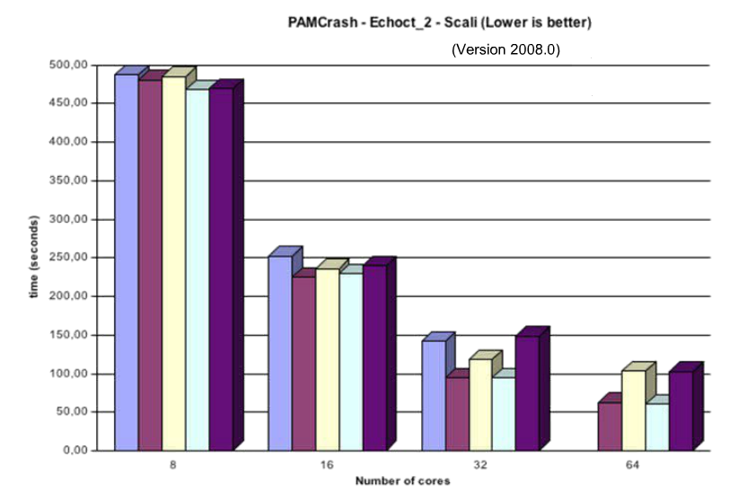
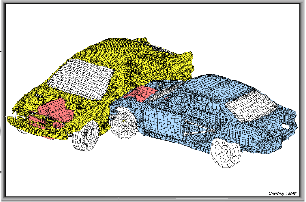
10G Application proof of performance
Pam CRASH: Elapsed time
10GE 32% Faster than 1G, for 32 cores case.

Slide 13
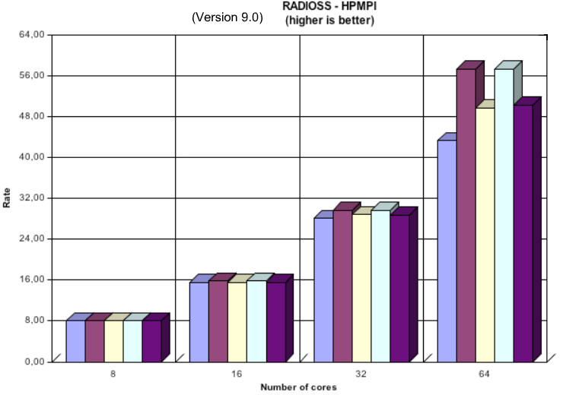
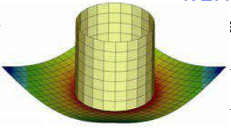
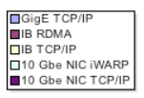
10G Application proof of performance
RADIOSS 9.0: speed up
10G 30% faster than 1G for 64 core case

Slide 14
Architecture Scaling
Legacy Clos architecture
2 Tier Design Spine and leaf
Meshed connectivity
1:1 Bandwidth between the Spine and Leaf
10G line rate access ports
Multiple active uplink
Predictable latency
Legacy CLOS topology
Spine
UP to 16 Spine Switchses
Interconnects Uplink
Leaf
Up to 32
Leaf switches

Slide 15
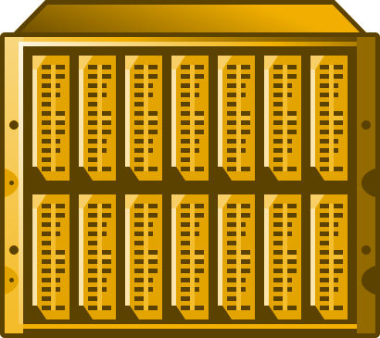
Architecture Scaling Evolution
Legacy CLOS topology
Spine
UP to 16 Spine Switchses
Interconnects Uplink
Leaf
Up to 32
Leaf switches
One hop more..... From 2 to 3 layer
Layer 2
Resiliancy
Latency
Over Subscription
....

Slide 16
Architecture Scaling Evolution Improve intra-chassis performance with local switching
Without Local Switching
With Local Switching
Top-of-Rack Switch
Top-of-Rack Switch
4x fewer ToR ports
= More ToR ports
=
West
East
West
East
All intra-chassis East-West traffic (blade-to-blade/VM-to-VM) sent to Top-of-Rack switch
All intra-chassis East-West traffic processed locally for improved performance

Slide 17
Architecture Scaling Evolution Designed for efficiency: Reduce uplink ports & cabling with 40G
10G Connectivity
40G Connectivity
Top-of-Rack Switch
Top-of-Rack Switch
More ToR
ports @ 10G
4x fewer ToR ports @ 40G
=
=
Using 10G port requires more ToR ports, more cables, more hassle
Using 40G port requires less ToR ports, less cabling, less headaches

Slide 18
Architecture Scaling Evolution
Legacy CLOS topology
Spine
UP to 16 Spine Switchses
40G Interconnects Uplink
Leaf
Up to 32
Leaf switches
Server scaling
Up to 16 Enclosure
4 x 40G uplink per enclosure
Load distribution based on OSPF ECMP
Separate VLAN & Ip net for each enclosure
Full network path redundancy
No spanning tree
Access OS from 1:1 to 4:1

Slide 19
40G ready & interoperable
IEEE 802.3ba 40Gb/s & 100Gb/s
Standard approved June 2010
Ethernet Alliance verified interoperability - June 2011 -
Transceivers
CFP MSA used for both 40 & 100 Gb/s
QSFP+ used for 40Gb/s
Optical cable
Copper cable assemblies
QSFP+ Direct Attach Copper
Systems, including
Test Systems,
Switch/Router,
Computer with HSE NICs

Slide 20
Next generation HPC Architecture
Take Away
10G is a mature proven technology ready for HPC
Proof point emerging
Banchmarks emerging
10G Switching architecture are ready to scale
To evolve next generation HPC
40 G ethernet is ready proved and interoperable
40G blade switch are ready to interconnect high density server blade enclosure
40G 2 layer simplified architecture are ready to scale

Slide 21
Thank You
Confidential

